Slide 1

First feedback and comments on HL-LHC IT STRING Review recommendations
M. Bajko, M. Pojer
HL-LHC IT STRING Coordination
61st TCC HL-LHC 15th of November 2108

Slide 2
Outline of my talk
Scope
  Recommendation 1
Configuration
  Recommendation 2
  Recommendation 3
Resource and Budget
  Recommendation 4
  Recommendation 5
  Recommendation 6
Schedule
  Recommendation 7
  Recommendation 8
  Recommendation 9
Project organization
  Recommendation 10

Slide 3
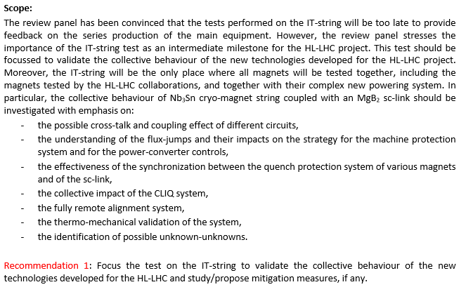
HL LHC IT STRING is foreseen to study the collective behaviour of the IT zone
The main components are: Q1-D1 with complete cold and warm powering
The test stand will be integrated into SM18
Infrastructure upgrade is well advanced
P5L will be reproduced without slope
180 quenches/or power aborts are planned
400 W heat extraction possibility exist
In line with the planned scope

Slide 4
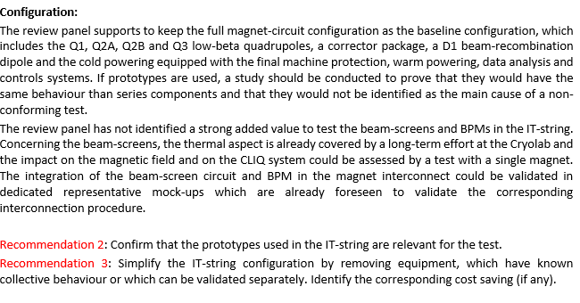
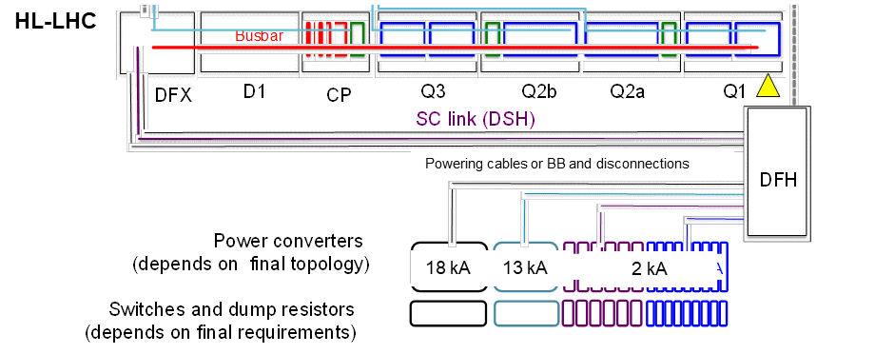
HL LHC IT STRING is foreseen to study the collective behaviour of the IT zone
The main components are: Q1-D1 with complete cold and warm powering
The test stand will be integrated into SM18
Infrastructure upgrade is well advanced
P5L will be reproduced without slope
180 quenches/or power aborts are planned
400 W heat extraction possibility exist
TBC by WPs: Q1, PC, SC link
Estimated cost saving:
580 kCHF (tbc by VSC)
100 kCHF (tbc by CRG)
TBC by corresponding groups and WPs!
Installations without beam screen!

Slide 5
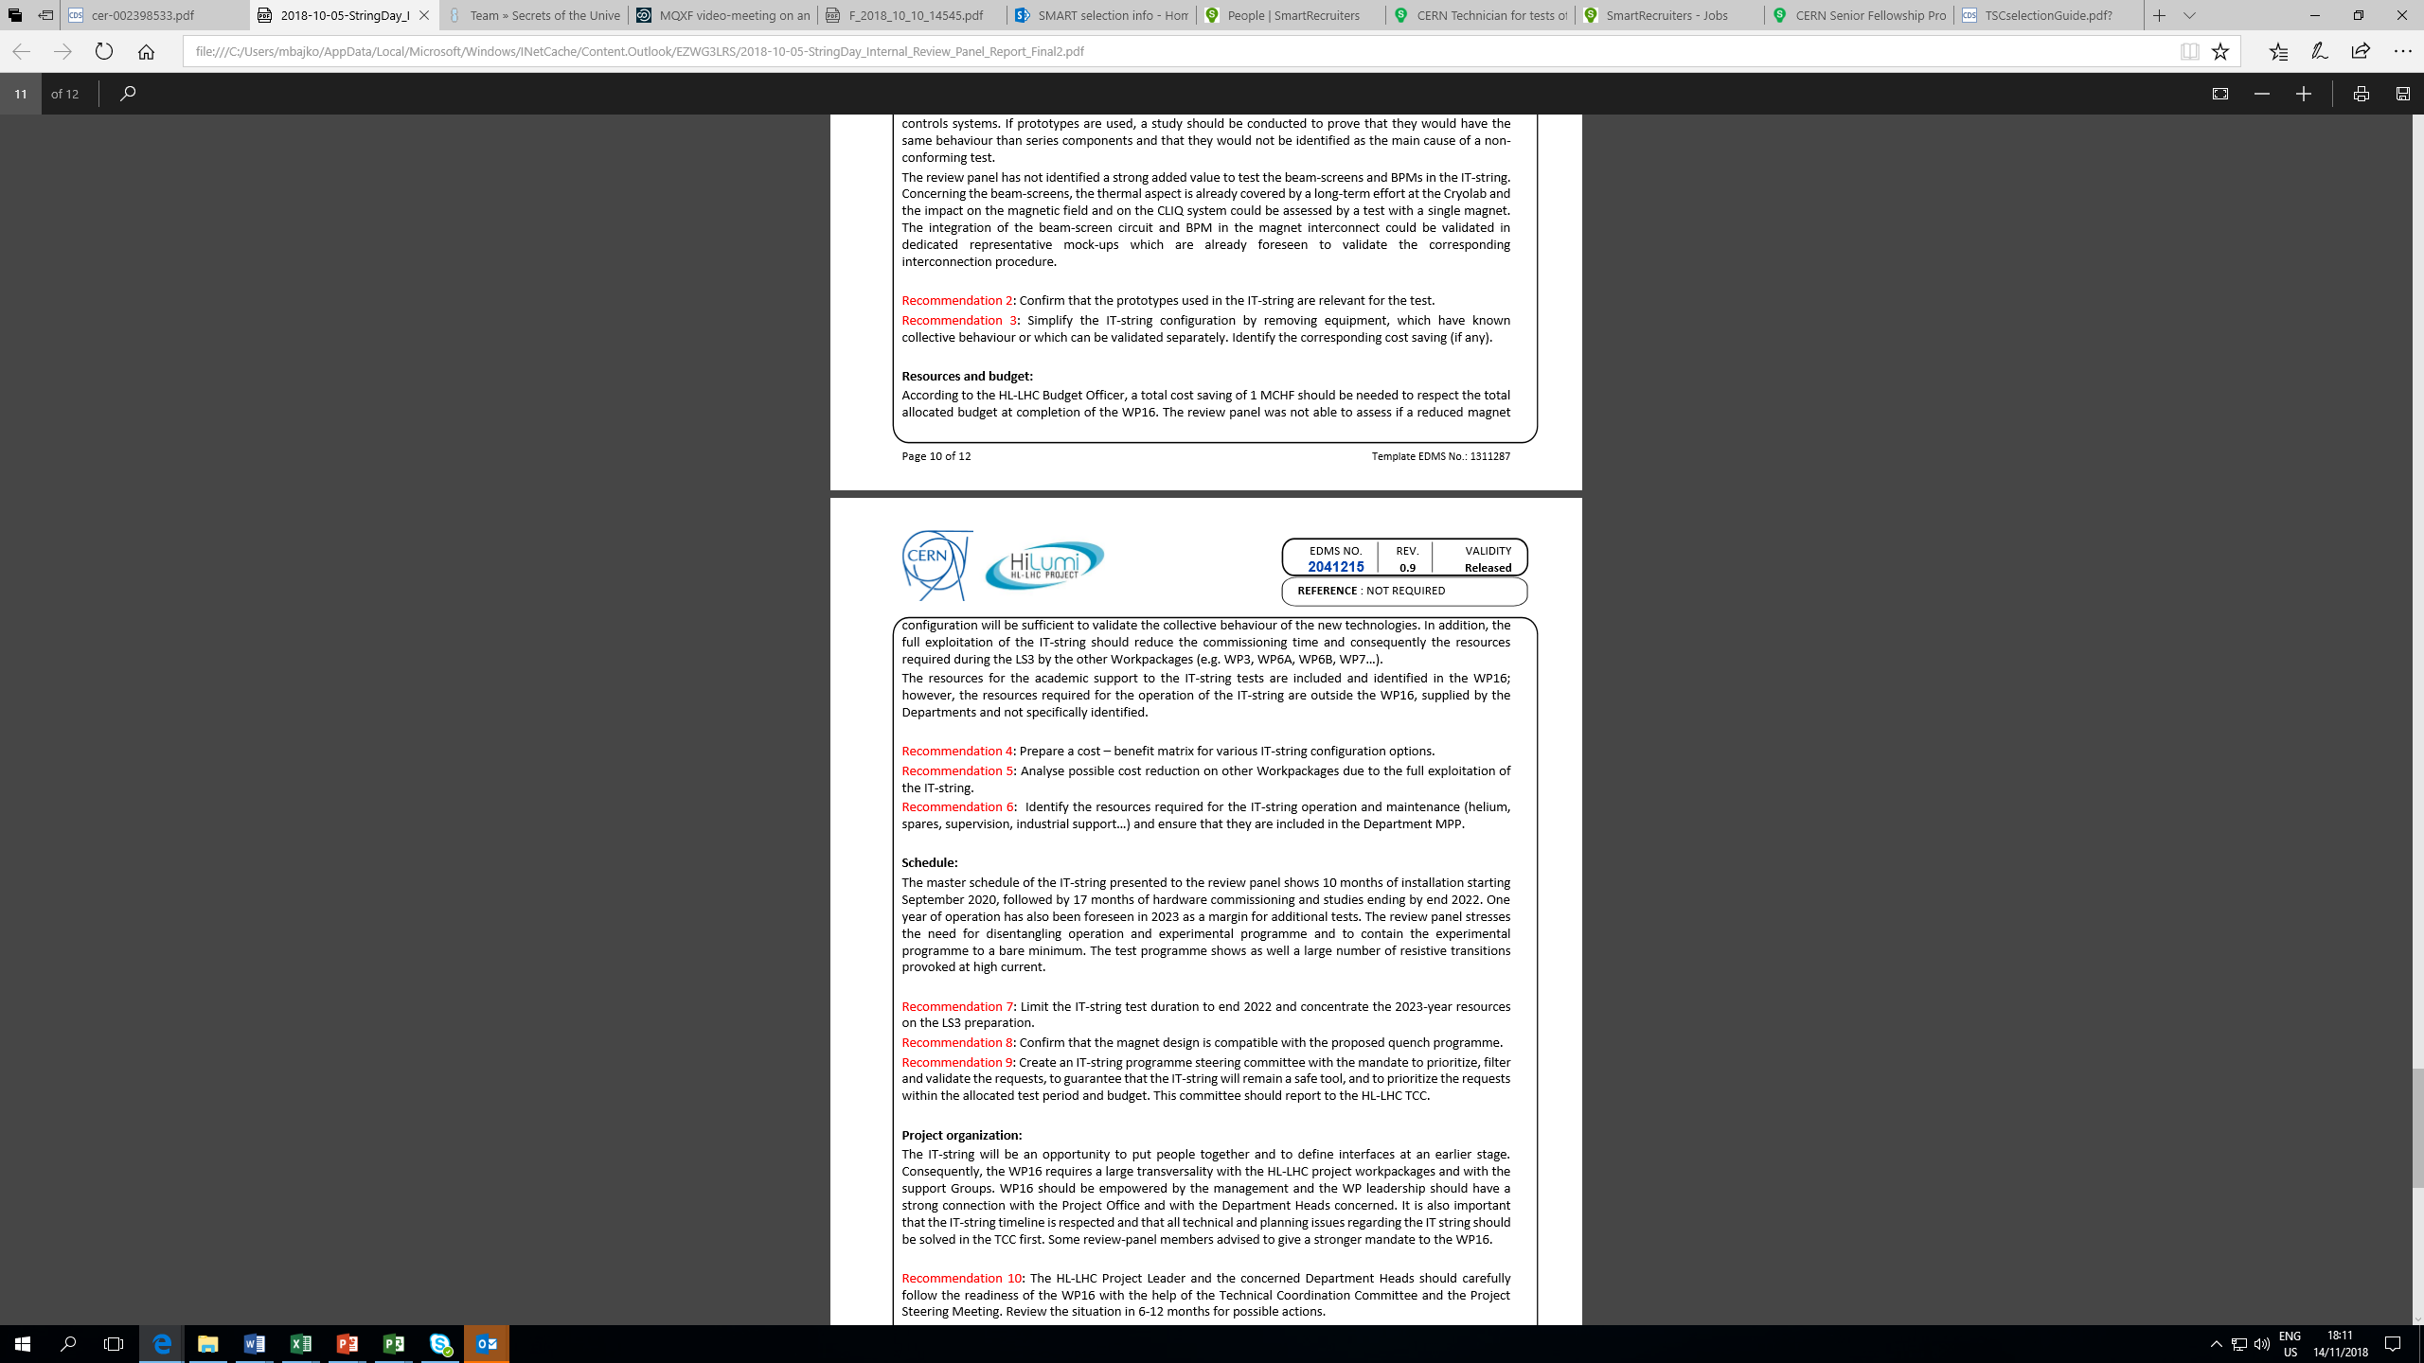
If these recommendations are retained by the project, will necessitate some time to work on it.
…. Recommendation 4: is overlapped with recommendations 1
…..Recommendation 5: in our opinion this is to be done by the project office
…..Recommendation 6: has been followed up by the TE department. To be confirmed by TE,BE department that all necessary resources are ( found) introduced by the groups into MPP.

Slide 6
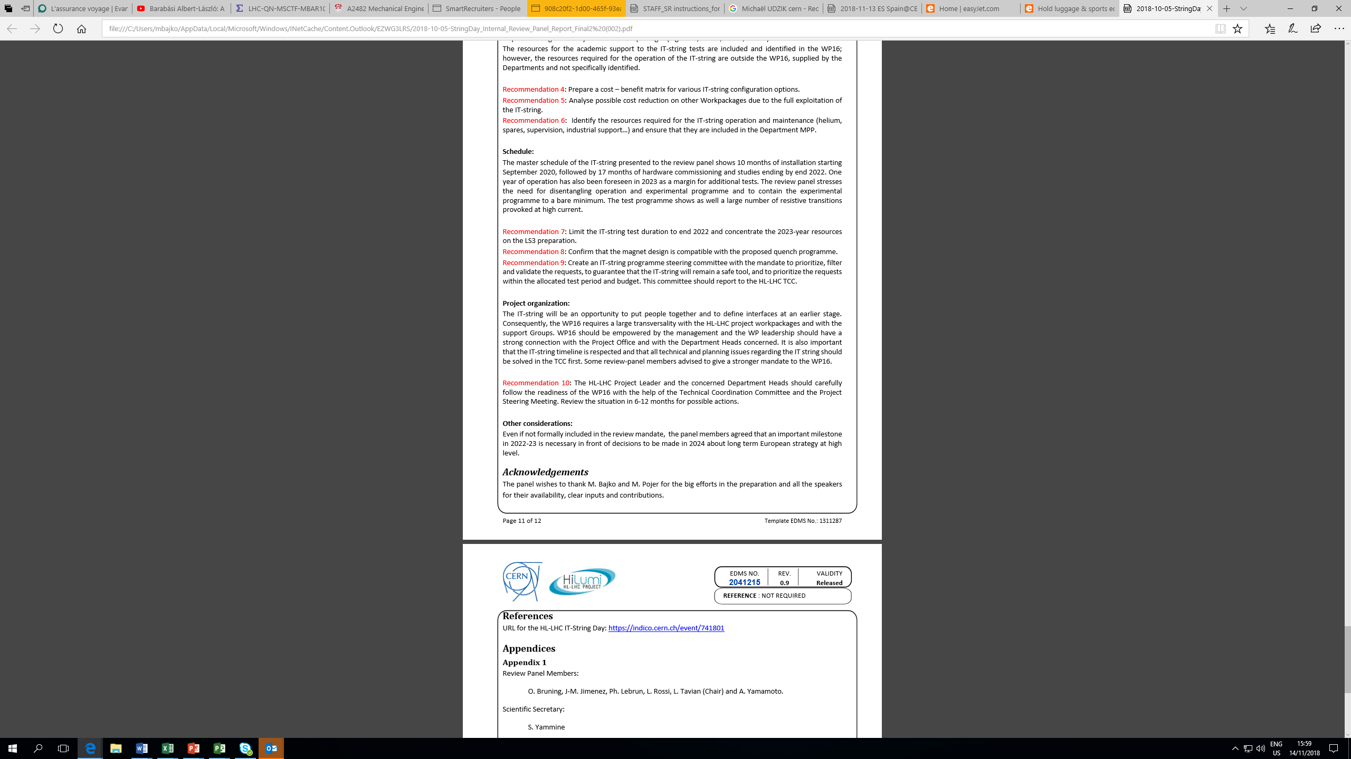
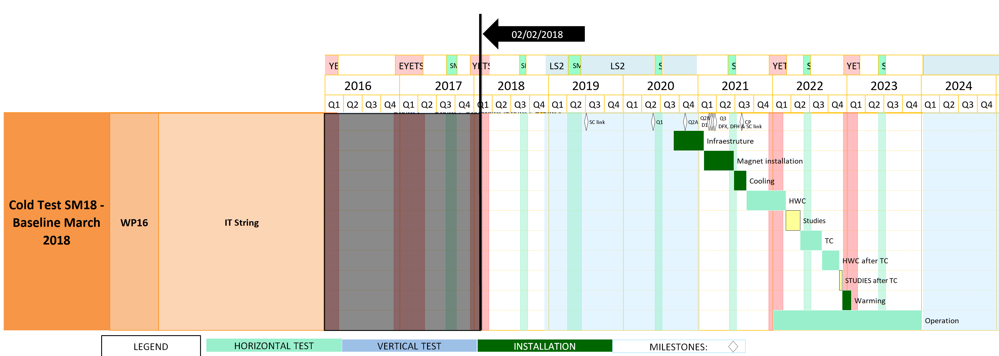
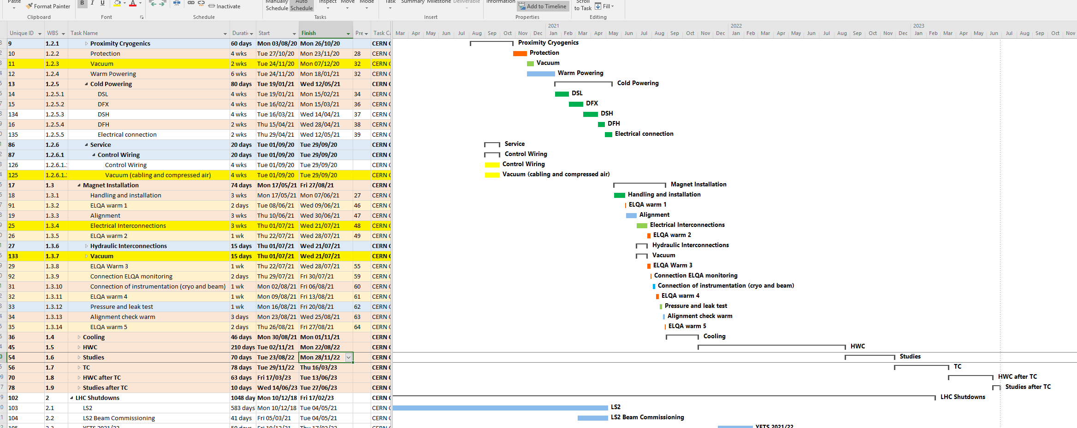
To be confirmed by WP3
Experimental program = Studies
The number of resistive transitions will be re-estimates as in every quench provoked in a high current magnet all others will quench and as a consequence the number of provoked quenches can be reduced.
- 6 months possible

Slide 7
To be worked out with the management (project and line) the next possible review content and dates to insure an optimum follow up.
I personally wish to thank for all WP members having worked till now with us ( Mirko and myself) for their work and constructive spirit which is a great help while WP16 is trying to coordinate test for other WPs ….aswell as the support of the HL-LHC project leader and office.
I look forward the next milestone of the HL-LHC STRING !

