Slide 1
MD3263 in MD3 and MD4
S. Fartoukh, Y. Papaphilippou, A. Poyet, A. Rossi and G. Sterbini
on behalf of the BBLR wire compensation team:
D. Amorim, G. Arduini, H. Bartosik, A. Bertarelli, R. Bruce, X. Buffat, L. Carver, C. Castro, G. Cattenoz, E. Effinger, S. Fartoukh, M. Fitterer, N. Fuster, M. Gasior, M. Gonzales, A. Gorzawski, G.-H. Hemelsoet, M. Hostettler, G. Iadarola, R. Jones, D. Kaltchev, K. Karastatis, S. Kostoglou, I. Lamas Garcia, T. Levens, A. Levichev, L. E. Medina, D. Mirarchi, J. Olexa, S. Papadopoulou, Y. Papaphilippou, D. Pellegrini, M. Pojer, L. Poncet, A. Poyet, S. Redaelli, A. Rossi, B. Salvachua, H. Schmickler, F. Schmidt, K. Skoufaris, M. Solfaroli, G. Sterbini, R. Tomas, G. Trad, A. Valishev, D. Valuch, J. Wenninger, C. Xu, C. Zamantzas, P. Zisopoulos.
Special thanks to LHC MD coordinators and the Collimation Team.
LSWG, 29 November 2018
Notes:
1

Slide 2
Outlook
YETS17-18
Installation of the IR1 wires
LMC 348
TS1 TCTV alignment
LMC 359
TS2 Wire Re-cabling
LMC 361
EoF Request
MD1,
12 h
14th June 2018
FILL6797-8-9
24th July 2018
FILL6972
14th September
FILL7169
29th October
FILL7386
From 2 to 4 wires
(validation)
4 wires compensation
Reducing crossing angle
TRAINS and NEW cabling
MD2,
7 h
26th July 2018
FILL6984
MD3, 7 h
MD4,
10 h
From SETUP BEAM to TRAINS
wire compensation at β*=30 cm (ROUND OPTICS)
θ_{c}/2=150 μrad
down to 130 μrad
36 h of MD in 2018. Thanks!
We will summarize the results of MD3 (wire compensation during Xing-angle anti-leveling) and MD4 (with trains).
2
MD3263 in MD3 and MD4

Slide 3
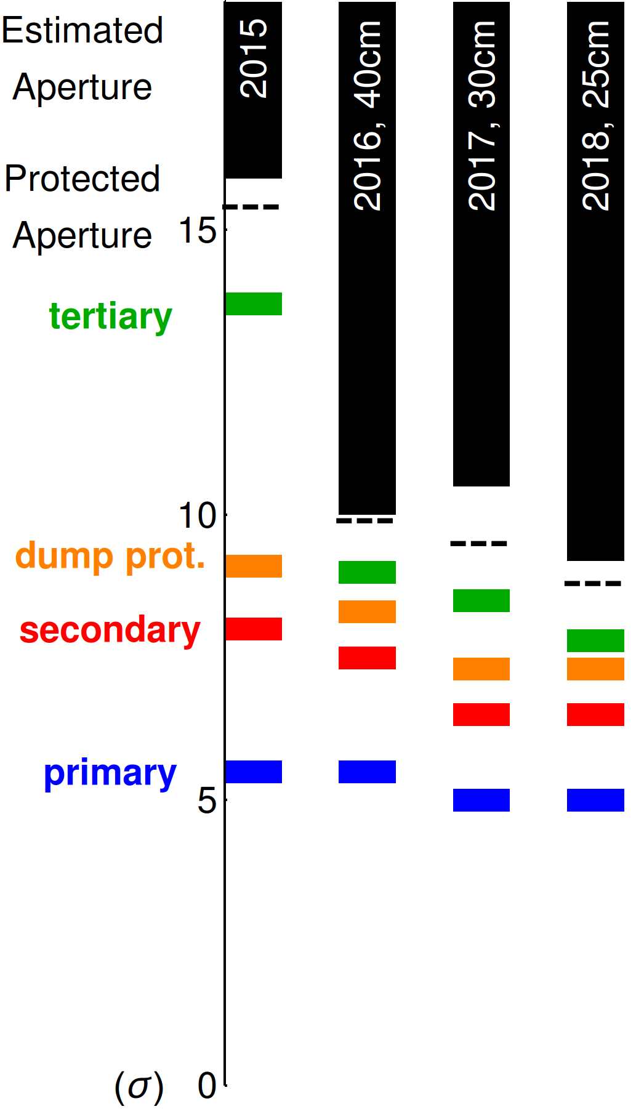
MD3 WIRES POSITION
Optimal beam-wire distance= 5.7 mm
⇒ It is not possible to operate the wires at the optimal distance wrt the beam.
Wire | Plane | Wire-beam distance [mm] | σ_{coll} [mm]
R1 | V | +7.42 | 0.80
L1 | V | -7.41 | 0.80
R5 | H | +8.24 | 0.95
L5 | H | -7.15 | 0.75
5.5 σ_{coll}
3 mm
5.5 σ_{coll}
WIRE COLLIMATORS
with SETUP BEAM
Courtesy of R. Bruce
3
MD3263 in MD3 and MD4

Slide 4
MD4 WIRES POSITION
To have trains in B2 we need to use nominal collimator gap but the vertical alignment of the TCTPH in IR5 (credit to Collimation Team).
Rights WIRES at ~10 mm
(vs 5.7 mm IDEAL)
Left WIRES too far.
Courtesy of R. Bruce
4
MD3263 in MD3 and MD4

Slide 5
Re-cabling during TS2
MD3
MD4
VERY IMPORTANT change of cabling during TS2 (EDMS 2027144) between MD3 and MD4.
5
MD3263 in MD3 and MD4
Notes:
Here you can see a plot of the …
5

Slide 6
MD3, 7 h
14th September
FILL7169
MD3: Crossing angle and compensation
Reducing crossing angle
Asymmetric fill
Strong octupoles
5th axis alignment
6
MD3263 in MD3 and MD4

Slide 7
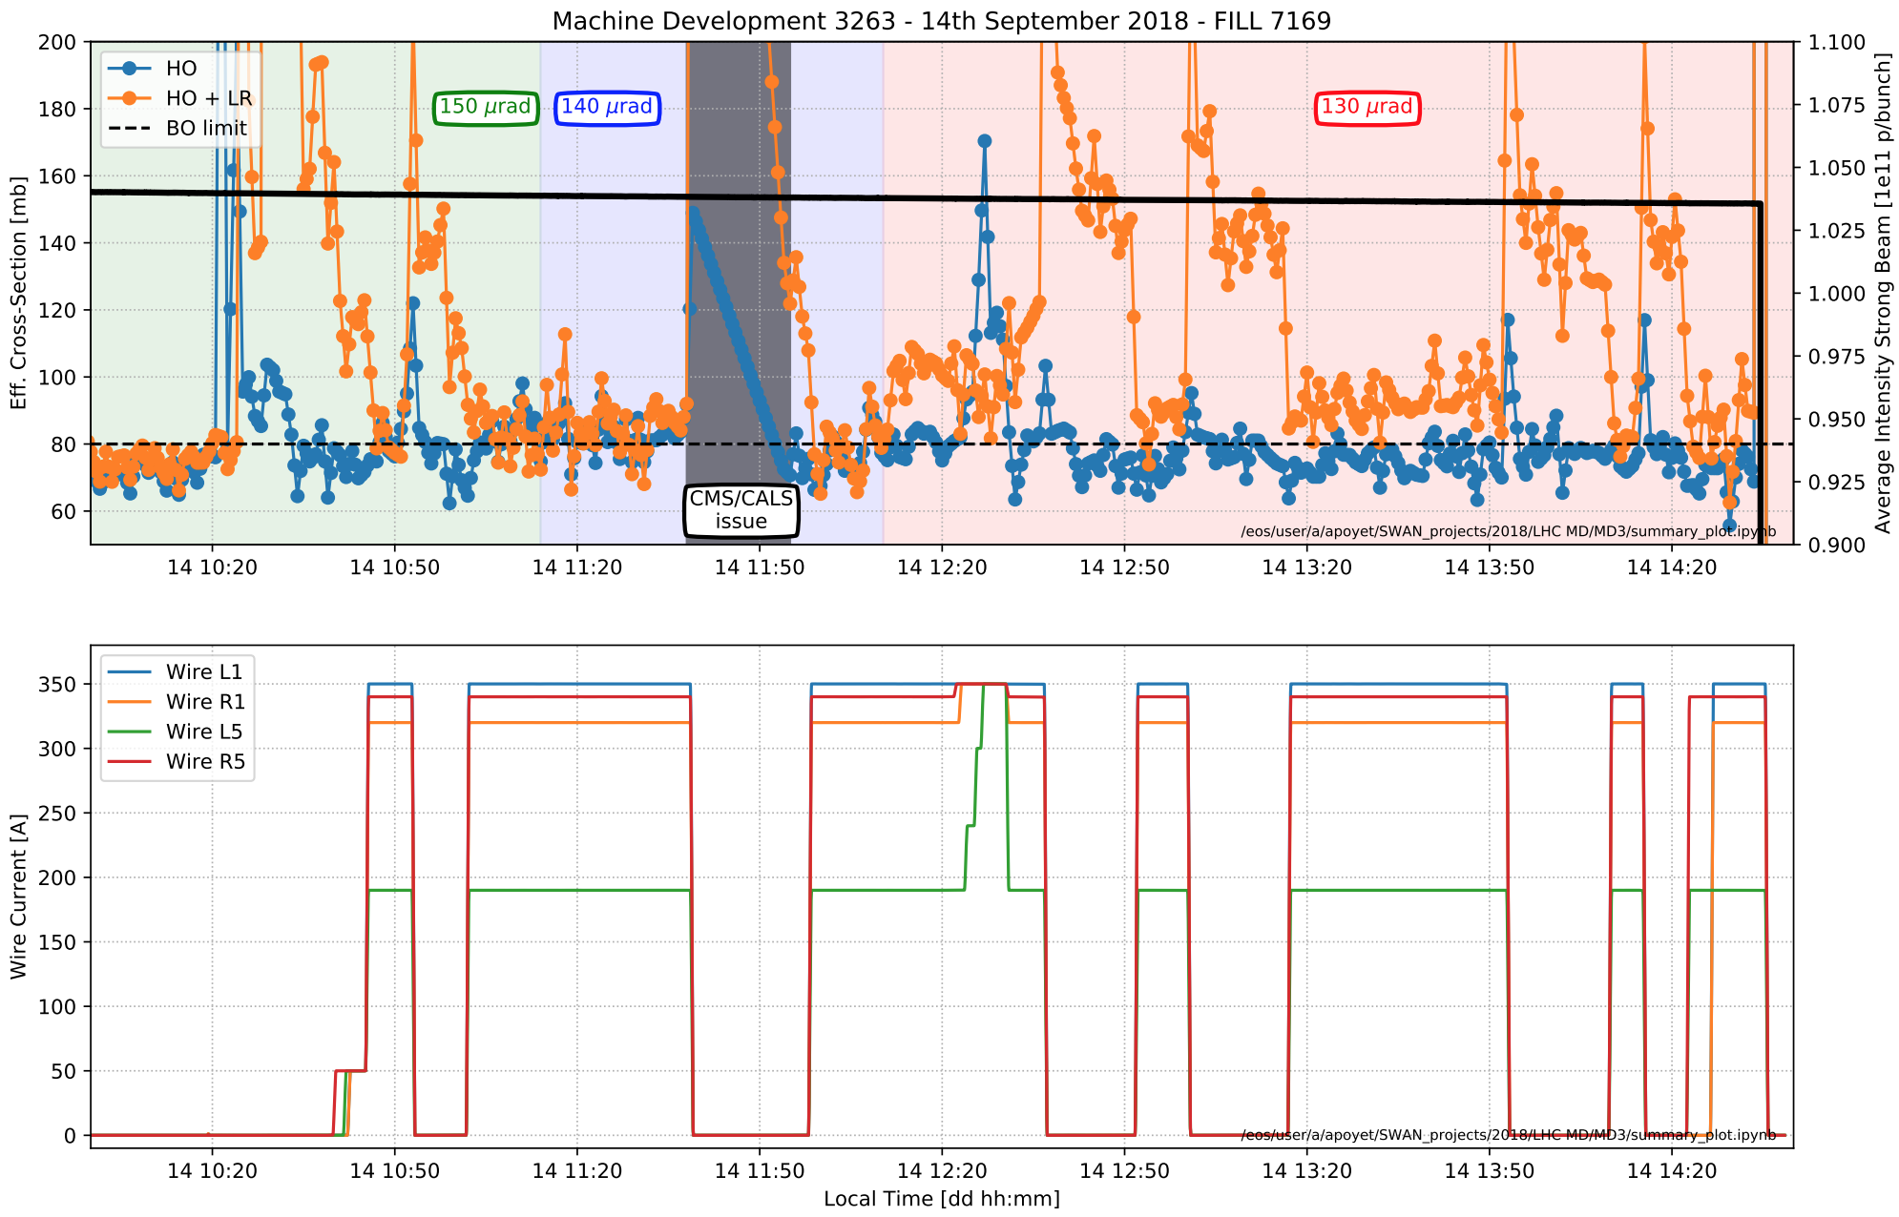
MD3, 7 h
14th September
FILL7169
MD3: Crossing angle and compensation
Reducing crossing angle
A. Poyet
L1
R5
R1
L5
Very clear effect of the compensation even at reduced crossing (130 μrad)!
Not possible to test the wire during the β-leveling
7
MD3263 in MD3 and MD4

Slide 8
MD4,
10 h
29th October
FILL7386
MD4: Validation FILL
TRAINS and NEW cabling
SETUP BEAM in B2
Polarity check at 450 GeV
Feedforward check at 6.5 TeV
8
MD3263 in MD3 and MD4

Slide 9
MD4,
10 h
29th October
FILL7386
MD4: Operation with trains
TRAINS and NEW cabling
Symmetric filling scheme
5th-axis alignement
9
MD3263 in MD3 and MD4

Slide 10
MD4,
10 h
29th October
FILL7386
MD4: Operation with trains
TRAINS and NEW cabling
A. Poyet
Very clear effect of the compensation even with trains and reduced crossing. Gain of ~10 urad with wires on.
10
MD3263 in MD3 and MD4

Slide 11
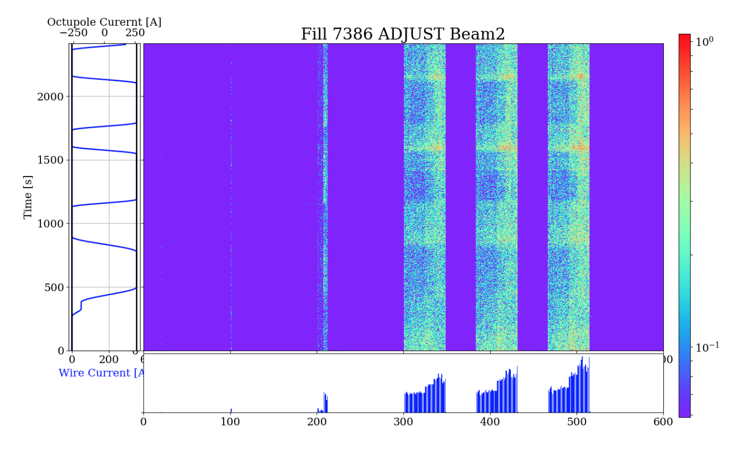
MD4,
10 h
29th October
FILL7386
MD4: dBLM analysis
TRAINS and NEW cabling
ON
OFF
A. Gorzawski
Effect of the wires also visible from the dBLM.
11
MD3263 in MD3 and MD4

Slide 12
MD4,
10 h
29th October
FILL7386
MD4: End-of-MD test with active filters
TRAINS and NEW cabling
S. Kostoglou
As End-of-MD, the MB active filter tests was performed.
12
MD3263 in MD3 and MD4

Slide 13
Summary
MD3:
  Positive effect of the wires visible also at reduced crossing angle.
MD4:
  First time wire compensation with trains. Clear effect of the wires on the BLM losses.
Before LS2
After LS2?
13
MD3263 in MD3 and MD4

Slide 14
Thank you for the attention!
On behalf of the BBLR wire compensation team
D. Amorim, G. Arduini, H. Bartosik, A. Bertarelli, R. Bruce, X. Buffat, L. Carver, C. Castro, G. Cattenoz, E. Effinger, S. Fartoukh, M. Fitterer, N. Fuster, M. Gasior, M. Gonzales, A. Gorzawski, G.-H. Hemelsoet, M. Hostettler, G. Iadarola, R. Jones, D. Kaltchev, K. Karastatis, S. Kostoglou, I. Lamas Garcia, T. Levens, A. Levichev, L. E. Medina, D. Mirarchi, J. Olexa, S. Papadopoulou, Y. Papaphilippou, D. Pellegrini, M. Pojer, L. Poncet, A. Poyet, S. Redaelli, A. Rossi, B. Salvachua, H. Schmickler, F. Schmidt, K. Skoufaris, M. Solfaroli, G. Sterbini, R. Tomas, G. Trad, A. Valishev, D. Valuch, J. Wenninger, C. Xu, C. Zamantzas, P. Zisopoulos and all participants to the design, production and commissioning of the wire compensator prototypes and LHC MD coordinators.
MD3263 in MD3 and MD4

