Slide 1
ATS MD highlights from MD3 & MD4
S. Fartoukh, A. Mereghetti, M. Solfaroli
With contributions from the OP, OMC, Collimation, Lumi, Beam-beam, Instability & ADT teams, MD-coordination and rMPP
LSWG Meeting on MD3/4-2018 Results
Combined Ramp and Double squeeze (CRDS): MD3270
TCDQ levelling: MD4023

Slide 2
MD 3270 - Round Telescopic optics with probes
Matched Point | Time [s] | Parabolic Fraction | Optics name | Tele- Index | β* [cm] at IP1 &5 | Energy [GeV]
1 | 0 | 0.1 | R2017a_A11mC11mA10mL10m | 1.000 | 1100.0 | 450
2 | 15 | 0.05 | R2017a_A11mC11mA10mL10m | 1.000 | 1100.0 | 452
3 | 30 | 0.05 | R2017a_A11mC11mA10mL10m | 1.000 | 1100.0 | 459
4 | 45 | 0.05 | R2017a_A11mC11mA10mL10m | 1.000 | 1100.0 | 470
5 | 60 | 0.05 | R2017a_A11mC11mA10mL10m | 1.000 | 1100.0 | 485
6 | 90 | 0.05 | R2017a_A11mC11mA10mL10m | 1.000 | 1100.0 | 531
7 | 120 | 0.05 | R2017a_A11mC11mA10mL10m | 1.000 | 1100.0 | 594
8 | 160 | 0.05 | R2017a_A11mC11mA10mL10m | 1.000 | 1100.0 | 705
9 | 241 | 0.05 | R2017a_A11mC11mA10mL10m | 1.000 | 1100.0 | 1013
10 | 293 | 0.13 | R2017a_A970C970A10mL970 | 1.000 | 970.0 | 1277
11 | 317 | 0.10 | R2017a_A920C920A10mL920 | 1.000 | 920.0 | 1416
12 | 337 | 0.15 | R2017a_A850C850A10mL850 | 1.000 | 850.0 | 1532
13 | 361 | 0.13 | R2017a_A740C740A10mL740 | 1.000 | 740.0 | 1671
14 | 385 | 0.10 | R2017a_A630C630A10mL630 | 1.000 | 630.0 | 1810
15 | 413 | 0.10 | R2017a_A530C530A10mL530 | 1.000 | 530.0 | 1972
16 | 437 | 0.11 | R2017a_A440C440A10mL440 | 1.000 | 440.0 | 2111
17 | 461 | 0.12 | R2017a_A360C360A10mL360 | 1.000 | 360.0 | 2250
18 | 493 | 0.15 | R2017a_A310C310A10mL300 | 1.000 | 310.0 | 2435
19 | 525 | 0.15 | R2017a_A230C230A10mL300 | 1.000 | 230.0 | 2620
20 | 545 | 0.15 | R2018a_A200C200A10mL300 | 1.000 | 200.0 | 2736
21 | 649 | 0.15 | R2018aT200_A182C182A10mL300 | 1.096 | 182.5 | 3339
22 | 749 | 0.20 | R2018aT200_A155C155A10mL300 | 1.290 | 155.0 | 3918
23 | 825 | 0.15 | R2018aT200_A122C122A10mL300 | 1.633 | 122.5 | 4358
24 | 925 | 0.16 | R2018aT200_A95C95A10mL300 | 2.105 | 95.0 | 4937
25 | 1025 | 0.20 | R2018aT200_A77C77A10mL300 | 2.581 | 77.5 | 5516
26 | 1169 | 0.10 | R2018aT200_A65C65A10mL300 | 3.077 | 65.0 | 6350
27 | 1210 | 0.05 | R2018aT200_A65C65A10mL300 | 3.077 | 65.0 | 6500
Combined Ramp and Double Squeeze (CRDS)
Constant optics
The pre-squeeze (11 m → 2 m) starts at 1 TeV
The tele-squeeze (2 m → 65 cm) starts at 2.7 TeV
Tele-index of 3 End of Ramp
(~1.5 KA equiv. MO current !)
Pre-squeeze
Tele-squeeze

Slide 3
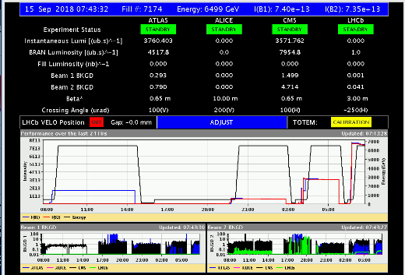
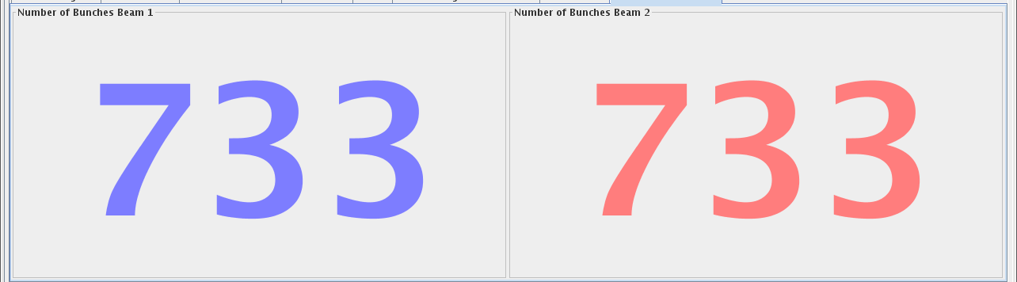
Successful revalidation in MD3 (Fill #7151) .. but TCL4 ..
MD3
Intensity ramp up in 3 steps (61b, 301 b, 733 b)
L= 3.6-3.7 × 10 ³⁴ cm⁻²s ⁻¹
@ β∗=65 cm – 120 μrad

Slide 4
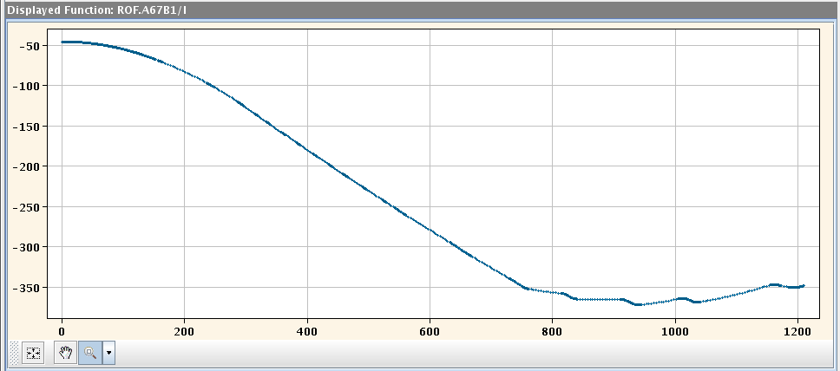
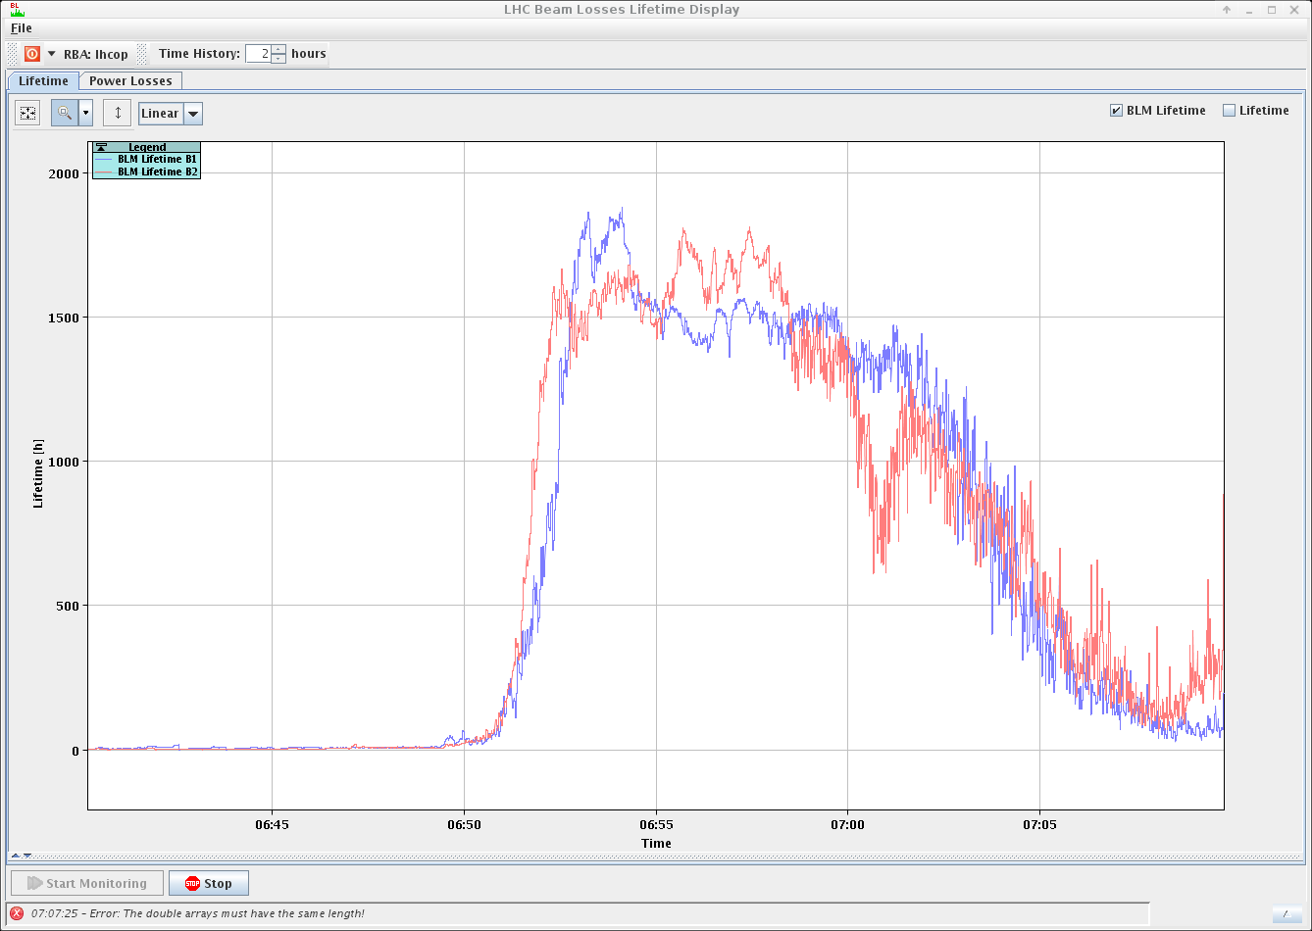
MD3
Good life time in the ramp
although reduced EoR (~50-100 h)
Ramp with MO <0 (-350 A EoR)
733 bunches
(Fiill #7174)
- 350 A
No ADT activities in the ramp

Slide 5
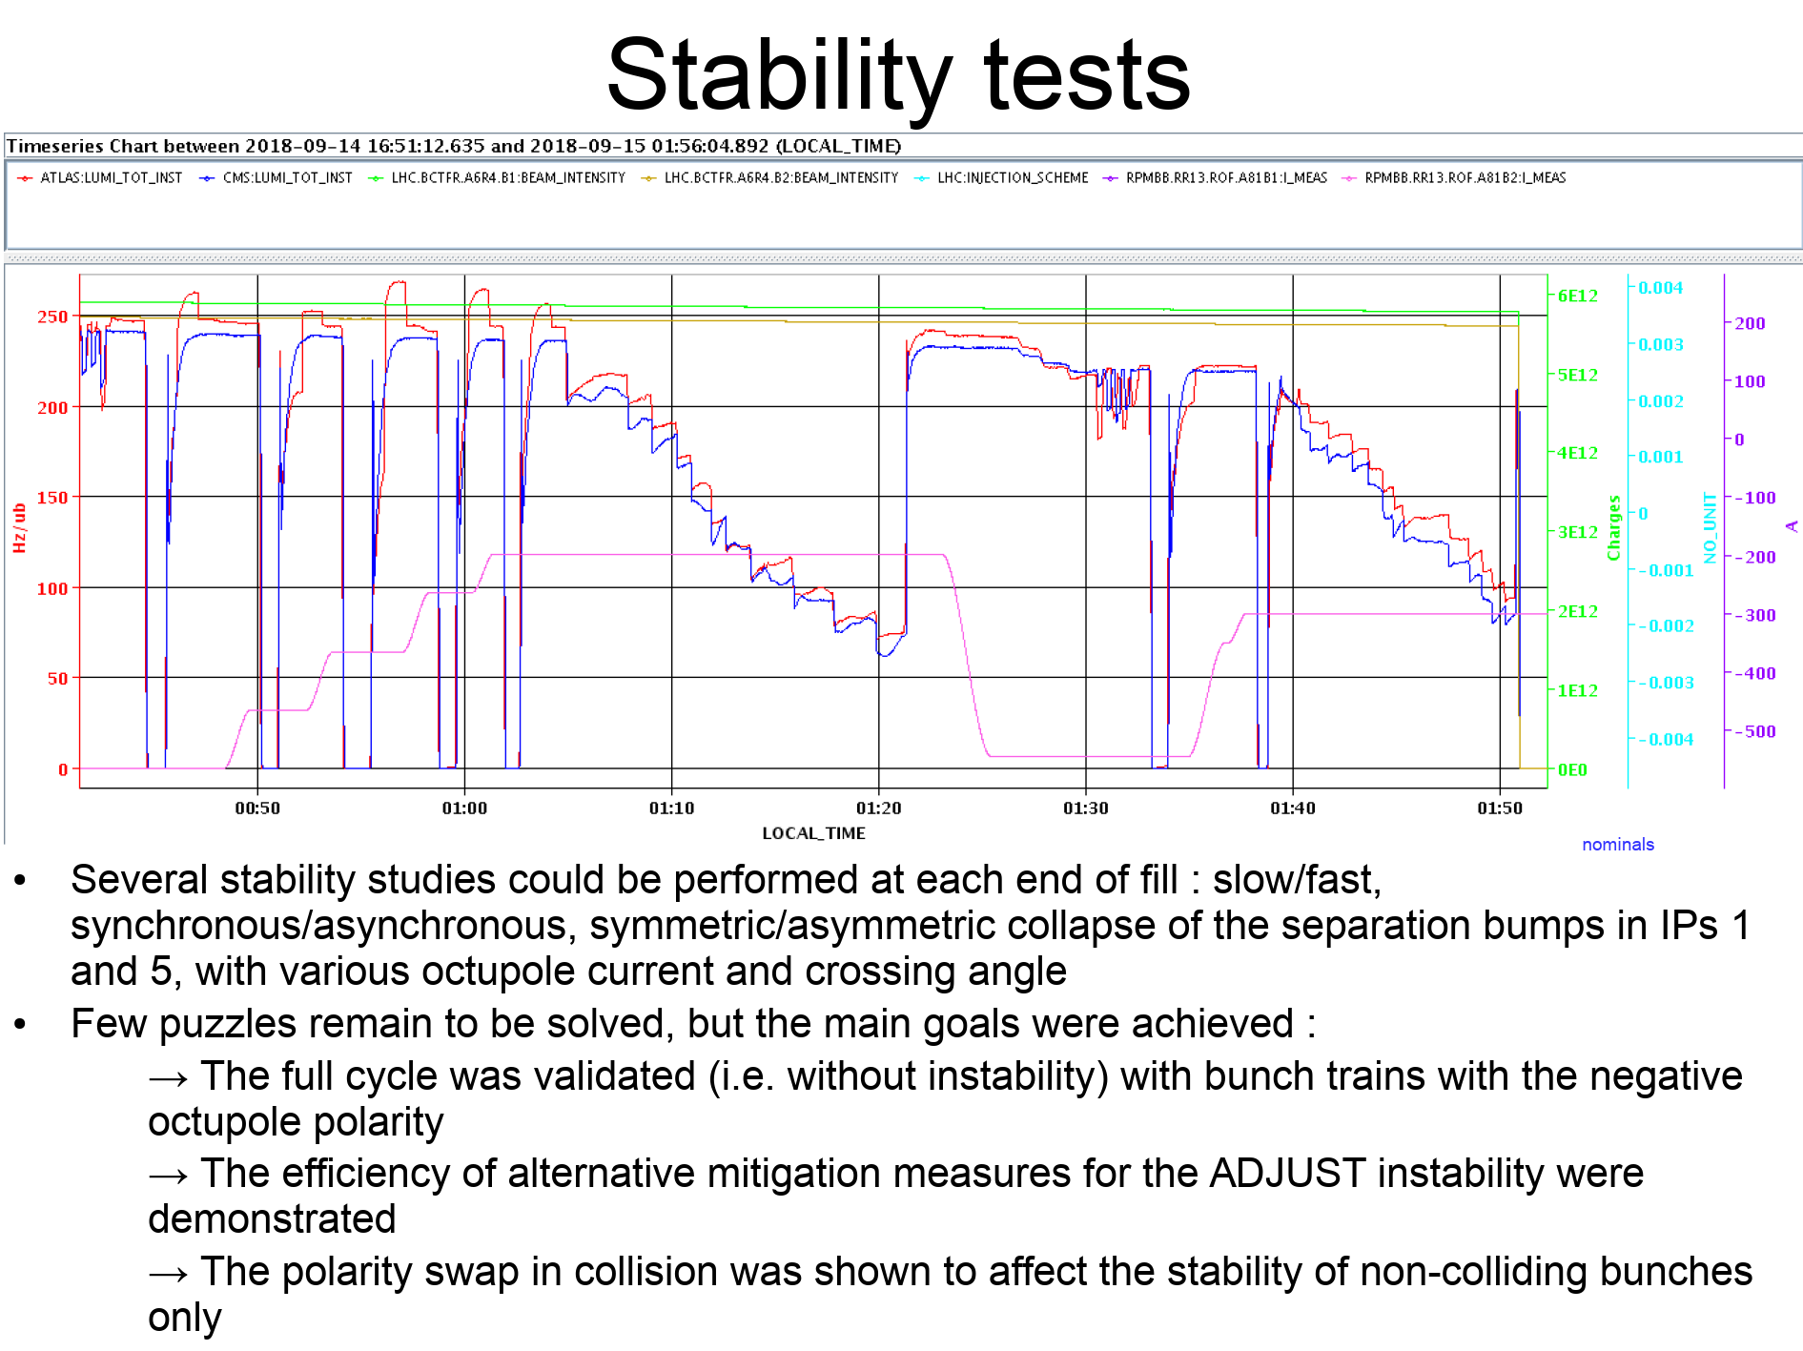
MD3
X. Buffat

Slide 6
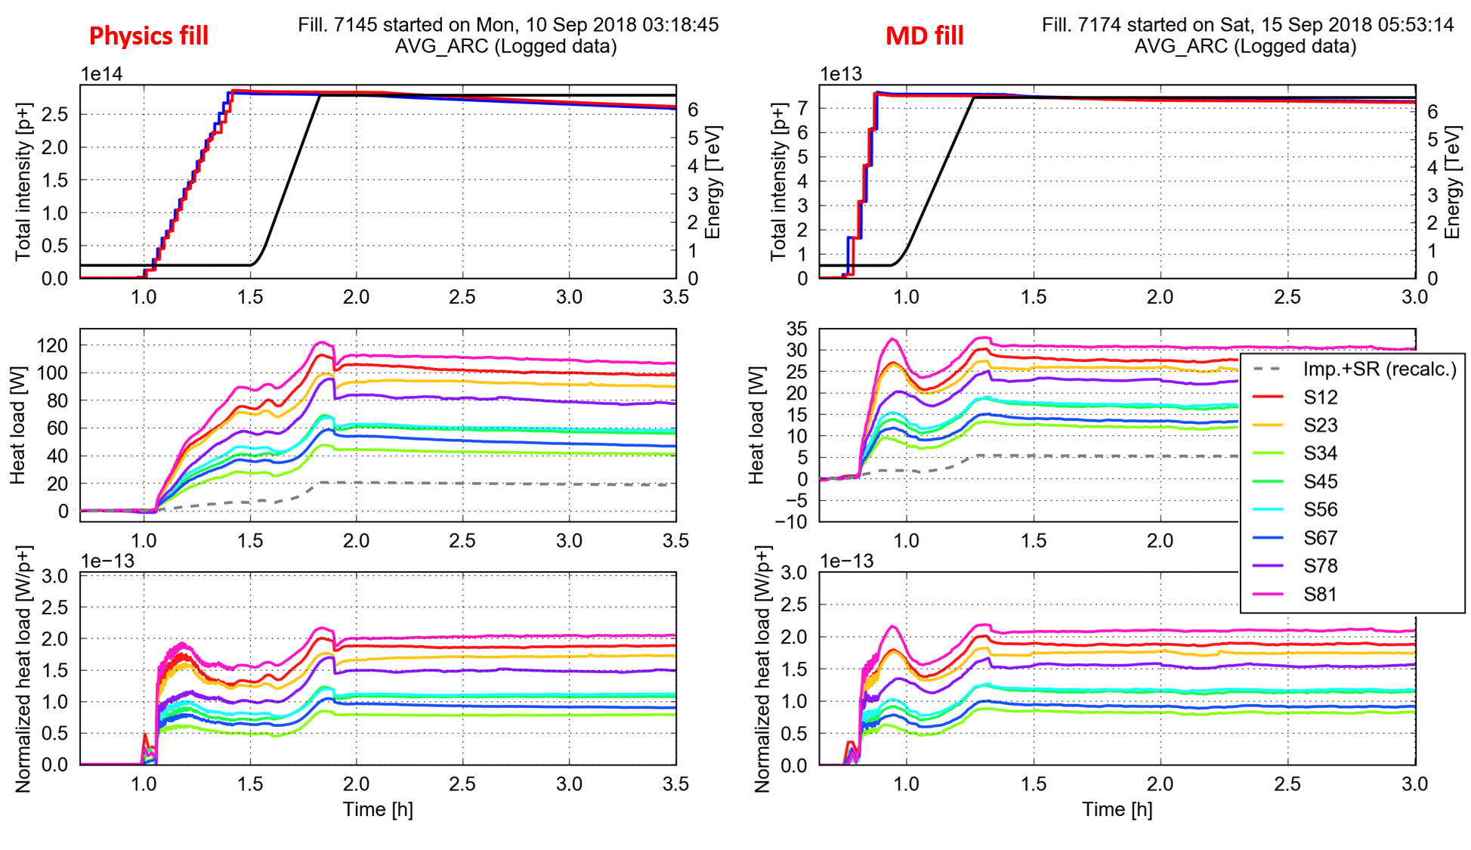
MD3
E-cloud:
→ No change in terms of norm. heat-load compared to physics fill
G. Iadarola

Slide 7
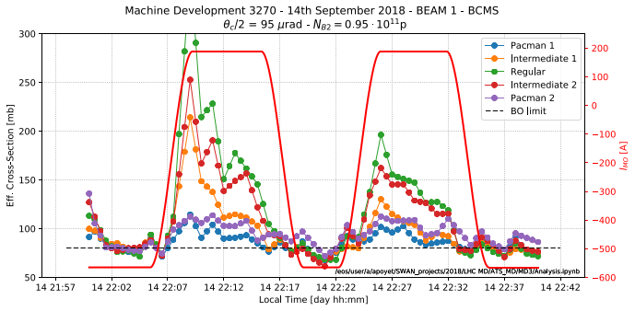
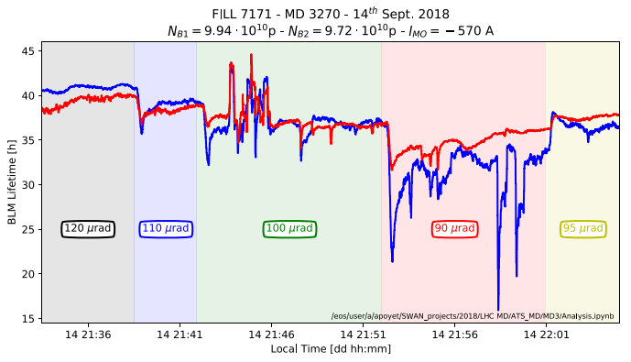
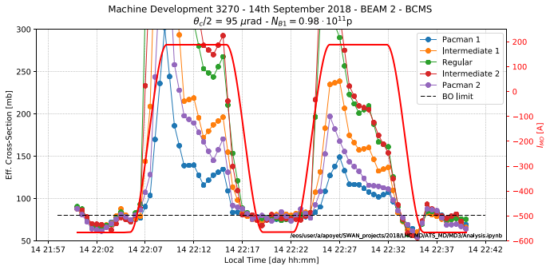

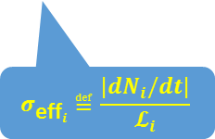
BBLR mitigations with octupoles:
→ it also work for round telescopic optics
MD3
Beam1: MO scan @ 95 μrad
Half-X of 95 μrad @ ~ 1E11 p/b
i.e. only 8 σ @ β*=65 cm !!
$$σ_{{\text{eff}}_{i}}≝\frac{{|dN}_{i}/dt|}{𝓛_{i}}$$
$σ_{burn−off}$~80 mb
Beam2: MO scan @ 95 μrad
X-angle scan @ -570 A in MOs
A. Poyet

Slide 8
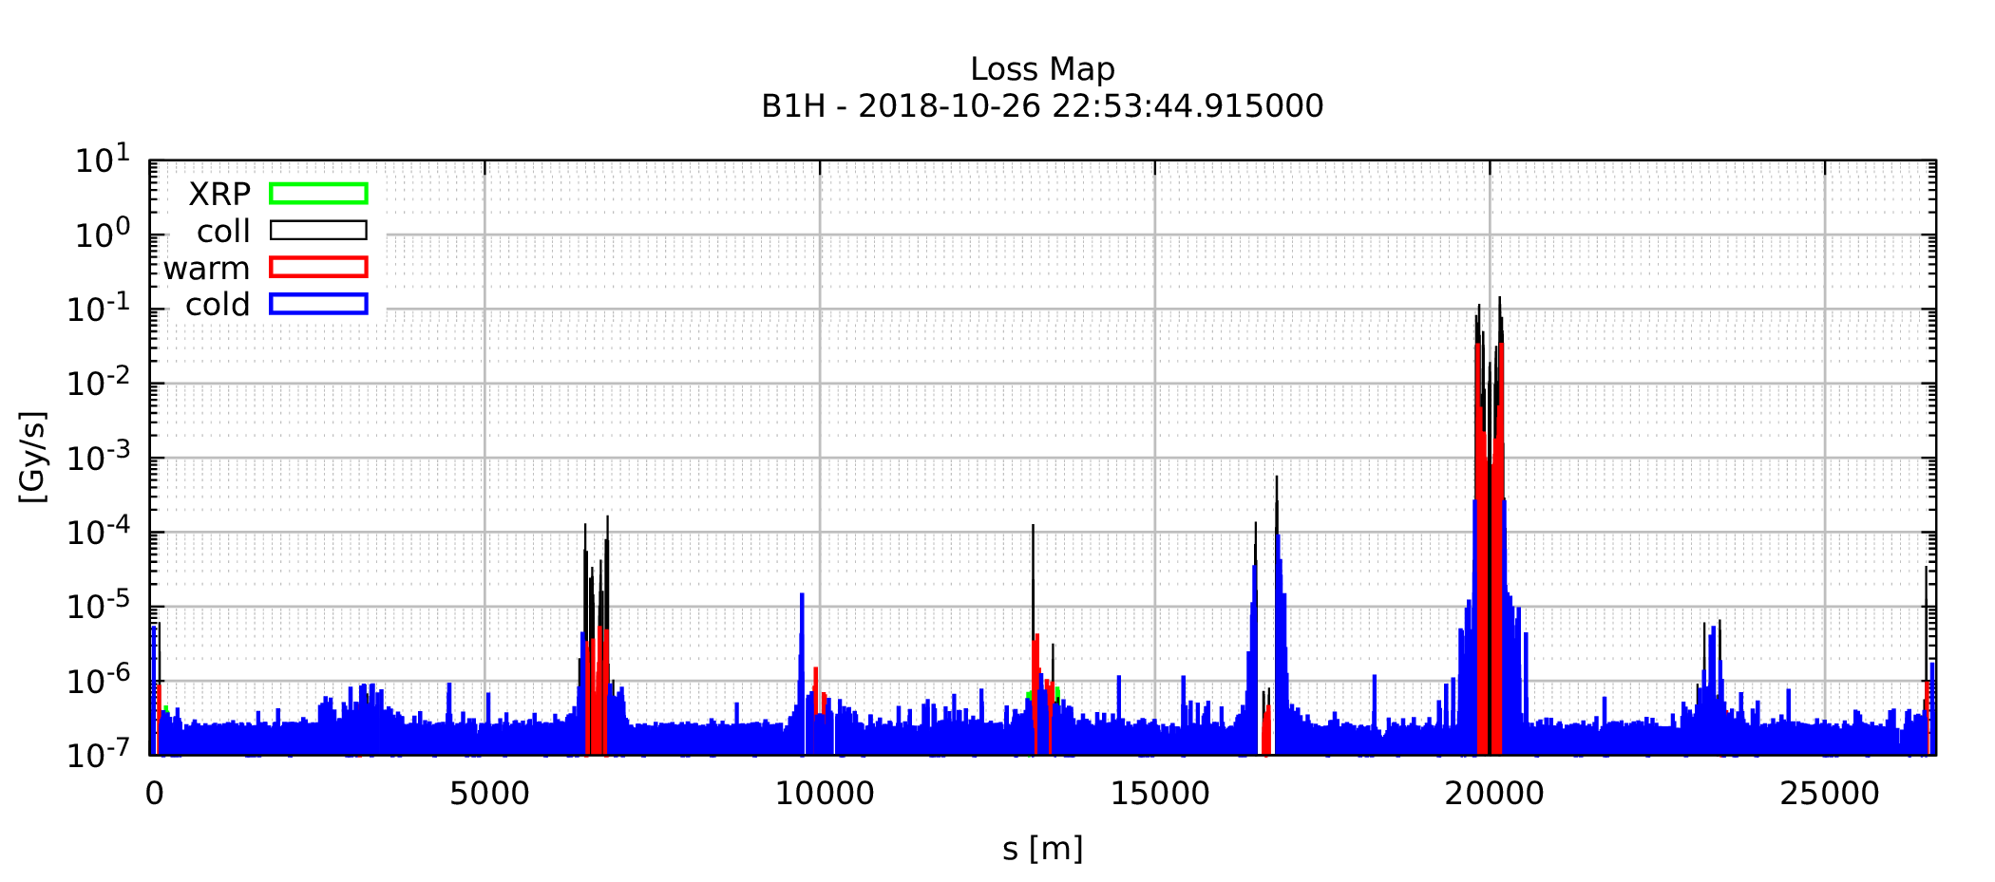
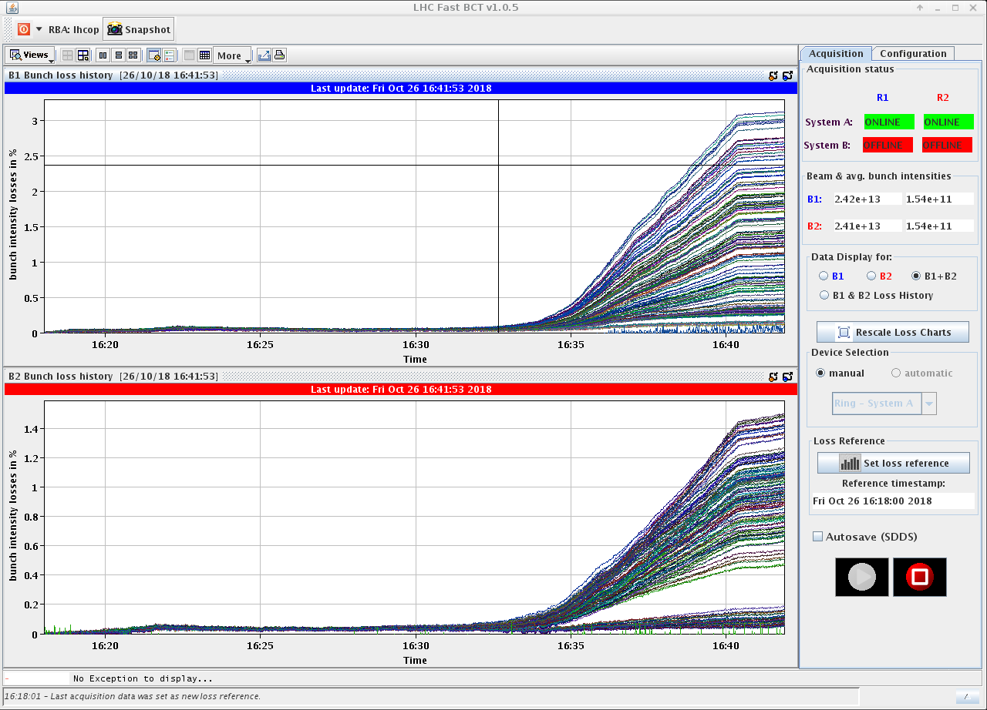
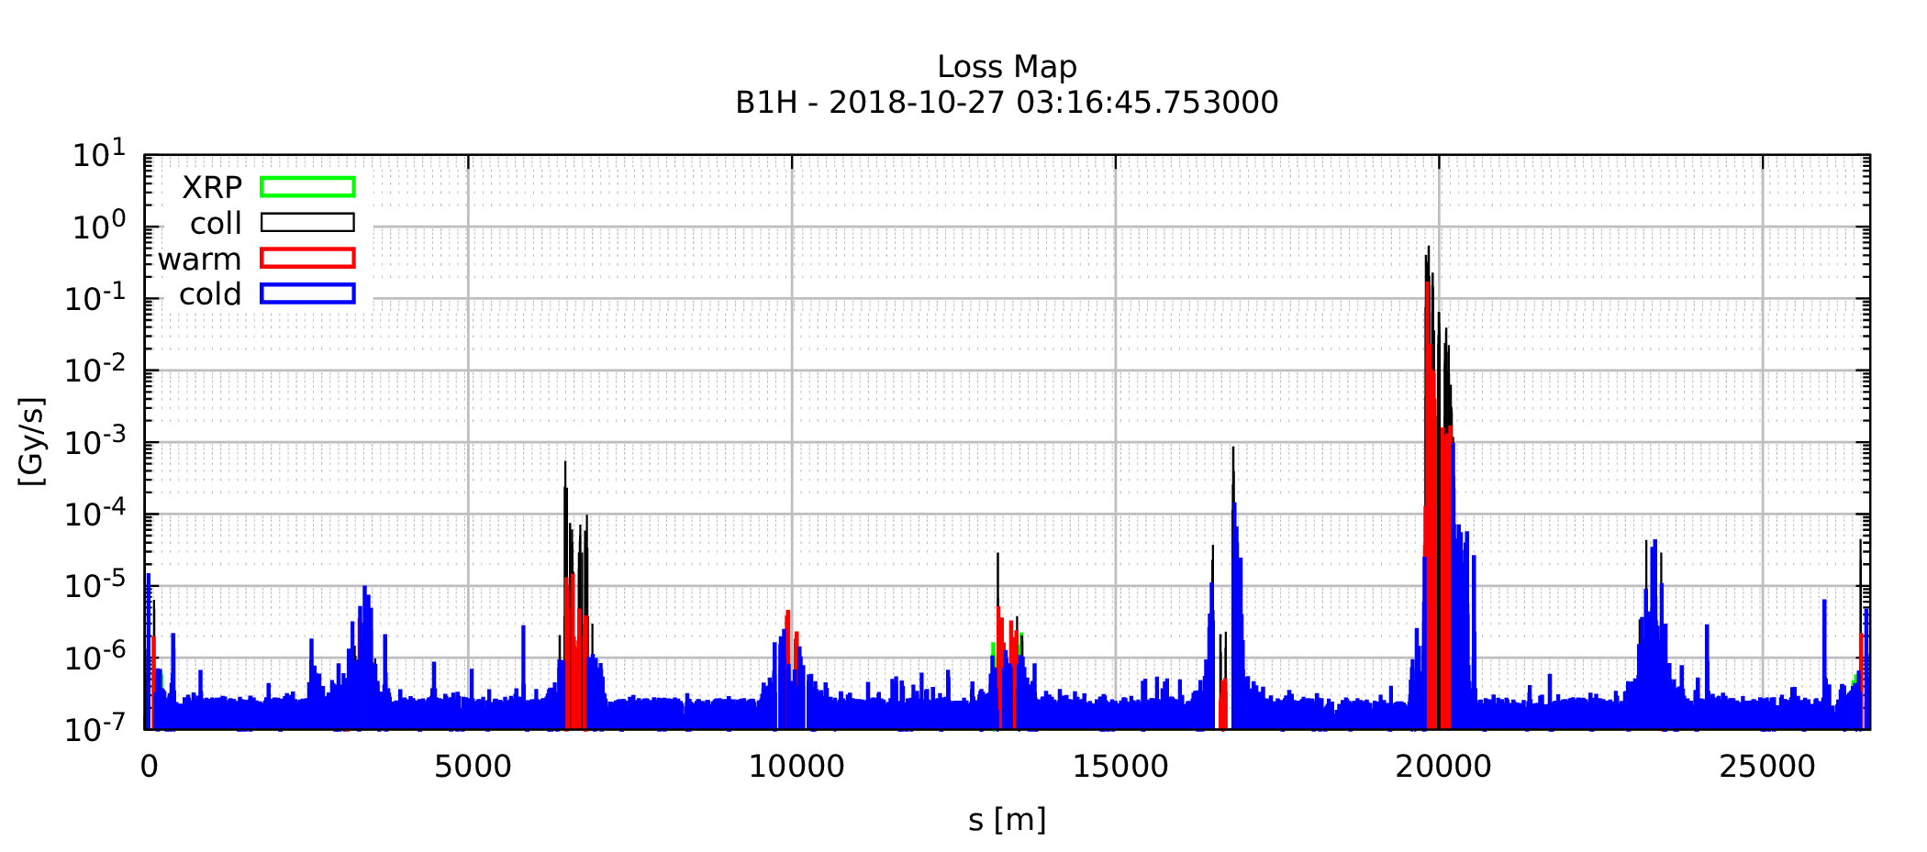
MD4
Successful revalidation in MD4 (Fill #7340) .. with TCL4 ..
8b4e (~ 1.6E11 p/b) intensity ramp up in 2 steps (CRDS not used for the 3rd step)
3 trains (+12 b+ 1 INDIV → 157 b)
~ 800 b showing high TCT losses EoR (TCT @ 11 σ vs. 15 σ for the nom. Ramp)
FIRST RAMP: 2-3% losses EoR cured after the Q-change (and marginal reduction of the MO current from -570 A up to -500 A)
CRDS
Nominal EoR

Slide 9
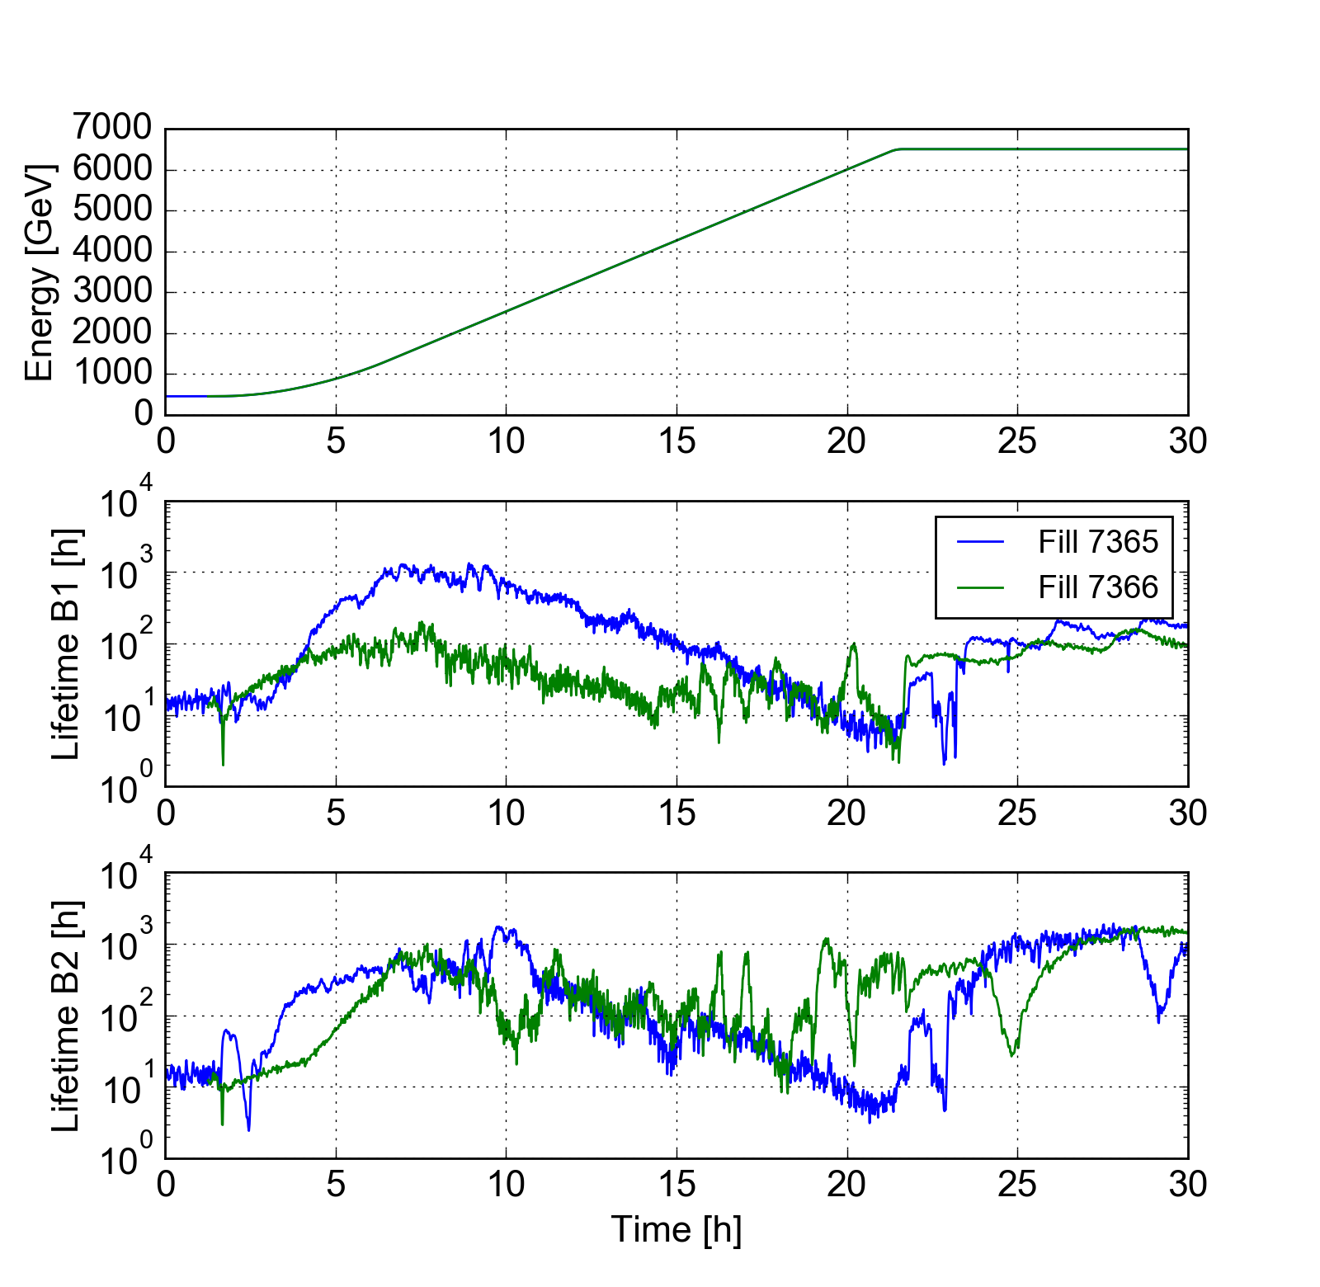
Fill 7365: 800 b with CRDS (8b4e)
Fill 7366: 1600 b with nominal ramp (8b4e)
( 1.5-1.6E11 p/b – γε ~ 3-3.5 μm)
MD4
Bad life time (< 10 h) EoR
For Beam1 (both ramps)
For Beam2 (only with the CRDS)
The TCT losses with 800 b were measured above 70% of the thresholds, vs. 30-40% in IR7 (84 s of integration time).
This justified the decision of using the nominal cycle for the 1600 bunches

Slide 10
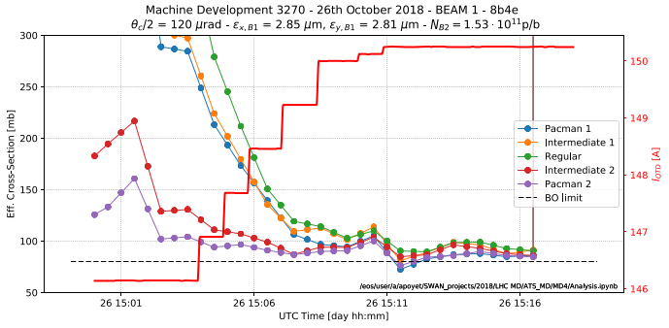
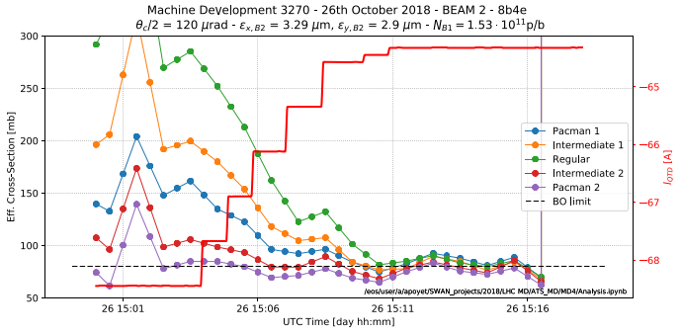
MD4
Beam-beam @ 1.5-1.6e11 p/b (γε ~3 μm) !!
8b4e trains successfully put into collision (MO<0 @ -570 A)
Burn off limit demonstrated after a Q-scan (ΔQ_{x,y}=+0.007/+0.005)
.. For a half X-angle of only 120 μrad @ β*=65 cm, i.e. 9.3 σ (@ γε ~3 μm)
A. Poyet

Slide 11
MD 4023 – TCDQ levelling
Motivation: reduce the TCDQ effective gap in collision when allowed at lower beam current, in order to preserve (maximize) the β* reach for Run III (HL-LHC)
Principle: moving the beam (and TCSP) instead of the TCDQ (BETS unchanged)
TCDQ
TCSP
(critical jaw)
TCDQ
TCSP
(critical jaw)
7.3 (→ 6.8) σ (min. 3 mm)
(low intensity, end of levelling)
4.9 mm (TCDQ min. gap for
HL-LHC intensity, EoR setting)
Δx via orbit bump (max 2 mm)
TCSP
2 Δx (max 4 mm).
The TCDQ did not move
The BPM readout is still zero !
TCSP

Slide 12
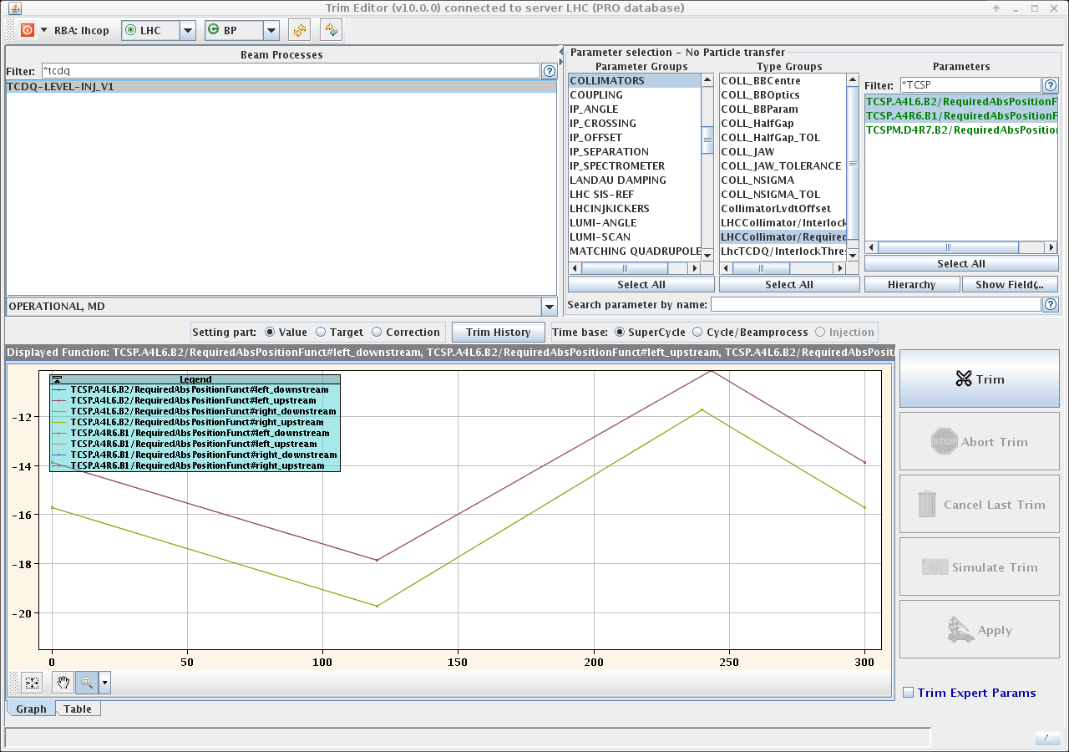
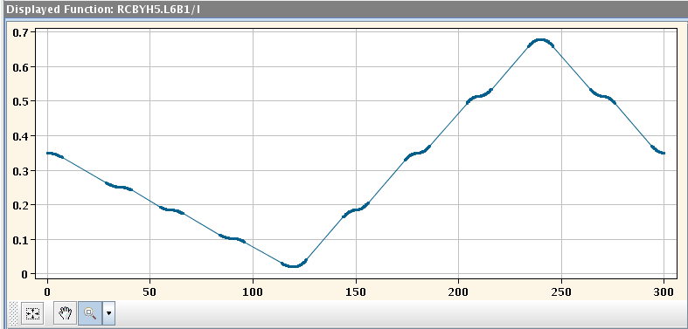
Preparation of a special BP at injection, varying the H orbit at the TCDQ (+/- 2mm), with synchronized displacements of the TCSPs (non-critical jaw)
TCSP orchestration (+/- 4 mm mvt)
Typical MCBY function
(with rounding in/out at stop points)
J. Wenninger et al.

Slide 13
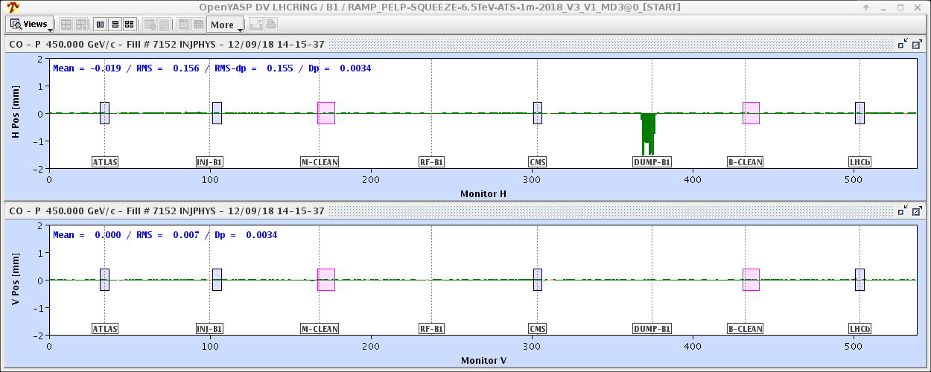
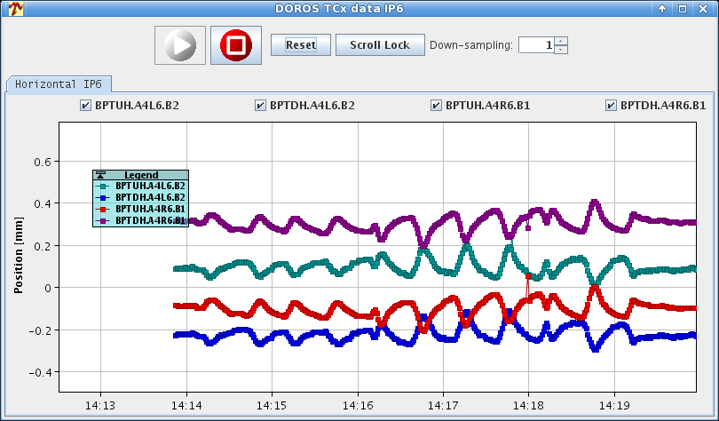
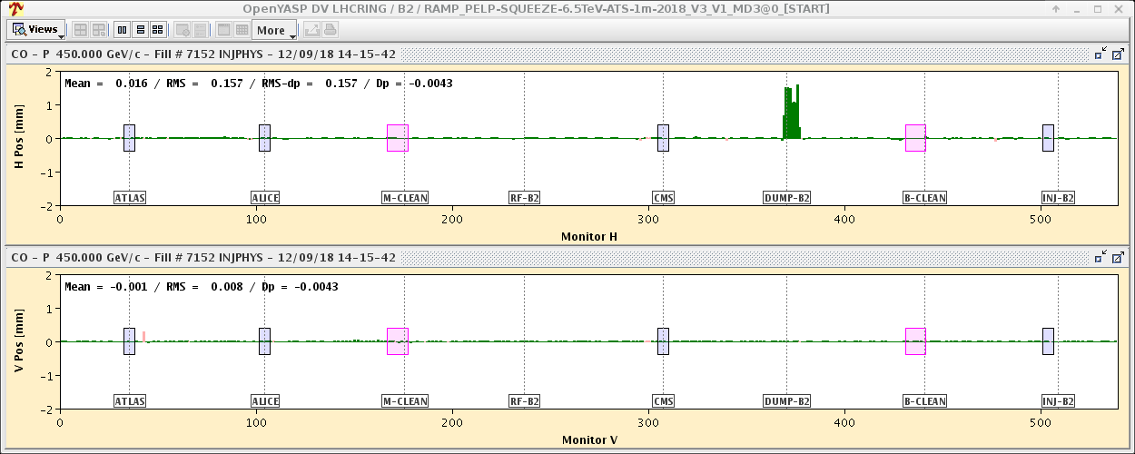
Results: no bad surprise, with a residual of +/- 100 μm (within the BPM SiS), largely dominated by the absence of rounding in/out in the TCSP functions
TCSP BPM read-out over the beam process (one INDIV/beam, OFB ON)
Max bump amplitude (+/- 2 mm)

Slide 14
Summary & Outlook
The Combined Ramp & Double Squeeze (CRDS) has been demonstrated up to a quasi- operational level (only missing the BLM threshold refinement, which is done anyway at each operational year).
A full LHC cycle with negative MO polarity has been demonstrated up to 1.6e11 p/b (8b4e), provided a tele-index deployed in the ramp (CRDS) and no offset levelling at FT, showing clear benefits on lifetime for colliding beams (BBLR mitigation with octupoles)
The TCDQ levelling principle perfectly works.
These three key ingredients are kept in mind for the OP scenarios at high intensity in Run III.

