Slide 2
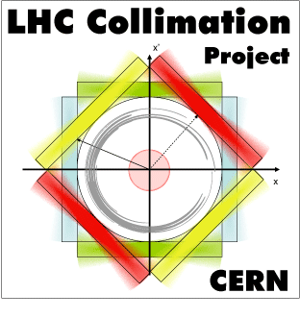
MD3327+MD4167
Crystal Collimation with Protons
M. D’Andrea, D. Mirarchi, S. Redaelli, R. Rossi
Acknowledgements: BE-ABP, BE-OP, EN-SMM

Slide 3
Overview of measurements
27th July 2018
MD3327 Crystal collimation tests with proton beams
  Angular scans: B1H (injection and flat top), B2H (flat top)
  Linear scans: B1H (injection and flat top), B2H (flat top)
  Loss maps with crystal collimation system
12th September 2018
MD4167 Operational aspects of crystal collimation with proton beams
  Angular scans: all four crystals (injection and flat top)
  Linear scans: all crystals except B1H (flat top)
  Loss maps with crystal collimation system and different TCLAs settings
  Energy ramp with all four crystals in

Slide 4
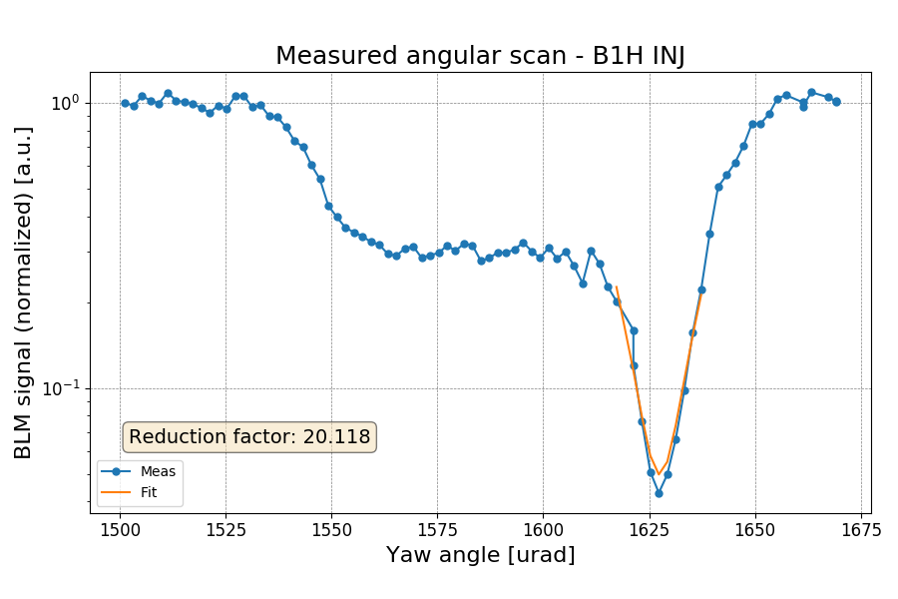
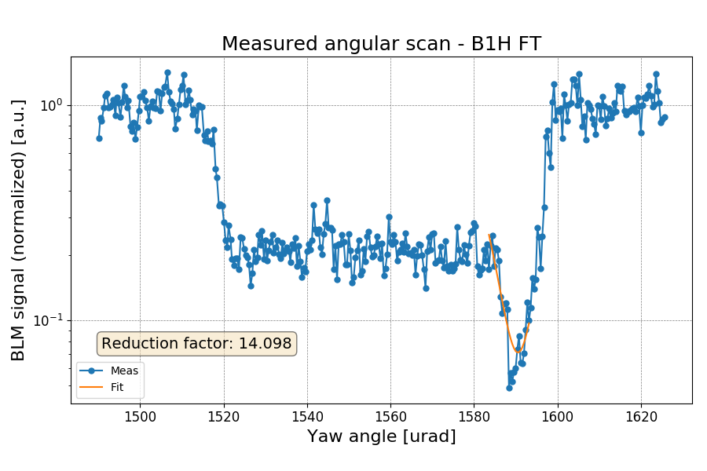
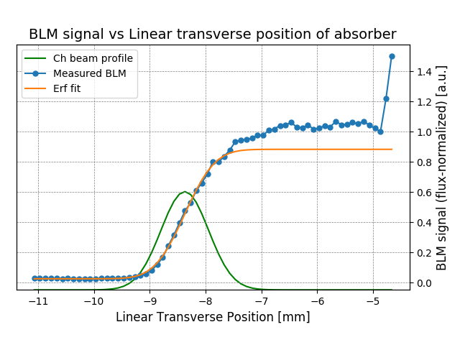
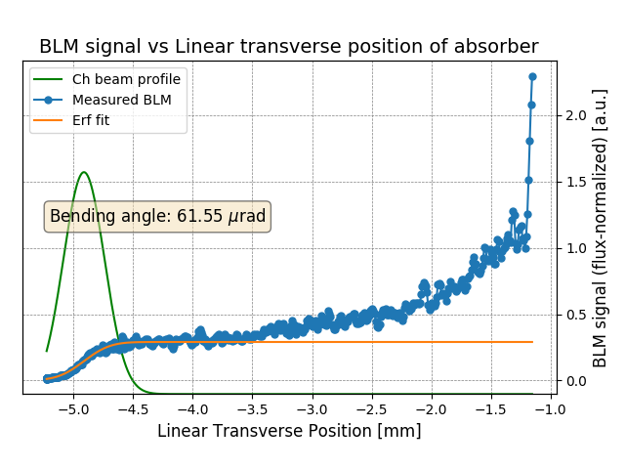
Angular and linear scans
B1H INJ
B1H FT
B1H INJ
B1H FT

Slide 5
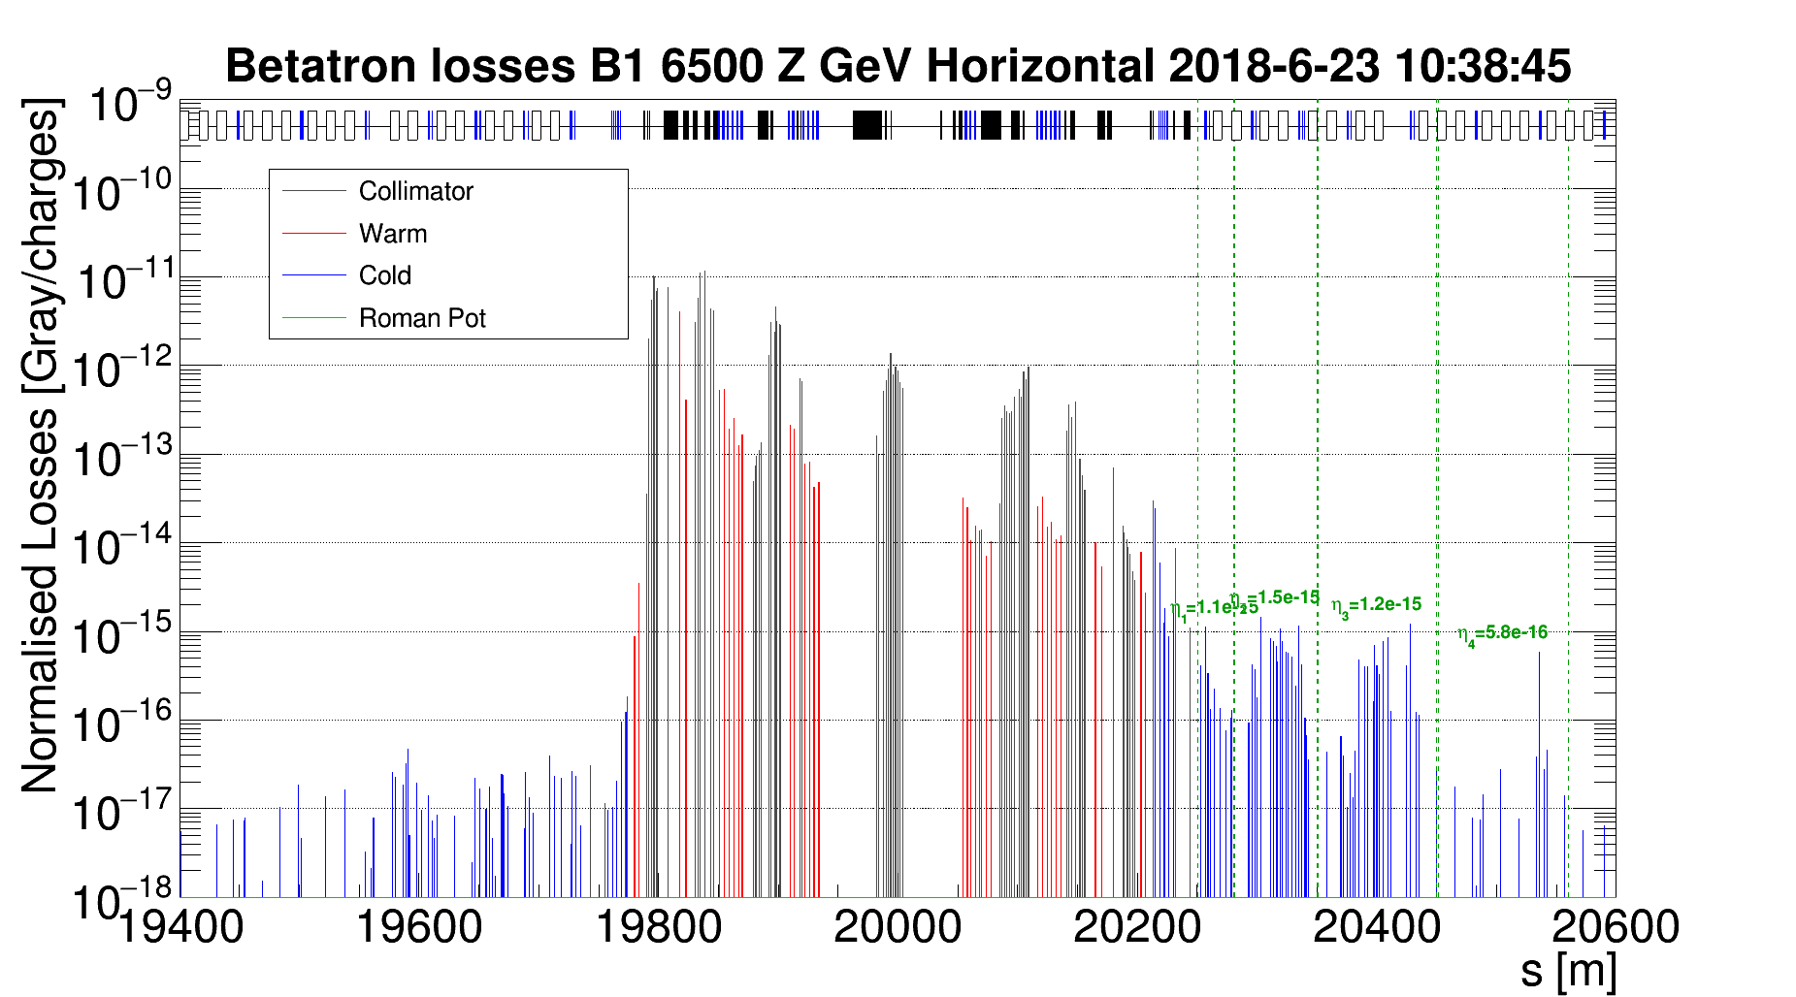
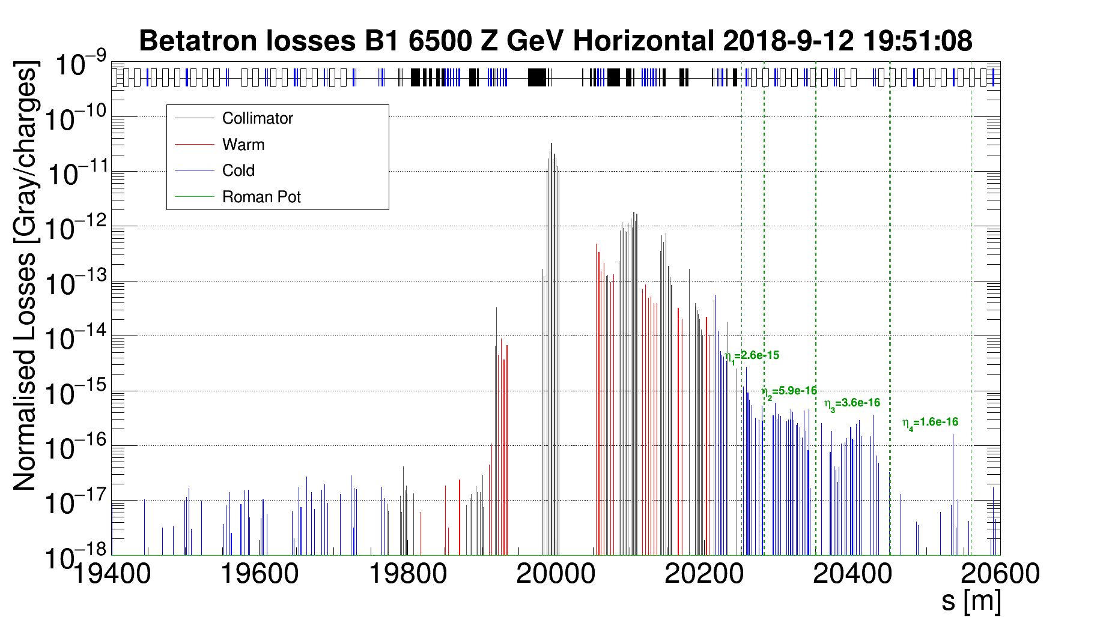
Loss maps
Crystal | Upstream TCPs, TCSGs | Downstream TCSGs | TCLAs | Planes
5.0 σ | Out | 6.5 σ | 10.0 σ | All
5.0 σ | Out | 6.5 σ | 8.0 σ | All
5.0 σ | Out | 6.5 σ | 6.5 σ | B1H, B1V
B1H std
B1H cry
Detailed analysis and comparison ongoing…

Slide 6
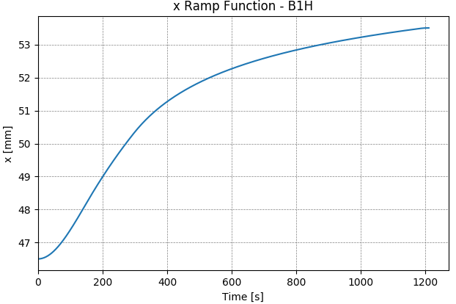
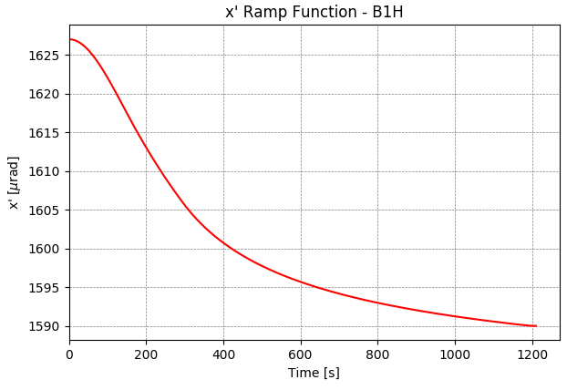
Cry collimation in dynamical phases
Ramp functions generated to change linear and angular positions of the crystals
~7 mm
~35 μrad
Initial and final positions fixed to measurements
Channeling conditions assessed by means of continuous loss maps
channeling
amorphous
R. Rossi
R. Rossi

Slide 7
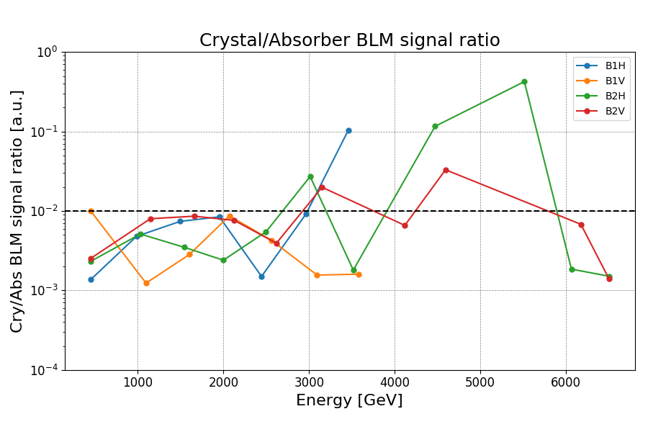
Channeling during the ramp
orbit correctors trip
Channeling was kept until the trip of the orbit correctors

Slide 8
Conclusions
Main goals for this year’s activities with protons were reached
  Complete characterization of all crystal devices, including the newly installed B2H crystal
  Loss maps with various settings to assess the cleaning inefficiency of the crystal collimation system
  First energy ramp with all four crystals in channeling
Detailed analysis still ongoing…

