Slide 1
MECHANICAL ENGINEERING OF ACCELERATOR COMPONENTS
Antti Kolehmainen
Tommi Mikkola
Tuukka Lehtinen
on behalf of CERN EN/MME

Slide 2
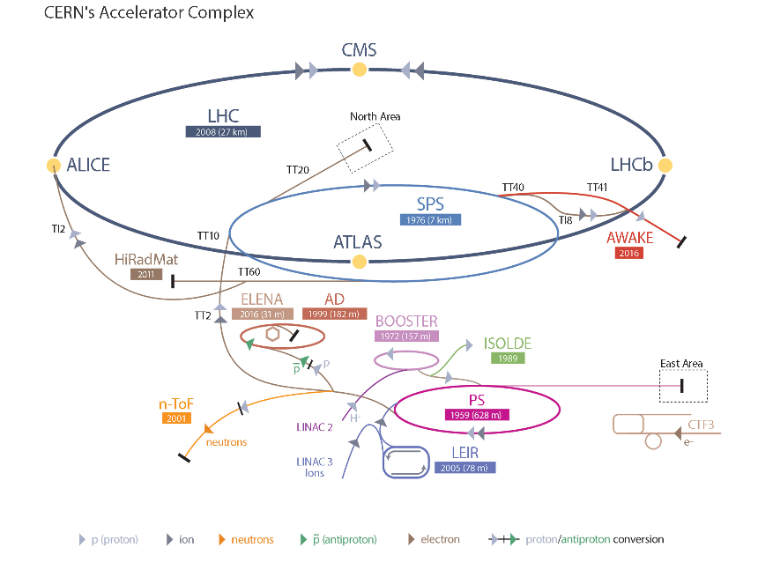
CERN EN-MME GROUP
“The mandate of the MME group is to provide to the CERN community specific engineering solutions combining mechanical design, fabrication and material sciences.”
We are around 150 people
We do:
  Material development and mechanical and geometrical measurements
  Engineering calculations and simulations
  Mechanical design
  Production and sourcing

Slide 3
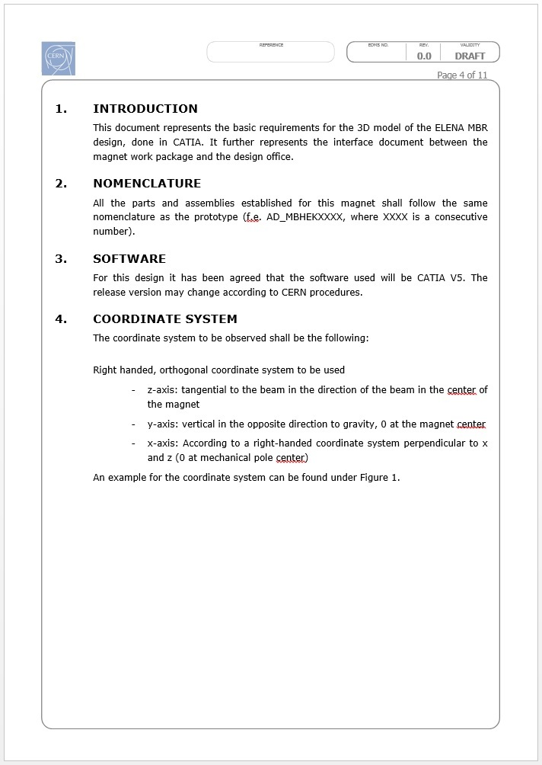
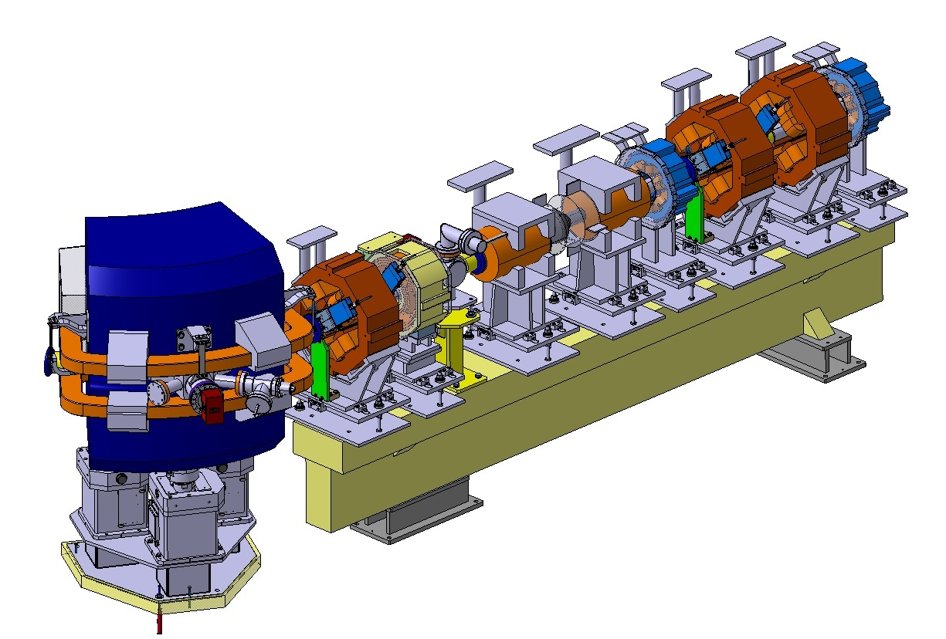
MECHANICAL DESIGN
DESIGN INPUTS
CLIENT SPECIFICATION FOR THE DEVICE
AVAILABLE SPACE FOR THE DEVICE
ALL PARTIES CONCERNED ARE INFORMED

Slide 4
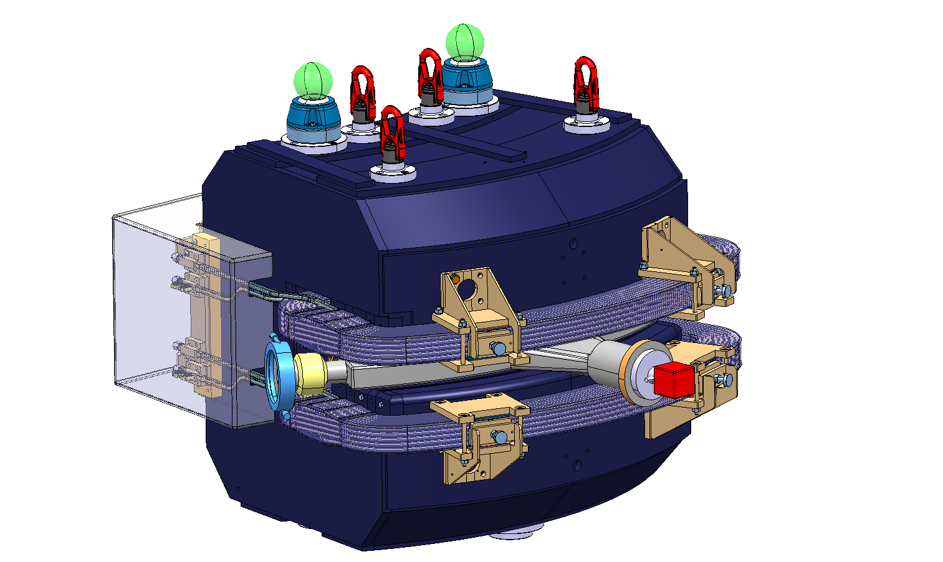
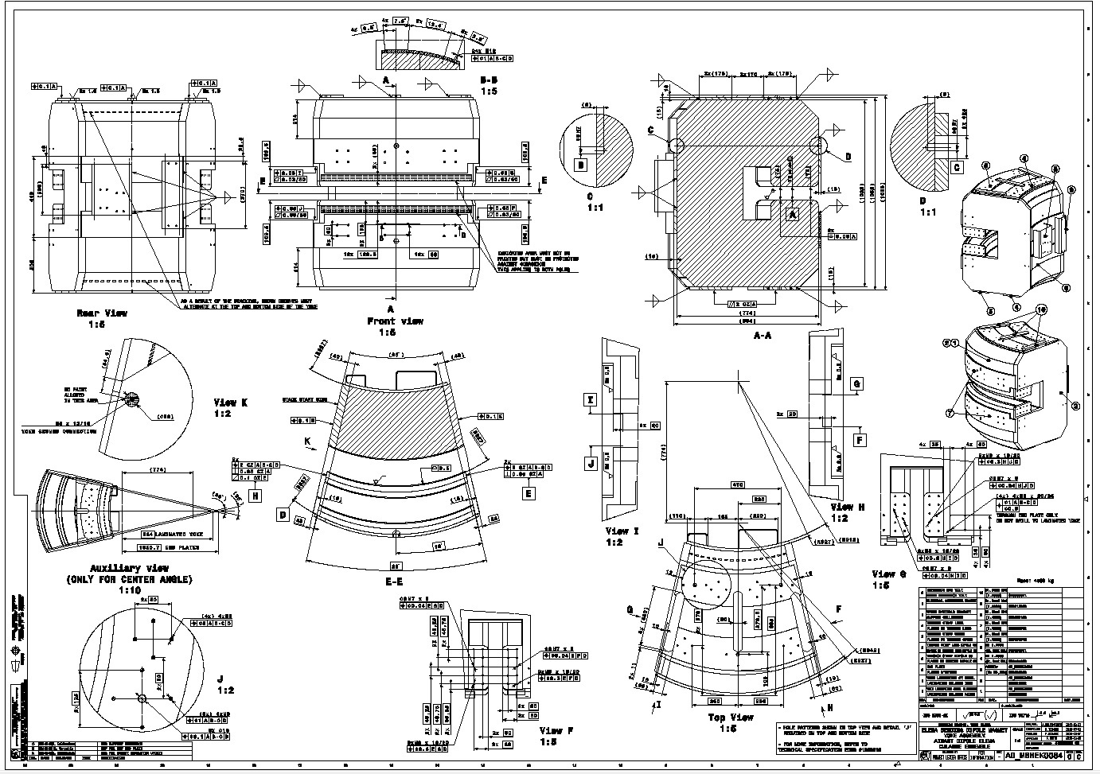
MECHANICAL DESIGN
DELIVERABLES:
2D DRAWINGS
3D MODELS
SUPPORT DOCUMENTS
ITERATIONS:
CLIENT
ANALYSIS
INTEGRATION
MANUFACTURING

Slide 5
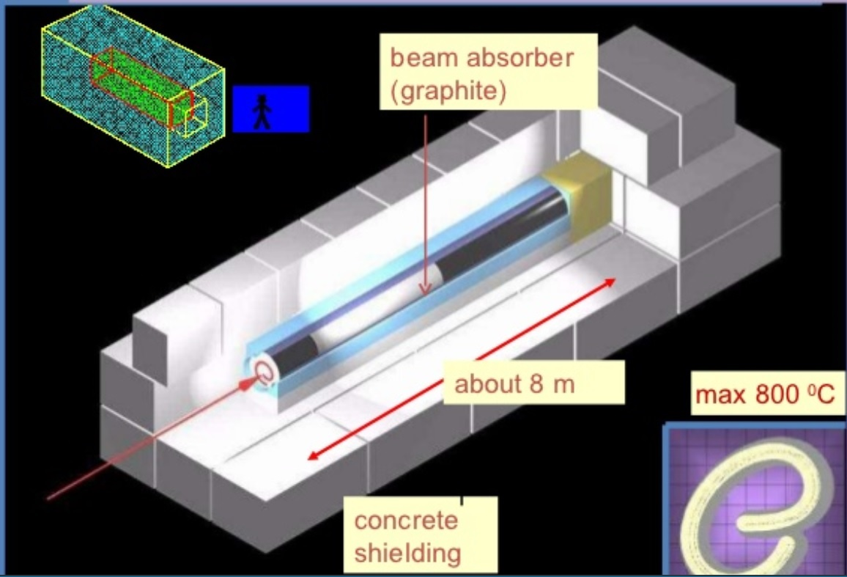
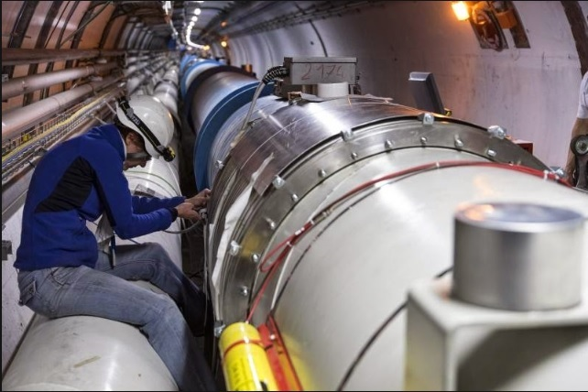
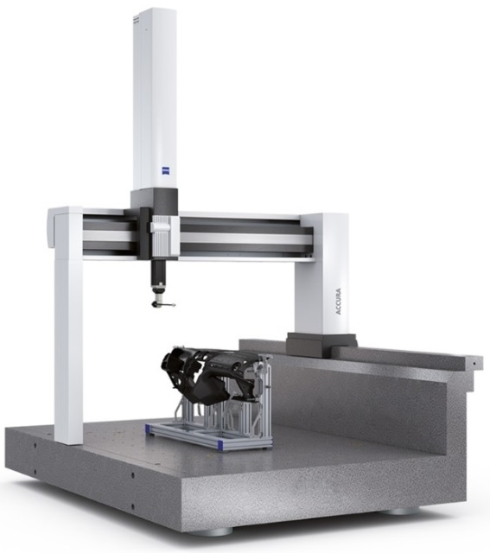
MATERIAL DEVELOPMENT AND MEASUREMENTS
MATERIAL DEVELOPMENT:
GRAPHITES FOR BEAM IMPACTS
STAINLESS STEEL ALLOY FOR PERMEABILITY
MECHANICAL MEASUREMENTS:
Non Destructive Test: X-RAY TESTS FOR THE LHC DIPOLE MAGNETS
Destructive Test: TENSILE TEST OF MATERIALS
GEOMETRICAL MEASUREMENT OF COMPONENTS TO VERIFY COMPLIANCE TO THE SPECIFICATIONS

Slide 6
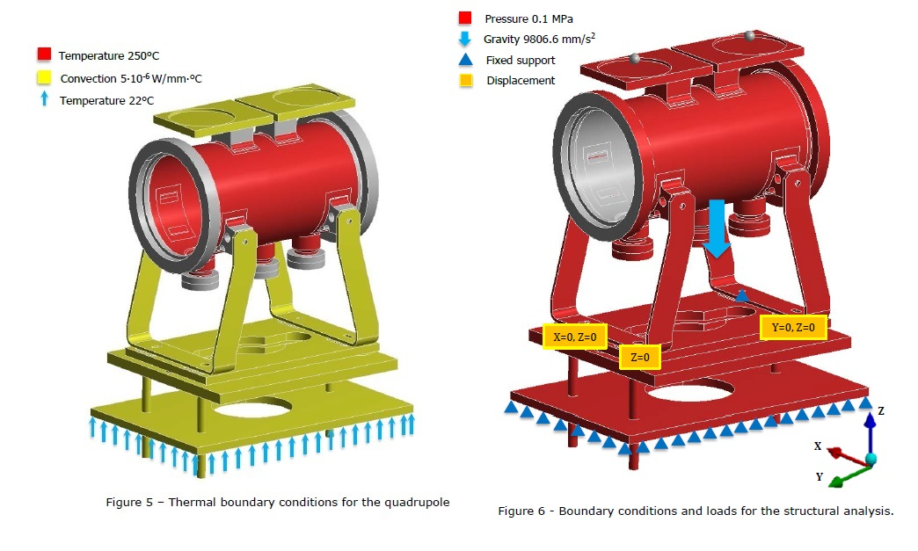
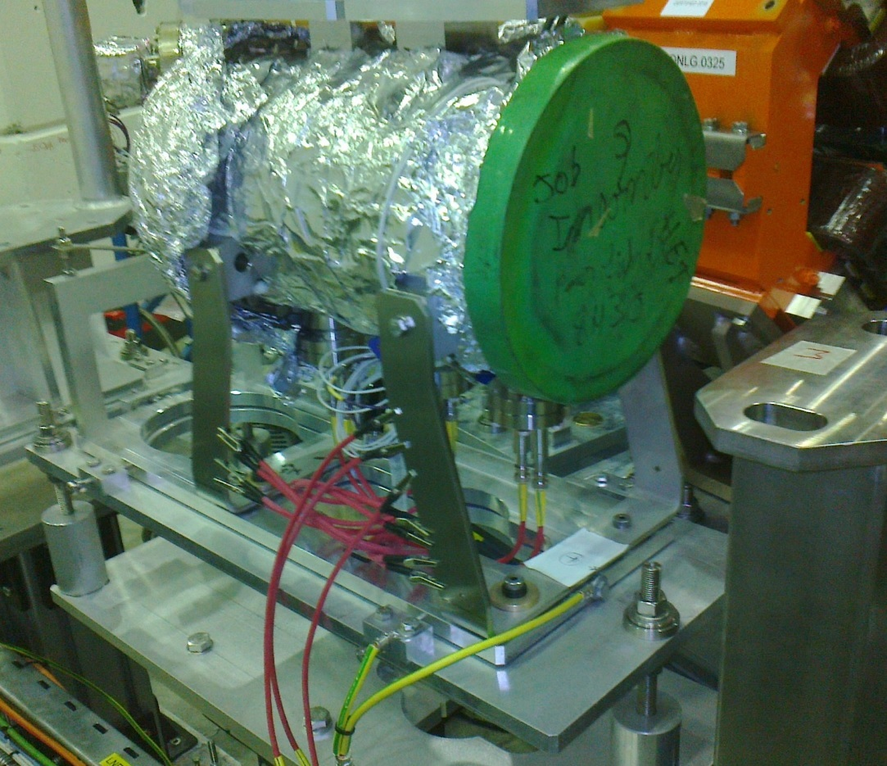
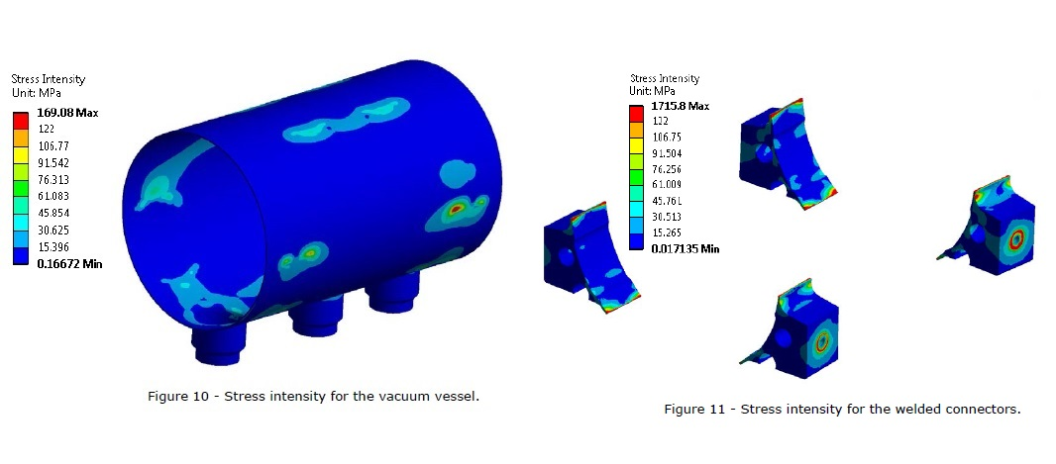
ENGINEERING CALCULATIONS
SAFETY ASSESMENT, GUIDES DESIGN WORK AND VERIFIES THAT A DESIGN MEETS ITS REQUIREMENTS
BOUNDARY CONDITIONS
FUNCTIONAL DEVICE
ANALYSIS RESULTS

Slide 7
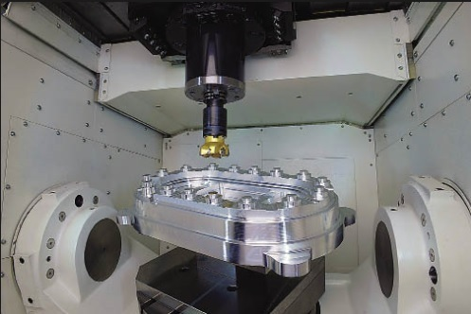
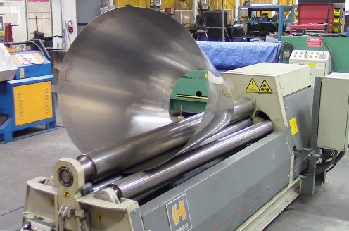
PRODUCTION
EN/MME HAS THREE WORKSHOPS
REMOVE MATERIAL BY CUTTING – ONLY METAL MATERIALS BY EN/MME
ADDING DEGREES OF FREEDOM ALLOWS MORE COMPLEXE GEOMETRIES
ELECTRICAL DISCHARGE MANUFACTURING – ELECTRICAL ARCS REMOVE MATERIAL
FORM MATERIAL
BEND / ROLL / DRAW
3D PRINTING IN USE – AND IN CONSTANT DEVELOPMENT!

Slide 8
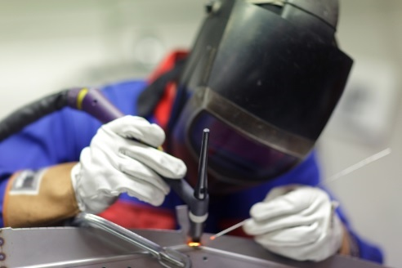
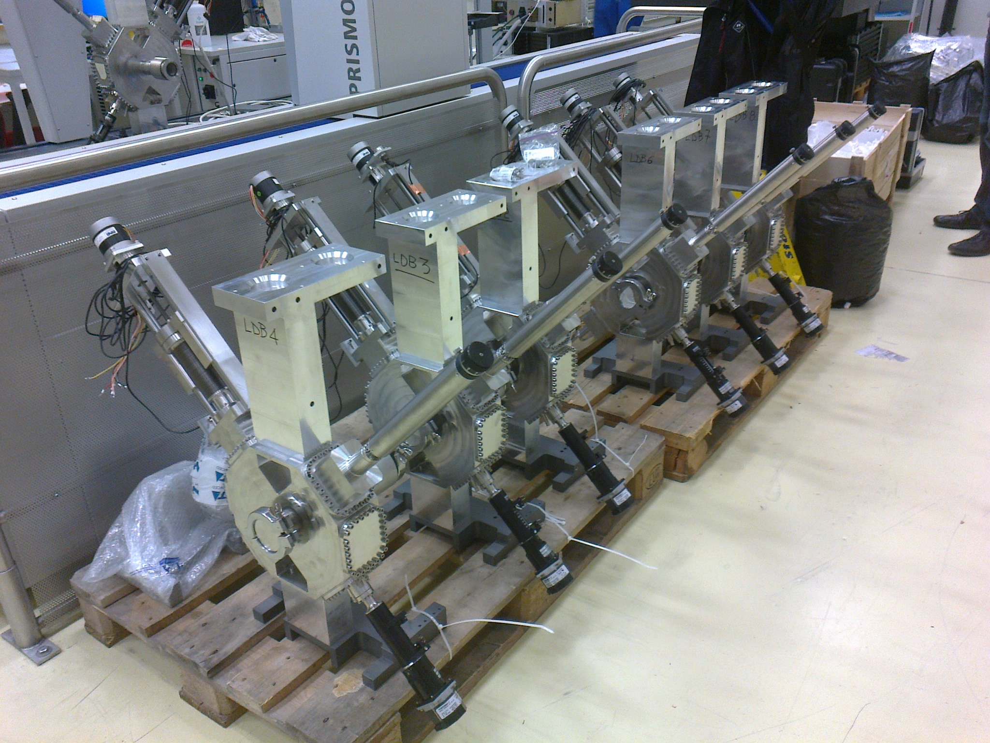
PRODUCTION AND OUTSOURCING
WELDING
  MELT THE PARTS TO BE JOINED LOCALLY – FILLER METAL MAY BE ADDED
BRAZING
  JOINED PARTS DO NOT MELT, ONLY FILLER METAL. DIFFERENT MATERIALS CAN BE JOINED
PURCHASE SIMPLE COMPONENTS AND LARGE SERIES FROM INDUSTRY

Slide 9
? / !
QUESTIONS? / THANK YOU FOR YOUR ATTENTION!

