Slide 1
Experimental results in 2018 from Cockcroft
H. Zhang, A. Salehilashkajani, C. Welsch

Slide 2
Outline
Gas jet in fluorescent mode v2
  System highlights
  Vacuum condition test
  Beam imaging using N₂ gas jet and Characterization of N₂ jet.
  Beam imaging using Neon gas and comparison to Nitrogen
  Vacuum condition test aiming for LHC installation
Future plan
Notes:
The motivation for this project is to develop a non-invasive beam profile monitor for hollow Electron lens and HLLHC. Although it is covered before, we will briefly talk about the principle of this supersonic gas jet beam profile monitor based on beam induced fluorescence mode.
Then we will discuss the progress of a prototype monitor we have built last recently as well as the experimental program.

Slide 3
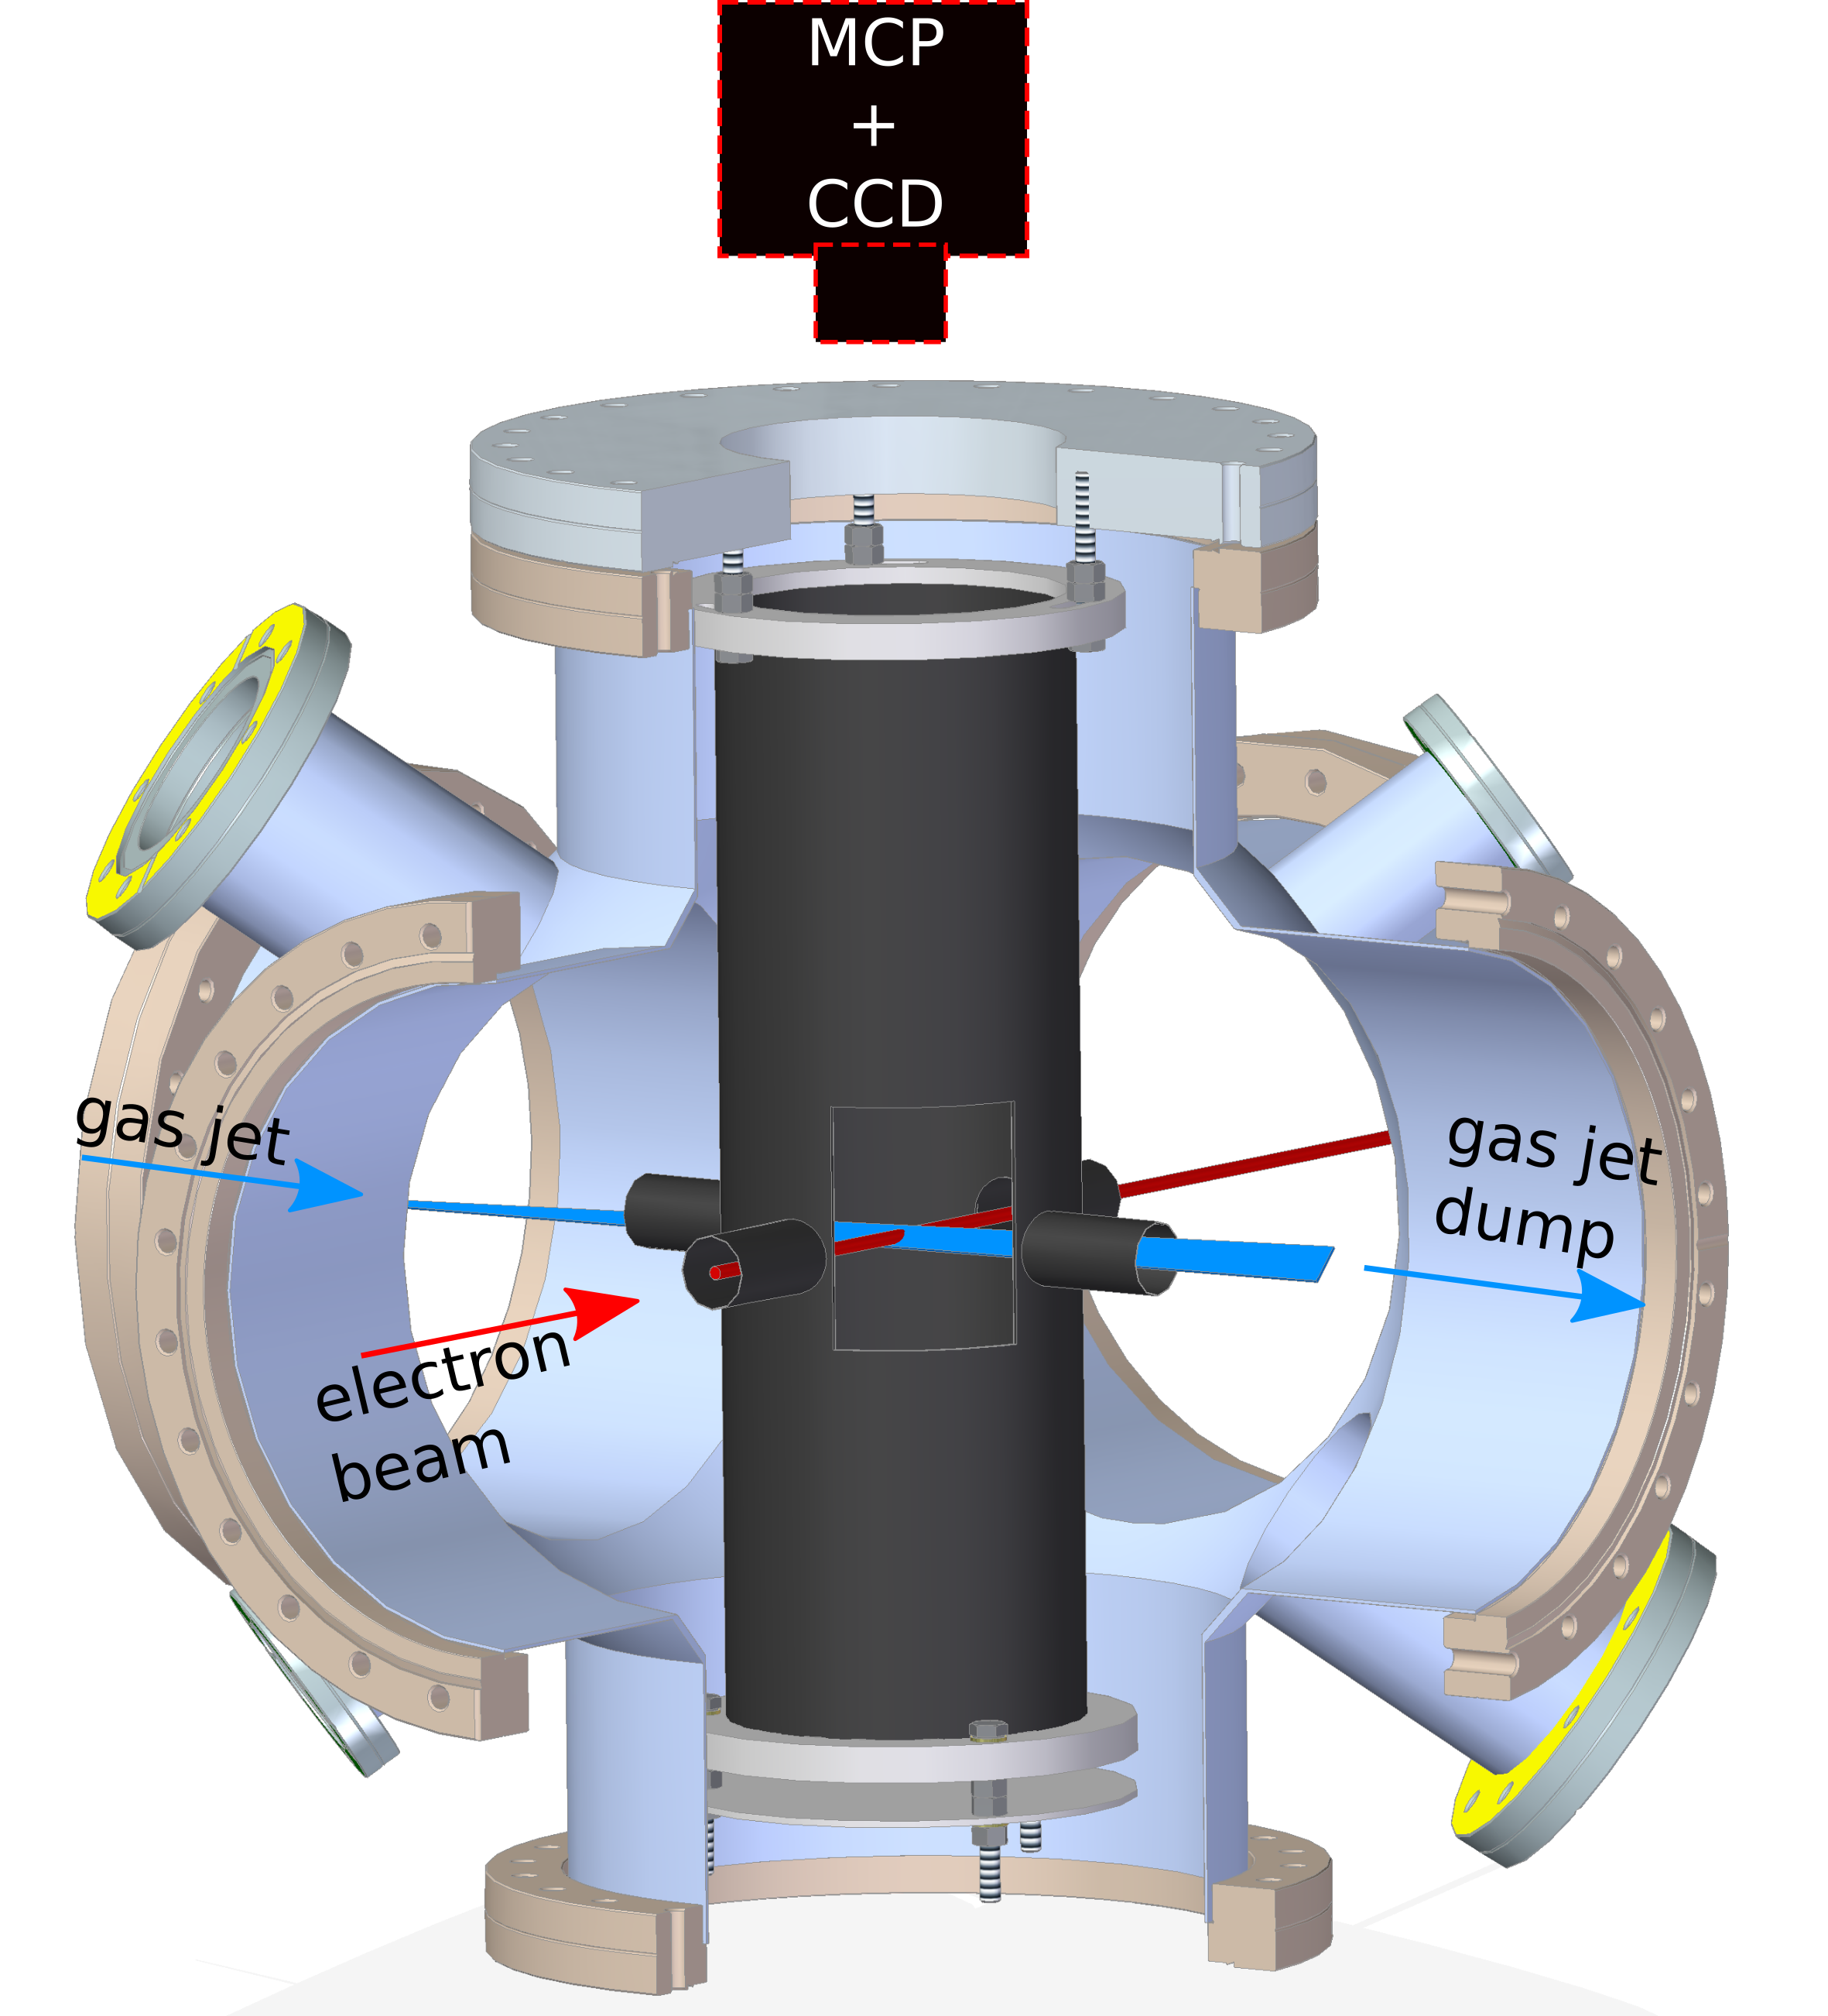
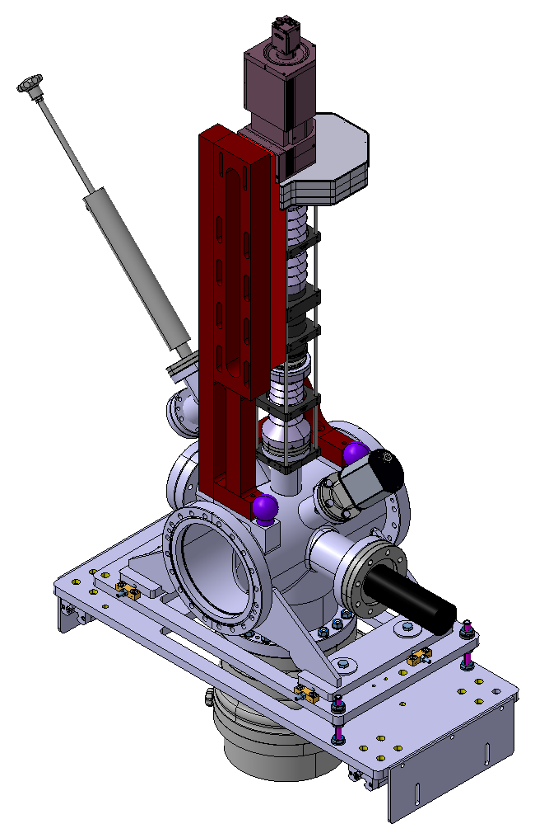
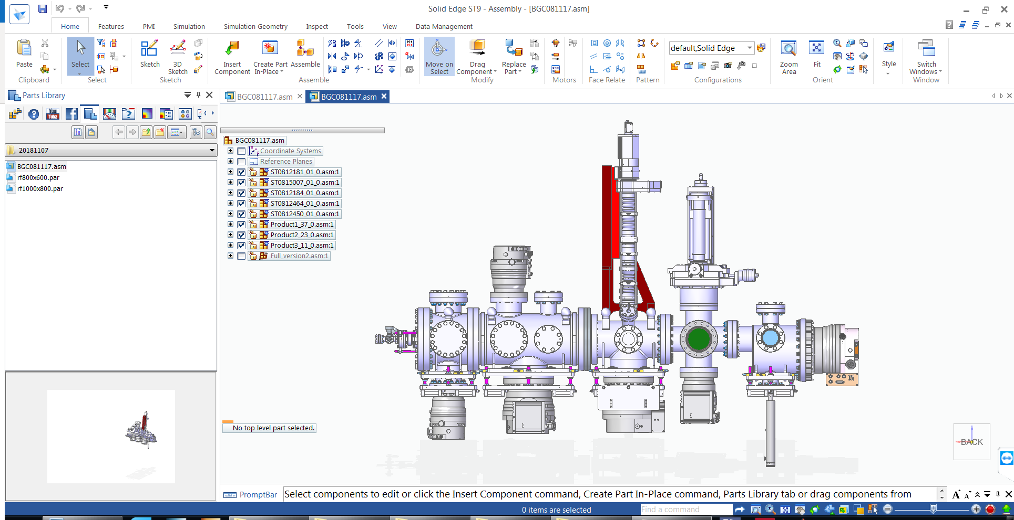
Building a prototype in CI
63 mm
63 mm
3
Notes:
Better pumping 2hour to start E-gun. Overnight to start experiment program.
Resolution up to 20 lp/mm
i.e. 50 µm for the beam
– Magnification @ MCP: 1.2 ± 0.1
Note: The DOF has been estimated to be 4.5 ± 0.5 mm

Slide 4
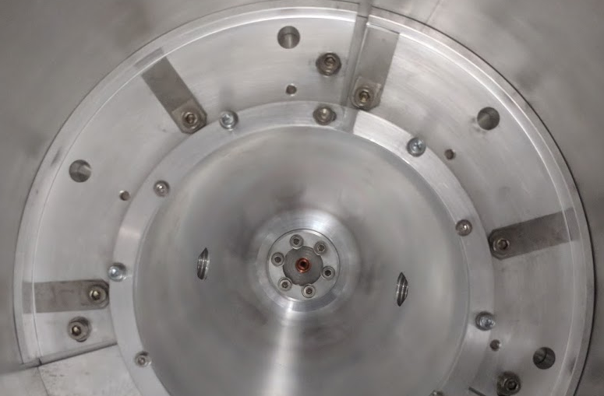
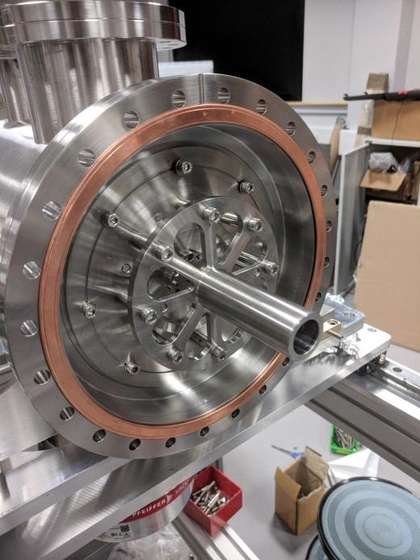
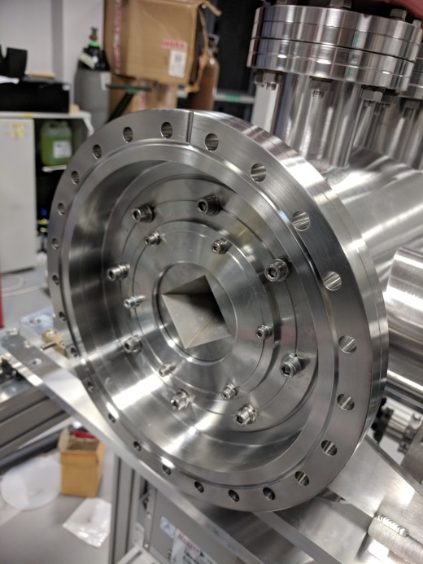
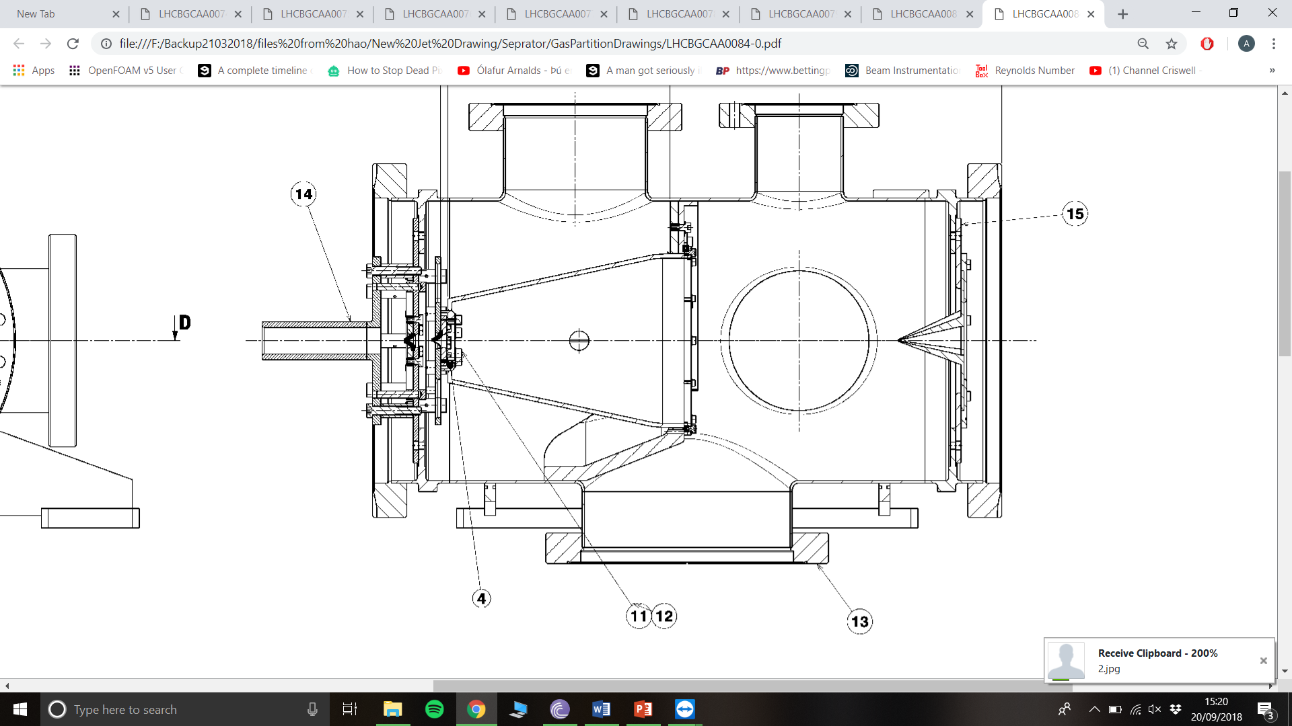
Nozzle and skimmers
~45 degree tilted
Notes:
The new nozzle design allow bake-out

Slide 5
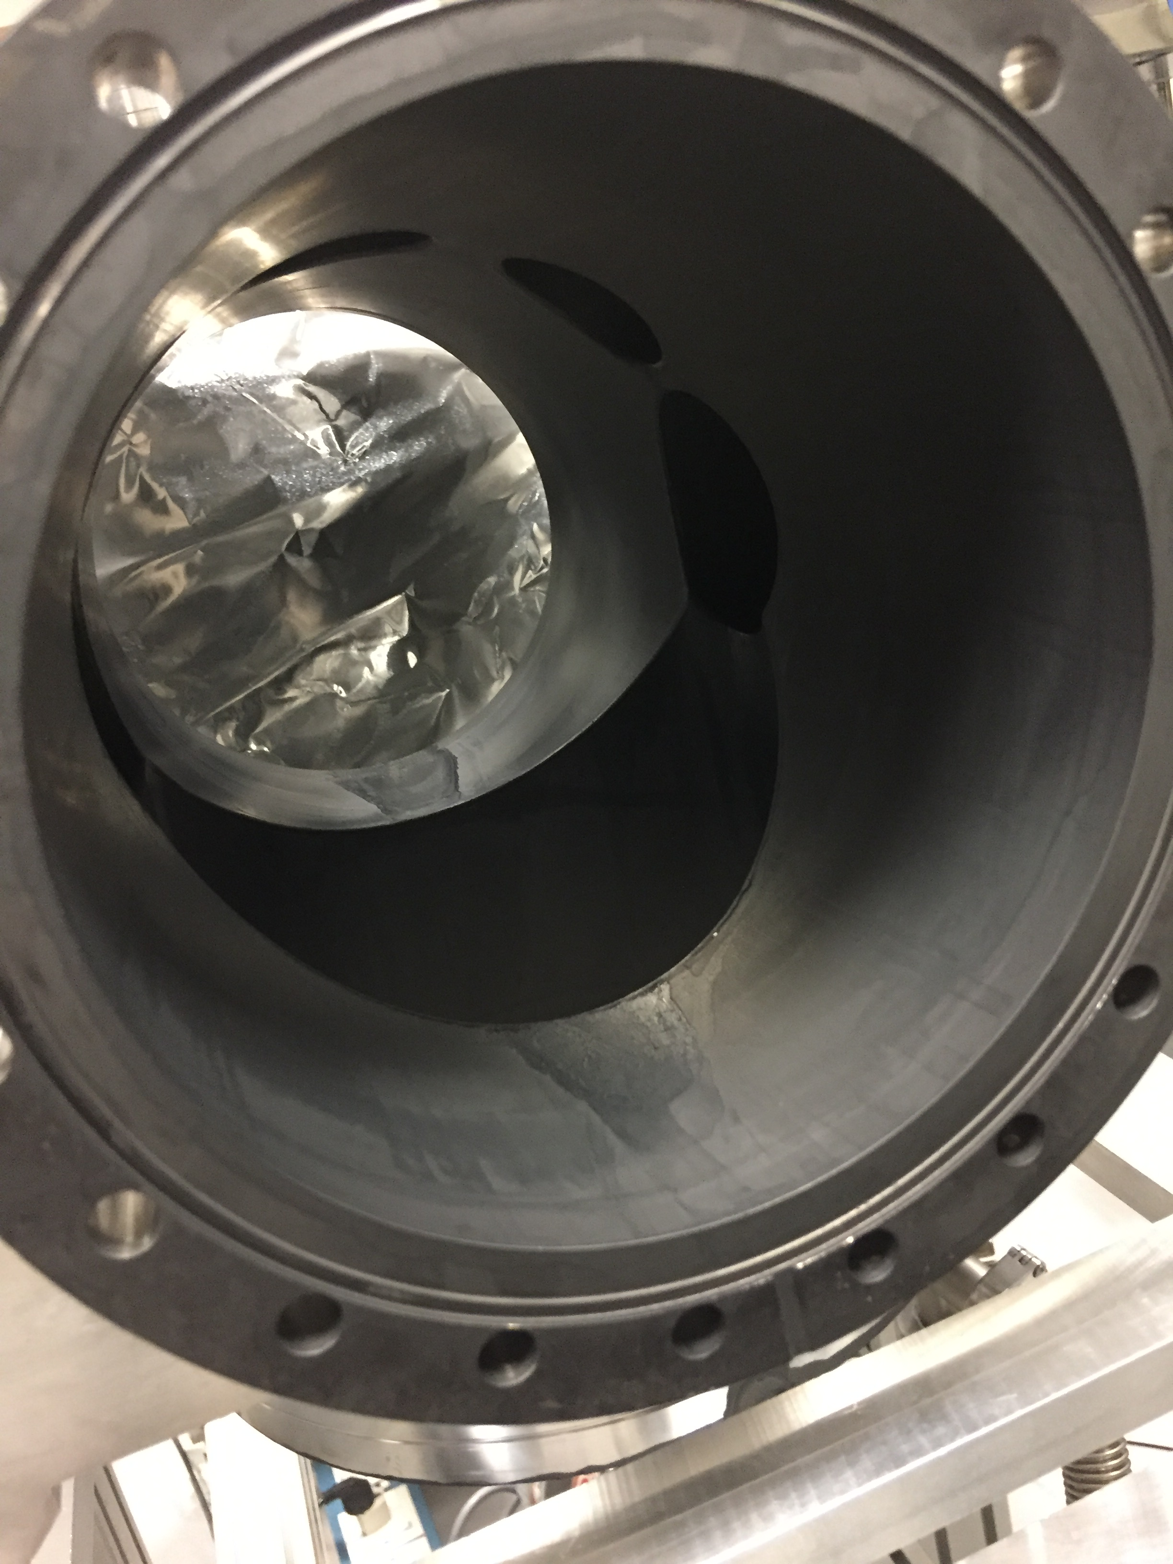
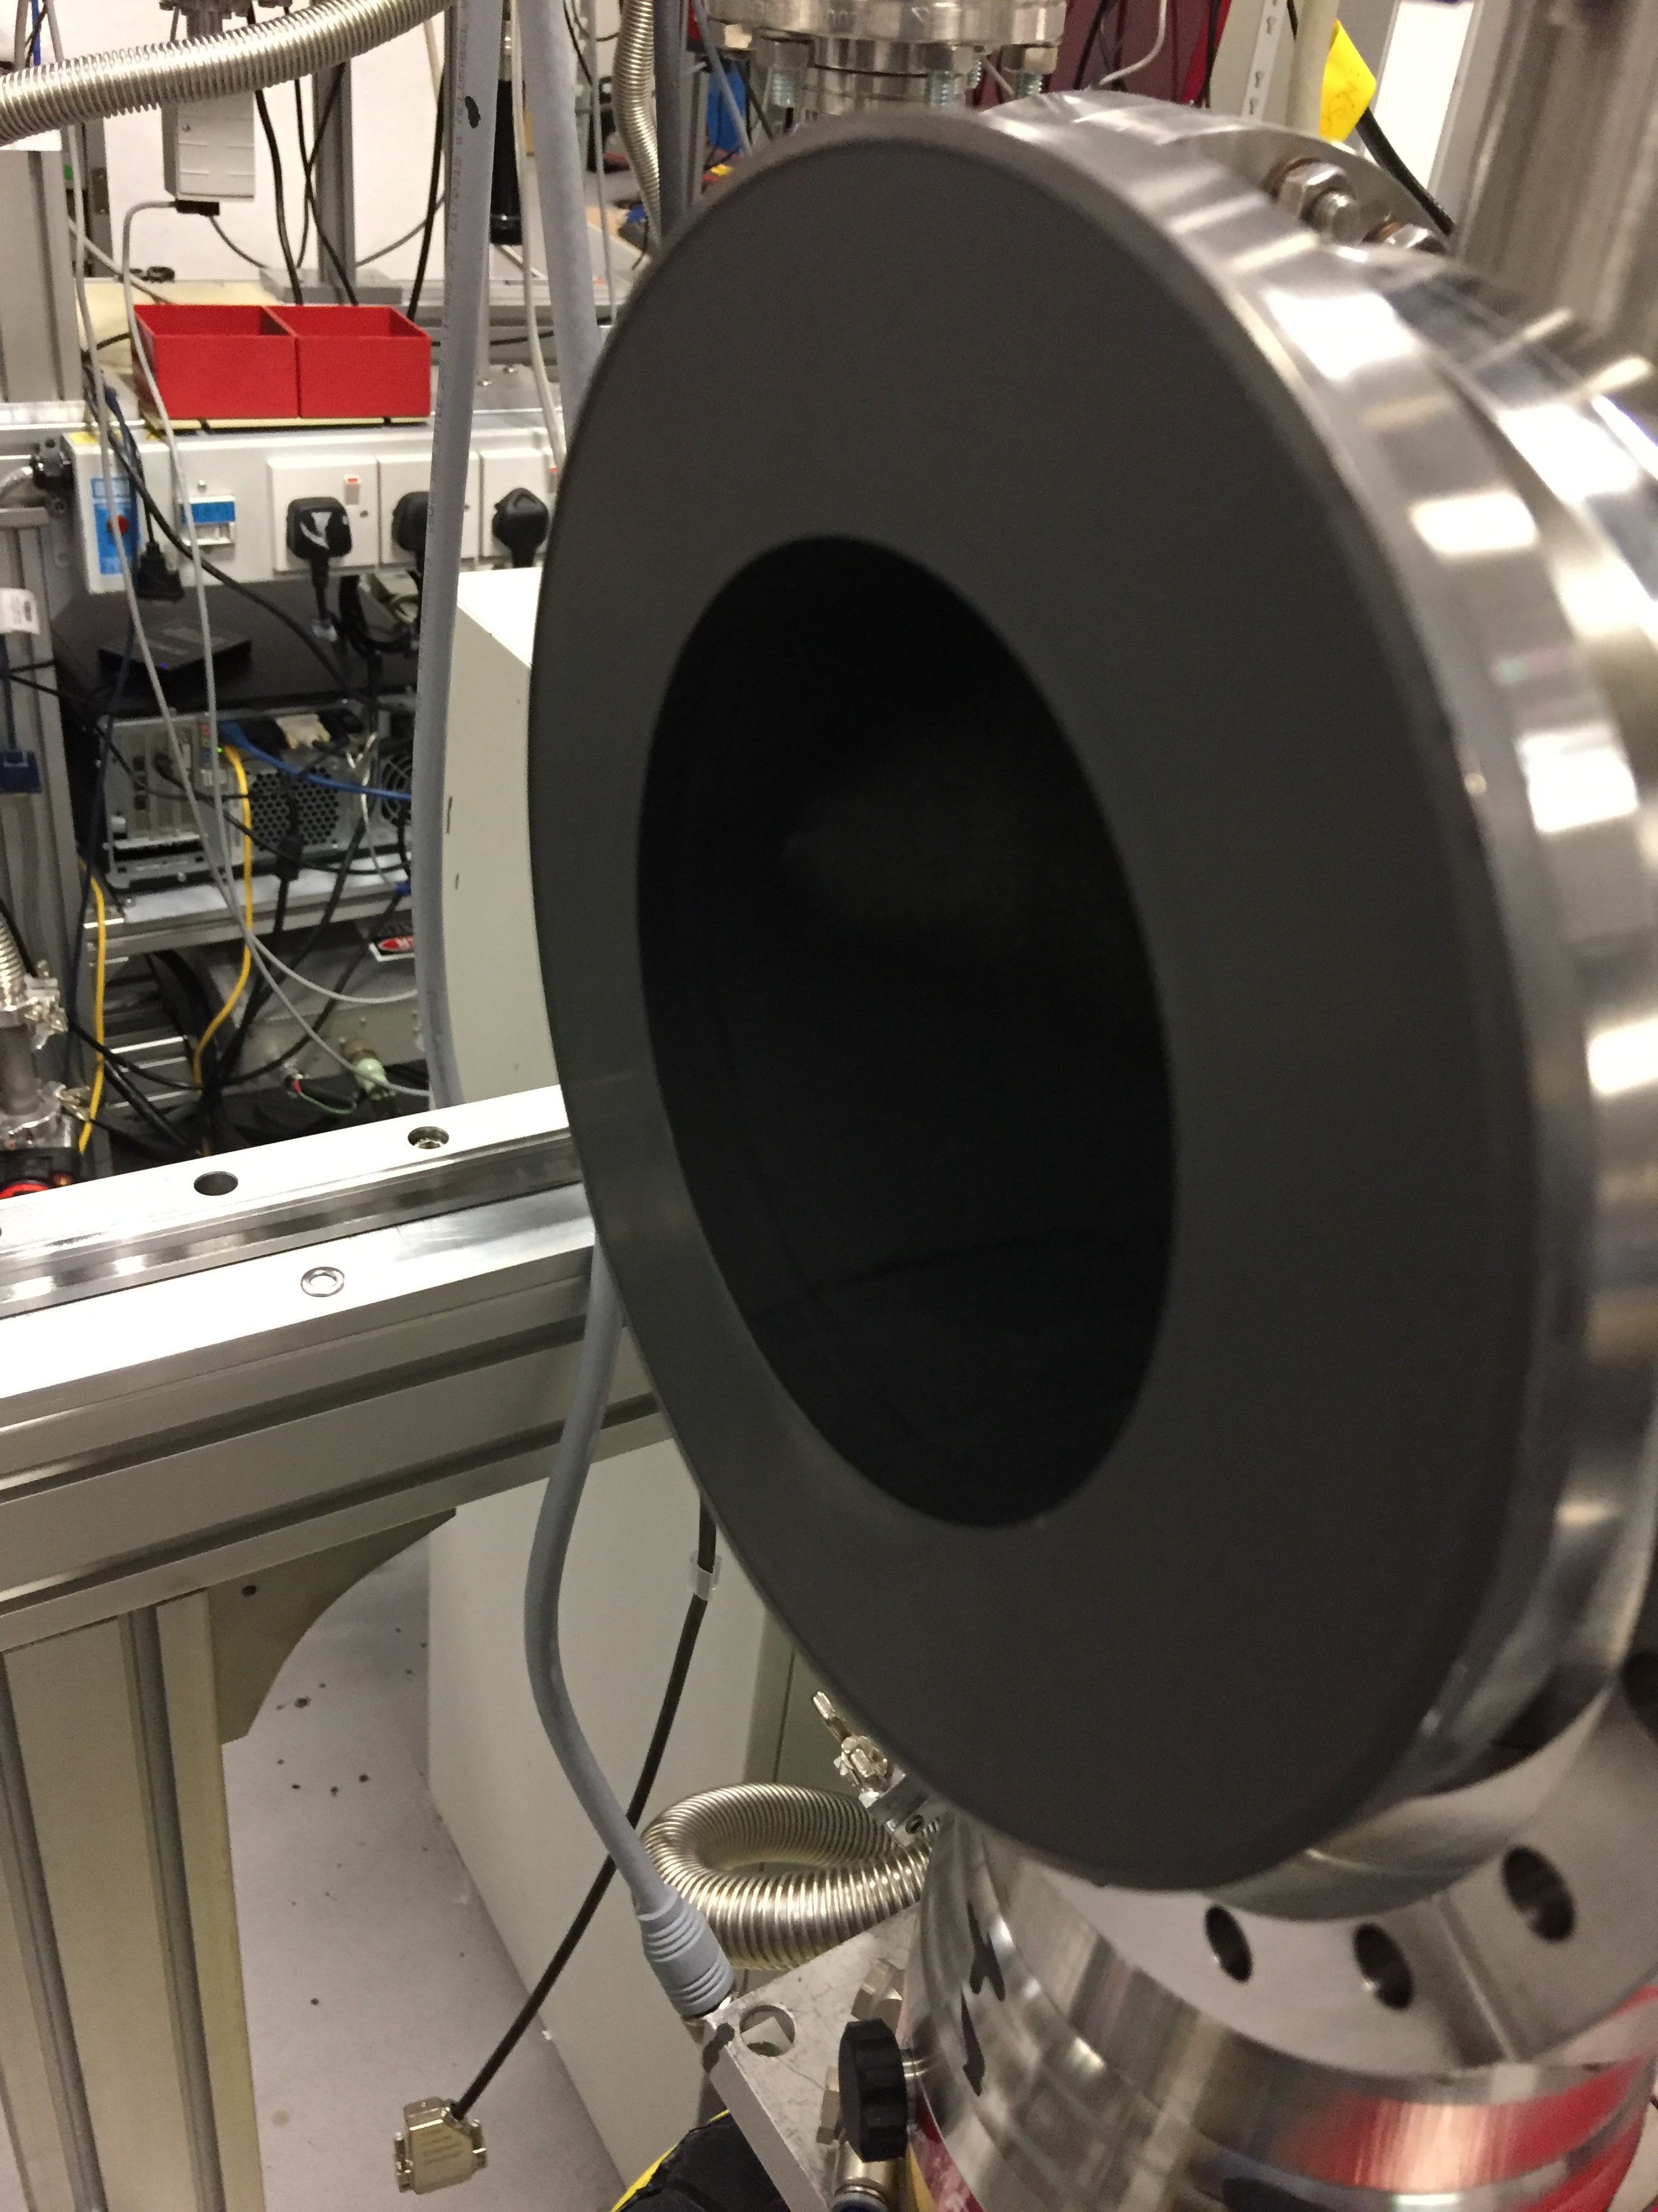
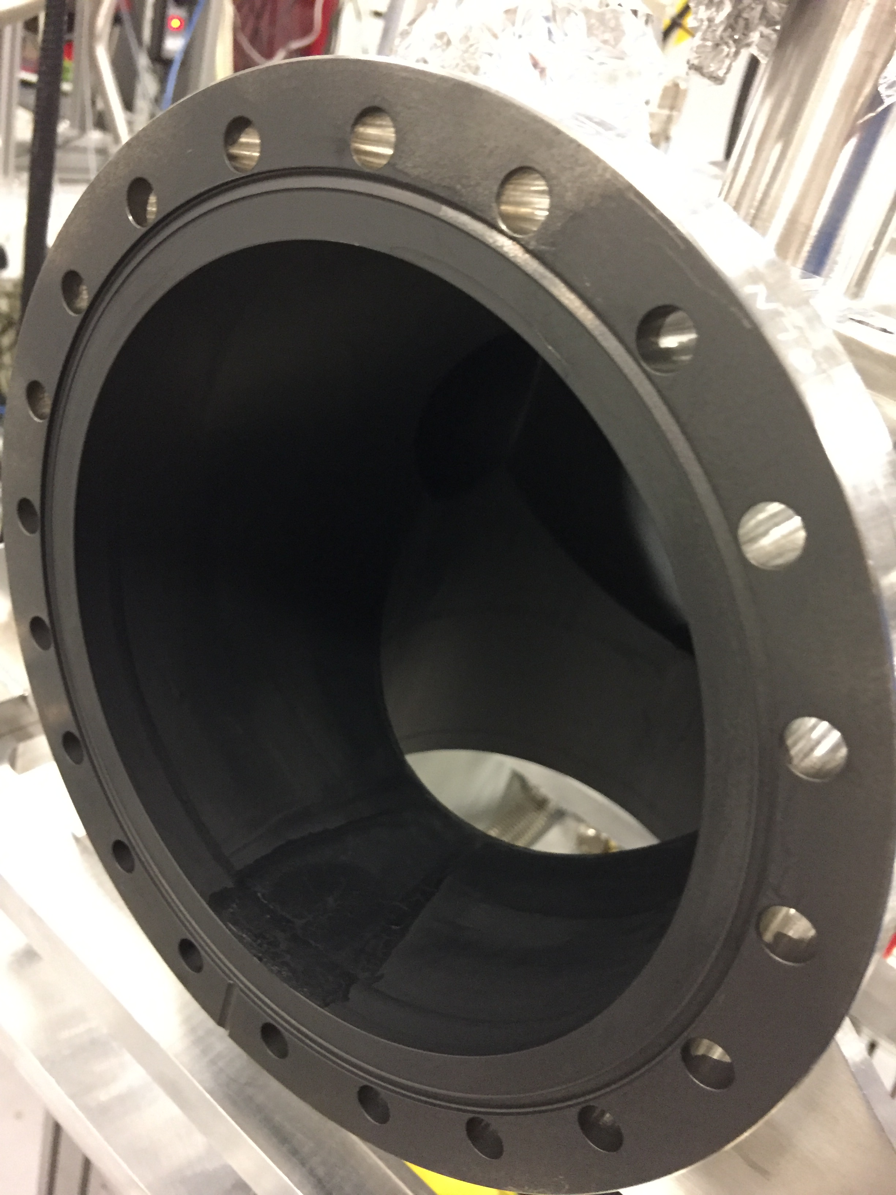
Blackening of the interaction chamber
Notes:
The graphite spray is used for black coating. The test did in CERN shows a reflection of 13%. This only applied to the interaction chamber.

Slide 6
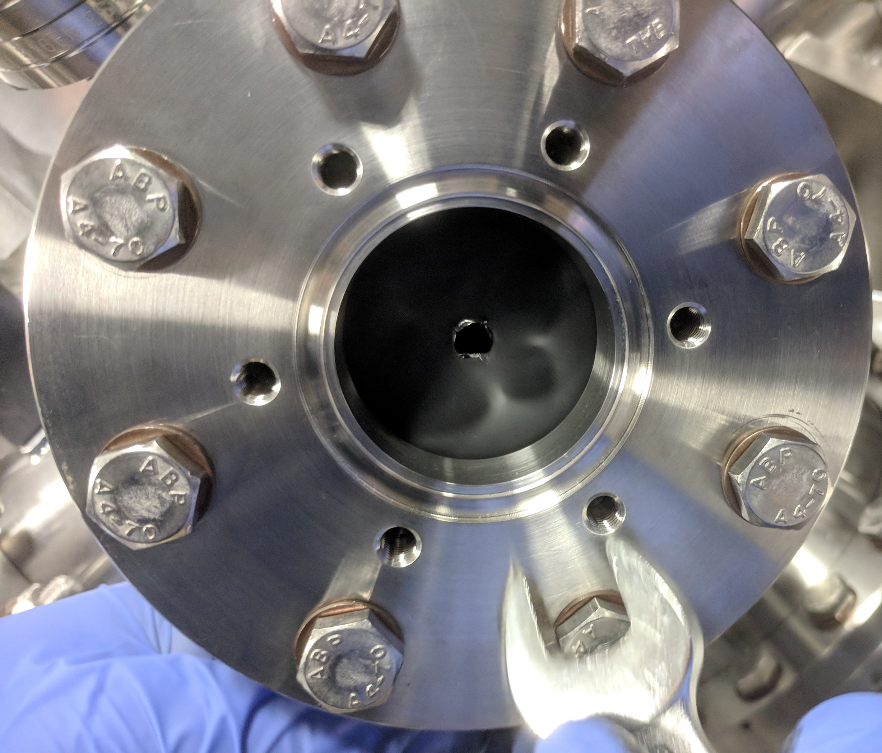
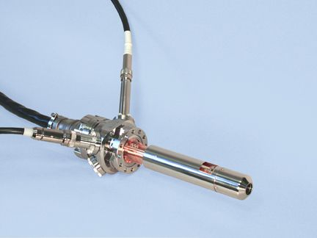
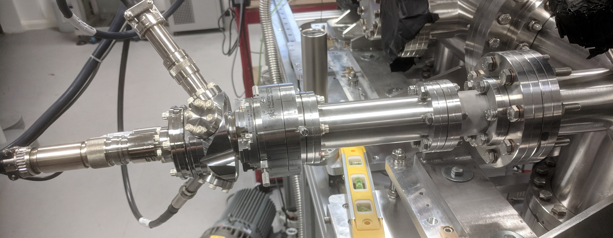
Electron gun
Energy: 100 eV to 10 keV
Current: 200uA to 10mA
Spot size: 1.5mm to 20 mm
Notes:
From Kimball physics. For neon measurement, extra aperture is used to reduce the light from the hot filament of the electron gun.

Slide 7
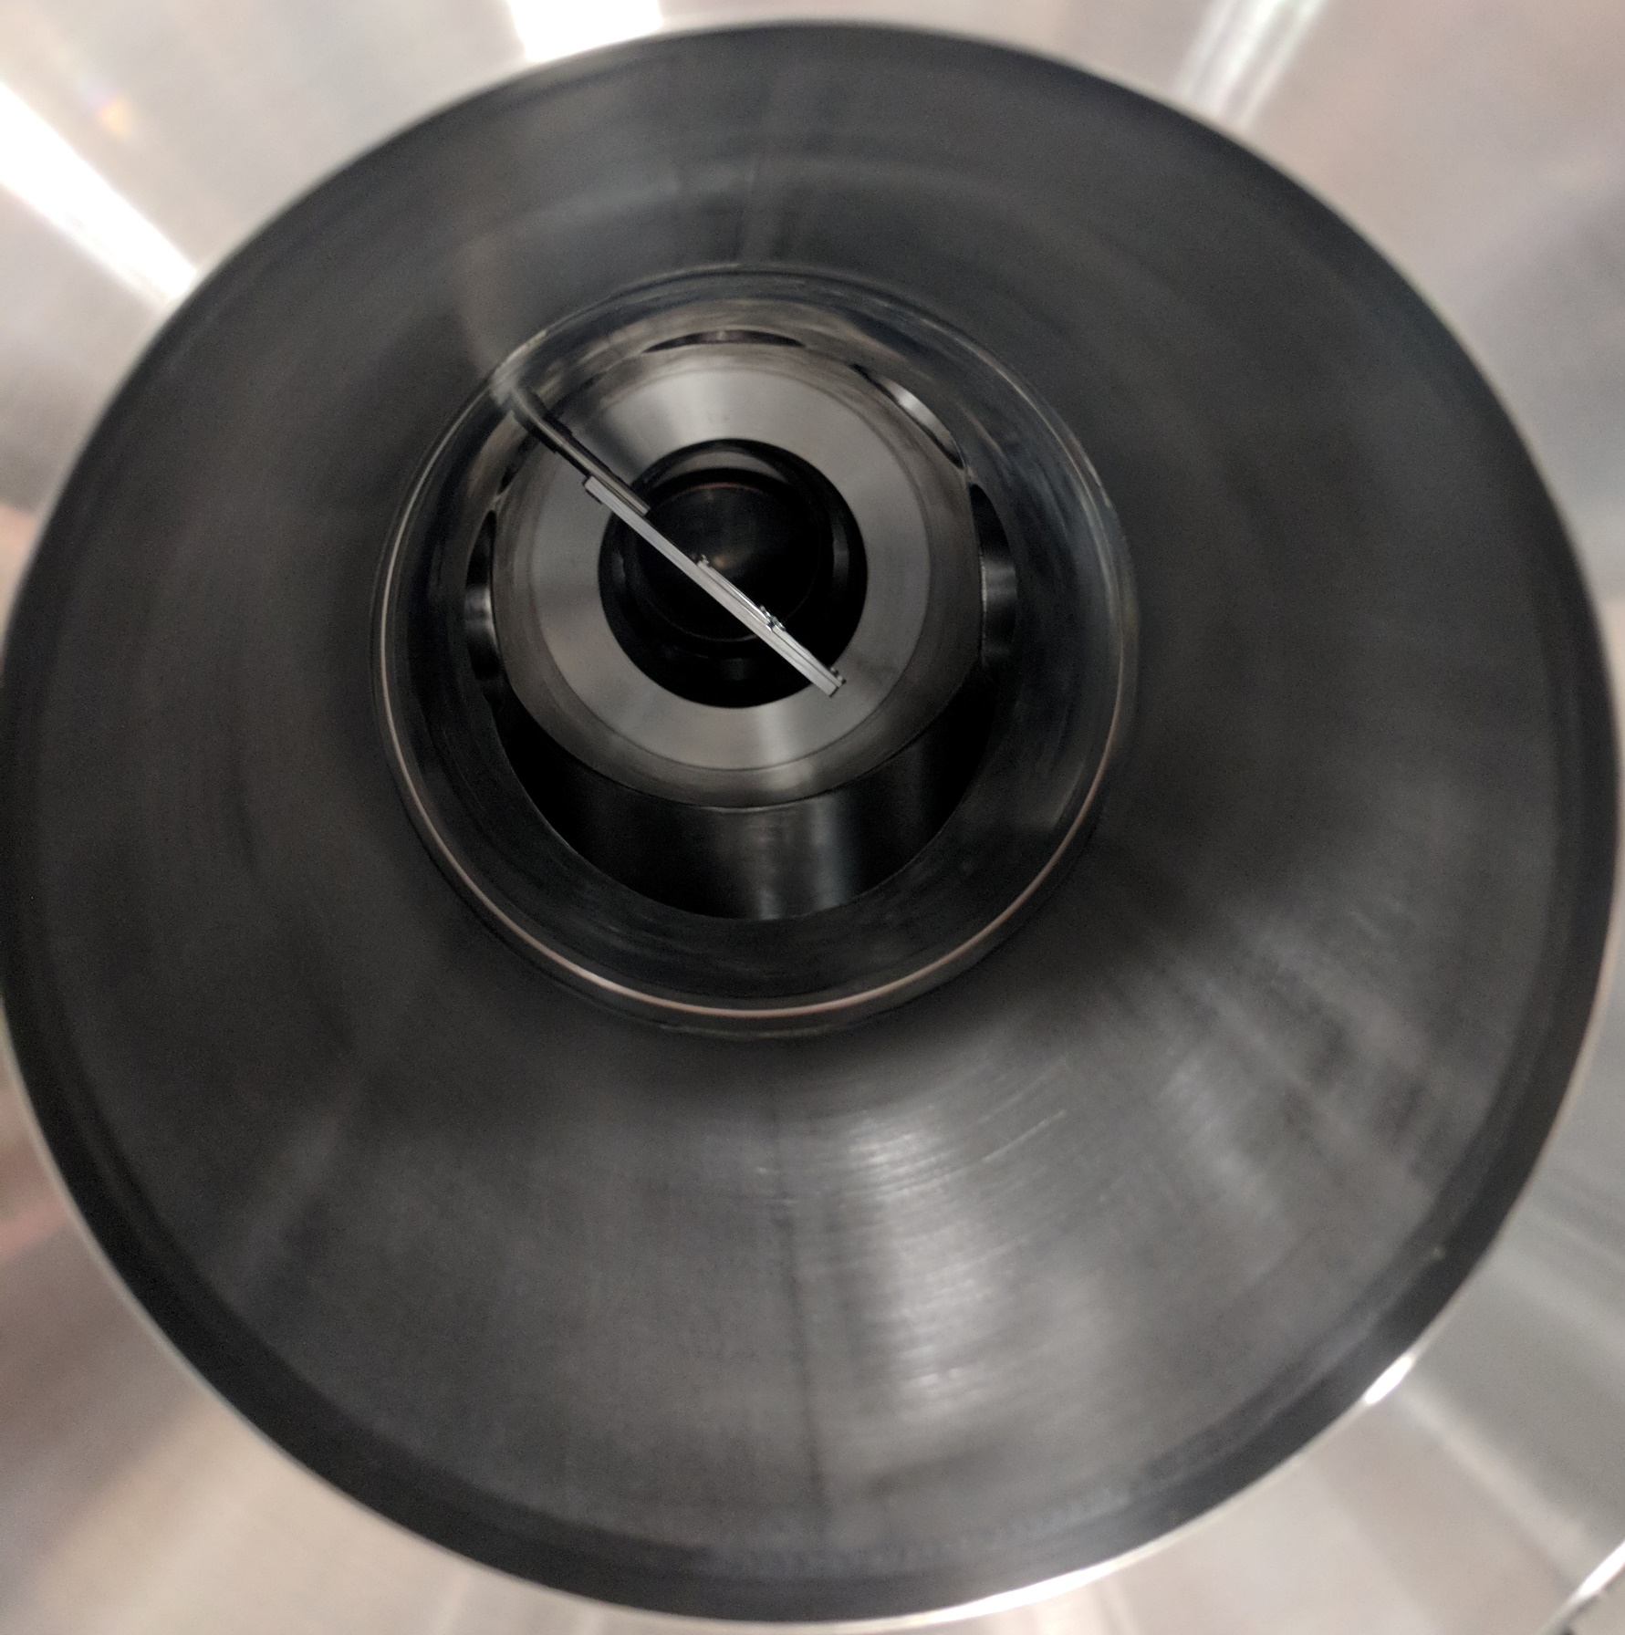
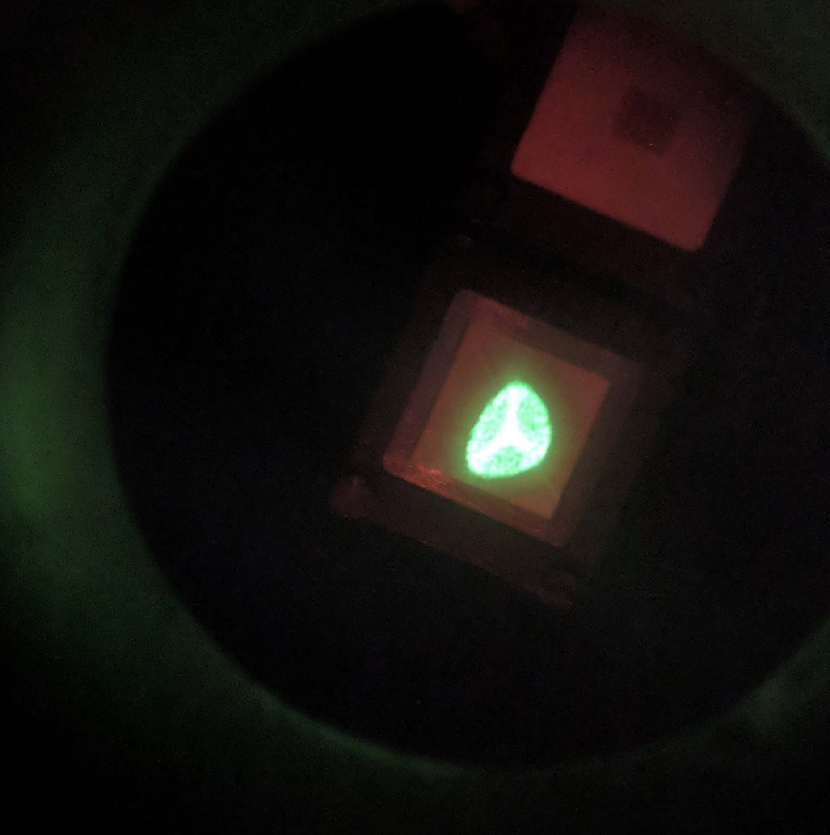
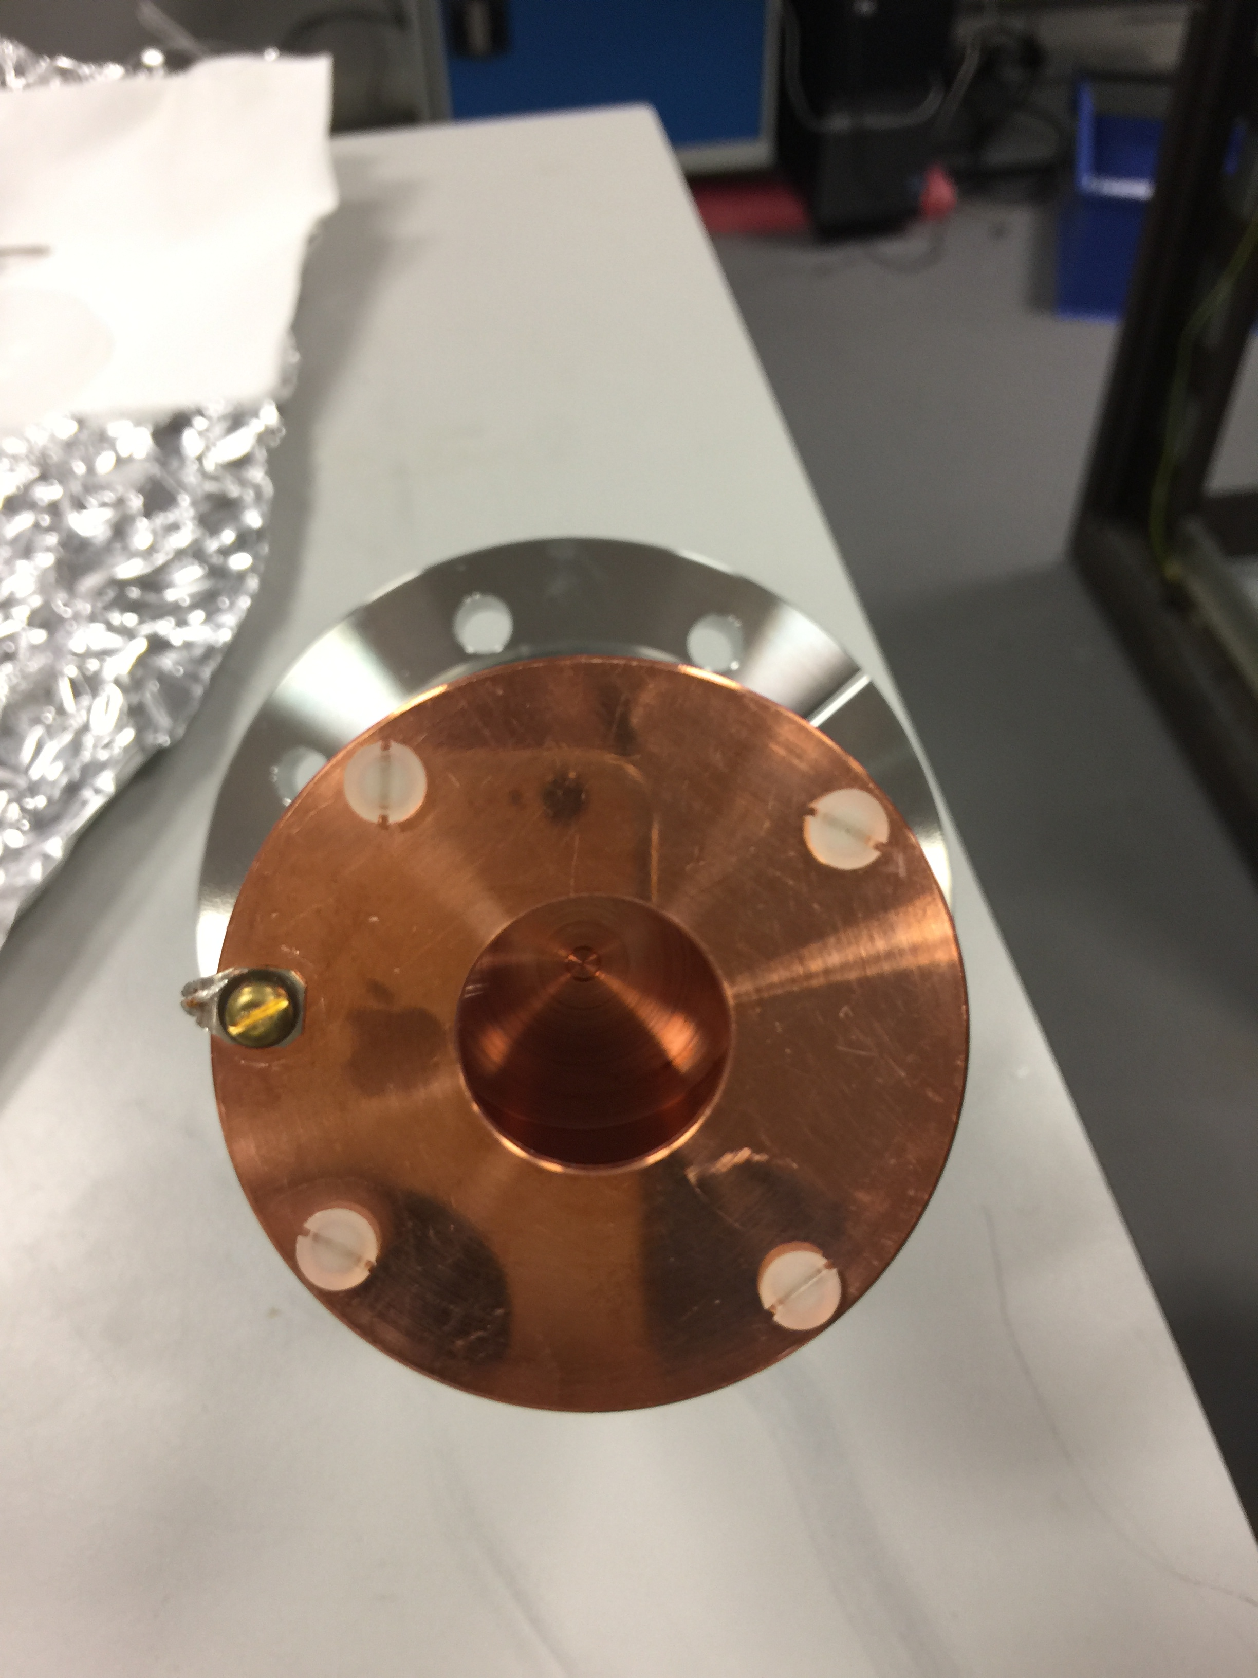
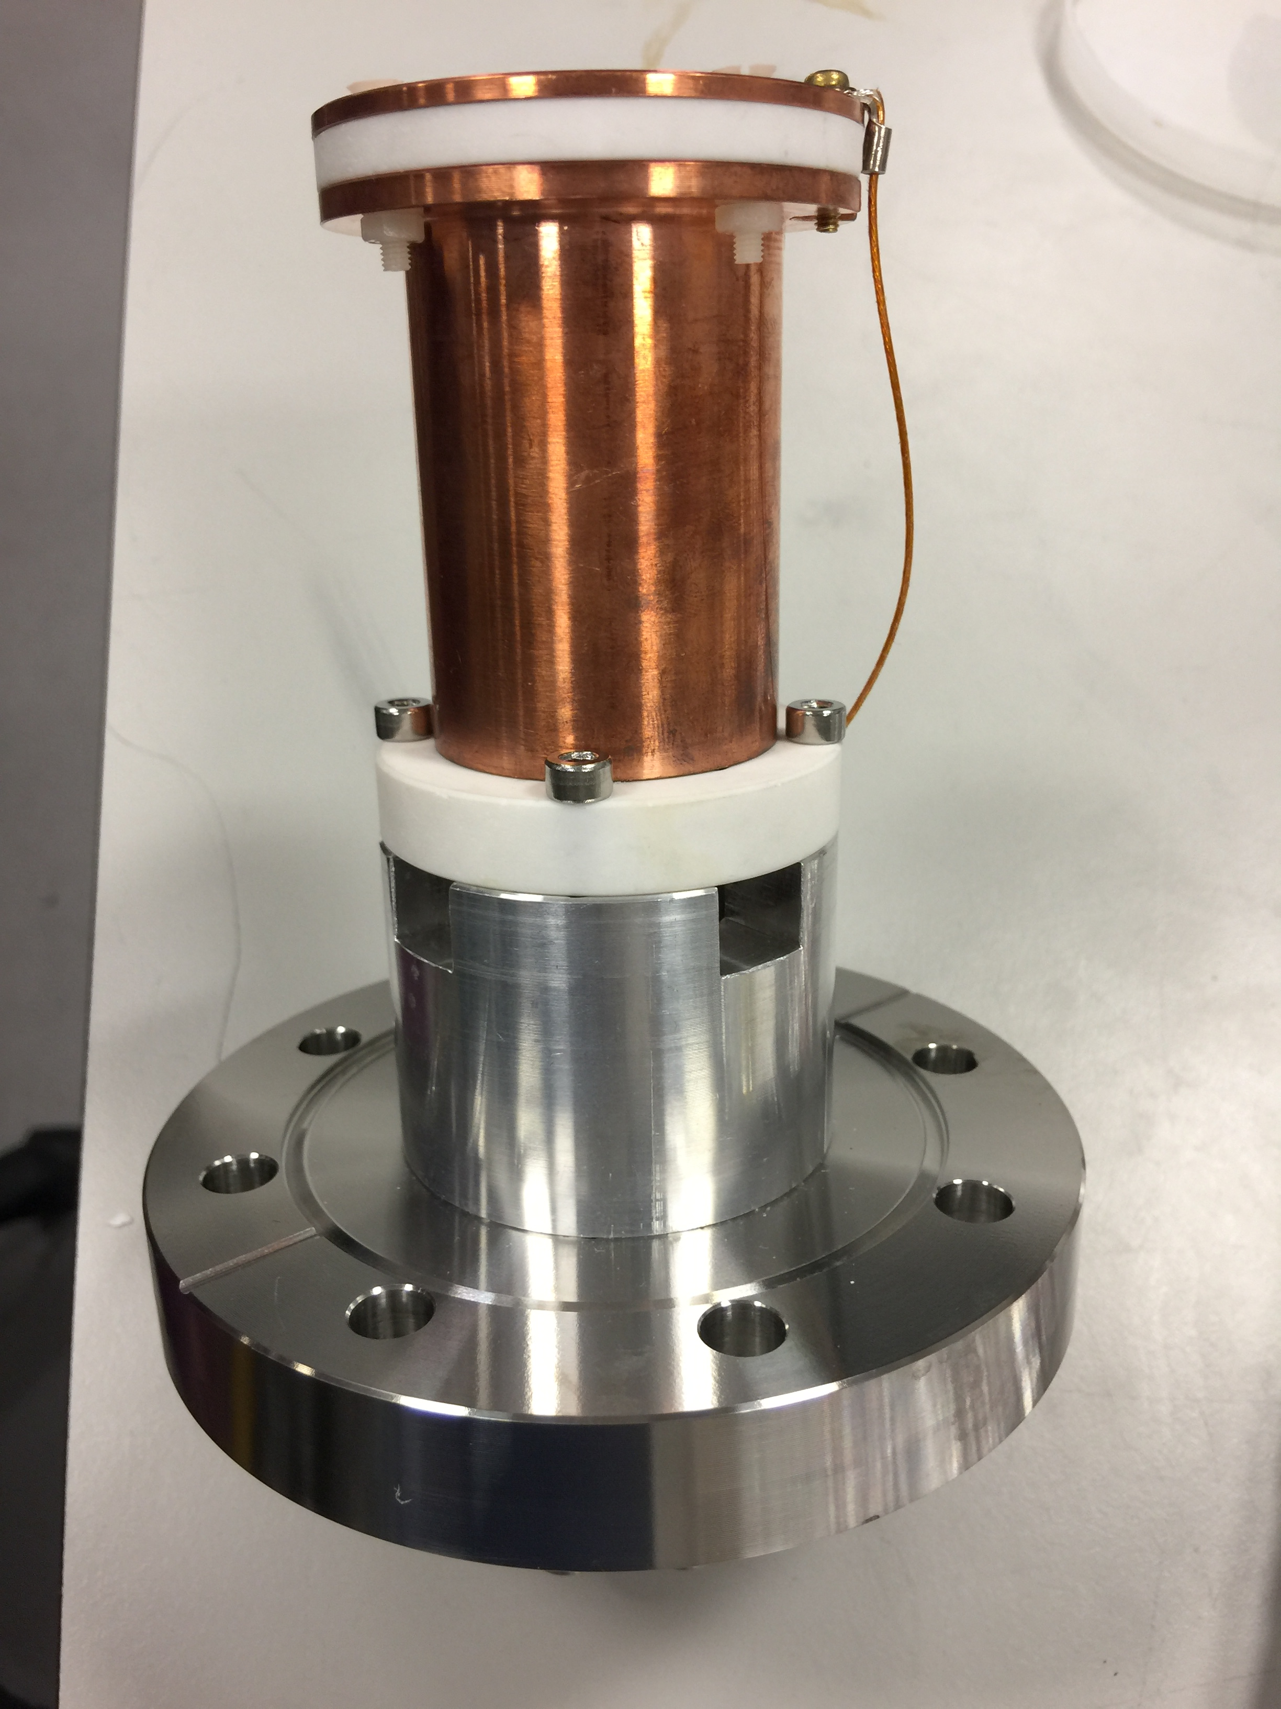
Electron beam diagnostics
20 mm
20 mm
115 mm
Phosphor screen
Faraday Cup

Slide 8
Vacuum test of current system
E-gun off
E-gun on
Notes:
Need a curve of pressure for interaction chamber and dump chamber

Slide 9
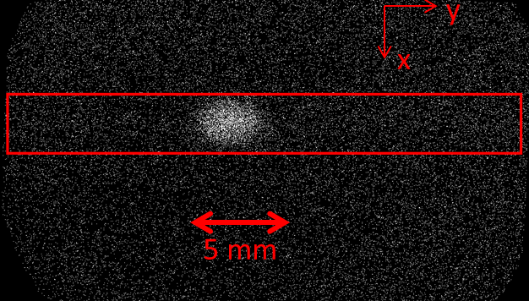
Nitrogen gas jet test
Electron energy: 5keV
Beam current:0.69mA
Integration time: 2 s
Gas jet type: N₂
Inlet pressure: 5bar
Gas jet direction
2.59 mm
Electron beam direction
200s integration time
2s integration time to give a profile
More time to give a 2D detailed image
Background pressure: 1.56E-08mbar

Slide 10
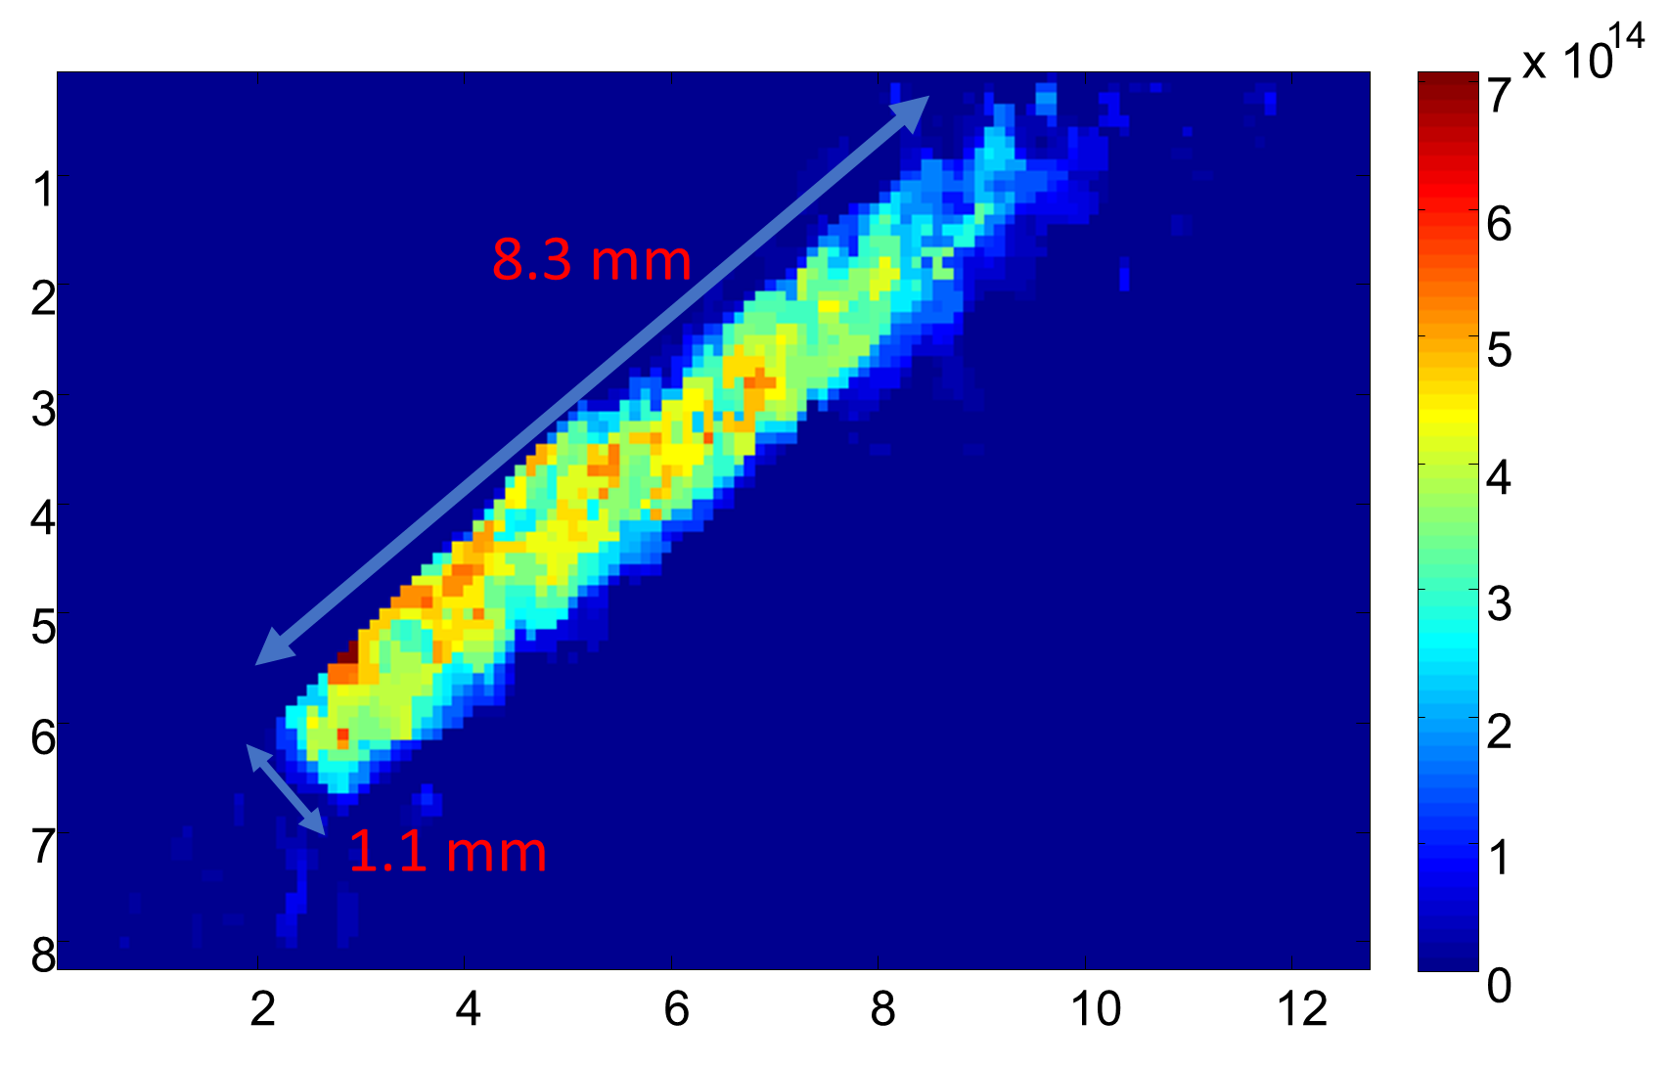
Moveable gauge chamber
224 mm
265 mm
4 mm
0.4 mm

Slide 11
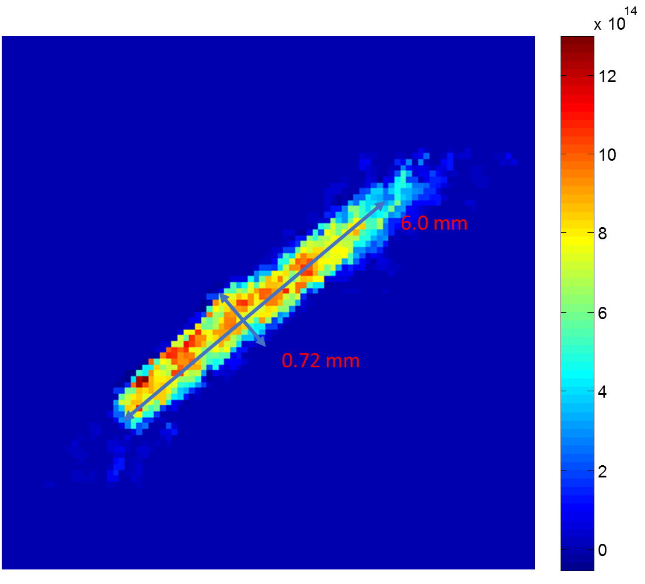
Interaction chamber
Assume linear expansion from the 3rd skimmer
The expansion is decoupled in both transverse direction
Average density = 9.0 e14 m⁻³
4 mm
0.4 mm
224 mm
265 mm

Slide 12
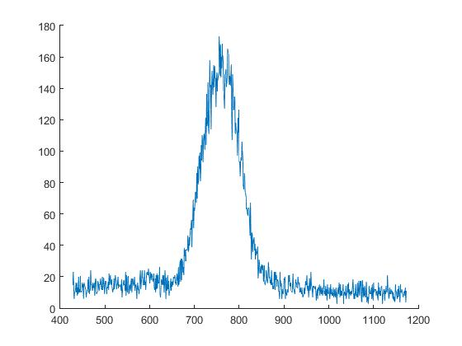
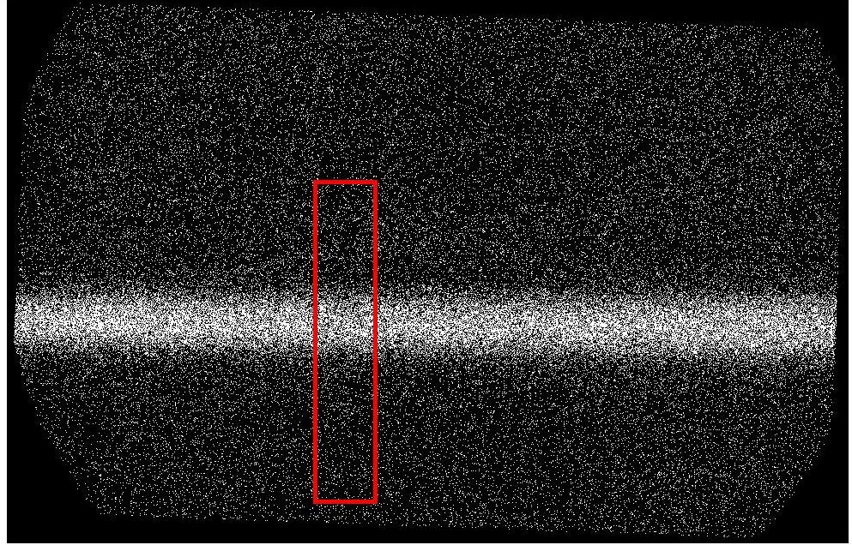
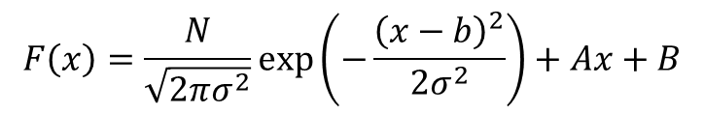
Residual gas calibration
Background pressure 2.5e-7mbar
Number of photons = 4.60E4
Number of photons per pixel per second = 0.82
140 pixels
$$F\left(x\right)=\frac{N}{\sqrt{2πσ^{2}}}\exp\left(−\frac{{\left(x−b\right)}^{2}}{2σ^{2}}\right)+Ax+B$$
Fitting equation:
Photon number
Beam size
Gaussian equation + linear background

Slide 13
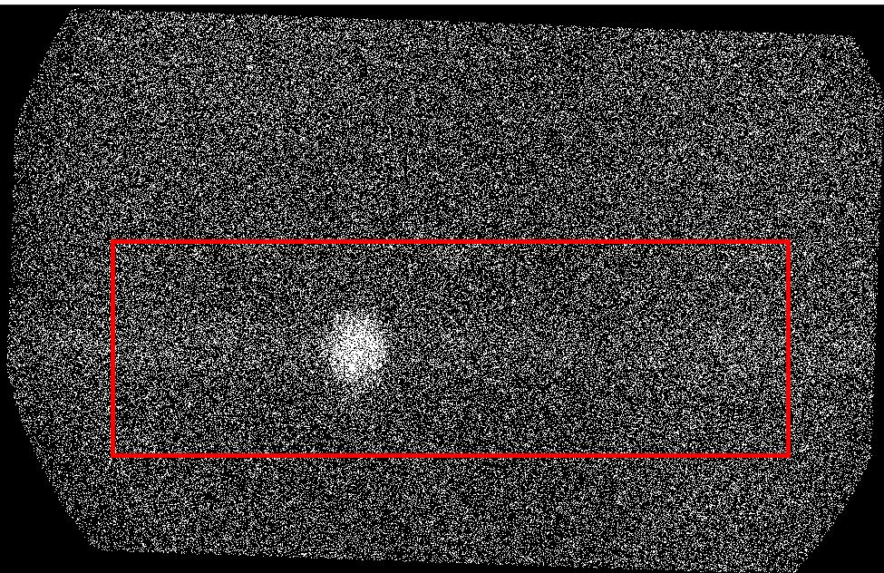
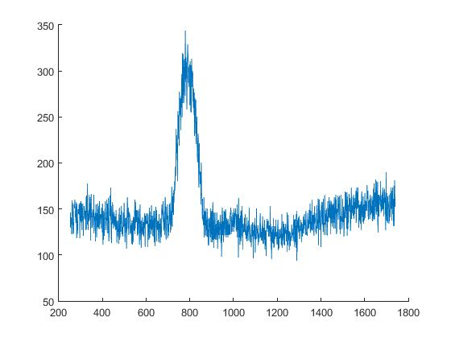
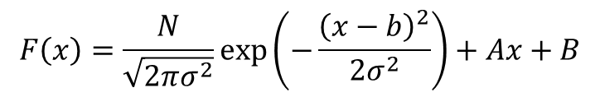
Gas jet image of a vertical 3rd skimmer
FWHM = 1.24 mm
Number of photons = 1.57e4
Number of photons per second per pixel = 0.117
24.3mm
1.24 mm
Gas jet image with Inlet pressure of 5bar
Integration time = 1600seconds
Electron beam energy = 5kev
electron beam current = 0.66mA
Third skimmer = vertical
$$F\left(x\right)=\frac{N}{\sqrt{2πσ^{2}}}\exp\left(−\frac{{\left(x−b\right)}^{2}}{2σ^{2}}\right)+Ax+B$$
~0 degree tilted
Fitting equation:
Photon number
Beam size
Gaussian equation + linear background
Notes:
Need to do a flat top analysis to get the FWHM.

Slide 14
Photon Gauge test
For gas jet image: The photon rate per pixel = 0.117
Gas jet average number density = 1.12e15 m⁻³ or 4.62e-8 mbar

Slide 15
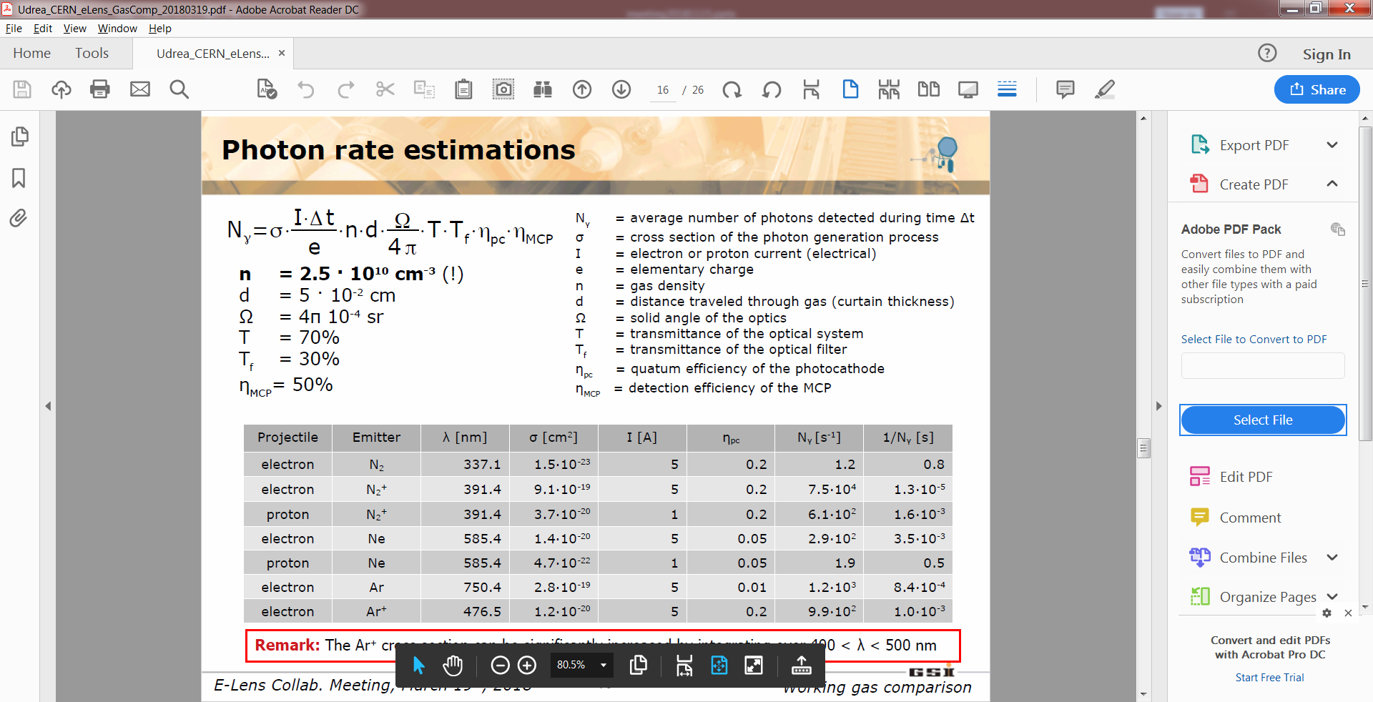
Cross section measurement
0.96e15 ±0.2e15 m⁻³
0.98e-3 ± 0.2e-3 m
0.0059
0.75 ± 0.05
0.45 ± 0.05
0.75 ± 0.15
η_{PC} = 0.19 ± 0.02
N = 15700 ± 100
Δt = 1600 s
Cross section: 1.07±0.55 e-18 cm⁻²

Slide 16
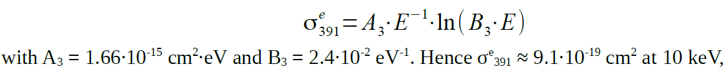
Comparison to the theory
1.59e-18 cm⁻² for 5keV electron beam
Prediction
Experiment: 1.07±0.55 e-18

Slide 17
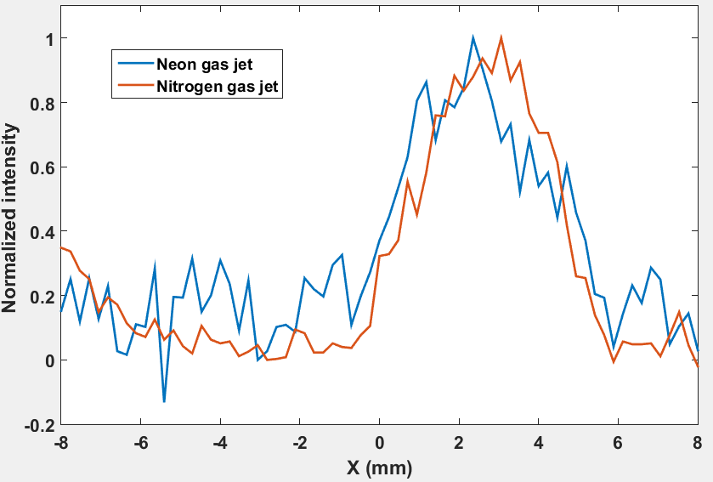
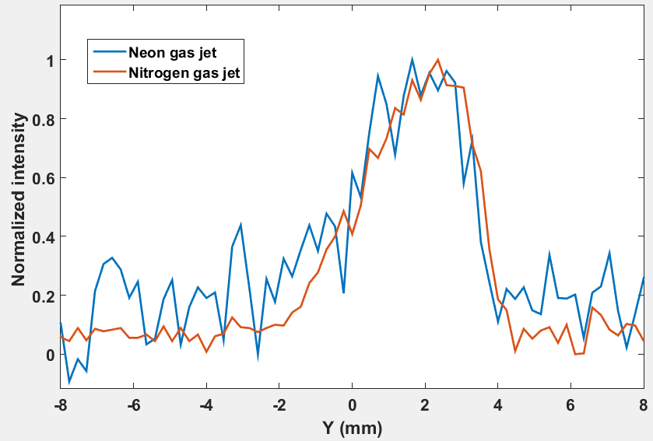
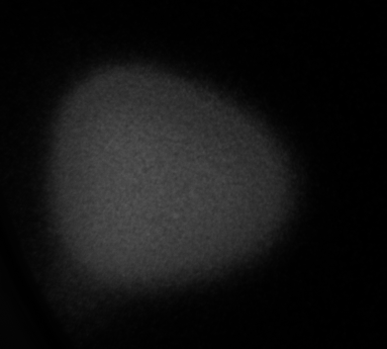
Preliminary results of Neon gas jet
Electron energy: 3 keV
Beam current: 0.50mA
Integration time: 200 s for N₂, 4000 s for Neon
Inlet pressure: 5bar
y
x
Image from the phosphor screen
5 mm

Slide 18
Comparison between N₂ and Neon
Gas jet condition: inlet 5 bar
Photon number per second
  Nitrogen: 5.63
  Neon: 0.77
Ratio of Nitrogen/Neon: 7.32

Slide 19
Possible reason
 | Neon | Nitrogen |  | Ratio of Nitrogen and Neon
 | 3keV | 3keV |  | 3keV
Degree of freedom | 3 | 5
Heat capacity ratio | 1.4 | 1.67
Atomic mass | 20 | 28
Pressure in the interaction from theory | 3.29E+17 | 2.62E+16 |  | 7.96E-02
(inlet 5 bar)
Cross section | 4.60E-20 | 2.37E-18 |  | 5.15E+01
Eff_PC | 0.09 | 0.19 |  | 2.111111
T_filter | 9.00E-01 | 4.50E-01 |  | 5.00E-01
Equal density |  |  |  | 5.43E+01
Take density into consideration |  |  |  | 4.32E+00
Notes:
Add curve of gas jet density for Nitrogen and Neon.

Slide 20
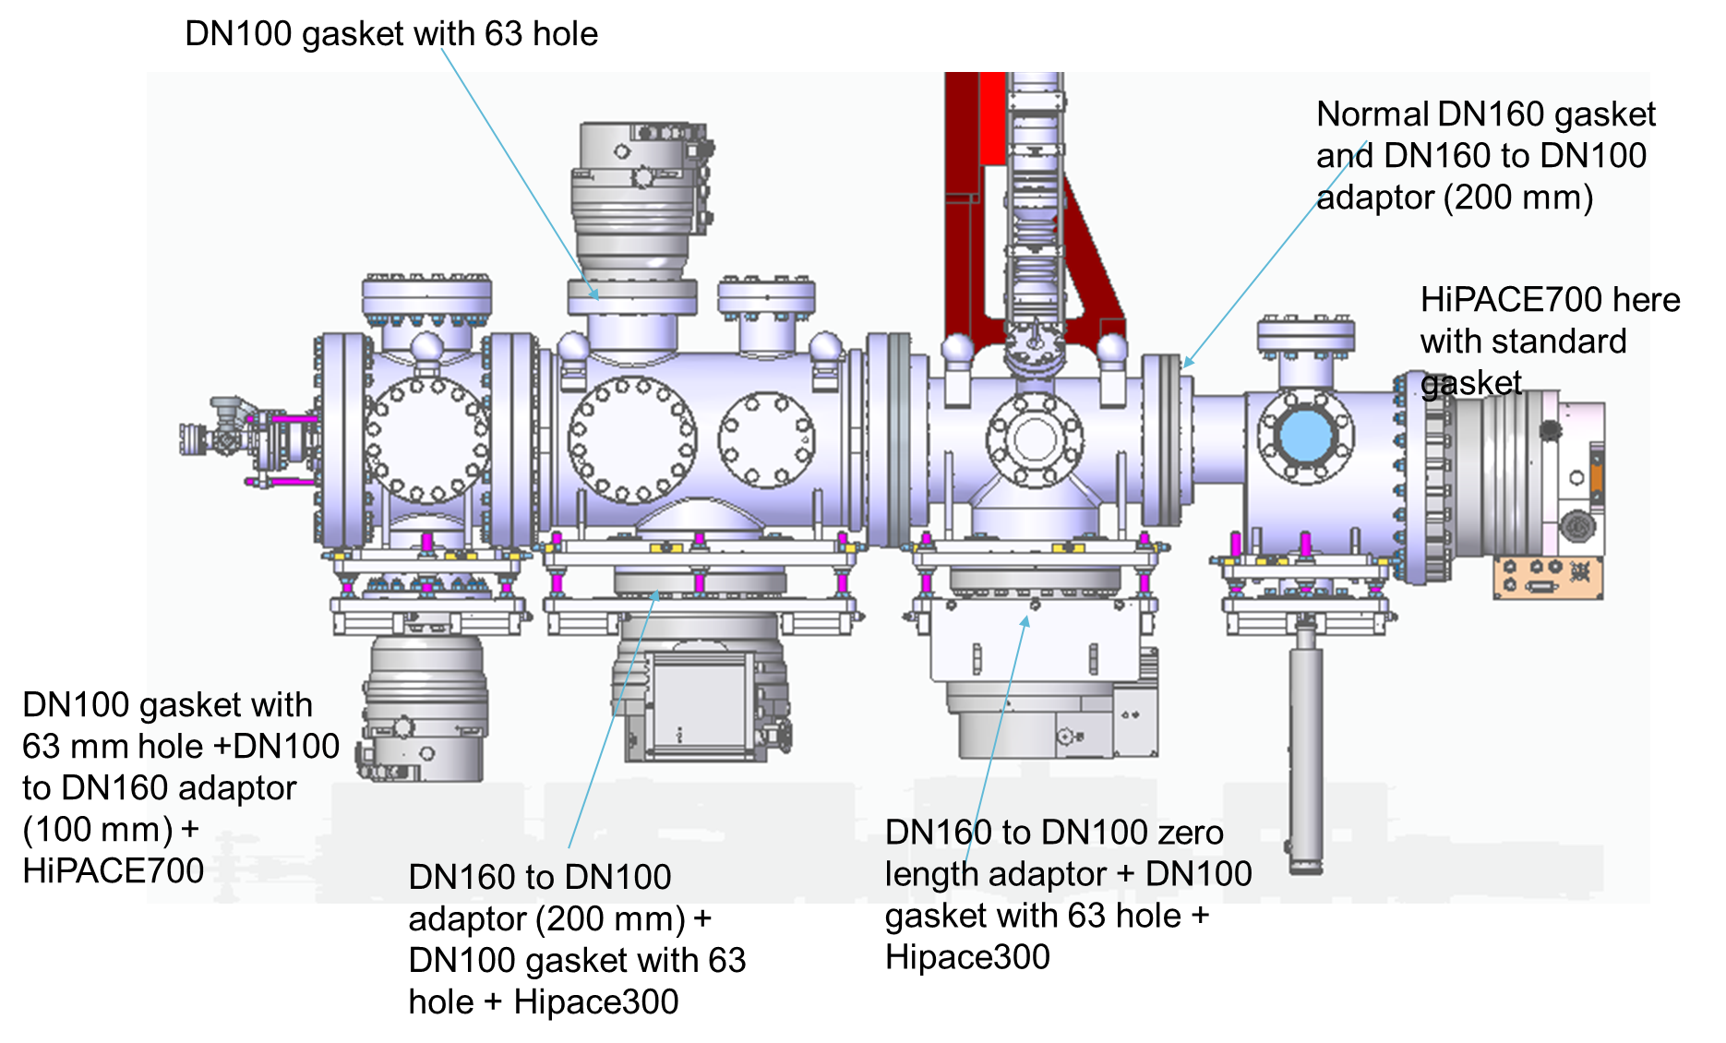
Vacuum test of modified system
(lower pumping speed)

Slide 21
Pressure data when e-gun is off
Detailed data for each chamber will be loaded to indico

Slide 22
Pressure data when e-gun is on
Detailed data for each chamber will be loaded to indico

Slide 23

Vacuum test of modified system
(lower pumping speed and back flow blocker)

Slide 24
Pressure data when e-gun is off
Detailed data for each chamber will be loaded to indico

Slide 25
Pressure data when e-gun is on
Detailed data for each chamber will be loaded to indico

Slide 26
Summary of highlight
A prototype supersonic gas jet monitor based on BIF mode was designed, built and successfully commissioned;
N₂ gas jet was carefully measured and has been successfully tested as a working gas using laboratory electron beam source;
Neon gas jet has been proven as working gas.
Vacuum test of a modified System in order to design a LHC compatible gas jet system.

Slide 27
Future work
Continue to optimize the design and geometry
  Check again the alignment
  E.g. new De Laval nozzle
  Change geometry of skimmers.
Characterize Neon gas jet
Argon used as a working gas
Design and building of v3 gas jet system (LHC compatible)
  Final deliverable for the HL-LHC-UK

Slide 28
Thank you

Slide 29
Optimize the gas jet parameter
Inlet pressure
Geometry (Nozzle to skimmer1 distance)
Nozzle to skimmer1 distance

Slide 30
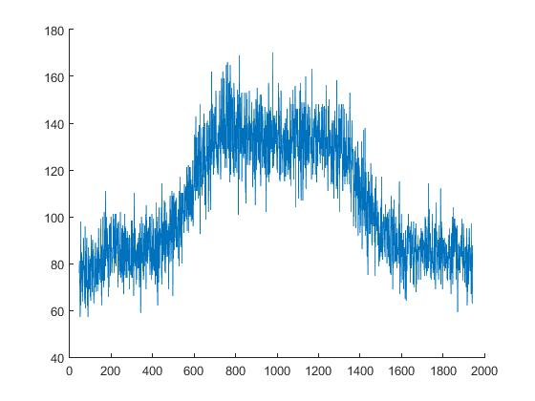
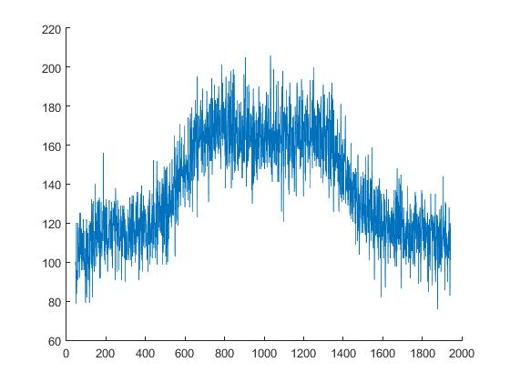
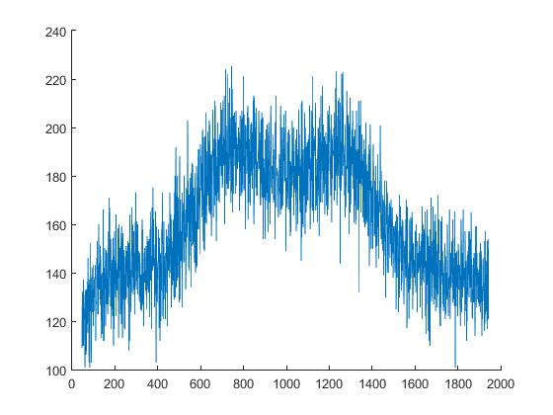
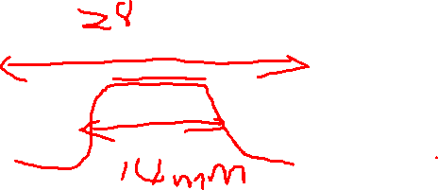
Skimmer to Nozzle Distance 6.06mm (No 3rd skimmer)
Inlet = 2bar
Inlet = 1bar
Photon Number Vs Pixel
Pixels
Inlet = 3bar

Slide 31
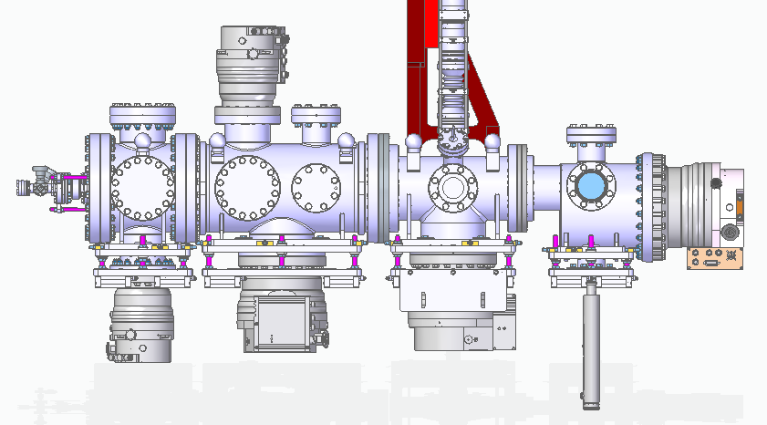
DN100 gasket with 63 hole
Normal DN160 gasket and DN160 to DN100 adaptor (200 mm)
HiPACE700 here with standard gasket
DN100 gasket with 63 mm hole +DN100 to DN160 adaptor (100 mm) + HiPACE700
DN160 to DN100 zero length adaptor + DN100 gasket with 63 hole + Hipace300
DN160 to DN100 adaptor (200 mm) + DN100 gasket with 63 hole + Hipace300

Slide 32
DN100 gasket with 63 hole
DN160 gasket with 32 mm hole (backflow blocker) + DN160 to DN100 adptor (200 mm)
HiPACE700 here with standard gasket
DN100 gasket with 63 mm hole +DN100 to DN160 adaptor (100 mm) + HiPACE700
DN160 to DN100 adaptor (200 mm) + DN100 gasket with 63 hole + Hipace300
DN160 to DN100 zero length adaptor + DN100 gasket with 63 hole + Hipace300

Slide 33
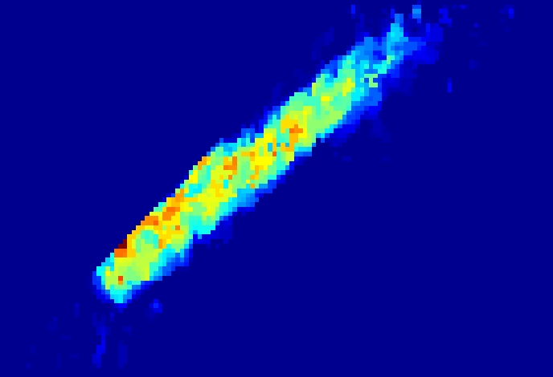
x 10
14
7
1
8.3 mm
6
2
5
3
4
4
3
5
6
2
7
1.1 mm
1
8
0
2
4
6
8
10
12

Slide 34
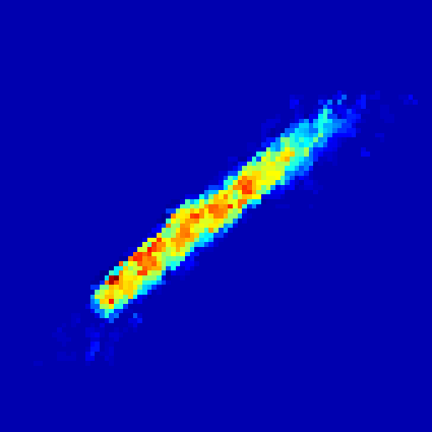
x 10
14
12
10
6.0 mm
8
6
0.72 mm
4
2
0

Slide 35
Plans for 2018
Install new gun in the old setup to further decrease the integration time (in seconds or less)
Scanning gauge working in continuous jet mode
Finish commissioning of the second gas jet setup
  Nozzle and skimmers alignment
  Chamber blackening
  Pumping test
  Bake-out
Experiment tasks for the second gas jet
  Jet image of e-beam, integration time and resolution
  Different gas species, Nitrogen, Neon, Argon
  Nozzle sizes (20um, 30um, 50um) and shape (regular or naval nozzle)
  Jet density measurement
  Nozzle, skimmer distance

Slide 36
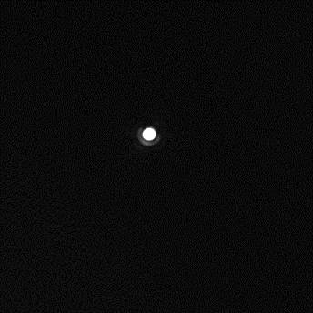
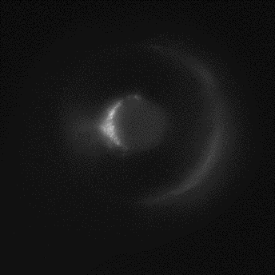
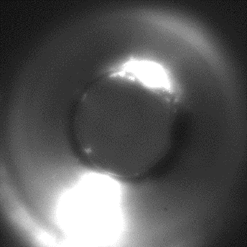
Alignment of the nozzle skimmers assembly
1. Only nozzle is mounted → marker on nozzle position
3. Adjust nozzle precisely, according to preparation
4. Mount 2nd skimmer and adjust it precisely, according to the preparation
2. 1st 2nd skimmer mounted
Notes:
The alignment is performed off-line using a imaging system.
The Imaging resolution about 3 um. The alignment is based on the position of the 1st skimmer, Images of Nozzle and 2nd skimmer is taken accordingly and adjust to the laser position.

Slide 37
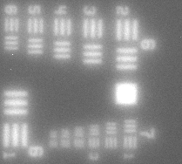
Camera system for alignment
Magnification (calibration): 1.35 um/ pixel
Resolution: Group 7 set3: 161.3 lines pair/mm

