Slide 1

Synchrotron Radiation:
Simulation,
Stoppers and Blackening
BGC Collaboration Meeting – 27.11.2018

Slide 2
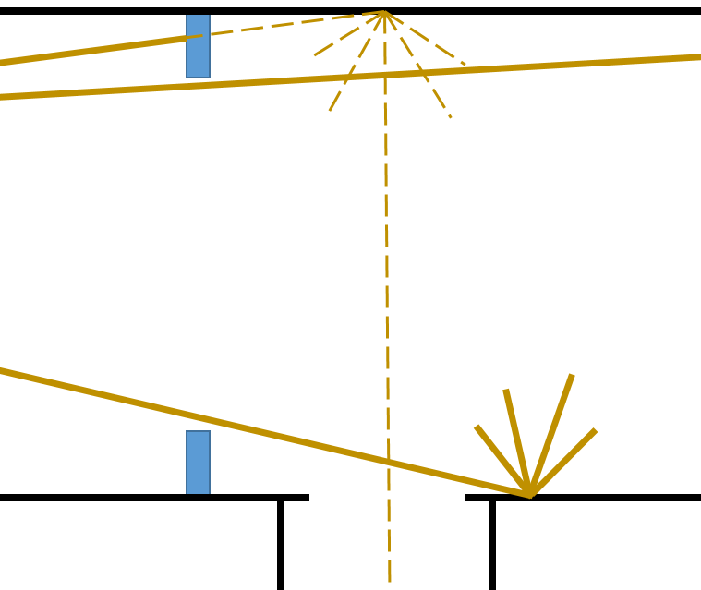
Principle of SR Masks/Stoppers
The SR masks should stop SR and prevent it from reflecting on surfaces in the optical path
Diffuse reflected light
SR mask
optics

Slide 3
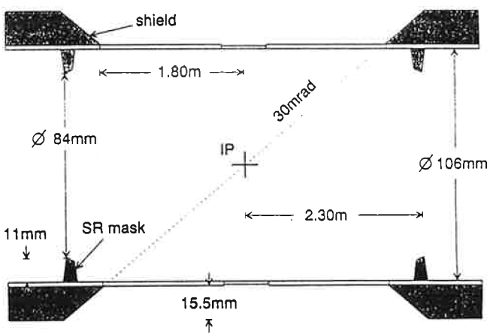
Experience from the LEP
Purpose: Decrease of the photon background in the detectors at the interaction points
The photon rates at a detector without SR masks was 25-30 times higher than at the detector with SR mask
Syncrotron Radiation Mask for LEP2 – CERN – SL/Note 93-23 (EA)
Test of Syncrotron Radiation Masks in LEP – CERN – SL-MD Note 144

Slide 4
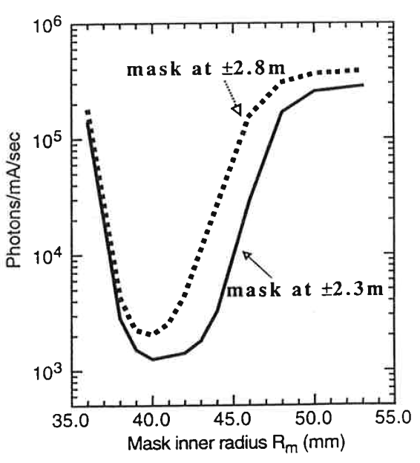
Experience from the LEP
Simulations
Simulation of different aperture diameters and distances
Masks could lower the photon rates by 2 orderes of magnitude (in the simulation)
Syncrotron Radiation Mask for LEP2 – CERN – SL/Note 93-23 (EA)
Test of Syncrotron Radiation Masks in LEP – CERN – SL-MD Note 144

Slide 5
Syncrotron Radiation (SR) Sources
Bending Magnets (D3 and D4)
The HEL? (not relevant for demonstrator)
The wiggler is on the outer beam (not relevant)

Slide 6
Basis of Simulations
List of apertures in the beam pipe
  Source is the layout data base
MADX survey for the magnetic elements
  → Synchrotron radiation sources

Slide 7
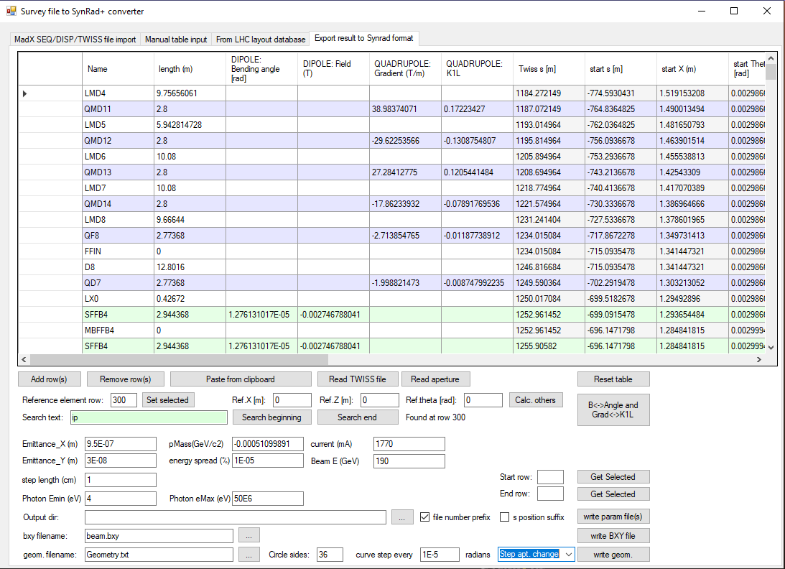
Tool reads elemnt and aperture list
Calculates X,Y,Z positions
Generates input files for Synrad
Generates polygonised vacuum chambers

Slide 8
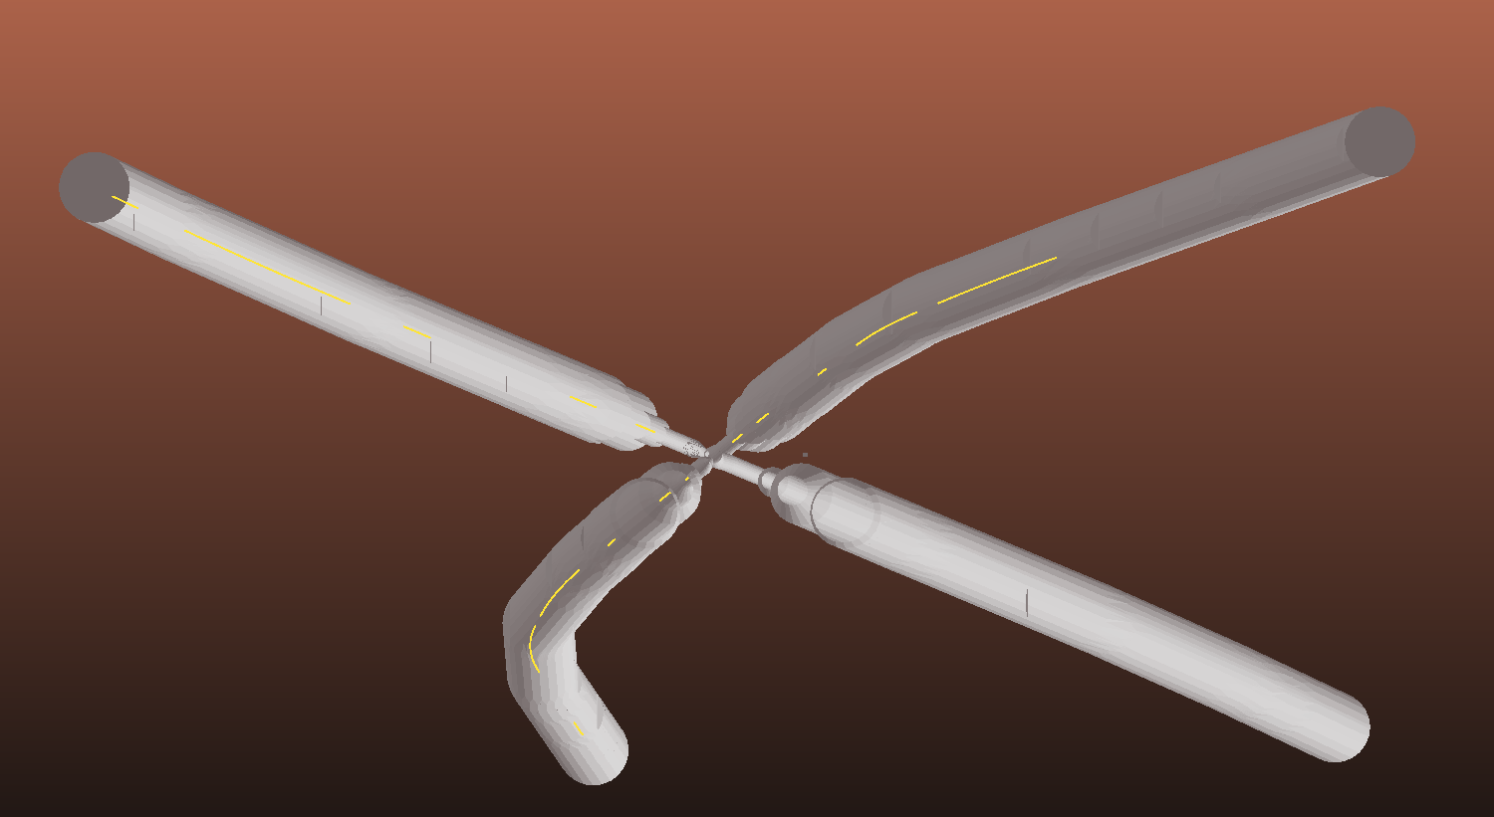
Generated aperture
Magnetic elements

Slide 9
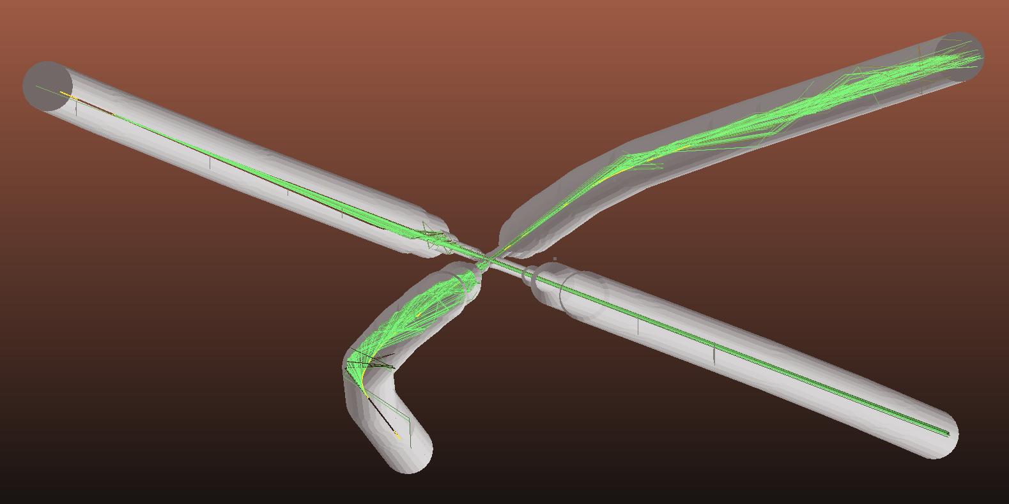
Primary and scattered photons

Slide 10

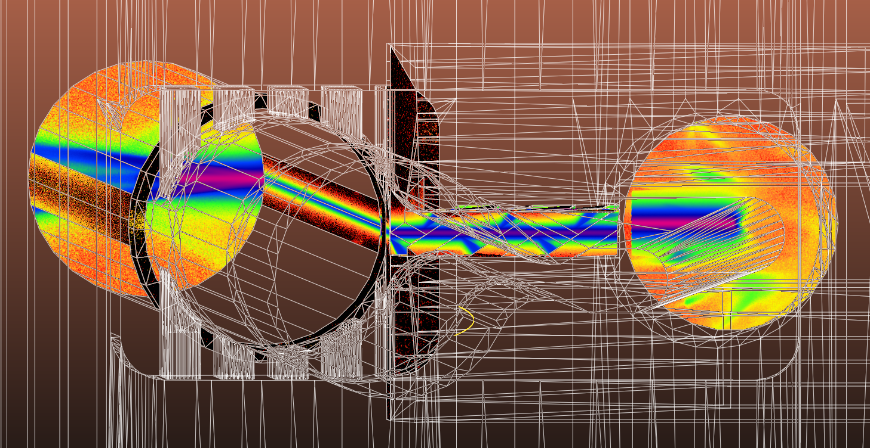
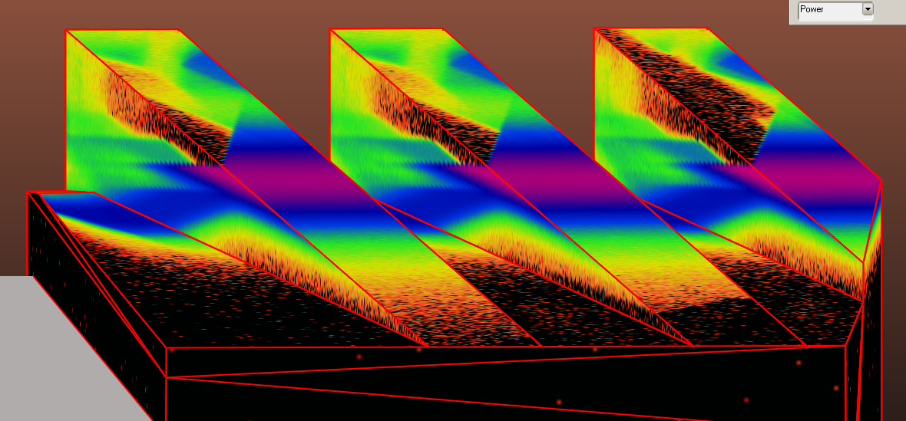
Front view (from bending magnet)
Power density [W/cm2]
Beampipe inner wall
60% of incident SR reflected, 40% absorbed
Absorbed power: 32.75W
Highest density: 0.174W/mm2
Crotch absorber
Total power absorbed: 407.18W
Flux visualized at absorption locations
Power density [W/cm2]

Slide 11
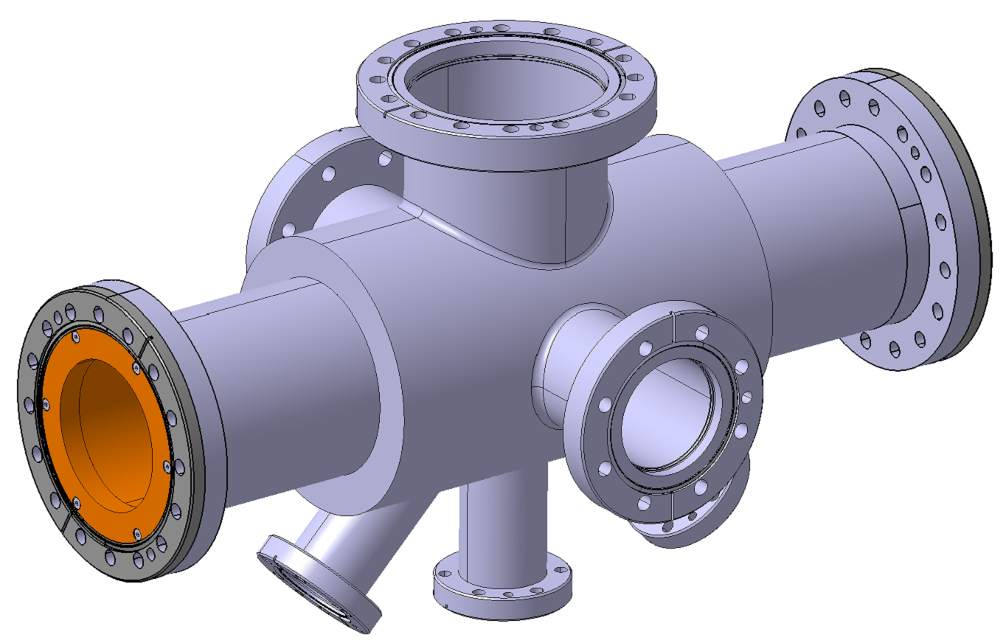
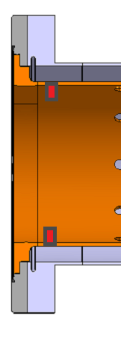
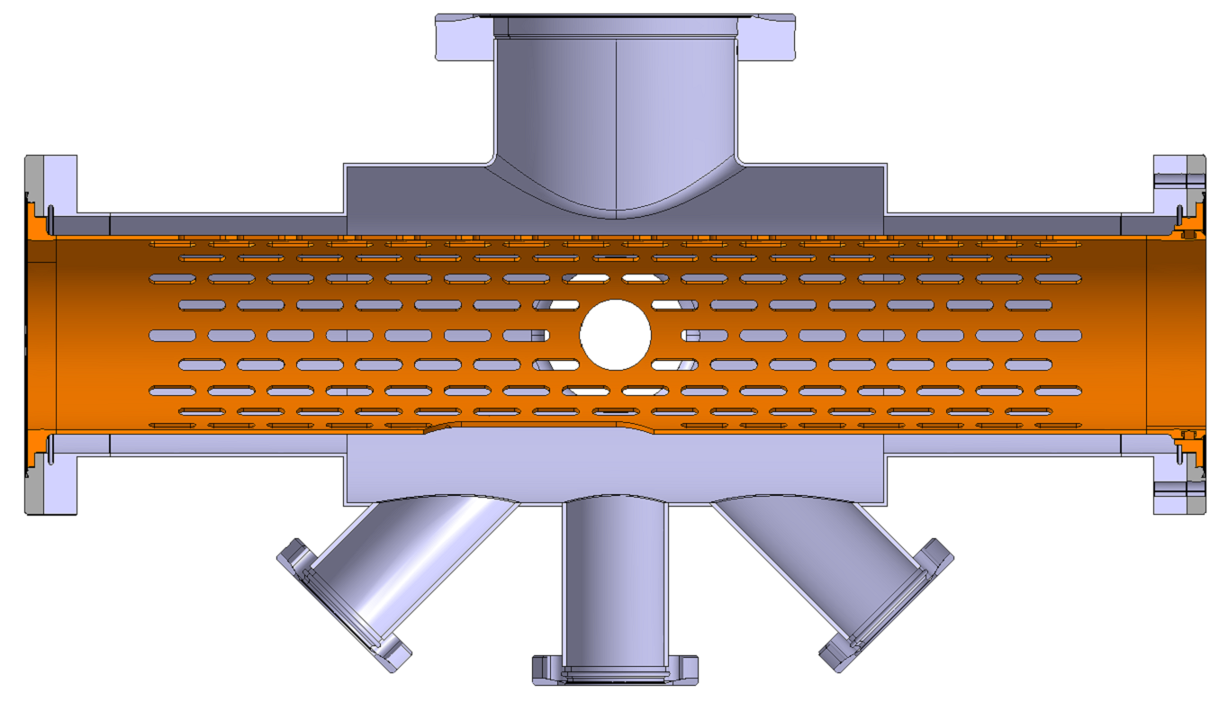
Feasibility for the Demonstrator
SR mask has to be on the copper liner
Total liner length is 500mm
Inner diameter Ø80mm
Stopper on the liner
Or in the gasket

