Slide 1
BGC “v3” design & integration
CERN TE-VSC
Marton Ady / Giuseppe Bregliozzi / Eric Page
BGC review meeting, CERN, 27.11.2018

Slide 2
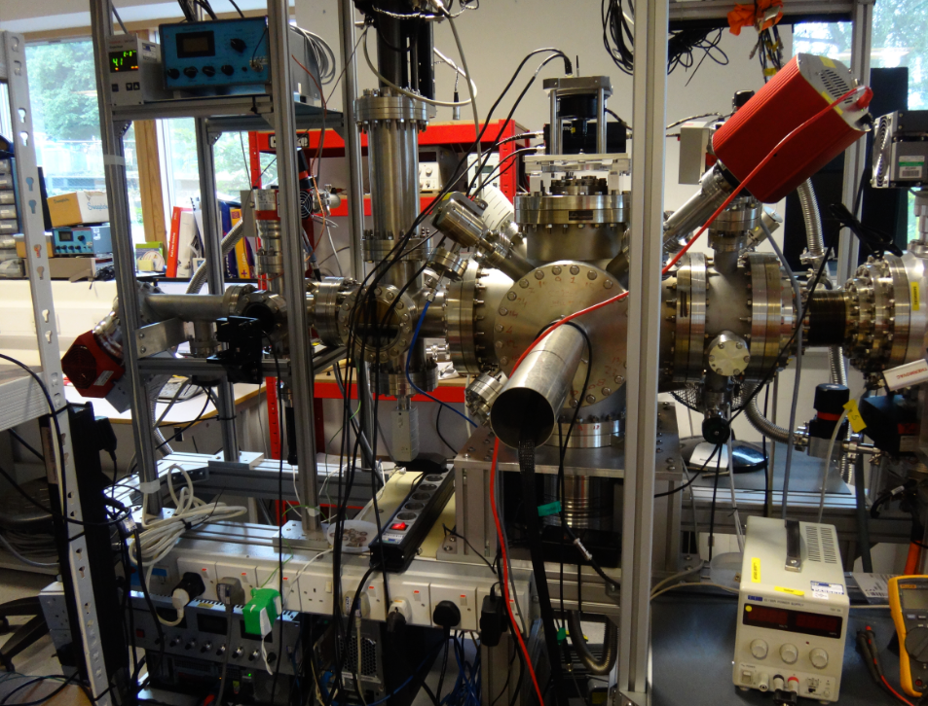
“v1” setup (past)
Context

Slide 3
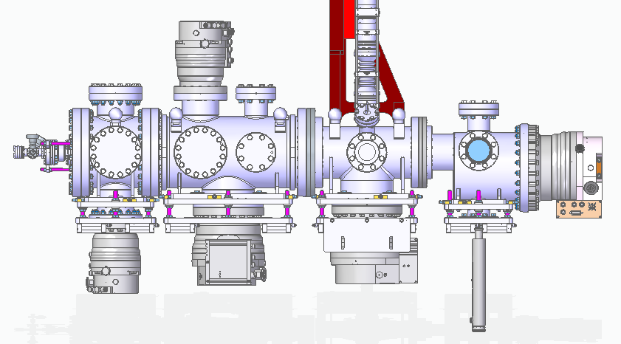
Context
“v2” instrument currently assembled in Cockroft institute
Image: Hao Zhang

Slide 4
From last review meeting
Free parameters, low pressure part
d1
d2
skimmer1
skimmer2
skimmer3
Distance between skimmers
Skimmer shape
Number of skimmers

Slide 5
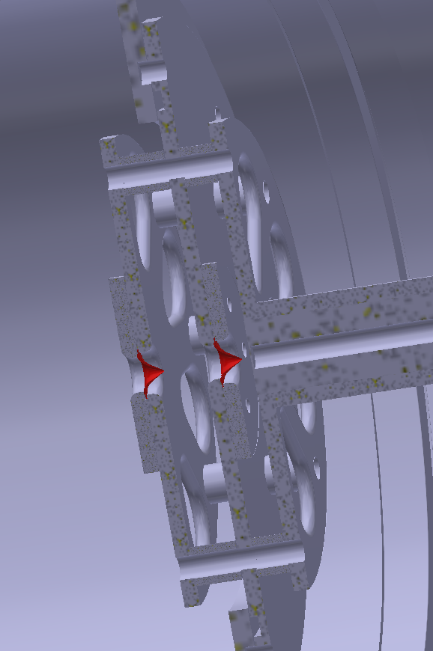
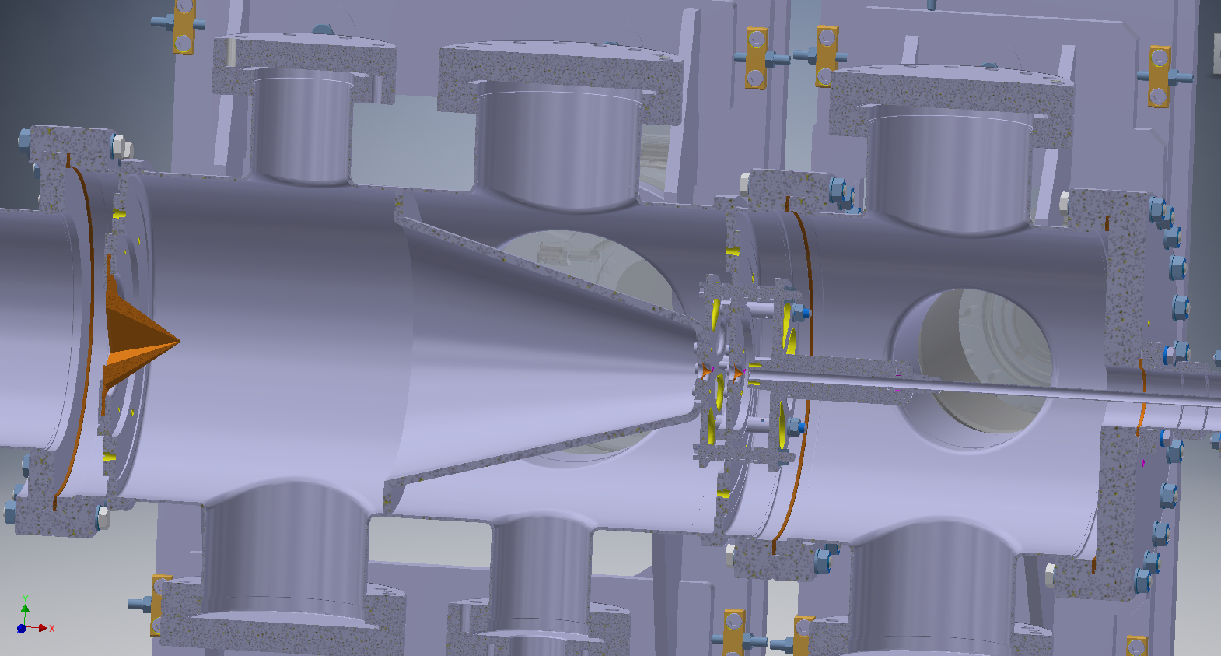
Problem
From last review meeting
Idea

Slide 6
From last review meeting
Backscattering reducer
Skimmer3
Interaction
chamber

Slide 7
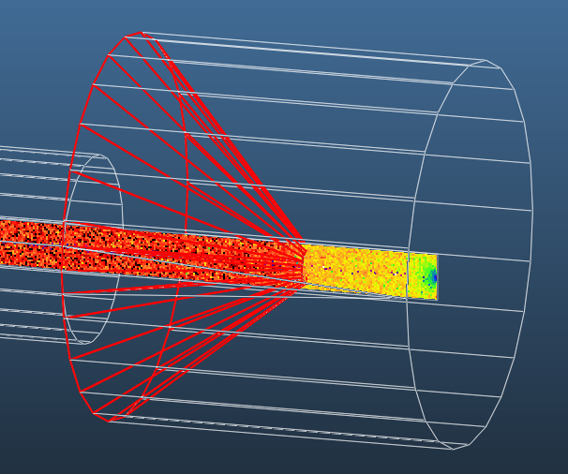
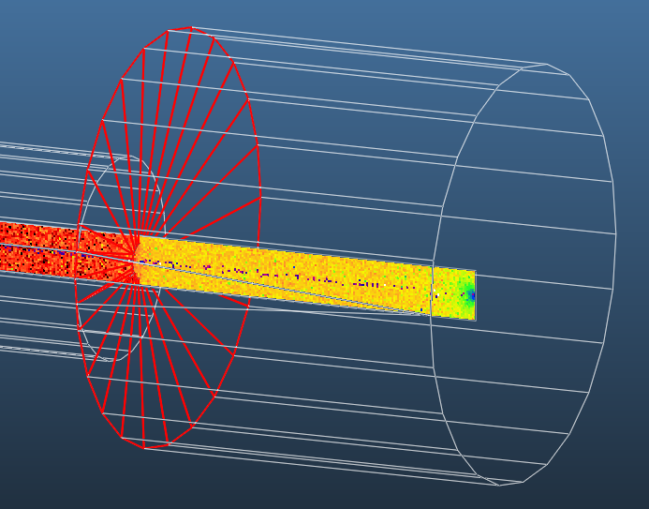
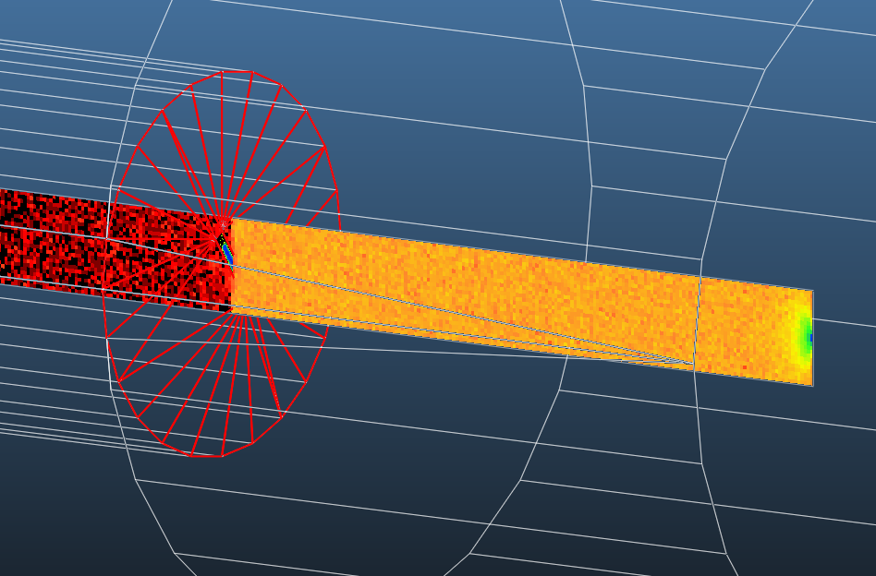
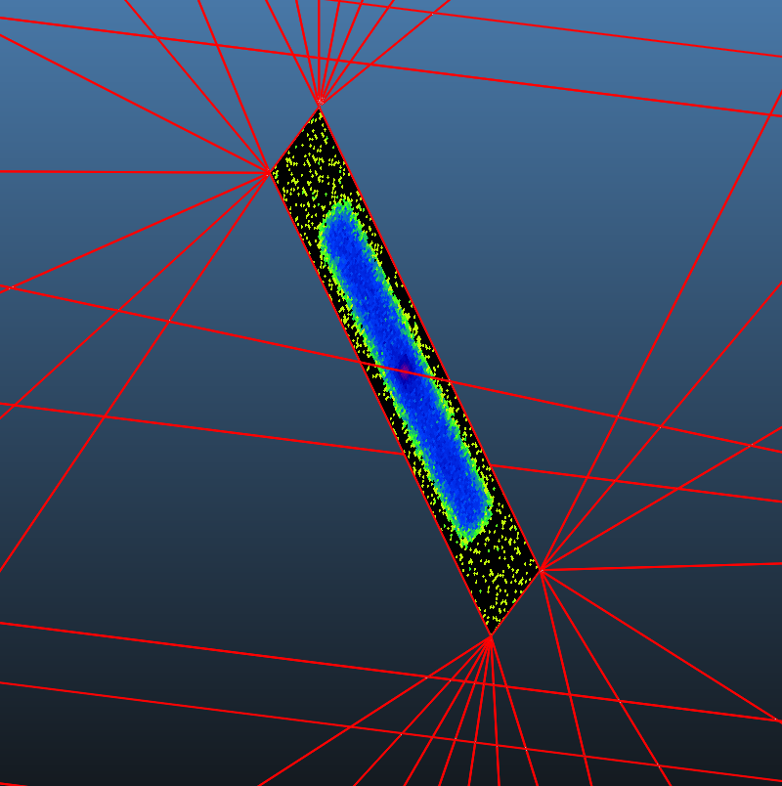
From last review meeting
Catch with cone
Catch with disc
Catch with shaped disc

Slide 8
Context
“v3” instrument needs to be more compact (goes in the LHC)
1
Hi-pressure nozzle
2
Between skimmers 1-2
Gauge: Penning
Ne
3
Between skimmers 2-3
Gauge: Piezoelectric (?)
Gauge: 2xPenning + Pirani
Gauge: 2xPenning + Pirani
Gauge: 2xPenning + Pirani
4
Interaction chamber
5
Dump area
max. 1E-3 mbar
~1E-5 mbar
~1E-7 mbar
~1E-9 mbar
nozzle
skim1
skim2
skim3
blackened tube
10 bar injection
32mm
Backscattering reducer
1
2
3
DN63
4
DN63
5
separator cone
min. spacing
200mm
DN63
DN63
DN63
DN63
CF/KF adpt.
63/100 adpt.
63/100 adpt.
DN63
63/100 adpt.
TMP
300l/s
TMP
300l/s
TMP
300l/s
63/100 adpt.
TMP
300l/s
Gauge: Penning + Pirani
Primary
Primary
Primary
Primary
Primary
Leak det. valve
2 venting valves
Leak det. valve
2 venting valves
Leak det. valve
2 venting valves
Leak det. valve
2 venting valves
Leak det. valve
2 venting valves

Slide 9
I don’t think DN160 gasket with 63 mm hole needed since there is 3 skimmer upstream
DN100 gasket with 63 hole
DN160 gasket with 32 mm hole
HiPACE700 here with standard gasket before CERN Elbow arrived
HiPACE700 with 63 mm hole gasket here before CERN Primary pump arrived
DN160 to DN100 adaptor + DN100 gasket with 63 hole + Hipace300
DN160 to DN100 adaptor + DN100 gasket with 63 hole + Hipace300
Slide: Hao Zhang

Slide 10
Simulation goals
Look for a suitable “v3” design
Understand pressure sensitivity to…
  Changing gas jet size
  Changing distances
  Changing pump sizes
  Using smaller valves
  Adding “backscattering reducer”
  Changing dump area
    90 deg. elbow
    Pump offset
    Pump tilting

Slide 11
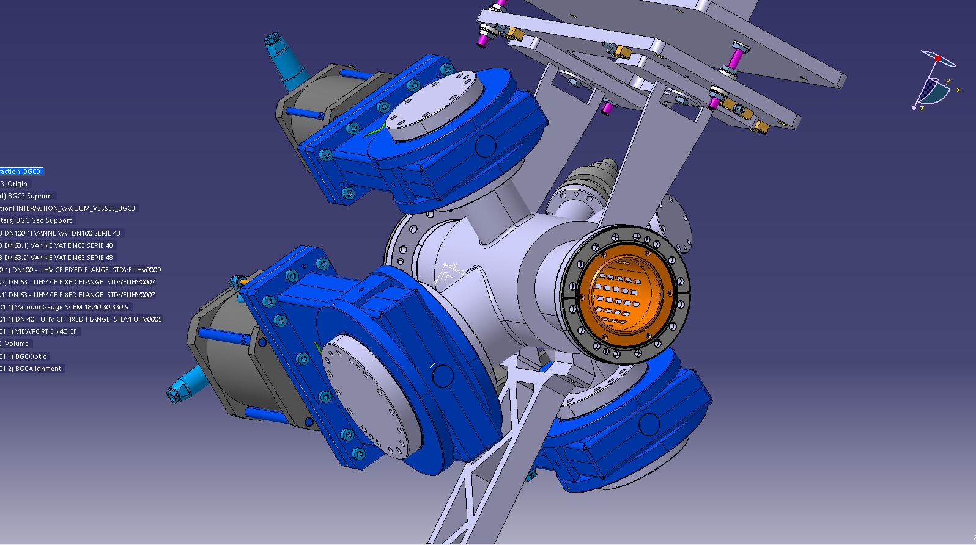
One fix point: the interaction chamber
Model: Tom Dodington

Slide 12
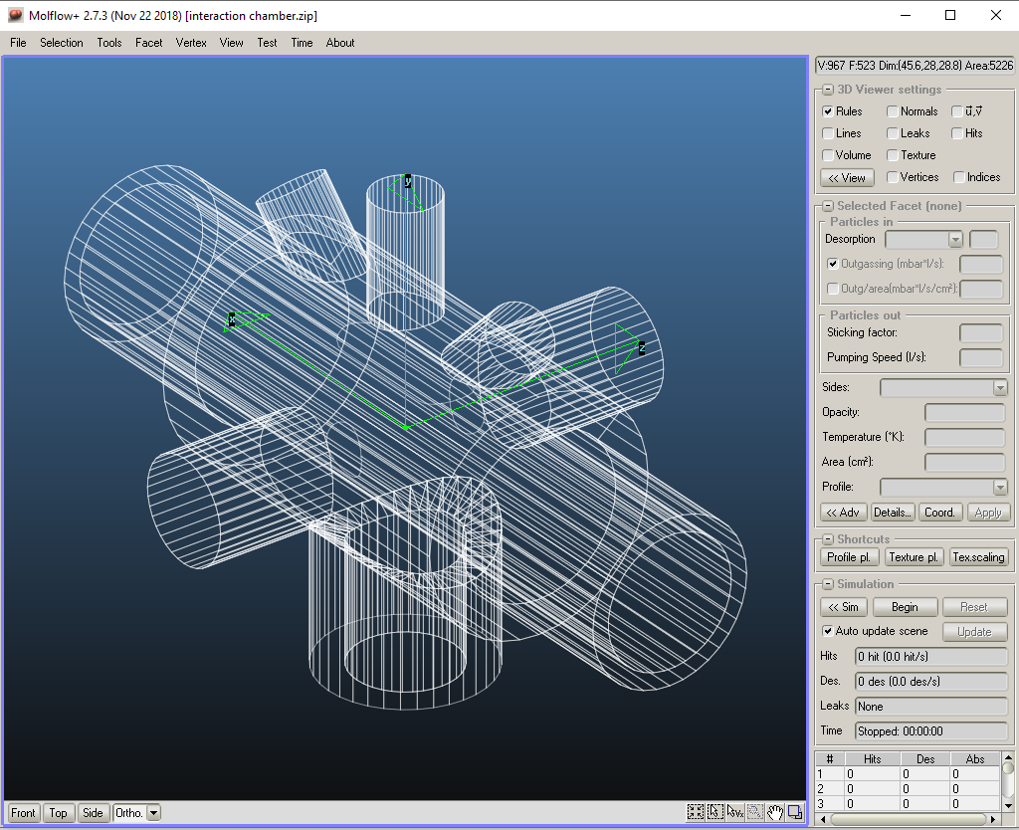
Beam
Camera
Dump
Gas jet
Pump
Simplified model for vacuum simulation

Slide 13
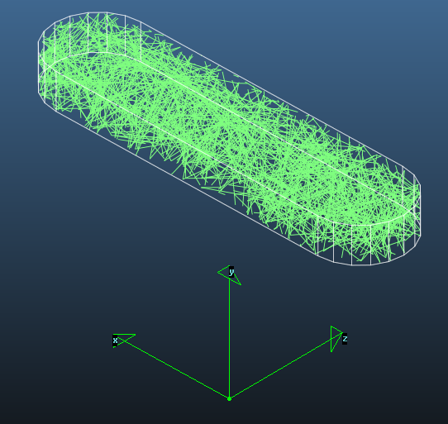
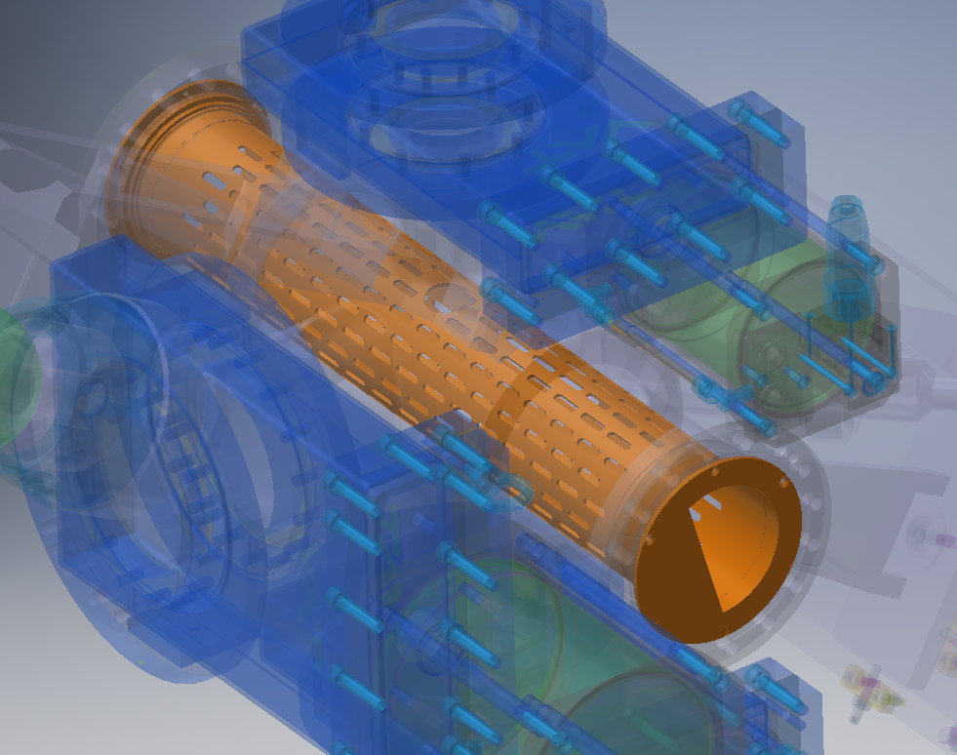
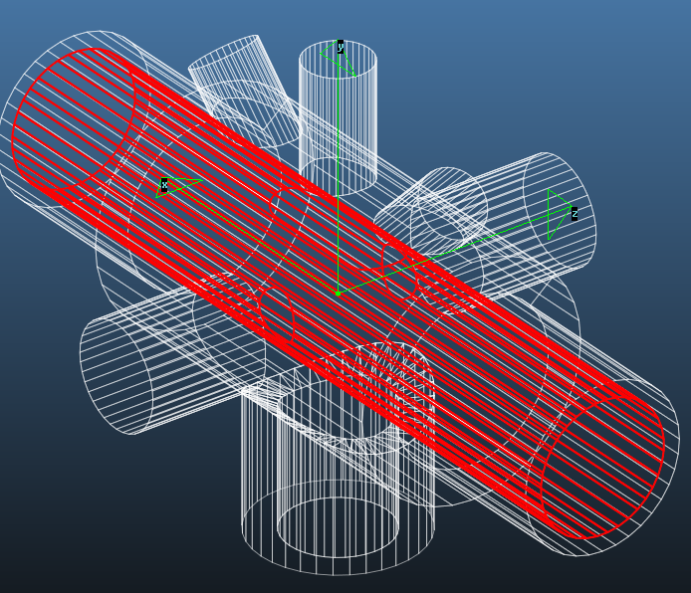
Single hole tr. probability calculation
Area ratio calculation
Replacing impedance insert with vacuum equivalent
Equivalent opacity ~80%

Slide 14
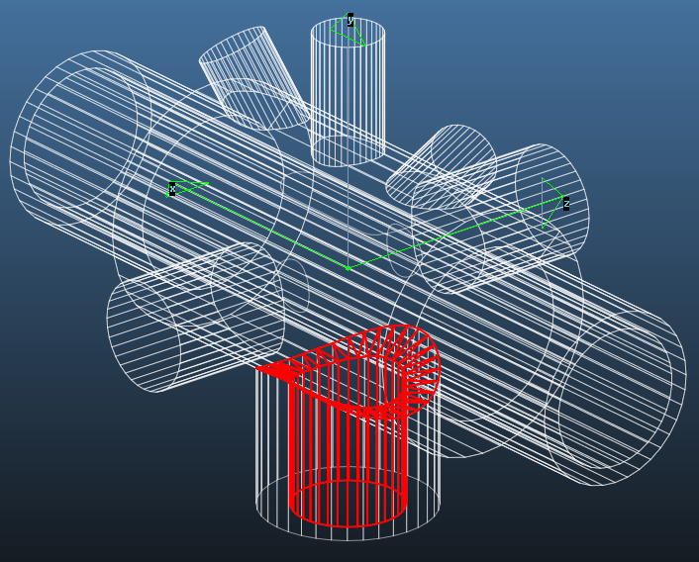
Variable pump size
DN100
DN63

Slide 15
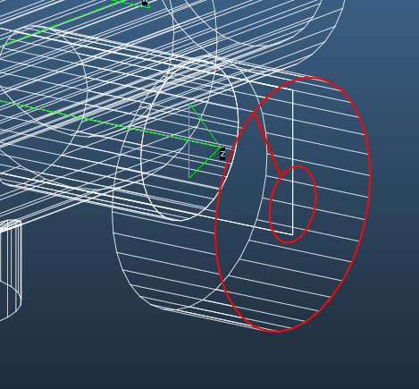
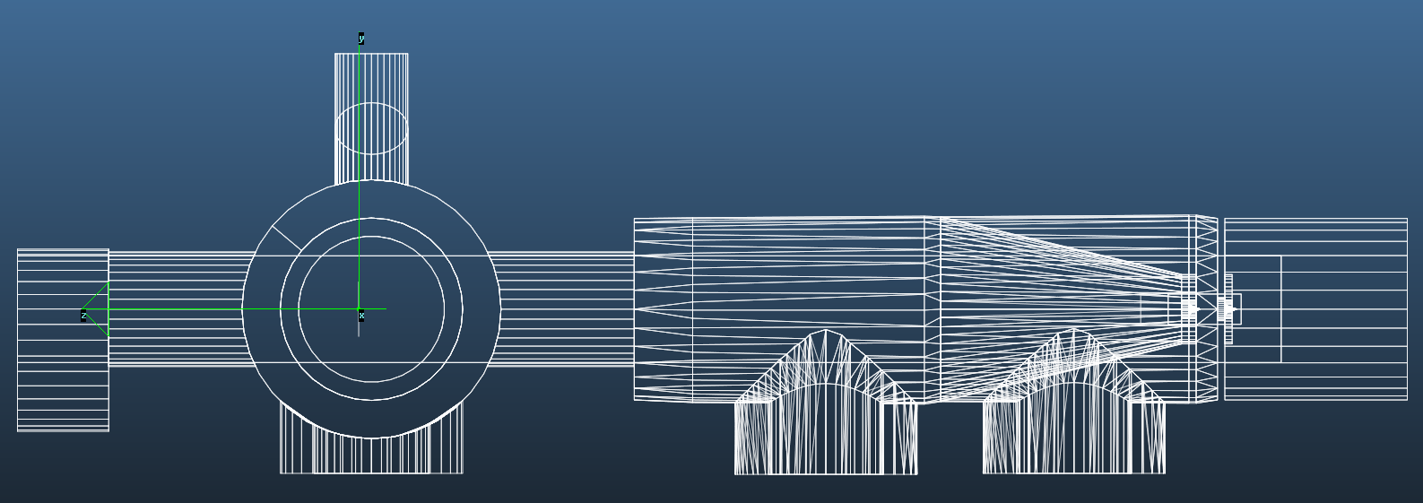
First “v3” attempt
Injection
(disabled)
Wide enough to fit a DN100 pump
Wide enough to fit a DN100 pump
DN100 pump w/ offset and axis
DN100
(as compact as possible)
Skimmer assy
as on v2
Skimmer 3:
simple plate
Variable pump
Variable pump
Variable pump

Slide 16
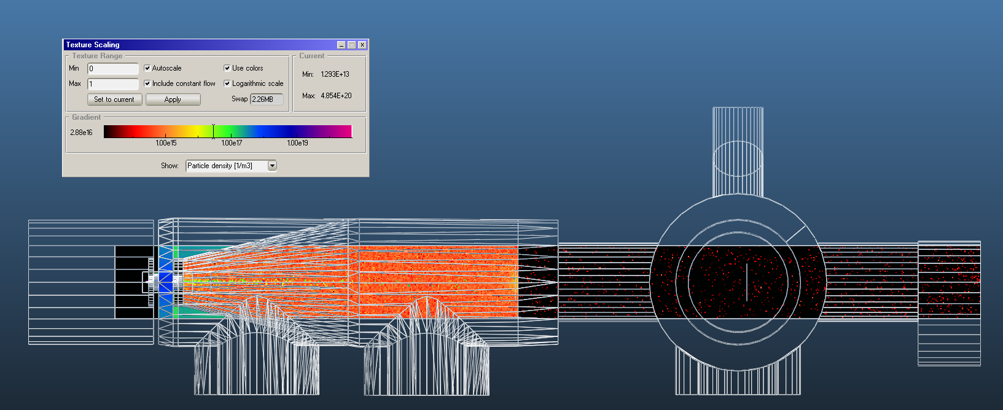
7 orders of magnitude
Direct simulation not possible

Slide 17
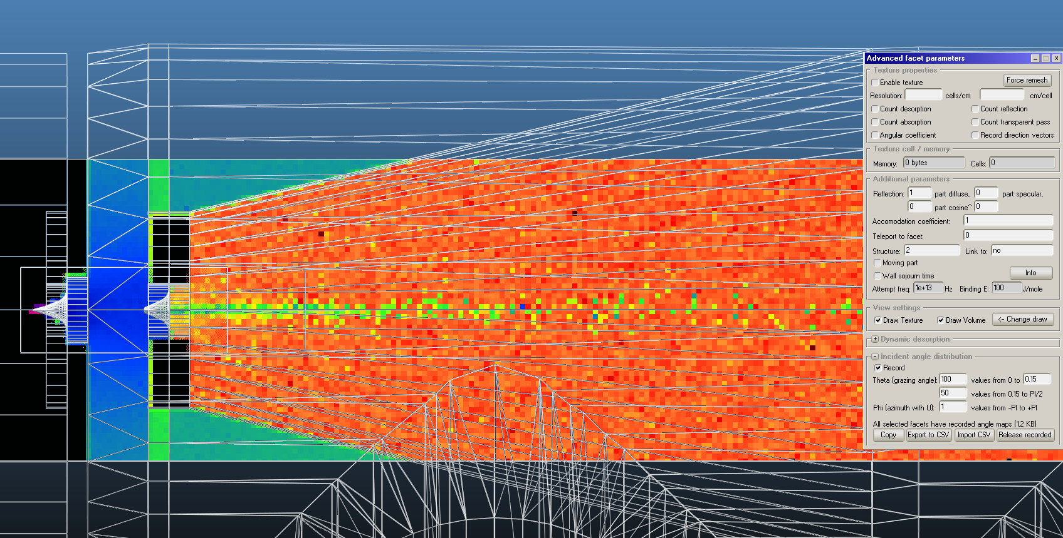
Iterative simulation 1st step: record angular distribution on skimmer 2
Around 0.4% passes skimmer 2

Slide 18
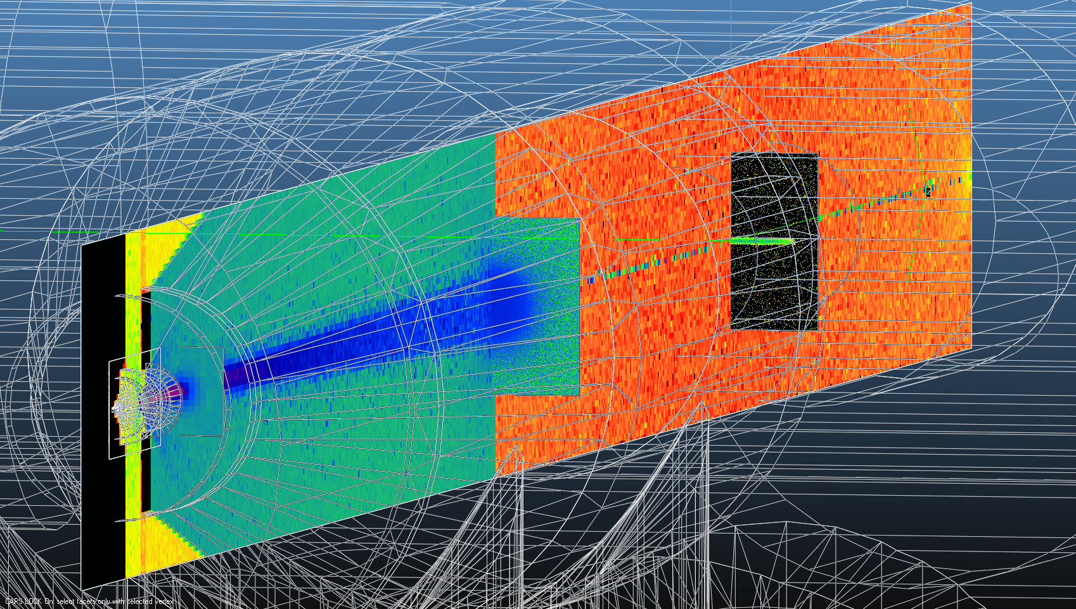
Iterative simulation 2nd step: use recorded distro for outgassing

Slide 19
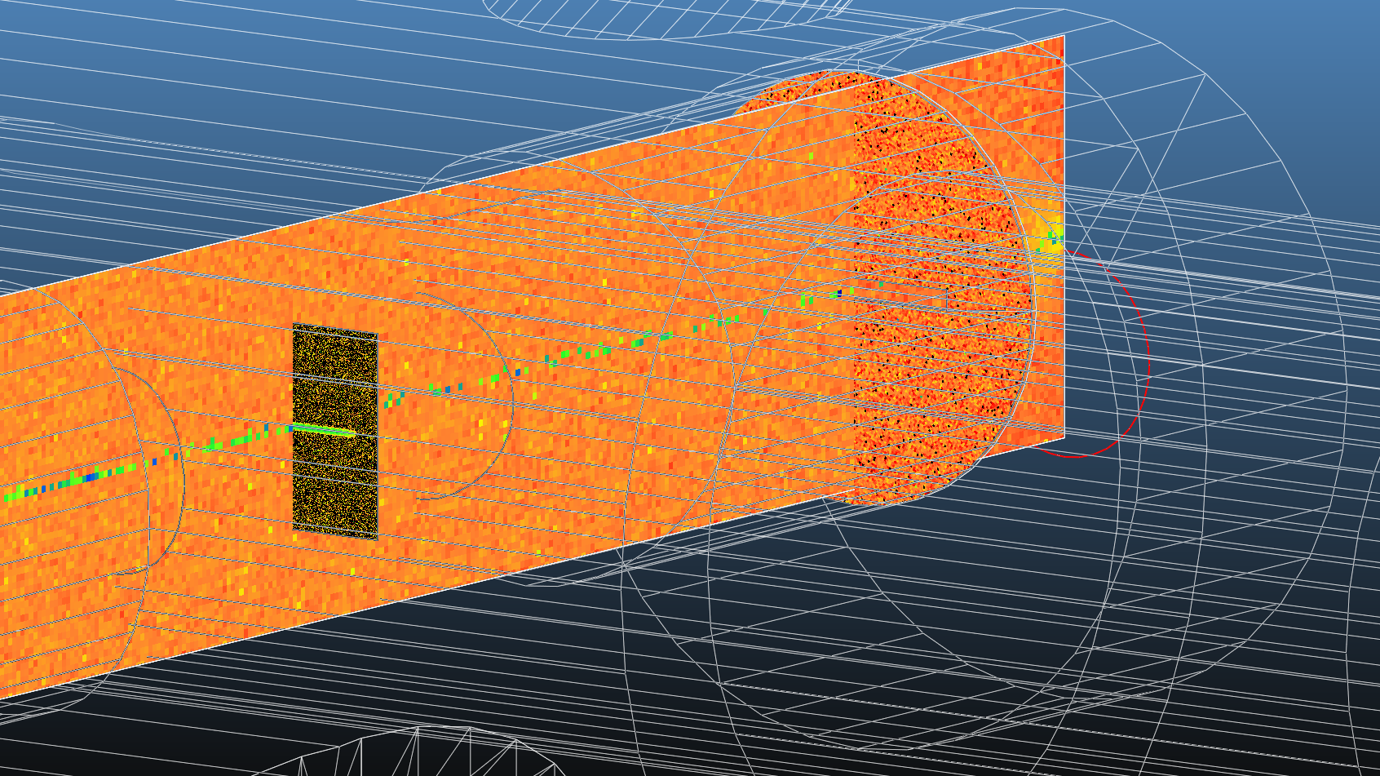
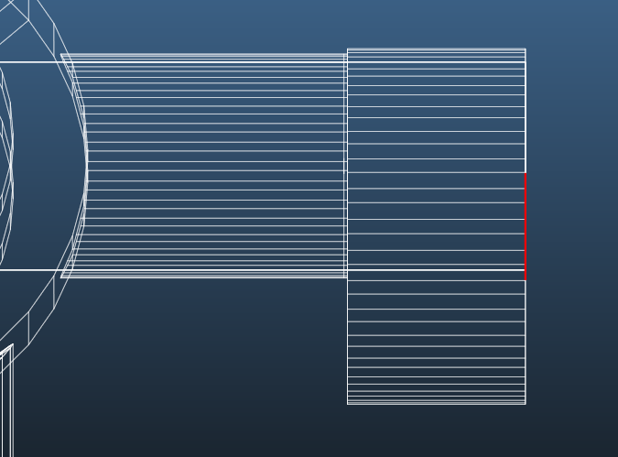
Gas jet shouldn’t hit axis

Slide 20
300l/s pump, 4x0.4mm skim3
 | SKim1-2 | Skim2-cone | cone-skim3 | IP | Dump
100% opaque cone | 8.7E-04 | 6.7E-04 | 3.3E-07 | 2.3E-09 | 4.7E-09
 |  |  | 3.7E-07 | 2.5E-09 | 5.1E-09
99.9% opaque cone | 8.7E-04 | 6.3E-04 | 8.0E-06 | 8.7E-09 | 6.7E-09 |  | <- seems probable, chosen as reference
99% opaque cone | 7.7E-04 | 5.3E-04 | 6.0E-05 | 3.3E-08 | 1.3E-08
99.9% op cone, increased skim2, pumps DN100 and 300l/s | 2.6E-04 | 1.9E-04 | 2.9E-06 | 9.6E-09 | 5.8E-09
 |  |  | 2.9E-06 | 7.6E-09 | 7.2E-09
99.9% op cone, increased skim2, first two pumps DN63 w/ 170l/s | 3.8E-04 | 3.2E-04 | 9.4E-06 | 2.0E-08 | 1.0E-08
 |  |  | 9.6E-06 | 2.1E-08 | 1.2E-08
99.9% op cone, increased skim2, first two pumps DN63 w/ 80l/s | 6.0E-04 | 5.2E-04 | 2.8E-05 | 5.0E-08 | 2.6E-08
 |  |  | 2.8E-05 | 5.4E-08 | 2.4E-08
99.9% op cone, increased skim2, first two pumps DN63 w/ 170l/s + IP 170l/s | 3.8E-04 | 3.0E-04 | 9.2E-06 | 3.0E-08 | 1.3E-08
99.9% op cone, increased skim2, first two pumps DN63 w/ 80l/s + IP 80l/s | 3.9E-04 | 3.2E-04 | 9.4E-06 | 3.4E-08 | 1.5E-08
99.9% op cone, increased skim2, first two pumps DN63 w/ 80l/s + IP 80l/s, no imped.insert | 3.9E-04 | 3.2E-04 | 9.3E-06 | 3.8E-08 | 2.0E-08
op cone, increased skim2, pumps DN100 and 300l/s | 2.6E-04 | 1.8E-04 | 4.8E-07 | 2.8E-09 | 5.7E-09
 |  |  | 4.8E-07 | 3.5E-09 | 5.6E-09
 |  |  | 4.8E-07 | 3.2E-09 | 5.4E-09 |  | no imped. insert
 |  |  | 4.8E-07 | 1.6E-09 | 7.2E-09 |  | backscattering reducer
op cone, increased skim2, first two pumps DN63 w/ 170l/s | 4.0E-04 | 3.3E-04 | 1.0E-06 | 4.0E-09 | 4.4E-09
 |  |  | 1.0E-06 | 4.7E-09 | 6.2E-09
op cone, increased skim2, first two pumps DN63 w/ 80l/s | 6.2E-04 | 5.6E-04 | 2.3E-06 | 7.2E-09 | 3.6E-09
 |  |  | 2.2E-06 | 6.5E-09 | 6.5E-09
op cone, increased skim2, first two pumps DN63 w/ 170l/s + IP 170l/s | 4.0E-04 | 3.3E-04 | 1.1E-06 | 7.0E-09 | 6.4E-09
 |  |  | 1.0E-06 | 6.5E-09 | 6.9E-09
 |  |  | 1.0E-06 | 6.2E-09 | 6.7E-09 |  | no imped. Insert
 |  |  | 1.0E-06 | 5.3E-09 | 7.2E-09 |  | backscattering reducer
 | 4.0E-04 | 3.3E-04 | 1.1E-06 | 4.8E-09 | 5.6E-39 |  | dn40 valves
 |  |  | 1.0E-06 | 6.0E-09 | 7.0E-09 |  | dn40 valves
op cone, increased skim2, first two pumps DN63 w/ 80l/s + IP 80l/s | 6.2E-04 | 5.6E-04 | 9.6E-07 | 1.0E-08 | 7.2E-09
 |  |  | 1.0E-06 | 8.8E-09 | 7.8E-09
 |  |  | 1.0E-06 | 8.6E-09 | 7.6E-09 |  | no imped. insert
 |  |  | 1.0E-06 | 9.6E-09 | 7.4E-09 |  | backscattering reducer
31 cases simulated

Slide 21
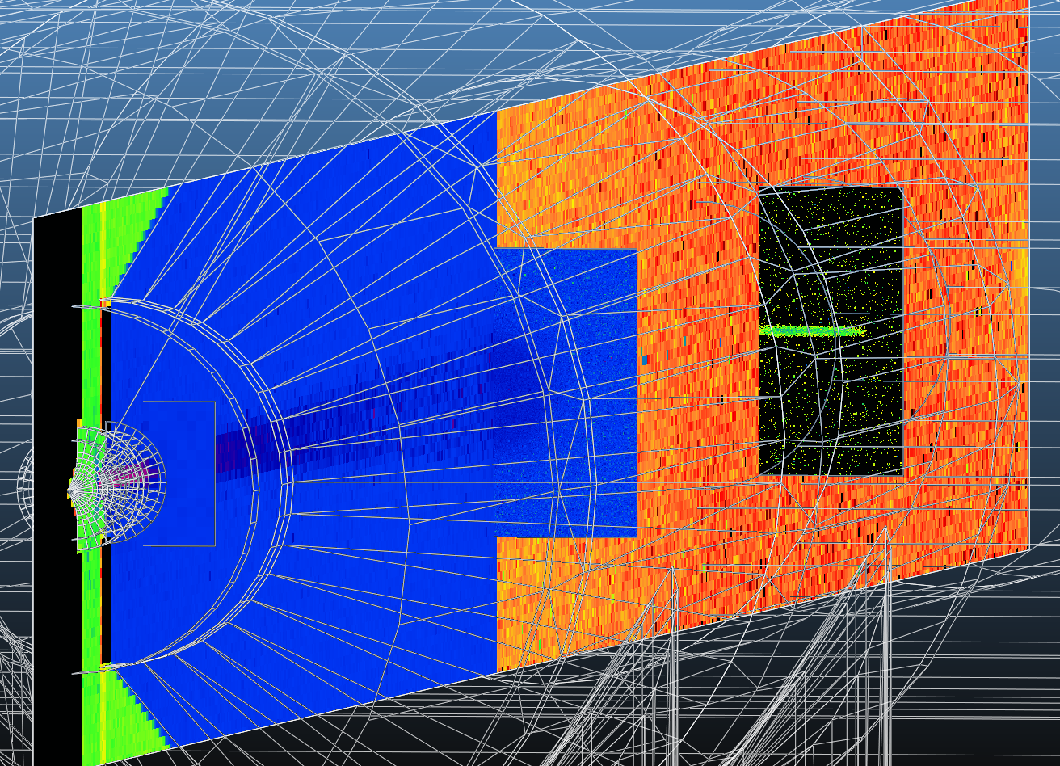
Gas jet -> 20mm: skimmer 2 and 3 need to be increased
Gas jet radius
Skimmer1 | Skimmer2 | Skimmer3 | IP | Dump entrance
0.00 | 0.2 | 3.99 | 6.43 | 8.26
 |  | 2.00 | 3.23 | 4.15
0.00 | 0.45 | 6.64 | 10.72 | 13.77
 |  | 6.60 | 10.65 | 13.68
 |  | 0.20 | 0.32 | 0.41

Slide 22
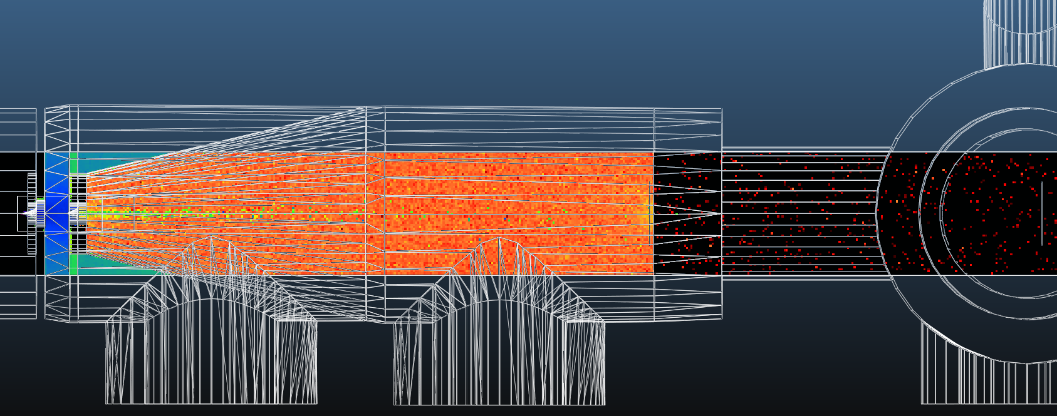
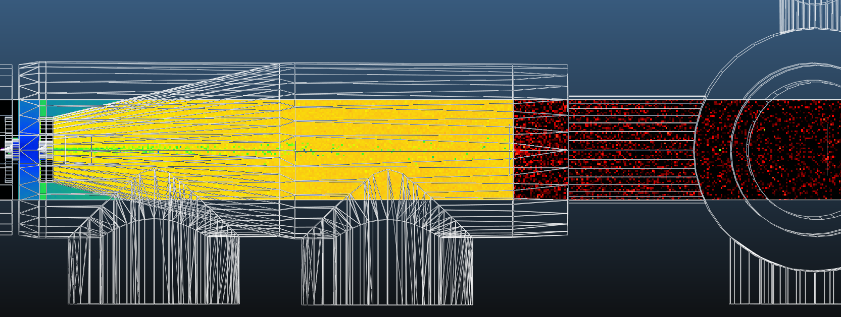
100% opaque cone
3E-4
1E-6
7E-9
6E-9
DUMP
4E-4
4E-4
3E-4
9E-6
3E-8
1E-8
DUMP
99.9% opaque cone

Slide 23
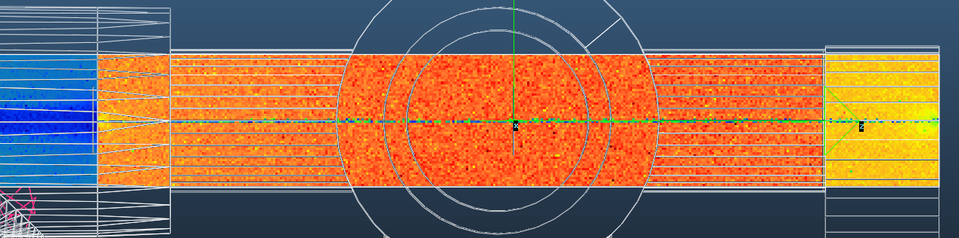
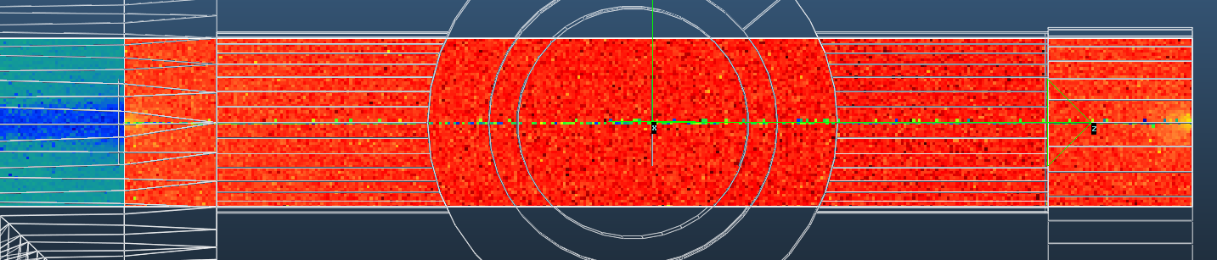
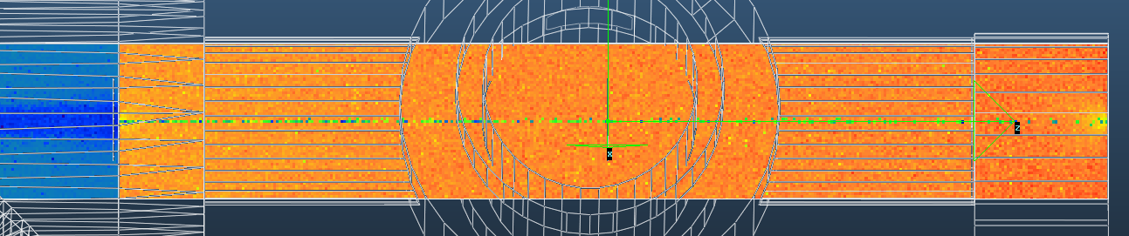
Role of backscattering reducer
Strong interaction chamber pump:
beneficial
(less gas load from dump area)
300l/s
Reduced interaction chamber pump:
slightly beneficial
170l/s
Weak interaction chamber pump:
slightly adverse
(less pumping from dump area)
80l/s

Slide 24
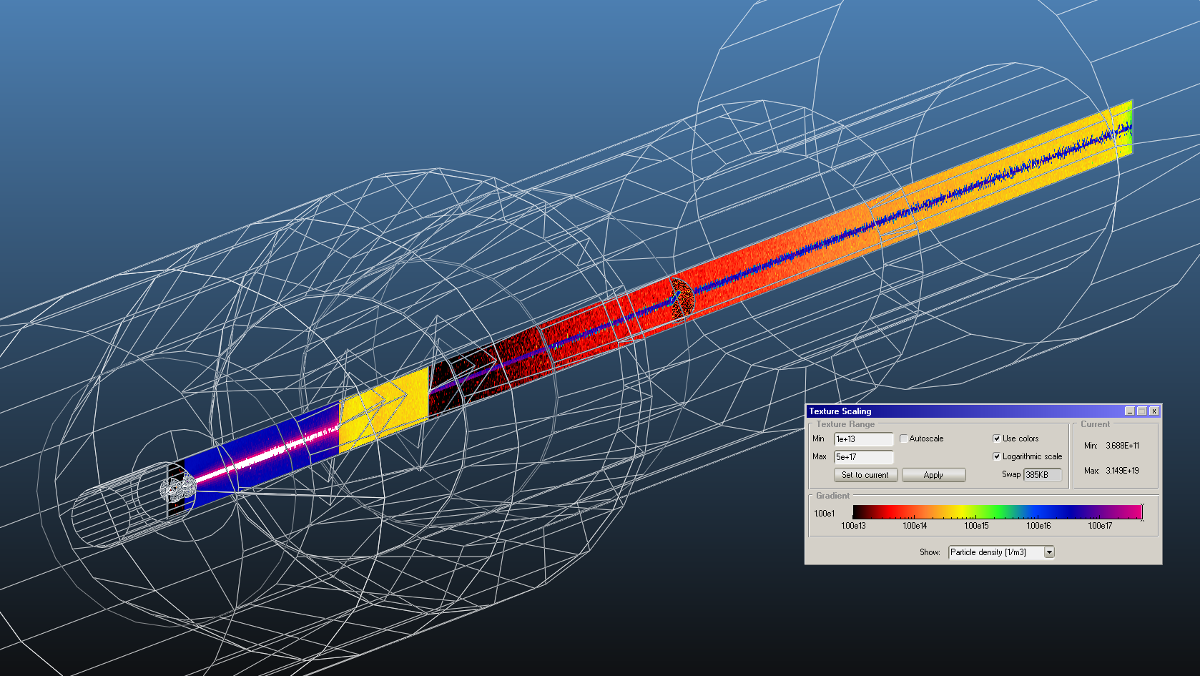
Looking back to my slides from Darmstadt
Simplified geometry, strong pumping everywhere
Gas source

Slide 25
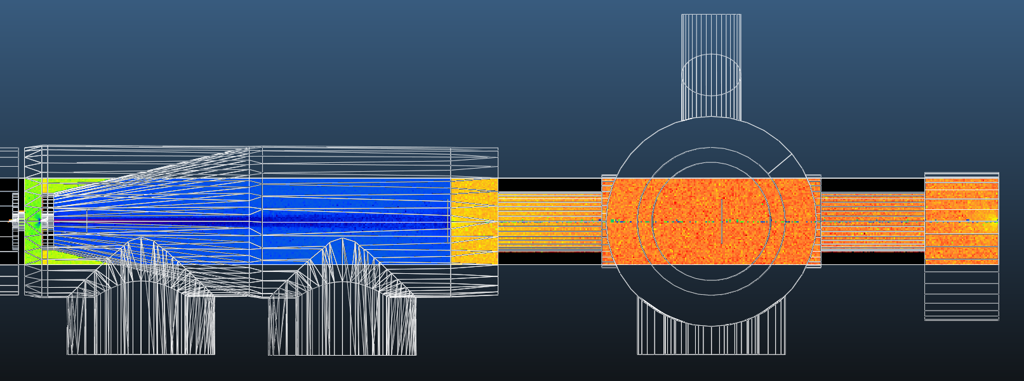
Reducing valves?
DN40
DN40
Just behind skimmer 3 (not much impact)
like a backscattering reducer
Current Engineering Change Request: DN63 ports
Using DN40 valves on the interaction chamber acts as a weak backscattering reducer
Very slight increase of pressure in dump area, and reduction in interaction chamber
Variations near statistical error, for simplicity: “no vacuum impact”

Slide 26
Cone: 100% opaque, Skimmer 2: 900um, Skimmer 3: 13.2/0.4mm
Case | Between skimmers 1-2 | Between skimmers 2-3 | Interaction chamber
1 | 250 l/s | 250 l/s | 250 l/s
 | 2E-4 mbar | 5E-7 mbar | 3E-9 mbar
2 | 170 l/s | 170 l/s | 250 l/s
 | 3E-4 mbar | 1E-6 mbar | 4E-9 mbar
3 | 80 l/s | 80 l/s | 250 l/s
 | 6E-4 mbar | 2E-6 mbar | 7E-9 mbar
4 / 5 / 6 / 7 | 170 l/s | 170 l/s | 170 l/s
 | default / no impedance insertion / backscattering reducer / DN40 valves
 | 3E-4 / 3E-4 / 3E-4 / 3E-4 mbar | 1E-6 / 1E-6 / 1E-6 / 1E-6 mbar | 7E-9 / 6E-9 / 5E-9 / 6E-9 mbar
8 | 80 l/s | 80 l/s | 80 l/s
 | 6E-4 mbar | 2E-6 mbar | 1E-8 mbar

Slide 27
Conclusions (simulations)
Many free parameters when designing “v3” instrument
Parameter change: mostly localized / predictable impact
Strongly suggesting leak-tight cone separation
DN63 pumping ports (with DN100 pumps) acceptable
Backscattering reducer still effective, but no dramatic improvement
Vacuum-wise OK to use DN40 valves on interaction chamber
Sensitive compromise between gas jet density and IP background pressure to be found
Nozzle chamber pumping still an issue
Dump area optimization: to do
LHC Neon impact / risk assesment: to do
Operation interlock logic: to do

Slide 28
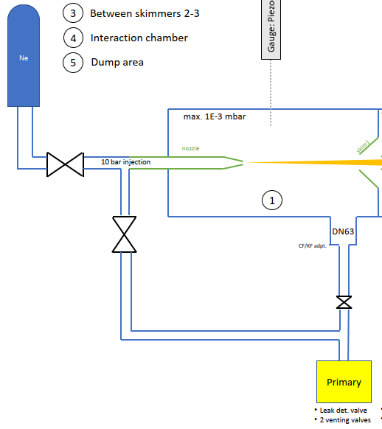
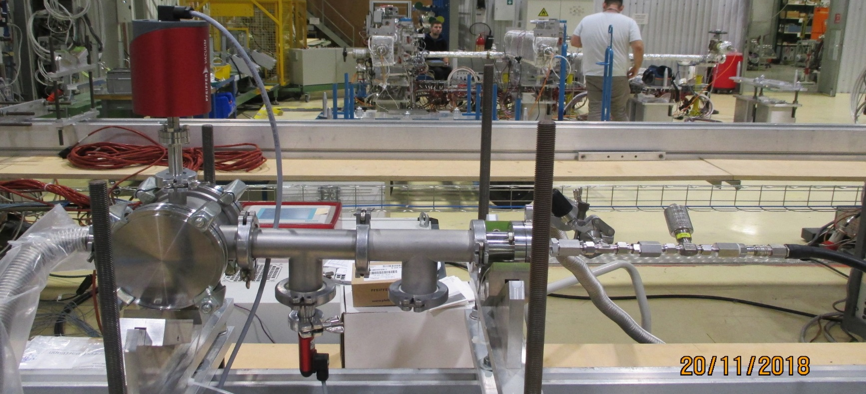
Dry pumps test for first vacuum chambers
Nozzle is 30 µm diameter over 300 µm length
Setup configuration:
Capacitance gauge
Nozzle roughing
To the pumping system
NOZZLE
N2 injection (from 0.5 to 11 bar abs.)
Pirani gauge

Slide 29
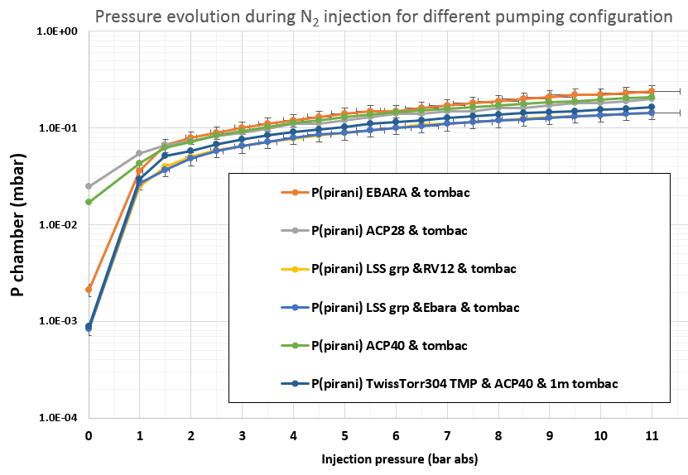
Dry pumps test for first vacuum chambers
Laminar flow through the nozzle.
Measured with a leak detector (atm pressure side of nozzle) Q_{He} 2.5E-2 mbarl/s
Calculated using gas viscosity for QN₂ 1.5E-2 mbarl/s
For every primary dry pump test, the measured pressure with an inlet pressure of 5 bar is between 10⁻¹ and 1.5x10⁻¹mbar range.
For a turbo molecular pumping group with any primary pumps (including rotary vane pump), the pressure remains in the same range.
These primary pumps do not managed to absorb the gas flow coming from the nozzle.
To be tests and confirm the impact of pressure low 10-1 mbar on the gas jet
We could think to plan some test in Cockcroft institute beginning of next year.

Slide 30
Beam Gas Curtain (BGC) Vacuum Controls Requirements
Cabling request (RQF0966942):
  Includes more than 33 cables
  Still has to be modified according to last-minute changes (3x additional VPG missing)
  OSVC signature awaiting…
UA43:
  Full Rack Re-arrangement and dedicated manpower for equipment installation, including inter-rack cabling, valve-interlock hardware configuration and Profibus network integration
  7x gauge controllers, 3x Valve controllers, 3x specific Valve-Interlock Crates and 5x dedicated Vacuum Pumping Group controllers
LHC Tunnel:
  5x local crates and 3x Mini-Racks Installation for Vacuum Pumping Groups
  Require EN-EL’s intervention for electrical distribution (not informed yet, awaiting ECR…)
PLC/SCADA development:
  3x Non-Standard Vacuum Pumping Groups requiring new specific PLC & SCADA development
  Full database integration (Vac-DB)
  New dedicated Control types, Synoptic integration (incl. Face-Plate) and Widget development required
Missing resources: Not in the LS2 baseline

Slide 31
Beam Gas Curtain (BGC) Vacuum Requirements
Final assembly & Commissioning of the system:
  The system shall be carefully tested in the lab to mimic all possible operation scenarios;
  Calibration curves for different gases shall be carried out;
  A detailed operation procedure shall be validated on the system and handled to VSC-ICM to be then integrated in the SCADA application;
  Safety margin and a detailed risk analysis shall be defined and agreed.
LHC Tunnel -> Excepted installation during YETS 2021-2022(?):
  Full Support to the assembly in the tunnel;
  Validation & commissioning of the vacuum system;
  Commissioning of system.
Missing resources: Not in the LS2 baseline

Slide 32
Outlook: LHC Beam Vacuum simulation
Fully detailed analysis of pressure profile on the LHC vacuum sector for different gases: need to finalize the BGC system to know the pressure ‘escaping’ from the interaction chamber.
Impact of this gas on possible beam lifetime (nuclear cross section) and determine the quantity of gas condensed on the beam screen surface of the neighbourhood cryogenic stand alone magnets: planning of the thermal regeneration.

Slide 33
Outlook: BGC Jet Simulations
Finalize “demonstrator instrument” design including pumps, which will be first installed in the LHC
Model neighboring region (extract apertures from LHC layout DB)
Model gas propagation from the instrument to the surroundings
Draw conclusions on operation (Ne accumulation on beamscreen, etc.)

Slide 34
Conclusions
Detailed simulation of the BGC is ongoing to optimize the design, pumping schemes, and aperture of the different chambers;
TE-VSC needs to guarantee a proper gas density on the jet while keeping as low as possible the pressure in the LHC beam vacuum;
The optimization of the BGC is crucial to have a system that would allow possible intervention during operation and maintenance during longer intervention of time;
The first ‘chambers’ is still under study: Difficult to reach the required performance with ‘standard’ vacuum system.
A detailed cost (hardware & resources) schedule review is missing for TE-VSC to proper guarantee the completion of the project

