Slide 1
BGC Planning
Global LHC LS2 Planning
https://espace.cern.ch/en-dep-mef-lpc/LS2/Global%20Schedules/Forms/AllItems.aspx
BGC Status
BGC Roadmap to installation

Slide 2
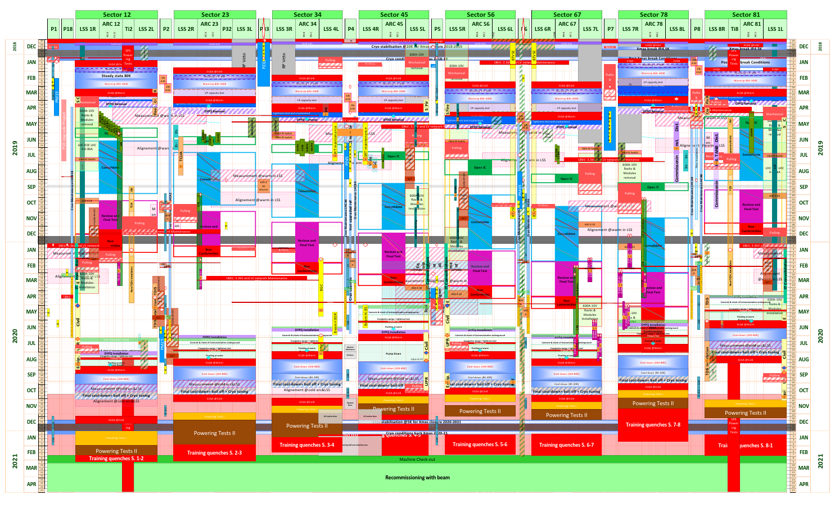
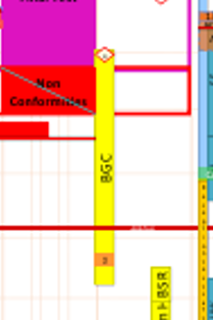
Global LHC LS2 planning: Start 03.12.18
Warm-up
End of easy access

Slide 3
Dates for LS2
Start: 03.12.2018, Progressive access, depending on point
BGC work finished by June 2020 → Note limited flexibility on other services due to resources
Difficult access as from August 2020

Slide 4
BGC Status
Mechanical and optical design advanced, Decisions to lead to detailed and manufacturing design to be taken in this review or action plan
Blackening studies advanced, several options, Decisions to be taken
Start-off gas type defined: Neon
Vacuum layout advanced, to be tested at CI
Administration:
  CERN Internal document to allow for BGC Stage1 installation approved: EDMS 2025553 including Safety Assessment Form EDMS 1936384
  Stage 2 ECR to be made by February 2019
Infrastructure: Cabling, Rack, Gas tube routing, Gas bottle position addressed and followed-up

Slide 5
BGC Roadmap to Installation
Tunnel installations (Cables, Racks, Tubes, Holes on Tunnel Floor, Gas bottle, Pressure Reducers…)
Start July 2019, End February 2020
Collaboration Meeting
27/28 Nov 2018
Manufacturing Drawings
and ECR2 by Feb 2019
Production and Procurement Start March 2019
Surface coatings July 2019
V3 Assembly Oct 2019
Only fully agreed and tested instrument will be installed in LHC.
Minimum requirement: Installation as per ECR 1
HEL Test Stand Test Dec 2019
Tunnel installation Feb to May 2020

