Slide 1
Layout of DFH and current leads: status of on-going optimization studies:
Work in progress
Jerome F., Yann L., Samer Y.
WP6a Integration weekly meeting #1

Slide 2
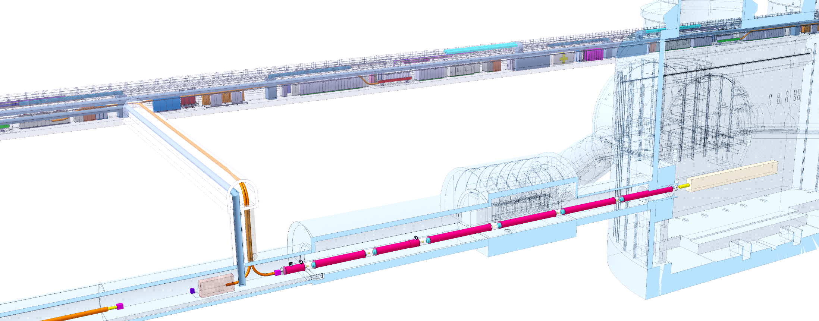
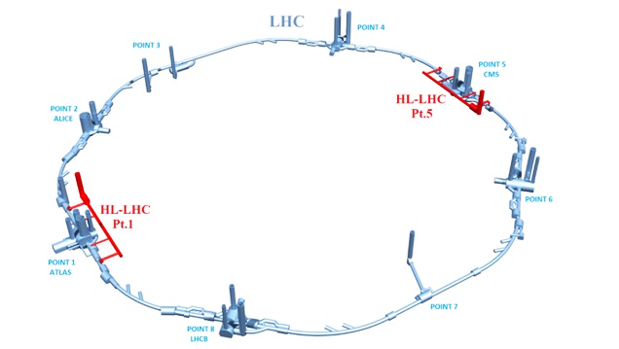
Context
2 x 13 kA
8 x 0.6 kA
Each IP1 and IP5 sides equipped with 2 cold powering chains of cryostats
Triplet insertion : DFHx – SC Link (DSH) – DFX
Matching sections : DFHm – SC Link - DFM
Status:
Some preliminary designs to identify key challenges
Iterations on-going wp6a-wp6b to reach common proposal toward the end of the year
Next step:
Propose & iterate through WP15 with other services
HTS
DFHm
DFHx
DSHm
DSHx
MgB₂
DFHx
DFHM
Power converters
Service tunnel
DSHx
Transverse tunnel
DSHm
Q1
IP
≈50m
≈8m
Q2b
Q2a
CP
Q3
≈45m
DFX
D1
≈80m
LHC tunnel
DFM
D2
LHC tunnel
MgB₂
Superfluid @ 1.9K
Liquid He @ 4.5 K
Gaseous He @ 4.5 K
DFM
Jumper DFM
DSHm
Jumper DFX
DSHx
DFX
Splice
NbTi
Jumper D2
Jumper D1
D2
MBCRD
MBRD
MBXF
Beam
D1

Slide 3
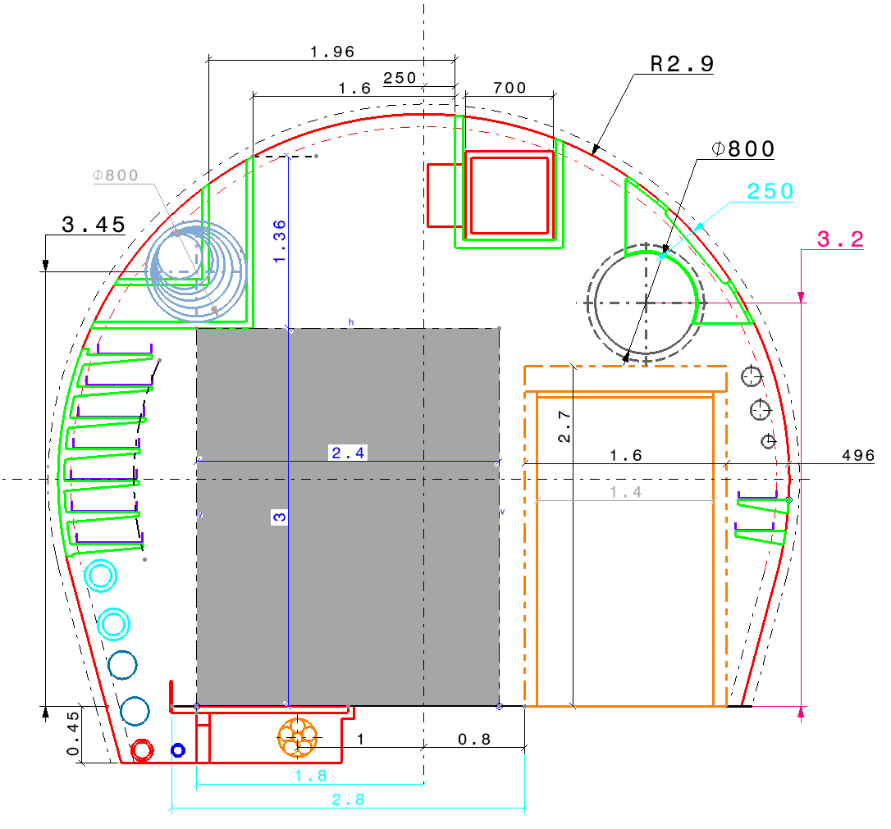
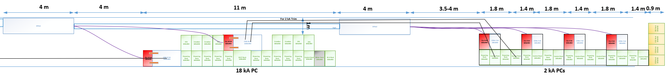
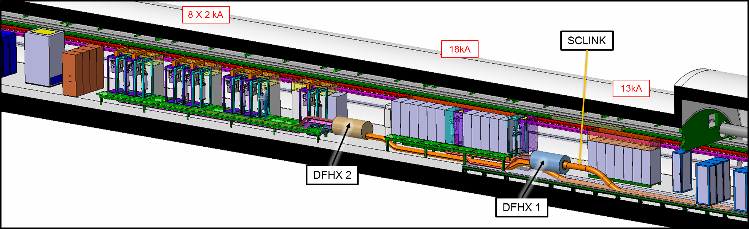
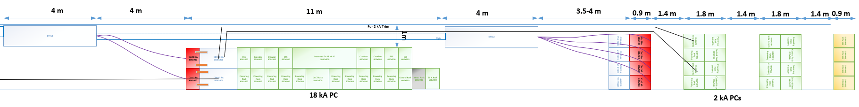
Specifications & design guidelines
Work in progress
Design objective:
  Ensure critical requirements
  Find a compromise between non critical requirements
Study:
  2 DFHx Units solution
  Boundary conditions:
    Power racks accessible from transport side
    Access to ESS, Crowbar racks from footbridge
    CL racks layout:
      1 for 2x18kA / 1 for 4x2kA type
    Integration : civil engineering
Courtesy S.Maridor
DFHx1
DFHx2
OptionA
Courtesy S. Yammine
Transport
DFHx1
DFHx2
Courtesy S.Maridor
Current leads racks
Discon. Box
PC racks
Service racks
OptionB
Transport
Courtesy S. Yammine

Slide 4
Specifications & design guidelines
Work in progress
 | Option A | Option B
Energy recuperation | Recuperate all magnet energy for 18 kA | Partial dissipation in warm cables (longer cables)
Warm connections | Length minimised (bus-bars or WCCs) | Use of WCCs (even though significantly reduced with baseline)
HTS cable length | Several lengths from 6 to 14 m. Needs further development to reach 14 m. | One length of ≈ 6 m.
Services integration (HTS flexibles, water& power lines) | Crossing at ground level Nested integration | Independent routing and access
Installation | Mixed sequence CL-PC | Independent CL-PC assembly sequcence
Access for maintenance on current leads | Difficult access with lifting tool Difficult replacement operation | Access from transport side Flexible extraction through transport paths
CL assembly spares: | 6 types: 2 x 18 kA [6m ; 10m] 4 x 2 kA [6m,10m,12m,14m] | 2 types: 1 x 18kA, about 6m long HTS cable 1 x 2kA, about 6m long HTS cable
DFHx1
DFHx2
OptionA
Courtesy S. Yammine
Transport
DFHx1
DFHx2
Current leads racks
Discon. Box
PC racks
Service racks
OptionB
Transport
Courtesy S. Yammine

