Slide 1

WIT Talk with
Pippa Wells interviewed by
Coralie Neubuser

Slide 2
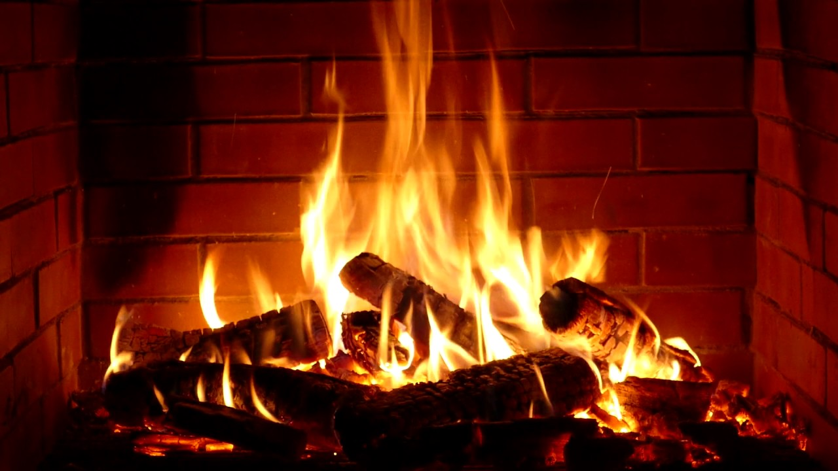

Slide 3
For news on upcoming events
Check Indico for all the details
  https://indico.cern.ch/category/8115
  next:
  WIT (CHRISTMAS) Drinks
  in CERN Data Center **11.12.** 5.30pm

Slide 4

CREDITS
Special thanks to all the people who made and released these awesome resources for free:
Presentation template by SlidesCarnival
Photographs by Death to the Stock Photo (license)

