Slide 1
Outcome of the bench impedance measurements on the LHC CFC collimator
F. Giordano, N. Biancacci, L. Teofili
Many thanks to: P. Arpaia, S. Antipov, I. Lamas Garcia, B. Salvant and TE-VSC collegues.

Slide 2
Outline
Brief introduction with results
Measurement setup
Data post-processing
Comparison with IW2D
Quick look at Mo on MoGr

Slide 3
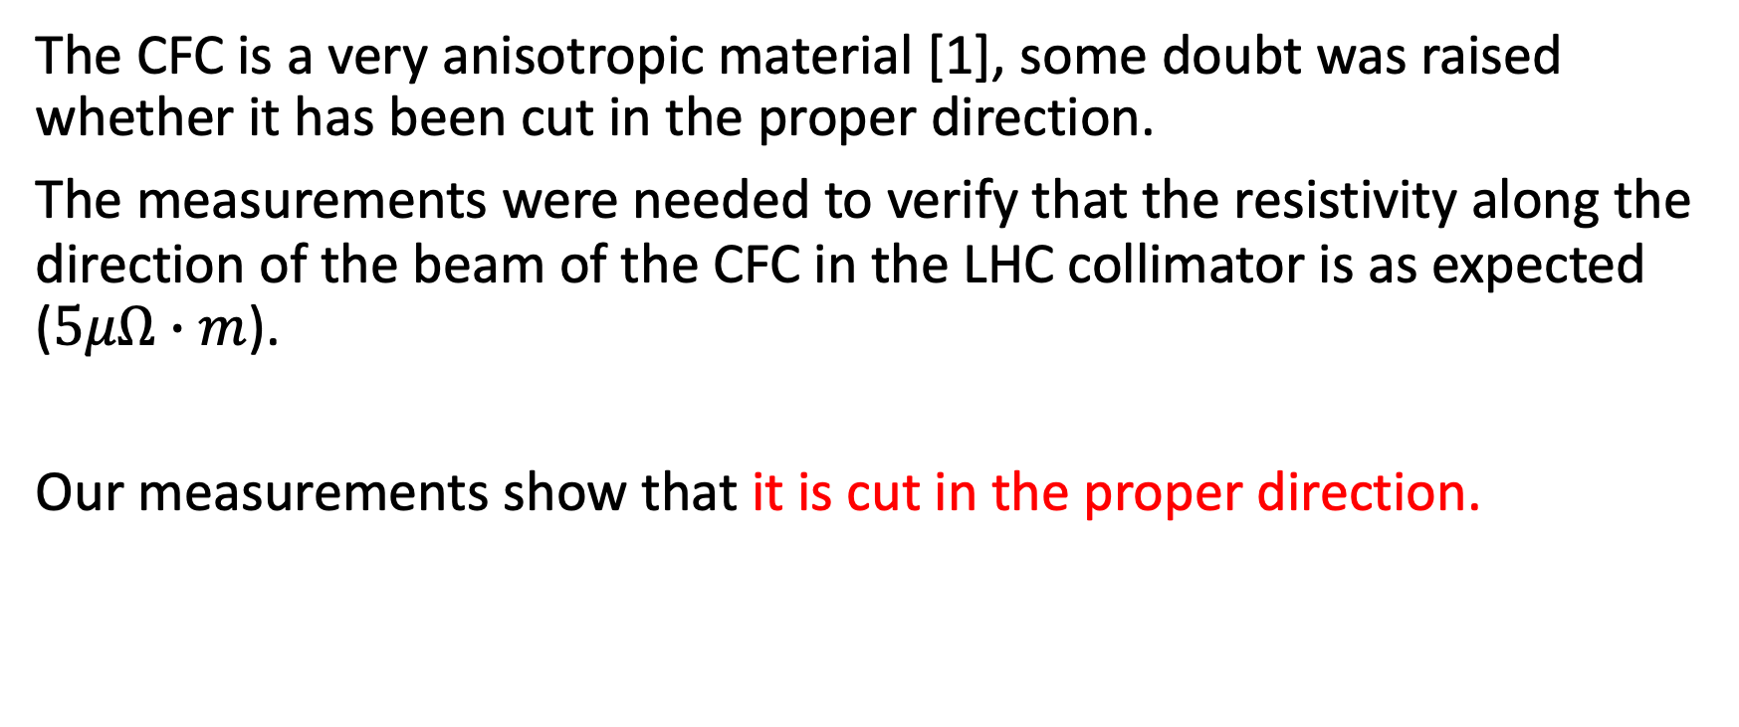
Why have we measured it?
The CFC is a very anisotropic material [1], some doubt was raised whether it has been cut in the proper direction.
The measurements were needed to verify that the resistivity along the direction of the beam of the CFC in the LHC collimator is as expected ($5﻿μΩ∙m$).
Our measurements show that it is cut in the proper direction.
[1]:MoGr and CFC: influence of the orientation on the electrical conductivity. F. Carra, A. Bertarelli, J. Guardia
125th HiLumi WP2 Meeting

Slide 4
Measurement setup: Resonant method [2]
The wire has been cleaned with ethanol and handled with gloves in order to not
contaminate the collimator.
Slow and careful installation without touching the jaw of the TCS.
A wire has been installed inside a spare TCS. It has been welded on one side and linked to a weight (4kg) on the other side in order to minimize the sag of the wire.
Two capacitors have been added at the extremity of the wire to create a resonant structure.
A VNA has been used to measure the S11, S12 and S22 inside the TCS.
The value of the capacity has been empirically chosen in order to better observe the resonance in the structure
[2]:Longitudinal and Transverse Wire Measurements for the Evaluation of Impedance Reduction Measures on the MKE Extraction Kickers. T. Kroyer, F. Caspers, E. Gaxiola
Check wich TCS is

Slide 5
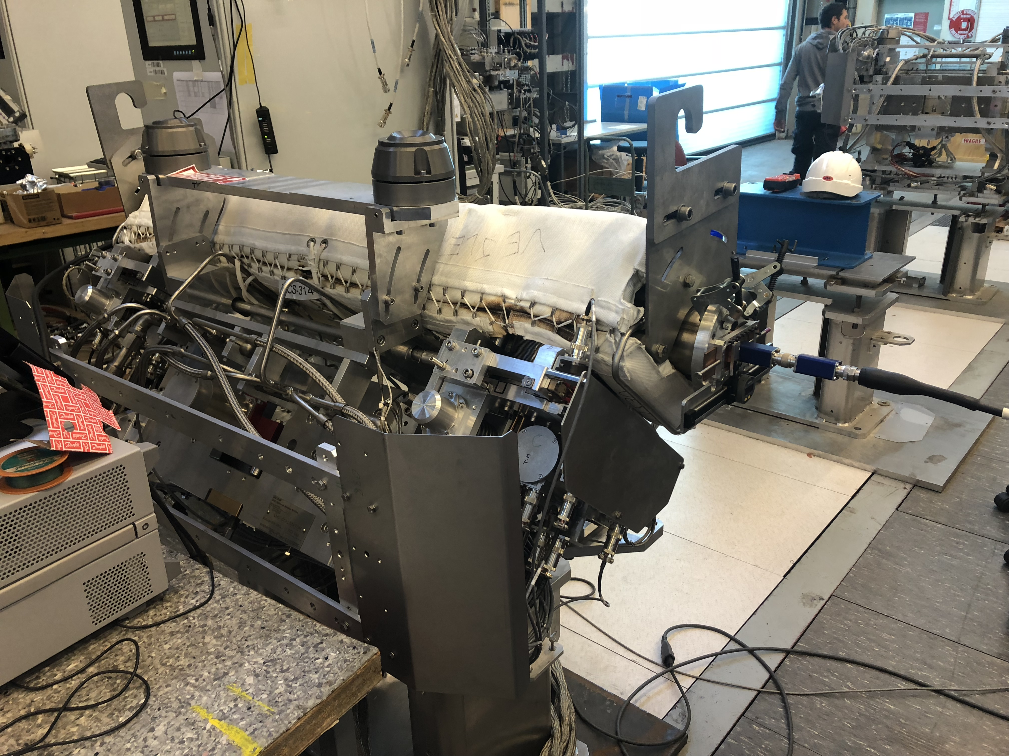
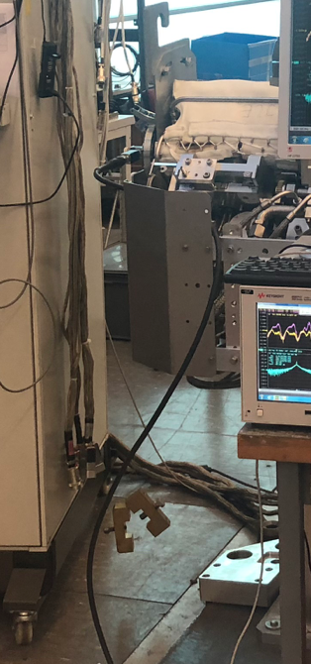
Measurement setup
TCS
Capacitor
Capacitor
4kg
VNA
4kg weight

Slide 6
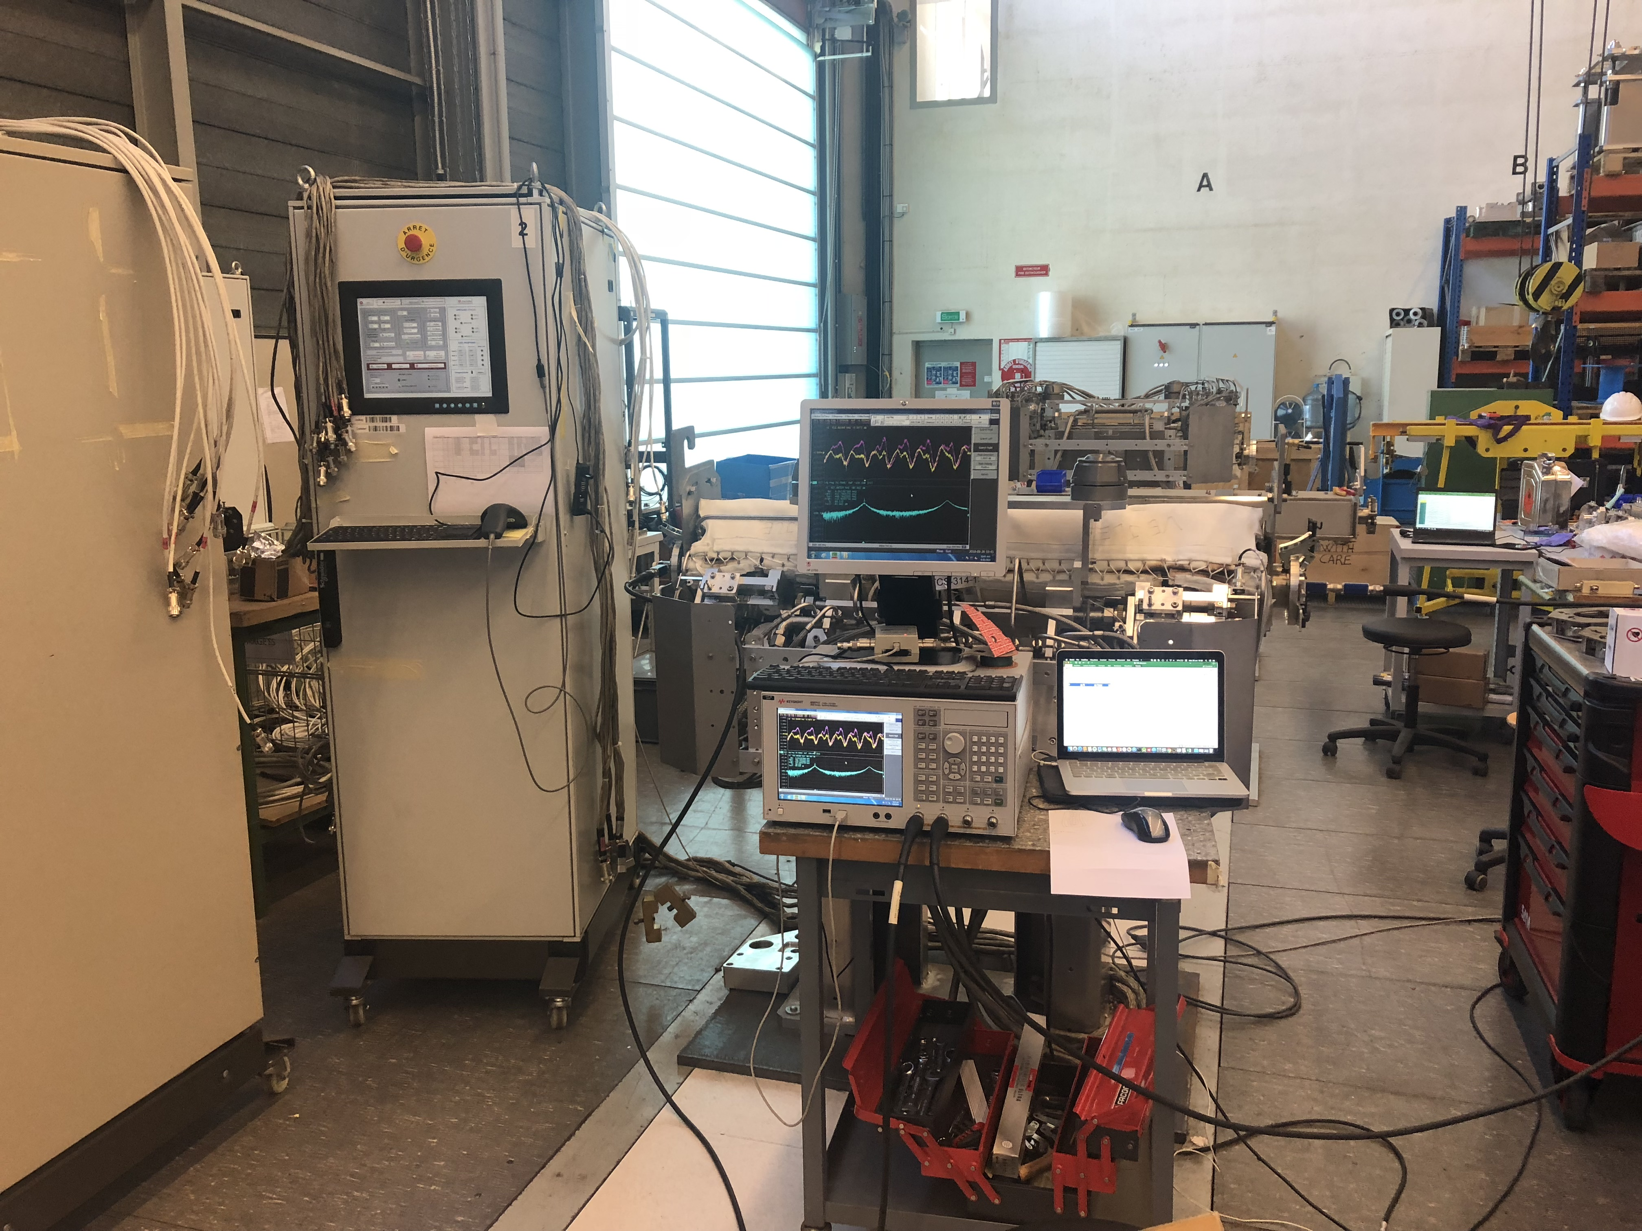
Measurement setup
The jaws of the collimator have been moved with micrometric precision by a remote controller

Slide 7
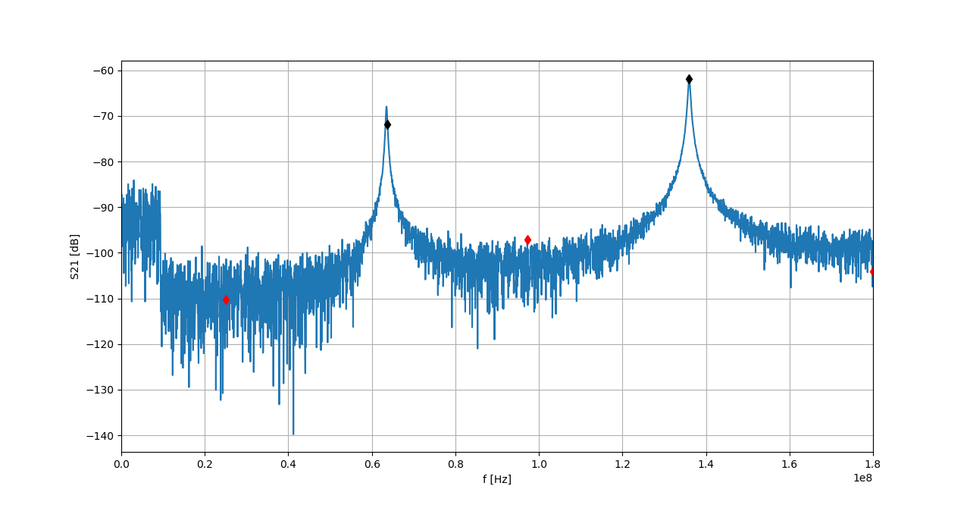
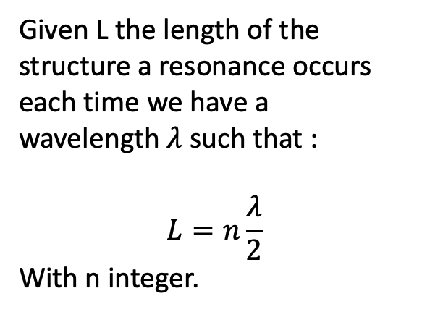
Measured data
Span from 0 to 1.8GHz with a step of 180 MHz
Given L the length of the structure a resonance occurs each time we have a wavelength $λ$ such that :
$$L=n\frac{λ}{2}$$
With n integer.
The Q factor of each resonance peak has been computed

Slide 8
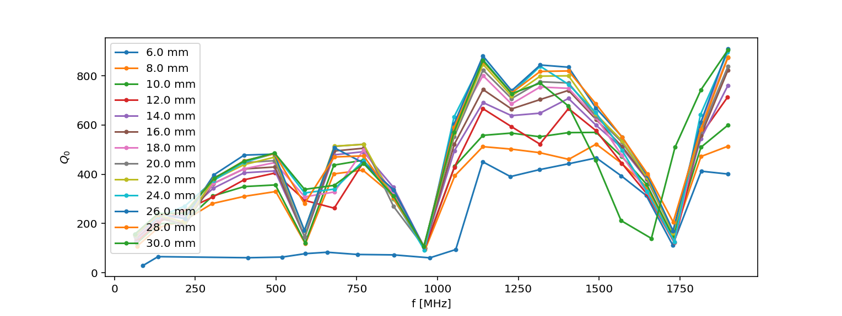

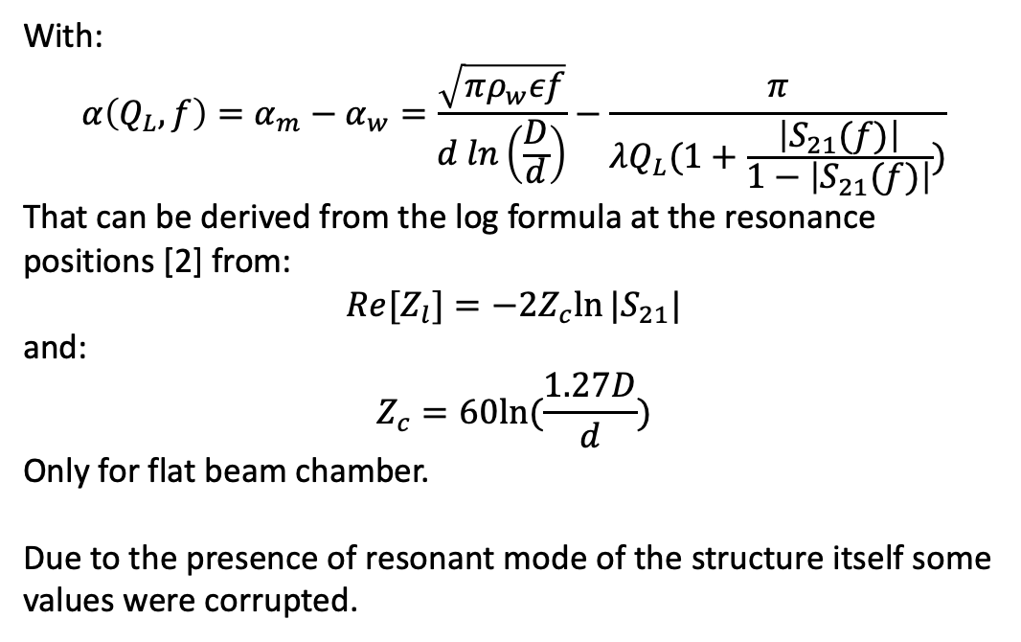
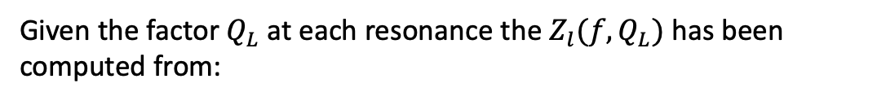
Data post-processing
Given the factor $Q_{L}$ at each resonance the $Z_{l}(f,Q_{L})$ has been computed from:
$Re\left[Z_{l}(Q_{L},f)\right]=2α\left(Q_{L},f\right)Z_{c}$
With:
$$α\left(Q_{L},f\right)=α_{m}−α_{w}=\frac{\sqrt{πρ_{w}εf}}{d ln\left(\frac{D}{d}\right)}−\frac{π}{λQ_{L}(1+\frac{\left|S_{21}(f)\right|}{1−\left|S_{21}(f)\right|})}$$
That can be derived from the log formula at the resonance positions [2] from:
$$Re[Z_{l}]=−2Z_{c}ln⁡|S_{21}|$$
and:
$$Z_{c}=60ln⁡(\frac{1.27D}{d})$$
Only for flat beam chamber.
Due to the presence of resonant mode of the structure itself some values were corrupted.
[2]:Longitudinal and Transverse Wire Measurements for the Evaluation of Impedance Reduction Measures on the MKE Extraction Kickers. T. Kroyer, F. Caspers, E. Gaxiola

Slide 9
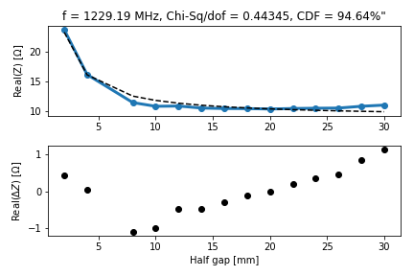
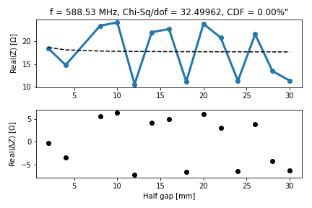
Data post-processing
To check which value were good and which not the scaling of the impedance with the gap has been analysed:
Good scaling: 1/gap
Bad scaling
Half gap [mm]
Half gap [mm]

Slide 10
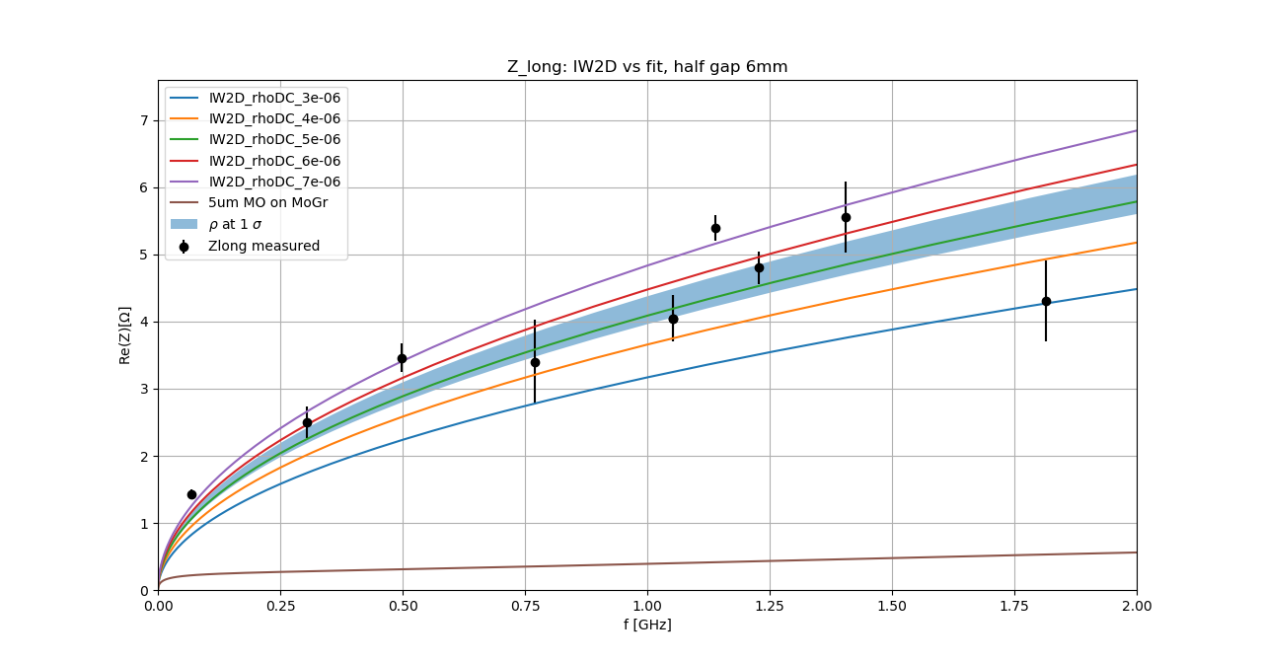
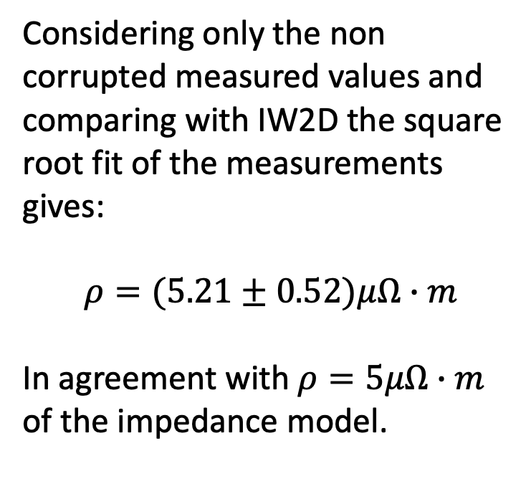
Comparison with IW2D
Considering only the non corrupted measured values and comparing with IW2D the square root fit of the measurements gives:
$$ρ=(5.21±0.52)﻿μΩ∙m$$
In agreement with $ρ=5﻿μΩ∙m$ of the impedance model.

Slide 11
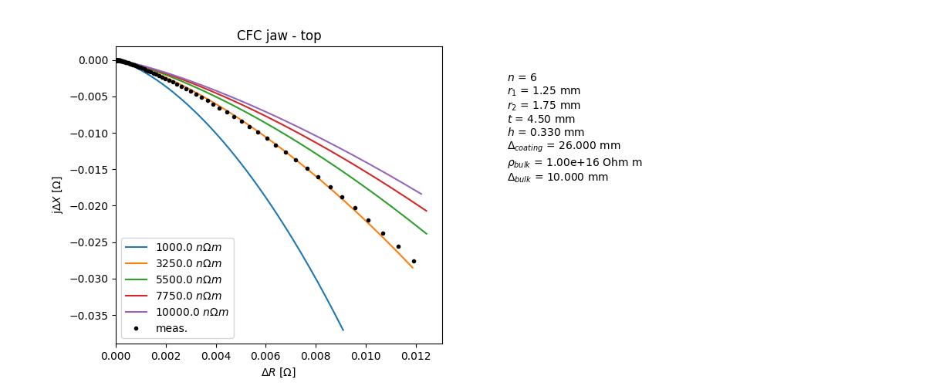
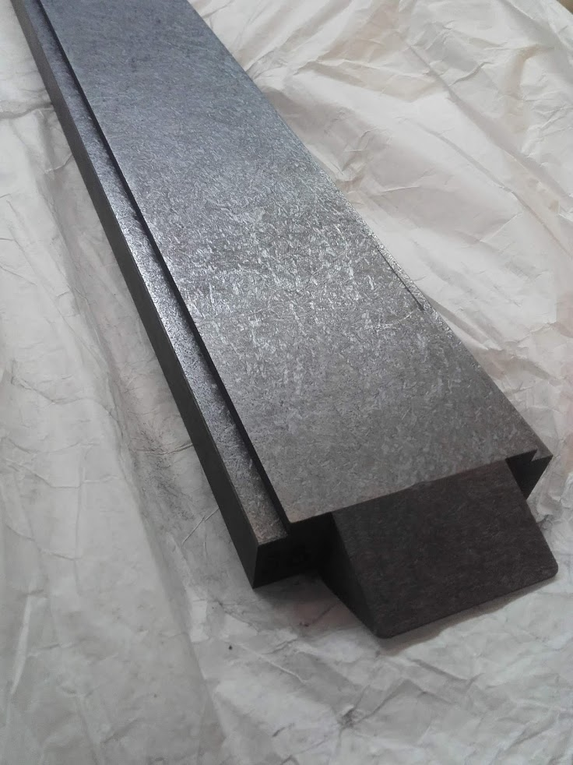
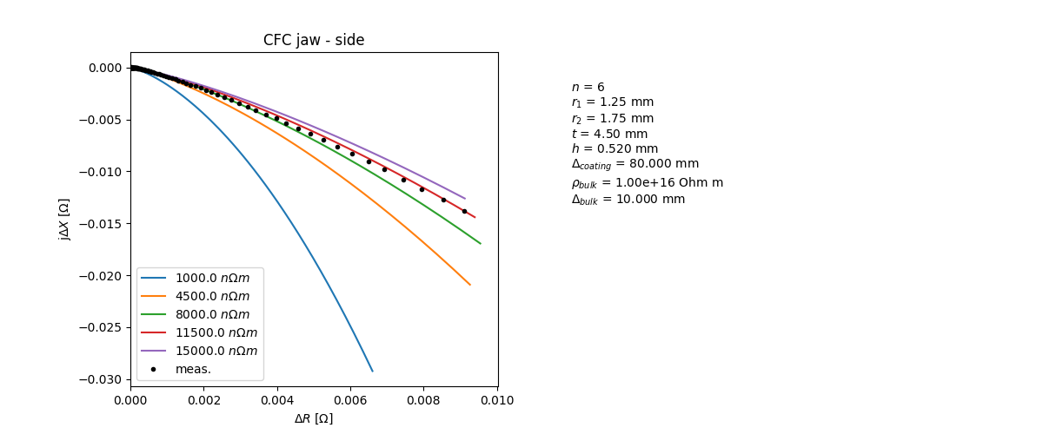
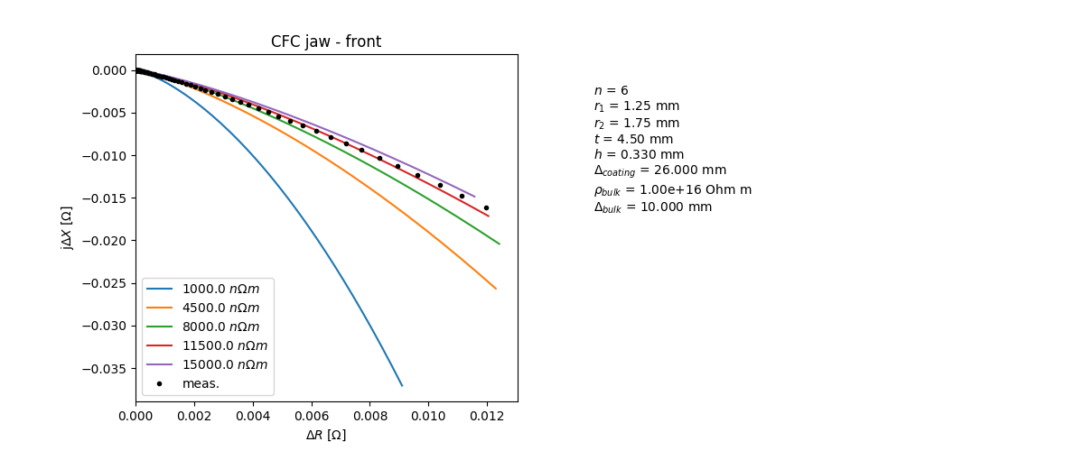
Eddy current measurement on naked CFC jaw:
top
side
front
The resistivity of the CFC has been measured on the top, front and side of a naked jaw.
N. Biancacci

Slide 12
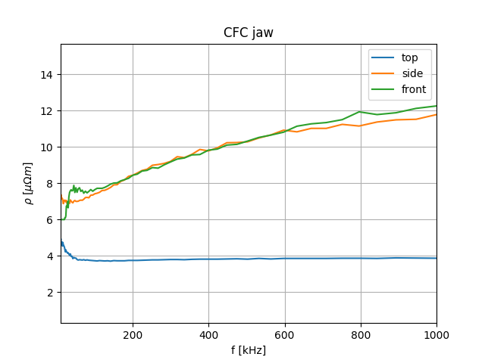
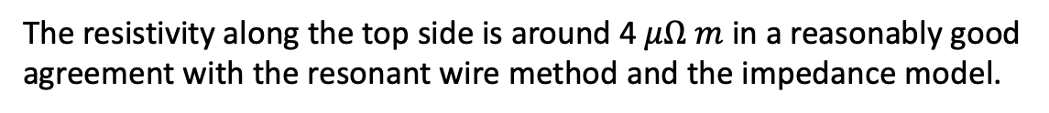
Eddy current measurement on naked CFC jaw:
top
side
The resistivity along the top side is around 4 $μΩ m$ in a reasonably good agreement with the resonant wire method and the impedance model.
front
N. Biancacci

Slide 13
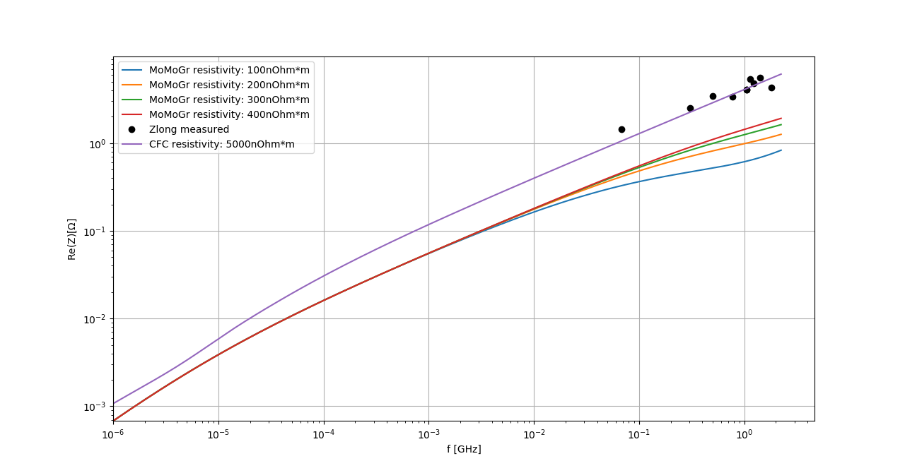
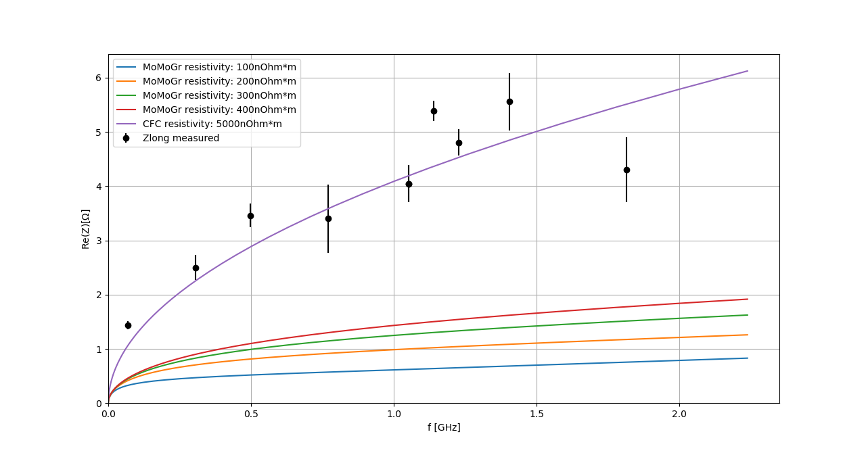

Can we apply the same method to measure the MoMoGr?
Log scale
Linear scale
$$ρ=(5.21±0.52)﻿μΩ∙m$$
Depending on the resistivity of the Mo on MoGr the method has to be applied within the accuracy limit.

Slide 14
Conclusions
Both the resonant wire method and the eddy current one show that the CFC installed in the TCS is cut in the proper direction.
The Mo on MoGr has a factor 10 of improvement w.r.t. the CFC.
In order to get a good measurement of the Mo on MoGr resistivity the resonant method can be applied within the accuracy limit.

Slide 15
Thank you for the attention!

Slide 16
Back up slides

Slide 17
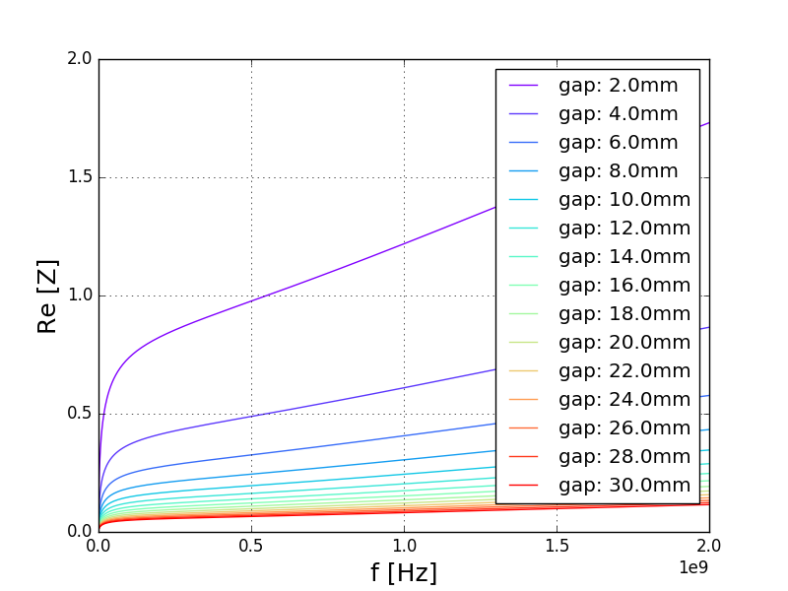
Mo on MoGr

Slide 18
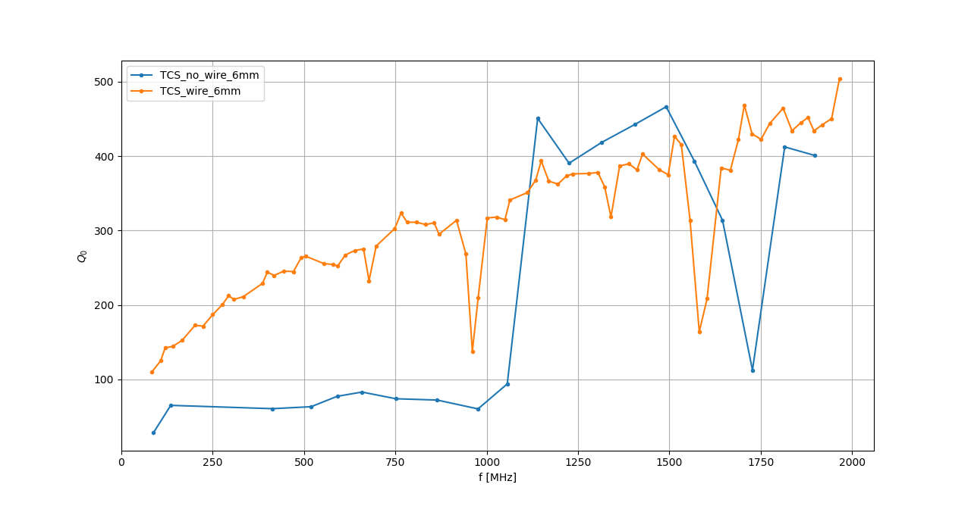
Q_no_wire vs Q_wire

