Slide 1


Effect of the actual taper geometry on the collimator impedance and octupole thresholds of LHC and HL-LHC
E. Carideo, S. Antipov, N. Biancacci, B. Salvant

Slide 2
Estimate the impact of the actual geometric impedance on the overall impedance model and octupole current of LHC and HL-LHC
Outline
  Compare the Theory with the results of the CST simulation
  Impedance model : LHC and HL-LHC
  Results of comparing geometrical impedance with total impedance for LHC and HL-LHC
  Octupole current contribution of all collimators
  Conclusion and Future work
27/11/18
2

Slide 3
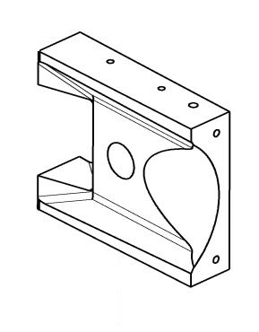
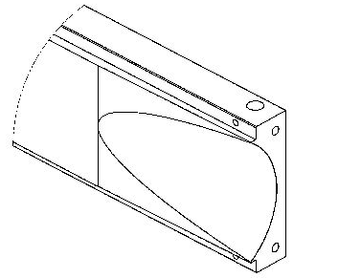
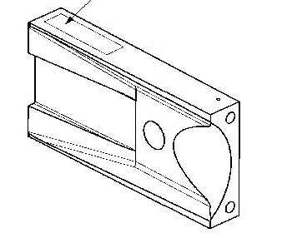
Three taper geometries in LHC and HL-LHC
Name | Angle [degree] | Length[mm]
TCS | 11,6° | 97
TCSP | 16,0° 16,5° | 37 27
TCSPM | 16,5° 5° | 36 80
TCS
TCSP
TCSPM
27/11/18
3

Slide 4
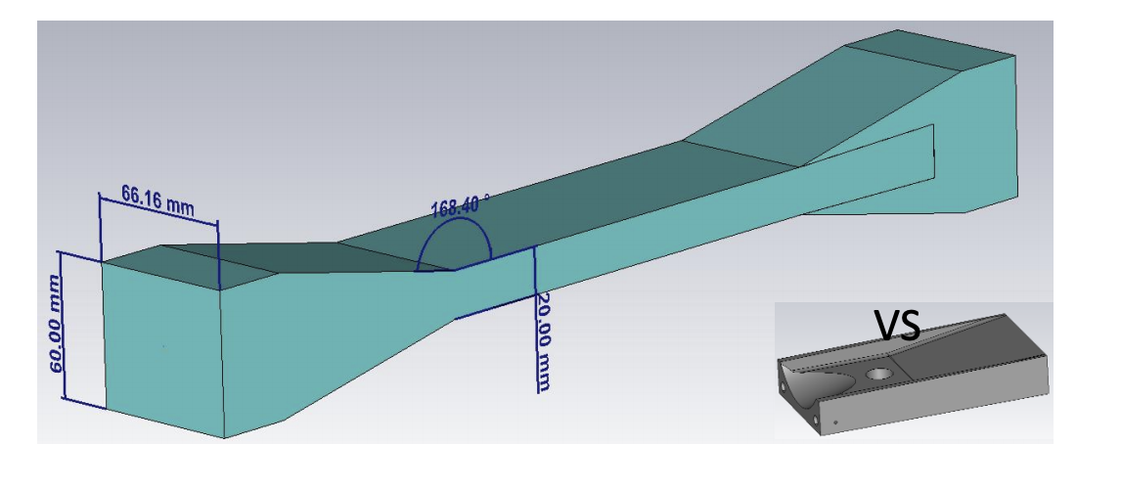
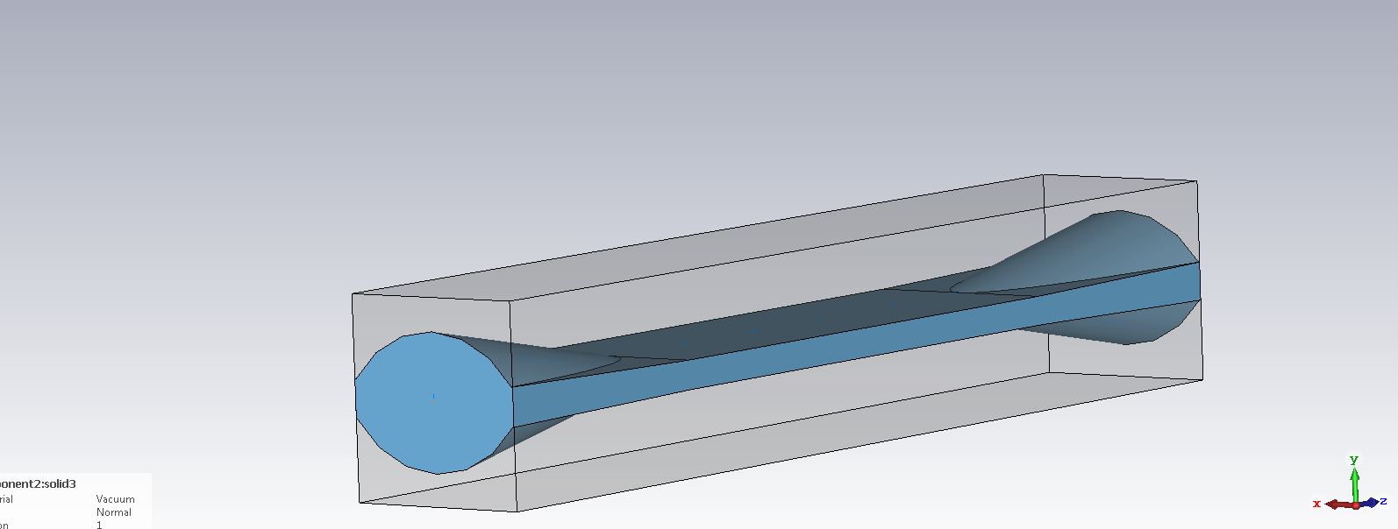
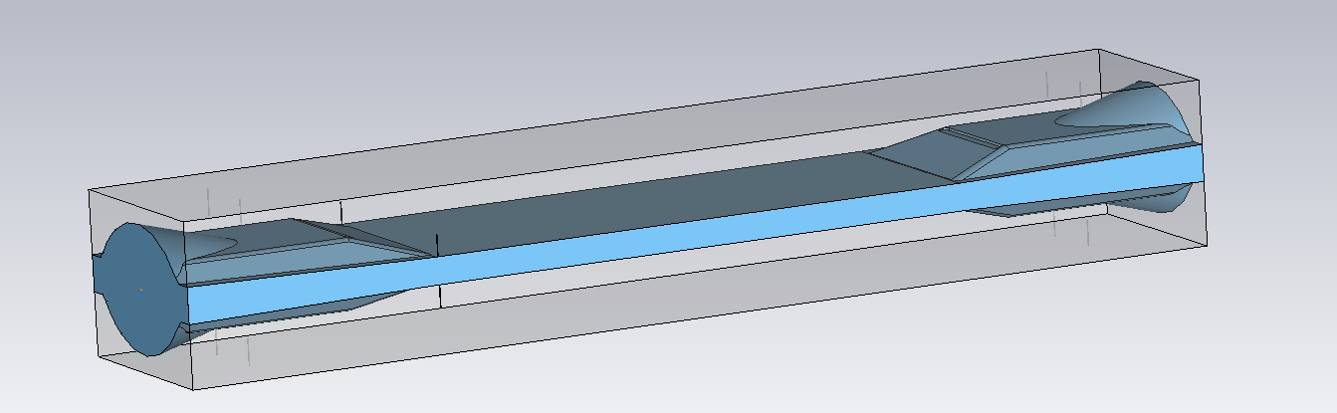
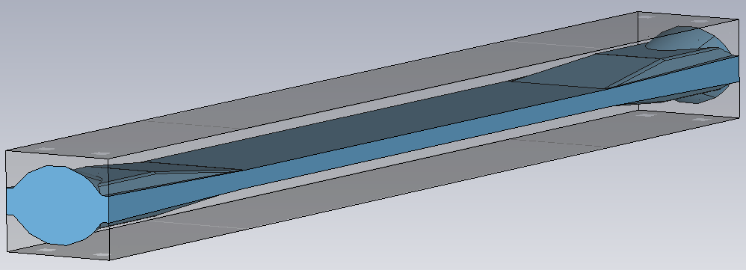
Model of CST software
Flat Model
TCS Model
TCSP Model
TCSPM Model
27/11/18
4

Slide 5
These are all frequencies for the transition angles by taper.
For all geometry the impedance is flat with the frequency, as expected.
Zoom-in
27/11/18
5

Slide 6
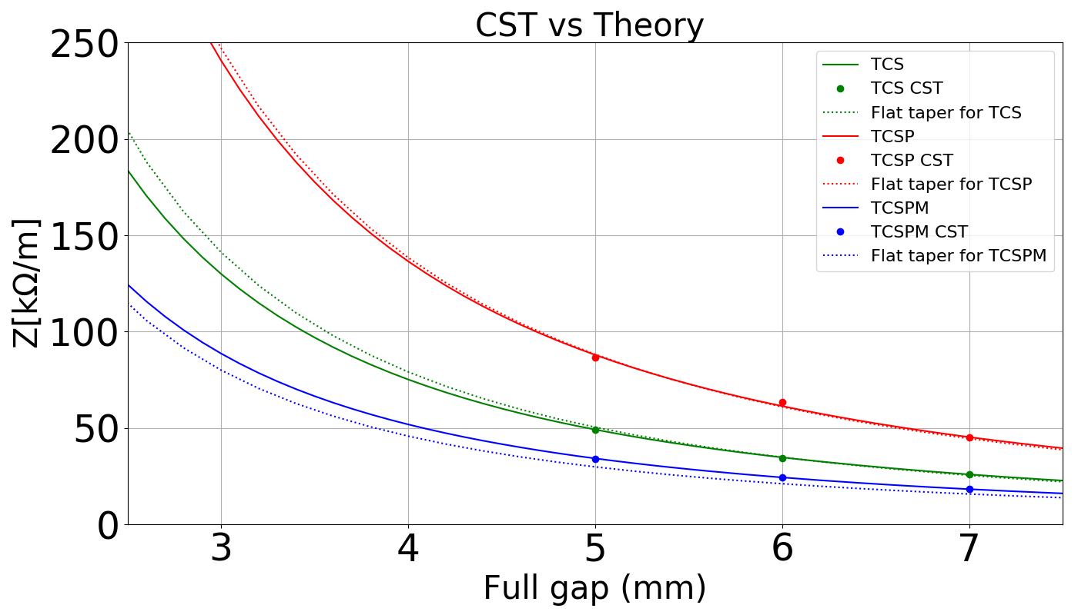
The flat taper theory agrees with the CST simulation
The transverse impedance has been plotted at the full gap of the collimator using a frequency average.
The plot compared the simulation results of three taper geometries (TCS, TCSP, TCSPM) with the flat taper theory.
27/11/18
6

Slide 7
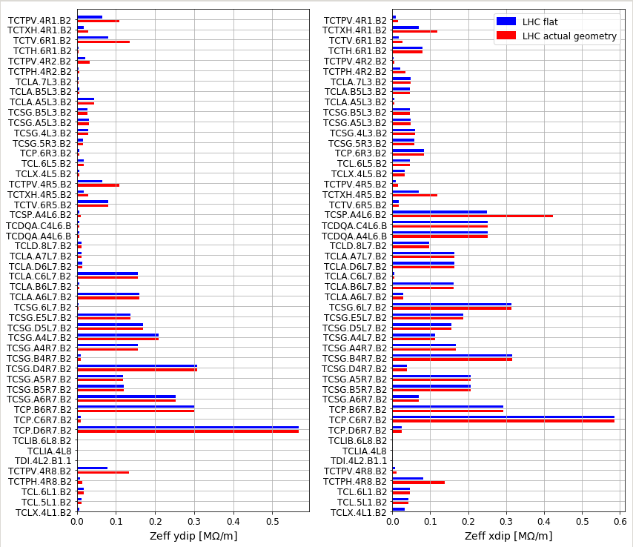
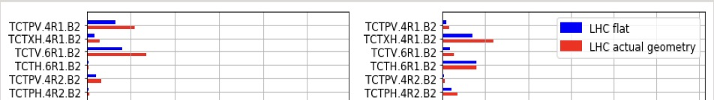
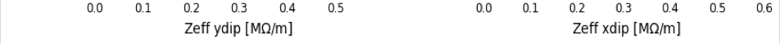
Impedance Model: Geometrical impedance of LHC
TCSP, TCTP, TCTW, TCTV and TCTH: Zeff * 1.7
We have LHC collimators but with HL-LHC beam parameters and collimation settings.
27/11/18
7

Slide 8
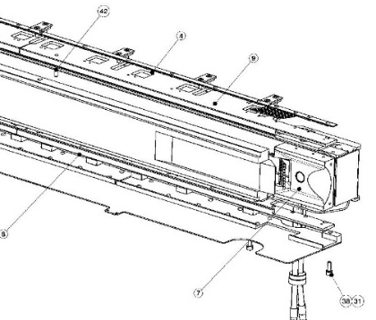
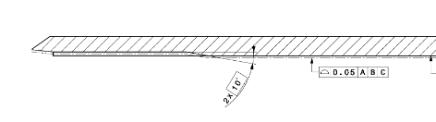
TCP.C6R7 doesn’t change because the primary collimators have a transition in the jaw. It is the major contributor to the geometrical impedance.
Taper of TCPP
Ztaper = 35,4 KOhm/m
Jaw :10°
5mm
Zjaw = 121,9 KOhm/m
27/11/18
8

Slide 9
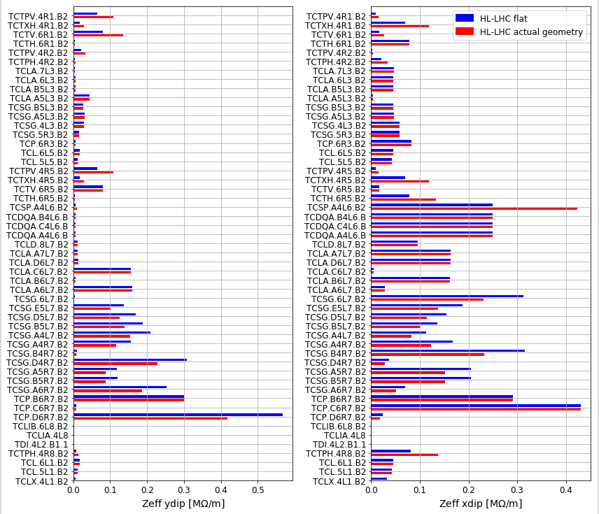
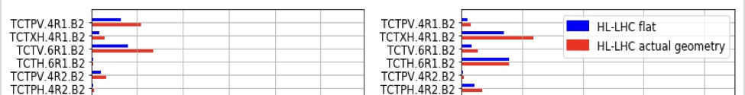
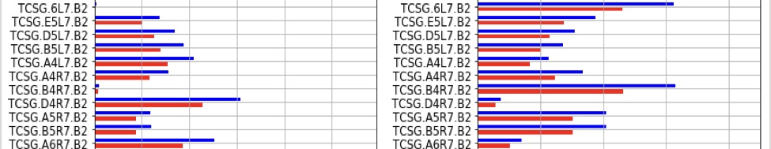
Impedance Model: Geometrical impedance of HL-LHC
The changes for LHC actual geometry
+
TCSG.IP7 and TCP.D6R7: Zeff/1.36
27/11/18
9

Slide 10

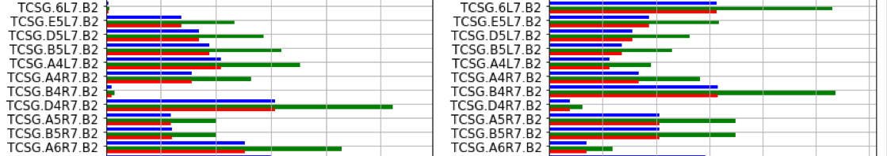
Impedance Model: Geometrical impedance of HL-LHC with old taper (TCSP)
For the green line I have multiplied TCSG.IR7 by 1.7
27/11/18
10

Slide 11
Results of Impedance model
Model | LHC | HL-LHC | HL-LHC with old taper
Total: x(y) | 29.97(24.80) MOhm/m | 16.41(14.38) MOhm/m | 16.41(14.38) MOhm/m
Geometrical impedance of flat taper | 4.94(3.33) MOhm/m | 5.45(3.45) MOhm/m | 5.45(3.45) MOhm/m
Geometrical impedance of actual geometry | 5.31(3.57) MOhm/m | 5.36(3.05)MOhm/m | 6.77(4.61) MOhm/m
Change of impedance | +1.23%(+0.97%) | -0.55%(-2.78%) | +8.04%(8.07%)
27/11/18
11

Slide 12
Octupole current approximately scales with imaginary impedance
We are looking at the most critical case - the BCMS beam
Current | Horizontal (A) | Vertical (A)
I_{oct} | 300 | 260
27/11/18
12

Slide 13
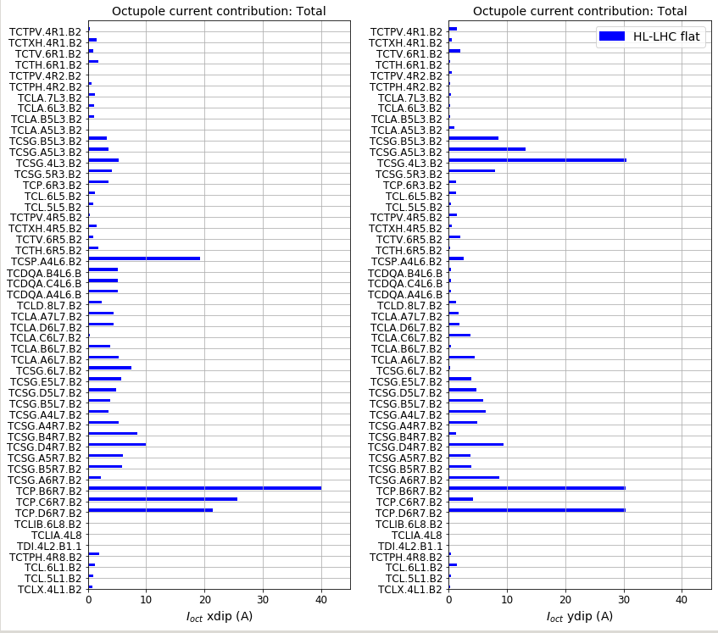
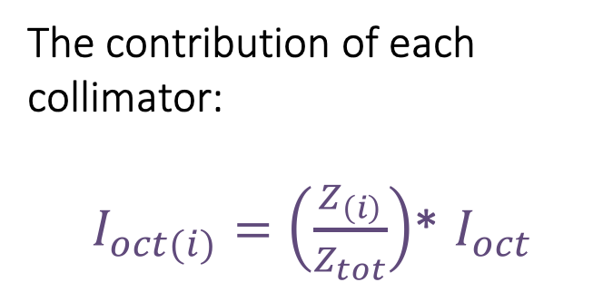
Impact on Octupole Current for the HL-LHC
The contribution of each collimator:
$I_{oct(i)}=\left(\frac{Z_{\left(i\right)}}{Z_{tot}}\right)$* $I_{oct}$
27/11/18
13

Slide 14
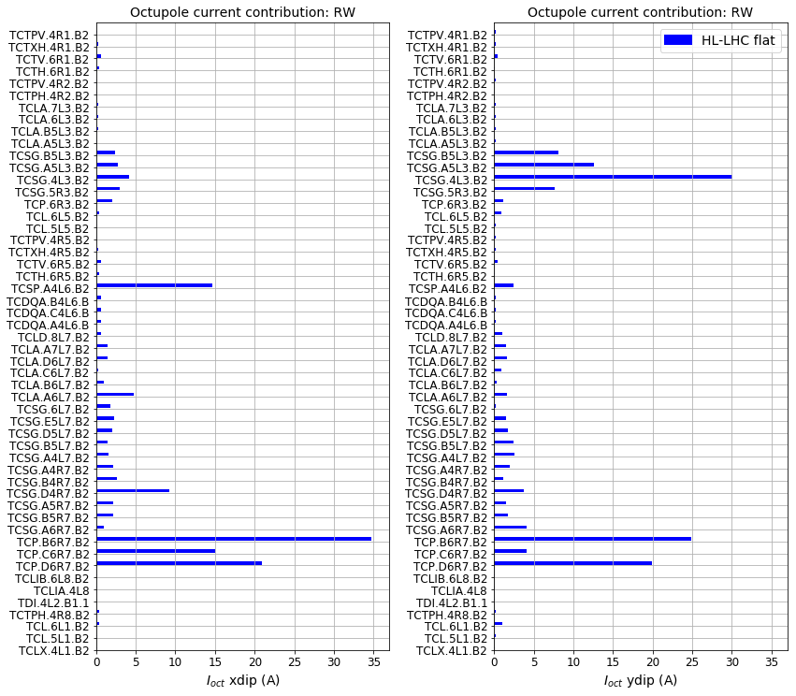
Impact on Octupole Current for the HL-LHC baseline
27/11/18
14

Slide 15
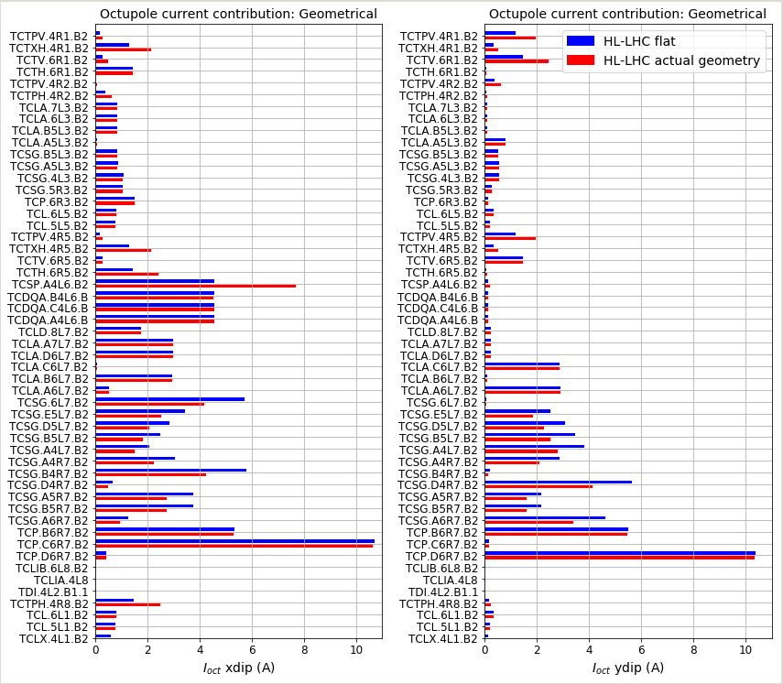
Impact on Octupole Current for the HL-LHC
HL-LHC actual geometry:
Current | Horizontal (A) | Vertical (A)
I_{oct} | 300*(-0.55%) | 260*(-2.78%)
27/11/18
15

Slide 16
Future work
Conclusion
  Study of the impact of taper geometry on our impedance budget
  The CST results are in good agreement with the flat taper model for every type of taper (TCS ,TCSP,TCSPM)
  Estimate the impact of the actual geometric impedance on the overall impedance model of LHC and HL- LHC
  For LHC we have an increase of 1.23% and for Hl-LHC a decrease of 0.55%
  Estimate the octupole current contribution for each collimator.
                Implement the impedance model
19/10/18
16
27/11/18
16

Slide 17
Thank for your attention!
27/11/18

Slide 18
Back-up slides
27/11/18

Slide 19
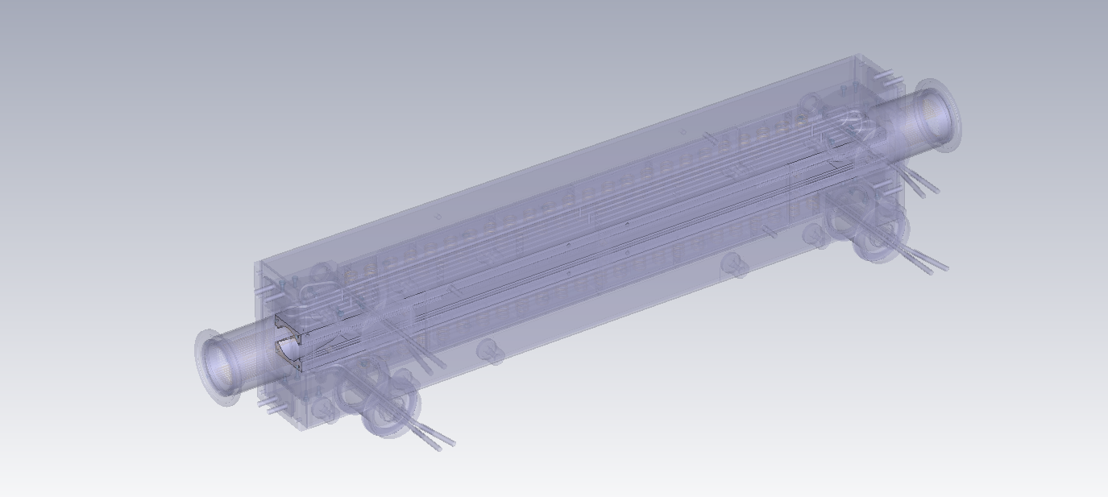
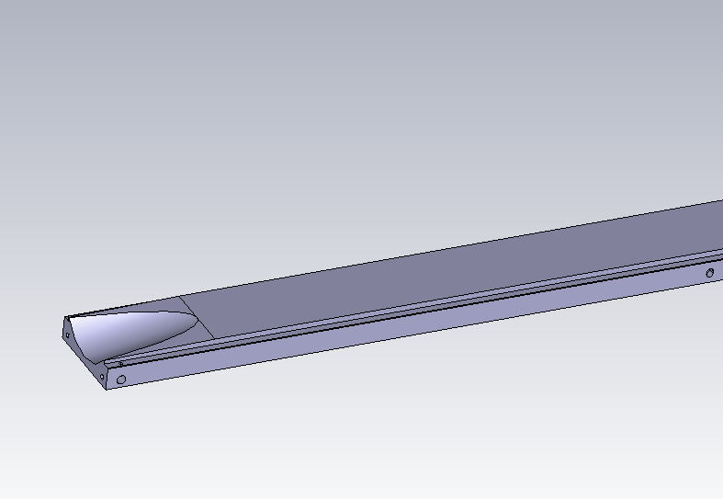
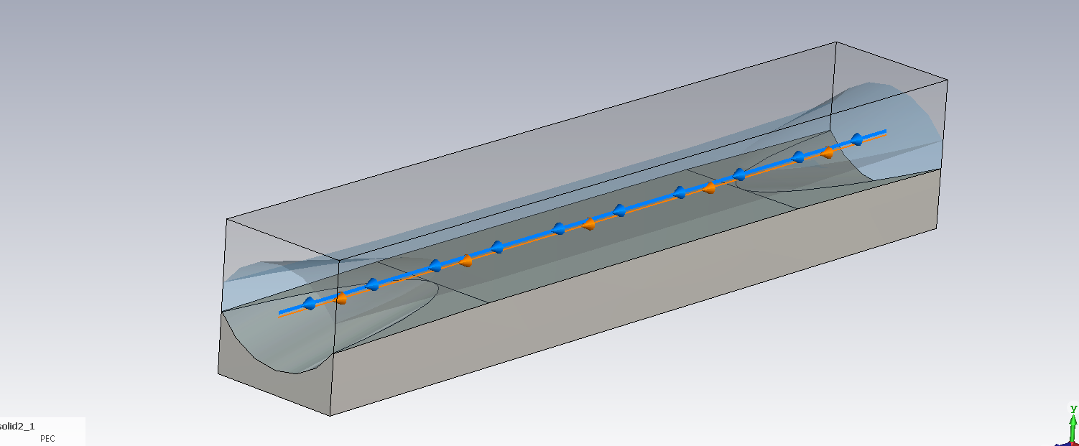
CST software: The TCS model
Simulation procedure:
Start from the collimator model of TCS
Extrapolate the taper
Clean the model
Add all parts of the model, suc as the jaws
Add the beam
Start to run the simulation
On the left a 3-D model of a TCS collimator in CST.
The taper model has been shown below.
On the left and on the right, the TCS vacuum model and its jaws have been shown, respectively.
27/11/18

Slide 20
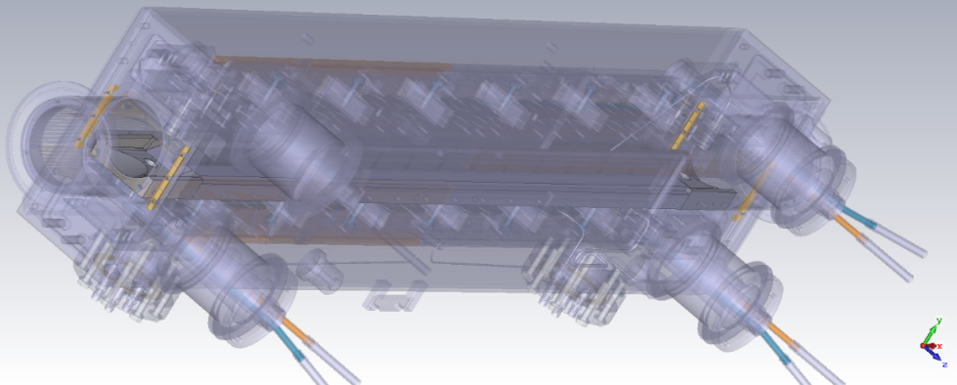
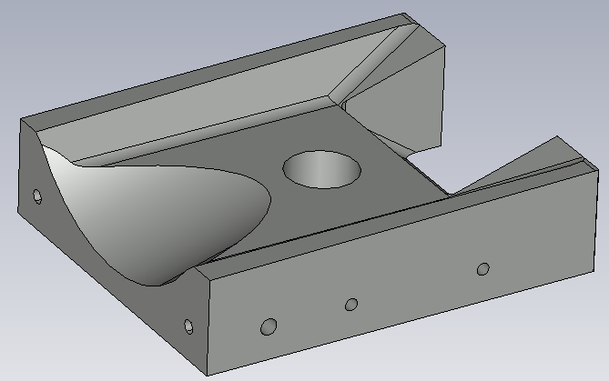
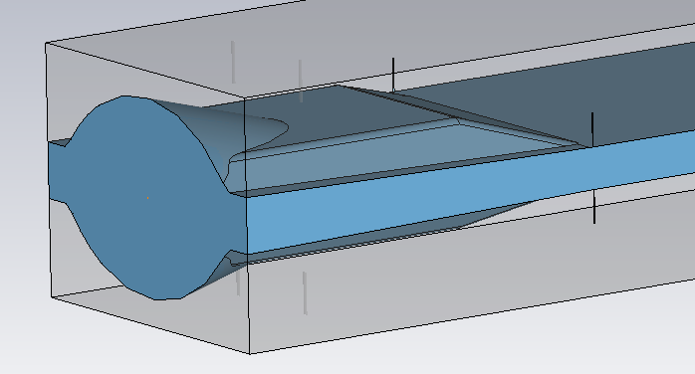
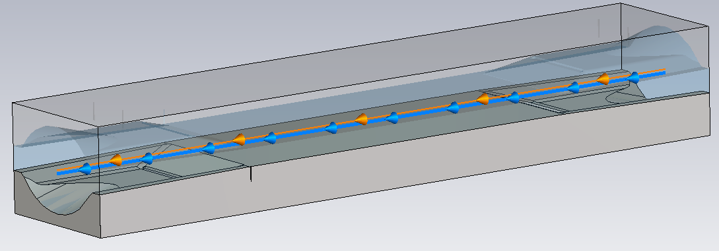
CST software: The TCSP model
On the left a 3-D model of a TCSP collimator in CST.
Below its taper model
For the TCSP model the simulation procedure is similar to the one for the TCS.
However, in this case we had to face the time-demanding procedure of removing several minor details.
On the right and on the left, the TCS vacuum model and its jaws have been shown, respectively.
Zoom-in of the CST simplified model of the taper
27/11/18

Slide 21
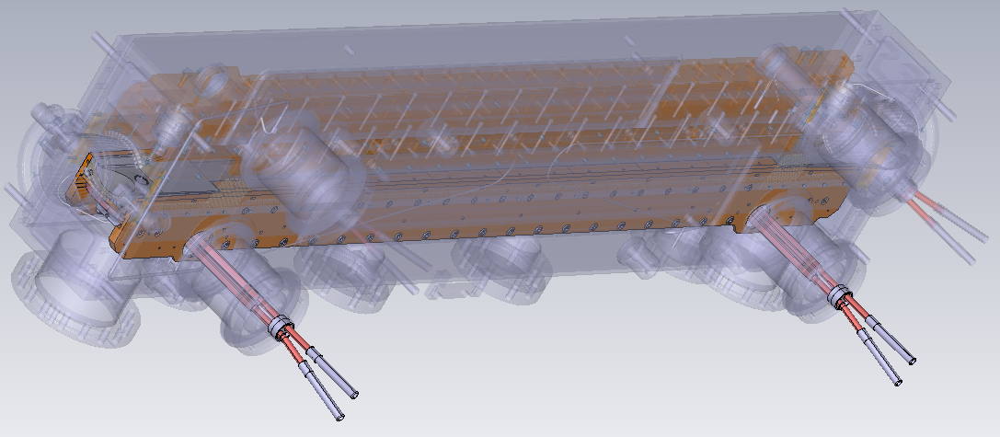
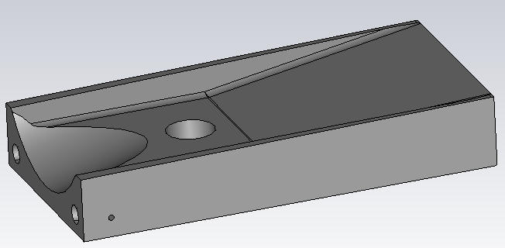
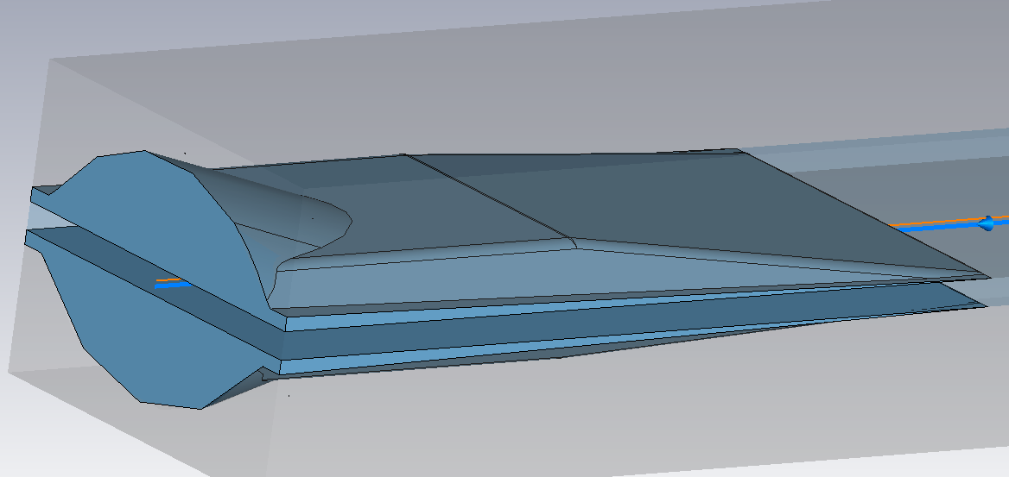
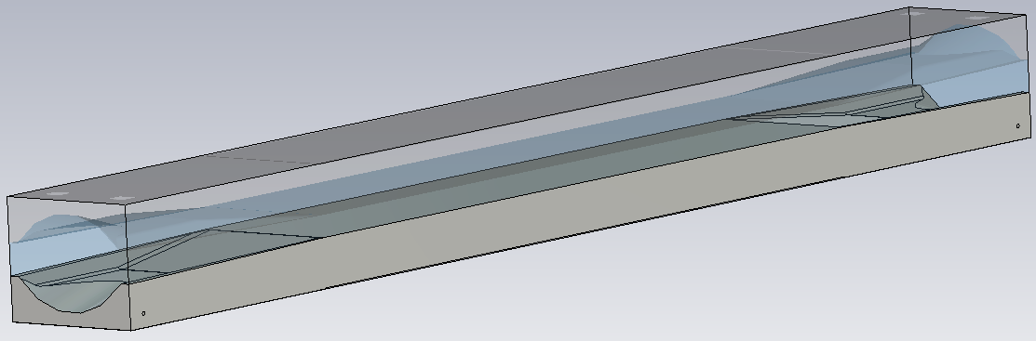
CST software: The TCSPM model
Same procedure as for the TCSP.
Moreover, the taper holes have been cleaned and filled and a simplified model has been created
On the left a 3-D model of a TCSPM collimator in CST.
Below a model of its taper
Below a zoom-in of the simplified taper model in CST.
On the right and on the left, the TCS vacuum model and its jaws have been shown, respectively.
27/11/18

Slide 22
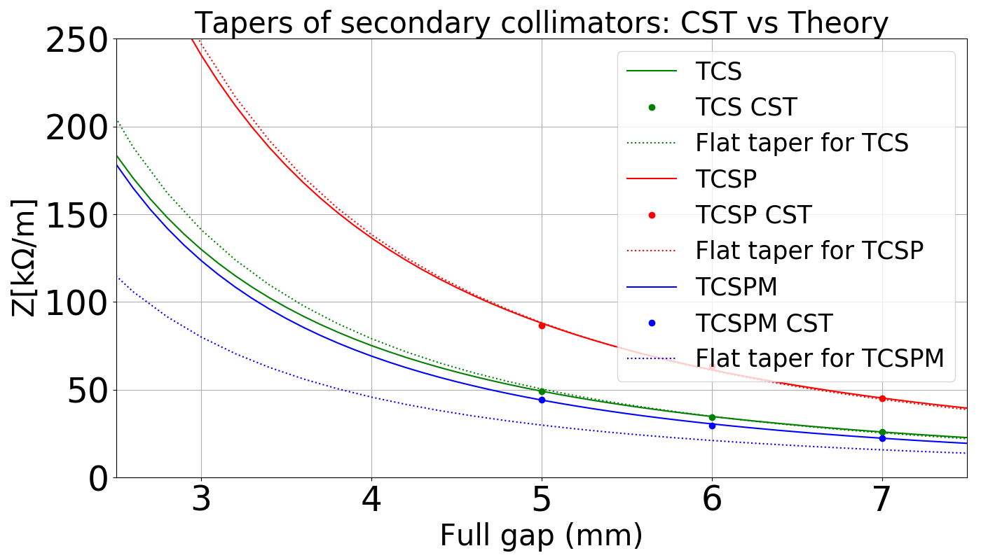
Compare the results of CST and flat Theory
There is a good agreement for theory with the TCSP and TCS but there is a factor of two for the TCSPM.
This discrepancy could be due to internal noise of CST software.
https://indico.cern.ch/event/721640/contributions/2966582/attachments/1636803/2611823/Presentation_EMANUELA_CARIDEO_.pdf
27/11/18

Slide 23
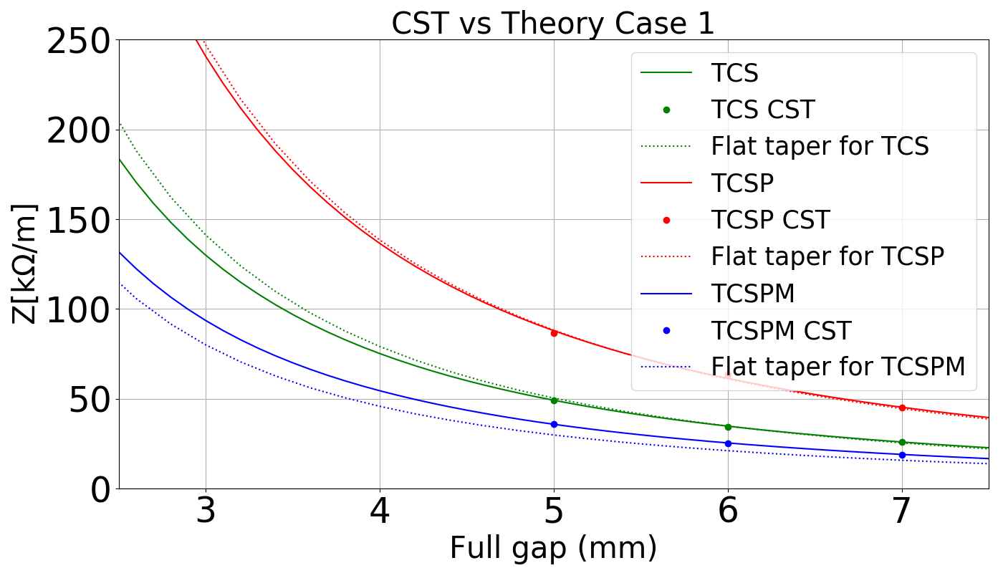
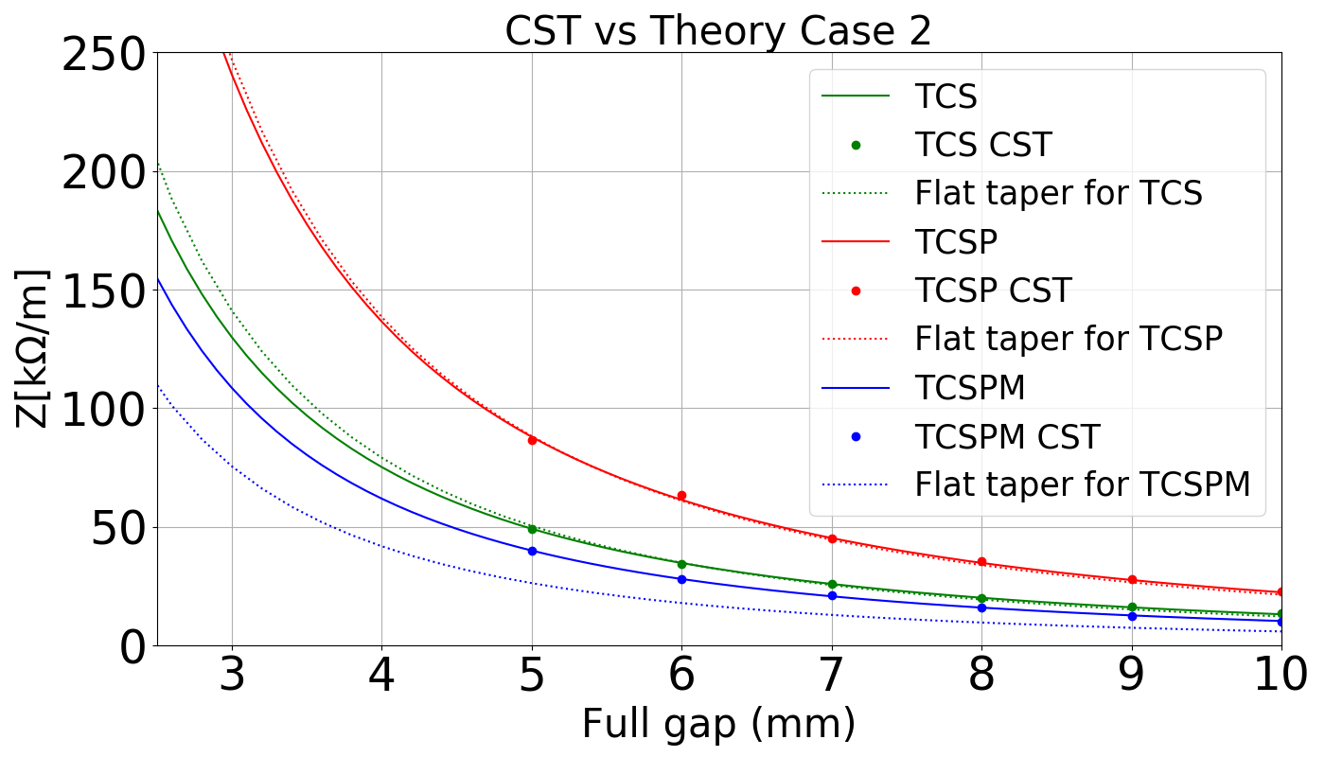
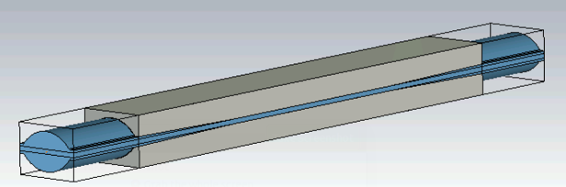
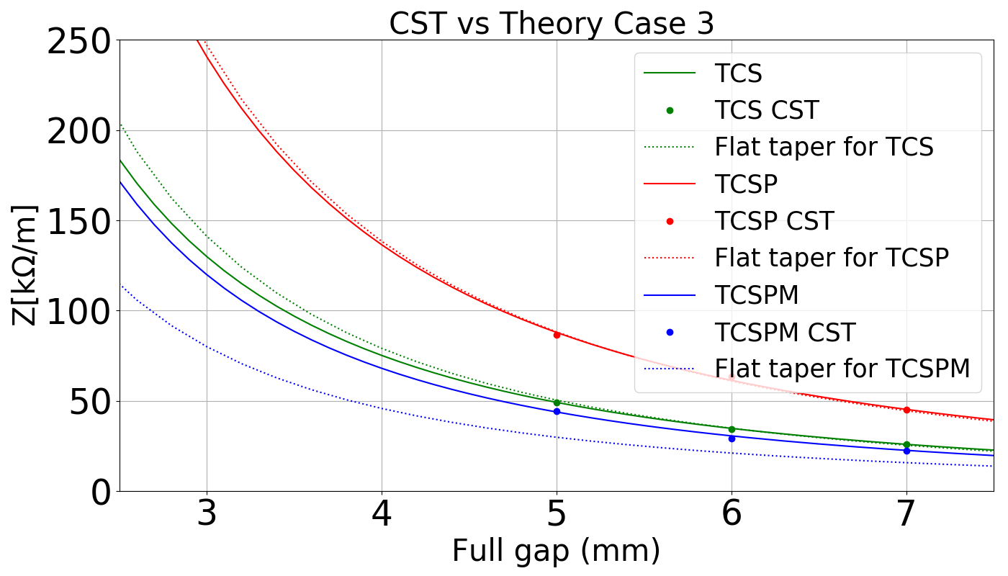
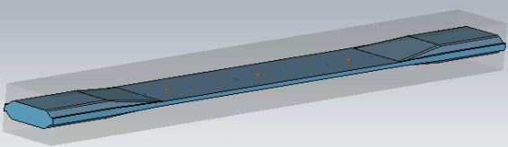
Modify the model in CST software to reduce the noise
Case 1 : Extrude the vacuum and reduce the frequency
Case 2: Cut the first angle and create flat taper
The best reduction of the distance between TCSPM CST and flat taper theory is in the Case 1
Case 3 : Reduce the range of frequency from [0.5-3.5] GHz to [0.5-1.7] GHz
27/11/18

Slide 24
Average of CST results for TCSPM: with 100 mm of vacuum and 200 mm of vacuum
27/11/18

Slide 25
Octupole thresholds for different coating scenarios
Coating / Op. Scenario |  |  | Ultimate Hor (Vert) | BCMS Hor (Vert) | Comment
Secondaries IR-7 |  | Primaries
CFC |  | CFC | 385 A (320 A) | 470 A (400 A) | “As is”
Mo+MoGr |  | CFC | 265 A (230 A) | 330 A (280 A) | Based on expected bulk conductivity of Mo
Mo+MoGr (Meas.) |  | CFC | 285 A (240 A) | 355 A (295 A) | Worst possible case for Mo coating
Mo+MoGr |  | 2 in MoGr 2 in CFC | 240 A (210 A) | 300 A (260 A) | Upgrading the 2 TCPs, that are approved at the moment
Mo+MoGr |  | MoGr | 230 A (195 A) | 280 A (245 A)
Partial coating of IR-7 | Option 1 | CFC | 320 A (275 A) | 395 A (340 A) | Picking the highest contributors in both planes
 | Option 2 | CFC | 315 A (295 A) | 390 A (365 A) | Avoiding the most exposed to steady losses
 | Option 3 | CFC | 350 A (280 A) | 435 A (350 A) | Avoiding hor. and vert. for protection reasons
 | Option 4 | CFC | 320 A (275 A) | 400 A (340 A) | Optimizing protection at the top energy
27/11/18

Slide 26
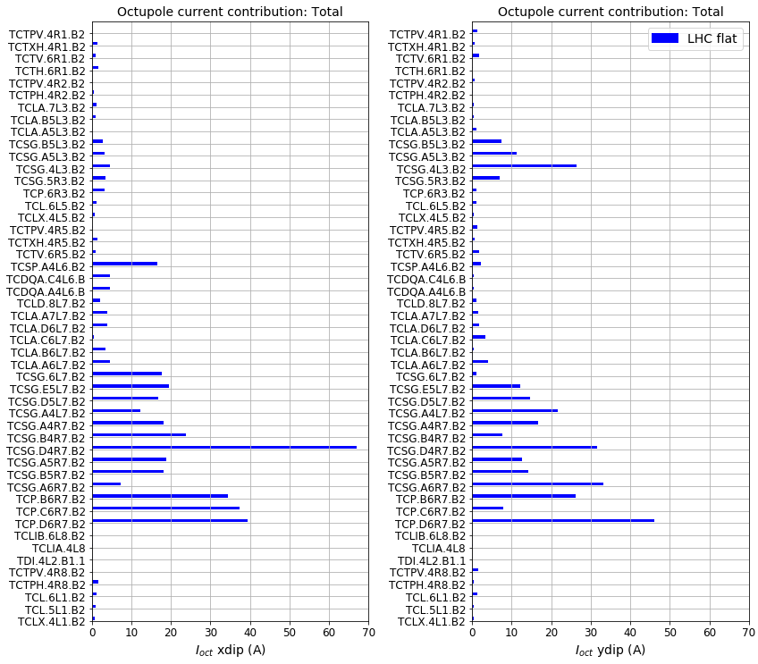

Impact on Octupole Current for the LHC
Current | Horizontal (A) | Vertical (A)
I_{oct} | 470 | 400
The contribution of each collimator:
$I_{oct(i)}=\left(\frac{Z_{\left(i\right)}}{Z_{tot}}\right)$* $I_{oct}$
27/11/18

Slide 27
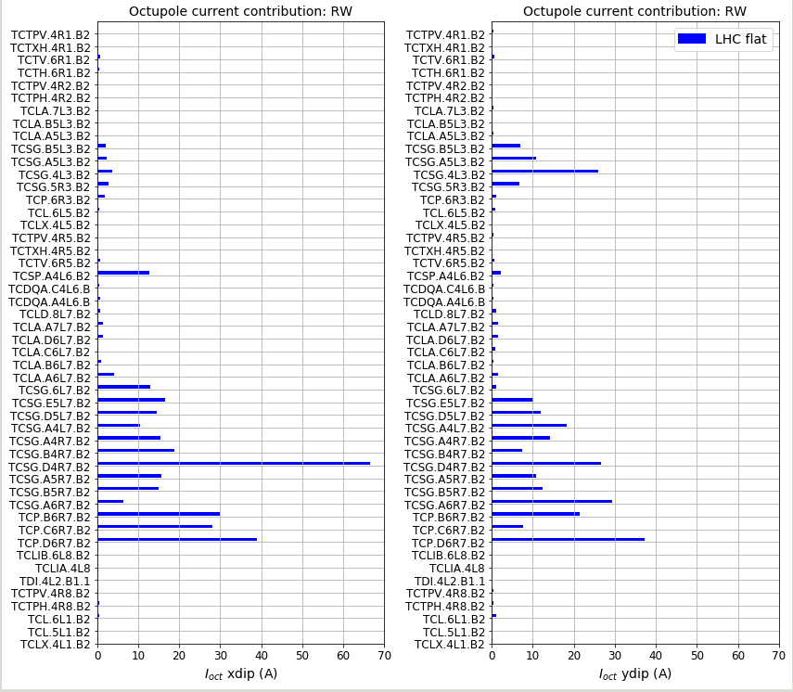
Impact on Octupole Current for the LHC (“CFC” material)
27/11/18

Slide 28
Impact on Octupole Current for the LHC
LHC actual geometry:
Current | Horizontal (A) | Vertical (A)
I_{oct} | 470*(+1.23%) | 400*(+0.97%)
27/11/18

