Slide 1
Crab layout options
R. Calaga, R. De Maria, P. Fessia, R. Tomas,
WP2 meeting 2/12/2018

Slide 2
Crab Layout: distance options
B2(E)
B1(E)
Nominal
C
C
C
C
C
C
C
C
B2(I)
B1(I)
3 to 6 m
3 to 6 m
B2(E)
B1(E)
Shift 1
C
C
C
C
C
C
C
C
B2(I)
B1(I)
3 to 6 m
3 to 6 m
B2(E)
B1(E)
Shift 2
C
C
C
C
C
C
C
C
B2(I)
B1(I)
One spare per plane => cryomodule needs to fit when rotated.

Slide 3
Crab Layout: ordering option
B2(E)
B1(E)
B1B2-B1B2
(nominal)
C
C
C
C
C
C
C
C
B2(I)
B1(I)
B2(E)
B1(E)
B1B2-B2B1
C
C
C
C
C
C
C
C
B2(I)
B1(I)
B2(E)
B1(E)
B2B1-B2B1
C
C
C
C
C
C
C
C
B2(I)
B1(I)
One spare per plane => cryomodule needs to fit when rotated.

Slide 4
Crab Layout: crab angle
Layout | Crab H | Crab V | 1==5 | 1!=5 | HLB1 | HRB1 | HLB2 | HRB2 | VLB1 | VRB1 | VLB2 | VRB2
 | [μrad] | [μrad] | [μrad] | [μrad] | [MV] | [MV] | [MV] | [MV] | [MV] | [MV] | [MV] | [MV]
B1 B2 IP B1 B2 | 379.4 | 384.2 | 379.4 | 384.2 | 3.40 | 3.19 | 3.19 | 3.40 | 3.40 | 3.38 | 3.38 | 3.40
B1 B2 IP B2 B1 | 379.0 | 379.3 | 379.0 | 379.3 | 3.40 | 3.36 | 3.18 | 3.33 | 3.36 | 3.40 | 3.33 | 3.18
B1 3m B2 IP B1 3m B2 | 373.5 | 367.4 | 367.4 | 373.5 | 3.40 | 3.14 | 3.14 | 3.40 | 3.40 | 3.23 | 3.23 | 3.40
B1 3m B2 IP B2 3m B1 | 366.5 | 366.7 | 366.5 | 366.7 | 3.34 | 3.40 | 3.07 | 3.22 | 3.40 | 3.34 | 3.22 | 3.07
B1 6m B2 IP B1 6m B2 | 367.5 | 350.6 | 350.6 | 367.5 | 3.40 | 3.09 | 3.09 | 3.40 | 3.40 | 3.09 | 3.09 | 3.40
B1 B2 3m IP 3m B1 B2 | 373.2 | 367.1 | 367.1 | 373.2 | 3.40 | 3.27 | 3.27 | 3.40 | 3.40 | 3.28 | 3.28 | 3.40
B1 B2 3m IP 3m B2 B1 | 366.5 | 366.7 | 366.5 | 366.7 | 3.34 | 3.40 | 3.21 | 3.27 | 3.40 | 3.34 | 3.27 | 3.21
B1 B2 6m IP 6m B1 B2 | 366.9 | 350.0 | 350.0 | 366.9 | 3.40 | 3.36 | 3.36 | 3.40 | 3.40 | 3.18 | 3.18 | 3.40
Based on the same optics. Still possible optimizations for individual layouts.
Non closure (for 380 μrad) is 0.029 σ (nominal) to 0.033 σ (worst case scenario +6m)
It is more efficient to have B2B1-B2B1 in IR1 and B1B2-B1B2 in IR5.
With 3 m shift 380 μrad -> 366 μrad (unless optimizing 1/5 -> 373 μrad)
With 6 m shift 380 μrad -> 350 μrad (unless optimizing 1/5 -> 373 μrad)
Moving one cavity gives the same penalty of one, but it gives it is better for sorting.

Slide 5
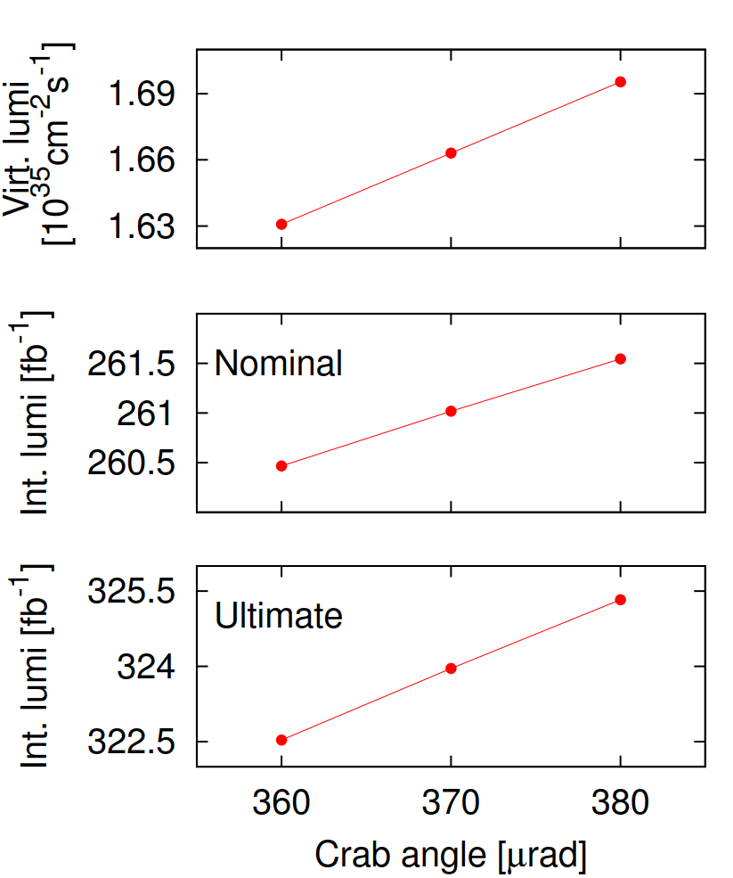
Luminosity vs Crabbing Angle
Crab angle | -5.5% (360 μrad)
Virt. Lumi | -3.6%
Int. Lumi [N] | -0.38%
Int. Luni [U] | -0.93%
Extrapolation
Crab angle | -8.5% (350 μrad)
Virt. Lumi | -5.6%
Int. Lumi [N] | -0.59%
Int. Luni [U] | -1.4%
R. Tomas

