Slide 1
AENEAS: Designing a Federated Regional Centre for SKA Computing
Richard Hughes-Jones
GÉANT Association

Slide 2
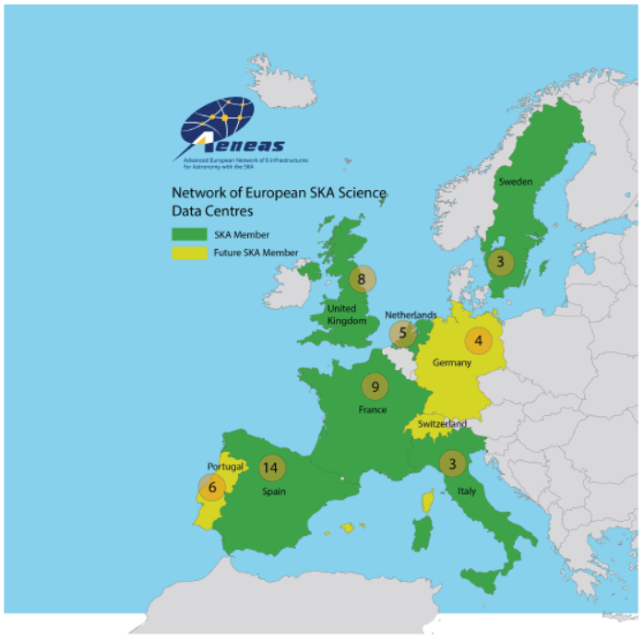
AENEAS H2020 Project: Design an European SKA Regional Centre
Create a specification and design for
a European-scale, federated, Regional Centre for the SKA.
Host replica of the SKA science archive.
Provide access to and distribute
Science Data Products and the Advanced Data Products .
Provide compute and storage resources for
SKA science extraction by users.
Provide analysis capabilities.
Provide user support.
Build on current facilities.
Coordination with ICT communities, industry,
and service providers.
The ESRC is part of a global network of centres.

Slide 3
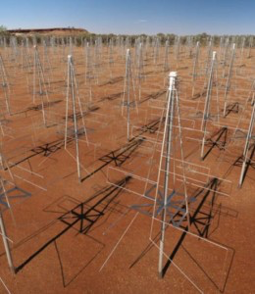
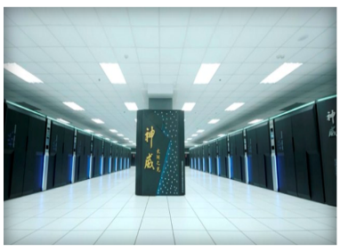



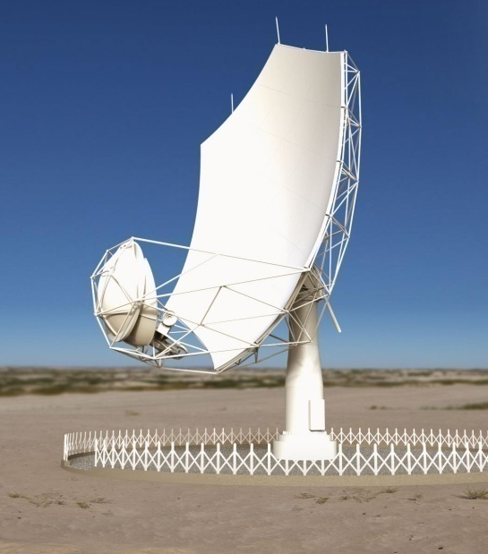
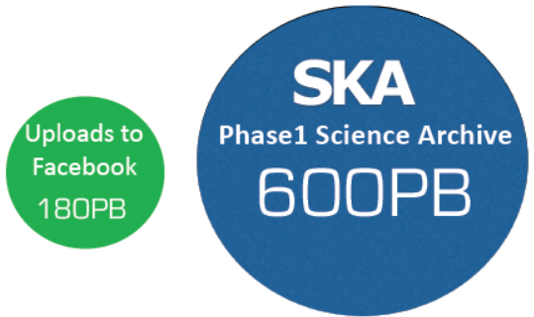
SKA Phase1 Data Flows
~130 Pflops
300 PB/y
~ 2 Pbit/s
~ 7 Tbit/s
9.3Tbit/s
100 Gbit/s
~130 Pflops
300 PB/y
SKA
Regional Centres
SKA1-LOW Australia
7.9Tbit/s
~ 20 Tbit/s
100 Gbit/s
SKA1-MID South Africa
Observatory Data Products
pushed from SDP → SRC
Notes:
SKA1-Low Remote Processing Facilities (RPFs)
2019 System design finalised
2020 Construction begins

Slide 4
The Compute Architecture for the Different Observatory Data Products
Pulsars Independent parallel – most like LHC
Visibilities image data cubes All image data for one sky section needs to be in one place
– high bandwidth storage – memory – cpu power
Radio Weak Gravitational Lensing Uses gridded visibilities - needs high memory
EOR Power spectra – closely coupled supercomputer
– cell cubes influence each other
Cosmic Magnetism Faraday rotation measure synthesis
can be done as independent parallel computations
Object detection / classification Requires large numbers of GPUs
Notes:
RM = Faraday rotation measure

Slide 5
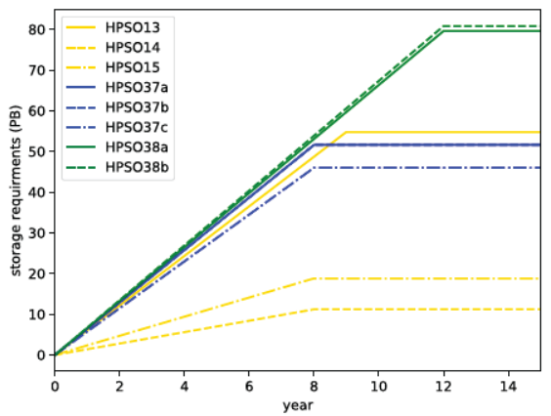
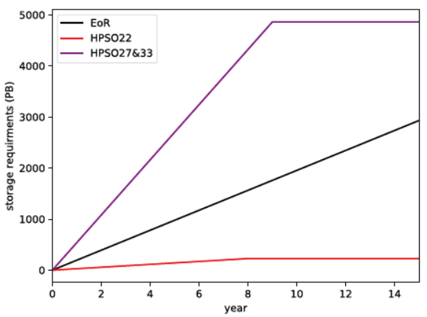
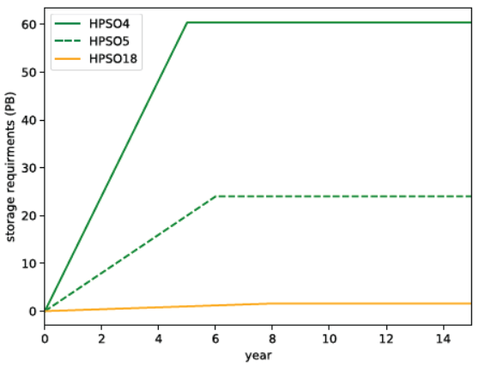
AENEAS: The ESRC Storage Requirements
Estimated storage volume and number of products for:
  SKA science data products
  User created Advanced data products
Based on:
  Produce Advanced data at rate α rate SDP produces data
  ESRC holds a full mirror copy
  Size of advanced data products based on use cases
  Volumes Advanced data:SDP data :: 3:1
Minimum storage needed for High Priority Science:
750 PB per year for the first 10 years
200 PB per year for the following 5 years
Total storage volume required for
High Priority Science at an SRC is
8.5 ExaBytes over the course of 15 years
HI and Continuum
EOR, Mag, Cradle of life
Pulsars and Transients

Slide 6
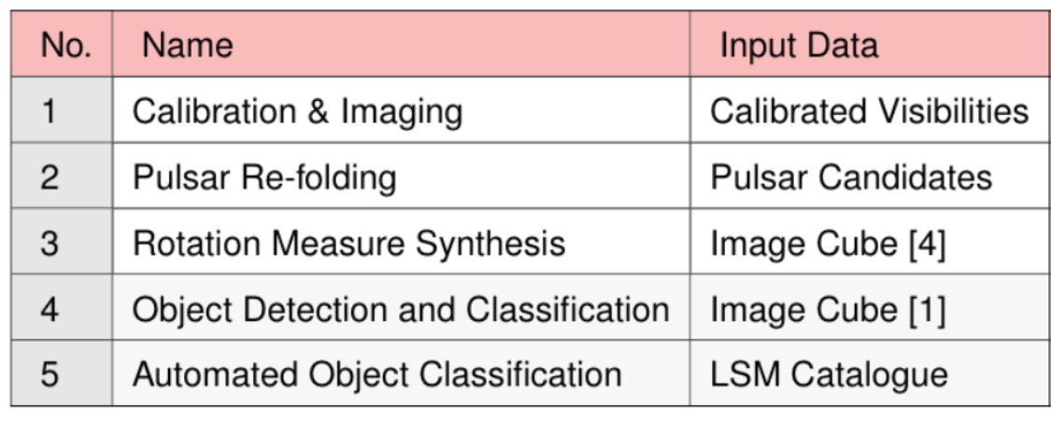
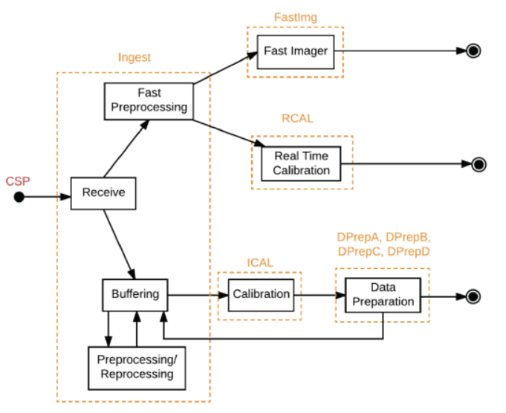
AENEAS: The ESRC Computing Requirements
Estimated the processing required based on Use Cases:
Strong assumptions:
  Re-processing of all (EOR) SDP data products.
  Post-processing to generate all advanced datasets.
  Re-processing & Post-processing performed only once.
  Processing of SDP data products is performed at the same rate and they are ingested into the ESRC.
Minimum processing needed for High Priority Science:
29 PFlops
SDP Pipelines

Slide 7
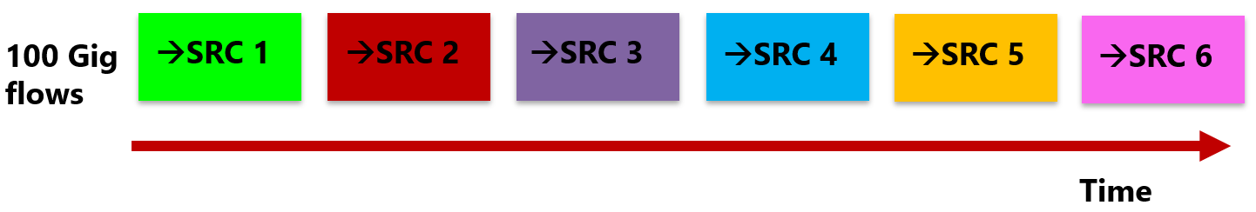
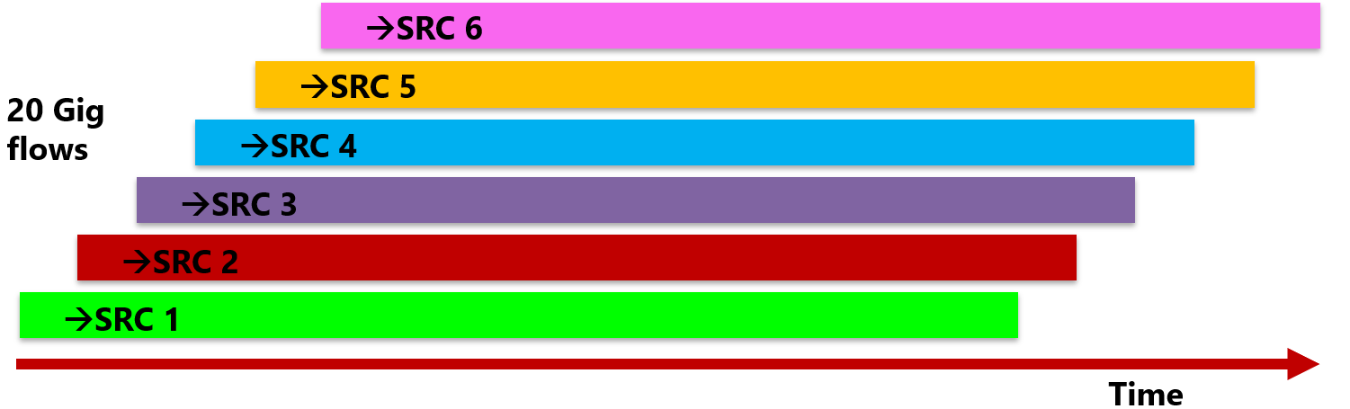
Models of Data Flows from the Telescopes to a SRC
Data sent to each SRC in turn.
Requires clean 100Gbit/s paths to each SRC.
Worst case the SRC would require a 200 Gbits/s.
Several flows to different SRC taking place in parallel.
Operationally more realistic.
Makes efficient use of the network to each SRC.
WP4 demonstrated stable
28 Gbit/s flows – TCP limit.

Slide 8
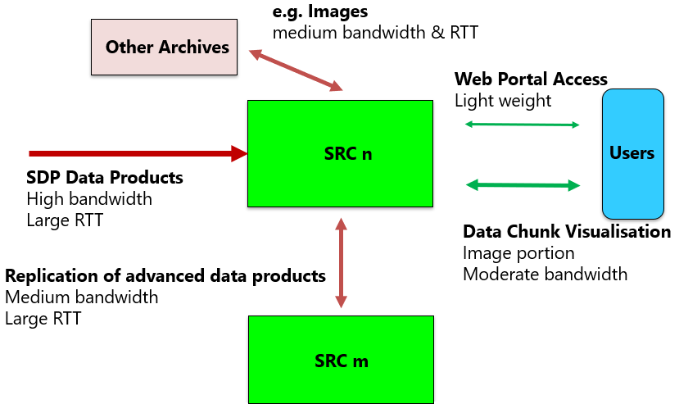
Network Traffic into & out of a SKA Regional Centre
Assumptions
20 Gbits/s at a time from each Telescope
peak 40 Gbit/s to a site
At a given time all of a Data Product goes to one site
10 Gigabits/s to other ESDC sites
10 Gigabits/s to non SKA data Archives
10 Gigabits/s to other RDC
70 Gigabit/s (peak) to each site.
Flexible but secure ACL and high performance DMZ
Say 100 Gigabit/s for SKA to each site in 2024/25.
This is affordable.
(c.f. the UK WLCG sites which have 10-40 Gbit/s dedicated links now)

Slide 9
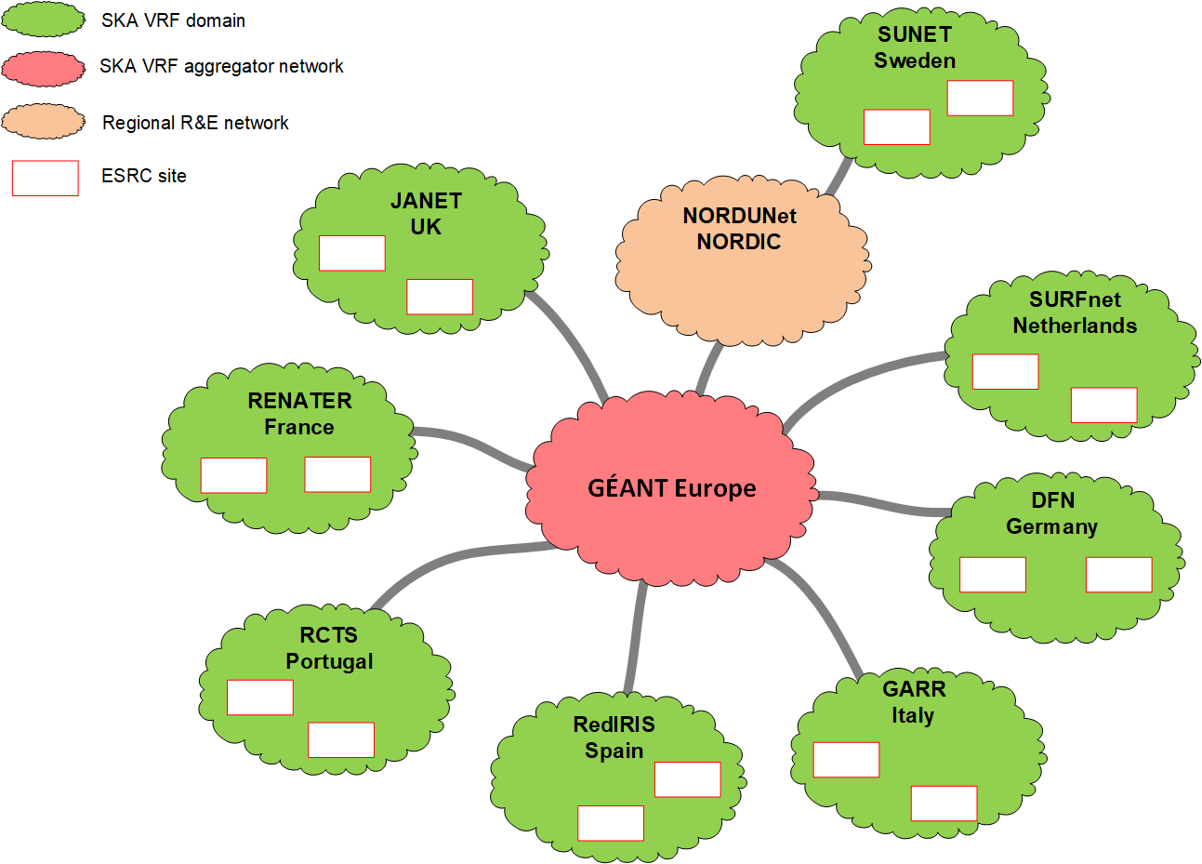
Network Architecture for the ESDC
VRF based overlay on the academic networks
Isolation of SKA traffic from other users
Easier for NRENs to implement the routing and policies
SKA traffic can be engineered to use specific paths and routes to provide the high bandwidth
Layer 3 routing provides isolation of any network configuration issues and strictly limits broadcast storms
Layer 3 will re-route traffic as long as there is an alternative network path
Configuration actions have to be undertaken by the NREN and a Site to join the SKA VRF, which provides an extra layer of security

Slide 10
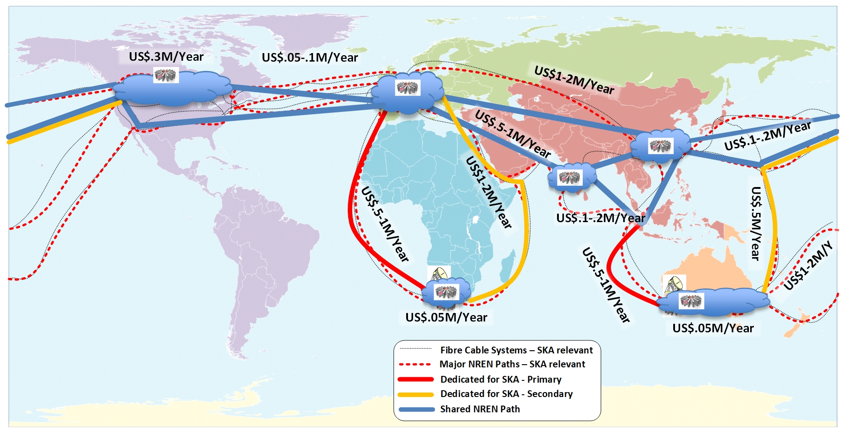
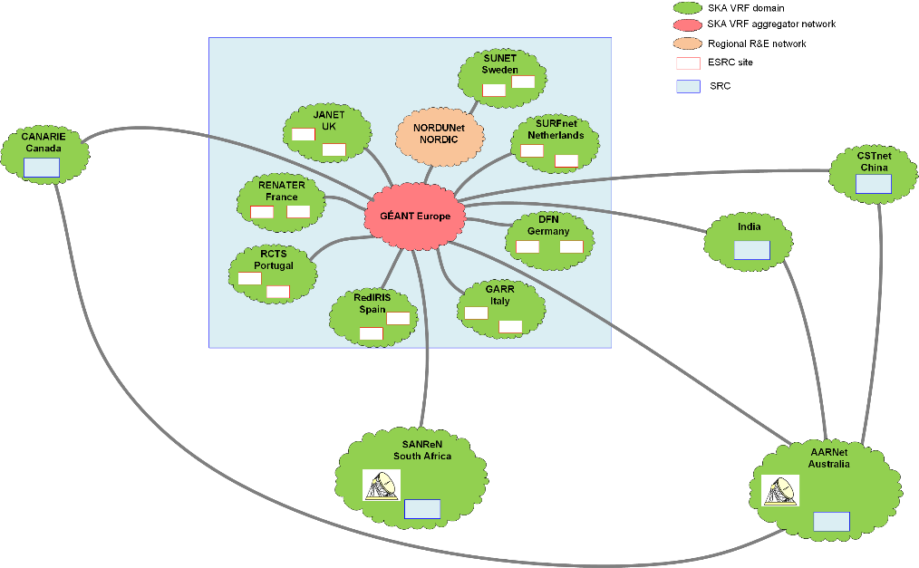
Global Network Architecture & Paths of Interest to SKA
VRF based overlay with peering linked over the shared academic network
Dedicated Primary & Backup links from both telescopes
1 PetaByte/day pushed by SDP from each Telescope → 100 Gigabit/s
Costs based on 10 to 15 year IRU per 100 Gbit circuit projected to 2020 prices

Slide 11
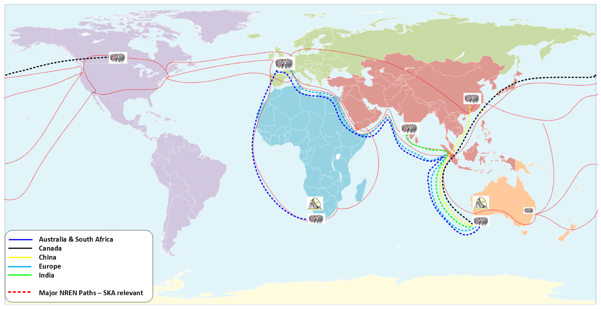
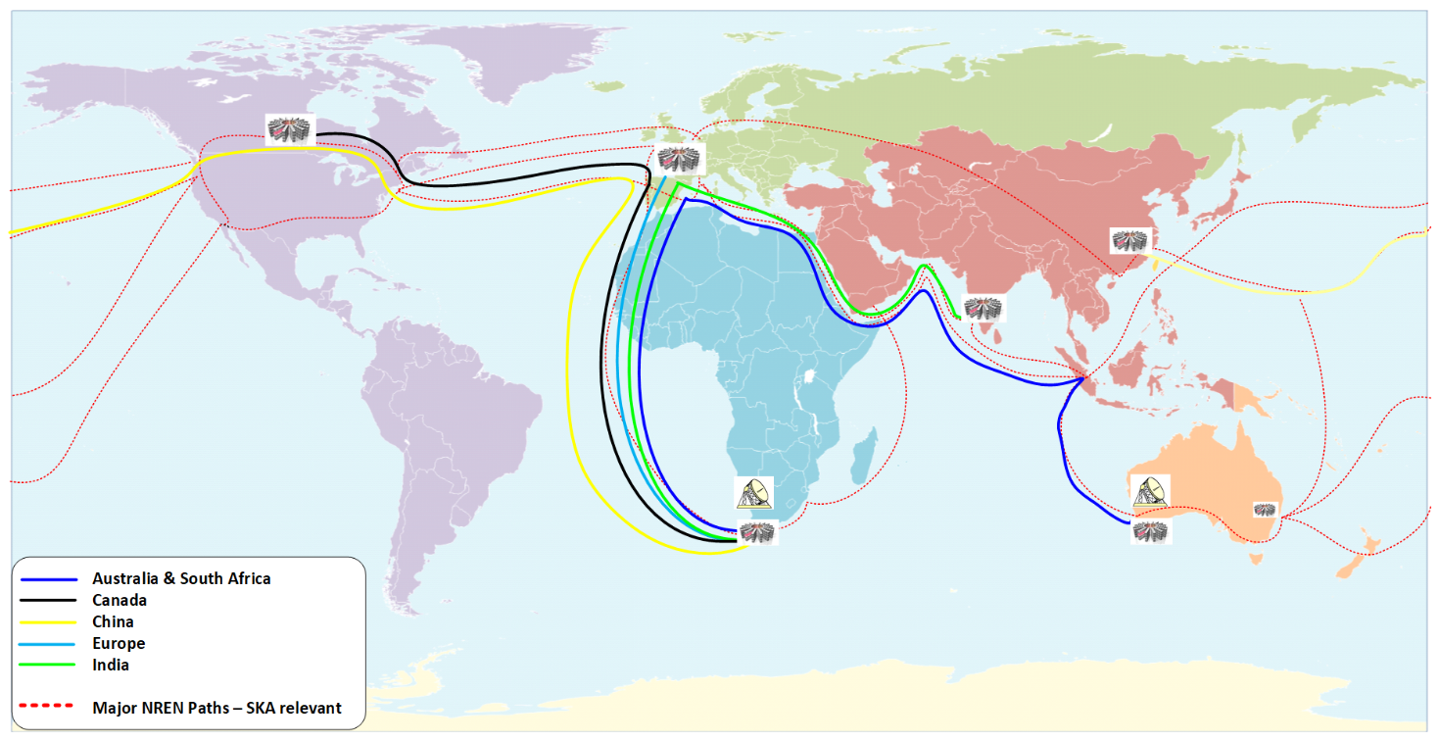
Global Paths of the Data Flows Pushed to the SRC – 1 Replica
Five flows on the submarine cable from Perth to Singapore .
Then join the general purpose routed IP academic network.
Single flows on the routes to Canada, China and India,
Australia is local, and
two 20 Gbit/s flows would be carried to London to reach SRCs in Europe and South Africa.
Five flows on the submarine cable from Cape Town to London.
Then join the general purpose routed IP academic network.
Different submarine cables used to reach India and Australia,
Europe is local, and
two 20 Gbit/s flows cross the Atlantic to SRC in Canada and China.
SKA1-LOW Australia
SKA1-MID South Africa

Slide 12
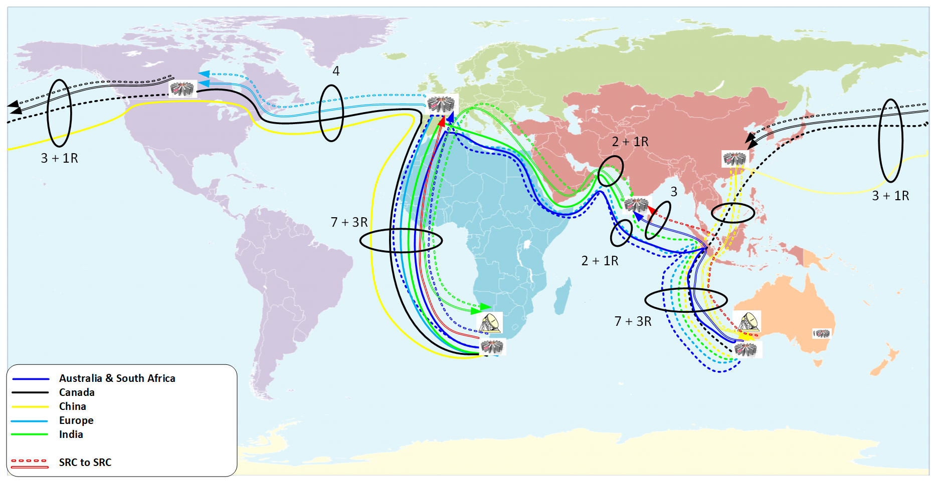
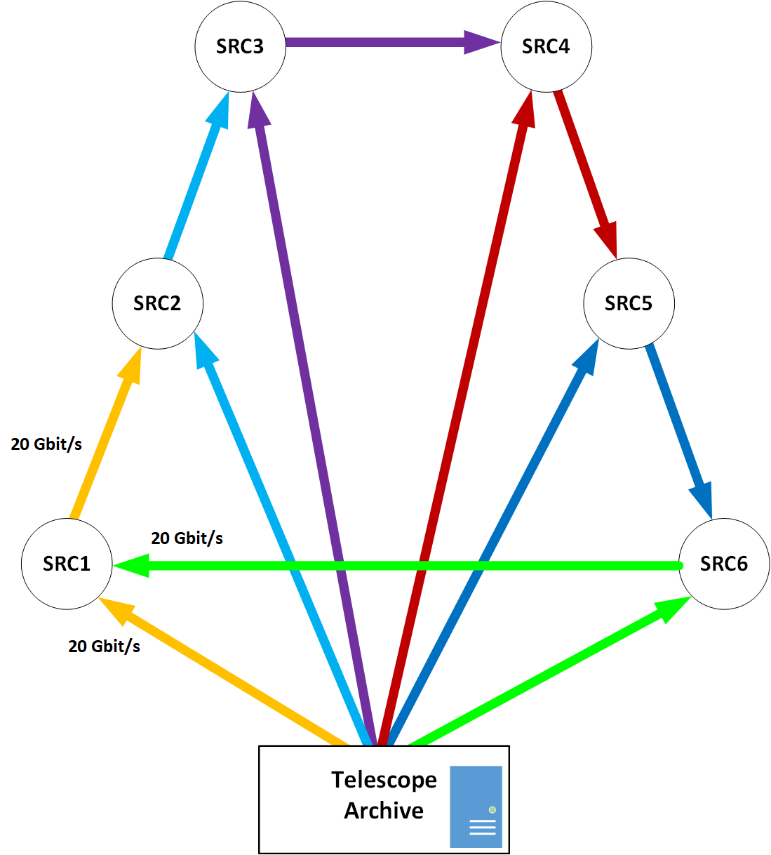
Global Data Flows if the SRC Re-distribute data – 2 Replicas
Each SRC accepts its fraction of the Observatory Data Products and re-distributes to another SRC.
SRC has 20 Gbit/s flow from the telescope & a second continuous 20 Gbit/s flow from another SRC.
Each SRC sends out a 20 Gbit/s flow.
Makes substantial use of the shared academic network which would imply charges to the SKA community.

Slide 13
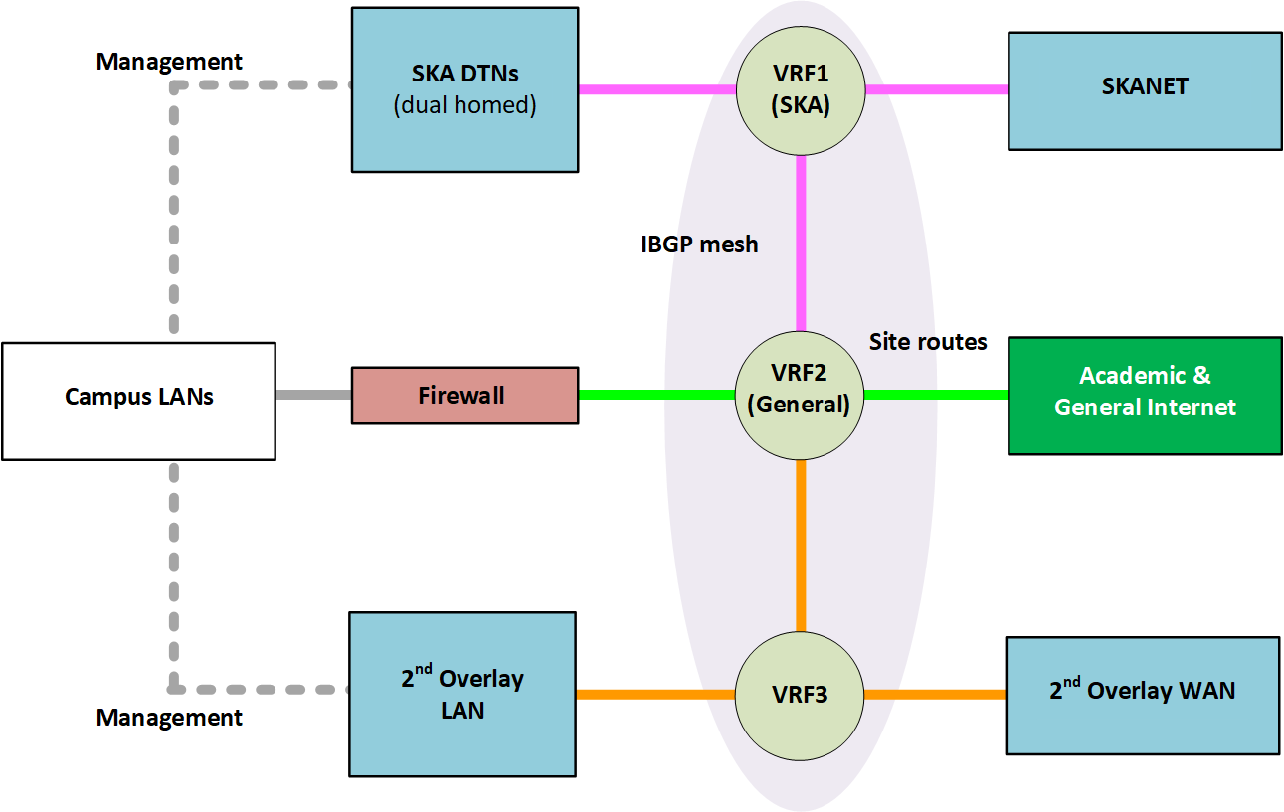
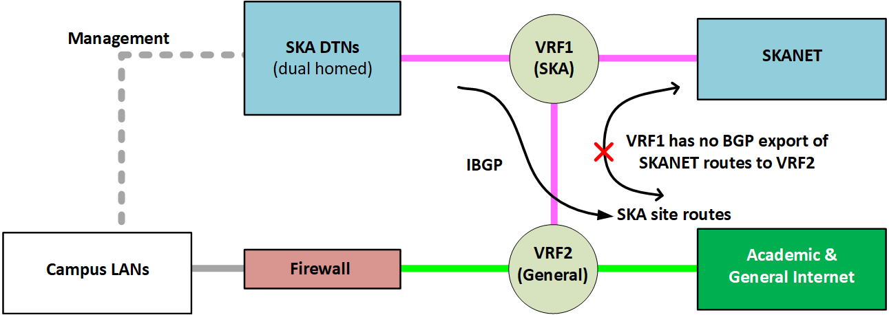
Network Considerations for a ESRC Site
Need for high performance Data Transport Node hardware
  Tuned for RTT ~300 ms
  Network – disk transfer rate ~20 Gbit/s
Flexible but secure ACLs and high performance DMZ
Uncongested site access link

Slide 14
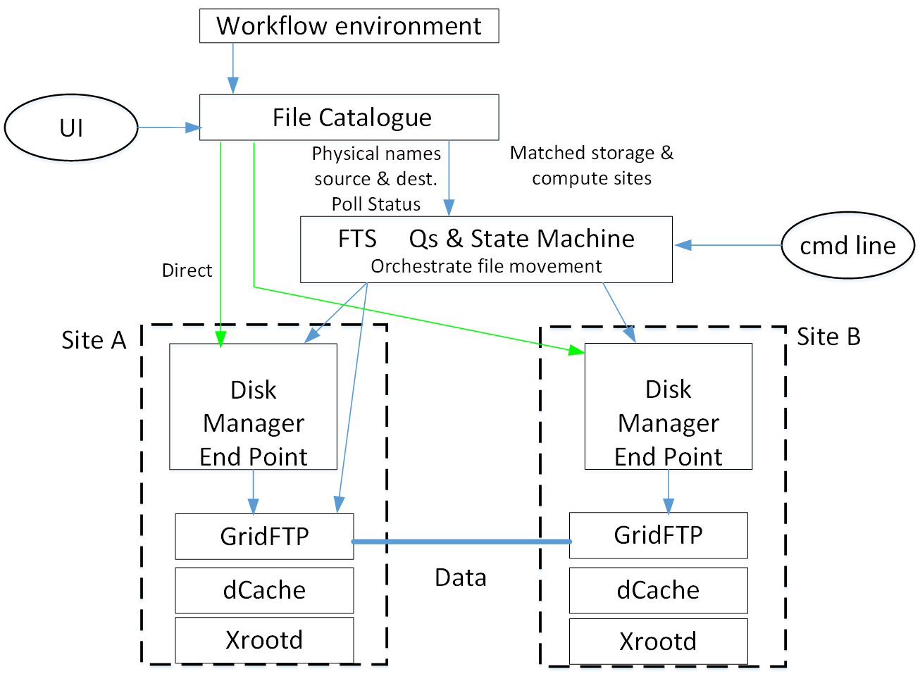
Integrating Global Distributed Computing Sites (AENEAS) & SDP
Need for state of the art middleware for:
  Replica management.
  Orchestration of the data file movement.
  Workflow management
  E.g. Rucio & FTS
The SDP design needs to be integrated into
the distributed computing environment, e.g.
  Read-write loads on hot/cold buffers or archive
  Linking SDP & global file catalogues
Realistic flow demonstrations are an
excellent infrastructure candidate
for SKA Data Challenges
AENEAS proposes an SKA – NREN Forum

Slide 15
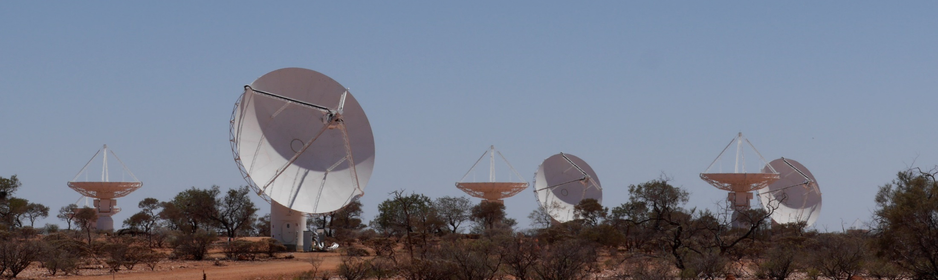
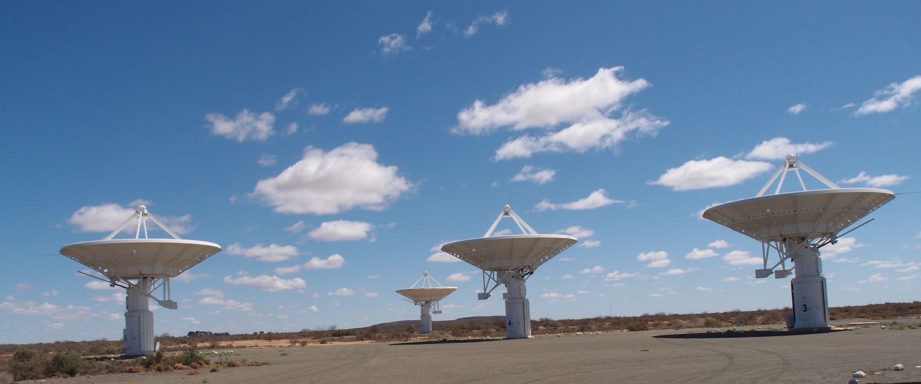
Questions

