Slide 2
Analysis of Data Access Patterns in ATLAS and CMS
Andrea Sciabà, Markus Schulz, Shreya Krishnan, Olga Chuchuk [CERN] Carlos Pérez Dengra [PIC/CIEMAT]

Slide 3
Introduction
Data access/storage by production and analysis jobs drive the design and cost of data management systems for LHC computing
At the scale of HL-LHC the current storage and access strategies will not be affordable
Several concepts are studied:
  Fewer persistent storages and cache/buffers at smaller sites
  Tape/Disk dynamic usage
  See WLCG-DOMA talks
A first step is to study access/storage patterns and use them to model different architecture choices

Slide 4
What have we used?
CMS logs
  Stored in a Spark cluster
  Cover access to production and analysis data
  No data on data management
ATLAS Panda and RUCIO logs
  JSON and AVRO files (1/2 year on laptop)
  Production and analysis up to DAOD/ntuple generation
  Data access and management logs
  No logs on the individual local analysis on ntuples
For PIC and CERN we use logs from local storage systems
  dCache and EOS
Many thanks to ATLAS and CMS for the data!

Slide 5
What have we looked at?
Cache simulations
  Sizes, retention strategies, data tiers
  Differences between sites
  Details on selected sites
Access patterns over time
  Access frequencies
  Time structure of accesses
  Data lifetime and active lifetime
  Details on selected sites
Too much to show in 15 minutes .....

Slide 6
Why use a site cache?
What is it?
  A storage system that creates replicas of files on demand and appropriately deletes them to reclaim space
    To hide latency a cache can read forward
  The most used implementation is XCache, which supports xrootd
What are the advantages?
  By caching a file:
    Subsequent accesses to it will not cause additional WAN traffic
    Impact of latencies can be reduced
    The application needs not to be aware of where a file is located
    No prior staging is needed, no deletion either
  A cache is simpler to manage than a classic storage system
    (dCache, DPM, etc.) and allows for a lower and cheaper QoS
  By using storage space only for “hot” data, much less storage needs to be purchased

Slide 7
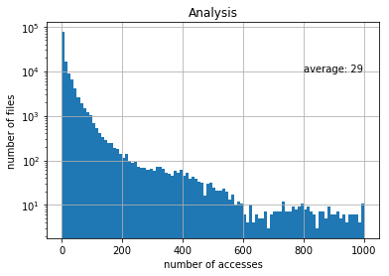
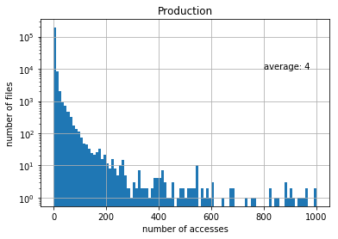
File access patterns and caches
log scale
Analysis
CMS Data from Jan 2018 to Jul 2019, all sites
29
The usefulness of a cache is strongly dependent on the access patterns
  Ideally, files will be processed only once by production jobs, hence they can stay cached (if at all) for just a short time
  Files read by analysis jobs will might be accessed several times over the course of a long interval of time, hence they should stay cached for longer times
  Therefore, caches are most relevant for Tier-2 sites
Access patterns are also very correlated to the data tier
Production
4

Slide 8
Managing the cache space
Caches are unmanaged, but different strategies to free up space can be used
  When? For example
    When the cache occupancy reaches a certain threshold
    When the cache decides that a file is not needed (at any time)
  How? For example:
    By deleting the least recently used (LRU) files until the cache occupancy falls below a certain threshold
    When, given the history of the file accesses, the cache decides that it is unlikely that a file will be needed again
One objective of this work is to compare strategies

Slide 9
Simulating a site cache
Some sites run production caches
  CMS SoCal Tier-2 does, see Matevz’ talk just after this one
Data popularity records may allow to “simulate” the effect of having a site cache
CMS collects and stores, for each CMSSW job, information about the files during its execution
  File name, size, access time, user, site, type, host name of the client and the server, bytes read and written, etc.

Slide 10
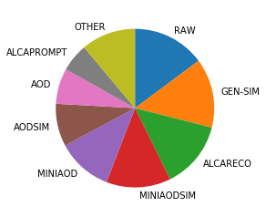
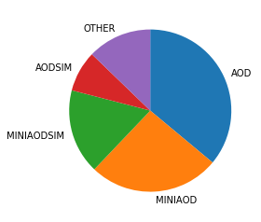
File types (“data tiers”)
We can extract to which “data tiers” belong the files accessed
  RAW, GEN-SIM: ~ 1 MB/event
  AOD(SIM): ~300 kB/event
  MINIAOD(SIM): ~30 kB/event
  ALCA*: for alignment and calibration tasks
Very different distributions for production and analysis
  Assuming that caches are needed only for analysis, the only relevant data tiers are (MINI)AOD(SIM)
  NANOAOD’s volume makes caching very inexpensive
Data from Jan 2018 to Jul 2019 for all sites
production
analysis

Slide 11
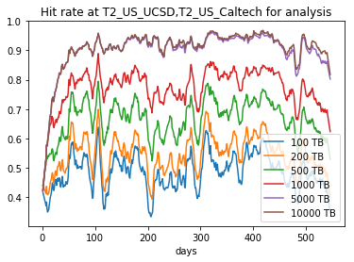
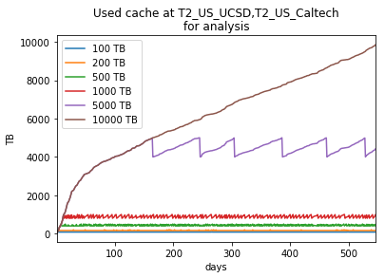
“LRU” caches
Estimated the hit rate vs time and vs cache size of a hypothetical site cache from actual access data
LRU algorithm for cache management
  Triggered when cache occupancy exceeds a certain limit (the “cache size”)
  Purge files from the least recently accessed on, until the cache occupancy drops below 80% of the cache size
Done for several sites
  Will concentrate on the Southern California Tier-2 (Caltech + UCSD) for being the target of several studies in CMS on caching, for analysis jobs and for (MINI)AOD(SIM) files

Slide 12
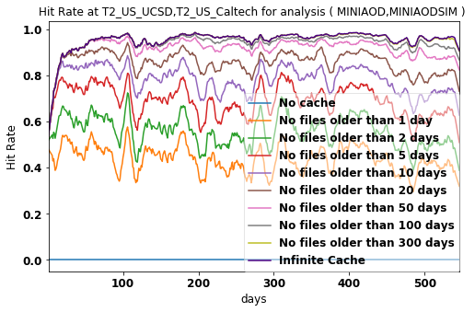
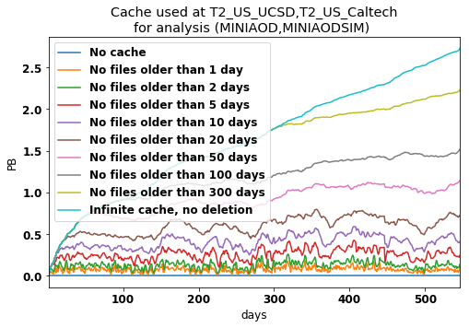
“N-days” caches
Age-based algorithm for cache management
  File “age”: time passed after latest access
  Purge files “older” than N days
  N = 0 means “no cache at all”
  N = 1 means that files are cached for just one day unless accessed again, etc.
Given a value of N, measure:
  Average cache hit rates
  Average cache occupancy
  Average external traffic
  Value of “cost function”

Slide 13
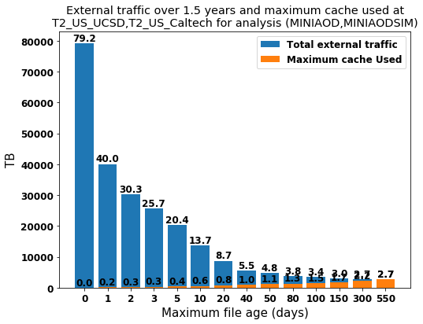
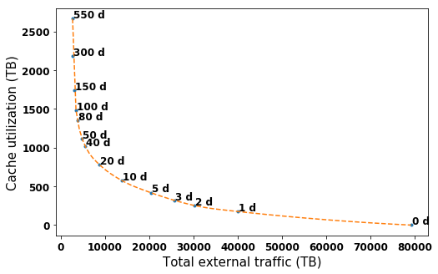
Cost function
Total cost = network cost + storage cost
Storage cost = max(cache occupancy) × cost / disk storage
  Relatively straightforward, caches have low QoS, so cheap HDDs in JBOD configuration are sufficient
Network cost = avg(external traffic / time) × cost / bandwidth
  Much more difficult to estimate, as it is not proportional to usage

Slide 14
Unitary cost estimation
Disk
  Cost estimated in the WLCG/HSF cost model working group
    1 HDD: 8 TB, 400 EUR, 4 years lifetime
    Disk server cost / TB ~ twice disk cost
    ⇒ cache cost ~ 25 EUR/TB/year
  Baseline HDD scenario: 25 EUR/TB/year
  Pessimistic HDD scenario: 50 EUR/TB/year
  SSD scenario: 100 EUR/TB/year
Network
  Cost estimated very roughly from a couple of WLCG entities
  Baseline: 1 EUR/TB
  Pessimistic: 10 EUR/TB

Slide 15
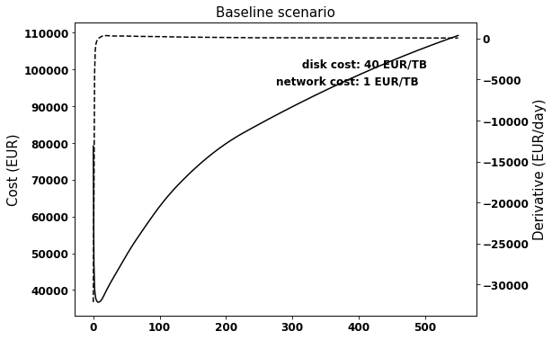
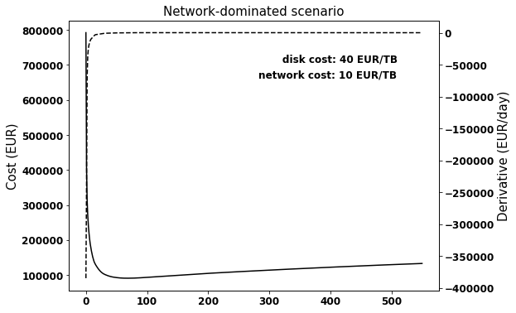
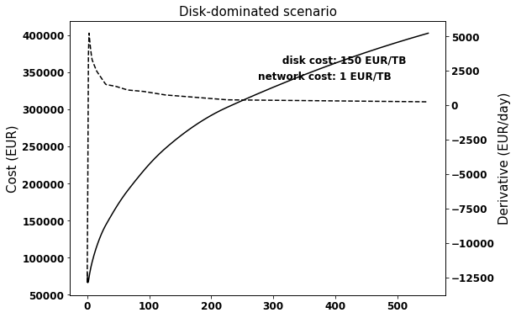
Cost optimisation
 |  | Disk cost (EUR/TB)
 |  | 40 | 100 | 150
Network cost (EUR/TB) | 1 | 8 | 2 | 1
 | 10 | 68 | 36 | 26
Optimal maximum file age
 |  | Disk cost (EUR/TB)
 |  | 40 | 100 | 150
Network cost (EUR/TB) | 1 | 522 TB | 252 TB | 175 TB
 | 10 | 1262 TB | 980 TB | 870 GB
Optimal cache size

Slide 16
Access time patterns
For each file, it is possible to analyse the access history
  The idea is to devise a way to estimate the probability that a file will be accessed again within a given time
  This can be use to decide when it is “best” to expunge a file from the cache
  Supposedly better than to simply expunge the least recently used file, or any file not accessed since N days
Often files are accessed multiple times within a very short time
  Due to concurrent jobs reading from the same file
  Such accesses can be considered as single accesses if happening within the “minimum” lifetime of a file in the cache (e.g. one day)
    But hit rates should be calculated using all accesses
Possible strategy
  (file accessed N times, time passed since last access) ⇒ probability it will be accessed at least another time
    It ignores the fact that such probability can change a lot if the N accesses happened in a short or a long time span
    On the other hand, if we assume that access patterns are identical for all files, the time span distribution for N accesses depends only on N

Slide 17
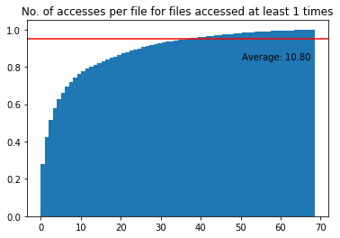
Access time patterns

Slide 18
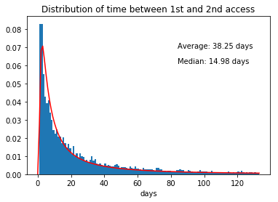
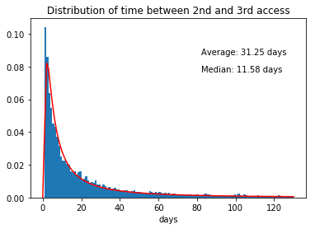

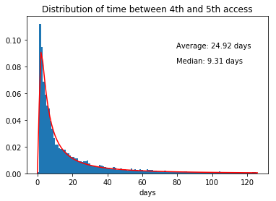
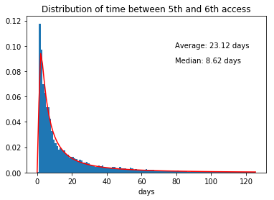
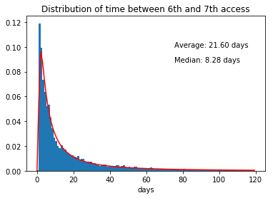
Distribution of time to next access
1 → 2
2 → 3
3 → 4
4 → 5
5 → 6
6 → 7

Slide 19
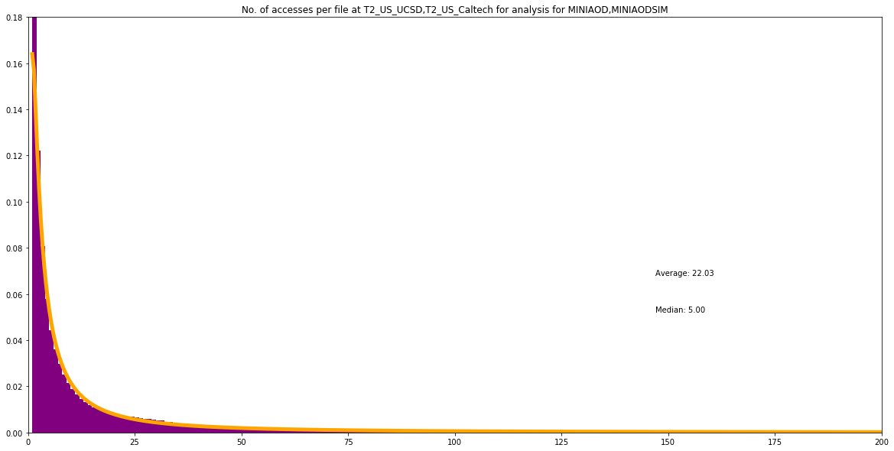
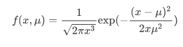
Access Probabilities
The probability density function for a file being accessed the n-th time can be described by a simple function
The probability for an access after a given time can be described by the same function
→ Monto Carlo Model for data access with very few parameters

Slide 20
What to do with this?
Condense many measurements into a very compact representation
Compare sites/workflows/changes over time
Build a model for MC studies
Spot anomalies (maybe)
Try to understand why many independent Physicists doing independent research, synchronised by a few conferences create these patterns…..

Slide 21
Comparing Caches on Different Sites
Using ATLAS Panda logs
LRU caches with different sizes
Relation between cache size and network increase
  Cache size is relative to unique data in ½ year
  Network is relative to network use with infinite cache
This allows to look at large and small sites at the same time
Can be combined with the cost function before
Can be used to decide on trade-off between network and storage

Slide 22
All data types, 50, 100, 200, 400, 800 Tbyte caches
All ATLAS sites

Slide 23
AOD & DAOD & NTUP , 50, 100, 200, 400, 800 Tbyte caches

Slide 24
Larger Caches

Slide 25
How long is data used?
Lifetime (T_{deleted} – T_{move})
Active-Lifetime (T_{last access} – T_{first access})
“Cost” = Lifetime x Size [GByte days]
“Value” = Active-Lifetime x Size [GByte days]
Analysis vs. Prod Data

Slide 26
Analysis data active/stored
Cumulative
probabilities
active
stored
days
days

Slide 27
Non Analysis data active/stored
Cumulative
probabilities

Slide 28
Storage is actively managed
Days that non analysis data is stored on a site
days

Slide 29
Cost / Value
Volume * time the data is active
Volume * time the data is stored
[days Gbyte]
[days Gbyte]

Slide 30
Cost of data not accessed
Cost Never Accessed / Cost All Data ≈ 0.15
Data is moved and deleted only
[days Gbyte]
[days Gbyte]

Slide 31
Site Perspective

Slide 32
Site Perspective
Not all data access is traced by the experiments → ask the storage systems
PIC T1
  dCache traces
CERN T0
  EOS traces

Slide 33
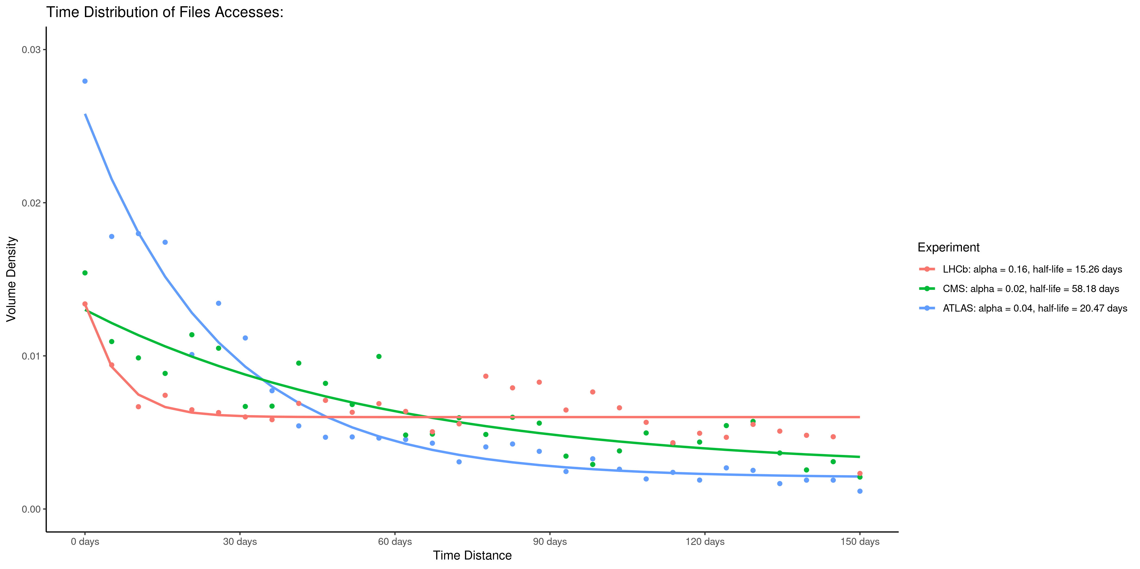
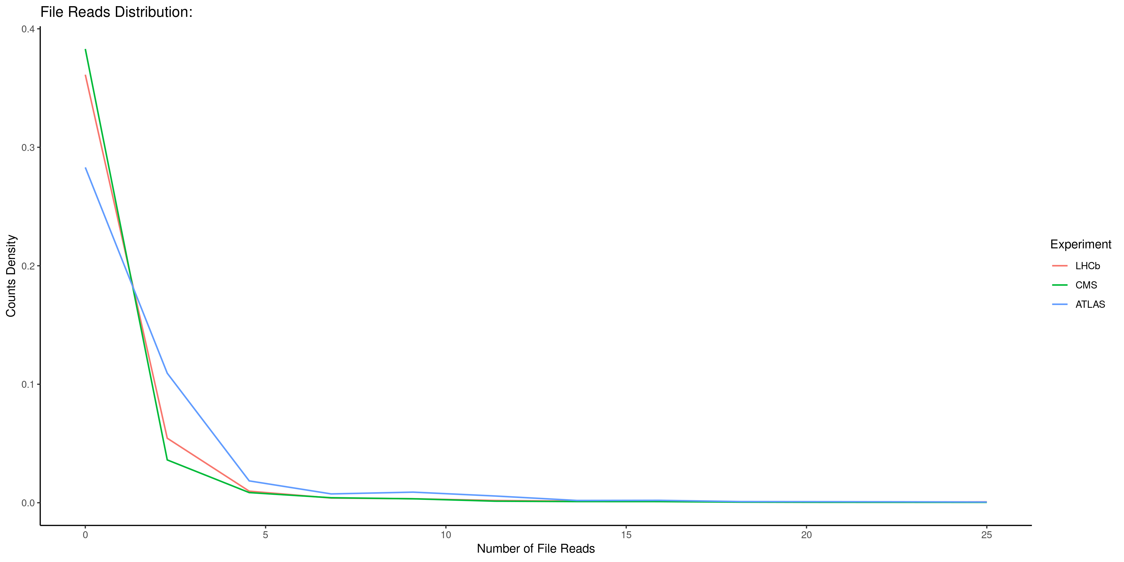
CERN LHCb CMS ATLAS

Slide 34
PIC/CIEMAT Carlos Pérez Dengra
PIC Tier-1 [CMS]
Sept-2017→ Sept-2018
Average disk usage ~2.3 PB
8.8 PB writes (10.5M files)
24.0 PB read (3.5M distinct files)
8.8 PB removed (11.0M files)
Covered by: CMS data access and usage studies at PIC Tier-1 and CIEMAT Tier-2

Slide 35
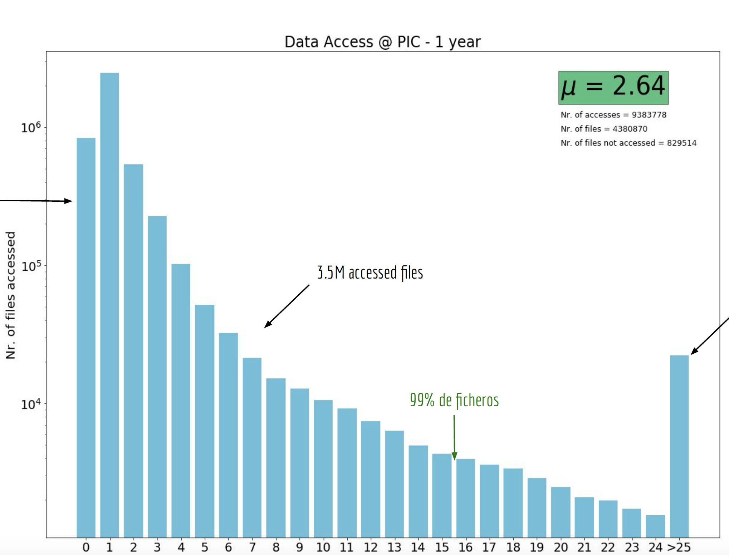
Number of accesses: PIC
All Data/MC
Tiers
Log scale
800k written and
unaccessed files
Covered by: CMS data access and usage studies at PIC Tier-1 and CIEMAT Tier-2
22k files accessed > 25 times
6.7M written files,
unaccessed and deleted are Not considered

Slide 36
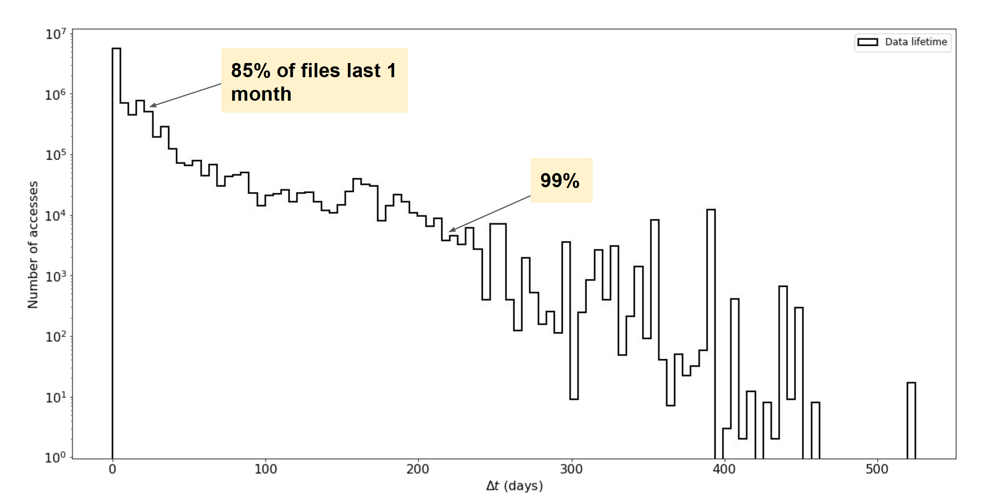
File lifetime at PIC
85% are removed within 1 month
Covered by: CMS data access and usage studies at PIC Tier-1 and CIEMAT Tier-2

Slide 37
Summary
With access logs the impact of caches can be simulated
  The trade off between storage and network (cost)
Large and small sites show very similar behaviour (ATLAS)
The bulk of the data isn’t accessed very often (90% < 15 times)
Time between accesses is short (days)
Lifetime is short (<80days for >90% of the data )
Active lifetime is shorter than storage lifetime
  ATLAS (some potential gain)
The probability density for access in time and frequency can be described by a simple model (inverse gaussian with one shape factor)
  Handle for mathematical description
Access patterns within sites show similar patterns as those traced by experiment frameworks

Slide 38
What would be nice ;-)
Same format for access logs (binary format)
  Between experiments
  Between storage systems
  Agreed subset of information
    File-name/id, size, data-tier,
    time, operation, source, destination
    Data media (Archive (tape), Active (disk))

Slide 39
Related work
  M. Tadel, Moving the California distributed CMS xcache from bare metal into containers using Kubernetes, track 4
  D. Spiga, Smart caching at CMS: applying AI to XCache edge services, track 4
  J. Flix, CMS data access and usage studies at PIC Tier-1 and CIEMAT Tier-2, track 4

Slide 40
Backup slides

Slide 41
Probability of another access
P(x; x₀, …, x_{n}) = probability density of the file being accessed at time x if it was accessed already at times x₀, …, n_{n}
Let’s assume time invariance, which leads to
P(x; x₁-x₀, …, x_{n}-x_{n-1}) = probability density of the file being accessed at time x after the last access if it was accessed already at times x₀, …, n_{n}
Special case
P(x) = probability density of the file being accessed at time x after it was accessed once
R₂=∫P(x)dx = probability of the file being accessed at least a second time
R₃(x₁-x₀)=∫P(x; x₁-x₀) = probability of the file being accessed at least a third time if x₁-x₀ seconds passed between the 1st and 2nd access
R_{n+1}=∫P(x; x₁-x₀, …, x_{n}-x_{n-1}) = probability of the file being accessed at least an (N+1)-th time if etc.

Slide 42
Probability of another access
P(x)=R₂P’(x)
P’(x) = normalised PDF of time between 1st and 2nd access
P(x; x₁-x₀)=R₃P’(x; x₁-x₀)
P’(x; x₁-x₀) = normalised PDF of time between 2nd and 3rd access if x₁-x₀ seconds passed between the 1st and the 2nd access

Slide 43
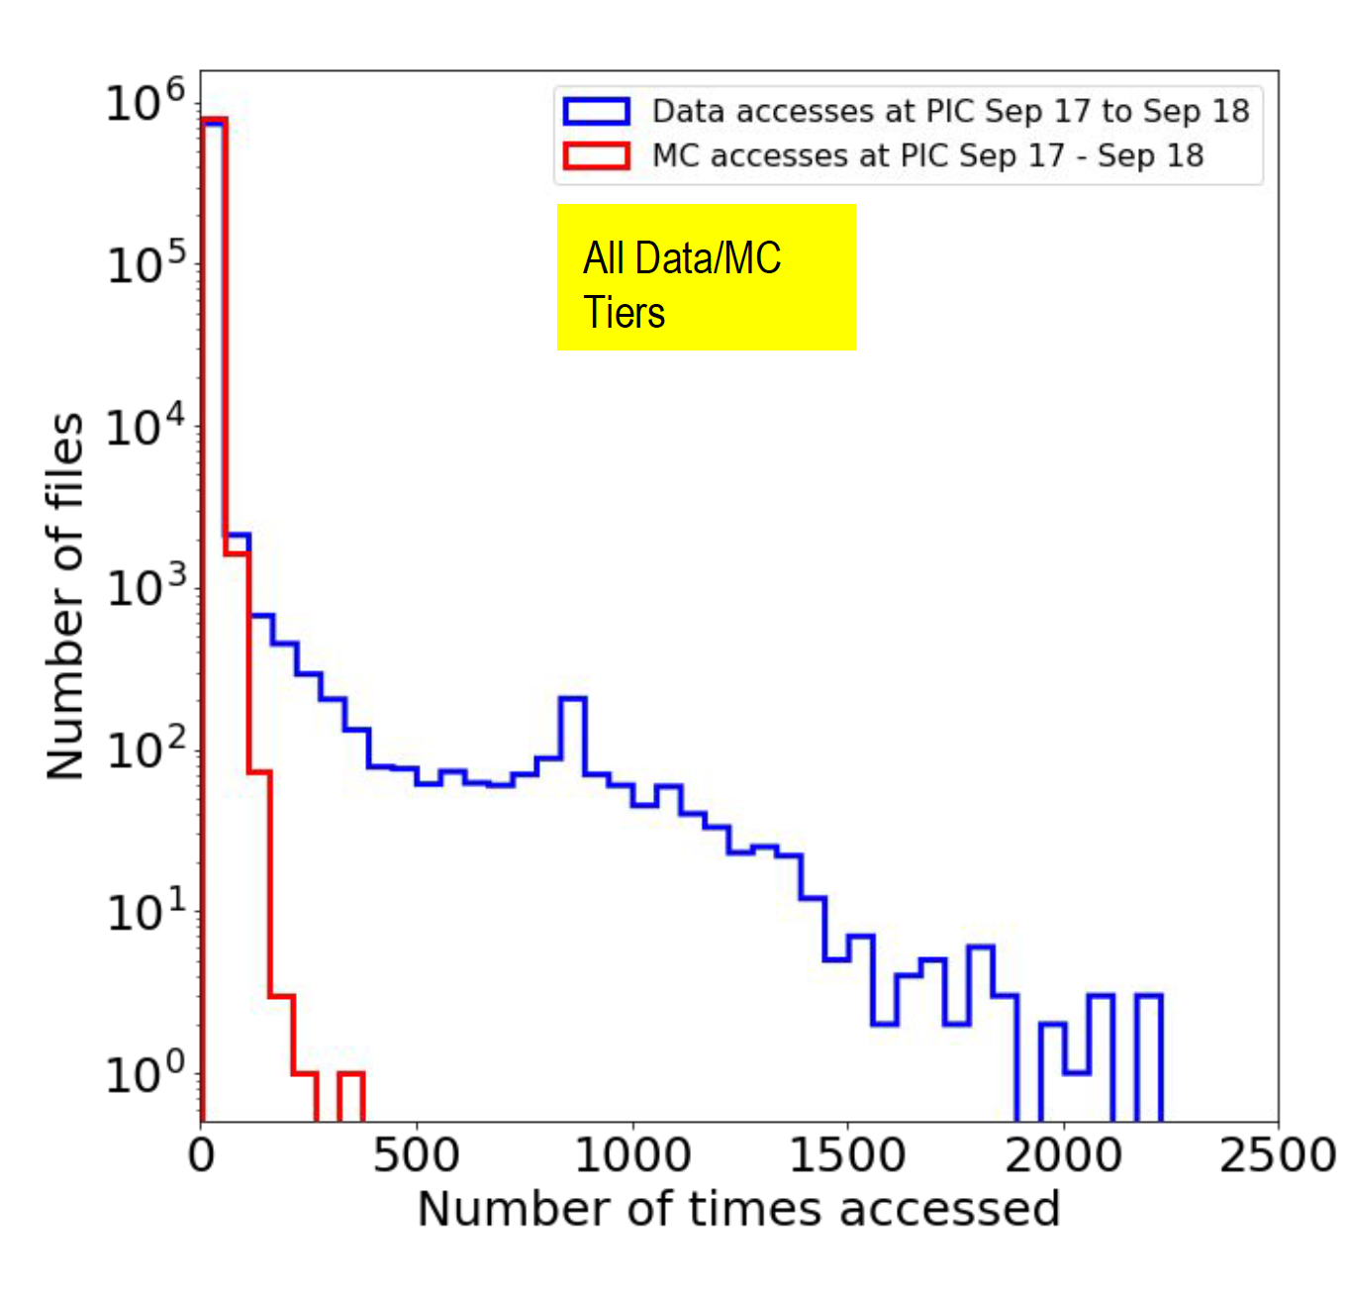
PIC

Slide 44
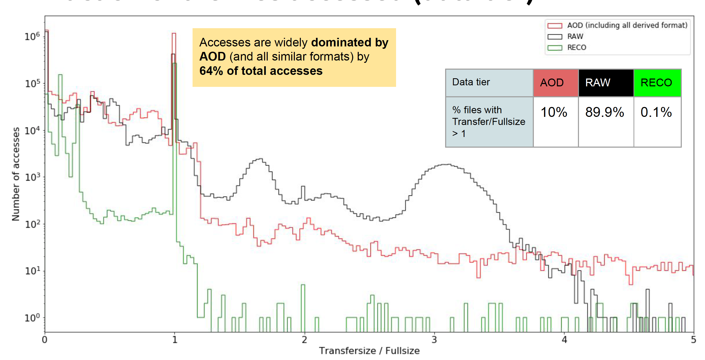

Slide 45
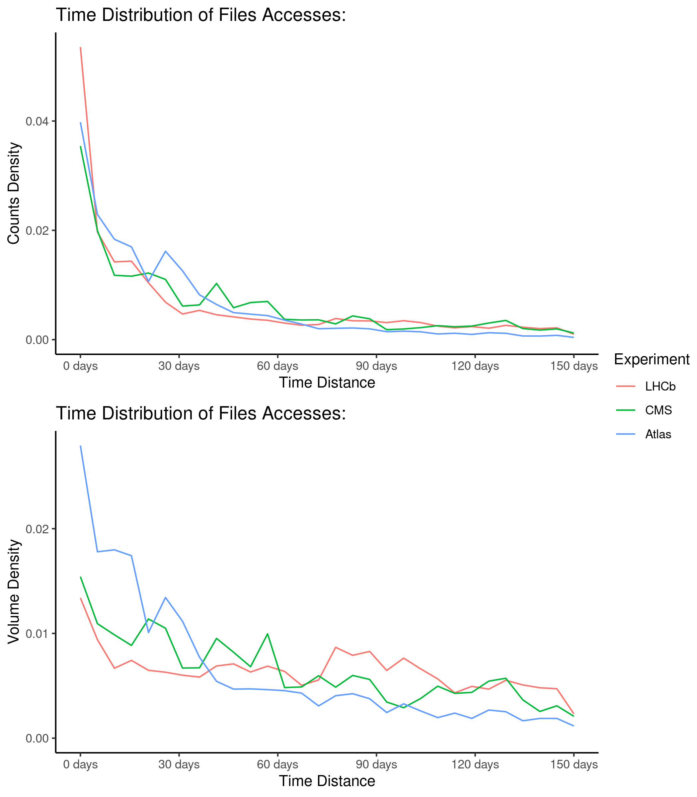
CERN

Slide 46
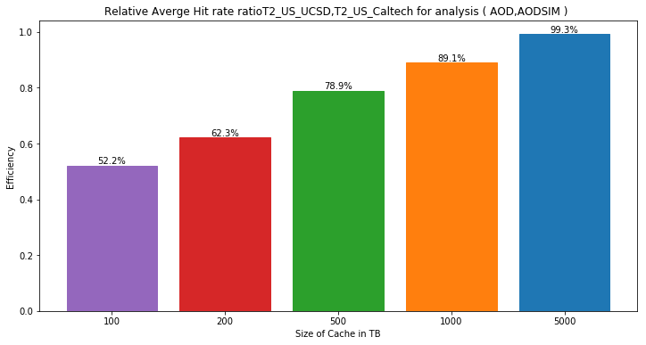
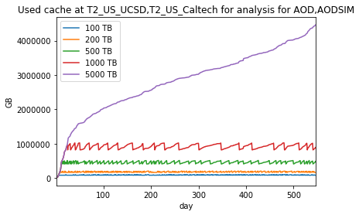
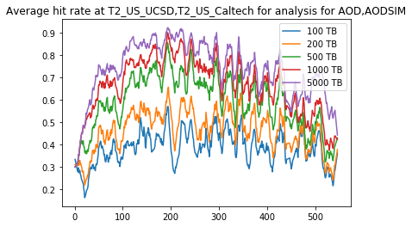
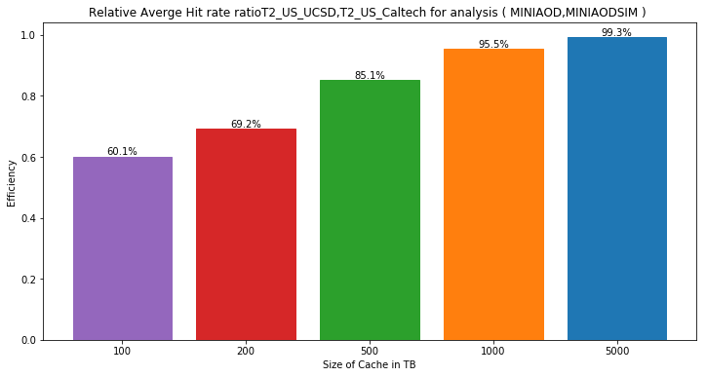
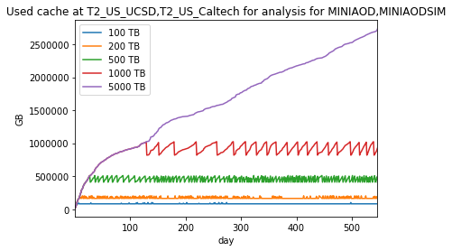
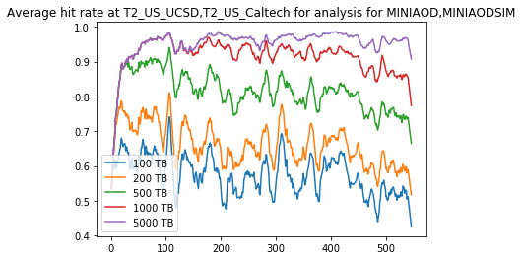
AOD(SIM) vs. MINIAOD(SIM)
No qualitative difference between AOD and MINIAOD
  Choosing to work on MINIAOD as AOD usage for analysis will reduce in the future

Slide 47
Data management operations: copy and delete
Small differences between analysis and prod data:

Slide 49
File access patterns

Slide 50
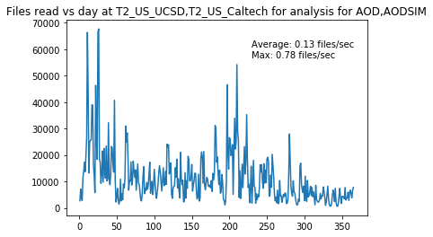
File access rates at a T2

