Slide 1
A Graph Neural Network Approach for Neutrino Signal Reconstruction from LarTPC Raw Data
A. Maksim, S. Vallecorsa, F. Carminati
P. Sala, M. Alonso, S. Monsalve, M. Pierini
4th November, 2019
Sofia Vallecorsa, Ahmad Siar Hesam

Slide 2
  Introduction
DUNE experiment
The Deep Underground Neutrino Experiment (DUNE)
Two neutrino detectors placed in the world’s most intense neutrino beam.
Exploration of the three-flavor model of neutrino physics

Slide 3
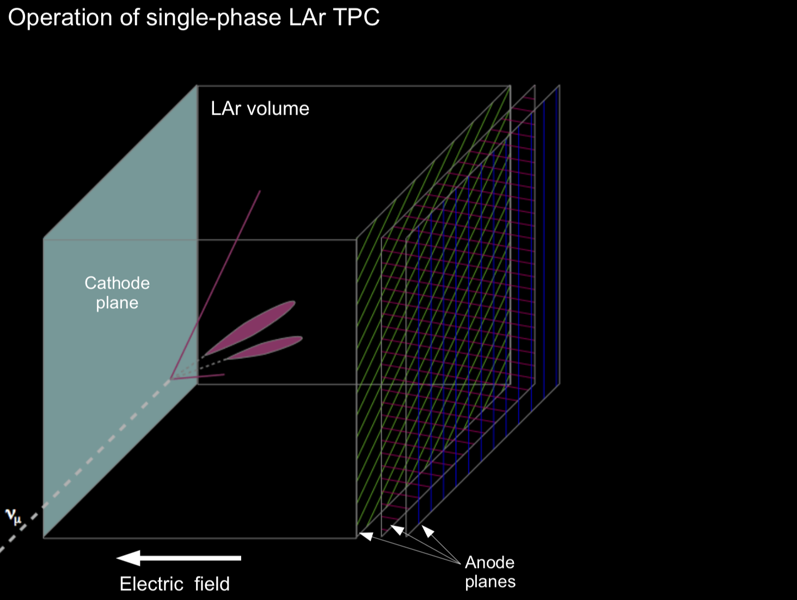
  Setup
protoDUNE TPC
Detector measures the amount of the ionized electrons as the result of the neutrino interactions with argon atoms

Slide 4
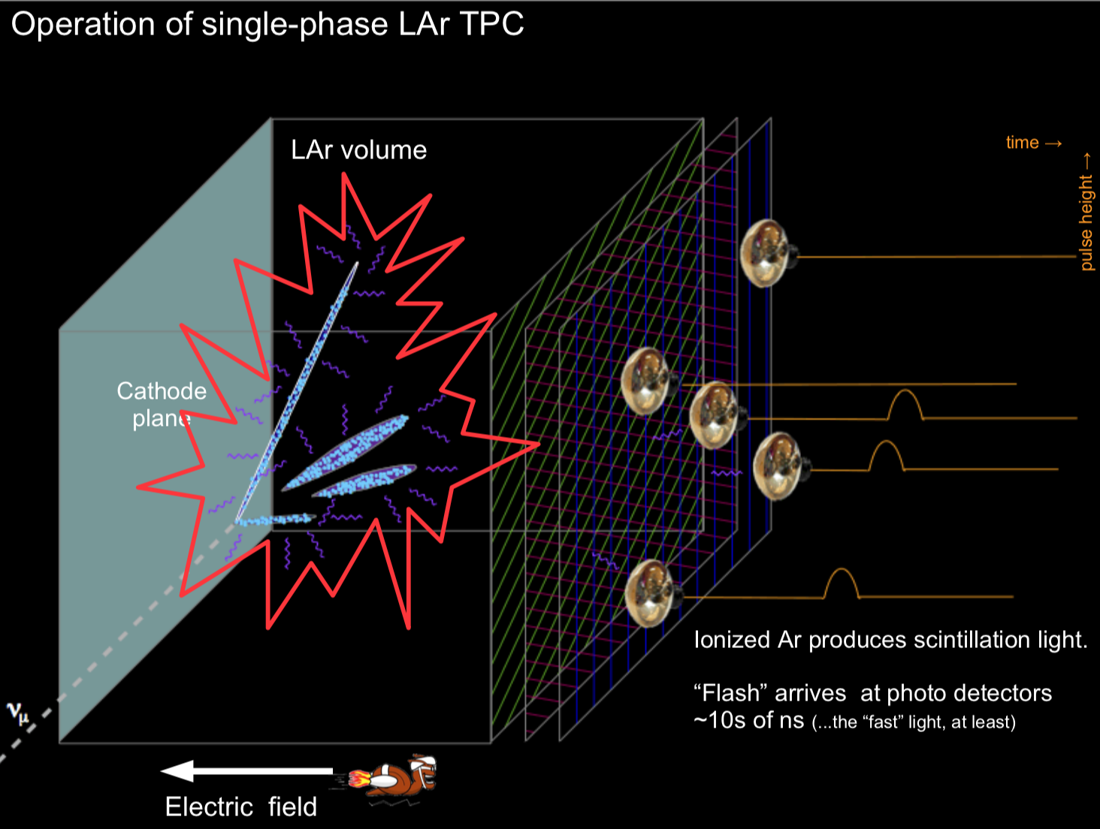
  Setup
protoDUNE TPC
Detector measures the amount of the ionized electrons as the result of the neutrino interactions with argon atoms

Slide 5
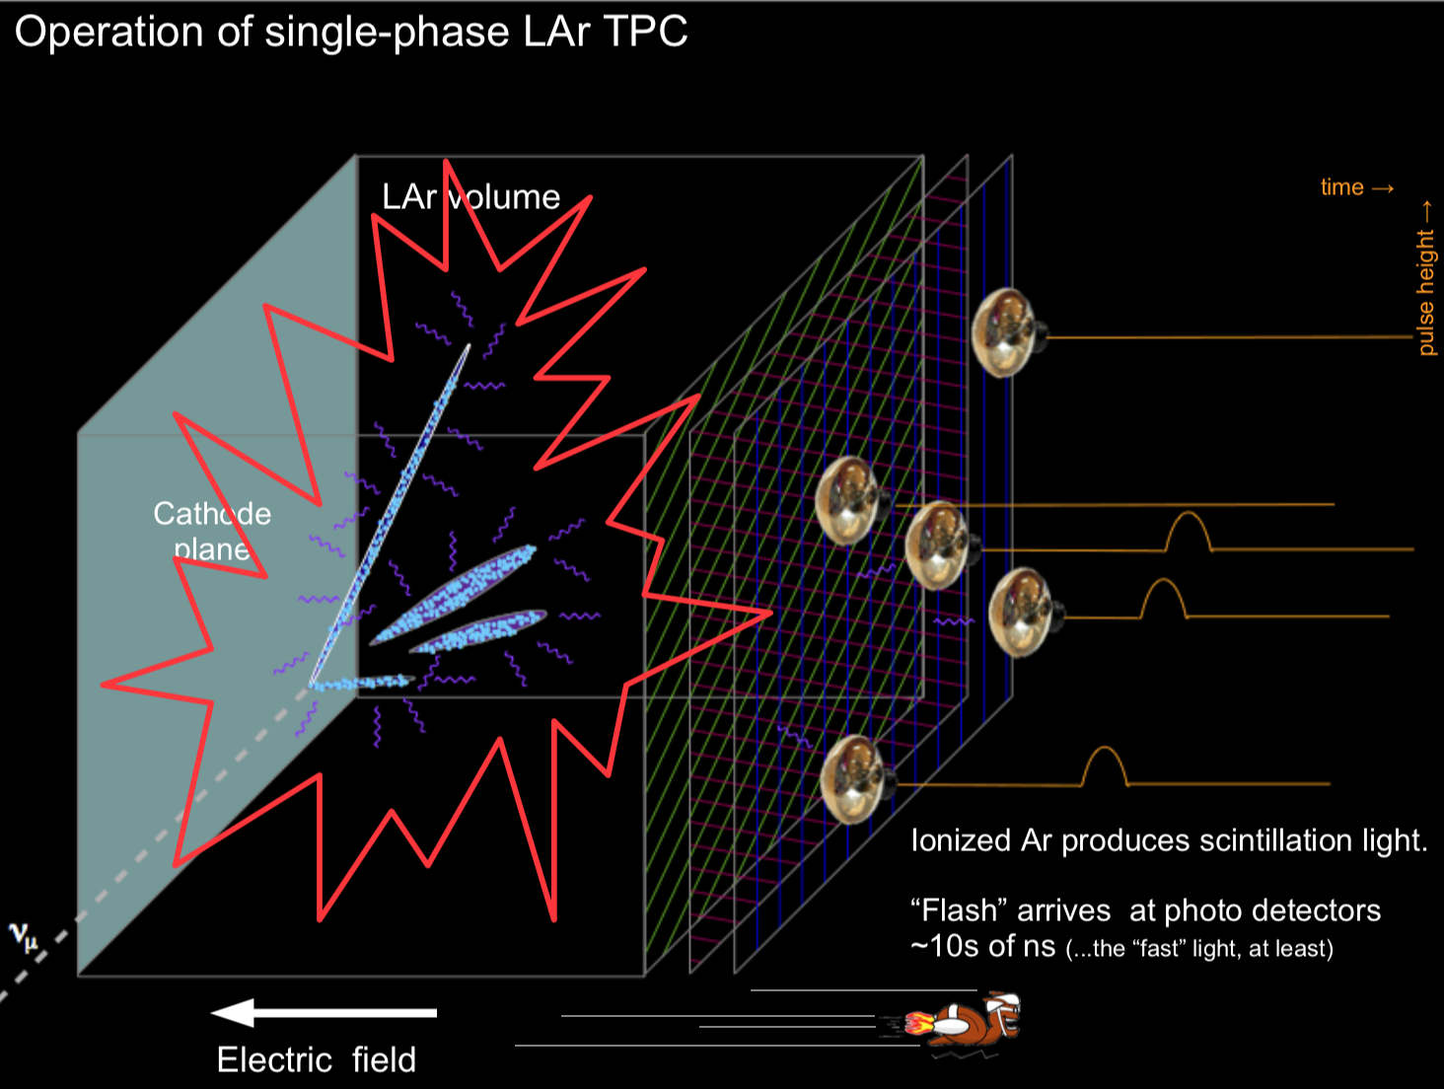
  Setup
protoDUNE TPC
Detector measures the amount of the ionized electrons as the result of the neutrino interactions with argon atoms

Slide 6
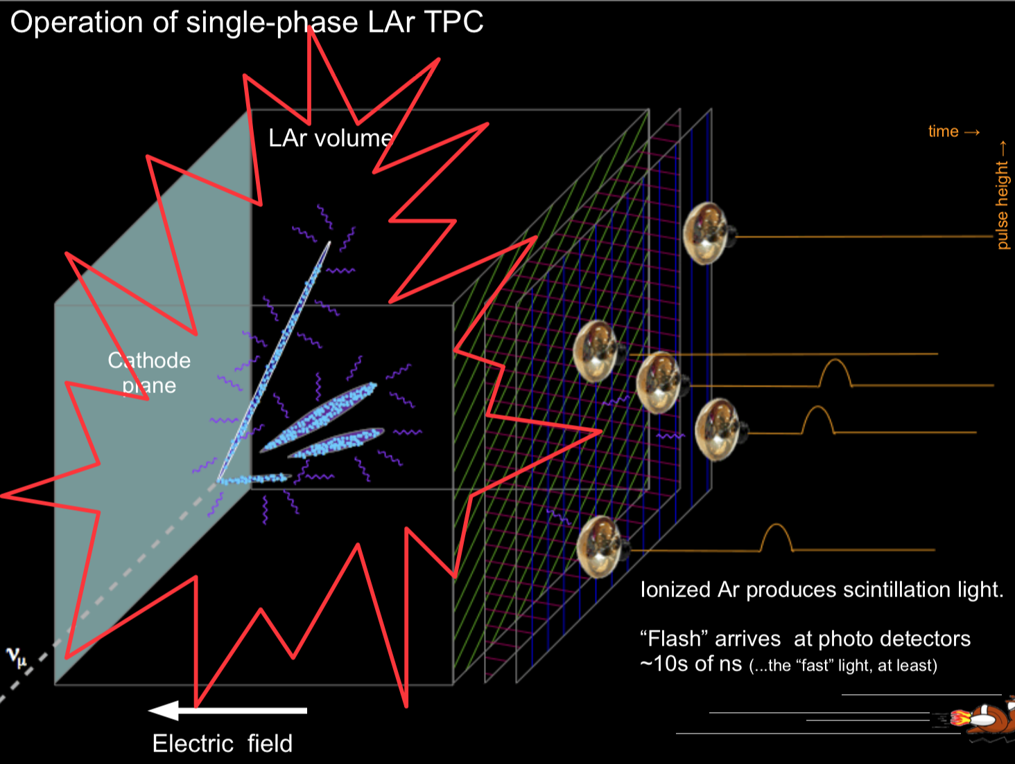
  Setup
protoDUNE TPC
Detector measures the amount of the ionized electrons as the result of the neutrino interactions with argon atoms

Slide 7
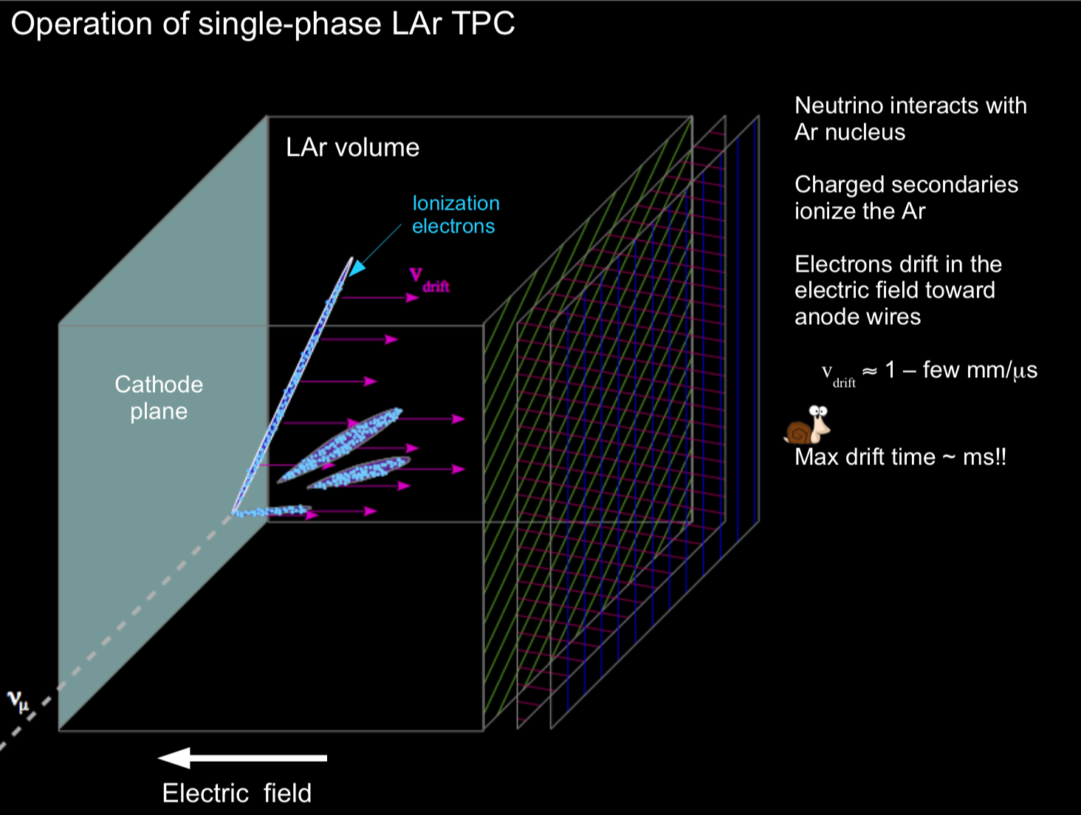
  Setup
protoDUNE TPC
Detector measures the amount of the ionized electrons as the result of the neutrino interactions with argon atoms

Slide 8
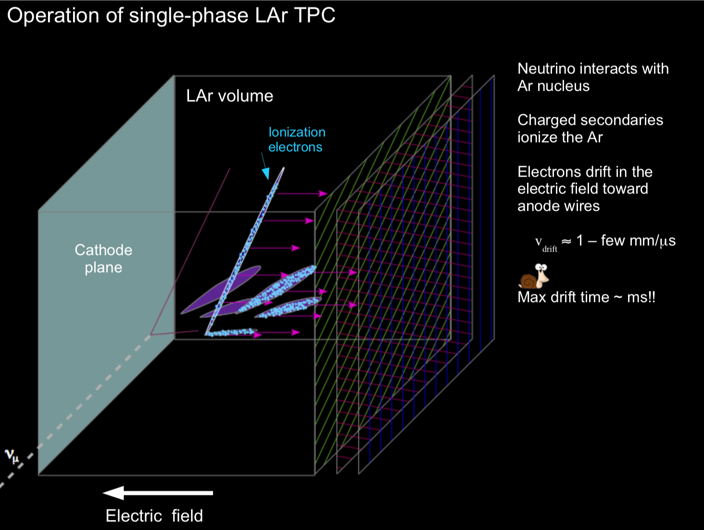
  Setup
protoDUNE TPC
Detector measures the amount of the ionized electrons as the result of the neutrino interactions with argon atoms

Slide 9
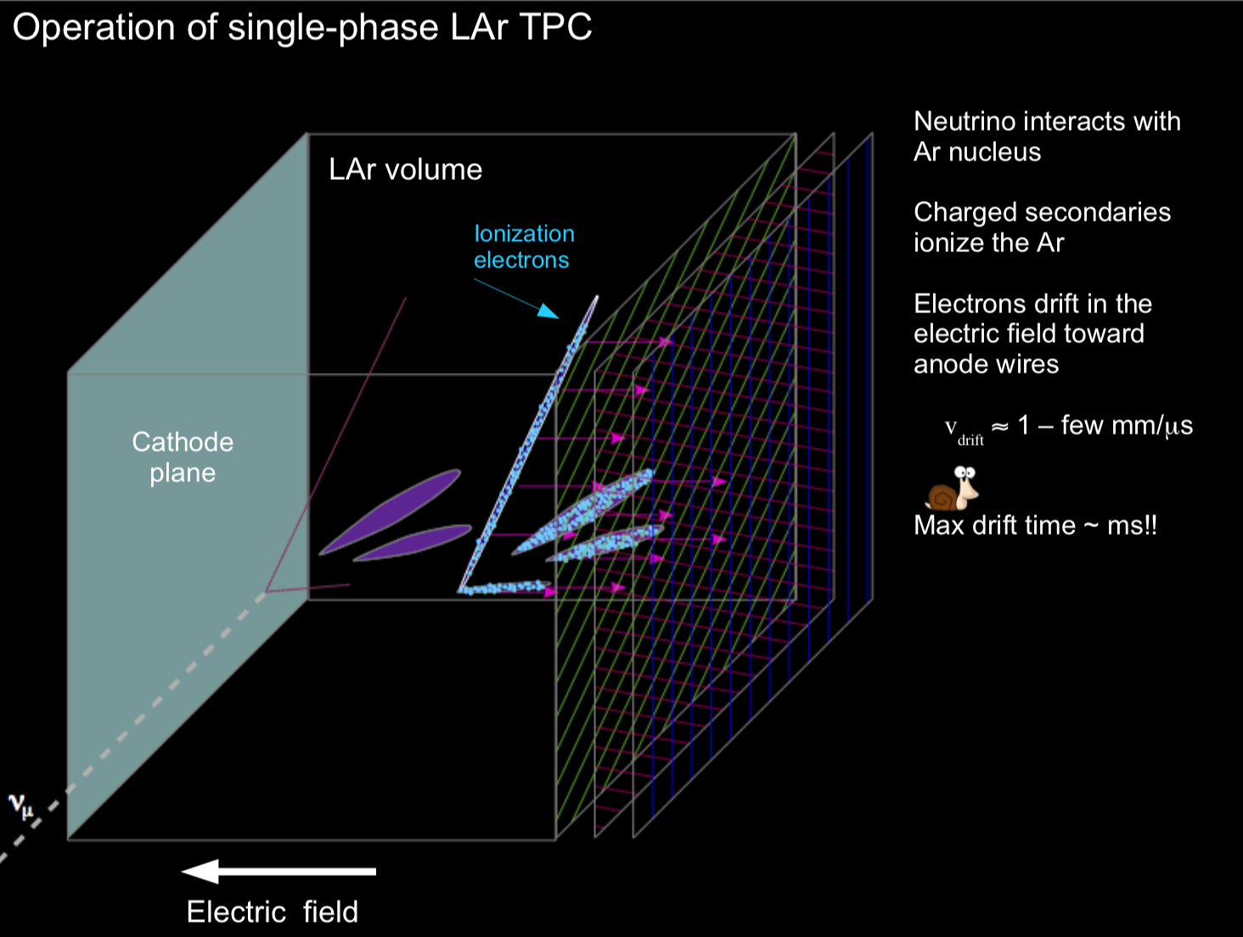
  Setup
protoDUNE TPC
Detector measures the amount of the ionized electrons as the result of the neutrino interactions with argon atoms

Slide 10
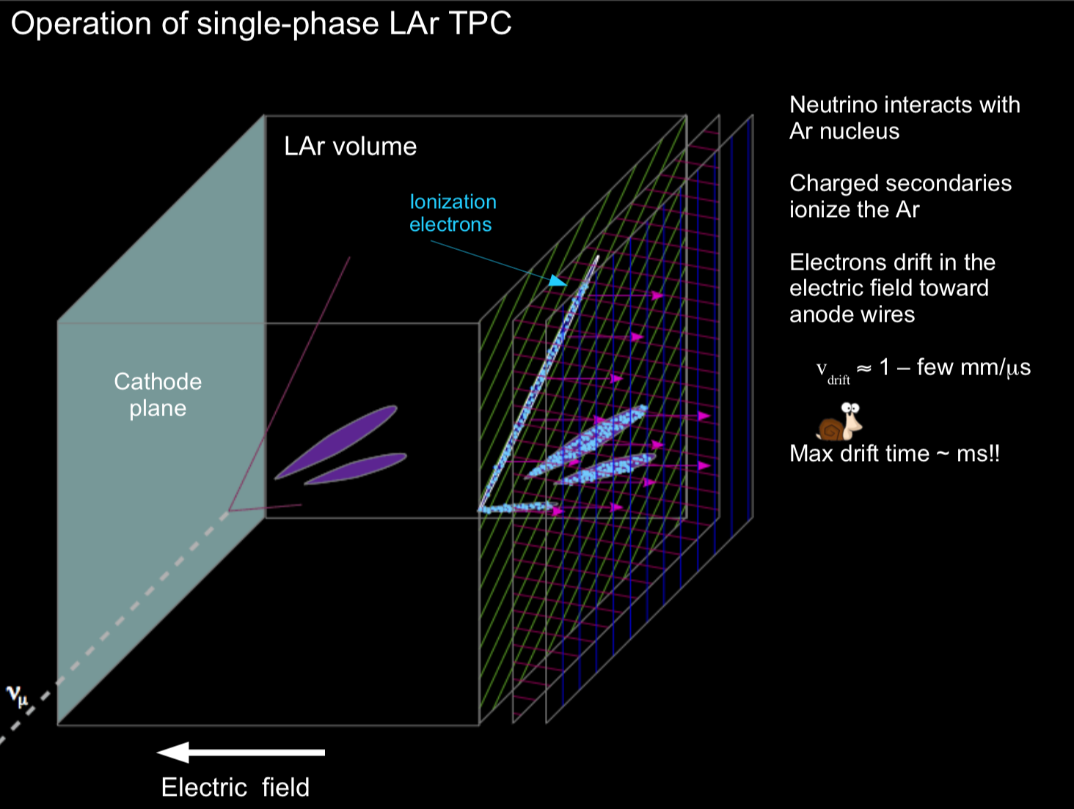
  Setup
protoDUNE TPC
Detector measures the amount of the ionized electrons as the result of the neutrino interactions with argon atoms

Slide 11
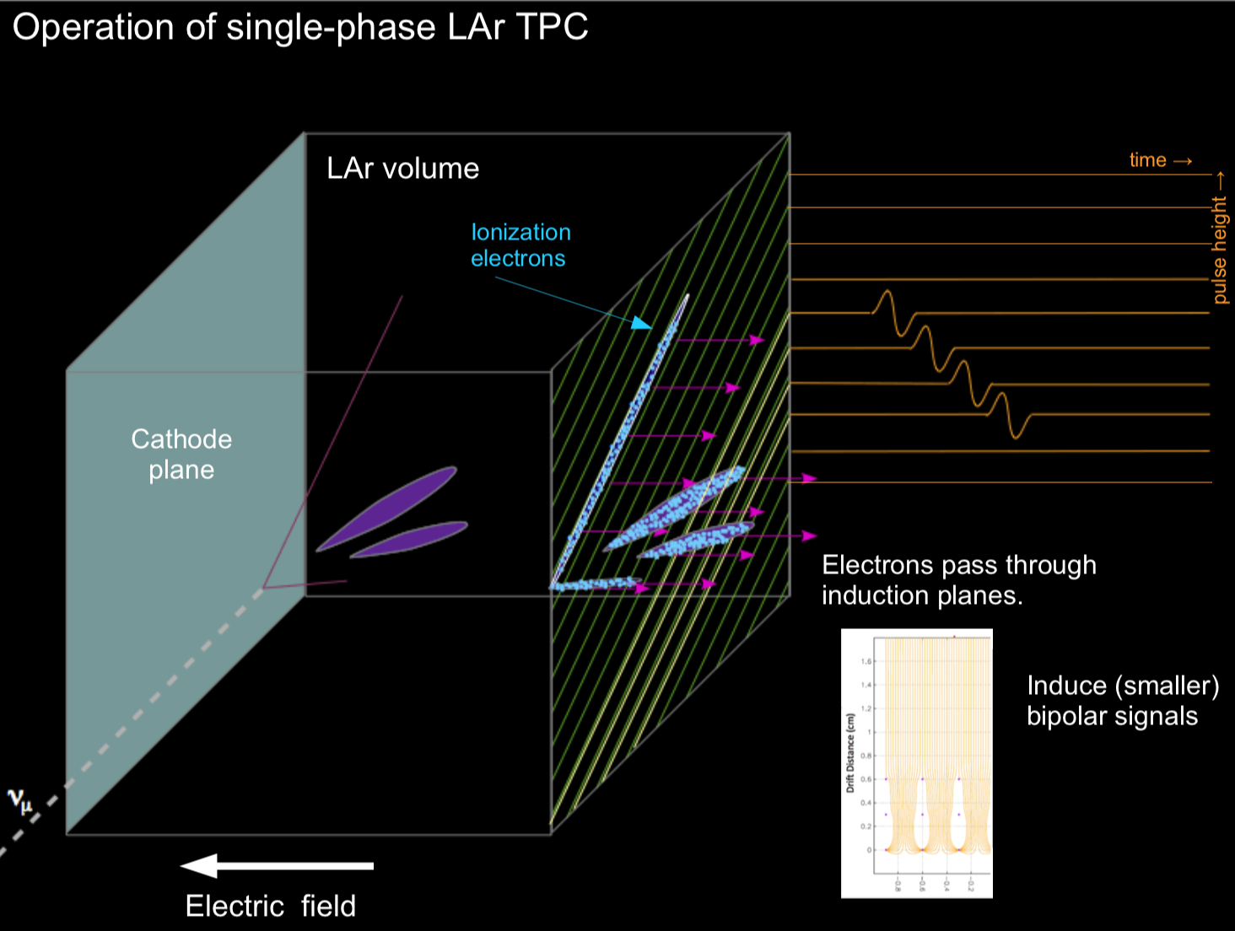
  Setup
protoDUNE TPC
Detector measures the amount of the ionized electrons as the result of the neutrino interactions with argon atoms

Slide 12
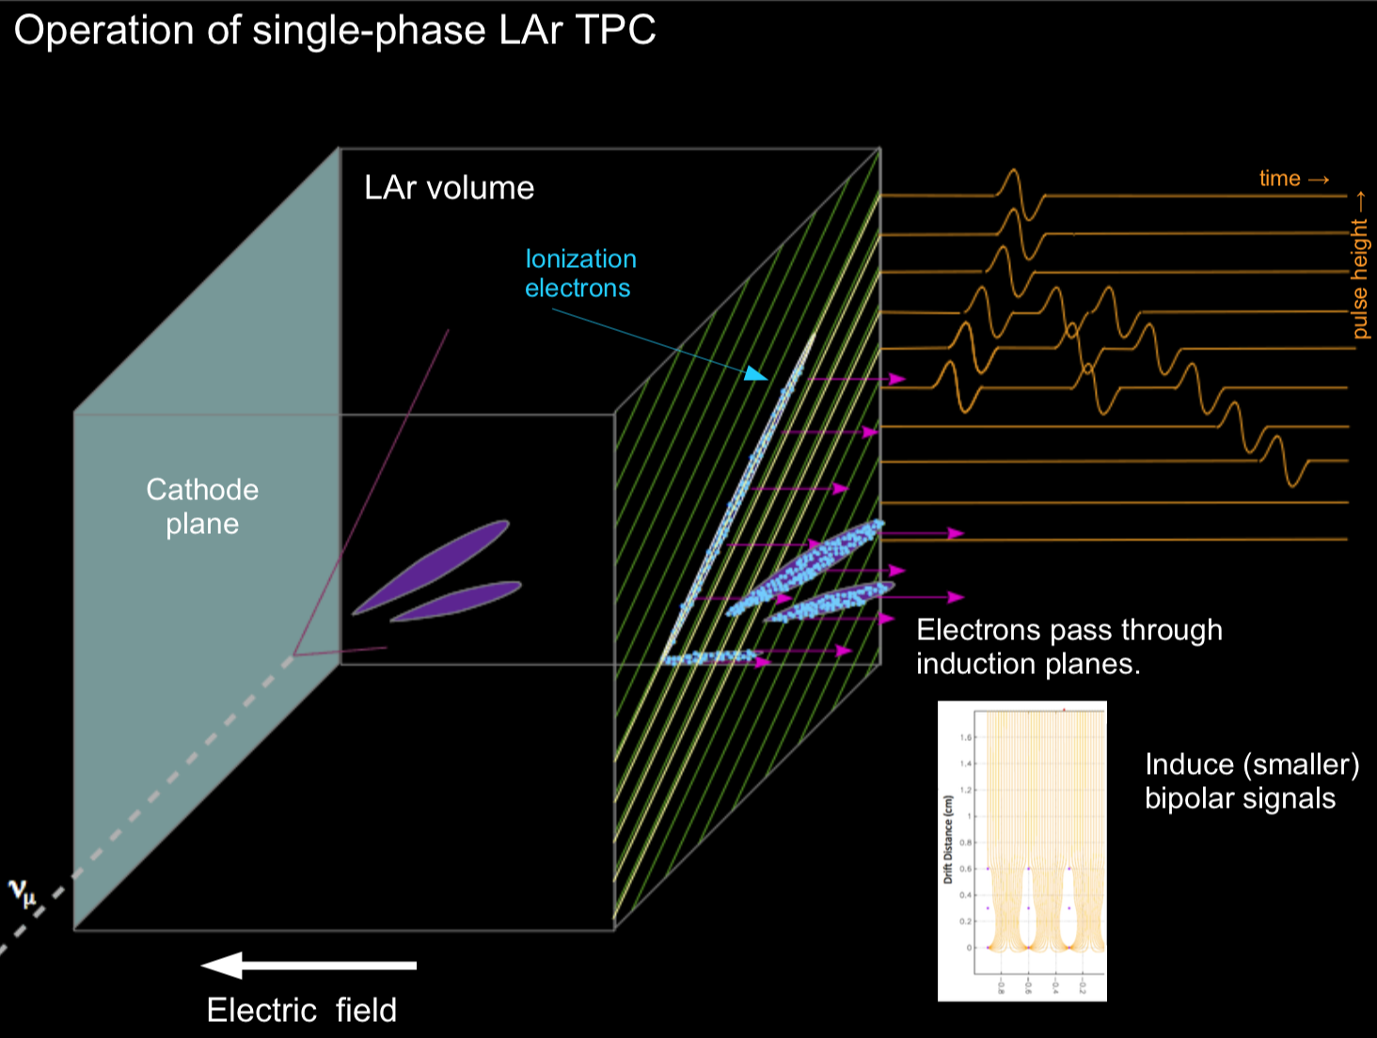
  Setup
protoDUNE TPC
Detector measures the amount of the ionized electrons as the result of the neutrino interactions with argon atoms

Slide 13
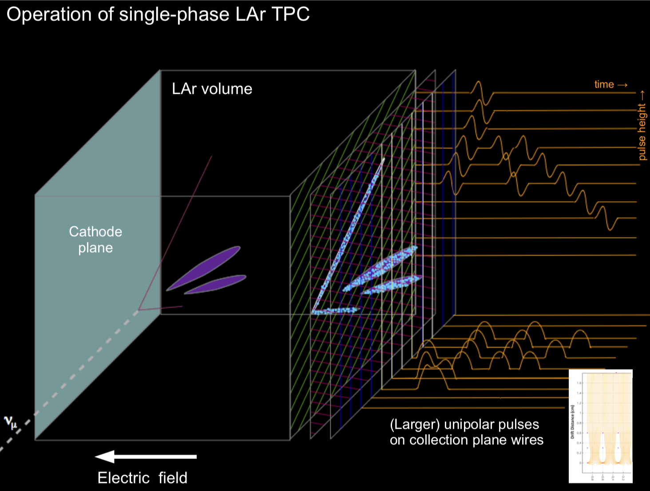
  Setup
protoDUNE TPC
Detector measures the amount of the ionized electrons as the result of the neutrino interactions with argon atoms

Slide 14
protoDUNE Data
protoDUNE experiment

Slide 15
  Current pipeline
protoDUNE experiment
Denoising
Hit finding
Energy Reconstruction
PID DL Model

Slide 16
  Ideal pipeline
protoDUNE experiment
Denoising
Hit finding
Energy Reconstruction
PID DL Model
Preprocessing DL Model

Slide 17

  Denoising Model
Convolutional layers
Advantages:
  Fast
  Reliable
  Easy to use
Disadvantages
  Small receptive field
  Can’t use cross-pixel similarity

Slide 18
  Denoising Model
Graph-Convolutional layers
Advantages:
  Enormous receptive field
  Well suited for sparse data
  Can use cross-pixel similarity
Disadvantages
  Slow for big images
  Memory inefficient

Slide 19
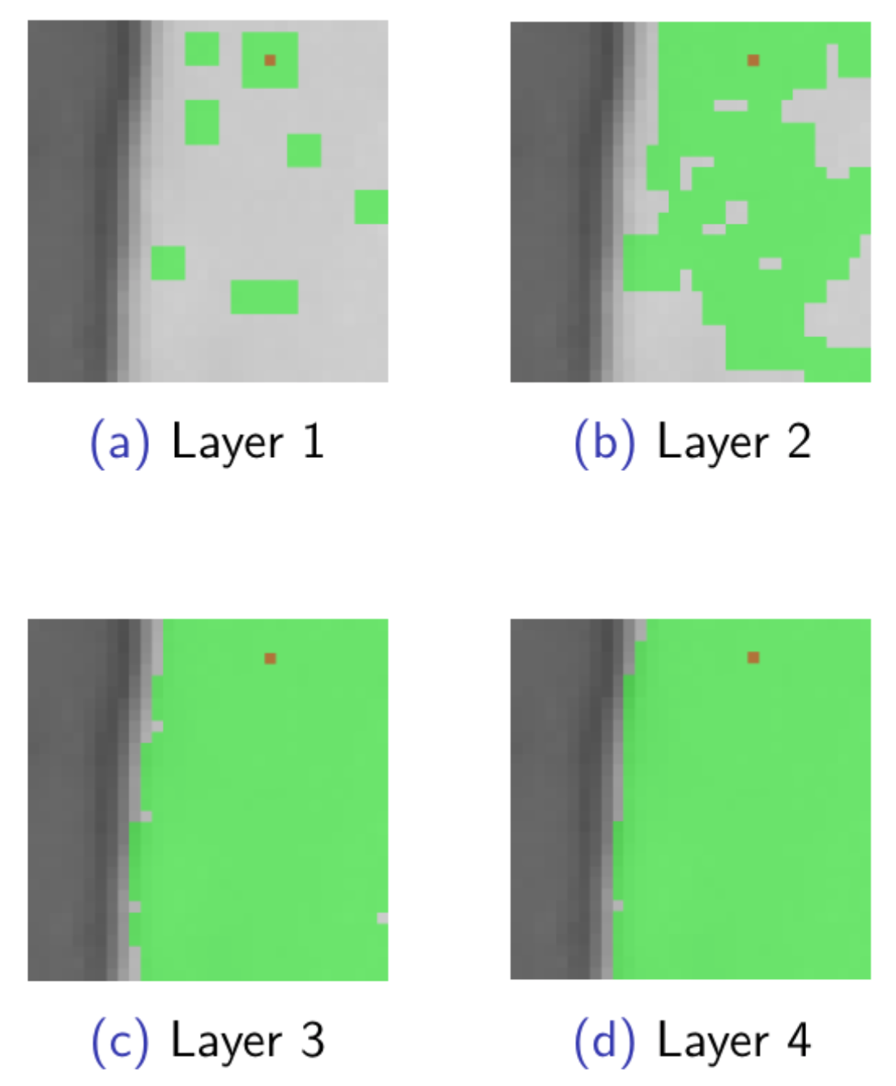
  Denoising Model
Graph-Convolutional layers
Green - receptive field of a single pixel
Each consecutive application of the Graph-Convolutional layer greatly increases the receptive field

Slide 20
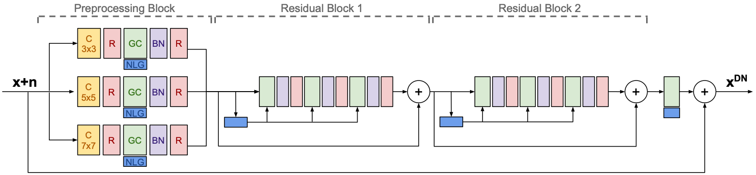
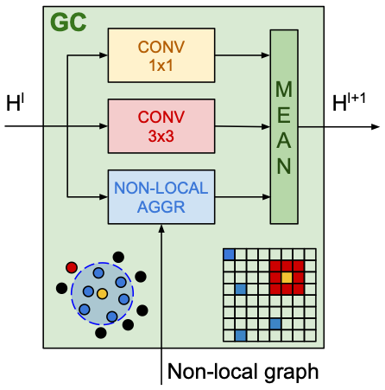
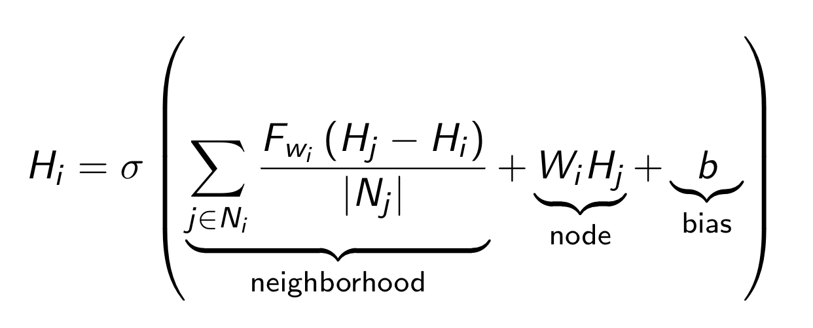
  Denoising Model
Full model
С 3x3
Convolutional Layer 3x3
GC
Graph-Convolutional Layer

Slide 21
  Denoising Model
Results
CIFAR-100 32x32 Denoising
Result of our denoising DL model

Slide 22
  Denoising Model
Results
protoDUNE 32x32 Denoising
Result of our denoising DL model

Slide 23
Sampling technique
Problems
It’s hard to work with full event (4000x1000) images.
        A way to split an image into chunks of smaller size (32x32) is needed.
The naive approach is to split image into chunks the grid with cell size of 32x32.
Unfortunately, our image is only ~3% signal and ~97% background. Thus, splitting the grid will only train the network to denoise background.

Slide 24
Sampling technique
Problems
Another possible solution is simply to use a weighted loss with the naive approach. Let’s say we have a 3/97 signal/noise ratio.
Then to train a network we should use a BCE (Binary Cross Entropy) with 0.97/0.03
This way we can control our network’s signal/background priorities, but we still must process whole image, while getting only 0.03 useful information from each background patch

Slide 25
Sampling technique
Problems
Our approach is to use a specific sampling technique to get necessary signal/background ration while maintaining a reasonable training complexity:
Treat each pixel as a center of an according patch (32x32)
Normalize each pixel value and add a constant C (~0.05) to each background pixel
Treat each pixel value as a sampling probability of the pixel’s patch

Slide 26
Sampling technique
Problems
Sample from all pixels with their probability
Sample a number N (~100) of pixel patches from previously sampled pixels
Repeat until the training dataset is created
Using this approach one can balance signal/background ratio with constant C and maintain the amount of information gained from the image with constant N.

Slide 27
Perceptual loss
Problems
Training a big model with a simple MSE (Mean Square Error) loss is very unstable. To stabilize the process one can use the perceptual loss technique.
The goal is to make the hidden representation of the noised image similar to the clear one, to teach network to iteratively remove noise layer by layer.
The recommended way is to submit to the network both clear and noised patches and then to apply MSE loss to the output of a number of hidden layers as well as to the model output

Slide 28
  General Model
Full model
Denoising
Recreate clear image
Hit finding
Select only interesting tracks
Energy Reconstruction
Reconstruct real energy values

Slide 29
  Summary
Implemented the denoising model on Pytorch (DL framework) from scratch
Proposed new perceptual loss to stabilize the training
Developed a new approach to process high-resolution images
The general model can be used to imitate the whole preprocessing step
The model implemented (even KNN search) as a matrix-multiplication sequence, thus making it easy to replicate it to the FPGA

Slide 30
References
Fancy setup slides are from «Introduction to LArSoft» presentation of Erica Snider @ Fermilab
GC-Layers are from https://arxiv.org/abs/1905.12281
Perceptual loss are from https://arxiv.org/abs/1603.08155

