Slide 1
ATLAS Public Web Pages
Evolution to Drupal 8
K. Anthony, Universita degli Studi di Udine
S. Goldfarb, University of Melbourne (Speaker)
M. Hutinet, Haute Ecole Spécialisée de Suisse Occidentale – Genève
S. Mehlhase, Ludwig Maximilians Universitat
C. Nellist, Nikhef National institute for subatomic physics
Presented on behalf of the ATLAS Collaboration at CHEP, Adelaide, Australia, 5 Nov, 2019

Slide 2
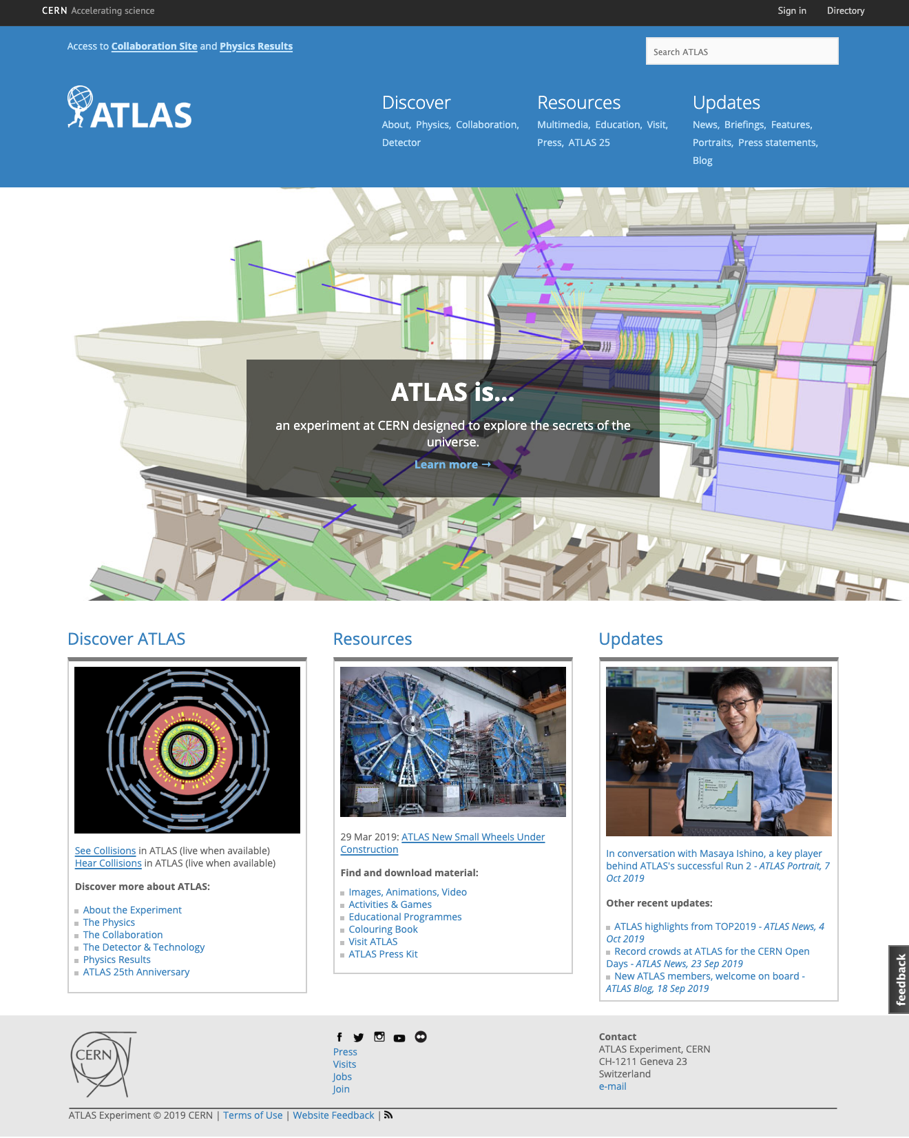
ATLAS Public Web Site
http://atlas.cern
Public access to
Descriptions of Experiment
Educational Resources
Updates (News, Briefings, Blog, etc.)
In Drupal since March, 2016
Replaced original html site
Developed in Drupal 7
Maintained by ATLAS Communication Team

Slide 3
Spikes correspond to publications, events
Steady growth over 3+ years (now around 30k views/week)

Slide 4
Migration to Drupal 8
Motivation
  Drupal is an Open Source Content Management System (CMS)
    Selected for security, management of large sites
  CERN supports Drupal 7 until mid-2020
    CERN guarantees support for Drupal 8
  Opportunity to Improve ATLAS Public Site
    More dynamic look & feel
    Better, automatic portability between screen sizes
Technicalities
  Migration not automatic
    Change of template language from php to twig
    Original ATLAS designers used short codes in ATLAS theme
  Opportunity to improve maintainability
    Decrease ATLAS-specific code
    Simplify future migrations
Notes:
movingDrupal 7Drupal 7

Slide 5
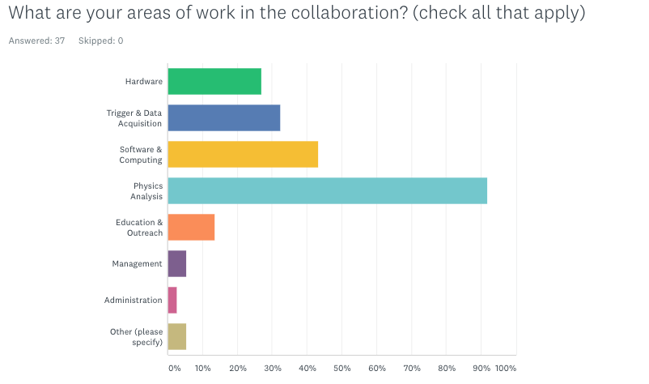
Extracts from Collaboration Poll

Slide 6
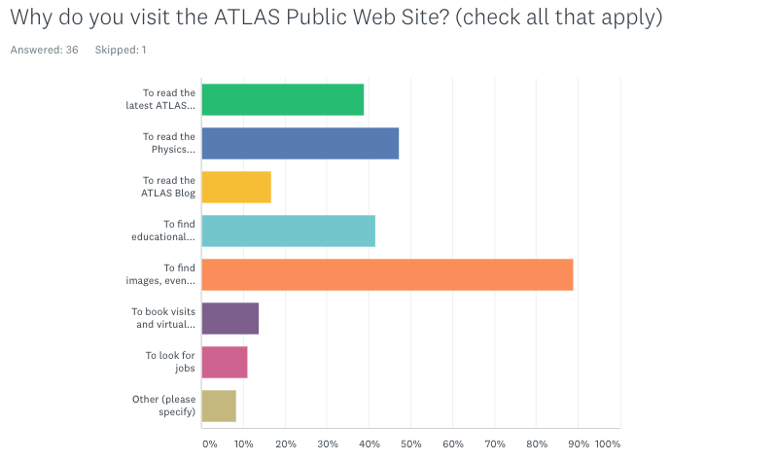
Extracts from Collaboration Poll

Slide 7
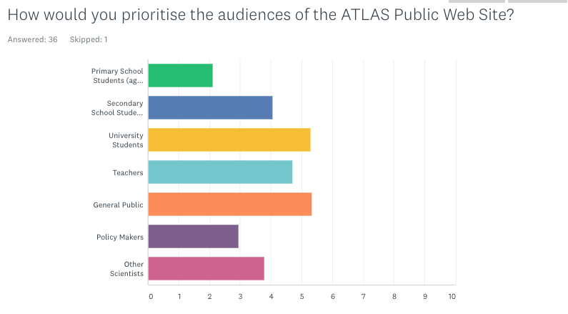
Extracts from Collaboration Poll

Slide 8
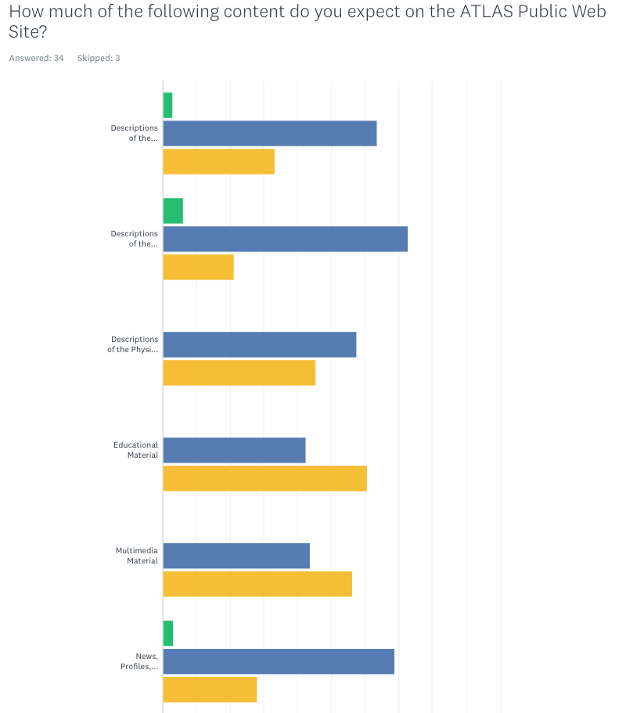
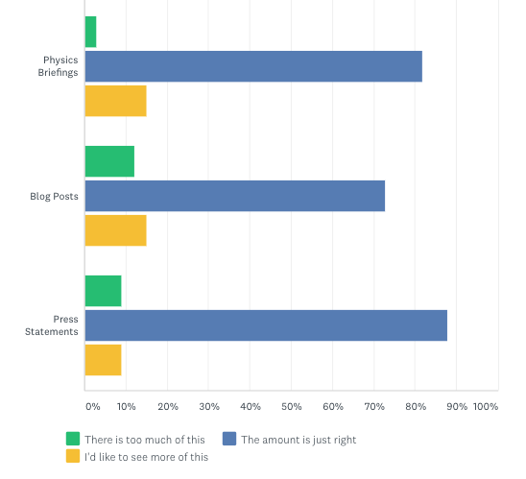
Extracts from Collaboration Poll

Slide 9
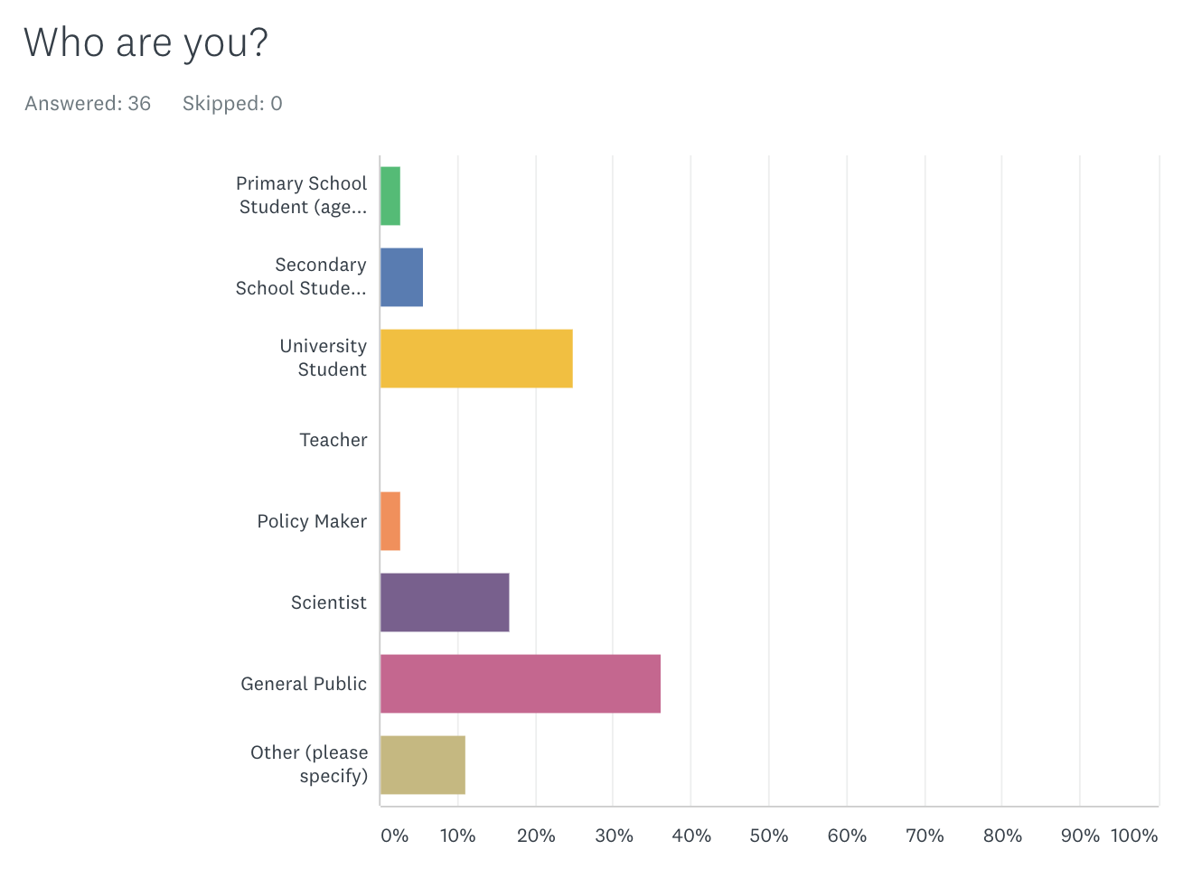
Extracts from Public Poll

Slide 10
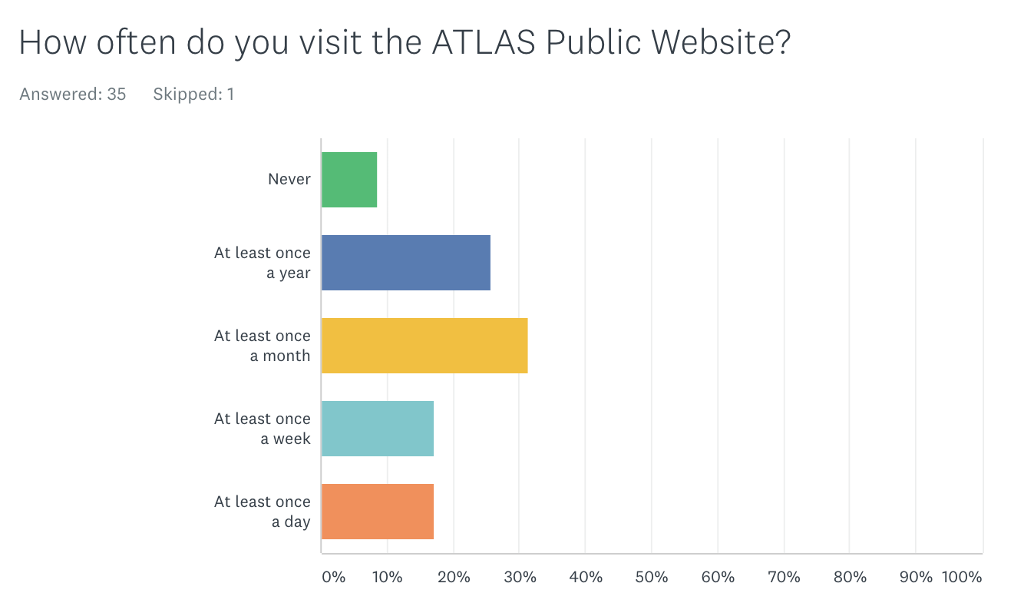
Extracts from Public Poll

Slide 11
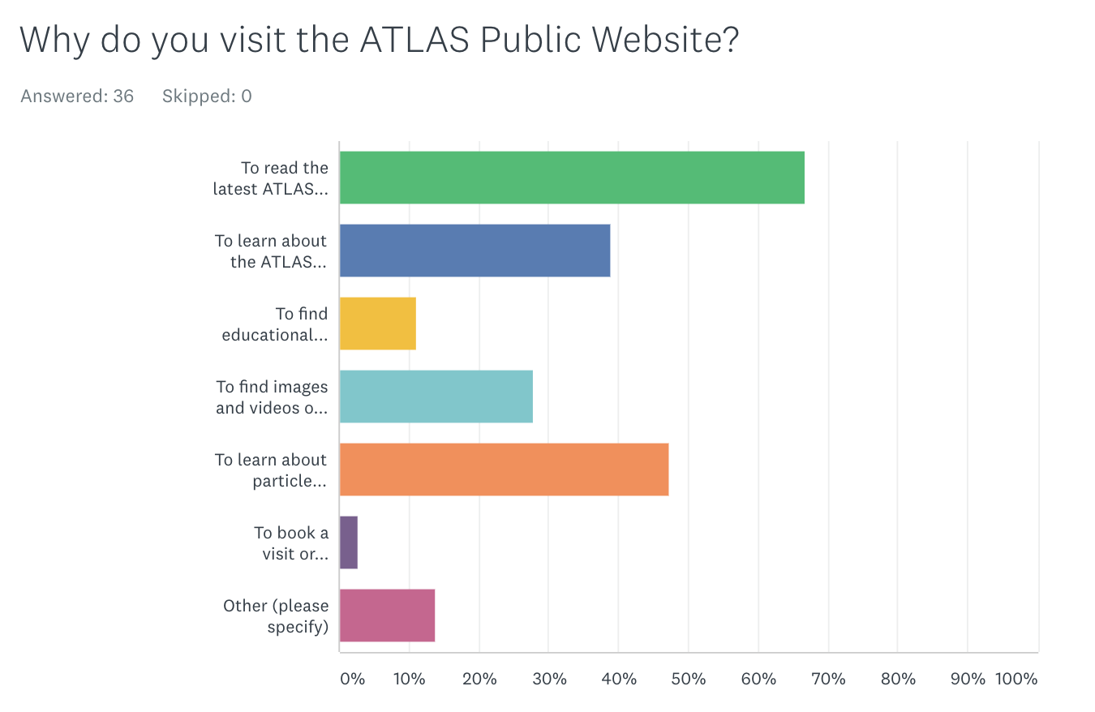
Extracts from Public Poll

Slide 12
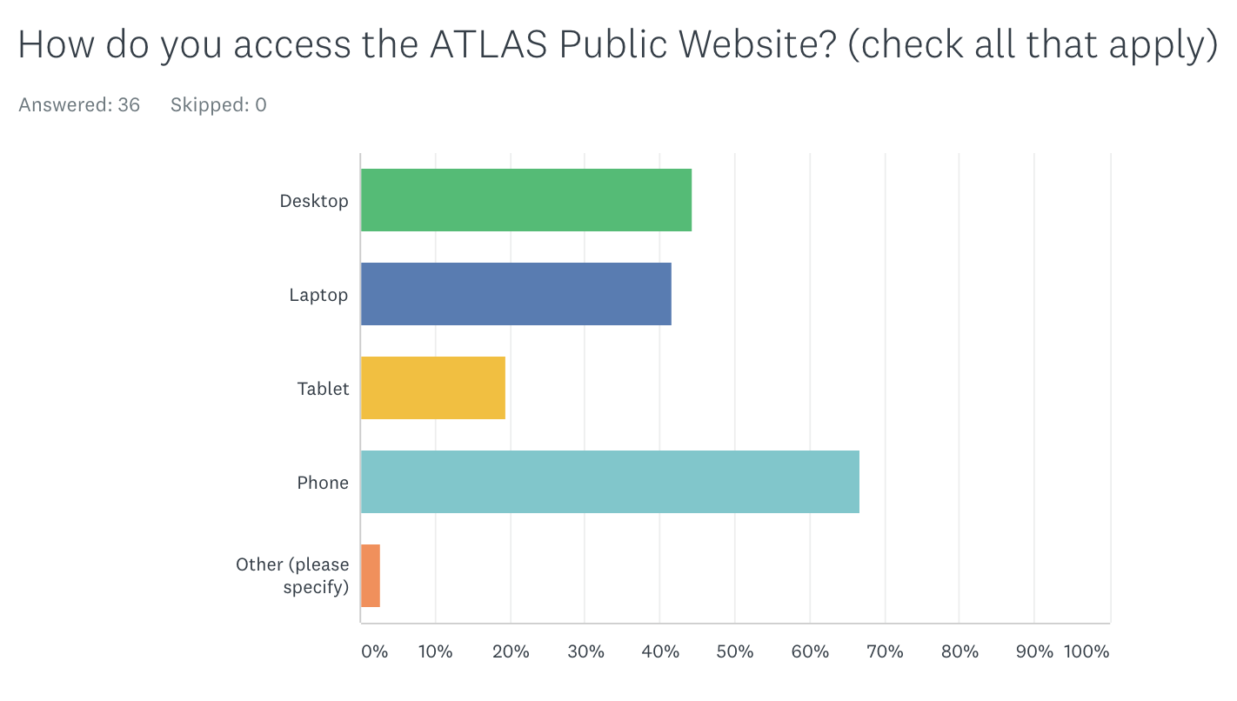
Extracts from Public Poll

Slide 13
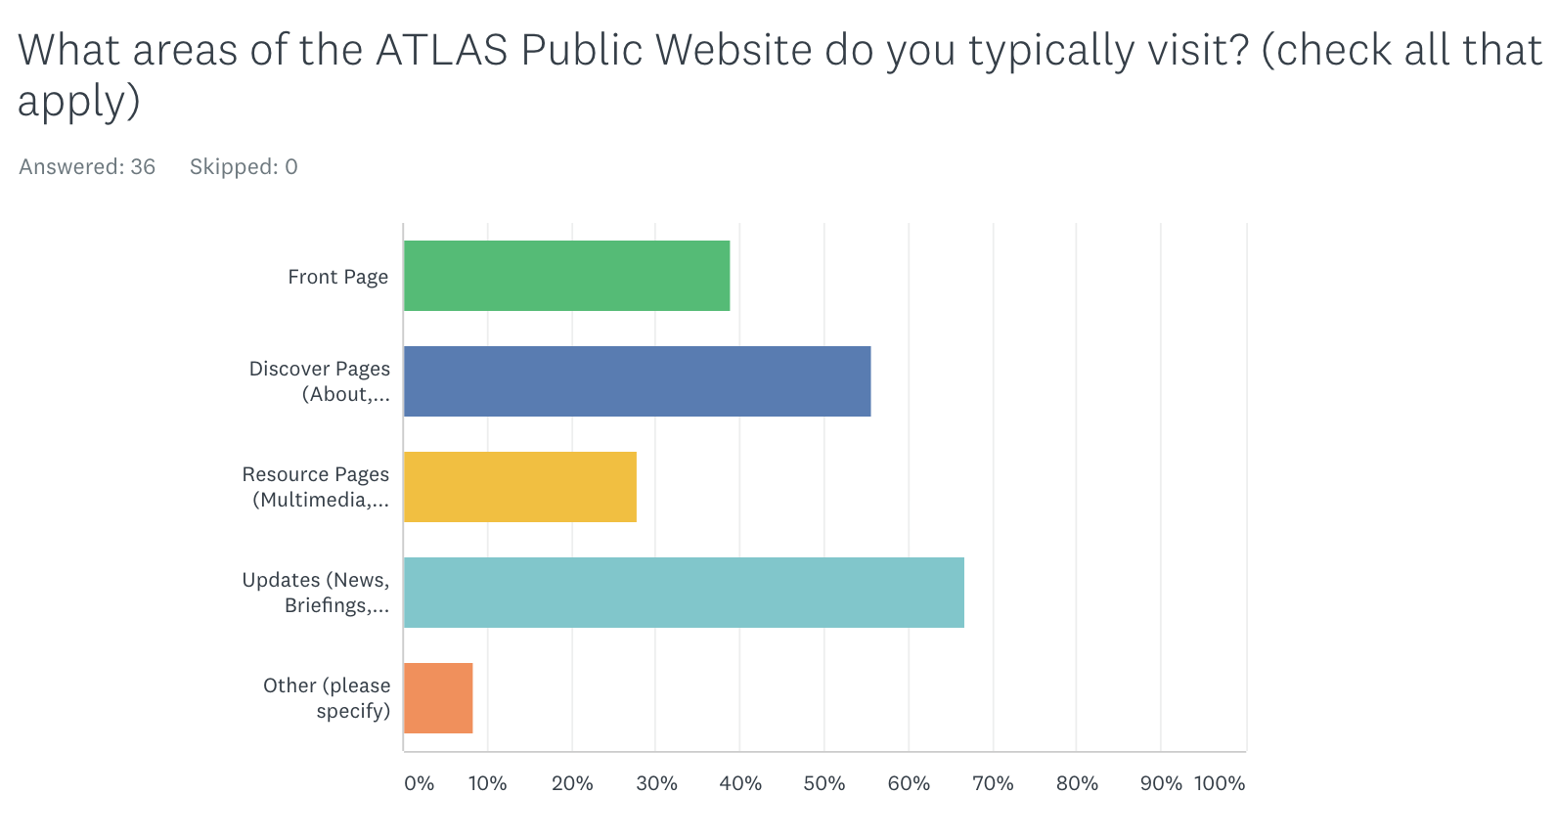
Extracts from Public Poll

Slide 14
Quick Summary of Poll Input
The Collaboration
  Comes to public site for Material, News
  Expect a broad range of audiences
  Want more educational material
The Public
  Identify as General Public, University Students, Scientists
  Visit fairly frequently
  Want the latest News and to learn about ATLAS & Particle Physics
  Uses a variety of screens
In General
  Statistics limited, but matches data from polls of 4 years ago
  Our structure (Description, Educational Material, Updates) remains valid

Slide 15
Migration Wish List
Upgrade Infrastructure
  Rebuild ATLAS site in Drupal 8
    Content Types, Views, Blocks, Style, Tools, Content
  Use “CERN Override” theme instead of “ATLAS” theme
    Remove specialised templates
Improve Design
  Follow current trends
    Dynamic, responsive content (all screen sizes)
    More scrolling, easy to use menus, no hovering
  Better usability for content developers
    Easier Layout Capability
Automated Large-Scale Migration of Content

Slide 16
The Challenge
Content Types
  Current: Glossary Term (22), Home Page (2), Job Posting (400+), Multimedia Page (1), Page (40), Update (400+), Webform (2)
  Drupal 8: Glossary Term, Home Page, Job Posting, Landing Page, Update Virtual Visit, Webform
Views
  Current: Author Profiles, Updates, Blog, Briefings, Features, News, Portraits, Profiles, Press Statements, Updates Side Bars, All Updates pages, RSS Feeds, Glossary, Jobs, Discover, Resources pages
  Drupal 8: Author Profiles, Updates, Blog, Briefings, Features, News, Portraits, Profiles, Press Statements, Glossary, Jobs, Virtual Visits
Totals
  More than 1000 pages of content and a few dozen new landing pages and views

Slide 17
Where Are We, Now?
Design
  ATLAS Visual Identity Implemented in CERN Override
    Colour Palette, Logo, Favicon, Fonts (no, not comic sans, but open sans)
  Regions & Blocks Similar to Drupal 7 site
    Forced to redefine footer, but not an issue
Content Types
  Using Landing Page as is, others redefined, as in Drupal 7
  Being tested and refined (77 nodes, so far)
Views
  Re-defined as in Drupal 7
  Being tested and refined
Which ATLAS
used FIRST!!!

Slide 18
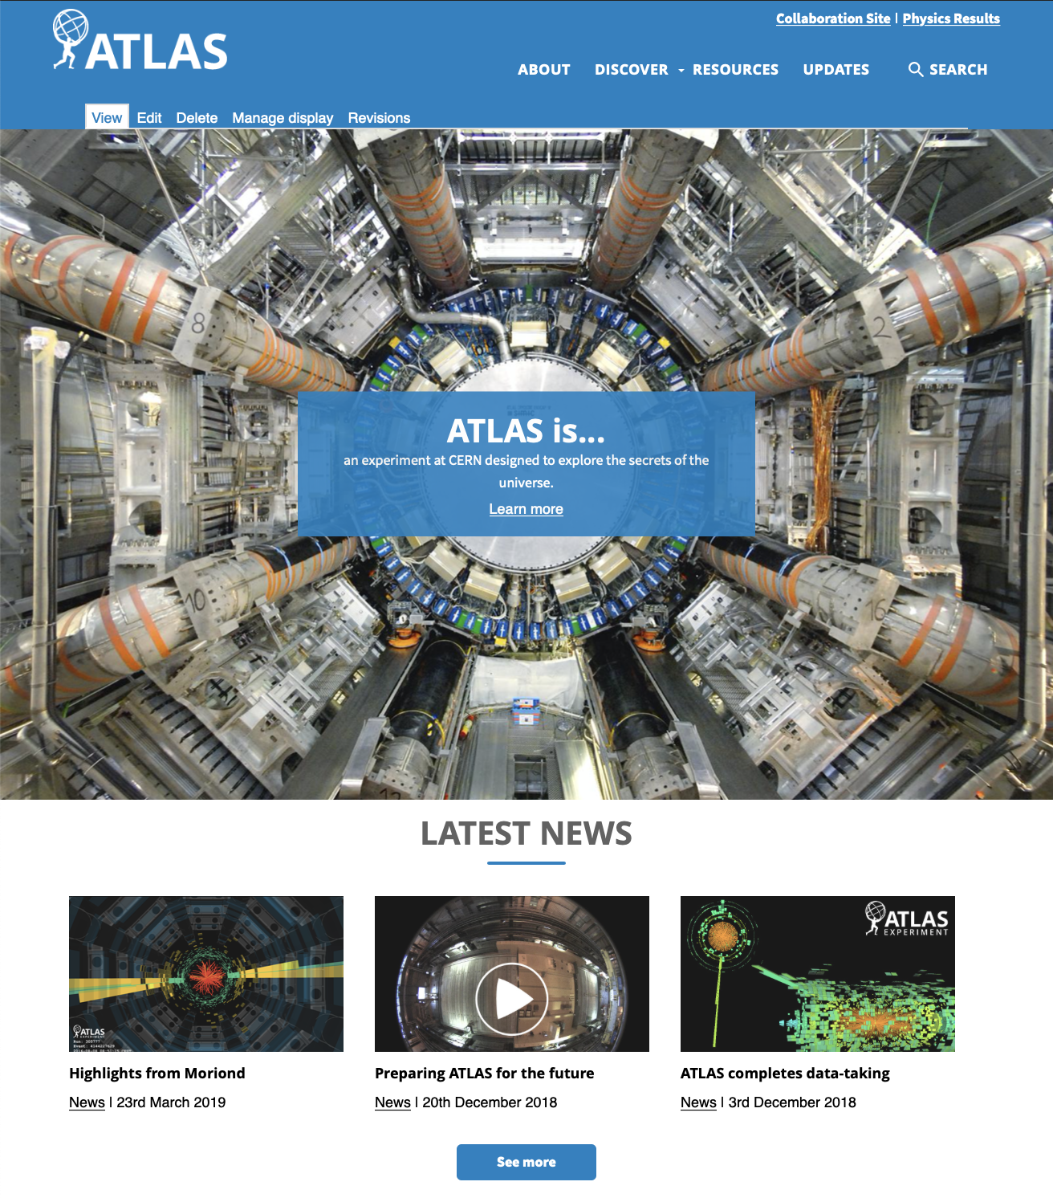
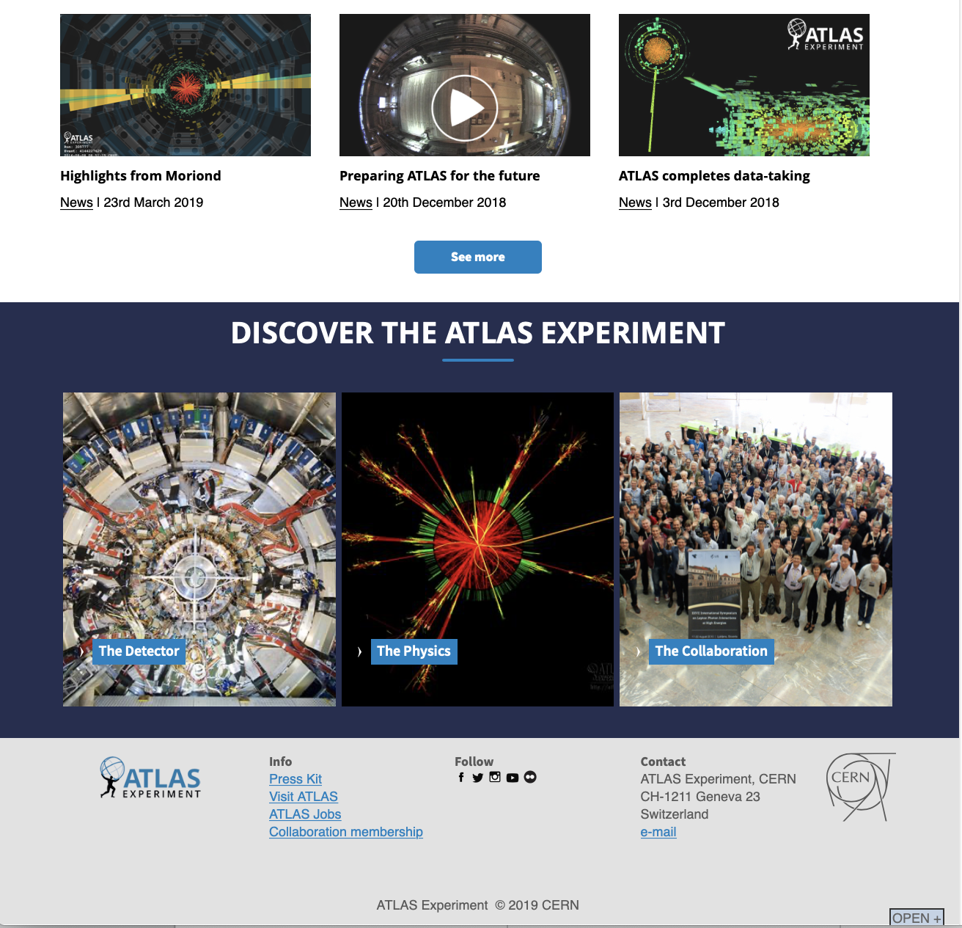
Work in progress…

Slide 19
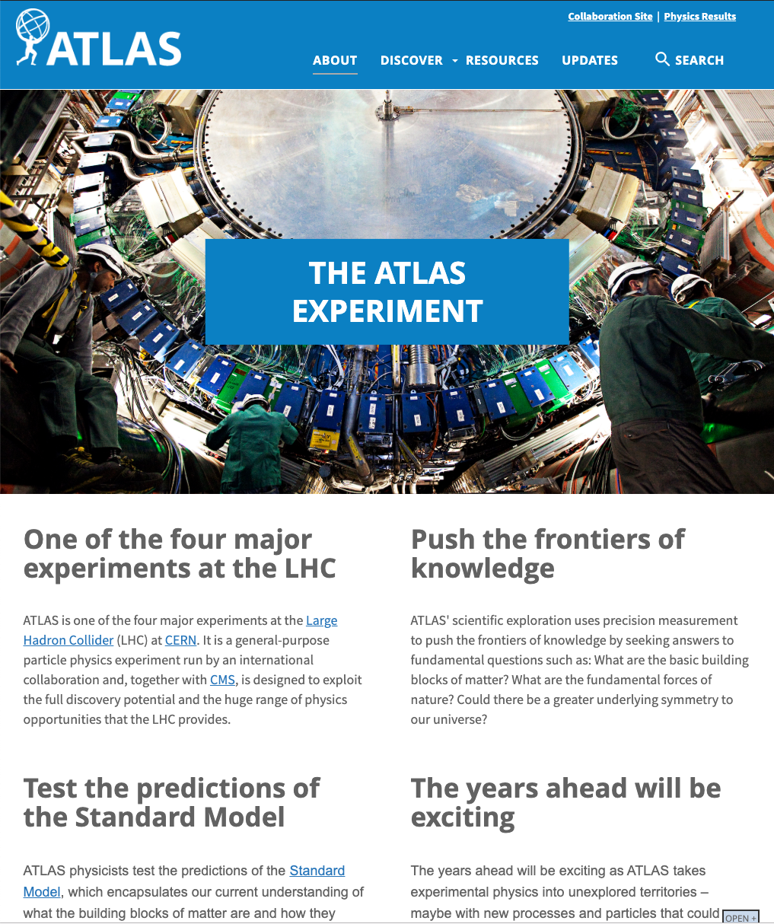
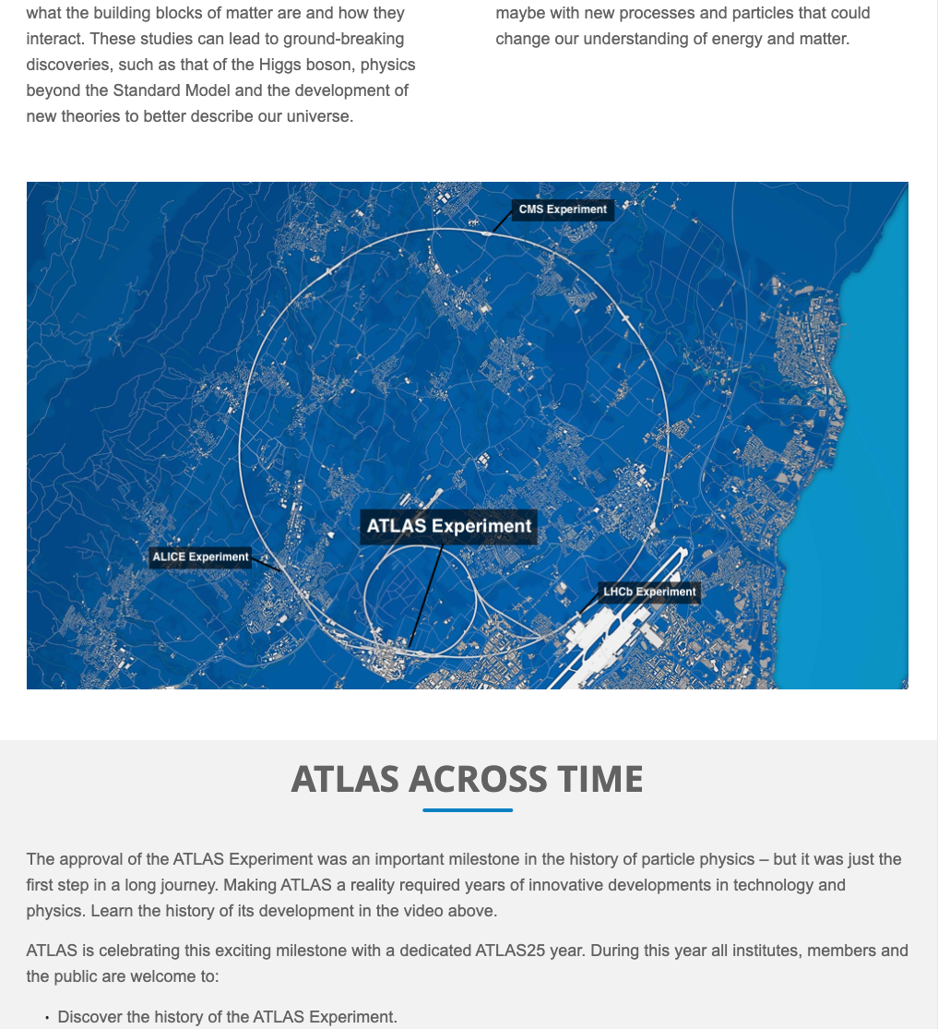
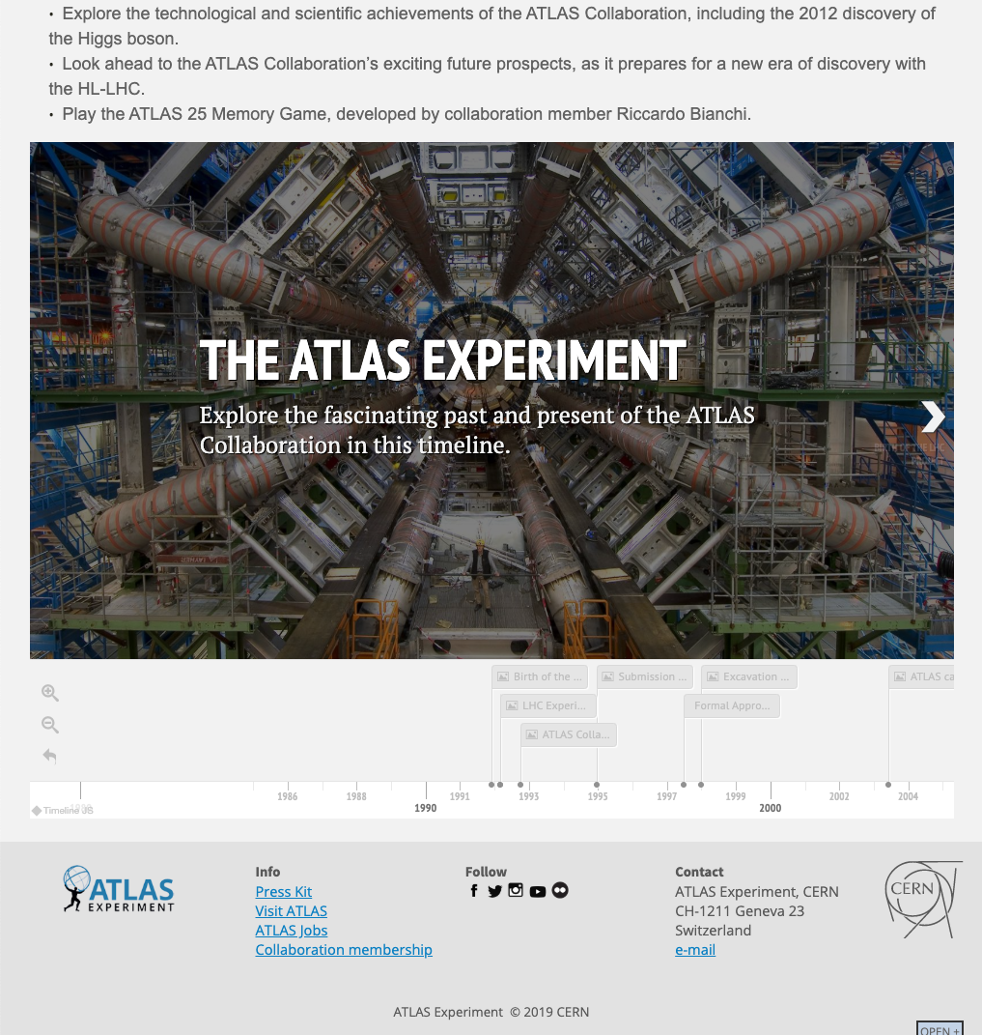
Work in progress…

Slide 20
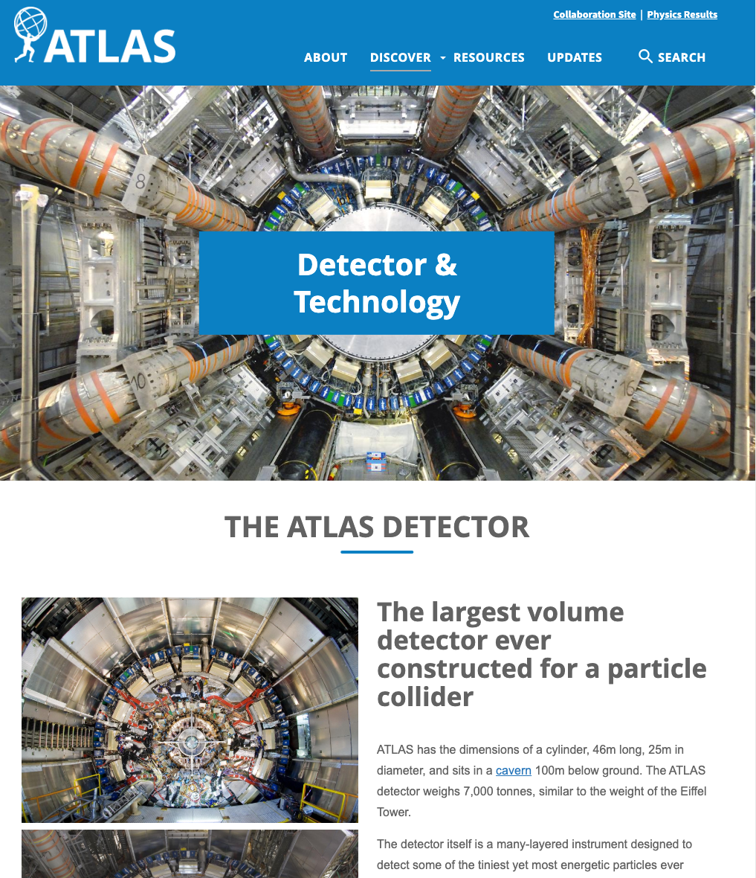
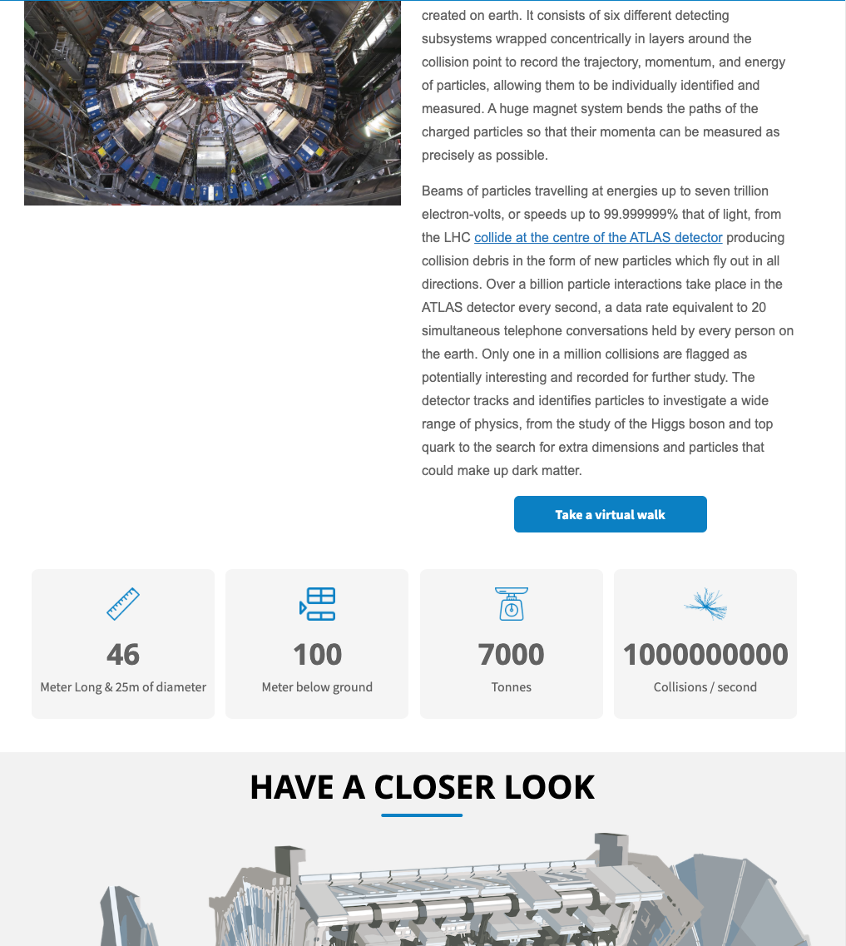
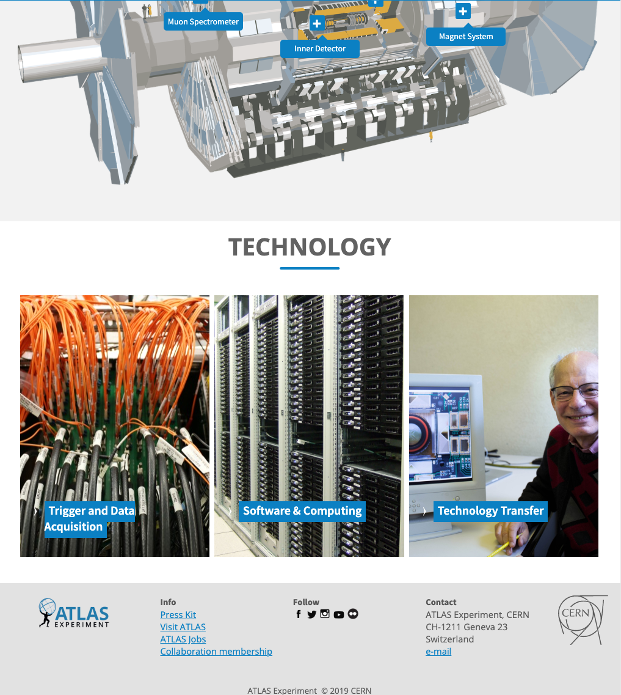
Work in progress…

Slide 21
What Remains
Development
  Completion of Landing Pages for Physics, Resources, etc.
    Adjusting style of cards and other elements
  Completion of Example Updates pages with quality layout
    Simplification of interface for writer
Content
  Automatic porting of high-quantity Content Types
    Updates, Job Postings, Virtual Visits
  Refinement of the automatically ported content
Design
  Modification of elements, like cards, to our own ATLAS style (see images of home page, e.g.)

Slide 22
Development Issues
Landing Pages
  Flexible, but not trivial for writer to work with
  For example, lack of clone feature for elements is a show-slower
Updates (News, Briefings, etc.)
  Article Content Type insufficient for creating quality content visually
    Editing source to add Bootstrap classes by hand!
  We need to be able to lay out an article professionally
    My writer keeps begging me for WordPress
    Hasn’t anyone come up with a similar environment for Drupal? Why not?
Short Codes
  In Drupal 7, we defined short codes, like [img right 50%] or [span1of3]
  Perhaps this can be handled in the WYSIWYG?

Slide 23
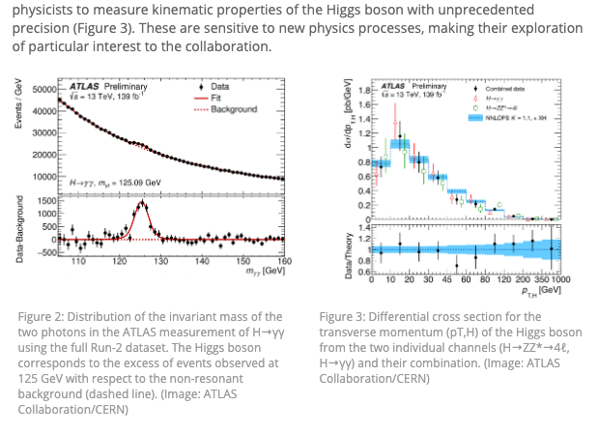
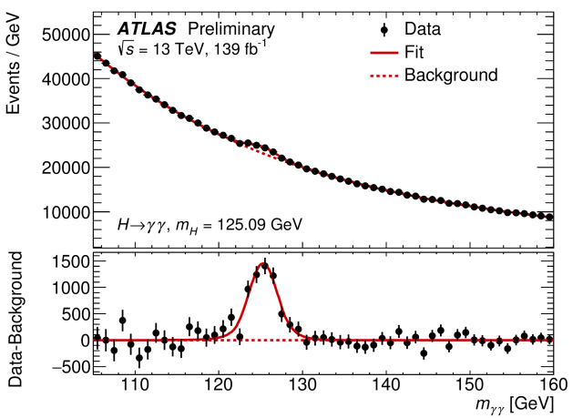
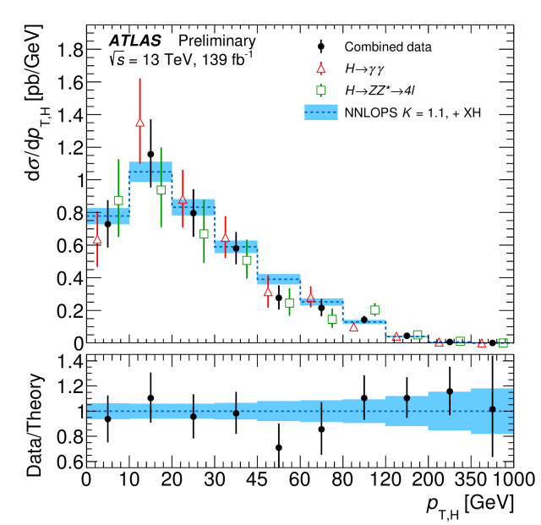
Layout images side-by-side (Drupal 7 ATLAS theme)
[span1of2]
[img]
[/img]
[/span1of2]
[span1of2 last]
[img]
[/img]
[/span1of2]

Slide 24
Layout two images side-by-side (Drupal 8 CERN theme)
<div class="col-sm-6"> <figure class="cds-image" id="ATLAS-PHOTO-2018-020-2"><a href="//cds.cern.ch/images/ATLAS-PHOTO-2018-020-2" title="View on CDS"><img alt="Plots or Distributions,Physics,ATLAS,Higgs boson" src="//cds.cern.ch/images/ATLAS-PHOTO-2018-020-2/file?size=large" /></a>
<figcaption>Figure 3: A recent distribution of candidate Higgs events from the H to ZZ to 4 leptons analysis using 13 TeV data from the LHC. The excess of events around 125 GeV is consistent with Standard Model predictions for the Higgs boson. (Image: ATLAS Collaboration/CERN)</figcaption></figure></div>
<div class="col-sm-6"> <figure class="cds-image" id="ATLAS-PHOTO-2018-020-1"><a href="//cds.cern.ch/images/ATLAS-PHOTO-2018-020-1" title="View on CDS"><img alt="Plots or Distributions,Physics,ATLAS,Higgs boson" src="//cds.cern.ch/images/ATLAS-PHOTO-2018-020-1/file?size=large" /></a>
<figcaption>Figure 4: The measured interaction strength as a function of the mass of different particles in the Standard Model. (Image: ATLAS and CMS Collaborations/CERN)</figcaption></figure></div>
Need to learn bootstrap classes

Slide 25
Large-Scale Porting of Data
Updates
  There are 400-500 articles that need to be ported
  They contain short codes for the layout
    They will need to be translated manually or automatically
Job Postings
  There are 400-500 postings that need to be ported
    We maintain an archive of past postings
  Should be straightforward
Virtual Visits
  There are around 400 visits that need to be ported
    They are in a different Drupal 7 site

Slide 26
Summary
Move to Drupal 8
  We are trying to comply with the choice of Drupal 8 for upgrade
    The CERN support team is very helpful
    CERN Override Theme provides most of the functionality we need
  The theme (perhaps Drupal, in general) is frustrating for high-level design
    The environment for content providers (writers) is clunky
    We are having to develop code (templates) to implement our style
  We do not yet know how the mass import (>1000 nodes) will go
Common Goals, Different Approaches
  CMS, ALICE seeking developer
  IPPOG using designer / first implementation (we will port data)
  Don’t we all (including CERN) have same needs for publishing articles?

