Slide 1
Installation of the SC-Link cryostat at P1
Pre-study for handling and routing
P. Schneider, A. Gharib, Y. Leclercq, R. Betemps
20/11/2018

Slide 2
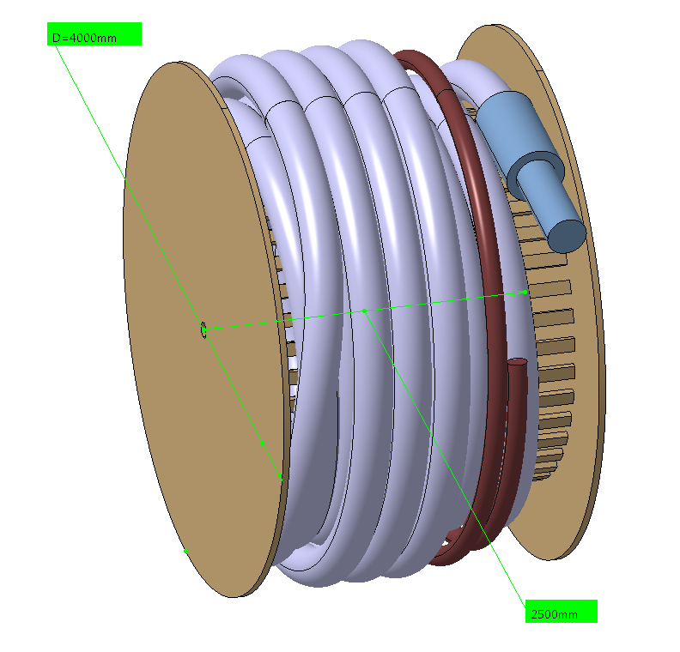
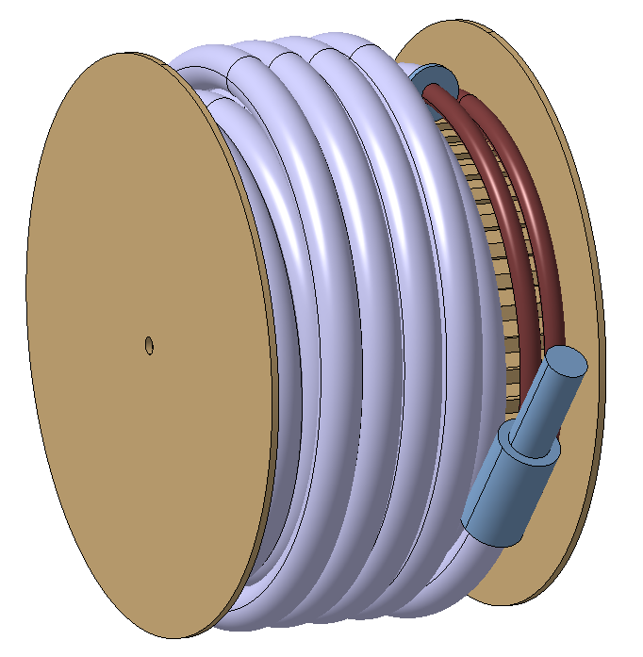
Real dimensions
DSHx:
Diameter: 4 m
Width: 2.5 m
Minimum cryostat radius: 1.55 m
Length of cryostat: 110 m
+ 15 m cable
DSHx:
Same dimensions
Opposite winding

Slide 3
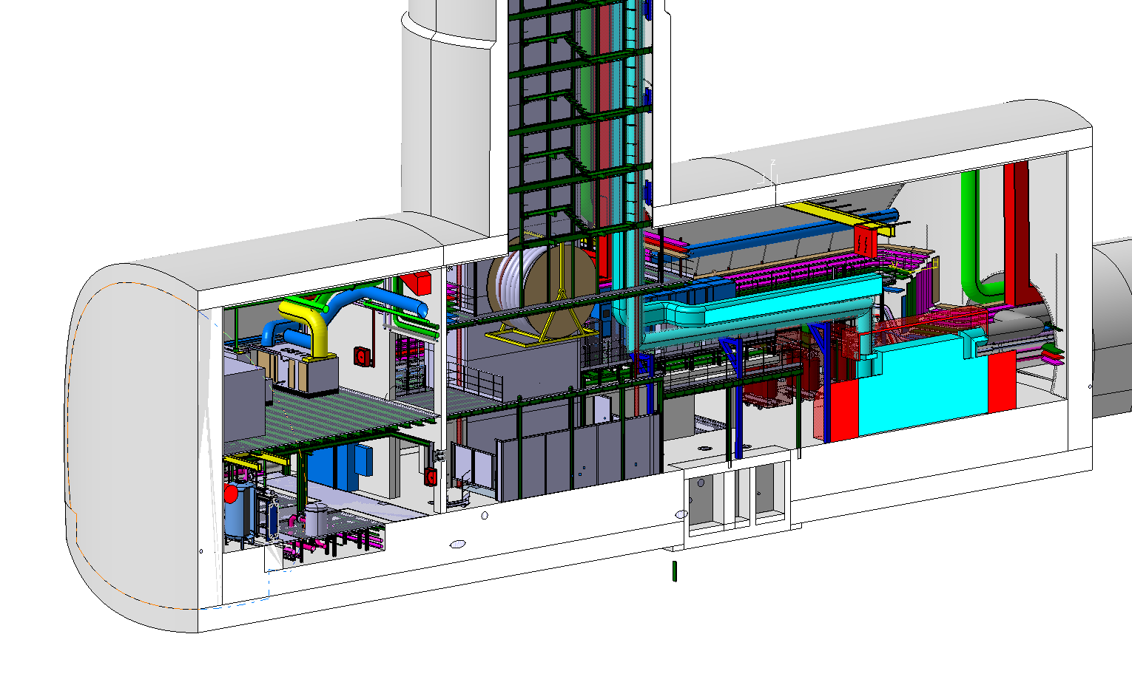
Down to US17 cavern (with support)

Slide 4
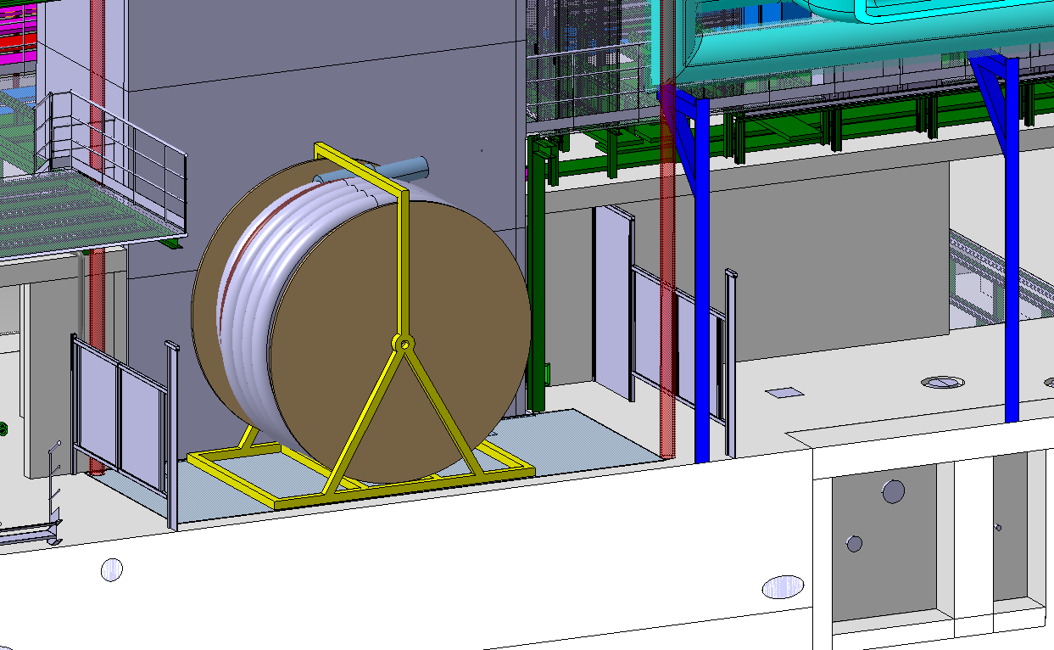
Down to US17 cavern

Slide 5
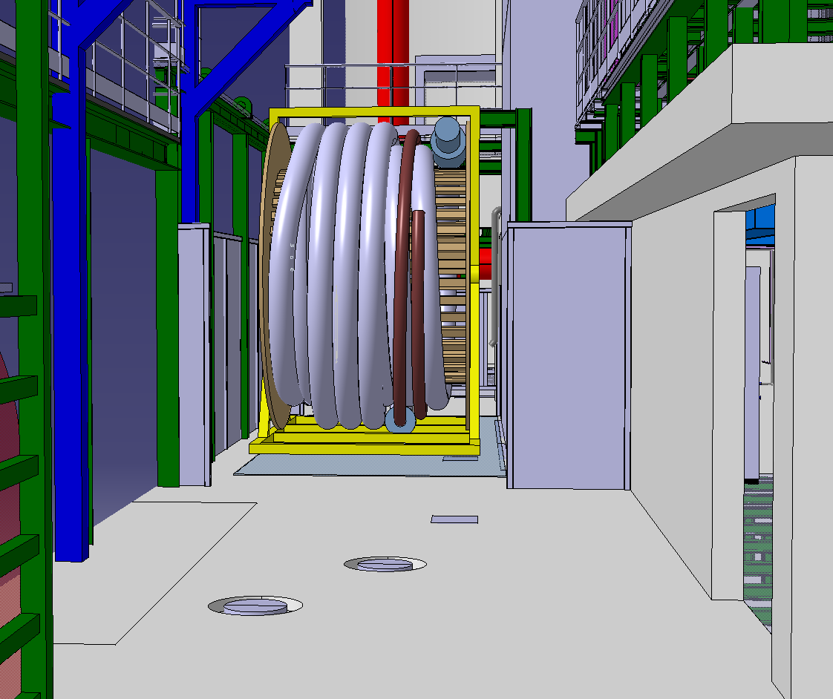
Arrival in US17 cavern

Slide 6
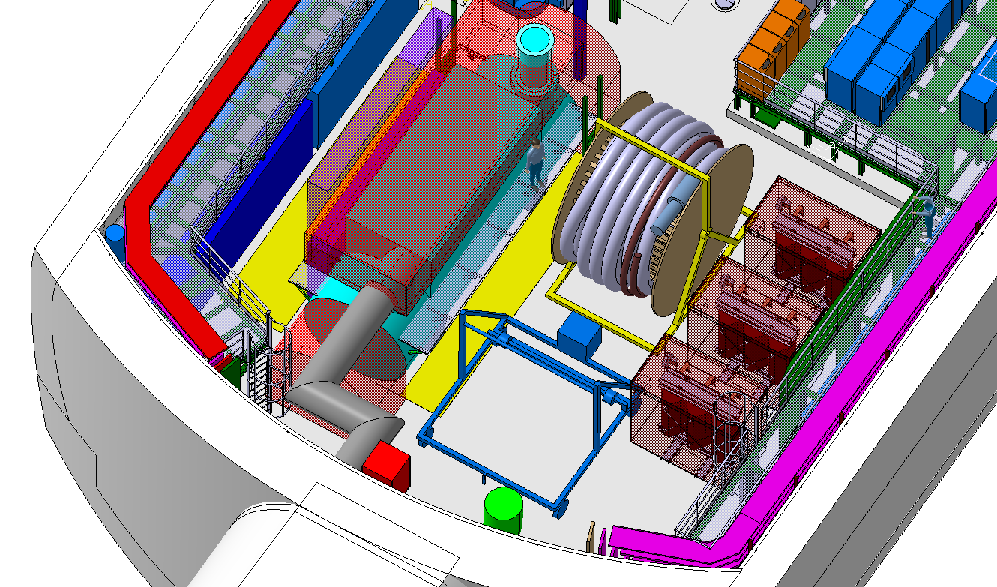
Move to unroller

Slide 7
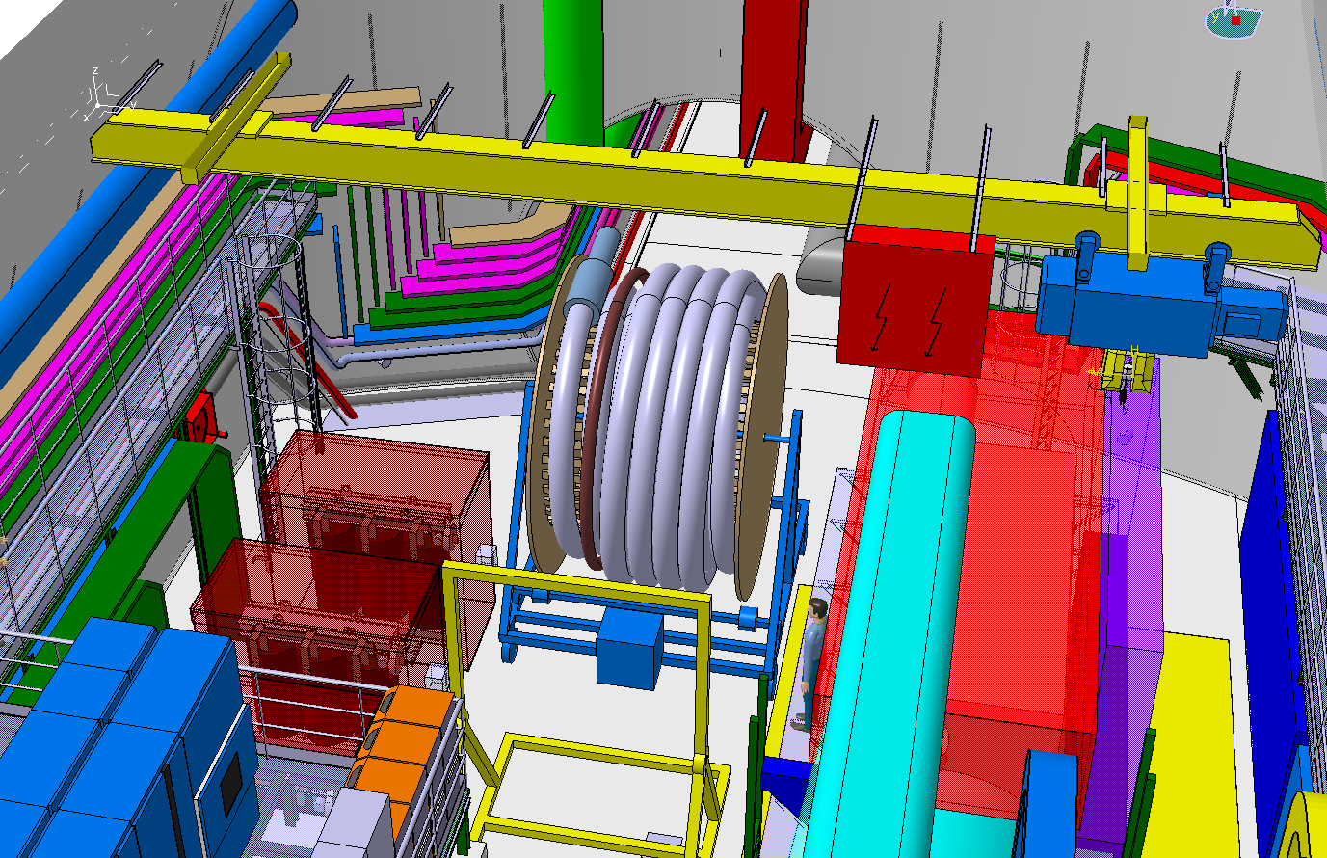
Installation unroller (5 t crane)

Slide 8
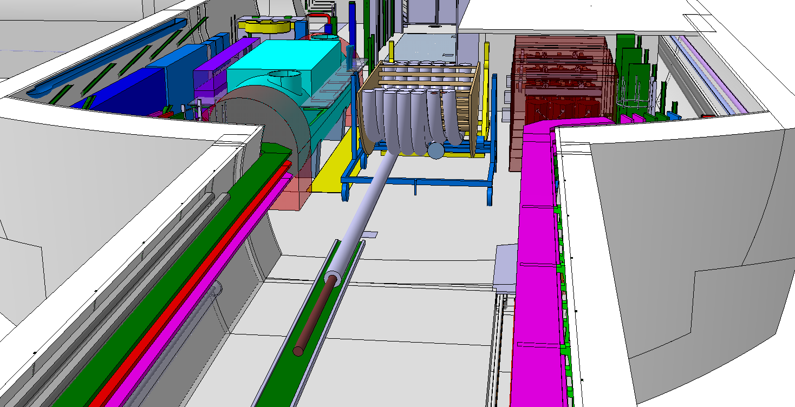
Unwinding on roller conveyor

Slide 9
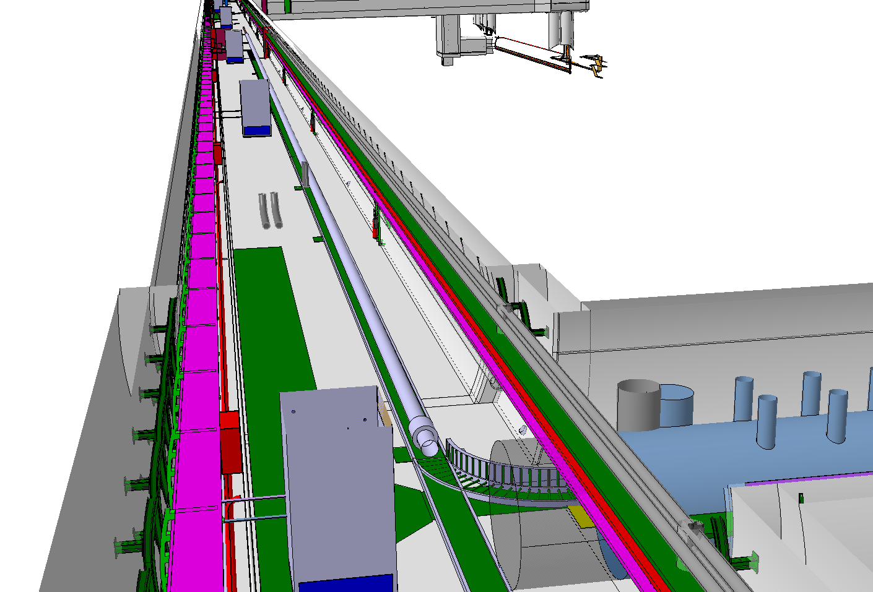
Unwinding on roller conveyor (≈150 m)

Slide 10
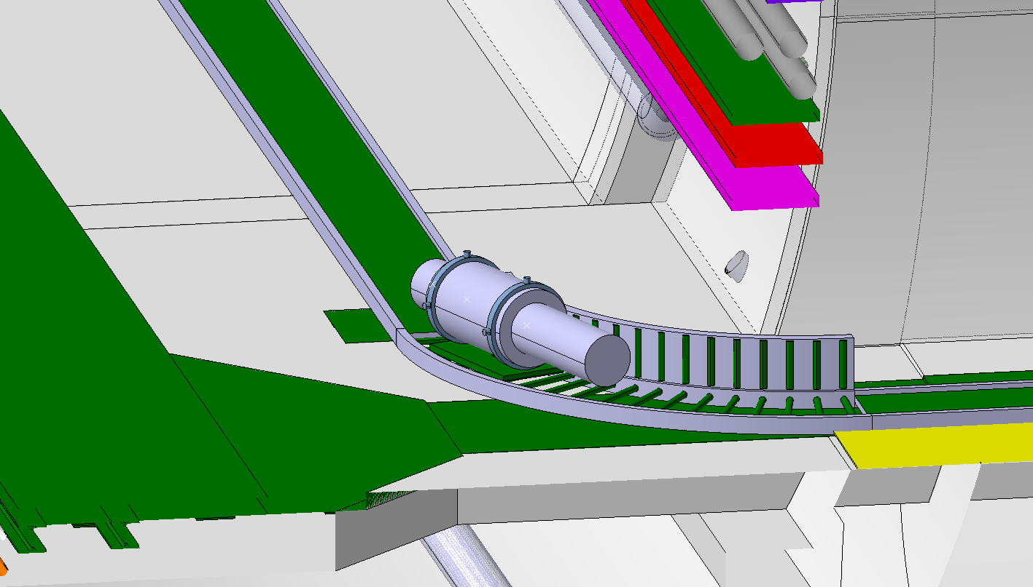
Transport into the UL tunnel

Slide 11
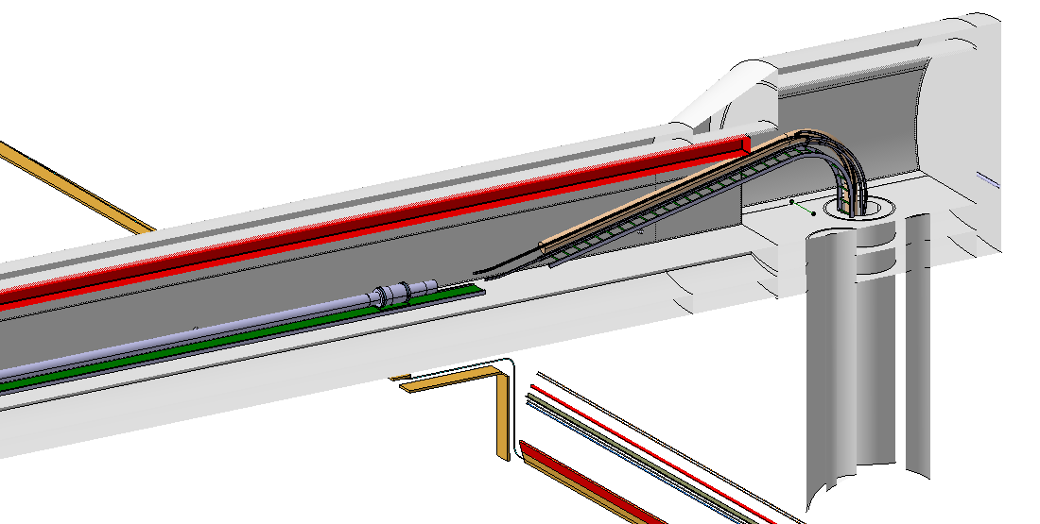
Towards the vertical shaft

Slide 12
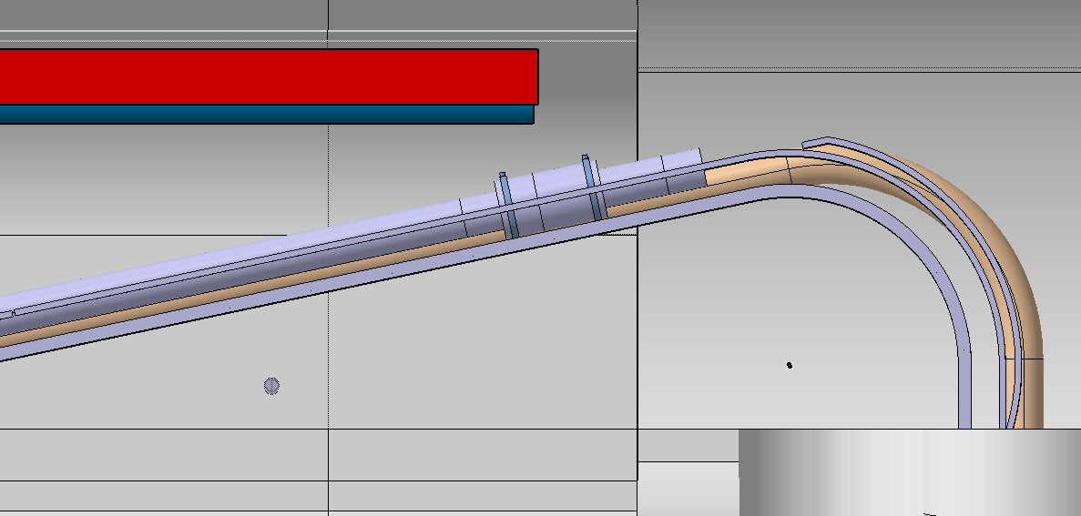
Guiding rails to maintain the minimal radius…

Slide 13
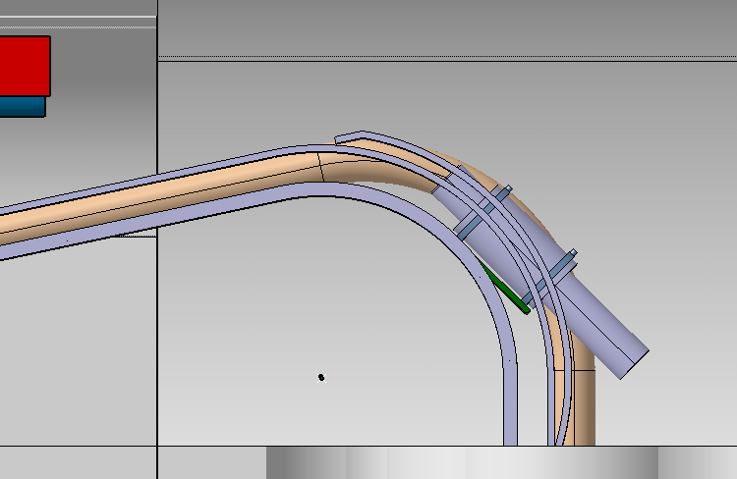
… and prevent overbending at the
cryostat / head junction (tangent to guiding)

Slide 14
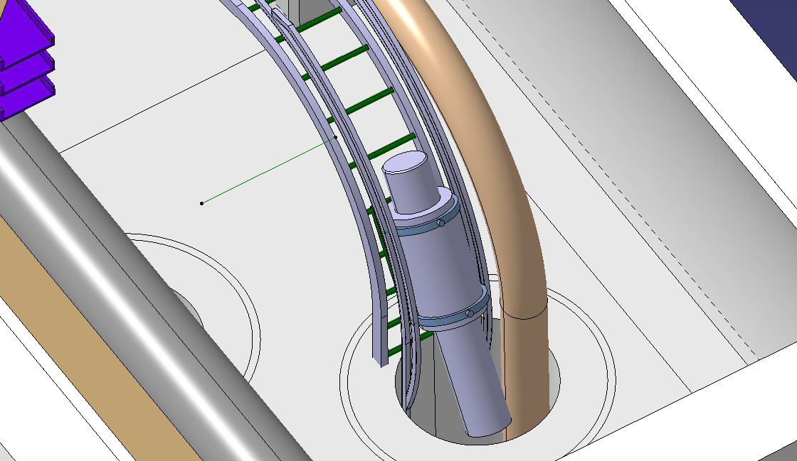
Insertion in the vertical shaft
Ø 450 lg: 800
Ø 300 lg 800

Slide 15
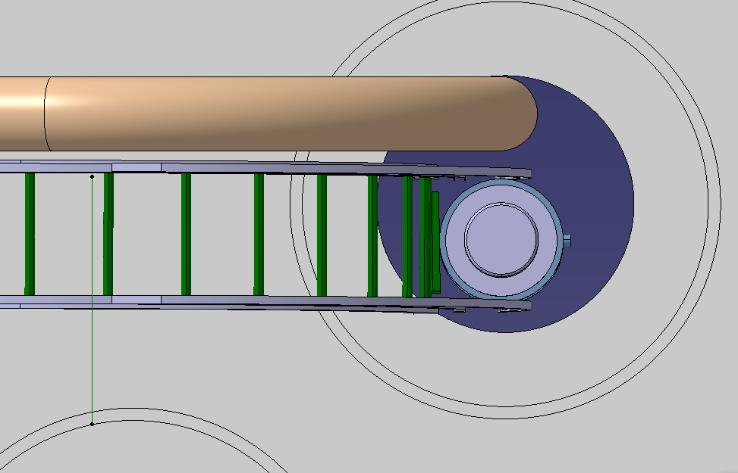
With previously installed DSHm

