Slide 1
DFX transport & installation brainstorming
Y.Yang, Y.Leclercq
WP6a : integration meeting #3

Slide 2
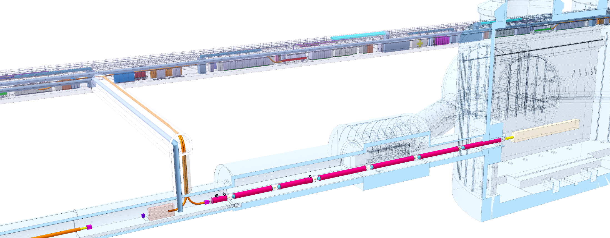
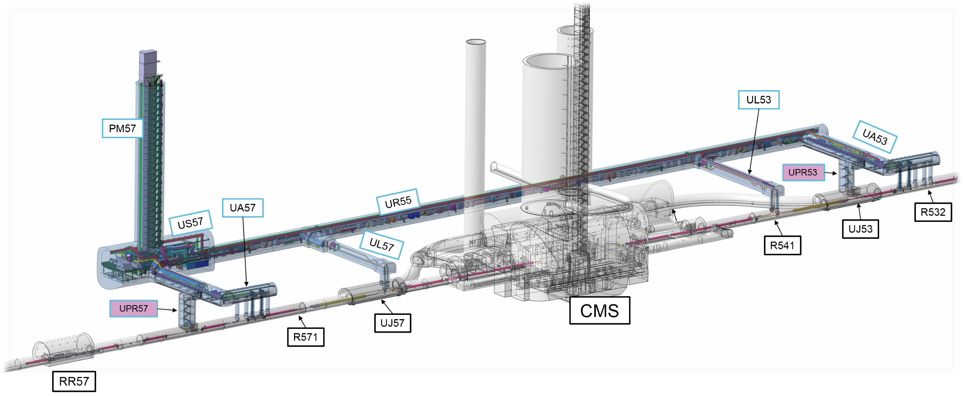
DFX installation
DFHx1
DFHx2
Each IP1 and IP5 sides equipped with 2 cold powering chains of cryostats
Triplet insertion : DFHx – SC Link (DSH) – DFX
Matching sections : DFHm – SC Link - DFM
DFX/DFM basic functions:
Electrical interface between SC Link and superconducting magnets
Supply cryogenics to the SCLink
Total : 4 DFX boxes to install
Weight < 2 Tons
Biggest component to transport
  Helium inner vessel : Ø0.5m x 1m
  Flexible : Ø0.3m x 8m
  Heaviest independent part < 1 Ton
DFHM
Power converters
Service tunnel
DSHx
Transverse tunnel
DSHm
Q1
IP
≈50m
≈8m
Q2b
Q2a
CP
Q3
≈45m
DFX
D1
≈80m
LHC tunnel
DFM
D2

Slide 3
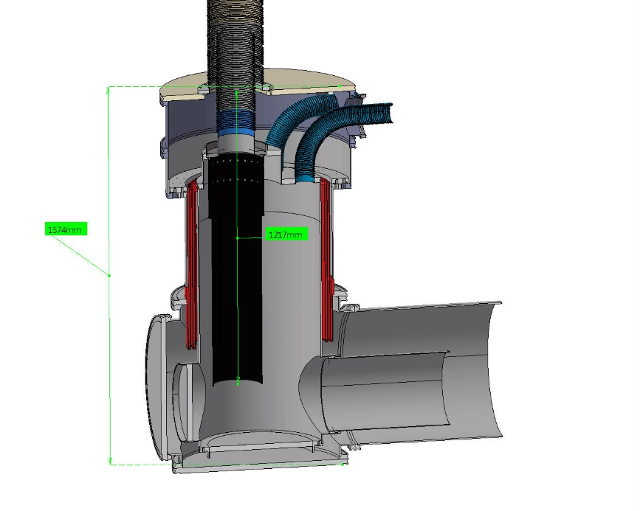
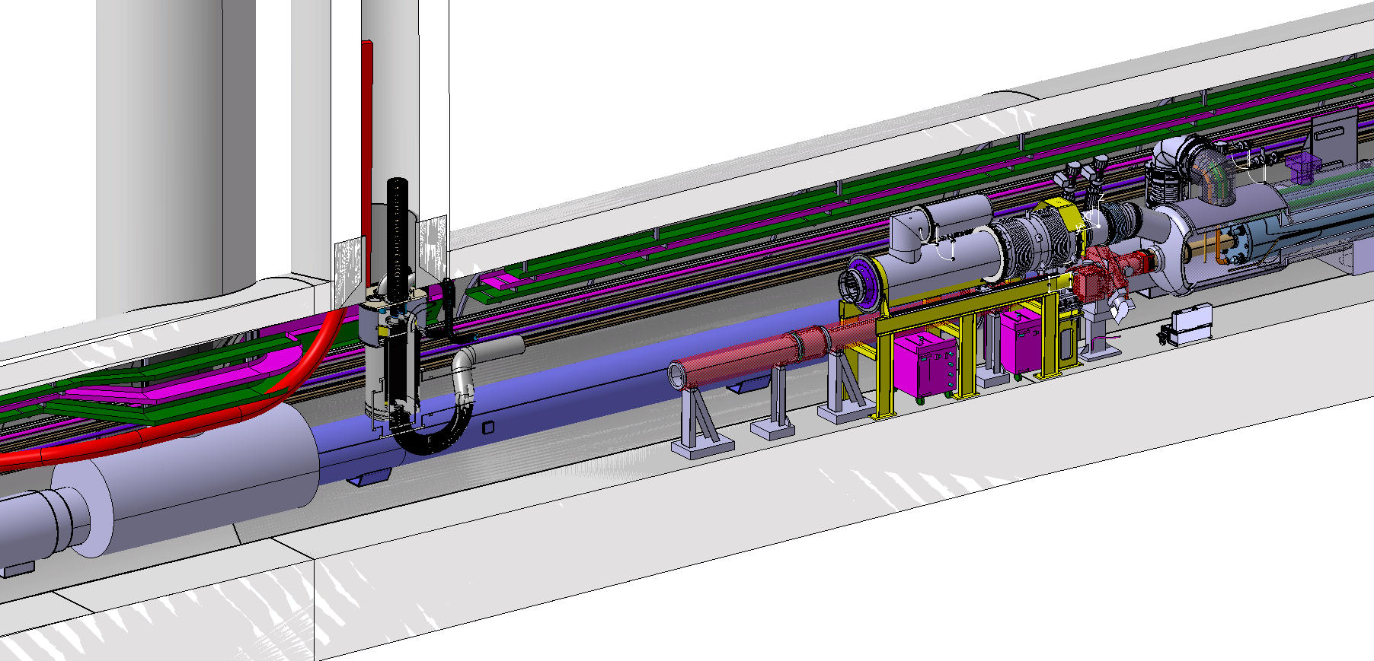
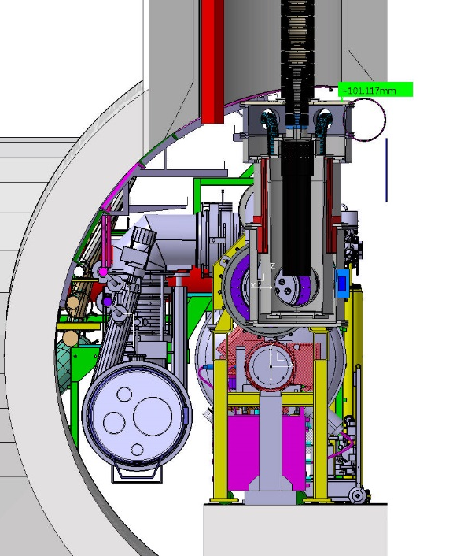
DFX properties
Ø800mm
DFX nominal location
  Each side of IP1 & IP5
  Underneath the vertical shaft
Proposal assembly sequence
  After magnet and cryolines installation
  Before beam pipes installation
Transport
  Transported in several parts
  Assembled in situ
  Dimensions of main parts:
    Helium inner vessel : Ø0.5m x 1m
    Flexible : Ø0.3m x 8m
    Heaviest independent part < 1 Ton
1.6m
Ø0.5mx1m
Transport path to be discussed
Transport area
D1
D1 & beam
Cryo-lines
LHC tunnel
Flexible
Ø0.3mx7m

Slide 4
DFX Vertical v3.2 - Components | Quantity | OD | Thickness | Unit Mass | Total Mass
 |  | [mm] | [mm] | [kg] | [kg]
Vacuum Vessel - Top Flange | 1 | 800 | 22 | 78 | 78
Vacuum Vessel - Top Ring Flange | 1 | 800 | 22 | 8 | 8
Vacuum Vessel - Retractable - Intermediate Ring Flange | 2 | 800 | 22 | 8 | 16
Vacuum Vessel - Retractable Wall Section 1 | 1 | 758 | 4 | 15.2 | 15.2
Vacuum Vessel - Retractable Wall Section 2 | 1 | 758 | 4 | 15.8 | 15.8
Vacuum Vessel - Retractable - Bottom Ring Flange | 1 | 758 | 4 | 14.1 | 14.1
Vacuum Vessel - Retractable - Floating Ring Flange | 1 | 740 | 22 | 24 | 24
Vacuum Vessel - Middle Section - Top Ring Flange | 1 | 675 | 22 | 12 | 12
Vacuum Vessel - Middle Section - Wall | 1 | 608 | 4 | 23.2 | 23.2
Vacuum Vessel - Middle Section - Bottom Ring Flange | 1 | 720 | 22 | 19.1 | 19.1
Vacuum Vessel - Bottom Cross - Large Ring Flanges | 3 | 720 | 22 | 10.6 | 31.8
Vacuum Vessel - Bottom Cross - Small Ring Flanges | 3 | 600 | 22 | 5.9 | 17.7
Vacuum Vessel - Bottom Cross - Large Blank Flange | 1 | 720 | 22 | 70 | 70
Vacuum Vessel - Bottom Cross - Small Blank Flange | 1 | 600 | 22 | 48.3 | 48.3
Vacuum Vessel - Bottom Cross - Body | 1 | 660 | 4 | 49.6 | 49.6
Vacuum Vessel - Horizontal Section | 1 | 560 | 4 | 41.8 | 41.8
Vacuum Vessel - Vacuum Break | 1 | 608 | 2 | 72.45 | 72.45
Vacuum Vessel - Flexible Hose - Ring Flange | 6 | 180 | 1.5 | 0.52 | 3.12
Cold Vessel - Bottom Cross - Body | 1 | 508 | 4 | 46.3 | 46.3
Cold Vessel - Upper Body Extension | 1 | 508 | 4 | 9 | 9
Cold Vessel - Side Hatch Blank Flange | 1 | 320 | 22 | 14.75 | 14.75
Cold Vessel - Bottom Hatch - Ring Flange | 1 | 508 | 22 | 9.7 | 9.7
Cold Vessel - Bottom Hatch - Blank Flange | 1 | 430 | 22 | 26.4 | 26.4
Cold Vessel - Top Flange | 1 | 508 | 22 | 18 | 18
Cold Vessel - Top Flange Extension - Wall | 1 | 326 | 3 | 3.3 | 3.3
Cold Vessel - Top Flange Extension - Flange | 1 | 326 | 22 | 6.7 | 6.7
Cold Vessel - Flexible Hose Wall | 1 | 78 | 1.5 | 3 | 3
Cold Vessel - Horizontal Section | 1 | 304 | 2 | 7.6 | 7.6
SC Link - Cold Vessel - Weldable Flange | 1 | 250 | 15 | 4.35 | 4.35
SC Link - Vacuum Vessel - Mounting Flange | 1 | 310 | 15 | 4.3 | 4.3
SC Link - Inner Flexible Collar | 1 | 150 | 2 | 0.42 | 0.42
SC Link - Outer Flexible Wall (per metre length) | 8 | 220 | 1.5 | 18.4 | 147.2
SC Link - Inner Flexible Wall (per metre length) | 8 | 160 | 1.5 | 12.3 | 98.4
SC Link - Rigid Sleeve | 1 | 254 | 2 | 10.1 | 10.1
Vacuum Vessel - Total Mass |  |  |  |  | 560.17
Cold Vessel - Total Mass |  |  |  |  | 144.75
SC Link Flexible - Total Mass |  |  |  |  | 264.77
Total Mass - (without liquid + cables/splices) |  |  |  |  | 969.69

