Slide 1
DFM transport & installation brainstorming
Y.Leclercq
WP6a : integration meeting #3

Slide 2
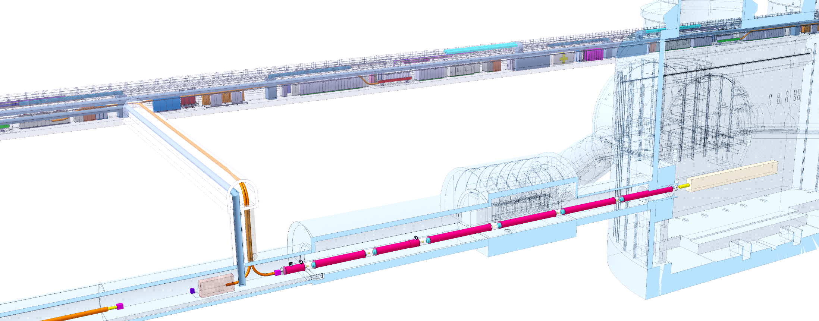
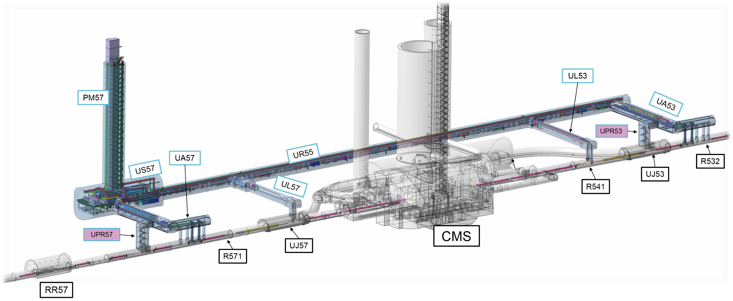
DFM installation
DFHx1
DFHx2
Each IP1 and IP5 sides equipped with 2 cold powering chains of cryostats
Triplet insertion : DFHx – SC Link (DSH) – DFX
Matching sections : DFHm – SC Link - DFM
DFX/DFM basic functions:
Electrical interface between SC Link and superconducting magnets
Supply cryogenics to the SCLink
Total : 4 DFM boxes to install
Weight < 1 Tons
Biggest component to transport
  Pre-assembly : Ø1m x 3m
  D2-DFM link :
  Heaviest independent part < 1 Ton
DFHM
Power converters
Service tunnel
DSHx
Transverse tunnel
DSHm
Q1
IP
≈50m
≈8m
Q2b
Q2a
CP
Q3
≈45m
DFX
D1
≈80m
LHC tunnel
DFM
D2

Slide 3
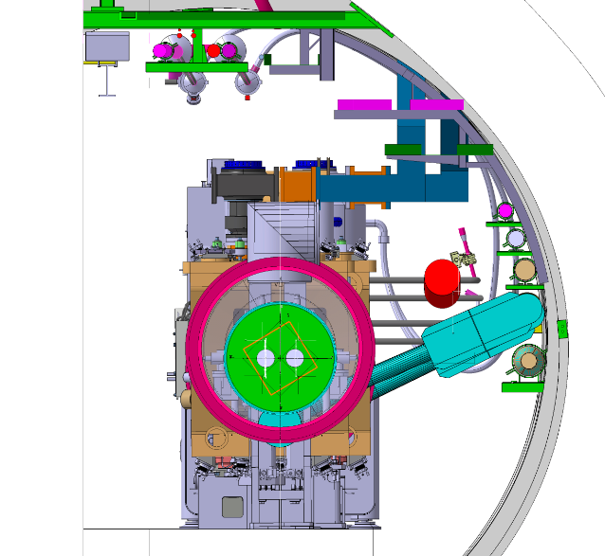
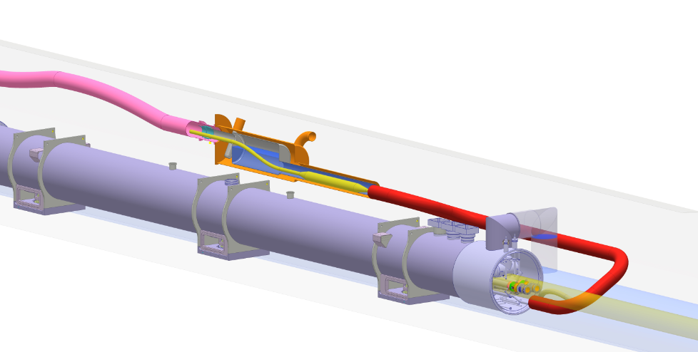
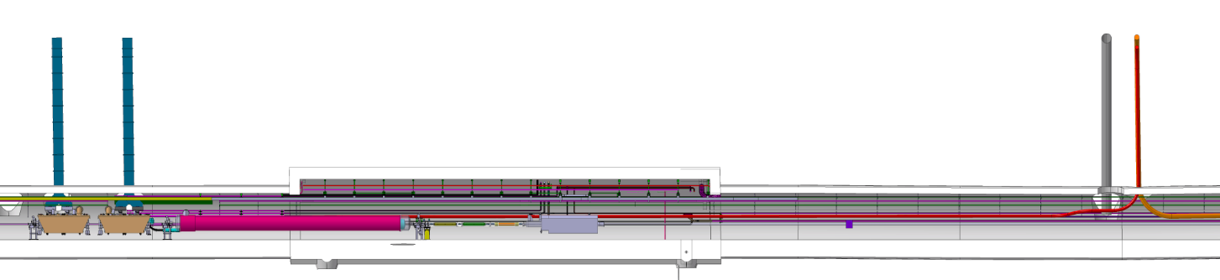
DFM installation overview
DFM location
  Close to D2 for electrical connection
  Aligned with SCLink to ensure interface
  Provide access for in situ electrical connections
  Match with various reservations
  ➔ Above D2
Assembled DFM dimensions: ≤ Ø1.5 m x 5m
Proposed assembly sequence:
  Install D2
  Install Link D2-DFM
  Install DFM
  Connect SCLink & DFM
Transport
  D2
  D2-DFM link (up to 6m long)
  DFM pre-assembled (Ø1 m x 3m)
  SCLink (DSHm)
Transport area
D2 & beam
Transport path to be discussed
Cryo-lines
DSHm
DFM
Splices
D2
← IP ≈140m
LHC Tunnel
D2-DFM link
Preliminary illustration of possible integration of DFM above D2
Beam
QXL
R≈1.9 m
≈45 m
≈1.5 m
DSHm
CC
CC
DFM
D2
≈140m
93.25m
From IP

