Slide 1
Update on Integration checks and possible concept revisions
Y.Yang, W. Bailey, R. Betemps
23/11/2018

Slide 2
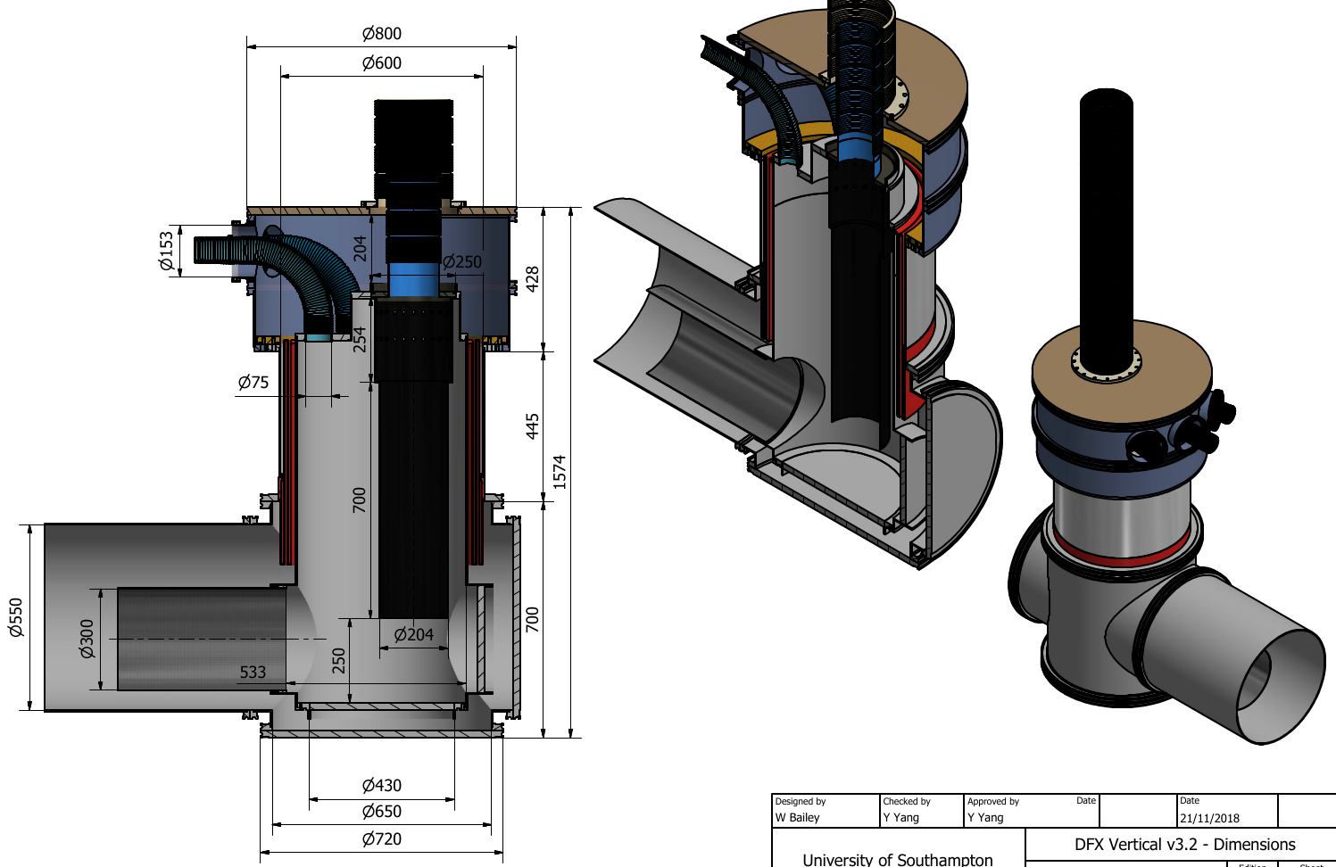
Vertical DFX with DFB type “box” (2)
A cylindrical box section can be achieved with the advantages of the “box” format fully realized (many thanks for Wendell Bailey at SOTON for quickly turning into 3d models)
A. Implemented:
Overall height reduced to 1600mm, less than the nominal 1700mm available space (RB to show integration variations at P1/5 L/R)
A LTS bending height of 250mm can be afforded (JF to confirm/discuss)
Liquid level to horizontal determined by the diameter/positioning of the feedthrough port for the LTS bus-bar. (φ320mm shown, position can be raised or diameter increased)
Flexible hoses for interfaces cryogenic/safety/instrumentation moved to the side and more accessible during installation using double outer tubes
(thanks to RB for the suggestions)
B. Further detailing
Top LHe filling as requested, excess
GHe return to Line D also allowed
(to be determined with cryogenics on implementation)
Up to three access ports for LTS bus-bar handling, 5 possible ($$$). Optimization with JF
LTS Bus-bar
bending space
LTS Bus-bar
feedthrough

Slide 3
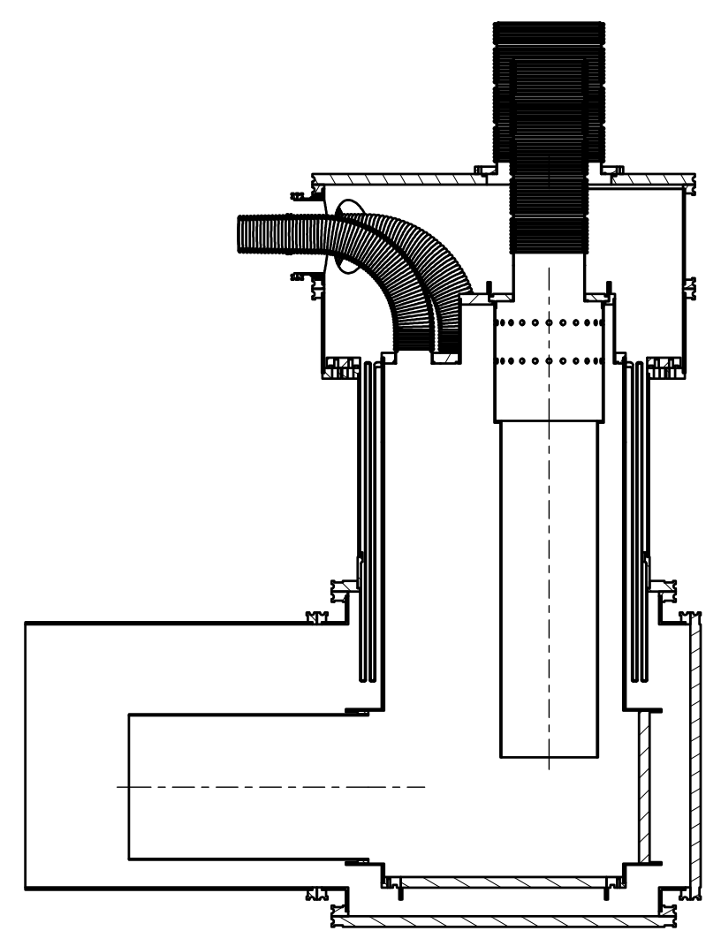
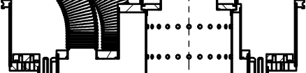
Vertical DFX with DFB type “box” (3)
Installation:
Top outer tubes (double sections) down for inserting the SC-Link: LTS bus-bars and MgB₂/LTS splice section are guided in. LTS bus-bars are bent to horizontal and fed through the port continuously.
Weld (1: red dots) the MgB₂/LTS section to the DFX inner top
Raise the first outer tube to position while feeding through the flexible interface hoses. The second outer tube stays down to give access
Connecting interfaces (instrumentations)
Weld (2: blue dots) the inner ports
Maintainability:
Aiming for retrofitting of heaters and level sensors within φ75mm flexible hose. Optimized heater size/shape or cut the inner flexibles.
After cutting weld (1), the DFX can be lowered to expose the MgB₂/LTS splice section if the beamline is moved. Otherwise SC-Link shall be raised.
Safety Devices
LHe blow-off built-in at the end of a flexible hose.

Slide 4
Integration situation
Reference : IP 5R & IP5L EDMS 1991506
ST0999873_01 & ST1001705_01
Integration of the last version of the DFX design
(2018/11/23)
Integration last version Cold diode (ST0997561_01)

Slide 5
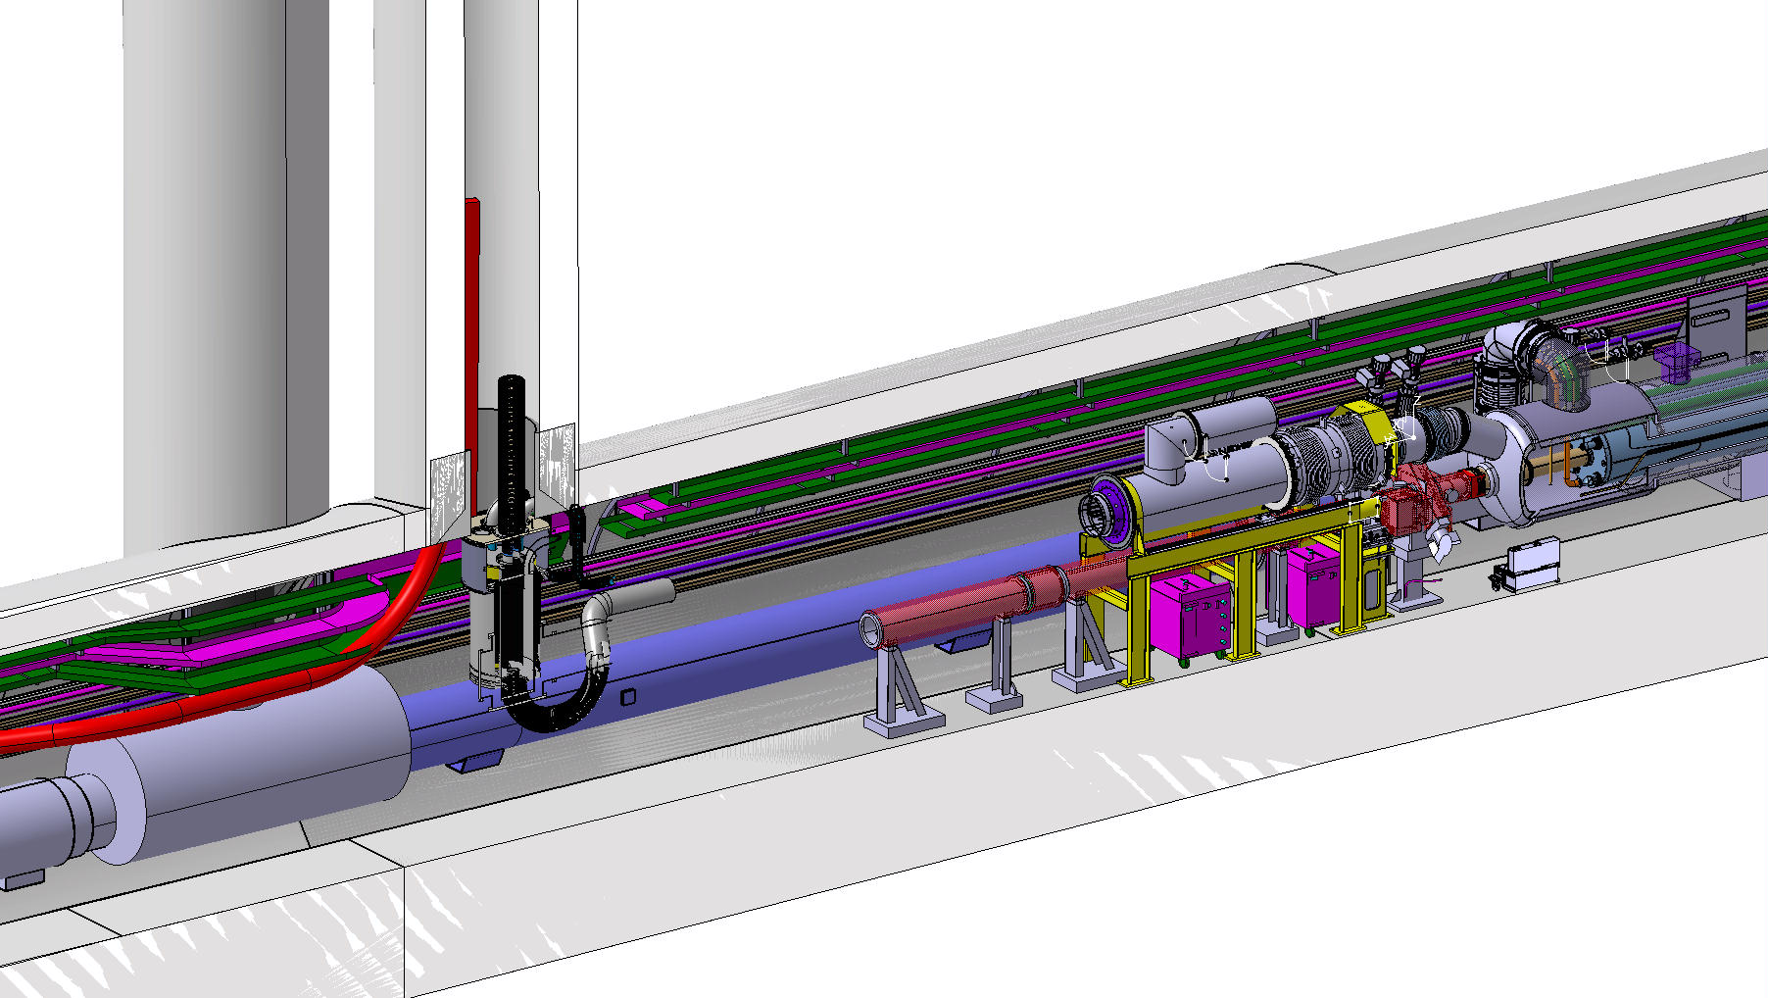
Starting Point

Slide 6
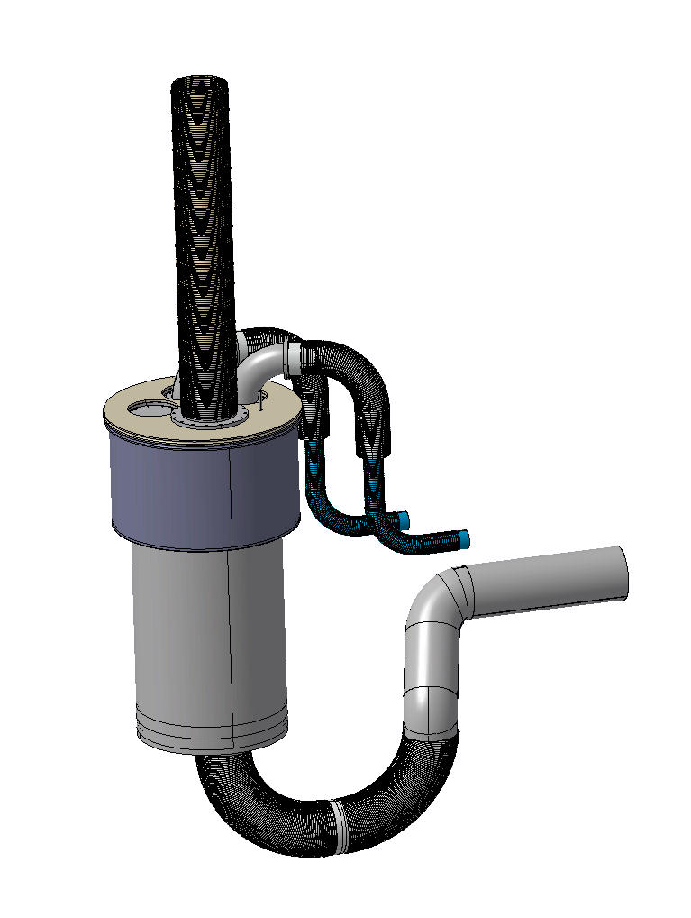
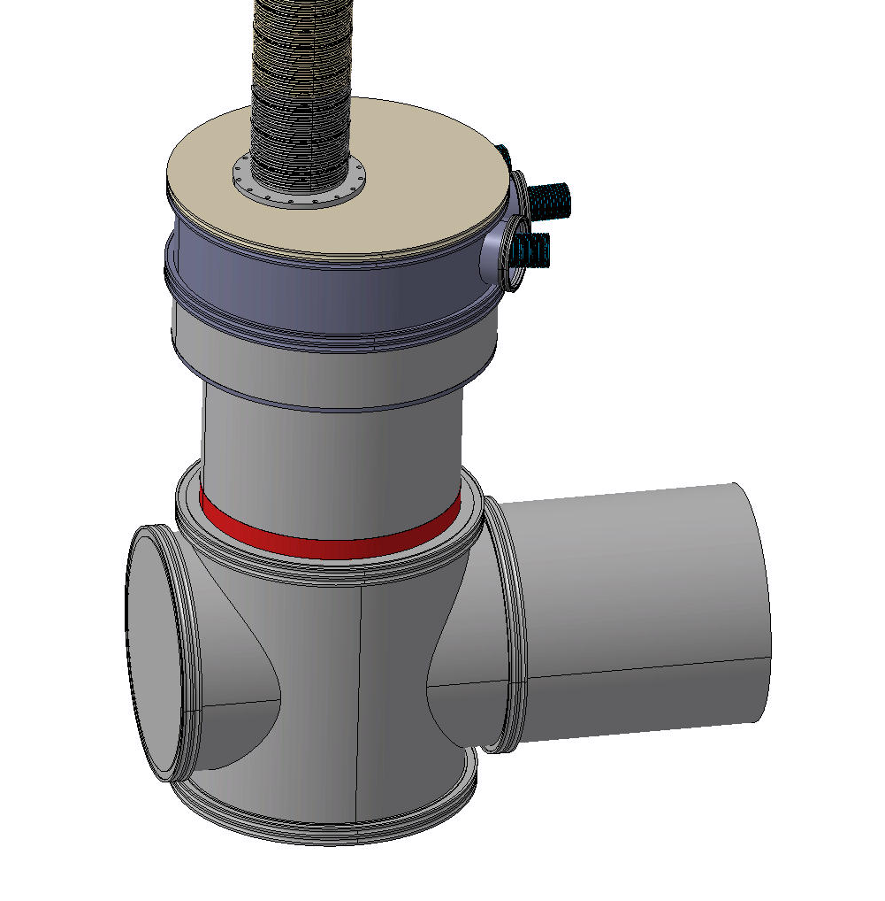
Last version of the DFX

Slide 7
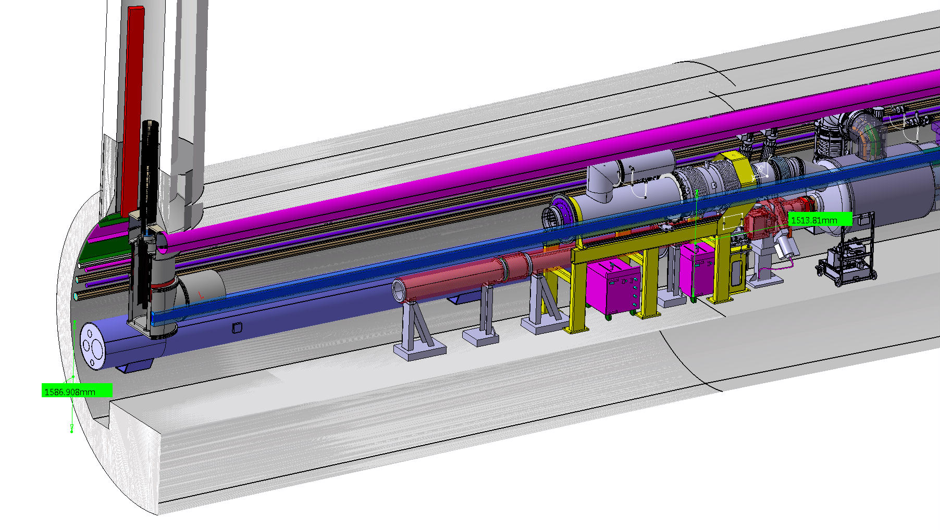
IP5 Left

Slide 8
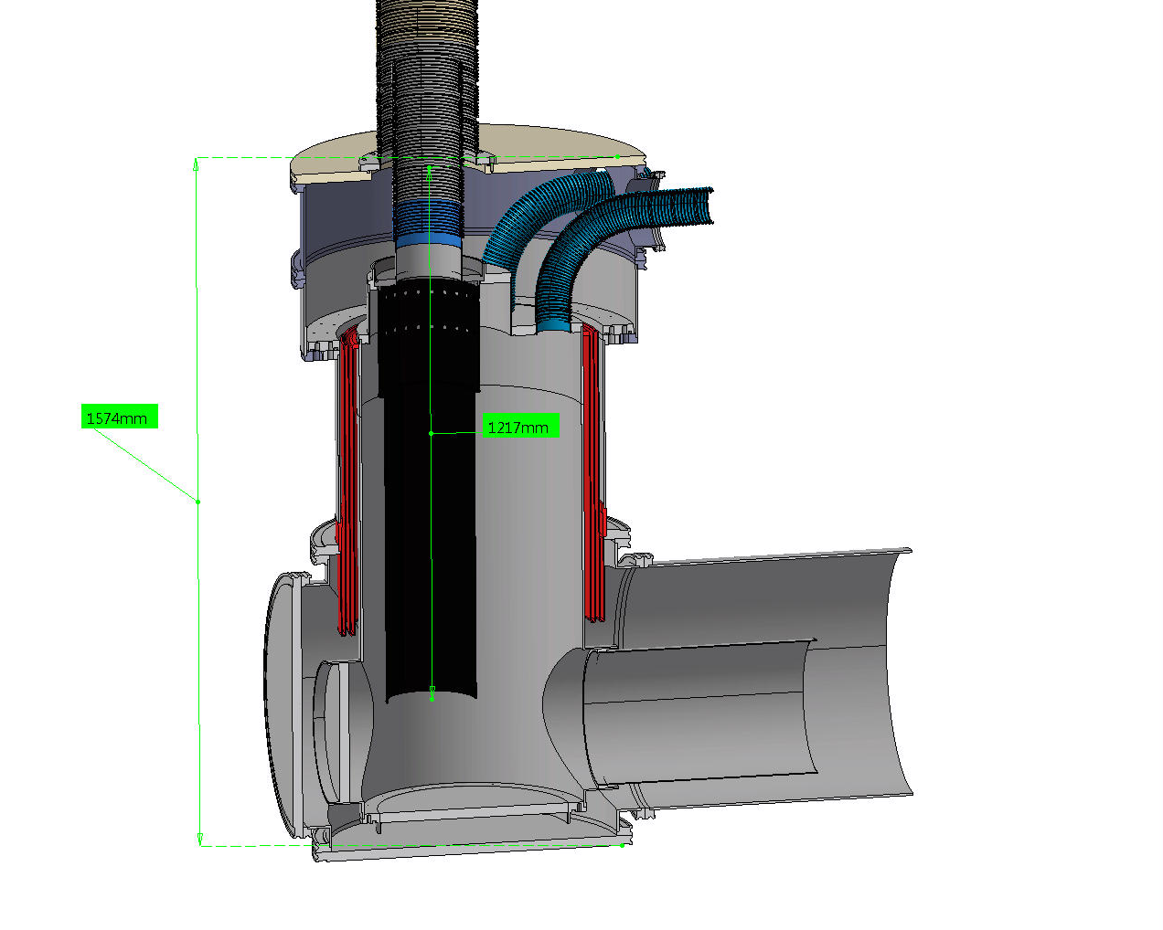
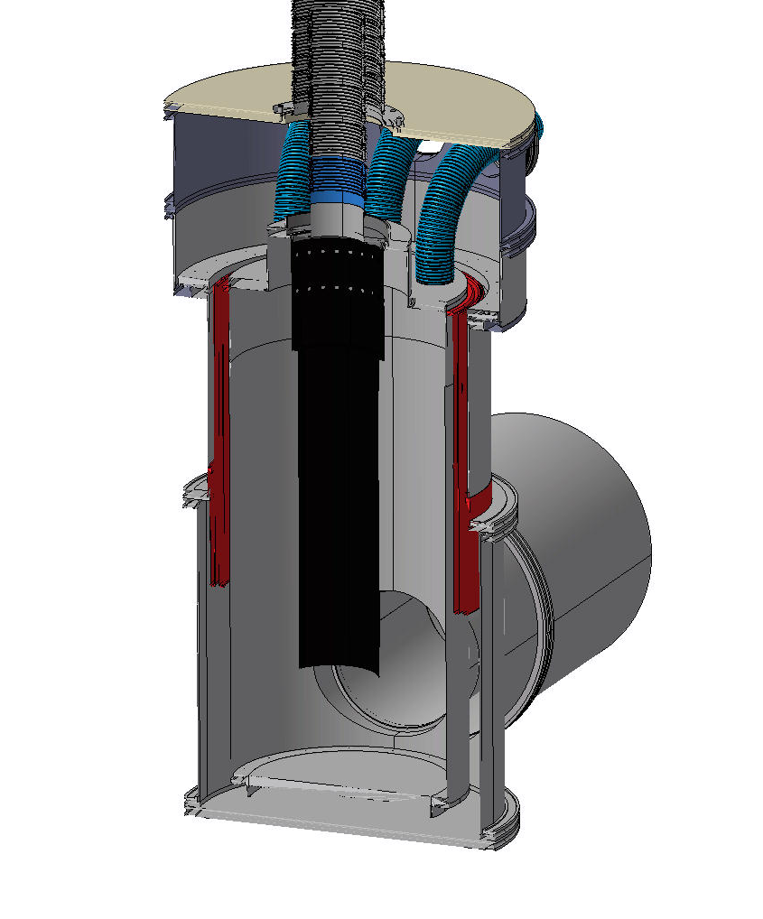
Last version of the DFX Cut

Slide 9
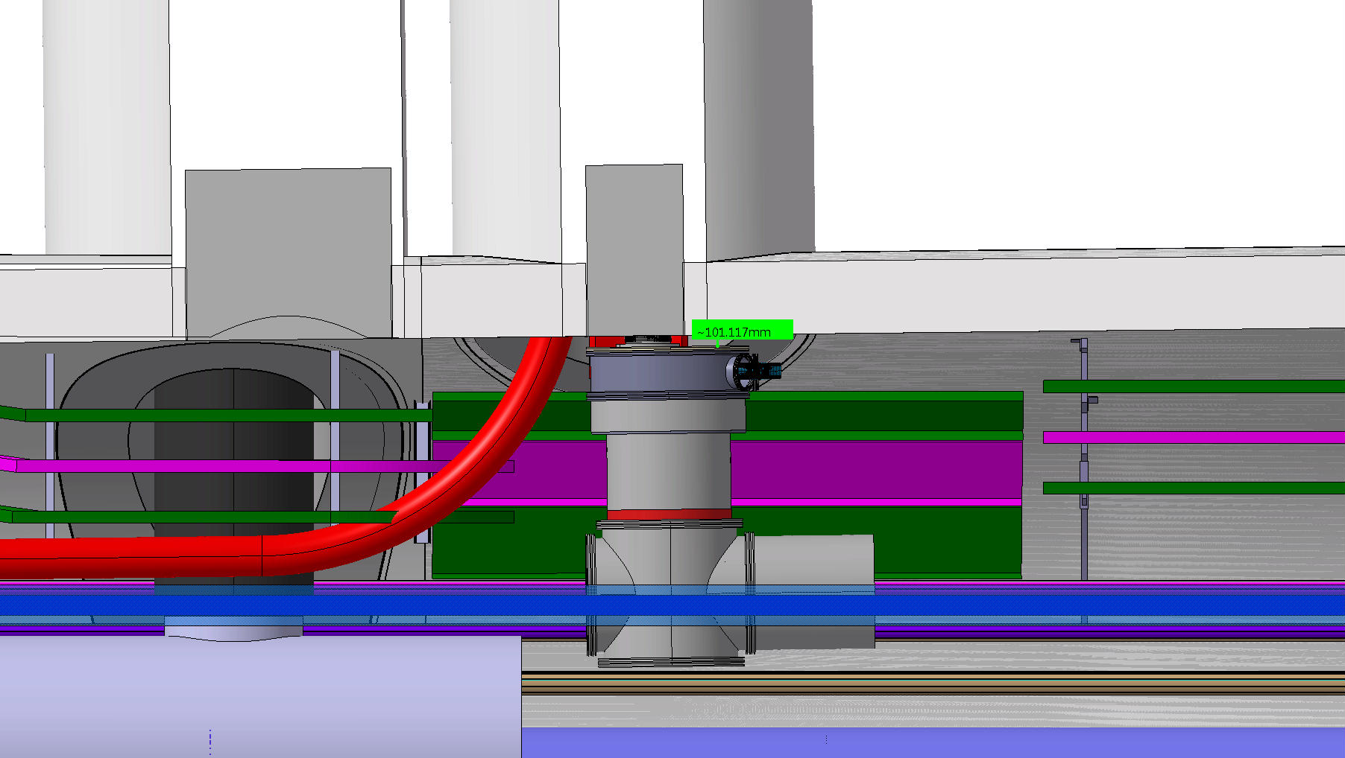
IP5 Left

Slide 10
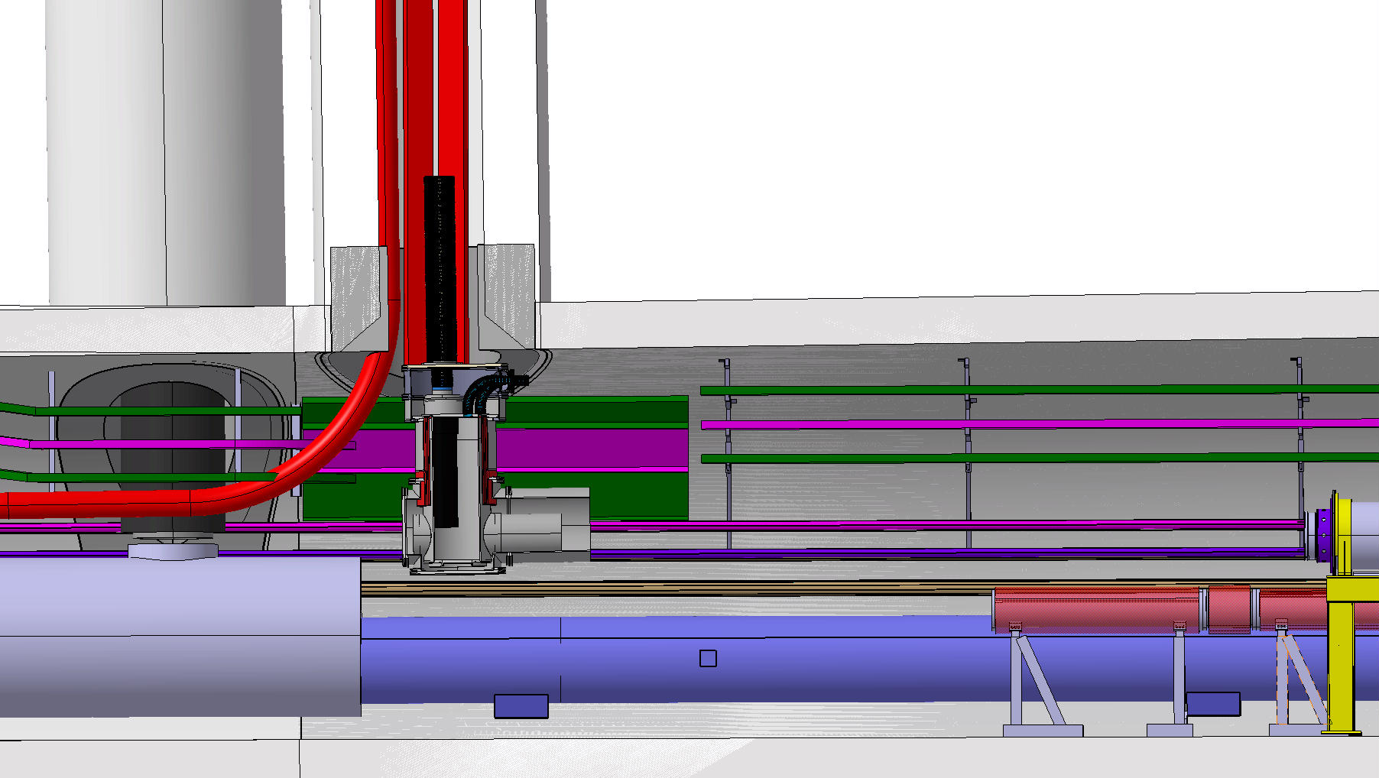
IP5 Left

Slide 11
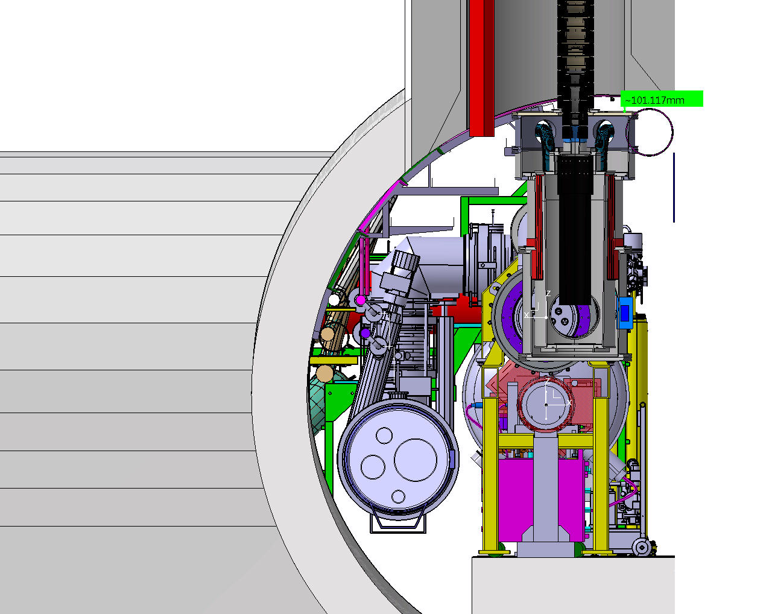
IP5 Left

Slide 12
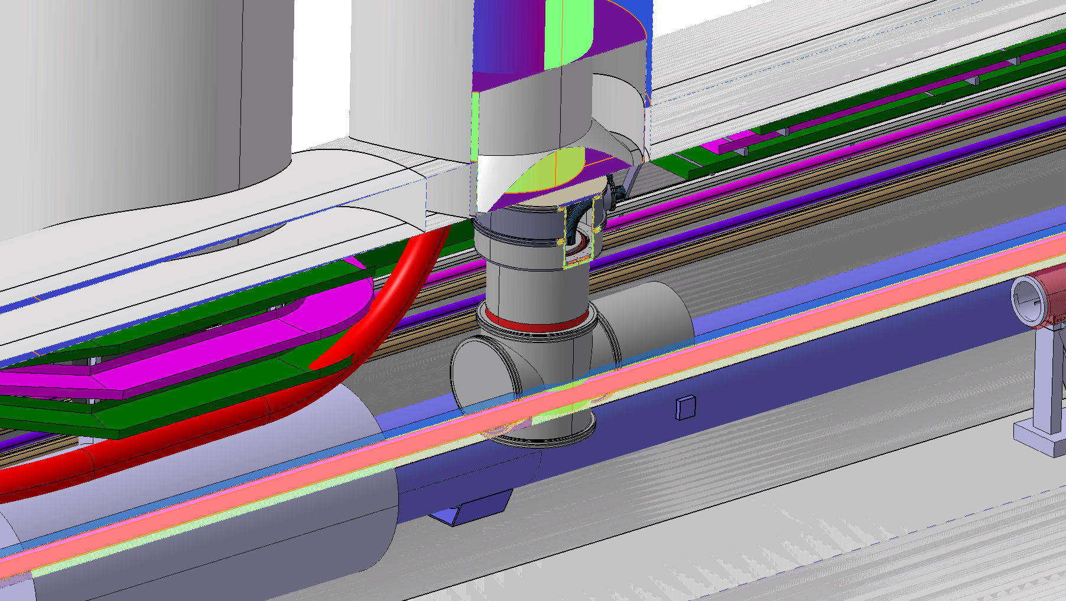
IP5 Left

Slide 13
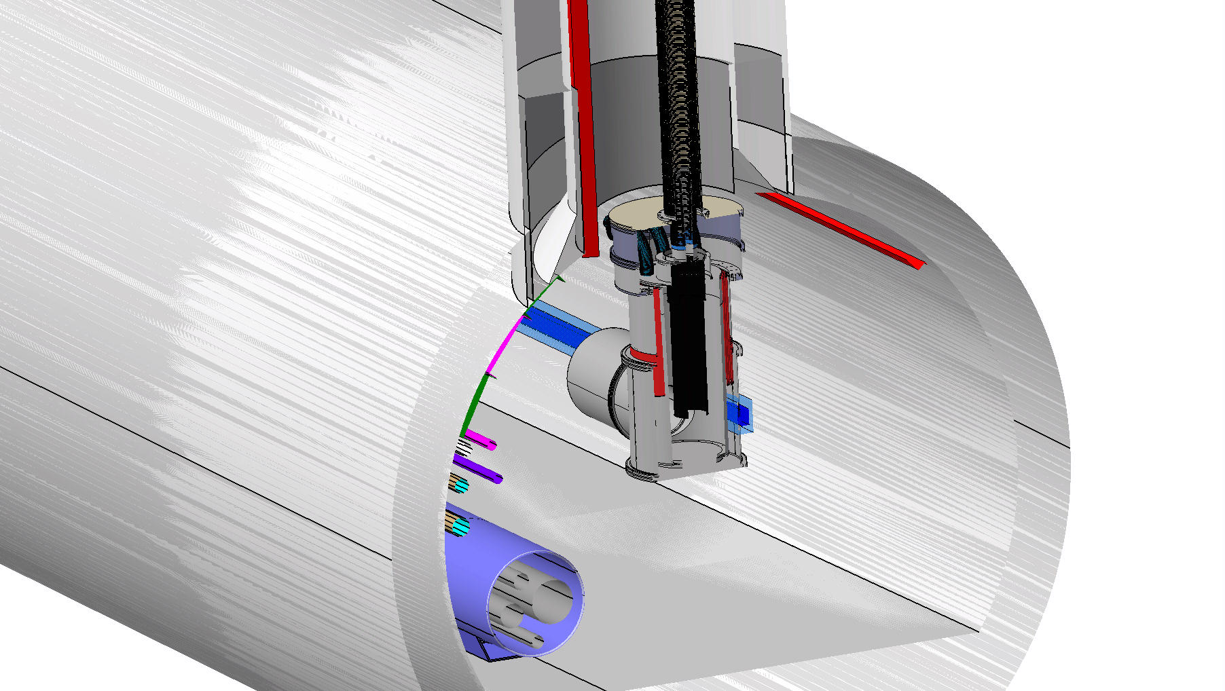
IP5 Left

Slide 14
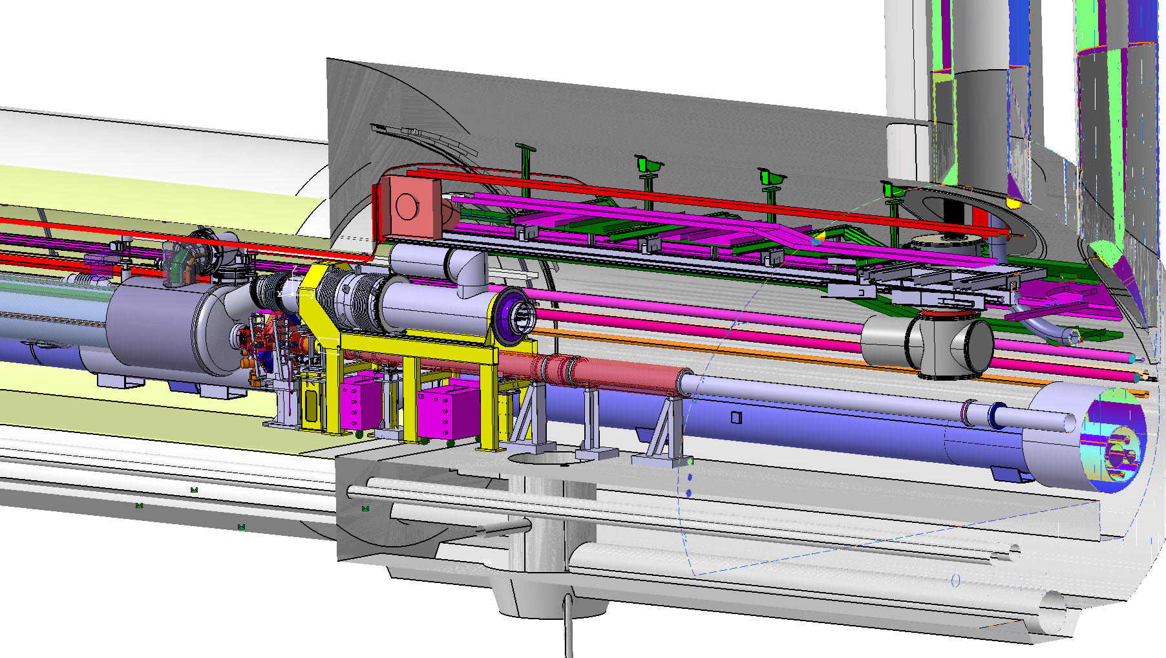
Check Point IP5 RIGHT

Slide 15
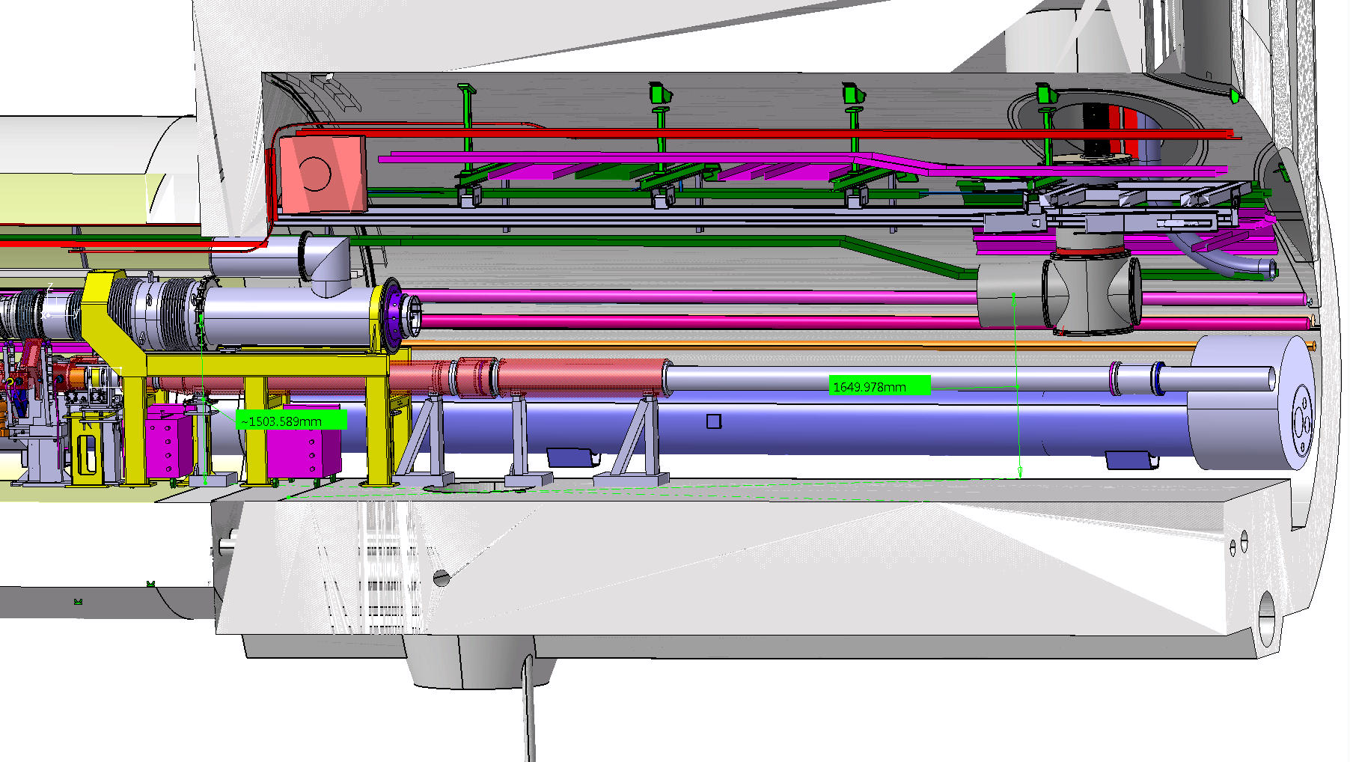
Check Point IP5 RIGHT

Slide 16
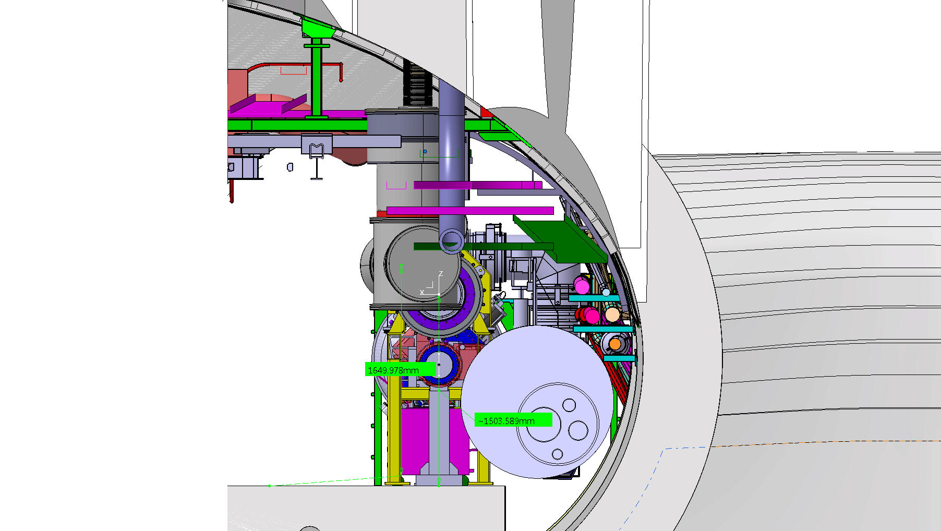
Check Point IP5 RIGHT

