Slide 1
MCBRDP1 test results
Franco Mangiarotti, Vincent Desbiolles, Michał Duda, Jerome Feuvrier, Jean-Luc Guyon, Gerard Willering
WP3 meeting – 2018 Nov 21

Slide 2
Contents
Test setup
  Quench detection
  Quench protection & energy extraction
Test results
  Training & endurance
  Protection studies
  Inductance measurements
  Splice resistance
  RRR
Conclusions

Slide 3
Contents
Test setup
  Quench detection
  Quench protection & energy extraction
Test results
  Training & endurance
  Protection studies
  Inductance measurements
  Splice resistance
  RRR
Conclusions

Slide 4
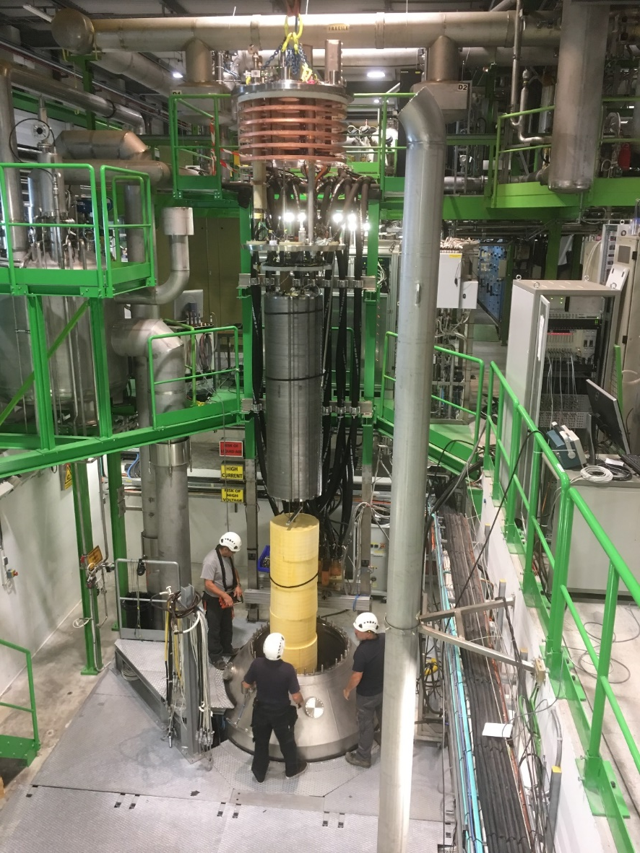
Test setup
MCBRDP1 with two individually powered apertures
One standard LHC 600 A power converter rack with two converters
One standard LHC 600 A energy extraction rack with two switches and two 700 mOhm resistors

Slide 5
Quench detection (per aperture)
EE2
EE3
QDS setup (baseline):
  2.3(EE3-EE5) – (EE5-EE8)
  Trigger after 4 ms @ 100 mV
Potaim setup:
  (EE3-VCL) – (VCL-EE8)
  Trigger after 10 ms @ 50 mV
Lead +
EE4
EE5
VCL
EE6
EE7
Lead -
EE9
EE8

Slide 6
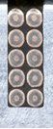
Quench detection (per aperture)
QDS setup (baseline):
  2.3(EE3-EE5) – (EE5-EE8)
  Trigger after 4 ms @ 100 mV
Potaim setup:
  (EE3-VCL) – (VCL-EE8)
  Trigger after 10 ms @ 50 mV

Slide 7
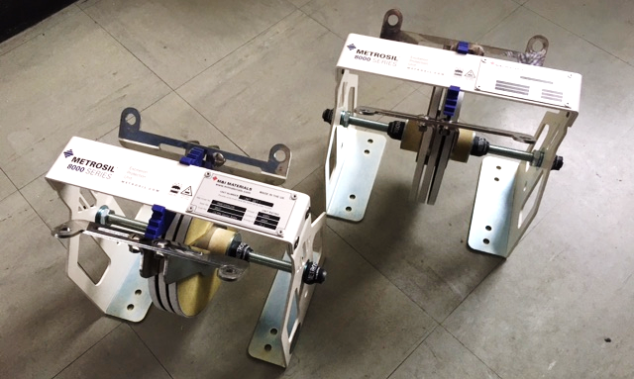
Quench protection
Baseline: 0.7 Ohm resistor
We also used other energy extractions:
  2x Metrosil varistor (#1) designed for <400 V at 460 A
  2x 0.15 Ohm resistor
  2x Metrosil varistor (#2) designed for <475 V at 470 A
    Brought from England during the tests after we saw some problems
  Thanks to Bozhidar Panev & MPE-EE, and Jeff Robertson & M&I Materials for their help

Slide 8
Contents
Test setup
  Quench detection
  Quench protection & energy extraction
Test results
  Training & endurance
  Protection studies
  Inductance measurements
  Splice resistance
  RRR
Conclusions

Slide 9
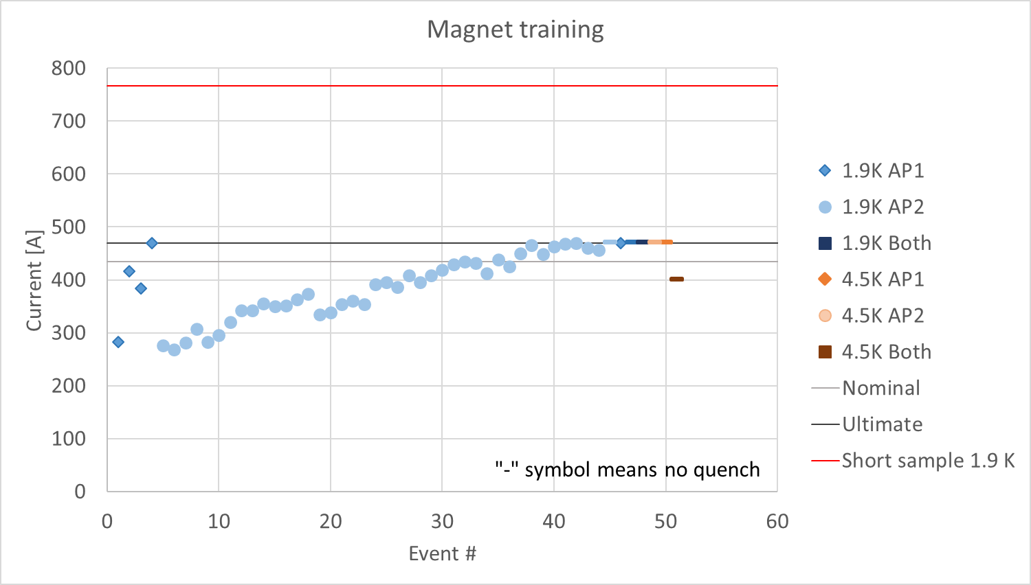
Training
Both apertures have the first quench at ~280A (37% ss)
Fast training in AP1
Slow training in AP2
No additional training with both apertures
No additional training at 4.5K
More details in the next slides

Slide 10
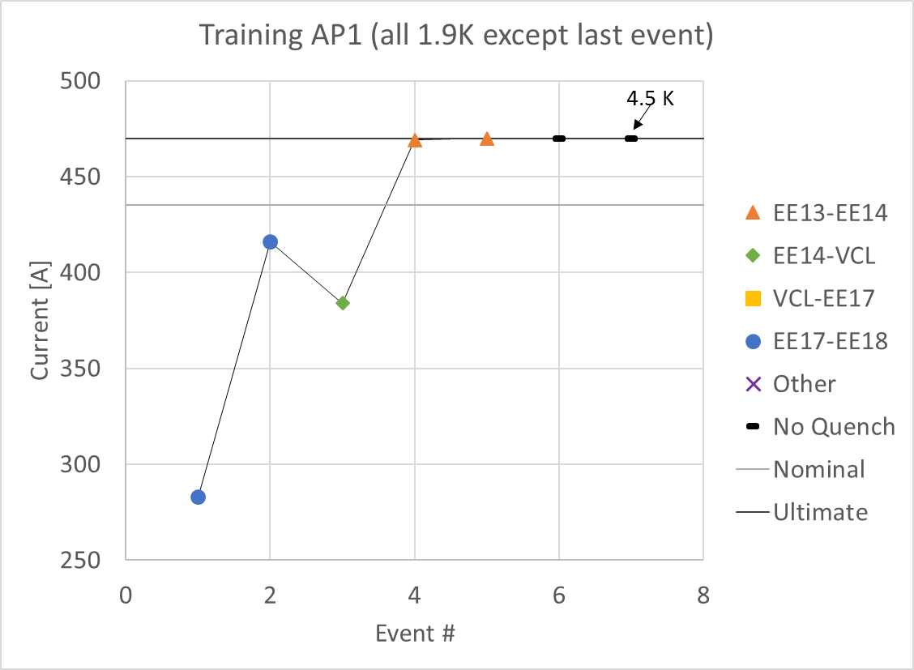
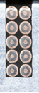

Training AP1
Shallow
Three quenches to nominal current
Two last quenches within 1 A of ultimate current (in the decelerating ramp)
No precursor in any quench
Afterwards: held 2 h at ultimate current
Protection: first two quenches above maximum allowed QI (hotspot temperature ~350 K)
  More on this later
Deep

Slide 11
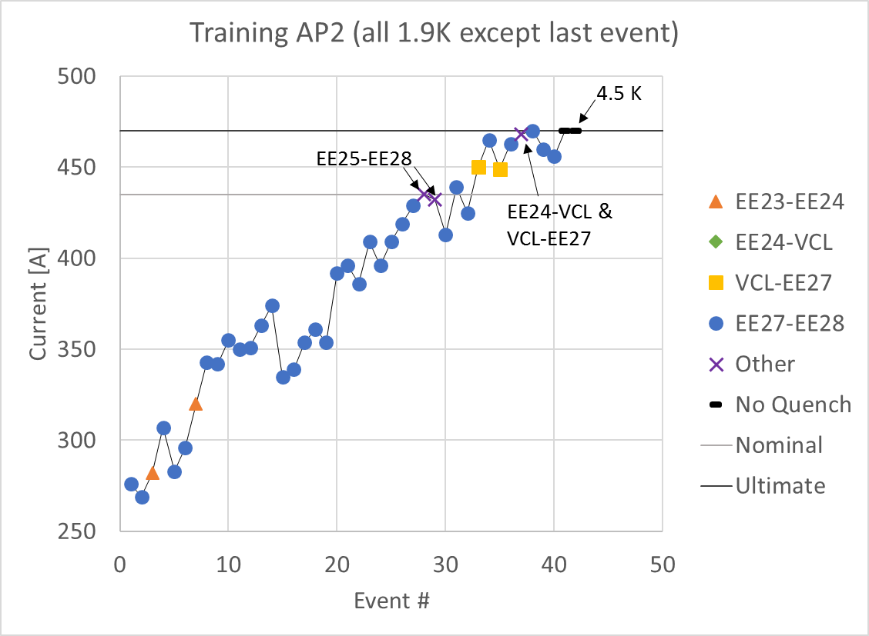
Training AP2
Shallow
Very long training, mostly on EE27-EE28
After 32 quenches: no quench below nominal
After 40 quenches training finished to ultimate current
Held 2h at ultimate
Quench #37 is symmetric
Deep

Slide 12
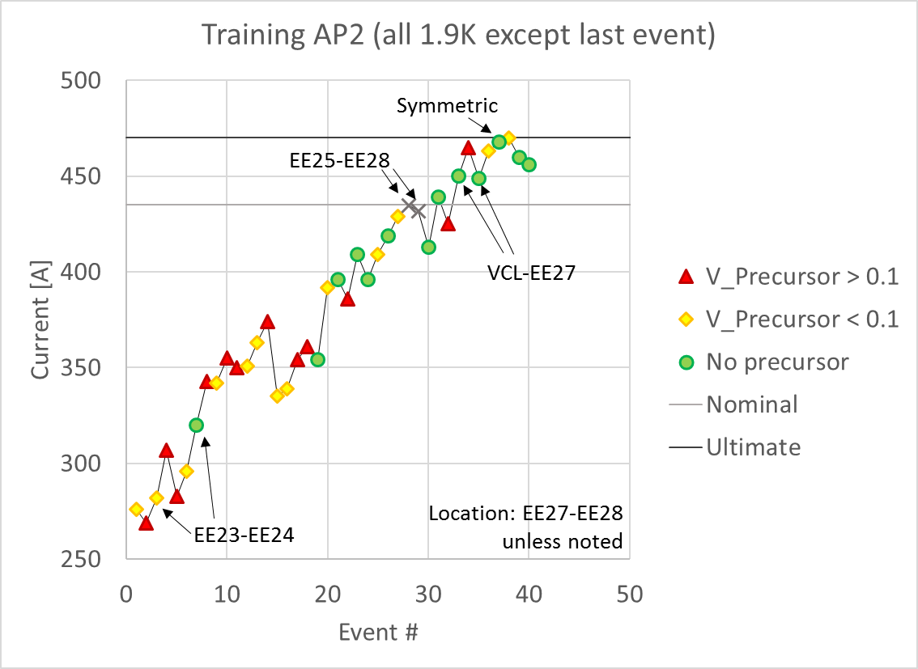

Training AP2: precursors
Large precursors mostly in the first half of the training
No precursors mostly in the second half
Location statistics:
V_Precursor in [V]
 | Total | Large prec | Small prec | No prec
EE23-EE24 | 2 | 0 | 1 | 1
EE24-VCL | 0 | 0 | 0 | 0
VCL-EE27 | 2 | 0 | 0 | 2
EE27-EE28 | 33 | 12 | 12 | 9

Slide 13
Contents
Test setup
  Quench detection
  Quench protection & energy extraction
Test results
  Training & endurance
  Protection studies
  Inductance measurements
  Splice resistance
  RRR
Conclusions

Slide 14
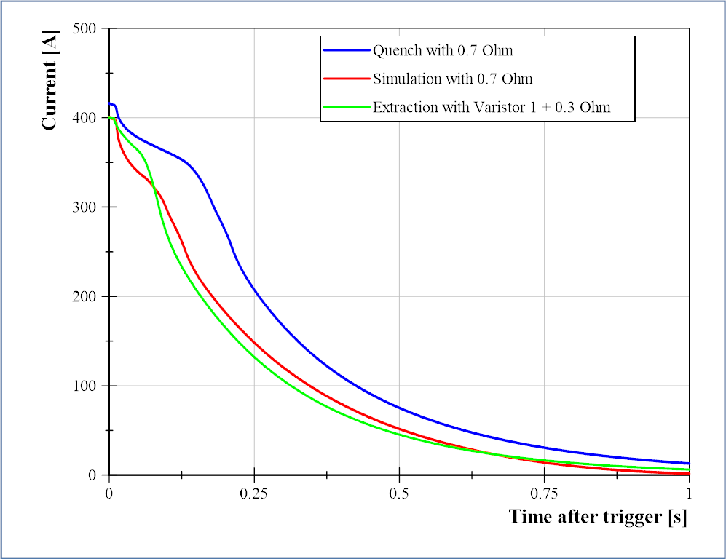
Protection studies
All results presented in this section are at 1.9 K
The expected current discharge is much slower than expected (quench-back starts later)
With the baseline energy extraction (0.7 Ohm) we cannot keep the hotspot temperature below 200 K
  We had two quenches at ~350 K
We looked at several energy extraction setups to optimize discharge:
  No more than ~200 K hotspot
  No more than ~450 V in switch
Dump: R=0.7 Ω
Dump + quench-back:
R=3-4 Ω

Slide 15
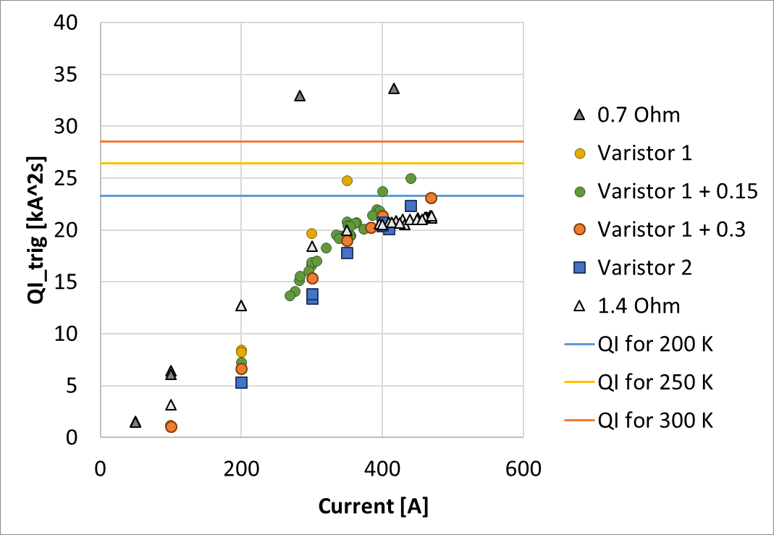
Protection: QI from trigger vs current
Quench detection typically adds 4 kA²s
We can get to low QI with:
  Varistor 1 + 0.3 Ohm resistor in series
  Varistor 2
  1.4 Ohm (2x 0.7 Ohm resistors)
Maximum voltage in the switch (450 V) limits the options

Slide 16
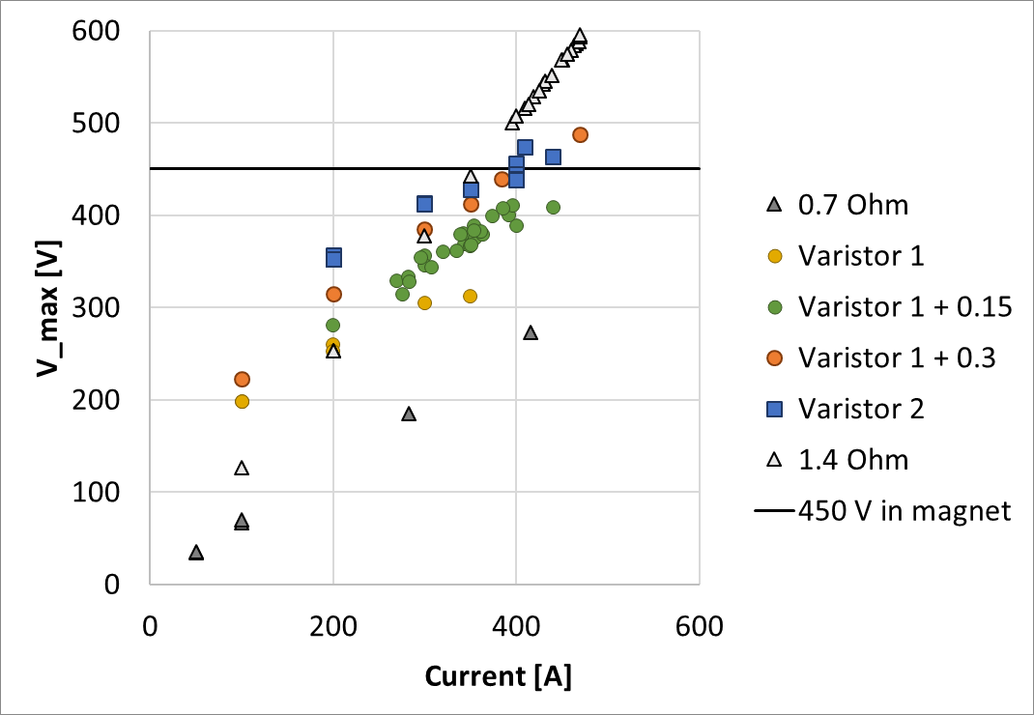
Protection: max magnet voltage vs current
The two original protection options (0.7 Ohm, Varistor 1) had too low maximum voltage, making the discharge too slow
Varistor 1 + 0.3 Ohm and Varistor 2 have slightly too high voltage beyond 400 A
  The Varistor specs could be better adapted to our needs
  Increasing its temperature lowers the discharge voltage
1.4 Ohm is two switches in series, effectively duplicating the maximum allowed voltage

Slide 17
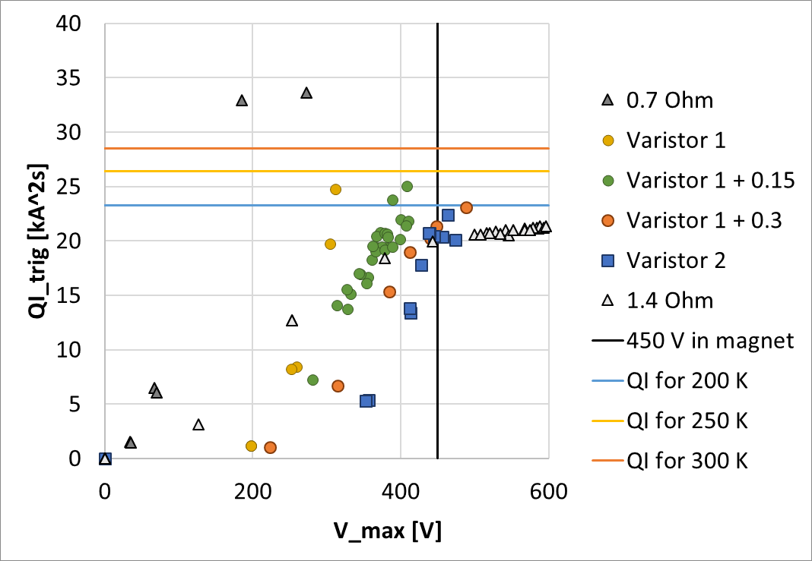
Protection optimization space
This plot shows the results compared the limits:
  Maximum QI for a limited hotspot temperature
  Maximum voltage for the switch
If we cannot stay within the limits, change the limits:
  Use two switches for 2x max voltage (SM18)
  Different switch components for optimized discharge voltage

Slide 18
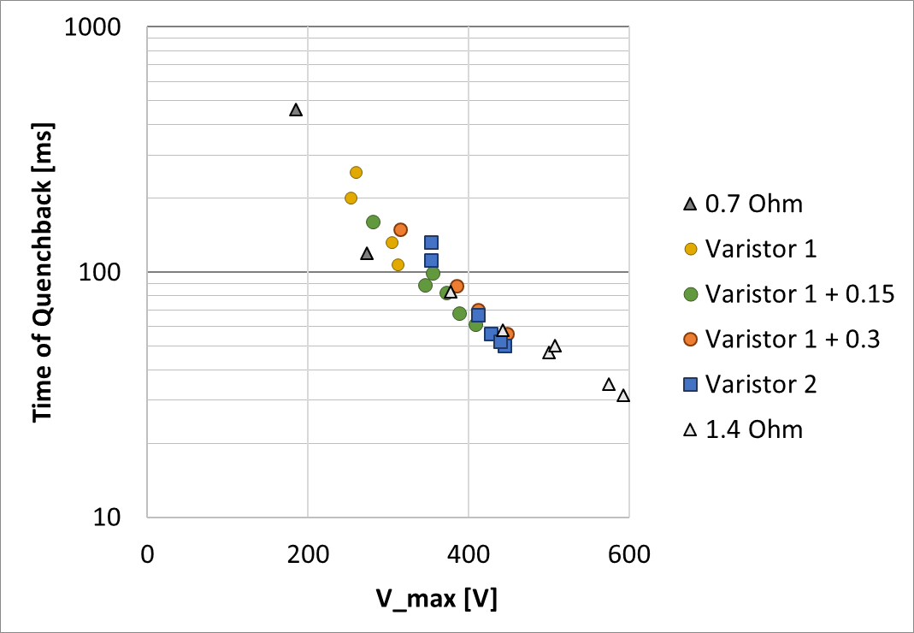
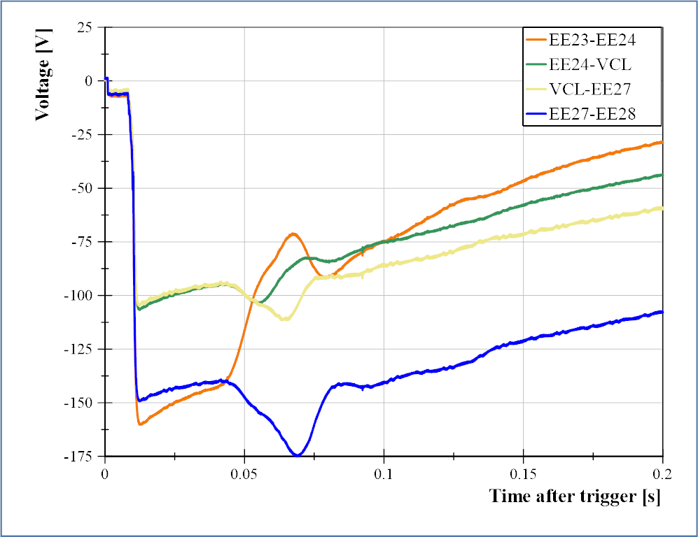
Max voltage effect on quench-back start
Quench-back start time determined from segment voltage after trigger
QB starts in deeper strands
QB start time mainly depends on the maximum voltage of the discharge

Slide 19
Contents
Test setup
  Quench detection
  Quench protection & energy extraction
Test results
  Training & endurance
  Protection studies
  Inductance measurements
  Splice resistance
  RRR
Conclusions

Slide 20
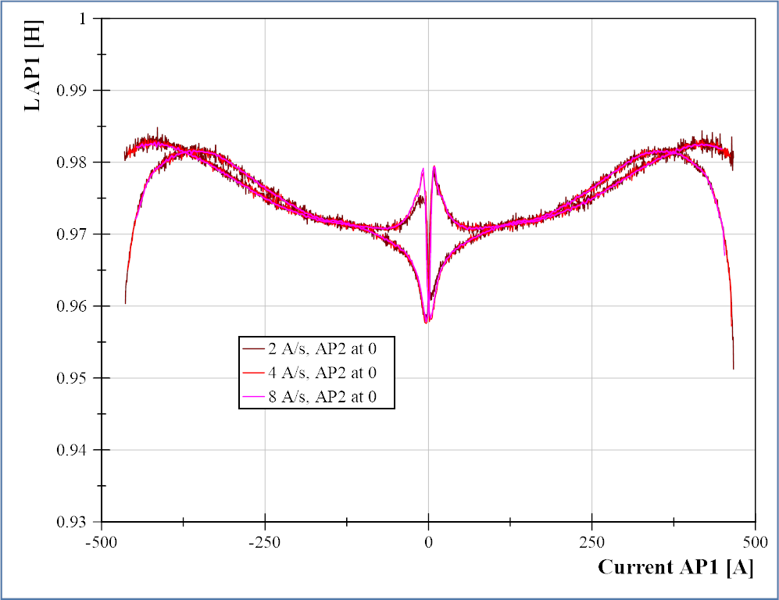
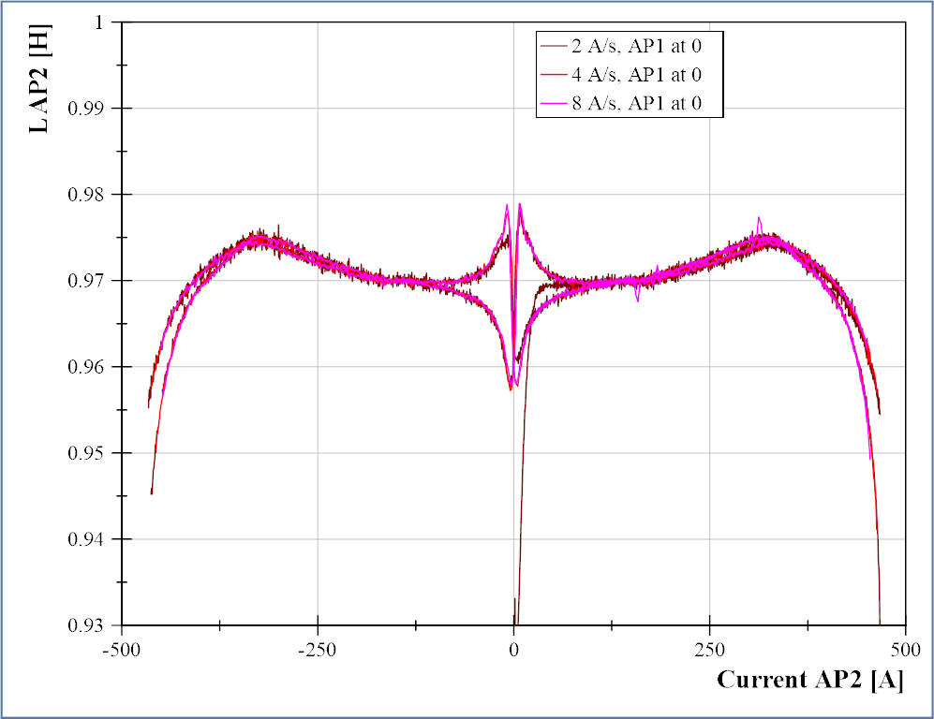
Inductance: only one AP powered
AP1
AP2
Inductance is much larger than expected 800 mH
Inductance does not depend on ramp rate between 2--8 A/s

Slide 21
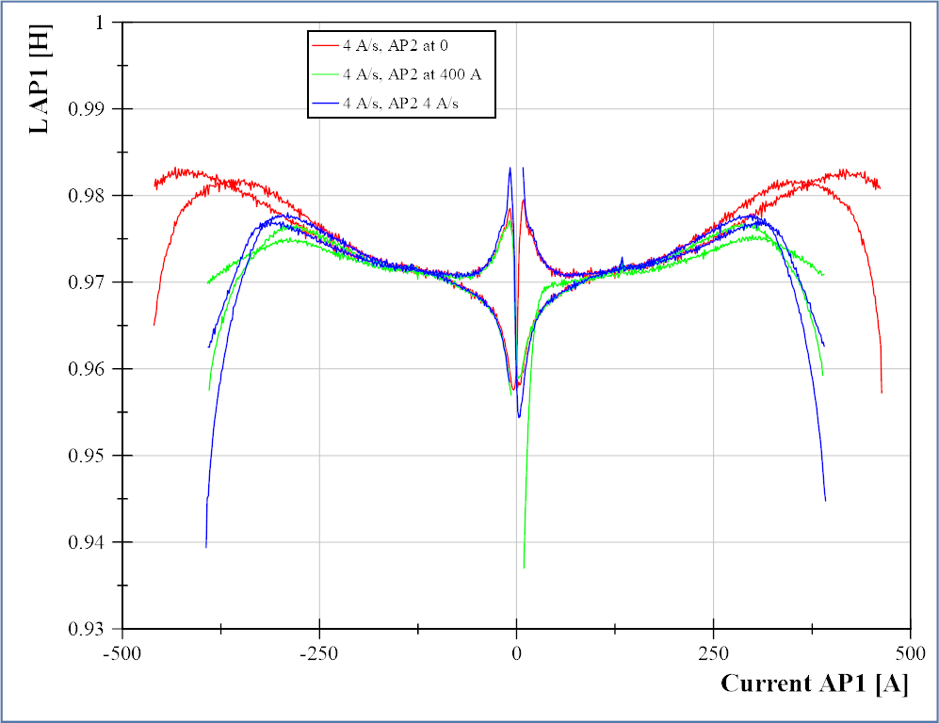
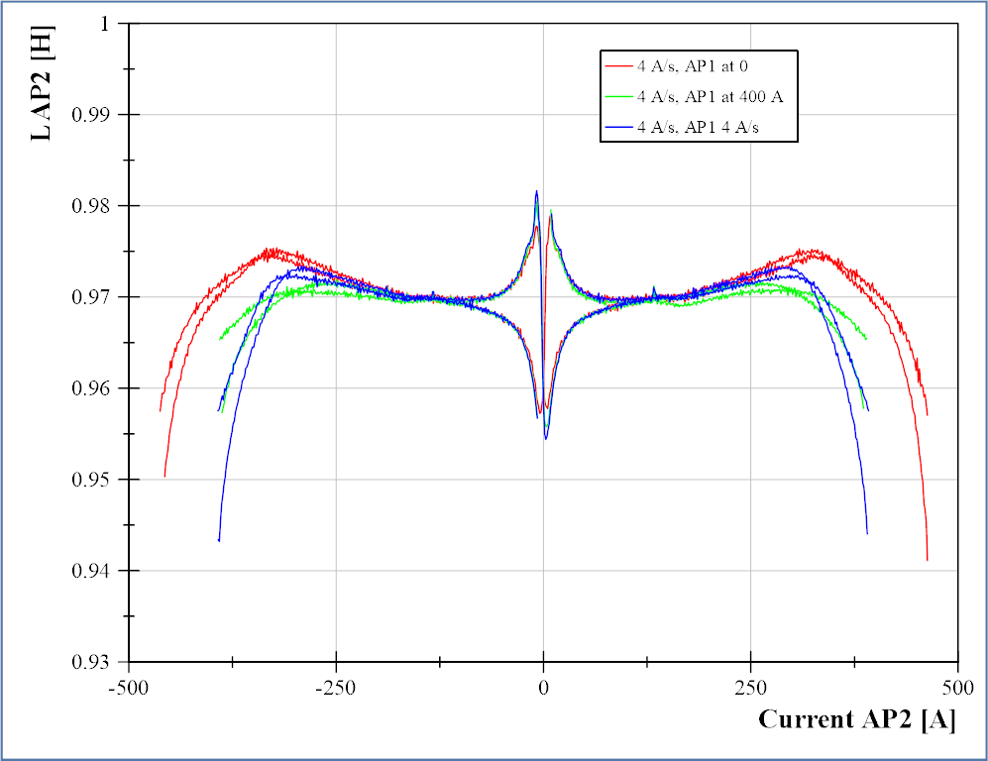
Inductance: both APs powered
AP1
AP2
Inductance decays earlier when both apertures are powered

Slide 22
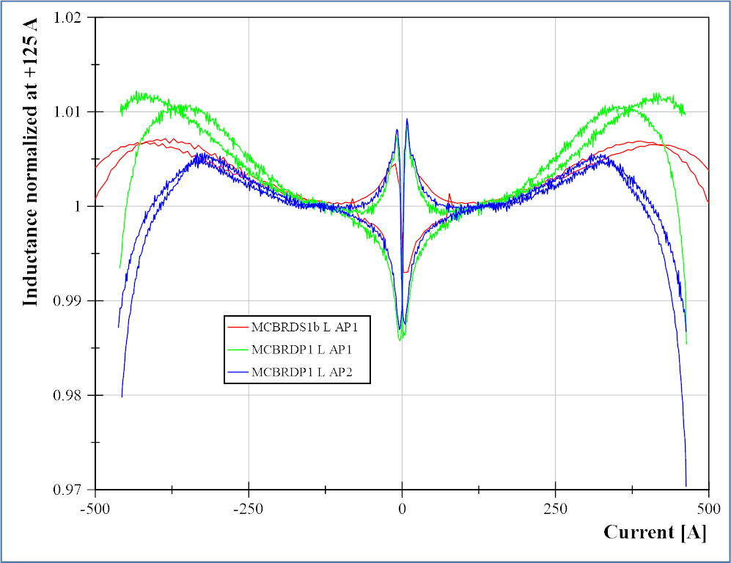
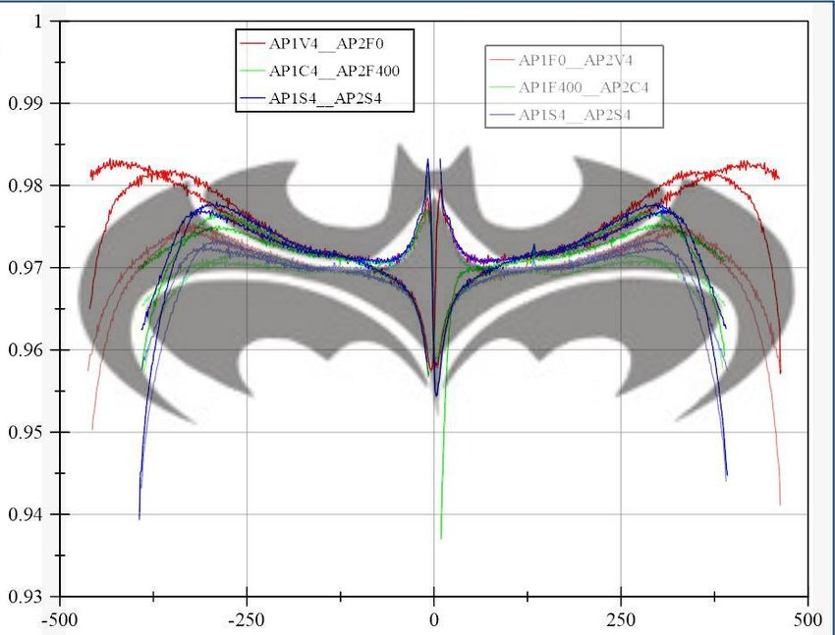
Inductance comparison with short model
Each aperture powered alone at 4 A/s
Inductance normalized to the value at +125 A
AP1 in model very similar to AP2 in prototype
  Do they have the same orientation?
Inductance reduction starts later in model
  Many differences: distance between apertures, iron yoke design
It looks like the Batman sign

Slide 23
Contents
Test setup
  Quench detection
  Quench protection & energy extraction
Test results
  Training & endurance
  Protection studies
  Inductance measurements
  Splice resistance
  RRR
Conclusions

Slide 24
Splices resistance & RRR
 | V taps | Resistance [nOhm] | Error [nOhm]
AP1 | EE14--EE15 | 5.38 | 0.06
 | EE16--EE17 | 5.03 | 0.07
AP2 | EE24--EE25 | 6.55 | 0.02
 | EE26--EE27 | 6.62 | 0.04
Segment | RRR
EE13-EE14 | 235
EE15-EE16 | 233
EE17-EE18 | 221
EE23-EE24 | 230
EE25-EE26 | 233
EE27-EE28 | 235
Individual splice resistance (5-6.6 nOhm) similar to that of model (5-10 nOhm)
Average splice resistance measurement too noisy, will repeat for the second cooldown
RRR values (220-235) lower than the short models (~260)

Slide 25
Contents
Test setup
  Quench detection
  Quench protection & energy extraction
Test results
  Training & endurance
  Protection studies
  Inductance measurements
  Splice resistance
  RRR
Conclusions

Slide 26
Conclusions & future plans
Training to ultimate current:
  Good in AP1 (3 quenches to nominal, 5 to ultimate)
  Very slow in AP2 (40 quenches to ultimate current). Mostly in the shallower three wires of the winding, where all quenches with precursor but one were originated.
  No further training at 4.5 K
Protection:
  Baseline protection not adequate for hotspot temperature < 200 K
  Need to optimize the protection systems
  Onset of quench-back (at given temperature) mostly determined by voltage
Other results:
  Inductance: much larger than expected (1 H instead of 0.8 H)
  Splices resistance: individual OK (5-6.6 nOhm), average data too noisy
  RRR: lower than models (220-235 instead of 260)
Future:
  Second test (in 1-2 weeks): training memory verification, splice resistance measurement and full magnetic measurements

