Slide 1
Magnetic measurements at cryogenic temperature on MCBRDP1 (D2 corrector prototype)
Lucio Fiscarelli
WP3 meeting, 21/11/2018

Slide 2
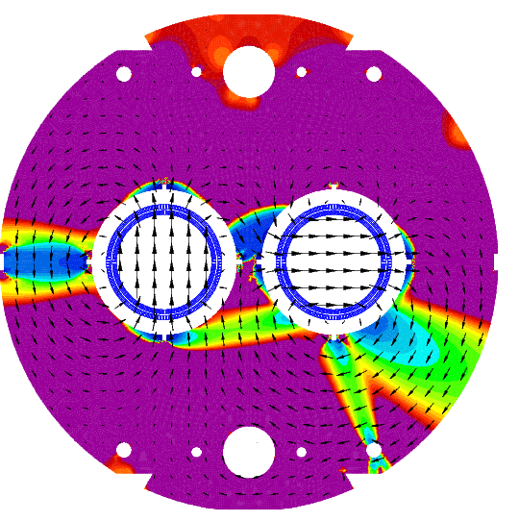
Up to now…
Available measurements
First aperture of the short model at room temperature
16 Jan 2018
Both apertures of the short model at cryogenic temperature
27 Jun 2018 https://indico.cern.ch/event/738022/
Both apertures of the prototype at room temperature
12 Sep 2018 https://indico.cern.ch/event/753441/
One aperture of the prototype at cryogenic temperature
this presentation

Slide 3
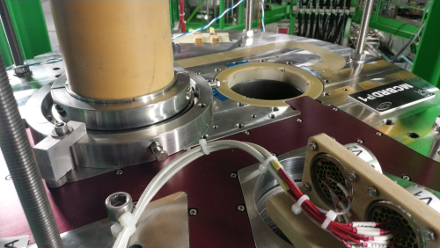
Measurement setup
Rotating-coil in the helium bath (vertical cryostat setup in SM18)
Only one shaft was available, one aperture was equipped
  Length = 2.1 m
  5 segments
  Not sufficient for covering the full integral field, we will focus on the central field (3 segments)
The equipped aperture is the one with field in the vertical direction (AP1 in the following)
Reference radius
35 mm

Slide 4
Measurement list
3 cycles with valid data:
  Stair-step cycle up to ±ultimate in AP1
  0 A in AP2
  Stair-step cycle up to ±400 A in AP1
  400 A in AP2
  Stair-step cycle up to ±400 A in AP1
  -400 A in AP2
  All cycles were preceded by a pre-cycle

Slide 5
AP1 up to ±ultimate and AP2 at 0 A
Specified value 6.02 T kA⁻¹

Slide 6
AP1 up to ±400 and AP2 at 400 A

Slide 7
Field quality table
 | AP1 at ambient temperature |  |  |  |  | AP1 at 1.9 K and 430 A
 | NCS | Center | CS | INTEGRAL |  | pos1 | pos2 | pos3
n | b_{n}
2 | 1.37 | -0.68 | -0.06 | -0.18 |  | -2.19 | -3.80 | -5.12 |  |  | units
3 | -10.13 | -9.79 | -11.18 | -10.11 |  | -10.93 | -11.18 | -11.19
4 | 0.19 | 0.07 | 0.07 | 0.09 |  | -0.17 | -0.13 | -0.13
5 | 2.57 | 2.26 | 2.10 | 2.29 |  | -0.01 | 0.09 | 0.19
6 | -0.04 | 0.02 | -0.13 | -0.02 |  | -0.06 | 0.02 | -0.06
7 | -0.96 | -0.98 | -1.20 | -1.02 |  | -0.38 | -0.31 | -0.33
8 | 0.07 | 0.01 | -0.02 | 0.02 |  | -0.02 | 0.03 | -0.02
9 | 0.31 | 0.13 | 0.42 | 0.22 |  | -0.02 | 0.00 | 0.01
10 | 0.00 | 0.01 | 0.19 | 0.04 |  | 0.00 | 0.01 | 0.00
n | a_{n}
2 | 13.07 | -6.34 | -31.48 | -7.41 |  | -4.80 | -3.23 | -4.78 |  |  | units
3 | -4.41 | -0.59 | 2.15 | -0.79 |  | -0.18 | -0.35 | -0.87
4 | -1.33 | 0.06 | 1.25 | 0.02 |  | -0.35 | -0.26 | -0.28
5 | -0.28 | 0.25 | 0.33 | 0.17 |  | 0.17 | 0.17 | 0.22
6 | -0.53 | -0.26 | -0.28 | -0.31 |  | -0.06 | -0.06 | -0.04
7 | -0.08 | 0.00 | -0.01 | -0.02 |  | 0.04 | -0.01 | 0.01
8 | 0.06 | 0.01 | -0.24 | -0.02 |  | 0.00 | 0.01 | -0.02
9 | -0.06 | -0.03 | -0.15 | -0.06 |  | -0.03 | -0.03 | -0.04
10 | -0.11 | -0.02 | 0.41 | 0.04 |  | 0.00 | 0.01 | 0.00
b₃ in agreement with results at ambient temperature

Slide 8
Cross talk
AP1 | +400 A
AP2 | 0 A | +400 A | -400 A |  | 0 A | +400 A | -400 A
n | b_{n} |  |  |  | a_{n}
2 | -3.84 | 1.31 | 0.98 |  | -3.39 | -10.61 | 3.96 |  | units
3 | -11.27 | -16.13 | -15.96 |  | -0.33 | 2.12 | -3.26
4 | -0.14 | 0.42 | 0.30 |  | -0.27 | -1.30 | 0.87
5 | 0.23 | -0.26 | -0.20 |  | 0.18 | 0.63 | -0.30
6 | 0.01 | 0.01 | -0.02 |  | -0.05 | -0.21 | 0.12
7 | -0.35 | -0.39 | -0.38 |  | -0.01 | 0.05 | -0.08
8 | 0.03 | 0.00 | -0.01 |  | 0.01 | -0.01 | 0.03
9 | 0.01 | 0.01 | 0.01 |  | -0.03 | -0.02 | -0.04
10 | 0.01 | 0.01 | 0.01 |  | 0.01 | 0.00 | 0.01
Cross-talking effects are noticeable in contrast with results from the short model.

Slide 9
Conclusions
From tests at cryogenic temperature (1.9 K)
  Transfer function larger than specifications (table WP3)
  In agreement with results at ambient temperature
  b₃ in the straight section is -10 units
  In agreement with measurements at ambient temperature
  Cross-talking effects are noticeable
  They were not visible on the short model
In occasion of the thermal cycle, we are equipping the magnet with two new shafts with suitable length in order to perform additional magnetic measurements

Slide 10
Additional slides

Slide 11
MCBRDP1 at room temperature 1
 | AP1 |  |  |  |  | AP2
 | NCS | Center | CS | INTEGRAL |  | NCS | Center | CS | INTEGRAL
 | 18.7% | 62.7% | 18.7% | 100.0% |  | 18.7% | 62.6% | 18.7% | 100.0%
I | 0.4467 | 0.4464 | 0.4466 |  |  | 0.4465 | 0.446 | 0.4463 |  |  | A
B1 | 0.877 | 2.944 | 0.877 |  |  | -0.876 | -2.942 | -0.878 |  |  | mT
TF |  |  |  | 12.672 |  |  |  |  | -12.675 |  | mT m A⁻¹
angle | 0.2045 | 0.2105 | 0.2137 | 0.2100 |  | -1.3642 | -1.359 | -1.3559 | -1.3594 |  | rad
Field repeatable between the two apertures within 2 units
Perpendicularity in the order of 1.5 mrad
Measured TF larger than calculations,
a verification (current generator) is ongoing

Slide 12
MCBRDP1 at room temperature 2
 | AP1 |  |  |  |  | AP2
 | NCS | Center | CS | INTEGRAL |  | NCS | Center | CS | INTEGRAL
n | b_{n}
2 | 1.37 | -0.68 | -0.06 | -0.18 |  | 2.36 | -1.09 | 1.04 | -0.05 |  | units
3 | -10.13 | -9.79 | -11.18 | -10.11 |  | -9.50 | -9.20 | -8.75 | -9.17
4 | 0.19 | 0.07 | 0.07 | 0.09 |  | 0.49 | 0.76 | 0.85 | 0.73
5 | 2.57 | 2.26 | 2.10 | 2.29 |  | 2.91 | 2.72 | 2.51 | 2.71
6 | -0.04 | 0.02 | -0.13 | -0.02 |  | -0.23 | -0.04 | -0.11 | -0.09
7 | -0.96 | -0.98 | -1.20 | -1.02 |  | -0.87 | -0.81 | -0.82 | -0.82
8 | 0.07 | 0.01 | -0.02 | 0.02 |  | -0.08 | 0.06 | 0.04 | 0.03
9 | 0.31 | 0.13 | 0.42 | 0.22 |  | 0.17 | 0.15 | 0.13 | 0.15
10 | 0.00 | 0.01 | 0.19 | 0.04 |  | -0.09 | -0.02 | -0.04 | -0.03
n | a_{n}
2 | 13.07 | -6.34 | -31.48 | -7.41 |  | -22.67 | 0.77 | 25.34 | 0.99 |  | units
3 | -4.41 | -0.59 | 2.15 | -0.79 |  | -3.81 | 0.09 | 2.36 | -0.21
4 | -1.33 | 0.06 | 1.25 | 0.02 |  | 1.40 | 0.13 | -0.61 | 0.23
5 | -0.28 | 0.25 | 0.33 | 0.17 |  | 0.04 | 0.34 | 0.17 | 0.25
6 | -0.53 | -0.26 | -0.28 | -0.31 |  | 0.34 | 0.17 | -0.06 | 0.16
7 | -0.08 | 0.00 | -0.01 | -0.02 |  | 0.11 | 0.05 | 0.09 | 0.07
8 | 0.06 | 0.01 | -0.24 | -0.02 |  | 0.21 | 0.03 | 0.05 | 0.07
9 | -0.06 | -0.03 | -0.15 | -0.06 |  | 0.04 | -0.02 | -0.06 | -0.01
10 | -0.11 | -0.02 | 0.41 | 0.04 |  | 0.11 | 0.01 | 0.05 | 0.04
Allowed multipoles are larger than expected but field quality is within specifications

Slide 13
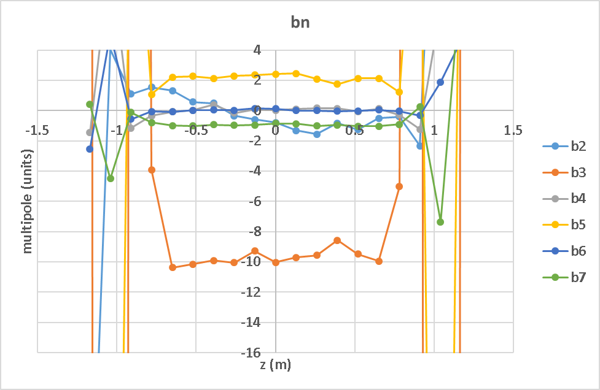
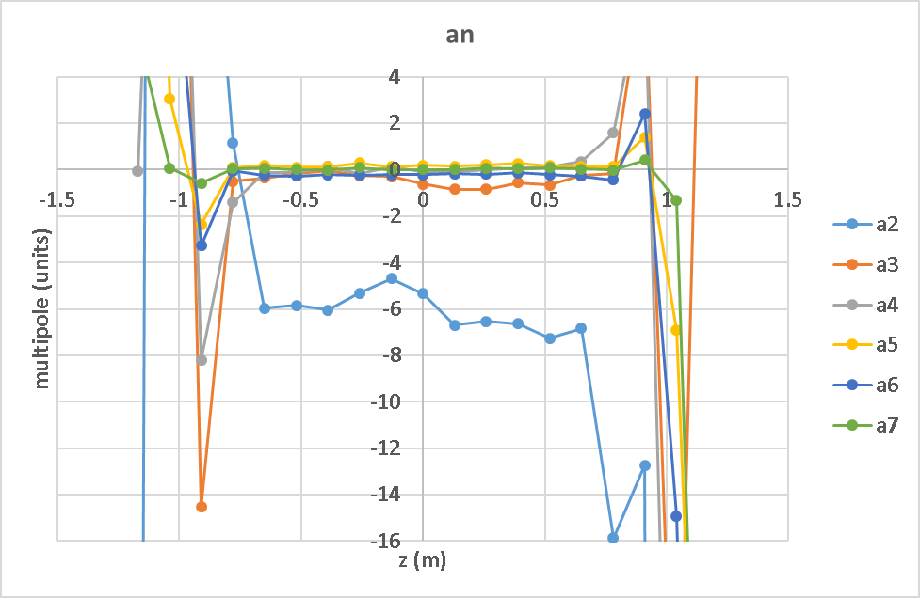
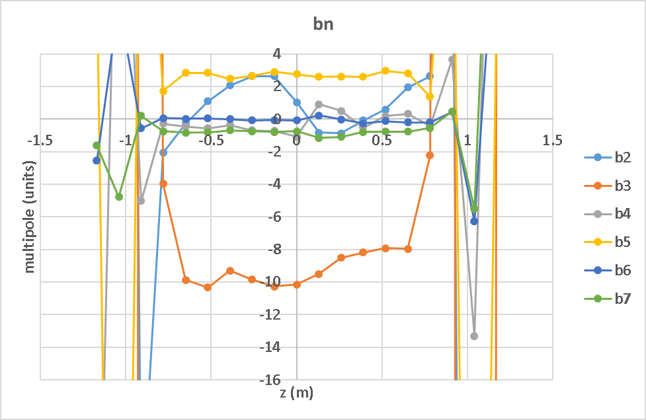
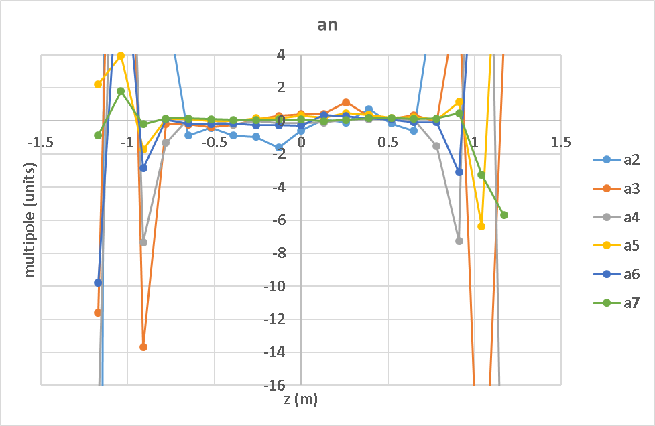
MCBRDP1 at room temperature 3
AP1
AP2

Slide 14
MCBRDS1b at cryogenic temperature
AP1 vertical field newest-built aperture
TF | 1.695 |  | T m kA⁻¹
n | b_{n} | a_{n}
2 | -4.1 | -2.97 | units at 35 mm
3 | -3.29 | -0.74
4 | -0.59 | -0.16
5 | -1.09 | -0.08
6 | -0.05 | -0.16
7 | -0.09 | -0.14
8 | 0.01 | -0.05
9 | -0.06 | -0.03
10 | -0.03 | -0.02
at nominal field level and 1.9 K
AP2 horizontal field first-built aperture
TF | 1.698 |  | T m kA⁻¹
n | b_{n} | a_{n}
2 | -2.05 | 1.7 | units at 35 mm
3 | -2.69 | -0.01
4 | 0.35 | 1.17
5 | -1.77 | 0.23
6 | 0.54 | 0.23
7 | 0.28 | 0.09
8 | 0.28 | 0.05
9 | 0.01 | 0.05
10 | 0.07 | 0.01
at nominal field level and 1.9 K

Slide 15
AP1 newest built (↕) Above nom.
MCBRDS1b at cryogenic temperature
TF = 1.696 Tm kA⁻¹

Slide 16
AP2 first built (↔) Above nom.
MCBRDS1b at cryogenic temperature
TF = 1.699 Tm kA⁻¹

Slide 17
MCBRDS1b at cryogenic temperature
AP1 newest built (↕) X-talk
TF = 1.696 Tm kA⁻¹

Slide 18
MCBRDS1b at cryogenic temperature
AP2 first built (↔) X-talk
TF = 1.699 Tm kA⁻¹

Slide 19
MCBRDS1b at room temperature
First-built aperture at room temperature 1 A
n | b_{n} | a_{n}
2 | 3.34 | 3.84
3 | -7.86 | 2.24
4 | -1.07 | 1.53
5 | -0.84 | -0.12
6 | -0.41 | 0.45
7 | 0.34 | -0.16
8 | -0.29 | 0.14
9 | 0.09 | -0.07
10 | -0.03 | 0.17

