Slide 1
WP5
Data acquisition systems for beam tests
D. Cussans,
AIDA-2020 Annual Meeting, Oxford

Slide 2
Aims
Provide tools to aid data acquisition in “small scale” systems.
  Within AIDA-2020
  … and elsewhere
Worked closely with WP15 (beam test infrastructure)
  Maintenance and development of EUDAQ

Slide 3
Deliverables
D5.2 Trigger Logic Ready ( M30 ).
  TLUs produced TLUs for AIDA-2020 beam-lines.
  TLU’s manufactured for other users at “Cost price”
  Added optical interface for timing/synchronization signal. Used at ProtoDUNE
  More details in Paolo Baesso’s talk
D5.3 DAQ Software ( M30 ).
  EUDAQ 2.0
  See Jan Dreyling-Eschweiler’s talk
D5.4 , D5.5 Data acquisition hardware ( M30 )
  Linked to D5.2
D5.6 Common DAQ system used in combined beam tests ( M45 )
  Already running combined beam tests between different Calo systems.
  Integration of Silicon strip tracker progressing
  See talks by Katja Kruger (AHCAL) , Mengqing Wu (SiTra)

Slide 4
Milestones
MS43 , M21 ( TLU Design ready ) reached.
  TLU exists. Report written
MS46 , M24 ( EUDAQ interfaces to other DAQs available. )
  Achieved with of EUQDAQ 2.0
MS62 , M27 ( Development of run control ready )
  Was reached when EUDAQ 2.0 is released ( Calorimeter groups already gaining experience integrating run control with EUDAQ )
MS66 , M30 ( TLU ready hardware )
  See D5.2
MS67 , M30 ( Data quality tools ready )
  Tom Coates ( Uni Sussex ) worked on DAQ4HEP tools ( Ete, Mirabito IN2P3 ) and enhancing integration with EUDAQ. Used for Calice
  Full online monitoring not achieved – near-online.

Slide 5
Milestones
MS68 ( Slow control system ready ) , M30
  A light weight implementation
MS80 (Common DAQ system ready for combined beam-tests) , M36
  Already mounting common beam-tests between different ILC detector prototype DAQ systems.
  Pushed back – will allow experience from more beam-tests to be incorporated in report.

Slide 6
Trigger and DAQ is 100
Phys. Rev. 13, 272 , 1st April 1919
“... visual or audible methods of counting are quite trying on the nerves ... A self-recording device would therefore be an obvious improvement.”

Slide 7
Hardware - TLU
TLU hardware designed during AIDA to replace TLU designed during EUDET
  More inputs, better timing precision, better quality clock
  Replaces obsolescent FPGA
Open hardware/firmware https://ohwr.org/project/fmc-mtlu
Latest version has optical I/O for timing/synchronization data
  Used with ProtoDUNE.
19 units produced in total
  For AIDA-2020 beam-lines
  At cost for other users
Negotiating with company to make another batch.

Slide 8
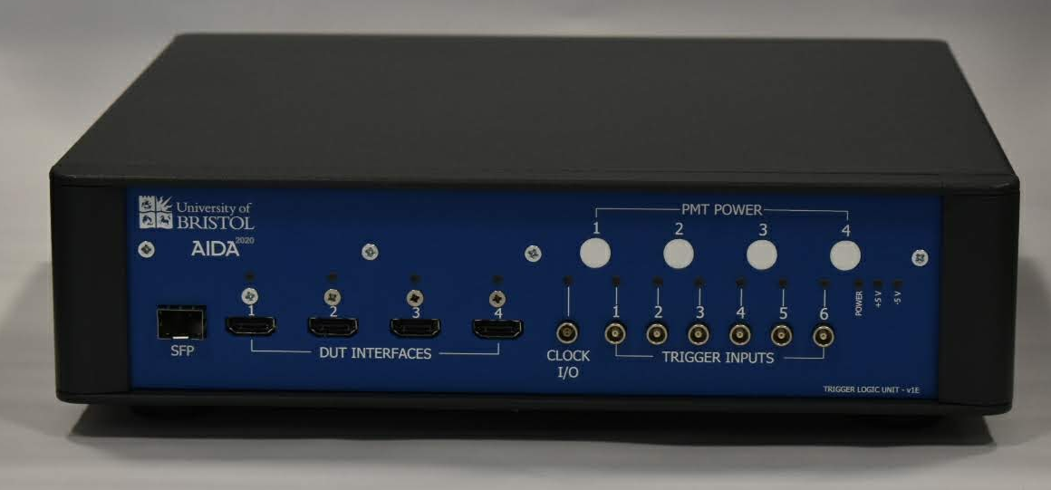
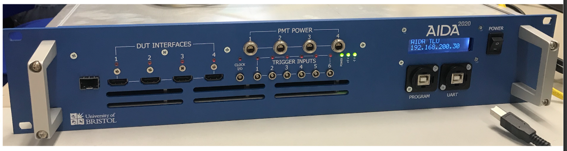
AIDA TRIGGER LOGIC UNIT
TLU v1E versions
HARDWARE
19” 2U enclosure has additional display and built-in AC/DC converter to operate with mains.
Identical core-hardware inside so no operational difference.
SOFTWARE
  Full integrated in the EUDAQ framework
(above) TABLE TOP ENCLOSURE
(below) 19” RACK MOUNTED 2U ENCLOSURE

Slide 9
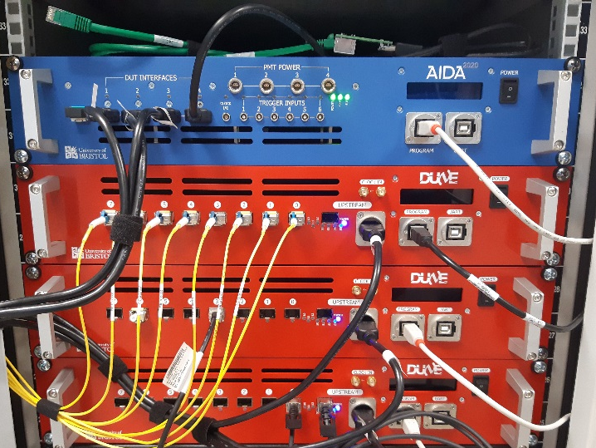
TLU v1e hardware status
A total of 19 units produced:
  10 in TABLE TOP enclosure
  9 in RACK MOUNT 2U enclosure 19”
  Two units currently in Bristol for testing.
  All other units distributed to users and beam lines.
19” unit at ProtoDUNE

Slide 10
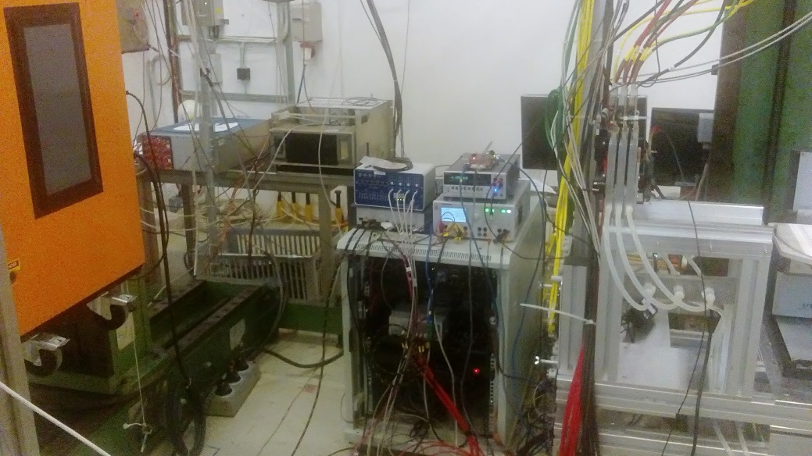
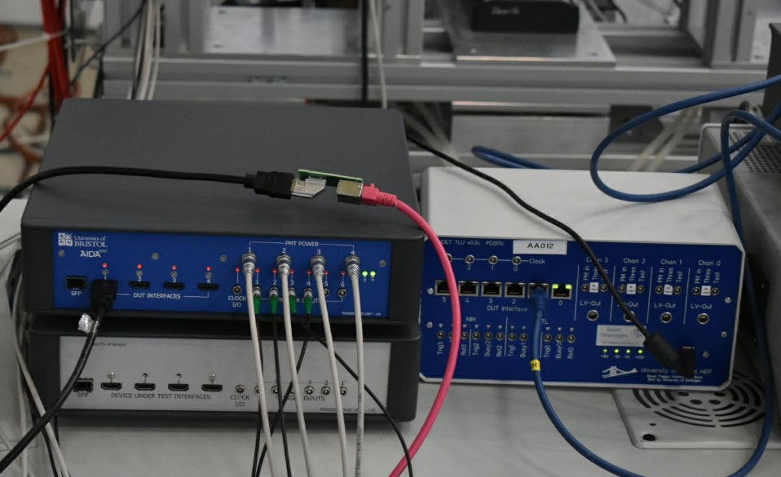
TLU v1e usage
Units successfully deployed at CERN and DESY beam-lines as well as several laboratories.
  Slowly replacing old EUDET TLUs
TLUs have been used for 15+ months by several users/experiments.

Slide 11
Software - EUDAQ
EUDAQ2 Released. Improvements w.r.t. EUDAQ1:
  More general – some beam-telescope assumptions removed.
  More flexible -
    definition of “event” more general.
      Allows data from detectors with different integration times to be combined
        Rolling shutter MIMOSAs with triggered FE-I4
    Can have multiple data collectors
      Better scaling if required.
      Can combine data into events offline if required
  Better defined State Transition Diagram for run control
  Python bindings
    Can write a data producer in Python.
  See talk by Jan Dreyling-Eschweiler , https://indico.cern.ch/event/773447/contributions/3362994/

Slide 12
EUDAQ1 + Telescope

Slide 13
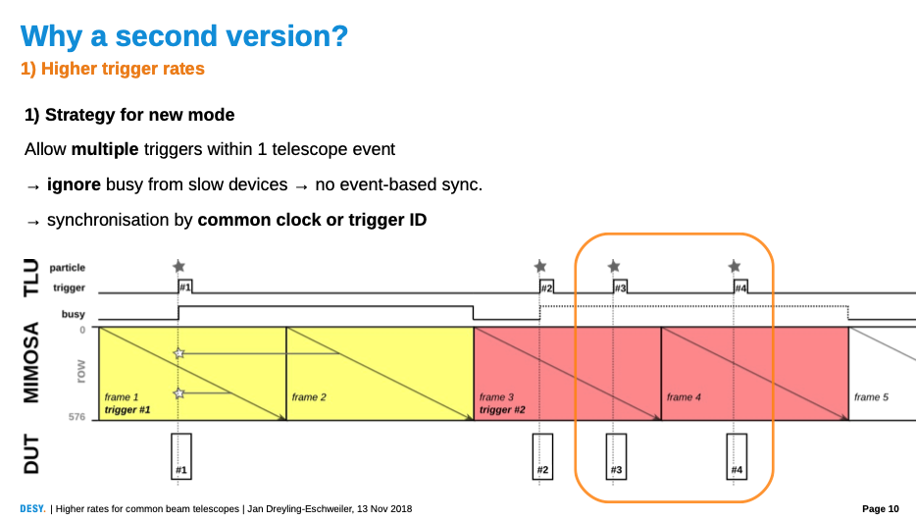
EUDAQ2 + Telescope

Slide 14
EUDAQ2 + Telescope
“Mixed Mode”

Slide 15
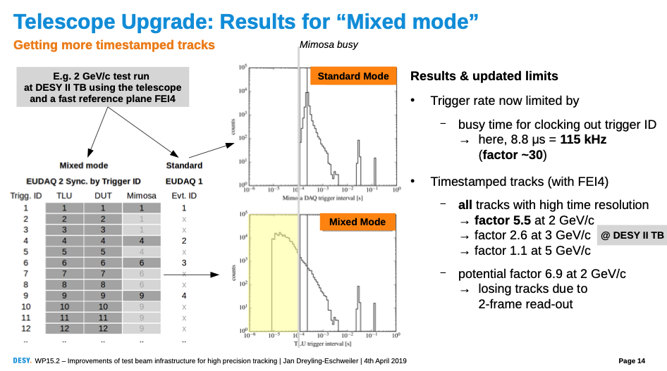
EUDAQ2 + Telescope
“Mixed Mode”

Slide 16
Data Quality Monitoring
DQM system for beam telescopes available
  Written quickly, pragmatic. Little flexibility
DQM4HEP ( Ete, Miribito : IPNL/IN2P3 , Pingault : Ghent ) adopted as platform for common DQM
  Used in Calice Calorimeter beam-tests ( AHCAL, SDHCAL ) and other Calorimeter beam-test ( DREAM )
  “Near online”
  Looking for more effort to develop further
    Use for improved beam telescope DQM
  Can be used for data logging ( slow control )

Slide 17
Data Quality Monitoring

Slide 18
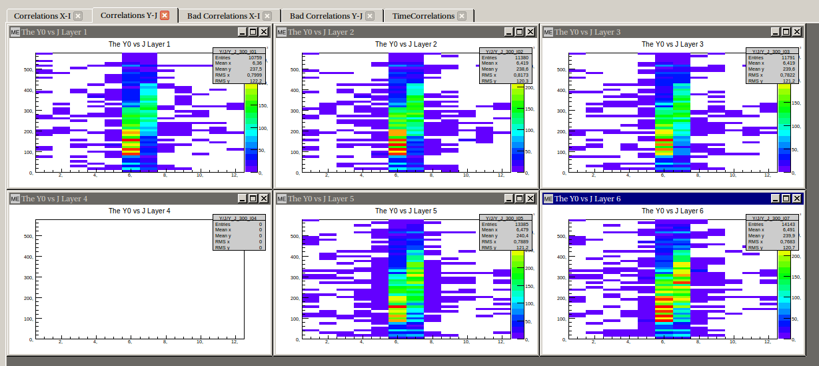
Data Quality Monitoring
Correlation Plots

Slide 19
Data Quality Monitoring
Event Display

Slide 20
Data Quality Monitoring
Slow Control

Slide 21
Beam Test Use - Calorimetry
EUDAQ2 used as a way of providing some integration for combined beam tests within Calice
Provided valuable way of finding some beam-telescope specific assumptions that had been missed in move from EUDAQ1 →EUDAQ2
Different levels of integration possible:
  Run control
  Timing / synchronization hardware
  Data collection
See Katja Kruger’s talk https://indico.cern.ch/event/773447/contributions/3362996/

Slide 22
EUDAQ2 + Calorimeter
( AHCAL + CMS HGCAL )

Slide 23
EUDAQ2 + Calorimeter
( AHCAL + CMS HGCAL )

Slide 24
EUDAQ2 + Calorimeter
( AHCAL + CMS HGCAL )
300GeV Hadrons

Slide 25
Beam Test Use –
Silicon Strip Tracker
Compact Silicon Strip Tracker telescope being constructed for use with superconducting magnet in DESY beam test area
Will use EUDAQ2 + AIDA-2020 TLU
  Integrate against EUDAQ2 + TLU and can use any beam telescope.
See Mengqing Wu’s talk https://indico.cern.ch/event/773447/contributions/3362999/

Slide 26
Silicon Tracker

Slide 27
Silicon Tracker –
“native DAQ”

Slide 28
Silicon Tracker –
Readout Integation

Slide 29
Silicon Tracker –
Readout Integation

Slide 30
Ideas for Future
Rest of AIDA-2020 will be used for bug fixing and support of existing features
Enhancements possible for future project:
  TLU:
    Put FPGA onto main PCB ( currently separate CoTs module)
      Lower cost, more inputs, more DUT interfaces
    Optimize software to allow hardware performance limit to be reached ( > 1 MHz triggers )
    More firmware/software features ( from those suggested by users )
    Ease of use

Slide 31
Ideas for Future
Enhancements possible for future project:
  EUDAQ2:
    Maintain “light weight” easily portable nature.
    Make more robust.
    Ease of use.
    Modernize e.g.
      move threading to C++20 task management?
      Replace “home brewed” networking with libraries that are now available.
    Separate run control GUI from finite state machine
    Customizable run control GUI.

Slide 32
Ideas for Future
Enhancements possible for future project: online Data Quality Monitoring
  DQM4HEP:
    Use as a basis for a flexible, easy to adopt, data quality monitoring framework.
    Successfully AIDA-2020 for calorimeter beam tests
      Currently operates by reading from files.

Slide 33
Summary
Common DAQ (WP5) helped tied together the work of different teams working on detector development
Hardware and software tools developed that have been of use testing detectors.
  TLU used inside and outside AIDA-2020
  EUDAQ2 used for calorimeters and strip trackers as well as beam telescopes
  EUDAQ2 used with and without AIDA-2020 TLU
Extension period of AIDA-2020 project being used to allow involvement in more combined beam-tests
A follow-on from AIDA-2020 would allow tools to be supported and enhanced.

