Slide 1
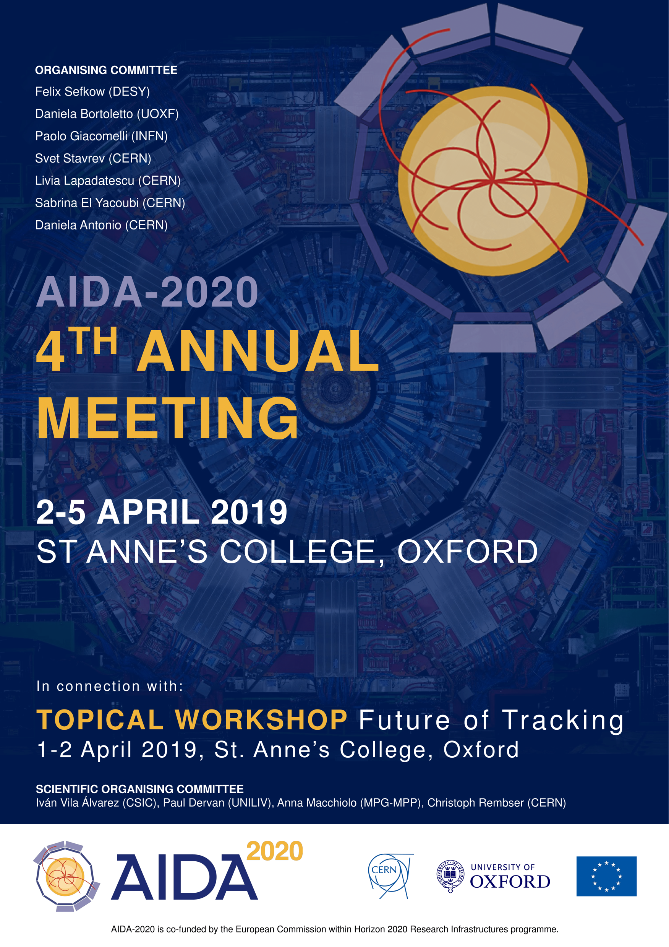
Report from the
Science Advisory Panel
4th Annual Meeting
Marcel Demarteau
on behalf of the SAP
Oxford, April 5, 2019

Slide 2
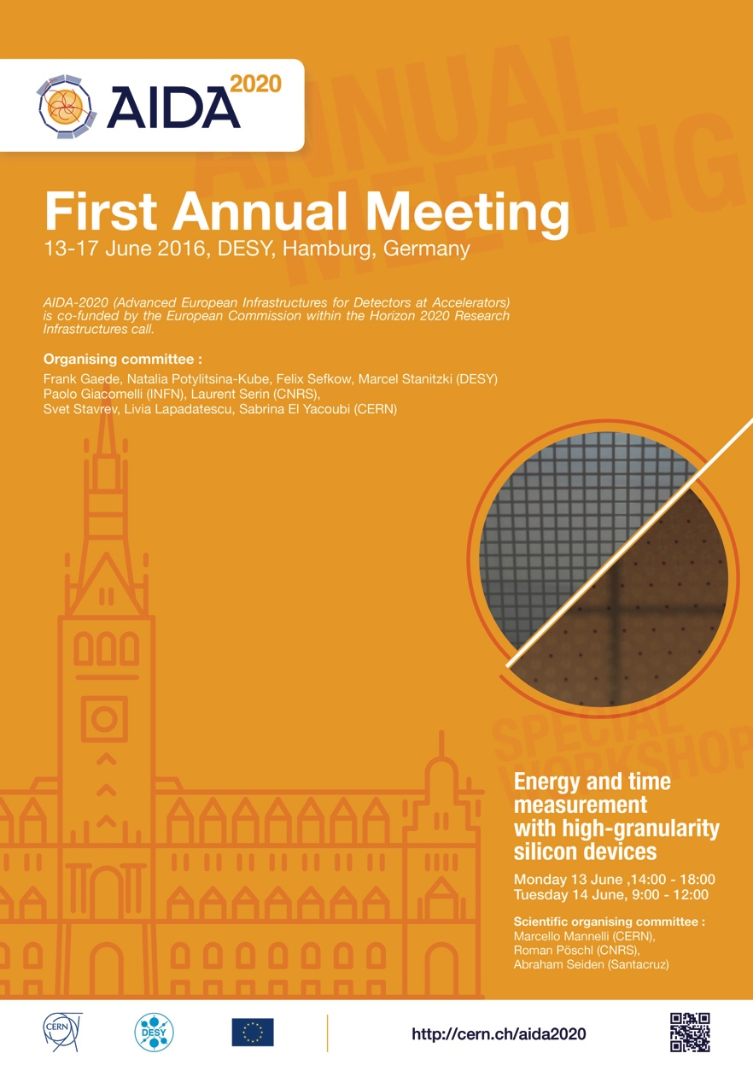
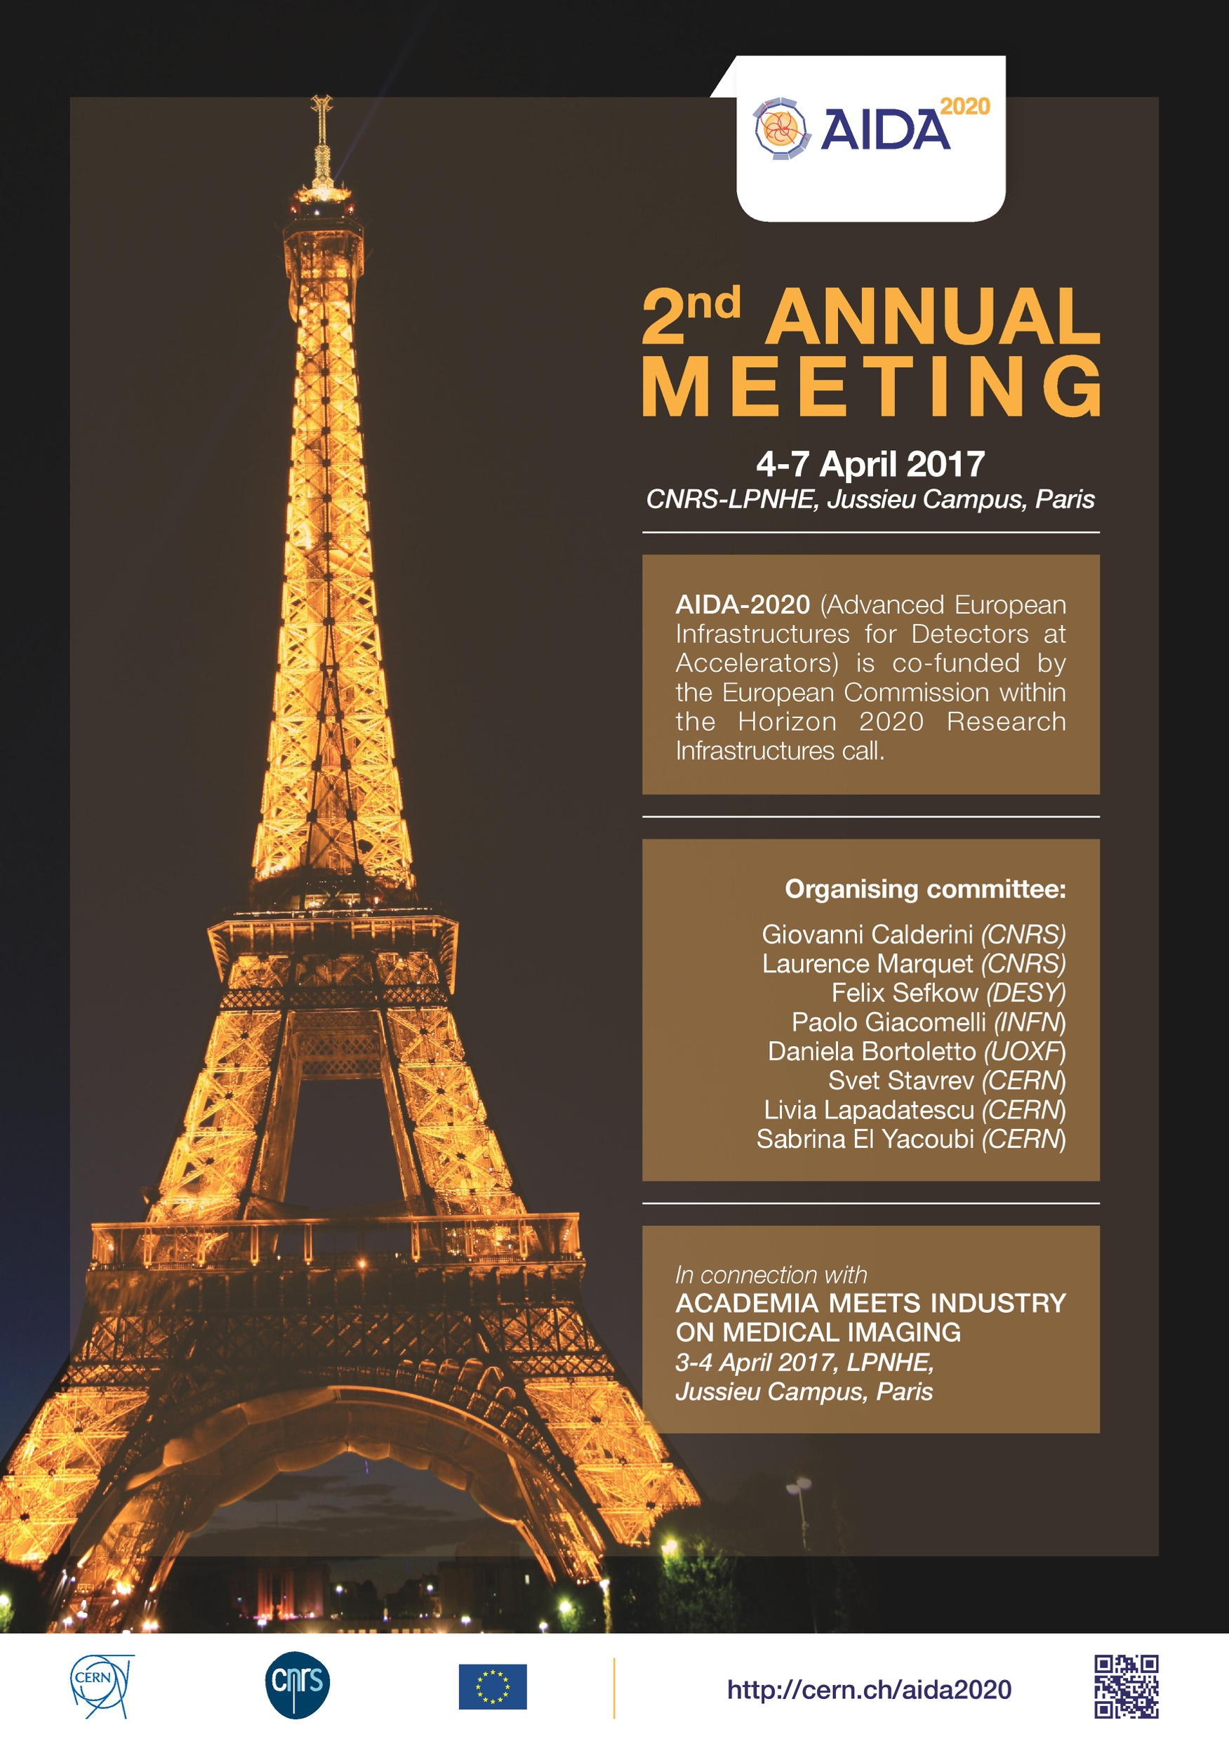
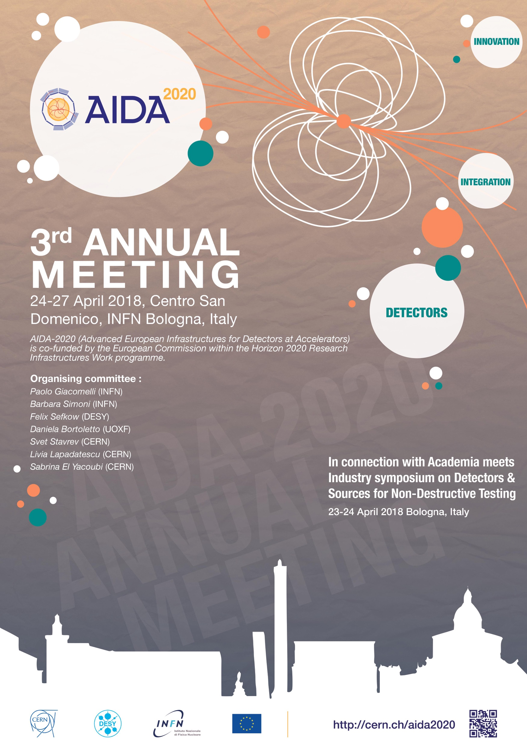
Annual Meetings
Thank you for the great venues, interesting history,
terrific hospitality, great food, superb support, ….

Slide 3
Fourth Annual Meeting
First three workshops were impressive:
  2016: 135 participants
  2017: 134 participants
  2018: 124 participants
Fourth workshop impressive:
  95 participants
  24 parallel sessions with a total of
  96 excellent presentations and discussions
  in parallel sessions
Very enthusiastic and dedicated teams in
each working group and excellent progress
reported by all groups.
Many young scientists involved !
Congratulations on the accomplishments
to date!
Thank you!

Slide 4
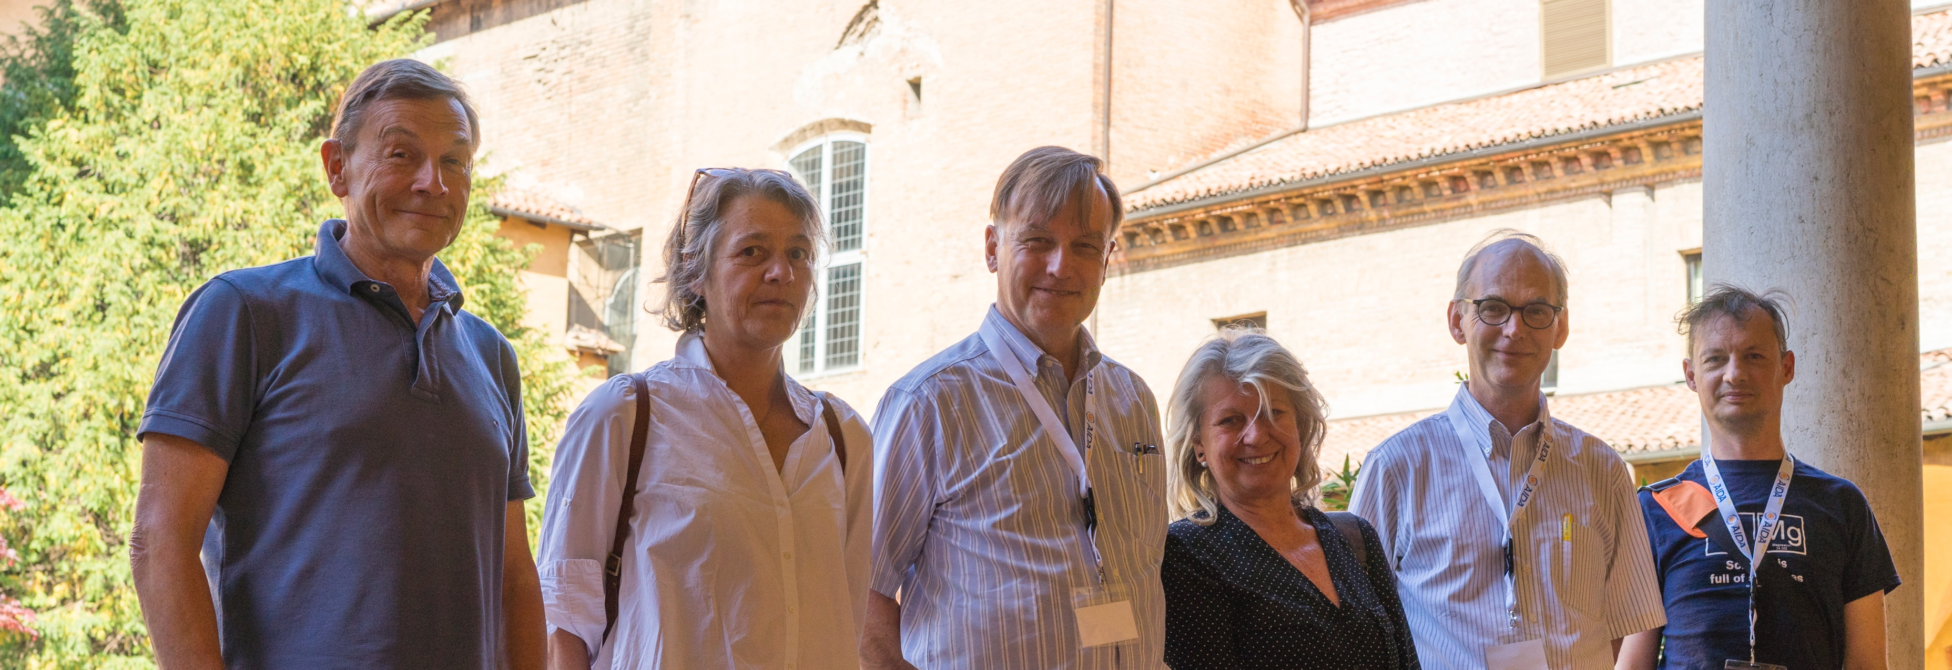
Reminder of the SAP
  Lead for
  WP4
  WP2
  WP11
  WP12
  WP15
  Lead for
  WP2
  WP10
  WP14
  Lead for
  WP1
  WP2
  WP8
  Lead for
  WP2
  WP9
  WP13
  Lead for
  WP2
  WP6
  WP7
  Lead for
  WP3
  WP2
  WP5

Slide 5

Message ?
Honi Soit Qui Mal Y Pense
“May he be shamed who thinks badly of it"

Slide 6
SAP and AIDA
We understand our task to provide constructive advice to the Management Team (MT) on a regular basis on technical and strategic matters related to the scientific program of the projects
Dialogue with MT resumed ~2 months ago with email exchange between SAP members to review the program.
Thank you for answering our long list of questions on short notice and helping us prepare for this meeting!

Slide 7
WP1: Observations
WP 1: Project management and coordination
The management team continues to do a excellent of job running this wide-ranging and important program. The success of the program is a tribute to the work of the management team.
The program is at the end of its original 4‐year
duration. Seventeen of the 80 deliverables are
subject to the no-cost extension into year 5.
Of the 63 deliverables due by now, 57 have been
achieved, 3 are due this month, and 3 have been
formally delayed.
The SAB is pleased that the no-cost extension was granted and believes that good use is being made of the additional time to increase the impact of AIDA-2020.
Overall spending is on track, with some work packages spending a bit ahead of schedule and others a bit behind. AIDA‐2020 management is taking appropriate action to balance the remaining resources.

Slide 8
WP1: Observations
WP 1: Project management and coordination
The management team is to be congratulated on very successfully addressing the previous lag in the number of publications. The project stands to exceed their target, though there remains a large variance in the number of publications between the work projects (some still have zero publications!)
Although the AIDA project is in the home-stretch, we caution to not let down your guard and ensure adequate monitoring until the project is officially closed. Credit is easily lost.
We strongly suggest an early start on the timely closure of the project; with the follow-up program there will be many conflicting demands that ought to be avoided as much as possible.
A broad, but targeted solicitation for the follow-up program is recommended – more on this later.

Slide 9
WP1: Extension
WP 1: Management
The committee strongly advises the team to use the extension period to re-evaluate the accomplishments and impacts of the work packages to provide input in the preparation for the next proposal.
The AIDA-2020 team is encouraged to start engaging in an active dialogue with a broad community outside the current core AIDA-2020 membership to guide the formulation of the next proposal submission.
Slide From Last Year !

Slide 10
WP2: Observations
WP 2: Innovation and outreach
Task 2.2 Communication, dissemination, outreach
  Number of impressions, views, clicks assessed.
  Suggest to organize seminars at CERN about results.
Industrial relations and technology transfer: Academia Meets Industry was well attended in 2018
  Feedback concerning the 2 AMI events to be sent after the Annual meeting
  Preparing summary slides for each project, to improve the KT/TT from AIDA2020 to Industry
    To be followed with WP leaders.
Proof of Concept: three projects seeking impact beyond HEP
  The three projects (RaDoM, SMART, TSV with IZM) successfully built and operated devices
    The PoC concept and the outcomes deserve larger visibility; they should be further and widely publicized in the HEP community with seminars or ad hoc AIDA events
  What is the future of these developments for the market ?
Industrialisation of large areas silicon detectors: market survey
  Infineon has decided to stop R&D
  Common order from ATLAS+CMS to Hamamatsu: Phase-II Upgrades will need more than 46.000 x 6-inch and 30.000 x 8-inch wafers
Milestones since last AIDA2020 general meeting reached.
Science Advisory Board
5 April, 2019

Slide 11
WP3: Observations I
WP 3: Advanced Software
DD4HEP
  Outstanding success of WP3 in AIDA2020, wide adoption by the community (has become the de facto choice); good support for users – congratulations!
  But continued production support, documentation and further feature demands will come – keep up that good work
DDG4/DDSim
  Now in use for significant simulation by ILC/CLIC/FCCee
  Could look for synergy with new DD4hep users and alternative framework integrations, like Gaussino (used by LHCb and FCChh)
VecGeom
  Delivery into Geant4 almost complete; low level improvements for all users with little/no migration costs – exactly what was required
Alignment
  Successful use for LHCb VELO upgrade and DD4hep integration finished
PODIO
  Delivered a functional EDM for FCChh, reimplementation of LCIO has been done
  Performance tests and adding different I/O strategies are key to proving the strengths of the design and attract more users in the future
ACTS and Tracking
  State of ACTS (A Common Tracking Software) did not allow easy integration of AIDA2020 work, but it should be the longer term strategic goal in this area

Slide 12
WP3: Observations II
WP 3: Advanced Software
Frameworks
  Difficult external constraints as this is very hard area to achieve synergy
    Useful contributions to Gaudi not in the core – at least should target a solution for new experiments
  Marlin (ILC/CLIC framework) multi-threaded extensions are useful to try, but should have clear, achievable targets and be reviewed regularly – might help to reinvigorate community framework activity?
Particle Flow
  Excellent results as the default reconstruction algorithm for ProtoDUNE; also used successfully by CLIC and MicroBooNE
  Continuing the work for DUNE is a high priority, including extension to the dual-phase detector
Overall Impressions and AIDA++
  Work package has delivered on all major points – congratulations to the whole team
  Publications in reasonable shape, but further opportunities exist for the 5th year
  Drivers for AIDA++ will be
    Software support for detector concept and design studies
    Software upgrades for running experiments (can happen during shutdowns)
    Much to build on here for current projects, but also scope for new ideas
  Most successful projects are ones that had a clear single focus and could be migrated to as a isolated component - but often this took both rounds of AIDA support, e.g., DD4hep

Slide 13
WP4: Observations
WP 4: Microelectronics and Interconnects
The RD53A chip as baseline for the ATLAS/CMS HL-LHC pixel detectors has been successfully tested. Taking into account the lessons learned, the larger
RD53B will be submitted with technical improvements Sep 19/April 20 for ATLAS/CMS.
(‚SiGe‘, now) CMOS 130nm for high granularity calorimeter readout: Last deliverable on time and under review
Chip underwent intensive and successful tests.
“The successful results confirm the suitability of the 130 nm CMOS process and of the analog and digital architectures that were implemented.”

Slide 14
WP4: Observations
WP 4: Microelectronics and Interconnects
Important progress on the vias has been achieved in collaboration between Bonn and IZM (parallel effort has not reached a mature status):
Successful Proof of Concept project
Modules with vias with the FEI4 chip work as well as standard chips.
Some 90% yield (!!)
Next step: try out with RD53-A. Aim for test results in M58
Note: AIDA deemed to have been essential to do this!
Implications for industrial applications
Highly interesting for planned replacement of pixel layers during
LHC Run 2

Slide 15
WP5: Observations
WP 5: Data acquisition system for beam tests
Trigger Logic Units (TLUs) are in place and working in labs across Europe
  We believe that continuing support for the this hardware is vital to profit from this work
  Finding a sustainable way to produce more units is a priority
  Releasing the product as open hardware is a positive step
EUDAQ2 Software
  Working in a number of test beam and telescope setups, delivering improved functionality
  We recommend solid software development practice (track issues, continuous integration) to support production work and shake out bugs – not quite robust yet
AHCAL and SiCAL DAQ
  Both projects working and using AIDA2020 TLUs and EUDAQ2
  This finds issues: bugs, glitches and missing features – these need fixed
    Support here is an essential part of making a robust production system
DQM4HEP
  No update this year – stalled due to lack of effort
Work Package 5 has delivered all key milestones and deliverables
  Congratulations on that success!
    A number of publications now in the pipeline and we strongly support that effort
  TLU and EUDAQ2 are now a working system that need support and further development to be a real success – should be in AIDA++
  DQM4HEP has not made it for online monitoring, but a need still exists – this is something to consider for AIDA++, but unique features and target use cases should be very well defined

Slide 16
WP6: Observations
WP 6: Novel CMOS sensors
The four deliverables (no milestones) during this reporting period, which were all met:
  D6.1: Delivery of TCAD libraries
  D6.2: Sensor-design guidelines (report is imminent)
  D6.6: Delivery of Assemblies
  D6.7: Recommendation for industrialization
Deliverables
D6.1: TCAD Libraries
  Developed and delivered detailed simulations of HVCMOS silicon devices.
  Comparison with measurements done on devices before and after irradiation (LFCPIXV2)
  Verified detailed simulation
  Detailed description and release of simulation protocol would be beneficial to the community at large.

Slide 17
WP6: Observations
D6.2 Sensor Design Guidelines:
  Simulation of the charge collection in different designs of depleted CMOS devices
  Full simulation of devices studying aspects of HV/Bias isolation, its influence on other parts of the design, inter pixel isolation and breakdown performance, sensor guard ring design for maximum allowed bias
  Study of pixel geometry (including dimensions and dose and energy of deep/sensor implants) and its effect on capacitance and charge collection.
Valuable design study for depleted CMOS sensors
D6.6: Delivery of CMOS assemblies
  H35Demo and FE-I4 ASIC AC coupled devices produced and tested.
  H35Demo and FE-I4 ASIC AC and DC coupled device produced and tested
  LFCPIX and FE-I4 DC coupled devices were produced.
  All devices were delivered to the community for further tests.
  New version of the LC CPIX and Monolithic FEI3 pixel matrix being developed and presented
  Results of a new version of the MALTA chips in 180nm TJ-process presented
Even though not part of the HL-LHC upgrade, paving the way for future pixel detectors

Slide 18
WP6: Observations
D6.7: Developing a technique with industry for wafer level packaging
  Build capacitively coupled devices on a wafer level with MicroFabSolutions (Trento)
  Good progress being made; precision placement is currently the key limitation;
  Recommend continuing prototyping effort to complete project and deliver a specific protocol for industry.
WP 6: Deliverables still to be completed
Three deliverables still to be completed during the extension period
D6.3: Performance characterisation results (M58)
  Report on performance characterisation of test structures and sensors, including electrical, laser, source and test-beam measurements
D6.4: Radiation tolerance assessment (M58)
  Report on measured radiation tolerance of optimised test structures and sensors
D6.5: Optimised interconnection process (M49) – Delayed
  Reason for delay: effort shifted from hybrid devices to monolithic ones, which do not require a complicated interconnection technique. Now investigation of the wafer packaging technique of DC and AC coupled devices.

Slide 19
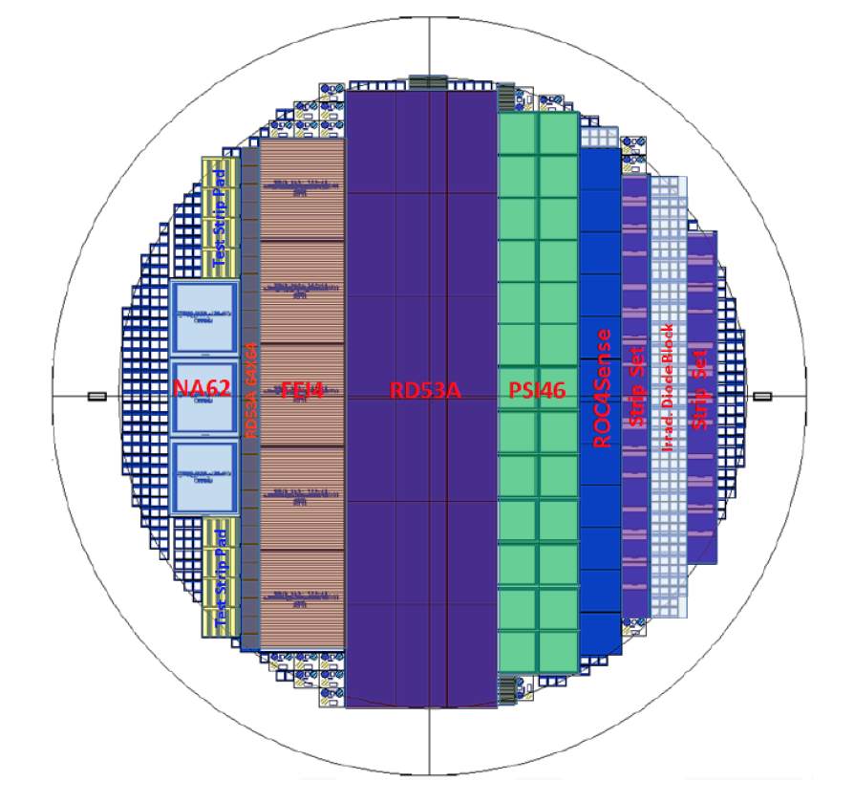
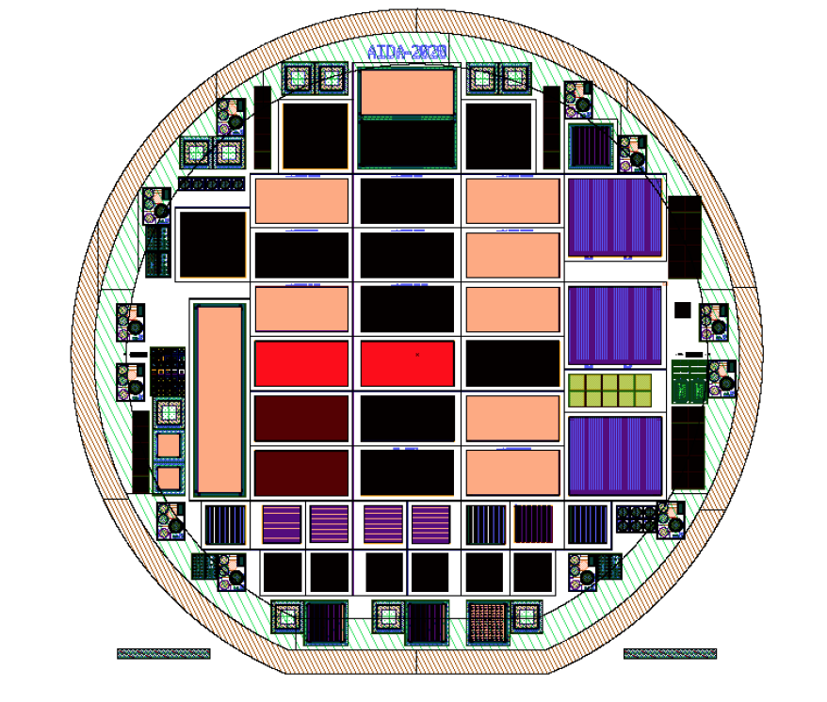
WP7: Observations
WP 7: Advanced Hybrid Pixel detectors
Three technologies (planar, 3D, LGAD) being studies in the framework of WP7
Project very well integrated and aligned with ongoing projects; 3D and LGAD productions are a major part of the sensor R&D activities of the pixel and timing detector at ATLAS and CMS.
Milestones:
  MS81: Test beam campaign for 3D and planar sensors (M36)
  MS87: MPW runs completion (M42 -> one run to go)
  MS98: Validation radiation damage model with data comparison (M46 -> M52)
MS87 has been completed but the active edge planar production at FBK has just started because lack of SOI wafers at the company. Devices should be available in June.
3D FBK
Planar Active Edge FBK
3D CNM
LGAD CNM

Slide 20
WP7: Observations
Milestones:
MS81: Test beam campaign for 3D and planar sensors
  Very successful campaigns of prototype sensors
  Irradiated LGAD sensors at CERN PS with 24 GeV protons at five different fluences
    Uncovered hot spots in leakage current; new modified sensor design submitted
    Significantly better behavior of 35μm thick LGAD compared with 50 μm
  3D run at CNM completed in February 2019, seven wafers being bonded to RD53A
  3D run at FBK completed and tested on beam,
  irradiated with RD53A prototype chip
  Stepper implemented at FBK for production
  Large fraction of the objectives are being met
  for the HL-LHC experiments
  Good efficiencies even after irradiation
  Excellent progress, though a lot of work ahead
  Excellent coordination with experiments
  Efforts instrumental for HL-LHC projects, and
  project needs to be congratulated on the
  tremendous contributions!

Slide 21
WP7: Observations
Milestones:
MS98: Validation radiation damage model with data comparison (M46 -> M52)
  Valuable development of very detailed, verified and accurate radiation damage model (Perugia model)
  Given the high level of detail and investment, releasing the simulation to the larger community should be considered.
  Publication of ‘handbook’ is suggested.
Deliverables to come:
D7.4: TCAD model radiation damage (M52)
D7.7: Final pixel characterisation (M52)
D7.8: LGAD characterization (M52)
Very well on track to meet all deliverables

Slide 22
WP8: Observations
WP 8: Large Scale Cryogenic Liquid Detectors
Four of the five deliverables are complete:
  D8.1 Purification and monitoring
  D8.3 Light readout
  D8.4 Very high voltage
  D8.5 Magnetisation of large-scale cryogenic liquid detectors
The fifth deliverable, D8.2 Charge readout and double phase, was subject of the no-cost extension to allow exploitation of ProtoDUNE-DP. It is due in October.
  ProtoDUNE-DP is currently scheduled to start data taking (with cosmic rays) in August, leaving little time to include results in the deliverable report.
  Much will be learned from hardware commissioning even if no cosmic ray data are taken in time.
  It seems that success could be declared based on results from the 3 x 1 x 1 m³ detector, if necessary.
WP8 has done important work to advance the state of the art for large LAr detectors, as well as to demonstrate a novel iron magnetization scheme.
The results have been well disseminated in a significant number of publications (notably a major paper on the 3 x 1 x 1 detector) and on twiki pages.
  Neither the list of publications on the WP8 page nor the summary of AIDA-2020 publications captures the full set of publications. This needs to be corrected for AIDA-2020 to get the credit it deserves.
Excellent synergy with WP3 (Advanced Software – PFA event reconstruction) and WP13 (Innovative Gas detectors – thick GEMs)
ProtoDUNE-DP

Slide 23
WP9: Observations
WP 9: New support structures and μ-channel cooling
WP9 is to be congratulated for the steady progresses demonstrated in all the pioneering activities and for the successful completion of T9.3 set-ups
Exhaustive and conclusive answers to all SAP questions were provided
Cooling in future experiments has additional stringent requirements:
  It is highly recommended to further extend the research (e.g. in the field of: new eco-friendly coolants, applications to large & densely packed systems…..)
The implementation of μ-channel solutions in existing experiments is a convincing proof of the successful work performed so far
  Nonetheless additional investigations in the direction of: large-scale production, industrialization and optimization of production costs are needed
Many detector technologies need innovative and performant cooling systems.
  It would be highly profitable that the expertise collected within WP9 could be shared with other detector technologies. .
Science Advisory Board
5 April, 2019

Slide 24
WP10: Observations
WP 10: Test beam (TA DESY & TA CERN)
Transnational Access funds were spent by 2017.
  24 projects supported in 2015 and 18 projects in 2016, then funds ran out (altogether 42 projects)
  196 visits to CERN supported, 10 days on average.
  Participants from 19 countries
DESY infrastructure
  Three beam lines, now three Pixel Beam telescopes (three out of four teams request use of telescopes), one 1T solenoid, one big dipole
  TA essentially completed now.
  14/27 AIDA users have published with AIDA reference; many publications w/o references to AIDA
CERN infrastructure
  24 projects in 2015, 18 in 2016, then funds run out
  WP10.1 allows simplified test beam user registration at CERN, when they have no affiliation to a CERN experiment.
  Publications: 40/42.
  No beam at CERN in 2019-2020
Mode of operation (giving access to equipped beam lines, with support) has been very successful for R&D developments
  Transnational Access is working well and is appreciated by users: will not be continued in next AIDA
Science Advisory Board
5 April, 2019

Slide 25
WP11 + WP12: Observations
WP 11 + 12: Transnational Access for Test Facilities
All transnational facilities are significant for the European theme of a common research infrastructure. They are imperative for innovative detector development - AIDA’s theme for now and future.
The use of these facilities continued to be strong during the past year. The complementary elements of this network are crucial for detector characterizations.
Discussion emerged on the correctness of the calibration of irradiations. Cross calibrating between facilities could help to increase confidence. This could be interesting and should be looked into.
Main problem is the lack of funding in Y5. The effect is to lower priority of some users, charging more etc.
SAB finds it important that AIDA finds resources to allow a projectable and balanced use of facilities also during the extension period. This is especially important for the smaller test facilities.

Slide 26
WP13: Observations
WP 13: Gas Detectors MPGD
WP13 is to be congratulated for their progress, the exhaustive and conclusive answers to all SAP questions, the successful and timely completion of the milestones
Despite the large progress, the large scale MPGD industrial production still remains a key point to be successfully implemented.
  The team is recommended to focus on the subject and to invest efforts to achieve an effective TT with European factories to increase the number of possible producers and to make industrial production a more cost-effective process.
Expanding/creating a new WP on novel visionary technologies for future PID with gaseous detectors (Innovative radiator from metamaterials, photonic crystals - hydrogenated Nano Diamond Carbon (NDC) powder…..) might be a high gain strategy for AIDA++
Science Advisory Board
5 April, 2019

Slide 27
WP14: Observations
WP 14: Infrastructure for advanced calorimeters
Four key tasks:
  Task 14.2 Test infrastructure for innovative calorimeters with optical readout
  Task 14.3 Test infrastructure for innovative calorimeters with semiconductor readout
  Task 14.4 Readout systems for innovative calorimeters
  Task 14.5 Mechanical and thermal tools for innovative calorimeters
Deliverables
Task 14.2 - Test infrastructure for innovative calorimeters with optical readout
  Fibre test benches (14.2.1. - D14.2 - 06.03.2019)
    Several test benches in institutes, operational and used
    Some instabilities from the sources observed - to be investigated further
  Performance of test infrastructure for highly granular optical readout - (14.2.2 - D14.1 - 20.08.2018)
    Three test benches built in MPP, Heidelberg & Mainz (SiPM tests, cosmic tests) operational and used
Science Advisory Board
27 April, 2018

Slide 28
WP14: Observations
Task 14.3 - Advanced Assembly chain for Si calorimeters
  Task 14.3.1 - D14.3 (18.05.2018)
    MIP studies on multi layers assembly provided good results (after correcting for some effects)
    Assembly system produced in Paris region and duplicated in Kyushu: obtained similar results
    Ongoing development of ultra thin sensors with chip on board.
  Task 14.3.2 Infrastructure for Very Compact Tungsten-based Calorimetry
    Measurement of Molière radius successful & good MC description
    Next readout chip FLAME submitted for fabrication
Task 14.4 Compact Digital Electronics for SiW Ecal and other applications
  Optimisation of thickness and integration proceeding well; preparing for a testbeam in DESY in June 2019
  Will then address power pulsing & HV distribution on kapton
  D14.5 (18.05.2018) Using EUDAQ developed by WP5, testbeam data have been acquired in common mode.
Science Advisory Board
5 April, 2019

Slide 29
WP14: Observations
Task 14.5 Mechanical and thermal tools for innovative calorimeters
  Task 14.5.1 Mechanical and thermal tools for innovative calorimeters
    The electron beam welding technique allowed the assembly of the demonstrator with plenary ± 0.6 mm.
    Concerns for production as manipulation of large element not well suited to electron laser welding (vacuum)
  Task 14.5.2 Infrastructure to evaluate thermal properties of calorimeter structures (D14.8 - June 2018).
    Operational system
    Development of a leak detection for fast intervention (Polarographic probe)
Work Package 14 has delivered all key milestones and deliverables: Congratulations on that success!
  15 journal publications + some in preparation: very good record - we strongly support that effort
  Serious progress in calorimetry development with large impacts in HEP
  For the last year: secure the test-benches (documentation, spares, movies)
Science Advisory Board
5 April, 2019

Slide 30
WP15: Observations
WP 15: Infrastructure at Test Facilities
Continuous upgrade infrastructure for these European test beam facilities mandatory to optimize their usefulness and adopt to new requirements. AIDA has contributed in several ways by hardware and software projects.
Two directions:
Improvements for specific facilities:
Frascati, GIF++, Birmingham ….
Standardization of components:
Test beam telescope, database on irradiation facilities ….
Improves facilities (mostly at large labs) and makes their use easier.
Obviously this lays the foundation for being ‘innovative’

Slide 31
WP15: Observations
WP 15: Infrastructure at Test Facilities
In general, all milestones have been achieved in time.
Many components developed are in use already. Excellent!
A few exceptions:
Exception 1: Frascati beam line, which had been postponed to M44.
Hardware (including pulse dipole) in place ‘milestone can be
considered achieved’. However waiting for authorization by
ministry. Related to this Frascati photon tagging, somewhat
delayed of installation. Operation planned for end 2019..
Exception 2: GIF++ cosmic ray tracker, chambers are available, but one
manufacturer has tax problems.
But also very little progress of software development for
augmented reality event display => now postponed to Aug 19
Clear and reliable planning needed for this.
Important to monitor closely the progress in the next months.
Still 1y to go, but could become tight!

Slide 32
What Worked Well?
The SAB was asked to provide feedback on the program to date as input to the follow-up program
Overall the project is managed very well, with some innovative features.
The Transnational Access program has been a flagship part of the program.
Contributions of many work packages are instrumental to the current particle physics program
The neutrino community has been brought into this process for the first time.
The Proof of Concept program has been very successful; four successful projects in four years is a huge achievement:
  Silicon‐based Microdosimetry System for Advanced Radiation Therapies
  Advanced Through Silicon Vias for Pixel Detectors
  Radon Monitoring: RaDoM
  Infinion (even though in the end it was not successful, it has established a relationship that can be nurtured going forward).

Slide 33
What Didn’t Work So Well?
The publication record is terrific, but could have even been stronger with some more oversight/encouragement and/or better communication.
In certain area there is a large discrepancy between the number of projects and the publications submitted by the same group of projects. As an example, this is particularly true in area of key importance like irradiation facilities.
The collaboration between some work packages started a bit late, though overall the existing synergies between the work packages has been effectively leveraged.
The SAP feels that the Proof of Concept program has not received the visibility it deserves.

Slide 34
To Consider …
The current form of the AIDA program distributes the money over many projects with relatively small amounts of money disbursed.
As a consequence, AIDA has sometimes had a relatively small incremental effect.
In contrast, there are projects, where has AIDA really made an impact
  TSV, Software, CMOS, …
Although it is understood that the self-imposed requirement of the matching contribution can be limiting, it might be useful to consider if AIDA would have ‘owned’ more projects – that is would have provided more resources to a select set of tasks – if the program would have had a bigger impact.

Slide 35
AIDA++
FP8 Call 5: Large initiatives and support measures to foster the innovation potential of research infrastructures.
  This includes a program for “Innovation in detector technologies”
  Deadline March 17, 2020
AIDA-2020 management is actively preparing to develop a proposal
(code-name “AIDA++”), but time is short and a focused effort is required.
Putting together a high-quality, high-impact proposal will be a challenge:
  The current program is closely linked to the LHC upgrade project and large-scale ongoing neutrino projects (and initially to the ILC).
  The LHC upgrades are moving into construction and will provide a less clear guide than they did for AIDA-2020.
  The form of the first DUNE detectors are also becoming well defined.
  The next European Strategy Update will be released after the proposal deadline.
  The proposal must be framed without a clearly agreed roadmap for the field, and therefore must focus on detector (system) developments that address fundamental limitations in our ability to measure particle interactions.

Slide 36
AIDA++
Various diagonalizations for a future program are possible.
The SAP recommends a diagonalization along technologies guided by the need to address fundamental particle physics questions:
  Provides an opportunity to clearly articulate the boundary conditions of the new program so that it is not “wide open” and can be “tailored”.
  Provides a means to establishes a clear connection with future particle physics experiments, without explicit mention.
  Allows the solicitation of a balanced program that has appropriate representation of incremental R&D and transformational R&D.
The SAP recommends to keep an open mind and explore the benefit of expertise from outside the HEP community while ensuring that the program remains focused on particle physics.
Suggest to explore companies interested either in various topics of research or in developing technologies for HEP and other applications as soon as possible.
Suggest to be “creative” to continue support for the transnational access.

Slide 37
AIDA++
Suggested technologies can be:
  Continued development of D-CMOS
  High-bandwidth, low-mass, low-power data acquisition systems
  Machine learning and advanced software
  Triggerless data acquisition systems
  Instrumentation for future liquid argon detectors, e.g. better low-energy sensitivity
  Cryogenic electronics
  Through-Silicon-Via technology
  Particle Identification technologies
  Cost-effective crystal growth
  High QE VUV photodetection
  Ultra-fast timing detectors
  …
The board also strongly recommends that the future version of the program includes education to train the next generation of physicists in experimental techniques.

Slide 38
Planning Elsewhere
The SAP was asked to give some information about the process followed in the US
The Coordinating Panel for Advanced Detectors organizes a workshop about once a year to take stock of the ongoing instrumentation efforts in the field.
  2015: University of Texas, Arlington (http://www.uta.edu/physics/cpad2015/)
  2016: Caltech (http://hep.caltech.edu/cpad2016/)
  2017: University of New Mexico (http://physics.unm.edu/CPAD2017/)
  2018: Brown University (https://www.brown.edu/Conference/CPAD2018/)
These workshops are community organized and present the ongoing efforts in instrumentation; each working group is asked to address:
  Present Status of Technology Development
  Major Challenges
  Future Opportunities
  Grand Challenges in case warranted
There is also an Agency (DOE) organized process: a BRN

Slide 39
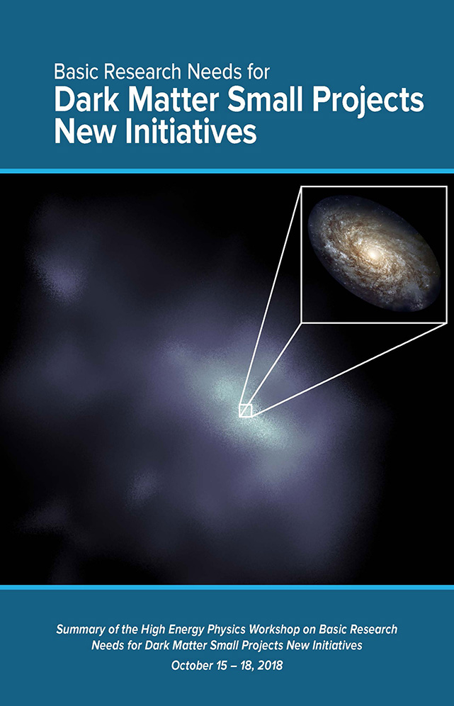
Process: Basic Research Need
The process followed in a Basic Research Need (BRN) workshop is a very prescribed process with detailed tasks for co-chairs, speakers, panels and panel leads, panelists, writers, …
It originated from the Office of Basic Energy Science (BES) of the DOE:
https://science.energy.gov/bes/community-resources/reports and has as deliverable a report with Priority Research Directions (PRD).
The BRN does not:
  Recommend anything
  Advise DOE
  Prioritize projects
  Rank PRD opportunities
The BRN does describe SCIENCE OPPORTUNITIES
First BRN last year
for HEP in small Dark
Matter experiments

Slide 40
Instrumentation BRN
Charge:
  Survey the present state of the HEP technology landscape.
  Identify key enabling capabilities and associated performance requirements.
  Identify technologies to provide/enhance such capabilities.
  Articulate PRDs to push well beyond the current state of the art, potentially leading to transformative technological advances with broad-ranging applicability.
  Flesh out the required R&D efforts with deliverables with notional timelines and key technical milestones along the way.
  Elucidate the technical infrastructure required to support these efforts.
  Formulate a small set of instrumentation Grand Challenges that could result in game-changing experimental capabilities.

Slide 41
PRDs
Some Priority Research Directions being considered:
  Quantum Sensors – The US now has a national quantum Initiative
  Noble Liquids – Including Large Volume Dark Matter Detectors
  Calorimetry
  Tracking and Vertexing
  Photodetectors
  Trigger and Data Acquisition Systems
  ASICs and Readout Electronics
  Micro-Pattern Gas Detectors
  Muon Detectors
  Superconducting Detectors
  Computing
  Ultra-fast Timing
For each Priority Research Direction:
  Paragraph describing the physics goals of the research direction
  Description of the Basic Technology Needs
  Articulation of the key performance parameters
  Description of the relevant new technologies
  Description of the relevant expertise

Slide 42
Conclusions
AIDA-2020 has had another great year with tremendous progress in all areas
It has been a pleasure to see the collaboration between the various work packages and the leverage of synergies.
All teams are to be congratulated on their successes. The extension provides an opportunity to make the impact even stronger.
Please don’t forget to publish!
We’d like to thank the organizers for the terrific program and hospitality
and all participants for the presentations and discussions.
Good luck with the end run!

