Slide 1
WP4 Status Report
Christophe de la Taille (CNRS/IN2P3)
Valerio Re (INFN/Univ. Bergamo)
April 3rd, 2019

Slide 2
AIDA WP4 deliverables
D4.1 CMOS 65 nm engineering run (availability of the run with the “ATLAS/CMS” and CLICPIX pixel chips) (CERN)
M36 (April 30, 2018) ACCOMPLISHED
M95 test report of D4.1 M44 (28 feb 19) : accomplished
D4.2 BICMOS SiGe engineering run (availability of run with SiPM calorimeter-WP14 and gas detectors-WP13 chips) (CNRS)
M36 (April 30, 2018) ACCOMPLISHED
M95 test report of D4.1 M44 (28 feb 19) : accomplished yesterday
D4.3 Through Silicon Vias production (fabrication of TSV in wafers of deliverable 4.1) (INFN)
postponed to M54 (October 31, 2019)

Slide 3
Large-scale 65 nm chip RD53A
Submission August 31, 2017, first chips received beginning of December, 2017
The chip works, test results are good, testing is still going on (radiation hardness, SEU effects, low temperature operation, analog front-end)
Chips have been made available to users (beam tests by the AIDA2020 sensor workpackage)

Slide 5
Current activities
Selection of the analog front-end to be integrated in the final chip for ATLAS and CMS (Differential, Linear, Synchronous)
Work is ongoing for the submission of the next chip generation in 2019: pixel readout chips for ATLAS to be submitted in June 2019, chip for CMS in December 2019)

Slide 6
Deliverable chip in 130 nm
CNRS-IPNL, CNRS-OMEGA, DESY, AGH-UST
This work aims at developing a multi-channel readout chip for calorimeters of WP14 and fast RPCs of WP13
It will also serve ATLAS HGTD and CMS HGCAL at HL-LHC
It allows to share expertise on TSMC 130 nm CMOS selected by CERN for HEP
Two small size prototypes were fabricated and were measured
The large-scale prototype chip HGCROC1 was submitted end of July 2017 in an MPW run
Chips were received at the end of October
We are continuing the tests of HGCROC and preparing a new version for December with AGH’s ADC and Saclay's TDC.
We have also modified a PETIROC chip in SiGe 350 nm and sent it in fabrication in July.

Slide 7
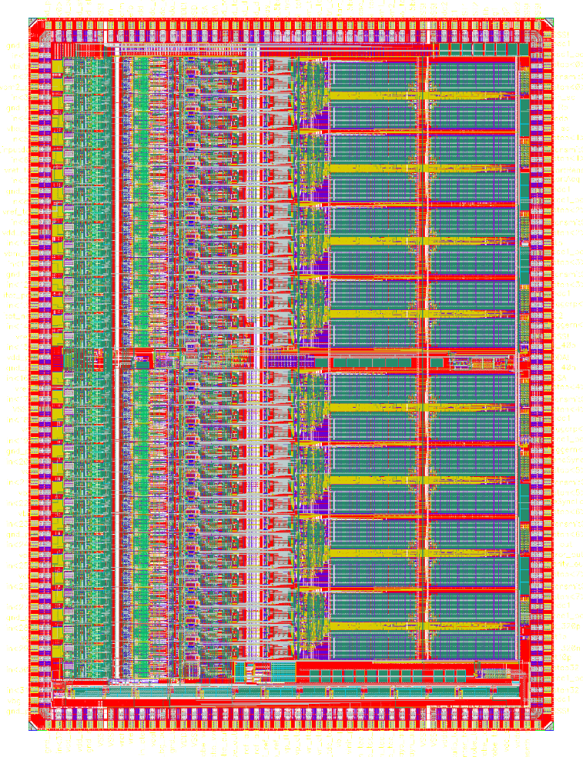





HGCROCV1
Large dynamic range chip for calorimeter/sipm/rpc measurement
32 ch
7x5 mm² 224 pads
8 blocs of 4 ch + digital
Analog on top
Bias, DLLs, CKs in the middle
DACs, REFs at the bottom
Analog and digital probes
Bias accessible on pads
All stages switchable ON/OFF
Slow control separated
1.28 Gb High speed e-links
Submitted 26 July 2017
Arrived end October and successfully tested

Slide 8
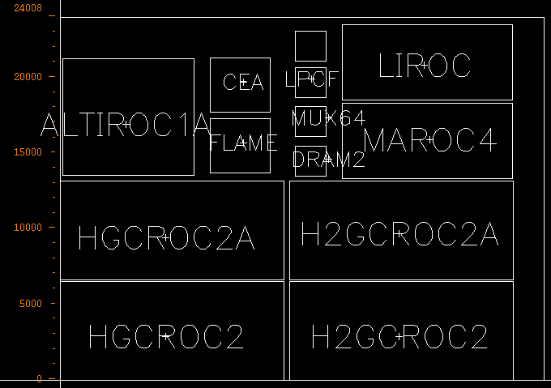
New engineering run jan 2019
Alhough not in the program, there is a new 130 nm engineering run with several AIDA chips (HGCROC2, FLAME)
Tape out february

Slide 9
Task 4.4 Interconnections and TSVs
(CERN, INFN-GE, INFN-PV, INFN-PG, CNRS-CPPM, CNRS-LAL, MPG-MPP, UBONN, UNIGLA)
Produce through-silicon vias on wafers from Task 4.2
Connect chips with TSVs to detectors from WP7
Test radiation hardness of interconnections

Slide 10
Goals of TSV processing
The RD53A chip and other chips in the RD53A engineering run are designed so that they are “TSV enabled” (i.e. , compliant with TSV design rules); this involves the peripheral bonding pad regions
MS4.7 Selection of TSV process M14 (June 2016) was accomplished: both processes (IZM and CEA-LETI) were selected for the following stages of WP4
We have a deliverable concerning TSV processing in 65 nm wafers: the 1-year AIDA-2020 extension gives more time to this task

Slide 11
Next steps
Preliminary steps were made with the TSV provider; we are trying to benefit from the experience by the Bonn group in the WP2-funded project (Advanced Through Silicon Vias for Pixel Detectors), in partnership with Fraunhofer IZM
TSV process setup is connected with destructive inspection at wafer level. The gds2 layout data of M1-2 BEOL-layer with location of TSVs is needed and the backside RDL design with contact pads.
In the WP4 CERN budget, we have 81,600 CHF that we agreed to spend for wafer purchase and TSV processing.
More news today in the meeting

Slide 12
WP4 outlook
WP4 has accomplished its deliverables D4.1 and D4.2; work will go on with 65 nm and 130 nm CMOS readout chips
We will profit from AIDA2020 1-year extension to give more time to deliverable D4.3 (TSVs)
We now need to discuss possible contribution in the future call
Note : don’t forget to quote AIDA2020 in your publications. WP4 is way below average…

