Slide 1
WP15.5 - IRRAD Facility Upgrade D15.6 Status: IDM, Databases and Plans for Y5 and beyond
B. Gkotse^{1&2}, M. Glaser¹, G. Gorine^{1&3}, P. Jouvelot², I. Mateu¹, E. Matli⁴, G. Pezzullo¹, F. Ravotti¹
AIDA-2020 Fourth Annual Meeting - 4 April 2019
¹ CERN EP
² MINES ParisTech
³ EPFL
⁴ CERN BE

Slide 2
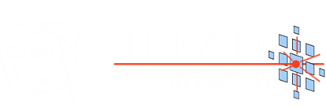
Outline
  Summary of the IRRAD Run 2018
  IRRAD Data Manager (IDM)
  Irradiation Experiment Data Management Ontology (IEDM) and Web Application Generation
  Irradiation Facilities Database Status
  Y5 Extension: Test-Beam Facilities Database
  Ideas for innovations beyond AIDA-2020

Slide 3
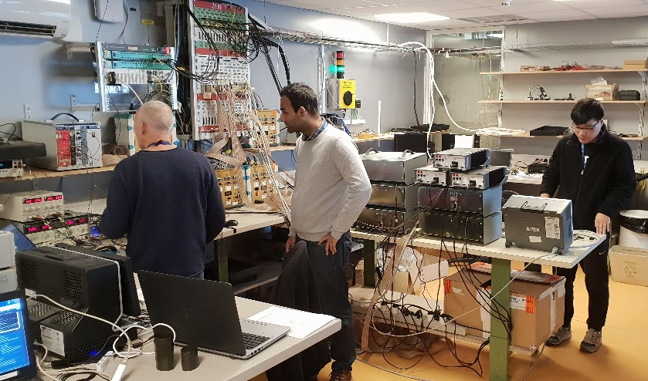
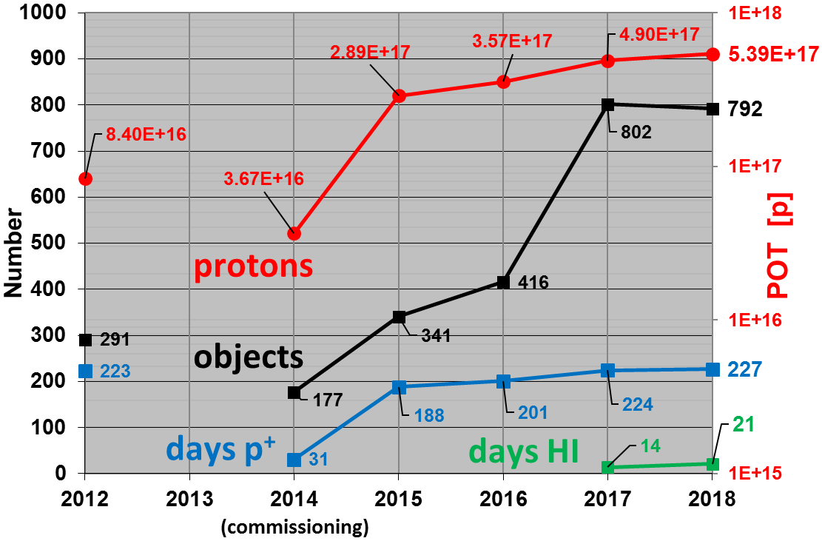
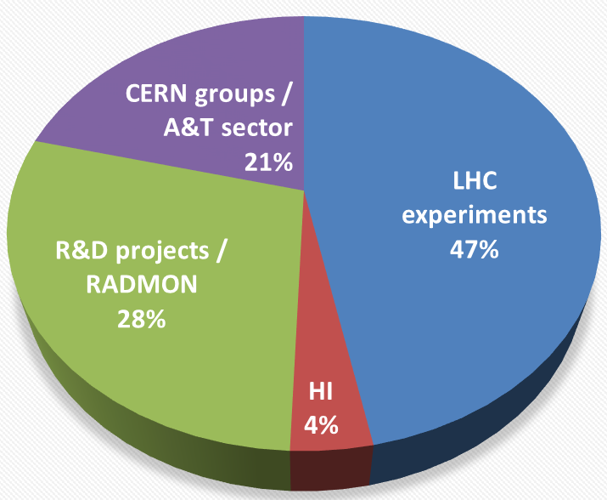
Summary Run 2018
    81 experiments completed in 2018:
      92 users registered in the IRRAD Data Manager (cern.ch/irrad-data-manager)
      999 objects declared by the users
      792 objects irradiated
    Experiments distribution

Slide 4
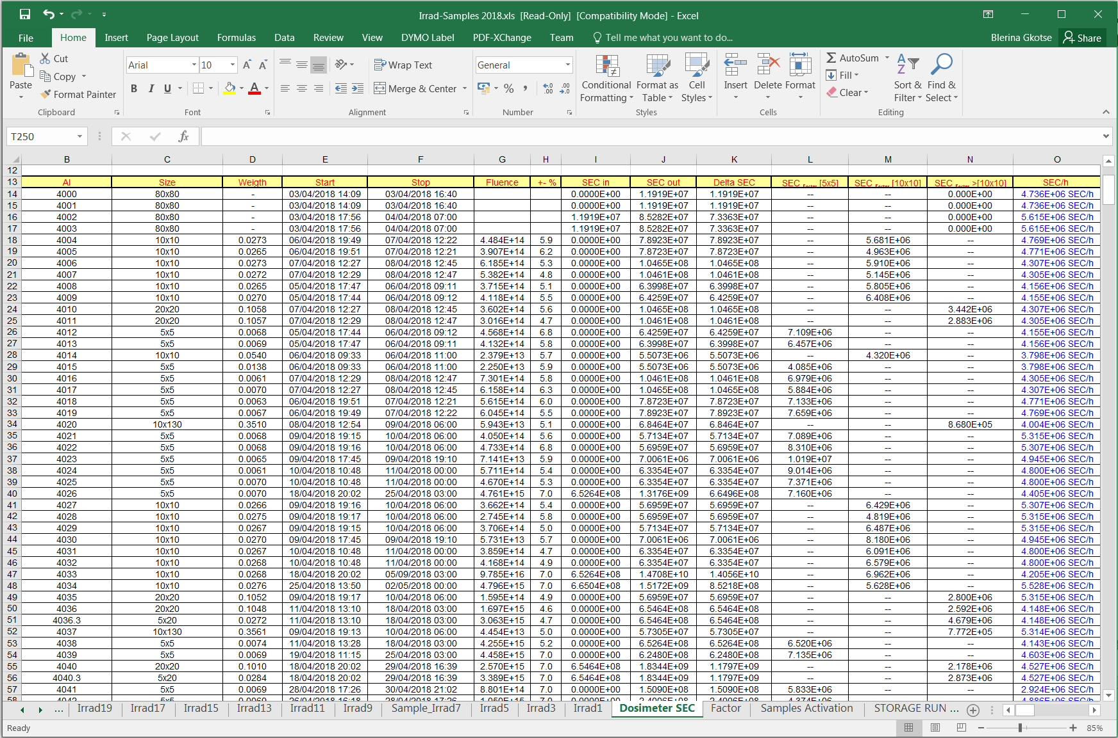
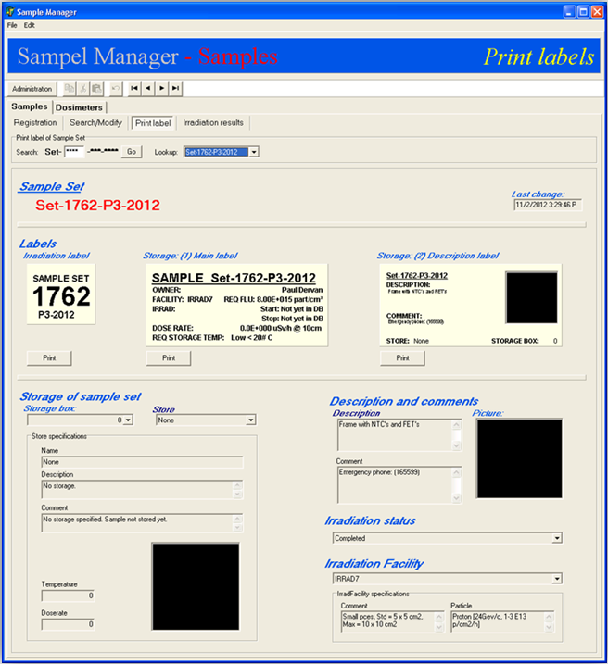
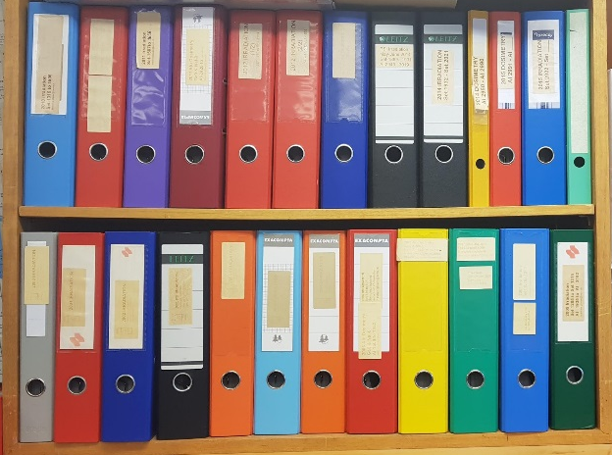
IRRAD Data Manager (IDM)
IDM
Facility Operation
(During)
cern.ch/irrad-data-manager
Identification
(Before)
Dosimetry Results & Archive
(After)

Slide 5
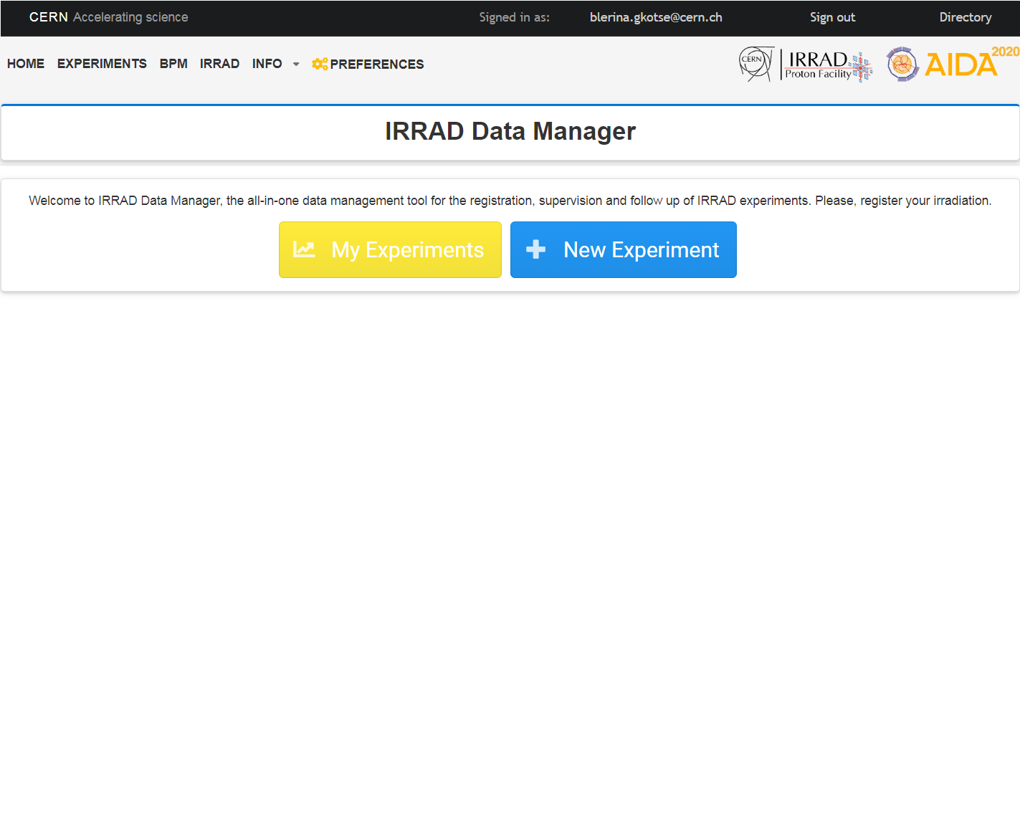
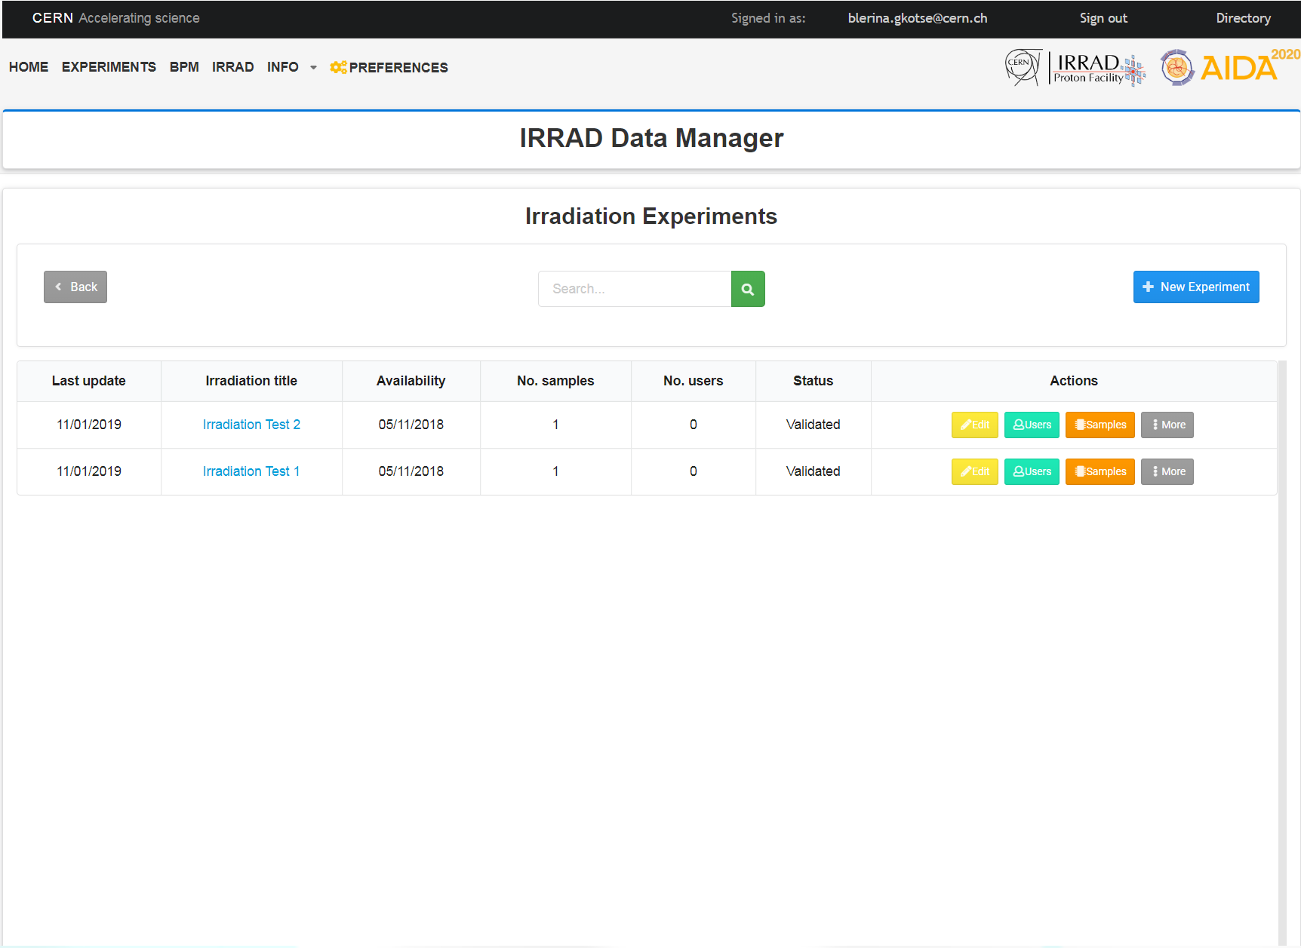
IDM: Irradiation Experiment View
Before
cern.ch/irrad-data-manager

Slide 6
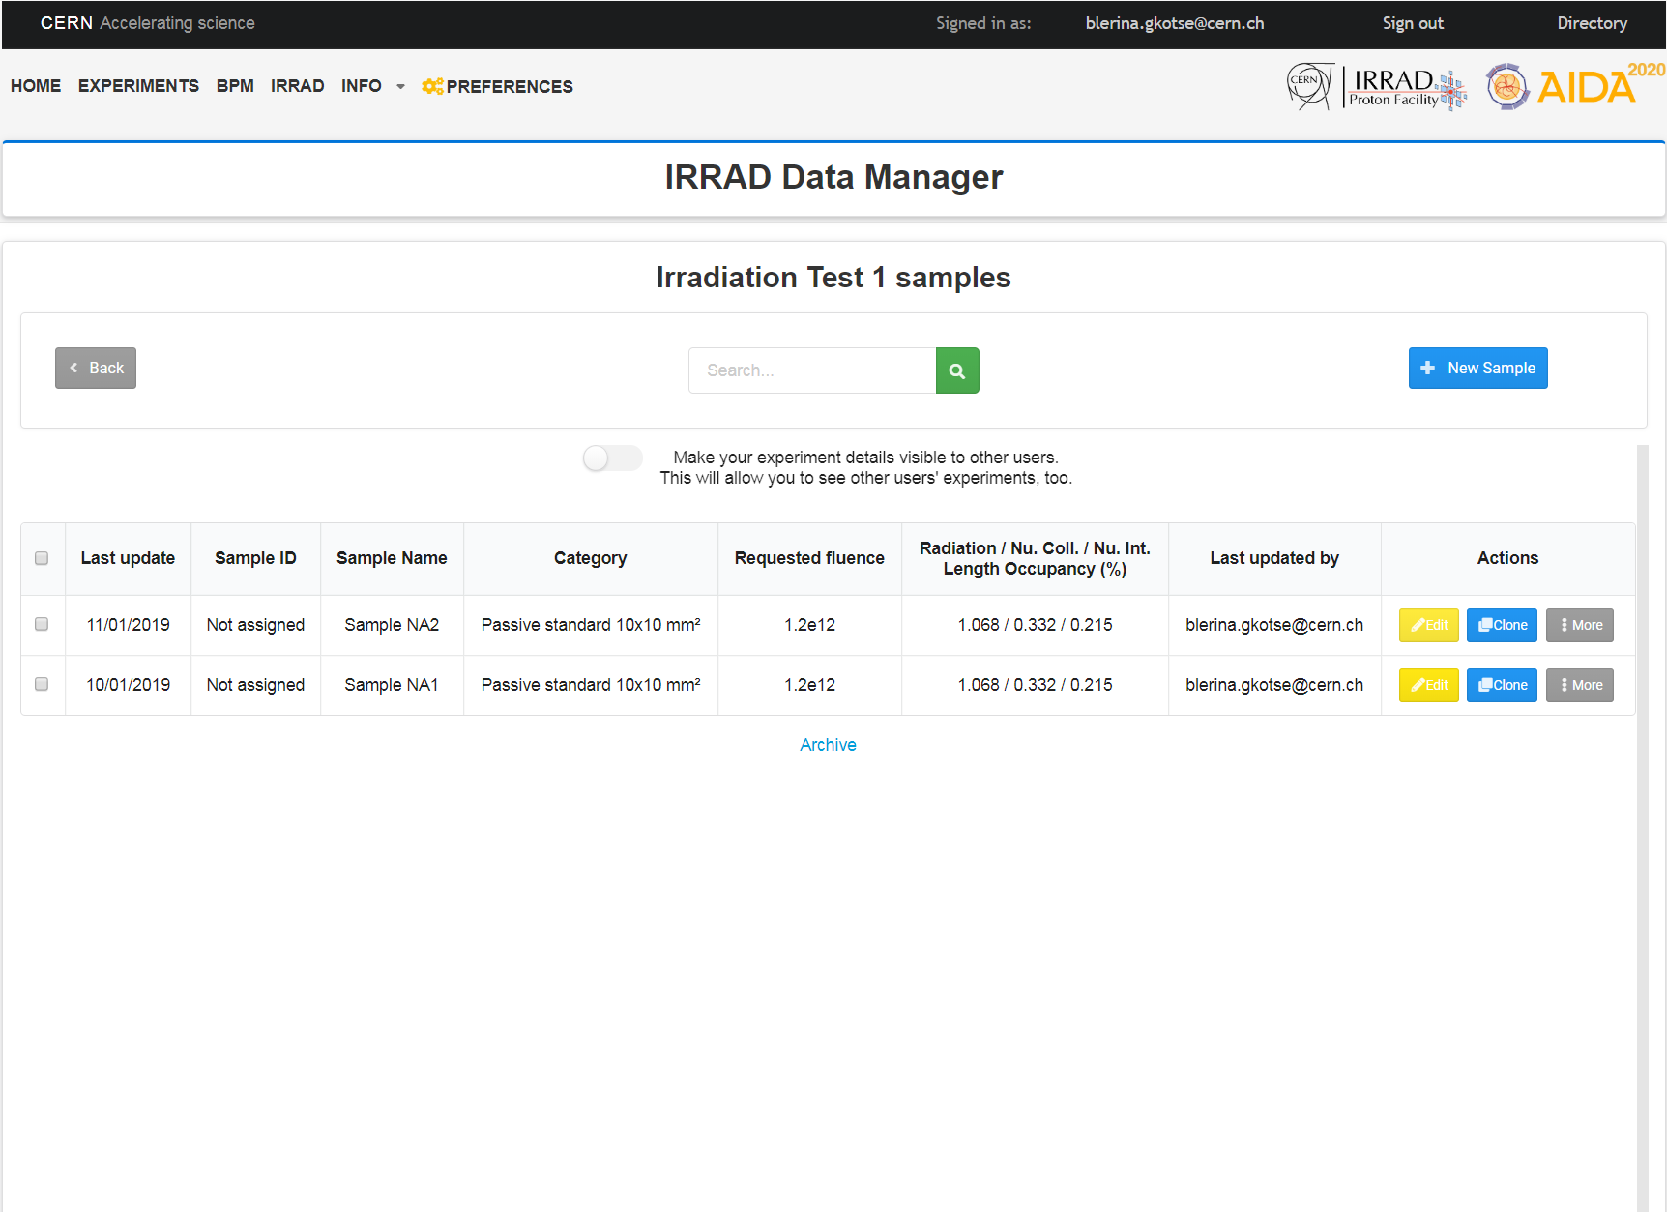
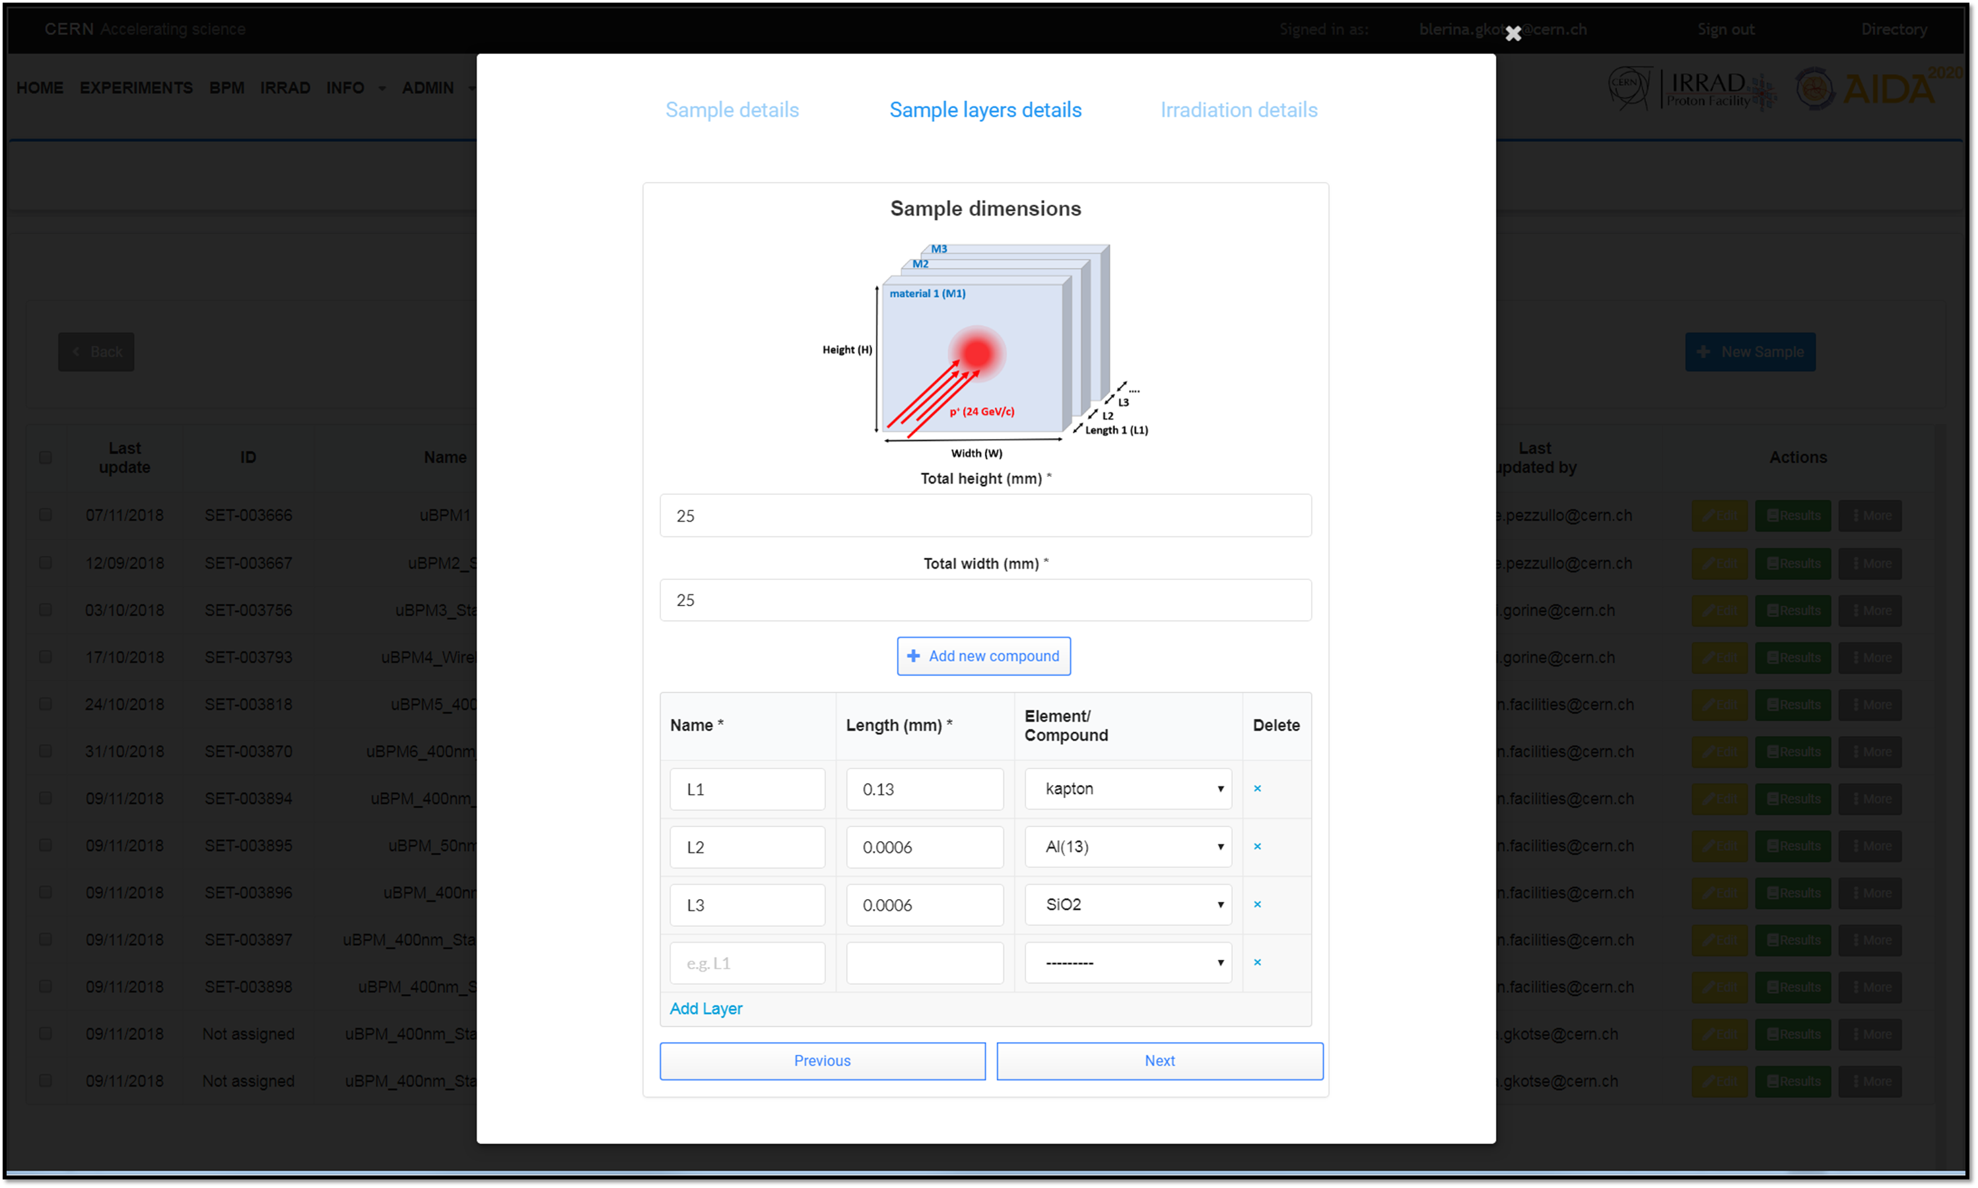
IDM: Sample View
Before
cern.ch/irrad-data-manager

Slide 7
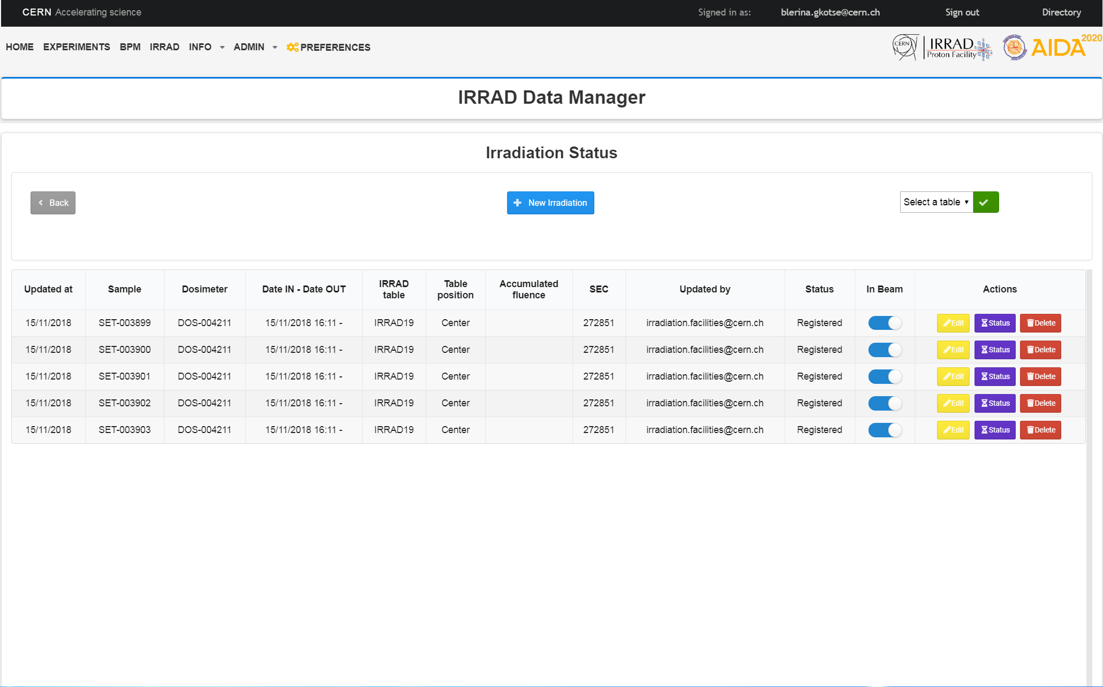
IDM: Irradiation Status View
During

Slide 8
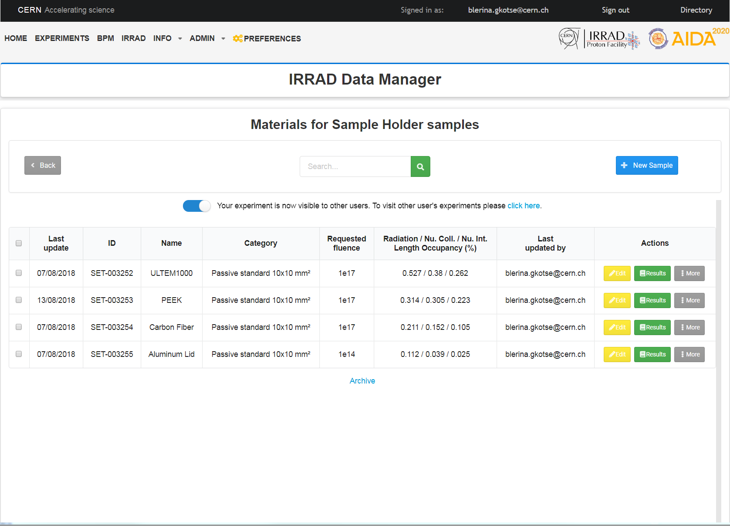
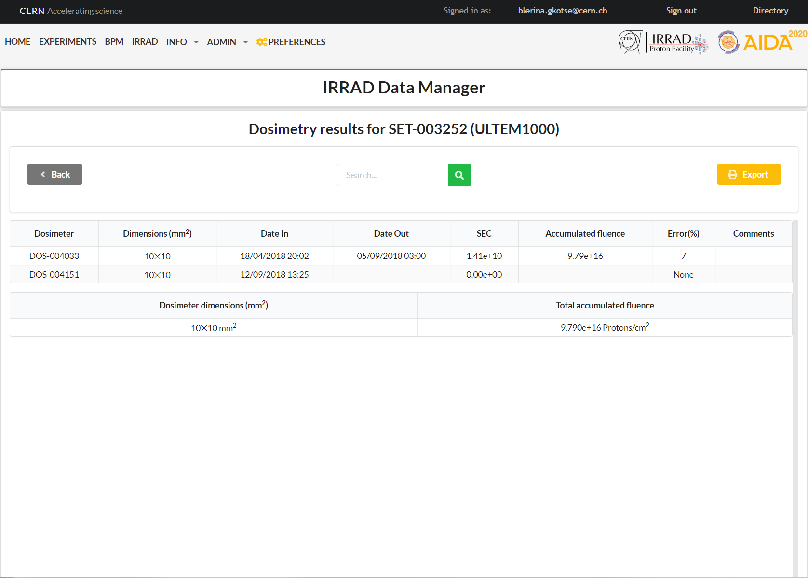
IDM: Dosimetry Results View
After
cern.ch/irrad-data-manager

Slide 9
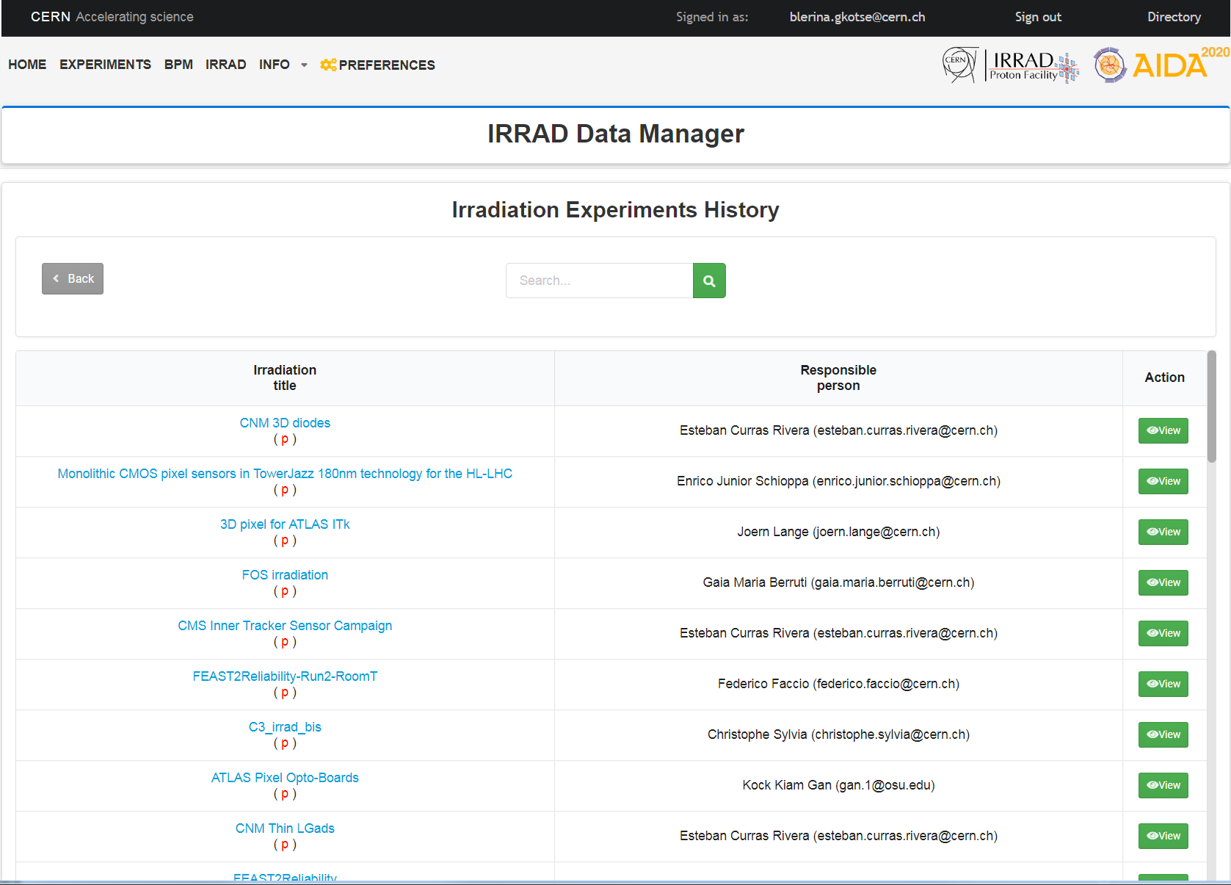
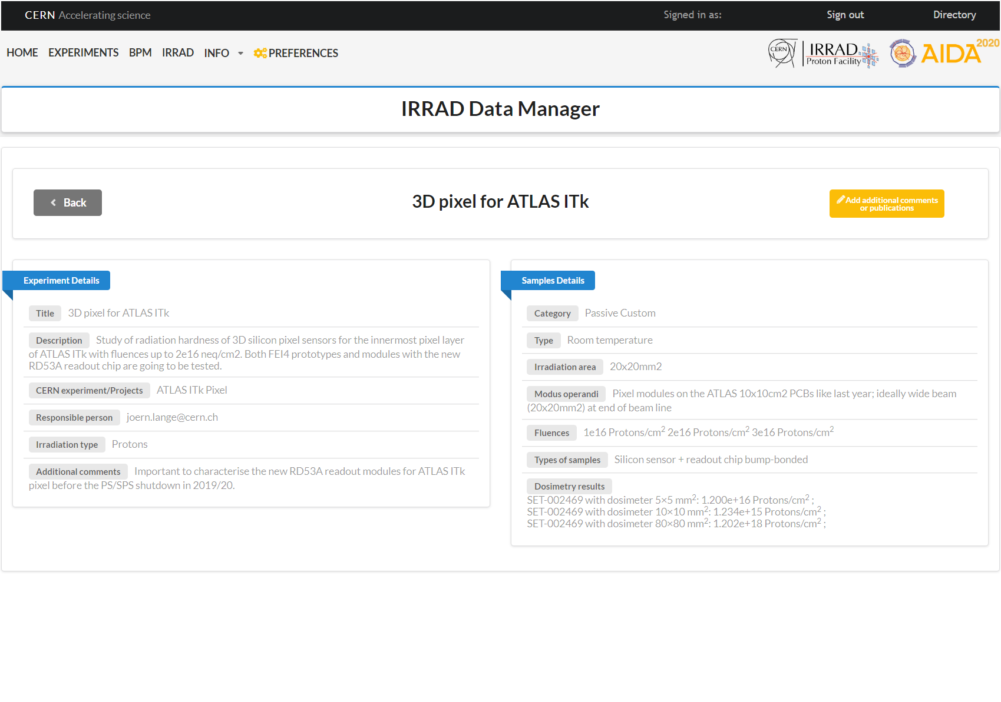
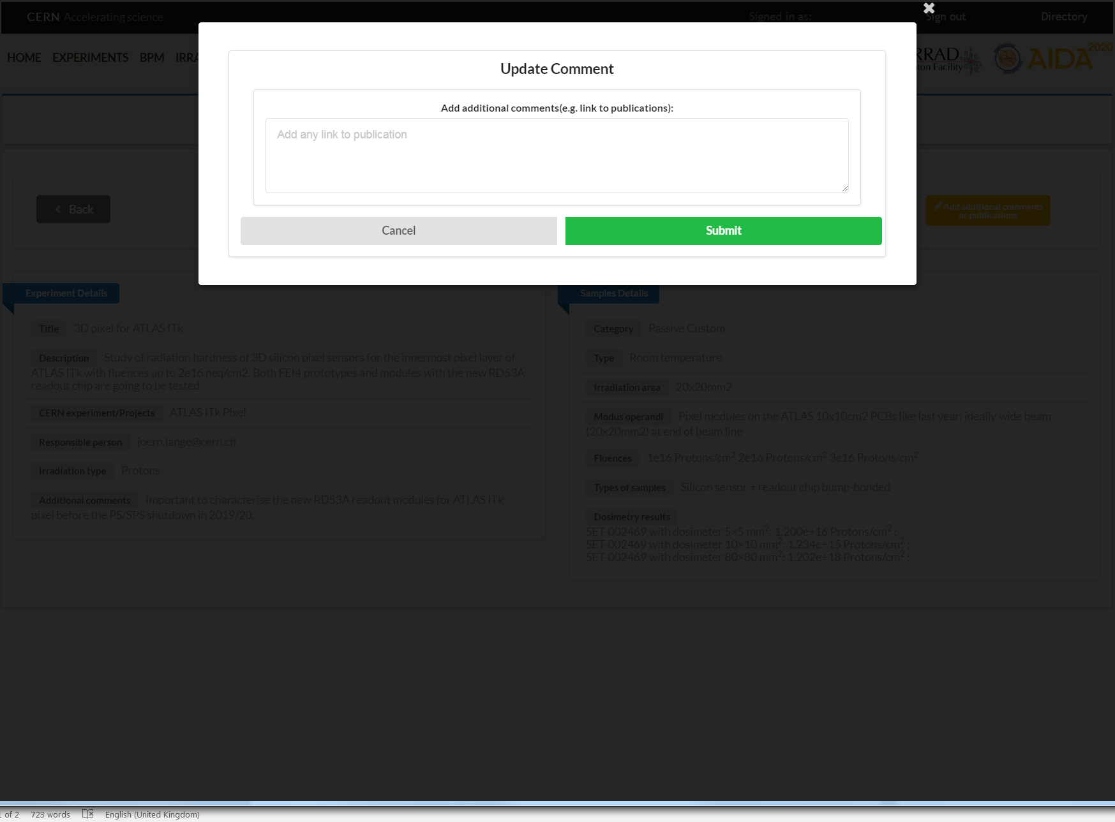
IDM: Experiments History View
After
cern.ch/irrad-data-manager

Slide 10
IDM: Key Features
      Experiments, samples, users and dosimeters registration
      Traceability label printing
      Real-time follow-up of irradiation experiments
      Computation of proton interaction parameters
      Display and archive of dosimetry results (~600 spectrometry measurements/year)
      User Interface preferences customization
      History and details of past experiments (with user permission)
      Could be used also for irradiations in other facilities (PSI, GIF++, …)
Old “Sample Manager”
Before
During
New
IDM
After
Extra

Slide 11
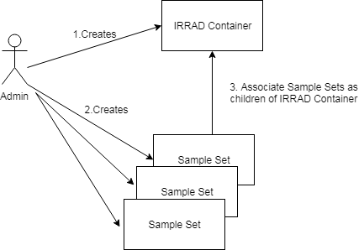
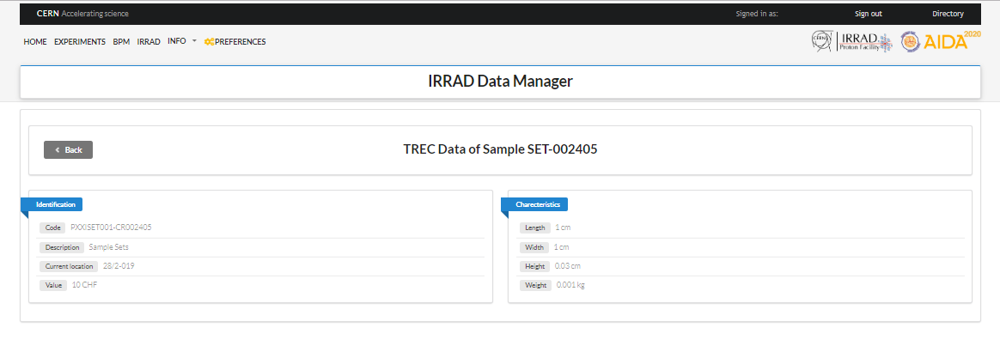
Traceability out of IRRAD via TREC
      As an AIDA-2020 Y5 extension we work on data exchange between IDM and the CERN traceability system (TREC):
  Equipment code
  Other ID
  Description
  Equipment Responsible
  Attach/Detach Equipment
  Location
  Last Location
  Length
  Width
  Height
  Weight
  Value
  Family
  Main material
  Comments

Slide 12
Outline
  IRRAD Summary 2018
  IRRAD Data Manager (IDM)
  Irradiation Experiment Data Management Ontology (IEDM) and Web Application Generation
  Irradiation Facilities Database Status
  Y5 Extension: Test-Beam Facilities Database
  Ideas for innovations beyond AIDA-2020

Slide 13

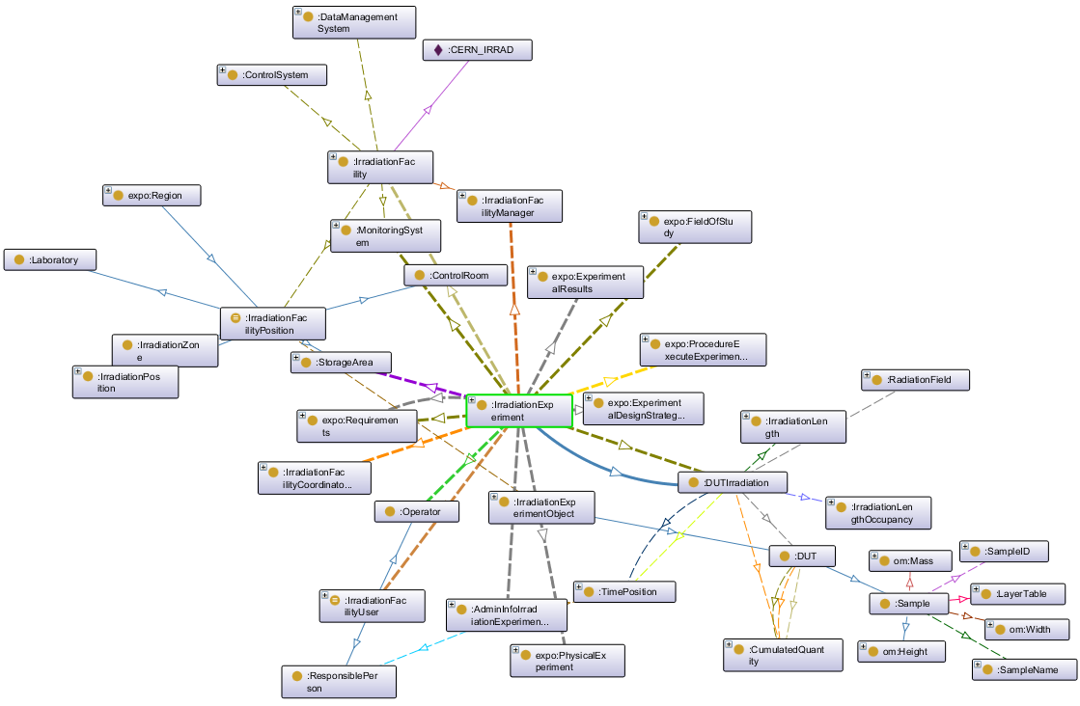
Ontology for Irradiation Experiment
Data Management (IEDM)
PhD thesis with MINES ParisTech
    Lessons from IDM design and implementation
    In-depth study of operation and data management practices at other irradiation facilities (slide 18)
    IEDM:
    The IEDM ontology (model) includes key entities and relations of irradiation experiment data management
    Knowledge formalization
    Enhanced world-wide collaborative development efforts
Ontology for Irradiation Experiment Data Management (IEDM)
*Abstract and paper submitted to the European Web Semantics Conference 2019 (ESWC https://2019.eswc-conferences.org/)

Slide 14
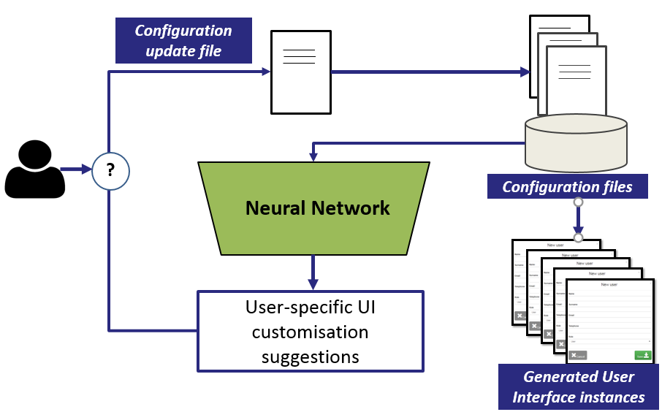
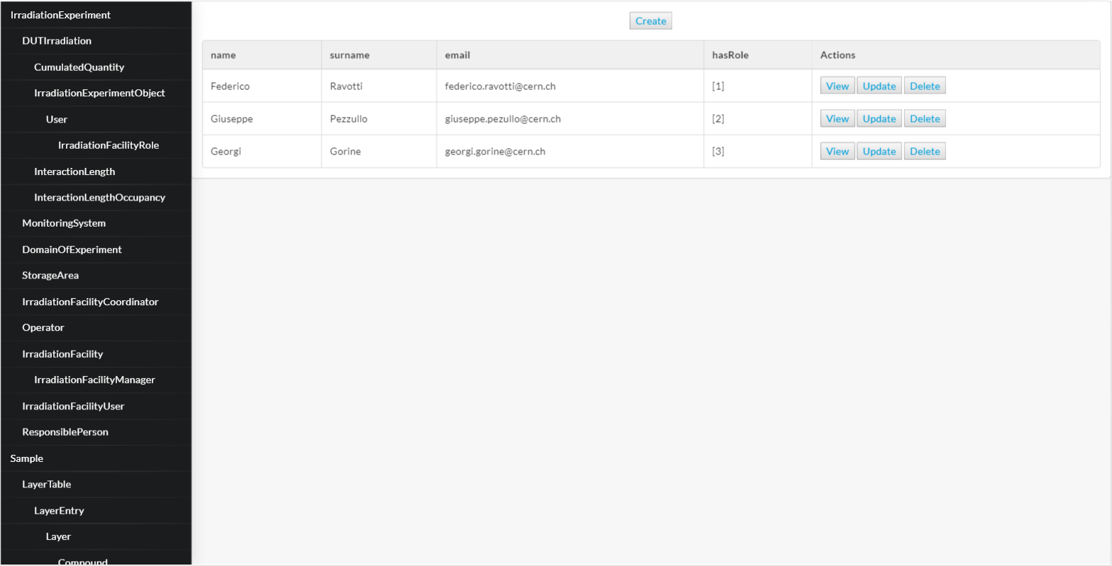
Web Application Generation and UI preferences recommender
IEDM Ontology (Model)
    IEDM-based automatic code generation:
    Web application
    ML-based recommender for UI preferences selection
Automatically generated web application
ML-based recommender system

Slide 15
Outline
  IRRAD Summary 2018
  IRRAD Data Manager (IDM)
  Irradiation Experiment Data Management Ontology (IEDM) and Web Application Generation
  Irradiation Facilities Database Status
  Y5 Extension: Test-Beam Facilities Database
  Ideas for innovations beyond AIDA-2020

Slide 16
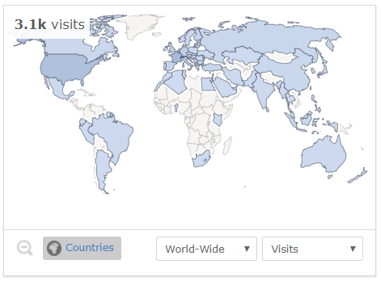
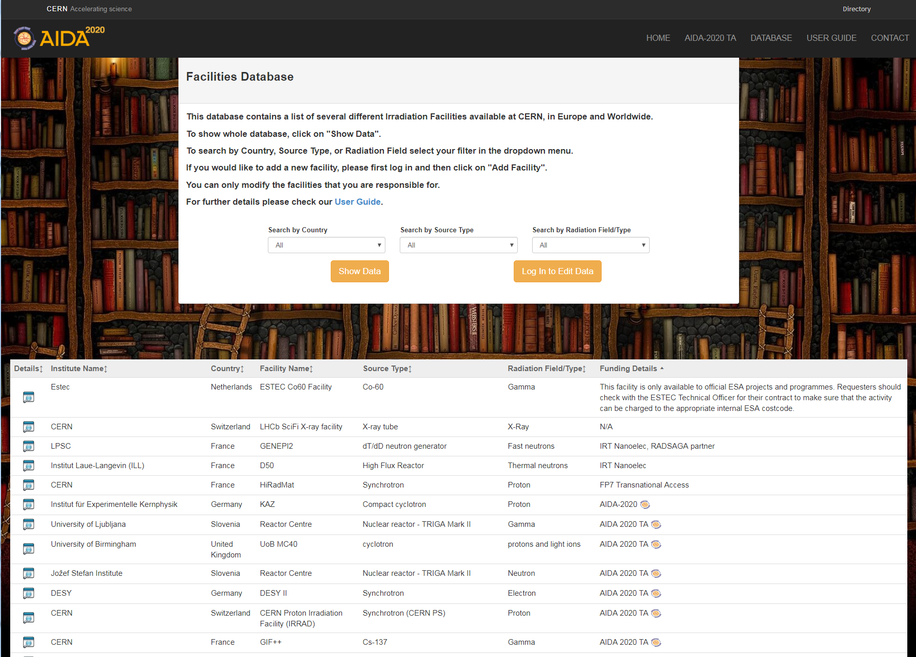
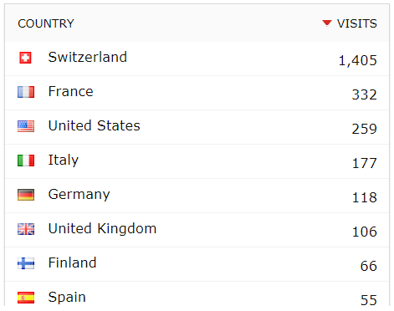
Irradiation Facilities Database Status
An online platform for finding suitable facilities for irradiation experiments*, very important during LS2!
211 irradiation facilities
3100 visits since first launched (February 2017)
~40% of irradiation facilities validated
cern.ch/irradiation-facilities
*AIDA-2020 Newsletter On track article “One list to find them all”

Slide 17
Test-beam Facilities Database
An initiative pushed by the BTTB community within the AIDA-2020 extension.
Progress so far:
Web host : cern.ch/test-beam-facilities
Responsible person: Henric Wilkens (CERN)
A first collection of data from CERN, DESY and INFN LNF test-beam coordinators and additional list provided by C. Rembser
First discussions on specifications during the AIDA-2020 satellite meeting in BTTB7 (January 2019)
Summer student being recruited for the development

Slide 18
Test-beam Facilities Database schema
Facility Coordinator Contact Information
Name
E-mail
Alternative e-mail
Phone
Beamline
Name
Particle type
Particle type details
Particle Momentum/Energy
Particle Momentum/Energy Resolution
Experiments per beamline
Experiments per beamline details
Bunch Clock
Spill length
Spill rate
Particle per Spill
Effective flux
Beam line physicist
Comments
Infrastructure
Trigger signals & system
Tracker & Telescopes
Magnets
Slow Control
Stages
Is there any sample position system?
Gas
Comments
Accessibility
Status
Access selection & procedure
Availability: Up-time & shutdowns
Special Agreements
Agreement Details
Funding
Details
Institute/Organization Details
Name
Address
City
Country
Website
Deadline for suggestions June 2019
Safety
Dosimeter needed
Medical Certificate needed
RP training needed
Comments
Source Data
Name
Number of beamlines
User community
Beam Generation
Comments
Additional Comments
Comments

Slide 19
Outline
  IRRAD Summary 2018
  IRRAD Data Manager (IDM)
  Irradiation Experiment Data Management Ontology (IEDM) and Web Application Generation
  Irradiation Facilities Database Status
  Y5 Extension: Test-Beam Facilities Database
  Ideas for innovations beyond AIDA-2020

Slide 20
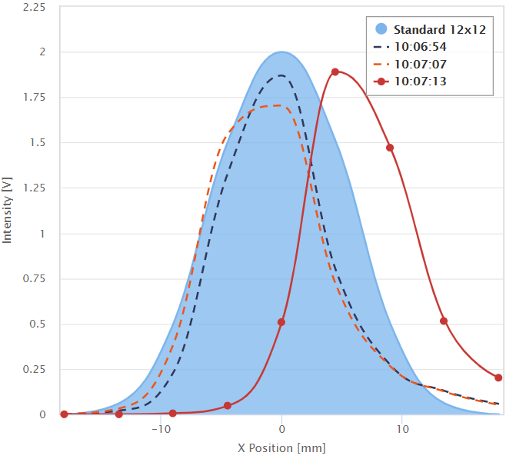
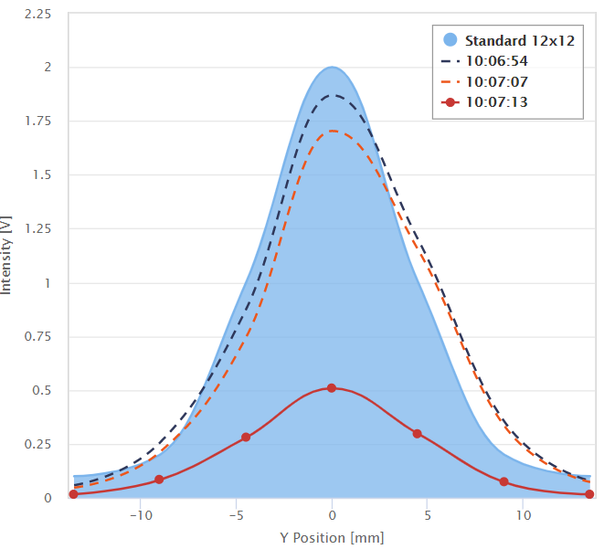
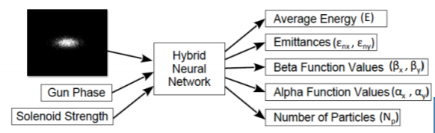
Ideas for innovations beyond AIDA-2020
Beam Profile diagnostics (from BPM) with Convolutional Neural Networks (CNN)
  Correct alignment, no beam loss → Higher cumulated fluence
  Beam classification (centered, mis-aligned, low/high intensity, etc.)
  Input to CERN Control Center (CCC)
User Interface (UI) personalisation for control systems using machine-learning recommenders
  User-specific background, experience and knowledge
  Control-system personalisation
  Safety and usability
Image-based prediction of multiple beam parameters ¹
IRRAD Beam Profiles from Beam Profile Monitors (BPM)
¹ "First steps toward incorporating image based diagnostics into particle accelerator control systems using Convolutional Neural Network", A.L. Edelen et al. NAPAC16 (TUPOA51)

Slide 21
Proposals for follow-up
Extension of IDM to handle GIF⁺⁺ data (and more irradiation facilities)
Operational integration of the overall EA-IRRAD (IRRAD/CHARM) facility at CERN with information sharing about interaction length data
Text mining in irradiation-experiment literature for articles classification with the purpose of advising users for related work (knowledge sharing)
Automatic assessment of the radioactive state of samples using CNNs
Semantic extension of the IEDM ontology with operational rules (physics, constraints, planning-based) for checking input consistency

Slide 22
Summary
  IDM fully operational for facility management [D15.6]
  Ongoing work on Irradiation Experiment formalization and related automatic code generation [D15.6]
  Irradiation facilities database running [D15.6]
  New test-beam facilities database under development [Y5 extension]
  New ideas for innovations in IRRAD and beyond [beyond AIDA-2020]

