Slide 1
GaN for large fluence irradiation monitoring
J.Vaitkus, E.Gaubas, T.Ceponis, J.Pavlov, V.Rumbauskas
¹ Vilnius University, Institute of Photonics and Nanotechnology
² CERN
Outline: WP15 task for VU: contribution to radiation monitoring & imaging.
Motivation
Characterization techniques
Results on AT GaN
Commercial GaN LED structures as dosimeters
Summary.

Slide 2
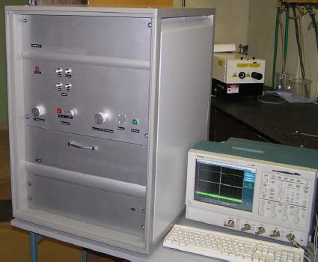
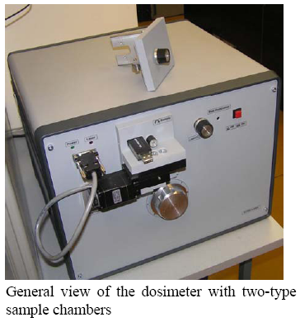
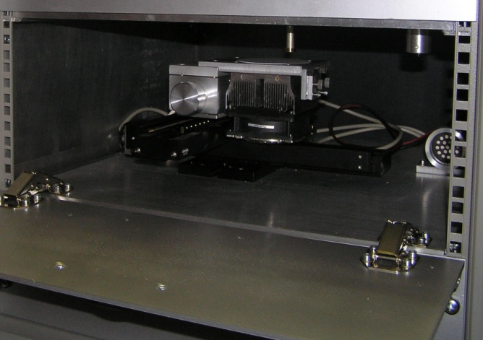
The devices for integrated fluence monitoring and radiation field imaging based on Si properties
The device for 2D integrated fluence imaging up to 3“.
To remind previous contributions
The “trapping” time
The device for the contactless fluence monitoring delivered to CERN.
Si

Slide 3
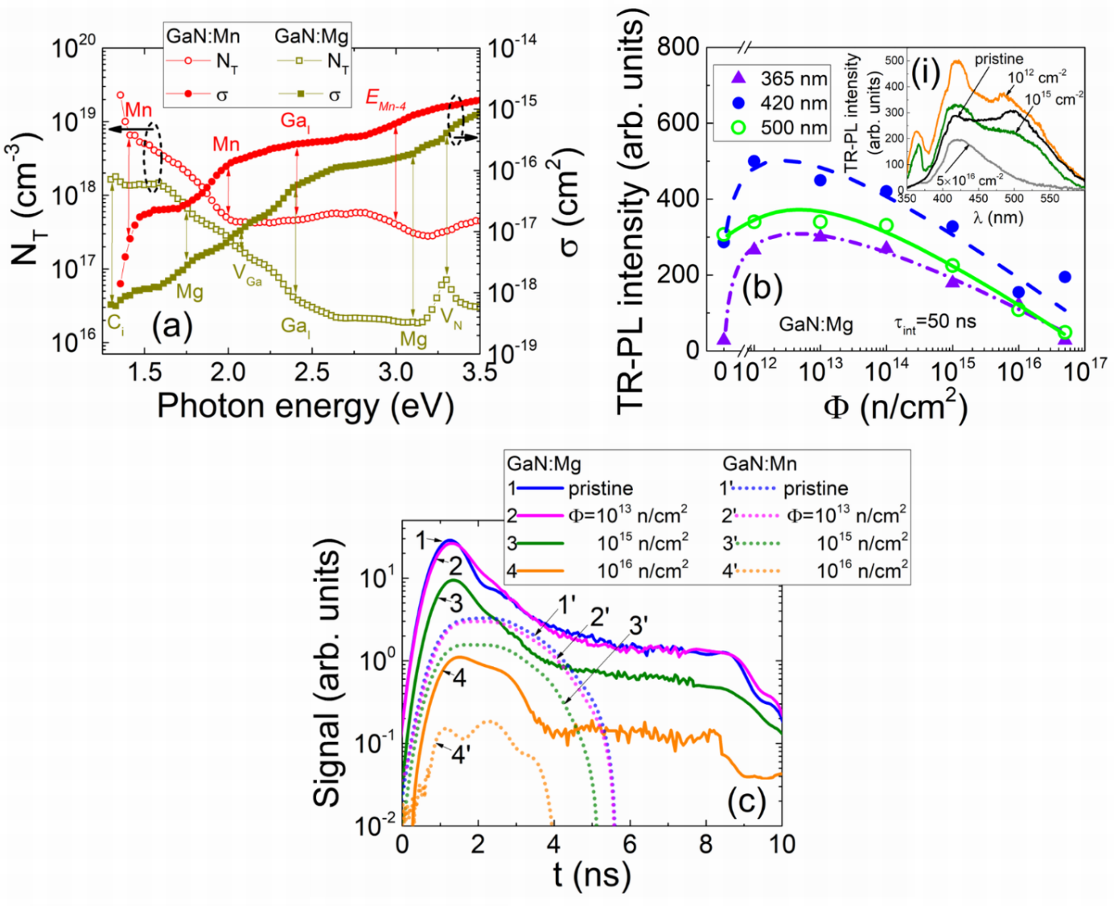
GaN promise
Variations of the current transients (in the tentative detectors made of GaN:Mg and GaN:Mn for the 290 fs laser pulses at 315nm wavelength excitation) dependent on neutron irradiation fluence.
J. Grant et al J.Vaitkus et al. / NIMA 576 (2007) 60–65

Slide 4
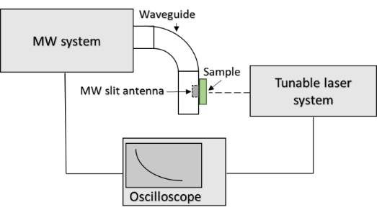
Characterization techniques (1):
Pulsed photoionization spectroscopy (PPIS)
The PPIS were implemented using excitation by a tuneable wavelength laser and measurements of the photo-response by applying microwave probed photoconductivity transient (MW-PC) technique.
Tuneable wavelength femtosecond-nanosecond lasers (210 to 2300 nm) were employed.

Slide 5
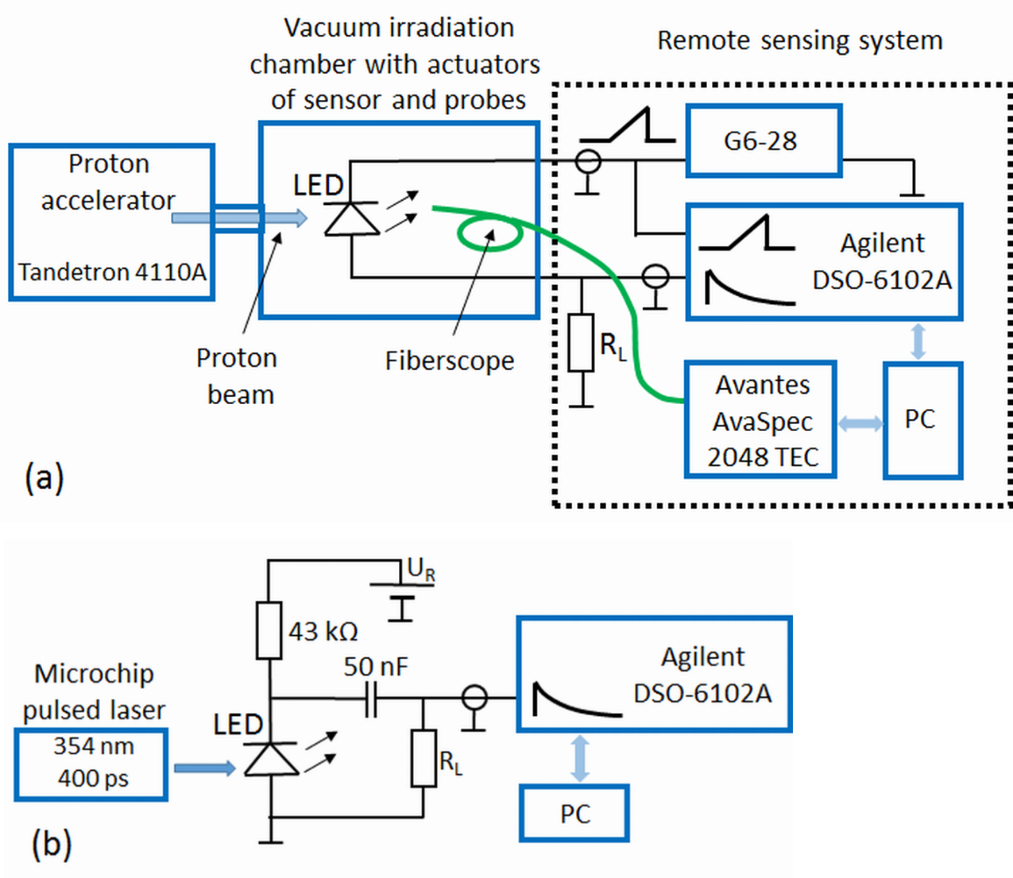
Characterization techniques (2):
Pulsed barrier evaluation by linearly increased voltage (BELIV)
Proton induced luminescence spectroscopy (PIL)
TCT

Slide 6

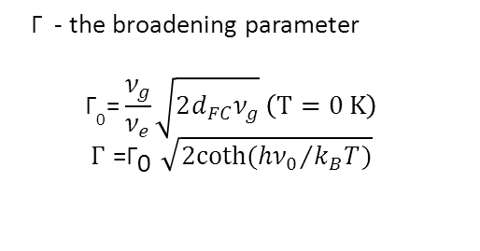
Results on AT GaN irradiated by 1 MeV neutrons
 | Non-irradiated |  | Irradiated with Φ=10¹⁶ cm⁻²
GaN:Mn | Photo-activation energy (eV) | Γ | Photo-activation energy (eV) | Γ | Defect type
 | E_{Mn-1}=1.40 | 0.05 | E_{Mn-1}^{irr}=1.42 | 0.08 | Mn related
 | E_{Mn-2}=1.98 | 0.25 | E_{Mn-2}^{irr}=1.98 | 0.22 | Might be oxygen related
 | E_{Mn-3}=2.40 | 0.15 | E_{Mn-3}^{irr}=2.37 | 0.25 | Ga_{I} or N_{I}
 | E_{Mn-4}=2.97 | 0.25 | E_{Mn-4}^{irr}=2.96 | 0.28 | Unidentified
GaN:Mg | E_{Mg-1}=1.30 | 0.02 | − | − | Donor/acceptor state
 | E_{Mg-2}=1.70 | 0.15 | E_{Mg-1}^{irr}=1.71 | 0.22 | V_{N}Mg_{Ga}
 | E_{Mg-3}=2.07 | 0.23 | E_{Mg-2}^{irr}=2.05 | 0.27 | V_{Ga}
 | E_{Mg-4}=2.39 | 0.15 | E_{Mn-3}^{irr}=2.37 | 0.25 | Ga_{I} or N_{I}
 | − | − | E_{Mg-4}^{irr}=2.45 | 0.16 | Unidentified or N_{I}
 | E_{Mg-5}=3.00 | 0.32 | E_{Mg-5}^{irr}=3.00 | 0.35 | Unidentified
 | E_{Mg-6}=3.30 | 0.2 | E_{Mg-6}^{irr}=3.30 | 0.27 | Mg_{I}
GaN:Mn
GaN:Mg
Γ - the broadening parameter
$${\text{Γ}}_{\text{0}}\text{=}\frac{ν_{g}}{ν_{e}}\sqrt{2d_{FC}ν_{g}} \left(T=0 K\right)$$
$$Γ{\text{=}\text{Γ}}_{\text{0}}\sqrt{2coth({hν_{0}}/{k_{B}T})}$$

Slide 7
AT GaN
(a) -Variations of cross-sections of the photon-electron coupling and of trap concentration as a function of excitation photon energy in the pristine AT-grown GaN samples doped with Mg and Mn. Vertical arrows indicate the peak positions of the PPIS steps, ascribed to different centres.
(b) – Variations of the predominant TR-PL spectral peaks with neutron irradiation fluence. In the inset (i) variations of TR-PL spectra are depicted. (The excitation - 290 fs laser pulses, 315nm wavelength)
E. Gaubas, T. Čeponis, et al, “Pulsed photo-ionization spectroscopy of traps in as-grown and neutron irradiated ammonothermally synthesized GaN”, www.nature.com/scientificreports; Scientific Reports (2019) 9:1473

Slide 8
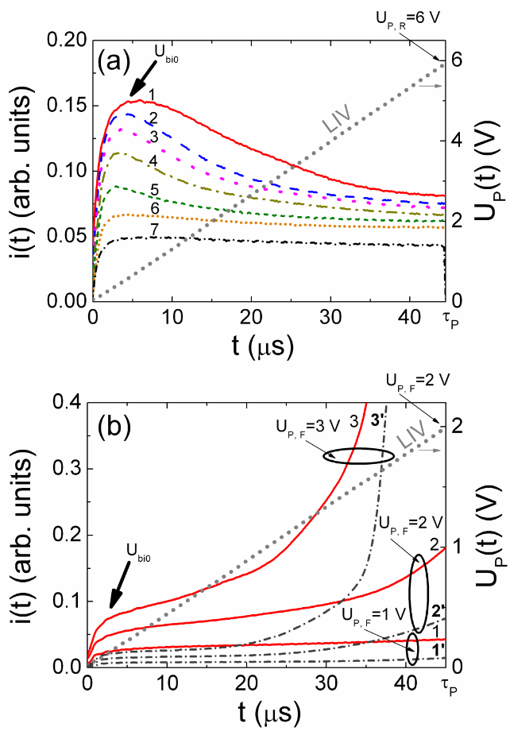
GaN LED-based structures for remote dosimetry
Evolution of the BELIV current transients for the reverse (a) and forward (b) biased GaN LED (τ_{PL} = 45 μs). (a) LED irradiated with the proton fluences of 0 (1); 5×10¹⁴ p/cm² (2); 8×10¹⁴ p/cm² (3); 1×10¹⁵ p/cm² (4); 2×10¹⁵ p/cm² (5); 3×10¹⁵ p/cm² (6); and 5×10¹⁵ p/cm² (7), respectively (U_{P,R} = 6 V). (b) Pristine LED (1-3) and LED irradiated with the fluence of 5×10¹⁵ p/cm² (1′ – 3′) for peak voltage U_{P,F} of 1 V (1 and 1’), 2 V (2 and 2’), and 3 V(3 and 3’).
E. Gaubas, T.Ceponis, D. Meskauskas, J. Pavlov, A.Zukauskas, V. Kovalevskij,V. Remeikis Sensors and Actuators A 267 (2017) 194–199

Slide 9
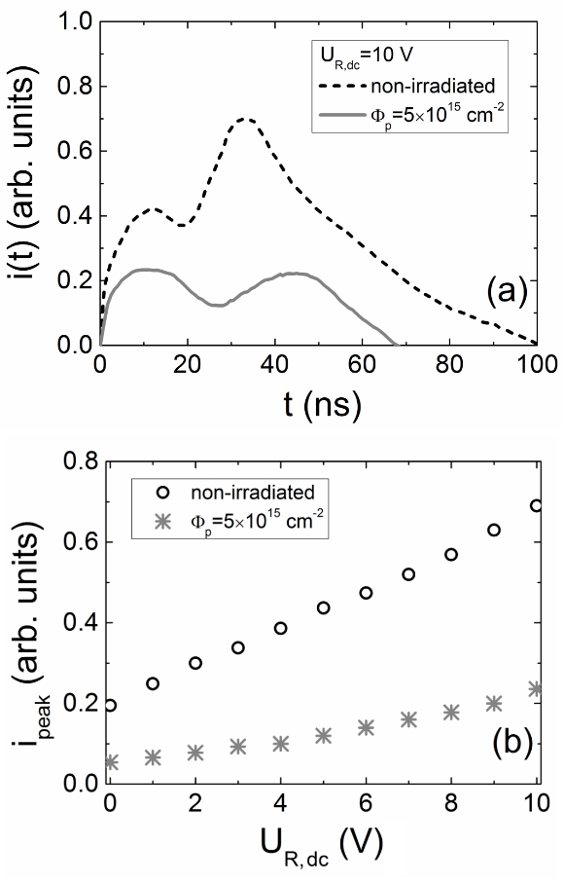
GaN LED-based structures for remote dosimetry
TCT transients (a) and peak-current (b) as a function of reverse-bias voltage measured on pristine and heavily irradiated LED-based sensor.
E. Gaubas, T.Ceponis, D. Meskauskas, J. Pavlov, A.Zukauskas, V. Kovalevskij,V. Remeikis Sensors and Actuators A 267 (2017) 194–199

Slide 10
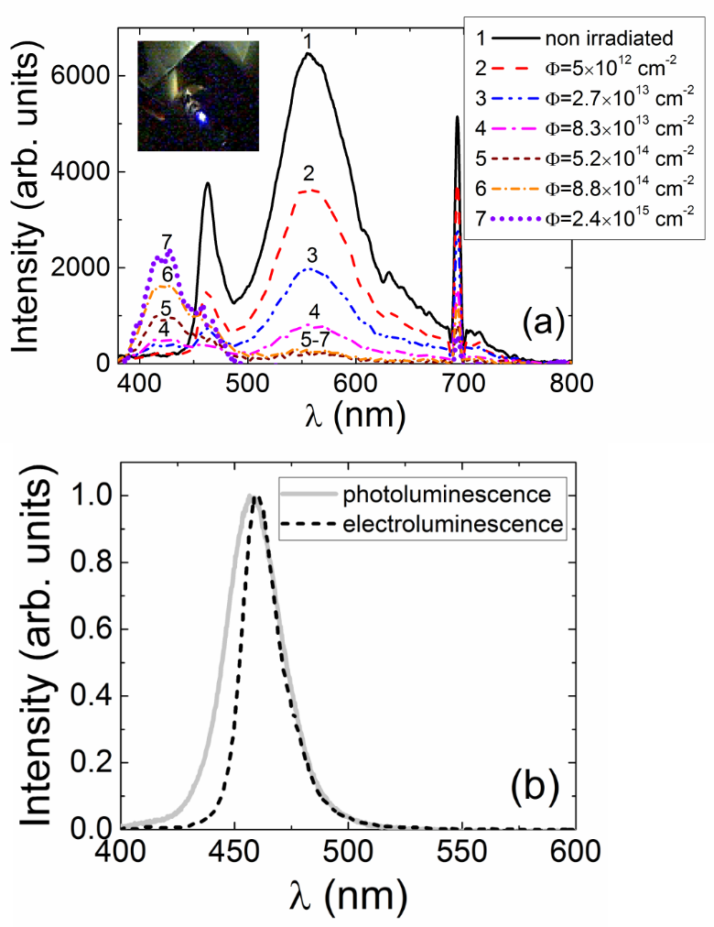
GaN LED-based structures for remote dosimetry
Evolution of the proton induced luminescence spectra as a function of 1.6 MeV proton fluence.
In the inset,- a picture of the proton-induced luminescence on GaN LED-based sensor, installed within irradiation chamber.
(b) – Comparison of spectra of the laser induced photoluminescence and electroluminescence, recorded on pristine LED.
E. Gaubas, T.Ceponis, D. Meskauskas, J. Pavlov, A.Zukauskas, V. Kovalevskij,V. Remeikis Sensors and Actuators A 267 (2017) 194–199

Slide 11
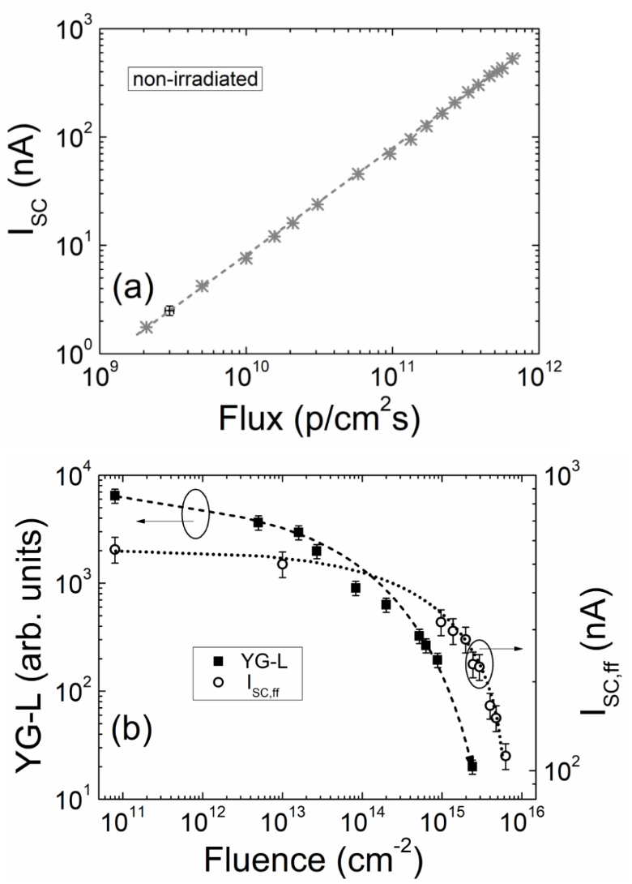
GaN LED-based structures for remote dosimetry
– The as-recorded short-circuit current (I_{SC}) as a function of proton flux for the initial irradiation stages of a few seconds.
- The as-recorded I_{SC} (measured for a fixed proton flux,- I_{SC,ff}) as well as YG-L intensity as a function of the irradiation fluence. Lines serve as the eye-guides to depict the experimental dependences of I_{SC} and YG-L on flux and fluence.
E. Gaubas, T.Ceponis, D. Meskauskas, J. Pavlov, A.Zukauskas, V. Kovalevskij,V. Remeikis Sensors and Actuators A 267 (2017) 194–199

Slide 12
Summary
  The AT-GaN material performance showed insignificant changes after neutron irradiation with large fluences (up to 5×10¹⁶ e/cm² ).
  GaN LED-based sensors can be used for the synchronous detection of hadron irradiation by recording the optical (B-L) and electrical signals (I_{SC} and TCT transients).
Acknowlegments: This project has received part of funding from the European Union’s Horizon 2020 Research and Innovation programme under Grant Agreement no. 654168, and from Lithuanian Research Council.

Slide 13

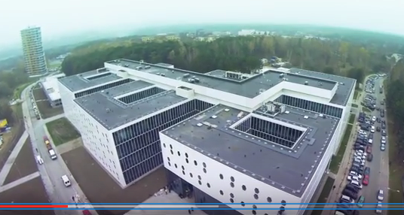
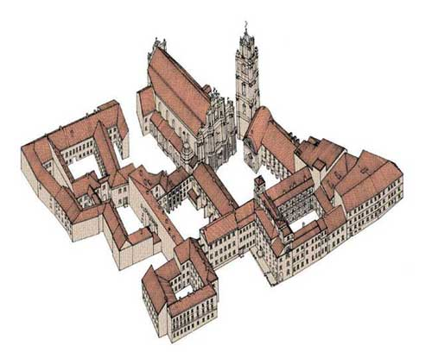
Thank you for your attention !
1579-1832

