Slide 1


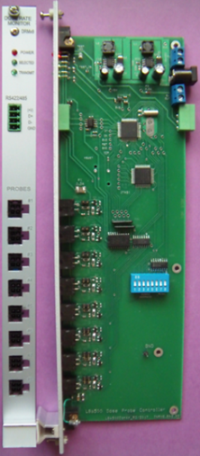
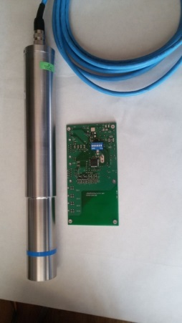
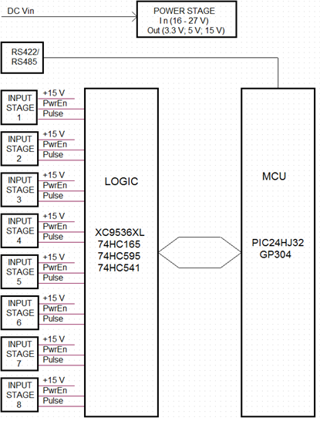
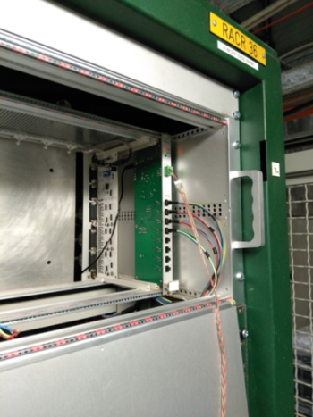
AIDA-2020 4th Annual Meeting - April 2-5, 2019
Radiation Monitoring Systems at GIF++ - INRNE,Sofia,Bulgaria
P.Iaydjiev, L.Dimitrov, I.Vankov, G.Mitev, L. Ratchev (INRNE-Sofia)
Instantaneous dose-rate monitor (DRM) for GIF++ and test of SiPM + scintillator as a DRM for Gif++
Instantaneous dose-rate monitor (DRM) for GIF++
The eight-channel version was designed and tested at GIF++ in parallel with a RADMON accumulated dose sensor. The self-adapting method of measurement was applied for the automatically selecting of pre-set time depending of input pulse rate. The Berthold LB 6500 Geiger-Mueller Dose Rate Probe was tested and compared with RADMON measurements at the same position in GIF++. The result shows good agreement in the limit of precision for the RADMON and Berthold probes.
This work was performed within the framework of AIDA-2020 WP 15.5.
Technical Data | Berthold GM LB6500–4 - H10
Dose Rate Range | 500 nSv/h – 3 mSv/h
Energy Range | 65 keV – 1.3 MeV (+/-40%) with regard to Cs-137 at 0⁰
Intrinsic Background | approx. 0.08cps
Calibration Factor | 0.617 μSv/h per cps
Test of the Berthold LB 6500 Geiger-Mueller Dose Rate Probes at several attenuations at Gif++
Berthold LB 6500 Geiger-Mueller Dose Rate Probe for 2 and 8 channel DRM
The block diagram
AIDA-2020-MS85 (http://cds.cern.ch/record/2311230)
Plamen Iaydjiev (INRNE-Sofia)

Slide 2
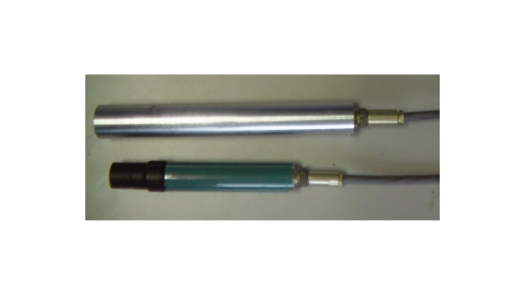
AIDA-2020 4th Annual Meeting - April 2-5, 2019
TEST at INRNE of the SiPM and Plastic scintillator as a dose rate monitor –
(activity during the 5th year of AIDA-2020)
Test configuration
SiPM - Hamamatsu S13360-1325CS (57.28V)
Photosensitive area: 1.3 x 1.3 mm, Pixel pitch: 25 μm, reduced crosstalk and dark count,
Gain (typ.) - 7.0×10⁵
Scintillator
- 250x10x7 mm³ , extruded polystyrene bar supplemented with 1.5% paraterphenyl (PTP) and POPOP 0.01%;
- 30-100 micron layer Uniplast actng as a
diffusive reflector;
Light shifter WLS Y11 KURARAY Φ 1 mm
Preamp – simple 2 transistors charge sensitive (RC = 22µs)
Amplifier - Canberra 2024, shaping time 2 µs, ADC – 4k, custom made
Dose rate µSv/h
Temperature dependences for two SiPM voltages
Counts vs Dose rate measurements
2. DRM with a NaI(Tl) scintillator and photomultiplier FEU-35 was assembled at INRNE for the test. The spectra of Caesium-137 measured with it is shown on the plot:
Plan to test at Gif++ in 2019:
The light yield and decay time for NaI and plastic scintillators differ significantly. The test and comparison between these 2 DRM’s at Gif++ (from 10 to 10000 mGy/h) could give an information for the possible use of the DRM’s at substantially different dose rate conditions.
Plamen Iaydjiev (INRNE-Sofia)

Slide 3
AIDA-2020 4th Annual Meeting - April 2-5, 2019
AIDA-2020 follow-up - ideas/expressions of interests
Monitoring and Dosimetry for
1. HEP experiments
2. Irradiation experiments
3. Nuclear facilities
4. Material testing facilities
5. Medical therapy
6. Space applications
field of application
Wireless, Portable Readout System
Sensors
RADMON sensors
1. RadFETs for the Total Ionizing Dose
2. p-i-n diodes for the 1MeV neutron equivalent fluence
Control and data transmission
Ethernet and Wi-Fi interfaces.
Plamen Iaydjiev (INRNE-Sofia)

