Slide 1
WP 13.2.3 closing summary
G. Aielli for the RPC collaboration

Slide 2
WP13.2.3 Deliverable 13.3
In April 2018 we produced the Deliverable 13.3 containing all the substantial achievements of the W.P. 13.2.3:
The milestone assessed the establishment of a new generation of large surface (> 1m^2 per unit) single gap RPCs, namely the R&D was targeted at ATLAS and CMS upgrades for HL-LHC.
The requirements are:
  Similar unit price and construction complexity
  An order of magnitude higher rate capability and longevity → 10 kHz/cm^2 and > 3000 fb^-1 achieved by operating the detector at a lower threshold (4 fC), for a correspondingly lower average total charge per count (5 pC).
  Thinner and lighter to be more easily inserted in an already built apparatus such as ATLAS detector → 1 mm gas gap and 1.2mm electrods insead of 2 mmgas gap and 1.8 mm electrodes
  Operable with eco gases → a lower multiplication required in the gas makes available new low GWP gas mixtures, which would have not enough safety margin and stability with the legacy RPCs
Further performance benefits → from the new FE and gas gap
  0.35 ns time resolution (instead of 1 ns)
  1 mm space resolution (instead of about 7mm)

Slide 3
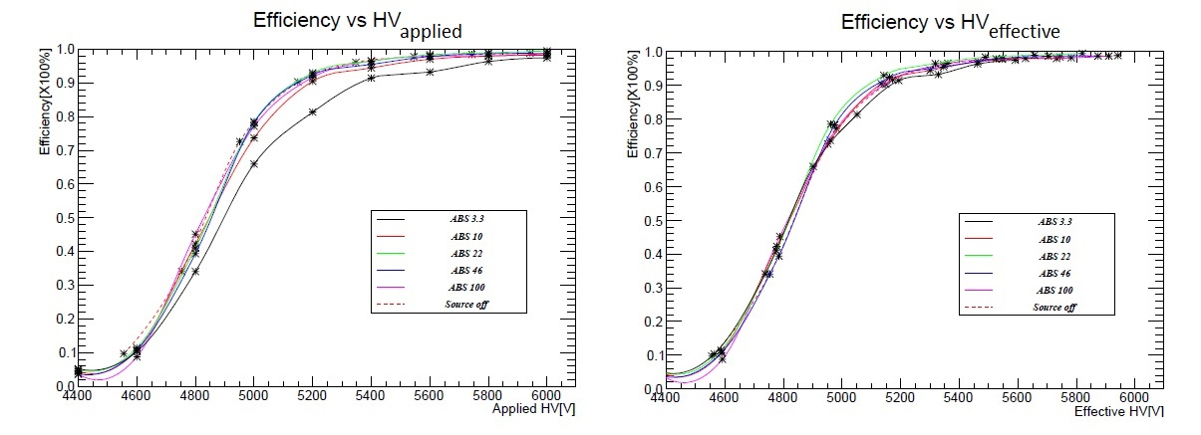
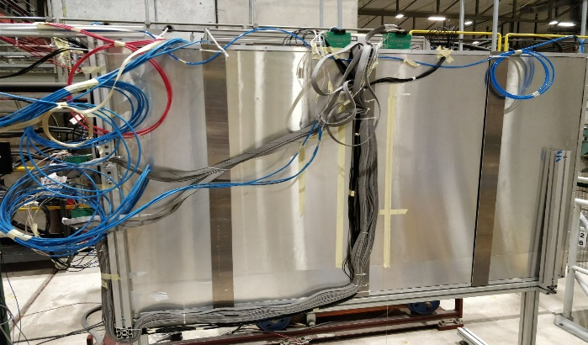
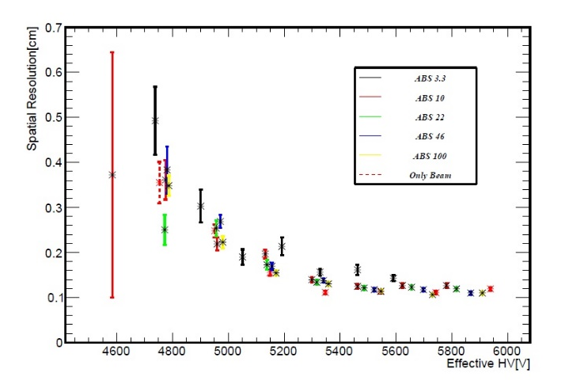
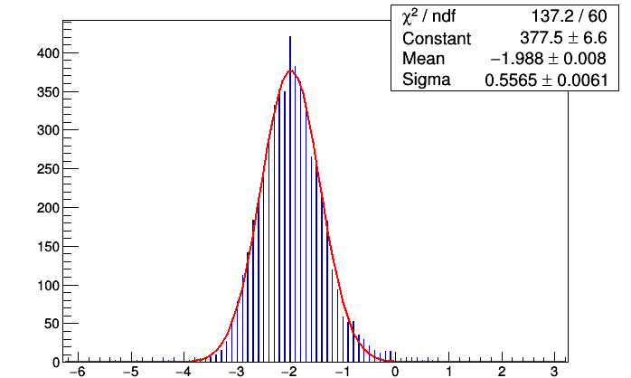

Test of the Final Prototype
0.5 m^2 detector tested for high rate at the GIF++ muon beam and photons
2 m^2 detector tested for performance at H8 (muon beam)
Efficiency for different irradiation intensity. Full efficiency is reached up to about 10 kHz/cm^2. Left, applied, right effective Voltage
$$\frac{0.5565}{\sqrt{2}}=\text{0.3935} \text{ns}$$
Space resolution
Time resolution

Slide 4
Present status
The final prototype, an about 2x1 m^2 single piece of detector, a replica of an ATLAS production chamber to be installed in the inner barred, has been tested.
The results allowed to pass the Final Design Report of the BIS78 project and obtain the green light for the pre-production
32 chambers with this technology are already in production for ATLAS to be installed in 2019
Intensive collaboration between ATLAS and CMS to share the results of this R&D
A new de-facto “classic” RPC performance standard is established

Slide 5
Next steps: completion of the R&D program
Not all the task have been fully accomplished, and we aim to exploit the next year to complete the R&D program:
The test is limited to the final prototype so we can yet not assess the reliability and the production performance uniformity of this RPC generation. In 2019/2020 we are producing 32 new large chamber of this type which will give a sufficient statistics for fixing this point
Longevity test is ongoing and 1 year will be necessary to integrate the equivalent of the full HL-LHC program
Test have been carried out to assess the compatibility of this RPCs with eco gases (see MS13.93) however an high rate and longevity test using these gases was never performed since the necessary infrastructure has been made available just recently at CERN

Slide 6
Future perspectives
Besides ATLAS and CMS Phase-1 upgrades this new RPC generation represents the baseline for the Phase-2 ATLAS upgrade (300 new large cambers in total)
For the phase-2 upgrade, the present layout will be substantially conserved, with the exception of the FE electronics which will include internally a 100 ps TDC. A new readout schema will be also proposed based on the mean-timer concept to calculate the second coordinate.
New experiments such as Mathusla and CODEX-B are seriously considering the presented RPC technology as a baseline. CODEX-B in particular has shown interest to fully adopt Phase-1 ATLAS RPC production to built the CODEX-B demonstrator already in LS2.
This technology developed for HL-LHC exploits the brute force of a new FE electronics, leaving the detector structure very similar to the classic one, including the materials. Now it is the time to innovate the detector as well..
  For the future colliders we can certainly renew the challenge, proposing a deeply innovative RPC structure, to better exploit the detector physics through this electronics
  Future collider’s muon systems and calorimeters can benefit of this progress

