Slide 1
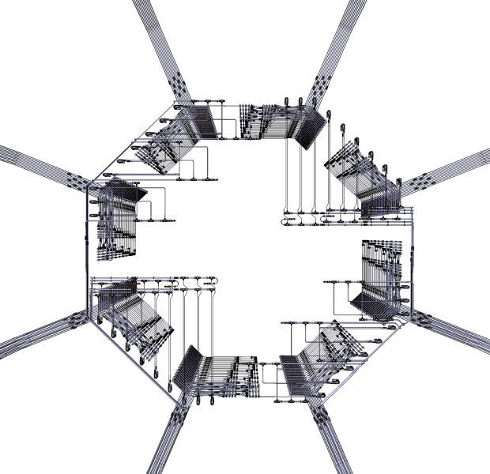
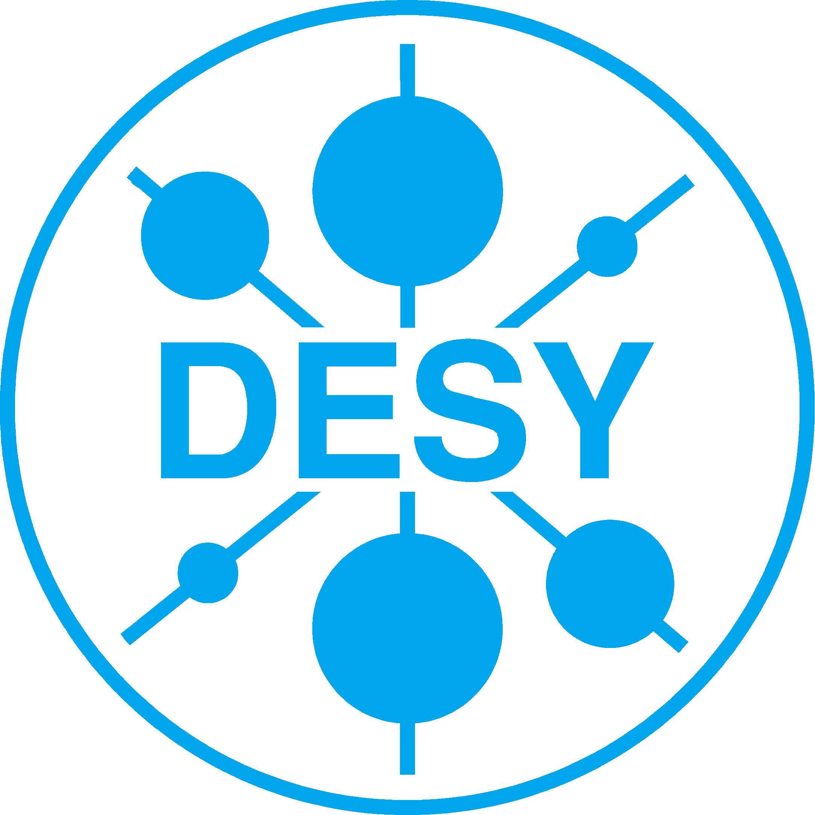




WP14.5
WP14.5 – Mechanical & Thermal tools for Innovative Calorimeters
Mechanical & Thermal tools for Innovative Calorimeters
Task 1 | Precision mechanics for calorimeter structures
Task 2 | Infrastructure to evaluate thermal properties of calorimeter structures
Katja Krüger [DESY], Denis Grondin [LPSC]
This project has received funding from the European Union’s Horizon 2020 research and innovation programme under grant agreement No 654168.

Slide 2

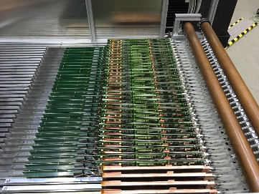
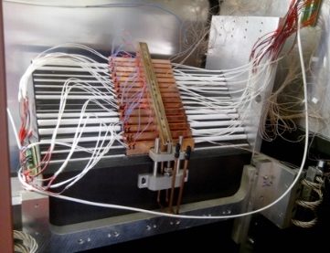
WP14.5 - Task 2
Compact and highly efficient Cooling Systems
2.1 Cooling system to test thermal modelling of large CF (carbon fiber) structures (ECAL - LPSC)
2.2 Cooling system for low power calorimeter readout electronics (AHCAL - DESY)
The development of a cooling system for low power calorimeter readout electronics is based on design close to those of the ILD innovative calorimeters @ ILC
Deliverables 14.8 (June 2018) / Large leak-less System, thermal model
  Construction of a real size water cooling circuit for both calorimeters
    Demonstrators and results
HCAL: (Stainless Steel absorber stack structures +…)
Cooling system for the full EUDET stack
(40 active layers of 2*2 HBUs)
Thermal coupling & system parameters
ECAL: (CFRP+W structures + Silicon detectors)
full size leak-less cooling-loop on 3 levels (13m-10m- 9m)

Slide 3
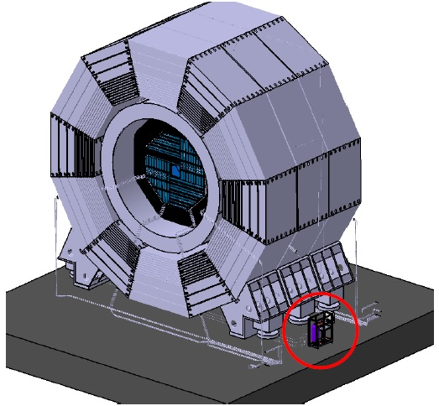
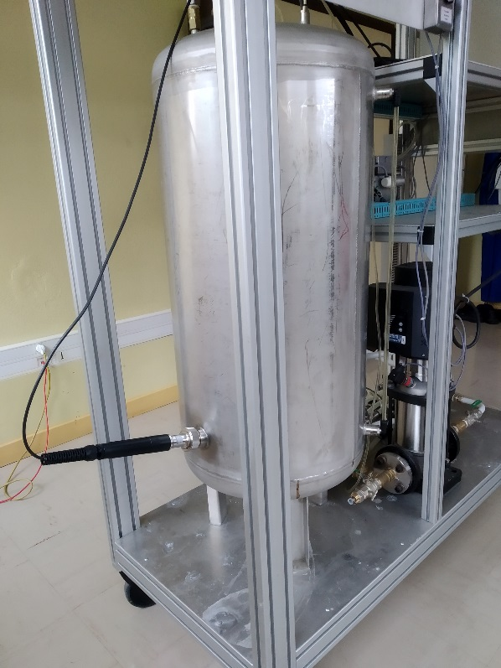
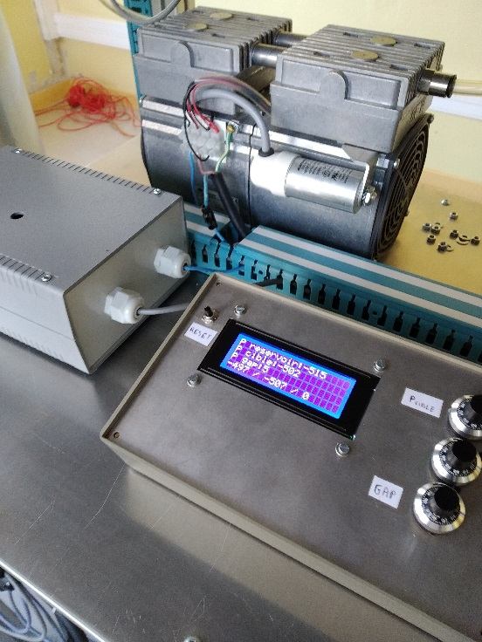
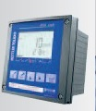
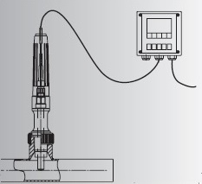
Task 2-1 ECAL: towards ILD - cooling developments in progress (LPSC)
Test of a Polarographic probe (for dissolved oxygen)
  to determine the rapidity of leak detection +
Location of the cooling station
(possibility to install it on the moving platform)
  Demonstration and performance of the full size leak-less cooling loop on 3 levels < summer 2019
Julien Giraud
ILD
New configuration corresponding to cooling station on the ILD platform.
Polarographic probe
Real dimensions detector / zone of tests
Maximum elevation between ground and ECAL top is 14m, (test zone 13 m).
Control Interface: OK
Integration: OK

Slide 4
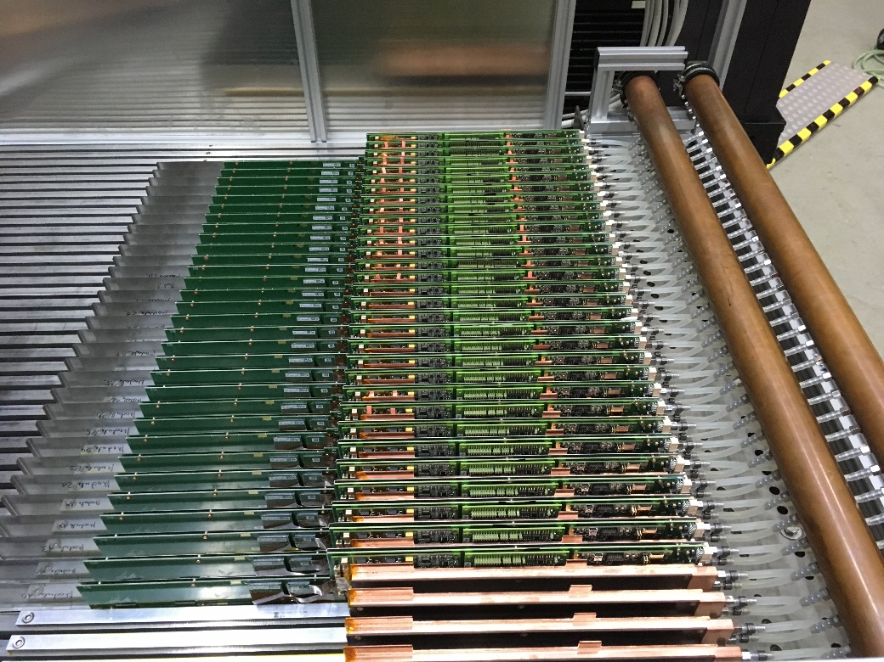

Task 2-2 AHCAL: Cooling system for low power calorimeter readout electronics
AHCAL: (Stainless Steel absorber stack structures +…)
EUDET stack equipped with 38 active layers of 2*2 HBUs
  allows test of system aspects (e.g. distribution of cooling water between layers)
  several testbeams at CERN SPS with prototype in 2018, so reliable cooling essential
    stay with the previous over-pressure system
    system parameters like pipe diameters are already designed for leak-less system, so experience gained with this prototype will be valuable lesson for leak-less system
Reliable operation during all periods with and without power pulsing
  2 weeks + 1 week AHCAL stand-alone + 2 weeks combined with CMS HGCAL prototype
documented in D14.8 report
No power pulsing
PP
PP
No PP
PP
Notes:
there will be a small update on the AHCAL part: we have now first tests of the new interface modules, and we see that the DIF now needs more power (new FPGA) while the power board has a much smaller power dissipation (low voltage reduced from 6 to 4 V).
So we now know where we need to cool, but not yet how much.

Slide 5
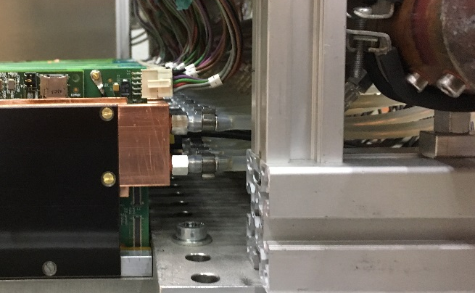
Task 2-2 AHCAL: Status and Plans
Cooling system for 40-layer testbeam prototype
  Successfully operated in several beam tests
  Next steps:
    At the moment cooling plates are thermally decoupled from absorber to understand cooling of interface boards
    Replace by thermally conductive material and understand influence of absorber
Thermal test with full layer
  Horizontal steel structure for 3 full layers exists
  assembled electronics for first large layer (3*6 HBUs)
    Final mechanics (~2 m long casettes) not yet available
Adaptations for leakless system
  Flexible cooling pipes need to be replaced by rigid ones
  Each cooling plate needs a valve to regulate the flow
  Tests with different configurations (horizontal / vertical)
Effort at DESY strongly limited by available engineering personpower

Slide 6

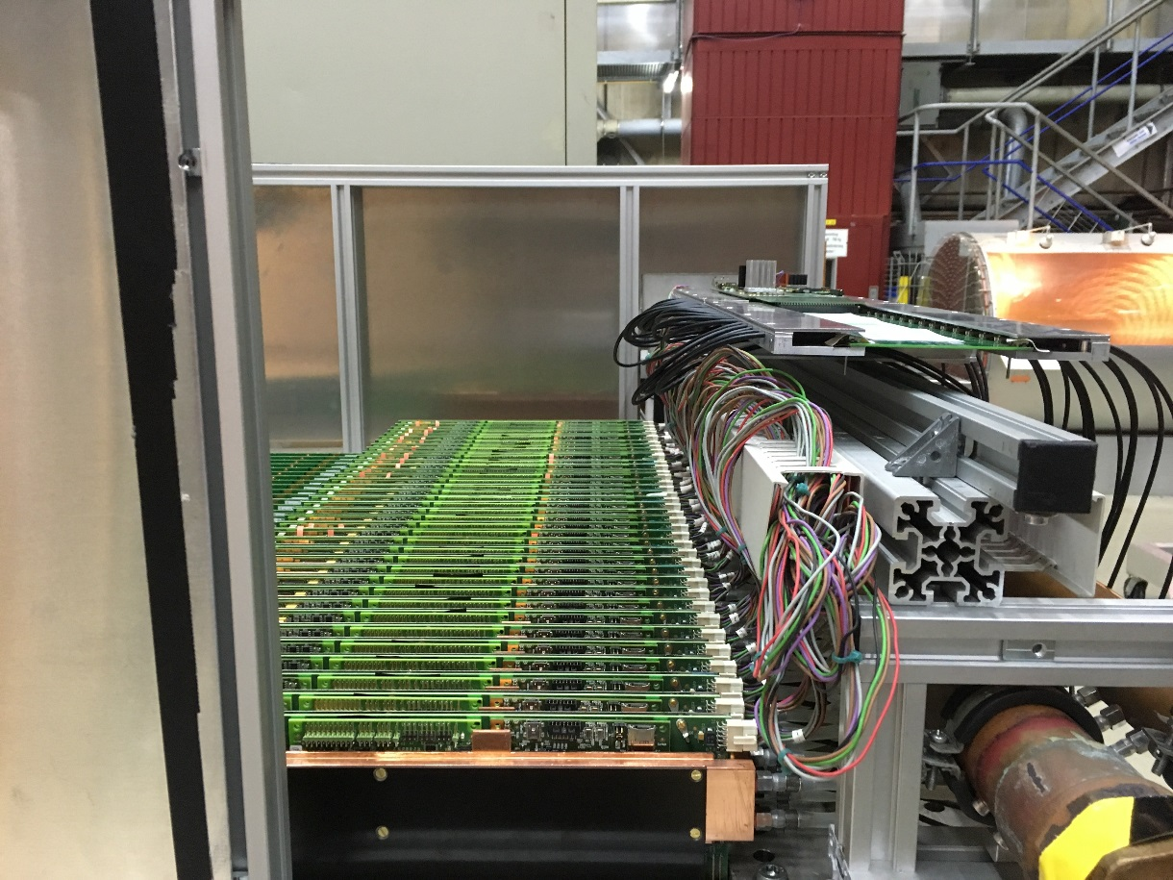
Task 2-2 AHCAL/ECAL services – recent updates
Detailed design of the AHCAL and ECAL services

Slide 7
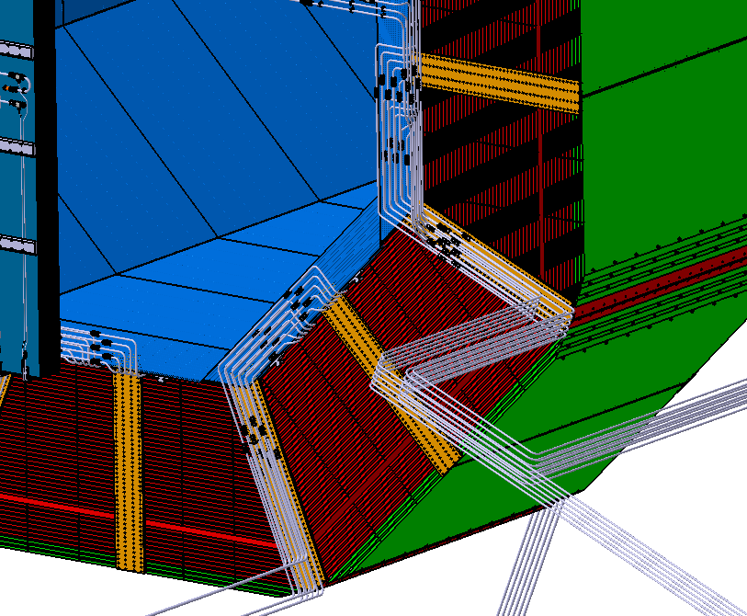
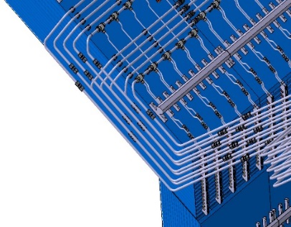
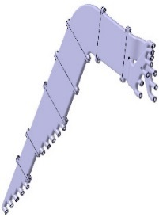
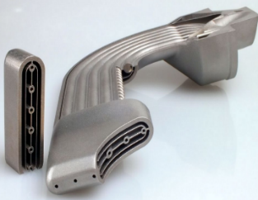
Task 2-2 AHCAL/ECAL services – recent updates
Detailed design of the AHCAL and ECAL services
Integration
ECAL End-Cap
ECAL Barrel
AHCAL Barrel
AHCAL Path
Hydraulic concentrators
ECAL Path
Ex.3D metallic printing hydraulic concentrator
(for the network integration / reduced place)

Slide 8
WP14.5 - Task 2
Compact and highly efficient Cooling Systems
Developments in progress:
  AHCAL
    Cooling system worked well and cooled the detector interfaces reliably
      Further analysis of the data to perform
      hardware is back at DESY, so further tests possible, but very little person power
  ECAL : the work on the cooling station continues in 2019
    Test of a Polarographic probe (for dissolved oxygen)
      To determine the rapidity of leak detection (On-going – results by mid. 2019) +
    Location of the cooling station (possibility to install it on the ILD moving platform)
      New configuration corresponding to cooling station on the ILD platform (ok)
      Demonstration and performance of the full size leak-less cooling loop on 3 levels (<mid. 2019)
    Hydraulic concentrators
      3D metallic printing of hydraulic concentrator (for network integration / reduced place)…(postponed)
    Cooling Test of a real size large End-Cap module (full network on rear side of a module) …(mid.2019)
    Test of the compatibility of the cooling system with the SL-Board developed at LAL (2019)

