Slide 1


WP 11.1 Transnational Access to the GIF++ and IRRAD facilities at CERN
AIDA2020, 4th Annual Meeting, St.Anne college,
Oxford, UK, 2-5 April 2019
Sabrina El Yacoubi, Blerina Gkotse, Martin Jaekel,
Livia Elena Lapadatescu, Isidre Mateu, Michael Moll, Giuseppe Pezzullo, Federico Ravotti, Laetitia Veyrat
CERN, Geneva, Switzerland

Slide 2
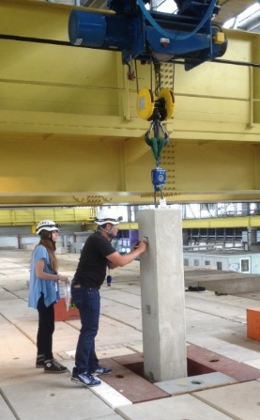

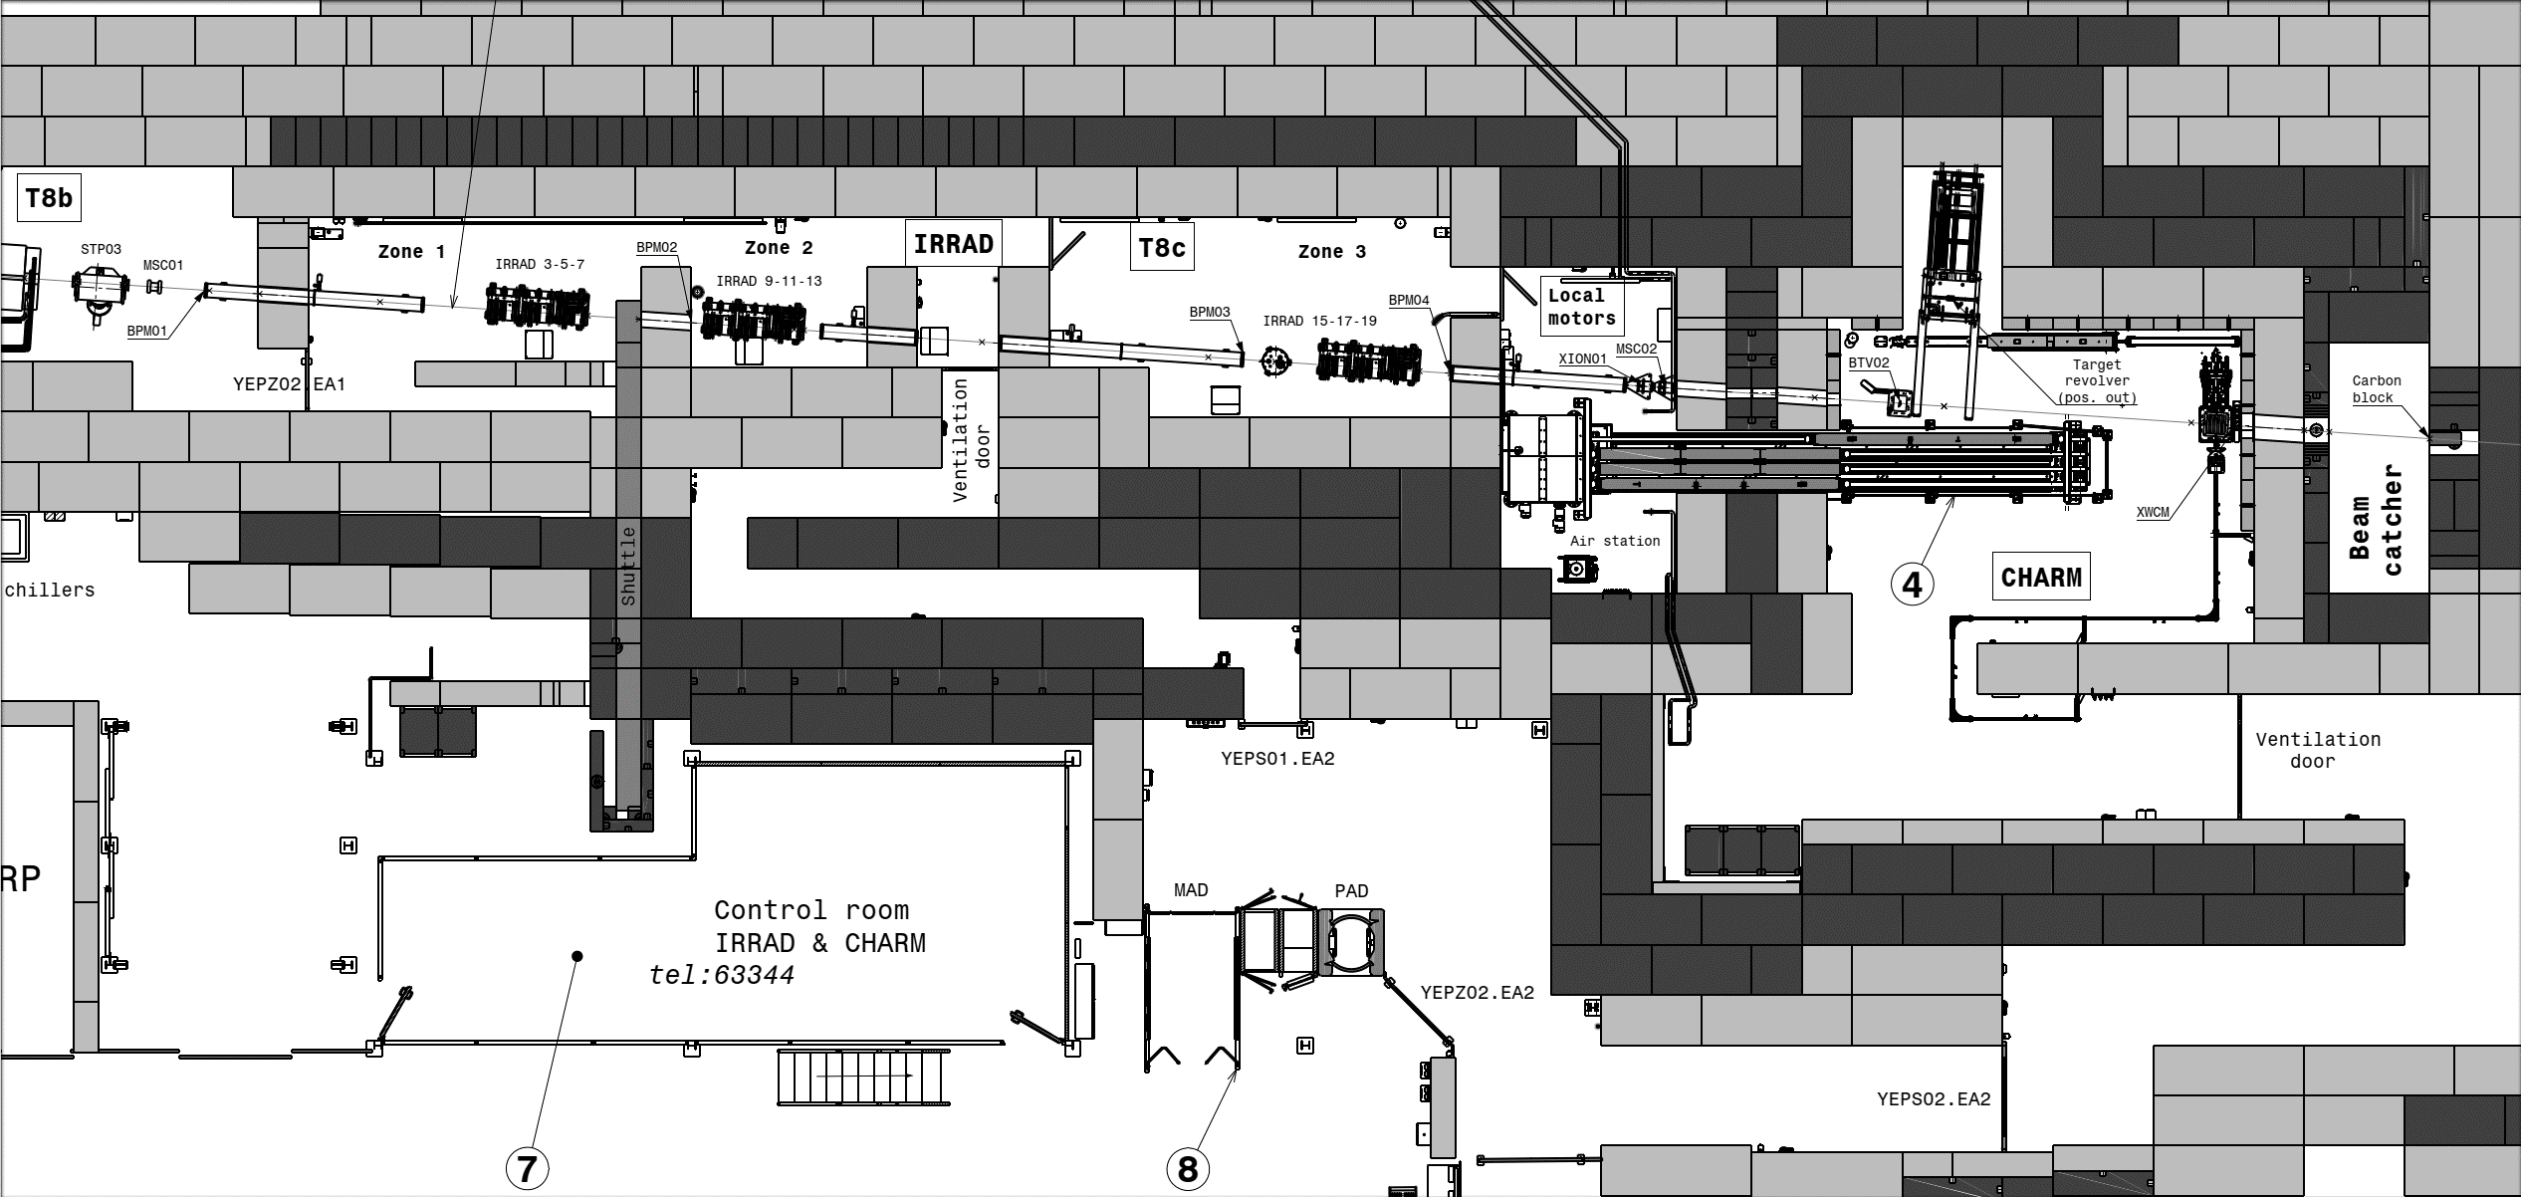

EA-IRRAD Facilities
CSBF
EP dept.
CERN Shielding Benchmark Facility
RP group
24GeV/c
30m
EN dept.
2
2

Slide 3
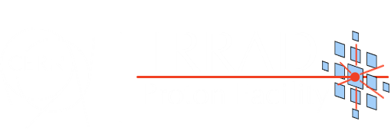
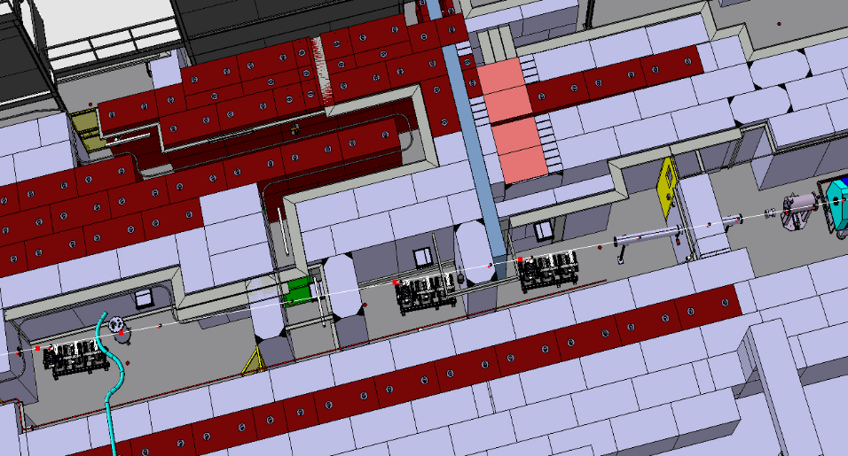
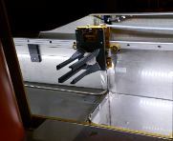
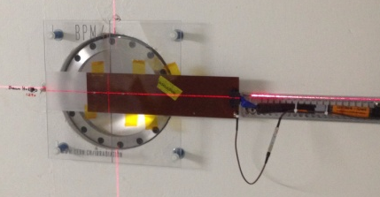
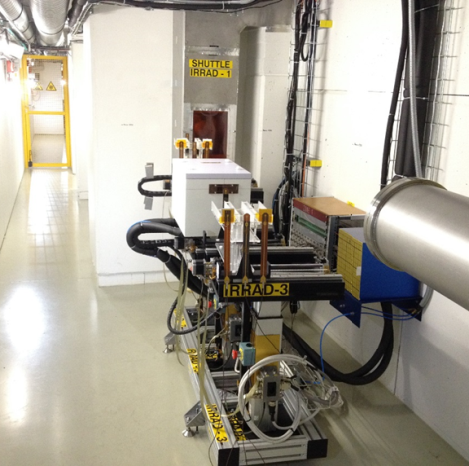
IRRAD Proton Irradiation Facility
Testing components of the HEP experiments
Beam of 24 GeV/c and size of 12×12 mm²
Spills of 400 msec every ~10 sec
Fluence of 1×10¹⁶ p/cm² in 14 days
Scanning also in dimensions of 10×10 cm²
Low temperature irradiation (-25°C)
Cryostat
with LHe 1.9K
Shuttle System
Fixed-BPM
BEAM
IRRAD Tables
Detectors
Electonics
30m
Calorimetry samples
3
3

Slide 4
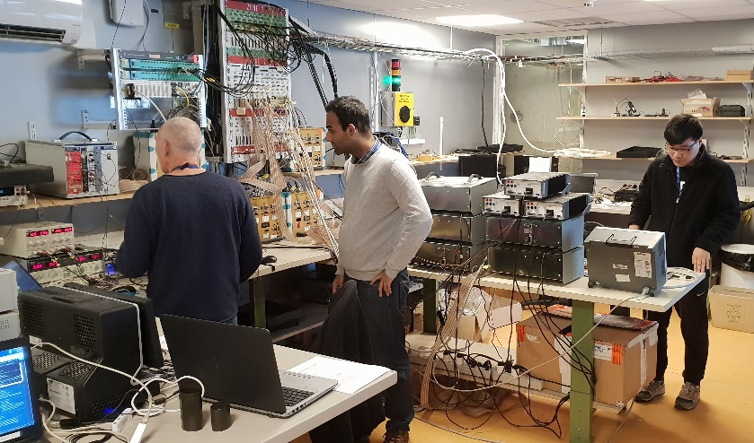
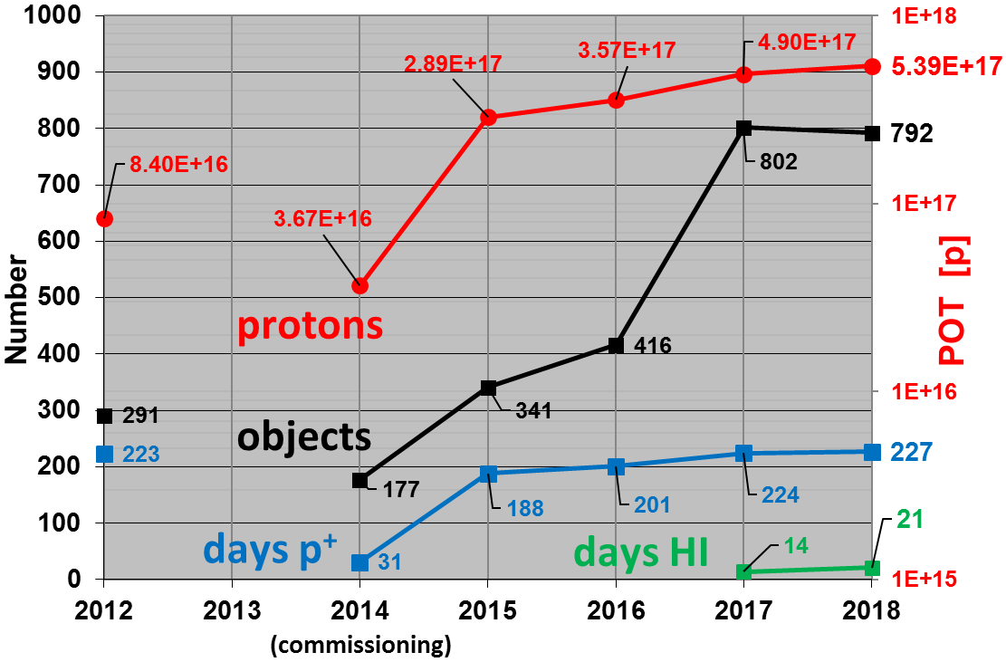
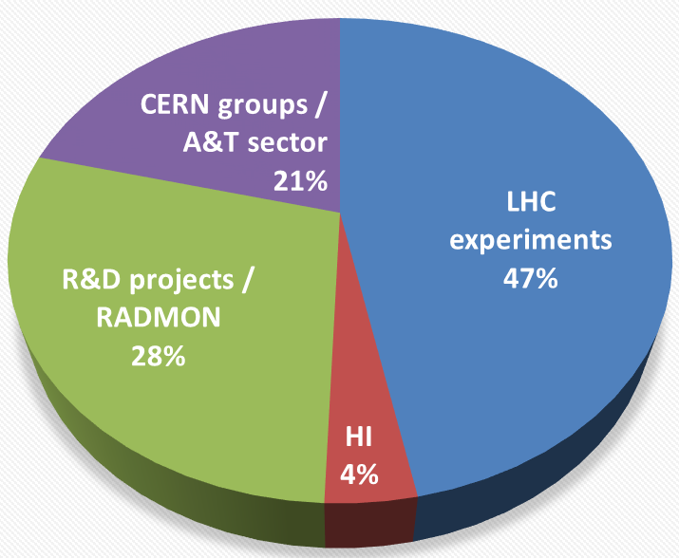
IRRAD: Summary Run 2018
    81 experiments completed in 2018:
      92 users registered in the IRRAD Expt. Data Manager (www.cern.ch/irrad-data-manager)
      999 objects declared by the users
      792 objects irradiated
    Experiments distribution

Slide 5
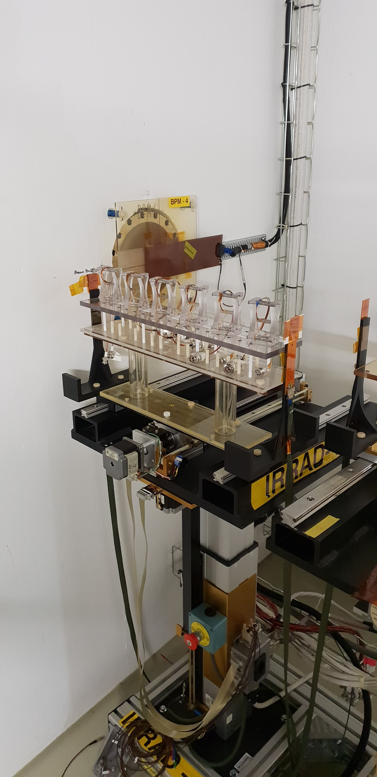
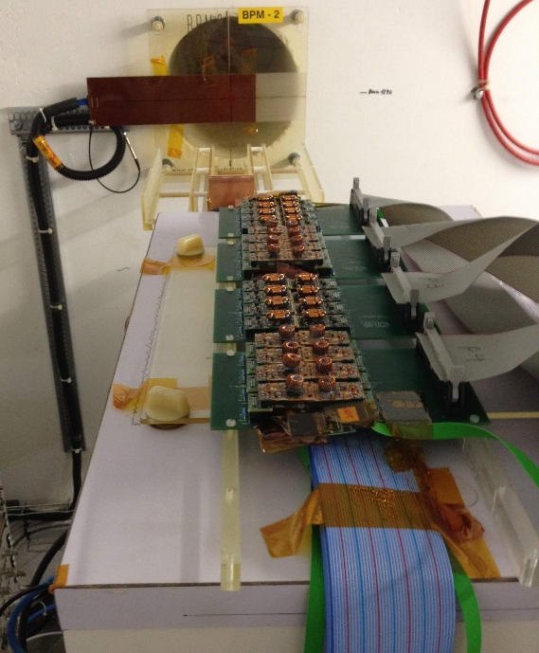
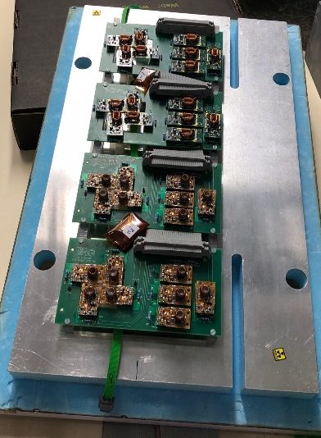
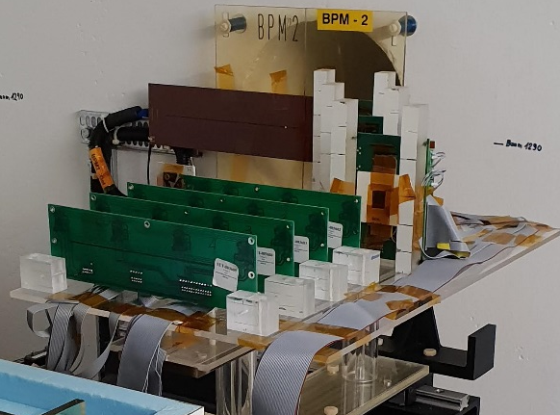
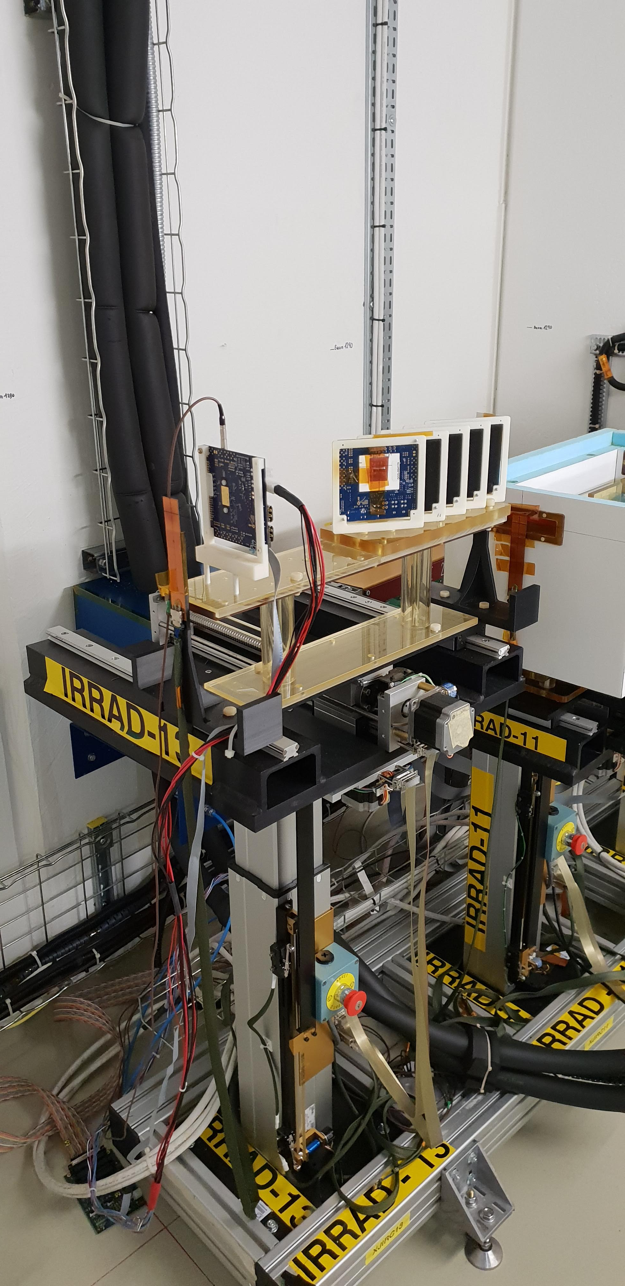
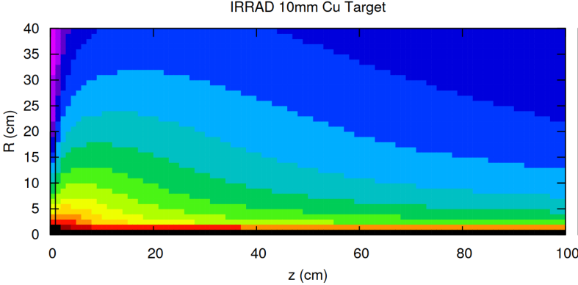
IRRAD: Experiments Run 2018
      2x FEAST2 DC/DC converters test in cold-box & RT with “thin” 10mm Cu target (EP-ESE)
Piezo actuators for Crystal Collimation, Vacuum, Cryogenics, etc. (EN,TE)
RT setup
RD53A modules for ATLAS ITk
CLARO ASIC for the LHCb RICH Upgrade
cold-box setup
Φ_{1MeVeq} simulations with Cu target
    © R. Froeschl (HSE-RP)
FEAST2
(http://project-dcdc.web.cern.ch/project-DCDC/public/Reports.html)

Slide 6
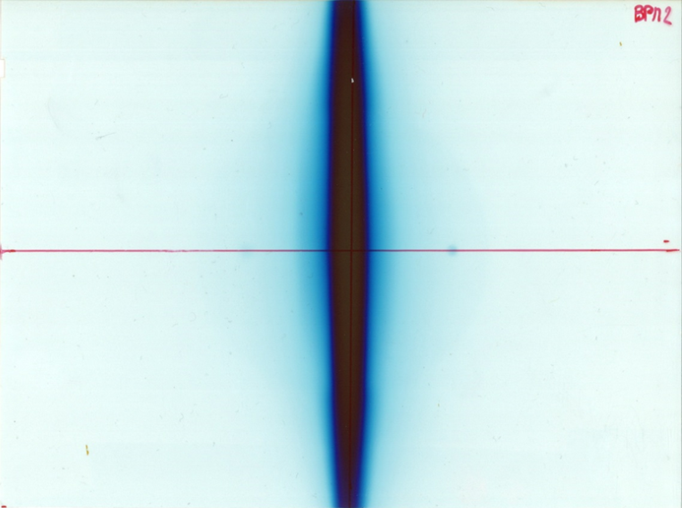
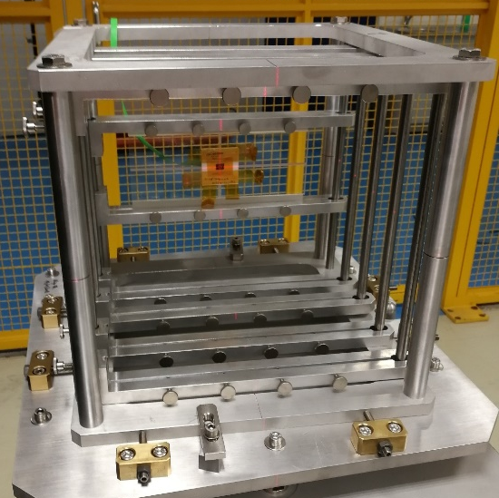
Heavy Ions in IRRAD
      2 weeks with ⁵⁴Xe in 2017, 3 weeks with ⁸²Pb in 2018.
        Energy per nucleon: ~ 6 GeV/n.
        Ion flux: ~ 10⁸ to 10⁹ ions/spill.
      Radiation Hardness tests of Space Electronics in CHARM ( downstream of IRRAD)
        Highly penetrating (SEE testing).
        Representative of Galactic Cosmic Ray spectrum.
      In IRRAD: attempts to experimentally determine the hardness factor of HI in silicon
        Irradiation of several batches of pin diodes at different fluences.
        Measurement of the increase of leakage current vs. fluence after controlled annealing step.
GafChromic film installed on the IRRAD BPM-2 (run 2017)
Samples on the CHARM conveyor (run 2018)

Slide 7
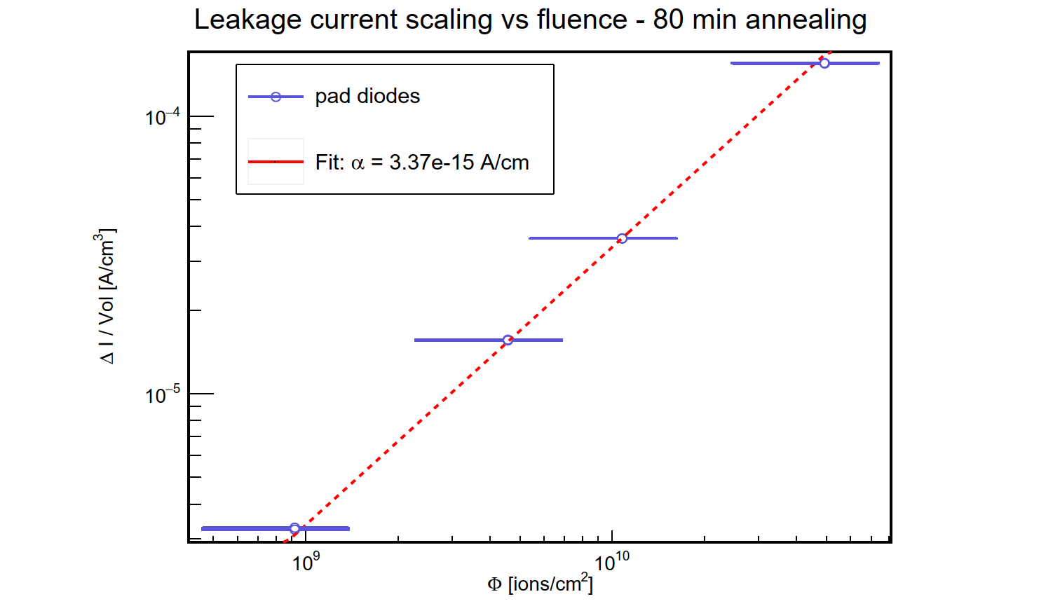
Heavy Ions in IRRAD
      Measured hardness factors diverge from the ones predicted by FLUKA
        ⁵⁴Xe: 115 measured vs 207 simulated.
        ⁸²Pb: 84 measured vs 400 simulated.
      Dosimetry is the main challenge
        For protons, determined from the production of ²²Na and ²⁴Na on aluminium foils irradiated together with the object to irradiate.
        Very little radioactivity measured on the foils irradiated with ions.
        For the hardness factors the fluence was estimated from the beam profile measured by the beam instrumentation.
        Beam instrumentation available in IRRAD is not calibrated for ions.
Increase of leakage current vs fluence
(⁸²Pb run 2018)
(http://project-dcdc.web.cern.ch/project-DCDC/public/Reports.html)

Slide 8
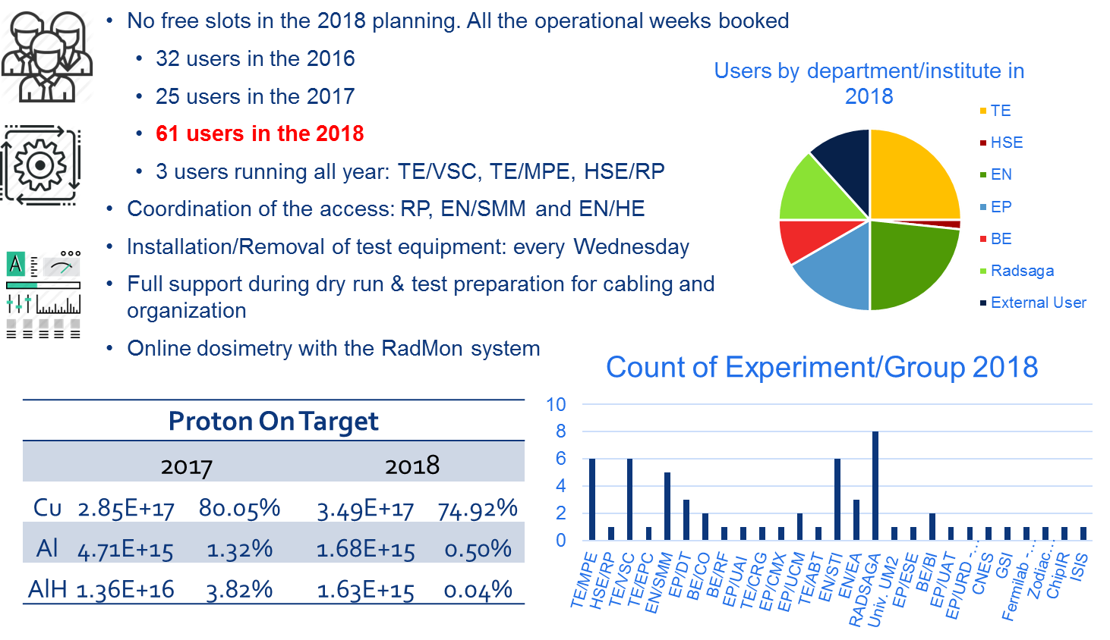
CHARM: Proton Run 2018
    © S. Danzeca (EN-SMM)

Slide 9
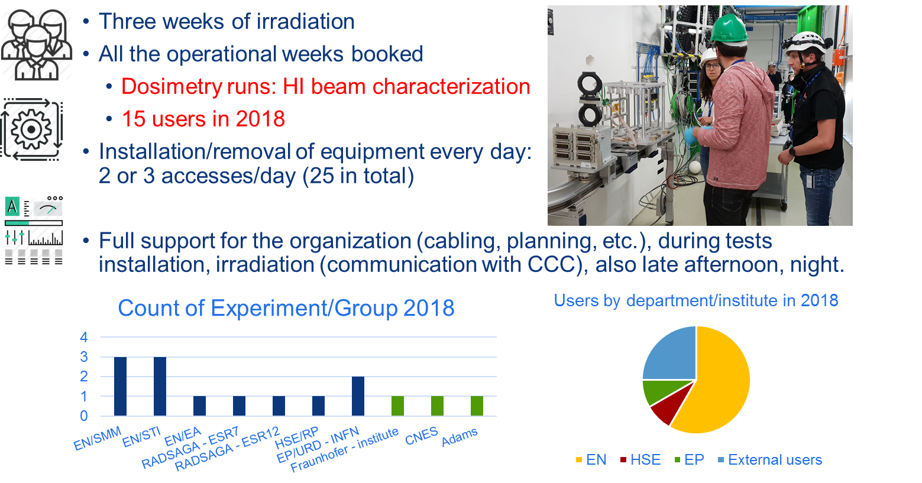
CHARM: Heavy Ion Run 2018
    © S. Danzeca (EN-SMM)

Slide 10
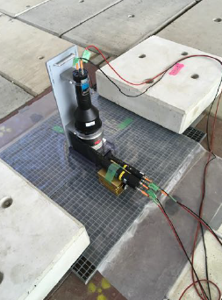
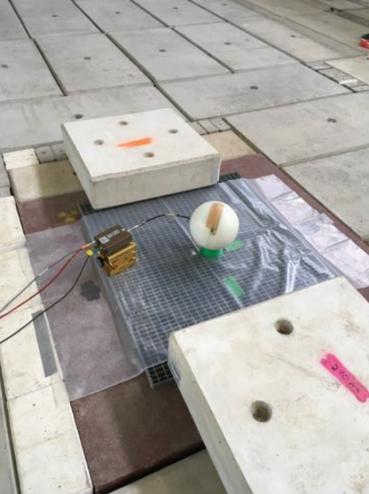
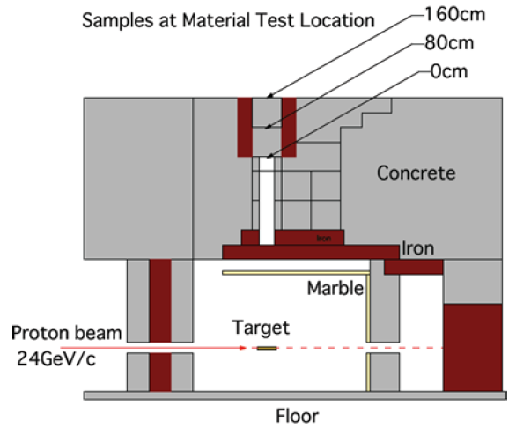
CSBF: “RP week” 2018
  22-29 August 2018
  Neutron spectrum measurement on the roof (NE213 and Bonner Spheres)
  Various shielding configuration
  Foil activation at the material test location
  Measured of induced radioactivity in air

Slide 11
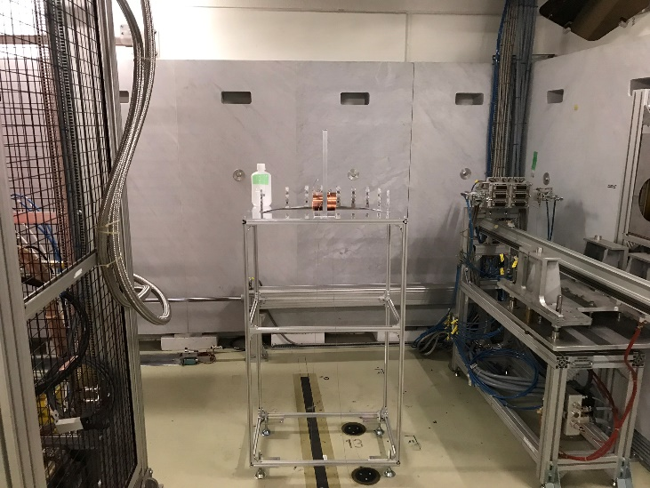
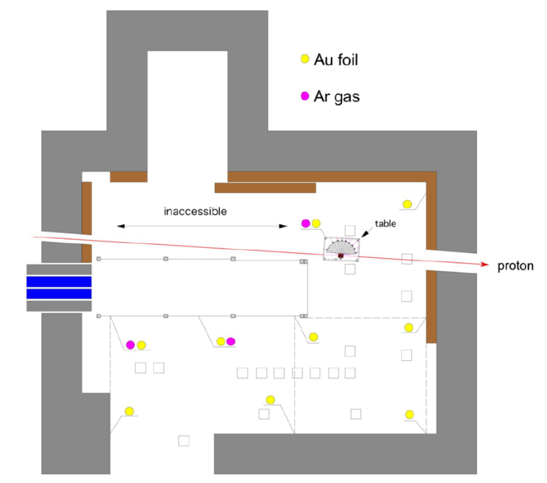
CSBF: “RP week” 2018
  Inside CHARM
  Installation of a Cu target with ∅=8cm and 10cm thickness in beam direction:
    measurement of angular distribution of neutron yield from target
    activation-foils in the target room
    neutron spectrum measurements in the access maze (NE213 and Bonner Spheres)
    activation-foils in the access maze
Cu Target
  EA-IRRAD teams would like to thank BE-OP, EN-EA -HE, HSE-RP and all other groups involved for their excellent support during our 1st run !
    © E. Iliopoulou (HSE-RP)

Slide 12
IRRAD/GIF++ AU counting
Counting of Access Units (AU) at CERN IRRAD and GIF++ :
  1 day of beam time corresponding to 10 AU
  (note that beam is supplied 24h/day)
  In experiments where users come to CERN and perform irradiations we count 10 AU per paid day of subsistence [GIF++ and IRRAD]
  In experiments where the irradiation is performed by the facilities staff and no subsistence is paid to the users, we count 10 AU per day of irradiation [IRRAD]

Slide 13
Status:
IRRAD Projects
Status of AIDA-2020 projects in IRRAD:
  18 projects (5 projects in P1; 9 projects in P2; 4 projects in P3)
  76 users (18 users in P1; 39 users in P2; 19 users in P3)
  4550 units (1370 units in P1; 2170 units in P2; 1010 units in P3)
P1 = M01-M18
P2 = M19-M36
P3 = M37-M60
P1
P2
P3

Slide 14
Status: IRRAD
CERN accelerators are in shutdown (LS2)
No more proton irradiations in the IRRAD facility.
TA for IRRAD facility is closed
Final status of AIDA-2020 TA projects in IRRAD:
  18 projects (60% of anticipated 30 projects)
  76 users (127% of anticipated 60 users)
  4550 units (113% of aim: 4032 units)
Conclusion:
  Number of delivered units in line with proposal value
  Number of users higher than anticipated
  Number of projects is less than anticipated
  Note: 18 AIDA-2020 projects for the IRRAD facility, which is small compared to the overall irradiations performed in this facility (only faction of projects filled irradiation request)

Slide 15

GIF++ Aerial View

Slide 16


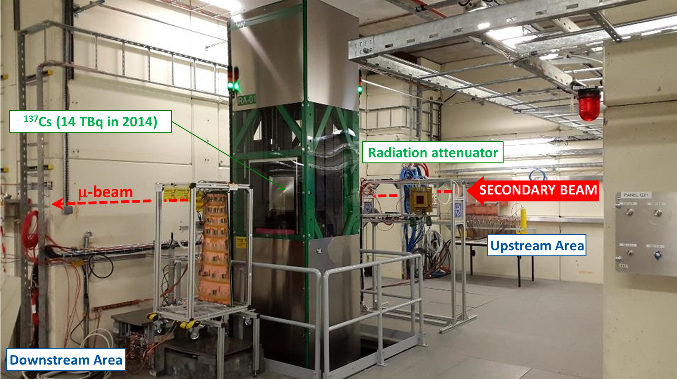
GIF++ Facility
    Typically for muon systems of HEP experiments
    E_{g} = 0.66 MeV; max. dose-rate ~0.5 Gy/h @ 1m from source (±37º angle) and 2.5 Gy/h @ glass contact
    Several attenuation factors available (up to ~50’000)
    μ-beam from T2 on H4 beam-line (100 GeV; ~10⁴ /spill)

Slide 17
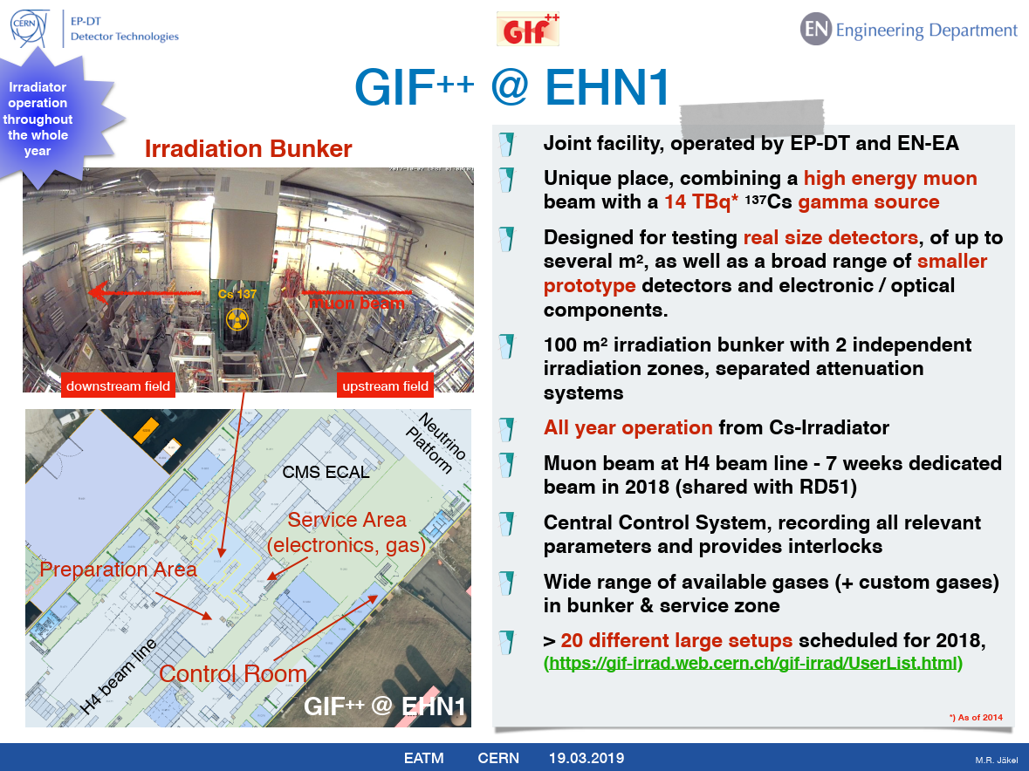

Slide 18
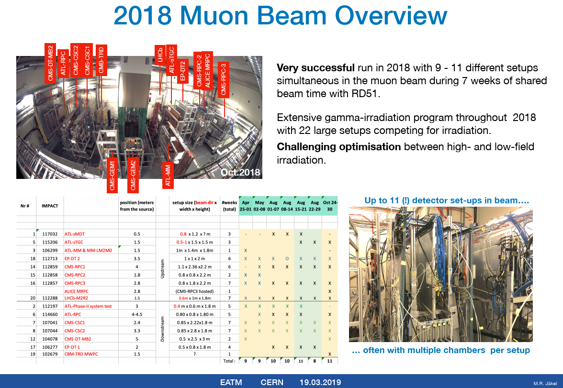

Slide 19
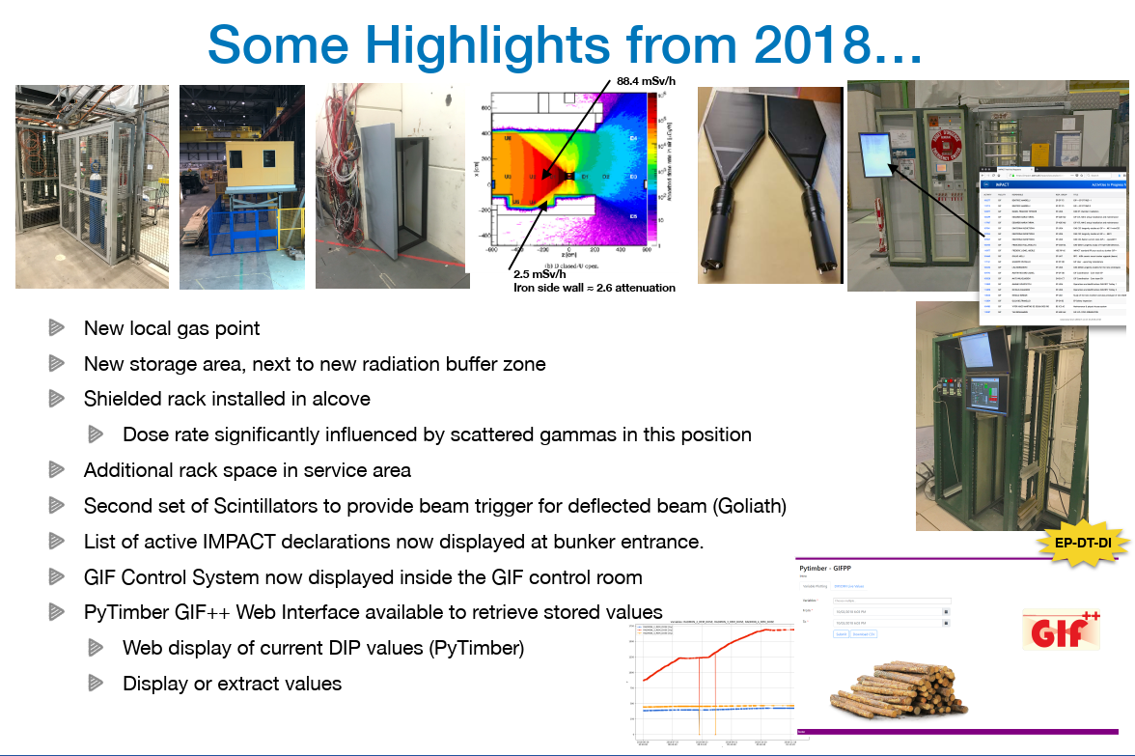
Some Highlights from 2018

Slide 20
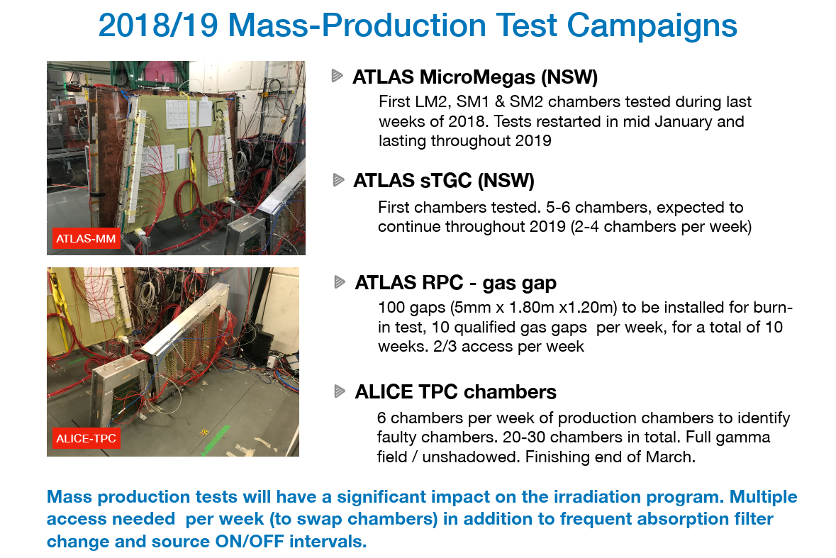
2018/19 Mass-Production Test Campaigns

Slide 21
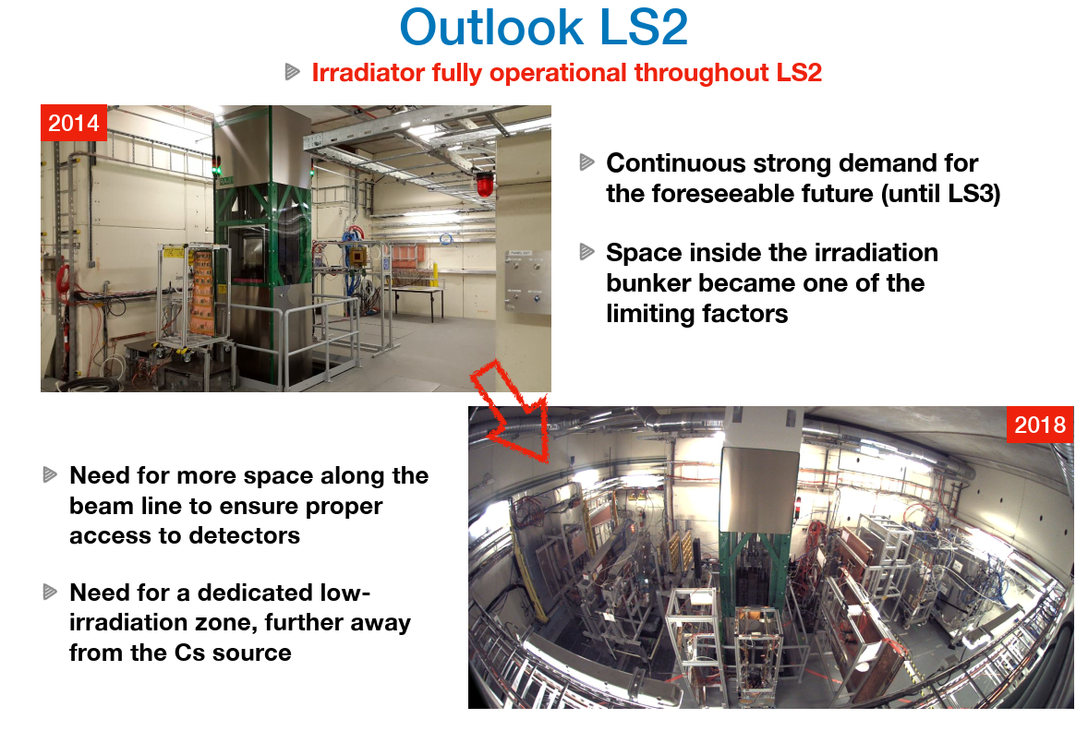
LS2 – Source in operation!

Slide 22
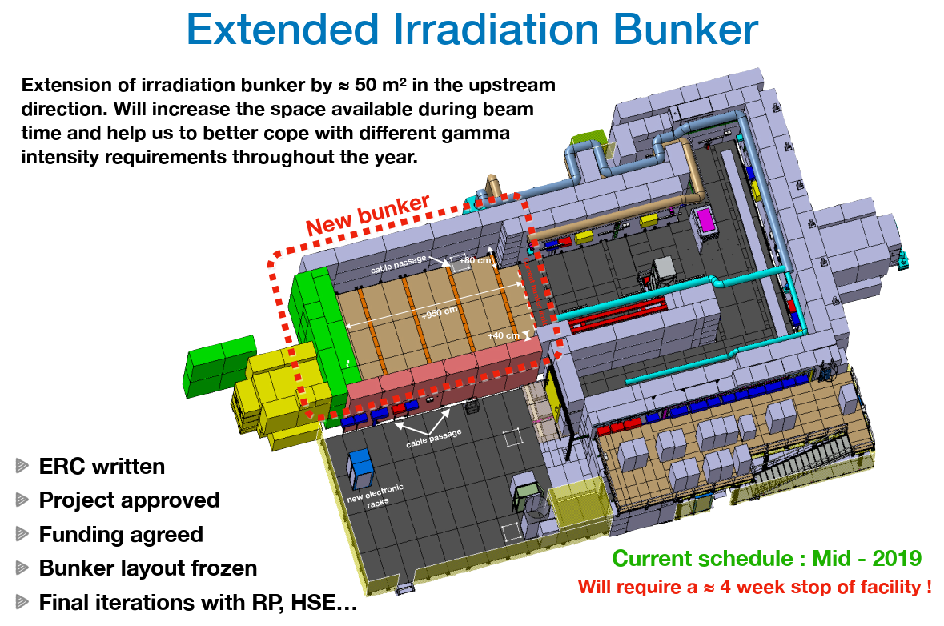
Extension of Bunker

Slide 23
Status: GIF++
Status of AIDA-2020 projects in GIF++:
  15 projects (anticipated: 20 projects)
  105 users (anticipated: 50 users)
  4210 units (aim: 4032 units)

Slide 24
Status: GIF++
Status of AIDA-2020 projects in GIF++ :
  15 projects (75% of anticipated 20 projects)
  105 users (210% of anticipated 50 users)
  4210 units (104% of aim: 4032 units)
  Irradiations at the GIF++ gamma source (without beam) are ongoing.
Conclusion:
  Number of delivered units already passed proposal value (deliverable)
  Number of users higher than anticipated
  Number of projects is less than anticipated
  Some funds are still available for irradiations at the GIF++ gamma source
  (without particle beam)

Slide 25
User distribution
Users split per country of home institution:
GIF++ IRRAD

Slide 26
Gender distribution
Users split per gender:
GIF++ IRRAD

Slide 27
Conclusions on TA to IRRAD and GIF++
AIDA-2020 TA resources were used to cover:
  subsistence of users coming to perform irradiations
  partial funding of facility personnel (Fellow/Student) to perform irradiations for users not coming to CERN
Long Shutdown 2 at CERN: No more particle beams
  IRRAD facility in shutdown (no more AIDA2020 TA irradiations)
  GIF++ facility TA continuing with gamma irradiations (without particle beam)
    Further resources available for users to perform these irradiations (about 50 per diem)
Number of delivered units has passed deliverable given in proposal
  GIF++: 4210 units delivered (104% of aim: 4032 units)
  IRRAD: 4550 units delivered (113% of aim: 4032 units)
Publications: Still waiting for further to come in, so far only 13 for IRRAD, 2 for GIF++
IRRAD and GIF++ TA via AIDA-2020 is a success

