Slide 1
Embedding microfluidics into microelectronics
WP9: New support structures and micro-channel cooling
Riccardo Callegari, Roberto Cardella
02/04/2019

Slide 2
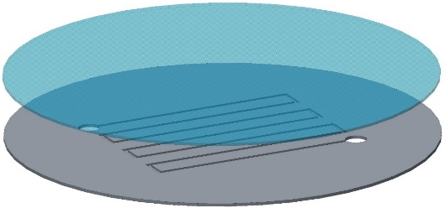
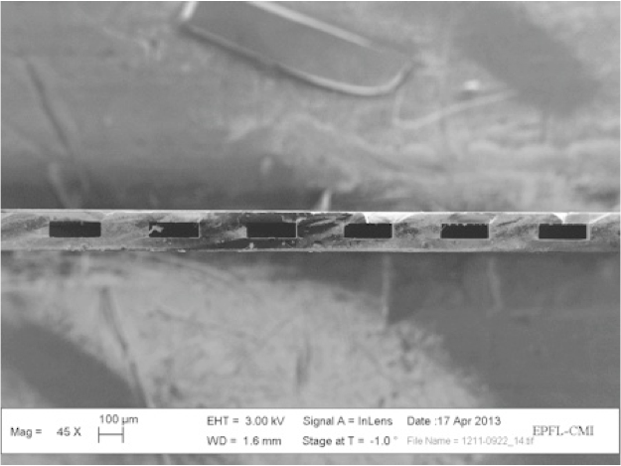
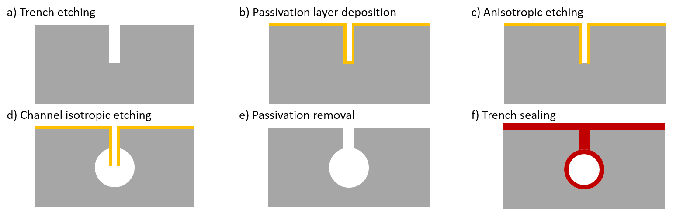
Last year
https://indico.cern.ch/event/677272/contributions/2976451/attachments/1638712/2615630/AIDA2020_status_update.pdf
Microchannels etched on a 4” silicon wafer and sealed with a glass wafer through anodic bonding process (350 °C) (close collaboration with Center of Micronanotechnology at EPFL)
Microchannels etched on a 8” silicon wafer and sealed with another silicon wafer through direct bonding process (1050 °C) (external partners)
150 µm
Silicon wafer
DRIE
Silicon-to-silicon direct bonding
Thinning
200 x 70 µm
Microchannels without bonding process: buried channels (300 °C) (just mentioned last year)
M. Boscardin et al., Silicon buried channels for pixel detector cooling, Nuclear Instruments and Methods in Physics Research, Section A, 2013
C. Lipp, Approaches for the fabrication of silicon buried channels for the thermal management of monolithic pixel detectors, MSc Thesis, EPFL, 2017

Slide 3
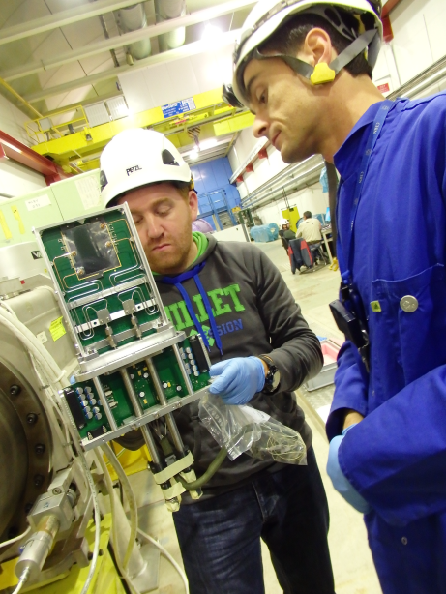

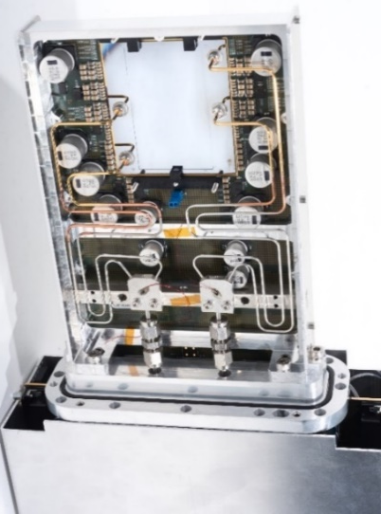



Microfluidic cooling plates for NA62 and LHCb (on hybrids)
Pixel detector
Bump bonds
Read-out chips
Thermal interface
Microfluidic cooling plate
Metallic layer
Soldered connector
2010: start of the R&D campaign
2014: first detector with cooling plates (NA62)
2021: integration of cooling plates in LHCb
On going research at CERN (on monolithics)
Low temperature wafer bonding
Microchannels embedded in CMOS device
Monolithic pixel detector to seal microchannels
Adhesive
3D printed connector
J. Bronuzzi, Transient Current Technique characterisation of bonded interfaces for monolithic silicon detectors, PhD Thesis, EPFL, 2018
R. Callegari, Integration of a microfluidic circuitry in a CMOS device operating in HEP experiments, MSc Thesis, Università di Genova, 2018

Slide 4
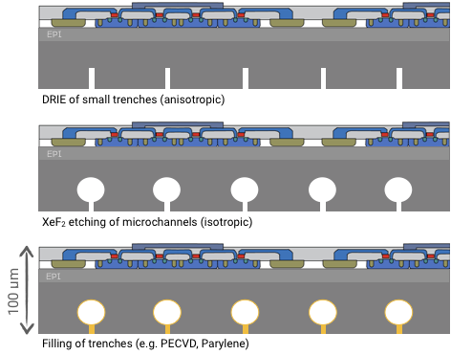
Microchannels etched directly on the backside of a monolithic pixel detector (MALTA: Monolithic from ALice To Atlas)
A pattern of small trenches (3 x 10 µm) is etched on the backside of the pixel detector to a depth of 30 µm
Microchannels are etched isotropically with XeF2 from the bottom of the trenches.
Diameter of the microchannels = 40 µm
Overall depth of the microfluidic circuitry = 50 µm
A thin film of parylene (5 µm) seals the microchannels. It is finally cured by a thermal cycle.
I. Berdalovic et al., Monolithic pixel development in TowerJazz 180 nm CMOS for the outer pixel layers in the ATLAS experiment, JINST 13 C01023, 2018

Slide 5
Microfluidic connection
https://indico.cern.ch/event/677272/contributions/2976453/attachments/1638722/2615654/AIDA2020_connectors.pdf
3D printed with Formlabs SLA:
Cheap
Fast
Easy
Shapes difficult to achieve with conventional machining
But…
Lack of dimensional repeatability
9
6
9
IFIC, Valencia
3
4.5
1

Slide 6
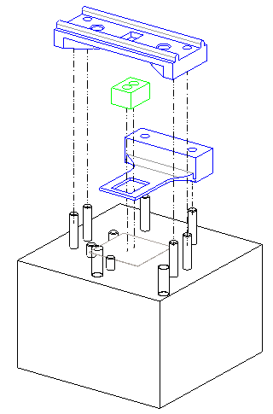
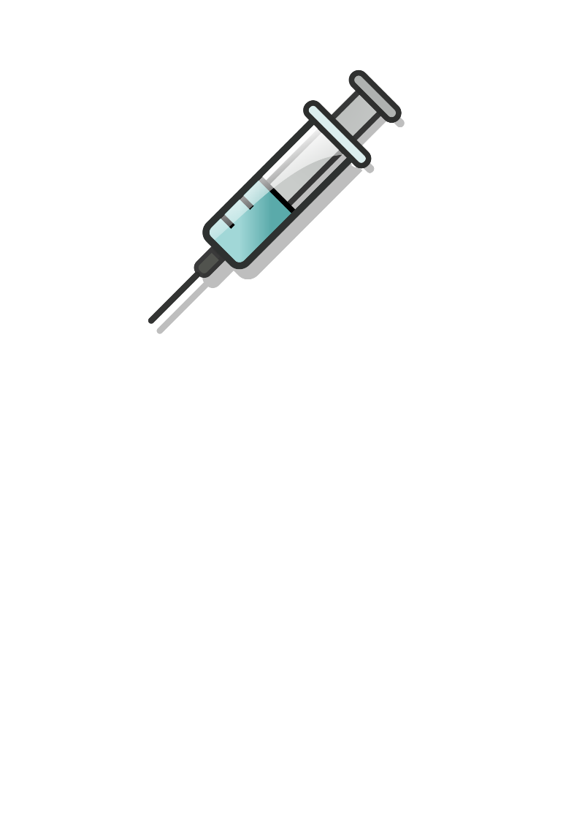
Assembly procedure
The plastic capillaries are glued to the connector
The connector is glued to the silicon chip
Bottom o-rings prevent liquid leakages
Top o-rings prevent glue infiltration
Araldite 2020
Blue parts: 3D printed
Black parts: machined
Green part: connector (3D printed)
Araldite 2011

Slide 7
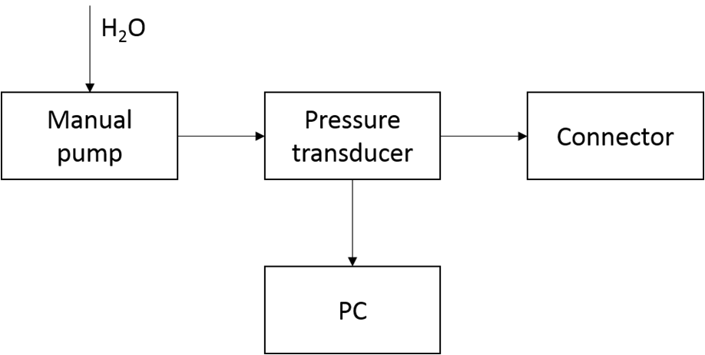
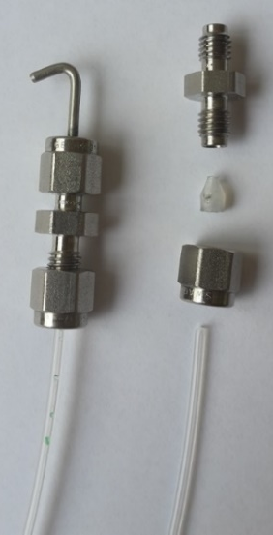
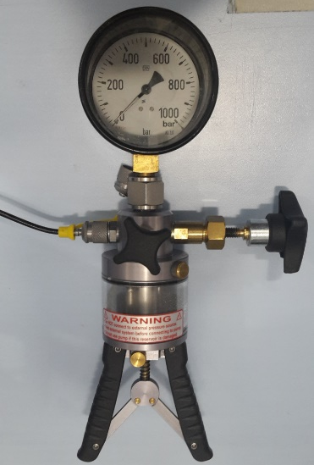
Connector characterization
Connector glued on a blank piece of silicon:
Helium leak rate: L_{He}≈10⁻⁸ mbar ∙ l / s
Failure pressure: p_{max}= 110 bar

Slide 8
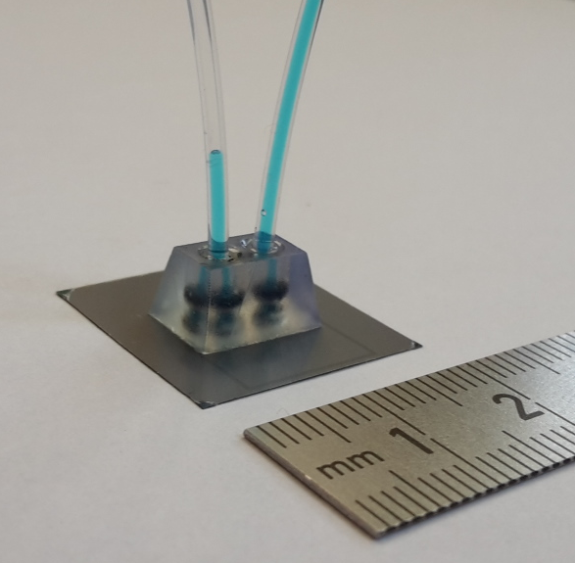
Circulation demonstrated
Microchannels and connector integrated into a 100 µm thick CMOS device
A fully CMOS-compatible microfabrication process to embed microchannels has been validated
As a post-process
At a die level
In an extremely thin substrate
In an operating device

Slide 9
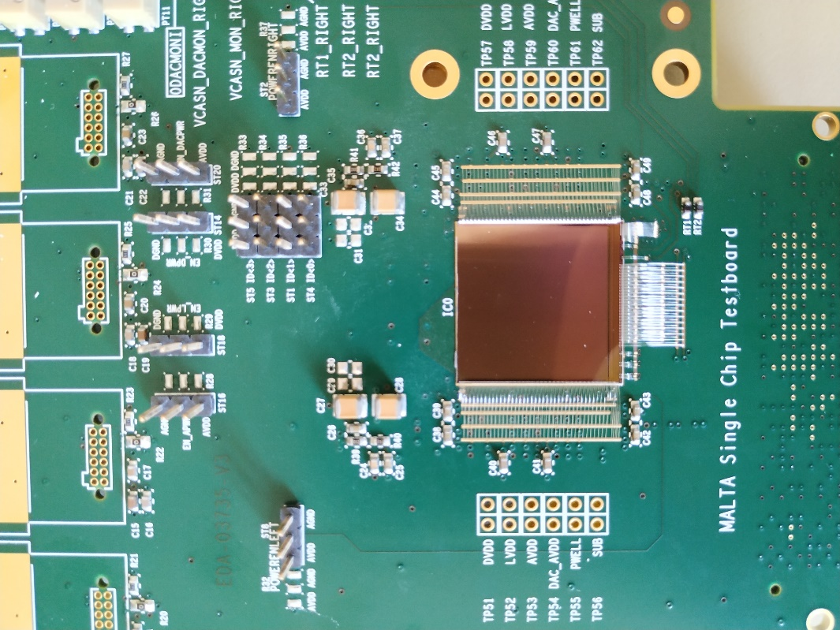
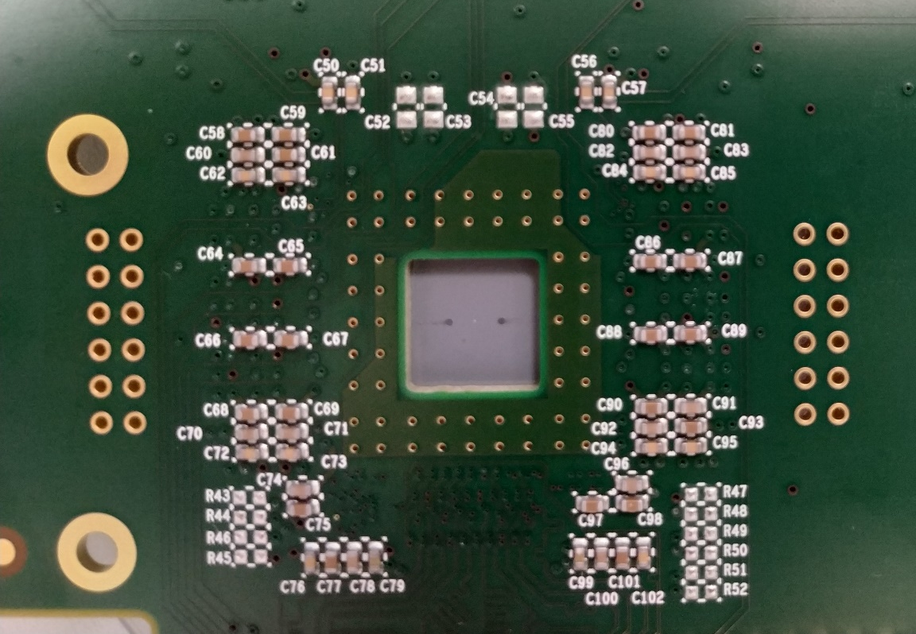
Integration with the PCB (ongoing)
First line of investigation:
Characterisation of a fully functional MALTA pixel chip with embedded micro channels to study possible effects of the post-processing
The first MALTA chip with embedded micro channels (without connectors) has been mounted on a PCB and wire bonded

Slide 10
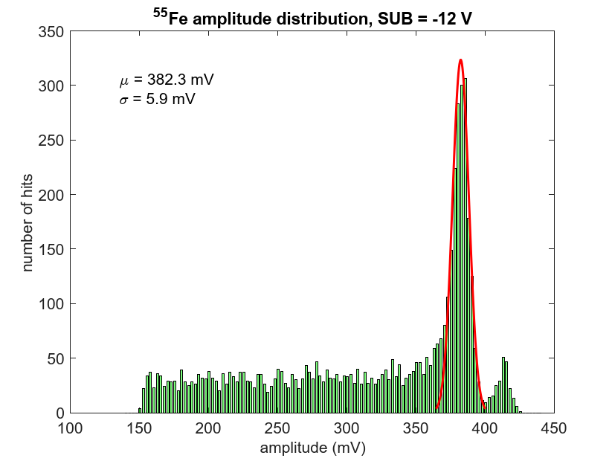
Iron source scan (preliminary)
Preliminary electrical tests and source scans using a 55Fe source show a similar behaviour as in standard MALTA chips. Further tests are planned in the near future including measurements in a testbeam

Slide 11
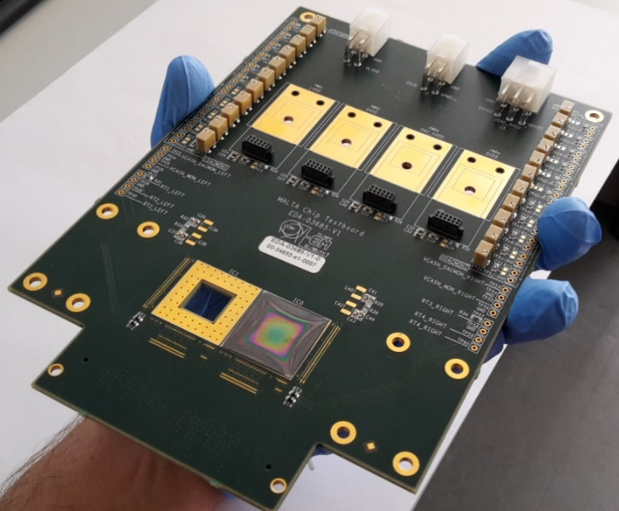
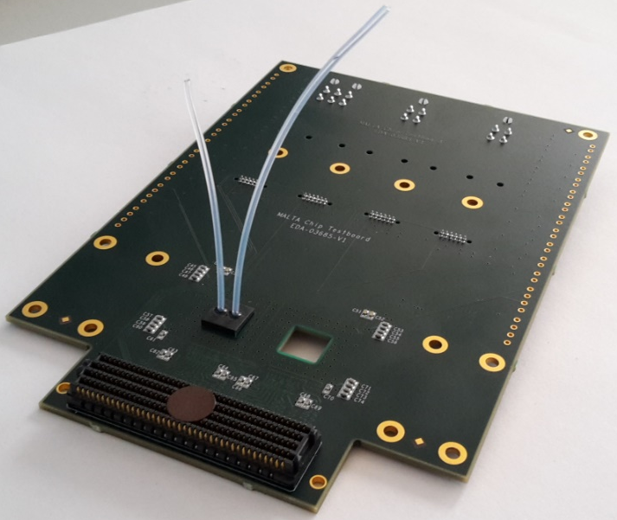
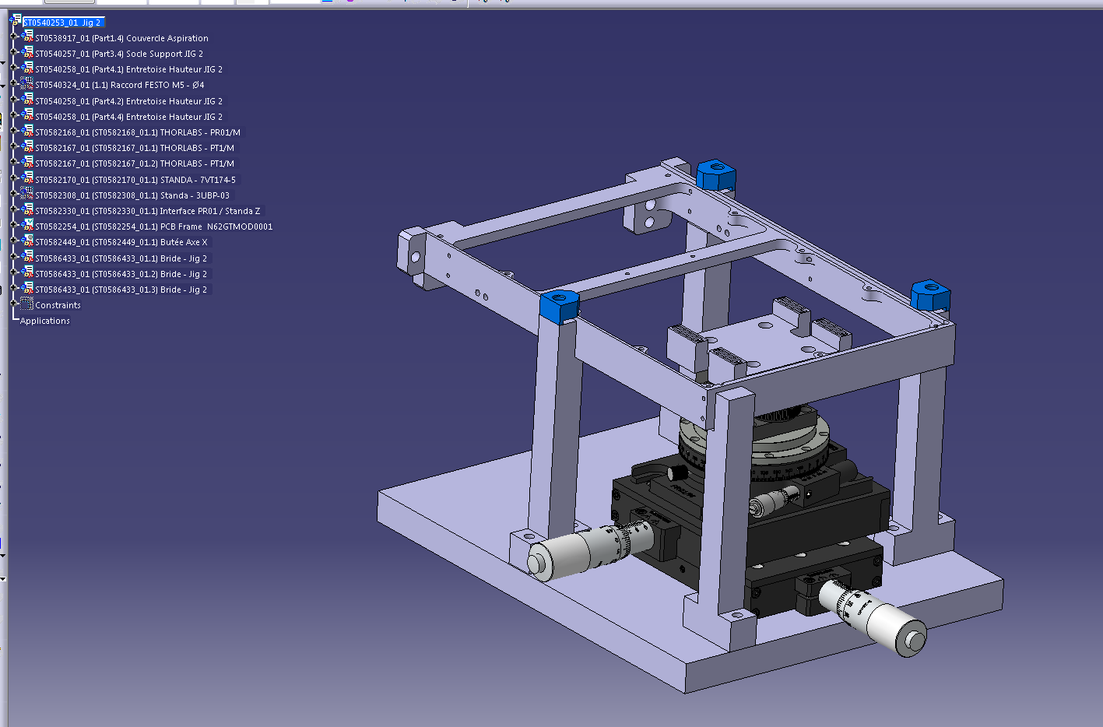
Integration with the PCB (ongoing)
Next step:
Thermo-fluidic measurements for on-detector cooling
Helium leak rate: L_{He}≈10⁻⁷ mbar ∙ l / s
To be able to perform the wire bonding over an assembled chip a jig is required (under development).
Three axis translation stages + rotation
A tailor-made clamp for the connector has to be designed
Alignment jig of the GTK for NA62

Slide 12
Conclusions
A CMOS-compatible microfabrication process to embed microchannels into microelectronics has been developed. It allows to minimize more and more the overall thickness, getting rid of any thermal interface between the electronics and the cooling system.
A 3D printed microconnector, with the purpose of a test vehicle, has been validated. Optimization is required to reduce the amount of material.
Electrical, thermal and fluidic characterizations are ongoing.

