Slide 1
ALICE LS2 Safety
K. BARTH, LEXGLIMOS ALICE

Slide 2
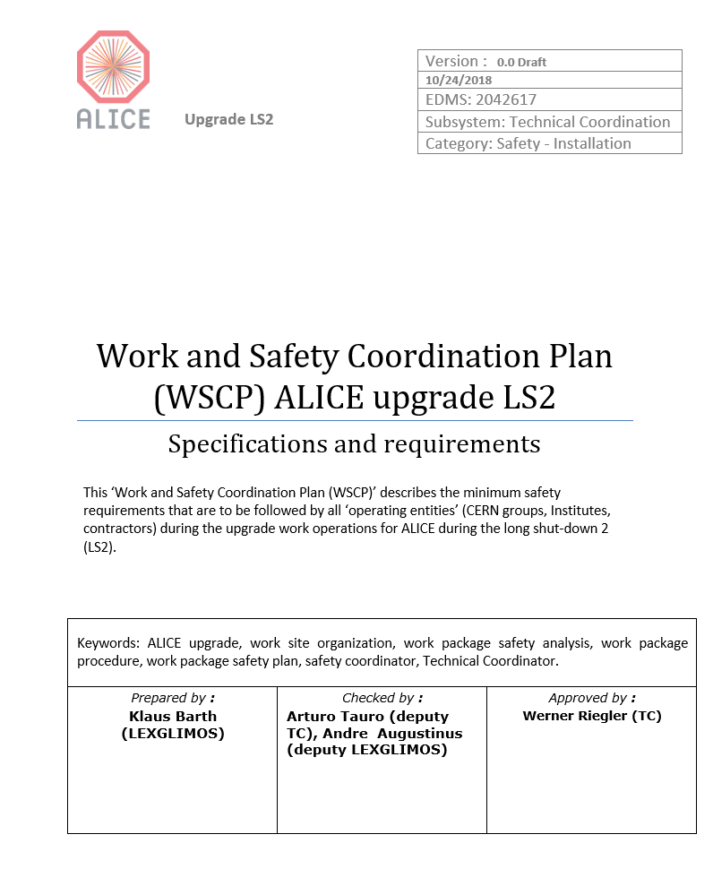
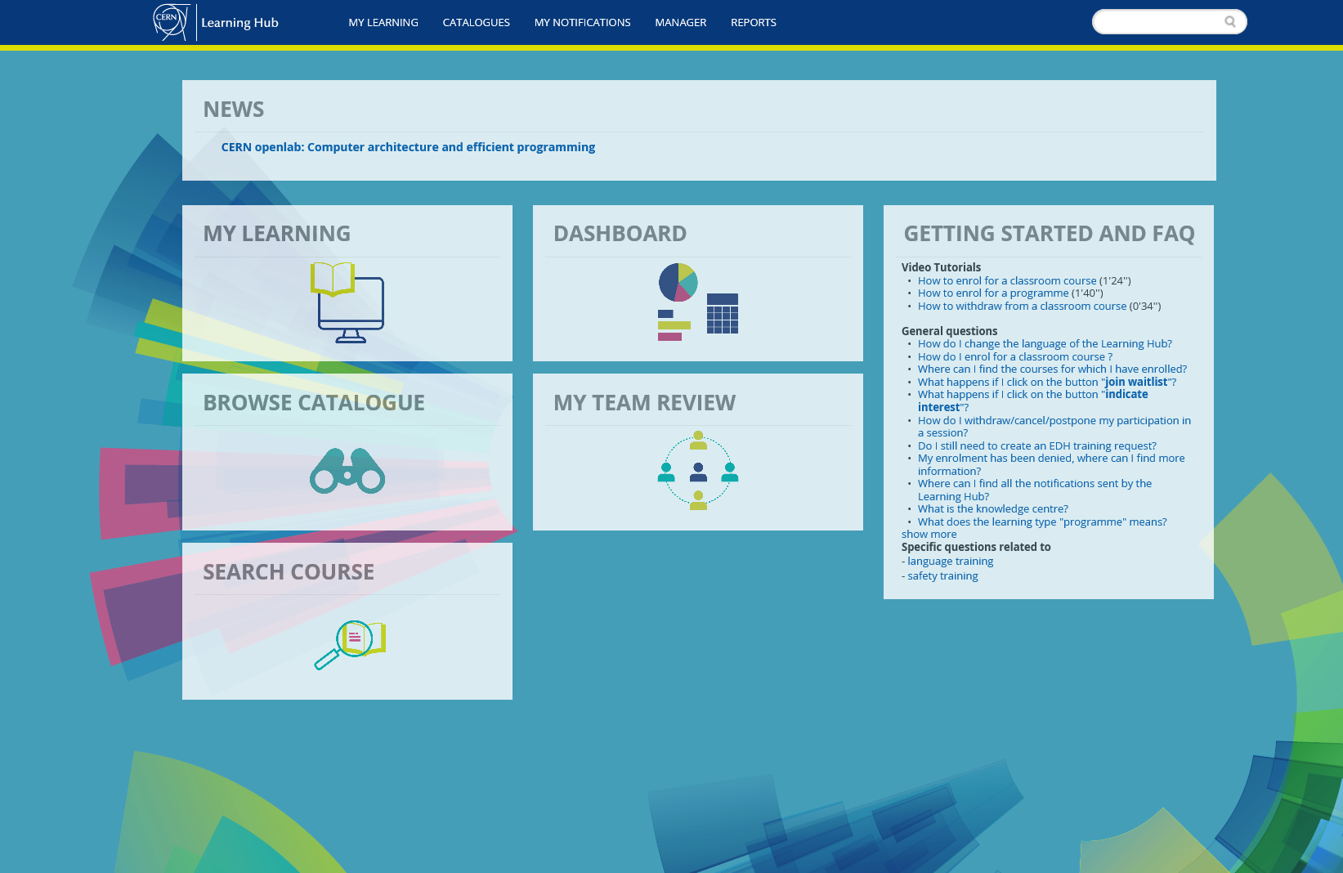
Outline
Minimum Safety requirements to access and work during LS2 at ALICE, P2
RP issues and requirements during LS2
New Training Interface “Learning Hub”

Slide 3
Minimum Safety requirements to access and work during LS2 at ALICE, P2
requirements and recommendations given in the CERN Safety Regulation SR-WS ‘WORKS AND SERVICES’ (EDMS 1440243v1)
in accordance with the above SR-WS, and the WSCP for ALICE, each and every ‘Operating entity’ (CERN group, Institute, contractor) is required to comply
A designated CERN ‘Safety Coordinator’ will assist the TC in coordinating safety during the design and execution phase of the works associated with LS2

Slide 4
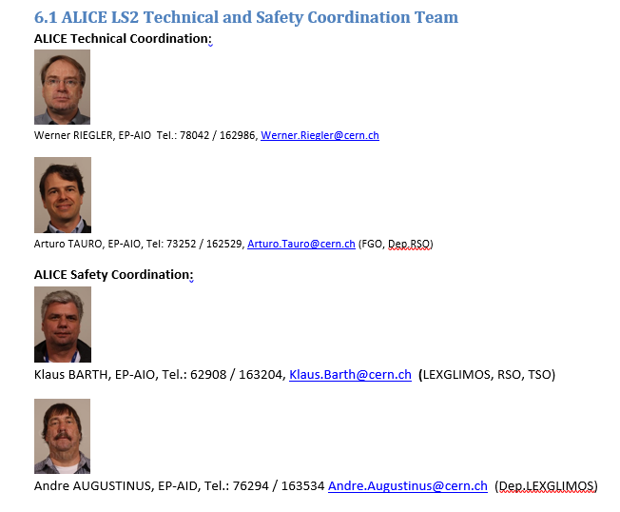
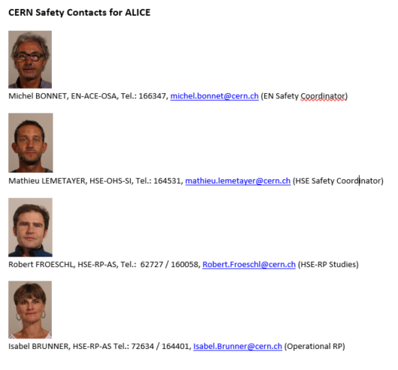
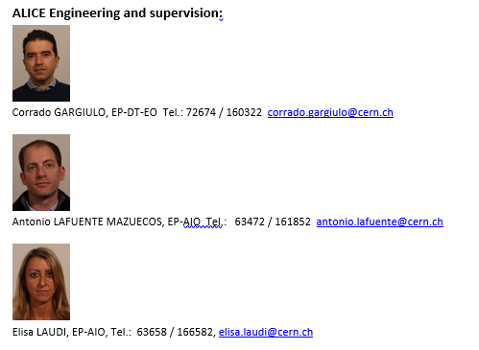
ALICE LS2 Technical and Safety Coordination Team

Slide 5
Common Safety Instructions for workers
Ref | Activity | Safety instruction
0 | Work in the surface bldg.’s / areas including CRs 1-5 of PX24 Declassified conventional area during LS2 | Wear appropriate personnel protection equipment: Safety helmet with head light Safety shoes
1 | Work in the underground cavern UX25 RP supervised area | Wear appropriate personnel protection equipment: Safety helmet with head light Safety shoes CERN personal dosimeter
2 | Work in UX25 inside L3/FASS RP supervised area When L3 doors open, not considered as a confined space | Wear appropriate personnel protection equipment: Safety helmet with head light Safety shoes CERN personal dosimeter
3 | Work in UX25 in proximity to beam pipe | Obtain prior approval from the PL before the start of work. Follow the specific and agreed precautionary measures to be identified in the specific instructions below.
4 | Work at height outside of collective protection (platform, scaffolding) | Obtain prior approval from PL before the start of the work. Ensure workers have received work at height training and are able to use safety harnesses and related equipment Wear safety harnesses

Slide 6
RP issues and requirements during LS2
TPC irradiation tests with x-ray source in SXL2 cleanroom during LS2 (evaluation of protective measures ongoing)
X-ray source (20 – 25 keV photons), Dos Rate along axis @ 30 cm: 1 Sv/h
RP-Zoning and material declassification
UX25 cavern: supervised area PX24 / Counting Rooms CRx: conventional area Materials taken out of UX25 to be measured by RP or ALICE RPE for declassification as conventional depends on zoning (beam pipe, adsorber)
Materials equipment taken out of ALICE detector will have to be verified / measured. Can be done in most of the cases by ALICE RPE

Slide 7
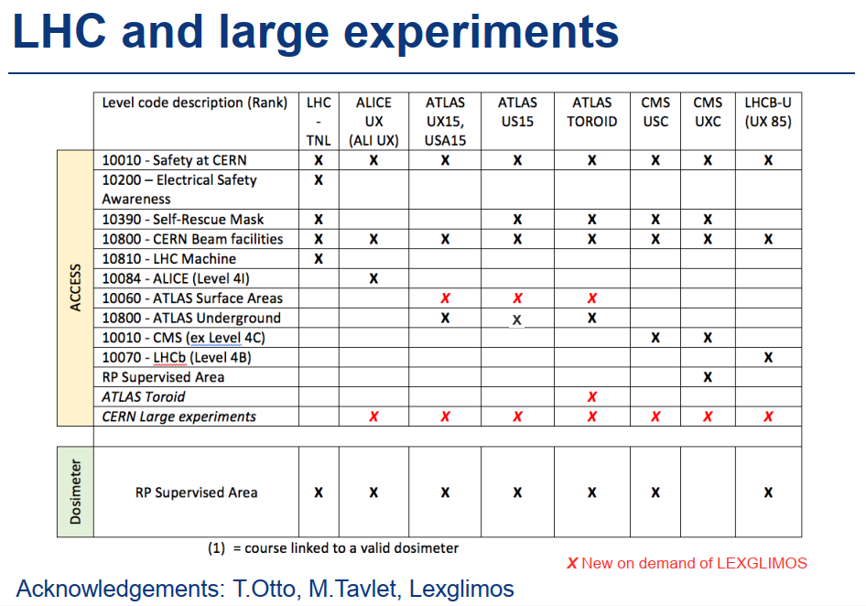
Safety Training
https://safety-training.web.cern.ch/safety-training/
The eLearning required to access the ALICE underground cavern ALICE (Level 4I) will be replaced in December 2018 by two eLearning modules: CERN LHC Large Experiments and ALICE - Surface and Underground Areas. ALI UX access based on the training rank ALICE (Level 4I) will stay valid until its end of validity date. For renewal, the new eLearning modules CERN Large Experiments and ALICE will have to be done.

Slide 8
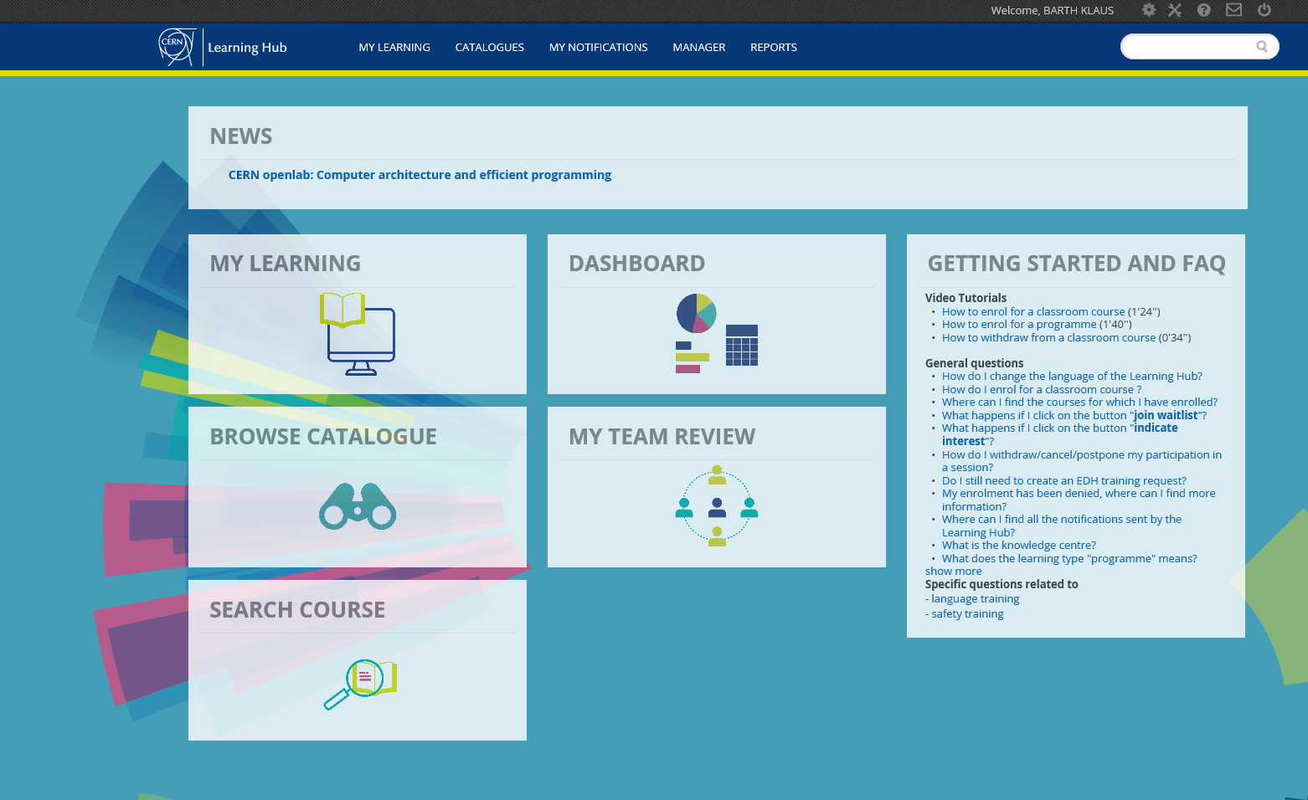
Safety Training Interface: https://lms.cern.ch
All safety trainings are listed and described in the Learning Hub. The classroom courses take place at the Safety Training Centre at Prévessin and they typically include both a theoretical and a practical part. The training session are held by CERN internal trainer or external training providers. CERN contractors need to consult the Learning Hub to find out to which classroom courses they are accepted in.

Slide 9
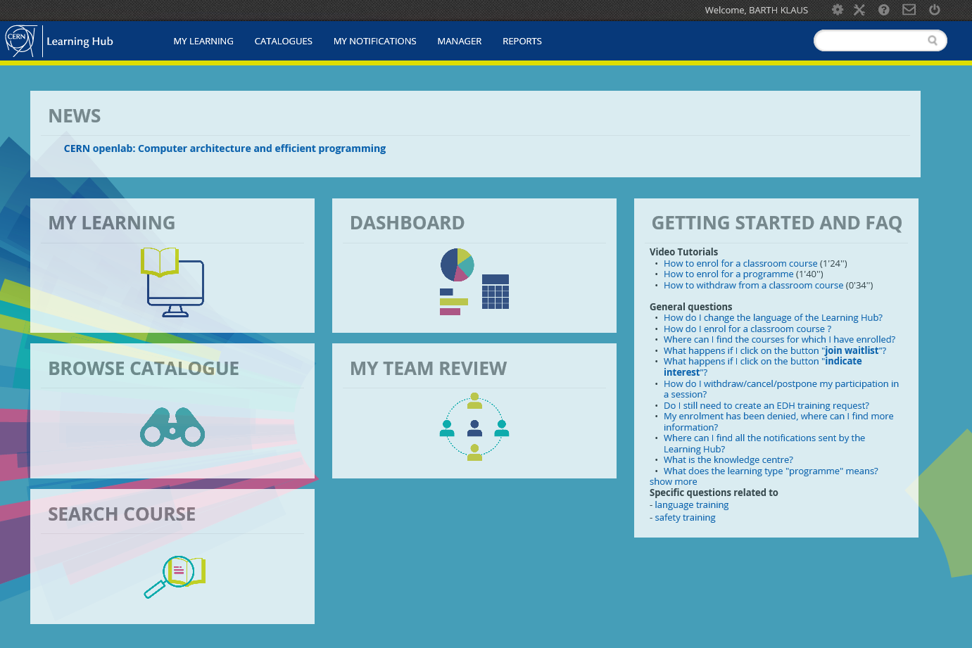
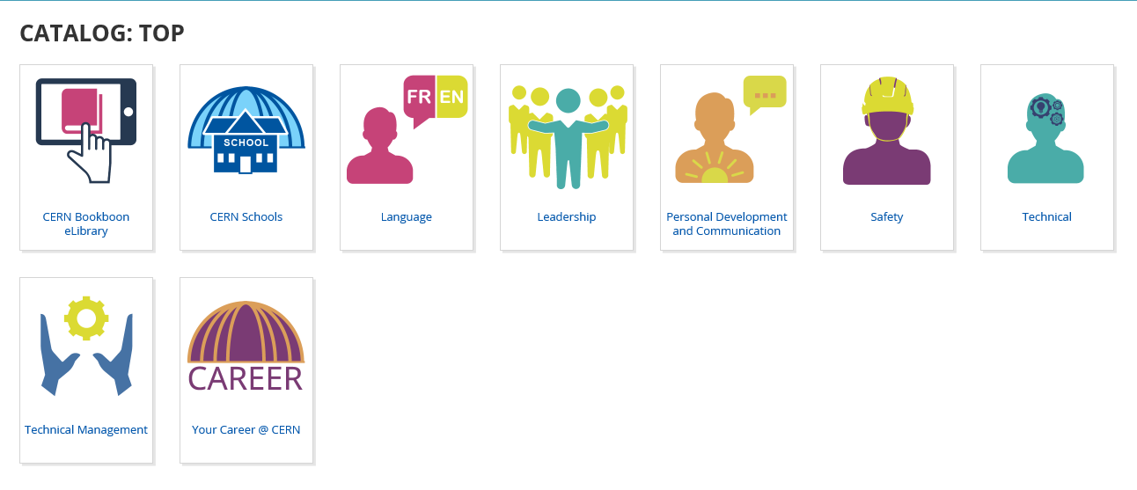
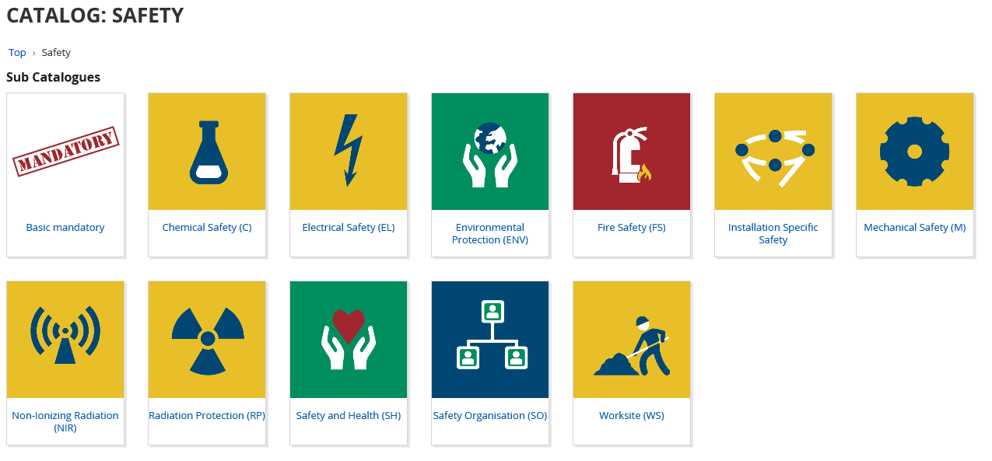
Safety Training - How to find basic eLearning !
Login to Learning Hub
Click on Catalogues
Click on Browse
Click on Safety
Click on Basic mandatory

Slide 10
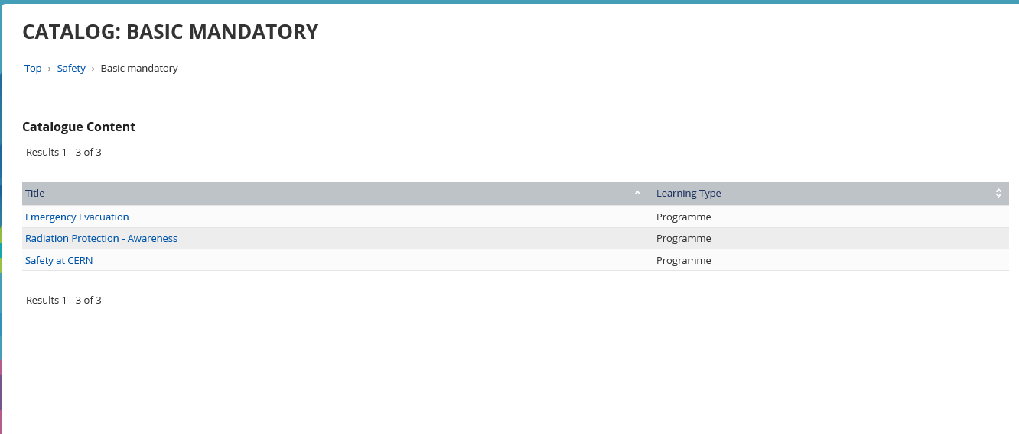
Safety Training - How to find basic eLearning !

Slide 11
Safety Training - How to find specific eLearning !
Login to Learning Hub
Click on Catalogues
Click on Browse
Click on Safety
Click on Installation Specific Safety

Slide 12
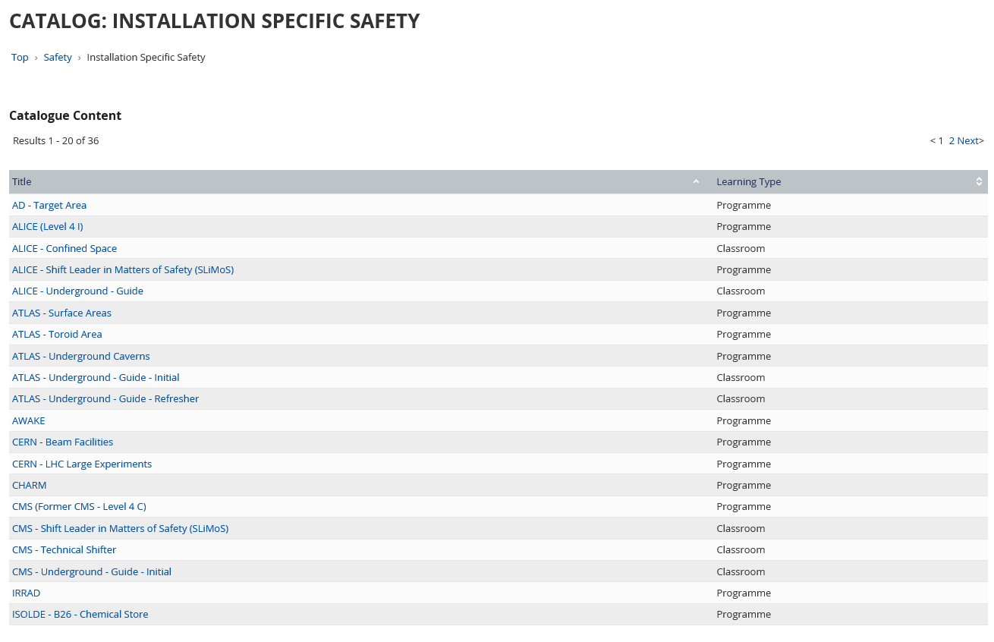
Safety Training - How to find specific eLearning !

Slide 13
Safety Training - How to find RP eLearning !
Login to Learning Hub
Click on Catalogues
Click on Browse
Click on Safety
Click on Radiation Protection RP

Slide 14
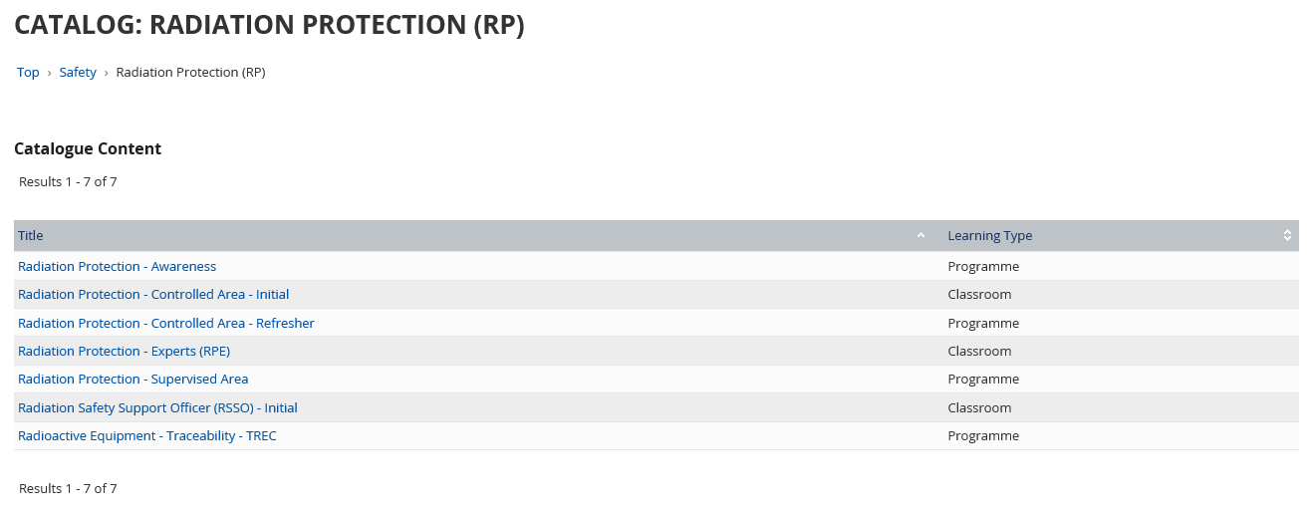
Safety Training - How to find RP eLearning !

Slide 15
Safety Training
How to take (enrol for) an eLearning...
Where can I find the courses for which I have enrolled?
On the homepage go to ‘My Learning’ - The tab 'My course request' contains all your courses pending approval - The tab 'My current courses' contains all your courses not yet completed - The tab 'My Training History' contains all your courses for which you have enrolled including their status.

Slide 16
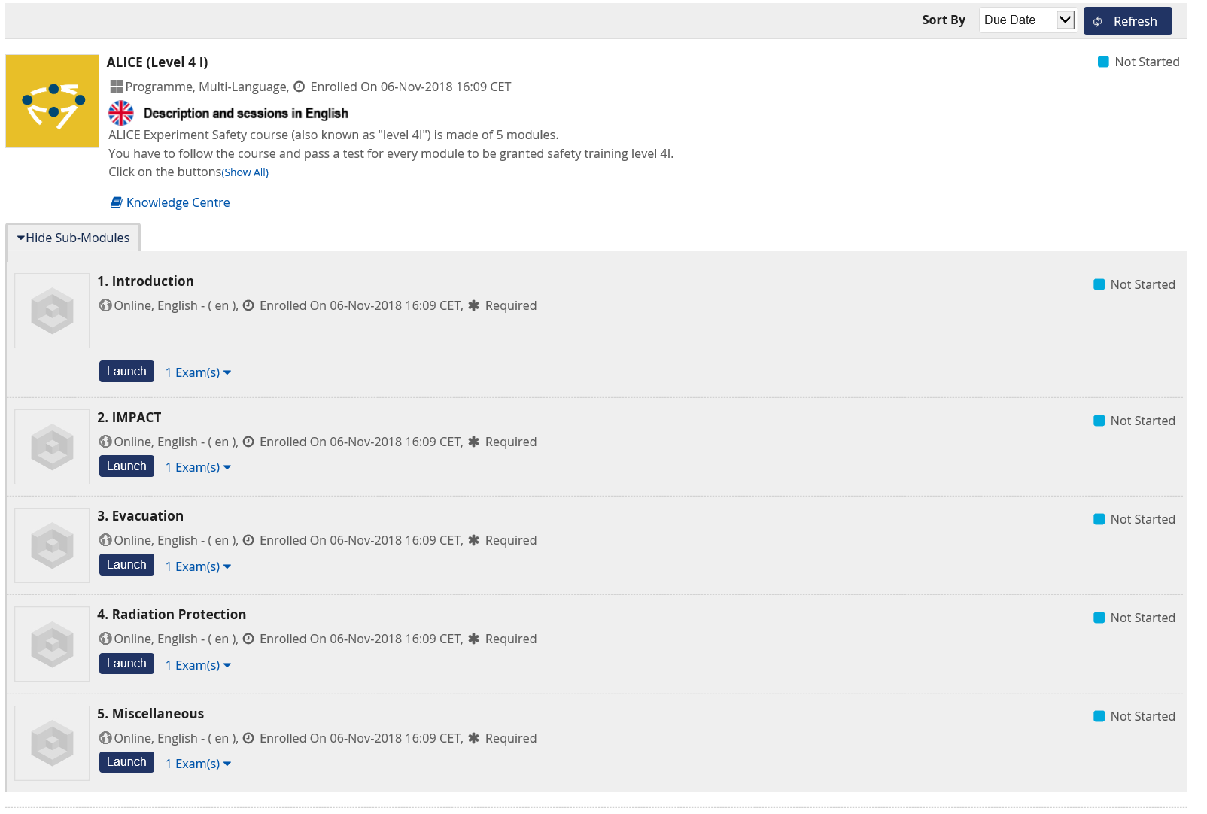
Safety Training

