Slide 1

Diagnostics of hot anode surface by optical methods
S. Gortschakow, St. Franke, D. Gonzalez, R. Methling, D. Uhrlandt
Leibniz Institute for Plasma Science and Technology
Greifswald, Germany

Slide 2
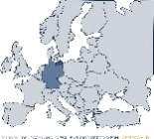
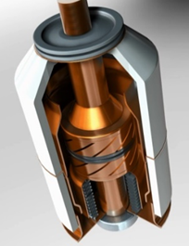
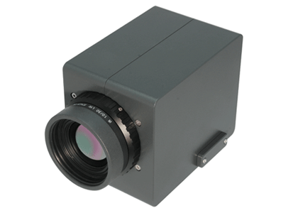
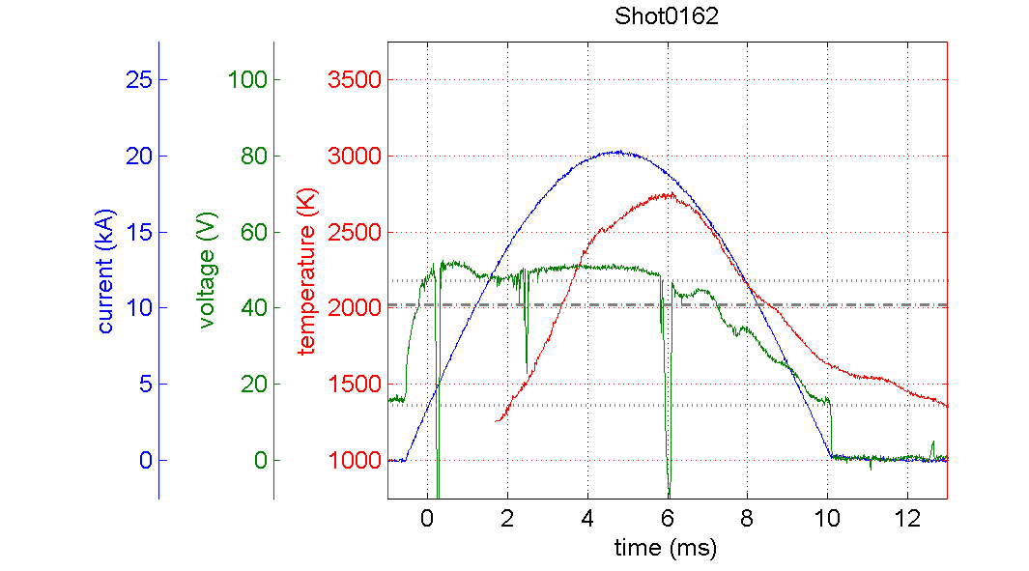
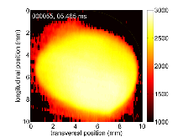
Outline
Introduction
Motivation
Optical methods for temperature determination
  Application examples:
    Measurements in the post-arc phase
    Measurements during the active phase
    Surface with impurities
  Summary and outlook

Slide 3
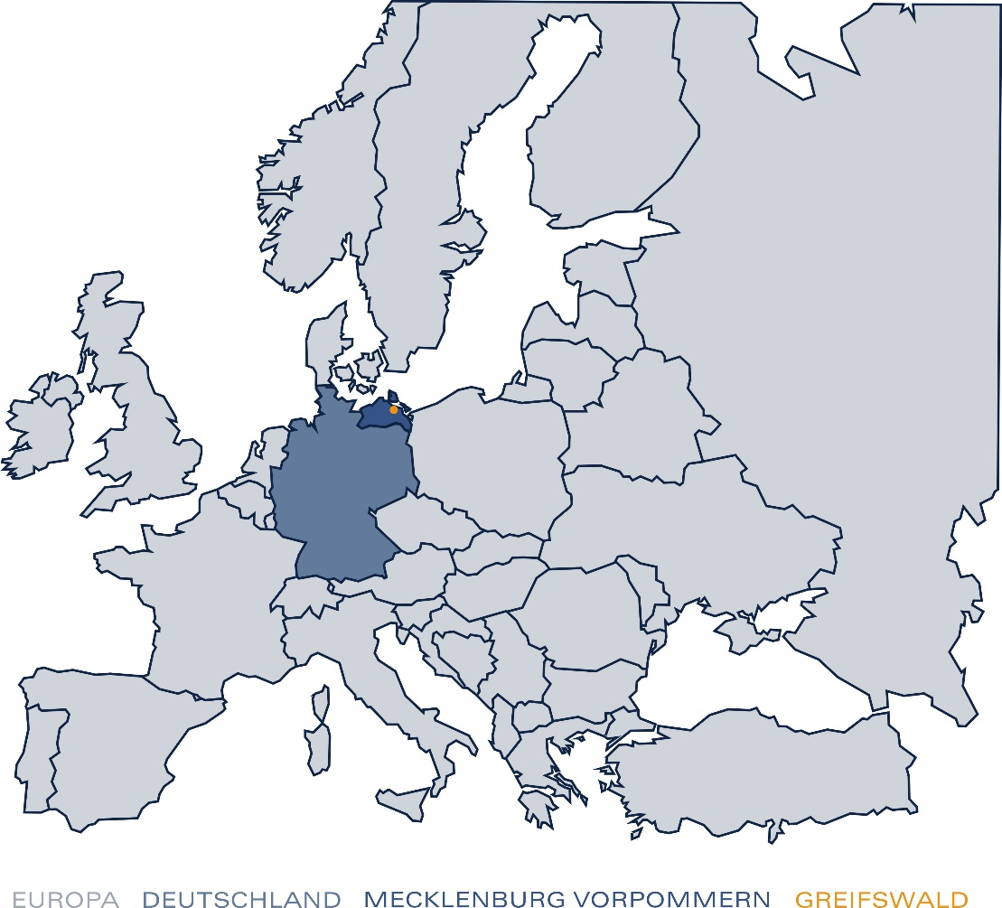
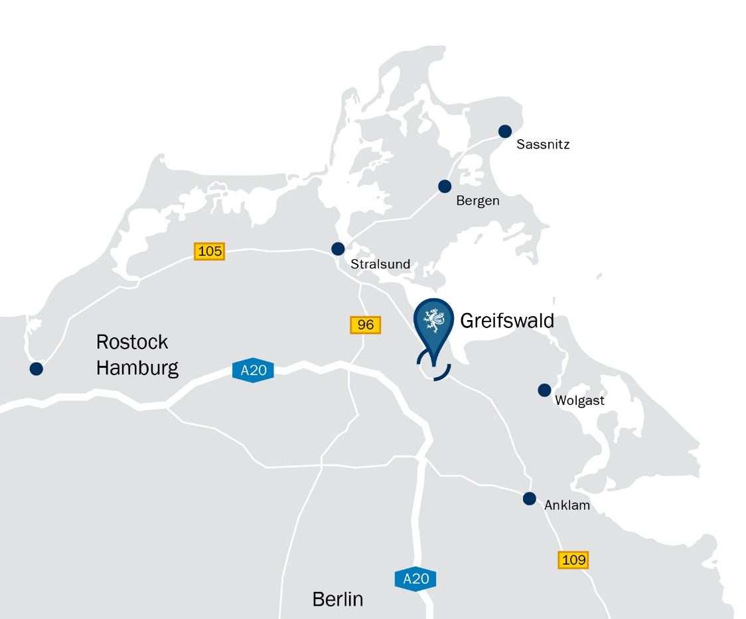
Introduction
Greifswald
Padua
972 km from Padua
235 km from Berlin, 265 km from Hamburg

Slide 4
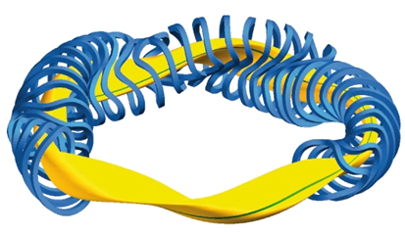
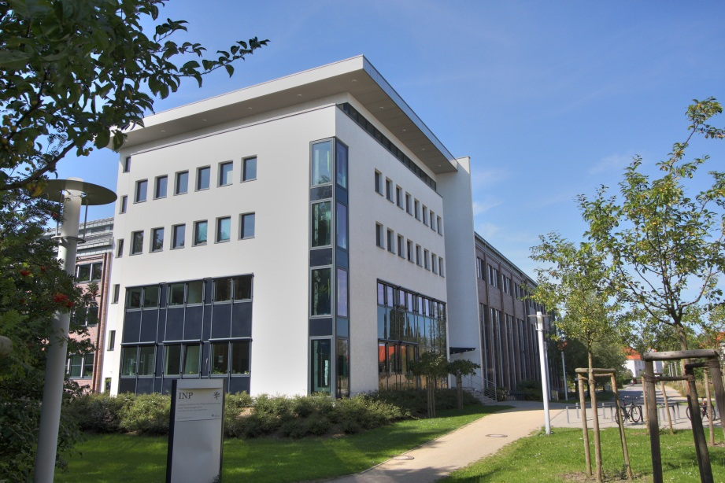
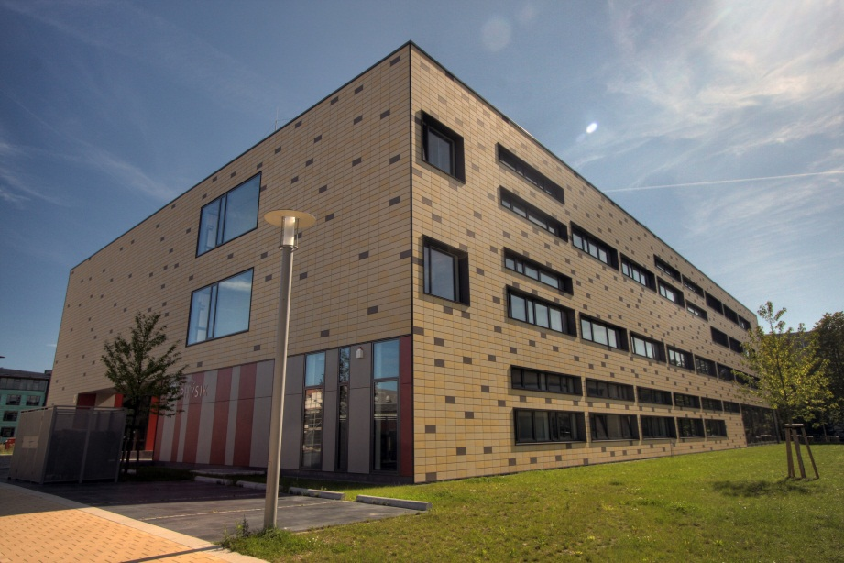
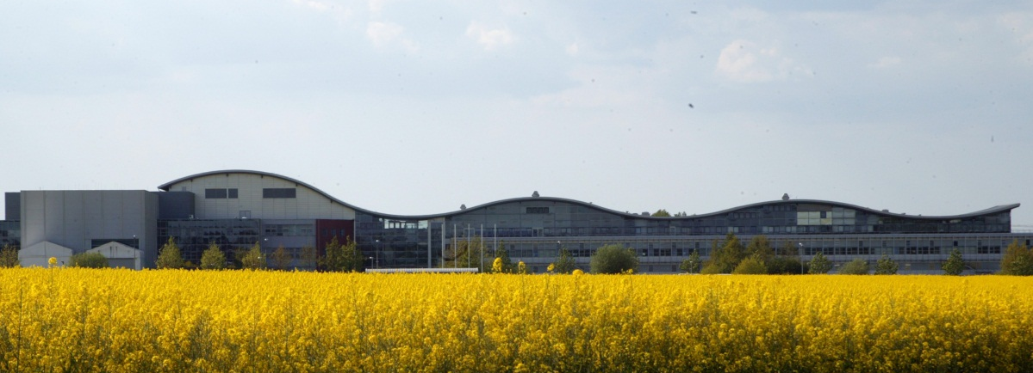
Introduction
Greifswald - Center of Plasma Science
Leibniz Institute for Plasma Science and Technology (INP)
Institute of Physics (IfP) of Greifswald University
Max Planck Institute for Plasma Physics (IPP) Nuclear fusion reactor Wendelstein 7-X

Slide 5
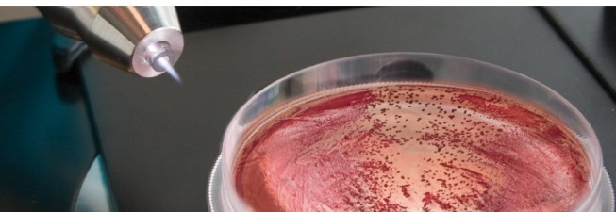
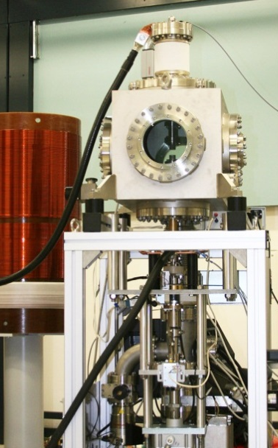
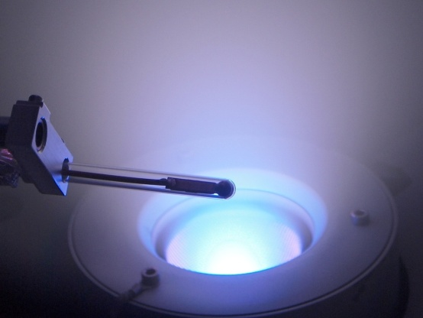
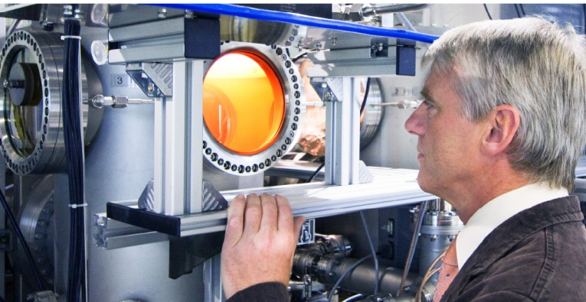
Introduction
Leibniz Institute for Plasma Science and Technology (INP)
Application-driven research
surface modification and chemistry
process diagnostics and monitoring
biomaterials and surfaces
plasma medicine, plasma decontamination
high-voltage techniques
switching and welding arcs
49 laboratories
200 employers
annual budget 20 M€

Slide 6
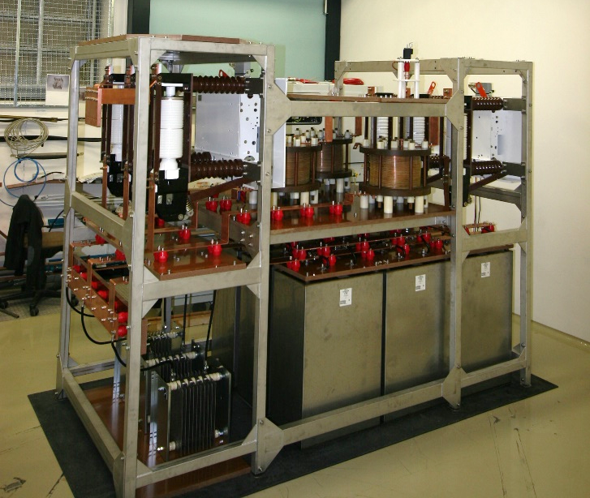
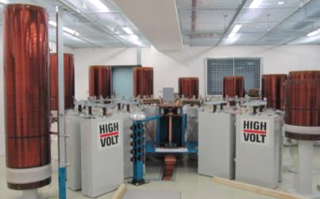
Introduction: switching arc research
since 06.2015
since 07.2019
Charging voltage | 500 V – 18000 V
Min current | 100 A@ 50 Hz
Max current | 10 kA @ 50 Hz
Other features | No TRV Flexible frequency 16 Hz – 1000 Hz, pulsed DC operation
Charging voltage | 50 V – 3500 V
Min current | 1.3 kA@ 50 Hz
Max current | 100 kA @ 50 Hz
TRV level | 41.5 kV @ 1000 Hz DAC

Slide 7

Introduction: switching arc research
vacuum circuit breaker
Volume 0.003 – 10 l
Stroke 0.5 – 25 mm
Operation velocity 0.1 - 5 m/s
model circuit breaker
Volume 52 l
Mountings for various electrodes
Stroke 0.5 - 25 mm
Operation velocity 0.5 - 4 m/s

Slide 8
Motivation
Electrodes in high-power applications
  current transfer
  interaction with substrate
  material source (vacuum arcs, welding, coating)
  source of problems – damage through erosion → contamination of plasma, gas, walls with electrode material, strong surface deformation → operation failure
  Processes to be understand, behavior to be characterized
  heating and cooling dynamics
  behavior of melted surface
  erosion behavior → vapor and droplets
  interaction with plasma
Monitoring of electrode temperature is crucial for phenomena understanding and
device optimization

Slide 9
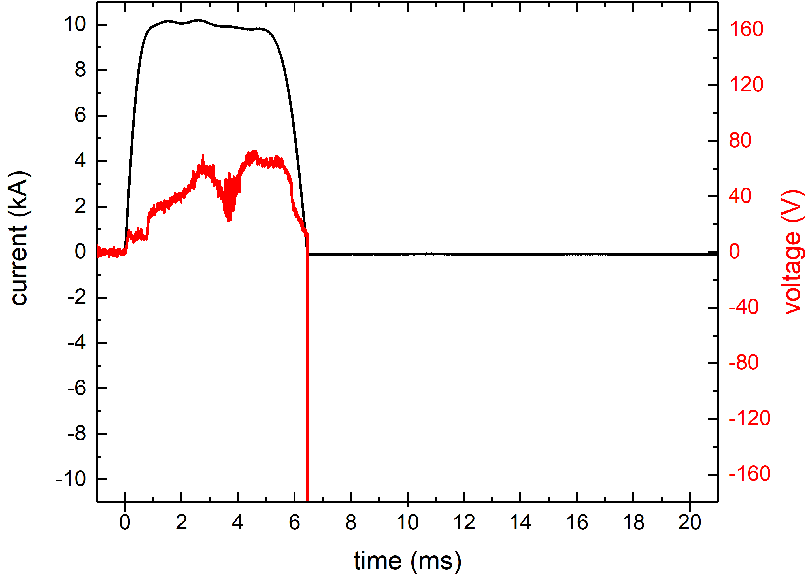

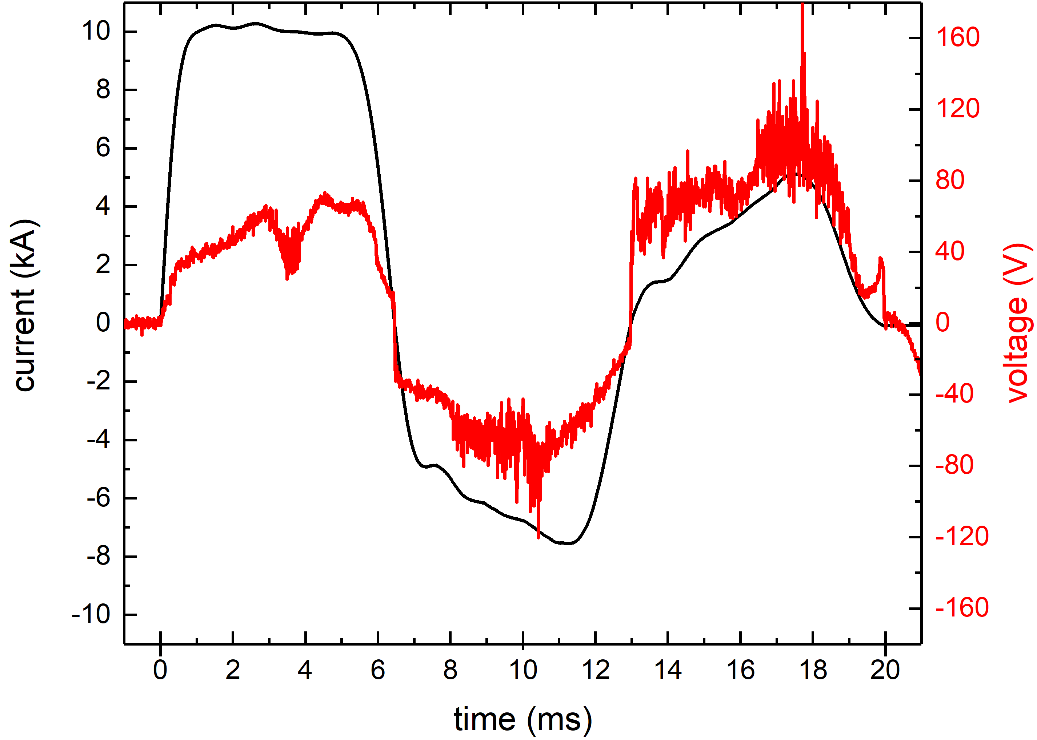
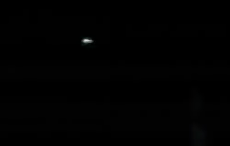
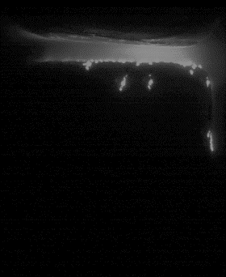
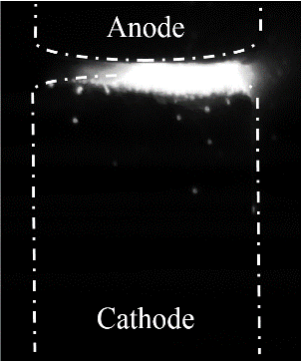
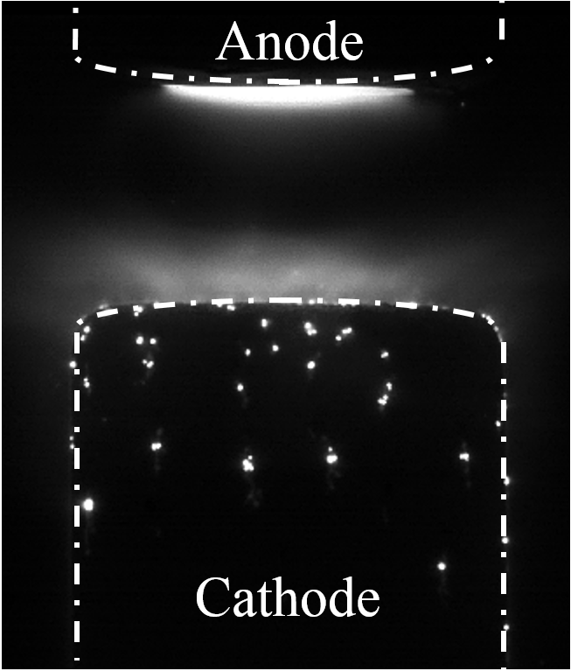
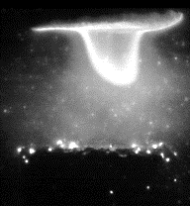
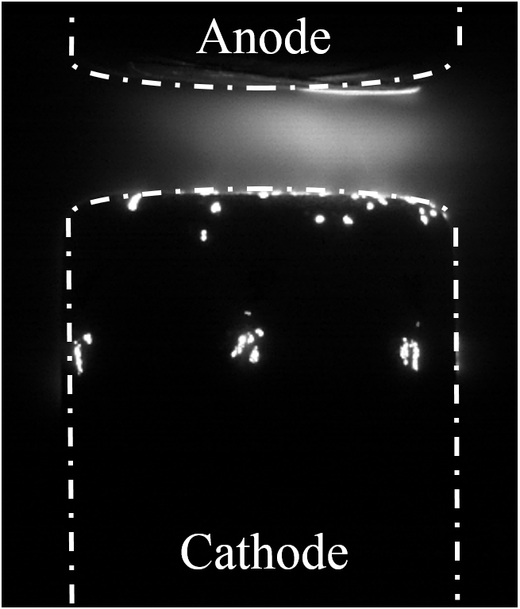
Motivation
Vacuum circuit breakers
  environmentally friendly operation
High-current operation
  (strong) electrode melting and evaporation
  atomic vapour as possible source for restrikes
  hot anode – major source of atomic vapour
  Focus on the anode surface temperature measurements
success
failure
diffuse
intense mode
footpoint
anode spot
anode plume
anode
Anode
cathode
Cathode

Slide 10
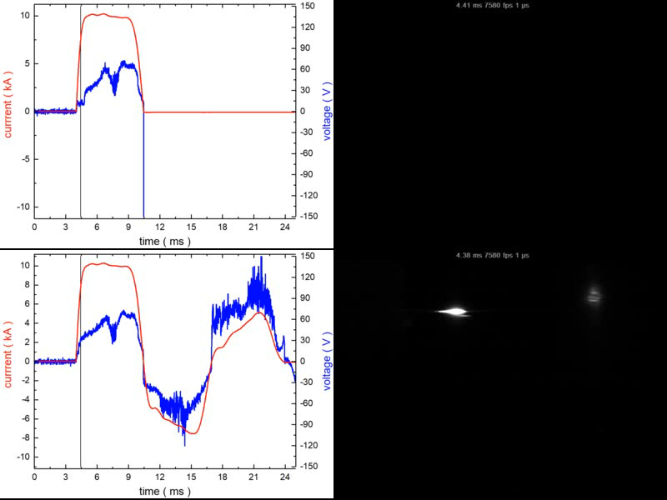
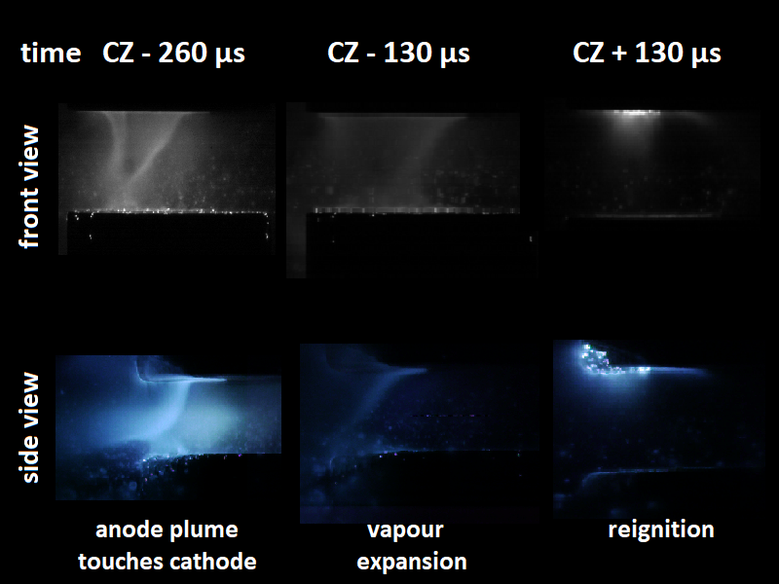
Motivation

Slide 11
Optical diagnostics: advantages and disadvantages
“Classical” method (thermocouple) fails
  probes will be damaged when placed within the region of interest
  signal distortion due to EM fields
  high spatial (and temporal) resolution required
Clear advantages of optical methods
  non-invasive
  qualitative and quantitative measurements possible
  high spatial resolution – local properties
  high temporal resolution – dynamics
  applicable in a wide parameter range due to variability of methods
Some disadvantages of optical measurements
  optical access to the object necessary
  radiation intensity must be sufficient
  distortions in the optical pathway through hot fluxes and plasma itself
  costs of the devices, complex apparatus and evaluation methods

Slide 12
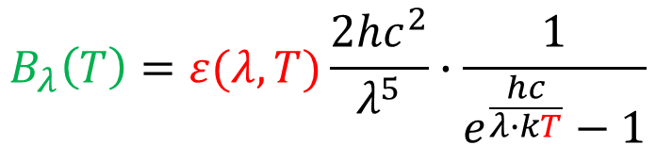
Optical diagnostics: basics of temperature determination
Black-body radiation acc. to Planck’s law
One measured value, but two unknowns – standard solution ways
  known emissivity from other measurements or theory
  measurements at two different wavelengths
$$B_{λ}\left(T\right)=ε(λ,T)\frac{2hc^{2}}{λ^{5}}∙\frac{1}{e^{\frac{hc}{λ∙kT}}−1}$$

Slide 13
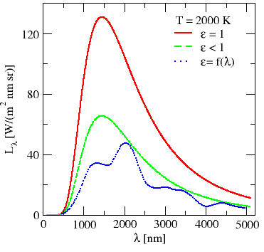

Optical diagnostics: basics of temperature determination
$$B_{λ}\left(T\right)=ε(λ,T)\frac{2hc^{2}}{λ^{5}}∙\frac{1}{e^{\frac{hc}{λ∙kT}}−1}$$
Data for emissivity
  Mostly known for “clean” surfaces
  measured at idealized conditions
  however emissivity depends on
    chemical composition
    surface roughness
    surface “state” – solid, liquid, boiling, phase transition…
    view angle
Best solution – ín-situ measurements simultaneously with temperature measurements

Slide 14
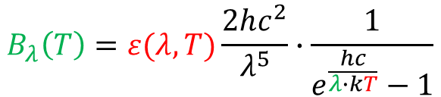
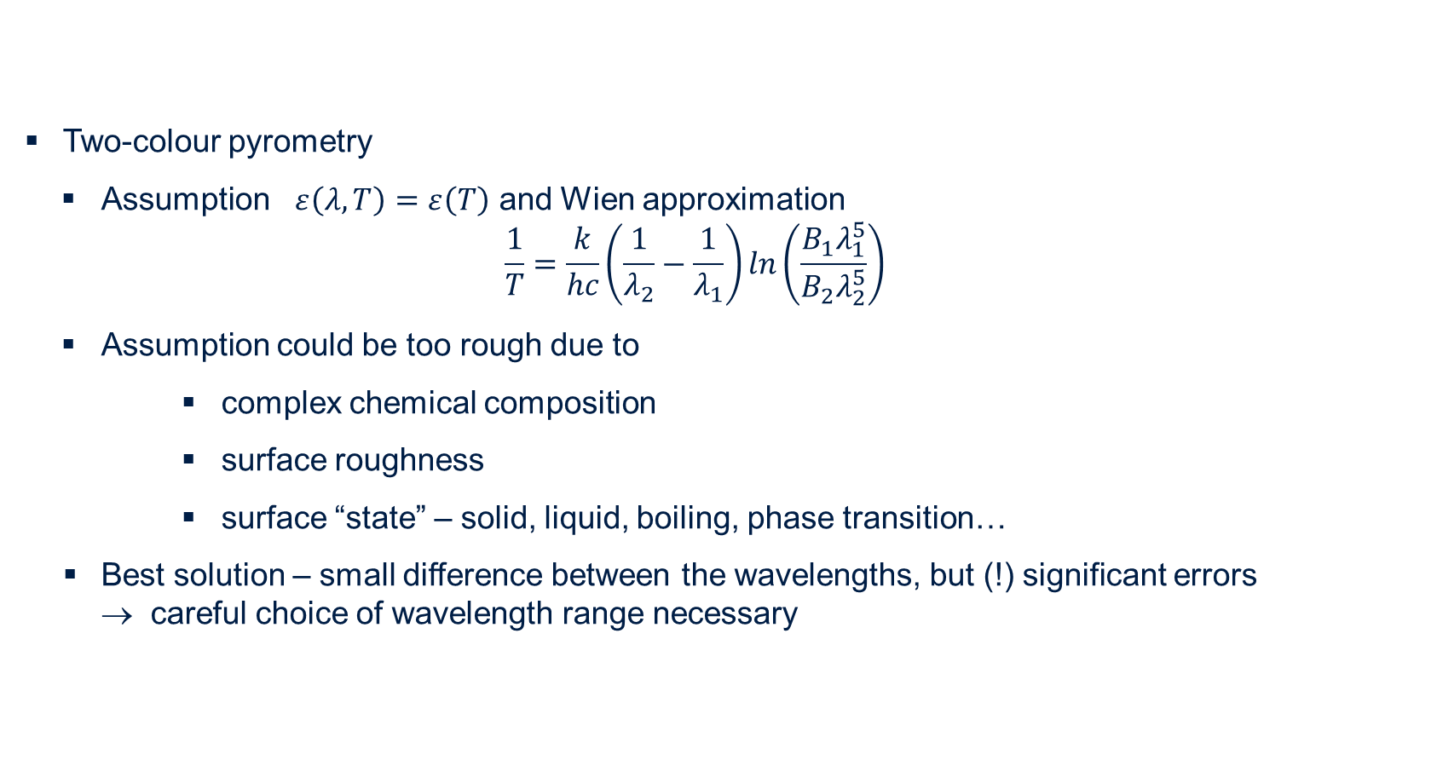
Optical diagnostics: basics of temperature determination
$$B_{λ}\left(T\right)=ε(λ,T)\frac{2hc^{2}}{λ^{5}}∙\frac{1}{e^{\frac{hc}{λ∙kT}}−1}$$
Two-colour pyrometry
  Assumption $ε\left(λ, T\right)=ε\left(T\right)$ and Wien approximation
  $$\frac{1}{T}=\frac{k}{hc}\left(\frac{1}{λ_{2}}−\frac{1}{λ_{1}}\right)ln\left(\frac{B_{1}λ_{1}^{5}}{B_{2}λ_{2}^{5}}\right)$$
  Assumption could be too rough due to
    complex chemical composition
    surface roughness
    surface “state” – solid, liquid, boiling, phase transition…
Best solution – small difference between the wavelengths, but (!) significant errors
→ careful choice of wavelength range necessary

Slide 15
Optical diagnostics: methods
Selected methods
  Pyrometry (commercial)
  Thermography (commercial)
  Optical Emission Spectroscopy (OES) (scientific)
  High-speed camera (HSC) techniques enhanced by filter (scientific)
Method choice and requirements
  sensitivity → surface should emit radiation (T high enough)
  possible distortions
  → plasma radiation is either absent or can be excluded from consideration
  → oxides and surface impurities influences the results
  → smooth surfaces/low roughness preferable

Slide 16
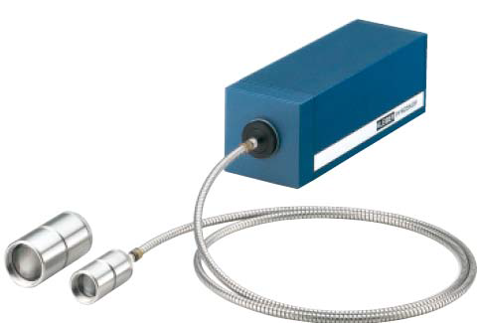
Optical diagnostics: pyrometry
Advantages
Commercially available devices (pyrometer)
Acquisition time between 10µs and 1s
Temperature range 200-4000 K
Simple setup and arrangement
Determination of the cooling dynamics possible
Disadvantages/ restrictions
Emissivity of the surface must be known (exception two-colour pyrometer)
Special optics (windows) depending on the temperature and spectral range necessary
Time resolved measurements with rough spatial resolution (min spot size 0.5 - 1mm)
Kleiber Pyroskop

Slide 17
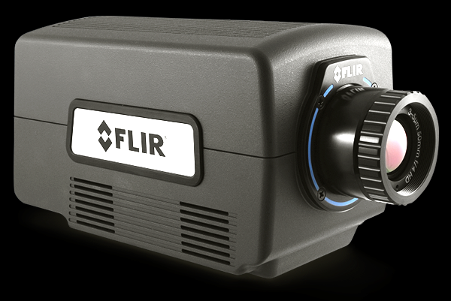
Optical diagnostics: thermography
Advantages
  Commercially available devices
  2D temperature distribution at one shot
  Temperature range 200-5000 K
  Simple setup and arrangement
  Determination of the cooling dynamics possible
Disadvantages/ restrictions
  Emissivity of the surface must be known (exception – two color cameras)
  Special optics (windows) depending on the temperature and spectral range necessary
Time resolved measurements with full size typically with 60 -125 Hz, but (!) temporal resolution with reduced number of pixels possible (up to 10 kHz)
IR camera VarioCAM with 60 Hz techniques
IR camera FLIR with 125 Hz techniques

Slide 18
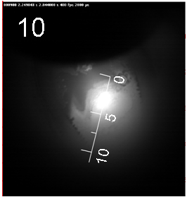
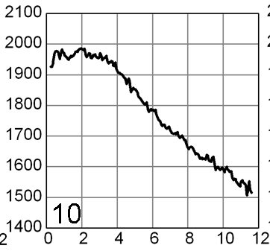
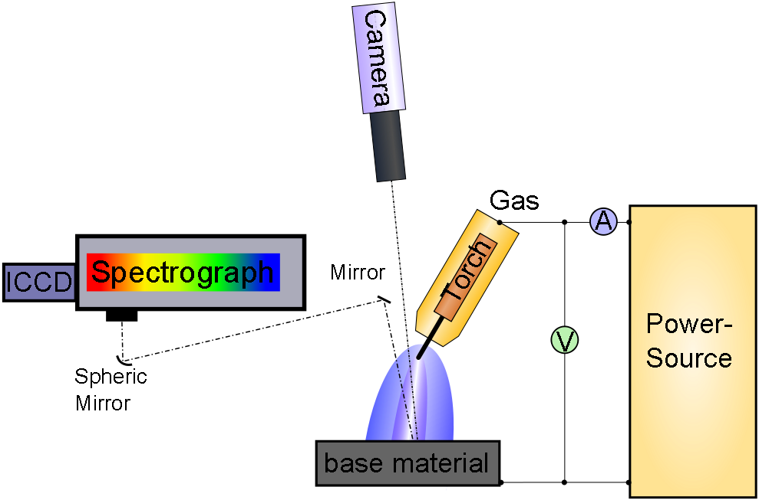
Optical diagnostics: emission spectroscopy
Advantages
Time resolve measurements possible
Simultaneous determination of surface emissivity possible
Flexibility by choice of spectral range
Characterization of surface impurities possible
Disadvantages/Restrictions
Light intensity calibration necessary (tungsten strip lamp)
Space resolved measurements along the slit
Additional optical setup necessary
Projection of the entrance slit
Temperature distribution

Slide 19
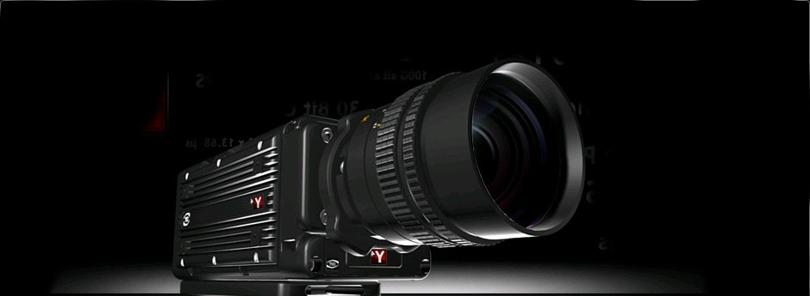
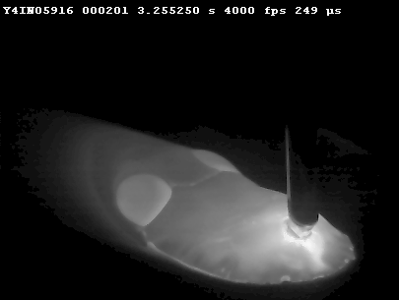
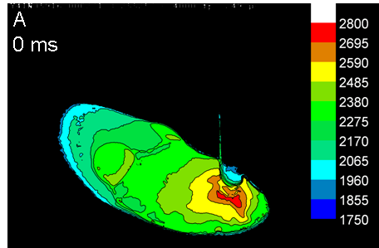
Optical diagnostics: high-speed camera techniques
Advantages
Time resolved measurements
2D picture of the surface
Manageable effort for setup
Disadvantages/Restrictions
Special optical filters (MIF, narrow band)/ optical modules necessary
Light intensity calibration necessary
Possible impurities of the surface should be taken into account
HSC MotionPro Y4
HSC image
Temperature distribution

Slide 20
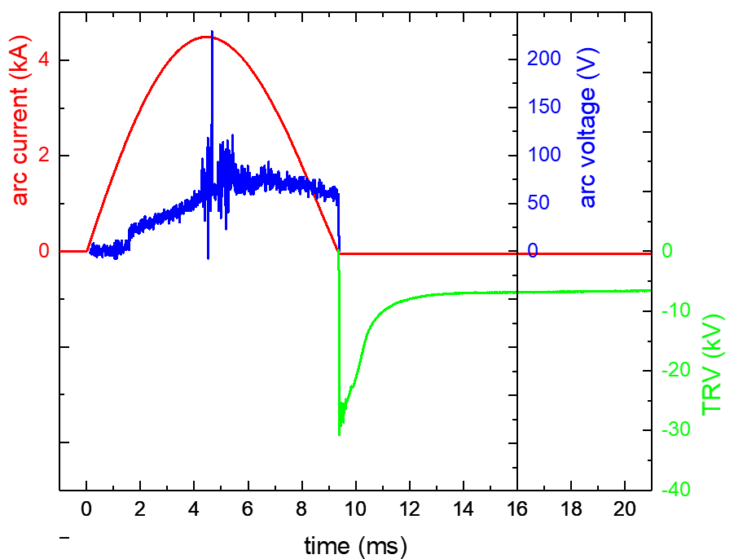
Optical diagnostics: method applicability
  Ignition phase
 | ignition | High-current | CZ | post-arc
pyrometry | - | (+) | + | -
thermography | - | (+) | + | -
OES | - | (+) | + | +
HSC | - | (+) | + | -
  High-current phase (active phase)
  Current zero crossing
T measurement possible
  Post-arc phase

Slide 21
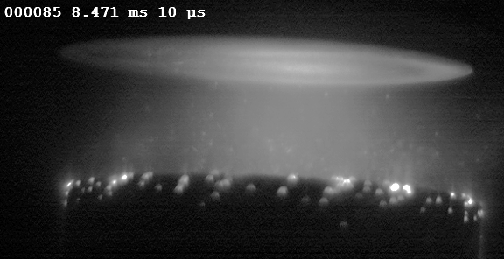
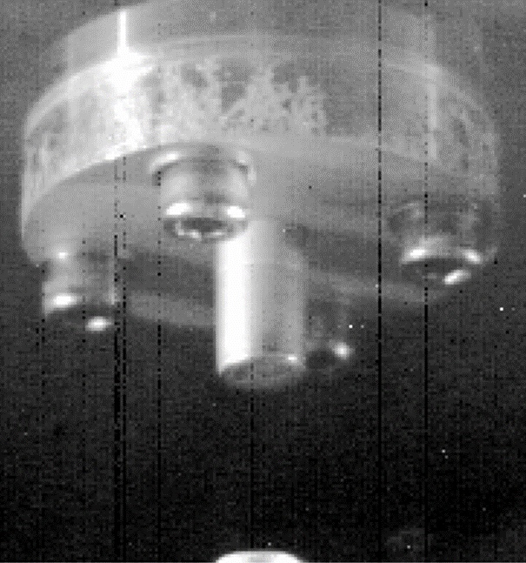
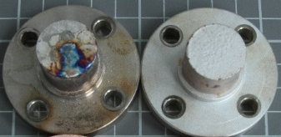
Practical examples
Clean surface with known chemical composition – CuCr contacts for vacuum arcs
Measurements in post-arc phase by
  NIR spectrometer
Measurement in the active phase
  pyroscopic measurements
  2D temperature profiles by enhanced high-speed camera techniques
  use of current cut-off techniques
Surface with impurities
  characterization of cold metal transfer welding by OES and HSC

Slide 22
Practical examples
Operation conditions:
Pulsed current, sinusoidal, 10 ms, 1- 20 kA
Electrodes diameter 10-60 mm; maximum distance 10 mm
Rough unpolished surface
Electrodes are moving from closed position (1 m/s)
Arc initialization (“breakdown”) from bridge explosion
Arc plasma separates the electrode from diagnostic setup
Simplification:
Anode is fixed, cathode is moving

Slide 23
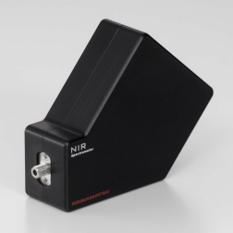
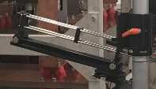
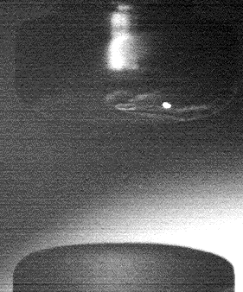
Measurements in post-arc phase by NIR
+
=
NIR optics
NIR 900-1600 nm
acquisition times
Plasma!

Slide 24
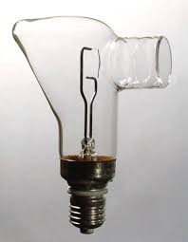
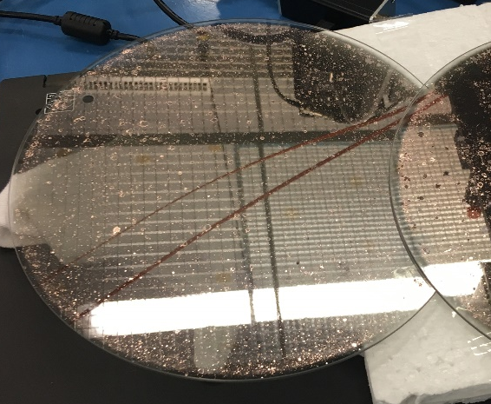
Measurements in post-arc phase by NIR
calibration
window transmission
W strip lamp
background correction
determination of T and ε
ε
T

Slide 25

Measurements in active phase by pyroscope
parallel measurement
surface measurement
Measurements parallel to surface for approximation of plasma contribution
Plasma contribution sufficiently low
Corrected signal gives reasonable temperature

Slide 26
Measurements in active phase by pyroscope
Cu-Cr eutectic
melting temp.
1.
2.
3.
Temperature maximum around 6 ms, i.e. after current maximum
Accelerated temperature decay after 6 ms up to Cu-Cr eutectic melting point (at 2020 K).
Plateau closely after current zero (occurs at different temperatures)

Slide 27
Measurements in active phase by pyroscope
Uncertainties NIR spectrometer:
± 100 K
Uncertainties pyroscope:
± 200 K around maximum,
± 50 K around eutectic point,
± 100 K at lower detection limit
Good agreement between temperatures from pyroscope and from NIR spectra
Higher currents lead to higher anode surface temperatures
Lower thermal radiation for Cu
No continuum emission observed after CZ with NIR
Due to comparable emissivity the anode surface temperatures for Cu should be considerably lower than for Cu-Cr

Slide 28

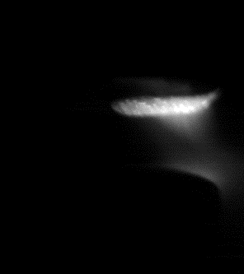
Measurements in active phase by HSC
+
=
Planck + plasma
plasma only
inspection
angle 9.2°
Without correction for plasma background radiation.
With correction for plasma background radiation

Slide 29
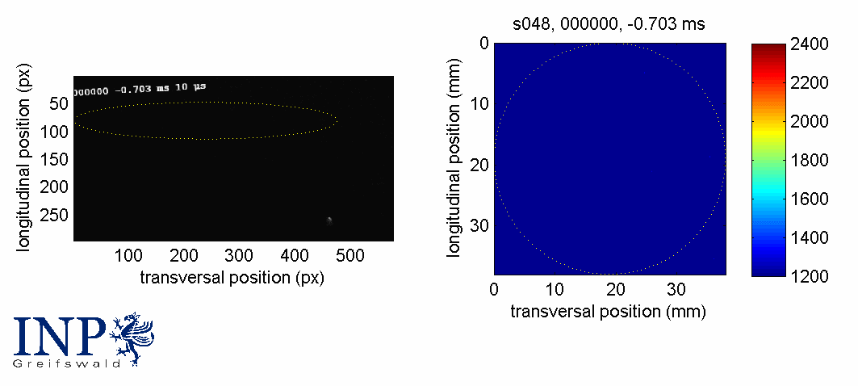

Measurements in active phase by HSC
Quantitative temperature from calibration with addition measurements, like e.g. NIR spectroscopy

Slide 30



Measurements in the active phase: current cut-off
Current flow through test object VI was switched artificially to zero by means of bypath SC
Diagnostics by
3 channel rackmount spectrometer
VIS 200-1000 nm / NIR 880-1700 nm / NIR 1.6-2.4 µm
High-speed NIR camera
1.5 – 1.7 µm, 6100 fps with 128 x 24 pix resolution

Slide 31



Measurements in the active phase: current cut-off
Current cut-off within Δt ~ 0.56 ms
Temperature about 3300 K before and about 4000 K after anode spot type 2

Slide 32
Measurements in the active phase: current cut-off
Before CZ: plasma radiation dominates emission → no information on anode temperature
After CZ: fit to Planck curve → anode surface temperature determinable

Slide 33
Measurements in the active phase: current cut-off
Higher anode surface temperatures and longer cooling in case of anode spot type 2
Peaks in temperature curve from thermography (lines) due to changing emissivity during solidification process – in spectroscopic method (dots) the emissivity was adapted during Planck curve fitting

Slide 34


Example 5: Surface with impurities
CMT welding – pulsed arc operation
High-speed camera
Spectrograph

Slide 35

Example 5: Surface with impurities
H. Schöpp, A. Sperl, R. Kozakov, G. Gött, D. Uhrlandt, G. Wilhelm, J. Phys. D: Appl. Phys. 45(2012) 235203
Material steel S235
Slit length 12 mm
Results after current cut-off
HSC image

Slide 36



Example 5: Surface with impurities
Kelvin
2300
1810
Planck-fit for each spatial position
1300
Colder slag due to higher emissivity

Slide 37
Summary and outlook
Summary
Various of optical methods for temperature determination is available
In case of an arc discharge:
“easy case” – measurements in the post-arc phase;
“complex case” – measurements during the active phase
Combinations of various methods increase applicability range
Outlook
Further development is necessary for temperature measurements within the active phase
Increase of temporal resolution
Further results will be presented at ISDEIV2020/Padova (IT), ICEC2020/ St. Gallen (CH) and GD2020/Greifswald

Slide 38

You are kindly invited to participate in

Slide 39


Thank you very much for your attention!
Dr. Sergey Gortschakow
Leibniz Institute for Plasma Science and Technology
Address: Felix-Hausdorff-Str. 2, 17489 Greifswald
Phone: +49 - 3834 - 554 463, Fax: +49 - 3834 - 554 301
Email: sergey.gortschakow@inp-greifswald.de
Web: www.leibniz-inp.de

Slide 40
Introduction
Cu-Cr butt,
15 kA,
120-180 mT
It is not possible to deduce an unambiguous temperature dependence of the electrode emissivity.
Uniform emissivity of ε = 0.3 was taken for evaluation of spectra.
Temperatures obtained for several assumptions of fixed emissivities
(determined for the example of 5 spectra).
Assuming ε = 0.3:
=> uncertainty ± 50 K => acceptable!

Slide 41
Literature
H. Schöpp, A. Sperl, R. Kozakov, G. Gött, D. Uhrlandt, G. Wilhelm, J. Phys. D: Appl. Phys. 45(2012) 235203
R. Methling, M. Kurrat, T. Pieniak, St. Franke, D. Uhrlandt, B. Weber, S. Gortschakow, Proc. of 28th ISDEIV, V 2, 2018
R. Methling, St. Franke, S. Gortschakow, M. Abplanalp, R.-P. Sütterlin, Th. Delachaux, K. O. Menzel, IEEE TPS 45 (2017)

Slide 42


Introduction
Greifswald – a Hanseatic City founded 1248
57000 habitants, University town since 1456,
one of the centers of North German Brick Gothic at the Baltic Sea coast

