Slide 1


8th International Workshop on Mechanisms of Vacuum Arcs
(MeVArc 2019)
Study on the post-arc sheath and the post-arc current in vacuum interrupters
Shenli Jia, Yongpeng Mo, Zongqian Shi
State Key Laboratory of Electrical Insulation and Power Equipment, Xi'an Jiaotong University, Xi'an, 710049 China
Modeling and Simulations
2
0
1
9

Slide 2
Contents
Background
Simulations of post-arc sheath
Simulations of post-arc current
Experimental studies of post-arc current
Summary

Slide 3

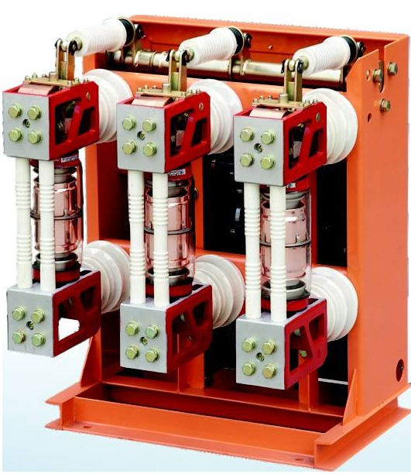
01. Background
Arcing Phase
Dielectric Recovery
Current Interruption
The dielectric recovery process is important for a successful interruption.

Slide 4
01. Background
Current Zero
The dissipation of metal vapor (ms)
The dissipation of residual plasma (μs)
Recovery of dielectric strength
The dissipation of residual plasma starts immediately after current zero, which is important for the study of dielectric recovery process.

Slide 5
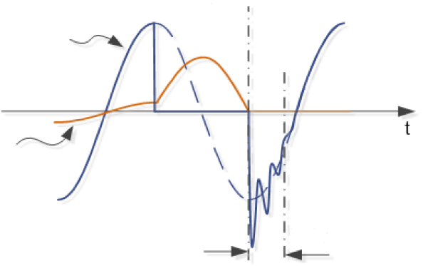
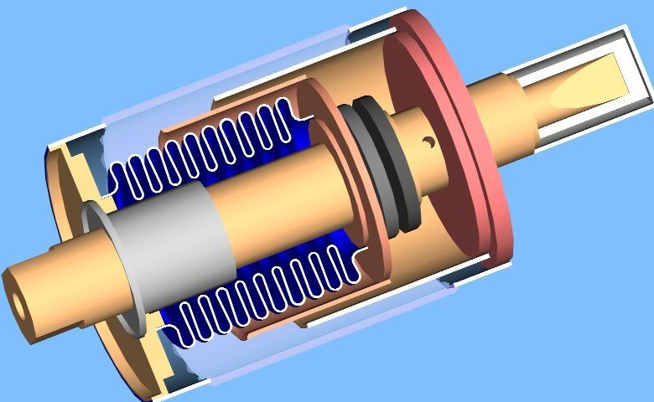
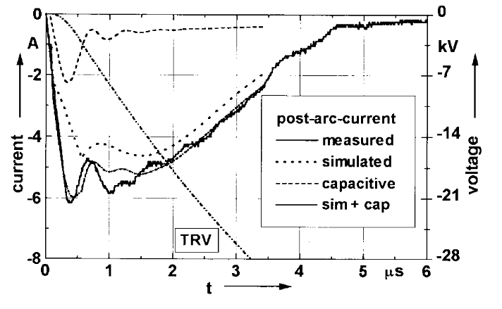
01. Background
Post-arc current
Voltage
Current
TRV
The dissipation of residual plasma
The post-arc sheath forms under the effect of transient recovery voltage. Meanwhile, the post-arc current forms when the charged particle are absorbed by the electrodes.

Slide 6
01. Background
Researches on post-arc current
Modeling & Simulations
  Continuous transition model (CTM)
    The derivation of this model is based on a semi-infinite collisionless plasma.
    It is numerically instable and not so self-consist
    It requires little computational time
    The simulations with CTM agree well with the post-arc current obtain with experiments in relatively low current interruptions
J. G. Andrews and R. H. Varey, "Sheath Growth in a Low Pressure Plasma," Physics of Fluids, vol. 14, no. 2, pp. 339-343, 1971.
R. Holmes and S. Yanabu, "Post-arc current mechanism in vacuum interrupters," Journal of Physics D: Applied Physics, vol. 6, no. 10, p. 1217, 1973.
J. Kaumanns, "Measurements and modeling in the current zero region of vacuum circuit breakers for high current interruption," IEEE Transactions on Plasma Science, vol. 25, no. 4, pp. 632-636, 1997.

Slide 7
01. Background
Researches on post-arc current
Modeling & Simulations
  Hybrid Maxwell-Boltzmann model (Hybrid-MB model)
    The electron density is obtained from Maxwell-Boltzmann relation
    The ions are treated as particles
    It requires less computational time
    The influences of plasma density, the rising rate of transient recovery voltage, metal vapor, evaporation of electrodes, polarity effect on the post-arc sheath
P. Sarrailh, L. Garrigues, G. J. M. Hagelaar, J. P. Boeuf, G. Sandolache, and S. Rowe, "Sheath expansion and plasma dynamics in the presence of electrode evaporation: Application to a vacuum circuit breaker," Journal of Applied Physics, vol. 106, no. 5, pp. 053305-053305-12, 2009.
P. Sarrailh et al., "Expanding sheath in a bounded plasma in the context of the post-arc phase of a vacuum arc," Journal of Physics D: Applied Physics, vol. 41, no. 1, p. 015203, 2008.
P. Sarrailh et al., "Two-Dimensional Simulation of the Post-Arc Phase of a Vacuum Circuit Breaker," IEEE Transactions on Plasma Science, vol. 36, no. 4, pp. 1046-1047, 2008.

Slide 8
01. Background
Researches on post-arc current
Modeling & Simulations
  PIC model
    Both the electrons and ions are treated as particles
    It is more self-consistent and costs more computational time than the hybrid Maxwell-Boltzmann model
    The PIC model has been applied to the study of post-arc sheath in recent years. The influence of metal vapor on post-arc sheath and post-arc breakdown has been studied.
S. Jia, Y. Mo, Z. Shi, J. Li, and L. Wang, "Post-arc current simulation based on measurement in vacuum circuit breaker with a one-dimensional particle-in-cell model," Physics of Plasmas, vol. 24, no. 10, p. 103511, 2017.
Y. P. Mo, Z. Q. Shi, Z. B. Bai, S. L. Jia, and L. J. Wang, "Influence of residual plasma drift velocity on the post-arc sheath expansion of vacuum circuit breakers," Physics of Plasmas, vol. 23, no. 5, p. 053506, 2016.
Y. P. Mo, Z. Q. Shi, S. L. Jia, and L. J. Wang, "One-dimensional particle-in-cell simulation on the influence of electron and ion temperature on the sheath expansion process in the post-arc stage of vacuum circuit breaker," Physics of Plasmas, vol. 22, no. 2, p. 023511, 2015.
Y. Mo, Z. Shi, S. Jia, and J. Li, "Experimental Investigation on the Postarc Current in Vacuum Circuit Breakers and the Influence of Arcing Memory Effect," IEEE Transactions on Plasma Science, pp. 1-8, 2019.

Slide 9
01. Background
Further study about post-arc current
Some questions
  How do the vacuum arc influence the formation of post-arc current still remains controversial in vacuum circuit breakers?
  How do the residual plasma influence the post-arc sheath expansion process are not very clear in vacuum circuit breakers ?

Slide 10
Contents
Background
Simulations of post-arc sheath
Simulations of post-arc current
Experimental studies of post-arc current
Summary

Slide 11



02. Simulations of post-arc sheath
1-D PIC model (both ions and electrons are treated as macro particles)
The potential and positions
Constraint condition
Simulating program flowchart
TRV=1kV/μs
Zero potential
$λ_{D}$ is the Debye length
$ω_{p}$ is the plasma frequency
$v_{e}$ is the thermal velocity
Schematic diagram of simulation model

Slide 12
02. Simulations of post-arc sheath
Comparison of 1-D PIC model and CTM
Introduction of CTM (Deduced from Poisson Equation, Continuity Equation and Momentum Equation)
Results
  The sheath expansion process with CTM and PIC are similar in the initial stage
  The sheath with PIC expands faster than that with CTM after about 2 μs which is more close to actual value.
Comparison with CTM and PIC

Slide 13
02. Simulations of post-arc sheath
Comparison of PIC model and Hybrid-MB model
The results with two models are close
Results with hybrid-MB model in Ref
Results with PIC model
Parameters：n₀=1×10¹⁹ m⁻³, T_{e}= 1 eV, T_{i}=1800 K, TRV=1kV/μs

Slide 14
02. Simulations of post-arc sheath
Introduction of ion rarefaction wave
  The ion rarefaction wave seems can be to explain the variation of plasma in the contact gap
  When the sheath are stable, the plasma density of sheath edge are 0.4 times of the plasma density of wave front
  Two ion rarefaction waves forms in both two electrodes and develop to the middle of the gap
  When the two rarefaction waves meets in the middle of gap, the overall plasma density begins to decrease and the sheath expansion velocity begins to increase
Electron density taken from PIC model
Sheath expansion velocity taken from PIC model

Slide 15
02. Simulations of post-arc sheath
The post-arc sheath with different plasma temperatures
  Influences of electron temperature
  The post-arc sheath expands faster to post-arc anode with higher electron temperature
  The sheath expansion process are similar in the initial stage with different electron temperature
  The sheath expansion velocity increases earlier with higher plasma temperature
The variation of sheath thickness
The variation of sheath expansion velocity

Slide 16
02. Simulations of post-arc sheath
The post-arc sheath with different plasma temperatures
  The influence of ion temperature
    The post-arc sheath expands faster with higher ion temperature
The variation of sheath thickness
The variation of sheath expansion velocity

Slide 17
02. Simulations of post-arc sheath
The post-arc sheath with different initial plasma drift velocities
  The influence of initial plasma drift velocity
    The sheath expands faster with higher v_{drift}
    The sheath expands slower with higher v_{drift} in the initial stage.
The variation of sheath thickness
The variation of sheath expansion velocity

Slide 18

02. Simulations of post-arc sheath
The influence of metal vapor-estimation of metal vapor
$T_{s}$ is the contact temperature
The temperature of contact can achieve 2200 K，the metal vapor density also could achieve 10²² m⁻³
The variation of plasma density ranges from 10¹⁸ m⁻³~10²²m⁻³
The relationship between the contact temperature and metal vapor density

Slide 19
02. Simulations of post-arc sheath
The influence of metal vapor-introduction of PIC-MCC model
  Electron and metal vapor
    Elastic collision
    Ionization collisions
    Excitation collision
  Ion and metal vapor
    Charge exchange collision
    Momentum exchange collision
  The collisions between the charged particles and metal vapor are dealt with Monte Carlo collision method (MCC)
collision cross section between electrons and copper atoms. A: elastic collisions, B: excitation for the 3d¹⁰4p²P_{1/2} and 3d¹⁰4p²P_{3/2}, C: excitation for the 3d⁹4s² ²D_{5/2} D: ionization.

Slide 20
02. Simulations of post-arc sheath
The influence of metal vapor
  The post-arc sheath without initial plasma drift velocity
    The metal vapor shows small influence on the post-arc sheath when the metal vapor density is smaller than 10²⁰m⁻³
    The metal vapor slows down the post-arc sheath expansion process when the metal vapor density is larger than 10²¹m⁻³
The variation of sheath thickness
The variation of sheath expansion velocity

Slide 21
02. Simulations of post-arc sheath
The influence of metal vapor
  The proportion of ions entering post-arc anode and total electrons β
    The metal vapor shows small influence on the β and the post-arc anode ionic current density when it is smaller than 10²⁰m⁻³
    the β and the post-arc anode ionic current density decreases obviously when the metal vapor density is larger than 10²¹m⁻³
The variation of β
The variation of post-arc anode ionic current density

Slide 22
02. Simulations of post-arc sheath
The influence of metal vapor
  The post-arc sheath with initial plasma drift velocity
    The metal vapor show small influence on the post-arc sheath when it is small than 10²⁰m⁻³
    The metal vapor shows dominant influence on the post-sheath when it is 10²²m⁻³. Meanwhile the v_{drift} shows no influence on the post-arc sheath
The variation of sheath thickness with v_{drift} =1000m/s
The variation of sheath thickness with 1×10²² m⁻³

Slide 23
02. Simulations of post-arc sheath
The plasma radial motions
  2-D PIC model
    Shield, right boundary and post-arc anode are zero potential
    The plasma is distributed uniformly in the gap
    The equipotential lines in the left boundary is supposed to be parallel to the axis of contacts
Schematic diagram of two-dimensional PIC model
PIC model with L_{c}=100 mm
(ions are in blue and electrons are in red)

Slide 24
02. Simulations of post-arc sheath
The plasma radial motions
  The dissipation of residual plasma
    The residual plasma diffuses out the contact gap
    The shape of sheath edge develops from flat to curve
    The ions would fly to 5~10 mm away with the post-arc cathode surface and then be absorbed
The variation of residual plasma with Lc =25 mm

Slide 25
Contents
Background
Simulations of post-arc sheath
Simulations of post-arc current
Experimental studies of post-arc current
Summary

Slide 26
03. Simulations of post-arc current
Influences on the proportion of ions and total electrons entering post-arc anode (β) are studied as part of ions are absorbed by the post-arc anode
  Influence of residual plasma density
    The post-arc sheath expansion process becomes slower with the increase of residual plasma density
    The β also increases with the residual plasma density
    The β approaches saturation when the residual plasma density is larger than 5×10¹⁸ m⁻³
The β with different residual plasma densities
The sheath expansion velocity with different residual plasma densities

Slide 27
03. Simulations of post-arc current
Influences on the post-arc current density
Comparison with measurement and simulation
  The variation of simulation results is smaller than measurement
  The peak value and duration time of post-arc current obtained from simulation is smaller than measurement.
The ions entering the post-arc anode are neglected when estimating the residual plasma. As a result, the estimated residual plasma density is small
Comparison with simulations and measurements

Slide 28
03. Simulations of post-arc current
Influences on the post-arc current density
Comparison with simulations and measurements
  Adjusting the residual plasma density according to β
  The simulated post-arc current is more closer to measurement after adjustment.
Q/(1-β)
The β with different residual plasma density
Comparison with measurement and simulations

Slide 29
Contents
Background
Simulations of post-arc sheath
Simulations of post-arc current
Experimental studies of post-arc current
Summary

Slide 30
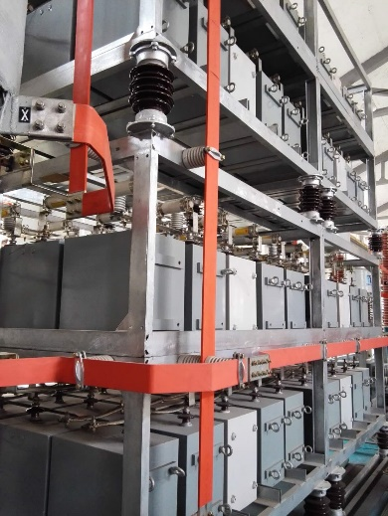
04. Experimental studies of post-arc current
Experimental setup
Synthetic circuit
The post-arc current is measured by a high-resolution current-zero diagnostic system.
The vacuum arc is recorded by a high speed camera (exposure: 2 μs， frame rate：19000 fps)

Slide 31
04. Experimental studies of post-arc current
Experimental setup
t₁ Current flows through VCB
t₂ VCB begins to open
t₃ Reversed current flows through VCB
t₄ Current decreases to zero
A typical waveform of the current interruption process in a vacuum circuit breaker.

Slide 32

04. Experimental studies of post-arc current
Typical post-arc current
T_{pa}
A typical waveform of the current interruption process in a vacuum circuit breaker.

Slide 33
04. Experimental studies of post-arc current
Contact parameters
TABLE. 1 Types of different contacts
Abbreviations | Diameter(mm) | Materials | Structure
30mm-Cu-butt | 30 | Cu | Butt
58mm-Cu-butt | 58 | Cu | Butt
58mm-Cu-TMF | 58 | Cu | TMF
58mm-CuCr50-AMF | 58 | CuCr50 | AMF
58mm-CuCr50-TMF | 58 | CuCr50 | TMF
Five types of contacts are adopted to study the influence of diameter, material and structure on the post-arc current.

Slide 34
04. Experimental studies of post-arc current
The influence of diameter
A comparison of I_{pa} ,Q and T_{pa} with different diameters
The I_{pa} , Q and T_{pa} of 30mm-Cu-butt contact is higher than that of 58mm-Cu-butt contact with the same current.

Slide 35
04. Experimental studies of post-arc current
The influence of structure
A comparison of I_{pa} ,Q and T_{pa} with different structure
The I_{pa}, Q and T_{pa} of 58mm-CuCr50-TMF contact is higher than that of 58mm-CuCr50-AMF contact with the same current.

Slide 36


04. Experimental studies of post-arc current
The influence of structure
AMF 18kA
TMF 18kA
19000fps
The vacuum arc of TMF contact burns more intensely than that of AMF contact.
The vacuum arc of TMF contact are more unstable.
The more intense vacuum arc of TMF contact results in a higher post-arc current.
AMF 18kA
TMF 18kA

Slide 37
04. Experimental studies of post-arc current
The influence of materials
A comparison of I_{pa} ,Q and T_{pa} with different materials
The I_{pa} , Q and T_{pa} of the Cu contact is higher than that of CuCr50 contact with the same current.

Slide 38

04. Experimental studies of post-arc current
The influence of materials
CuCr50 18kA
Cu 18kA
19000fps
Droplets occurs between the Cu contact.
The vacuum arc of Cu contact burns more intensely than that of CuCr50 contact.
The more intense vacuum arc of Cu contact also results in higher post-arc current.
CuCr50 18kA
Cu 18kA

Slide 39
04. Summary
The plasma temperature, initial plasma drift velocity and plasma radial motion have effect on the post-arc sheath expansion processes and post-arc current. The post-arc sheath expands fast with higher plasma temperature or initial plasma drift velocity.
The ions absorbed by the post-arc anode has a significant affect on post arc current. The simulations indicate that the residual plasma density, the metal vapor density show relatively obvious influence on the ions absorbed by the post-arc anode.
The experimental results indicates that the vacuum arc modes can influence the post-arc current. The post-arc current value and duration time increase when the vacuum arcs more intense.

Slide 40
8th International Workshop on Mechanisms of Vacuum Arcs
(MeVArc 2019)
Thank you for your attention !
2
0
1
9

