Slide 1
A possible mechanism for enhanced field emission
with essential input from Yinon Ashkenazy and Jan Paszkiewicz

Slide 2
Background
As far as I know, everyone who makes field emission measurements on a macroscopic system needs a large – 30, 100 or more – correction factor to get I vs V data to fit to Fowler-Nordheim. We certainly do.
There are quite a lot of ideas about how this enhanced emission comes about. Tips, oxides, carbon and dust, and these may indeed dominate most systems - you know your systems better than I do!
I propose a mechanism for observed enhanced field emission which I believe dominates in our high field systems.

Slide 3
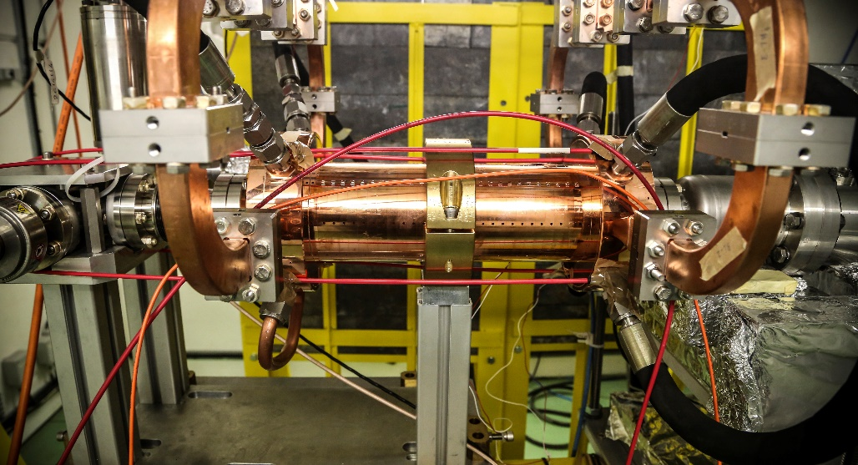
Introduction
CLIC 12 GHz high-gradient accelerating structures and associated dc systems have particular conditions:
  Surface electric fields in excess of 250 MV/m
  Over 50 structures and electrode sets tested
  Hundreds of millions of pulses per test, sometimes even billions
  Ultra-high vacuum
  Reproducible conditioning behavior
  Highly repeatable results – for example β around 30 every time in accelerating structures!
  Extensive microscopy
Presentations at MeVArc: D. Banon, J. Paszkiewicz, I. Profatilova, M. Jacewicz, A. Saressalo, L. Millar
All of which taken together, leads us to believe that we are working in a regime where the limiting surface field, and consequently the electron field emission mechanism, is given by the intrinsic characteristics of copper.

Slide 4
State-of-the-explanation
So if intrinsic, what can give enhanced field emission?
Two possibilities are geometrical “tips” and suppressed work function.

Slide 5
State-of-the-explanation
So if intrinsic, what can give enhanced field emission?
Two possibilities are geometrical “tips” and suppressed work function.
But we never see tips. From SEM we are sure they would have to be smaller than 100 nm. But they are thermodynamically unstable below 20 nm or so. Narrow window…
They might be built up dynamically. Timescale is then less than 5 ns and the process would have to be very reproducible and evolve as conditioning proceeds. Hmmm.
Excellent work on tips being done. But I’m not convinced they’re there…

Slide 6
State-of-the-explanation
So if intrinsic, what can give enhanced field emission?
Two possibilities are geometrical “tips” and suppressed work function.
Suppressed work function can come from lattice defects, add-atoms and so on.
Experiments show effect around 0.5 eV
H. Chen, Y. Du, W. Gai, A. Grudiev, J. Hua, W. Huang, J. G. Power, E. E. Wisniewski, W. Wuensch, C. Tang, L. Yan, and Y. You, Surface-Emission Studies in a High-Field RF Gun based on Measurements of Field Emission and Schottky-Enabled Photoemission, Phys. Rev. Lett. 109, 204802 (2012).
Theory also shows around 0.5 eV
Heikki Toijala, Kristjan Eimre, Andreas Kyritsakis, Vahur Zadin, Flyura Djurabekova, Ab Initio calculation of field emission from metal surfaces with atomic--scale defects, arXiv:1907.12903
Compared to 4.5 eV - not enough for corrections of 30 to 100 and more!

Slide 7
Have we missed an effect?

Slide 8
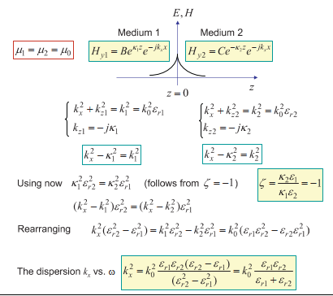
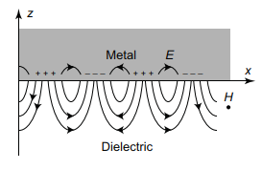
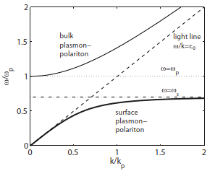
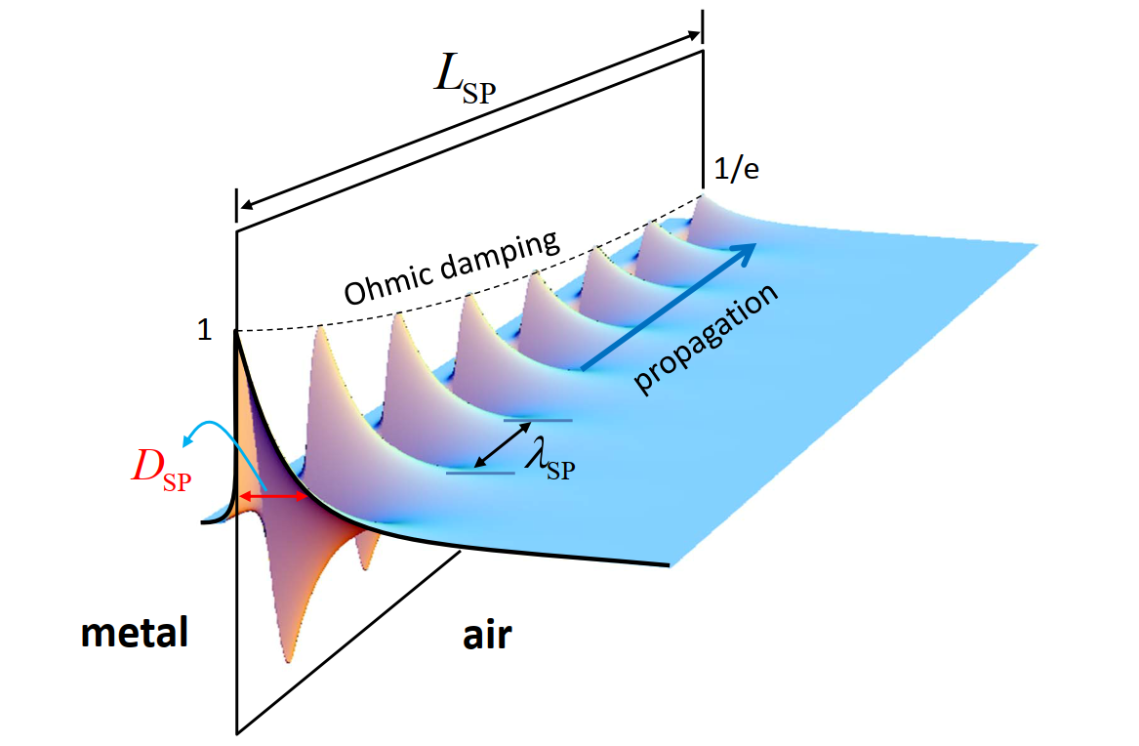
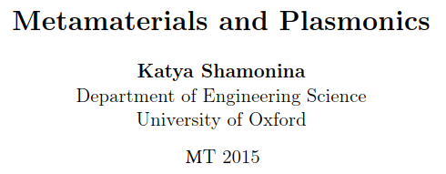
Surface Plasmon Polaritrons
Plasmons are waves confined to the metal surface. They wavelength of the order of 100 nm at optical frequencies.
From:

Slide 9
Plasmons generally
Plasmons exist, and there is a whole field studying them and using them.
They have a dimension scale, wavelength order 100 nm, so similar to ours.
They are notoriously difficult to observe due to the wavelength mismatch with light, so easy to miss.
Turns out that excitation with electron beams is a standard technique!

Slide 10
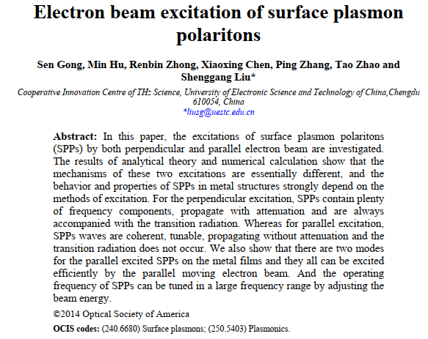
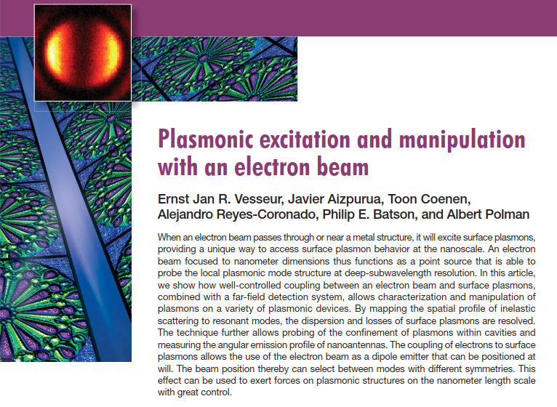
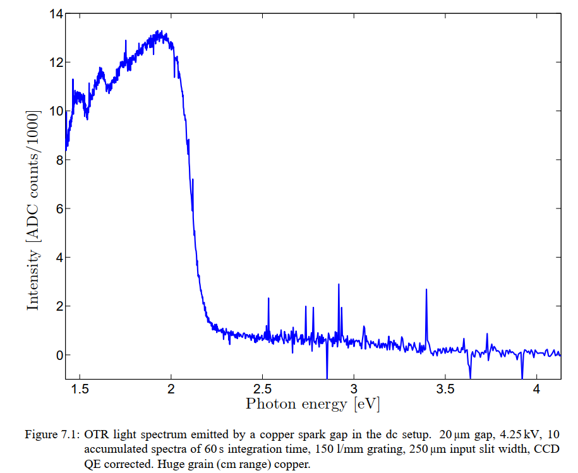
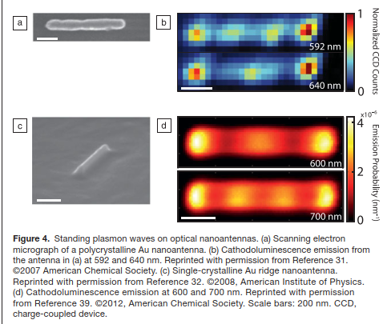
Plasmons, optical transition radiation and electron beams
620 nm
PhD thesis Jan Kovermann
CERN dc system a few years back, light spectrum generated during field emission, copper electrodes. Attributed to OTR (Optical Transition Radiation).

Slide 11
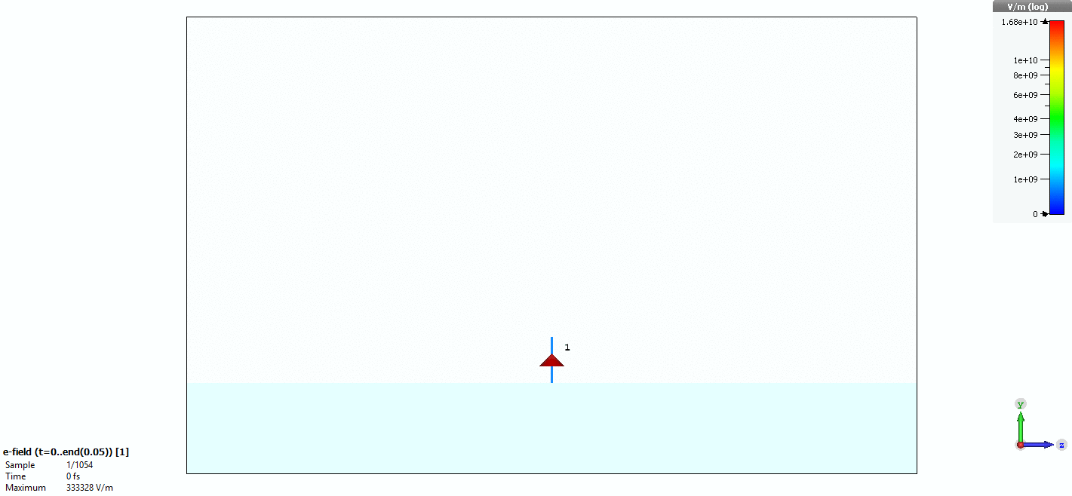
Plasmons, optical transition radiation and electron beams
OTR
Vacuum
Plasmon
current pulse
Copper (Drude model)
Simulation by Jan Paszkiewicz

Slide 12
Anode and cathode
OTR spectrum depends on electron beam energy so what we saw was most likely dominated by anode. But because plasmon is localized to metal surface, it doesn’t care if current goes in or out so excited on both anode and cathode.

Slide 13
The big question: are plasmons playing an important role in field emission?
Do these elements interact?
Significantly?
Enough to modify expected field emission?
It’s far from proven, but I propose that the correction to Fowler Nordheim field emission in intrinsic-dominated systems is caused by plasmon resonances.
Plasmons
e⁻
e⁻
e⁻
e⁻
Field emitted electrons
External electric field

Slide 14
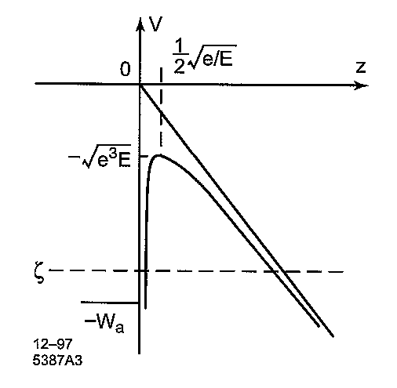
How might plasmons result in enhanced emission?
Spontaneous (thermally driven?) emission excites initial plasmons
Plasmon causes local increase in charge density, leading to increased field emission.
Etc. Requires mechanism for positive feedback, this is tricky.
Excitation grows to steady state value given by Q of plasmon resonance, and giving observed enhanced emission.
Plasmons
e⁻
e⁻
e⁻
e⁻
Field emitted electrons
External electric field
Generally – plasmons mean that the source of electrons for field emission is not an ideal current source, but rather one like a transmission line, or alternatively an effective inductance and capacitance. This means there are resonances.

Slide 15
How we will proceed
Plasmons may provide a very high resolution diagnostic tool for investigating our high-field surfaces. We would like to learn how to measure them and manipulate them.
Plasmons must be excited in our field emitting systems. We will investigate this experimentally.
Plasmons may contribute to enhanced field emission. Investigating the first two points are essential steps to addressing this question.
Experimental:
Implement interferometric techniques to excite and detect plasmons in our samples. First just as samples and later under high fields. Yinon and colleagues at the University of Jerusalem.
Measure light emission from pulsed dc system at CERN with new focus. Two metal anode/cathode pairs, voltage vs field dependencies etc. Part of Ruth Peacock’s PhD.
etc.
Theoretical:
Mathematical model for field emission to plasmon coupling to investigate positive feedback mechanism.
Clarify how increased charge density affects field emission, try to make a quantitative estimate of level of emission enhancement.
etc.

Slide 16
Thanks for your attention!

