Slide 1
Dynamic coupling between particle-in-cell and atomistic simulations
Mihkel Veske, Andreas Kyritsakis, Kyrre N. Sjobaek, V. Zadin, A. Aabloo and F. Djurabekova
Helsinki Institute of Physics and Department of Physics
University of Helsinki
Finland

Slide 2
Outline
The plasma onset stage of vacuum BD and its importance for BD mitigation
Two schools of thought:
“explosive emission” vs “thermal evaporation”
Concurrent ED-MD simulations on nanotips
The thermal runaway process
Integrating with PIC simulations
Results
Conclusions

Slide 3
Vacuum breakdown stages
Stage 1
Stage 2
Anode
+
Anode
+
UHV
e⁻
UHV
-
-
Cathode
Cathode
Sharp tips on surface, field enhancement, electron emission
Plasma onset: thermal runaway, neutral evaporation
Stage 3
Stage 4
Anode
+
Anode
UHV
UHV
Cathode -
Cathode
Ionization, plasma formation-expansion, high current, voltage collapse
Extinction of energy,
plasma cools- recombines, crater remains

Slide 4
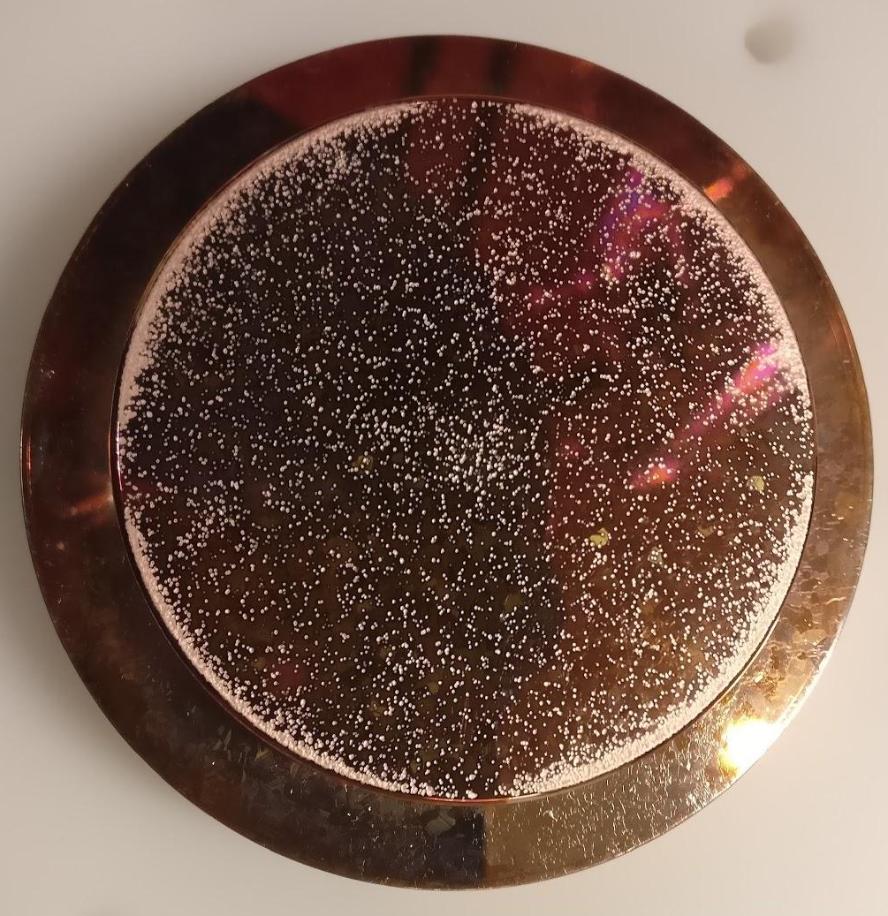
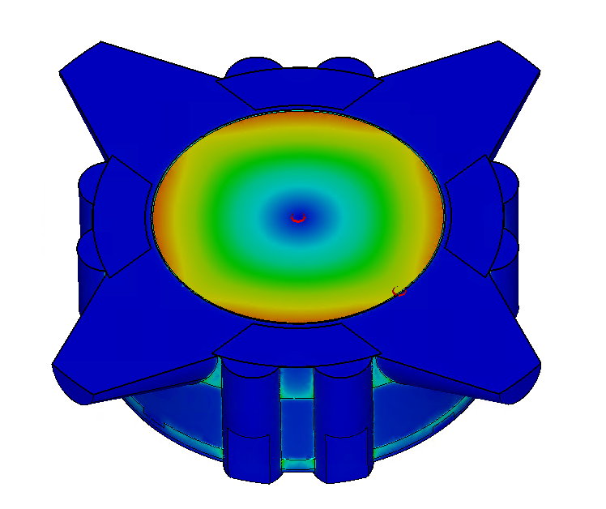
Importance of stages 2,3: power flow limits
Can we use this as a design way to mitigate Vacuum breakdown?
First we need to understand it
What is the limiting factor for BD initiation?
What makes the available EM power to be sufficient in some cases, while insufficient in other?
Soft Cu electrode,
Anton Saressalo
Calculated S_{c} @ 100 MHz
Jan Paszkiewicz

Slide 5
Vacuum breakdown stages
Stage 1
Stage 2
Anode
+
Anode
+
UHV
e⁻
UHV
-
-
Cathode
Cathode
Sharp tips on surface, field enhancement, electron emission
Plasma onset: thermal runaway, neutral evaporation
Stage 3
Stage 4
Anode
+
Anode
UHV
UHV
Cathode -
Cathode
Ionization, plasma formation-expansion, high current, voltage collapse
Extinction of energy,
plasma cools- recombines, crater remains

Slide 6
Plasma ignition: schools of thought
Explosive emission (ECTON model):
  Tip heats up by Joule heating (FE current)
  The heat accumulates while the shape stays constant
  Extreme temperatures
  Direct phase transition from metal to plasma
Thermal runaway - evaporation:
  Tip heats by Nottingham & Joule and melts on top
  Maxwell stress pulls and sharpens it
  Molten material at high temperatures emits vapor
  Vapor ionizes by e collisions (and field ionization)
  Ions sputter out more vapor
  Plasma gradually builds up

Slide 7
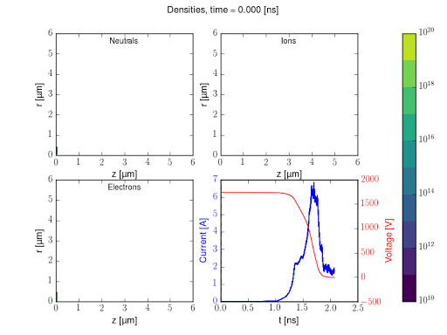
ArcPIC results
Plasma can ignite emitter assuming a small tip that:
  Emits e with an enhancement β>35
  Releases >15 evaporated neutrals per 1000 e.
What is the origin of those neutrals?
What are the mechanisms in Stage 2 that produce the necessary vapor?
H. Timko et. al., Contrib. Plasma. Phys. 4, 229 (2015).
Animation by K. Sjobaek

Slide 8
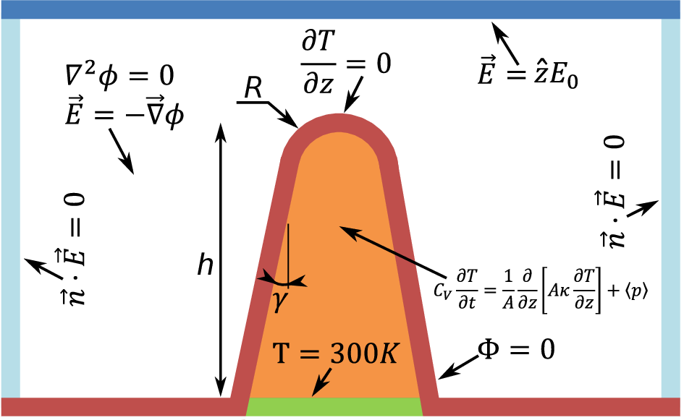
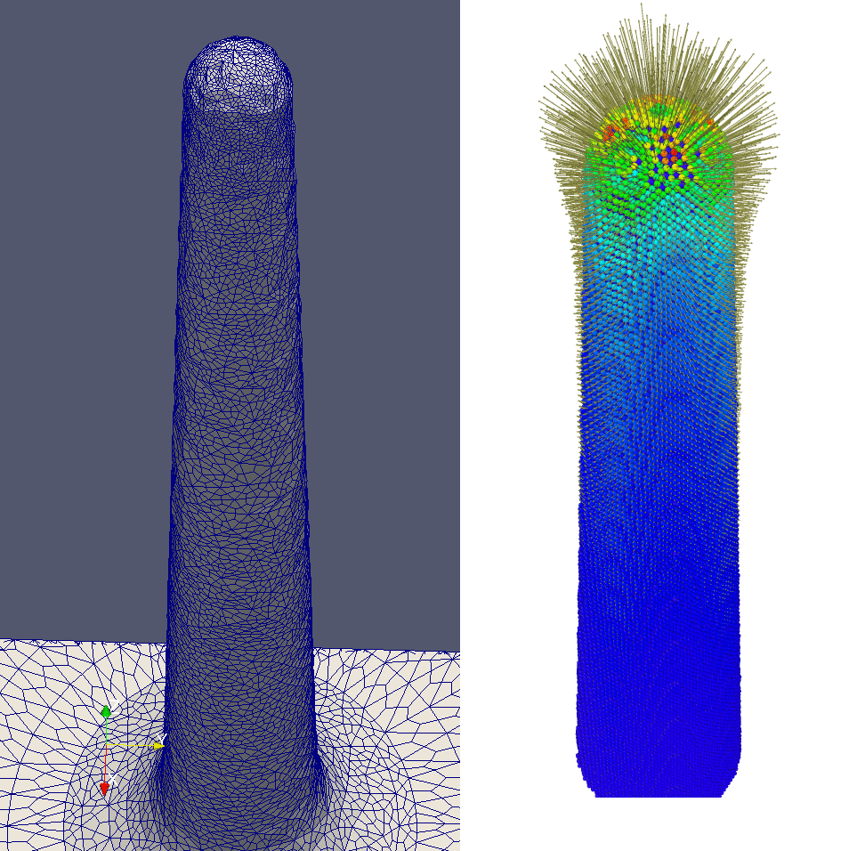
Hybrid MD-ED-Emission-Heat
Thermal runaway: complex process that involves various phenomena that have to be taken into account in the calculations

Slide 9
The concurrent algorithm
Atoms (MD)
Velocity
perturbration
Force perturbation
FEM mesh
Temperature distribution
Sur. charge distribution
Electric Field
Current distribution,
Nottingham heat
Surface emission currents

Slide 10


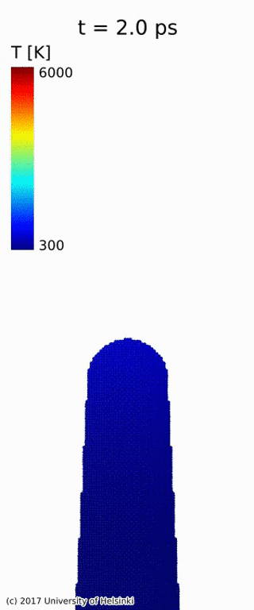
Thermal runaway
  E_{appl}=0.8GV/m
  Mean evaporation rate (first to last evaporation events) r_{Cu}= 75±11 atoms/ps
  Mean current r_{e} = 2807±153 e/ps
  r_{Cu/e}= 0.025±0.003 atoms/e
  The assumption of the ArcPIC simulations (0.015 atoms/e) was not unrealistic at all
  A. Kyritsakis et. al, J. Phys. D: Appl. Phys. 51, 225203 (2018)

Slide 11
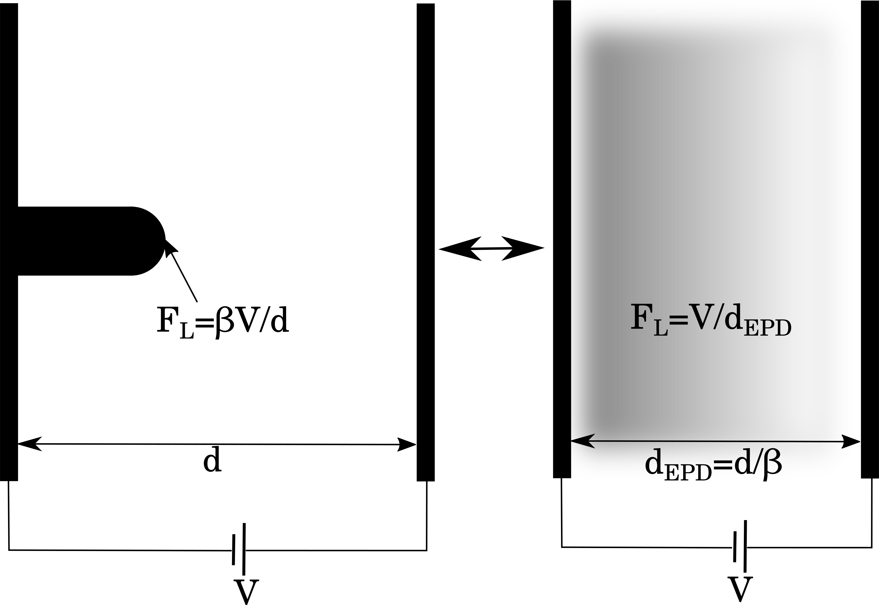
Problem 1: Space-charge limited Field Emission in 3D
In reality, no field emitter is flat and the 1D model is inadequate
Standard treatment: Equivalent Planar Diode (EPD) model
to correct for the field enhancement factor
EPD fails for a simple reason:
The electron beam spreads and J is not constant as in the 1D case
NEED for PIC simulations

Slide 12
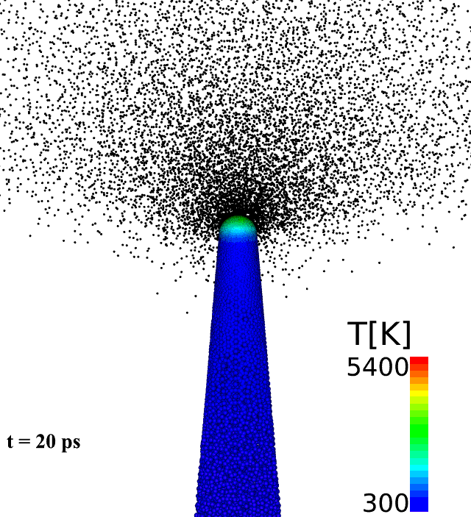
Problem 2: connecting stages 2 and 3
Stage 2 (runaway)
Stage 2&3 (multi-scale)
Stage 3 (Plasma onset)

Slide 13
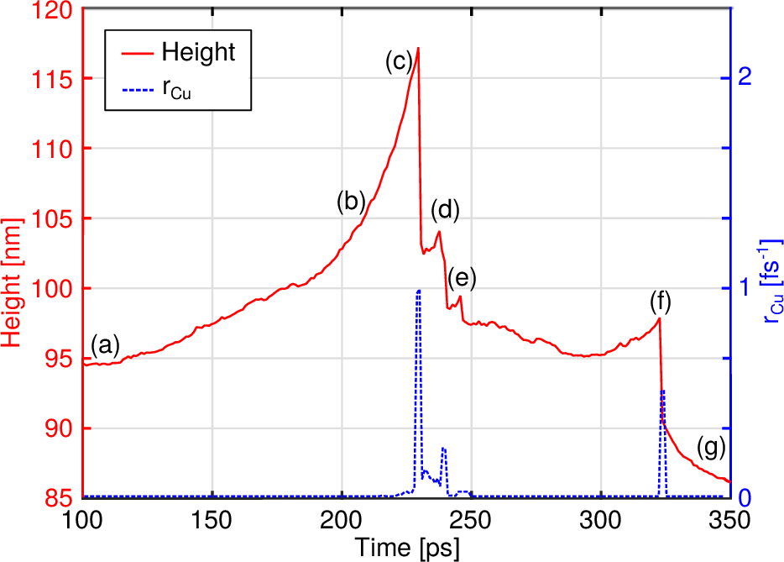
Problem 3: Does the runaway stop?
What happens if we continue?
Does the process continue providing necessary evaporation for a sufficient time to ignite plasma?

Slide 14
Incorporating PIC in FEMOCS
Atoms (MD)
Velocity
perturbration
Force perturbation
FEM mesh
Temperature distribution
PIC
Electric Field
Current distribution
Sur. charge distribution
Particles (e), Positions, Injections

Slide 15
Runaway with full PIC-FEMOCS simulations
r_{thin} = 17nm, r_{wide} = 54nm
E_{appl} = 600MV/m (closer to reality)

Slide 16
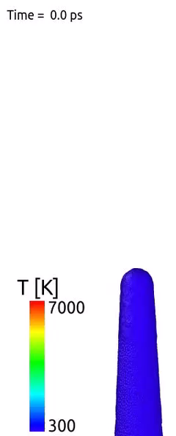
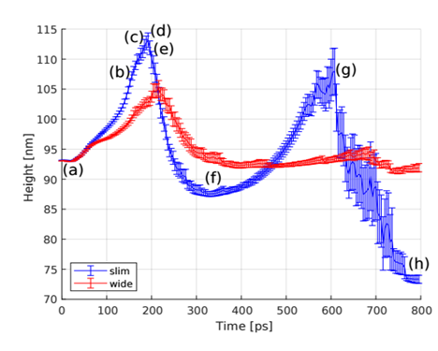
Results I
M. Veske, et. al. https://arxiv.org/abs/1906.08125

Slide 17
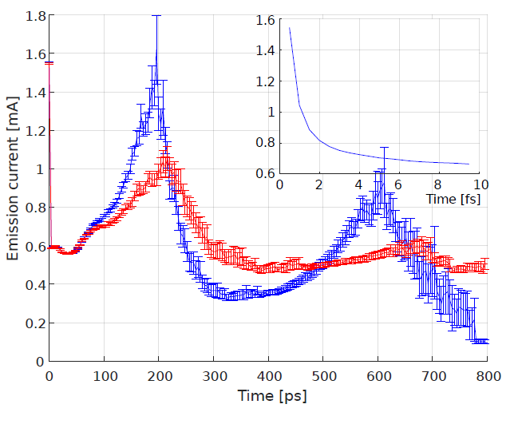
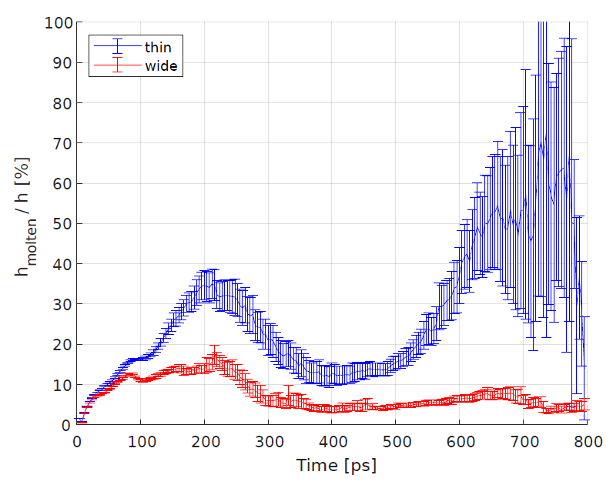
Results II
Power flux density in a cylinder of 10nm radius: 9.5 MW/mm²
Similar to SC limit calculations [1]
[1] A. Grudiev et. al. Phys. Rev. accel. beam. 12 102001

Slide 18
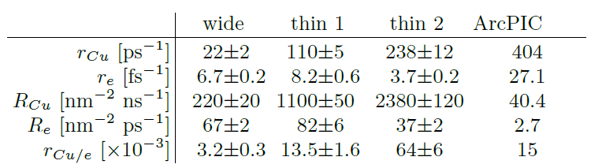
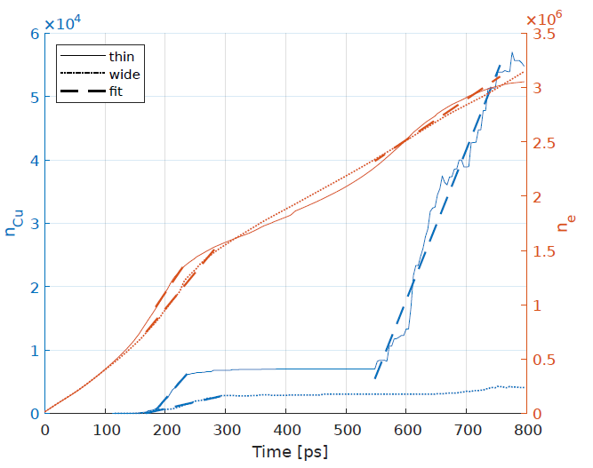
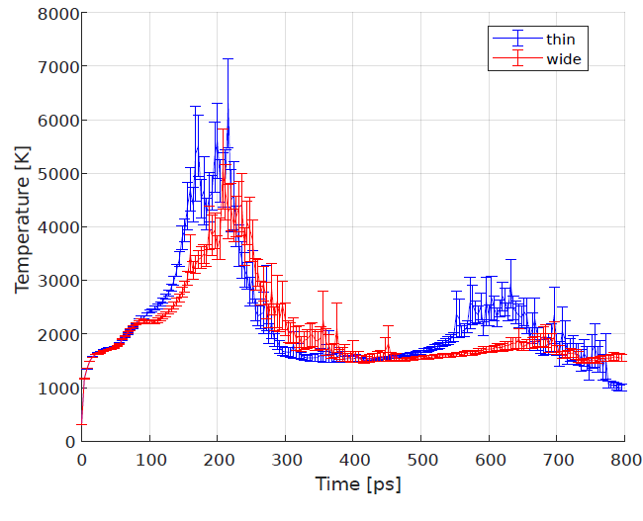
Evaporation rates

Slide 19
Outlook for plasma onset simulations
Ultimate goal: direct connection of stages 2 and 3, simulation of the full BD process
Including other particle species (Cu, Cu⁺, Cu⁺⁺ etc)
  Managing boundary injection between MD and PIC domains (quite challenging)
  Simulating larger systems for longer times to check whether the runaway continues
Understanding the limitations of the arc ignition progress with respect to:
  Power flow and related quantities
  Tip size, shape, β, etc

Slide 20
Conclusions
Getting closer to understanding the transition from intense FE to arc plasma, more complex simulation methods required
Experiments show that the anode does not play a significant role on BDs. Even the anode flare seems to be caused by cathode material
Now we know how to properly calculate the biased diffusion parameters, preliminary results indicate a possibility to grow tips by this mechanism
Surface defects do not affect FE dynamics apart from a slight φ lowering. More evidence that field enhancement is most probably geometric

Slide 21



THANK YOU

