Slide 2
Direct field ionisation
Sergio Calatroni – CERN

Slide 3
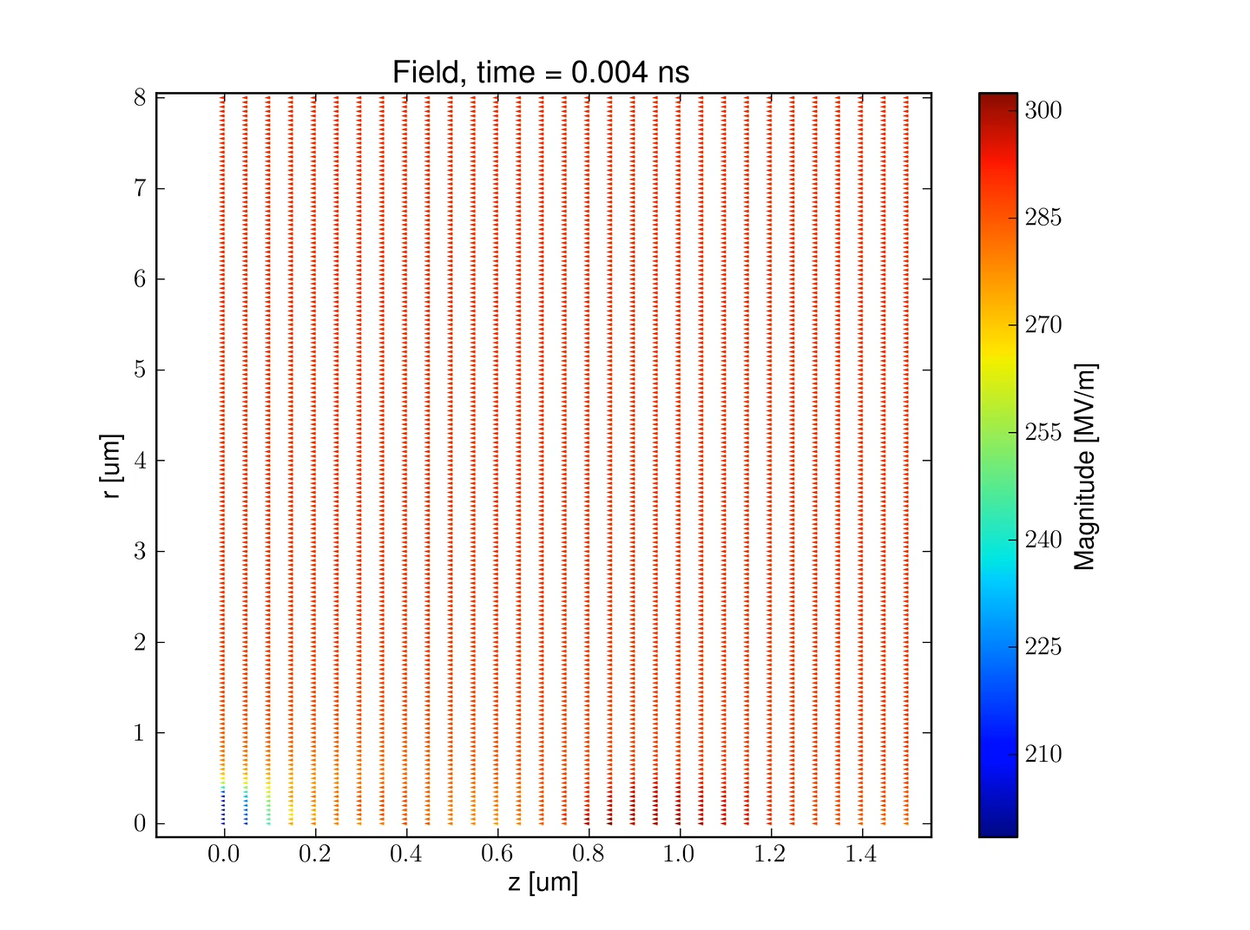
ArcPIC simulations
Courtesy of Andreas Kyritsakis, Kyrre Ness Sjobaek, Helga Timko

Slide 4
Impact ionisation cross section
ArcPIC is based on impact ionisation mechanism
e⁻ + Cu → 2e⁻ + Cu⁺
Courtesy of H. Timko. Values from: M. A. Bolorizadeh et al., J. Phys. B: At. Mol. Opt. Phys. 27 (1994) 175.

Slide 5
Direct field ionisation
Direct ionisation of atoms under electric fields of magnitude comparable to atomic electric field
  Laser WakeField Acceleration: huge electric fields from fs lasers ionise gases
  CLIC: ionisation of residual gas in the vacuum pipes by the field of the (extremely dense) particle bunches
Field ionisation is a tunneling phenomenon
Review: D. Bauer and P. Mulser, Phys. Rev. A 59, (1999) 569.
Is this relevant for vacuum arcs?

Slide 6
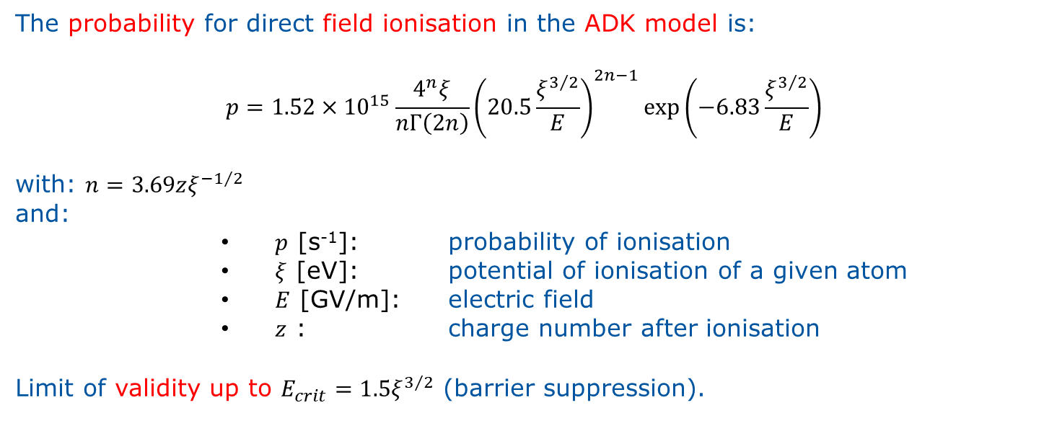
Modelling field ionisation
The probability for direct field ionisation in the ADK model is:
$$p=1.52×{10}^{15}\frac{4^{n}ξ}{nΓ\left(2n\right)}{\left(20.5\frac{ξ^{3/2}}{E}\right)}^{2n−1}\exp\left(−6.83\frac{ξ^{3/2}}{E}\right)$$
with: $n=3.69zξ^{−1/2}$
and:
        $p$ [s⁻¹]: probability of ionisation
        $ξ$ [eV]: potential of ionisation of a given atom
        $E$ [GV/m]: electric field
        $z$ : charge number after ionisation
Limit of validity up to $E_{crit}=1.5ξ^{3/2}$ (barrier suppression).
ADK model: M.V.Ammosov, N.B.Delone, and V.P.Krainov, Sov. Phys. JETP 64, (1986) 1191.
Solution by: D.L.Bruhwiler et al., Physics of Plasmas 10 (2003) 2022.

Slide 7
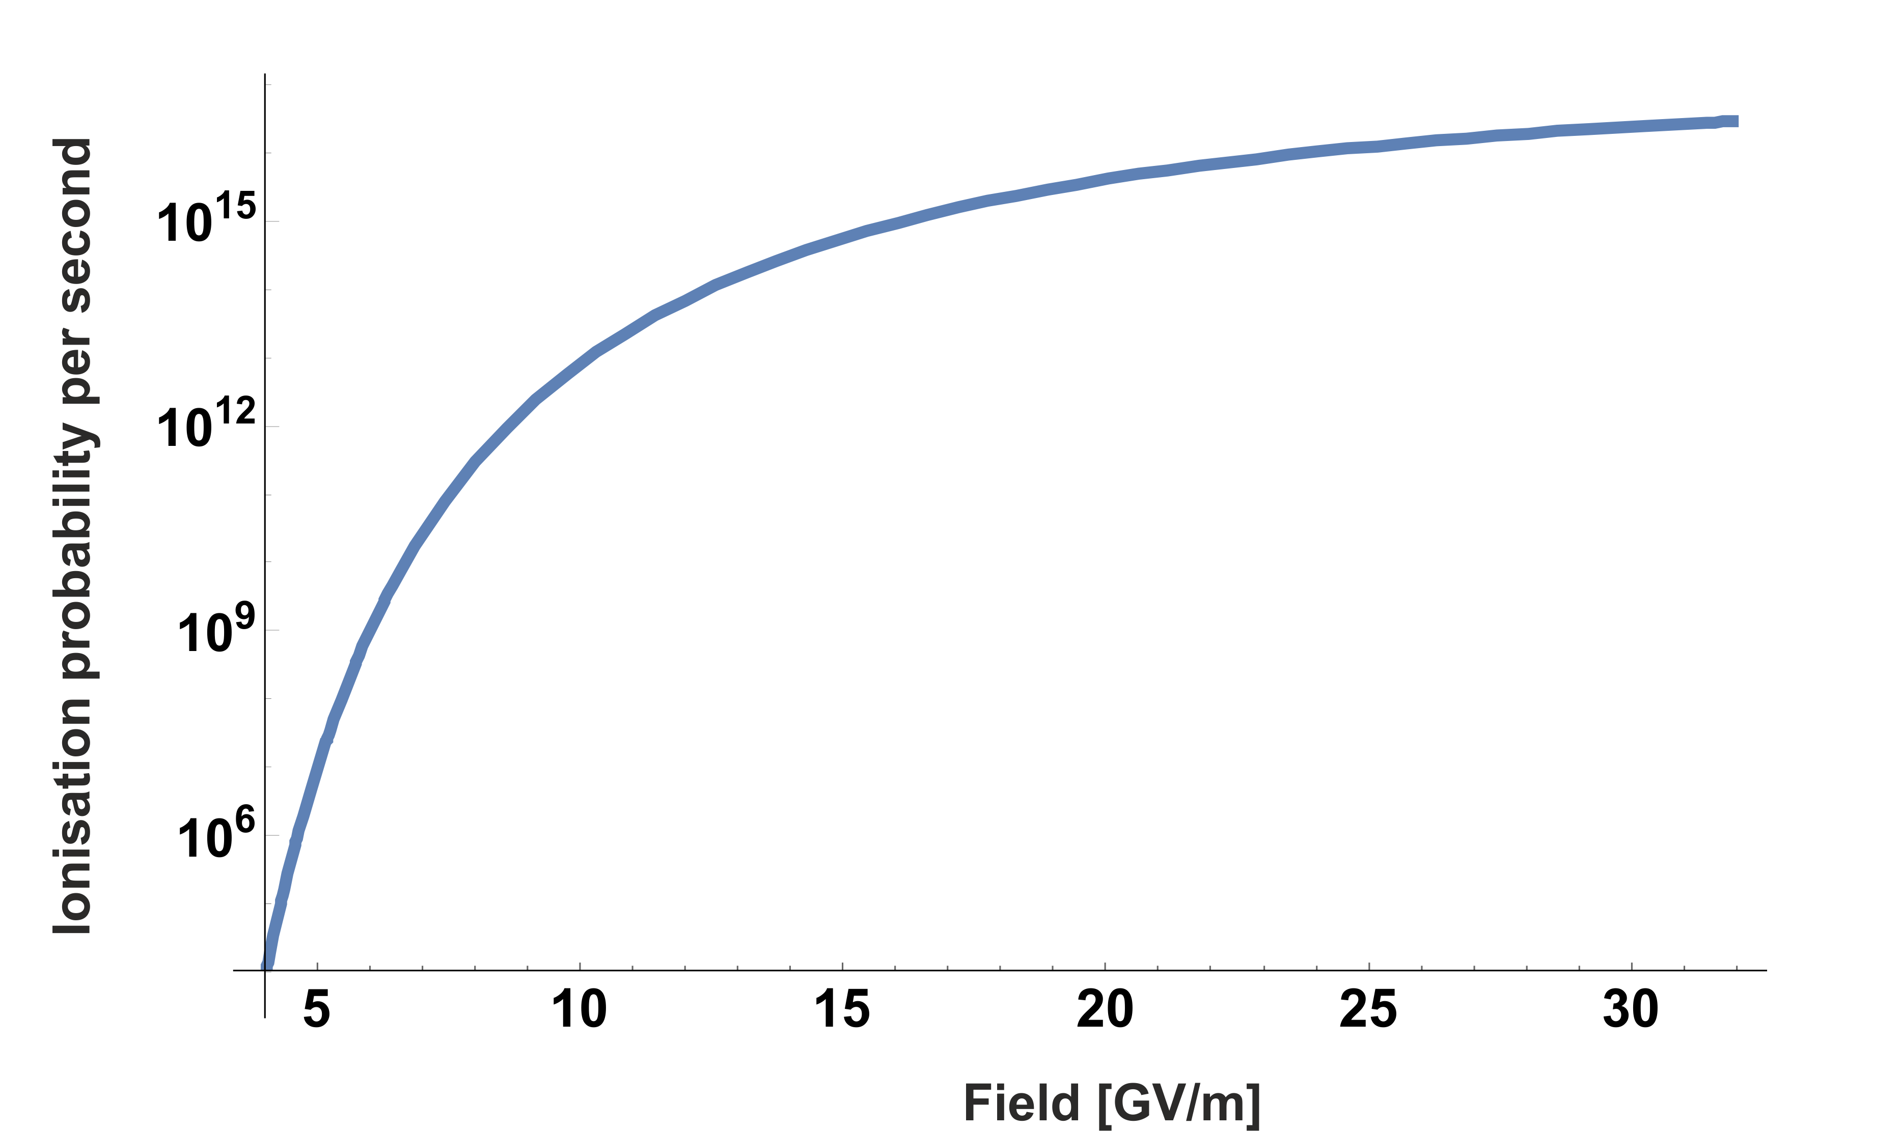

Direct field ionisation probability for Cu
Calculated for Cu, ionisation state $z=$+1, first ionisation potential $ξ=$7.726 eV
Valid for field $E<$32 GV/m
(numbers have meaning of course at ps-fs time scales)
Field [GV/m] | Probability per unit time
5 | 1.1x10⁷
6 | 1.1x10⁹
7 | 2.8x10¹⁰
8 | 3.1x10¹¹
9 | 1.9x10¹²
10 | 8.4x10¹²

Slide 8
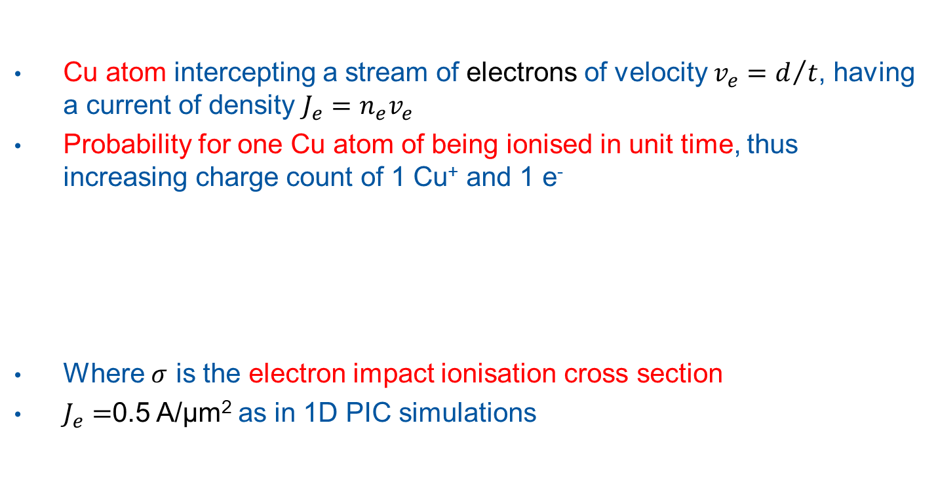

Cross section vs. probability
Cu atom intercepting a stream of electrons of velocity $v_{e}=d/t$, having a current of density $J_{e}=n_{e}v_{e}$
Probability for one Cu atom of being ionised in unit time, thus increasing charge count of 1 Cu⁺ and 1 e⁻
Where $σ$ is the electron impact ionisation cross section
$J_{e}=$0.5 A/µm² as in 1D PIC simulations
$$P=σ_{e}n_{e}v_{e}=σJ_{e}$$
d

Slide 9
Ionisation probability per unit time, J_{e} = 0.5 A/µm²
Note: the values are directly proportional to J_{e}

Slide 10
Impact ionisation vs field ionisation: probabilities
9 GV/m
8 GV/m
7 GV/m
6 GV/m
5 GV/m
Purple: direct field ionisation Red: impact ionization

Slide 11
Conclusion
Direct field ionisation may be relevant in:
  Ionisation in the plasma sheath (competition with other mechanisms, i.e. impact ionisation)
  Ionisation in vicinity of field emitter tip (influence on the breakdown triggering process).
In ArcPIC simulations, we need 0.015 electrons/neutral copper atom in order to trigger runaway. Including field ionisation in the simulations may lead to relaxing this number.

Slide 12


Slide 13

Tesla coil!

Slide 15
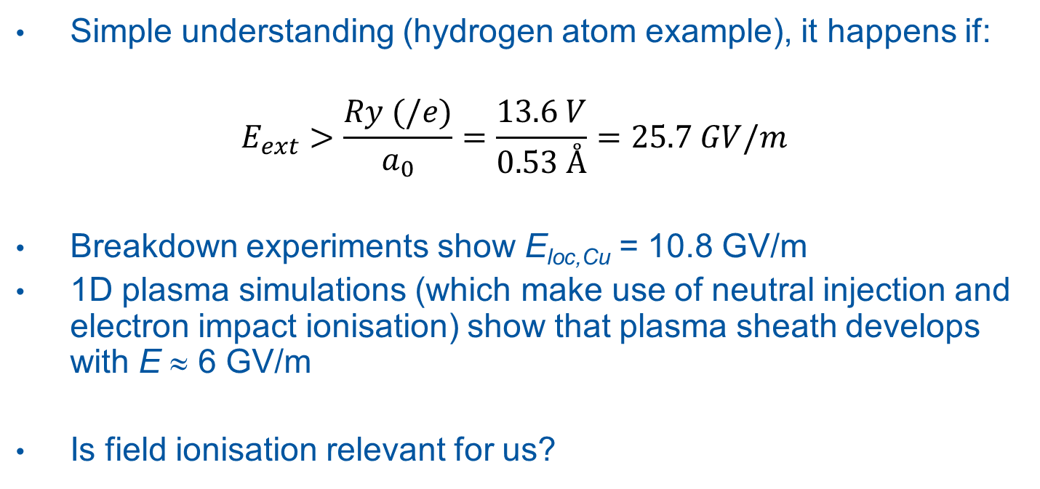
Field ionisation
Simple understanding (hydrogen atom example), it happens if:
$$E_{ext}>\frac{Ry (/e)}{a_{0}}=\frac{13.6 V}{0.53 Å}=25.7 GV/m$$
Breakdown experiments show E_{loc,Cu} = 10.8 GV/m
1D plasma simulations (which make use of neutral injection and electron impact ionisation) show that plasma sheath develops with E ≈ 6 GV/m
Is field ionisation relevant for us?

