Slide 2
LHC Injectors Upgrade Workshop
Montreux, 13-15 February 2019

Slide 3
LIU beam performance reach
S. Albright, F. Antoniou, H. Bartosik, N. Biancacci, H. Damerau, M. Fraser, A. Lasheen, A. Lombardi, G. Rumolo, E. Shaposhnikova, R. Tomás
Acknowledgements: R. Alemany, M. E. Angoletta, F. Asvesta, P. Baudrenghien, E. Benedetto. G. Bellodi, F. Bertin, A. Blas, T. Bohl, K. Cornelis, G. P. Di Giovanni, A. Findlay, V. Forte, B. Goddard, S. Hancock, K. Hanke, S. Hirlander, W. Höfle, A. Huschauer, G. Iadarola, V. Kain, G. Kotzian, D. Küchler, K. Li, E. Mahner, M. Meddahi, B. Mikulec, J. Molendijk, Y. Pappaphilippou, G. Papotti, J. Repond, A. Saa Hernandez, M. Schwarz, R. Scrivens, G. Sterbini, F. Tecker, H. Timkó, F. Velotti and the Operations Teams of Linac3, LEIR, PSB, PS, SPS

Slide 4
Overview
Beams for HL-LHC
LIU baseline for protons
  Removing the present limitations
  Sensitivity of HL-LHC luminosity to beam parameters
Performance with protons
  Linac4, PSB, PS and SPS
Performance with lead ions
  Linac3, LEIR, PS and SPS
Conclusions
  Main challenges
  Progress summary

Slide 5

Menu of beams for HL-LHC
 | Beam type
1. | 72b standard | Nominal beam with up to 4 × 72b from SPS
2. | 72b + 24b mixed | Optimized version with more bunches in LHC Mixed 24b + 72b + 72b from SPS ( )
3. | 48b BCMS | Up to 5 × 48b, no advantage for 6 × 48b
4. | 8b+4e mixed with BCMS | Mixed 2 × 56b + 3 × 48b and 1 × 56b + 1 × 48b Reduce electron cloud heat load
5. | 80b + 32b | 4 × 80b and 1 × 32b + 1 × 80b ( )
Back-up
Mixed schemes might require improving operational flexibility of injectors
Shorter fills have impact on injector operation

Slide 6
Overview
Beams for HL-LHC
LIU baseline for protons
  Removing the present limitations
  Sensitivity of HL-LHC luminosity to beam parameters
Performance with protons
  Linac4, PSB, PS and SPS
Performance with lead ions
  Linac3, LEIR, PS and SPS
Conclusions
  Main challenges
  Progress summary

Slide 7
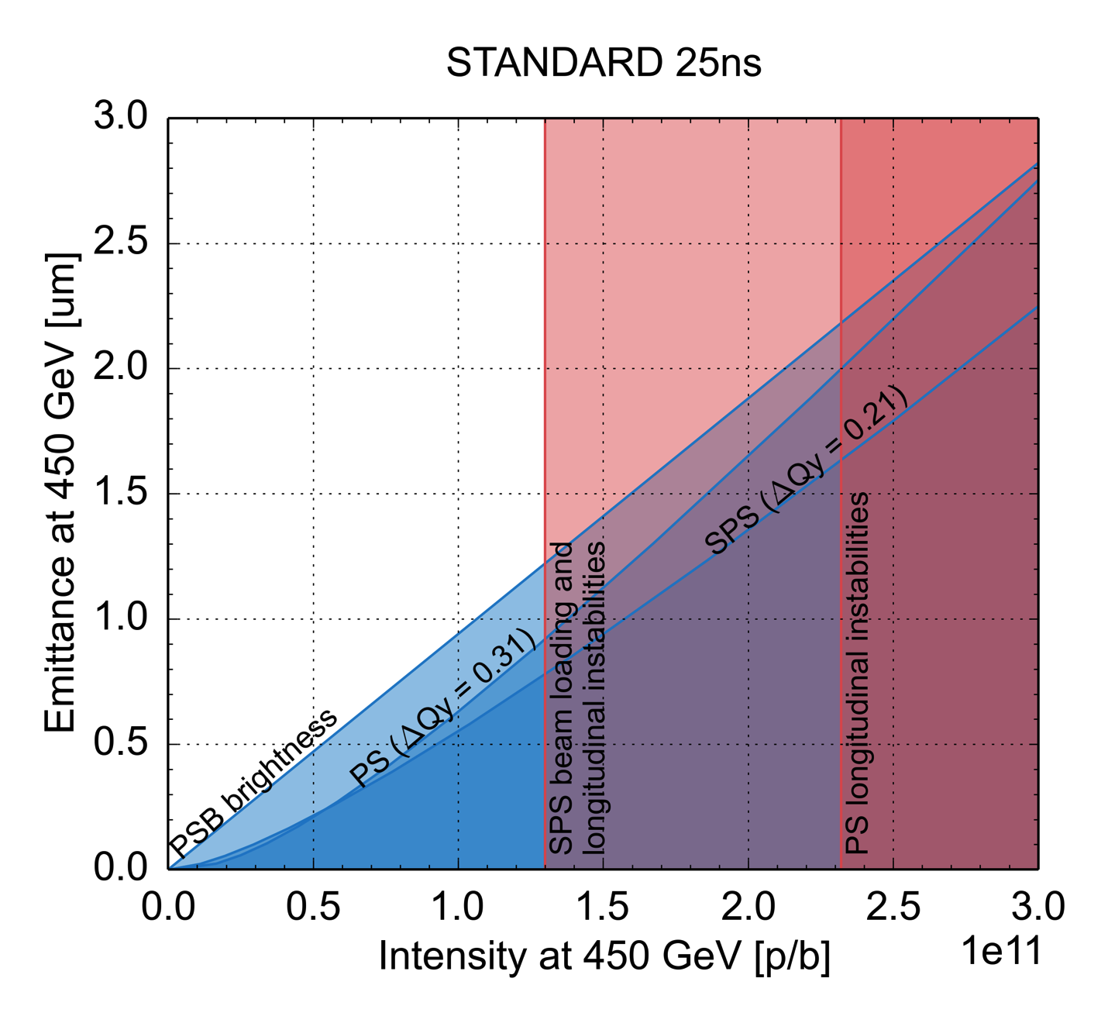
LIU performance reach for protons
Linac4-PSB connection
  Reduced space charge, double PSB brightness
PS upgrade
  2 GeV injection + large longitudinal emittance transfer from PSB
  RF feedbacks to suppress longitudinal instabilities and reduce transient beam loading

Slide 8
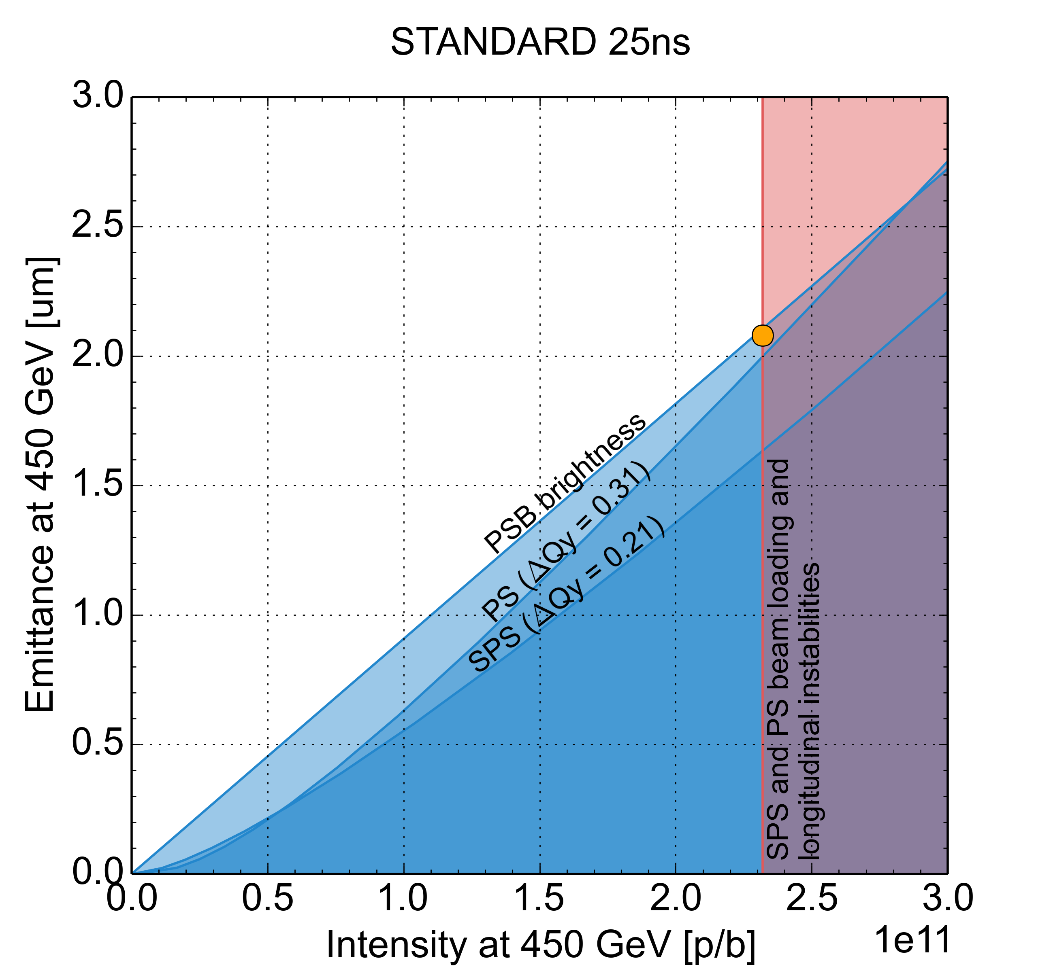
LIU performance reach for protons
Linac4-PSB connection
  Reduced space charge, double PSB brightness
PS upgrade
  2 GeV injection + large longitudinal emittance transfer from PSB
  RF feedbacks to suppress longitudinal instabilities and reduce transient beam loading
SPS upgrade
  200 MHz RF power upgrade and new LLRF
  Q20, scrubbing + partial (staged) SPS aC coating
  New beam dump & transfer line collimators
  Longitudinal impedance reduction (flange shielding and HOM reduction)
HL-LHC target

Slide 9
Parameter sensitivity of HL-LHC
2% luminosity loss of nominal can be caused by
  0.13 ∙ 10¹¹ p/b less at constant brightness
  0.4 μm larger emittance
  at constant intensity
  14 minutes turn around time
  β* increase by 8 cm
  1% efficiency reduction
HL-LHC
Request with
2% luminosity change
Injectors

Slide 10
Parameter sensitivity of HL-LHC
2% luminosity loss of nominal can be caused by
  0.13 ∙ 10¹¹ p/b less at constant brightness
  0.4 μm larger emittance
  at constant intensity
  14 minutes turn around time
  β* increase by 8 cm
  1% efficiency reduction
Trade off performance with speed to serve LHC?
HL-LHC
Request with
2% luminosity change
Injectors

Slide 11
Parameter sensitivity of HL-LHC
2% luminosity loss of ultimate can be caused by
  0.09 ∙ 10¹¹ p/b less at constant brightness
  0.2 μm larger emittance
  at constant intensity
  10 minutes turn around time
  β* increase by 4 cm
  1% efficiency reduction
Trade off performance with speed to serve LHC?
HL-LHC
Request with
2% luminosity change
Injectors

Slide 12
Overview
Beams for HL-LHC
LIU baseline for protons
  Removing the present limitations
  Sensitivity of HL-LHC luminosity to beam parameters
Performance with protons
  Linac4, PSB, PS and SPS
Performance with lead ions
  Linac3, LEIR, PS and SPS
Conclusions
  Main challenges
  Progress summary

Slide 13
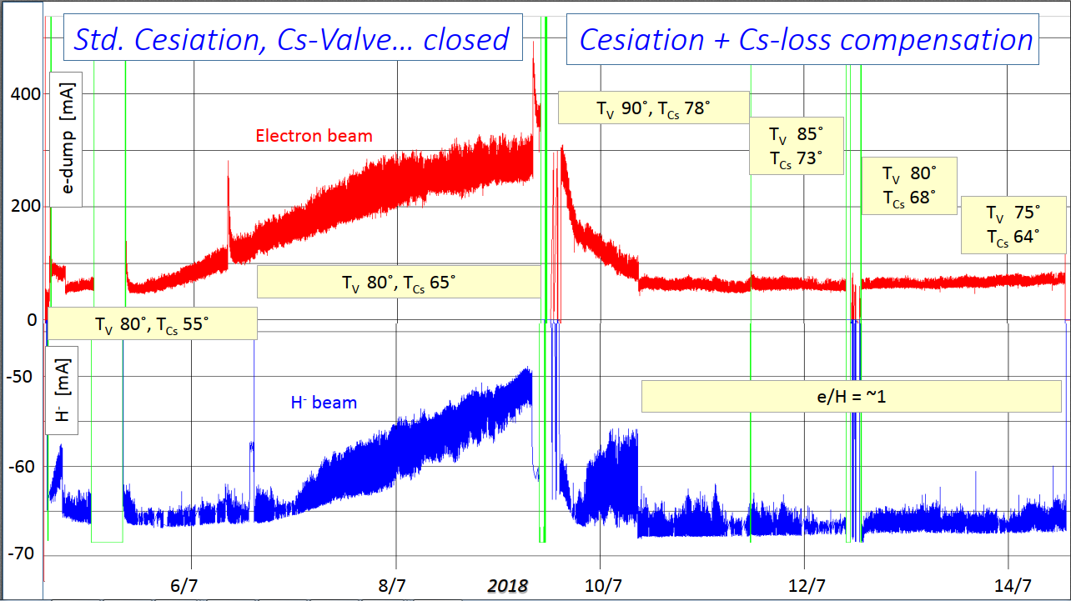
Linac4
Reliable operation with 25 mA current
after RFQ ensures 1.25 ∙ 10¹³ p/ring
  All pre-LS2 beams can be reproduced
  Reproducible transmission between
  3 MeV and 160 MeV
  Continuous source cesiation
  demonstrated to improve source stability
Challenges
  Position and energy variations along the pulse → LLRF regulation
  Current flatness and shot-to-shot reproducibility → Further tests during LBE run
  Make 45 mA from available by 2023

Slide 14
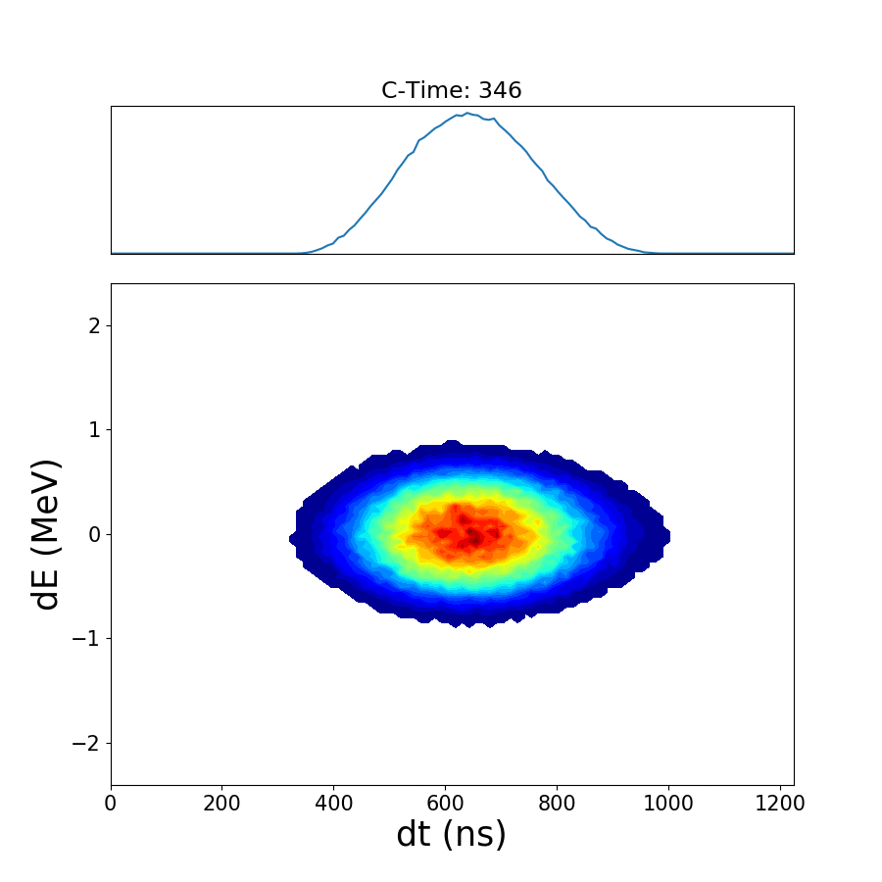
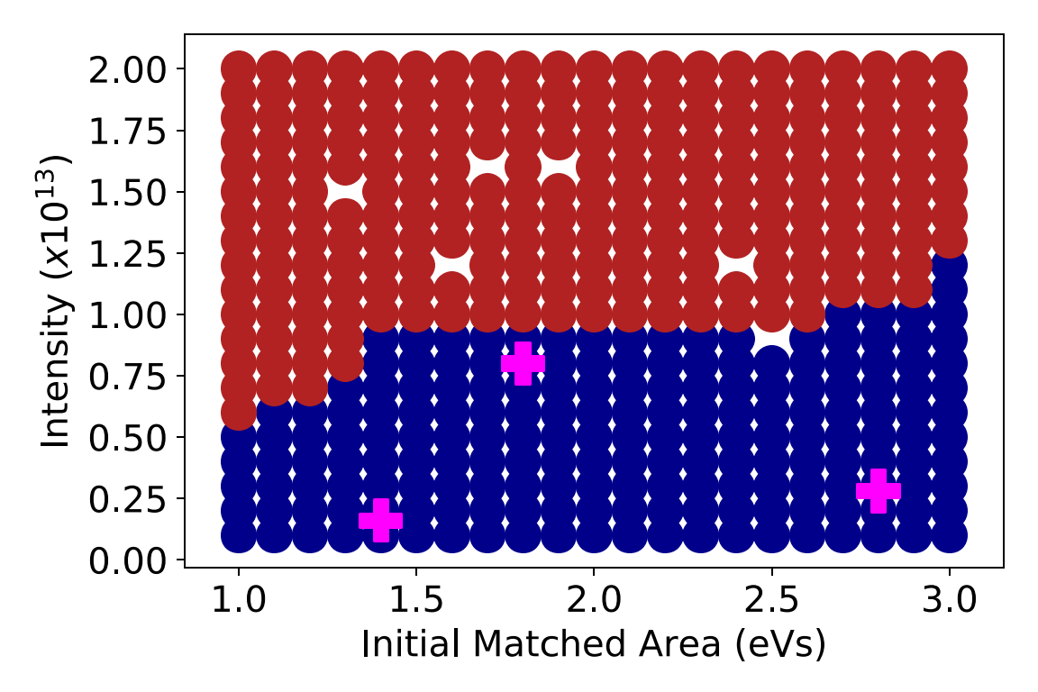
PSB longitudinal
Blow-up with phase noise
Finemet technology fully demonstrated before LS2
  Reliability runs since 2015
Blow-up technique based on phase noise validated and well understood
  Improved control of final distribution
  Reliability run in 2018
Impedance of new Finemet RF no issue for LHC-type beams
Potential concerns with
  Very high-intensity beams
  Operational complexity of multi-harmonic feedback
Longitudinal stability map
Unstable
TOF
Stable
LHC, post-LS2
LHC, pre-LS2

Slide 15
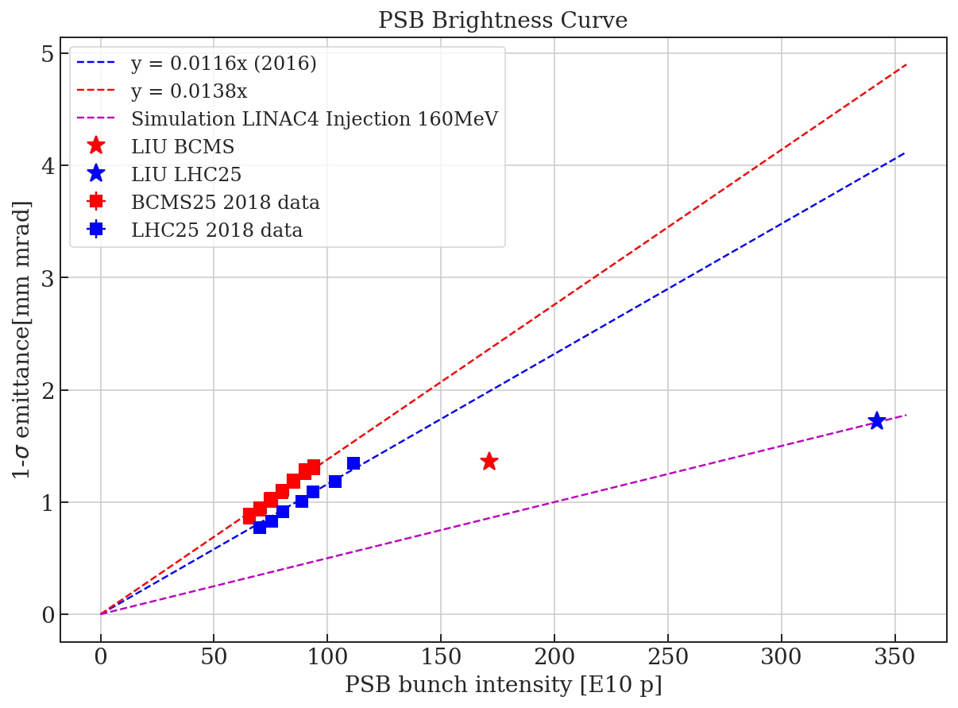
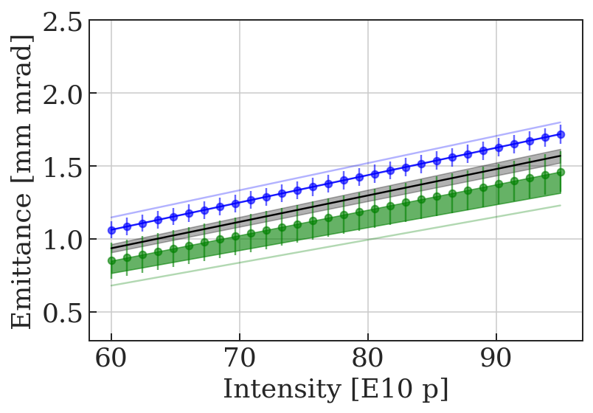
PSB transverse
Brightness curves with Linac2 well reproducible during run 2
  Doubled brightness with
  Linac4 + 2 GeV confirmed with simulations
Progress with understanding of emittance
  Measured β and D, beta beating
  Deconvolution for large ε_{l} beams
Prototype wire scanner validated
Detailed studies of H⁻ injection
1-σ emittance [mm mrad]
Linac4
+ 2 GeV
PS with measured D and β
PSB with measured D
PSB SEM Grids

Slide 16
Key studies in PSB
 | Activity | Timeline
Transverse | Conclude on transverse emittance measurements as input for brightness curve | Q2/2019
 | Establish common model for space charge simulations, including imperfections, to define optics choices at injection | Q3/2019
 | Study impact of unmatched termination of extraction kicker (horizontal instability) | Q3/2019
 | Prepare tool to optimize alignment of all rings after LS2 | Q1/2019
Longitudinal | Controlled longitudinal blow for longitudinal shaving | Q3/2019
 | Definition of longitudinal parameter sets for all beams | Q3/2019
 | Renovation and possible upgrade of longitudinal Tomography | Q1/2020
 | Longitudinal emittance model after LS2 | 2020

Slide 17
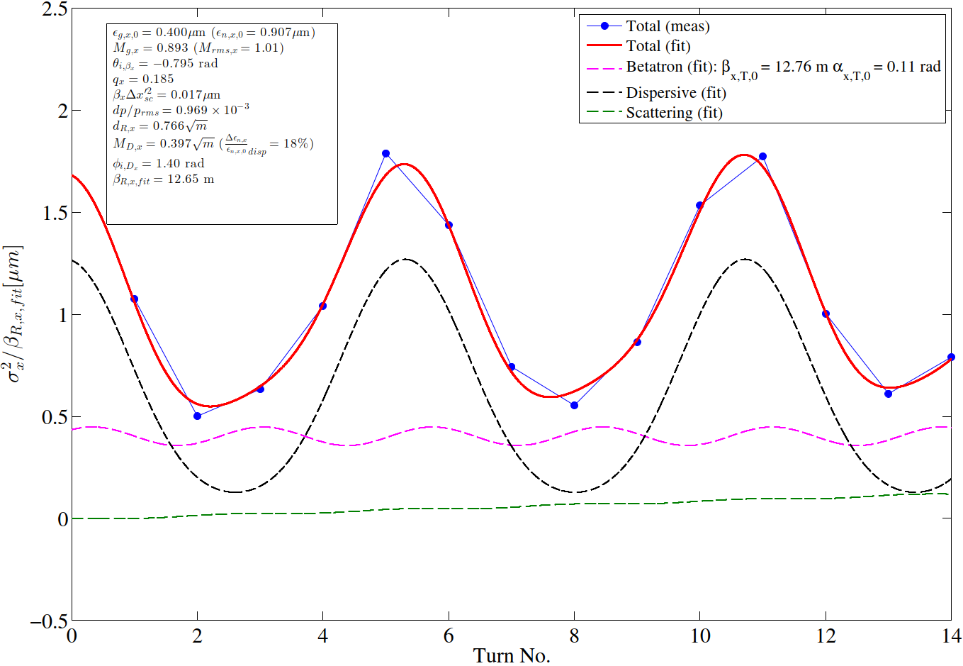
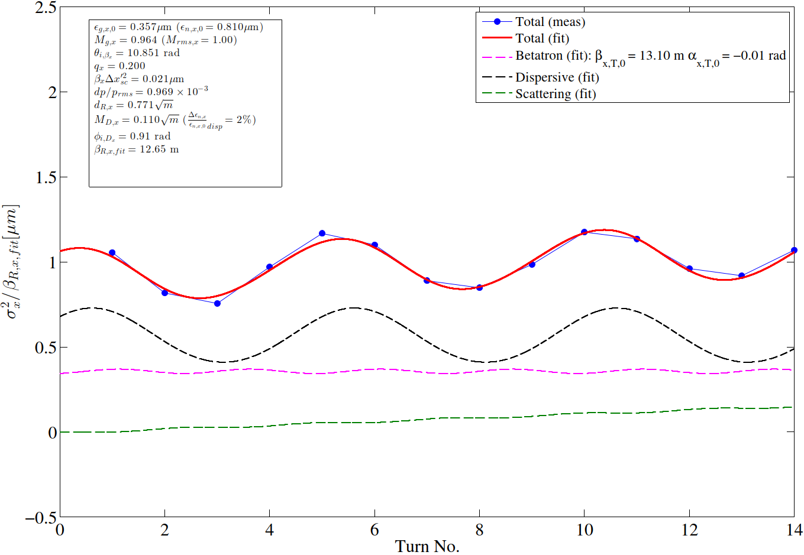
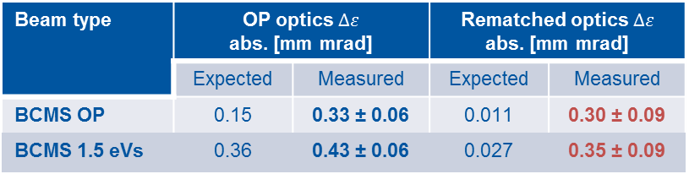
PS injection
Mismatch in PSB-PS transfer line
  Important dispersion mismatch
  Almost no betatronic mismatch
Studies of systematic errors
  Measured optics functions (β and D)
Deployment of turn-by-turn SEM grids
  Turn-by-turn beam size essential
  Electronics and software ready in 2018
Extensive kicker pulse
measurements
  Ripple in expected range
σ_{x}²/β_{x,fit} [μm]
Operational optics (horizontal plane)
Re-matched optics (horizontal plane)
Beam type | OP optics $∆ε$ abs. [mm mrad] |  | Rematched optics $∆ε$ abs. [mm mrad]
 | Expected | Measured | Expected | Measured
BCMS OP | 0.15 | 0.33 ± 0.06 | 0.011 | 0.30 ± 0.09
BCMS 1.5 eVs | 0.36 | 0.43 ± 0.06 | 0.027 | 0.35 ± 0.09

Slide 18
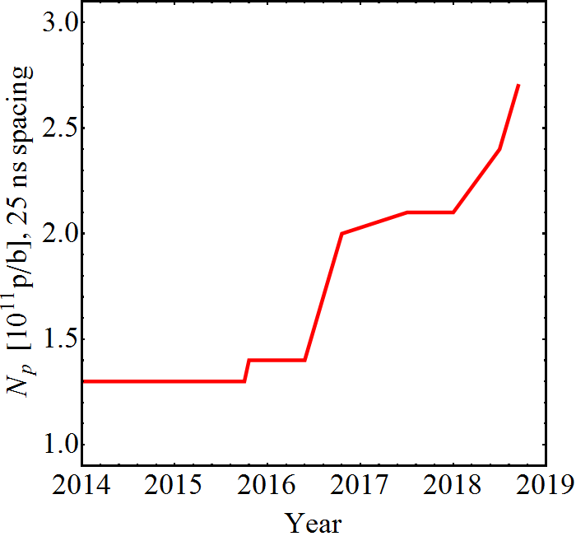
PS Intensity reach
LIU target intensity reached at nominal ε_{l} = 0.35 eVs
Large transverse emittance: ~5 μm
Excellent transmission of ~98% even at highest intensities
Transverse stability
  Careful tune and chromaticity adjustment
  Transverse damper
Intensity per bunch at PS extraction
Multi-harmonic feedbacks
40 MHz RF as Landau system
LIU baseline
Suspected feedback saturation
Optimization 2017
Finemet dipole-mode
coupled-bunch feedback
Reach with C10-86/96 coupled-bunch feedback (2005)*
*Intensities >1.3 ∙ 10¹¹ p/b were delivered <2016, but not with sufficient quality for LHC

Slide 19
Key studies in PS
 | Activity | Timeline
Transverse | Analysis of KFA45 field measurements | Q2/2019
 | Conclude on emittance blow-up measurement (systematic errors) | Q2/2019
 | PSB-PS transfer line matching using turn-by-turn acquisitions | Q4/2019
 | Simulations to understand relevance of space charge after injection | Q4/2019
Longitudinal | Identify impedance source exciting longitudinal instabilities | Q2/2019
 | Performance predictions for RF upgrades during LS2 | Q2/2019
 | Review longitudinal parameters at PS-SPS transfer | Q4/2019
 | Longitudinal impedance model after LS2 | Q4/2019

Slide 20
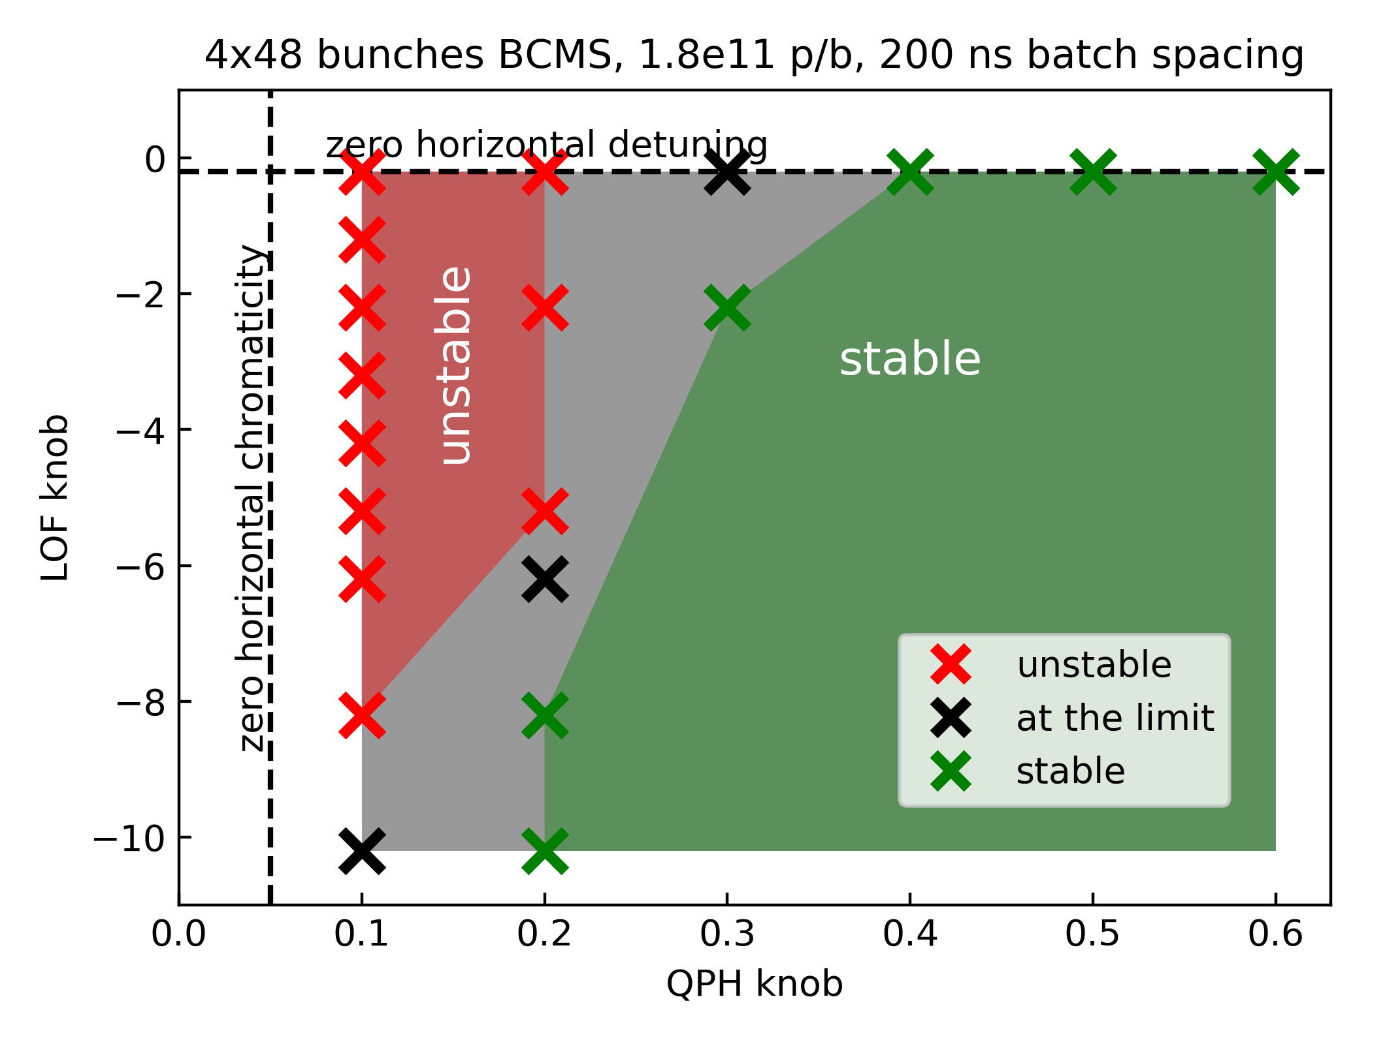
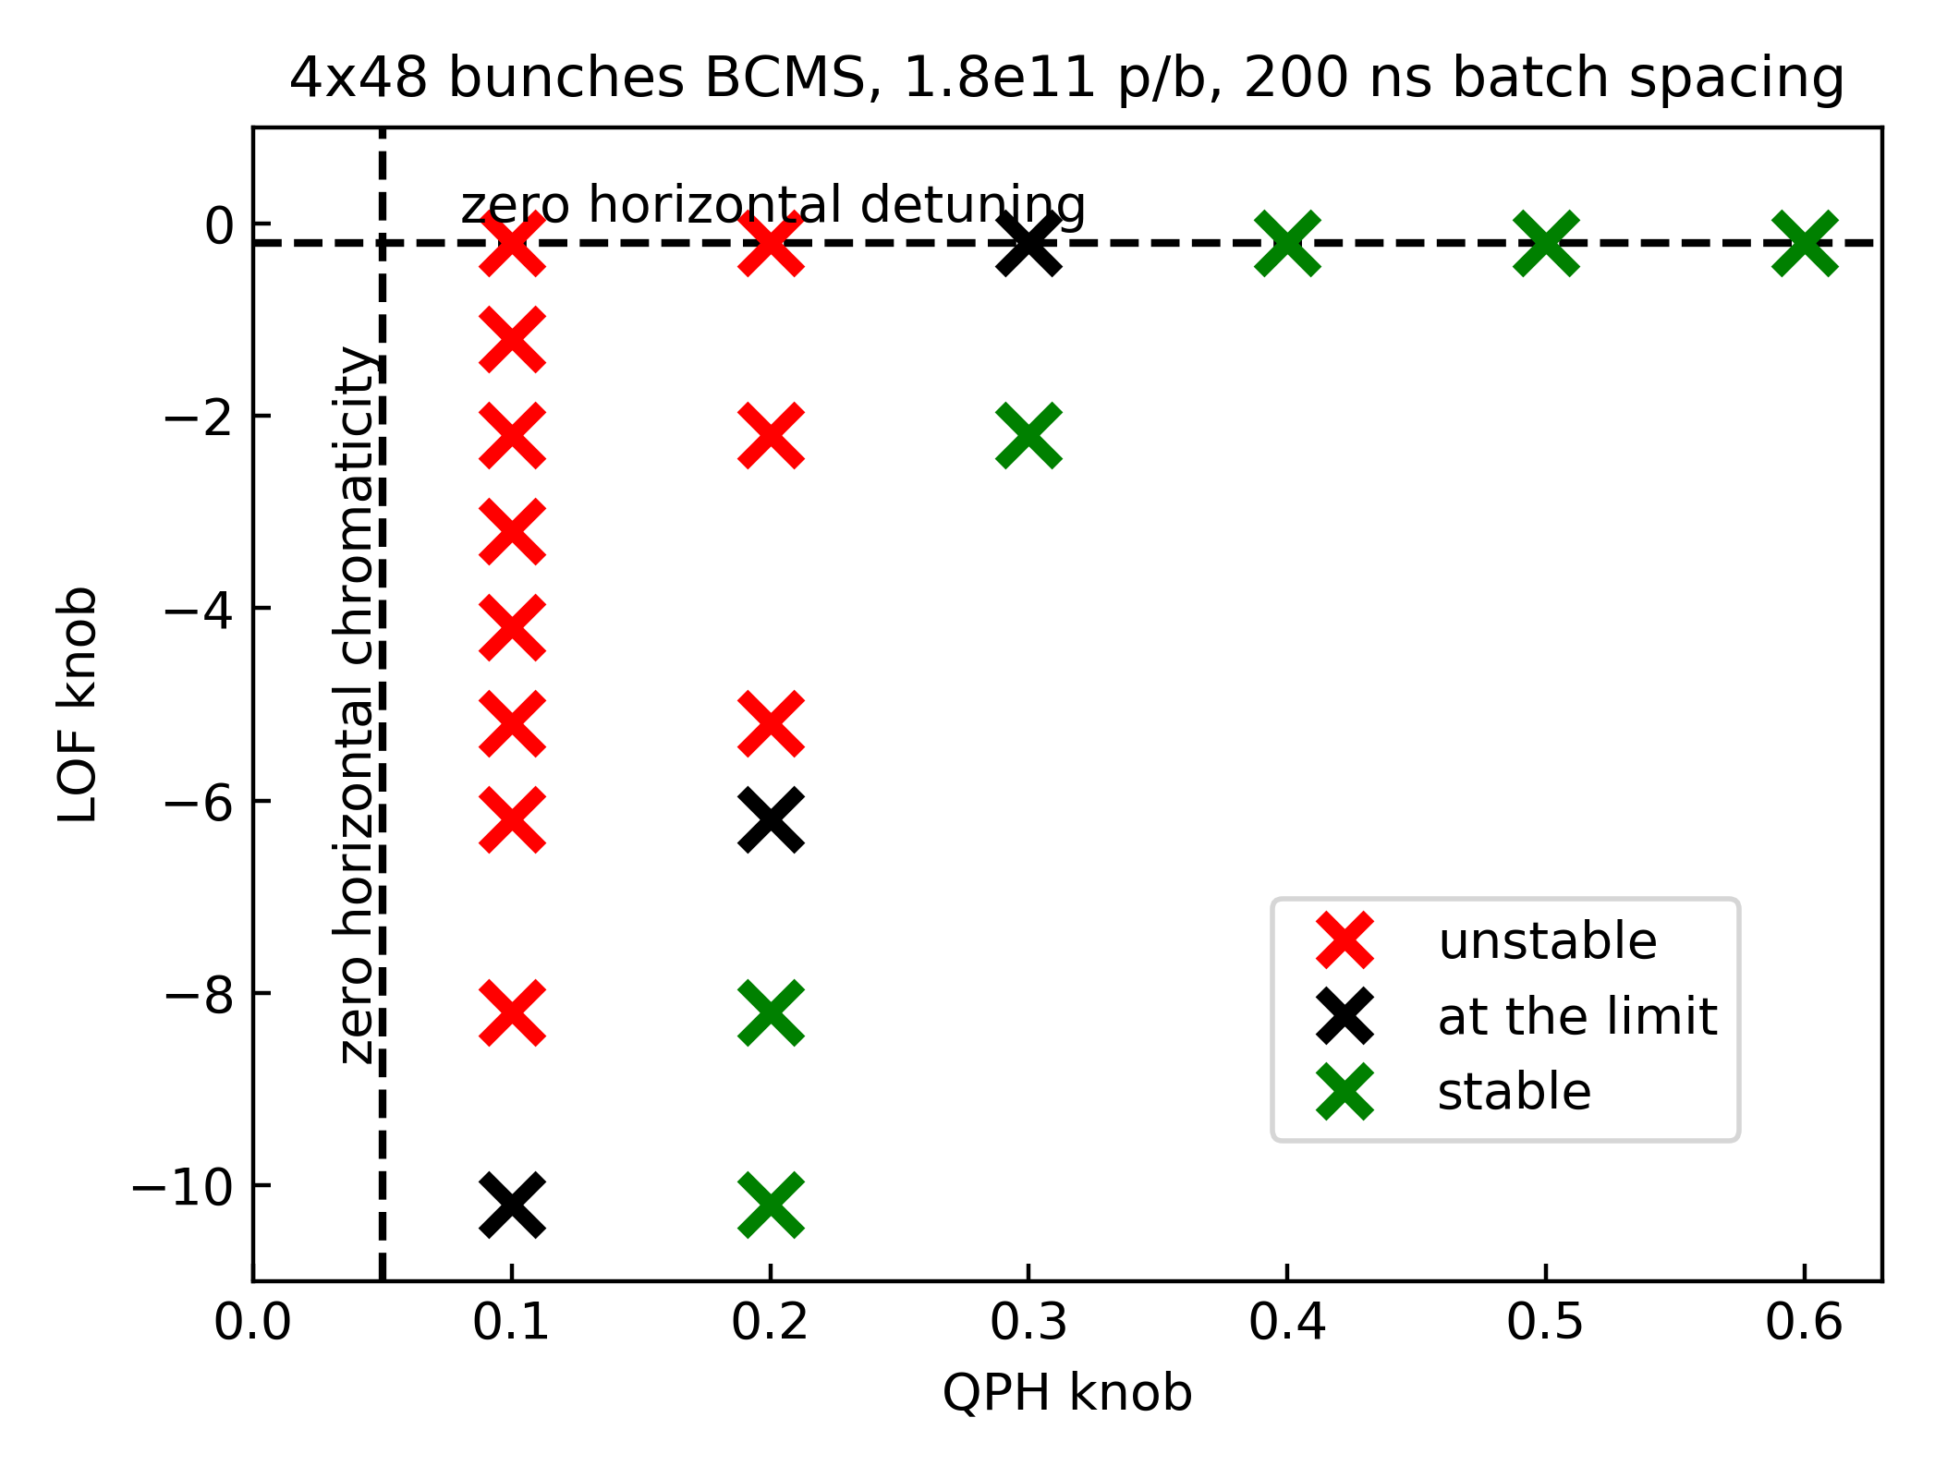
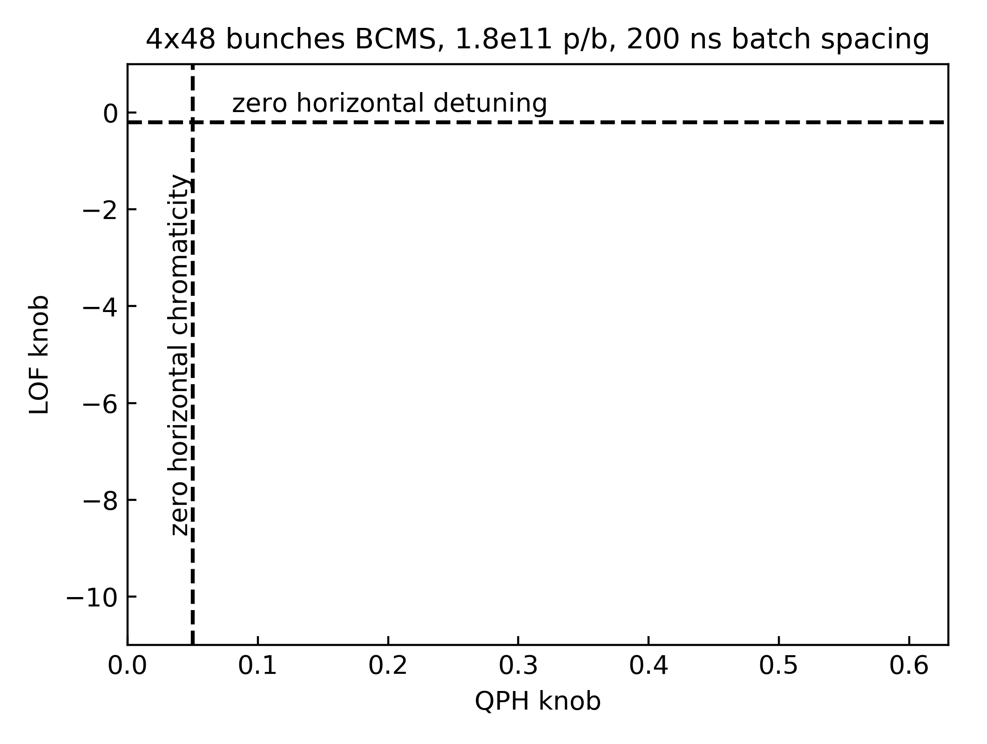
SPS transverse
Horizontal instability N_{b} > 1.8 ∙ 10¹¹ p/b
  Cured by either chromaticity, octupoles
  or combination at present intensities
Coherent tune shift at 26 GeV will
be on the order of ΔQ_{y} ~ 0.04 with
LIU intensities
  Wide tune acceptance of damper
  shown with beam in 2018
  Implications on working point choice
  to be studied in simulations
Electron cloud
  Mini scrubbing run in 2018 demonstrated emittance growth reduction to 10-15%
  at around 2 ∙ 10¹¹ p/b
← Octupole strength (LOF knob)
Chromaticity (QPH knob) →

Slide 21
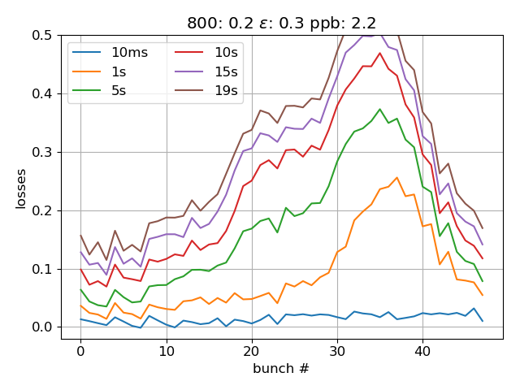
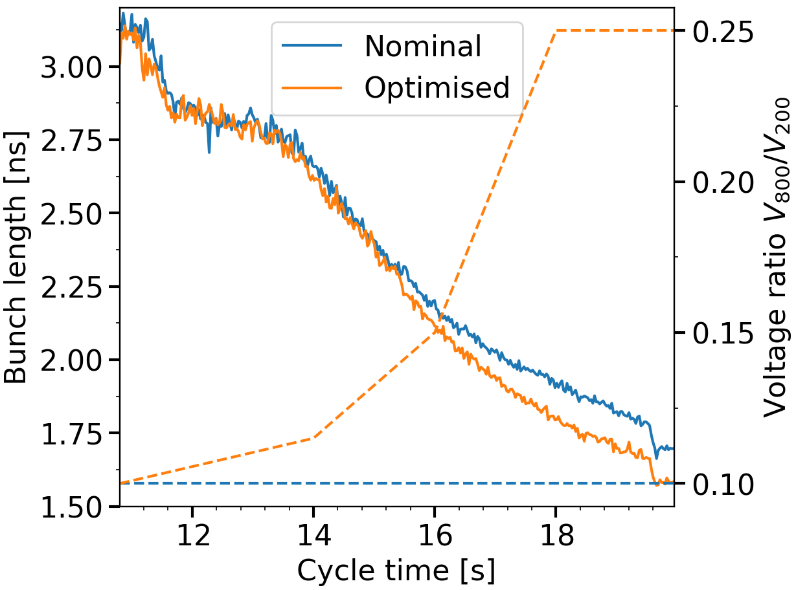
SPS intensity reach
2.2 ∙ 10¹¹ p/b, 0.3 eVs, 20% 800 MHz
Insufficient RF power with pre-LS2 SPS
  Losses increasing with total beam
  intensity
  Limited to 1.4 ∙ 10¹¹ p/b in long batches
Advance beam studies using 12 bunches
4 ∙ 12 bunches, 2 ∙ 10¹¹ p/b
Measurements and simulation agree well for 12 bunches and single harmonic case
Stability improvement with 800 MHz
  Measured with high-intensity in 2018
  BLonD simulations for post-LS2

Slide 22
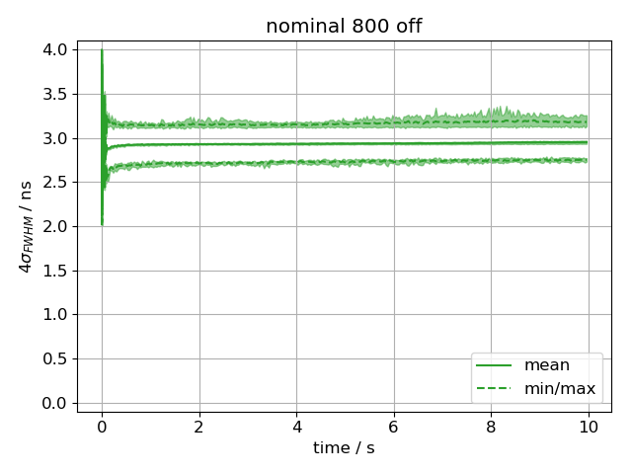
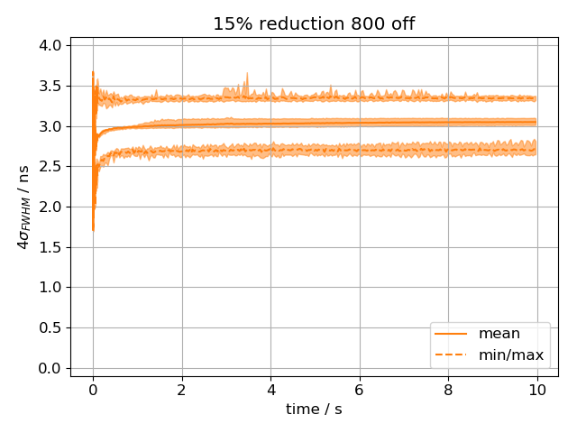
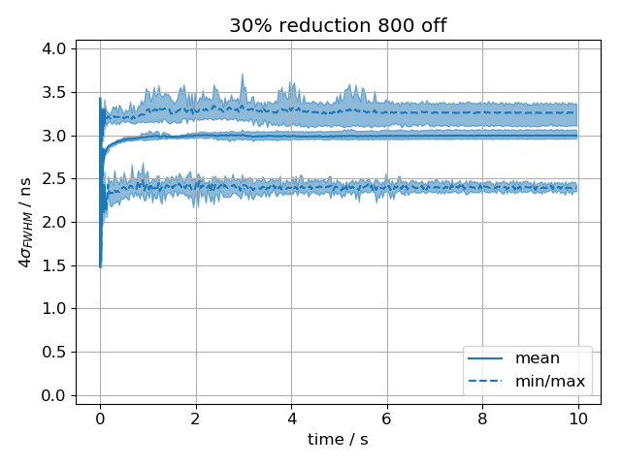
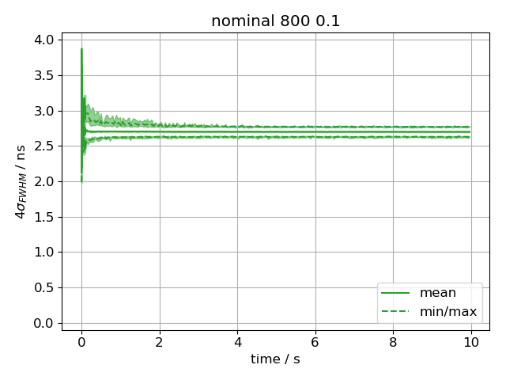
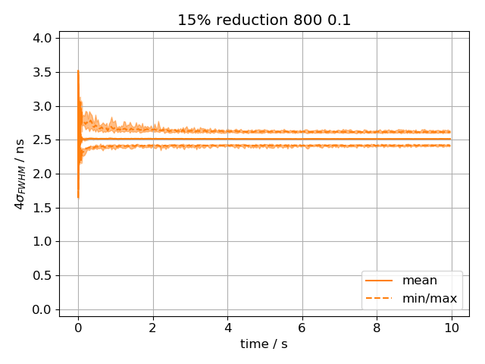
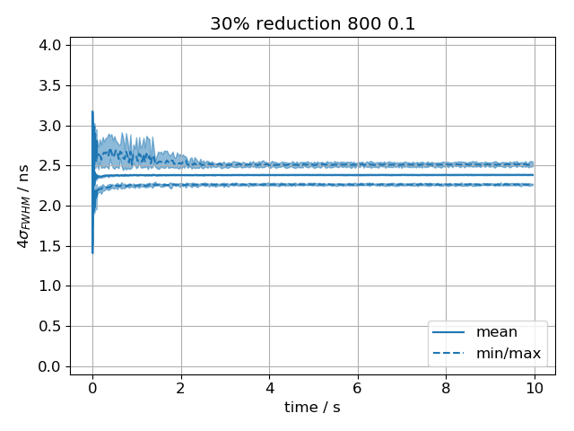
SPS longitudinal, what to expect after LS2
Simulations of stability at flat-bottom in SPS (48b, 25ns, Q20)
Nominal emittance
15% less
30% less
2.6 ∙ 10¹¹ p/b
800 MHz off
unstable
unstable
unstable
800 MHz on
10% ratio
Stabilisation by 800 MHz RF system with 0.1 voltage ratio
15% smaller longitudinal might be possible from PS
Little interest in Q22 optics (beam loading, long. stability)

Slide 23
Key studies in SPS
 | Activity | Timeline
Transverse | Removal of momentum aperture restrictions (MBB-SSS), decision on installation | Q1/2019
 | Benchmarking of bunch-by-bunch tune shift measurement with impedance model | Q2/2019
 | Horizontal instability at SPS injection, identification of source | Q4/2019
 | Impact of bunch-by-bunch tune shift on incoherent tune footprint of different bunches for working point optimization | 2020
Longitudinal | 630 MHz HOM damper (shift of fundamental mode), decision on installation | Q2/2019
 | Beam loss at flat-bottom and beginning of ramp, smaller longitudinal emittance | Q3/2019
 | Impact of smaller longitudinal emittance during acceleration | Q4/2019
 | Impact of installing 200 MHz cavities for eSPS (for PBC and CLIC) | Q4/2019

Slide 24
Overview
Beams for HL-LHC
LIU baseline for protons
  Removing the present limitations
  Sensitivity of HL-LHC luminosity to beam parameters
Performance with protons
  Linac4, PSB, PS and SPS
Performance with lead ions
  Linac3, LEIR, PS and SPS
Conclusions
  Main challenges
  Progress summary

Slide 25
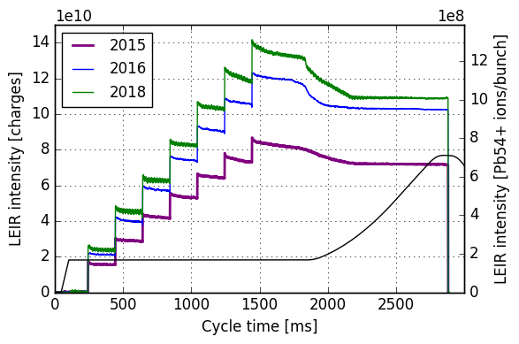

Linac3 and LEIR
LEIR record intensities
Pb source and Linac3
  Source autopilot
  Continuous support during LHC run
  30 uA golden value for LIU reached
LEIR
Improved accumulation and reduced losses in LEIR
  Careful tuning and understanding
  RF capture with frequency modulation
  Elimination of tune ripple
Improved reliability
  Automatic tools and optimizers
  Improved beam instrumentation
LIU target
pre-LS1
Linac3/LEIR ready to operationally deliver LIU target parameters

Slide 26
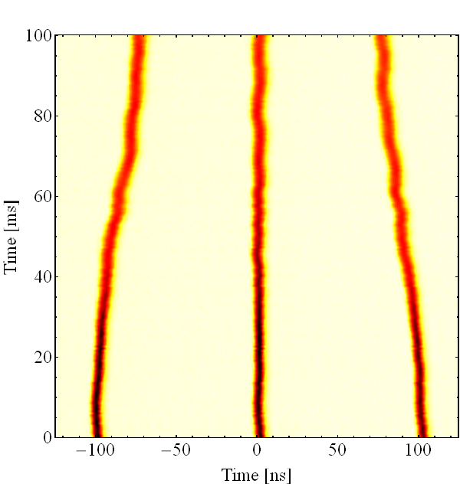
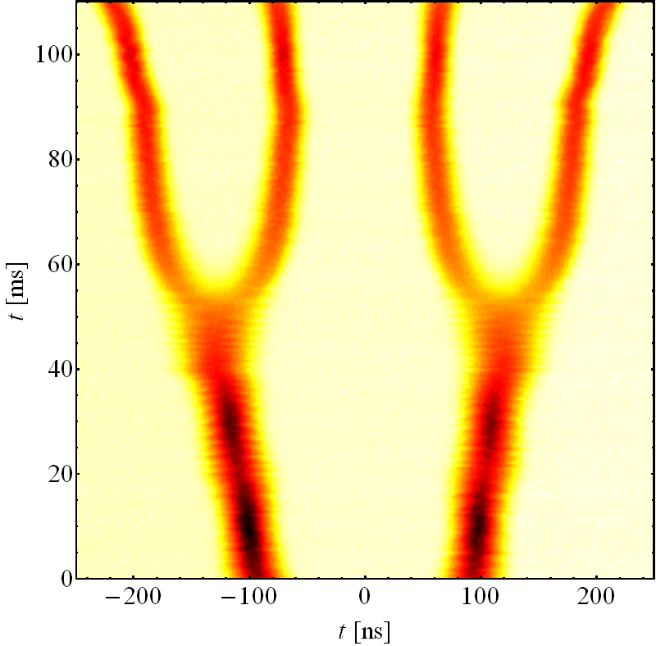
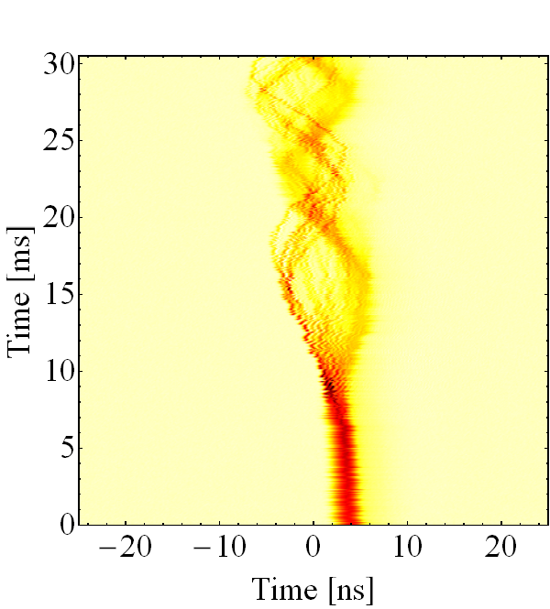
PS
4b spaced 100 ns
3b spaced 75 ns
LIU baseline
  Split 2 bunches from LEIR at intermediate plateau into
  4 bunches spaced 100 ns
Alternative
  3 bunches, 75 ns
Potential issues
  Instability after transition crossing
  for N_{b} > ~5 ∙ 10⁸ ions/b
  Cured by controlled blow-up, but satellite bunches at ±12.5 ns
Transition > 5 ∙ 10⁸ ions/b
Little margin, but PS reaches LIU target

Slide 27
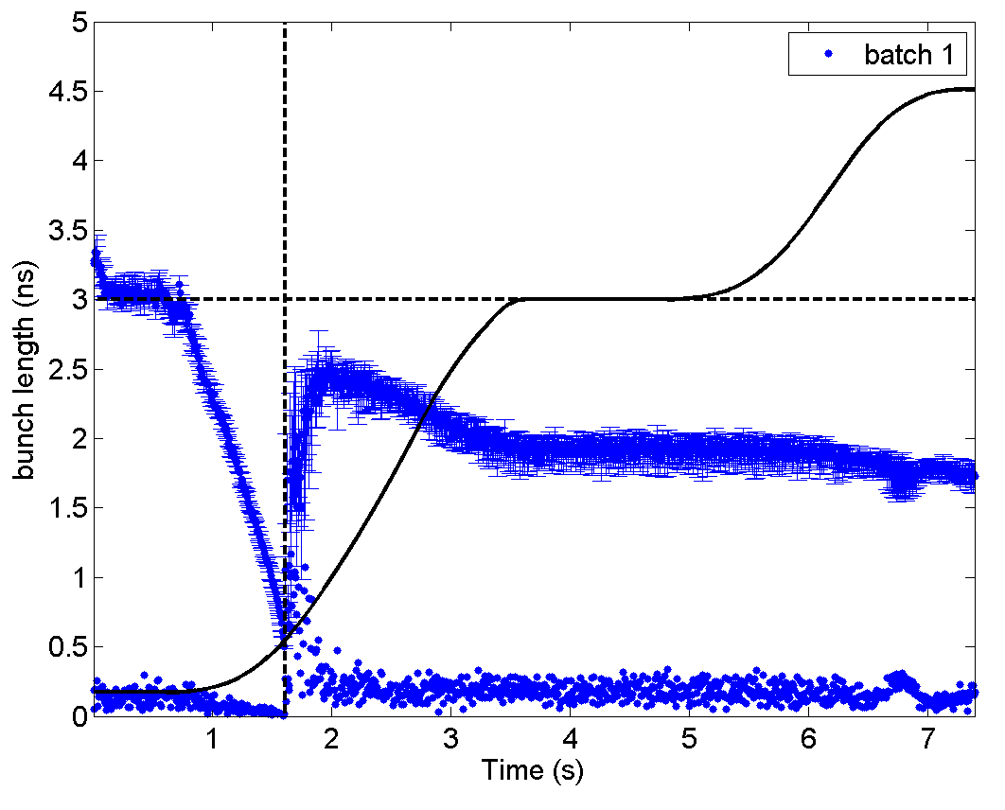
SPS
Bunch length, 2.8 ∙ 10¹⁰ ch./b
Longitudinal instability after
transition crossing
  Instability often starts at energy of plateau
  for future slip stacking
300 GeVZ/c
Oscillations
after γ_{tr}

Slide 28
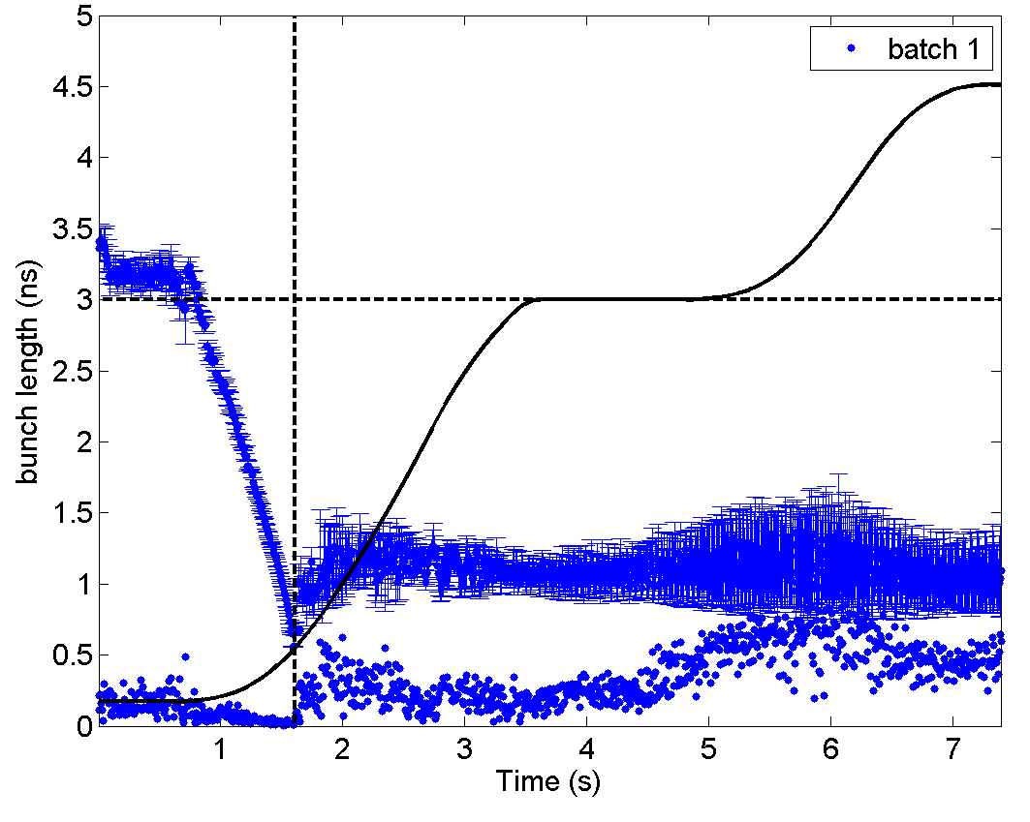
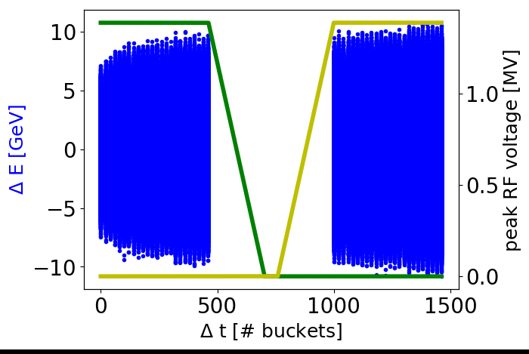
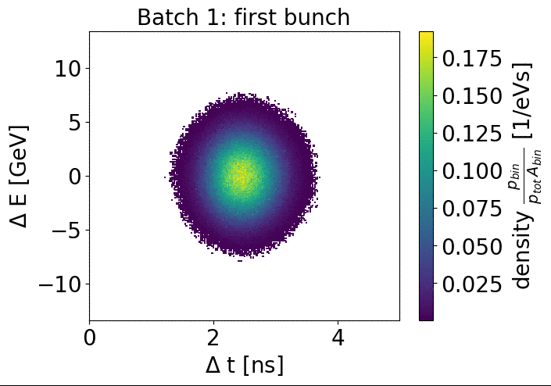
SPS
Bunch length, 5.1 ∙ 10⁸ ions/b
Longitudinal instability after
transition crossing
  Instability often starts at energy of plateau
  for future slip stacking
Simulation of slip-stacking with intensity effects
  Instability often starts at energy
  of plateau for future slip stacking
300 GeVZ/c
Instability
Slip-stacking challenging

Slide 29
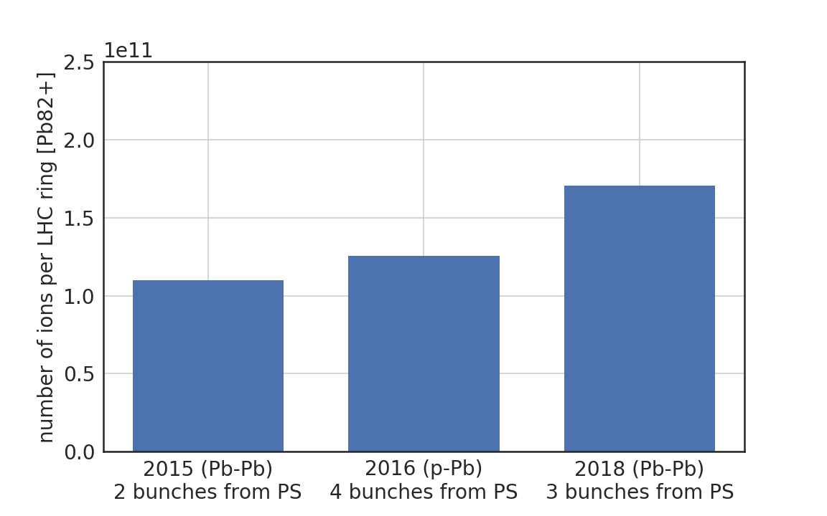
Ions
50 ns spacing
Achievements
  2 bunches at LEIR-PS transfer
  RF manipulations in PS
  4 bunches spaced by 100 ns at PS-SPS
  Multiple injections (~14) into the SPS
LIU goal
75 ns spacing
100 ns spacing
100 ns spacing
Slip stacking
in SPS
Post LS2 (Pb-Pb)
4 bunches from PS
Alternative
  3 bunches with 75 ns spacing
Challenges
  Longitudinal instabilities SPS → Beam studies in 2018
  Slip stacking: 100 ns → 50 ns spacing in SPS → LLRF upgrade

Slide 30
Key studies with ions
 | Activity | Timeline
Transverse | Space charge and IBS studies of capture beam losses | Q2/2019
 | Maximum accumulated intensity in LEIR (injection process, cooling) | Q4/2019
 | Analyse beam stability versus intensity in LEIR (impedance and cooling) | 2020
 | Injection optics to reduce losses from Linac3 to LEIR | 2020
Longitudinal | Optimum longitudinal emittance from LEIR | Q4/2019
 | Microwave instability at PS transition crossing, impedance source identification | Q4/2019
 | Simulate longitudinal ion instability in SPS and propose mitigation | Q3/2019
 | Definition of scenario for slip-stacking in SPS | 2020

Slide 31
Overview
Beams for HL-LHC
LIU baseline for protons
  Removing the present limitations
  Sensitivity of HL-LHC luminosity to beam parameters
Performance with protons
  Linac4, PSB, PS and SPS
Performance with lead ions
  Linac3, LEIR, PS and SPS
Conclusions
  Main challenges
  Progress summary

Slide 32
Challenges on the path to LIU performance
Protons | Mitigation | Activity
Large momentum spread transfer PSB-PS | Matched transfer line optics | In depth analysis of 2018 data and simulations
PS-SPS transfer | Smaller longitudinal emittance from PS | Simulation studies of transfer and long. stability in SPS
Transverse stability and e-cloud in SPS | Landau damping, wideband feedback system, scrubbing | Identification of instability source
Beam losses at SPS injection | Lower longitudinal emittance from PS, enlarge momentum aperture | Analysis of efficiency and margins, lift momentum aperture restrictions
Ions | Mitigation | Activity
Longitudinal stability in SPS (for slip-stacking) | Controlled emittance blow-up before transition | Simulation studies

Slide 33
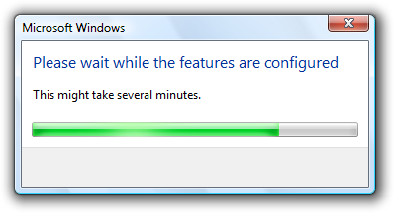
Progress summary
Linac4
Linac2
PSB
PS
SPS
Protons
Intensity
Brightness
(studied with BCMS)
Linac3
LEIR
PS
SPS
Ions
HL-LHC parameters reached with lead ion at PS extraction

Slide 35
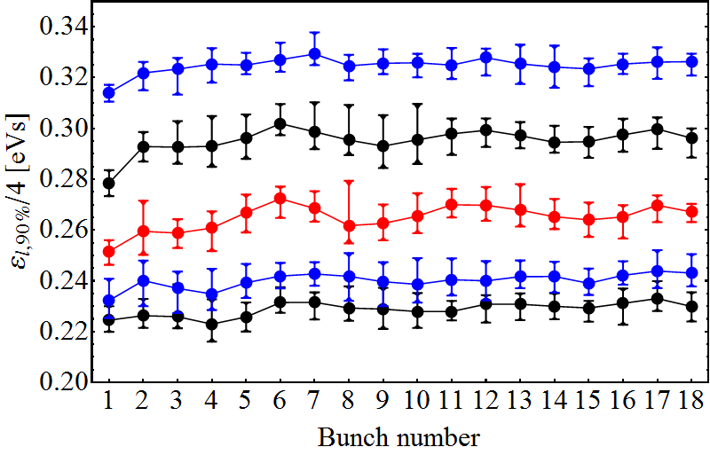
Smaller longitudinal emittance from PS for transfer?
ε_{l} (90%) at start of flat-top, per bunch at ejection
versus controller blow-up after transition, 2.6 ∙10¹¹ p/b
Blow-up 4 with 4×4.5kV
3×4.5kV
2×4.5kV
Corresponds to nominal ε_{l} at extraction
1×4.5kV
No blow-up after transition
Margin to deliver longitudinal emittance of 15% below nominal
How low can we go in longitudinal emittance?

Slide 36
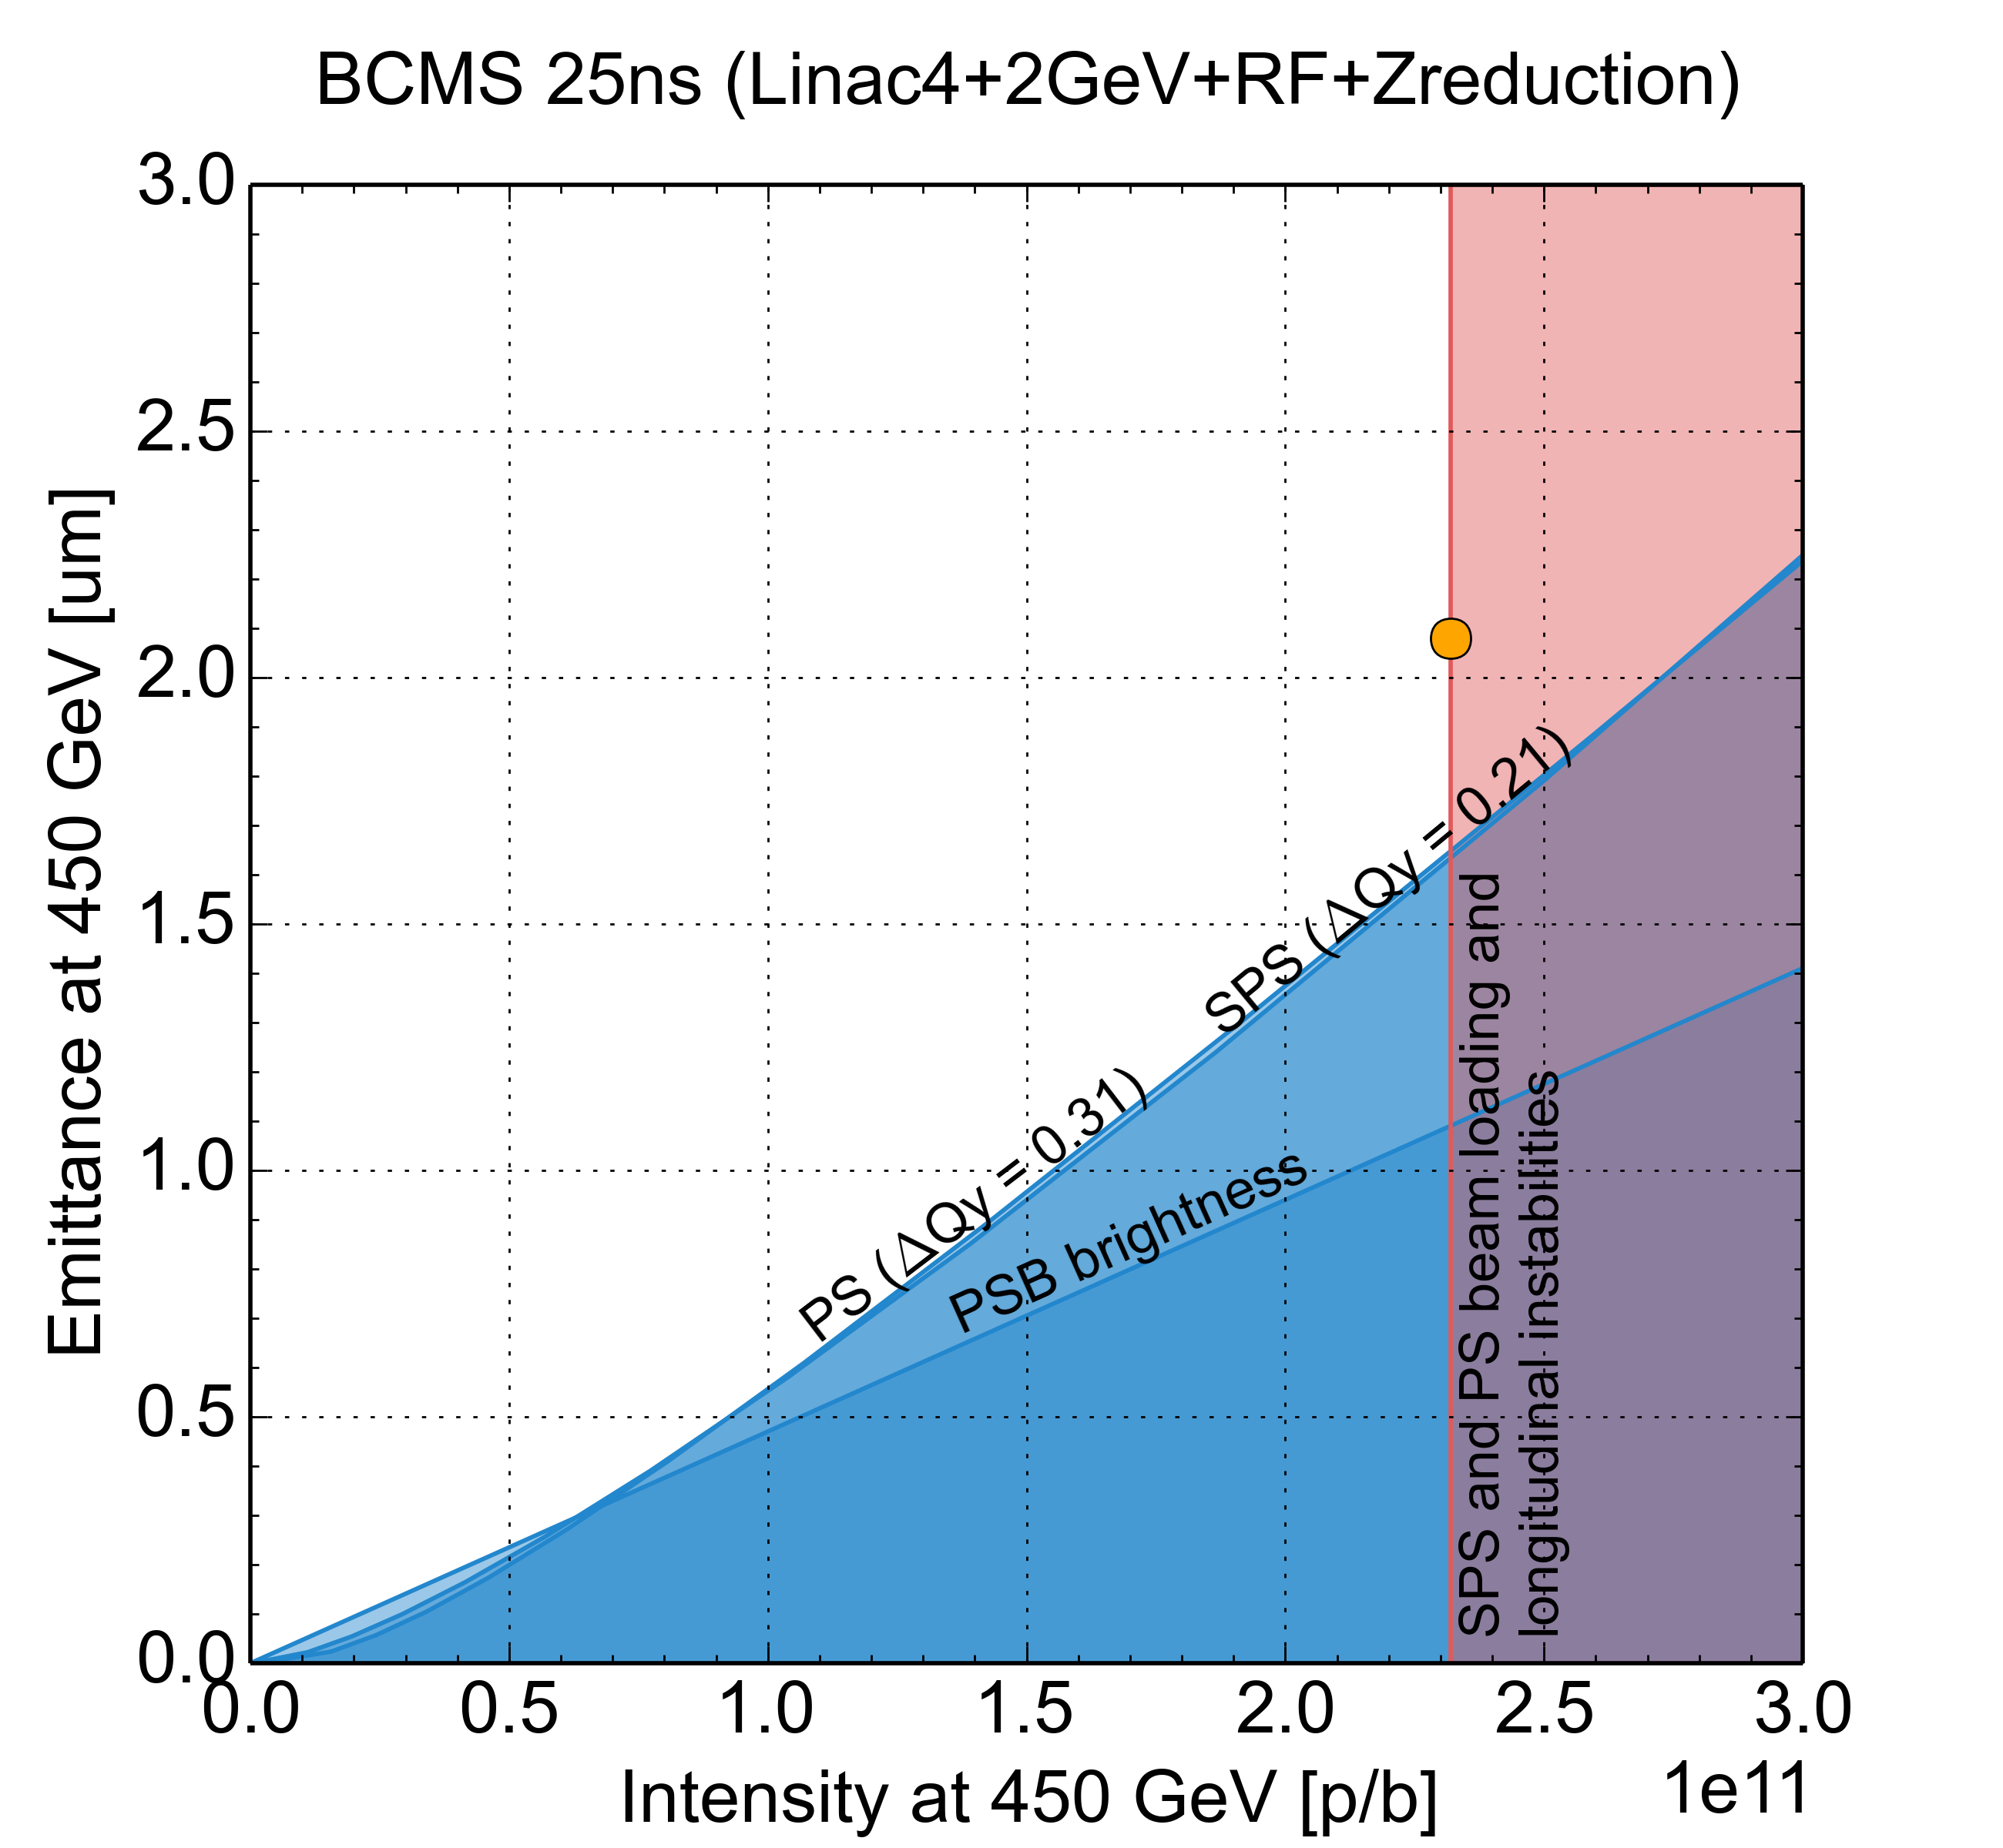
PS-SPS smaller emittance at transfer
2.0 GeV, post-LS2, LIU baseline, 0.35 eVs
Large momentum
spread required
for ΔQ_{y} = 0.31
Corresponds to
  ε_{l} = 3 eVs/12 (standard)
  ε_{l} = 1.5 eVs/6 (BCMS)
at PS flat-bottom
Little margin for RF
manipulations in PS
Standard, 72b → 2.2 μm
BCMS→ 1.6 μm
Standard, 72b → 2.1 μm
Standard, 72b → 2.2 μm
Splitting factor: 12
Splitting factor: 6
Gain margin by reducing longitudinal emittance already from PSB?

Slide 37
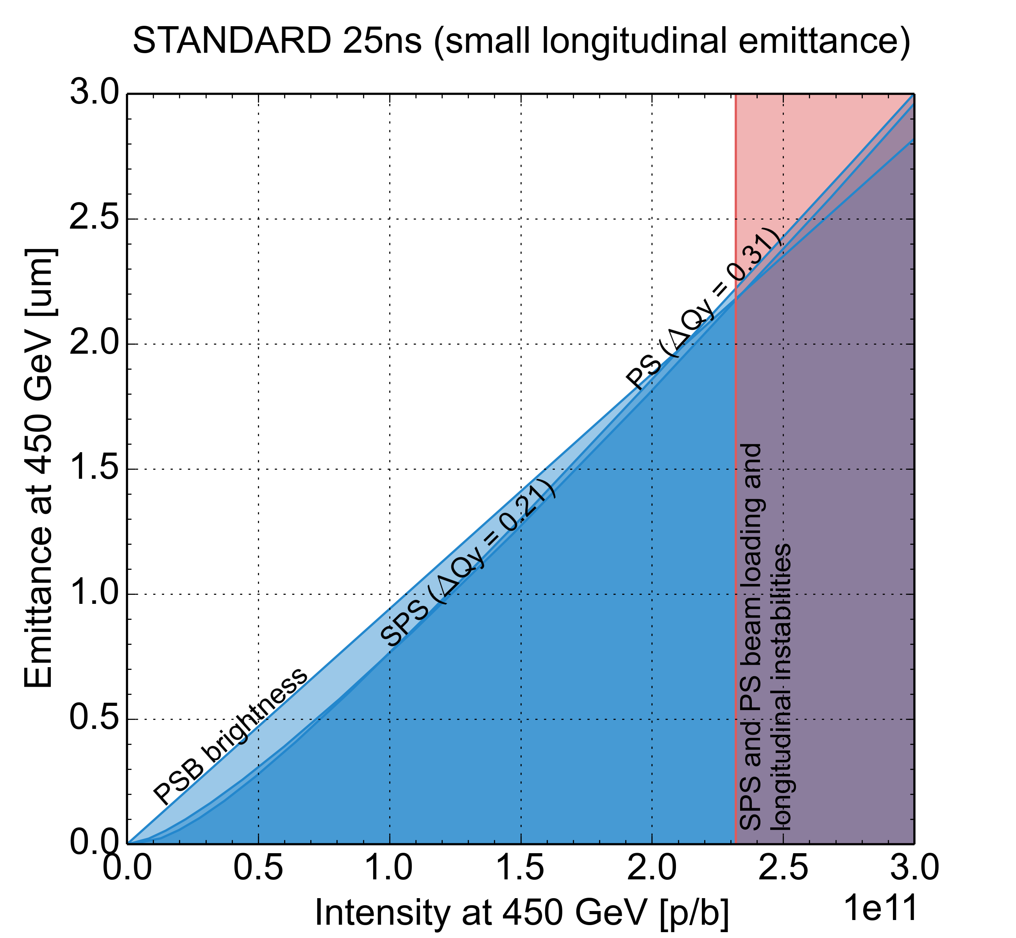
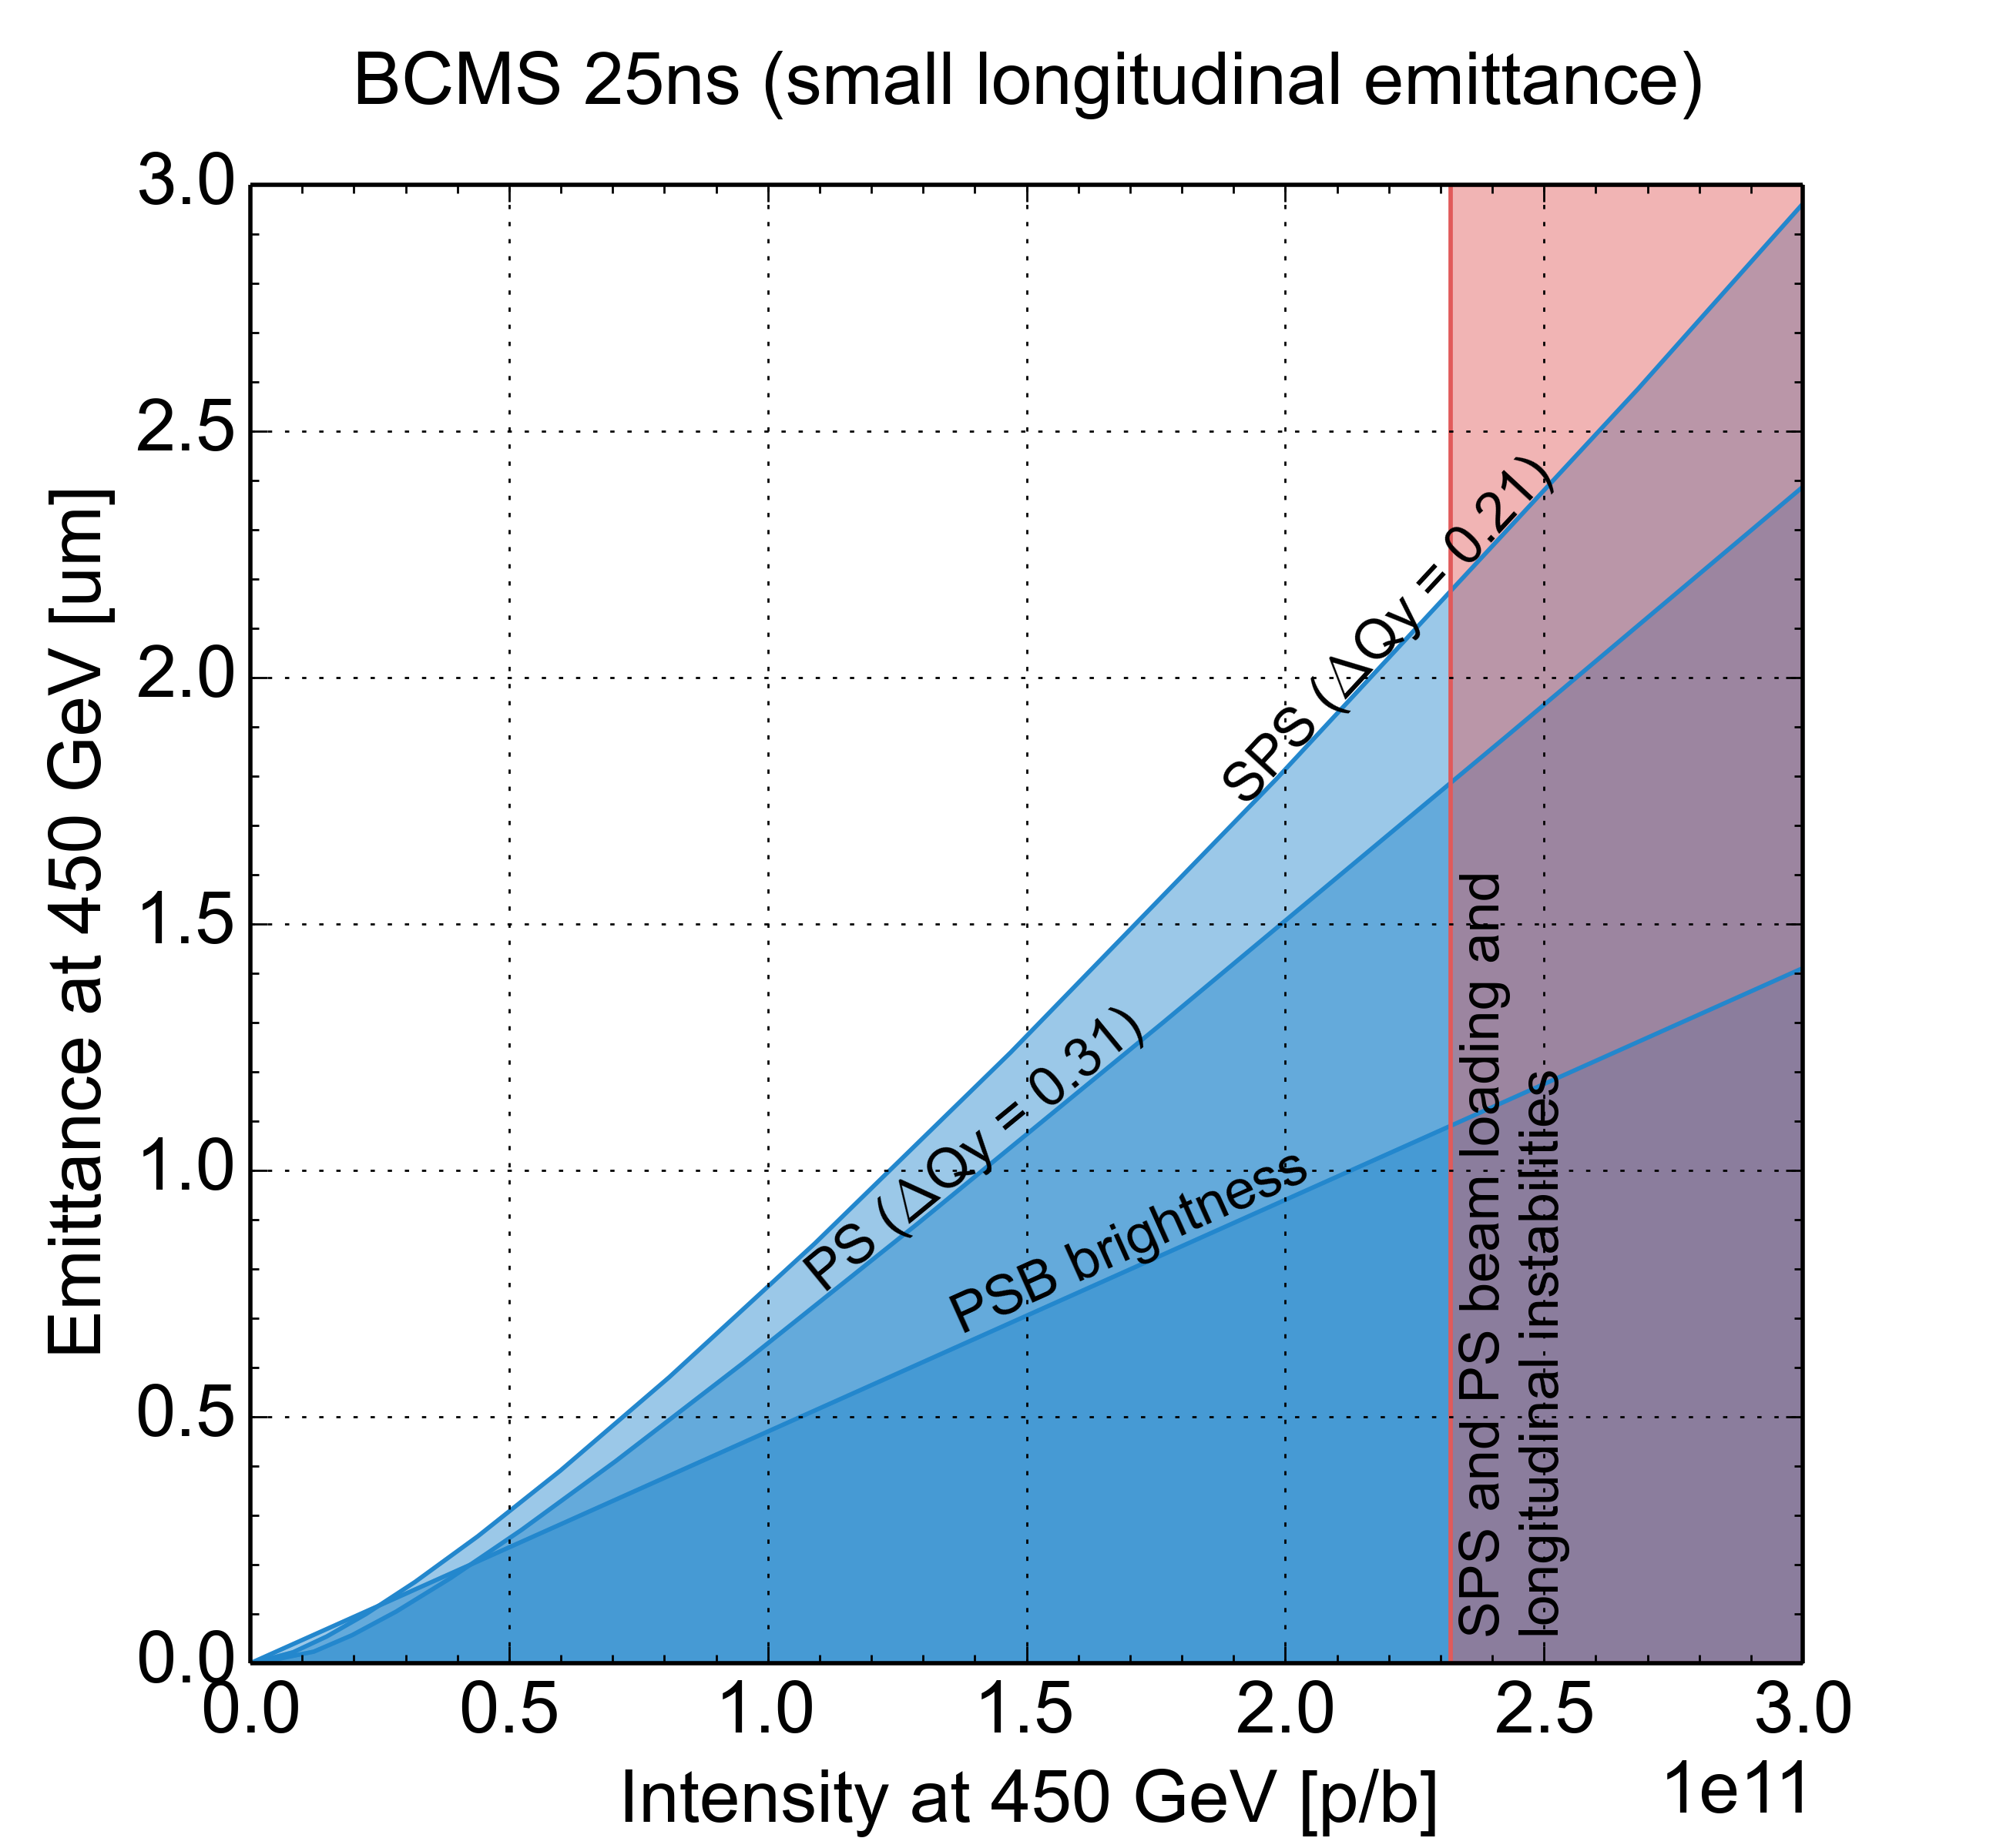
PS-SPS smaller emittance at transfer
2.0 GeV, post-LS2, 0.25 eVs at PS ejection (if stable)
Large momentum
spread required
for ΔQ_{y} = 0.31
Corresponds to
  ε_{l} = 3 eVs/12 (standard)
  ε_{l} = 1.5 eVs/6 (BCMS)
at PS flat-bottom
Little margin for RF
manipulations in PS
Standard, 72b → 2.2 μm
BCMS→ 2.1 μm
Splitting factor: 12
Splitting factor: 6
Interesting for standard (72b) beam, but not BCMS

Slide 38
High brightness variant (BCMS)
For the BCMS beam
  Same bunch intensity reach as standard 25 ns
    Due to SPS intensity limitation
    Extraction/transfer/injection protection devices validated for this brightness
  25% higher brightness in trains of 48 bunches
    Almost same number of bunches in LHC
    Shorter trains are usually easier in injectors and lead to lower e-cloud effects
    Brightness gain limited by hitting space charge limit in both PS and SPS
HL-LHC
request
BCMS reach

Slide 39
Intensity reach of PS, 25 ns standard
LIU target intensity reached at ε_{l} = 0.35 eVs
Intensity per bunch at extraction
Multi-harmonic feedbacks
C40-78 as Landau RF system
LIU baseline
Suspected feedback saturation
Optimization 2017
Finemet dipole-mode
coupled-bunch feedback
Reach with C10-86/96 coupled-bunch feedback (2005)*
*Intensities >1.3 ∙ 10¹¹ p/b were delivered <2016, but not with sufficient quality for LHC

Slide 40
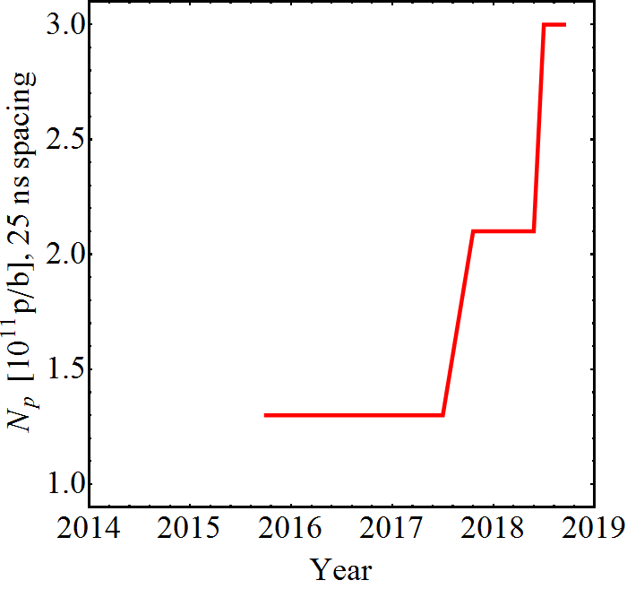
Intensity reach of PS, 25 ns standard and BCMS
LIU target intensity reached at ε_{l} = 0.35 eVs
Intensity per bunch at extraction
Longitudinally more stable than in 2017
Suspected feedback saturation
Not systematically checked
LIU baseline
Finemet dipole-mode
coupled-bunch feedback
No systematic beam tests to push intensity before 2017

Slide 41
Bunch-by-bunch variations (protons)
Transverse variations
  Differences between PSB rings (emittance and intensity)
  First and second transfer PSB-PS (blow-up in PS)
  Multiple transfers PS-SPS (blow-up in SPS)
Longitudinal variations
  Differences between PSB rings (emittance and intensity)
  Longitudinal emittance from PS due to splitting

Slide 42
Protons
Baseline
  Linac4 injection and H- injection at 160 MeV
  2 GeV PSB-PS transfer (large ε_{l} = 3.0/1.5 eVs)
  Triple splitting (standard) or BCMS and controlled long. blow-up
  Up to 288 bunches accelerated in SPS, controlled long. blow-up
Alternatives
  8b4e, 80b
  None of them validated up to 2.6 ∙ 10¹¹ p/b

Slide 43
Linac4
Short term goal (2018)
    25mA peak current after the RFQ (acceptance 2.6 mm mrad total normalised )
    Pulse length of 600µs
    Stability shot-to-shot of 2%
    Pulse flatness over
      600µsec : 5%
      120µsec : 2%
Long term goal (2023)
    45mA peak current after the RFQ (acceptance 2.6 mm mrad total normalised )
    Pulse length of 600µs
    Stability shot-to-shot of 2%
    Pulse flatness over
      600µsec : 5%
      120µsec : 2%
Intensity can be compensated (to a certain limit) with injection turns
In-Stability cannot be compensated
Reliability is key

Slide 44
Charge questions
Wrap up of Session 1: LIU beam performance reach, Giovanni + Heiko (20’+10’)
Keywords: LIU target performance, risks, mitigations, challenges for post-LS2 and LIU beam commissioning, protons and ions
Questions to be answered:
  What are the baseline beam parameters for LIU and the alternative production schemes (protons and ions)?
  What are the assumptions, do we need to review any of the assumptions based on 2018 experience or gained knowledge on some other items?
  What we can definitely tick out from Run 2 experience and what we still need to study in LS2 and prove in Run 3 (simulation and post-LS2 MDs)?
  How to balance pushing performance for protons and ions after LS2?
  Bunch-by-bunch variations within trains?

Slide 45
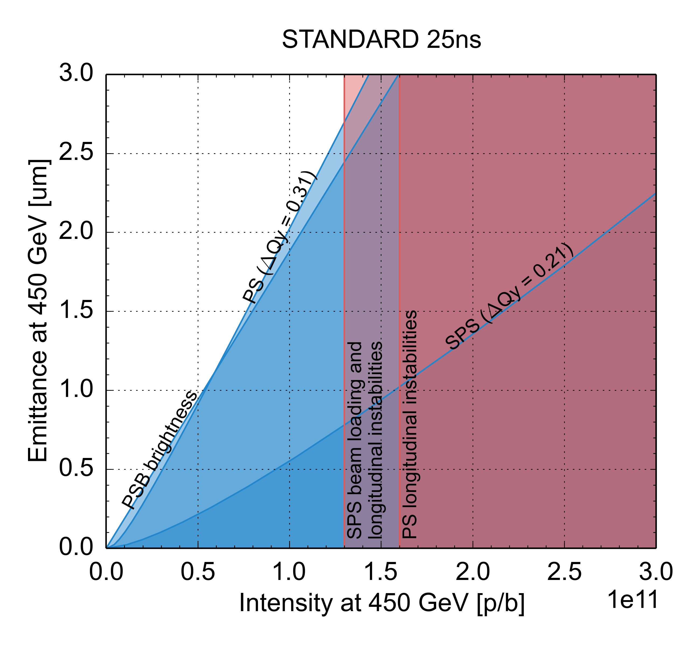
LIU performance reach for protons
 | N_{b} (x 10¹¹ p/b) | ε_{x,y,} (μm)
HL-LHC target | 2.3 | 2.1
Present | 1.3 | 2.7
PSB injection: Brightness limited by efficiency of multi-turn injection process and space charge effects
PS and SPS injection: Brightness limited by space charge – ΔQ<0.31 (PS) and 0.21 (SPS), to limit beam degradation
PS cycle: Bunch intensity limited by longitudinal coupled bunch dipolar instability
SPS cycle: Bunch intensity limited by RF power, longitudinal coupled bunch instability

