Slide 2
LHC Injectors Upgrade Workshop
Montreux, 13-15 February 2019

Slide 3
Beam quality and reproducibility from Linac4, including strategy for its source
Alessandra Lombardi for the LINAC4 team

Slide 4
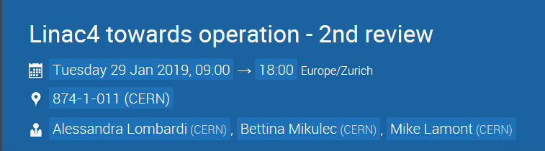
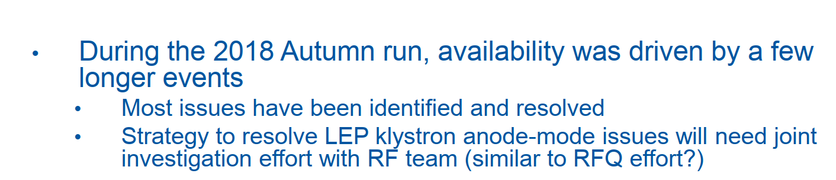
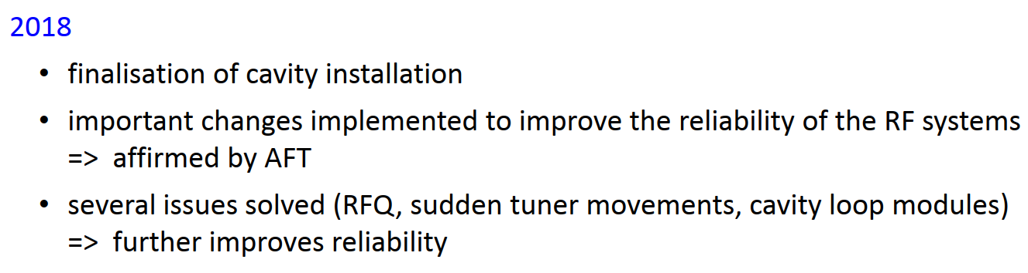
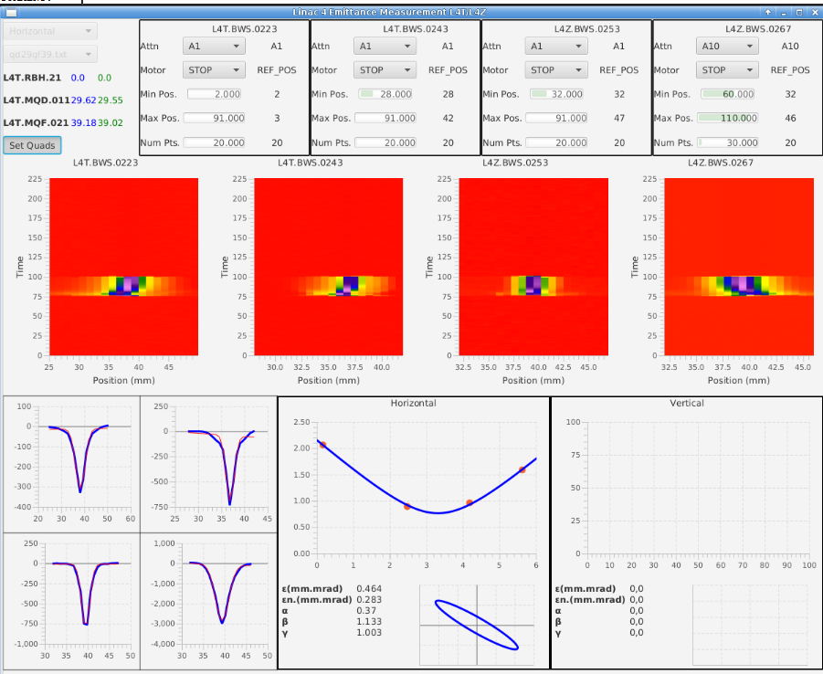
Impressive progress in 2018
Thanks to RF/ BI/ OP/ EPC and ABP
EPC reported by J. Parra-Lopez
OP reported by J-F Comblin.
RF reported by R. Wegner

Slide 5
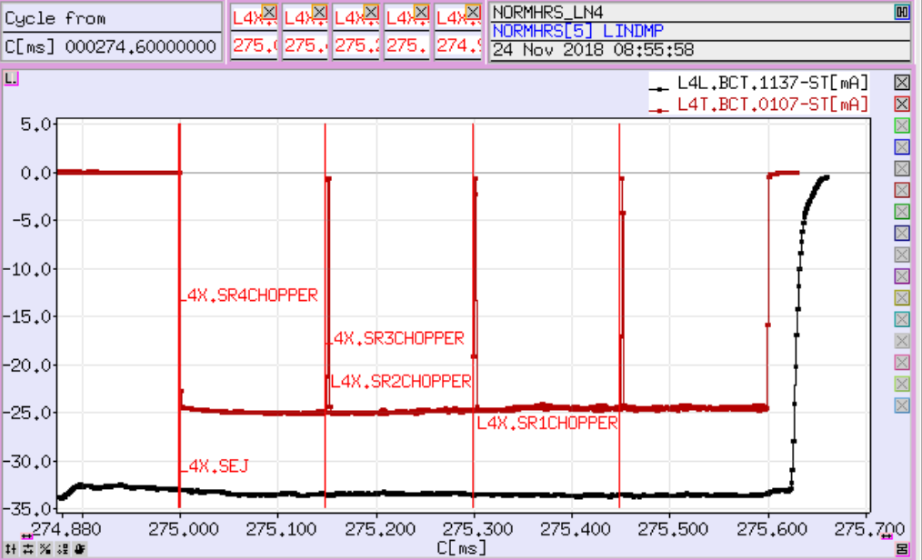
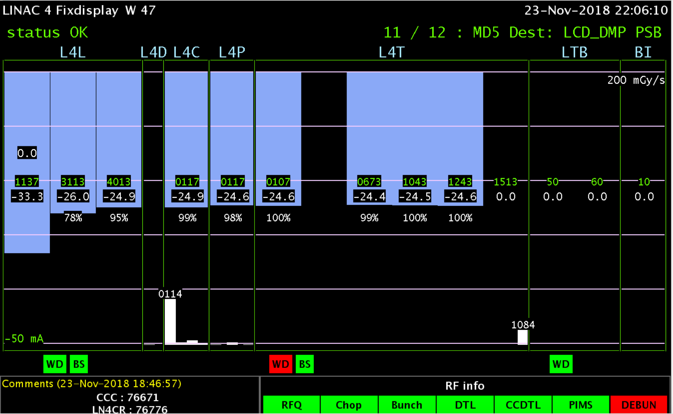
Achievements at 160MeV
Achievements at 160MeV
25mA peak current
Pulse length of 600µs
Stability shot-to-shot of 2%
Pulse flatness over
600µsec : 5%
120µsec : 2%
600 μs long flat 25 mA pulse just upstream the LINAC4 dump.
Taking a safety factor of 20% to include losses in the transfer lines and PSB this would correspond to 1.25 10¹³ protons per ring.
Work on PSB dynamics by
Elena Benedetto and Vincenzo Forte
45 turns LIU : 0.34 10¹³ ppb in 1.7µm
120 turns Isolde : 1 10¹³ ppb in 10µm

Slide 6
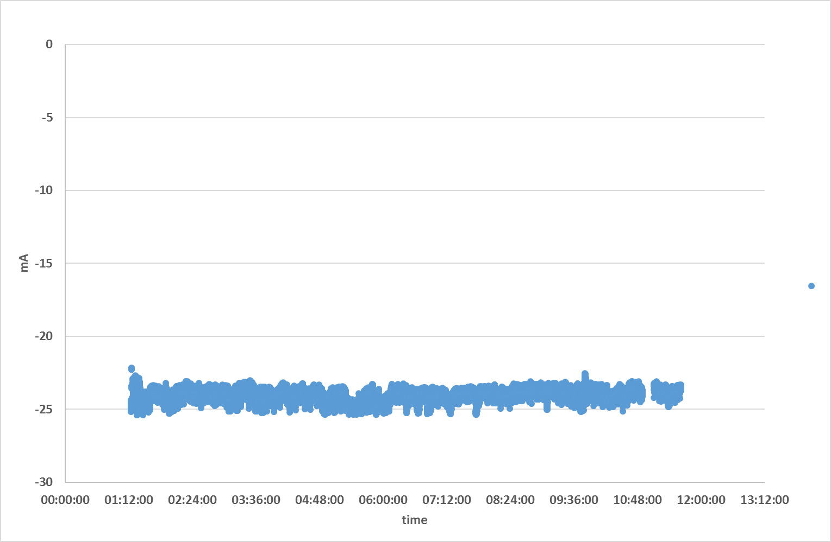
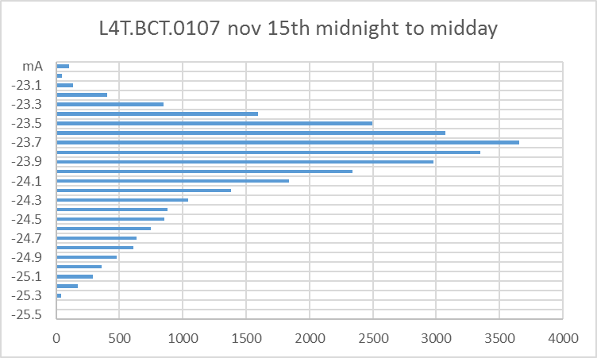
Stability shot-to-shot 2%
160MeV beam on l4t.bct.0107 Nov 15th 2018 midnight-to-midday
Mean -23.9702 mA
Sigma = 0.44 mA , 1.8%
Stability of the beam at 160 MeV.

Slide 7
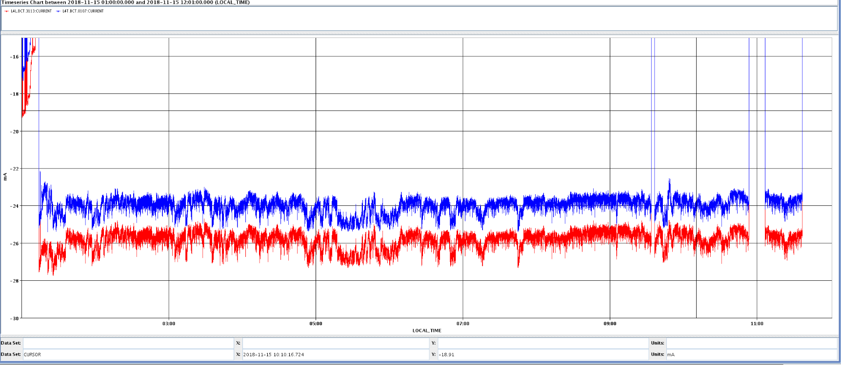
Where does the (in-)stability come from ?
IMPORTANCE OF TEST through the RFQ during LS2
Blue 160MeV
Red 3MeV
beam current measured on L4L.BCT3131 and l4t.bct.0107 Nov 15th 2018 midnight-to-midday

Slide 8
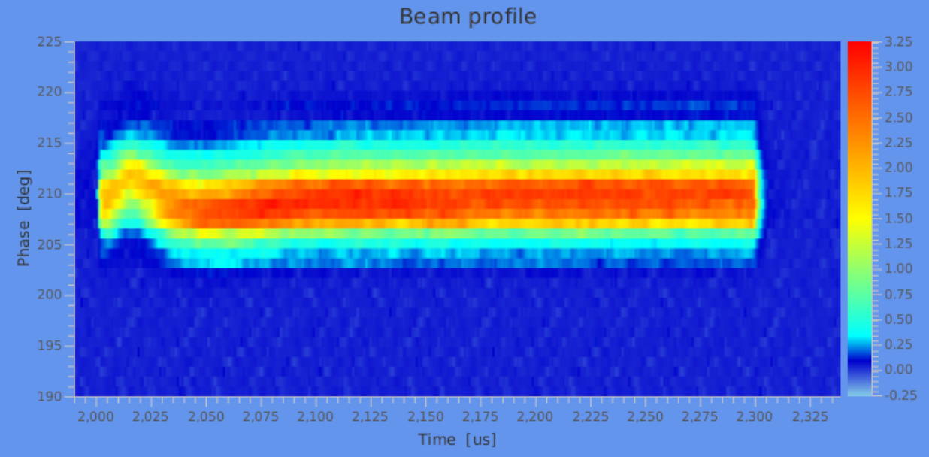
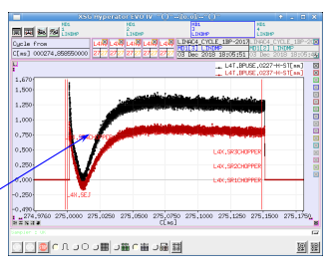
Energy and phase along the pulse
A 30 µs transient is visible : RF colleague will address this issue.
Beam Shape Monitor (BSM) at 160 MeV – beam phase spread along the pulse
Beam position monitors after the bend

Slide 9
Comparison with PSB-OP-EP-0001
Parameter | Value | Comment | Achieved
Peak current (before chopping) | 40 mA |  | 25
Intensity flatness along the pulse for pulse lengths up to 160 μs for pulse lengths >160 μs | ±2% ±5% | For uniform production of LIU LHC beams because variation of the number of turn per ring not wished. | YES
Horizontal/vertical position variations along the pulse | ±1 mm | To comply with target emittances required by LIU LHC beams | to be confirmed with LBE run after LLRF system improvement
Horizontal/vertical injection angle error | ±<0.4 mrad
Current stability shot-by-shot | ±2% TOTAL |  | Possible but not guaranteed unless autopilot is deployed
Normalized transverse emittances | ≤0.4 mm mrad | 0.3 mm mrad measured | Yes
Beam energy | 160 MeV |  | Yes
Ppm energy spread | ~80-450 (600) keV | Can be measured only in 2019 | to be confirmed with LBE run
Nominal chopper operation/extinguish factor | 65% at 1 MHz on 600 microsec | Variety of chopping patterns available. | Extinguish factor to be optimised
Energy painting | ±0.8 MeV in 40µs | Can be measured only in 2019 | to be confirmed with LBE run

Slide 10
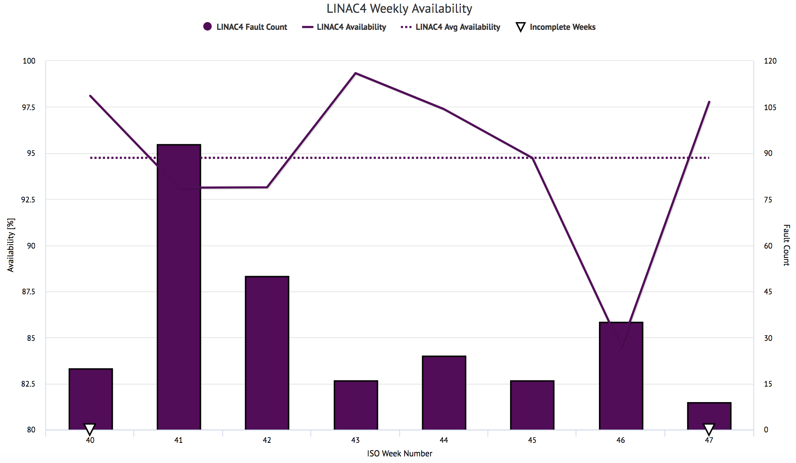
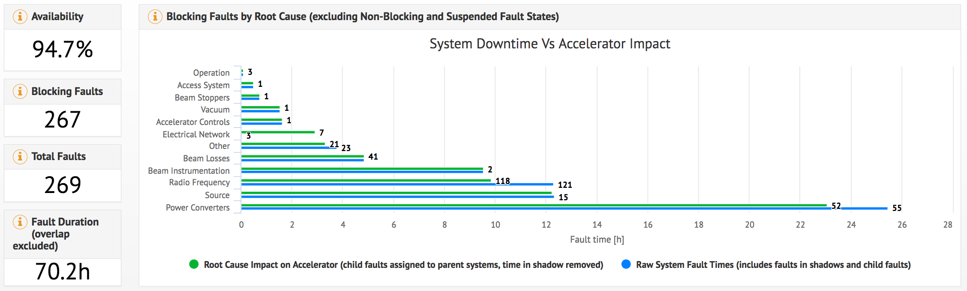
Availability
Availability is very good BUT there are still 200 meters and about 50 active elements between the linac and the PSB : importance of the LBE run in autumn 2019.

Slide 11
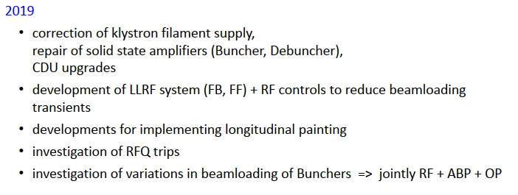
LINAC4 main improvements for LBE run
Source Beam stability - wait for next slides.
Beam stability (position phase and energy) : RF improvements
BI : GRIDS for single shot emittance measurements
Beam tuning and multi-users :
Automatic beam tuning and machine learning techniques (start experimenting with the beam through the RFQ, if approved by LS2committee, march 2019).

Slide 12
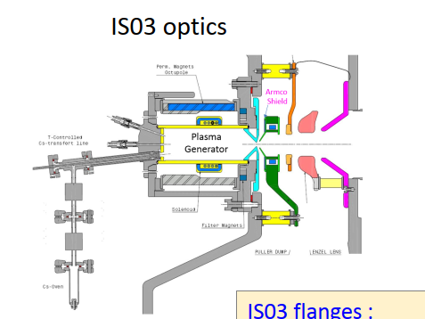
To the source

Slide 13
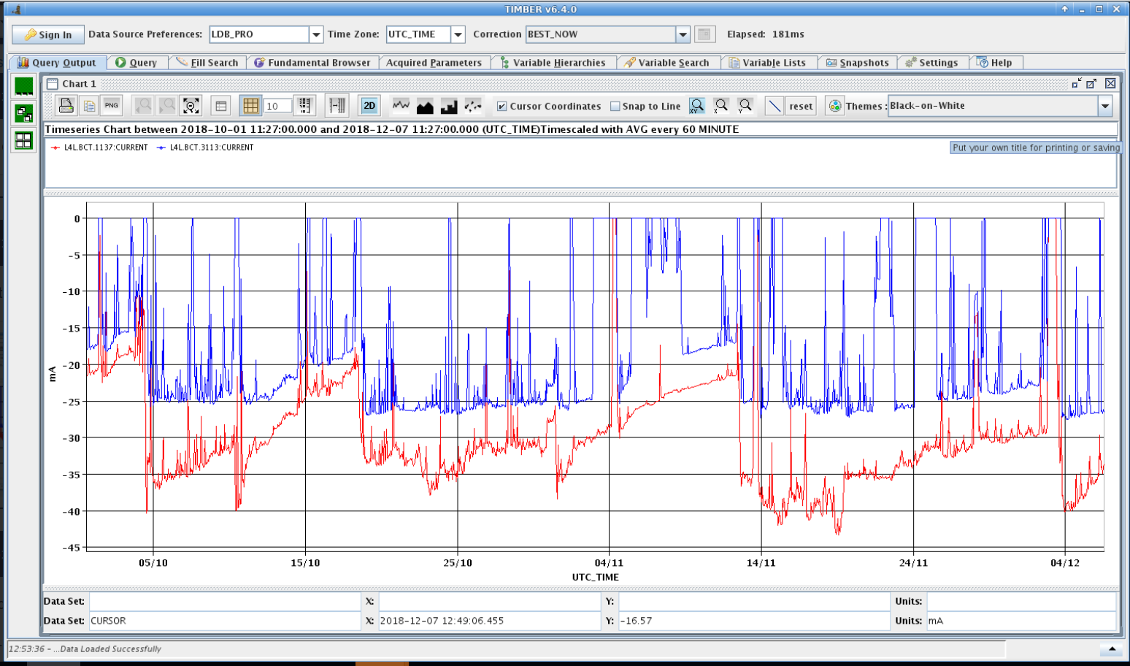
2018 run : 6.5mm bore/cesiated ISO3 type
25 mA after the RFQ with currents between 30 and 40 from the source
4 cesiation with different durations/temperatures. Source separated from the RFQ when cesiation takes place
Between 4 and 14 nov we intentionally left the current drift down : about 1mA/day if we don’t tune
A continuous cesiation + autopilot will avoid the slope (as fast as 1mA/day)
RED =LEBT current 45keV BLUE=MEBT current 3 MeV
C
C
C
C

Slide 14
Source for 2019 - LBE run
All these modifications will be implemented in time for the LBE run
We will run with the 2018 source with the following improvements
Modification | Expected benefit | Comments
2MHz RF amplifier : (upgrade of resistors and automatic measurement of source impedance and amplifier gain) | Improved amplifier stability and , basis for beam stability and correct functioning of autopilot and maintenance optimisation | warning when operation approaching the system limits
Autopilot – automatic tuning of RF power and gas injection. | Increased uptime, RF and gas regulated to the correct value | Effort shared ABP + OP +CO
“Continuous” cesiation | A more stable intensity vs time, long drift.
Increase the bore radius of the plasma electrode from 6.5mm to …8,9 mm | More current without degrading the emittance. This will allow more room for tuning and also a more reliable source as it will not run to its maximum. | Certainly 7.5mm , else 8 or 9 depending on emittance and saturation.

Slide 15
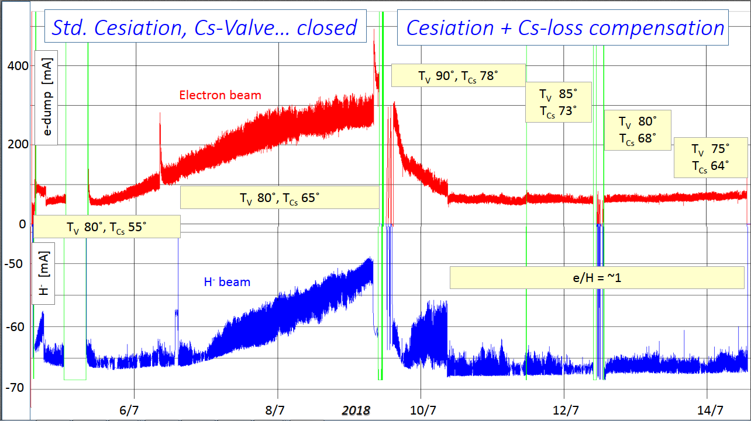
Justification for the proposed improvements : continuous cesiation
Measurements in the linac4 tunnel – July 2018

Slide 16
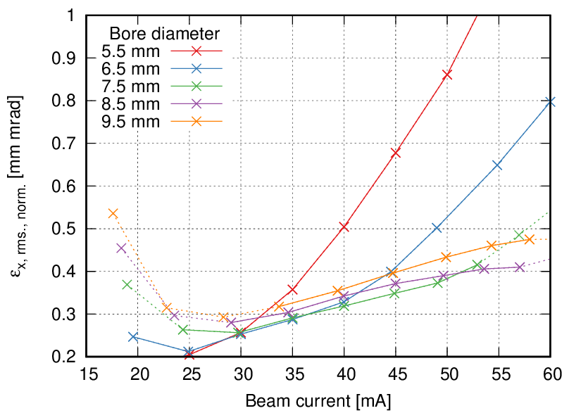
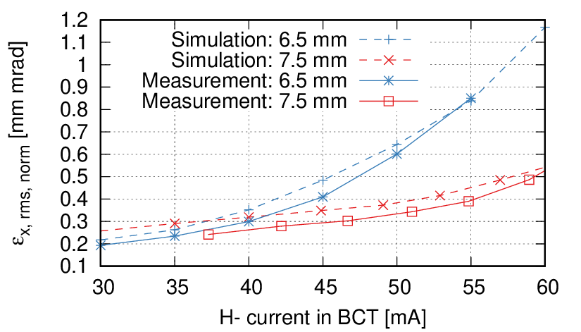
Justification for the proposed improvements : increase plasma bore radius
Simulations of expected beam current and emittance from the source for various plasma bore radius
Measurements at the test stand of emittance from the source for plasma bore radius 6.5 and 7.5 mm

Slide 17
Goal 45 mA available in 2023
Milestone | By when
Determine maximum current that we can deliver to the RFQ with the present design – including stability and availability. | June 2019
Study the geometry of J-parc and SNS where current in excess of 60mA are routinely obtained (their RFQ has comparable acceptance) and make some experiment in this direction at the test stand | December 2019
Test a different geometry à la J-parc (and review results ) | December 2020
Implement/optimise new geometry (extraction + LEBT) | June2021
Measurement and optimization of the new geometry at the test stand | June 2022
Beam formation studies to gain information's and better simulate the transition plasma to beam | June 2022
Long term test at the test stand and decision to install in LINAC4 | October 2022

Slide 18
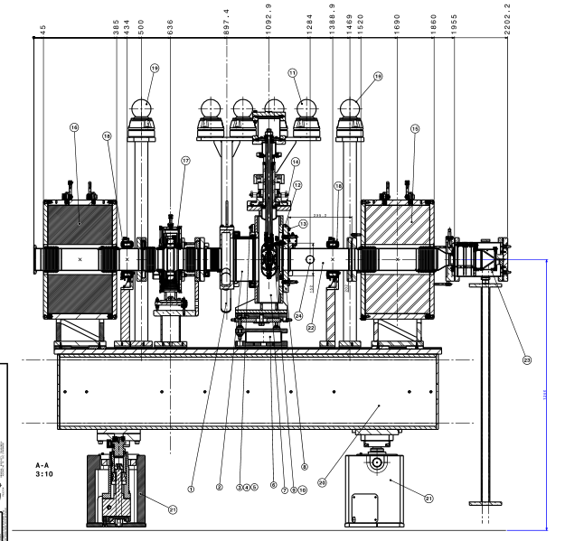
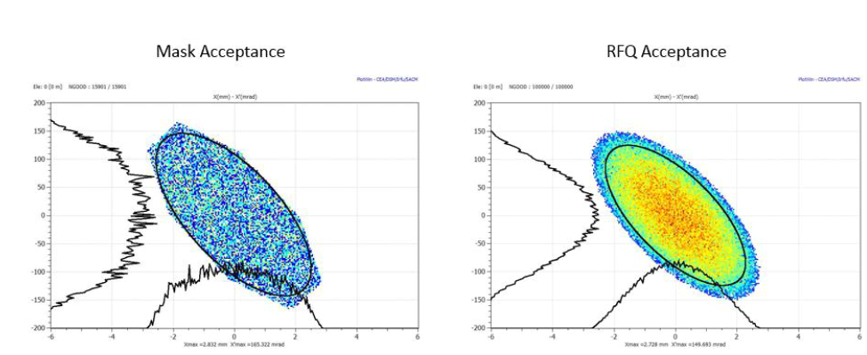
Resources for source studies – test stand
Test stand was never meant long-term so some “consolidation” is necessary.
Arbitration between short term goals and long term goals, accommodate visitors and collaborators.
Since July 2018 it is equipped with two solenoids (like tunnel) a delicate yet functional emittance meter and an rfq “mask”. Emittance meter and mask predict to 10% the transmission through the RFQ. Mask allows for fast on-line optimisation.
Particles reaching the Faraday Cup are within the transverse acceptance of the RFQ

Slide 19
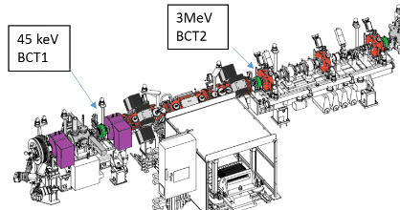
Resources 2 – low energy part of the linac
LS2 committee just validated that we can run source+ RFQ during 8 weeks in LS2
Possible to optimise the beam out of the RFQ in exactly the same condition as during the run. We suspect that the RFQ field influences the neutralisation in the LEBT. Studies started. More critical as the LEBT current increases.
planning and other info at
https://cernbox.cern.ch/index.php/s/M1Mo2g8iuleb06b

Slide 20
Summary - source
The source type that is installed in the tunnel can able to provide up to 1.25 10¹³ protons per ring and meets the requirement of stability of the PSB.
Operational issues for the next run have been identified and are being/will be addressed both in the tunnel and at the test stand : shot-to shot stability to be addressed.
Modifications of the design to improve operability and possibly the current after the RFQ will be put in place before the LBE run. Stability and reliability is the first priority. Margin in the current will be used for regulation.
The 2 MHz RF source issues will be addressed by RF colleagues. A solid state alternative is under consideration.
Follow the progress of the source and R&D at the test stand and in the tunnel at https://cernbox.cern.ch/index.php/s/o0ivN2cm5PLpW3S

