Slide 2
LHC Injectors Upgrade Workshop
Montreux, 13-15 February 2019

Slide 3
Performance and reliability with ions from Linac3 to PS
N.Biancacci
Acknowledgements: R.Alemany Fernandez, S.Albright, M.E.Angoletta, H.Bartosik, G.Baud, A.Beaumont, G.Bellodi, S.Bertolo, M.Bozzolan, J.Cenede, S.Cettour, D.Cotte, H.Damerau, F.Di Lorenzo, A.Dworak, A.Frassier, C.Gagliardi, D.Gamba, R.Gorbonosov, S.Hirlander, A.Huschauer, M.Jaussi, V.Kain, G.Kotzian, T.Kovener, D.Kuchler, A.Lasheen, A.Latina, T.Levens, E.Mahner, E.Manosperti, O.Marqversen, M.C.Mastrostefano, A.Michet, D.Moreno Garcia, D.Nicosia, M.O’Neil, E.Ozturk, G.Piccinini, A.Poscia, S.Ramberger, J.Resta Lopez, A.Saa Hernandez, E.Said, R.Scrivens, L.Soby, G.Tranquille, D.Valuch, B.Veglia, F.Wenander, M.Zampetakis, P.Zisopoulos, and PS/SPS OP teams.

Slide 4
Outline
Highlights from 2018
Performance overview from Source to PS
Source/Linac3
LEIR
  Preparation to the LHC run
  Performance during the LHC run
PS
Summary

Slide 5
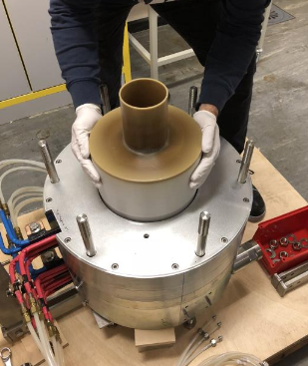
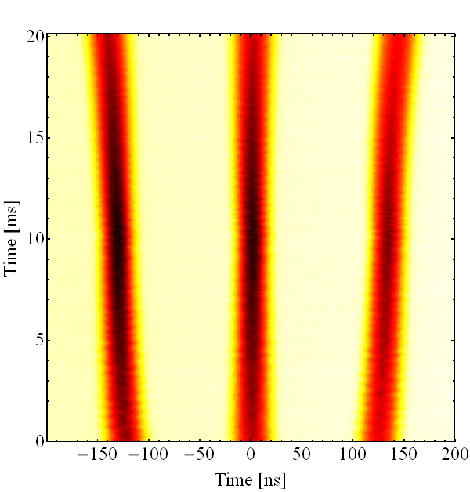
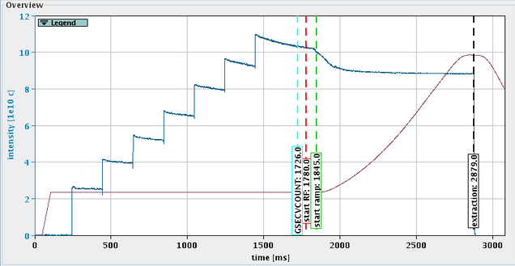
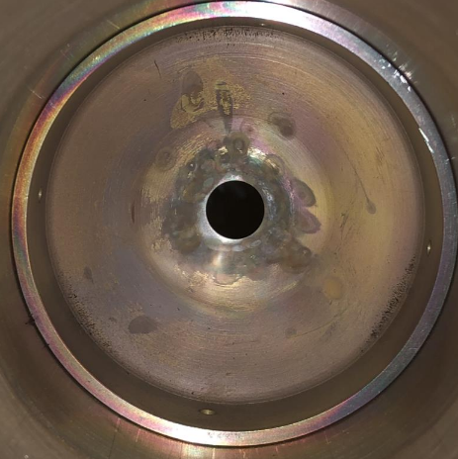
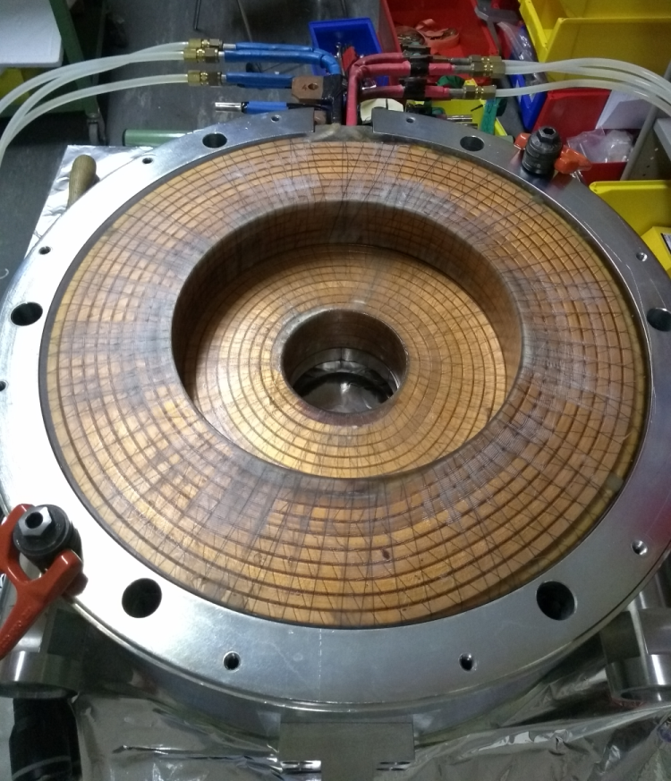
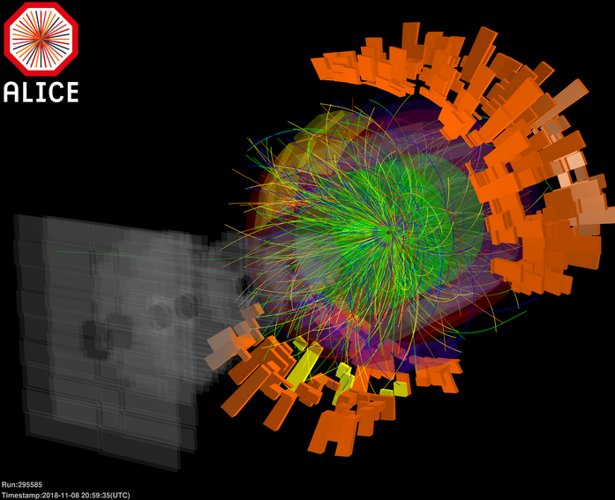
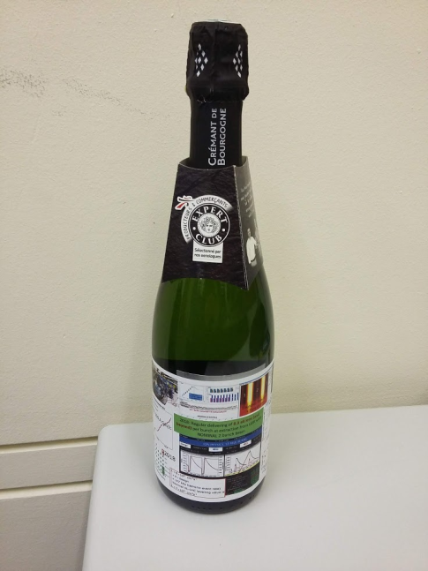

Highlights from 2018
PS
EE
EE
ETL
EE
ETL
ETL
LEIR
LEIR
ITE
LEIR
ITE
ITE
EI
EI
EI
Linac3
$$Pb^{29+}→Pb^{54+}$$
LIU
Jan
Feb
Mar
Apr
May
Jun
Jul
Aug
Sep
Oct
Nov
Dec
End of 2017 YETS
18th: NOMINAL 3+6 (75 ns) to PS
23rd: Birth of optimizers in LEIR
New GSI stripper foils tested
Source change of main insulators
Source commissioning
27th: NOMINAL at LIU (8.8e10c)
Source solenoid incident
Linac3 commissioning
6th: 2016 performance reached.
Start of LHC run
9th: Intensity record 10.88e10c
17th : Ions in TL + LEIR
25th : Ions to PS
Source extraction system repair against breakdowns
End of LHC run

Slide 6
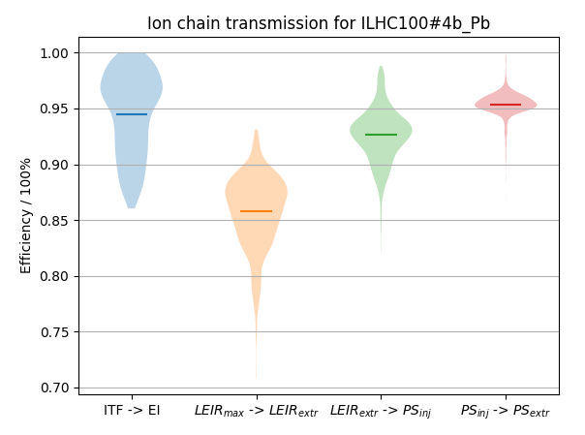
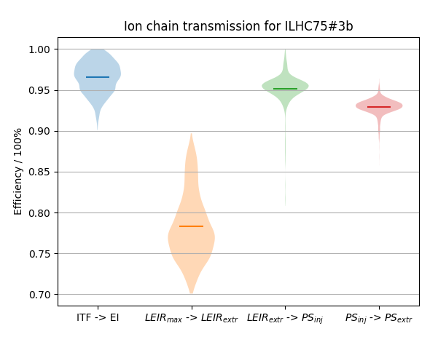
Overview from Source to PS
PS
EE
EE
ETL
EE
ETL
ETL
LEIR
LEIR
ITE
LEIR
ITE
ITE
EI
EI
EI
Linac3
LEIR capture & ramp are the most important losses.
Otherwise above 90%.
NOMINAL 2+4 (100 ns)
NOMINAL 3+6 (75 ns)

Slide 7
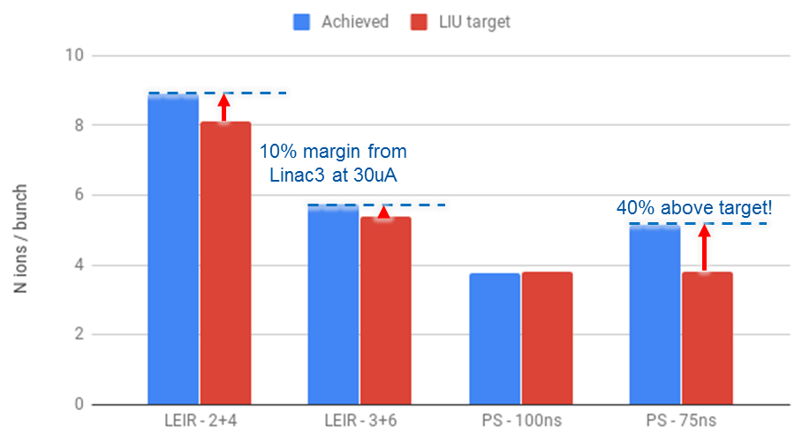
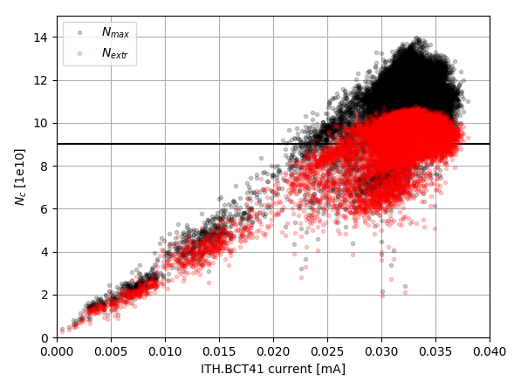
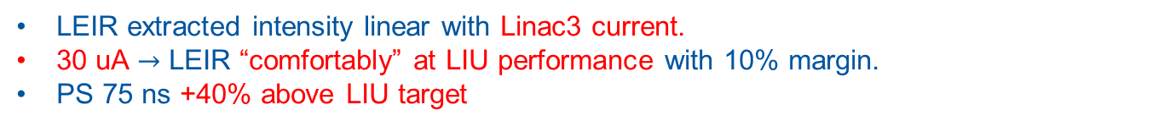
Overview from Source to PS
LEIR extracted intensity linear with Linac3 current.
30 uA $→$ LEIR “comfortably” at LIU performance with 10% margin.
PS 75 ns +40% above LIU target
ITH.BCT41 [mA]- first pulse intensity

Slide 8
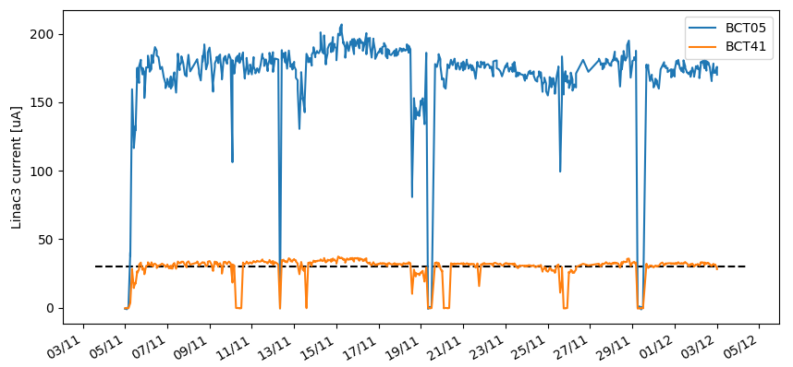

Source + Linac3 at LIU target!
PS
EE
EE
ETL
EE
ETL
ETL
LEIR
LEIR
ITE
LEIR
ITE
ITE
EI
EI
EI
Linac3
Source solenoid incident
Foil ($Pb^{29+}→Pb^{54+}$)
Oven refills
30uA required
for LEIR - LIU
RF faults

Slide 9
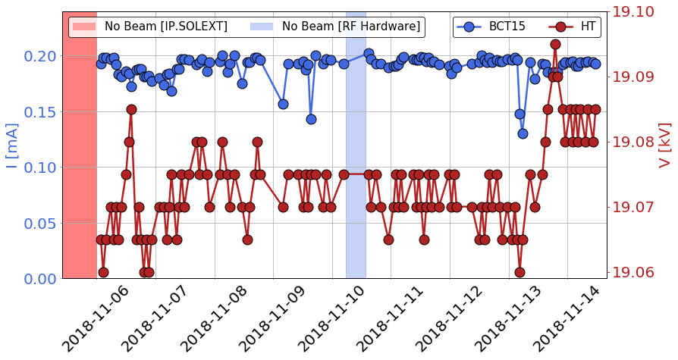
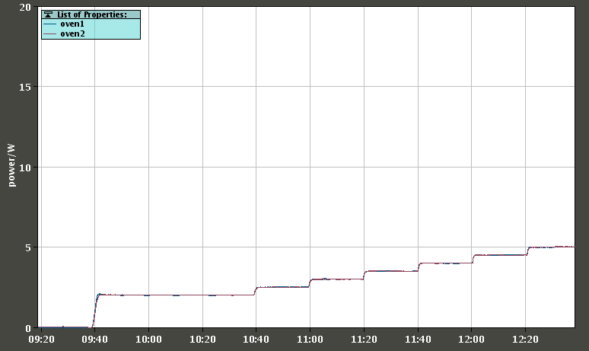
Source performance
Good performance thanks to:
24/24h support (normally on working hours only outside the LHC run).
Only fresh Pb was used through the year: faster recovery after refill (8-9 hours).
25 yo Thomson RF generator replaced with Sairem before start of operation
GHOST: two modules tested to improve source stability.
Source HT extraction voltage optimization
Automatic ramping of the oven power at source restart after an oven refill
Development of additional modules planned in LS2.
Oven power ramp after refill

Slide 10
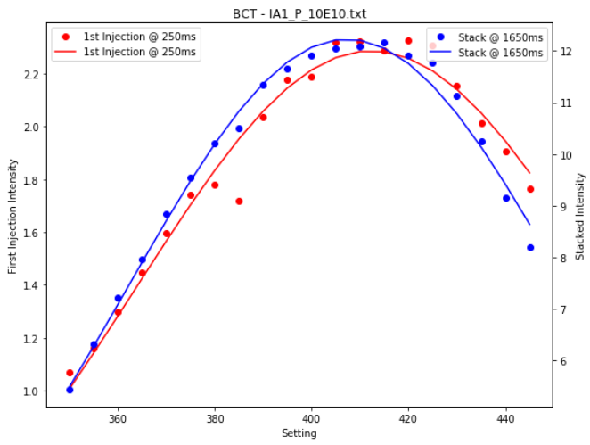
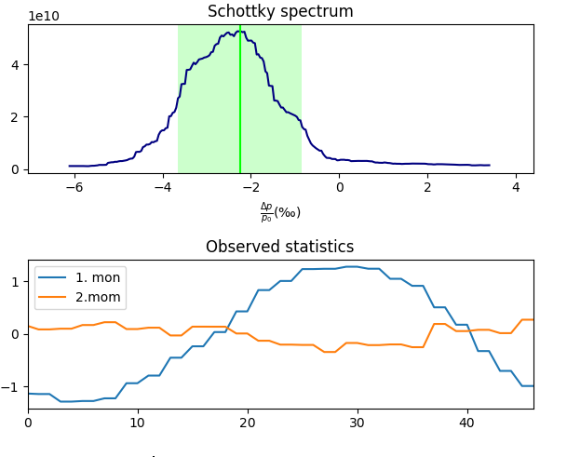
Linac3 performance
Joint efforts together with LEIR team to:
  Identify tolerances on RF parameters (in synergy with LLRF upgrade needs).
  Find optimal RF settings to improve LEIR injection performance.
Example: tank 1 phase scan
Example: Schottky observation from LEIR
Schottky spectrum
Mean energy
$Δp$ mean
$Δp$ std
Ramping cavity phase setting #
LS2: refining simulations models based on these measurements

Slide 11
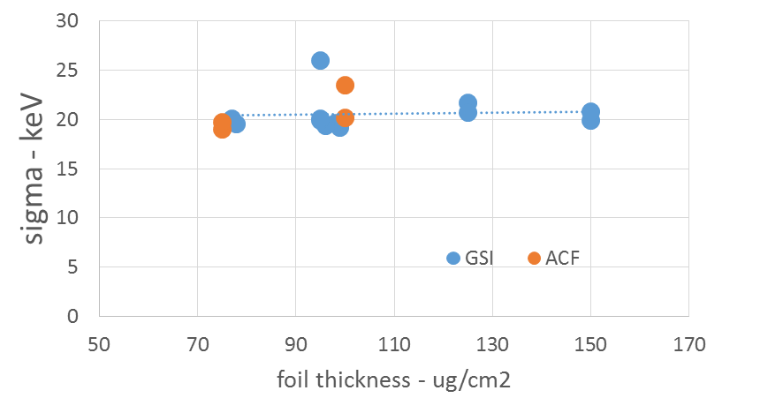
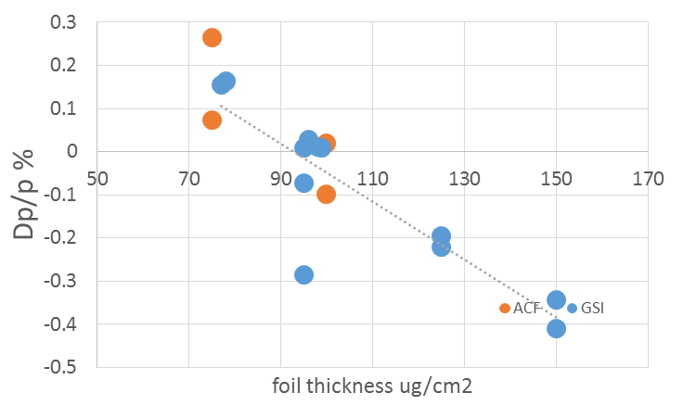
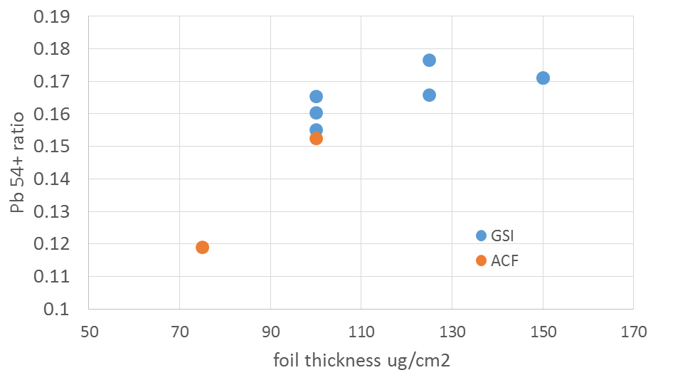
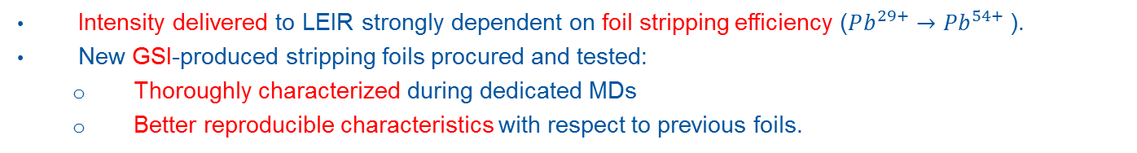
Linac3: a closer look to the foils
Intensity delivered to LEIR strongly dependent on foil stripping efficiency ($Pb^{29+}→Pb^{54+}$).
New GSI-produced stripping foils procured and tested:
  Thoroughly characterized during dedicated MDs
  Better reproducible characteristics with respect to previous foils.
Energy spread
Energy mean
Pb54+ production
used

Slide 12
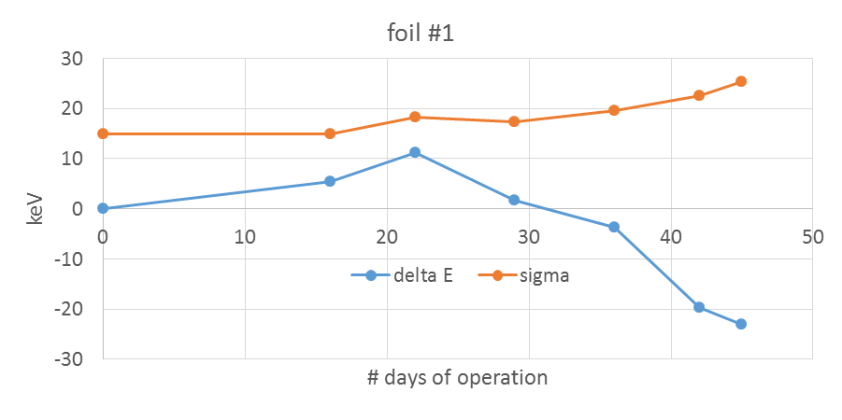
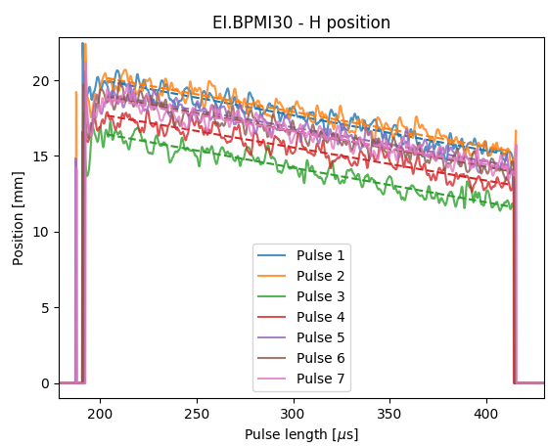
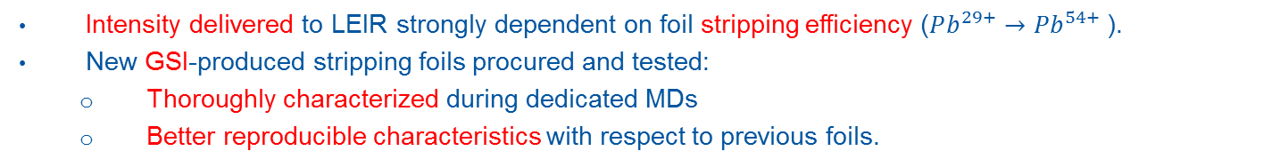
Linac3: a closer look to the foils
Intensity delivered to LEIR strongly dependent on foil stripping efficiency ($Pb^{29+}→Pb^{54+}$).
New GSI-produced stripping foils procured and tested:
  Thoroughly characterized during dedicated MDs
  Better reproducible characteristics with respect to previous foils.
Monitoring foil performance:
ITFS + Schottky + transfer line BPMs: now possible to carefully monitor it!
ITFS spectro-line
Schottky spectrum
BPMs

Slide 13
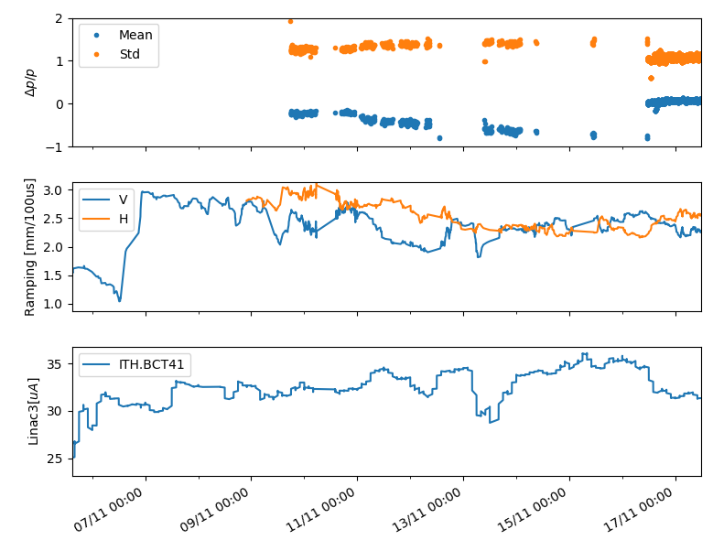
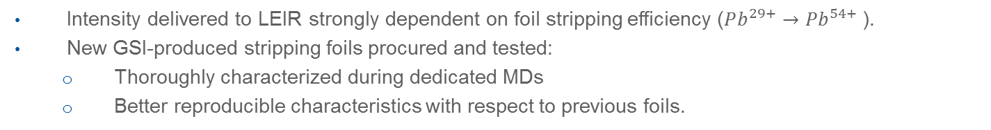
Linac3: a closer look to the foils
Example of foil performance monitoring
Intensity delivered to LEIR strongly dependent on foil stripping efficiency ($Pb^{29+}→Pb^{54+}$).
New GSI-produced stripping foils procured and tested:
  Thoroughly characterized during dedicated MDs
  Better reproducible characteristics with respect to previous foils.
Mean/Std energy shift
Monitoring foil performance:
ITFS + Schottky + transfer line BPMs: now possible to carefully monitor it!
Ramping rate shift
ITFS spectro-line
Schottky spectrum
BPMs
Higher charge states production
Old foil
New foil

Slide 14
Linac3: RF consolidation
Present situation:
Several faults with long downtime due to RF-related failures: 3% of LHC Ion run.
LLRF mostly analogue system dating to 70’s concepts with 90’s additions.
No LLRF internal remote diagnostics.
Large fluctuations in acquisition channels (amplitude should be stable at 0.1%, acquisition fluctuates by 0.3%).
Ramping/Debunching LLRF have obsolete components.
Consolidation (as planned for LS2):
Replacement of SS amplifiers for buncher, debuncher and ramping cavities (in sync with LLRF).
Maintenance of RF amplifiers foreseen for RFQ, IH-DTL Tanks 1,2,3 with new LLRF monitoring.
RFQ and Tank1 high power SS (post-LS2), in procurement phase (only one system budgeted in consolidation).
Agreed with TE-EPC to request post-LS2 consolidation for power converter (Tanks 2,3).
Expected improvements:
Acquisition accuracy compatible with required stability.
More reliability of the system.
Better LLRF diagnostics: identify long term drifts (including phase).

Slide 15
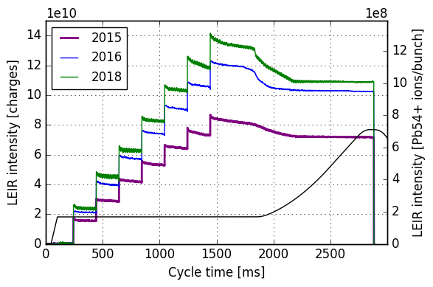
LEIR performance in 2018
Improvement in performance reach:
  Maximization of momentum acceptance.
  Orbit correction during all the cycle.
  Orbit bump in SS4 to minimize vacuum pressure.
  RF capture with voltage amplitude/frequency modulation.
  Tune bump towards 2.75 during capture.
  Optimizer tools to improve injected pulse energy distribution.
  Optimizer tools to improve injection efficiency.
  Tune ripple elimination.
  Cooler optimization with “cooling maps”
  Momentum correction during accumulation (radial loop -like).
Improvements in performance stability:
  Cure of ETL.BHN10 temperature drifts
  Injection optimizers+equalizer+aut
  Performance monitoring tools
  Impedance
2016
2017
2018
Details in
LIU-Ions Beam Performance 22/01/2019!
Notes:
Choose a subset

Slide 16
LEIR performance in 2018
Improvement in performance reach:
  Maximization of momentum acceptance.
  Orbit correction during all the cycle.
  Orbit bump in SS4 to minimize vacuum pressure.
  RF capture with voltage amplitude/frequency modulation.
  Tune bump towards 2.75 during capture.
  Optimizer tools to improve injected pulse energy distribution.
  Optimizer tools to improve injection efficiency.
  Tune ripple elimination.
  Cooler optimization with “cooling maps”
  Momentum correction during accumulation (radial loop -like).
Improvements in performance stability:
  Identified source of drifts with temperature
  Optimized injection optimizers+equalizer+autopilot
  Introduction of performance monitoring tools
  Suppression of impedance source
2016
2017
2018

Slide 17
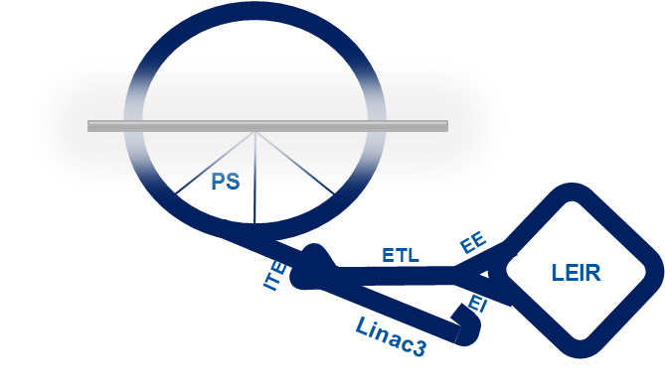
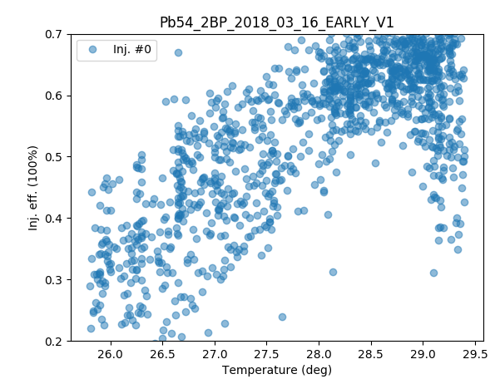
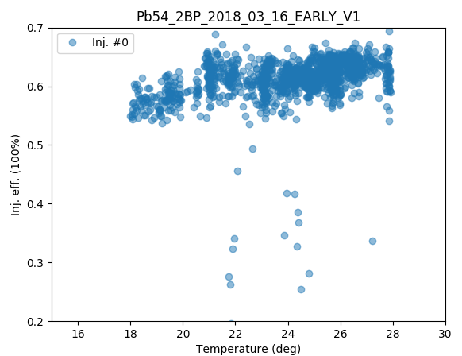
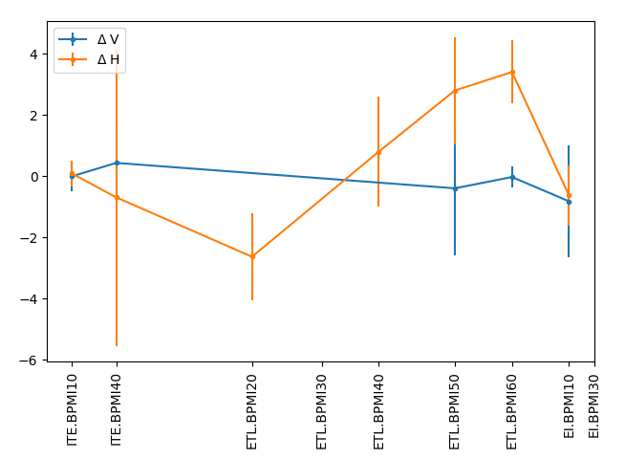
1. Source of drift with temperature
LEIR injection reproducibility highly affected by temperature variations.
Mainly first injection affected -> -10%/degree reduction in injection efficiency!
New injection line BPMs helped for source identification: ETL.BHN10
BEFORE
AFTER
Dependence on temperature due to large current transient: cured with new current function.

Slide 18
Optimizers
First application in 2018.
Essential tool for OP to maintain LEIR machine performance.
Concept applied as well at level of the source and in the SPS.
Example of single parameter optimization
Example of a multi parameter optimization
Further development followed up in a dedicated forum.

Slide 19

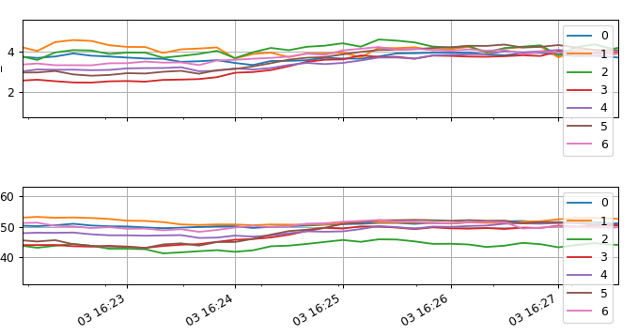
Optimizers + Equalizer
Injection trajectory “equalized” against PS stray fields (n average in a super-cycle).
  Observe position at ETL BPM + injection efficiency in LEIR.
  Correct with ETL.BHN10
Position in ETL line / pulse
Injection efficiency / pulse
Before correction
After
correction

Slide 20
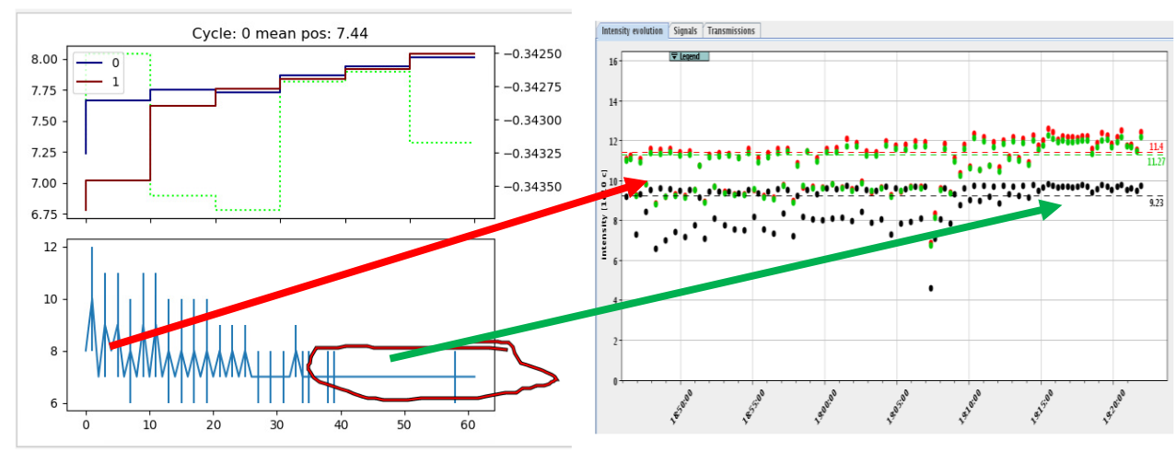
Optimizers + Equalizer + Autopilot
Cycle-by-cycle compensation of the PS stray fields with automatized scripts.
Further development/strategies followed up in LS2
Autopilot OFF
Autopilot
ON

Slide 21
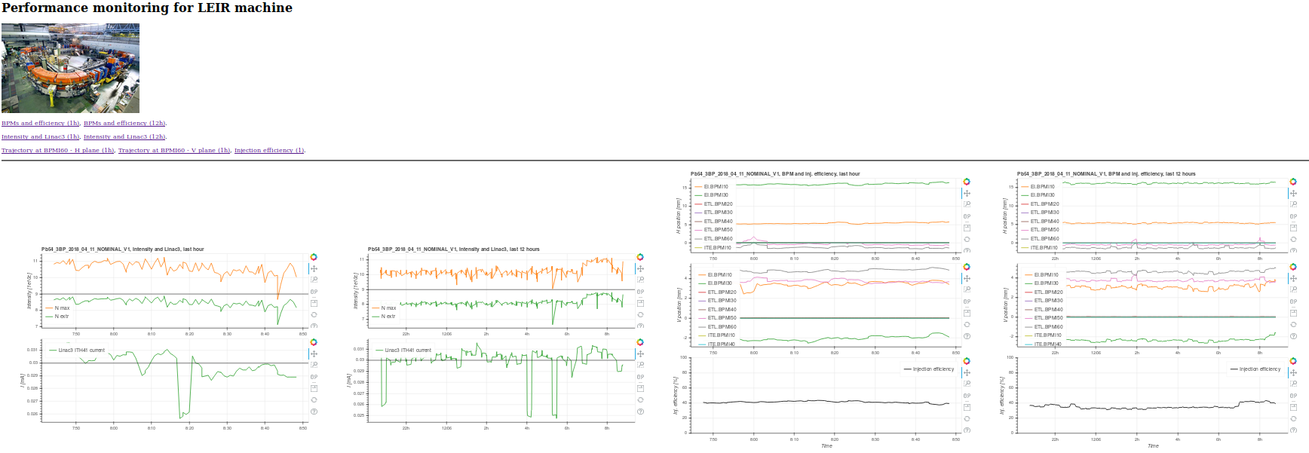
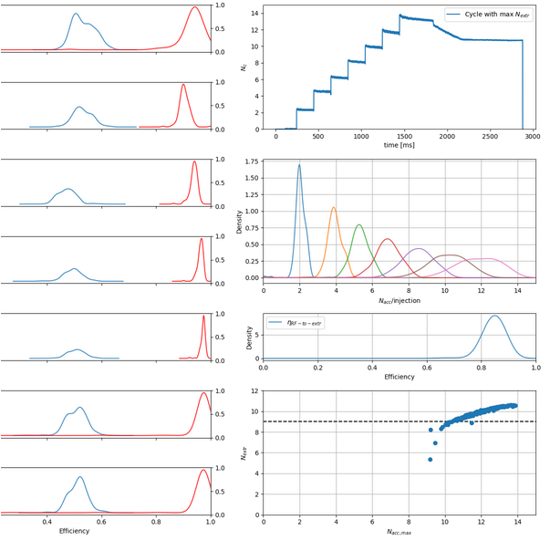
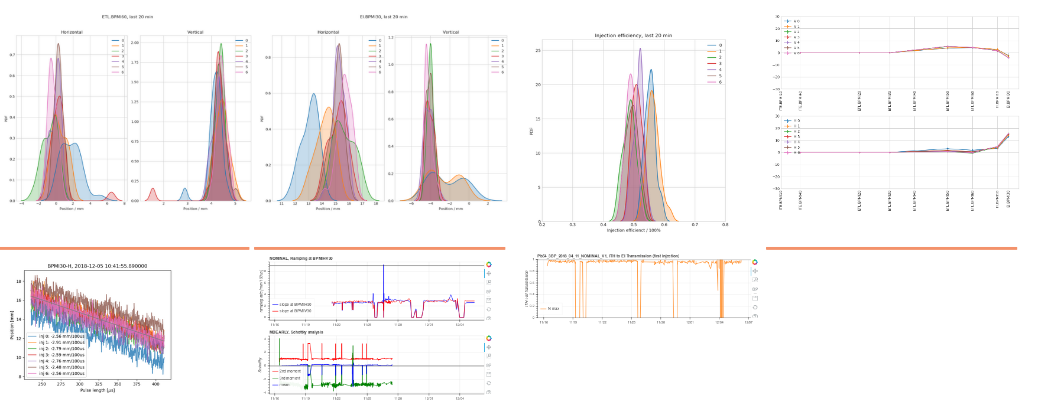
3. Performance monitoring tools
Monitoring website to identify source of performance loss on https://info-leir.web.cern.ch/info-leir/main.htm
Helpful tool for OP support
Performance tracking and statistics

Slide 22
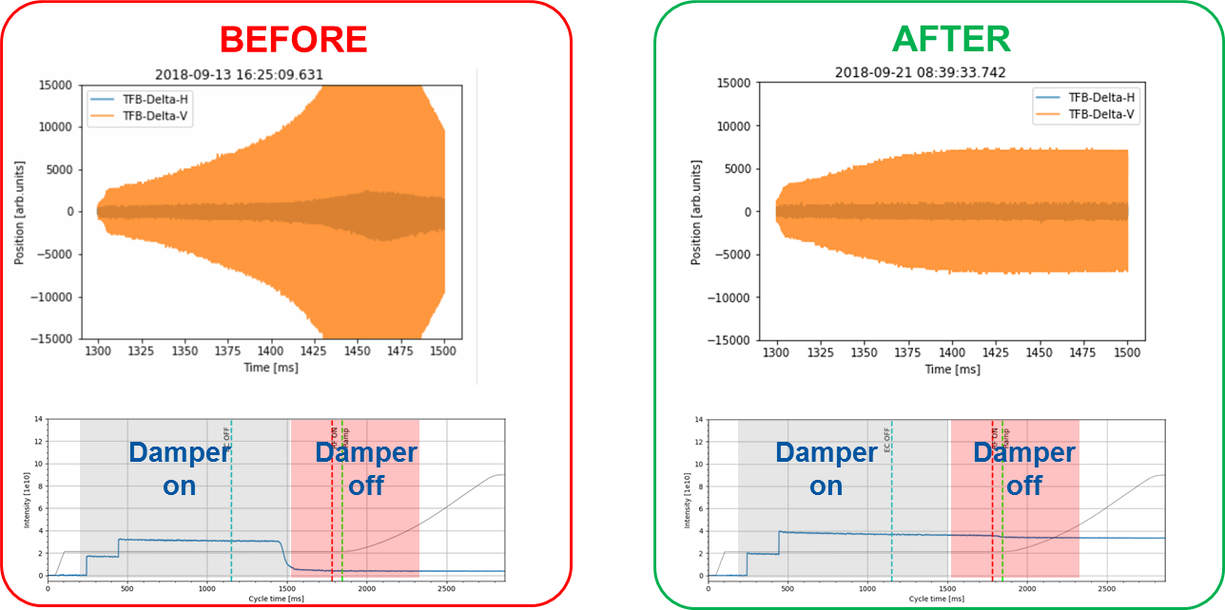
4. Impedance source suppression
ABP+BI joint effort identified the source of strong V instability (ER.UQFHV41, unused BTF pickup).
It was a potential limitation with high intensity or very cooled beams (MD).
Impedance removed by termination matching: instability suppressed.
matching terminations
of BTF pickup

Slide 23
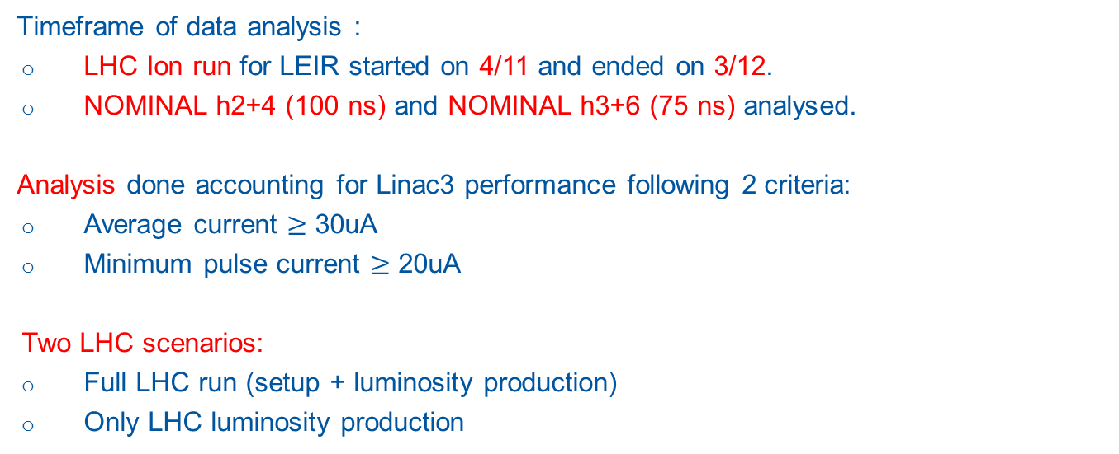
LEIR performance during LHC ion run
Timeframe of data analysis :
LHC Ion run for LEIR started on 4/11 and ended on 3/12.
NOMINAL h2+4 (100 ns) and NOMINAL h3+6 (75 ns) analysed.
Analysis done accounting for Linac3 performance following 2 criteria:
Average current $≥$ 30uA
Minimum pulse current $≥$ 20uA
Two LHC scenarios:
Full LHC run (setup + luminosity production)
Only LHC luminosity production

Slide 24
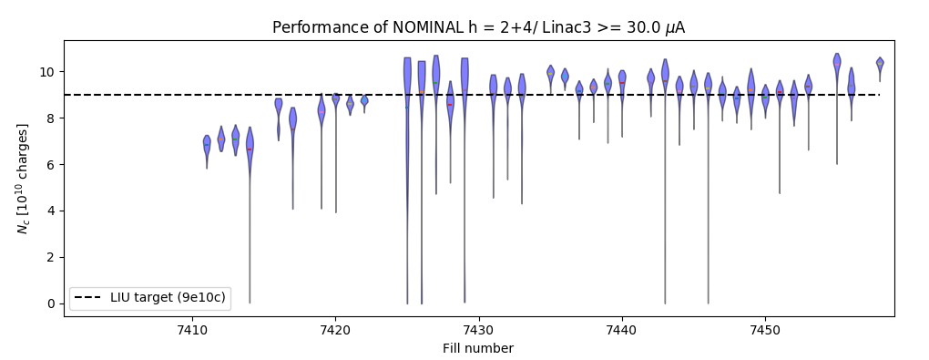
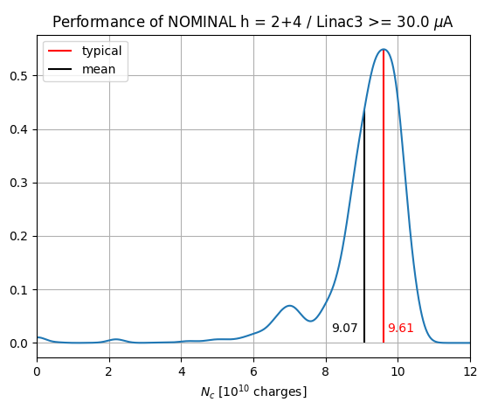
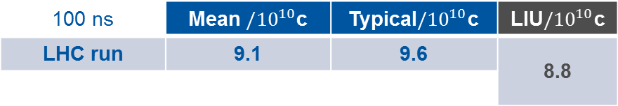
NOMINAL h = 2+4 (100 ns)
Statistical analysis on extracted intensity: full LHC run
100 ns | Mean $/{10}^{10}$c | Typical$/{10}^{10}$c | LIU$/{10}^{10}$c
LHC run | 9.1 | 9.6 | 8.8

Slide 25
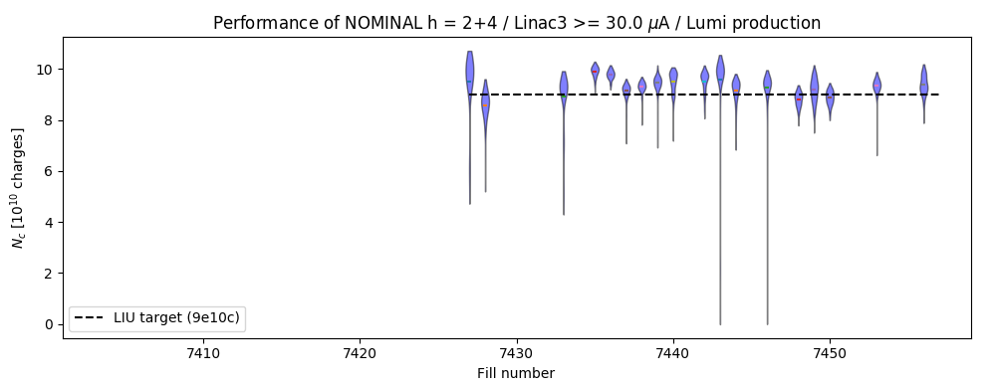
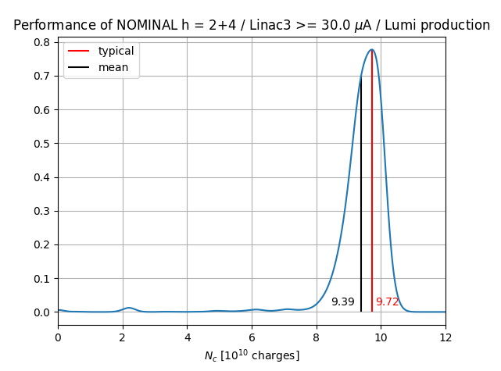
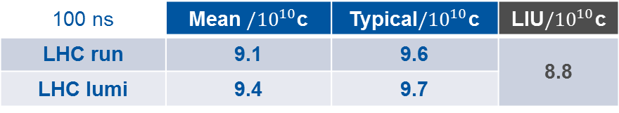
NOMINAL h = 2+4 (100 ns)
Statistical analysis on extracted intensity: LHC lumi production
100 ns | Mean $/{10}^{10}$c | Typical$/{10}^{10}$c | LIU$/{10}^{10}$c
LHC run | 9.1 | 9.6 | 8.8
LHC lumi | 9.4 | 9.7

Slide 26
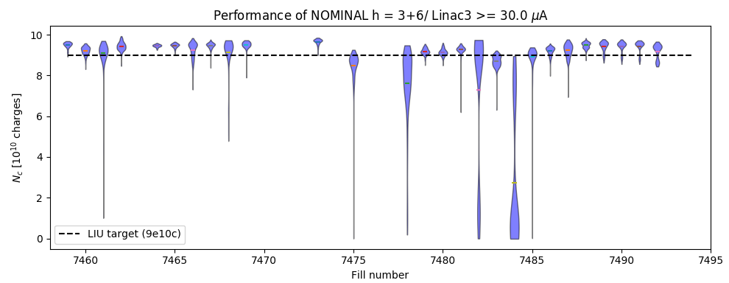
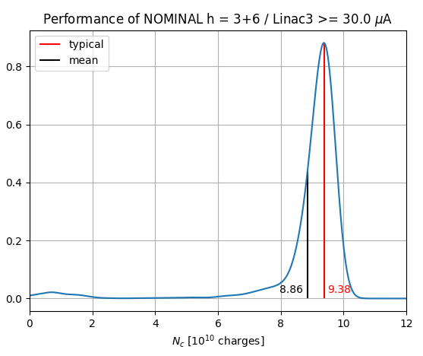

NOMINAL h = 3+6 (75 ns)
Statistical analysis on extracted intensity: full LHC run
75 ns | Mean $/{10}^{10}$c | Typical$/{10}^{10}$c | LIU$/{10}^{10}$c
LHC run | 8.9 | 9.4 | 8.8

Slide 27
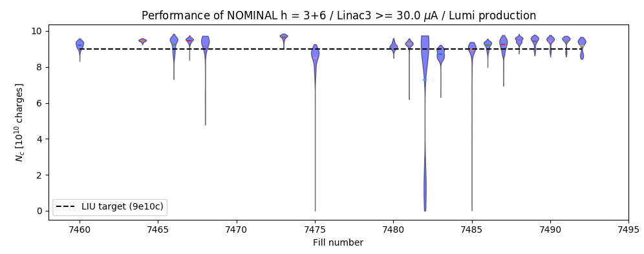
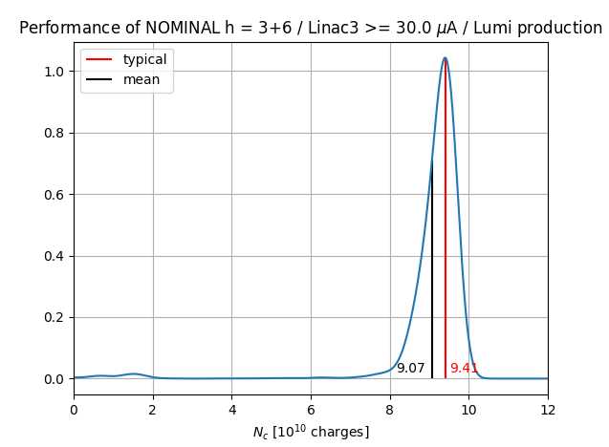
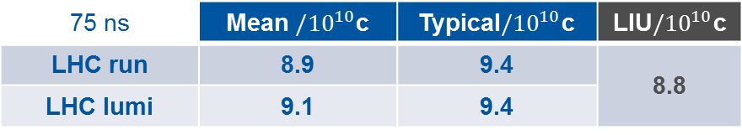
NOMINAL h = 3+6 (75 ns)
Statistical analysis on extracted intensity: LHC lumi production
75 ns | Mean $/{10}^{10}$c | Typical$/{10}^{10}$c | LIU$/{10}^{10}$c
LHC run | 8.9 | 9.4 | 8.8
LHC lumi | 9.1 | 9.4
New WR Btrain
calibration lost

Slide 28
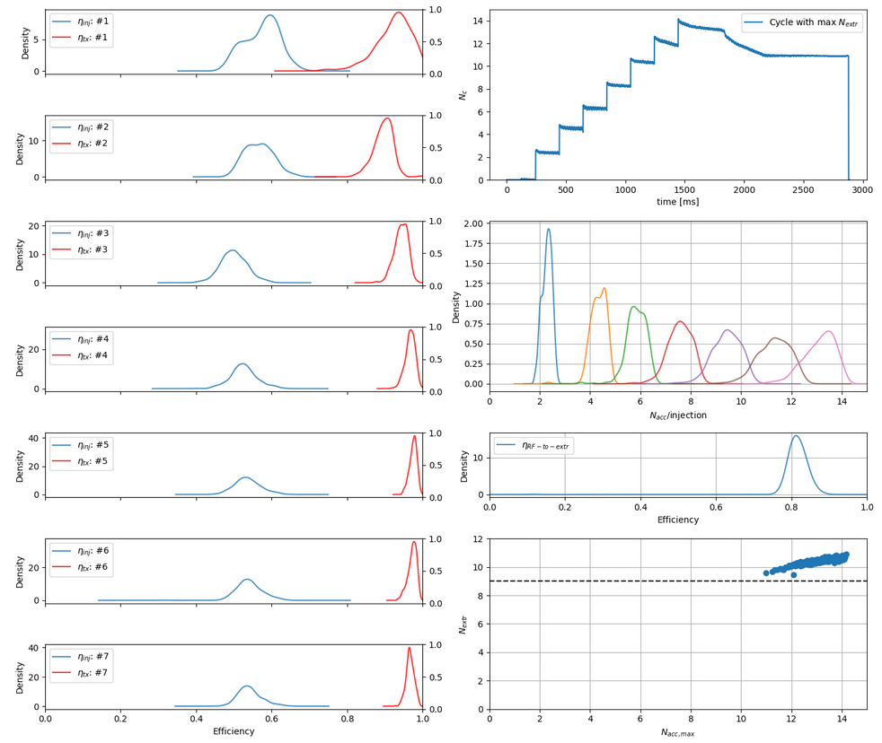

LEIR efficiency
Injection efficiency ~ 50% on average
Injection

Slide 29

LEIR efficiency
Injection efficiency ~ 50% on average
Transmission efficiency > 90% on average.
Injection
Transmission

Slide 30




LEIR efficiency
Injection efficiency ~ 50% on average
Transmission efficiency > 90% on average.
Capture efficiency: 80% $→$ 95% (ceiling at 11e10c?)
  Main players: IBS + SC $→$simulation efforts in LS2 to improve understanding.
Injection
IBS+SC
IBS
$$N_{extr}$$
$$N_{acc}$$

Slide 31


75 ns bunch spacing in the PS
Pros:
Simple RF manipulation scheme in PS
40% above LIU intensity target for the PS (67% of LIU target on total intensity in LHC compared to
58% for 100 ns case).
Observations:
Satellites when handling 20 MHz to 80 MHz: between buckets in SPS
  Microwave instability at transition: > 1GHz, input for longitudinal impedance model.
Not an issue for LHC so far

Slide 32
Summary
2018: another year of record performance!
Source and Linac3 steadily delivered 30uA during LHC ion run.
LIU targets achieved and exceeded in LEIR and PS:
  +10% intensity margin in LEIR
  +40% bunch intensity in PS for 75 ns
Several sources of performance drift identified both in Linac3 (e.g. foils, RF settings) and LEIR (e.g. temperature drifts on BHN10).
Source of faults between Linac3 and LEIR understood and identified for consolidation (if not already planned, e.g. LLRF).
LEIR machine better understood year by year, both in operation (e.g. injection efficiency) and intensity limitations (SC+IBS).
Largely profited of new instrumentation (ring BPM electronics, transfer line BPMs and SEM fast electronics, new Schottky electronics) and new tools for OP to increase machine reproducibility.
LS2: prepare restart and progress on simulations (injection, cooling, SC, …)

Slide 33
Thanks for your attention!

