Slide 2
LHC Injectors Upgrade Workshop
Montreux, 13-15 February 2019

Slide 3
Acceleration and longitudinal emittance control in the PSB after LIU
S. Albright, M.E. Angoletta, A. Findlay, M. Paoluzzi, D. Quartullo
Acknowledgements: A. Lasheen, H. Timko, E. Shaposhnikova, M. Jaussi, J. Molendijk, S. Hancock, B. Mikulec,
G. P. di Giovanni, H. Damerau, A. Harle, A. Beaumont, F. Boattini, M. Buzio, A. Newborough, L. De Mallac, J. Wallbank,
M. Haase, N. Nasresfahani, C. Vollinger, CPS Island OP Crew

Slide 4
Contents
Controlled longitudinal emittance blow-up
Longitudinal instability threshold
Possibilities for reducing ramp duration
Experience with Finemet®
Conclusion and outlook

Slide 5
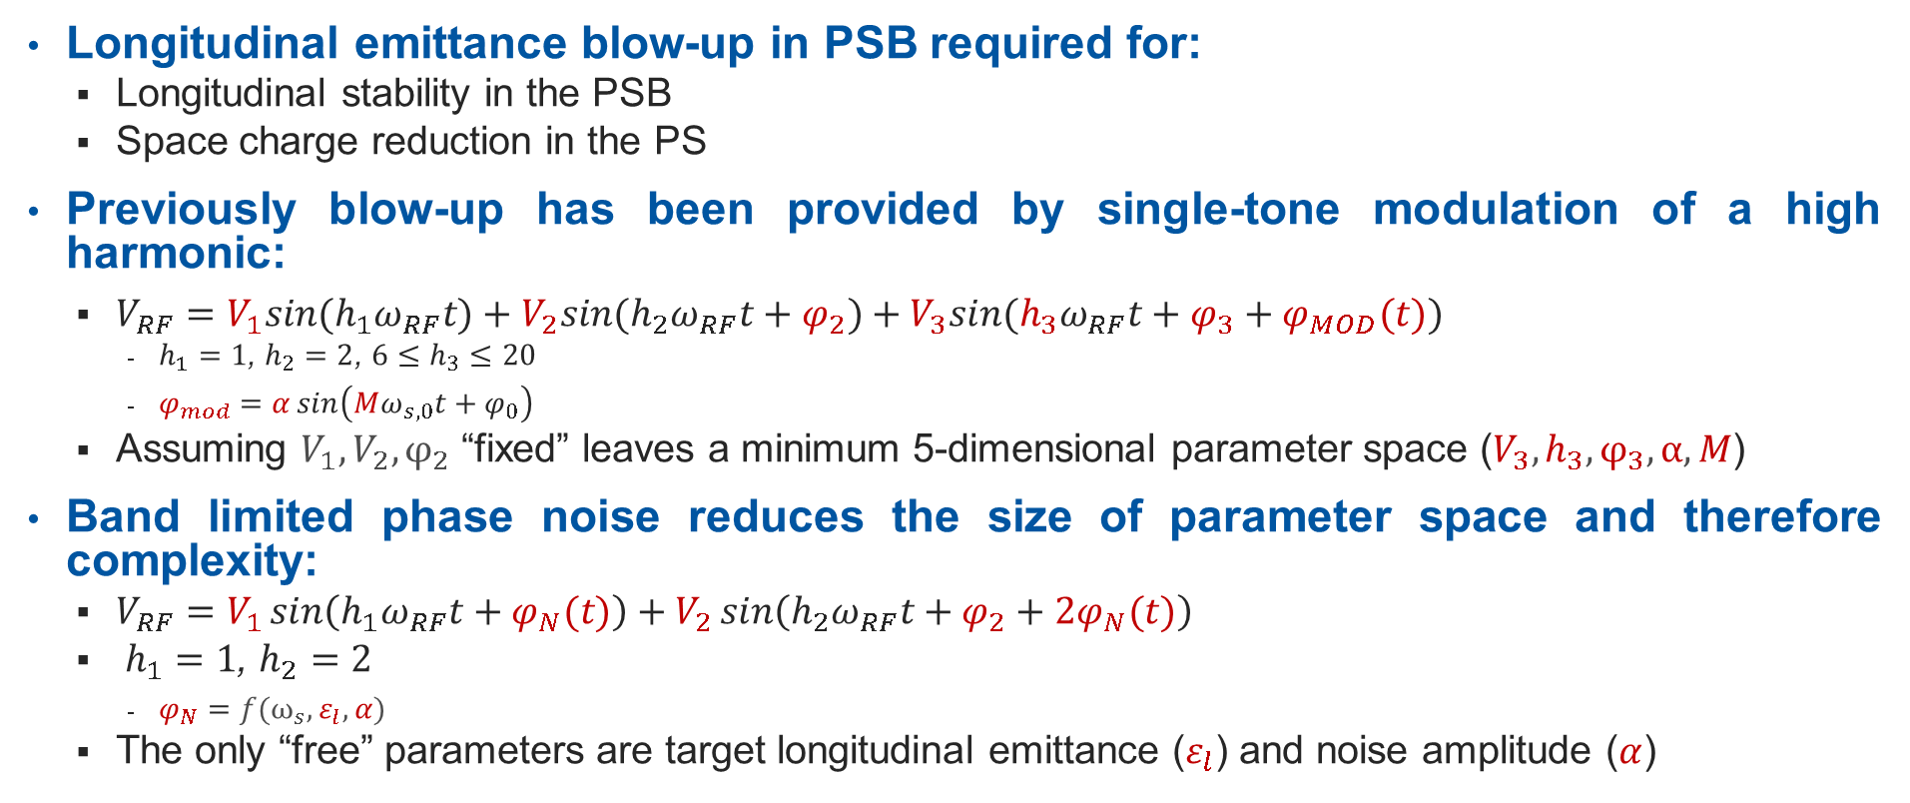
Controlled Longitudinal Emittance Blow-up (1/4)
Longitudinal emittance blow-up in PSB required for:
  Longitudinal stability in the PSB
  Space charge reduction in the PS
Previously blow-up has been provided by single-tone modulation of a high harmonic:
  $V_{RF}=V_{1}sin⁡(h_{1}ω_{RF}t)+V_{2}sin⁡(h_{2}ω_{RF}t+φ_{2})+V_{3}sin⁡(h_{3}ω_{RF}t+φ_{3}+φ_{MOD}(t))$
    $h_{1}=1$, $h_{2}=2$, $6≤h_{3}≤20$
    $φ_{mod}=α\sin\left(Mω_{s,0}t+φ_{0}\right)$
  Assuming $V_{1}, V_{2},φ_{2}$ “fixed” leaves a minimum 5-dimensional parameter space ($V_{3}, h_{3},φ_{3},α, M$)
Band limited phase noise reduces the size of parameter space and therefore complexity:
  $V_{RF}=V_{1}\sin\left(h_{1}ω_{RF}t+φ_{N}(t)\right)+V_{2}\sin\left(h_{2}ω_{RF}t+φ_{2}+{2φ}_{N}(t)\right)$
  $h_{1}=1$, $h_{2}=2$
    $φ_{N}=f(ω_{s}, ε_{l},α)$
  The only “free” parameters are target longitudinal emittance ($ε_{l}$) and noise amplitude ($α$)

Slide 6
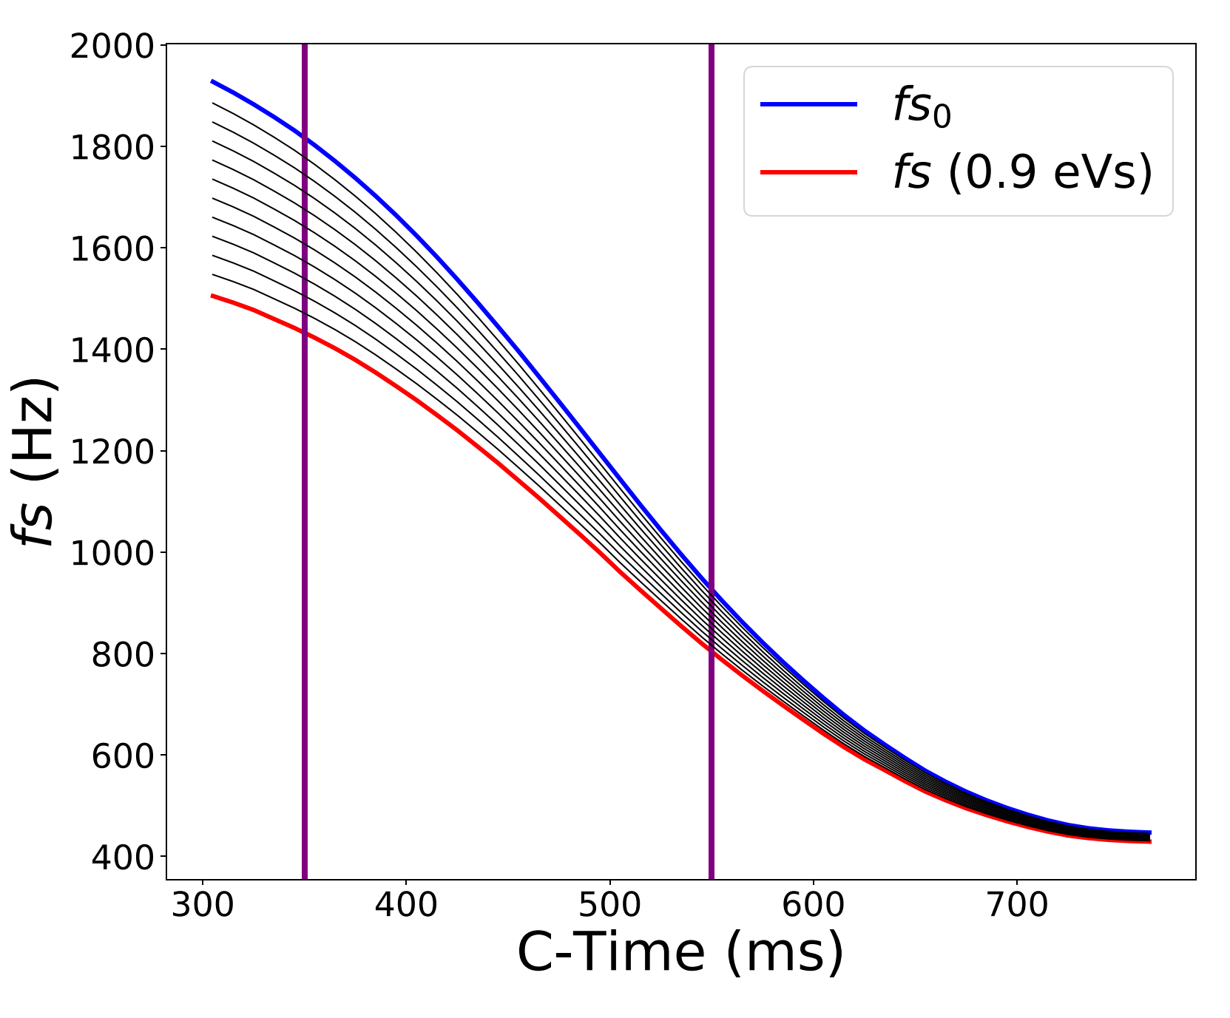
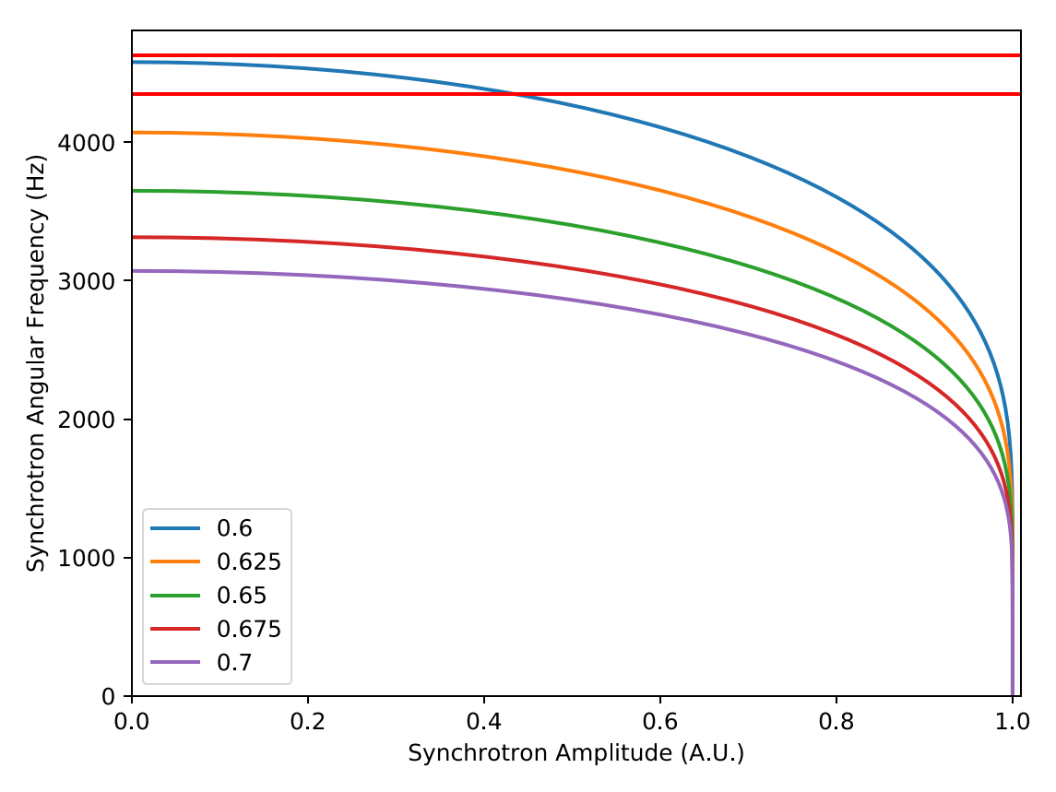
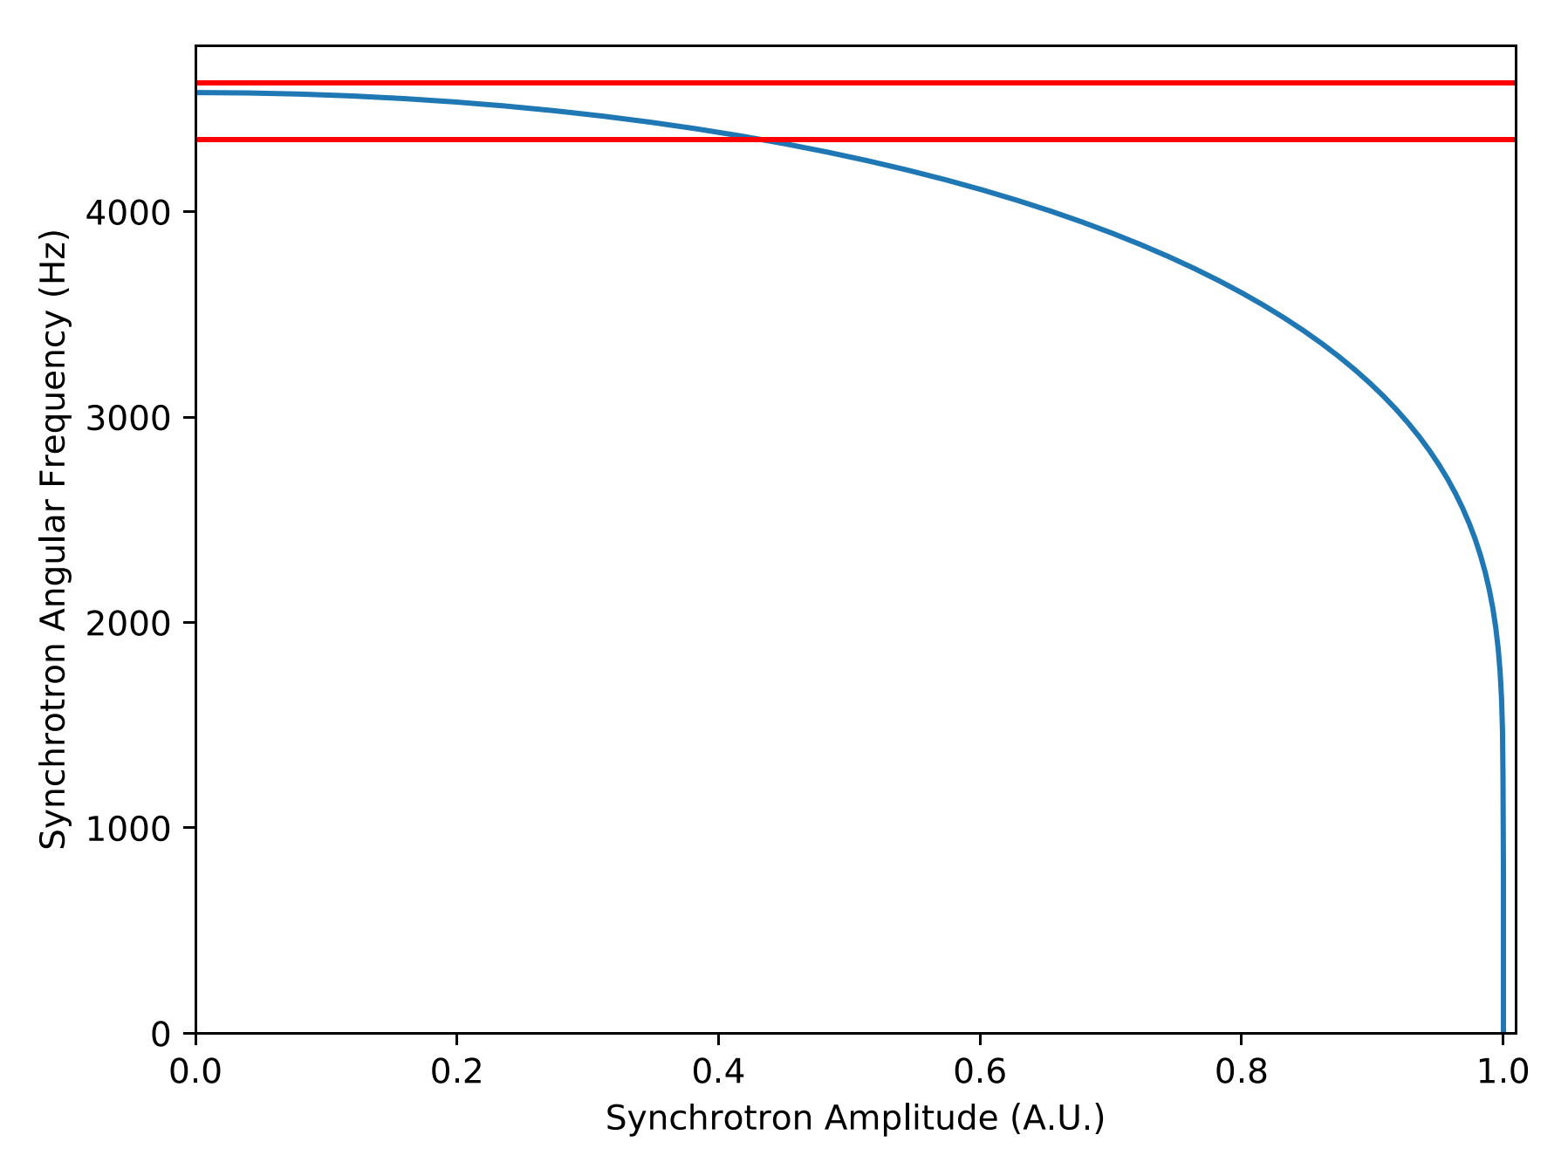
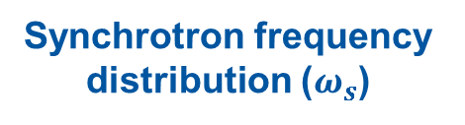
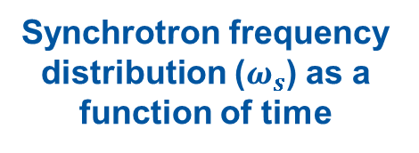
Controlled Longitudinal Emittance Blow-up (2/4)
Band limited phase noise can be used to excite particles within a well defined synchrotron frequency band
During acceleration the synchrotron frequency reduces and the target band gets narrower
The noise program must follow the band between small amplitude frequency and frequency at target longitudinal emittance
Synchrotron frequency distribution ($ω_{s}$)
Synchrotron frequency distribution ($ω_{s}$) as a function of time
BCMS blow-up between C350 and C550

Slide 7
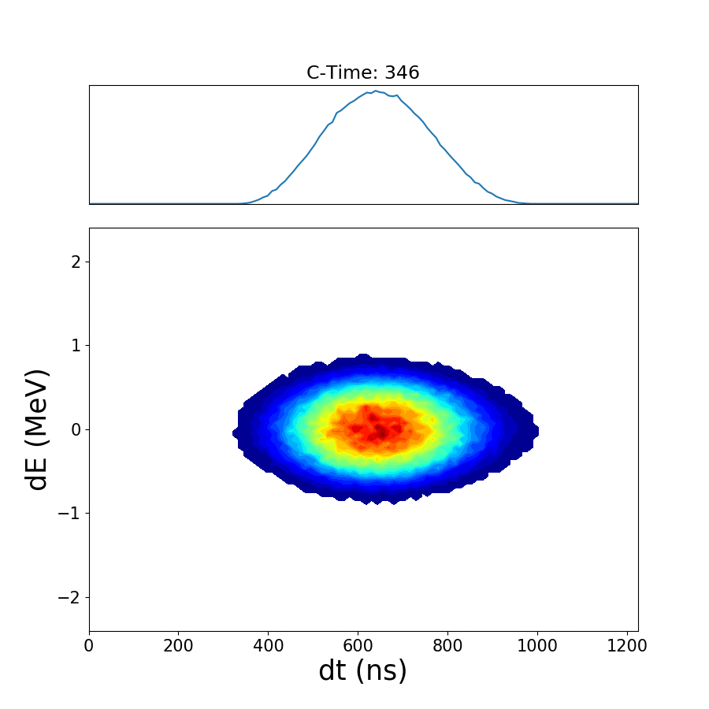
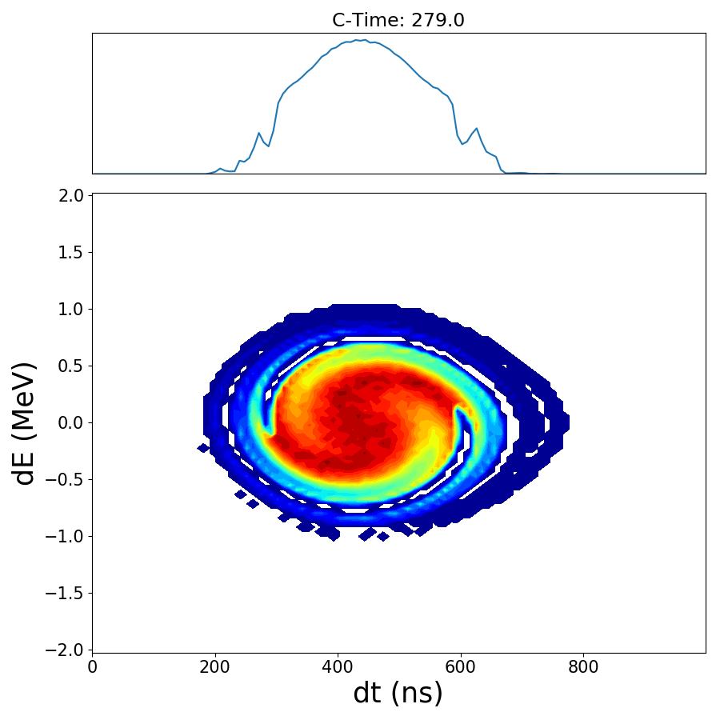
Controlled Longitudinal Emittance Blow-up (3/4)
Two available methods have different advantages and disadvantages, both are expected to be used after LS2:
Phase noise (new to PSB):
Directly target required emittance
Typically faster to set up
Slow
Difficult to follow changing synchrotron frequency
High harmonic (operational):
Fast
Easy to follow changing
synchrotron frequency
Requires additional harmonic
Typically slower to set up
+
+
-
-
BCMS emittance blow-up (200 ms)
LHCINDIV longitudinal shaving (30 ms)

Slide 8
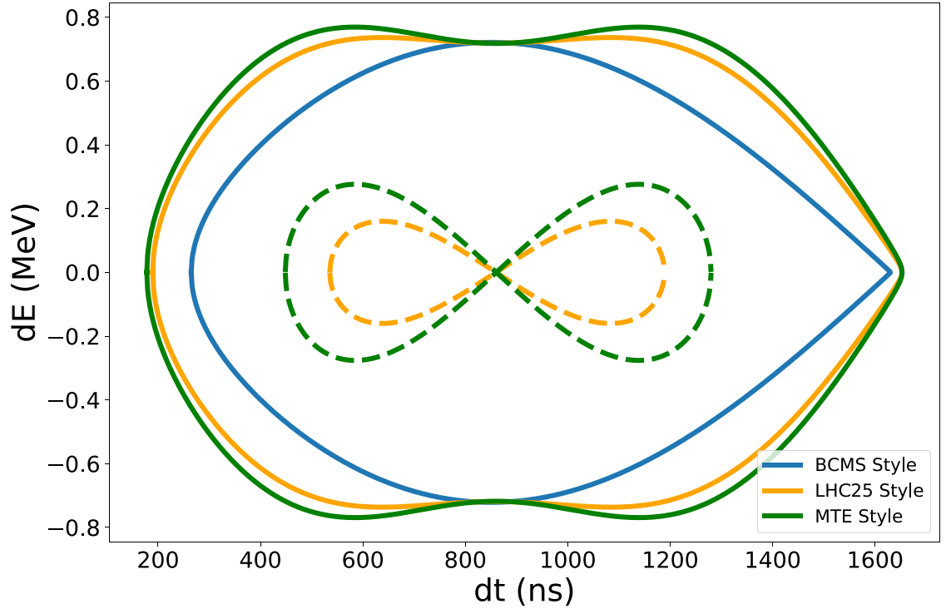
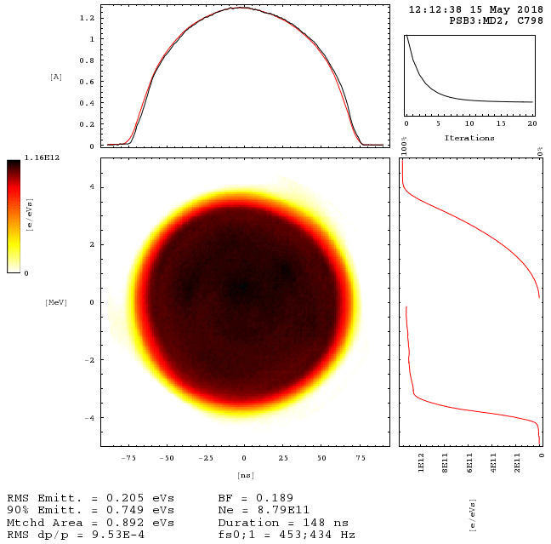
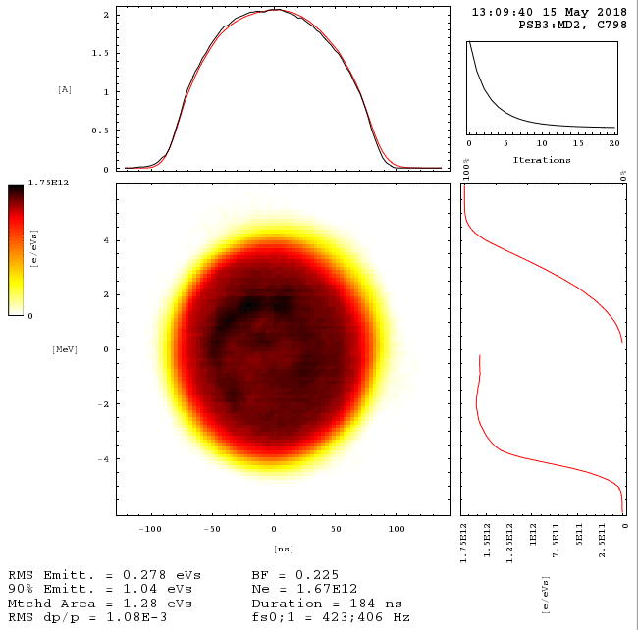
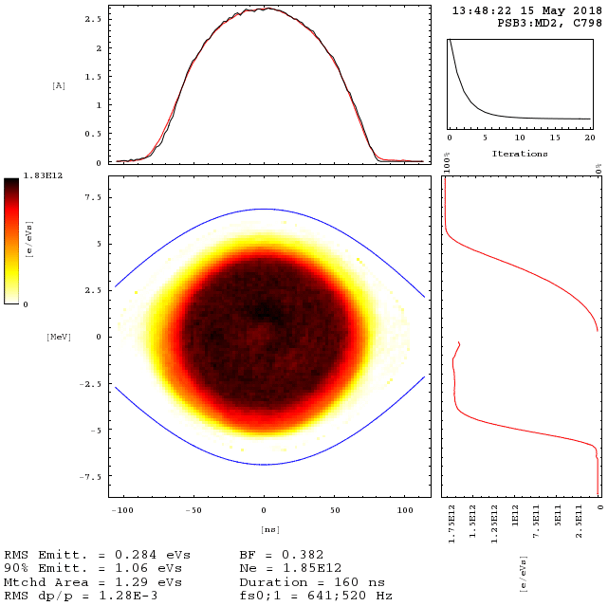
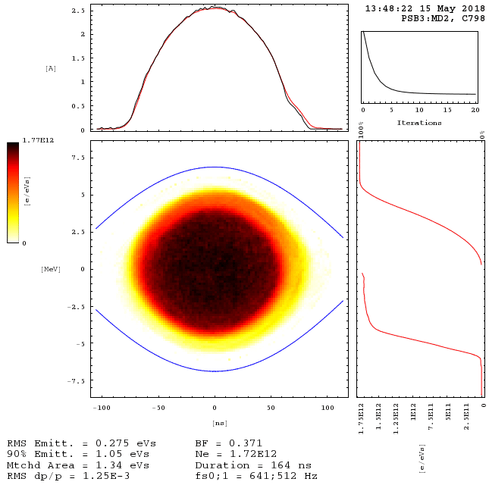
Controlled Longitudinal Emittance Blow-up (4/4)
Initial phase-noise demonstration in 2017 for thesis of
D. Quartullo
  Demonstrated in MD and predicted to be effective via simulations for after LS2
Successful reliability run in 2018 in main beam parameter spaces:
  BCMS: Low intensity (0.85E12) h1 = 8 kV, h2 = 0 kV
  LHC25: Moderate intensity (1.6E12) h1 = 8 kV, h2 = 6 kV, anti-phase
  MTE: High intensity (5.0E12) h1 = h2 = 8 kV, anti-phase (split before extraction)
Separatrix variants for BCMS, LHC25, and MTE style beams during blow-up
MTE
(Left)
MTE
(Right)
BCMS
LHC25

Slide 9
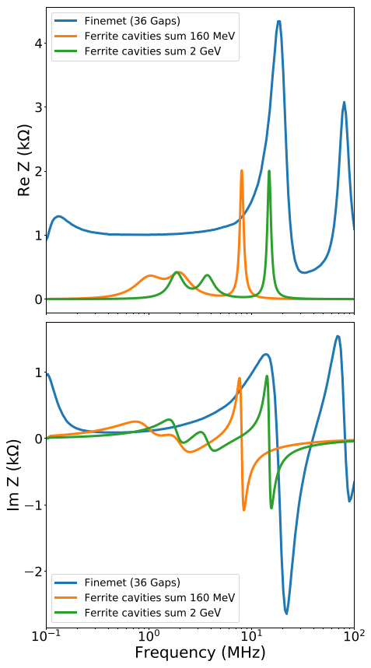
Longitudinal Stability Threshold (1/3)
Major changes that could impact beam stability:
  New injection and extraction energy (160 MeV and 2 GeV)
  Replacement of ferrite cavities (C02, C04, C16) with Finemet® cavities
Comparison of cavity impedance before and after LS2 (C16 at h=8)
  Moved from tuned resonant cavities (ferrite) to un-tuned broadband cavities (Finemet®)
  Finemet® impedance reduced at specified harmonics by servo loops counteracting induced voltage
Finemet® cavities will allow much greater flexibility, increase in the total voltage (20 kV total instead of 8 kV at h = 1 and 8 kV at h = 2), and have the benefit of being modular
Real longitudinal impedance
Imag longitudinal impedance

Slide 10
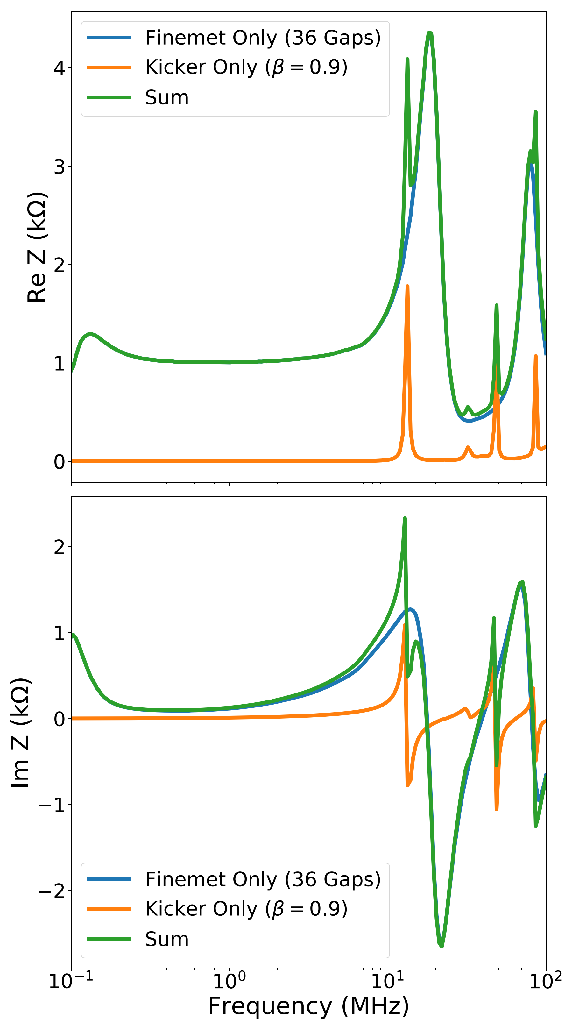
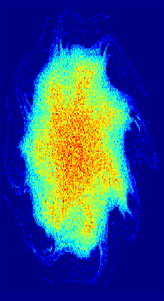
Longitudinal Stability Threshold (2/3)
Longitudinal impedance sources after LS2:
  Finemet® (broad band, maximum 4.4 kΩ), independent of β
  Extraction kicker (narrow band, maximum 2 kΩ at f < 100 MHz), varies with β
  Space charge (Z/n = 603 Ω at 160 MeV), varies with β
  Other impedances |Z| < 100 Ω in frequency range of interest, most independent β
Finemet® LLRF servo loops control beam loading – effective impedance reduction
  Simulations to date used servo loops on h=1..8, target is h=1..16 (to be validated)
  Frequency domain model of servo loops used in simulation
  with servo loops at h=1..8 the stability threshold is determined by the 18 MHz peak (microwave instability)
Real longitudinal impedance
Imag longitudinal impedance

Slide 11
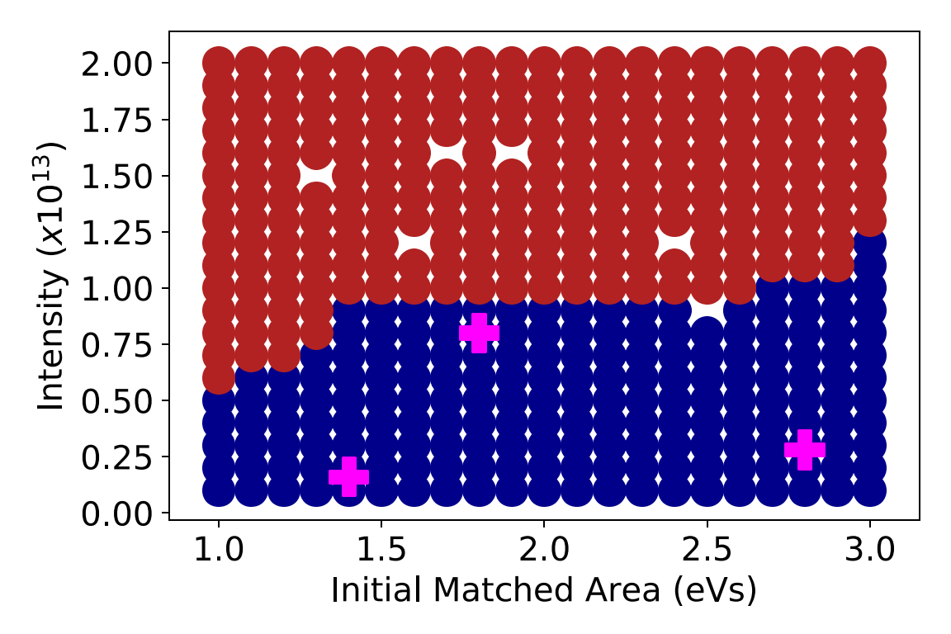

Longitudinal Stability Threshold (3/3)
All required beams expected to be stable from current simulations, e.g.:
  TOF, 1.8eVs, 800x10¹⁰ PPR
  LHC25 (post-LS2), 2.8eVs, 280x10¹⁰ PPR
  LHC25 (pre-LS2), 1.4eVs, 160x10¹⁰ PPR
Additional stability margin is expected:
  Servo loops on more Finemet® harmonics
  Careful design of RF program (e.g. h = 2 in bunch shortening to increase $\frac{Δp}{p}$)
h = 1, 16 kV
Unstable
Stable

Slide 12
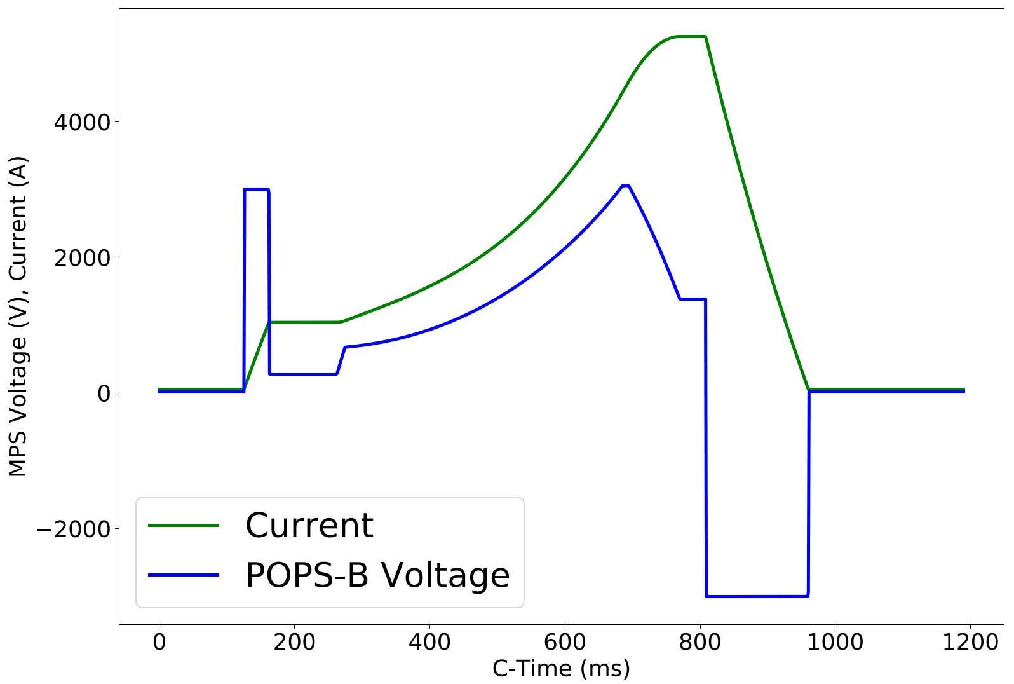
Possibilities for ramp duration reduction (1/3)
Baseline ramp duration is 530 ms with extraction at C805, earlier extraction of interest for the PS with LHC type beams
Requirements and limitations:
EDMS PSB-OP-ES-0001
Comfortably within POPS-B limits for:
  V – Max allowed = 3 kV
    Reached briefly at max dB/dt
  dV/dt – Max allowed = 1 kV/ms
    Max during ramp: ~0.13 kV/ms
  dI/dt – Max allowed = 28 A/ms
    Max during ramp 18 A/ms
No problems for magnets and POPS-B to increase ramp rate

Slide 13
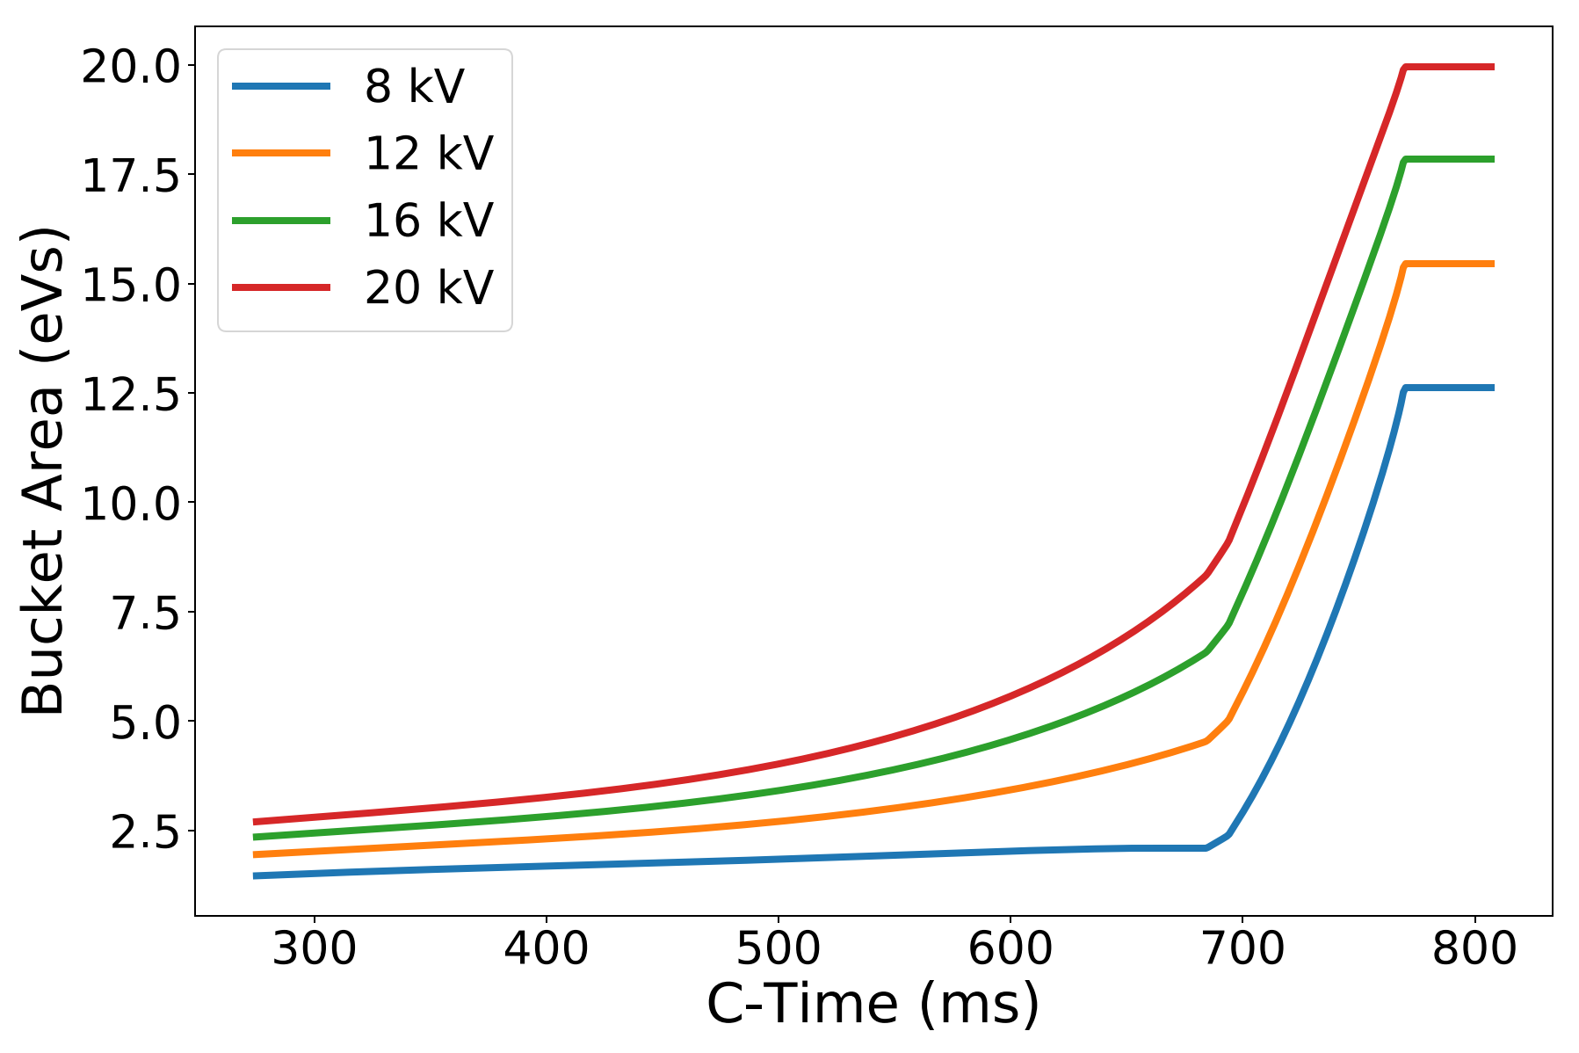
Possibilities for ramp duration reduction (2/3)
Available current and voltage from Finemet® amplifiers (includes programmed voltage and beam loading compensation):
  Numerical calculation of small high intensity beam (1 eVs, 800x10¹⁰) and 12 kV at h = 1 the maximum amplifier current is ~28 A (max allowed = 30A)
  Longitudinal acceptance at 12 kV increasing through ramp
For low intensity beams (LHC25, BCMS) the RF systems are expected to be able to accommodate a faster ramp

Slide 14
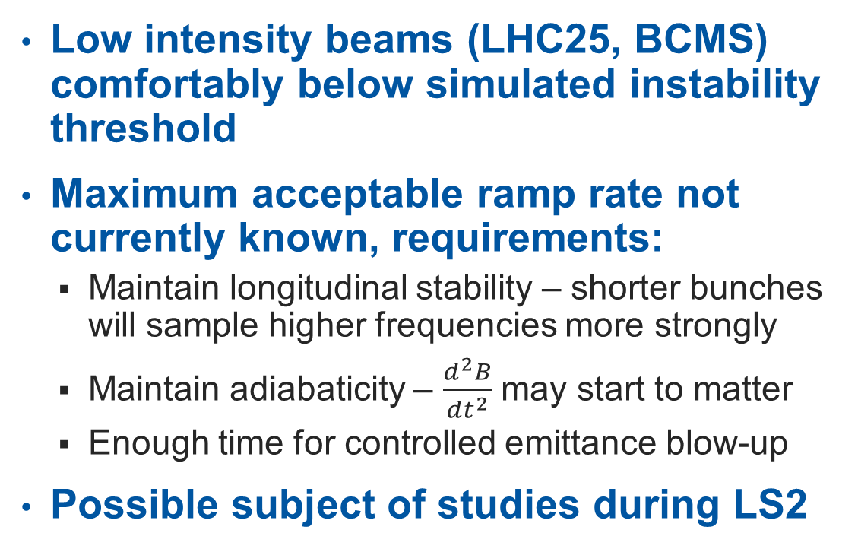
Possibilities for ramp duration reduction (3/3)
Low intensity beams (LHC25, BCMS) comfortably below simulated instability threshold
Maximum acceptable ramp rate not currently known, requirements:
  Maintain longitudinal stability – shorter bunches will sample higher frequencies more strongly
  Maintain adiabaticity – $\frac{d^{2}B}{{dt}^{2}}$ may start to matter
  Enough time for controlled emittance blow-up
Possible subject of studies during LS2
h = 1, 16 kV

Slide 15
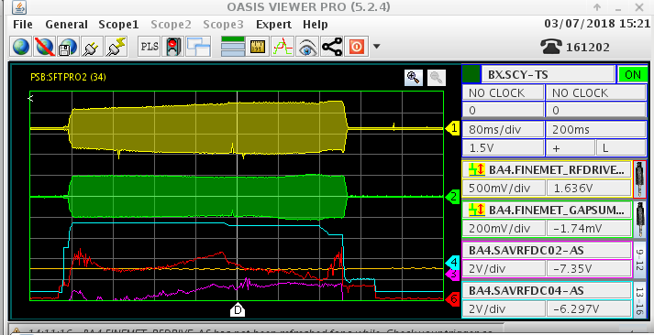
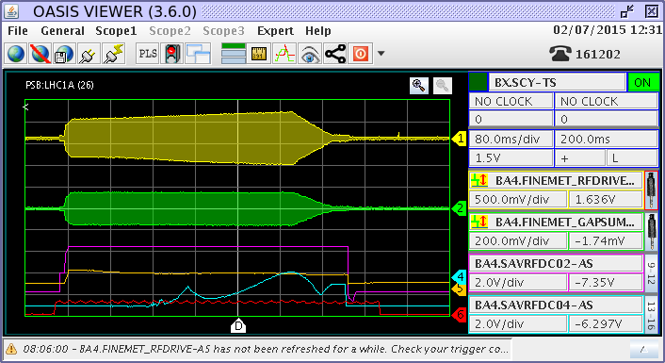
Experience with Finemet® (1/2)
Working with present prototype system since 2015 with reliability runs and extensive MD program each year
Nominal LHC beams, and high intensity beams for other users produced with Finemet® system replacing:
  h = 1 (600 kHz - 1.75 MHz)
  h = 2 (1.2 - 3.5 MHz)
  high harmonic longitudinal blow-up cavity (6 - 16 MHz)
The Finemet® system also used as multiple harmonic system providing 3.5 kV on h = 1 and h = 2 simultaneously
Finemet® used for record accelerated intensity (1.1E13) and record split intensity (1.05E13)
For the 2017 & 2018 reliability runs, there were no issues to report, with ~99% availability of the system
Nominal beam parameters were achieved when using the Finemet® system for operational beams
Finemet® system used as 1st harmonic for high intensity ISOLDE type beam
Finemet® system used as 2nd harmonic for LHC25 beam

Slide 16
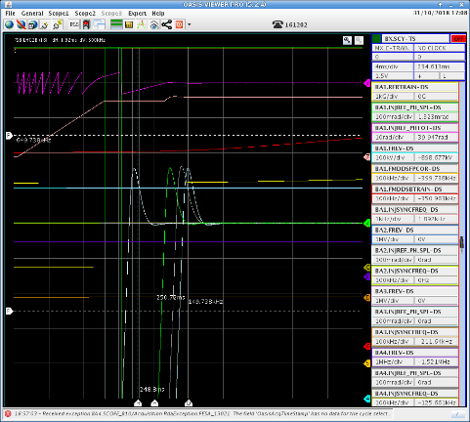
Experience with Finemet® (2/2)
Validated PSB Rings Injection synchronisation
Deployed and validated interface with WR Btrain.
  Successful and valuable reliability run from 19th April 2018 for validation and debugging
LLRF Ring 0 upgraded (Sept 2018) and operated with post-LS2 h/w configuration (5 boards)
Deployed (2018) in LLRF lab a test system that implements servo loops at 16 harmonics
First half 2019: Validate closure of servo loops on 16 harmonics for voltage/phase control or beam loading compensation
  Required input for beam dynamics simulations to investigate increase of instability threshold
Operational harmonics controlled: h = 1, 2, 3, x (x = high h for blow-up)
Longitudinal emittance blow-up: same methods as before LS2 (high harmonic, phase noise)

Slide 17
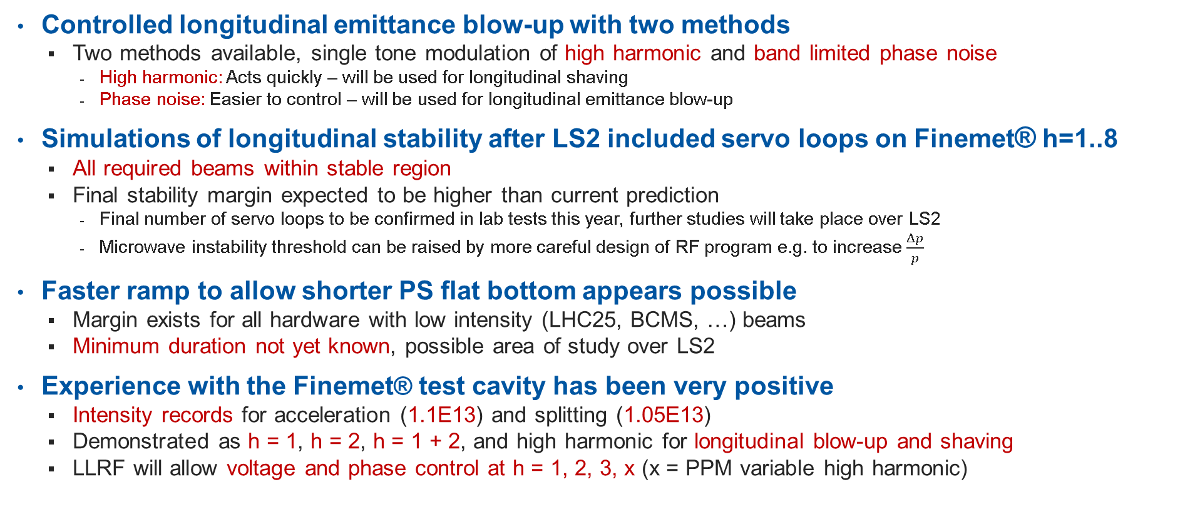
Conclusion and outlook:
Controlled longitudinal emittance blow-up with two methods
  Two methods available, single tone modulation of high harmonic and band limited phase noise
    High harmonic: Acts quickly – will be used for longitudinal shaving
    Phase noise: Easier to control – will be used for longitudinal emittance blow-up
Simulations of longitudinal stability after LS2 included servo loops on Finemet® h=1..8
  All required beams within stable region
  Final stability margin expected to be higher than current prediction
    Final number of servo loops to be confirmed in lab tests this year, further studies will take place over LS2
    Microwave instability threshold can be raised by more careful design of RF program e.g. to increase $\frac{Δp}{p}$
Faster ramp to allow shorter PS flat bottom appears possible
  Margin exists for all hardware with low intensity (LHC25, BCMS, …) beams
  Minimum duration not yet known, possible area of study over LS2
Experience with the Finemet® test cavity has been very positive
  Intensity records for acceleration (1.1E13) and splitting (1.05E13)
  Demonstrated as h = 1, h = 2, h = 1 + 2, and high harmonic for longitudinal blow-up and shaving
  LLRF will allow voltage and phase control at h = 1, 2, 3, x (x = PPM variable high harmonic)

Slide 19
Questions to be answered:
How does the experience with the longitudinal emittance blow up by phase noise compare to particle tracking? What are the limitations of this blow-up technique? Can we completely retire the blow-up using modulated higher-harmonic RF?
Limitations and margins with new 2 GeV cycle (duration from injection to extraction)?
What are the expected longitudinal stability limitations due to the new Finemet® RF system with LLRF feedback?
How far are we with commissioning of Finemet® RF system and relative LLRF (with specs for future operation – which harmonics, what functions for blow up)?

Slide 20
Questions answered:
How does the experience with the longitudinal emittance blow up by phase noise compare to particle tracking?
  Both simulations and MDs during run 2 showed good results with phase noise in the PSB
What are the limitations of this blow-up technique?
  Primary limitations are speed and difficulty of following synchrotron frequency, neither is a showstopper but may have implications for a faster ramp
Can we completely retire the blow-up using modulated higher-harmonic RF?
  No, required for longitudinal shaving (LHCINDIV) and beneficial if fast blow-up is required
Limitations and margins with new 2 GeV cycle (duration from injection to extraction)?
  No hard limits at the moment, significant work will be required to find fastest acceptable ramp for LHC type beams
What are the expected longitudinal stability limitations due to the new Finemet® RF system with LLRF feedback?
  Impedance peak at 18 MHz will limit stability if fewer servo loops than expected can be operated. If all h = 1..16 servo loops are available the limitation is not yet known
How far are we with commissioning of Finemet® RF system and relative LLRF (with specs for future operation – which harmonics, what functions for blow up)?
  HLRF progressing on schedule, LLRF and beam experience during run 2 puts us in a good position for putting the new systems into operation, h = 1, 2, 3, X will be available for control in voltage and phase with blow-up via phase noise or high harmonic

Slide 21
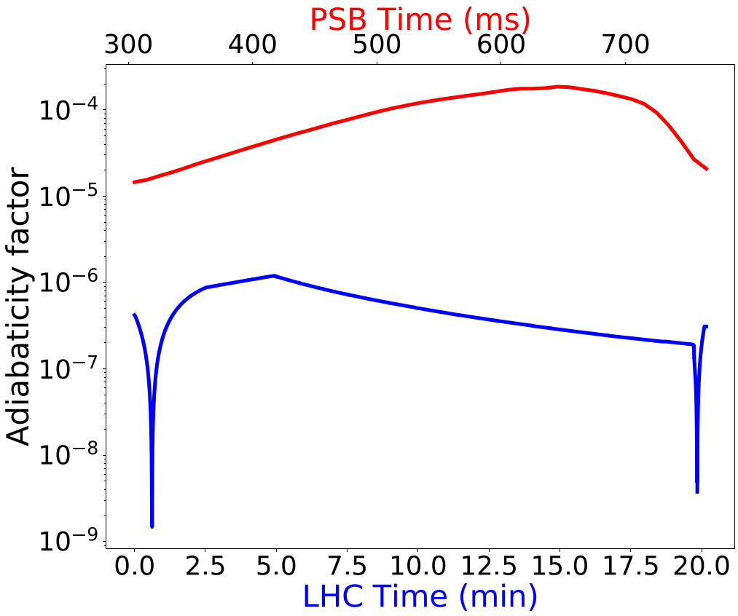
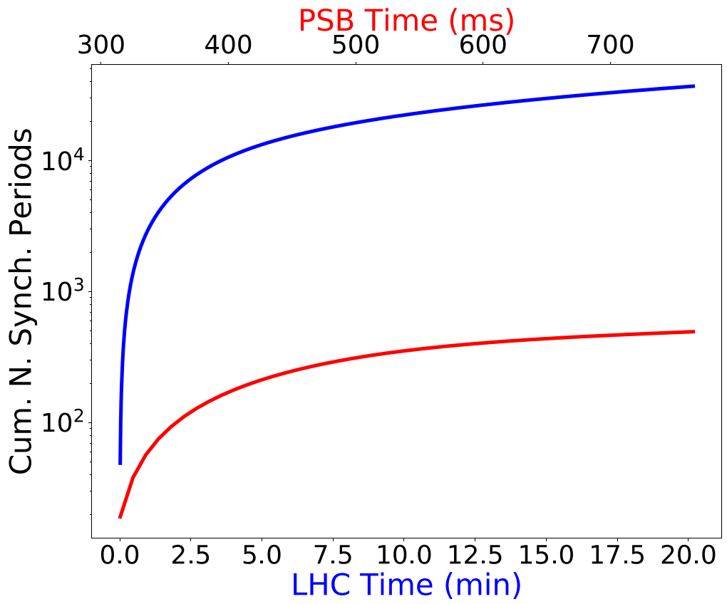
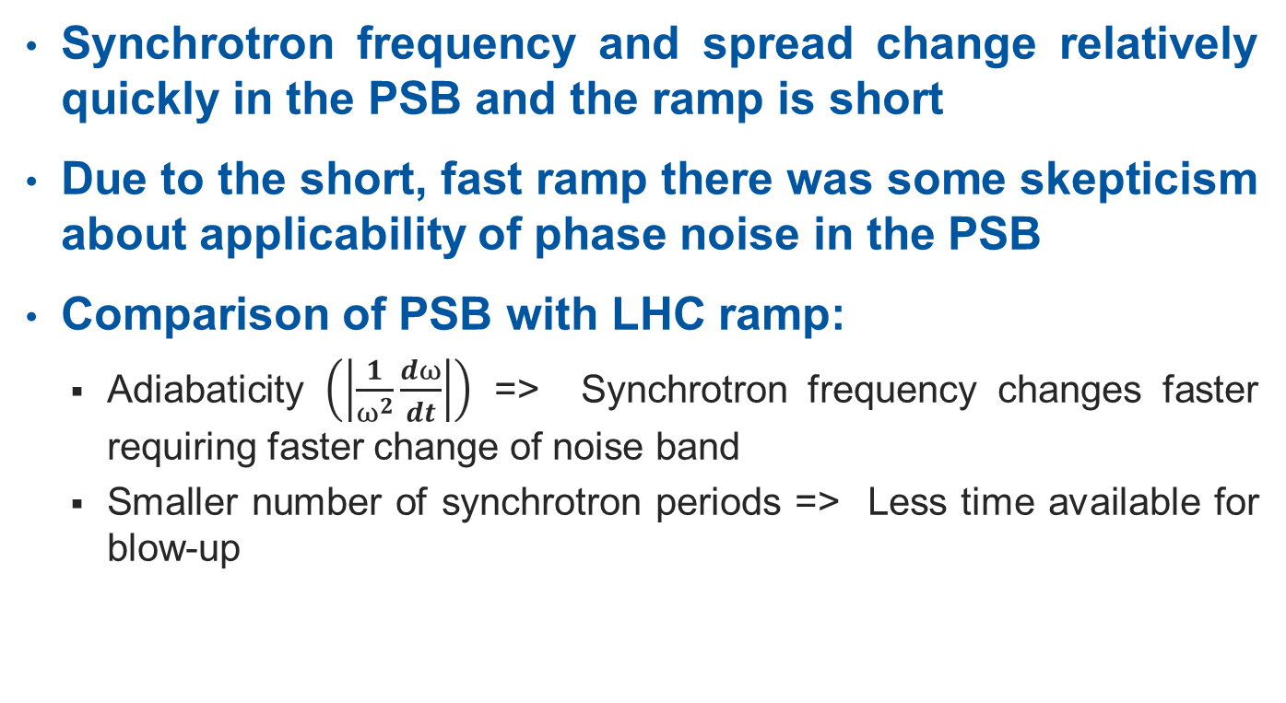
Controlled Longitudinal Emittance Blow-up (2/4)
Synchrotron frequency and spread change relatively quickly in the PSB and the ramp is short
Due to the short, fast ramp there was some skepticism about applicability of phase noise in the PSB
Comparison of PSB with LHC ramp:
  Adiabaticity $\left(\left|\frac{1}{ω^{2}}\frac{dω}{dt}\right|\right)$ => Synchrotron frequency changes faster requiring faster change of noise band
  Smaller number of synchrotron periods => Less time available for blow-up

