Slide 2
LHC Injectors Upgrade Workshop
Montreux, 13-15 February 2019

Slide 3
PS intensity reach and longitudinal parameters after LIU
F. Bertin, H. Damerau, G. Favia, A. Lasheen, B. Popovic
Acknowledgements: M. Haase, A. Huschauer, A. Jibar, P. Kozlowski, M. Migliorati, M. Morvillo, E. Shaposhnikova, MD coordinators, BLonD developers, CPS operators, contributors to the PS impedance model, LIU-PS Beam Dynamics Working Group, Landau cavity study group

Slide 4
Outline
Introduction, intensity reach in 2017
Beam performance reach in 2018
  RF upgrades during YETS17/18
  Multi-harmonic feedbacks
  Landau cavity
Outcome of studies in 2018
  Quadrupolar coupled bunch-instability
  Status of simulations
Expected performance post-LS2
  10 MHz cavities amplifier upgrade
  Modification of impedance
Conclusion and plans for LS2

Slide 5
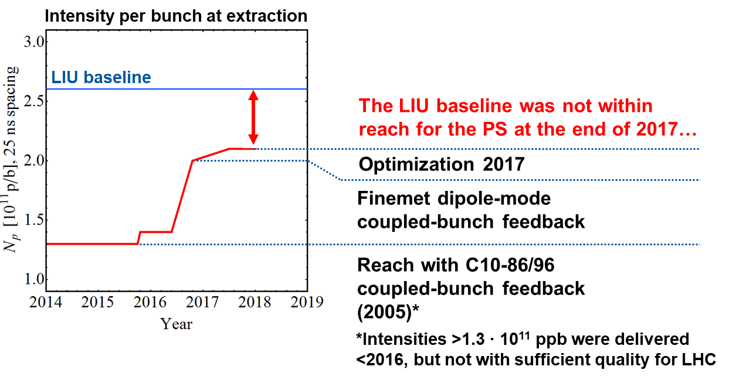
Introduction, intensity reach in 2017

Slide 6
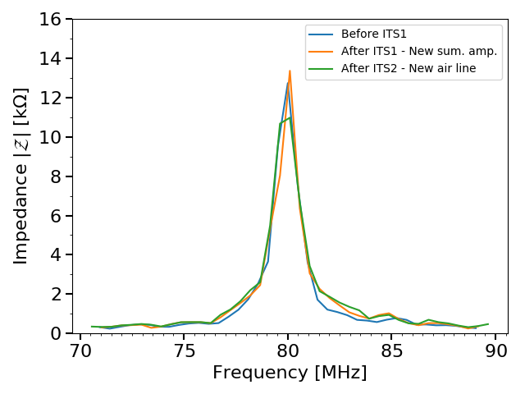
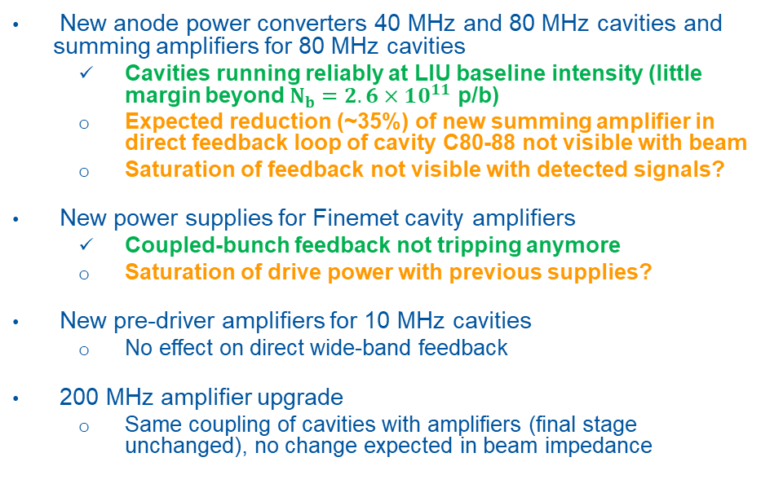
RF upgrades during YETS17/18 and ITS18
New anode power converters 40 MHz and 80 MHz cavities and summing amplifiers for 80 MHz cavities
  Cavities running reliably at LIU baseline intensity (little margin beyond $N_{b}=2.6×10^{11}$ p/b)
  Expected reduction (~35%) of new summing amplifier in direct feedback loop of cavity C80-88 not visible with beam
  Saturation of feedback not visible with detected signals?
New power supplies for Finemet cavity amplifiers
  Coupled-bunch feedback not tripping anymore
  Saturation of drive power with previous supplies?
New pre-driver amplifiers for 10 MHz cavities
  No effect on direct wide-band feedback
200 MHz amplifier upgrade
  Same coupling of cavities with amplifiers (final stage unchanged), no change expected in beam impedance
Beam measurements of C80-89 impedance along 2018
No visible impedance reduction measured with beam

Slide 7
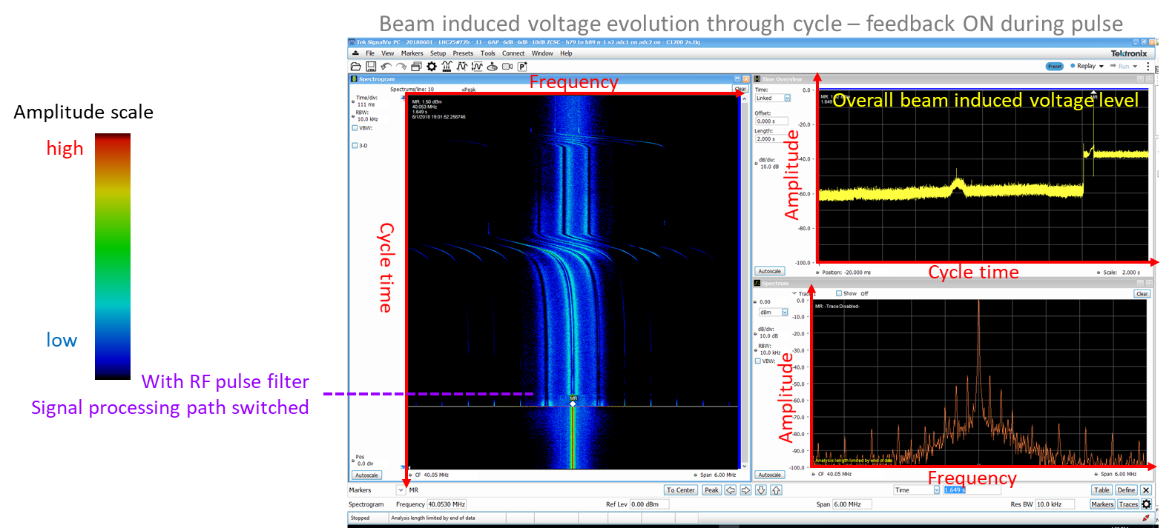
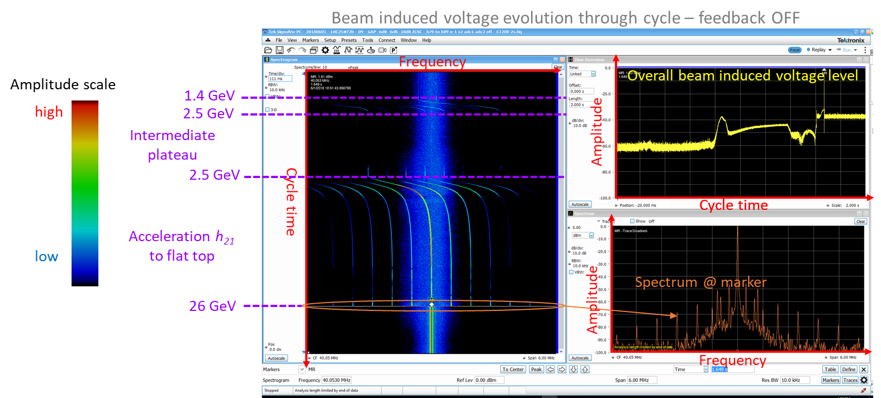
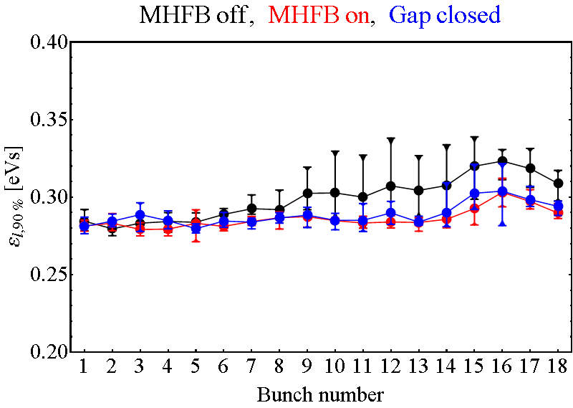
Multi-Harmonic Feedback (MHFB)
Long. emittance (RMS) at start of flat-top with 3rd 80 MHz gap closed, MHFB on/off
N_{b} = 2.4 ∙ 10¹¹ p/b
Successfully implemented on all 40 MHz and 80 MHz cavities in 2018
Factor 10 impedance reduction on revolution harmonics
Improves longitudinal emittance along the batch
As efficient as cavity gap closure

Slide 8
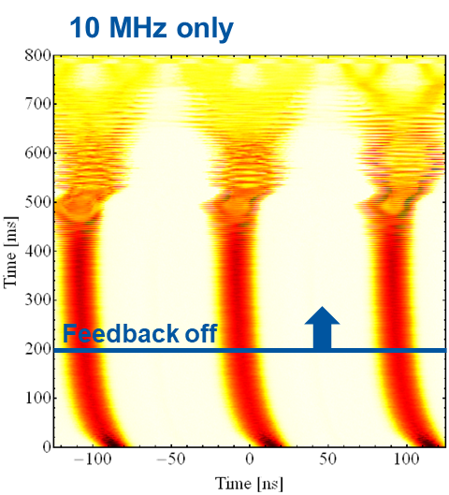
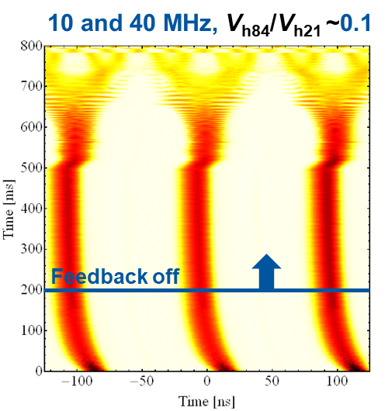
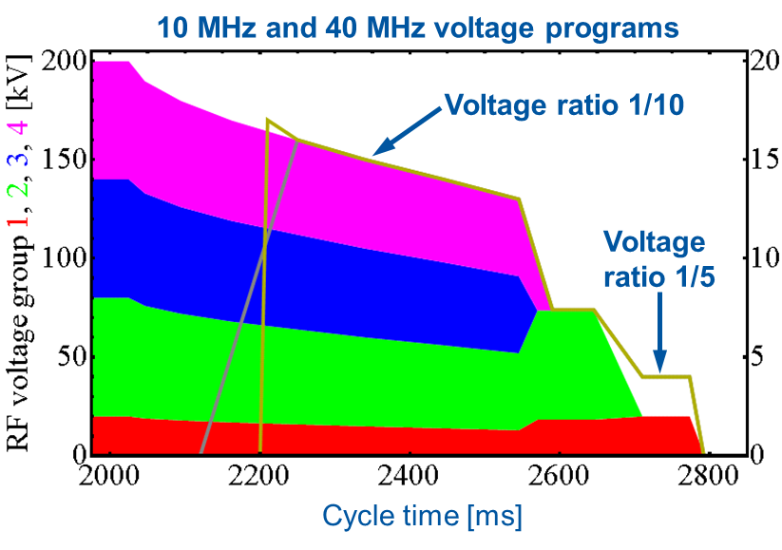
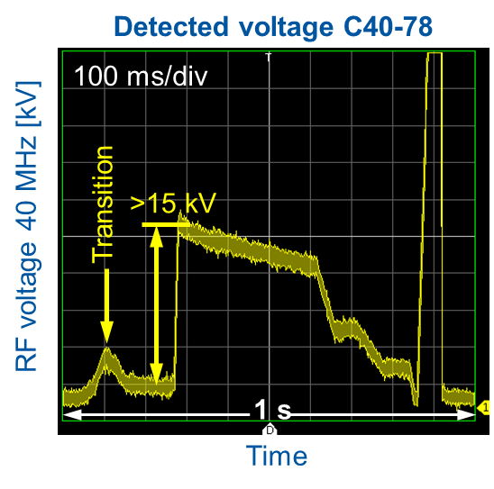
Existing 40 MHz cav. as Landau rf system
Cavities pulsed at harmonic ratio = 4, wrt main rf system (SPS-like)
Can be used from 13 GeV: narrow-band resonator with no tuning. A dedicated rf system was studied in the frame of the PS Landau Cavity Study Group
Significant stabilization using higher-harmonic RF in complement with the Finemet dipole-mode coupled-bunch feedback
Stability margin beyond LIU baseline

Slide 9
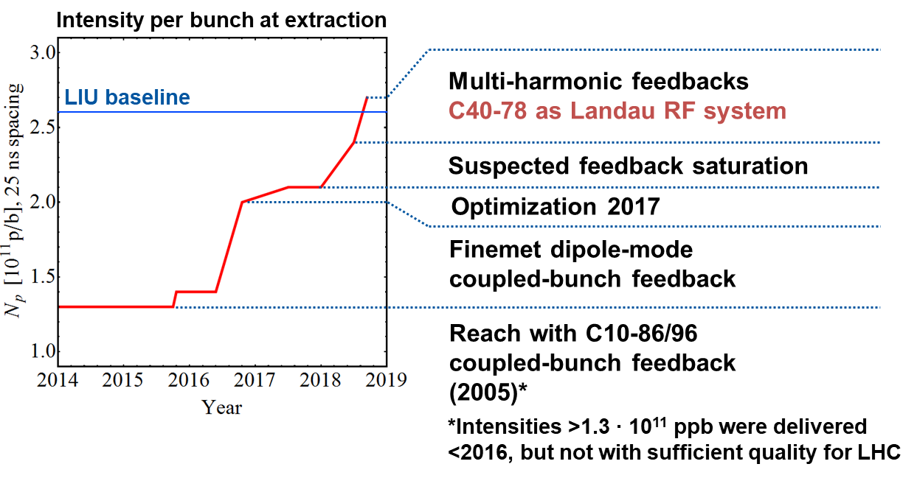
Intensity reach, end 2018

Slide 10
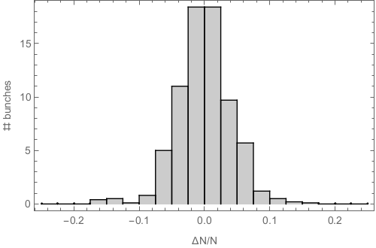
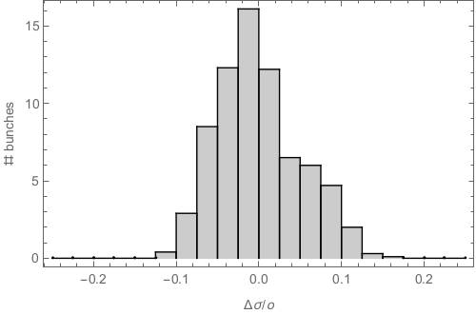
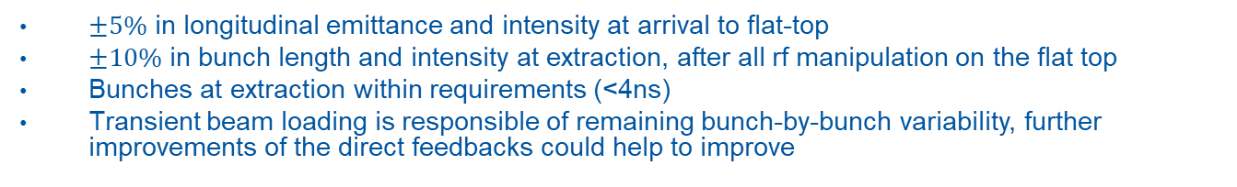

Beam quality at extraction
Extracted bunch intensity variation
Extracted bunch length variation
N_{b} = 2.6 ∙ 10¹¹ ppb
4$σ$ = 4 ns
$±5\%$ in longitudinal emittance and intensity at arrival to flat-top
$±10\%$ in bunch length and intensity at extraction, after all rf manipulation on the flat top
Bunches at extraction within requirements (<4ns)
Transient beam loading is responsible of remaining bunch-by-bunch variability, further improvements of the direct feedbacks could help to improve

Slide 11
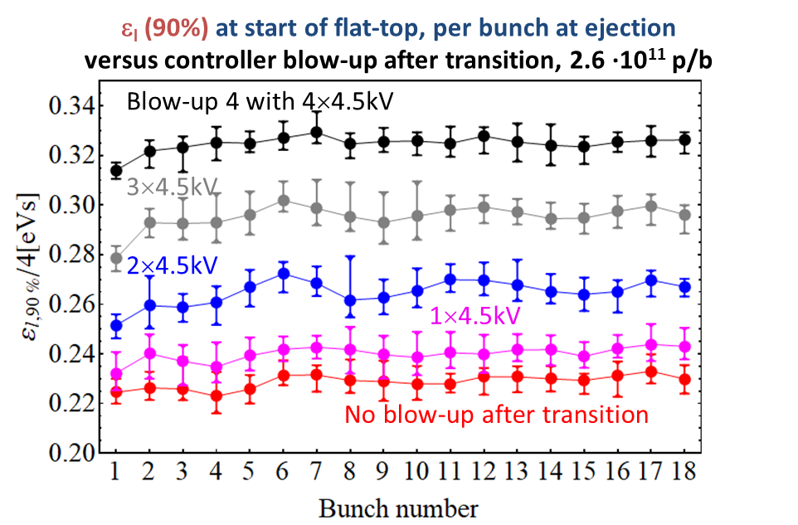
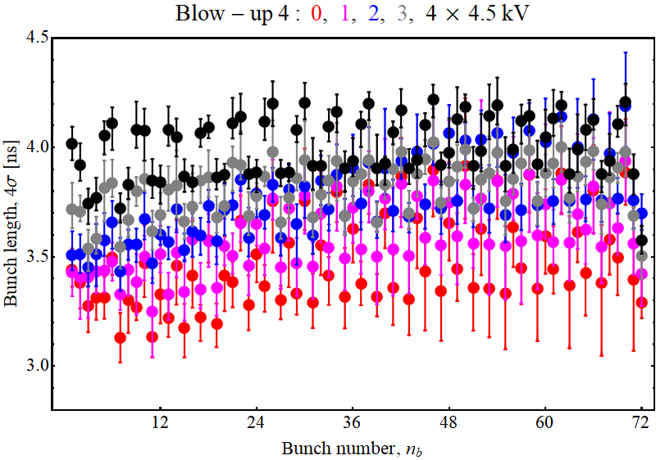
Margins beyond LIU baseline
Nominal
ε_{l}
Margin to deliver 10-15% smaller longitudinal emittance to the SPS
The limit in the PS to reach lower longitudinal emittance is beam loading due to short bunches
The extracted bunch length is still below 4ns with no major sign of uncontrolled emittance blow-up

Slide 12
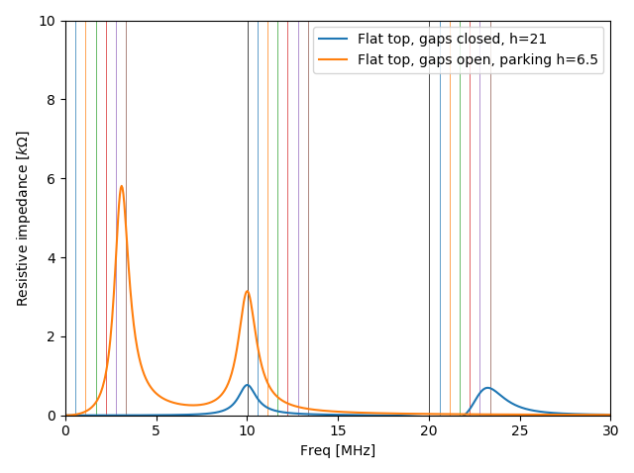
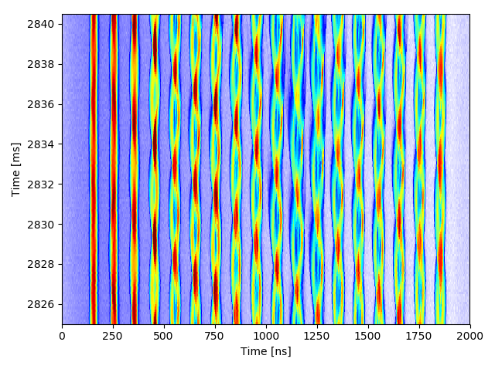
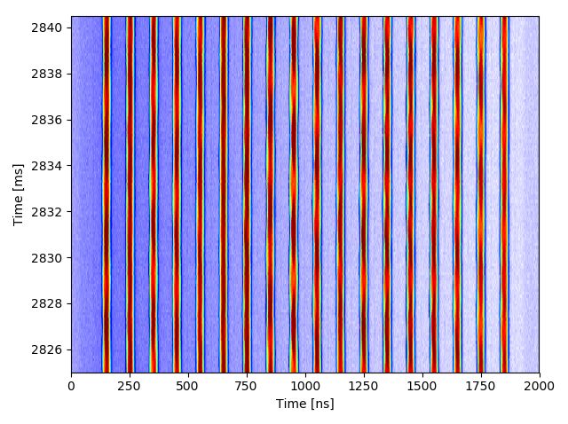
Identification of impedance source
Coupled bunch instability
BU4: 0x4.5 kV
Parking + open gap
Quadrupolar coupled bunch oscillations without C40-78 as Landau cavity
10 MHz cavities with closed gap relays are a clear candidate as source of instability
NB: not an operational solution, bigger transient beam loading during splittings

Slide 13
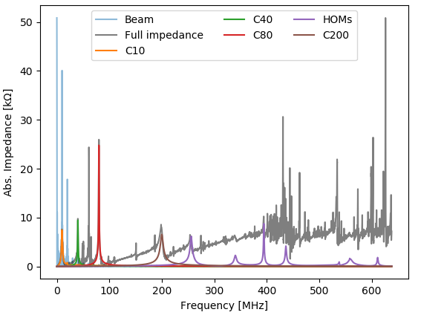
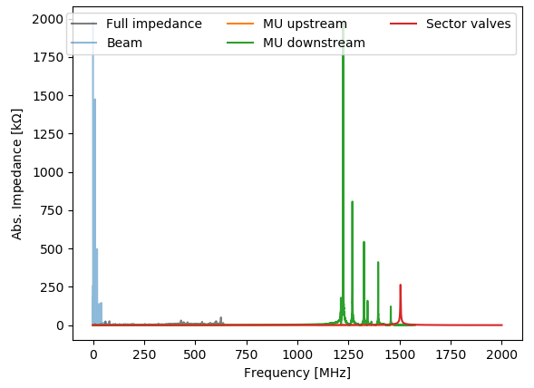
Status of PS impedance model
* See N. Biancacci - Talk on PS Ions
Influence visible on ion beam at transition? *
Status of the impedance model:
  RF cavities (C10, C20, C40, C80, HOMs…)
  Kickers (KFAs, BFAs)
  Vacuum equipment (Magnet Units)
  Beam dumps
  Space charge & resistive wall
  Ongoing (remaining kickers and beam instrumentation)

Slide 14
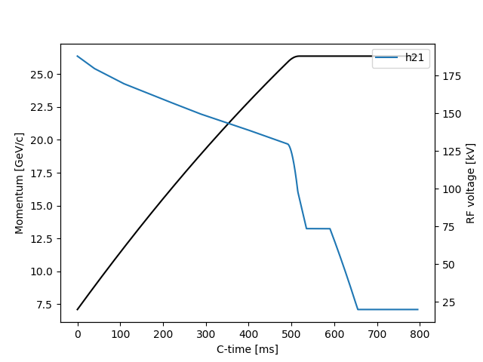
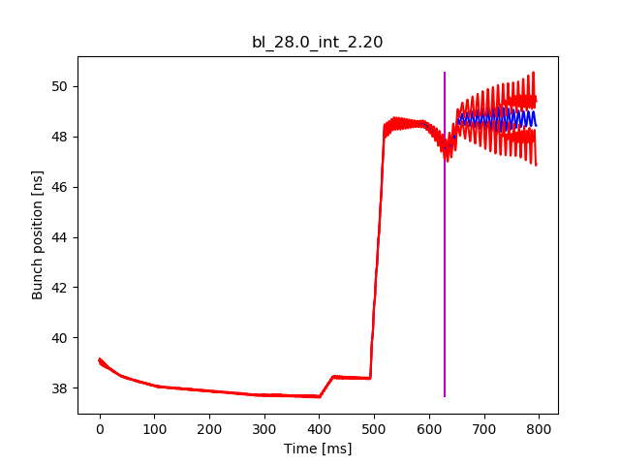
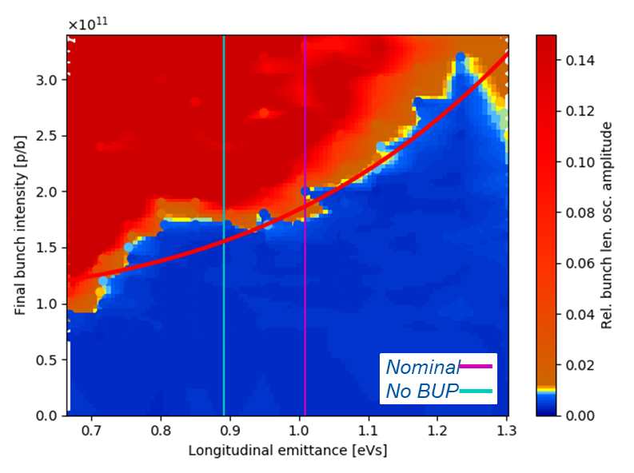
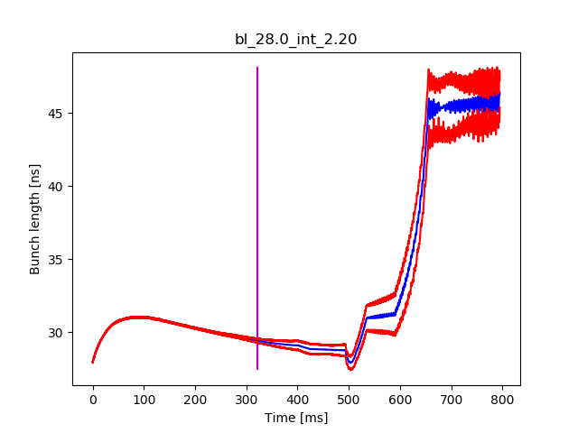
Progress in particle simulations
Single RF program transition -> flat top
Instability
Acceleration ramp implemented in BLonD with present PS impedance model
Stability diagrams (emittance vs. intensity) are already in fair agreement with measurements. Although slightly optimistic, allowed some preliminary studies

Slide 15
Expected performance post-LS2
Upgrade of the 10 MHz cavities amplifier
  Shunt impedance reduced by a factor 2
  Reduced transient beam loading for the first third of the batch and reduced bunch-by-bunch variation in emittance/intensity
  Influence on instability threshold to be assessed, but expected improvement since 10 MHz cavities are known to drive coupled bunch instabilities
Removal of CT extraction kickers
  Reduced single bunch effect (not a limitation presently)
  Influence on coupled-bunch instability to be assessed
Addition/Exchange of equipment (wire scanners, internal dump, ralentisseur)
  Impedance optimized in collaboration with the Impedance Working Group
  The overall addition of impedance is expected small in comparison to the present equipment in the machine
  Quantitative impact of high frequency impedance sources to be assessed

Slide 16
Conclusion
LIU baseline for the beam performance was reached in 2018!
  The MHFB and the new anode power converters for high frequency cavities were the main elements in 2018 to reach higher beam intensity with nominal longitudinal emittance
  The existing 40 MHz as Landau rf systems allowed to provide margins
  The beam is kept stable both in the longitudinal and the transverse planes (NB: large transverse emittance)
Beam performance is already satisfactory and reproducible.
  The high frequency cavities do not trip at high intensity with the new anode power converters
  The coupled bunch feedback does not trip at high intensity with the new power supplies
Remaining rf upgrades should allow to reduce bunch-to-bunch variation.
  Amplifiers upgrade in 10 MHz cavities (shunt impedance /2) will reduce transient beam loading
The margin beyond LIU baseline thanks to the 40 MHz as Landau rf systems can allow to reach for smaller longitudinal emittance. The main potential benefit is the PS-SPS transfer, where smaller longitudinal may allow to reduce losses at injection.
Progress in the understanding of the source of coupled bunch instability have been made, and will be used during LS2 to predict post-LS2 performance and define cycle parameters.

Slide 17
Plan for 2019 and LS2
Coupled bunch instability study and simulations
  Source of coupled-bunch instabilities and uncontrolled emittance blow-up
  Further implementation in particle simulations (transition crossing, rf manipulations, mode analysis)
  Completion of the PS impedance model
  Completion of data analysis of acquisitions with LHC-type beam in 2018
Performance prediction for rf upgrades during LS2
  Remaining transient beam loading and expected bunch-by-bunch variability
  Evolution of instability threshold with pre and post-LS2 impedance models
  Optimization of rf parameters (amplitude, phase) for existing 40 MHz cavities as Landau rf systems
Choice of parameters for post-LS2 era
  Choice of intermediate plateau for rf manipulations
  Definition of rf voltage programs
  Means for optimization of bunch-by-bunch variability (e.g. machine learning)

Slide 19
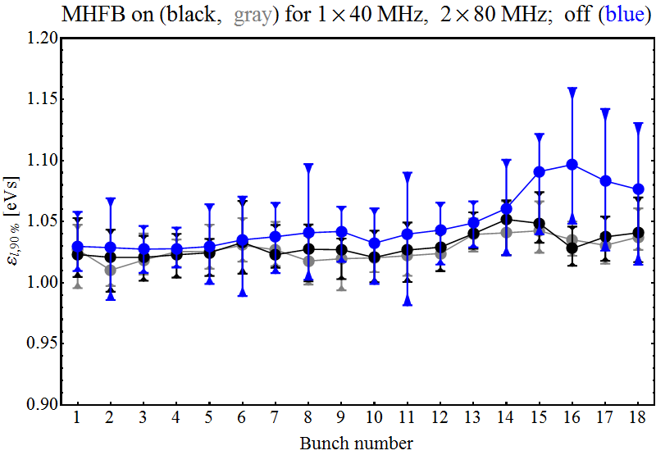
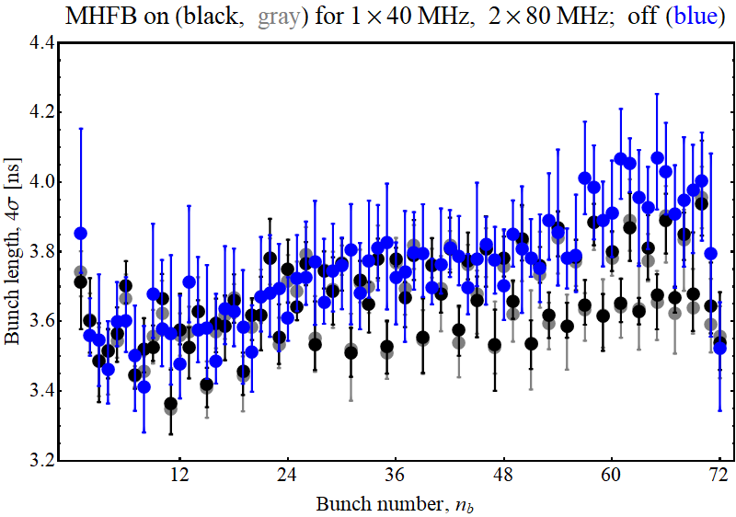
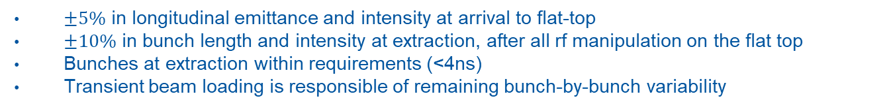
Beam quality at extraction
ε_{l}, arrival at flat-top
Bunch length at extraction
N_{b} = 2.6 ∙ 10¹¹ ppb
$±5\%$ in longitudinal emittance and intensity at arrival to flat-top
$±10\%$ in bunch length and intensity at extraction, after all rf manipulation on the flat top
Bunches at extraction within requirements (<4ns)
Transient beam loading is responsible of remaining bunch-by-bunch variability

Slide 20
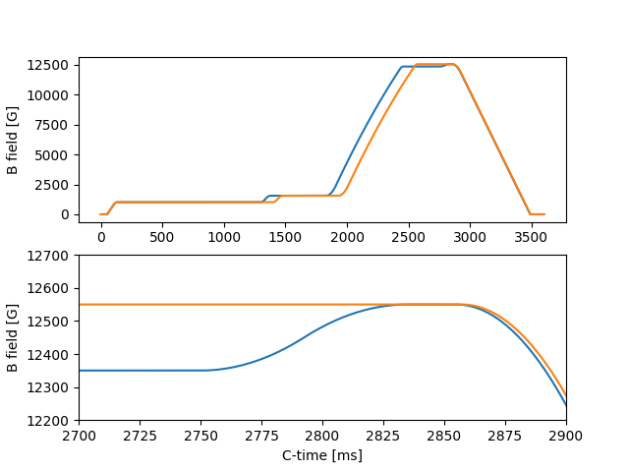
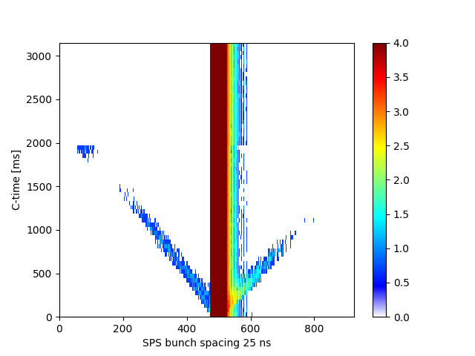
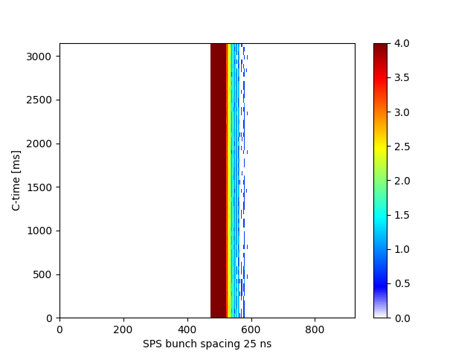
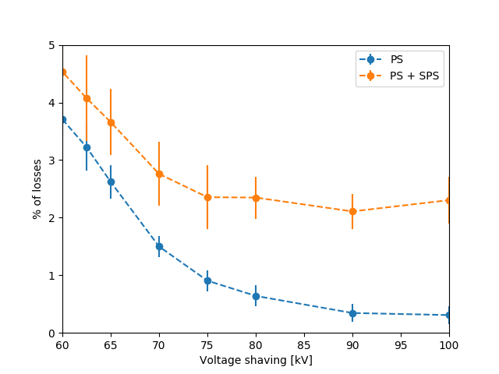
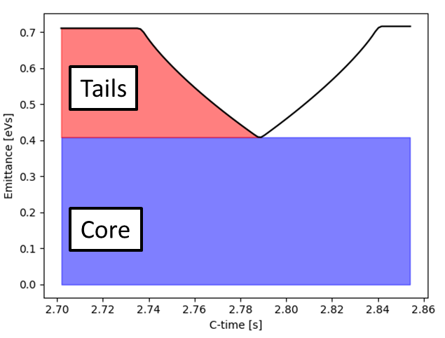
Longitudinal shaving and PS-SPS transfer
SPS fast BCT, without shaving
SPS fast BCT,
with shaving
PS: BCMS with post-acceleration
Uncaptured beam
Long. shaving
BCMS beam, nominal intensity
Post-acceleration and shaving achieved for high intensity BCMS beam in 2018, thanks to new power converters in 40 MHz cavities (only 36b nominal intensity in 2017)
Shaved beam in PS can be analyzed to quantify halo population
SPS losses
PS losses

Slide 21
Questions to be answered
What is the parameter reach in terms of intensity/longitudinal emittance? What was achieved in 2018 and what is expected from simulations with the further LS2 RF improvements?
What is the contribution of each of the upgrades (coupled-bunch, 1-turn delay, multi-harmonic feedbacks)?
Which impedance sources mainly excite the observed instabilities?
Are there any new ideas to further improve the longitudinal beam quality, e.g. bunch shape after rotation, to better suit the SPS?
What are the observed and expected bunch-by-bunch parameter variations (2018 and post-LIU)?

Slide 22
Outline
Introduction
Beam performance reach in 2018
  Summary plot for intensity reach with all upgrades
    Multi-harmonic feedback
    Landau cavity
  Present beam quality at extraction and margin beyond LIU (smaller long. emittance)
Outcome of studies in 2018
  Coupled bunch instability
    Progress in impedance model and particle simulations
    Identification of guilty impedance sources (quadrupolar instability)
  Longitudinal shaving and PS-SPS transfer
Expected performance post-LS2
  RF upgrade (10 MHz high-level upgrade)
  Impedance reduction (removal of CT extraction kickers)
  New impedance sources (beam dump, etc.)
  Optimization of the beam quality
Conclusion and plans for LS2
Questions
What is the parameter reach in terms of intensity/longitudinal emittance?
What is the contribution of each of the upgrades (coupled-bunch, 1-turn delay, multi-harmonic feedbacks)?
Which impedance sources mainly excite the observed instabilities?
Are there any new ideas to further improve the longitudinal beam quality, e.g. bunch shape after rotation, to better suit the SPS?
What was achieved in 2018 and what is expected from simulations with the further LS2 RF improvements?
What are the observed and expected bunch-by-bunch parameter variations (2018 and post-LIU)?

Slide 23
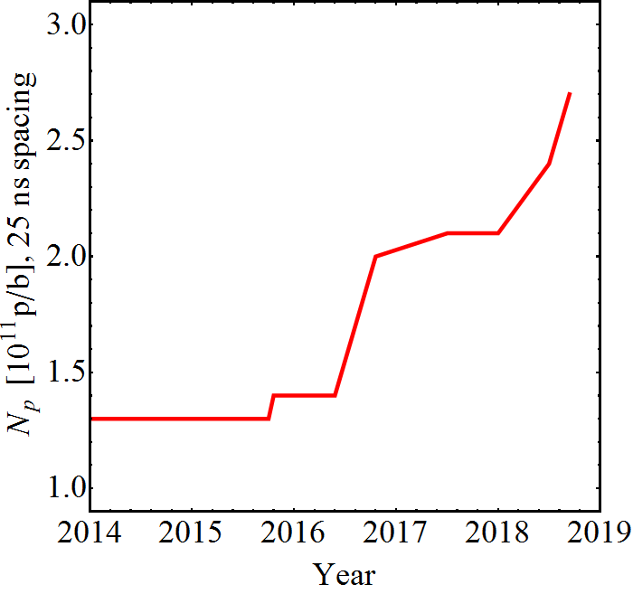
Beam performance reach in 2018
Intensity per bunch at extraction
LIU baseline
The LIU baseline was not within reach for the PS at the end of 2017…
Optimization 2017
Finemet dipole-mode
coupled-bunch feedback
Reach with C10-86/96 coupled-bunch feedback (2005)*
*Intensities >1.3 ∙ 10¹¹ ppb were delivered <2016, but not with sufficient quality for LHC

Slide 24
Beam performance reach in 2018
Intensity per bunch at extraction
Multi-harmonic feedbacks
C40-78 as Landau RF system
LIU baseline
Suspected feedback saturation
Optimization 2017
Finemet dipole-mode
coupled-bunch feedback
Reach with C10-86/96 coupled-bunch feedback (2005)*
*Intensities >1.3 ∙ 10¹¹ ppb were delivered <2016, but not with sufficient quality for LHC

