Slide 1
LHC Injectors Upgrade Workshop
Montreux, 13-15 February 2019

Slide 2
Longitudinal beam quality and stability in the SPS
E. Shaposhnikova, T. Argyropoulos, H. Bartosik, T. Bohl, A. Lasheen, G. Papotti; simulations: J. Repond, M. Schwarz, D. Quartullo (ions); impedance: M. Beck, R. Calaga, A. Farricker, P. Kramer, N. Nasresfahani, C. Vollinger for LIU-SPS BD WG
Acknowledgements: S. Albright, H. Damerau, B. Goddard, G. Hagmann, K. Iliakis, V. Kain, K. Li, E. Montesinos, H. Timko and OP shifts

Slide 3
Contents
Main achievements and limitations in 2018
Longitudinal stability studies (12 bunches)
Optimized 800 MHz RF voltage program, power limitations
Losses now and after LS2; possible mitigations
Q22 optics
SPS impedance
Intensity reach after LS2
Ions: slip-stacking and longitudinal instabilities
Open issues and possible improvements
Summary

Slide 4
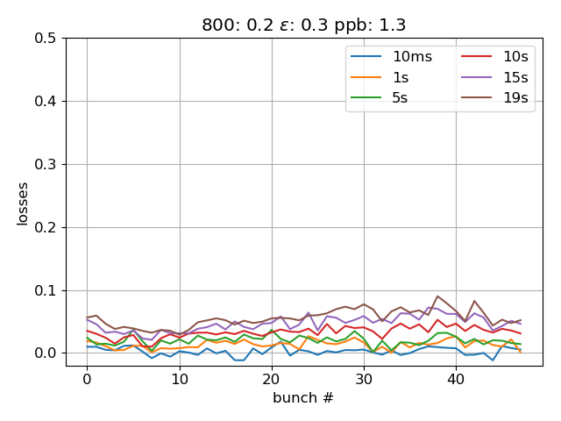
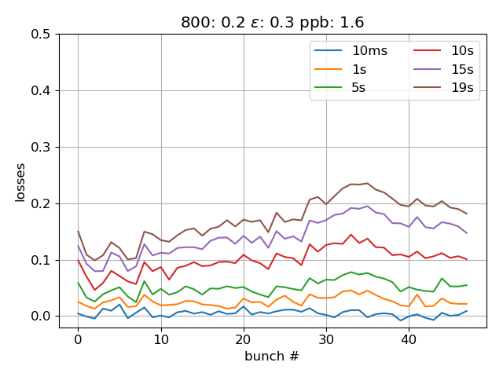
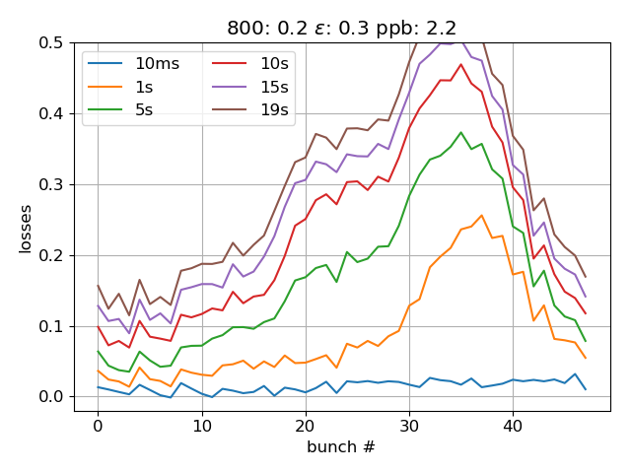
Performance of LIU beams in the SPS in 2018: main limitations in longitudinal plane
Total beam intensity limited by beam loading in 200 MHz RF system and multi-bunch instabilities → LIU RF upgrade (F. Gerigk’ talk) and impedance reduction
Losses increasing with total beam intensity → maximum 1.4x10¹¹ ppb at 450 GeV → to advance use 12 bunches for high intensity studies
1.3E11 ppb
1.6E11 ppb
2.2E11 ppb
Flat bottom losses along 48 bunches: emit=0.3 eVs, V₈₀₀/V₂₀₀ =0.2, V₂₀₀ =4.5 MV, Q20

Slide 5
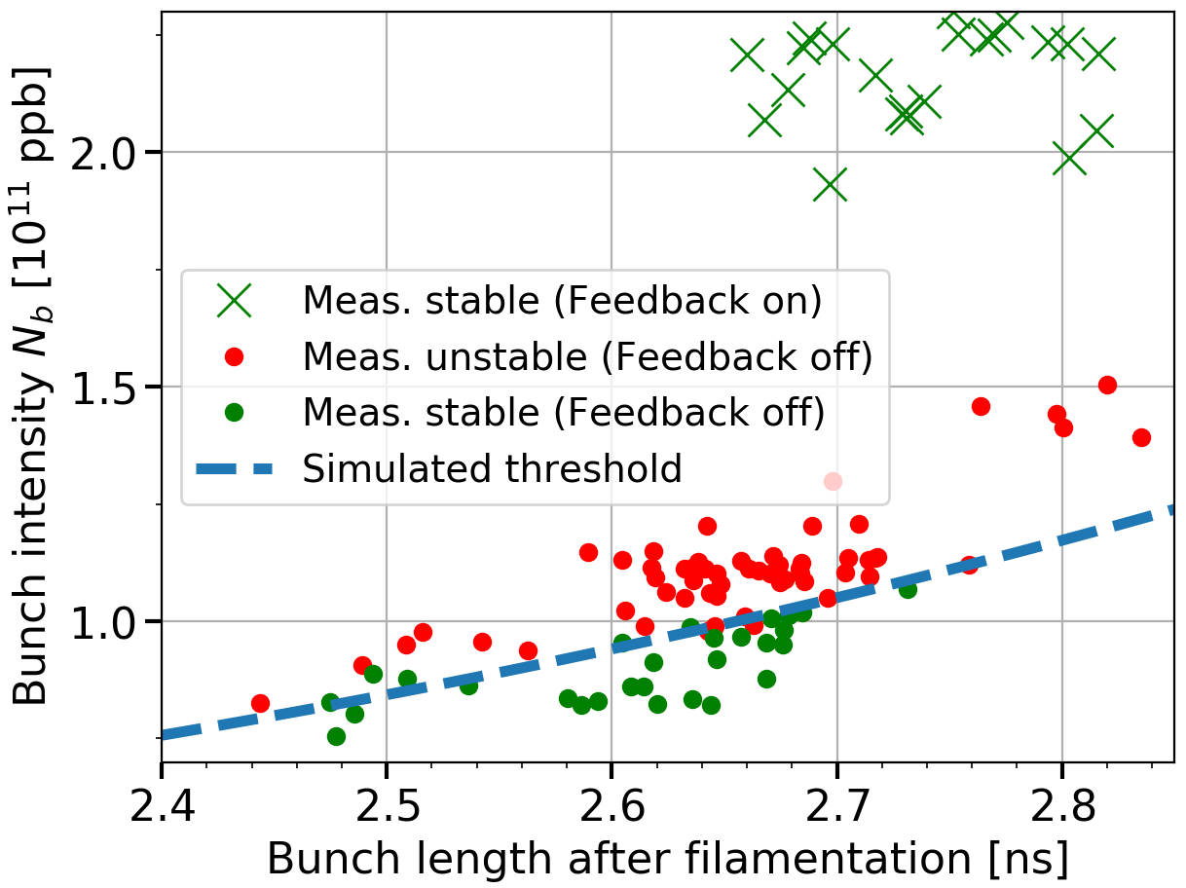
Performance of LIU beams: flat bottom instability
Observed in 2017 for high intensities (48 & 72 bunches) with feedback (FB) on
Studied in 2018 for 12 bunches with FB on/off, 800 MHz RF on/off, no BUP
With FB on 12 bunches are significantly more stable at flat bottom and first part of the ramp (next slide)
→ Instability is driven by main 200 MHz impedance
→ Good agreement of simulations with measurements for 12 bunches rotated in PS (single RF, FB off)

Slide 6
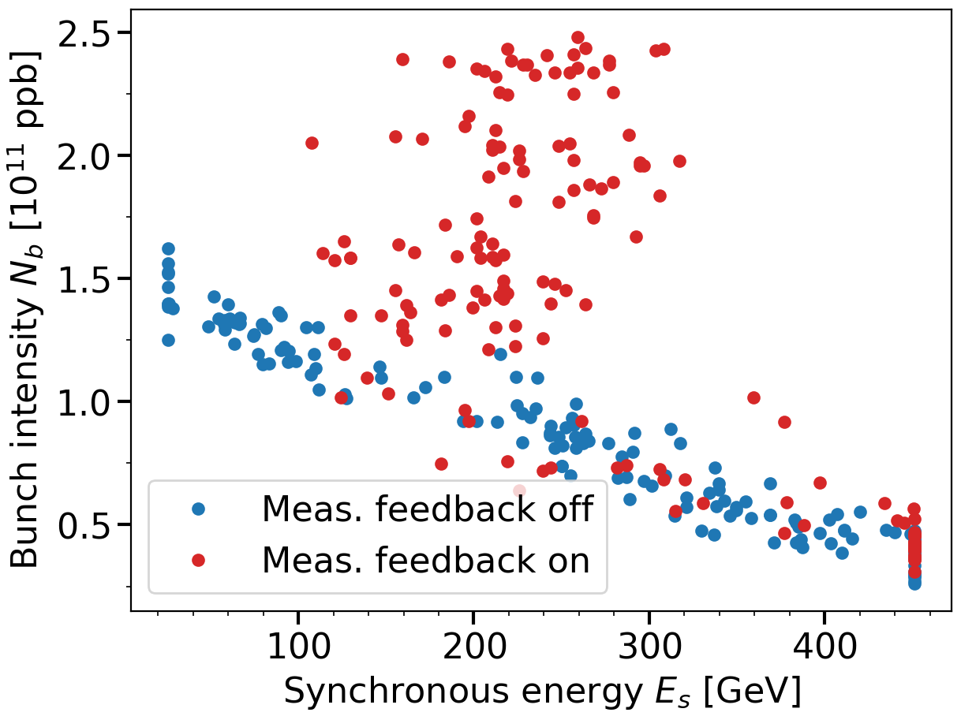
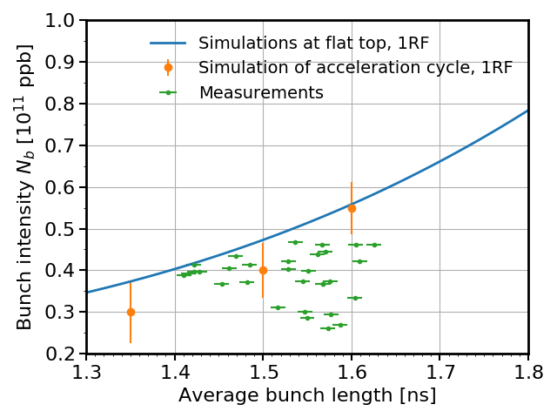
Performance of LIU beams: studies with 12 bunches (800 MHz off, FB on/off)
Ramp: instability threshold
as a function of energy
Flat top: stable bunch length;
measurements and simulations
V200 =7 MV, FB off
increasing bunch length
→ The same threshold with FB on/off at flat top
→ Simulations agree with
measurements for FB off

Slide 7
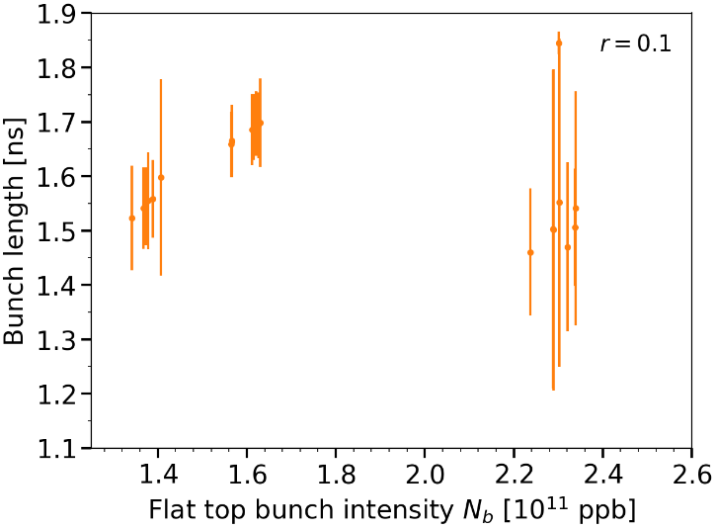
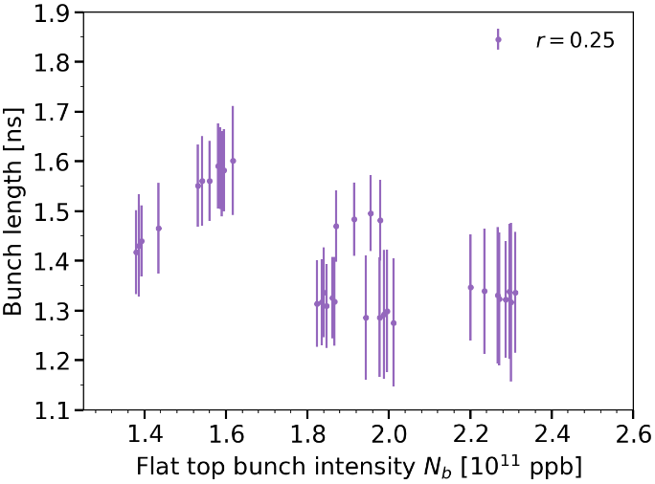
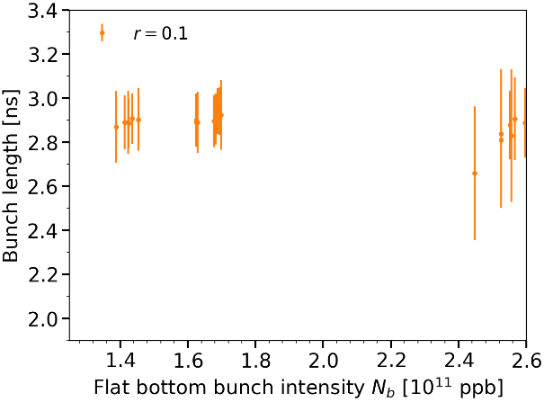
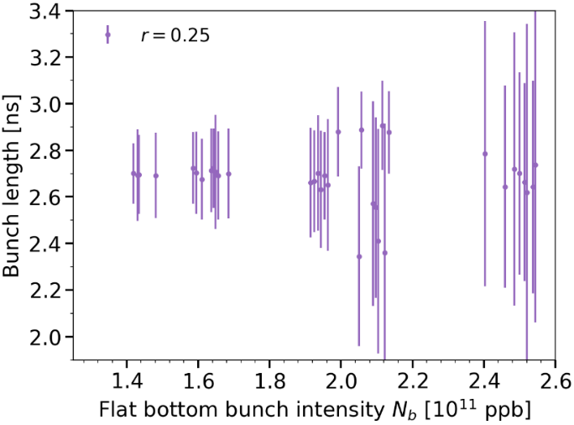
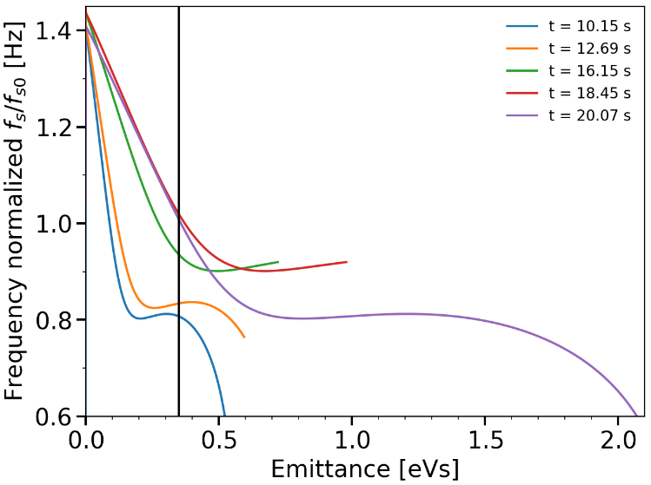
Effect of 800 MHz voltage on stability of 12 bunches with active FB & FF (feedforward)
→ Large V₈₀₀/V₂₀₀ voltage ratio improves beam stability on flat top, but not on flat bottom
flat top
flat top
V₈₀₀ = 0.1xV₂₀₀
V₈₀₀ = 0.25xV₂₀₀
Synchrotron frequency distribution at different moments during cycle
flat bottom
flat bottom
flat region leading to loss of Landau damping
V₈₀₀ = 0.1xV₂₀₀
V₈₀₀ = 0.25xV₂₀₀
V₈₀₀ = 0.25xV₂₀₀

Slide 8
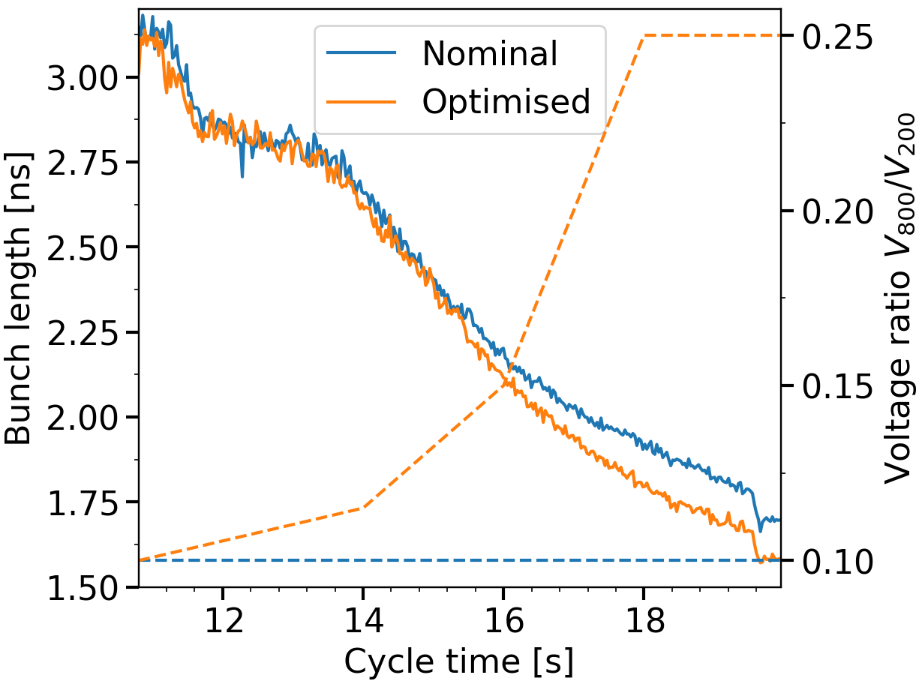
Performance of LIU beams in 2018: acceleration of 4x12 bunches with 2x10¹¹ p/b
→ Optimised voltage ratio V₈₀₀/V₂₀₀ was applied in cycles for all high intensity beams at the end of 2018
→ High intensity beam was successfully stabilized and used in the LHC for MDs (e-cloud, instabilities,…)
The ratio of 0.25 was used on flat top
with V₂₀₀=7 MV.
What will be possible after RF upgrade?
V₈₀₀/V₂₀₀ = 0.1 used in operation till end 2018

Slide 9
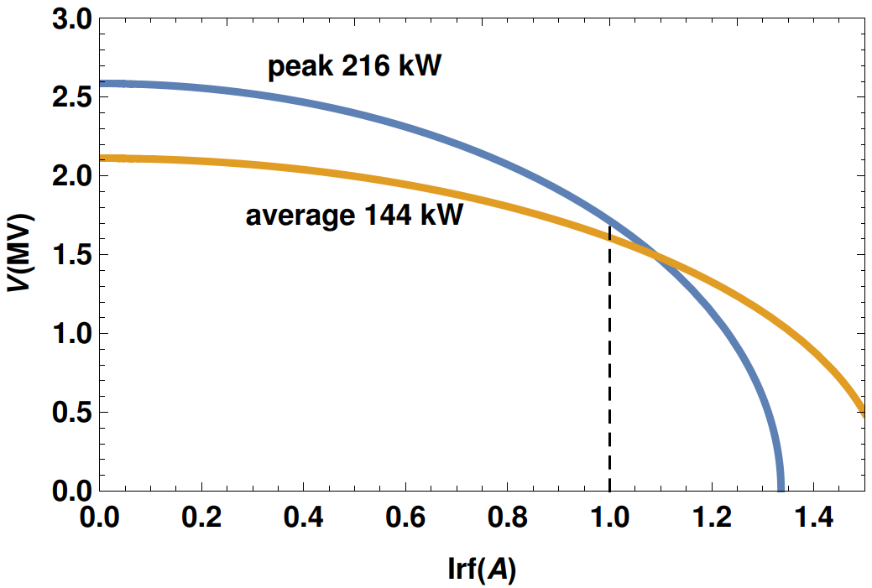
800 MHz voltage available on the SPS flat top
Maximum total 800 MHz voltage
(2 cavities)
After upgrade two 800 MHz cavities are available with power (-10% at cavity input):
peak 240 kW (216) kW,
average 160 kW (144) kW
→ max V₈₀₀ = 1.7 MV for peak 216 kW (needs RF pulsing at f_{rev}) and
max V₈₀₀ = 1.6 MV without pulsing (limited by average 144 kW)
→ For 10 MV at 200 MHz after upgrade maximum ratio V₈₀₀/V₂₀₀ = 0.16
For 2.4x10¹¹ ppb: Irf = 1.0 A (formfactor = 0.35)

Slide 10
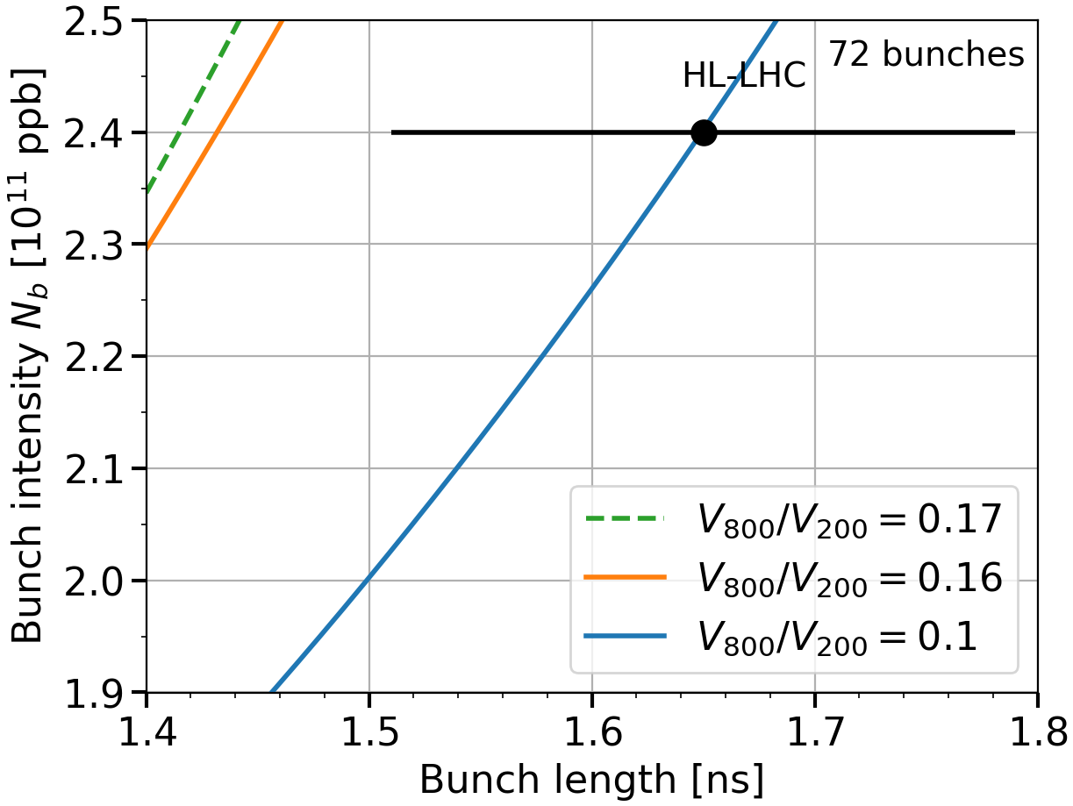
Future performance of LIU beams: effect of higher 800 MHz RF voltage on beam stability
Beam stability thresholds on flat top
with baseline LIU upgrades
→ Higher V₈₀₀/V₂₀₀ voltage ratio provides significant increase of threshold on flat top (where it is minimum), but…
Potential of higher voltage ratio needs to be accessed in simulations of ramp with controlled emittance blow-up and LLRF (feedback, phase loop) .

Slide 11
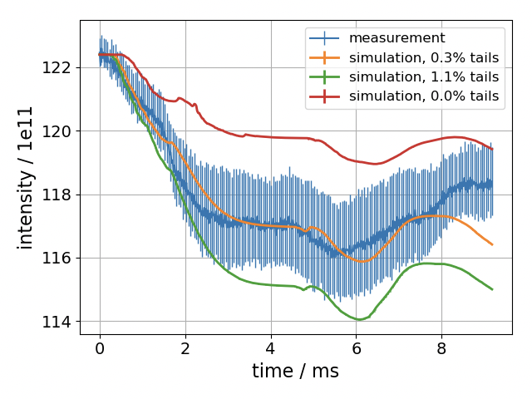
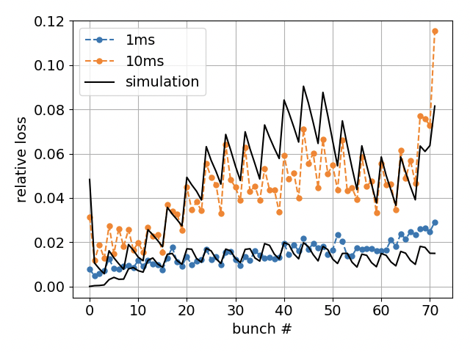
Main limitations in longitudinal plane: capture and flat bottom losses
→ Strong effect of
- injected particle distribution (halo)
- bunch length modulation
- phase loop
→ Good agreement between measurements and BLonD simulations for 72 bunches during 1 s for 1.7E11 ppb, V200 = 2 MV, V800 = 0, Q22, feedback on, phase loop on, FF off
→ 2% losses at 1 s for 2.6E11 after RF upgrade, but bucket is full → losses at start of ramp

Slide 12
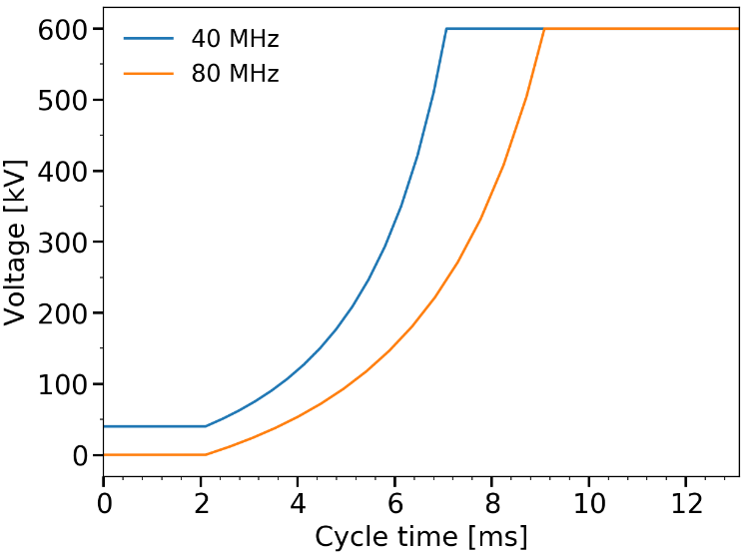
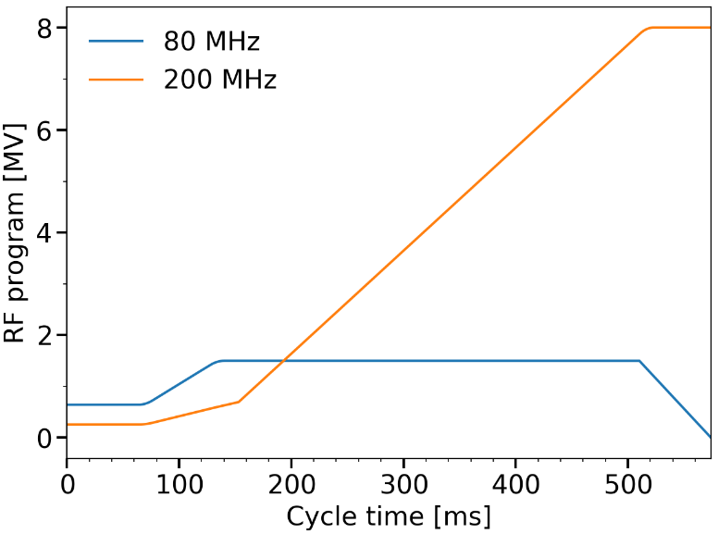
PS-SPS transfer: new capture RF system in the SPS?
PS: 5.5 – 6.0 ns long bunches without rotation
SPS: new 80 MHz RF system
  V = (0.6 - 0.8) MV for capture (to minimise emittance blow-up)
  V = (2.0 - 2.5) MV for re-capture into the 200 MHz RF system to minimise satellites
  Impedance model of the PS 80 MHz cavity (300 kV)
200 MHz TW used as Landau system in bunch shortening mode on flat bottom and then as a main system for acceleration (+ 800 MHz RF)
→ Losses are significantly reduced. The exact gain depends on PS particle distribution (bunch halo)
PS voltage
programs
SPS voltage
programs

Slide 13
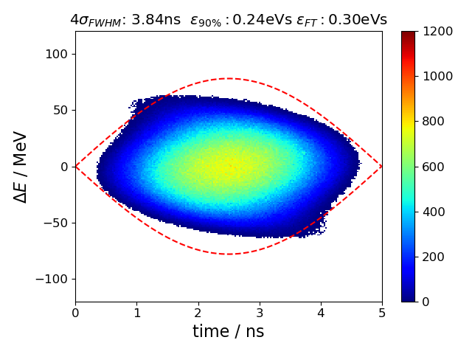
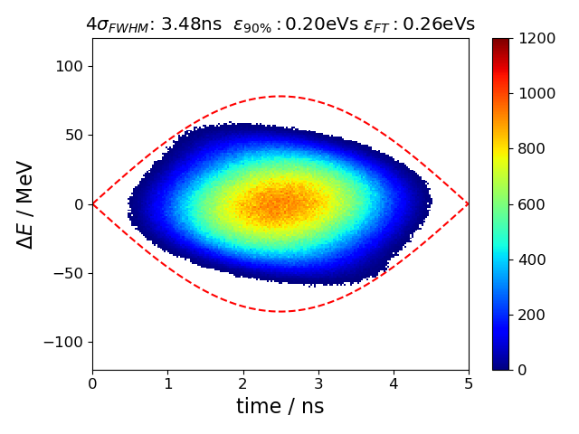
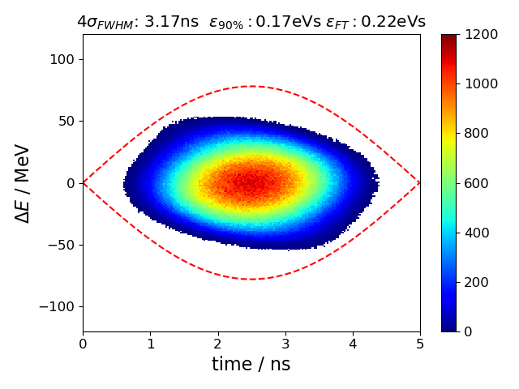
PS-SPS transfer: smaller injected emittances?
Longitudinal emittance reduction by ~ 15% possible with PS Landau RF system
Nominal emittance
15% smaller emittance
30% smaller emittance
(A few hours) BLonD simulations on the SPS 10 s flat bottom for 48 bunches with 2.6e11 ppb,
Upgraded 200 MHz RF and LLRF: FB: - 26 dB (instead of -15.5 dB now), V=4.5 MV
Improved phase loop (averaging over all bunches, not only over first 12 as now)
SPS after impedance reduction (HOM, vacuum flanges) in Q20
→ > 50% loss reduction on flat bottom (subject of exact halo population). Stability?

Slide 14
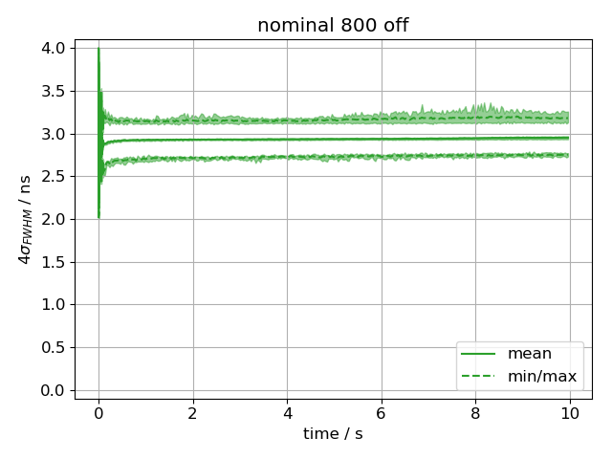
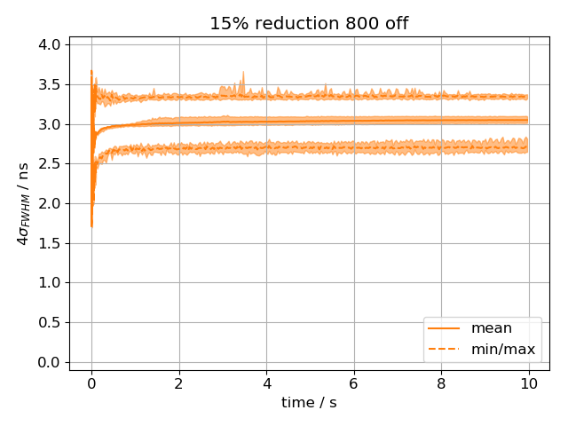
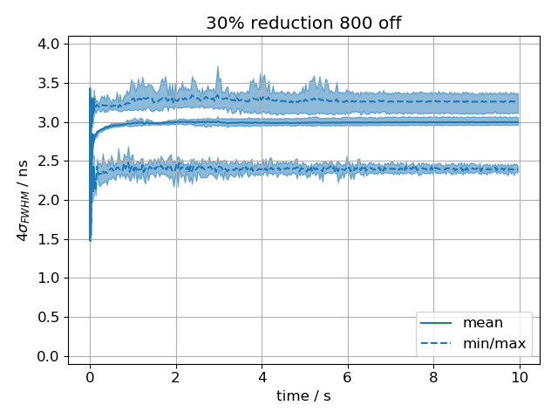
Flat bottom instability after LIU upgrades (Q20): simulations for smaller 48 bunches with 800 MHz off
Nominal emittance
15% smaller emittance
30% smaller emittance
Bunch length
on flat bottom
800 MHz off
unstable
unstable
unstable

Slide 15
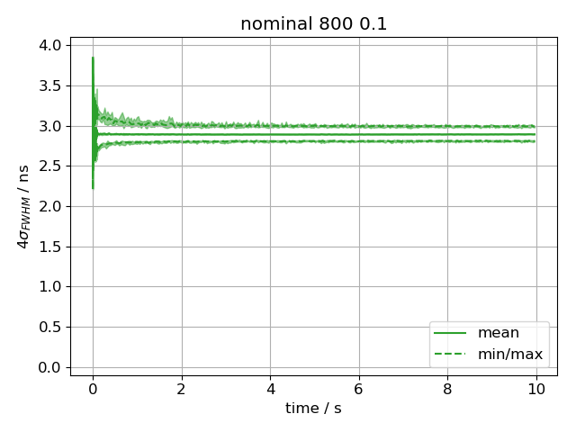
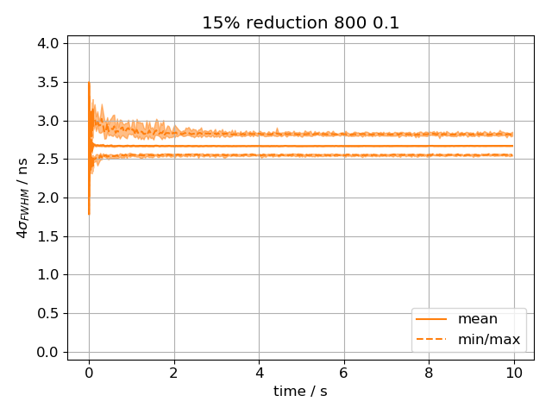
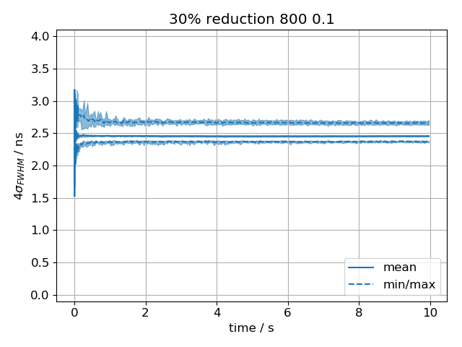
Flat bottom instability after LIU upgrades (Q20): simulations for smaller 48 bunches with 800 MHz on
Nominal emittance
15% smaller emittance
30% smaller emittance
Bunch length
on flat bottom
800 MHz off
unstable
unstable
unstable
800 MHz on
10% ratio
→ Stabilisation by 800 MHz RF system with 0.1 voltage ratio

Slide 16
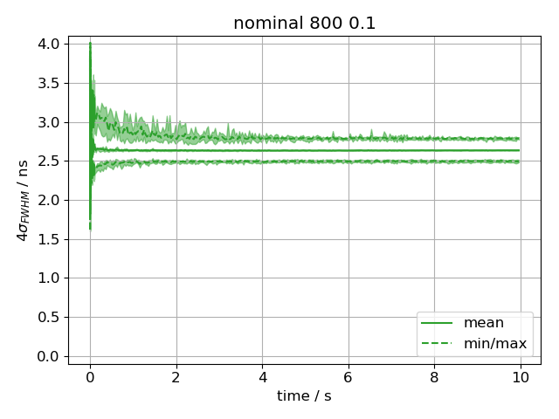
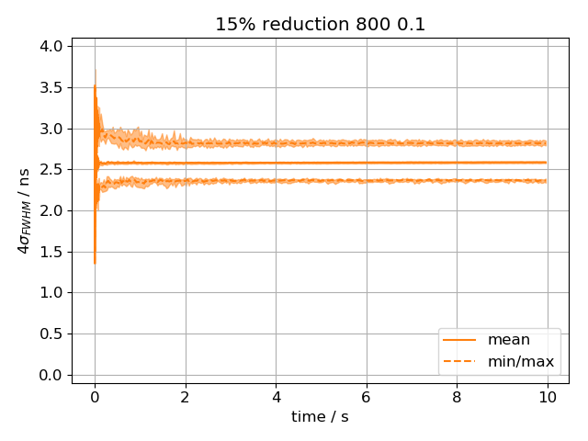
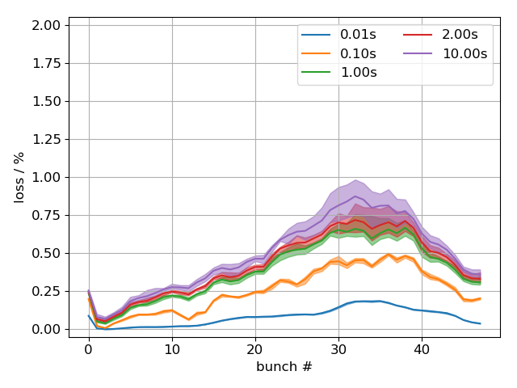
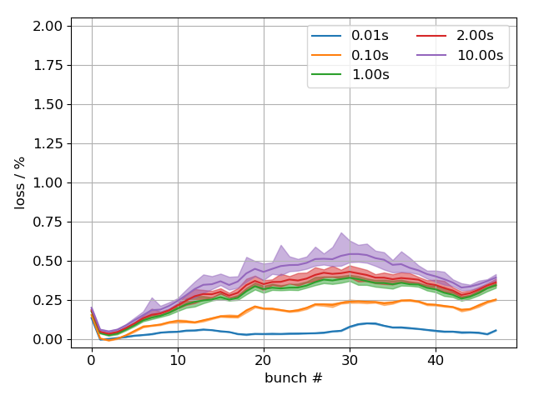
Q22 vs Q20: instability and losses after LIU upgrades
Main motivation for Q22: smaller required RF voltage and power at the start of ramp.
Main issue during SPS MDs in 2018: controlled emittance blow-up for beam stabilization.
Stronger beam loading effect (smaller matched voltage: 3.6 MV vs 4.5 MV)
Higher voltage required at the LHC injection → LHC MD in 2018 with extracted beam (limited intensity during run3 due to potential RF power limitation in the LHC?)
Less stability (than in Q20) on the flat bottom (for given PS emittance) → higher losses
^{Q22}
^{Q22}
^{Q22}
^{Q20}
30% red ε, 800 at 10%
30% red ε, 800 at 10%
nominal ε, 800 at 10%
15% red ε, 800 at 10%

Slide 17
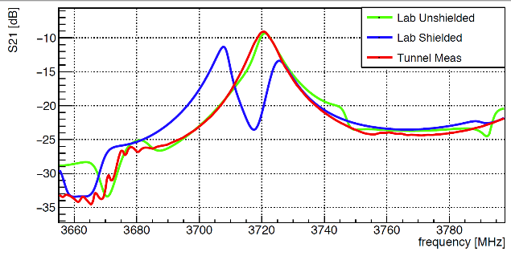
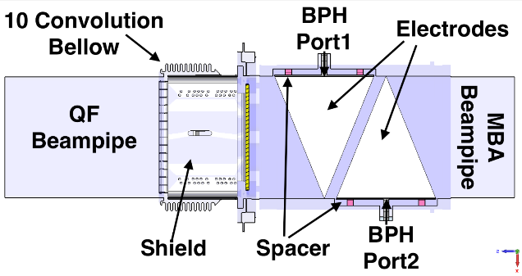
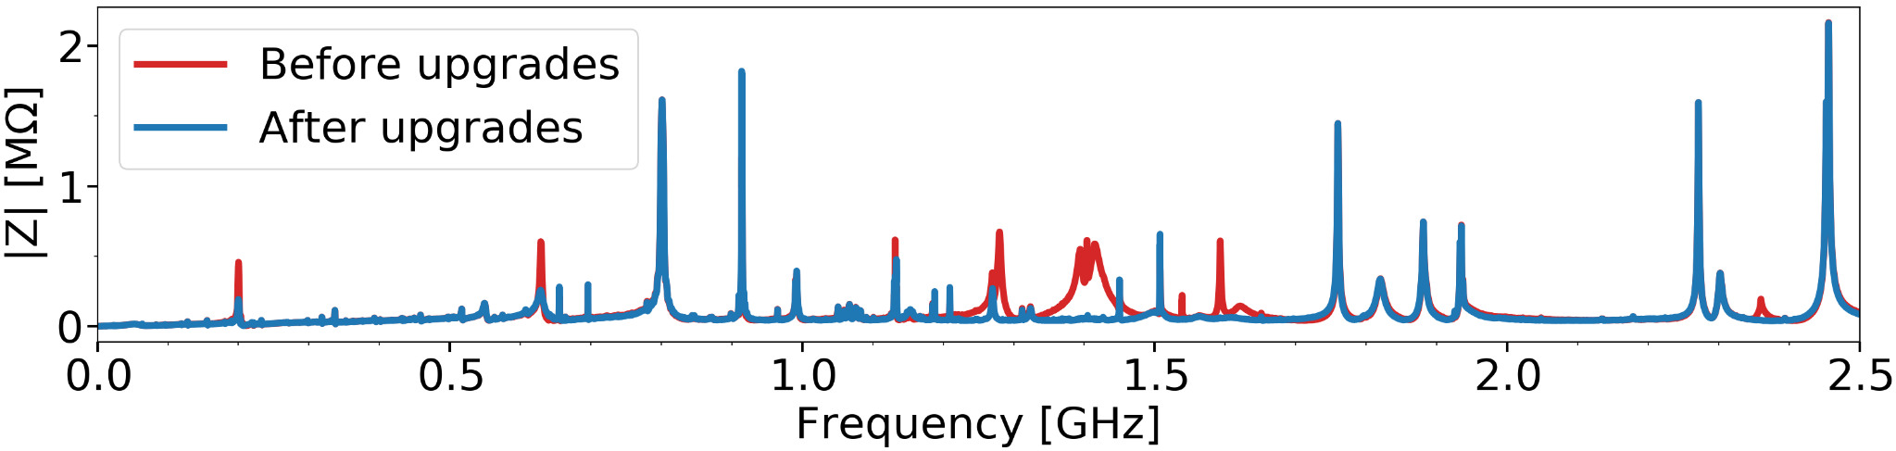
Updates on SPS impedance
Longitudinal impedance model further evolved,
some (“missing”?) impedance was found
Quality control of impedance shields in BPH-QF
flanges (installation by VAC Group) is prepared
Reference impedance measurements with beam
(long bunches, synchronous phase shift - new, …)

Slide 18
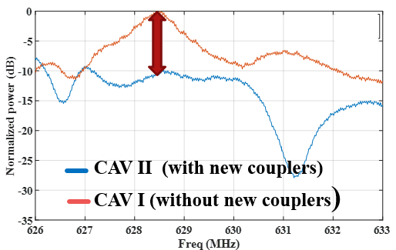
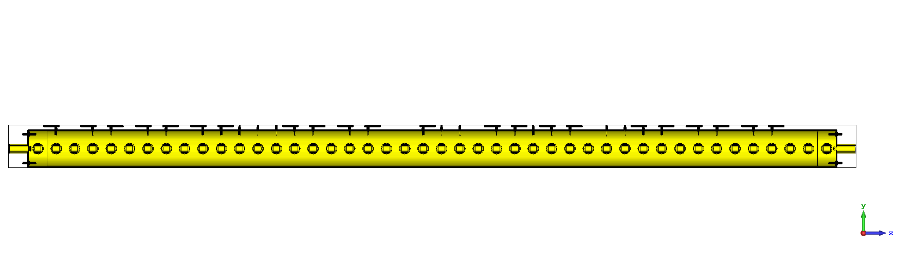
630 MHz HOM damping
Required HOM damping by factor 3 is achieved for both 3- and 4-section cavities using different types of couplers and damping schemes
Measurements with beam confirm this factor for 4-section cavities (installed last YET)!
All four 200 MHz cavities were measured 2 weeks ago before removal from SPS tunnel
1
2
3
4
5
6
7
8
9
10
11
1
2
3
4
5
6
7
8
9
10
11
1
2
3
4
5
6
7
8
9
10
11

Slide 19
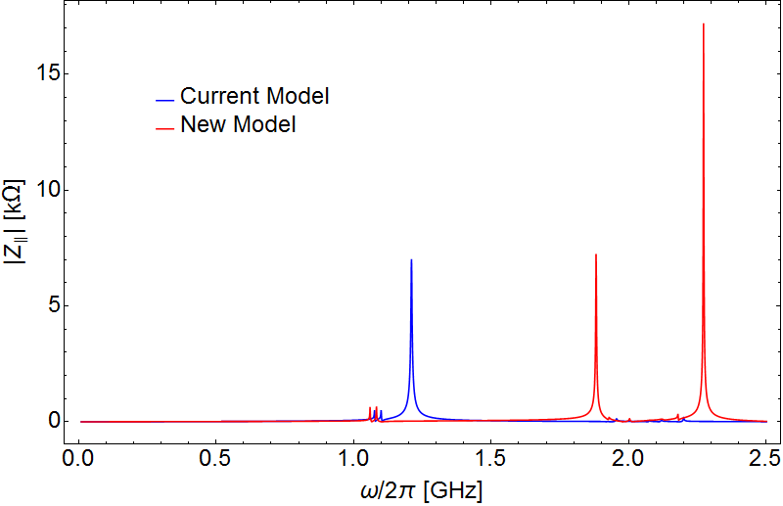
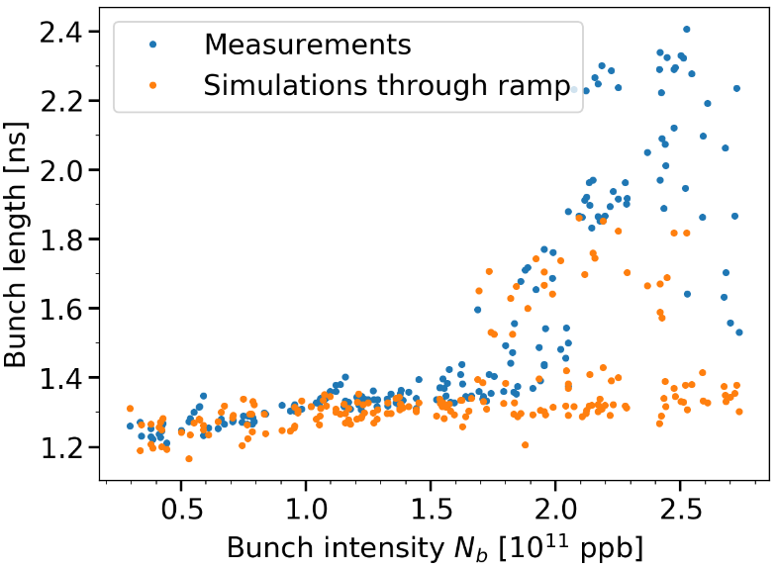
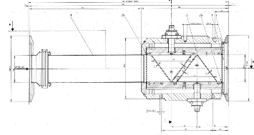
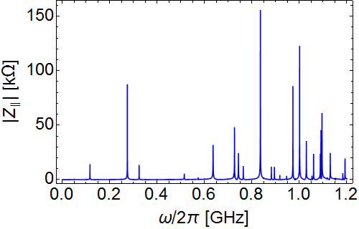
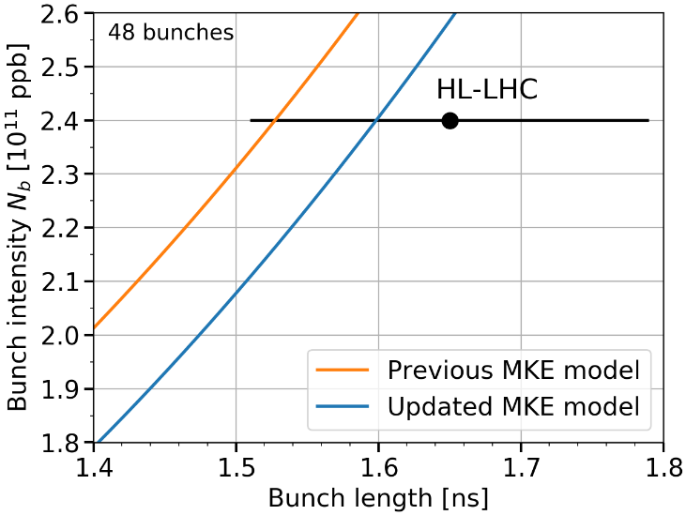
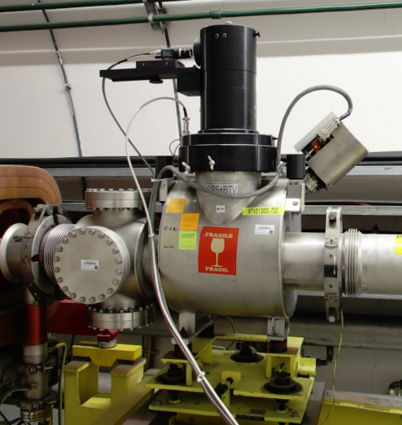
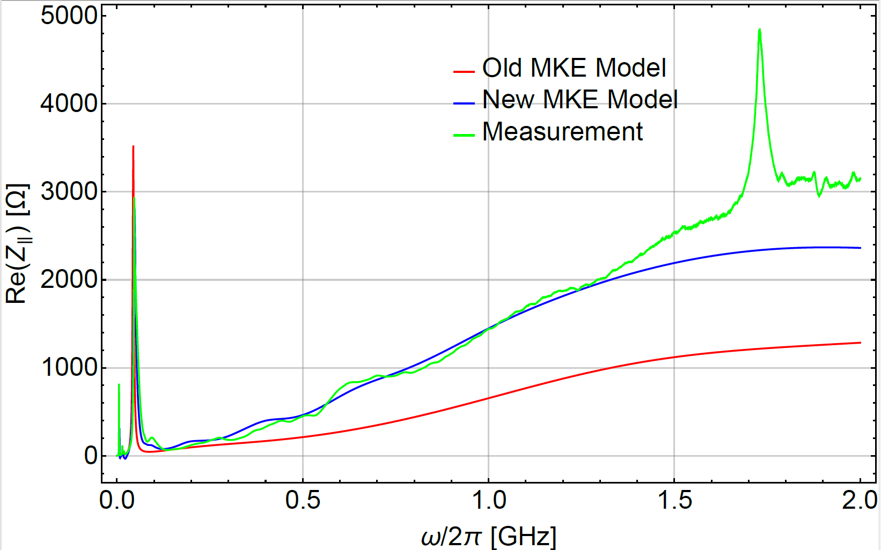
Updates to the SPS impedance model
Updated BPV Model
LSS1 & LSS5 optimization (during beam dump relocation)
Elements around the QFA’s
Impedance minimization of TIDVG#5, TPSC4, ZS, BSRT, Crystal Goniometer, Beam Dump BTV
Not Simulated Originally
→ better
agreement
This moves
Beam Dump BTV (7 in the ring)
Updated MKE model
→ reduced
stability

Slide 20
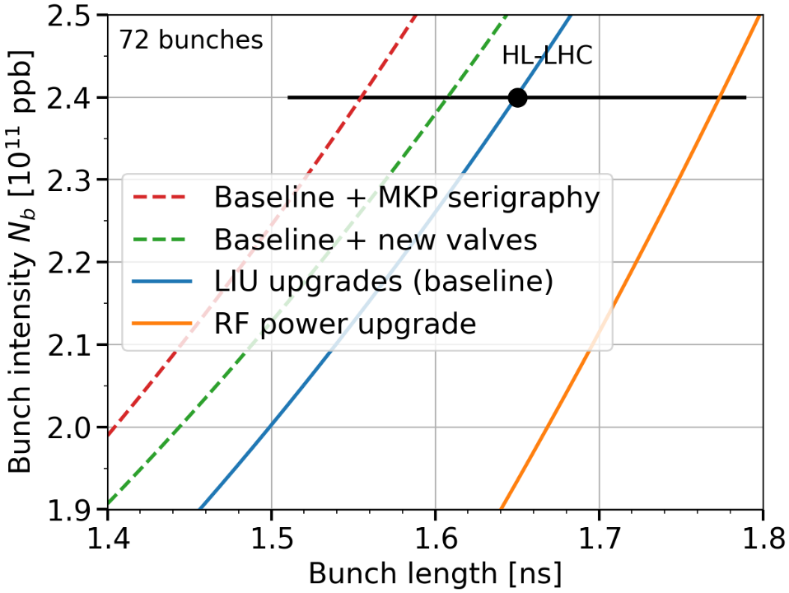
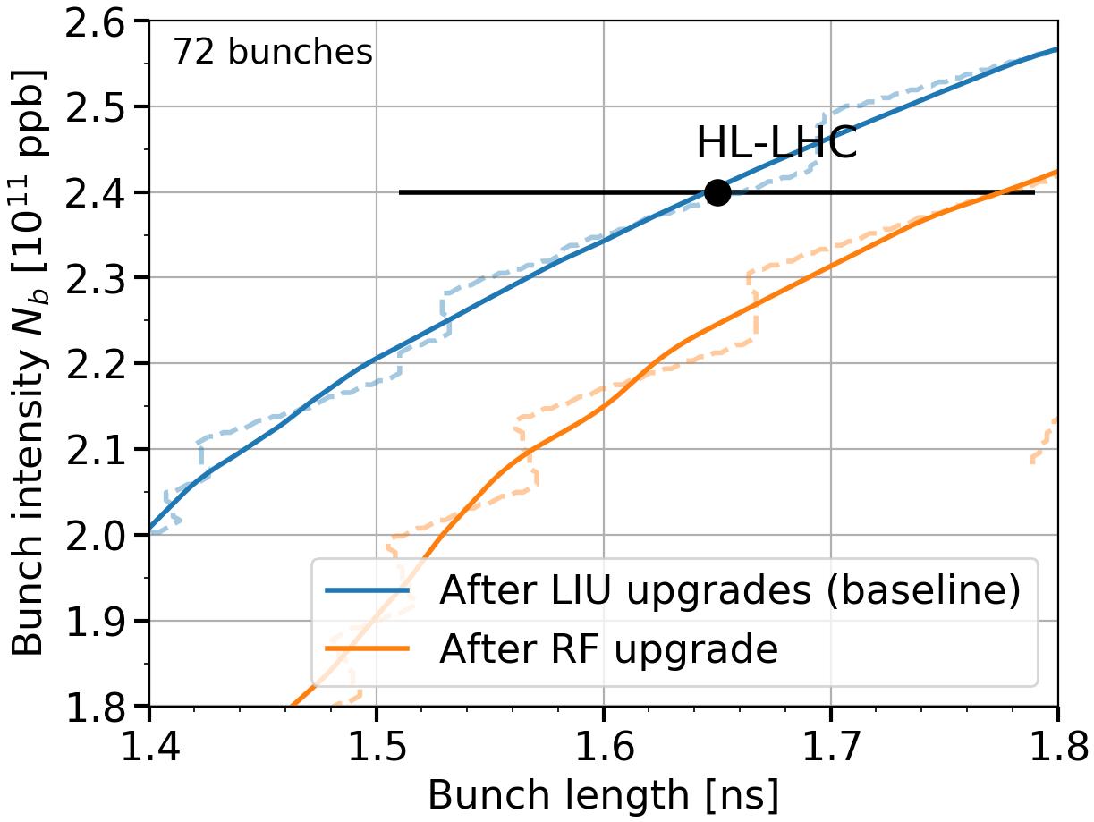
Intensity reach after LS2: instability thresholds at the SPS flat top
Stability for V₂₀₀=10 MV & V₈₀₀= 1 MV
Baseline: VF & 630 MHz HOM
Stability taking into account decrease of RF voltage with intensity (beam loading)
H. Bartosik, F. Schmidt
→ Extra margins can be obtained from additional impedance reduction and higher 800 MHz voltage
→ Beam loading limitation (V₂₀₀ < 10 MV) above HL-LHC intensity to be taken into account

Slide 21
LHC proton beam: what can be improved for high-intensity operation?
Voltage program optimisation for 200 MHz & 800 MHz RF during the ramp with intensity effects (future SPS impedance model). → For positive 800 MHz phase shift additional increase of instability threshold is expected from simulations
Procedure for accurate 800 MHz phase calibration during the whole cycle.
RF noise reduction for 200 MHz & 800 MHz, especially on FB, for loss reduction
Controlled emittance blow up:
  Feedforward on bunch intensity and length
  LHC experience: correct effect of phase loop; feedback on bunch length?
Optimum partition of RF voltage between 3- and 4-section cavities is a function of intensity and should be automatic in operation

Slide 22
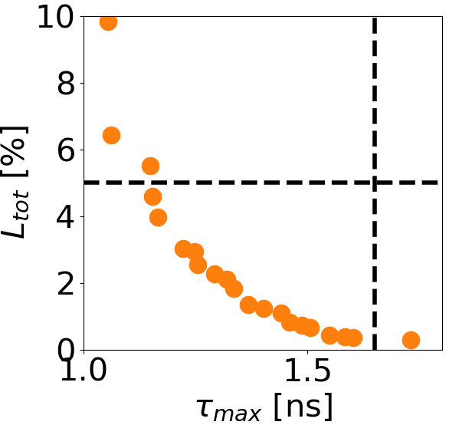
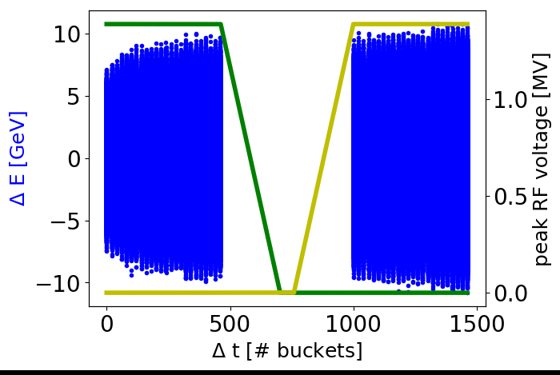
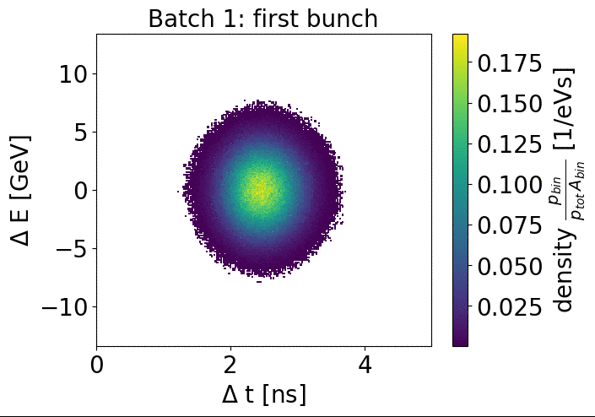
LHC ion beam: slip-stacking simulations in 2018
Simulations of slip-stacking up to extraction with intensity effects (SPS impedance) using realistic (measured) bunch-to-bunch parameters (in Q20, Q22 and Q26 optics)
Optimum settings found for all cases. Bunch rotation in Q20 → Q26 used in MDs in 2018
Loss of Landau damping, need of the 800 MHz RF after slip-stacking
phase space
optimisation
study

Slide 23
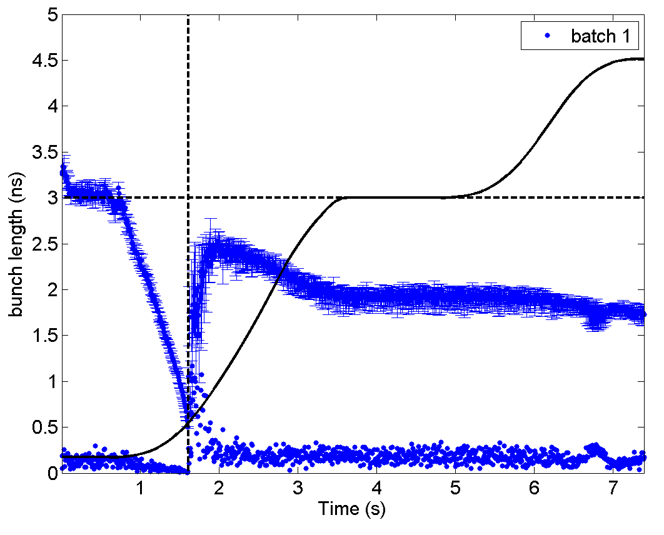
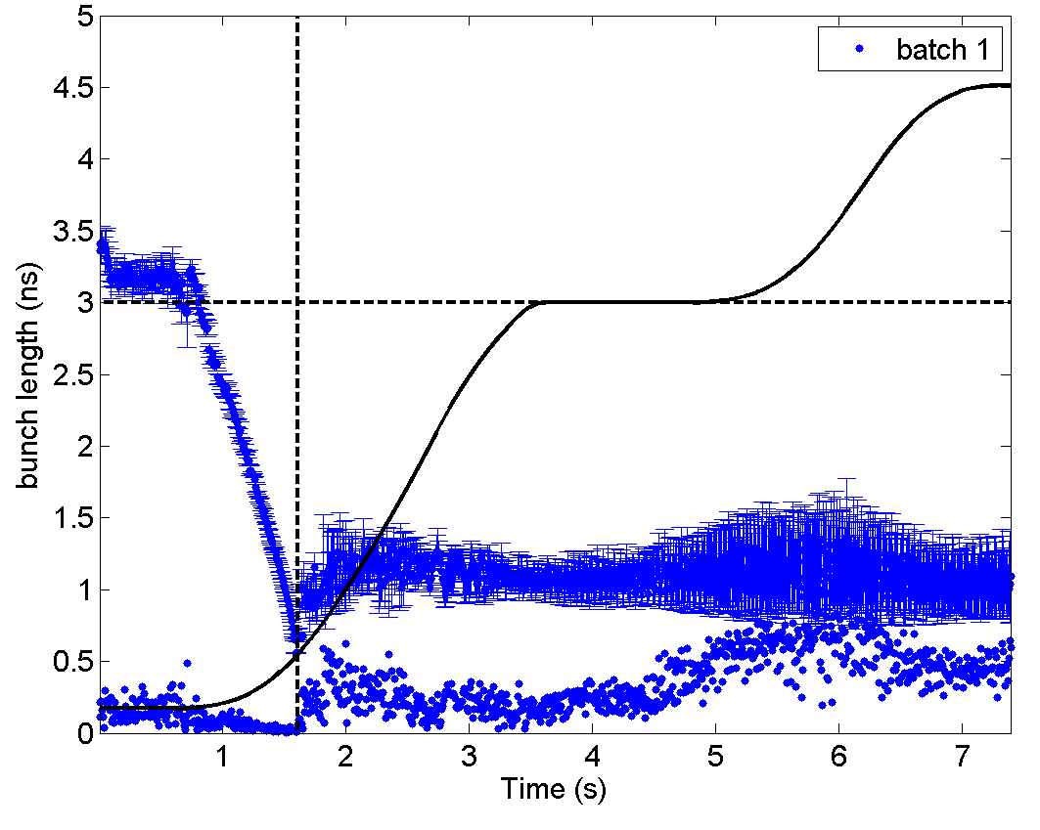
LHC ion beam: observations during slip-stacking MDs (1/2)
Improving transition crossing leads to smaller blow-up but beam becomes unstable later: instability is often starting at the 300 GeV Z/c (slip-stacking) plateau
Adjusted
transition
crossing
More reproducible,
but unstable
→ Extracted to LHC
Bad transition,
not reproducible
MD Dec 2018 : one batch of 4 nominal bunches (~2.8E10 charges/bunch)
Transition crossing will be improved after LS2 due to LLRF upgrade (phase discriminator, ..)

Slide 24

Observations during slip-stacking MDs (2/2)
LHC filling 7446
Reduction of intensity and bunch length along SPS flat bottom (due to IBS, RF noise, …) leads to
  large spreads in beam parameters (± 15-20%)
  instability of the shortest (and less intense) bunches
Slip-stacking of the unstable beam is not feasible
Need to stabilise beam before transition crossing → controlled emittance blow-up in a single RF (800 MHz is not available below transition)
Radial beam displacement at the intermediate flat portion (20 mm) didn’t lead to visible BCT losses
  → only one beam can be moved during slip-stacking
Improvement in lifetime (and spreads) on flat bottom are expected due to foreseen RF noise reduction (LLRF upgrade)

Slide 25
Possible improvements for LHC ion beam
One-turn delay feedback for the 200 MHz RF: after slip-stacking beam intensity becomes comparable to the (low intensity) FT proton beam
Controlled emittance blow-up before transition crossing (in a single RF) using 200 MHz phase modulation. Large bunch-to bunch variation in intensity and bunch length – f_{rev} modulation(?); other methods (800 MHz)
Use of the 800 MHz RF (above transition) – briefly tested at the of end 2018 (no effect). Separate control of two cavities during slip stacking (?)
RF noise reduction on flat bottom with fixed h (4653) avoiding FM&AM
Phase loop per beam (signal from “edge” bunches) during slip stacking
Fast voltage reduction between batches during slip stacking

Slide 26
Questions to be answered
What has been achieved with the acceleration of short bunch trains at highest intensities?
Do we understand the losses at flat-bottom and the longitudinal instabilities? What is the effect of different optics?
Which improvement do we expect from impedance reduction?
How complete is the longitudinal impedance model?
How can 2018 observations with high-intensity beams be projected to the after-LIU era?
What is the impact of RF upgrade and impedance reduction on intensity reach?
What are limitations and requirements of double RF acceleration with 800 MHz?
Can we expect a better ion lifetime in the SPS due to the RF upgrade (power and LLRF)?
What can be learned from 2018 measurements with ions (including slip stacking tests)?

Slide 27
Summary
Studies of nominal LHC beam were limited to 1.3E11 ppb due to beam loading effect
12 bunches with 2.0E11 ppb were accelerated in the SPS using optimised 800 MHz voltage program. Potential of increased 800 MHz voltage need to be fully exploited.
Flat bottom instability is most likely driven by main 200 MHz impedance and should be suppressed by upgraded one-turn-delay FB system, which should also reduce present capture losses
Injection of smaller PS bunches could further reduce the flat bottom losses and voltage (power) needed at the start of the ramp
LIU beam will be unstable in Q22 optics on flat bottom even after planned upgrades
Required HOM damping in 200 MHz RF cavities was achieved in design and demonstrated for 4-section cavity with beam
Ion beam need to be stabilised before slip stacking
Various improvements can be implemented for ion and proton operation after LS2

Slide 28


LS2: 200 MHz RF TW sections on their way out from the SPS tunnel…

