Slide 1
SPS Schedule, Co-activities & Logistics
D. Mcfarlane EN-ACE
on behalf of all contributors

Slide 2
Content
Organisation
LS2 Master and Baseline Schedules
LS2 Activities & ALARA works
LS2 LIU Main Activities
Critical Paths
Documentation Status
Summary

Slide 3
LIU Project: SPS
IEFC
LS2C
LMC
LIU Beam Dynamics Coordination
H. Bartosik, G. Rumolo
LIU Executive Committee
LIU Commissioning Coordination
V. Kain, G. Rumolo, A. Huschauer
LIU SPS BD WG
Chairs E. Shaposhnikova, H. Bartosik
LIU SPS Technical Coordination
Chair B. Goddard
Deputy E. Shaposhnikova
LIU SPS Commissioning WG
Chair K. Li
SPS Shutdown Coordination
Chair D.Mcfarlane
As needed
LIU SBDS coordination (EC)
LIU 200 MHz (FG)
LIU aC/Impedance (PC)
Ad Hoc meetings
LIU RF integration (KL)
LIU SBDS integration (FV)
Ad-hoc meetings
Other projects in SPS

Slide 4
Organisation
Facility Coordinators
EROS
Integration
Configuration / Layout DB
Activity Technical Coordinator
De-cabling/Cabling
Georgi Minchev Georgiev
David Mcfarlane
Julie Coupard(Deputy)
Emmanuel Paulat
Frederic Galleazzi
Sonia Bartolome
Machine
WP1 Fire Compartments
A. Martinez Selles
Upgrade of the RF 200 MHz in BA3
Eric Monesinos
BA1 & BA5
Jonathan Meignan
John Etheridge
Scharif Mehanneche
Blanca Vazquez
Surface
WP2 Fire Detection
Michael Dole
aC coating & impedance reduction
Wil Vollenberg
Beamline activities
Antonio Grande Mallavia
Daniel Del Alamo
WP3 Dry Riser
Willy Van Den Broucke
Beam dump Project
Etienne Carlier
Jean-Baptiste Mayolini
WP4 Fire Sprinkler
Anna Suwalska
Exchange of the ZS in LSS2
Bruno Balhan

Slide 5
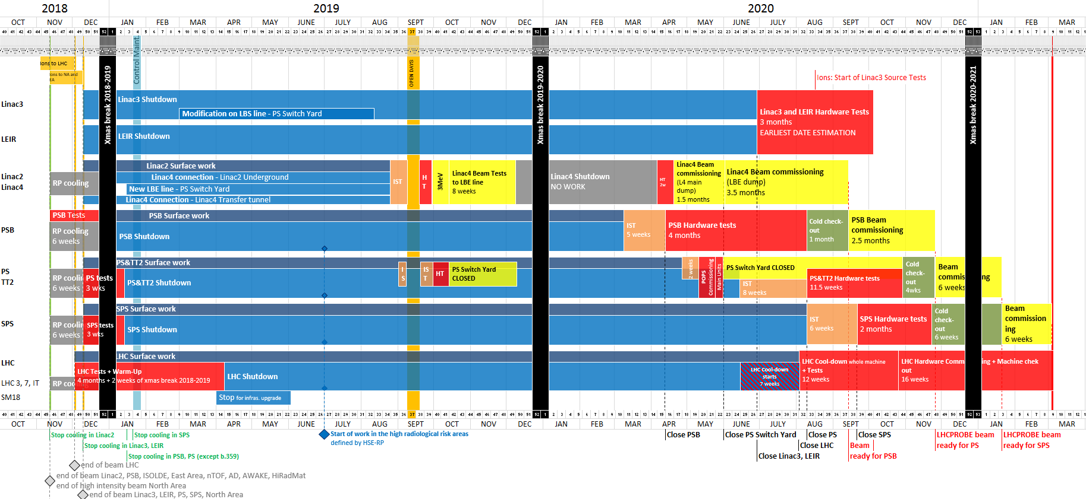
LS2 Master Schedule 1.4
14th January 2019
18th September 2020
Period with possible access restrictions
More details of this will be presented in the talk given by James Ridewood in Session 3 tomorrow morning
3
Start of Access to the SPS
19.5 months
Closure of the SPS

Slide 6
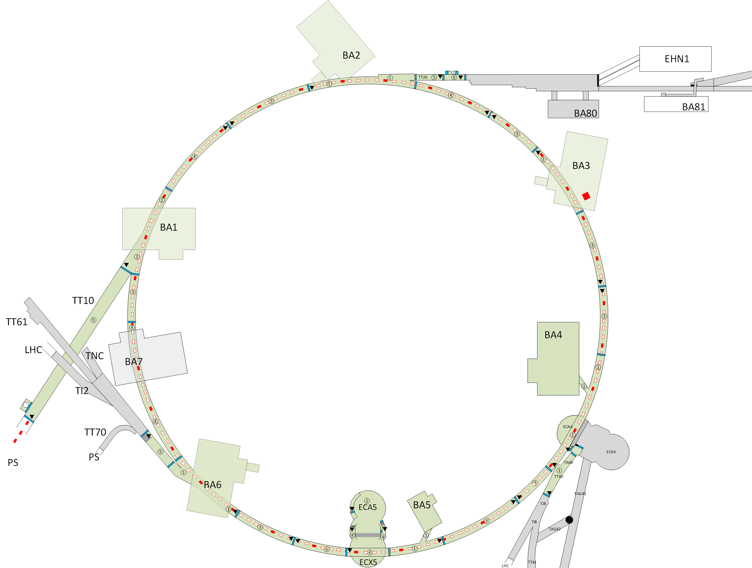
LS2 machine activities
SPS
LHC injection lines TI2 and TI8 (see LHC coordination)
New collimators TCDIs
New beam loss monitors
New vacuum valves
LIU Project
Change all the electrostatic septum ZS
(LSS2)
Add a vacuum valve
(sector 210)
Reconfiguration of LSS1 (LSS1, BA1)
New beam loss monitors
New upgraded scraper
Replace one injection kicker MKP
Reconfiguration of the enlarged quadrupoles
(11610, 11710, 11810)
200 MHz RF power upgrade
(LSS3, BA3, BAF3)
200 MHz low level RF upgrade
aC coating (QF SSS, MBB 5+ 6-, LSS drifts all)
New flanges for the impedance reduction
Replacement MOPOS electronics
(Sextants 1,2,3,4,5,6)
Extraction protection devices:
Replacement of TPSC4 (LSS4)
Replacement of TPSG6 (LSS6)
Reconfiguration of LSS5 (ECA5, ECX5, LSS5)
New Beam Dump
New beam loss monitors
Replace beam gas ionisation profile monitor (BGI)
Replace the synchrotron light monitor (BSRT)
New kicker magnet with vertical deflection for dumping MKDV (and generator)
Reconfiguration of the enlarged quadrupoles
(51610, 51810)
New rotational Wire Scanners BWSRE
(LSS4, LSS5)

Slide 7
LS2 machine activities
SPS
LHC injection lines TI2 and TI8 (see LHC coordination)
New collimators TCDIs
New beam loss monitors
New vacuum valves
LIU Project
Fire Safety Project
New PPS Project
New UA9 cristal and goniometer pair
Consolidations
Maintenance
Upgrade
Change all the electrostatic septum ZS
(LSS2)
De-cabling Project
Add a vacuum valve
(sector 210)
Reconfiguration of LSS1 (LSS1, BA1)
New beam loss monitors
New upgraded scraper
Replace one injection kicker MKP
Reconfiguration of the enlarged quadrupoles
(11610, 11710, 11810)
200 MHz RF power upgrade
(LSS3, BA3, BAF3)
200 MHz low level RF upgrade
Consolidation of BB3 cooling plant
New modern static var compensator (BEQ1)
New access systems
New personnal access devices PAD
New material access Devices MAD
New emergency exite doors
New beam loss monitors
aC coating (QF SSS, MBB 5+ 6-, LSS drifts all)
New flanges for the impedance reduction
Replacement MOPOS electronics
(Sextants 1,2,3,4,5,6)
Fire Safety
Fire compartments
Fires safety systems
Manual fire fithing systems
Automatic fixed fire fihting systems
Extraction protection devices:
Replacement of TPSC4 (LSS4)
Replacement of TPSG6 (LSS6)
New emergency lighting systems
New safety cable tray
Consolidation of the B-train
WIC and BIS deployment
Refurbishment of the lift (BA3, BA6)
Electrical sub-station consolidation
(BA1,2,4,6)
Reconfiguration of LSS5 (ECA5, ECX5, LSS5)
New Beam Dump
New beam loss monitors
Replace beam gas ionisation profile monitor (BGI)
Replace the synchrotron light monitor (BSRT)
New kicker magnet with vertical deflection for dumping MKDV (and generator)
Reconfiguration of the enlarged quadrupoles
(51610, 51810)
De-cabling Project
New rotational Wire Scanners BWSRE
(LSS4, LSS5)

Slide 8
ALARA level III
Facility | Work | Group in charge | Activity/Project Leader | Committee date
SPS | SPS fire safety upgrade (reduced scope) [excl. cabling] | BE-ICS | Ronny Billen | November 2018 (1st Part approved) Mid 2019 (2nd part)
SPS | Cabling BA1 & BA2 [incl. cabling SPS fire, TIDVG LSS1 removal] | EN-EL | Guillaume Gros | September 2019
SPS | Safety lighting infrastructure installation | EN-EL | Gerardo Velazquez Gutierrez | November 2018 (Approved)
SPS | TIDVG removal in LSS1 [excl de-cabling] | TE-ABT | Etienne Carlier | February 2019 (Approved)
SPS | Installation of new ZS in the SPS LSS2 extraction channel | TE-ABT | Bruno Balhan | March 2019
LIU related

Slide 9
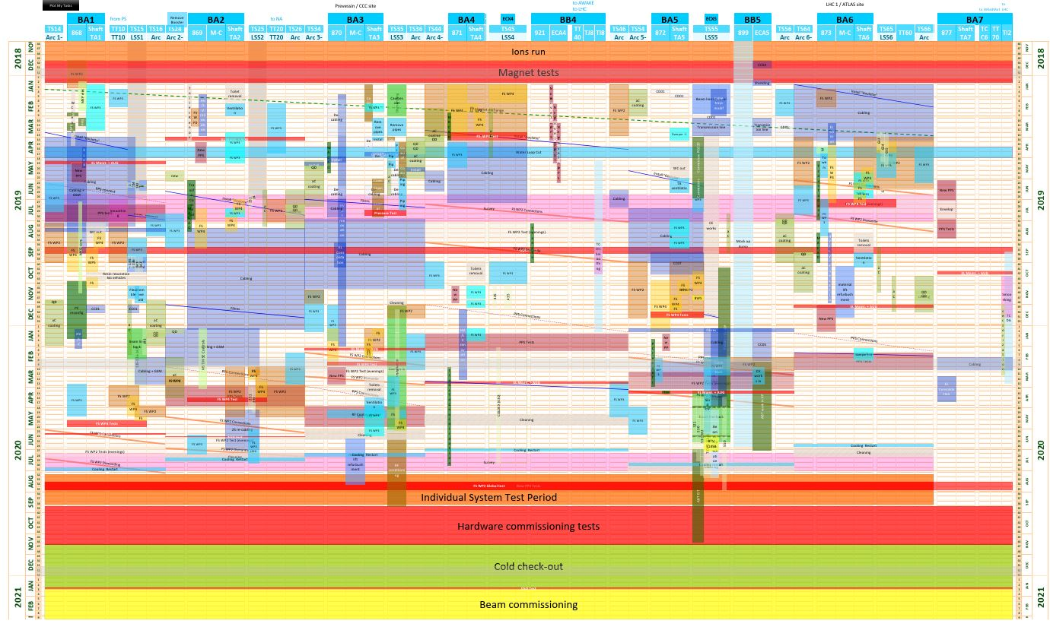
SPS Linear Schedule Baseline https://edms.cern.ch/document/1892837/2.0

Slide 10
LS2 Main LIU Activities

Slide 11

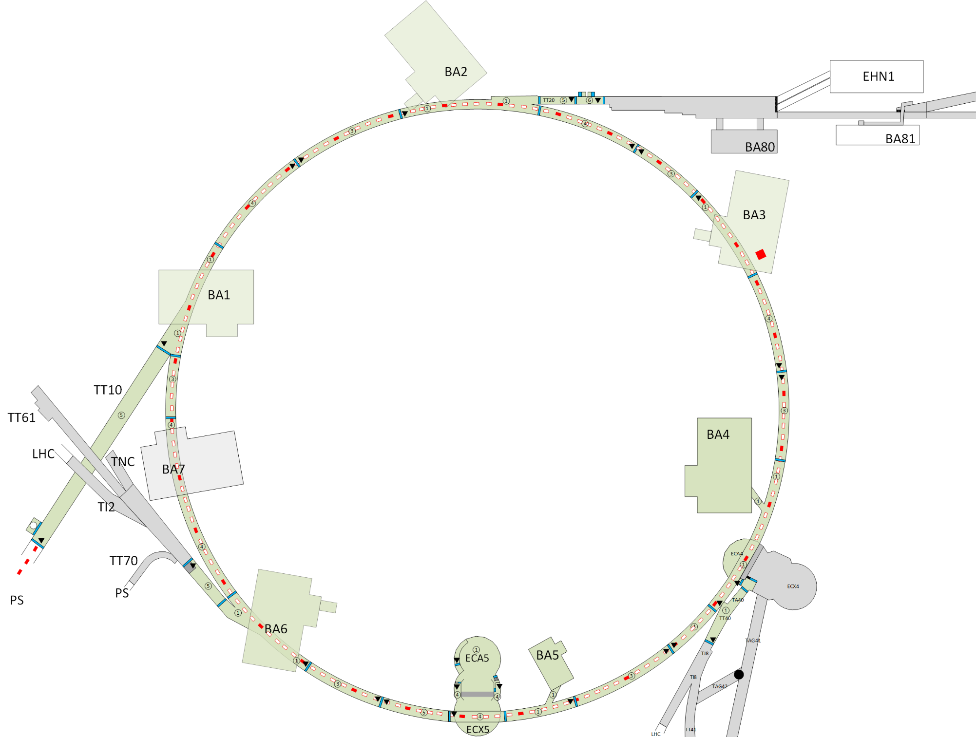

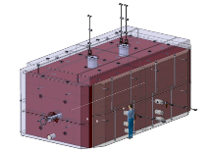
LIU Beam dump activities during LS2 (Point 1 & Point 5)
ECR 1976294 / 1963473 / 1574176
Scope of the project:
Move the SPS Beam Dumping System from SPS1 to SPS5 (ECX5)
Reconfiguration of the LSS5
  Dismantling more than 100 meters of beam line
  De-cabling / cabling campaign
  Civil engineering in ECX5
  Re-installation following the new layout including the new dump
Reconfiguration of the LSS1
  Removal of the dumps and their instrumentation
  Transfer of the kickers to LSS5
  Re-installation of the simplified LSS1, including e-cloud
Old dumps
New Beam dump
Kickers
More details of this project will be presented in the talk given by Etienne Carlier in Session 2 this afternoon

Slide 12
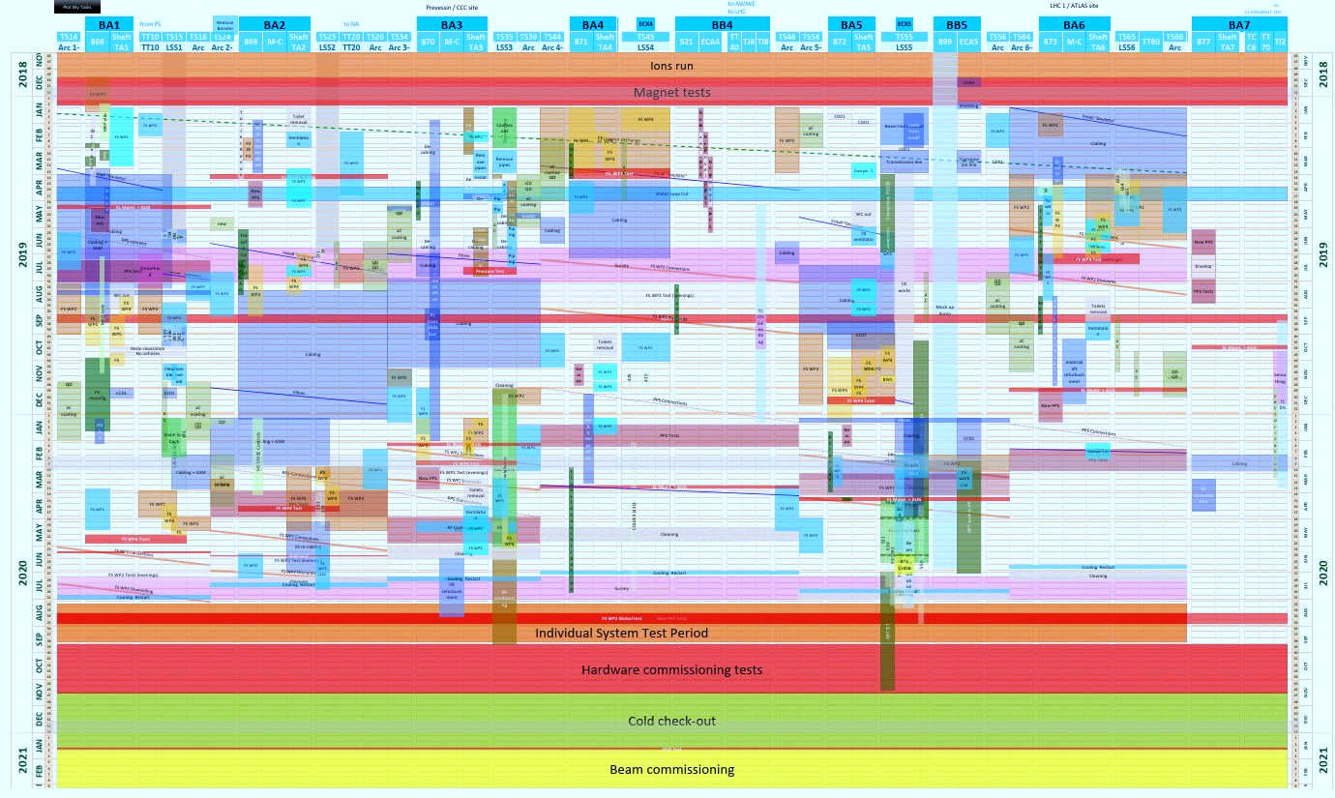
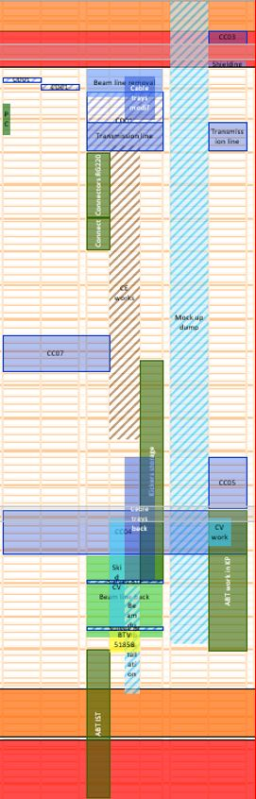
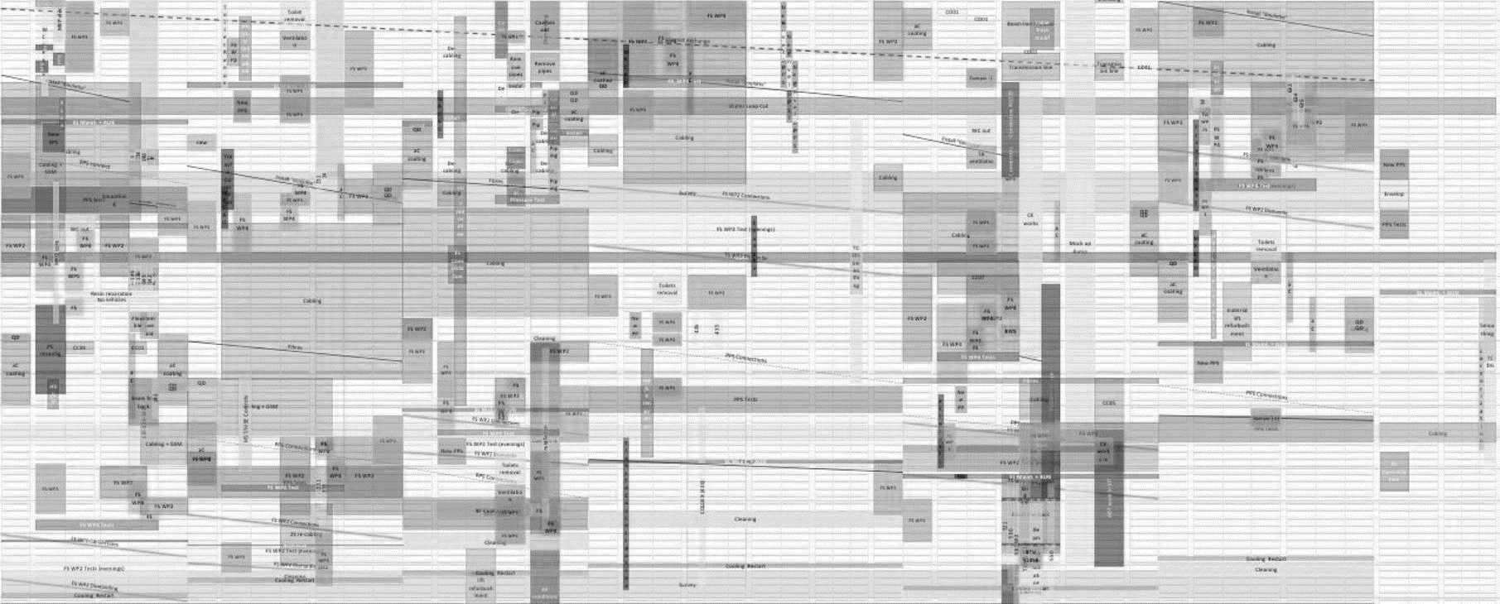
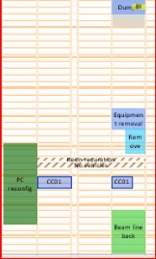
LIU Beam dump activities during LS2 (Point 1 & Point 5)
Preparation
Old dump removal
Civil engineering
Re-configuration
Re-installation

Slide 13

LS2 Transport restriction due to LIU Beam Dump Works BA5
The scheduling of works that require transport of equipment around the tunnel has taken this constraint into account.
Location of “Goods” lift
Transport crossing other works will have to be carefully addressed.
9 months of Civil Engineering works in ECX5

Slide 14
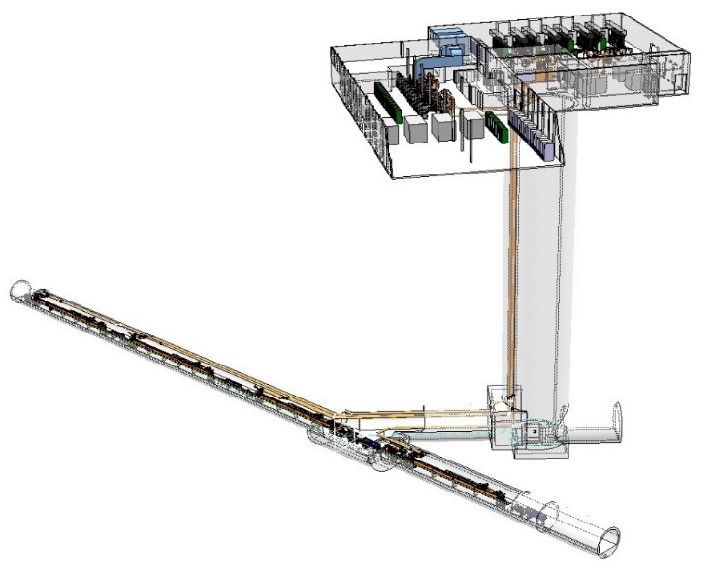


LIU 200 Mhz RF Upgrade in BA3
ECR 1900971
The upgrade of the 200 MHz RF system, which is the frequency at which main accelerating system of the SPS operates. This involves the addition of two new travelling-wave cavities and the construction of two new RF systems that will feed them, as well as the installation of the surrounding equipment to ensure the correct functioning of said systems.
Before LS2
After LS2
…
More details of this project will be presented in the talk given by Frank Gerigk in Session 2 this afternoon

Slide 15
De-cabling & Cabling Campaign
SPS POINT 3
De-cabling
 | Campaign Code | QTY [KM] | QTY Cables | Duration* [Weeks]
 | SP3CUC0-CD01 | 252 | 2827 | 17
 | SP3LIU0-CD01 | 69 | 1344 | 5
TOTAL | SPS point 3 | 321 | 4171 | 22
Original estimation was 12 weeks
Cabling
 | Campaign Code | QTY [KM] | Duration* [Weeks]
 | SP3FS0-CC01 | 10.2 | 5
 | SP3PPS0-CC03 | 25 | 8
 | SP3SMT0-CL201 | 0.8 | 1
 | SP3SMT0-CL2M1 SP3UTT0-CL2M1 | NA | 0.5
 | SP3LIU0-CC06 | 53 | 22
TOTAL |  | 89 | 36.5
Original estimation was 12 weeks

Slide 16
Planning (LIU 200 Mhz RF Upgrade in BA3)
Cavities removal
During May, June & July work teams will be split into Shifts to avoid co-activity in the same area
De-cabling, Cabling & Auxilary works
Install cavities
RF Commissioning

Slide 17
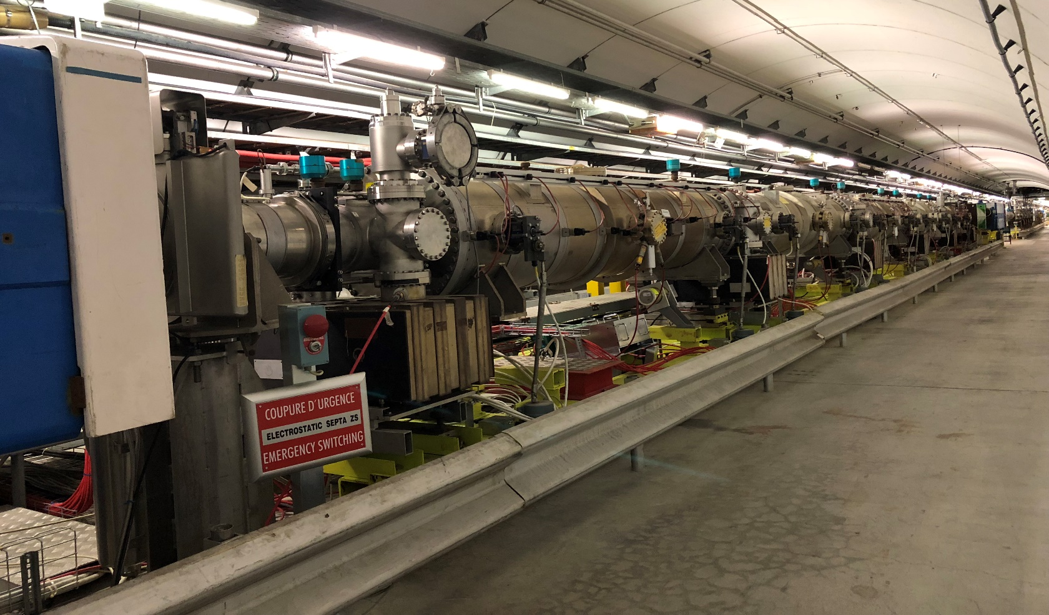
Installation of new ZS in the SPS LSS2 extraction channel
ECR 1949753
In order to reduce high spark rate and vacuum activity with LHC beams in the LSS2 ZS electrostatics septa, a new layout has been proposed.
The principal modifications to improve the vacuum in the ZS concern the installation of 5 new ZSs equipped with vacuum pumps directly onto the vacuum vessels. Each vacuum pumps will be equipped with a passive getters pumping system (Saes® CapaciTorr® D2000). Also the beam impedance of the new ZSs is reduced by introducing RF screens and grounding the anode support.

Slide 18
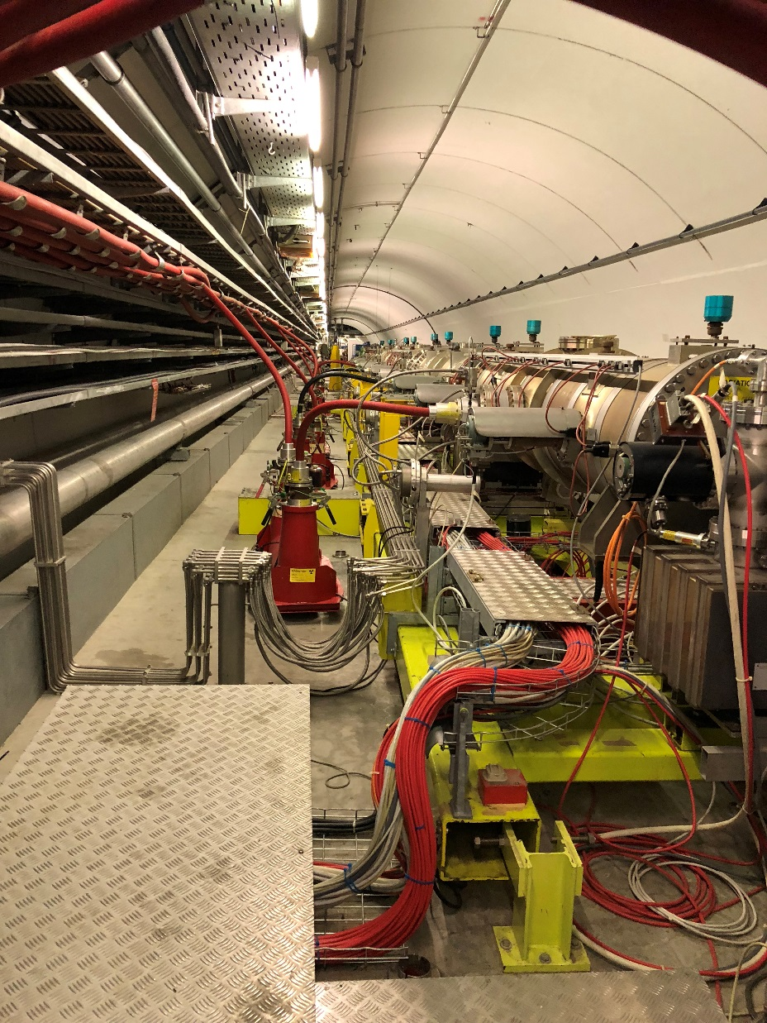
De-cable and re-cable ZS girder in LSS2
As presented in the LS2C #27 – 16th November 2018
The LSS2 general re-cabling campaign to replace all (irradiated) cables has been postponed to LS3.
The first cables start (Long HV cable in Sept ’18, short cable in BA2 in November) to die.
Particular cables have been identified and needing to be replaced in during LS2:
2.6 km cables for ABT from patch.
3.8 km for BI and VSC from TA.
An addition 8 weeks of cabling has been added to the planning to accommodate this additional works.

Slide 19
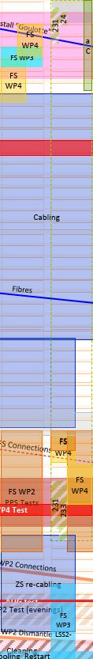
Planning (Installation of new ZS in the SPS LSS2)
Removal
Cabling Campaigns
Installation
ZS Cabling
Testing & Commissioning

Slide 20
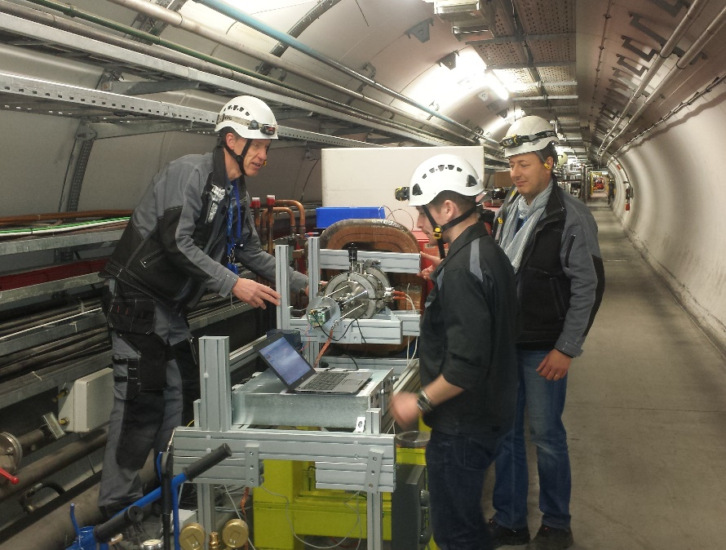
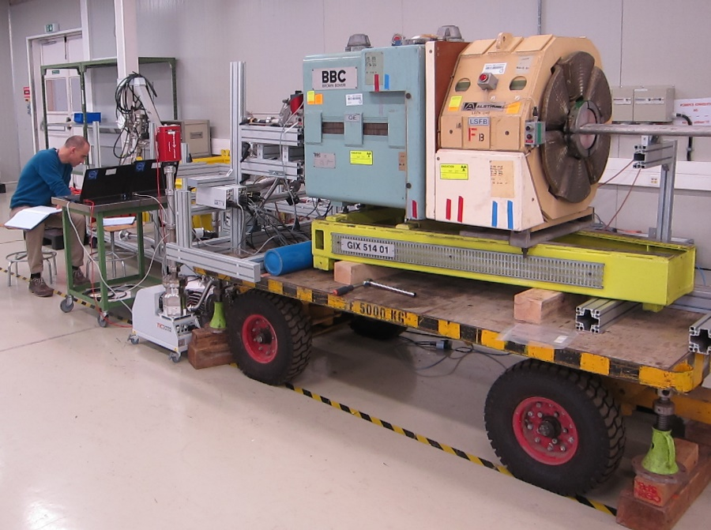
aC Coating & Flange Impedance Reduction: LS2
ECR 1968345
Prevessin site
(magnet lift)
LS2:
87 QF to be coated in SPS: 2 benches ¹
87 SSS QF to be coated in 867: 2 benches ²
~ 30 drifts to be coated in 181 (already started)
Flange impedance reduction at 87 SSS QF (2-4 impedance improvements per SSS QF position)
Work sequence BA5 to BA2 anticlockwise, then BA5 to BA2 clockwise.
(LS2)
BA3
(LS2)
(magnet lift)
RF
BA2
BA4
TT20 ext
TT40 ext
9 QF (EYETS 2016)
(LS2)
(LS2)
Injection
& Dump
Future
dump
3 QF quads (LS1 & YETS)
BA1
BA5
TT60 ext
ECX5
BHA5
BA6
(LS2)
(LS2)
Meyrin, P1 LHC
(magnet lift)
¹ SPS
² 867

Slide 21










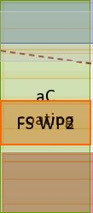
Planning (aC Coating & Flange Impedance Reduction)
Remove Magnets
Coating in-situ
Re-install Magnets

Slide 22
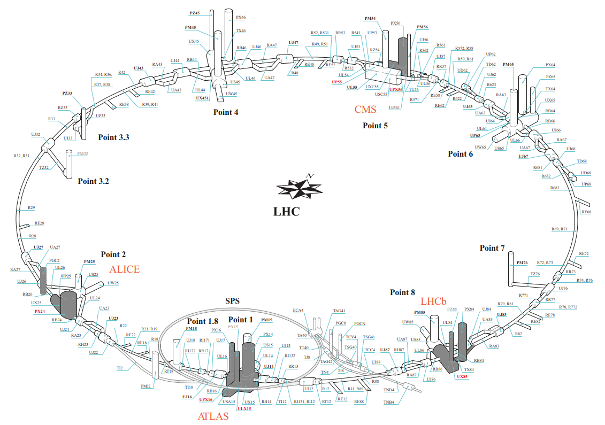
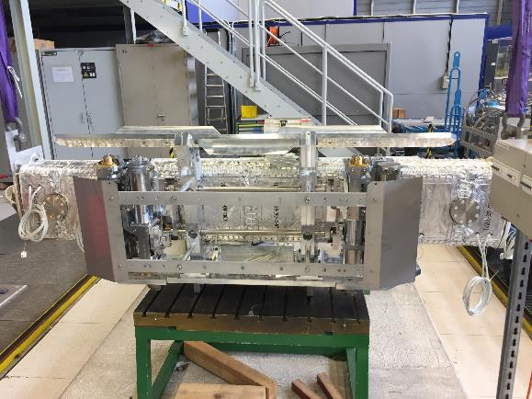
Upgrade of the TCDI Collimators in the SPS to LHC Transfer Lines (TI2/TI8)
ECR 1577759
This LHC injection protection collimator system in the SPS to LHC transfer lines (TI2/TI8) needs upgrading in order to safely bring the LHC into the high luminosity era. The existing TCDI collimators will be removed and replaced with longer collimators, and a limited number of TCDIM masks will also be replaced.
As these collimators are physically located in the LHC ends of TI2 &TI8, the coordination of these works is being followed by the LHC coordination team

Slide 23
Planning (TCDI Collimators)

Slide 24
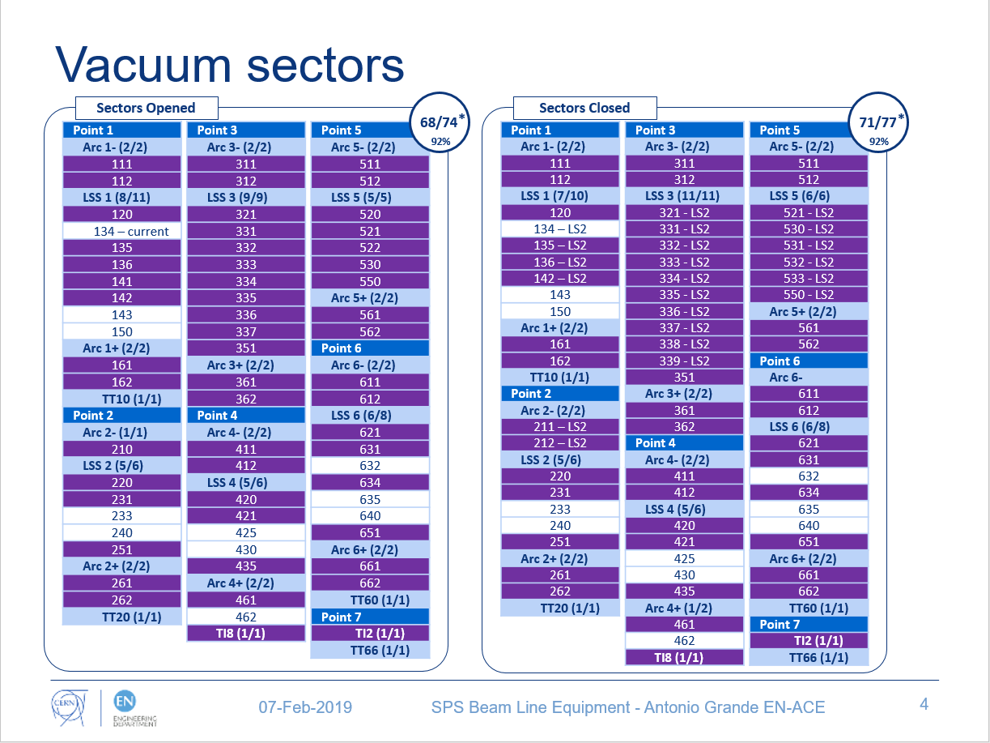
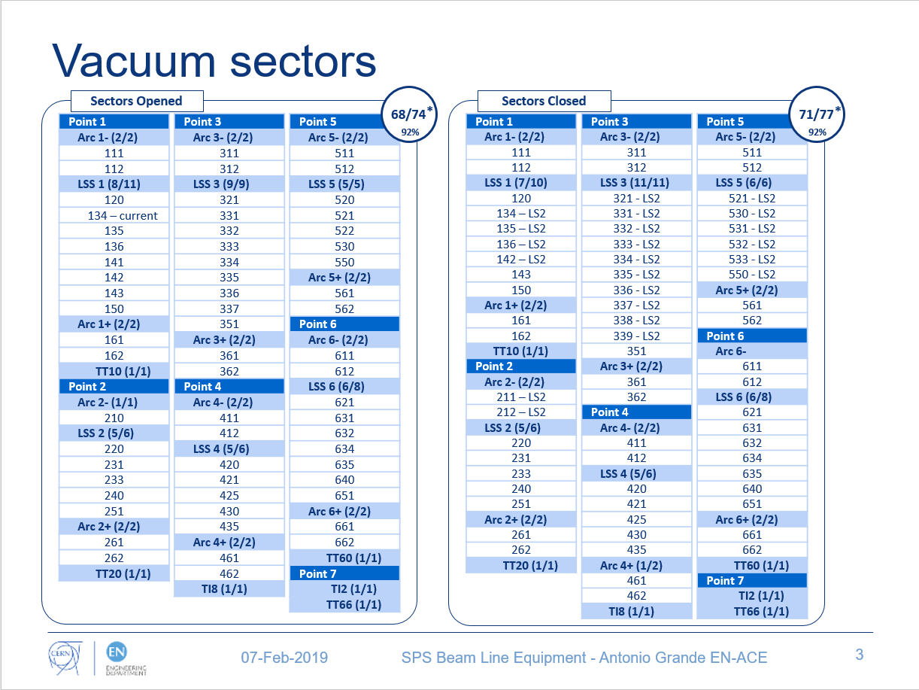
SPS Beam Line Activities
Vacuum sectors
Courtesy of Antonio Grande
Over 90% of the vacuum sectors will be open/closed (68 to 71 vacuum sectors)
3 long straight section will be mostly reconfigured for the LIU
Activities related to LIU will be held in all points of the SPS
  More than 75% of vacuum sectors will be opened due to LIU activities
*Change in total number due to vacuum sector reconfiguration
Total number may change depending of the magnet campaign
In each sector: (sectors opened / total)
In purple, sectors that will be opened to perform LIU activities

Slide 25
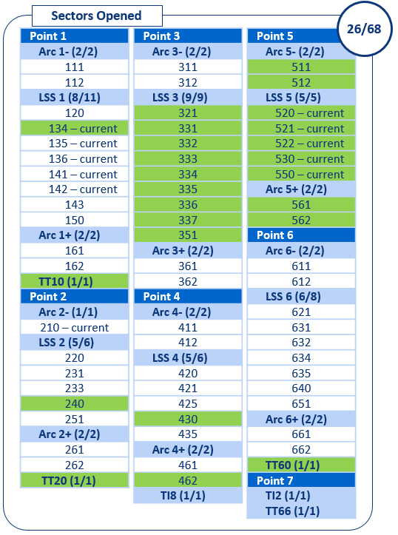
SPS Beam Line Activities
VSC resources levelling
Courtesy of Antonio Grande
In time | Extra* | In advance | Delayed
19/19 | 2 | 5 | 0
19 sectors opened in line with planning
1 extra sector opened for TT10 access
1 extra sector opened for magnet campaign
2 sectors opened before for granting TT20 – TT60 access
2 sectors opened before for Maintenance/OP request
1 sector opened before for COLDEX
Sectors opened during LS2 (week 6):
26 of 68
Week 6

Slide 26
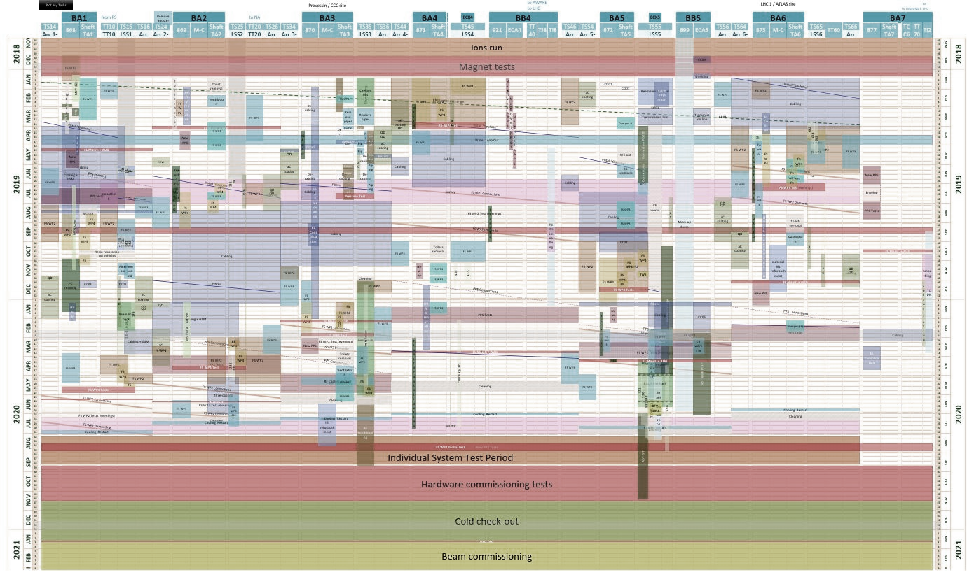
Critical Paths
Any delay in one work area will have a direct affect on the critical path in the other areas

Slide 27
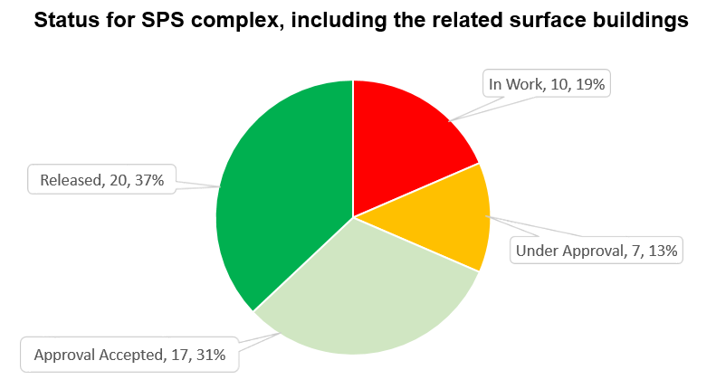
SPS Documentation Status (Engineering Change Request status)
54 ECRs/SRRs for LS2
35 related to the LIU project
10 ECRs “In Work”:
SPS-B-EC-0006: “Dismantling of obsolete SPS equipment for K-modulation during LS2” (BE-BI)
SPS-BLM-EC-0005: “Installation of new BLM system in TT10” (BE-BI)
SPS-SFD-EC-0002 SPS fire safety - Fire partitions during LS2
SPS-U-EC-0001: “SPS Fire Protection: Fire dampers and ventilation related works” (EN-CV)
  Related to the LIU project:
  SPS-BSRTA-EC-0001: “Installation of a BSRT tank in LSS5 of the SPS during LS2” (BE-BI)
  SPS-LJ-EC-0017: “Layout Optimisation for Machine Elements Upstream of QFA.21610 for Mitigation of Beam Impedance” (BE-RF)
  SPS-LO-EC-0002: “Proposal for SPS octupole relocation to restore the lattice symmetry” (BE-ABP)
  SPS-TMASC-EC-0001: “New masks for SPS during LS2” (EN-STI)
  SPS-LJ-EC-0014: “LSS1 vacuum layout after LS2” (TE-VSC)
  SPS-LJ-EC-0015: “LSS5 Vacuum Layout after LS2” (TE-VSC)

Slide 28
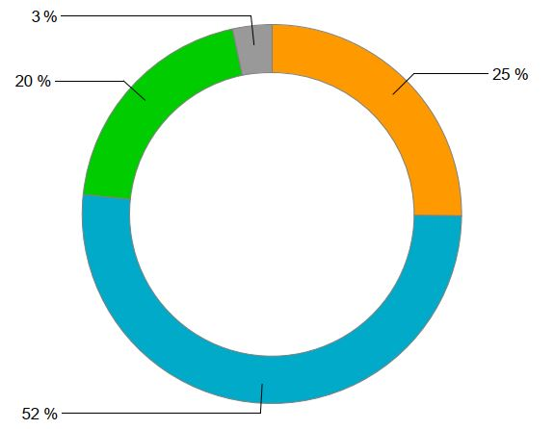
SPS Documentation Status (Integration status)
Total number of registered Integration Studies:
82
Number of LIU related Integration Studies:
29
Number of needed Integration Studies:
0
29
The completion of all the ECR and Integration study processes (Life Cycle) depend on the input and quality of information provided by the design offices in each Group.

Slide 29
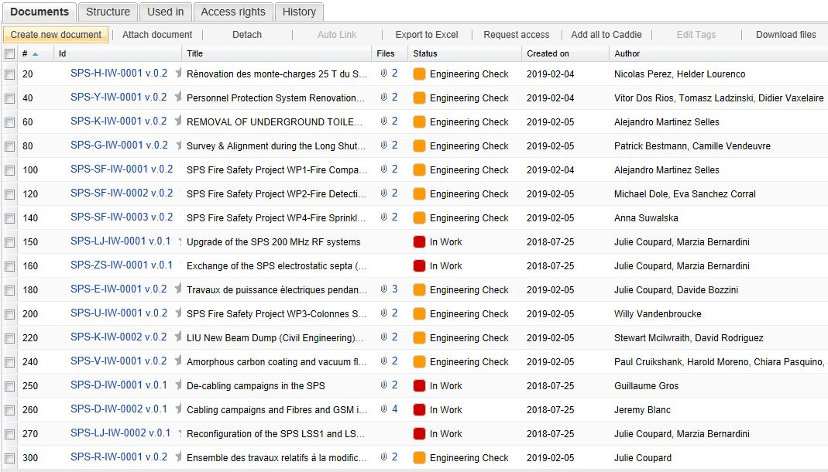
Documentation Status (Work Package Analysis status)
New for the SPS
(5 of which are for LIU works)
17 WPAs
Dedicated Procedures
Mise hors tension partielle du SPS lors des YETS, EYETS et LS https://edms.cern.ch/document/2058234/0.1
Under Approval
Demande de « SEPARATION DU RESEAU » par le Facility coordinator https://edms.cern.ch/document/2049809/1 Released
De-cabling – SPS5 lock-out procedure for De-Cabling during LS2 https://edms.cern.ch/document/1983418/1.0 Released
De-cabling – SPS3 lock-out procedure for De-Cabling during LS2 https://edms.cern.ch/document/1991126/1.0 Released
De-cabling – Identification, labelling and disconnection procedure for obsolete cables SPS1 and SPS3 during LS2 https://edms.cern.ch/document/2052872/1.0 Released
LIU related

Slide 30
Summary
19.5 months of access into the SPS during LS2.
  Open date: 14th January 2019.
  Closure date: 18th September 2020.
The LS2 is now in progress and we are currently on schedule.
Additional projects have been taken into account when organizing the LIU planning.
  Fire Safety project
  New PPS
  De-cabling / Cabling campaigns
Co-activities cannot be avoided and are identified (multiple project activities).
  These are being addressed (dedicated meeting, on-site visits, VICs etc.).
  Mitigations are proposed and are being validated (ex. Shifts in BA3).
Transport and Logistics to be carefully defined and are being followed-up on site.
  We have already faced our first difficulties, but support from LS2 space management and very good reactivity of RP and EN-HE to unblock situation.
We must keep a close eye on the critical path.

Slide 31
Thank you Q’s

Slide 32
Back up slides

Slide 33
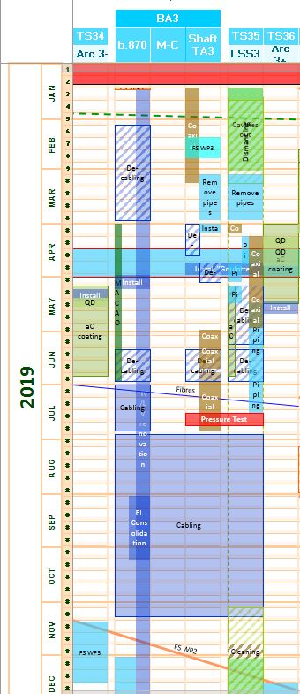
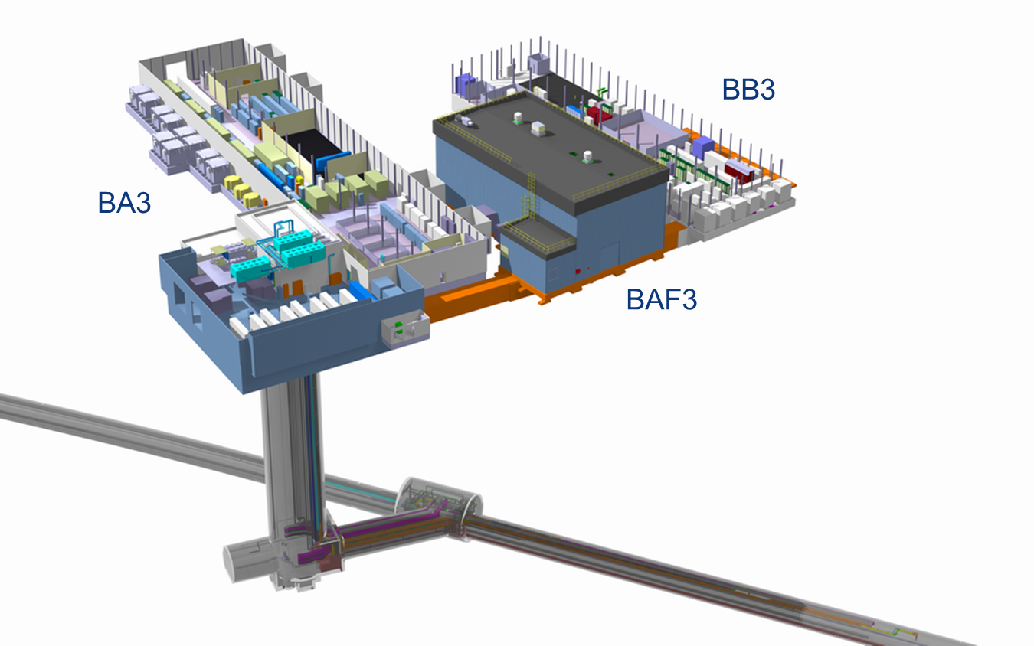
RF upgrade in SPS 3 during LS2 (2019)
RF upgrade works Surface/BA3/BAE3 → Jan’19-Feb’20
De-cabling campaign surface → Jan-March & June’19
De-cabling campaign shaft/TA → April & June’19
Install RF coaxial lines shaft → Jan-Feb’19
Install new ventilation dampers shaft → Feb’19
Remove redundant CV pipework in shaft → Feb’19
Install RF coaxial lines TA → June-July’19
Install Fibre-optic ducts Shaft/TA → July’19
Cabling campaign shaft/TA→ July-Nov’19
FS_WP2 & 4 Shaft/TA → Nov-Jan’20
SURFACE &
SHAFT/TA35
LSS3
Disconnection/removal of the Cavities & beam line→ Jan-Feb’19
Remove redundant CV pipework in LSS3 → March’19
Install RF coaxial → April-May’19
CV works for new RF Cavities → April-July’19
De-cabling campaign → May-June’19
Cabling Campaign → Aug-Nov’19
FS-WP2 LSS3- then LSS3+→ Nov-Dec’19
Cleaning of LSS3 → Nov’19
Install new cavities & beamline→ Dec’19-May’20
PA3
LSS3
TA3
During May, June & July work teams will be split into Shifts to avoid co-activity in the same area
33

Slide 34
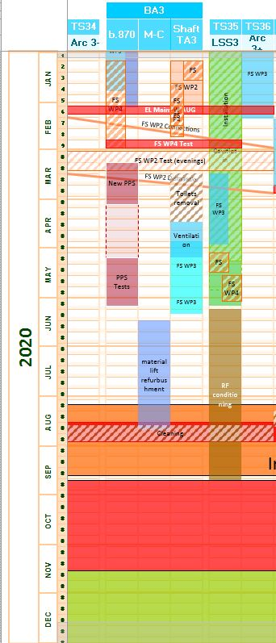
RF upgrade in SPS 3 during LS2 (2020)
RF upgrade works Surface/BA3/BAE3 → Jan’19-Feb’20
FS_WP2 & 4 Shaft/TA → Nov-Feb’20
EL Maintenance and AUG test→ Beginning of Feb’20
Testing of FS_WP2 & 4→ Feb’20 (Outside working hours)
Dismantling old fire detection system→ March’20
New PPS access system → March -May’20
Monte-Charge refurbishment→ June-Aug’20
SURFACE &
SHAFT/TA35
LSS3
Install new cavities & beamline→ Dec’19-May’20
Testing of FS_WP2 & 4→ Feb’20 (Outside working hours)
FS_WP3 Dry risers → March-April’20
IST RF Conditioning → June-Sept’20
The location of Sprinklers in the LSS3 have not yet been identified by integration!

Slide 35
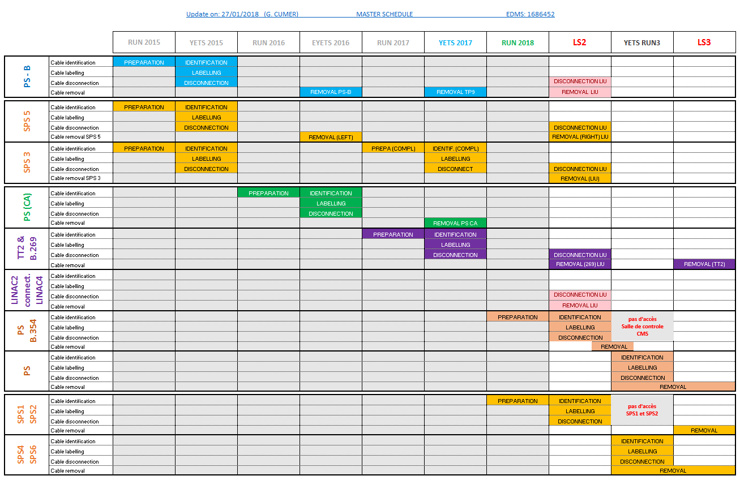
De-cabling project
As presented in the LS2C #23 – 27th July 2018

Slide 36
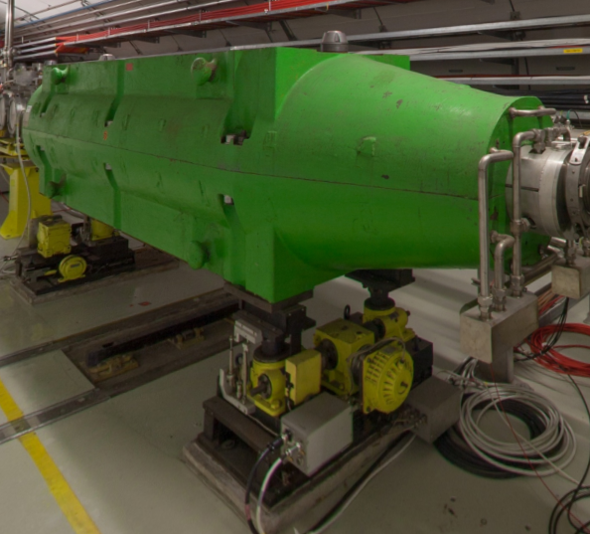
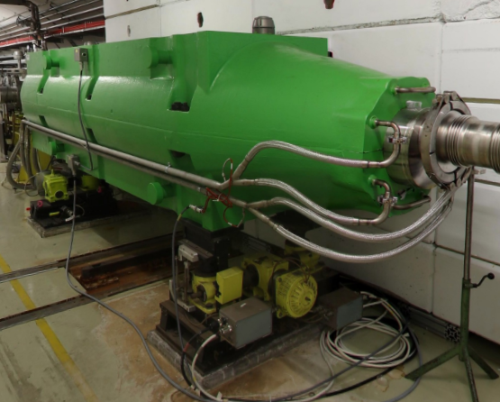
LIU Beam dump activities during LS2 (Point 1 & Point 5)
ECR XXXXXXX
Scope of the project
Move the SPS Beam Dumping System from SPS1 to SPS5 (ECX5)
New Beam dump
TIDH &
TIDVG
End of life

Slide 37
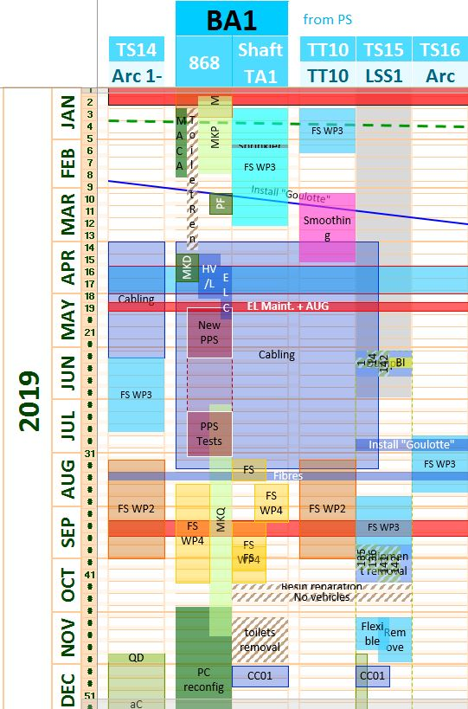
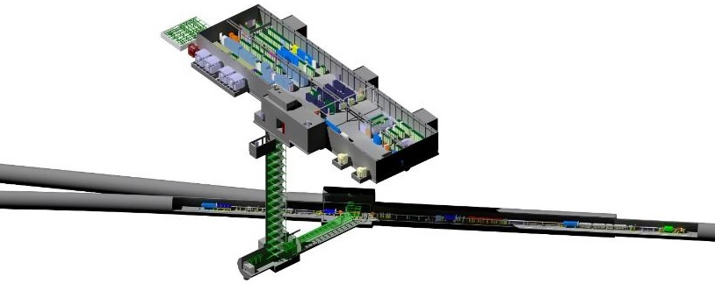
SPS 1: Main works during 2019
LSS1
  Removal of the dumps
  Removal of the beam line
  Cabling campaigns
BA1/Shaft/TA
  ABT racks reconfiguration
  PPS upgrade
All underground areas
  Fire safety WP3
Arc 1+/ Arc 1-
  aC coating

Slide 38
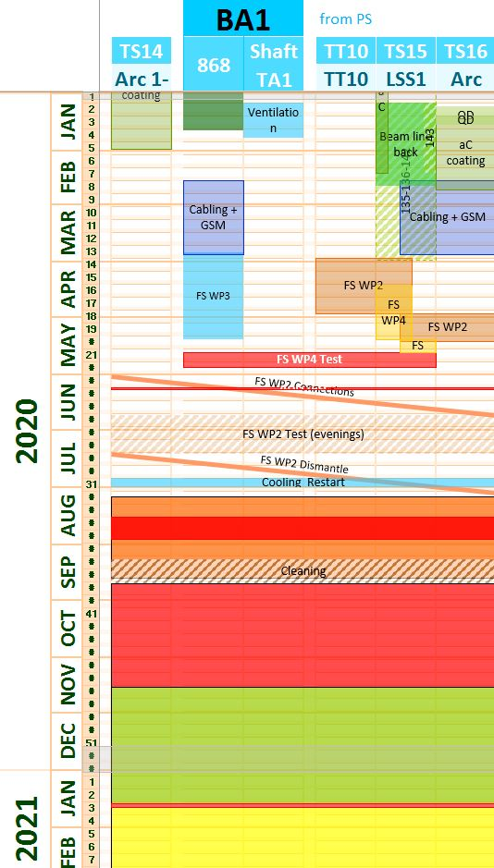
SPS 1: Main works during 2020
LSS1
  Re-installation of the beam line
  Fire safety WP4
  EN-EL cabling (High radiation areas)
BA1
  Fire safety WP3
Shaft/ TA/ LSS1
  Fire safety WP2

Slide 39
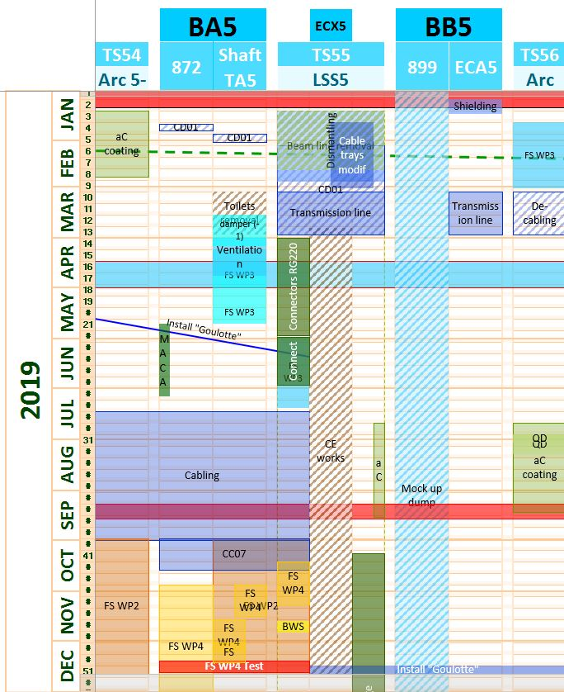
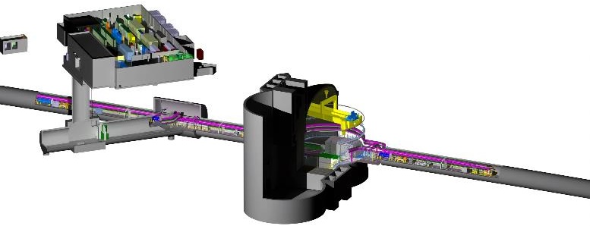
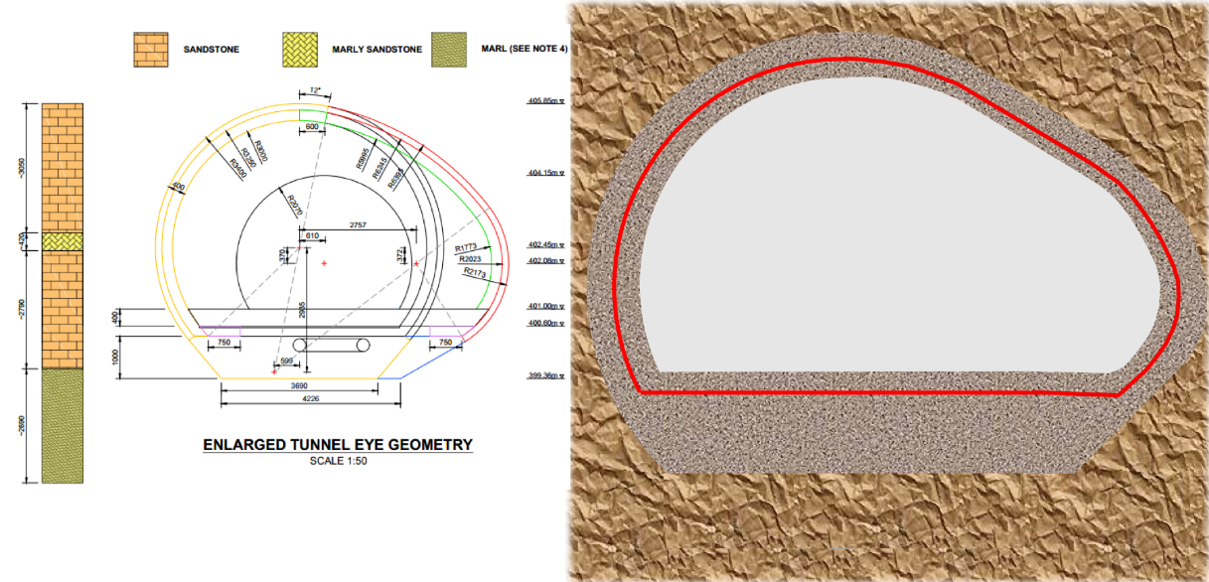
SPS 5: Main works during 2019
All underground areas
  Fire safety WP2 + WP3 (ECX5 in 2020)
  EN-EL cabling/de-cabling
  Kickers transmission line
Surface (BB5)
  Mock up of new beam dump
LSS5/ECX5
  Removal of the beam line
  Civil engineering for SBDS
No access in ECX5/ECA5 from 01/04/19 until 20/12/19!

Slide 40
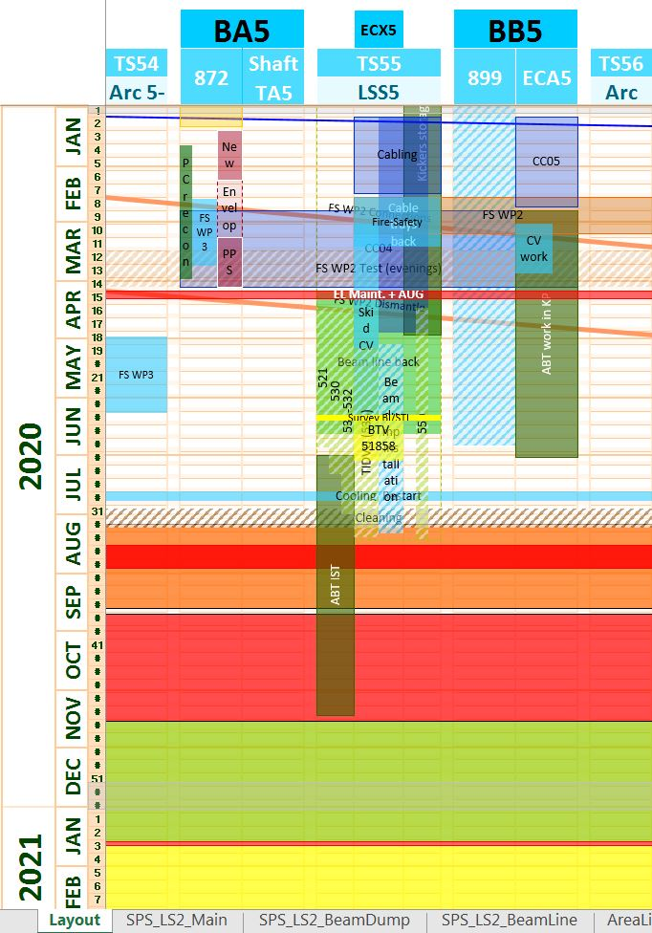
SPS 5: Main works during 2020
LSS5/ECX5
  Re-installation of the beam line
  SBDS cabling campaign 04
  Dump installation
  Cooling skid
ECA5
  Works in Kickers platform (El + ABT + CV)
Surface (BA5/BB5)
  Fire safety WP3 (+ECX5)
  PPS upgrade
Courtesy S.Mehanneche

Slide 41
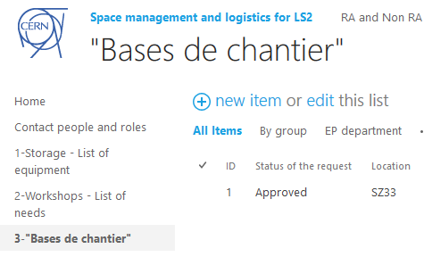
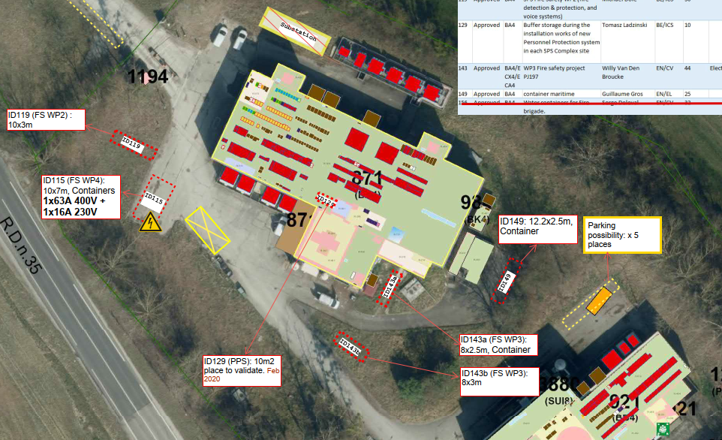
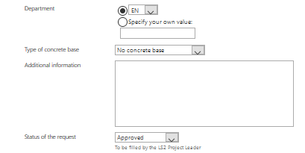
On-site storage strategy – “Bases de chantier”
As presented in the LS2C #22 – 22nd June 2018
1) Storage request via Sharepoint
3) Space attribution on-site (see EDMS 1989344)
2) Analysis + approval process

Slide 42
Fire Safety Project (BE-ICS / EN-CV / SMB-SE)
As presented in the LS2C #22 – 22nd June 2018
The implementation consists of a combination of four WPs
  WP1: Comprehensive active and passive fire compartment scheme with ventilation isolation
  WP2: Automatic fire detection and protection system
  WP3: Significantly enhanced manual fire fighting means with dry risers and Compressed Air Foam System trailers
  WP4: Modern water based automatic fire sprinkler protection system in access shafts, access galleries and long straight sections
The safety outcome depends on the integration of the four work packages acting as a whole.
The full period of SPS underground access during LS2 will be needed and used for the required works affecting all points of the SPS.

Slide 43
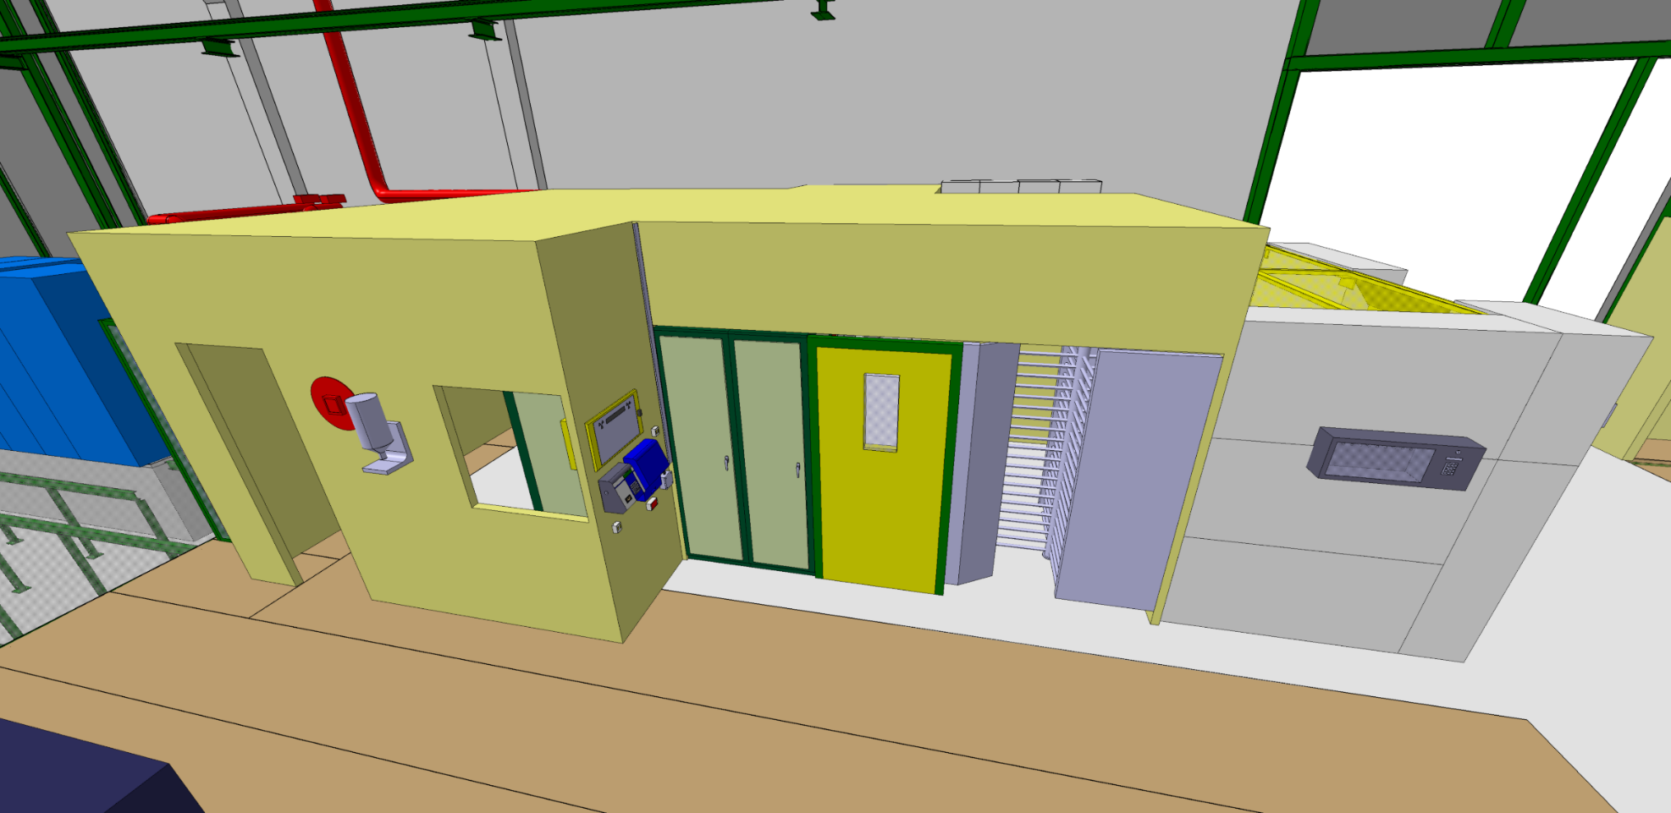
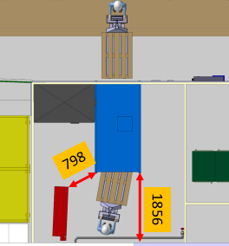
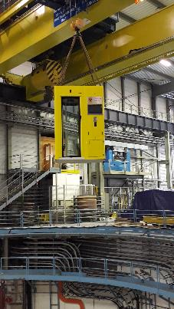
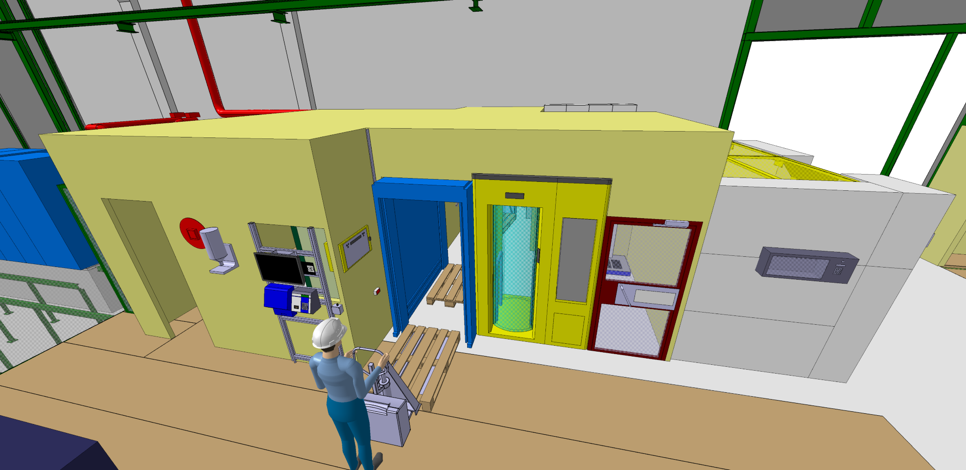
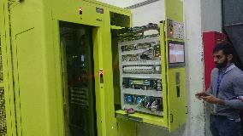
New access system (BE-ICS)
Renovation to cope with:
  Technical Obsolescence
  Commitments to Nuclear Regulatory Body
  Increase safety of the personnel
Complete refurbishing of the SPS Access System
Pilot access point installation in BB5 completed
LS2 Installation of 15 access zones and CCC tools
2018
LS2

Slide 44
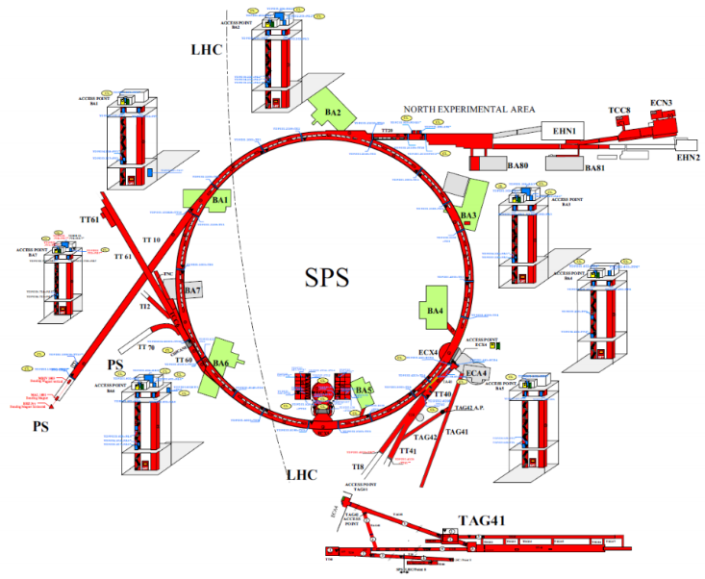
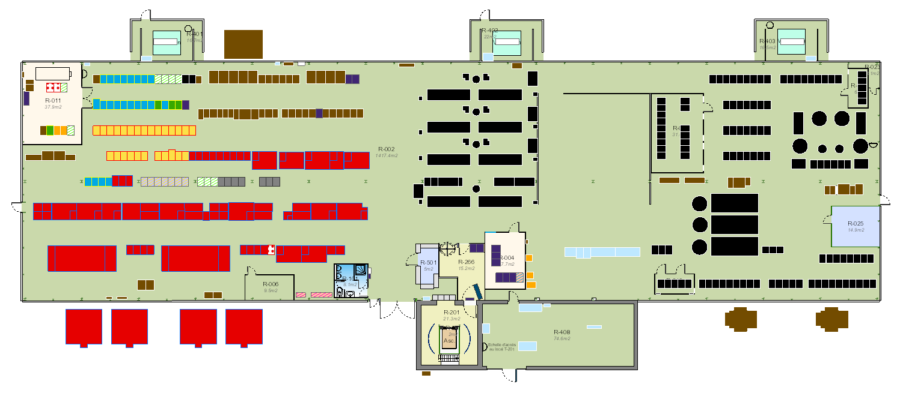
Surface activities (BA1)
BA1
2019
Legend:
SPS Fire Safety WP2 Fire detection Systems
SPS Fire Safety WP4 Sprinklers
SPS Fire Safety WP1 Fire Doors
SPS Fire Safety WP3 Dry Riser
SPS New Personnel Protection System
MACAO Power Converter for the SPS Ring and Transfer Lines Dipole
Consolidation Project
Distributed Optical Fibre Radiation Temperature Sensing in the SPS ring and TT20
Power converter modifications in building BA1/BA5 required by LIU-SPS
BA1 reconfiguration after relocation of SPS Beam Dumping System to LSS5
Consolidation of the SPS Tune Kickers during LS2
BLM Installation
Toilet refurbishment
Cabling Campaign
2020
2021

Slide 45
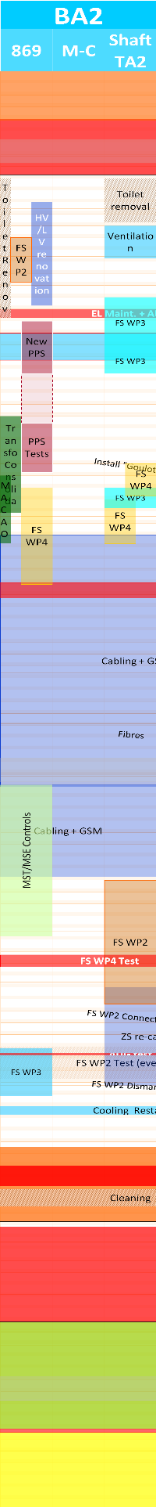
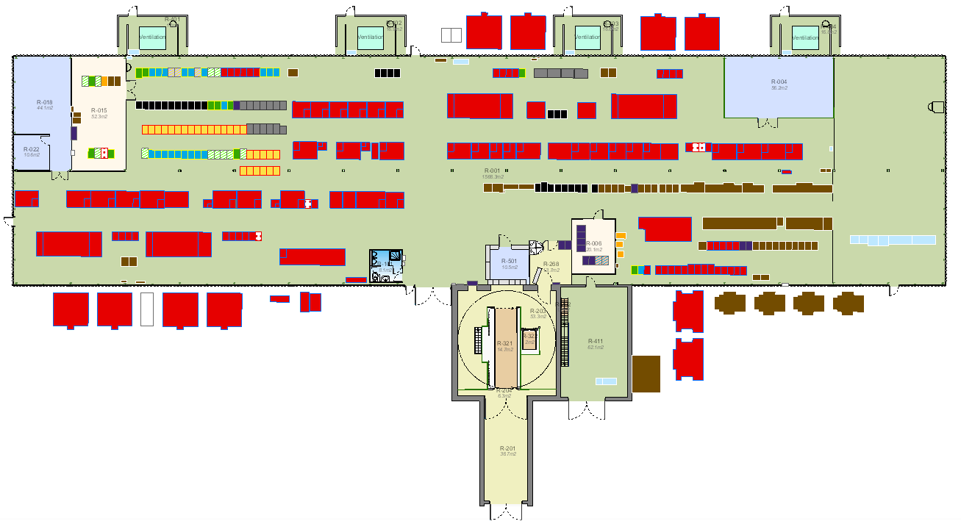
Surface activities (BA2)
BA2
2019
Legend:
SPS Fire Safety WP2 & WP4
SPS Fire Safety WP1
SPS Fire Safety WP3 Dry Riser
SPS New Personnel Protection System
MACAO Power Converter for the SPS Ring and Transfer Lines Dipole
Consolidation Project
Distributed Optical Fibre Radiation Temperature Sensing in the SPS ring and TT20
Toilet refurbishment
Cabling Campaign
2020
2021

Slide 46

Surface activities (BA3)
BA3
2019
Legend:
SPS Fire Safety WP2 & WP4
SPS Fire Safety WP1
SPS Fire Safety WP3 Dry Riser
SPS New Personnel Protection System
MACAO Power Converter for the SPS Ring and Transfer Lines Dipole
Consolidation Project
Distributed Optical Fibre Radiation Temperature Sensing in the SPS ring and TT20
De-cabling / Cabling Campaign
2020
2021

Slide 47

Surface activities (BA4)
BA4
2019
Legend:
SPS Fire Safety WP2 & WP4
SPS Fire Safety WP1
SPS Fire Safety WP3 Dry Riser
SPS New Personnel Protection System
MACAO Power Converter for the SPS Ring and Transfer Lines Dipole
Consolidation Project
Distributed Optical Fibre Radiation Temperature Sensing in the SPS ring and TT20
Legend:
SPS Fire Safety WP2 & WP4
SPS Fire Safety WP1
SPS Fire Safety WP3 Dry Riser
SPS New Personnel Protection System
MACAO Power Converter for the SPS Ring and Transfer Lines Dipole
Consolidation Project
Distributed Optical Fibre Radiation Temperature Sensing in the SPS ring and TT20
Cabling Campaign
2020
2021

Slide 48


Surface activities (BA5)
BA5
2019
Legend:
SPS Fire Safety WP2 & WP4
SPS Fire Safety WP1
SPS Fire Safety WP3 Dry Riser
SPS New Personnel Protection System
MACAO Power Converter for the SPS Ring and Transfer Lines Dipole
Distributed Optical Fibre Radiation Temperature Sensing in the SPS ring and TT20
Power converter modifications in building BA1/BA5 required by LIU-SPS
De-Cabling / Cabling Campaign
2020
2021

Slide 49


Surface activities (BA6)
BA6
2019
Legend:
SPS Fire Safety WP2 & WP4
SPS Fire Safety WP1
SPS Fire Safety WP3 Dry Riser
SPS New Personnel Protection System
MACAO Power Converter for the SPS Ring and Transfer Lines Dipole
Distributed Optical Fibre Radiation Temperature Sensing in the SPS ring and TT20
Consolidation Project
Cabling Campaign
2020
2021

