Slide 2
LHC Injectors Upgrade Workshop
Montreux, 13-15 February 2019

Slide 3
Readiness of RF equipment across the injector complex
Andy Butterworth BE/RF
M.E. Angoletta, P. Baudrenghien, J. Betz, B. Bielawski, R. Borner, H. Damerau, F. Gerigk, G. Hagmann, W. Hofle, G. Kotzian, K. Li, J. Molendijk, E. Montesinos, G. Papotti, M. Paoluzzi, S. Ramberger, A. Rey, C. Rossi, E. Shaposhnikova, H. Timko, D. Valuch, C. Vollinger, R. Wegner

Slide 4
Outline
Summary and timelines for LS2 upgrades
  RF LINAC4, PSB, PS
  RF LINAC3 and LEIR
  Transverse feedbacks
Settings management and software tools
  LINAC4, PS
  SPS LLRF software integration
Conclusions

Slide 5
LINAC4 HLRF
Buncher & debuncher amplifiers renovation
  1 out of 5 racks broke in 2018, cannot handle RF drive when not powered
  Change for more robust transistors, change bias point
Klystrons
  Modifications of all klystrons’ filament supply
  Optimisation for 600 µs long beam pulses and for output power (HV, mod anode)
  Decision taken not to exchange LEP klystrons against new klystrons for 2019 LBE Run
    Long term replacement strategy: replacement of CCDTL 1-2, CCDTL 3-4 and later DTL 1, CCDTL 7
    RFQ can stay equipped with LEP klystrons (< 1.0 MW).
  Klystron spares stock:
    3 MW klystrons: 4 (2018), planned 7 by 2022 (4 will be used for replacements)
    LEP klystrons: 6 (4x 1.1 MW, 2x 1.3 MW, measured in test stand)
Chopper drive unit
  Resolve plate monitoring problems and timing issues
  FPGA firmware, FESA class and Inspector panel to be updated before low energy run (March 2019)
  Chopper is a safety system with interlocks: will ask some work
  → Possible manpower conflicts with LIU-SPS

Slide 6
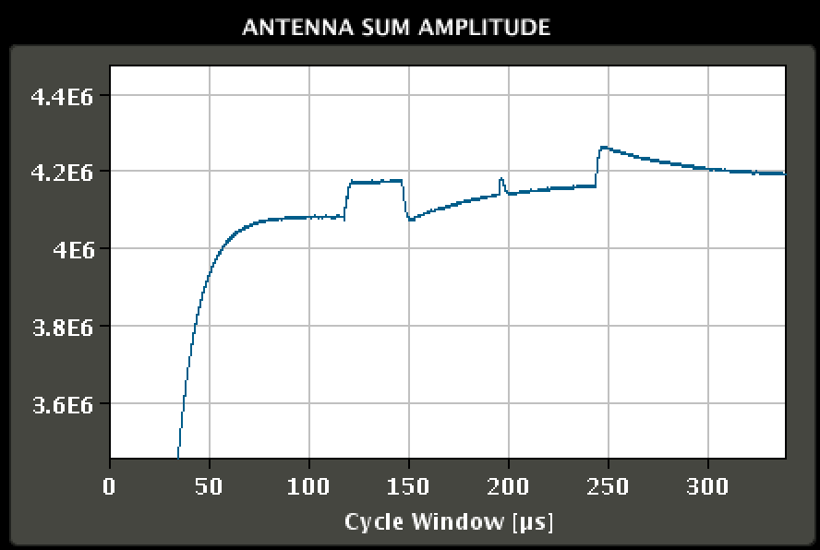
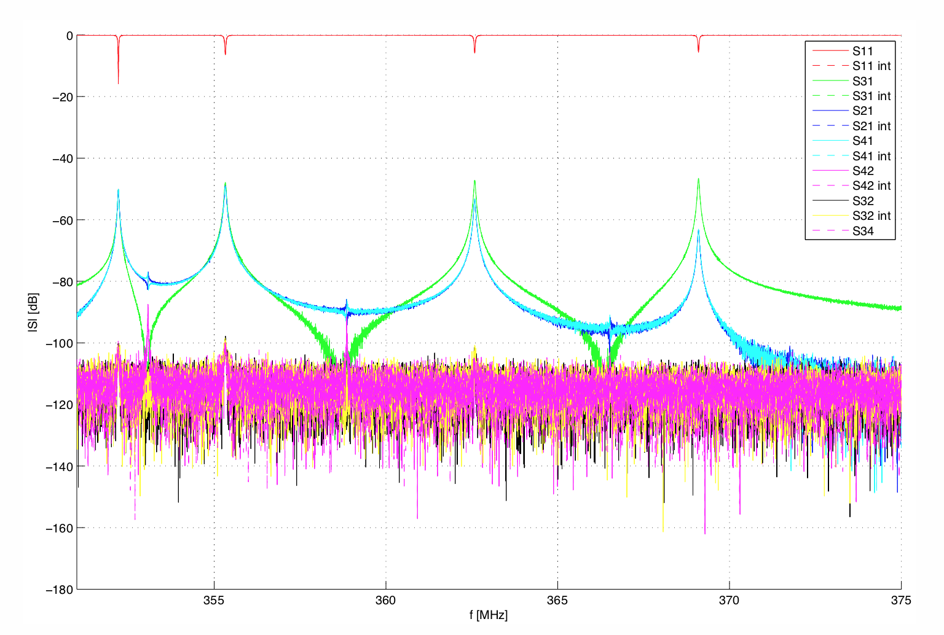
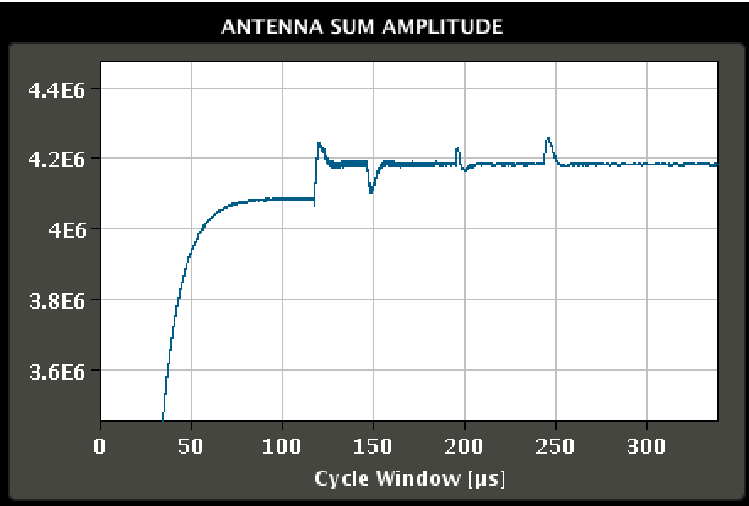
LINAC4 LLRF: What’s left to be done?
Cavity feedback
  Deploy the Linear Quadratic Gaussian Regulator (LQG) on all cavities
  Digital Notch Filter on the first non-accelerating mode
PIMS: accelerating mode 7/7 PI at 352.2 MHz.
Strong parasitic 5/7 PI at 355.7 MHz.
Damped by inserting a digital notch at 3.5 MHz after demodulation/sampling.
Frequency tuned to the mode of each cavity (all L4 cavities are different).
Beam Loading PIMS11/12 PI Controller
Outside the few µs at batch head the regulation is an order of magnitude better than the 1% specification
Beam Loading PIMS11/12 LQG Regulator (Kalman)

Slide 7
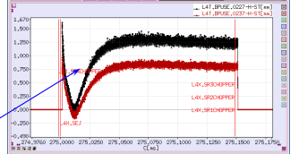
LINAC4 LLRF: What’s left to be done?
Adaptive FeedForward
  Uncompensated beam loading in the first few µs of beam pulse is about 0.1 MV
    ~2.5% compared with specification 1%
  Implement Adaptive FeedForward (pulse to pulse) for beam loading compensation at head of beam pulse
    Works only in the regions along the RF pulse where we see beam loading transients
    Will need ring start timing information
    Full PPM implementation as it is reliant on repeatable beam pulses.
Klystron Polar loop
  Keep RF amplitude and phase from klystron stable.
  Important with the increased RF pulse length
Beam energy and position in the transfer line varies over the first ~10 µs due to the beamloading transients

Slide 8
LINAC4 LLRF: What’s left to be done?
Longitudinal painting
  PIMS11-12 and Debuncher need to be driven by functions
    SPS function generator code being integrated into the Linac4 firmware
    FESA class under development
  Lab testing in the Linac4 CavityLoops firmware by end Q1 2019 (without FESA)
  Available for machine testing during the 2019 run (specs for data generation already available)
  Application SW: control chopper + PIMS + debuncher together (BE/OP)

Slide 9
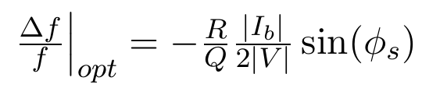
LINAC4 LLRF: Debuncher commissioning
Debuncher Cavity Loop
  Same PIMS cavity as in the accelerating part
  Demanded voltage is 10 times lower 0.4-0.7 MV compared to 4 MV
  So beam induced voltage relatively 10 times bigger
  Spec (1% voltage/1° phase) will likely not be reachable
Tuner
  Optimal tuning depends on the demanded voltage
  Want different voltage for different beams (painting or not)
  Do NOT want the tuner to move in PPM mode, between successive cycles
  → Tune will not be optimal for all cycles
First time we can commission Debuncher is in LBE run
  Optimization is likely to be difficult
  All HW is installed → will require commissioning time

Slide 10
LINAC4 software and settings management
Many expert LLRF settings not managed by LSA
  Stored only in FESA persistence
  OP need to follow procedure to acquire settings before PPM copy (script)
  Function generation for painting will require more sophisticated use of LSA
  RF working with OP to define future strategy
Cavity phase “lost references”
  Phase measurements were acquired in the cavity loops VME module
    Became invalid after each change of loops HW or firmware
  Now acquired in Tuner module to avoid this problem
  FESA class feature added for phase measurement logging in Timber

Slide 11
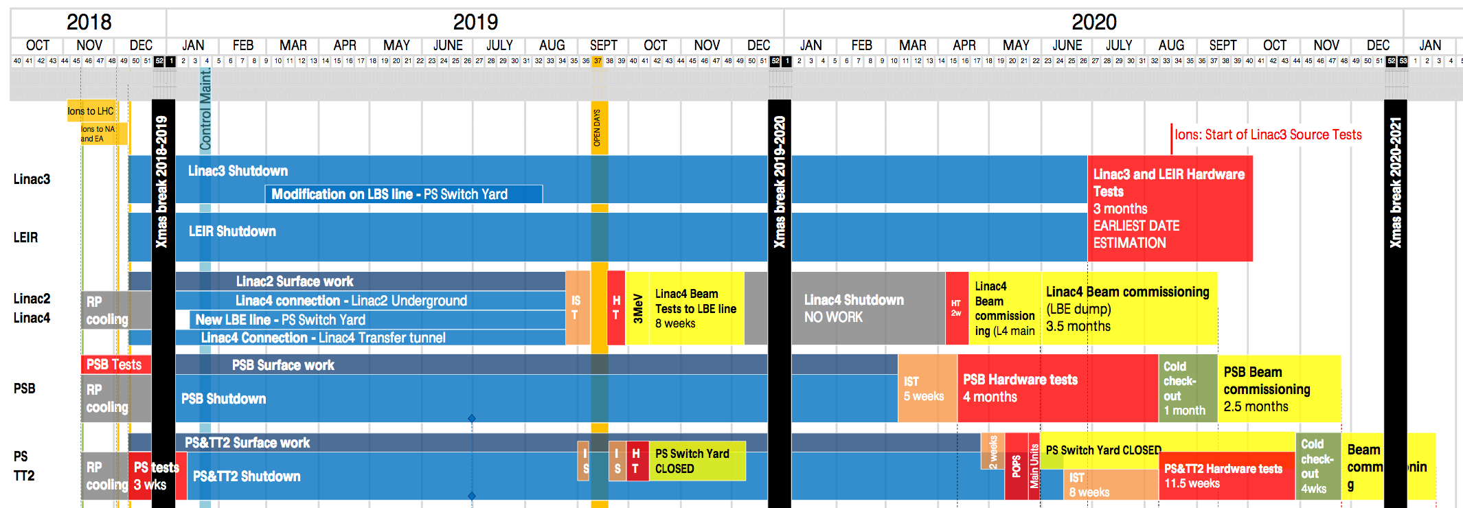
LINAC4 summary and milestones
March 2019:
  Chopper drive unit upgrade deployed
  Buncher & debuncher amplifiers renovated
  Klystron filament modifications complete
April 2019:
  Functions for PIMS/debuncher tested
September 2019:
  LQG/Kalman regulation deployed on all cavities
  Functions for PIMS/debuncher commissioning
  Commissioning of Adaptive FeedForward
December 2019:
  LQG/Kalman cavity loops commissioned
  LLRF functionality for longitudinal painting commissioned
April 2020:
  LLRF ready for beam commissioning
Lot of work left to set everything up, but no show stoppers and no single points of failure

Slide 12
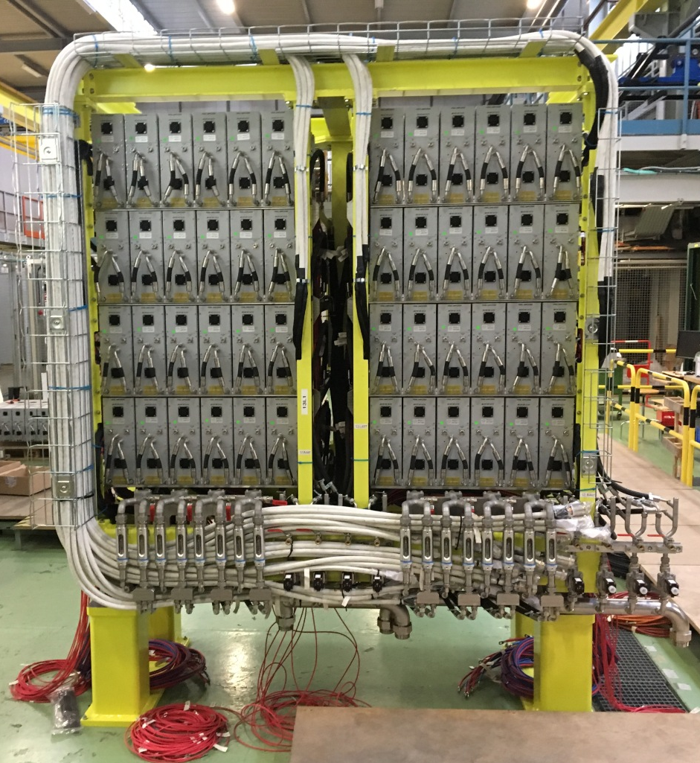
PSB Finemet RF system
All 6-cell cavities have been pre-tested and characterized in the test place by measuring :
  Single cell transfer function, nominal voltage, beam impedance
  Full cavity transfer function, nominal voltage
  Reliability and thermal properties with >60 hours, continuous operation at:
    Single frequency, 1 – 5 MHz, nominal voltage
    Multi-harmonic, fundamental, h2 and h9, nominal voltage
  The same test sequence, applied to the 12 gap assemblies, is foreseen for the system commissioning

Slide 13
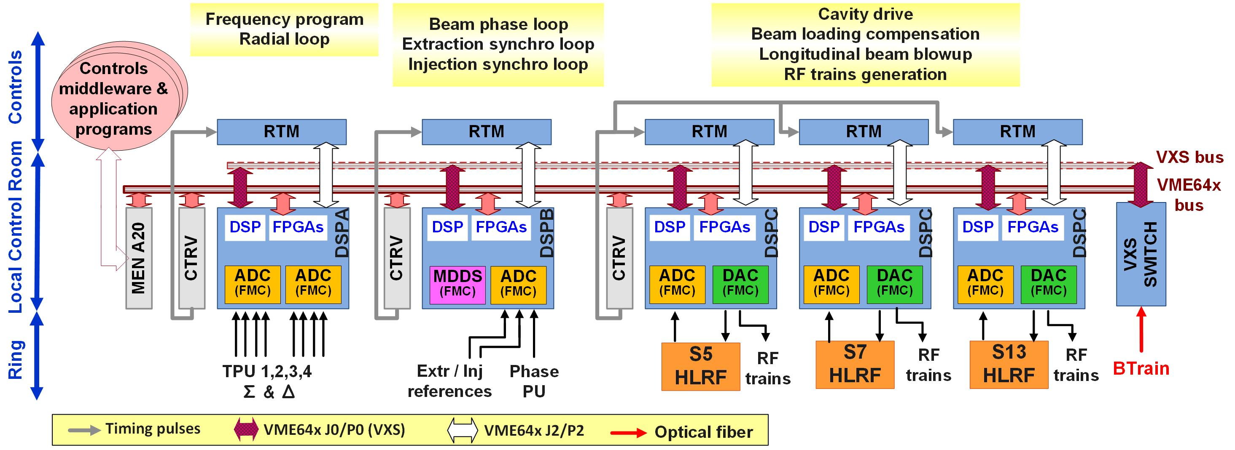
PSB LLRF new features for post-LS2 operation
Post-LS2 LLRF: 5 collaborating boards instead of 3 (pre-LS2 standard PSB LLRF) controlling the 3 Finemet cavities in a PSB Ring.

Slide 14
PSB LLRF new features for post-LS2 operation
One LLRF system per ring controlling the three HLRF Finemet-based systems in that ring
  “Distributed cavity” concept: voltage at a harmonic can be split over several cavities in the same ring (not possible with ferrite-based cavities)
Servoloops @16 harmonics for voltage/phase control or beam loading compensation
  Operational harmonics controlled (voltage/phase): h=1, 2, 3, x (x = high h for blowup)
  Potential MD option (phase 2): 3 additional harmonics with voltage/phase control
Longitudinal blowup: same methods as before LS2 (C16-style, phase noise) and new ones
Move to fixed sampling frequency implementation
  Currently RF-synchronous sampling
  Already deployed in ELENA & LEIR

Slide 15
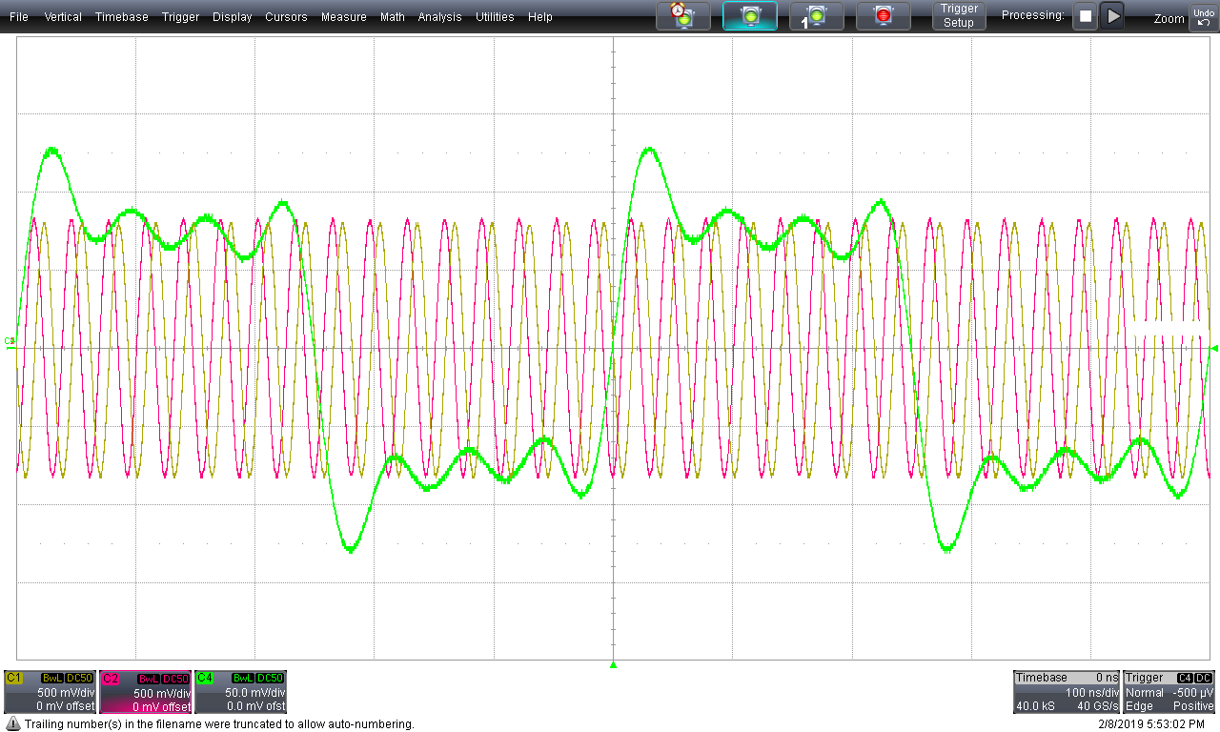
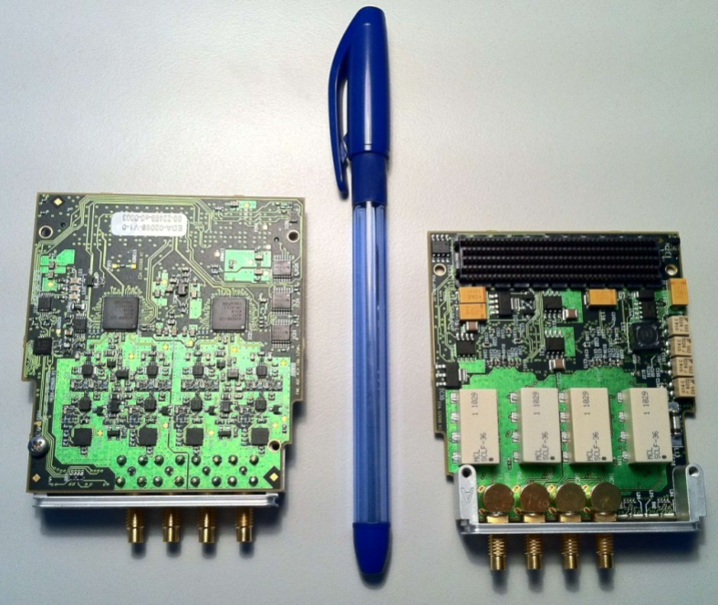
PSB LLRF: What’s left to be done?
Install LLRF test stand with 6-cells Finemet cavity in HLRF lab
  Phase 1: validate LLRF implementation of multi-harmonic feedback
    16 servoloops/cavity with HLRF
    Python scripts for HW testing
  Phase 2: provide Finemet testing capabilities for HLRF team
  Test stand will remain for future developments
Production of remaining hardware
  Test prototype Master DDS FMC modules
  Launch series production of ADC and MDDS FMCs
  Critical path for manpower!
Compatibility of Transverse Feedback with new LLRF
  TFB uses RF-synchronous clock, LLRF will use fixed frequency
  Decision taken not to modify TFB
  LLRF will provide RF synchronous clocks to provide compatibility with TFB (harmonic 64)
V_{cav} h1+3+5+7
h16 I, Q

Slide 16
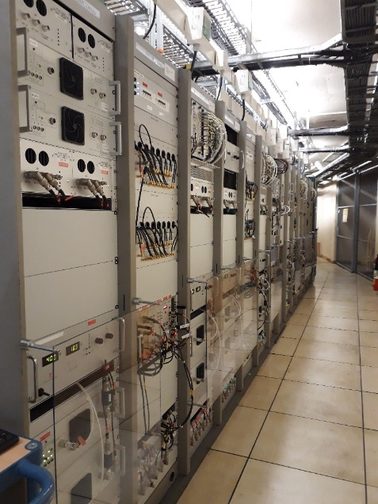
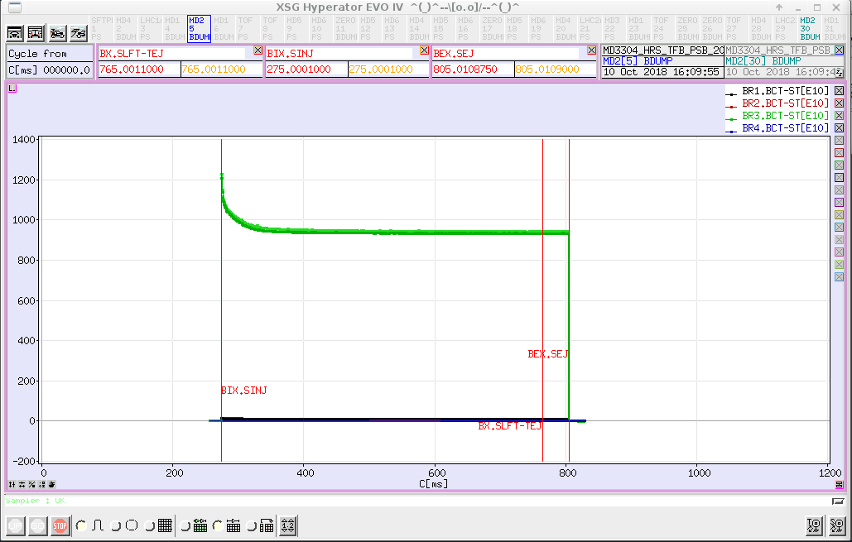
PSB transverse damper
2018 installation progress
  16 new 800 W power amplifiers + 4 W driver amplifiers installed/commissioned
  4 VME chassis (LHC-style) installed
  8 new digital signal processing cards installed in all rings and planes
  New FESA class for VME hardware
Commissioning of new damper in parallel with existing analog system in operation
  Horizontal damper essential to stabilize high intensity beams against transverse instabilities
Have 3 weeks of running experience with new digital LL
  Running on copies of operational beams
  ABP will do simulations for H- injection
  ISOLDE beam accelerated up to 950E10 ppb with the new TFB.

Slide 17
PSB summary and milestones
April 2019:
  LLRF test stand with 6-cells Finemet installed in HLRF lab
July 2019:
  HLRF cabling complete
August 2019:
  Finemet installation complete
September 2019:
  HLRF equipment installed in racks
November 2019:
  Start RF powering tests
December 2019:
  HLRF ready for cavity commissioning
January 2020:
  All LLRF HW (operational + spares) produced and validated
March 2020:
  LLRF HW cabled, firmware and software installed
April 2020:
  LLRF ready for hardware commissioning with HLRF
August 2020:
  RF ready for beam commissioning

Slide 18
PS HLRF
10MHz upgraded feedback amplifier
  Upgrade of existing amplifiers: fast feedback upgrade
40/80MHz feedback upgrade
  All cavities upgraded with fast air feedback lines
  Test of new summing amplifier prototype (to be confirmed)
80MHz fast tuner
  1 prototype fast tuner to be built and installed on one cavity during LS2 (to be confirmed)
Longitudinal feedback
  Install the final version of the amplifiers and docking base (plug-in system)
  Install motorised radiation screening doors to speed up interventions
HLRF controls
  10MHz: New PLCs replace interlocks and G64 crates
  40/80/200MHz upgrades and standardization

Slide 19
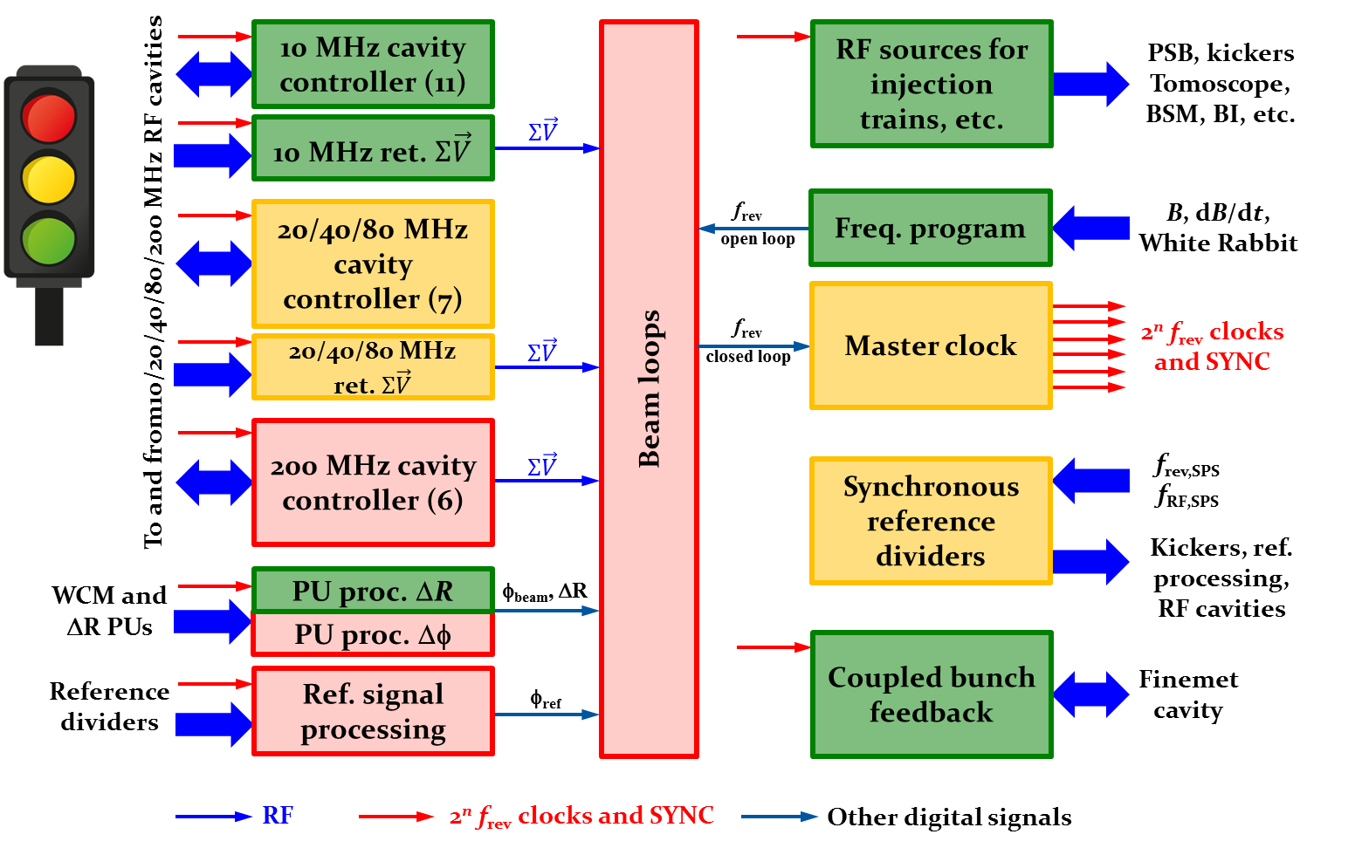
PS LLRF
LLRF items validated as prototypes with beam
  Master clock generation
  40 MHz and 80 MHz cavity controller
  Radial position offset detection
Ongoing developments
  20 MHz, 40 MHz and 80 MHz cavity controller
  Synchronous fractional divider: based on AWAKE HW
  Voltage control loop surveillance
Remaining parts
  Beam loops: most likely based on PSB VXS motherboard
  200MHz cavity controller: based on
  mTCA cavity controller from new SPS 200MHz

Slide 20
PS LLRF
Modular system
  For every subsystem replaced we the present system is kept as backup (as far as possible)
Flexibility
  Evolving away from “1 HW system per beam type”
  Successful proof-of-principle to use flexible LHC beam control for other beams

Slide 21
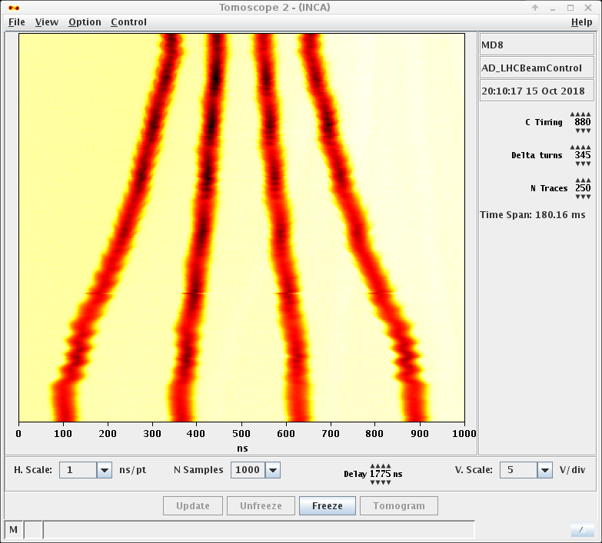
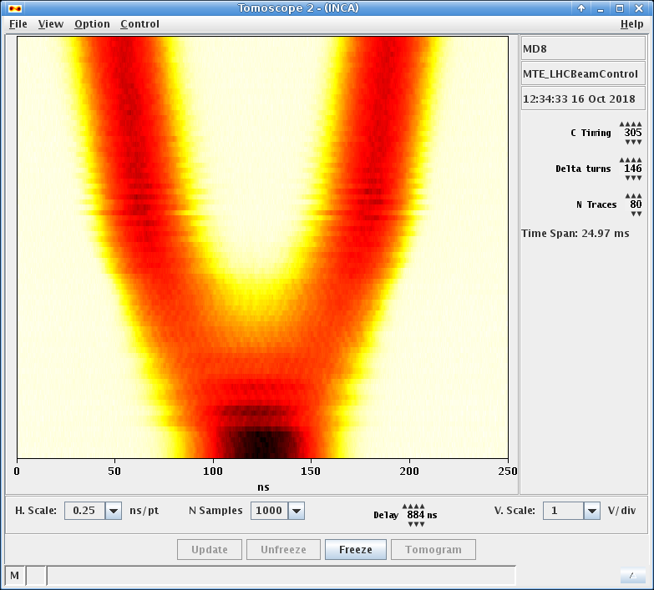
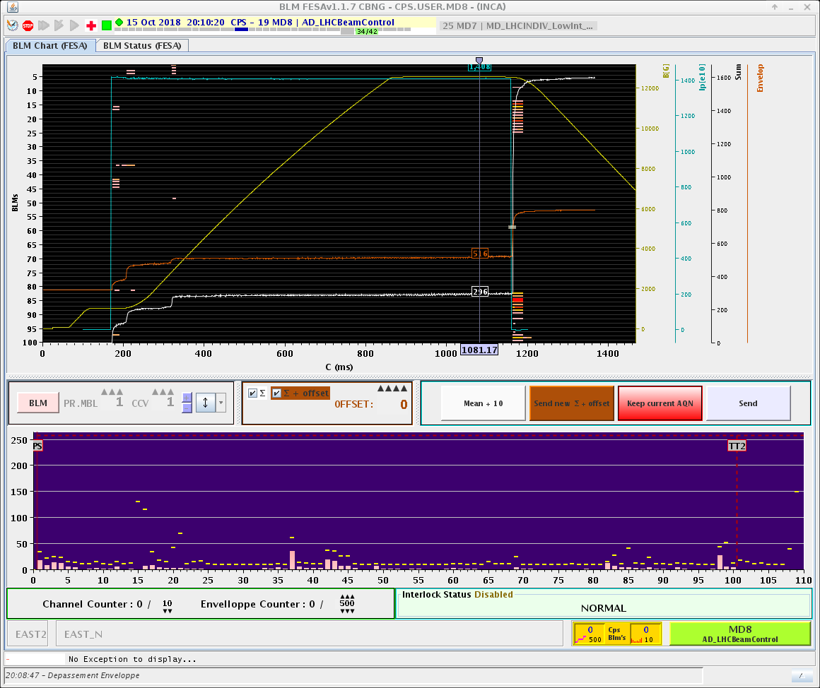
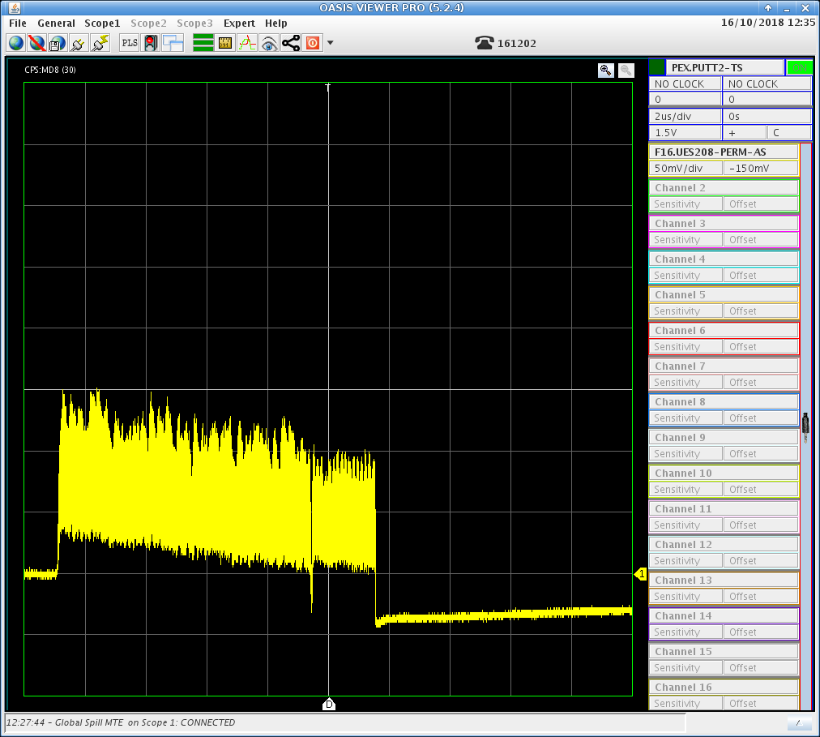
PS LLRF
Modular system
  For every subsystem replaced we the present system is kept as backup (as far as possible)
Flexibility
  Evolving away from “1 HW system per beam type”
  Successful proof-of-principle to use flexible LHC beam control for other beams
AD batch compression
MTE beam splitting
Losses during AD cycle
MTE spill

Slide 22
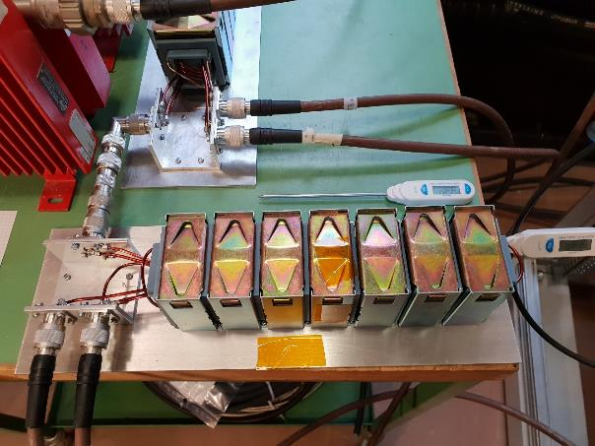
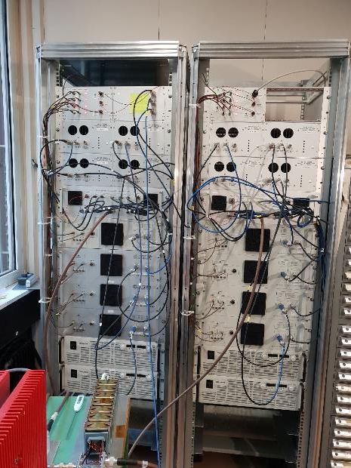
PS transverse damper
New digital signal processing hardware/FESA class for horizontal and vertical plane
  Used for injection damping as well as for beam excitation (e.g. BI tune meter)
  Vital for production of SPS fixed target beams (blow-up for MTE)
LIU baseline for LHC beams is to use damping instead of coupling
  Optimize in operation for LIU type proton beams
New Power system with 5 kW RF power per plate assembled for tests in lab
  new innovative RF transformer & combiner tested
  60% duty cycle at 5 KW and 30 MHz achieved
  series production and testing being prepared
RF transformer and combiner
5 kW test (building 864)

Slide 23
PS summary and milestones
March 2019:
  Water cooling manifolds for 10 MHz cavities installed
December 2019:
  Longitudinal damper cavity upgrade completed
  Renovation of electrical distribution and signal cabling for LLRF
January 2020:
  New 10MHz PLC controls installed
March 2020:
  New RF feedback amplifiers for 10MHz installed
  Coaxial air lines installed for 40/80MHz installed
April 2020:
  LLRF HW cabled, firmware and software installed
June 2020:
  LLRF ready for hardware commissioning with HLRF
  Prototype fast tuner installed (possibly) on 1 80MHz cavity
September 2020
  RF ready for beam commissioning

Slide 24
Lessons from PS LLRF issues: settings management
LLRF problems after power cut on 28th July
  Broken mixer module
  During fault finding, settings were adjusted, but failed to get back to good state due to a wrong timing setting
  24 to 30 hours lost
Human error not recovered due to lack of tools
  Would be good to have a facility like the old Varilog tool
    Used extensively by BE/OP/PS in the past
    Would have directly spotted the wrong timing
  Settings should be the 'gold of operations’
    allow to decide whether a system has a real problem (requiring intervention by an expert) or just a wrong setting
Settings management working group addressing this need

Slide 25
LINAC3 consolidation
Debuncher and ramping cavity
  Old digital LLRF systems
    Renovation obligatory for controls compatibility after LS2
    Replace with new systems based on HIE-ISOLDE LLRF
  New amplifiers
    5 kW instead of 3 kW
Buncher
  New amplifier and LLRF
Controls
  Change tuner driver + PLC for these 3 cavities
Commissioning
  8 weeks scheduled from August 2020 for new amplifiers and LLRF
  but can start earlier, in the shadow of the source commissioning as soon as ventilation is available

Slide 26
LINAC3 and LEIR summary and milestones
April 2019:
  New LEIR cavity PLC controls deployed
June 2020:
  New amplifiers installed in buncher, debuncher and ramping cavity
  New PLC controls and tuner drivers installed
  New digital LLRF deployed in buncher, debuncher and ramping cavity
July/August 2020:
  Start of HW commissioning period
October 2020
  RF ready for beam commissioning

Slide 27
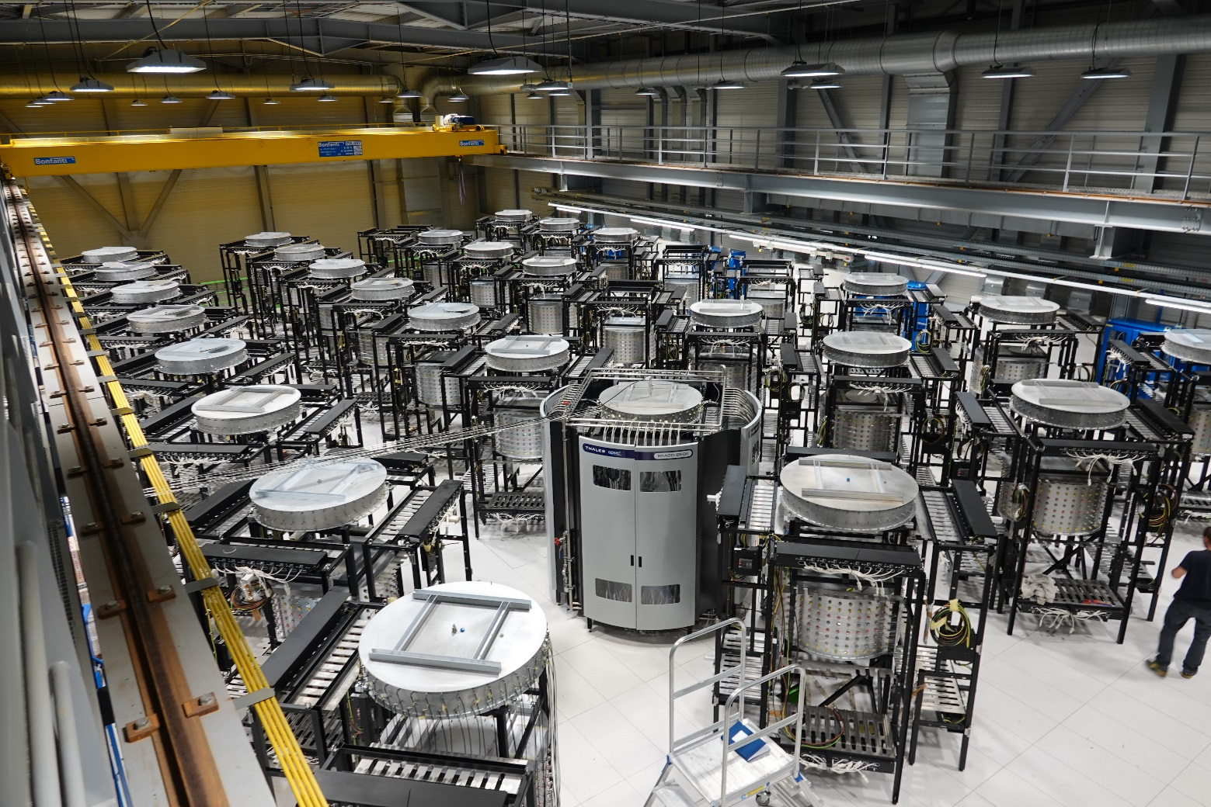
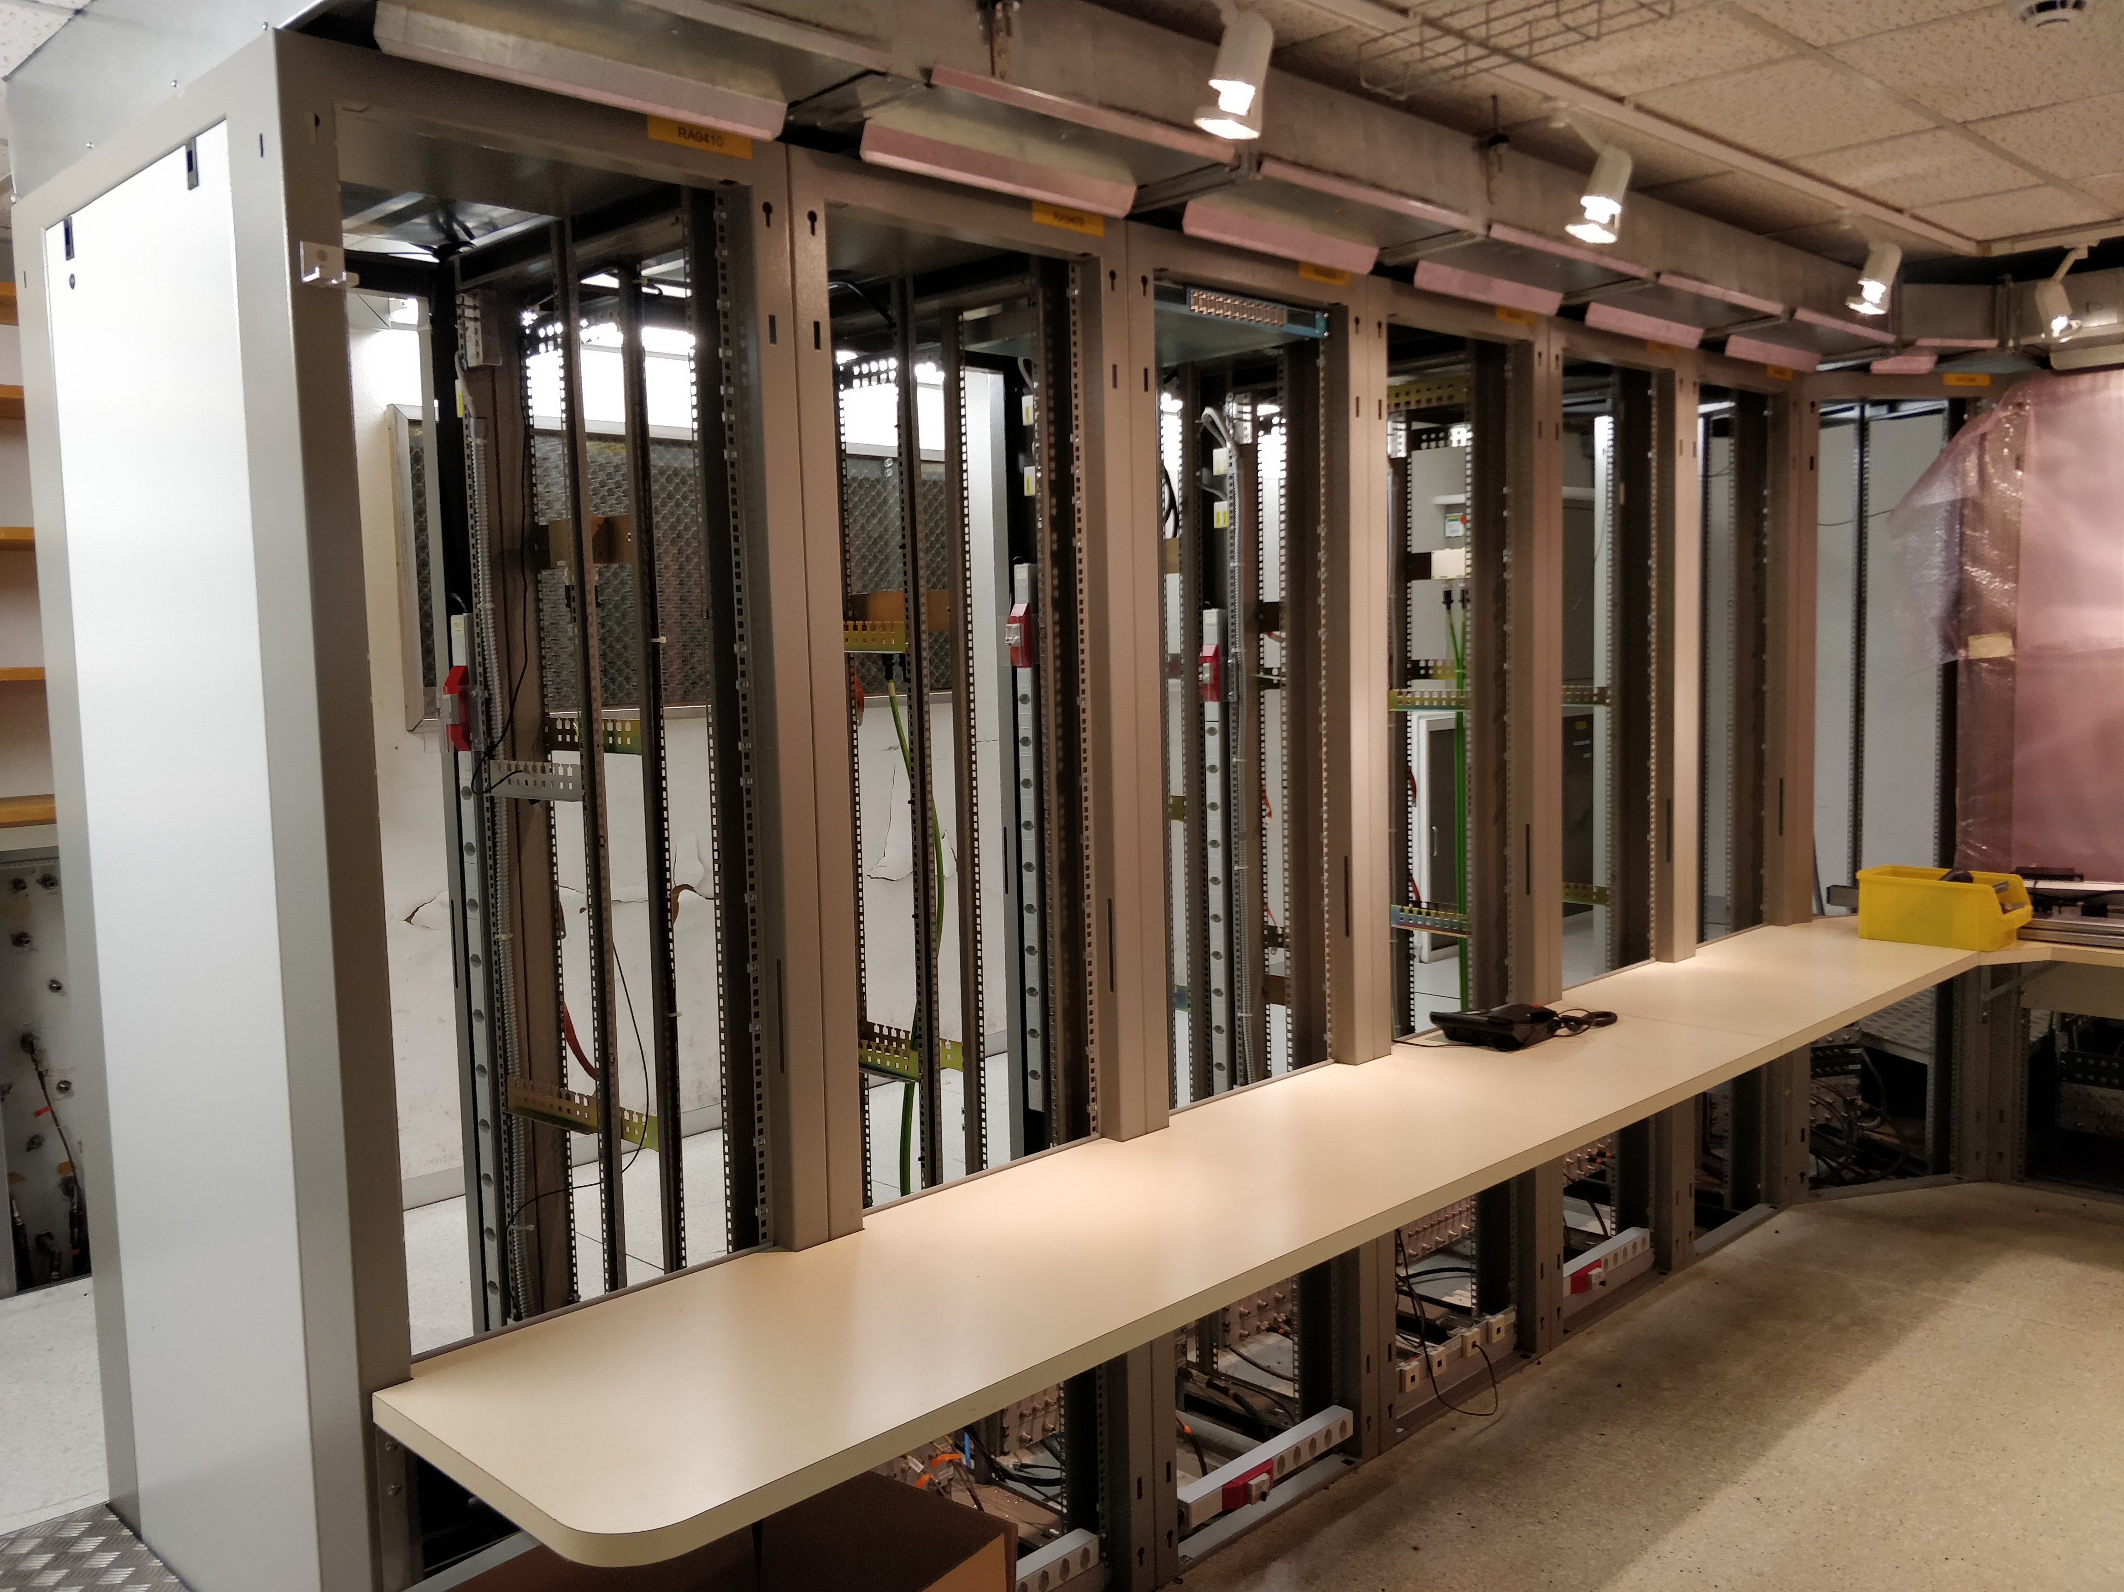
SPS 200 MHz upgrade
See detailed talk by F. Gerigk yesterday
200MHz power system upgrade
Low Level RF renovation
Solid State Power Amplifier towers in BAF3
BA3 Faraday Cage

Slide 28
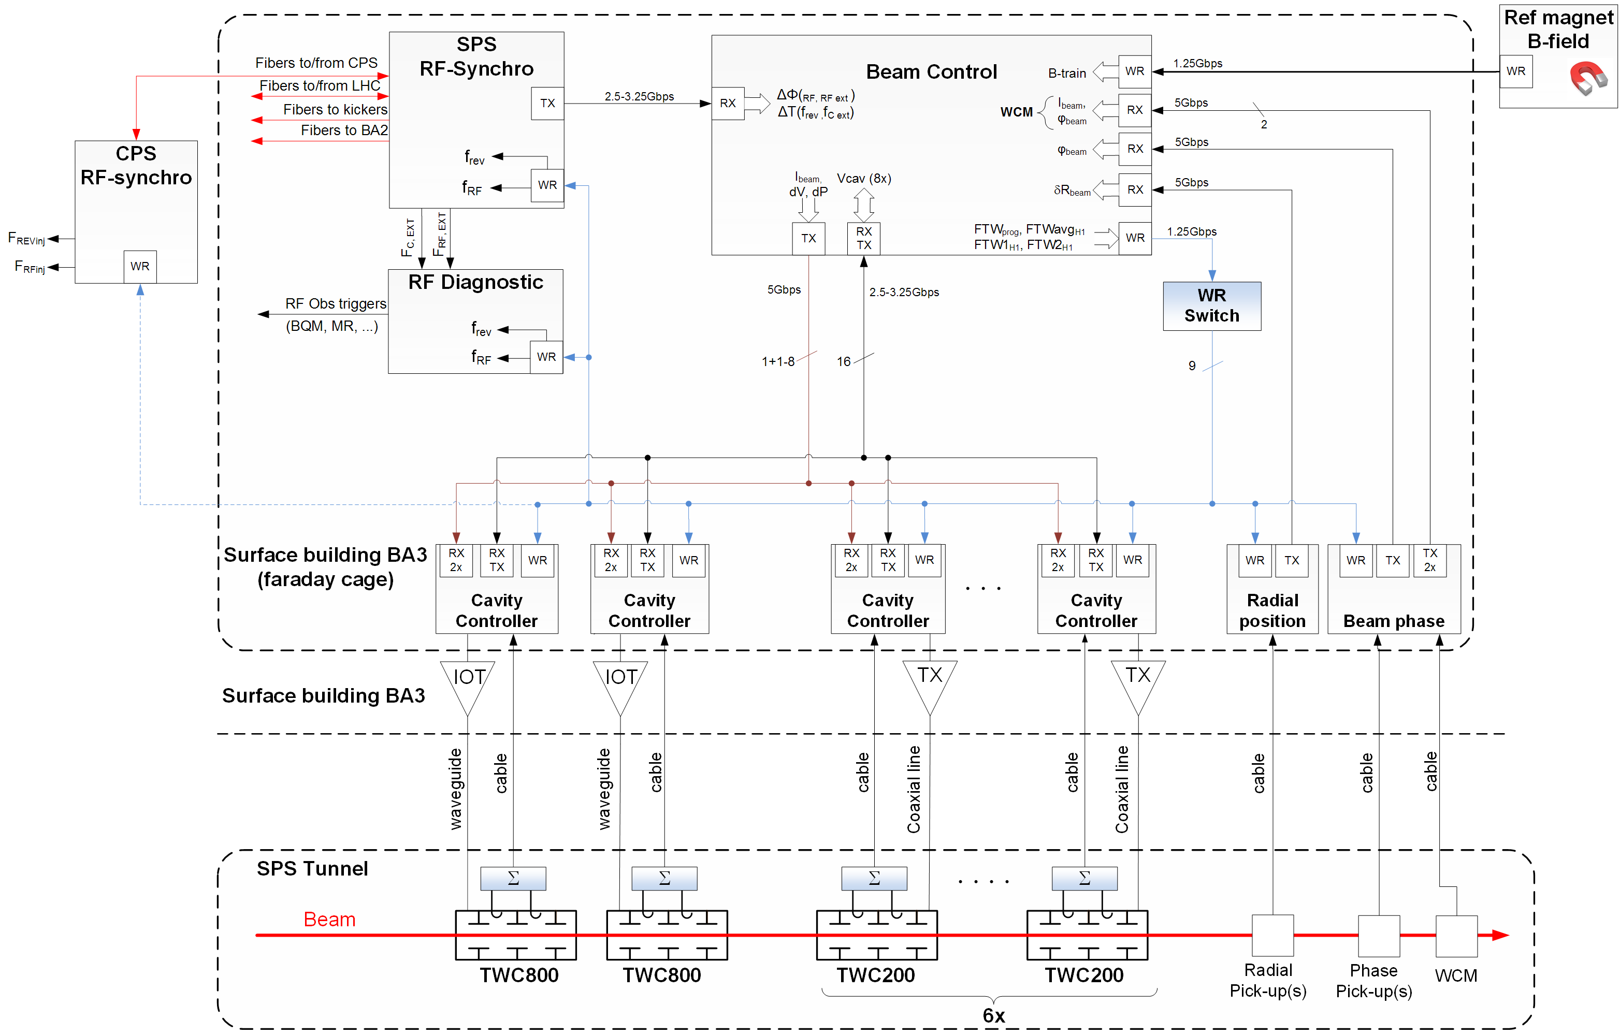
Overview SPS LLRF upgrade
Beam control
AFCZ (+FMC) framework
Beam Radial position measurement
Beam Phase&Intensity measurement
White-rabbit B-train
White-rabbit RF
Duplex Serial data link
Beam phase & Intensity wrt to TWC
Longitudinal Damper
Beam control loops
Pickup sampling card framework
External pickup Analog Front-end control
White-rabbit B-train
uTCA
Cavity controller
SIS8300-KU framework
One-Turn Delay feedback
Switch&Limit
IQ Modulator
IQ Demodulator
Polar loop
One-turn-feedforward
Fixed delay compensation
Voltage setpoint
Baseband network analyzer
VME/NIM
Generic components
Function generators
Timing tree
Acquisition buffers
G. Hagmann

Slide 29
SPS LLRF software planning & key milestones
2018 |  |  | 2019 |  |  |  |  |  |  |  |  |  |  |  | 2020 |  |  |  |  |  |  |  |  |  |  |  | 2021
O | N | D | J | F | M | A | M | J | J | A | S | O | N | D | J | F | M | A | M | J | J | A | S | O | N | D | J | F | M | A | M | J
 |  |  |  |  |  |  |  |  |  |  |  |  |  |  |  |  |  |  |  |  |  |  | HW tests |  |  | Cold check out |  | Beam commissioning
31.07.2019
End of BAF3 cavity controller tests
01.07.2020
LLRF controls “operational” for commissioning
23.11.2020
RF controls operational for SPS commissioning
Phase 1: Q1, Q2 2019
Basic cavity loop for testing in BAF3
SIS8300-KU Framework
1-T delay FB
Functions
Timing tree
RF NCO
IQ Modulator
IQ Demodulator (including fixed delay compensation)
WR interface FESA
Phase 2: Q2-Q4 2019
Cavity loop features and beam control loops
Embedded acquisition
Switch/limit
Polar loop
Voltage setpoint
Pickup sampling card
Beam phase & intensity
Beam control FCZ+FMC (Zynq)
Beam control loops
Phase 3: Q1, Q2 2020
Remaining cavity + beam loops features for startup
1-T Feedforward
Baseband Network Analyzer
Radial position meas.
RF gymnastics
FFA, slip stacking
RF switch VME module
Pickup analog front end
Duplex serial link control
Phase 4: Q3 2020
Infrastructure & integration
Crate Management for MTCA (BE-CO)
Logging (TIMBER)
Phase 5: during Run 3
WR2RF (BE-CO)
Phase 0: Upgrades for existing components: FESA3 + 800MHz…
Collaboration
OP + RF
LSA + Operational interfaces: Parameter model, makerules, Java applications…

Slide 30
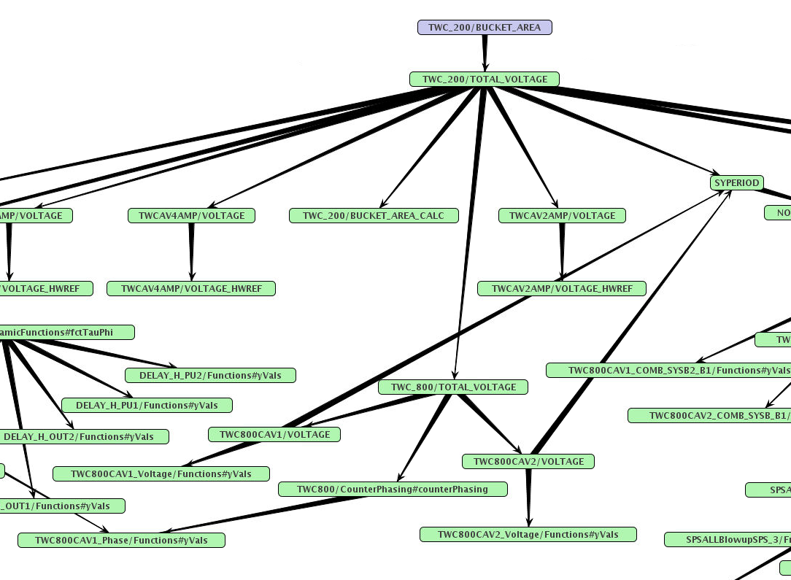
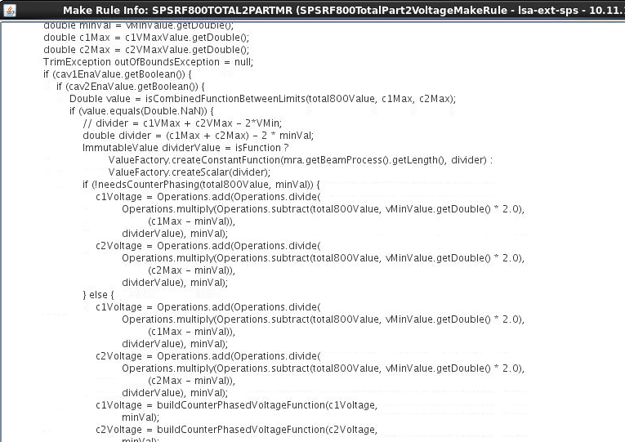
SPS LLRF software & settings management
LLRF weekly meetings
  RF-FB & RF-CS software team
LLRF integration meetings
  OP & RF
  Address all aspects of integration, control and operation of new LLRF
Informal LLRF settings management working group:
  Weekly work sessions (OP & RF)
  Review of existing LSA parameter model & define for new system
  New code where needed (makerules, value generators, SettingAware…)
  Cleanup (rewrite) of some existing code

Slide 31
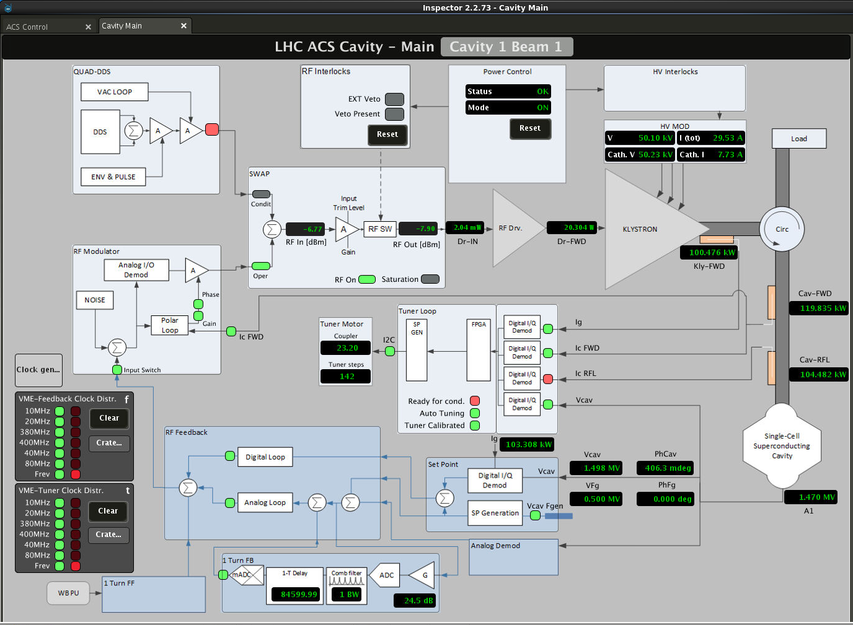
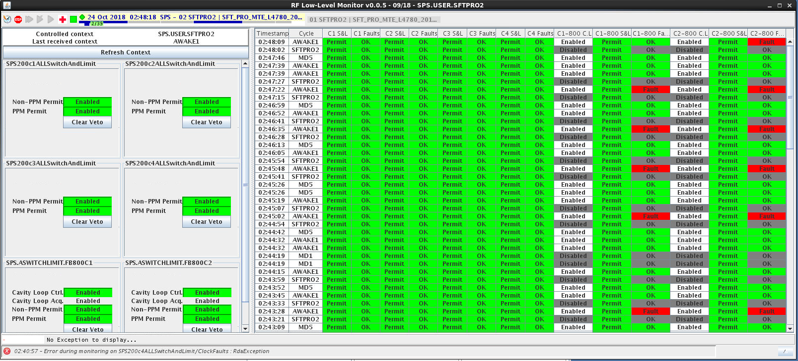
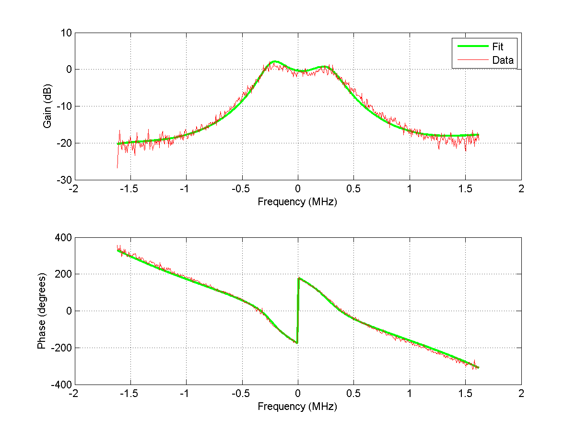
SPS Application software
Inspector expert panels: RF-CS software team
  Develop in parallel with FESA classes
  Facilitate expert intervention
Java applications for operation: BE-OP
  Built on top of LSA
  Specification by RF+OP
Setting-up tools (Python scripts): RF-FB & RF-CS
  Evolution of tools developed for LHC
  Essential for efficient setting-up of the digital LLRF

Slide 32
SPS vertical tests and dry runs
Vertical slice testing throughout LS2
  Drive hardware
    Start early on with generic components such as functions & timings
  Parameter hierarchies
    e.g. LSA voltage partition hierarchy → drive LLRF function generators
Dry run test period
  Few weeks/months before cold checkout
  e.g. 1 day per week
  Each dry run tests a specific aspect of LLRF controls
Will be essential for debugging of controls and to ensure we are ready for commissioning

Slide 33
Summary and conclusions
Linac4:
  LLRF upgrades for improved beam quality to be commissioned during LBE run
  Preparation for longitudinal painting, commissioning with debuncher will be challenging
  Work on chopper, possible manpower conflict with LIU-SPS
PSB:
  Finemet HLRF under control
  Major LLRF upgrade for multi-harmonic cavity servos
PS:
  LIU beam parameters already achieved before LS2
  Ongoing program of upgrades, modular approach compatible with operation
Ions:
  Linac3 amplifier and LLRF upgrades
  Ions functionality (including slip stacking) in SPS LLRF from day one
  SPS FFA to be delivered for LHC & FT ion runs
  In parallel, beam commissioning of slip stacking
SPS software and controls:
  LLRF and controls integration is a challenge
  Close collaboration between OP, RF LLRF and SW teams has been established
  Success can only be ensured by effective planning and communication coupled with careful testing

Slide 35
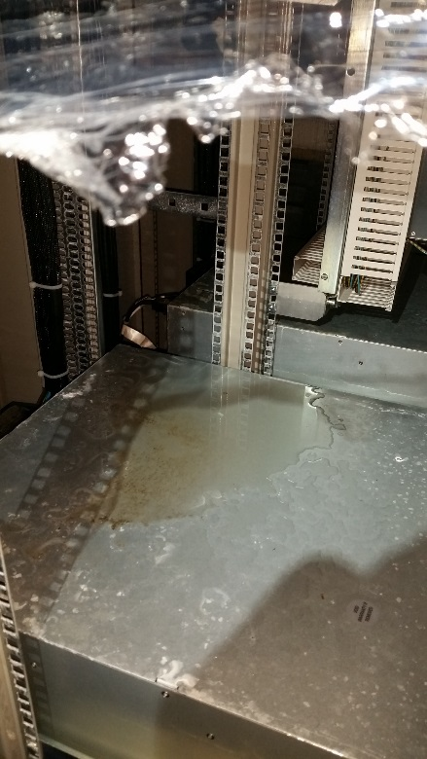
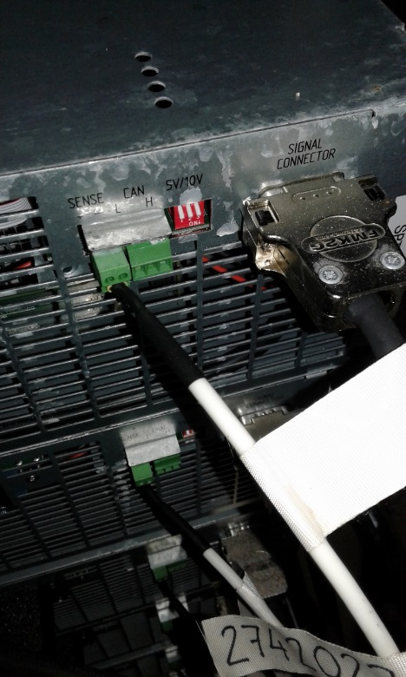
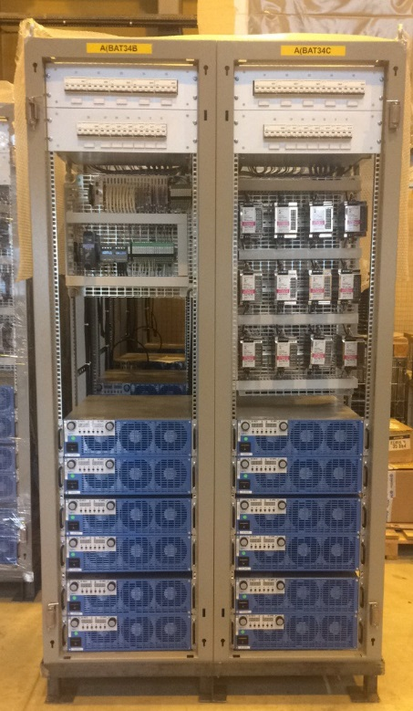
PSB HLRF equipment water damage
Water leak from roof in bldg. 190 (temporary storage allocated to the activity)
22 water damaged power supplies sent back to manufacturer for repair
First estimation : 70 kCHF covered by insurance.
Detail about final costs and repair time still to come

Slide 36
Progress, Installation and Commissioning of the PSB Finemet RF system
Impact on installation schedule due to water damaged amplifiers?
Vacuum not required for testing

Slide 37
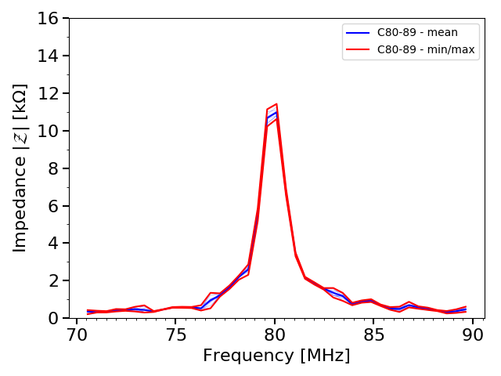
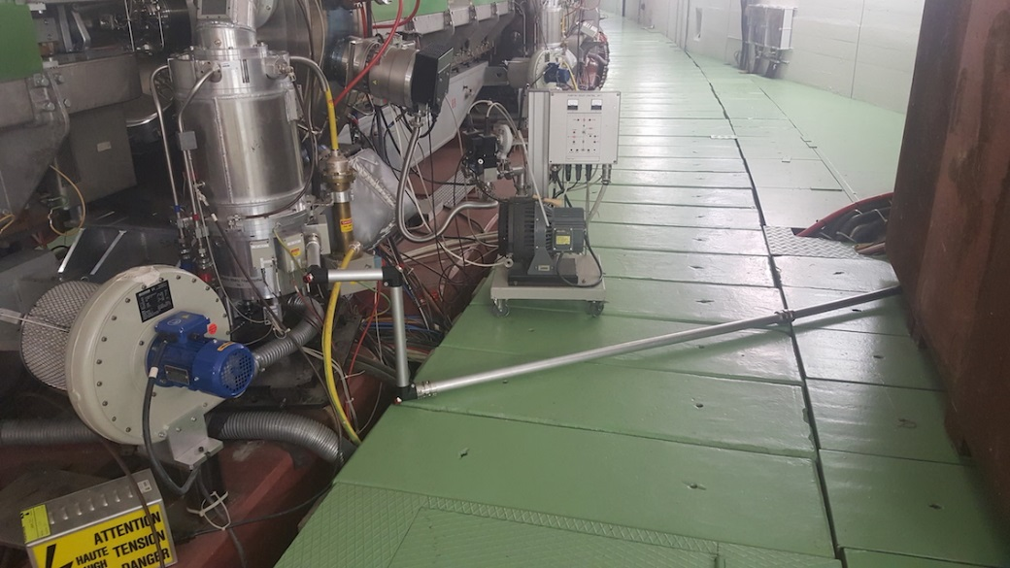
Feedback upgrade in PSC80-89
Coaxial airline installed in cavity PSC80-89 to reduce the group delay between the driver chain and the final amplifier. This allowed an increase of the closed loop feedback gain.

Slide 38
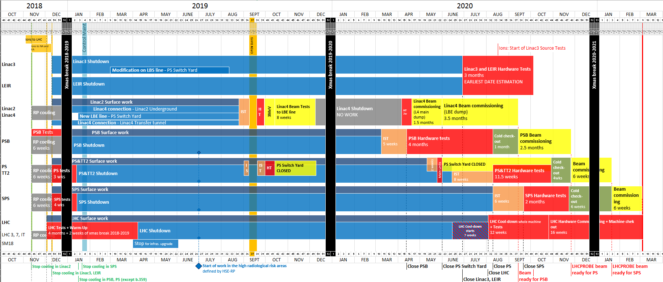
SPS summary and milestones
April 2019
  All devices removed from LSS3
June 2019
  Hardware (commercial uTCA modules) validated
July 2019
  Cavity Controller (One Turn Delay feedback) BAF3 tests finished
  uTCA modules series ordered
August 2019:
  Faraday Cage infrastructure (A/C, racks, patch panels) complete
September 2019
  Coaxial lines and waveguides installed
  Beam Loops hardware (commercial uTCA module) selected and ordered
Oct 2019
  Beam Loops RF front-end finalized
November 2019
  New cavities prepared including HOM couplers
December 2019
  SSPA integration and commissioning complete
  Cavity and SSPA PLC controls validated
March 2020
  Beam Loops firmware finalized
May 2020
  All LSS3 equipment reinstalled
June 2020
  Cavity Controller and Beam Control firmware finalized
  All LLRF HW installed in Faraday Cage
July 2020
  All ‘new’ power systems restarted
  Start of LLRF commissioning in SPS machine

Slide 39
SPS LLRF
BE-CO deliverables
  White-rabbit with Fixed latency and fixed phase, finalized Q3 2019
  MicroTCA SIS8300-KU framework firmware, finalized Q2 2019
  MicroTCA clock distribution module (eRTM), series by Q1 2020
  MicroTCA central Timing receiver, series by Q1 2020
  MicroTCA support from Q1 2020
  RF distribution over White-rabbit module (WR2RF), from Q1 2019

Slide 40
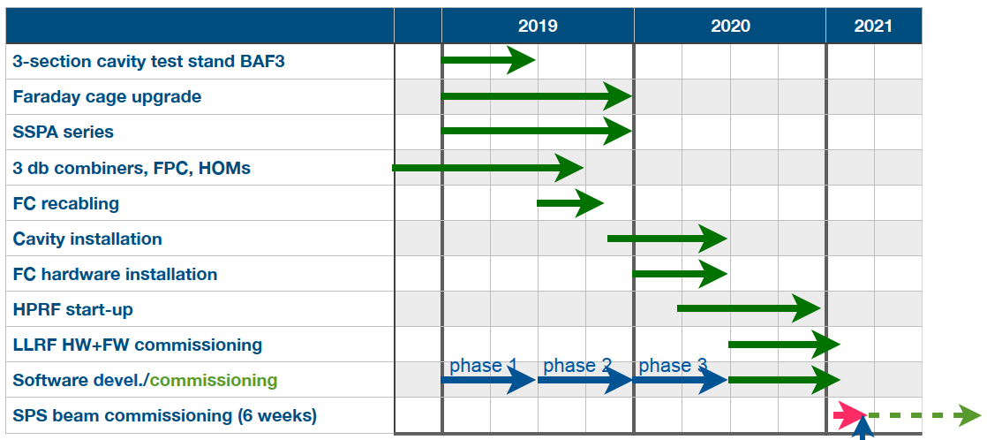
Overall planning and common milestones
F. Gerigk
Start of IST period

Slide 41
