Slide 2
LHC Injectors Upgrade Workshop
Montreux, 13-15 February 2019

Slide 3
Operating the injectors complex after LS2
Delphine Jacquet
Verena Kain, Alexander Huschauer, Gian Piero Di Giovanni, Grzegorz Kruk , Denis Gerard Cotte

Slide 4
OUTLINE
Accelerator controls
  Timing sequences managment
  Settings management
  Improve operation tools
Beam quality and performance tracking
  Across accelerators
  With time
Organizational aspects
Conclusions

Slide 5
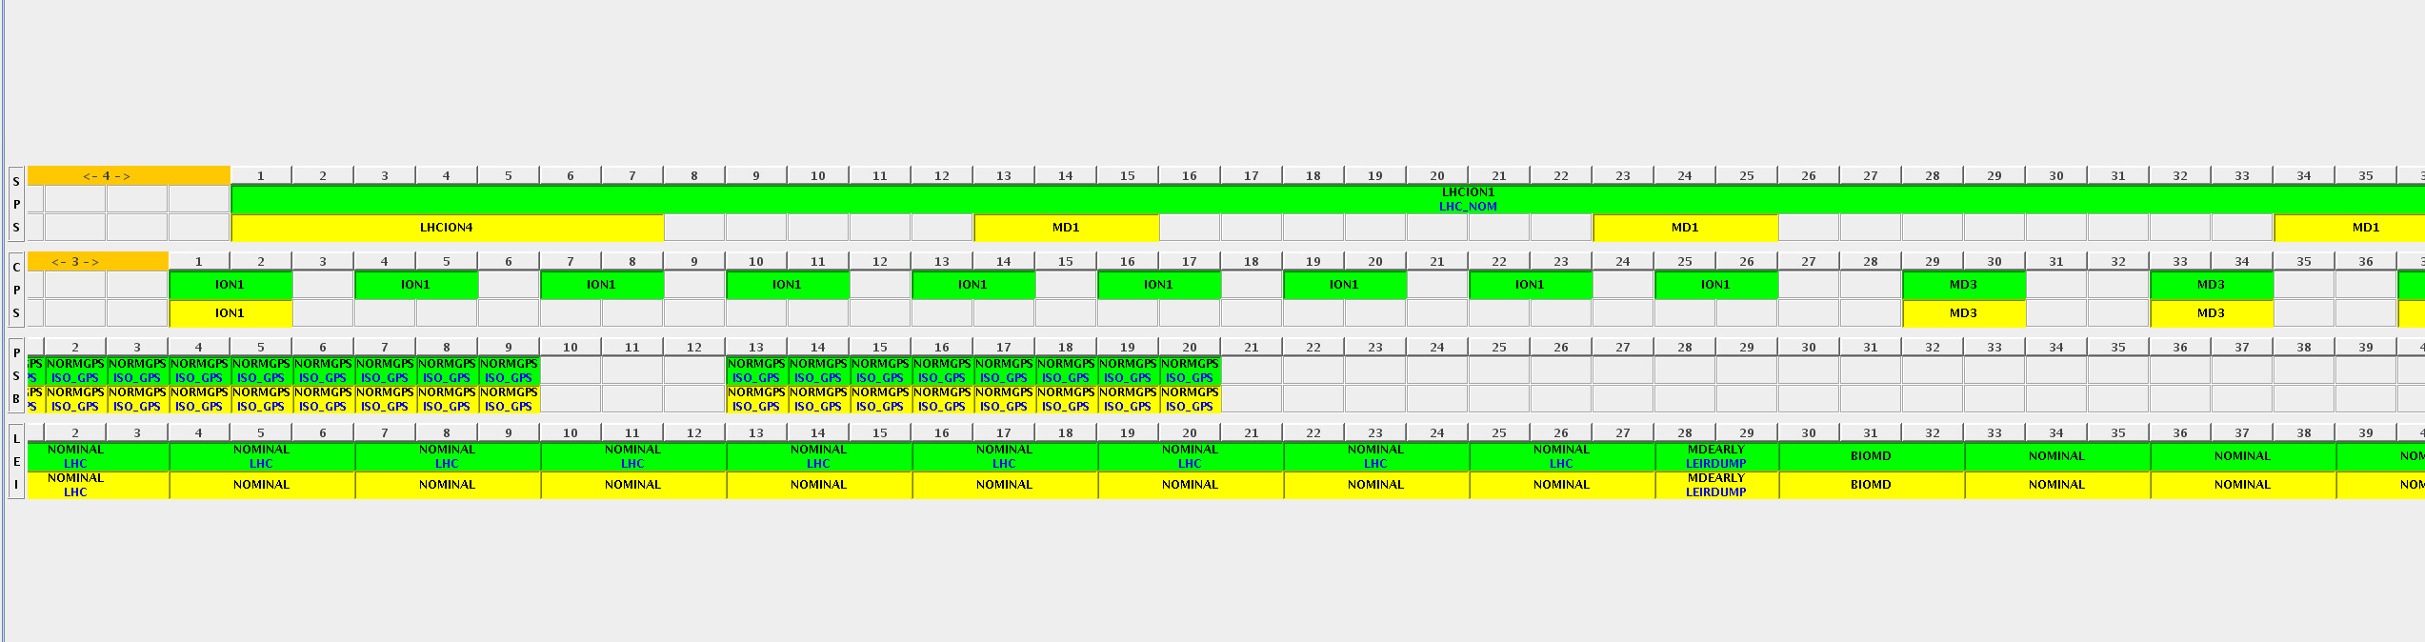
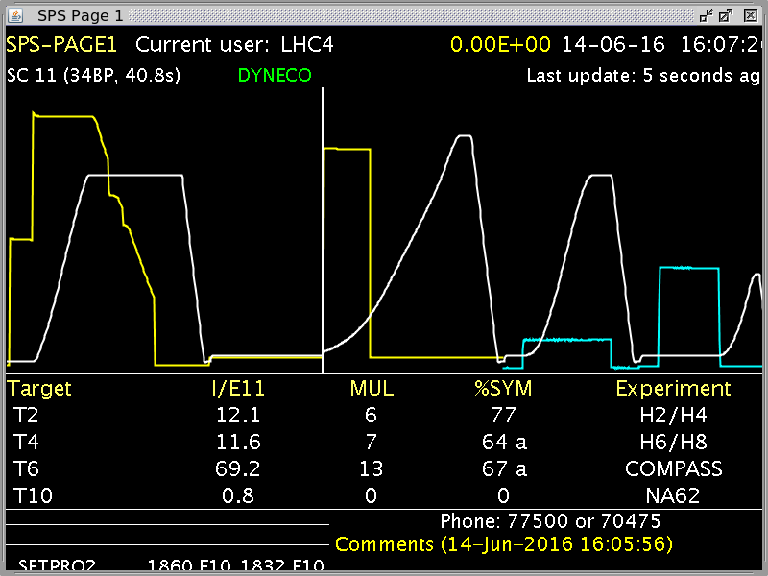
Accelerators control
Sequences and cycles management
  More and more flexibility is required for all accelerators
    New facilities like Awake, Hiradmat in SPS with complex requirements
    Challenging amount of MDs for all machines
    Constant modification of the running Sequences
    Reactivity and dynamism essential to fulfil all the needs in the most efficient way
Typical SPS supercycle
  Fixed target beam
  LHC beam
  Awake cycle
  MD beam
Our actual sequence manager is not adequate anymore

Slide 6
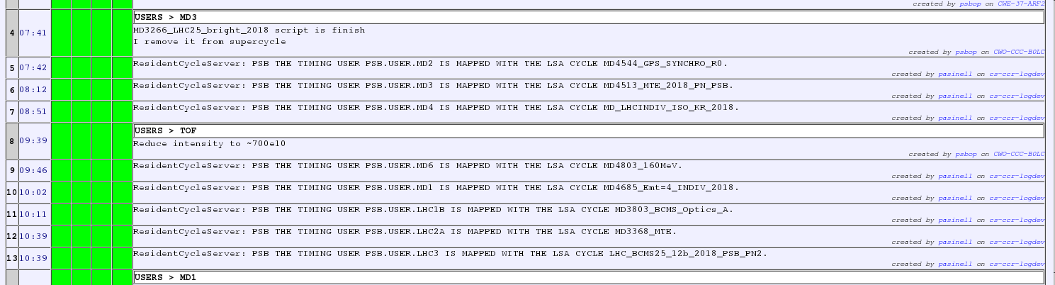
Accelerators control
Sequences and cycles management : timing users limitations
A typical shift in the PSB

Slide 7
Accelerators control
Sequences and cycles management : timing user limitations
  Actual system enforces a mapping of timing users to LSA cycles
  LSA cycles number > timing users (more than factor 5)
    Frequent mapping/unmapping : time consuming, operators not available for other work
    MDs compromised by lack of free timing users
      especially in booster
      operational cycles not unmapped
    Mapping between LSA cycles and timing users constantly modified for MD users
      → confusing , error prone, not efficient

Slide 8
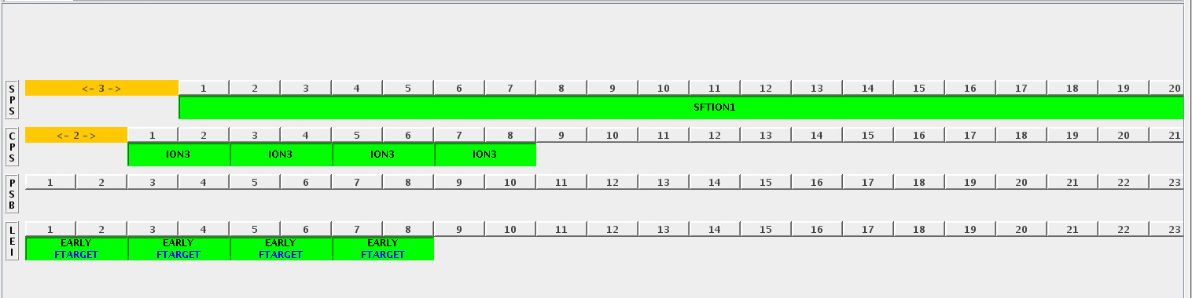
Accelerators control
Sequences and cycles management limitations
  Lack of flexibility
    The “beam” concept is too rigid, requires pre-configuration of every possible cycles combination
    Only 2 parallel path can be programmed : normal/spare.
    Concept extended to simplify LHC filling (nominal tag for LHC requests) : not enough
    OP still spending too much time with sequence edition (BCD updated every 20mins in average) : more automation is needed

Slide 9
Accelerators control
Sequences and cycles management limitations
  LHC/SPS Mastership concept :
    all the cycles for all possible injections statically programmed in the sequence
    Cycles are played or not according to LHC/SPS requests
  Take the space of other users even when not used : less duty cycle
  Most of the time: none or only some cycles are effectively played (setting-up with only one injection in SPS, while waiting for LHC to be ready etc…)
  Really very inefficient for all other users.

Slide 10
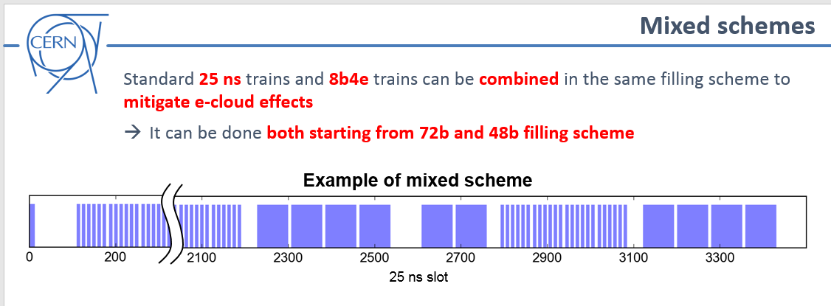
Accelerators control
Sequences and cycles management : more flexibility required for HL LHC
We have to be ready to fulfil any request in an efficient way
From G.Iadarola : HL-LHC filling schemes: possible optimization (140th HiLumi WP2 Meeting)

Slide 11

Accelerators controls
Sequences and cycles management: new concept?
  Already several discussions, brainstorming session for a new generation of sequence management
    Tight integration of timing concepts with LSA
      → schedule directly LSA cycles instead of users
    FESA will have to keep user (or slot) concept
      → should be fully managed by the sequence manager logic.
    Request for ”any” kind of beam on the fly with optimized supercycles (duty cycle, number of injections…)

Slide 12
Accelerators control
Sequences and cycles management: plans for LS2
  New tool to help automate cycle scheduling should be ready for the start-up
  LS2 is already very challenging for the timing team
  Most of the planned tasks are imposed by
    Accelerator schedule , OP/equipment groups requirements :
      i.e. LINAC4 connection, GMT monitoring, LBS/LBE measurement lines.
    Platform obsolescence :
      i.e. migration of central timing and FESA classes to 64bits/SLC7, external conditions renovation, migration of LTIM to SLC7
    Software obsolescence : LIC Central timing renovation:
      Improve AD beam negotiation, MTG diagnostics, testability
  → the discussions about new concepts postponed until end 2019.

Slide 13

Accelerators control
Sequences and cycles management : conclusion
  It was demonstrated what could be gained, and how the actual sequence management is limiting the operation efficiency
  → Really worth allocating more priority and resources on preparing a new system.

Slide 14
Accelerator Controls
Model based operation
  success of LSA in the LHC and SPS
  But not yet standard across the injectors or systems
  Sometimes because of different philosophy
  Sometimes because of technical obstacles

Slide 15
Accelerator Controls
Advantages of model based operation:
  HW Settings generated from optics
  Correction algorithms (YASP,…)
  Trimming physical beam parameters vs hardware values
    more intuitive
    less empirical
    does not depends on the hardware characteristics
→ Settings managment working group for injectors

Slide 16
Accelerators control
Settings management WG :
  Working group in place since 2018,
  All accelerator teams represented
  Workshops and meetings → exchanges, discussions and decisions making
  Goals
    Homogenize and improve settings management in all accelerators (i.e. develop the usage of high level physics parameters)
    Discuss issues and new requirements, solve it in a common way

Slide 17
Accelerators control
Main achievements in 2018
  Optics models : models for PS, LINAC4, PSB.
  Simplification of the mechanism for optics upload into LSA
  Generalization of beam process and cycle types
  Tune and Chroma parameters in PS
  New graph solution to simplify multi-directional hierarchies
  LINAC4-L4T LSA configuration
  Scalar KNOBs
  …

Slide 18
Accelerators control
Settings management WG : main goals for LS2
  Tools improvement
    Db configuration
    High level parameters in working sets
    More advanced trim history
  Simplification
    Review of the actual parameter hierarchies and makerules
    New high level parameters
    Generalize settings generation from optics

Slide 19
Accelerators control
Settings management WG: main goals for LS2
  Standardisation
    Common naming convention for high level parameters
    Jmad models where still missing
    Common convention for strength parameter (K vs KL) definition in LSA
  Issues, new requests
    Multiple non-ppm contexts
    PSB extraction line configuration review
    Complete LINAC4 configuration
    Settings generation for transfer line with strippers

Slide 20
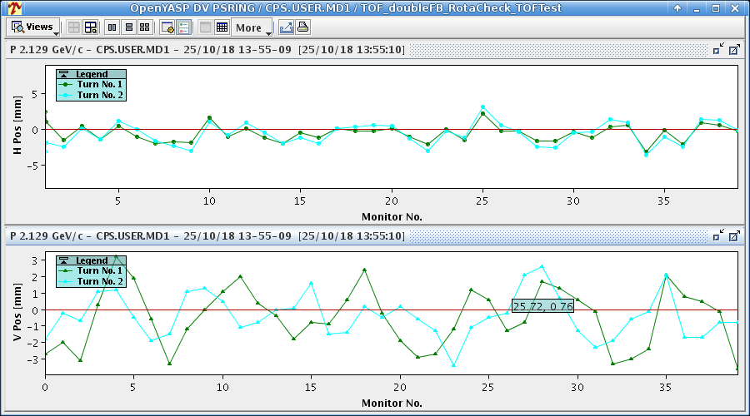
Accelerator Controls
Next challenge to improve injectors control :
use high level parameters in correction algorithms.
  Typical example: YASP
Notes:
Please find examples from other machines…

Slide 21
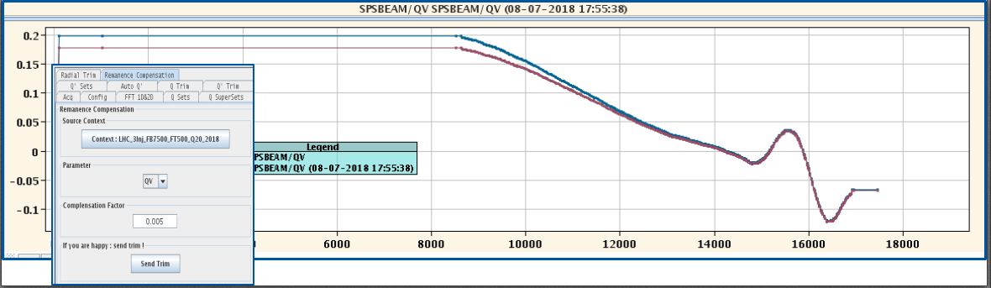
Accelerator Controls
Include physics in the tools: we are not doing enough yet!
  MDs, studies → better understanding / modelling accelerators components and beam
  Replace empirical corrections by clever algorithms using this knowledge: already some successful examples
    Automatic remnant magnetization compensation in SPS
    Automatic Laslett tune correction in the SPS, Constant Optics Slow Extraction in the SPS,…
Hysteresis corrections at flat bottom have to decrease with p through ramp.
Automatic incorporation takes care of it.
Notes:
Please find examples from other machines…

Slide 22


Accelerators Controls
Some of the accelerators and beam characteristics difficult to model i.e. :
  Space charge dominated beam dynamics in LINACs
  E-cooling setting up
  Alignment of electrostatic septum in the SPS : 10 degrees of freedom.
  Transmission optimization during transition crossing
Manual scans, trial-and-error:
  efficiency depends of the experience of the operator on shift.
How can we improve?
  Develop online models as much as possible
  Advanced optimization algorithms and machine learning.

Slide 23
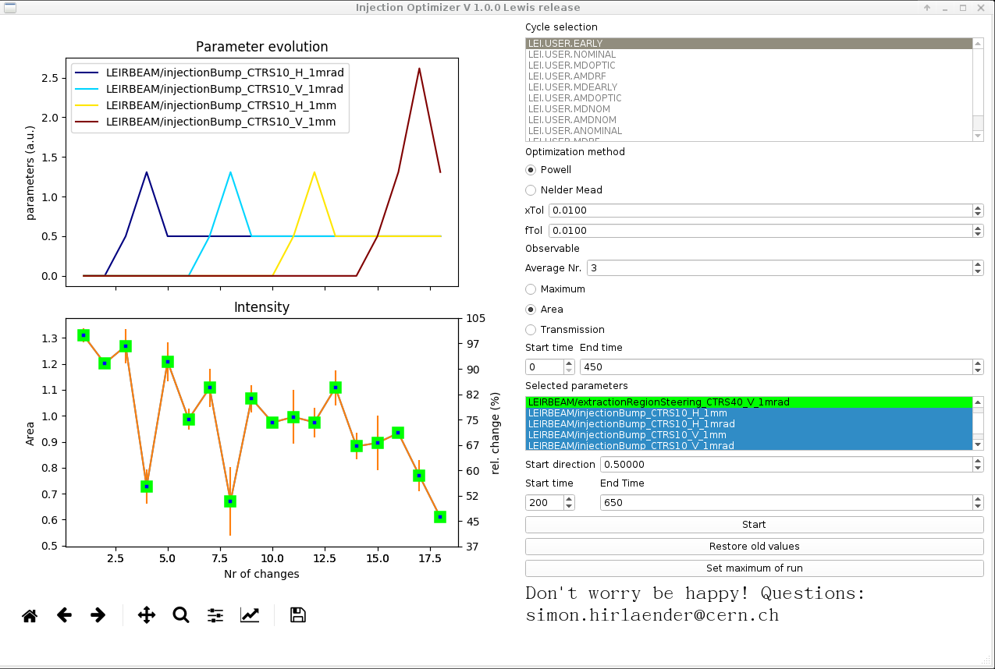
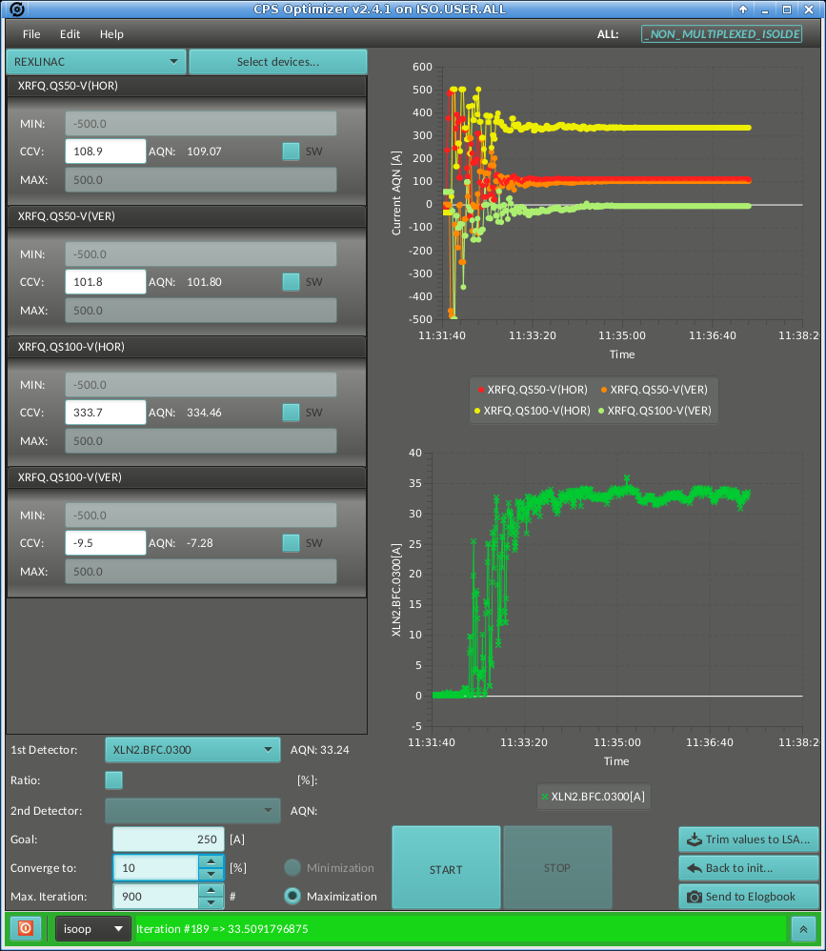
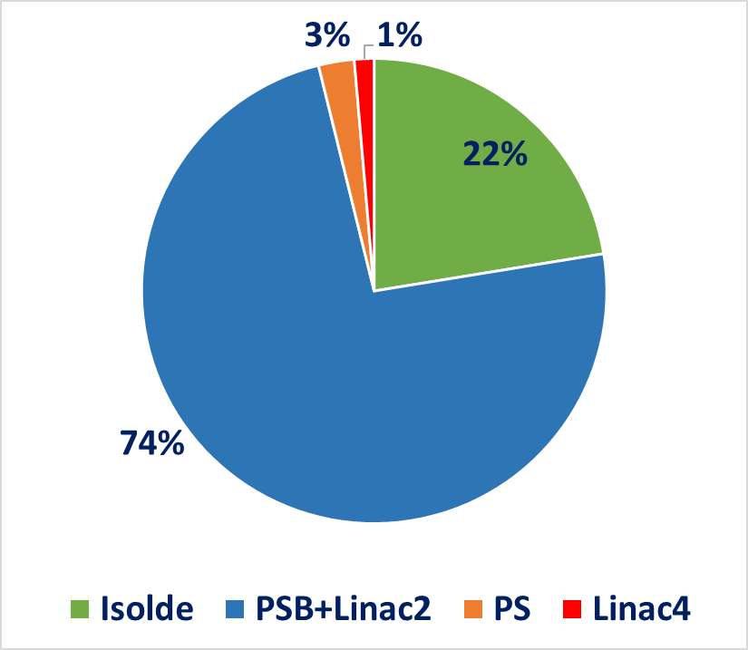
Accelerator Controls
First successful implementation examples of Automatic Optimization Tools:
  already used in PSB, Isolde since 2017. Another optimization tools has also been developed in LEIR.
  Principle: change one or several parameters in order to maximize or minimize beam observables, using optimization algorithms based on SIMPLEX or "extremum seeking algorithms"
CPS optimizer
LEIR optimizer
About 1200 scans performed in 2018
A.Akroh (BE-OP-PSB)
E.Piselli (BE-OP-ISO)
Simon Hirlaender (BE-OP-SPS)

Slide 24
Accelerator Controls
These tools have great potential: LEIR 2018 would not have worked as well without them
  ISOLDE: improve steering efficiency
  Electrostatic septum (ZS) alignment in the SPS:
    Conventional method: takes ~ 8 h, semi-automated scans
    Optimisation algorithm based on Powell: 9 degrees of freedom: 45 minutes from 0 settings.
Collaboration with EPFL and University of Malta to work on algorithms
  Next step: reinforcement learning
  Test bed: LINAC4 and AWAKE during LS2

Slide 25

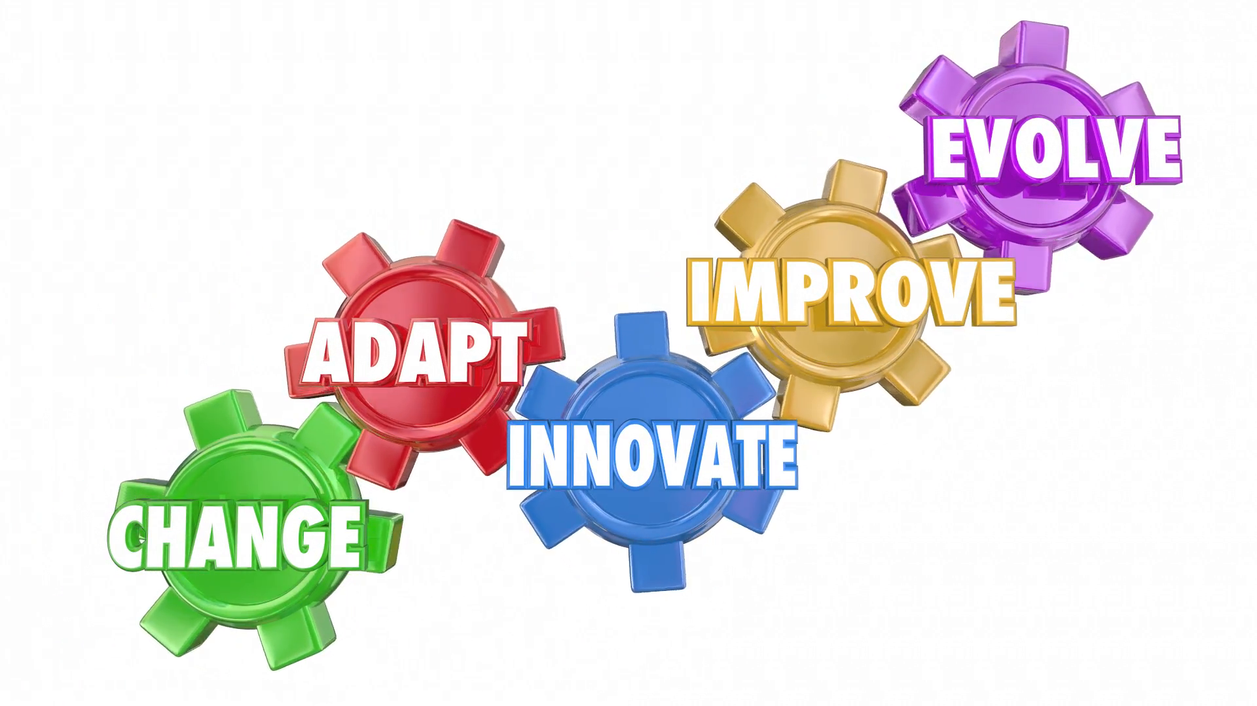

Accelerators control summary
Stay open minded.
Question operational habits: how can we improved, what could be done better…
A discussion forum is needed
  With representatives from all accelerators
  To progress together on this matters as we have common goals
Fellows/young scientists are needed to have the ideas

Slide 26
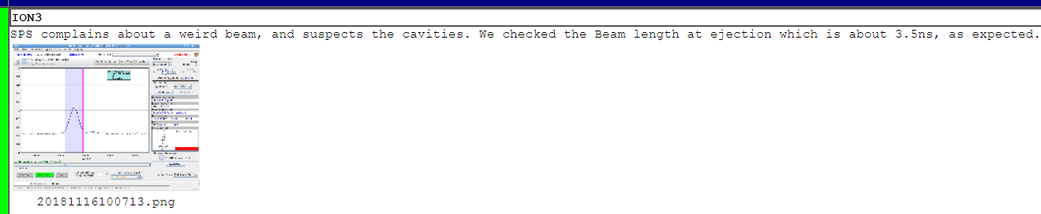
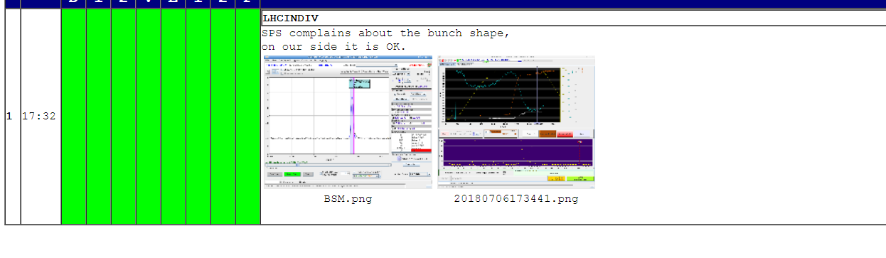
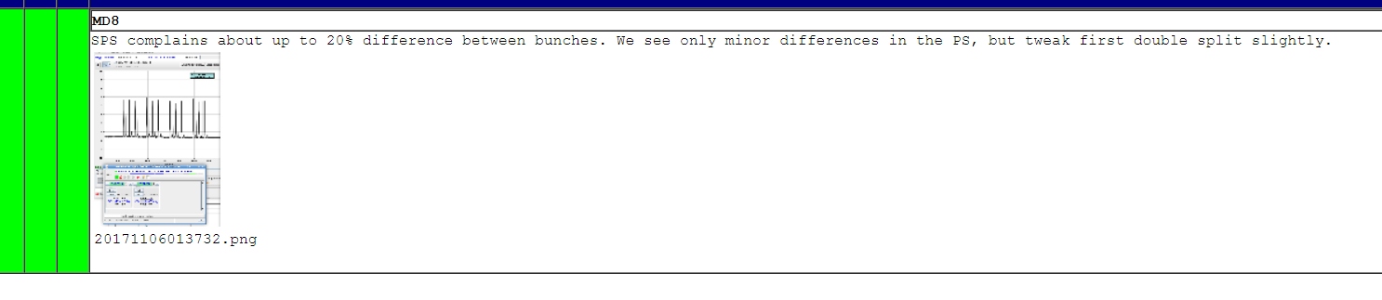

Beam quality and performance tracking
Performance tracking across accelerators virtually non-existent
  Tools missing to identify where the beam is degrading in the accelerator chain
“hot potatoes” effect

Slide 27
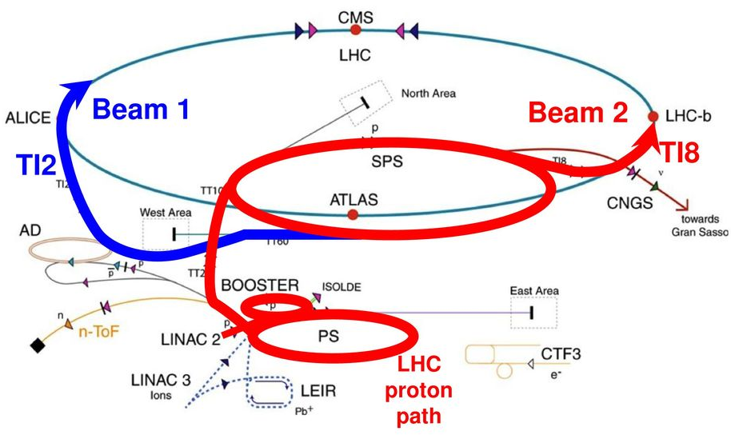
Beam quality and performance tracking
The beam quality has to be considered from source to client.
Need to develop tools that pre-analyze and record relevant measurements for all accelerators
Measurements have to be correlated and cross calibrated
      intensity: total and per bunch
      longitudinal and transverse emittance
      brightness
      MTE specific diagnostics
      relevant RF signals etc…

Slide 28
Beam quality and performance tracking
Need to start thinking about optimization per beam instead of per machine
  Lots of data collected and many analyzed to track beam performance in each accelerators (everyone using their own python scripts for that).
  Individual machines performance well followed-up and discussed in supervisors meetings.
  But no global strategy to improve the performance across the accelerator complex.
  → forum needed to follow-up the global beam performance in a regular basis, as one team.

Slide 29
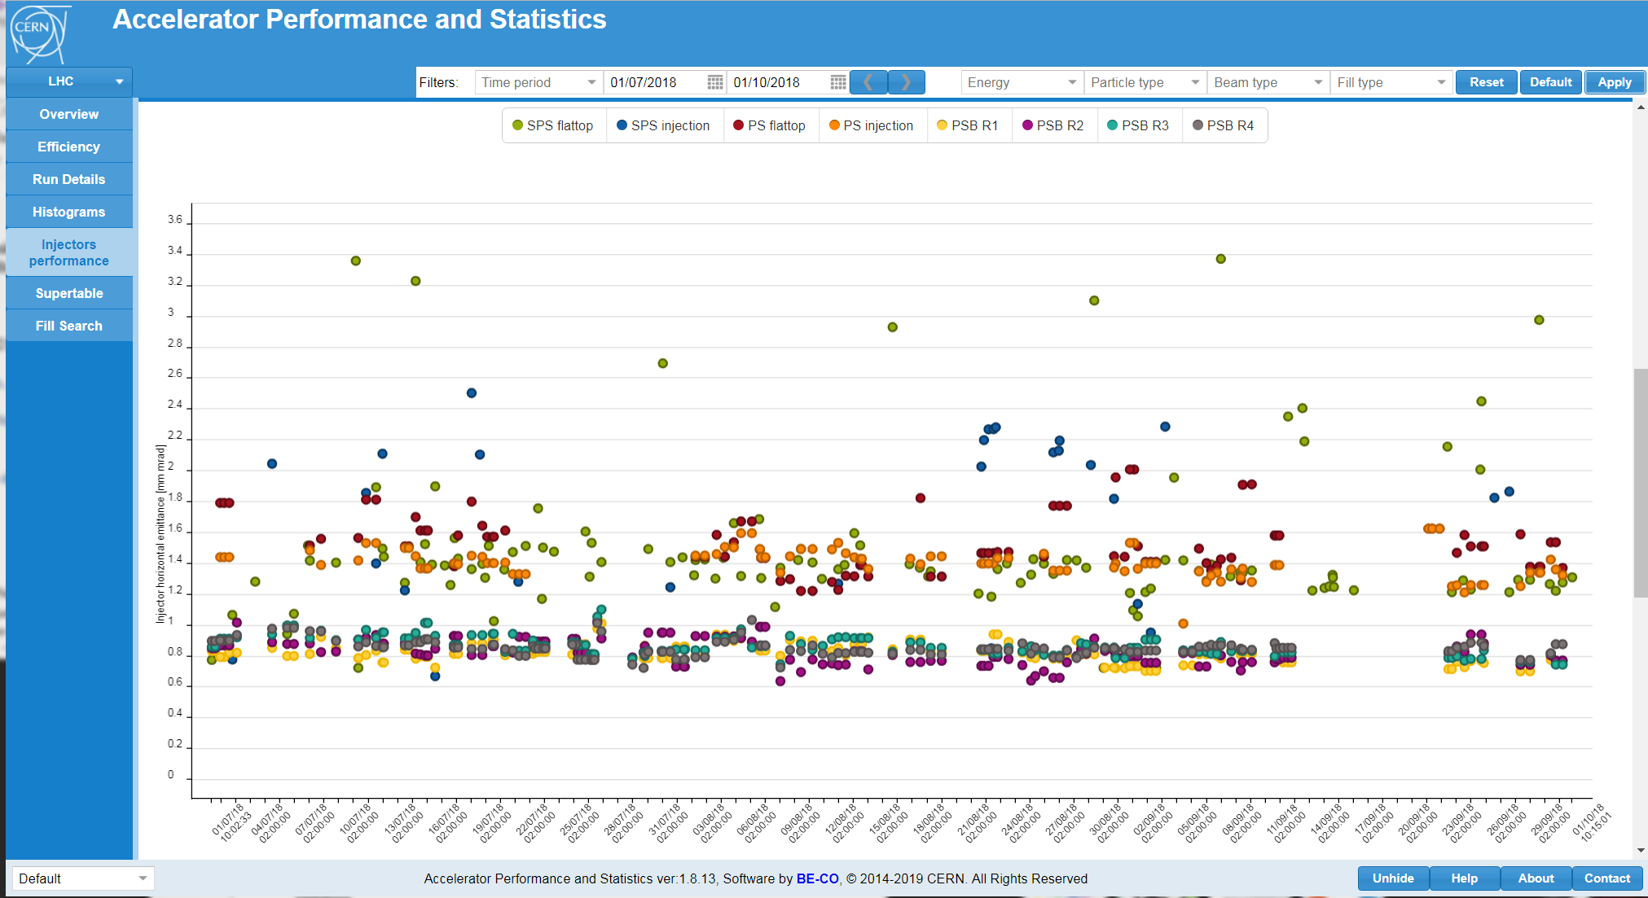
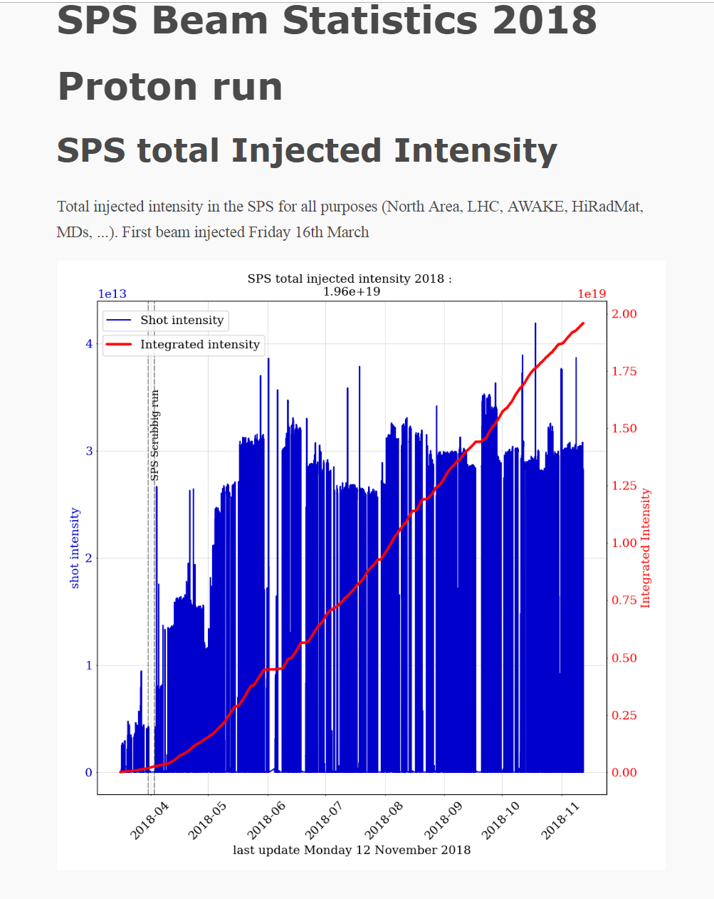
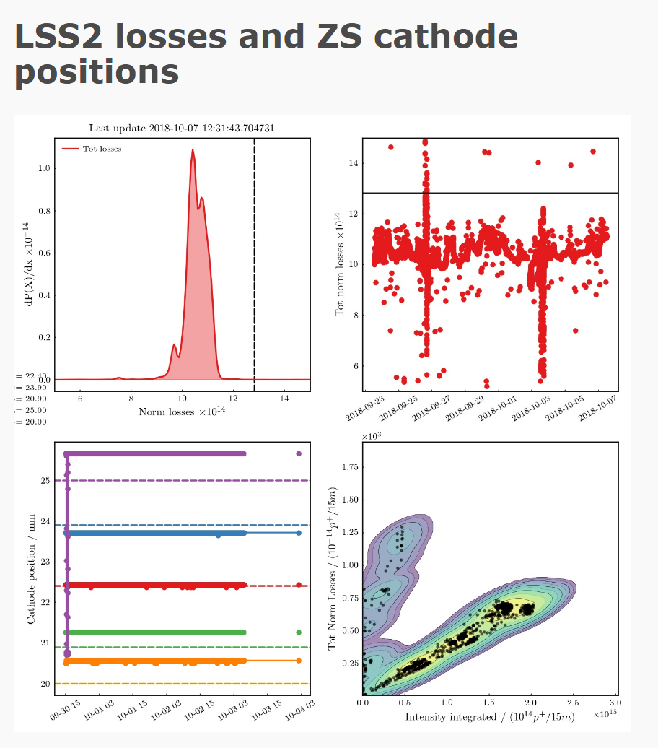
Beam quality and performance tracking
Performance evolution over time
  CO statistics page
    Very LHC oriented, not adapted to injectors
    Main missing features are
      possibility of post-processing CALS data
      Easy configuration of graphs (add, edit…)
  Everybody has cooked machine specific solutions
  → i.e. SPS statistic page: based on python scripts but not easy to maintain.
Renovation of the CO statistic page foreseen during LS2
Requirements are discussed now to cover OP needs

Slide 30

Organizational aspects
Communication across accelerators
  Much improved within injectors
    Example: avoided incompatible operation : i.e, the PS ralentisseur MD was correctly planed during coast in SPS
  Much better also in 2018 between injectors and LHC
  Still room for improvement, for example
    LHC beam requests need to be filtered, scheduled, coordinated.
    Communication of LHC beam preparation impact to injectors users: e.g. add to schedule
    Global optimization of physics program including HiRadMat, LHC MDs, NA physics,…

Slide 31
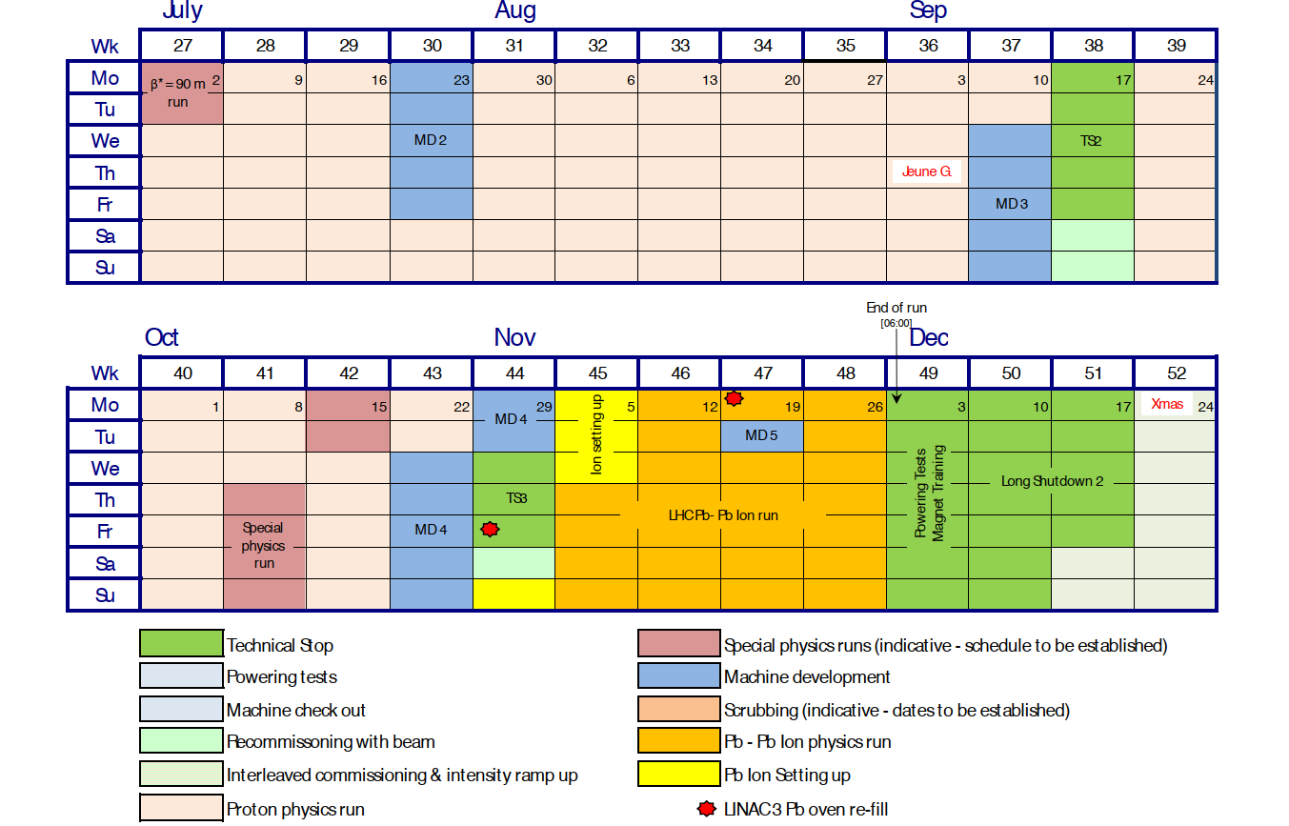
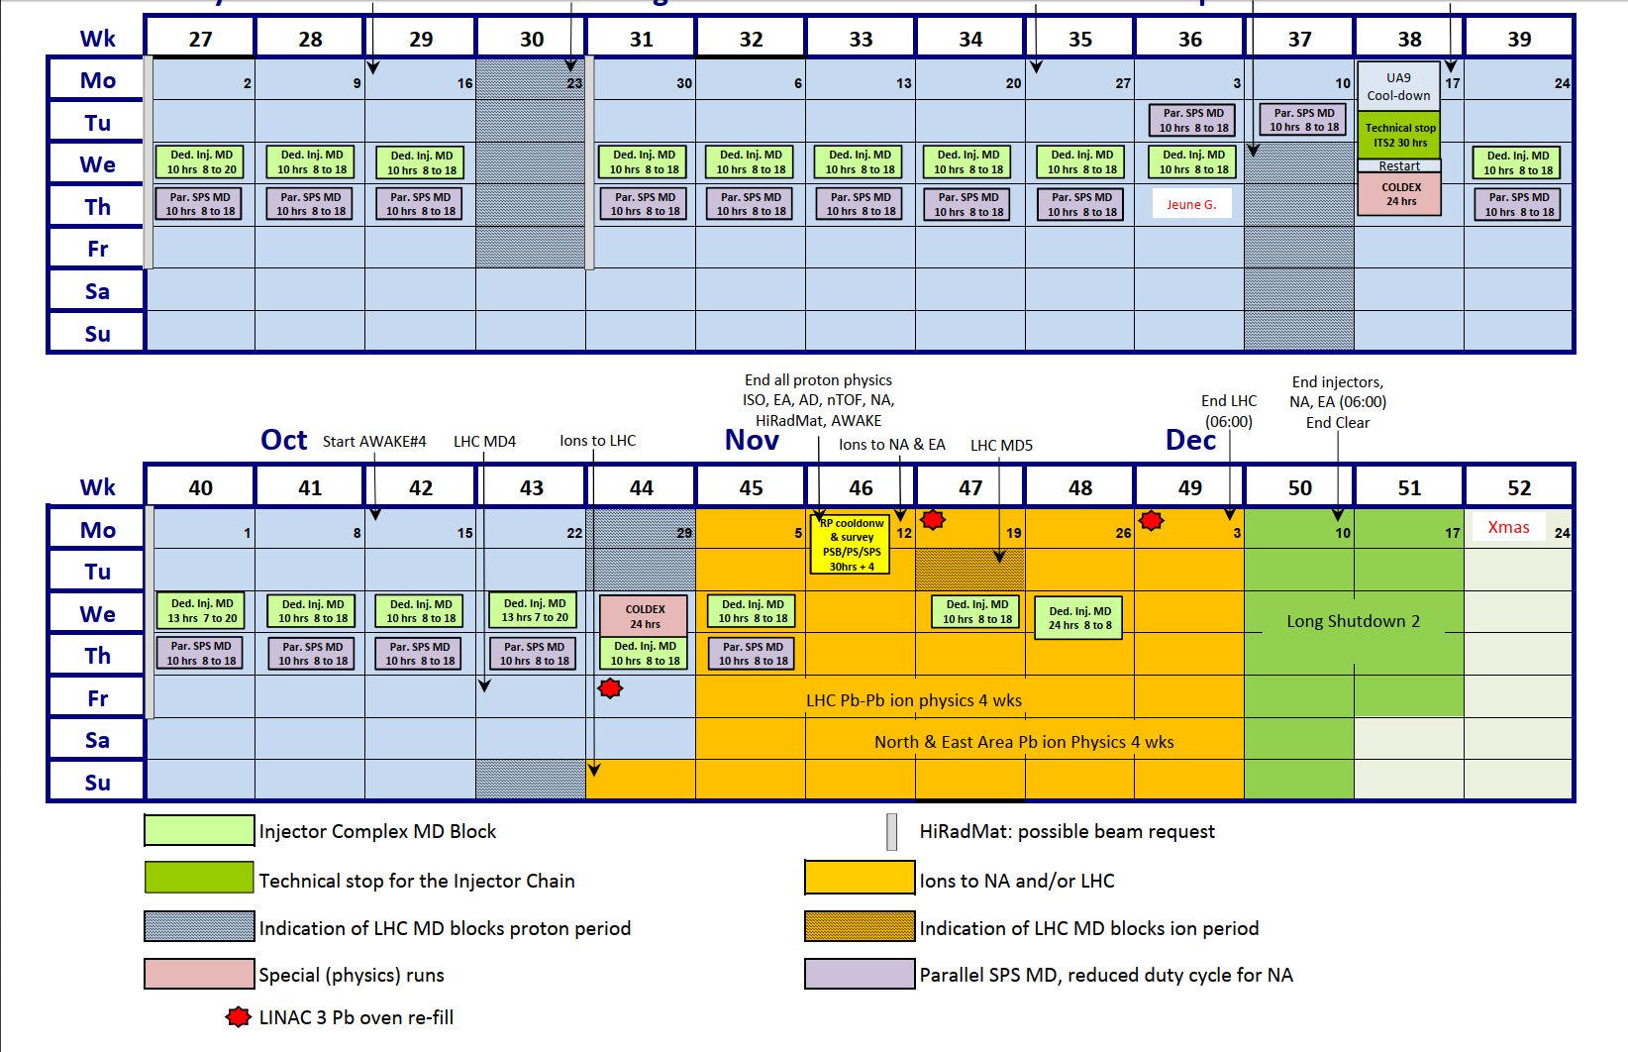
Organizational aspects
What about merging the injector and LHC schedule?

Slide 32
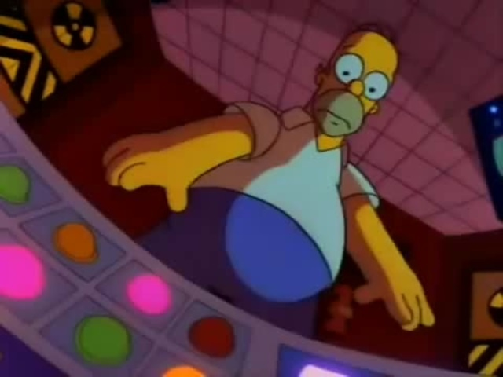

Organizational aspects
OPs weakness: formal training
  Was never seen as a priority
  Now becomes critical
    Lots of turn-over in all operation teams : 10 new shifters to be hired during LS2
    Volunteers from other groups come to help the op teams for 1-2 years (in LHC and also in SPS this year)
  TI developed EDMS based training tool
  Could be extended to all OP teams : this requires some time investment to create the courses
  LS2 is an opportunity, some OP teams have already started to work on this

Slide 33
Conclusion
All injector teams already started to work more closely together, the collaboration has to continue during and after LS2 on :
  Settings management
  More advanced control tools, automation, algorithms
  Beam performance tracking across the complex
Establish forum to discuss accelerators operation and prepare for the future
LS2 should be a starting point for more open minded operation
  Consider operation from more global point of view (accelerator complex instead of machine per machine)
  Learn from each other, share ideas, tools and resources
  Need to always keep a critical mind and continuously improve.

