Slide 2
LHC Injectors Upgrade Workshop
Montreux, 13-15 February 2019

Slide 3
SPS Post-LS2 Beam Commissioning
Kevin Li on behalf of the SPS Beam Commissioning WG
Many thanks to:
P. Baudrenghien, V. Kain, L. Jensen, G. Papotti, F. Velotti

Slide 4
Overview
Scope and framework of SPS re-commissioning
Prerequisites to be fulfilled
Schedule
  Considerations
  Plan in a nutshell
  Timeline
  Detailed list with key tasks and associated risks
Conclusions
Items
Detailed planning for pre-LS2 beam performance recovery according to the master schedule
Define milestones for the different beam commissioning phases for LHC and non-LHC beams
Details on commissioning of LIU equipment
Hardware and software prerequisites
Identify potential critical items/unknowns that could impact the schedule
Implications of the CERN 2020 Christmas closure on BC activities (lock-out strategy, piquet planning, rapid start-up,...)

Slide 5
SPS Post-LS2 recommissioning
During LS2 the SPS will have undergone a major upgrade to satisfy the LIU requirements – most of the new systems will have never seen beam before.
Key systems upgrades
  New orbit system (ALPS)
  New internal beam dump in LSS5 (SBDS)
  New injection interlock system, beam dump in BIS loop + modified behavior
  RF 200MHz system upgrade
    4 → 4 + 2 new cavities: re-partitioning of cavities (4 x 3 + 2 x 4 sections)
    New solid-state power amplifiers
    New fundamental power couplers
    Entirely re-engineered LLRF system based on state-of the-art technology (digital system, uTCA, WR)
Recommissioning in the limited time allocated will be driven by the need for complete validation while bringing these key systems to work. A more thorough analysis, preparation, planning and test definition is needed compared to past restarts.
Many other changes in the ring (a-C coating, impedance reduction, aperture fixes, instrumentation displaced) with most vacuum sectors opened.

Slide 6
Commissioning – pre-requisites
Tight beam commissioning schedule (next slides) → all prerequisites have had to be identified and sorted out in time to guarantee readiness of all systems for beam commissioning
  Revised structure of LIU with dedicated Beam and Hardware Commissioning forum
  LIU-SPS topics followed up in TC/BHC/BD Meetings
Some key prerequisites:
  Hardware readiness of all systems (→ TC)
  All systems fully integrated and tested in the controls environment (→ BHC)
    FESA classes
    Settings: parameters, value generators, make rules
  Tools and applications ready and tested during dry-runs and checkout (→ BHC)
  All systems successfully commissioned and tested without beam (→ BHC)
  Operational scenarios tested during dry-runs and checkout (→ BHC)
  Magnetic cycles prepared and ready in the SPS: LHCINDIV, MD26_Q26, MTE_APERTURE (→ BHC)
  Pre-injectors ready to deliver LHCINDIV (~1.2e11 nominal ) and MTE @5e11 (2 – 8 us batch length) (→ BHC)
See J. Ridewood’s talk

Slide 7
Commissioning – pre-requisites
Tight beam commissioning schedule (next slides) → all prerequisites have had to be identified and sorted out in time to guarantee readiness of all systems for beam commissioning
  Revised structure of LIU with dedicated Beam and Hardware Commissioning forum
  LIU-SPS topics followed up in TC/BHC/BD Meetings
Some key prerequisites:
  Hardware readiness of all systems (→ TC)
  All systems fully integrated and tested in the controls environment (→ BHC)
    FESA classes
    Settings: parameters, value generators, make rules
  Tools and applications ready and tested during dry-runs and checkout (→ BHC)
  All systems successfully commissioned and tested without beam (→ BHC)
  Operational scenarios tested during dry-runs and checkout (→ BHC)
  Magnetic cycles prepared and ready in the SPS: LHCINDIV, MD26_Q26, MTE_APERTURE (→ BHC)
  Pre-injectors ready to deliver LHCINDIV (~1.2e11 nominal ) and MTE @5e11 (2 – 8 us batch length) (→ BHC)
  During beam commissioning it will be crucial to have constant support by all the specialists involved!
  Moreover, the cross-injector coordination is crucial (being looked at in the overall commissioning coordination)
See J. Ridewood’s talk

Slide 8
Commissioning – baseline plan in a nutshell
Foresee to start up early on in week 3 to provide enough lead time for RF before OP works can start
Day 1: first beam type: LHC INDIV (Q26)
  To phase in cavities and establish capture (this will already be a big milestone for RF!)
Week 1: Fixed Target (FT) aperture beam @ 14 GeV (~5e11 ppb) needed for aperture measurement
Week 3: beam based alignment (= double optics alignment) needs to be carried out early on
  To establish golden orbits at injection and extraction orbits
  Requires in addition FT low intensity beam (~5e12 ppb) at 400 GeV; acceleration with transition crossing
Week 4: after BBA – final setup and optimization of single bunch cycles; LHC extraction setting up
After week 5: move to multi-bunch beams
→ Compromise on having the beam-based alignment at half of the commissioning time → end of week 6

Slide 9

Beam commissioning overall breakdown by system
Beams
BI
OP
RF
ABT
3
4
5
6
7
8
9
Beam-based alignment

Slide 10
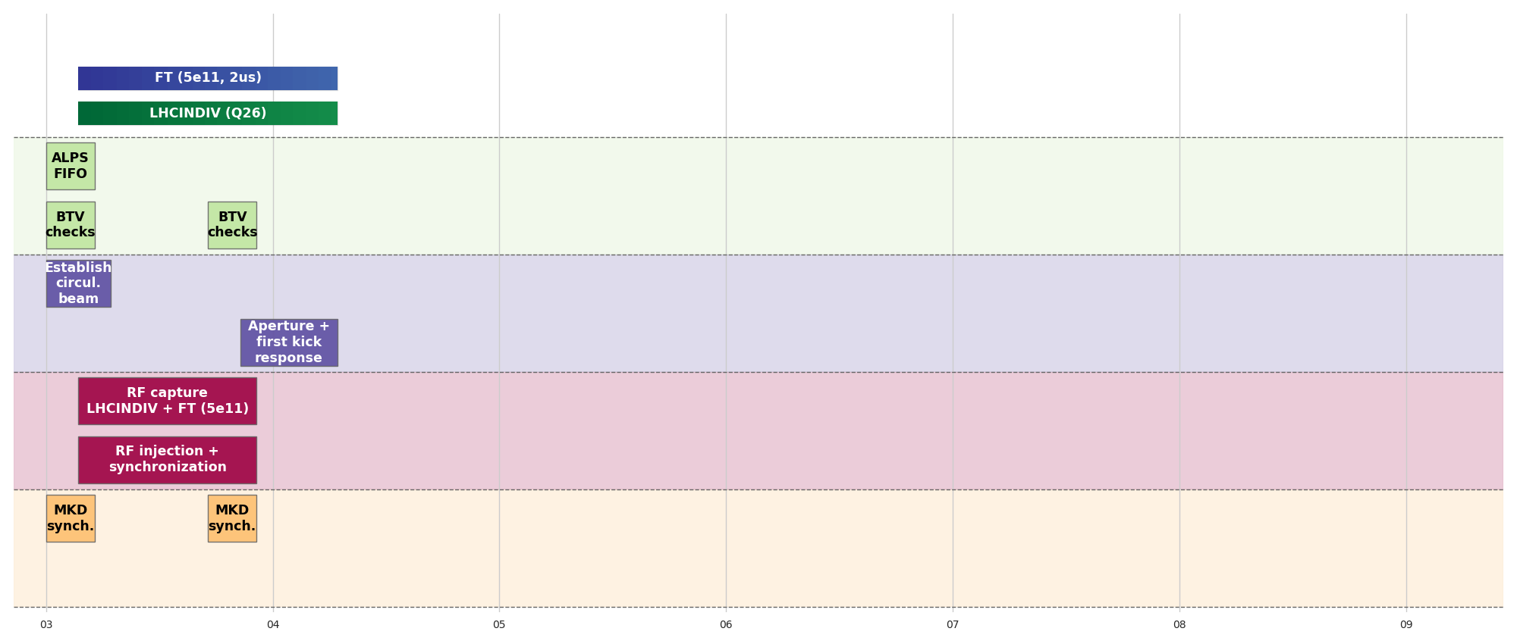
Beam commissioning overall breakdown by system
26 GeV
450 GeV
Beams
14 GeV
14 GeV
400 GeV
26 GeV
BI
OP
RF
ABT
3
4
5
6
7
8
9
Beam-based alignment

Slide 11
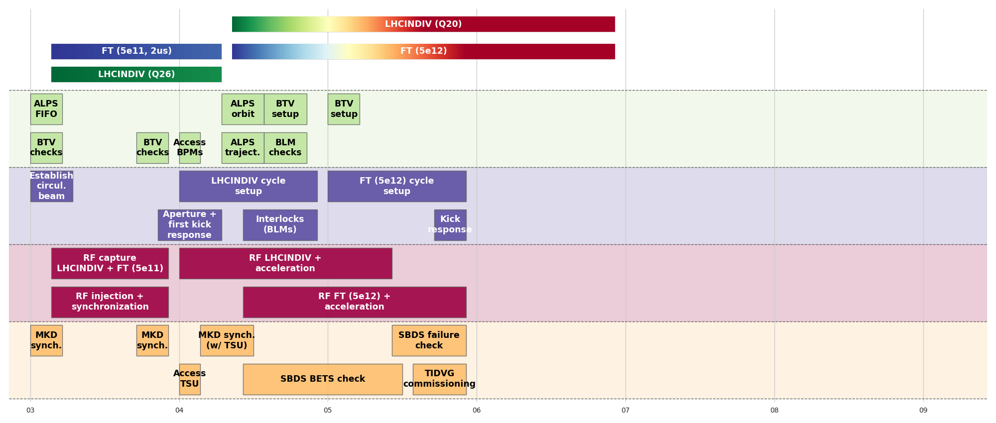
Beam commissioning overall breakdown by system
26 GeV
450 GeV
Beams
14 GeV
14 GeV
400 GeV
26 GeV
BI
OP
RF
ABT
3
4
5
6
7
8
9
Beam-based alignment

Slide 12
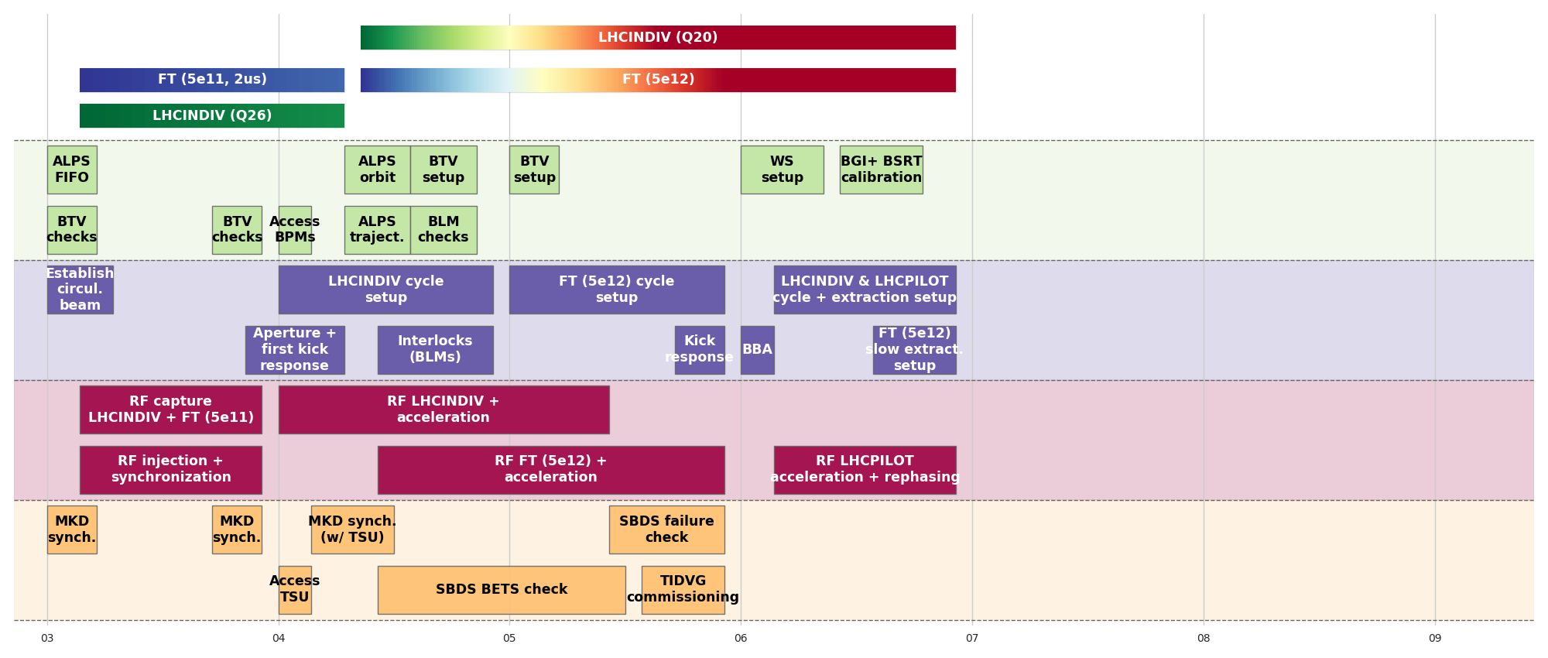
Beam commissioning overall breakdown by system
26 GeV
450 GeV
Beams
14 GeV
14 GeV
400 GeV
26 GeV
BI
OP
RF
ABT
3
4
5
6
7
8
9
Beam-based alignment
LHCPILOT
ready

Slide 13
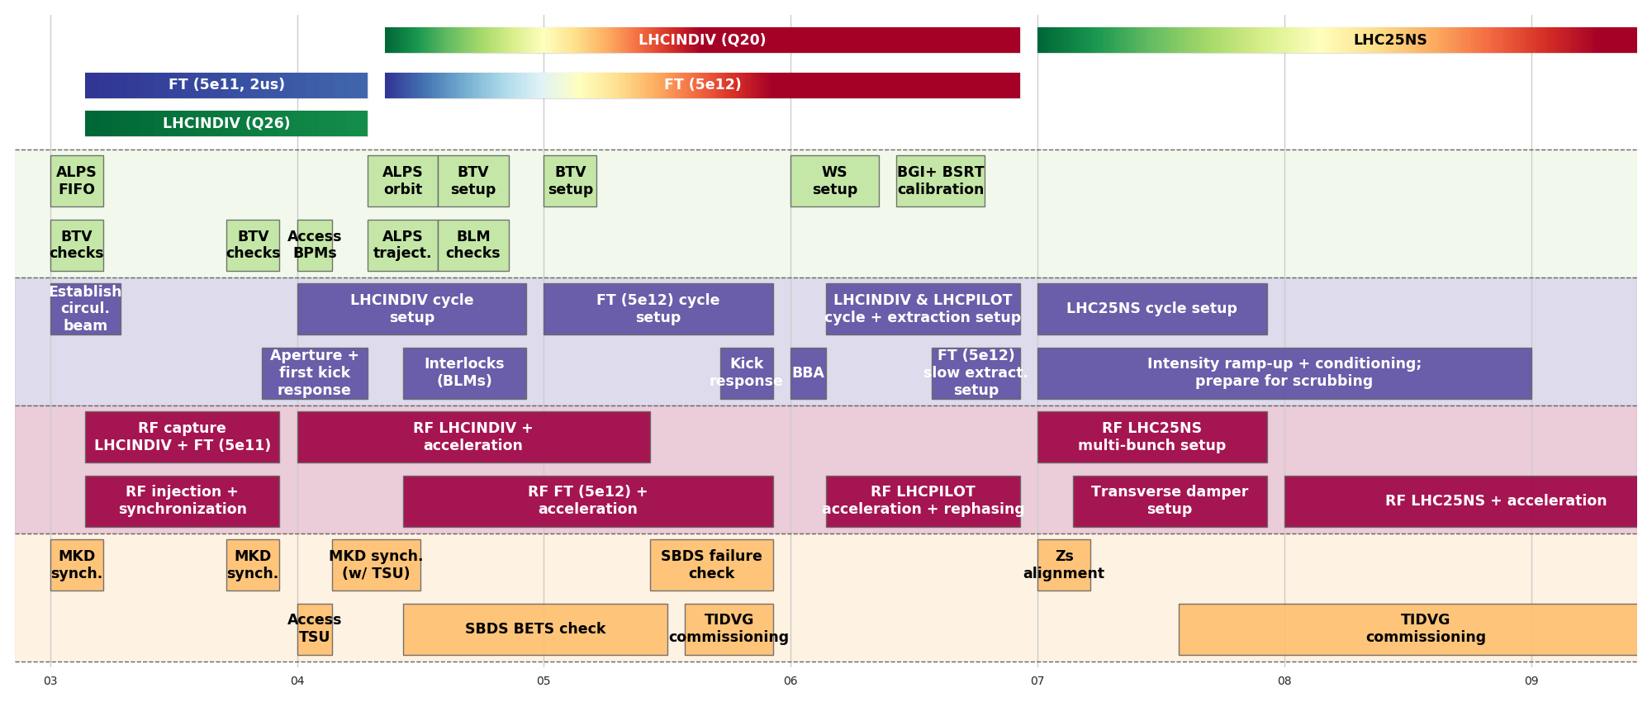
Beam commissioning overall breakdown by system
LHCPROBE beam
available for LHC
Week 9
04/03/2021
26 GeV
450 GeV
26 GeV
450 GeV
Beams
14 GeV
14 GeV
400 GeV
26 GeV
From week 9 – scrubbing for 10 days
BI
OP
RF
ABT
3
4
5
6
7
8
9
Beam-based alignment
LHCPILOT
ready
LHC25NS
setup
LHC25NS
conditioning

Slide 14
Beam commissioning timeline – overview
Week | 3 (1) | 4 (2) | 5 (3) | 6 (4) | 7 (5) | 8 (6) | 9 (7)
Milestones | Circulating beam and RF capture | LHCINDIV @450 GeV | Beam based alignment | LHCPILOT to TT40 / TT60 TEDs | LHC25NS setup | LHC25NS conditioning; TI2/TI8 steering | LHC25NS scrubbing
Beams | MD26_Q26 FT (5e11, 2us) LHCINDIV (1.2e11) | FT (5e11, 2us) LHCINDIV (1.2e11) | FT (5e12) LHCINDIV (1.2e11) | FT (5e12) LHCINDIV (1.2e11) | FT (5e12) LHC25NS intensity ramp-up (12b) | LHC25NS intensity ramp-up (12b +) | LHC25NS intensity ramp-up (12b +)
Key tasks | Establish circulating beam Phase in cavities Establish RF capture All beams at flat-bottom | OP and RF setup for LHCINDIV Acceleration of LHCINDIV Orbit system setup (first turn with BST, kick response) Aperture checks: capture FT aperture | Kick response Acceleration of FT (transition crossing) Beam based alignment + accesses | Establish goldens OP and RF setup of LHCPILOT for extraction OP and RF setup of FT for slow extraction | ZS alignment Start taking LHC25NS multi-bunch beams (12 bunches) Conditioning of equipment (kickers, vacuum,…) | OP and RF setup of LHC25NS multi-bunch beams Transverse damper setup Extraction setup to TI2/TI8 TEDs Conditioning | OP and RF setup of LHC25NS multi-bunch beams Acceleration of LHC25NS Scrubbing → scrubbing slot from week 9 for 10 days
Delivery of first beam commissioning goal

Slide 15
Beam commissioning timeline – week 1
Circulate & capture
Week 1
Week 2
Week 3
Week 4
Week 5
Week 6
Activity | Related tasks | Tool requirements | Risks | Remarks | Estimated duration
Establish circulating beam | Setup ALPS in FIFO | YASP with ALPS integration | Critical: but, vertical slice tests in 2018 | LHCINDIV | 1 day
Establish RF capture Setup RF injection | Setup LHCINDIV cycle Setup FT aperture cycle | Experts + RF tools old & new | Critical: entirely new system – first test with beam | LHCINDIV FT (5e11, 2us) | 5 days
Test BLM HW / SW interlock |  | New BLM software integration | Non-critical: BI intervention | LHCINDIV | 1 shift
Synchronize MKD Check BTVs | RF capture + settings (i.e., injection bucket) | Experts (ABT, BI, RF) + SBDS app + RF tools | Critical: new systems – first test with beam | LHCINDIV | 1 day
Kick response | RF capture ready | ALOHA | Medium: inconsistencies | LHCINDIV FT (5e11, 2us) | 1 shift

Slide 16
Beam commissioning timeline – week 2
LHCINDIV @450 GeV
Week 1
Week 2
Week 3
Week 4
Week 5
Week 6
Activity | Related tasks | Tool requirements | Risks | Remarks | Estimated duration
Access: fix BPMs, synchronization of TSUs |  | Experts | Medium: broken links or BPMs |  | 1 shift
Aperture checks | RF for FT (5ns structure) | Aperture measurement | Medium: aperture bottleneck | FT (5e11, 2us) | 2 days
Setup ALPS orbit system | RF BST ready | YASP with ALPS integration | Low: BI intervention | LHCINDIV | 1 shift
Acceleration of LHCINDIV | Setup RF acceleration for LHCINDIV to 450 GeV and re-phasing | Experts + RF tools old & new | Medium: acceleration first time with new RF system | LHCINDIV | 5 days
Synchronization of MKD with TSU | Setup BT, MKD WF | Experts + SBDS app + RF tools | Low: tested w/o beam | LHCINDIV FT | 2 days
Check SBDS energy tracking and waveform | TSU commissioned with beam | Experts + SBDS | Medium: tested w/o beam; could block acceleration | LHCINDIV | 1 day

Slide 17
Beam commissioning timeline – week 3
Beam-based alignment
Week 1
Week 2
Week 3
Week 4
Week 5
Week 6
Activity | Related tasks | Tool requirements | Risks | Remarks | Estimated duration
Setup & acceleration of MTE (5e12) to 400 GeV | Setup RF acceleration for MTE (5e12) to 400 GeV | Experts + RF tools old & new | Medium: FT beam with additional requirements and functionalities | FT (5e12) | 3 days (+ some days from previous week)
Check SBDS for MTE (5e12) | Setup BT, and synchronisation | Experts + SBDS app + RF tools | Non-critical: step in intensity for BTV | FT (5e12)
Commissioning of TIDVG for MTE (5e12) | Commissioning of the full SBDS functionalities | Experts + SBDS app | Medium: initial conformity evaluation of TIDVG (low intensity) | FT (5e12)
Beam-based alignment |  | YASP with ALPS integration | Non-critical: access for alignment | LHCINDIV FT (5e12) | 1 shift
Access for beam-based alignment |  | Experts (survey) | Non-critical: might need second access, provisioned | Ideally by Thursday the latest | 1 shift

Slide 18
Beam commissioning timeline – week 4
LHCPILOT
ready
Week 1
Week 2
Week 3
Week 4
Week 5
Week 6
Activity | Related tasks | Tool requirements | Risks | Remarks | Estimated duration
Establish goldens (trajectory & orbit) |  | YASP with ALPS integration | Non-critical | LHCINDIV | 1 shift
Setup LHCINDIV extraction | RF re-phasing; extraction interlock tests (FEI, BPMs) | YASP with ALPS integration, FEIs | Medium: several new subsystems | LHCINDIV | 5 days
Setup LHCPILOT up to extraction | RF re-phasing | YASP with ALPS integration | Non-critical: LHCINDIV already done | LHCPILOT | 1 day
Setup slow extraction on TED |  | Servospill | Non-critical: time for optimization | FT (5e12) | 2 days

Slide 19
Beam commissioning timeline – week 5
LHC25NS
injected
Week 1
Week 2
Week 3
Week 4
Week 5
Week 6
Activity | Related tasks | Tool requirements | Risks | Remarks | Estimated duration
Zs alignment |  | Further develop optimization tools | Non-critical | FT (5e12) | 1 shift at least
OP setup LHC25NS cycle | RF setup LHC25NS multi-bunch beams | Experts + RF tools old & new, Laslett tune correction | Medium: first experience with multi-bunch LHC beams | LHC25NS (12 b) | 5 days
OP intensity ramp-up; conditioning (kickers, vacuum) |  |  | Medium: many vacuum sectors opened; new elements | LHC25NS (12 b) | 5 days
Transverse damper setup |  | Experts + damper application | Non-critical | LHC25NS (12 b) | 2 days

Slide 20
Beam commissioning timeline – week 6
LHC25NS conditioning + scrubbing
Week 1
Week 2
Week 3
Week 4
Week 5
Week 6
Activity | Related tasks | Tool requirements | Risks | Remarks | Estimated duration
OP setup LHC25NS cycle | RF setup LHC25NS multi-bunch beams acceleration | Experts + RF tools old & new | Medium: first experience with multi-bunch LHC beams; acceleration | LHC25NS (12 b) | 5 days
Commissioning TIDVG for LHC25NS |  | Experts + SBDS app | Medium: performance evaluation of TIDVG (steps in intensity) | LHC25NS | 3 shifts
Prepare for scrubbing |  |  | Medium: delay due to slow/poor conditioning | LHC25NS | 10 days
Extraction to TI2 / TI8 TEDs |  |  | Non-critical | LHCINDIV | 1 shift

Slide 21
Summary
Specified pre-requisites to be met before start of beam commissioning
Highlighted details on commissioning of LIU equipment
Defined overall beam commissioning milestones
  Established beam commissioning planning skeleton around these milestones
  Established detailed planning for pre-LS2 beam performance recovery according to the master schedule
  Identified potential critical items / unknowns that could impact the schedule – absorbed part of the risks in contingency
  Defined dates and types for both beam requests and beam delivery
Analyzed order in which commissioning steps and beam types are needed, as a function of interdependencies
The CERN 2020 Christmas closure on BC activities (lock-out strategy, piquet planning, rapid start-up,...) does not have a direct impact on the SPS beam commissioning

Slide 22
Summary
Key messages:
  The start of the SPS post-LS2 beam commissioning should be early in week 3 (by 18.01.2021)
  First beam needed for the SPS post-LS2 beam commissioning is LHCINDIV (1.2e11- at Q26 optics)
  Essential milestones accommodated in first week – contingency included to absorb part of the risk:
    Establish circulating beam
    Establish RF capture
  The aggressive schedule and widespread machine changes require an extremely well prepared and efficient commissioning phase:
    Readiness of all systems and tools
    Cross-injector coordination
    Availability of experts
    Parallel activities
  Nevertheless, the delivery of LHCPILOT by 04.03.2021 according to the present planning looks feasible!
Outlined general scope of upgrade with key systems that impact commissioning strategy
Specified pre-requisites to be met before start of beam commissioning
Highlighted details on commissioning of LIU equipment
Defined overall beam commissioning milestones
  Established beam commissioning planning skeleton around these milestones
  Established detailed planning for pre-LS2 beam performance recovery according to the master schedule
  Identified potential critical items / unknowns that could impact the schedule – absorbed part of the risks in contingency
The CERN 2020 Christmas closure on BC activities (lock-out strategy, piquet planning, rapid start-up,...) does not have a direct impact on the SPS beam commissioning

Slide 24
Beam requirements and delivery dates – provisional
Beam requests
Week 3:
LHCINDIV & MTE (5e11, 2us)
Week 4:
MTE (5e12)
Week 5:
LHCPROBE
Week 7:
LHC25NS trains (12, 36, 48, 56, 72)
After week 11:
SFTPRO
~Week 16:
LHC25NS trains
Mid-May:
HiRadMat, AWAKE
Week 6:
LHCPILOT
Beam delivery

Slide 25
Priority subsystems per beam
 | SFTPRO | LHCPILOT | LHCINDIV | LHC1 | AWK
phase loop | yes 1 | yes 1 | yes 1 | yes 1 | yes 1
synchro loop | yes 1 | yes 1 | yes 1 | yes 1 | yes 1
radial loop, transit. | yes 1
200MHz cav loops | yes 1 | yes 1 | yes 1 | yes 1 | yes 1
800MHz ctrl. |  |  |  | yes 1 | yes 2
1TDFB | yes 1 |  |  | yes 1
feedforward |  |  |  | yes 2
long. damper |  |  |  | yes 2
rephasing |  | yes 2 | yes 2 | yes 2 | yes 2 + ext event
long. blowup |  |  | opt | yes 3
RF gym | yes 2 |  |  |  | yes 2
debunching
slip stacking
G. Papotti

Slide 26
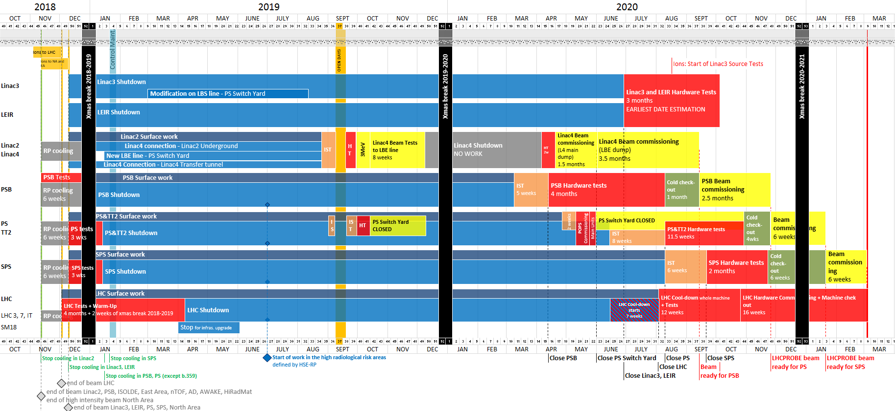
Schedule master plan to date
LHCPROBE beam
available for LHC
Week 9
04/03/2021
Allocated ~6 weeks for SPS beam commissioning: week 3 – week 9
we are here

Slide 27
Schedule master plan to date
LHCPROBE beam
available for LHC
Week 9
04/03/2021
Allocated ~6 weeks for SPS beam commissioning: week 3 – week 9
  Recommend to start early in week 3 – already on Monday:
  2 fundamental systems to commission with beam:
    Orbit system ALPS → establish circulating beam
    New 200 MHz RF system → establish first capture
  Establishing first capture is a crucial phase with the completely new LLRF system – it is allocated 1 week
  → start commissioning on Friday ≡ no OP work in first weekend
we are here

Slide 28
Commissioning – considerations
We are in the process of aligning and synchronizing activities, resolving dependencies and adjusting procedures where necessary
Cross-injector coordination crucial
  For beam readiness
  For expert availability: e.g. several of SPS RF experts work for LINAC4, SPS and LHC
  Prioritization required - at least during hardware and beam commissioning period
  This coordination is happening in the overall LIU Beam and Hardware Commissioning Working Group
Auxiliary tools: Improved ASM and commissioning check lists need to be ready middle of 2020 (for SPS case) to align with prerequisites from hardware commissioning

Slide 29
Commissioning – considerations
Further develop useful algorithms, new concepts, tools and procedures –
examples from 2018 run:
  LHC cycle setup entirely based on LHCINDIV (cannot measure tunes with multi-bunch)
    Pre-requisite was: injection tune measurement with damper pickups, automatic Laslett tune correction
  Establish golden trajectories (PS extraction + TT10) and golden injection orbit
  General concepts and tools to help in making operations simpler, faster, more flexible and robust
    Deployment of COSE for SFTPRO
    Use of automation techniques where tested and available (i.e. ZS alignment)
We are in the process of aligning and synchronizing activities, resolving dependencies and adjusting procedures where necessary
Cross-injector coordination crucial
  For beam readiness
  For expert availability: e.g. several of SPS RF experts work for LINAC4, SPS and LHC
  Prioritization required - at least during hardware and beam commissioning period
  This coordination is happening in the overall LIU Beam and Hardware Commissioning Working Group
Auxiliary tools: Improved ASM and commissioning check lists need to be ready middle of 2020 (for SPS case) to align with prerequisites from hardware commissioning
  these can be game changers:
    LHC beam SPS injection no issue in 2018, despite the reduced MKP strength
    Zs alignment time requirement moved from 9 hours (manual) → 45 minutes (automatic)

Slide 30
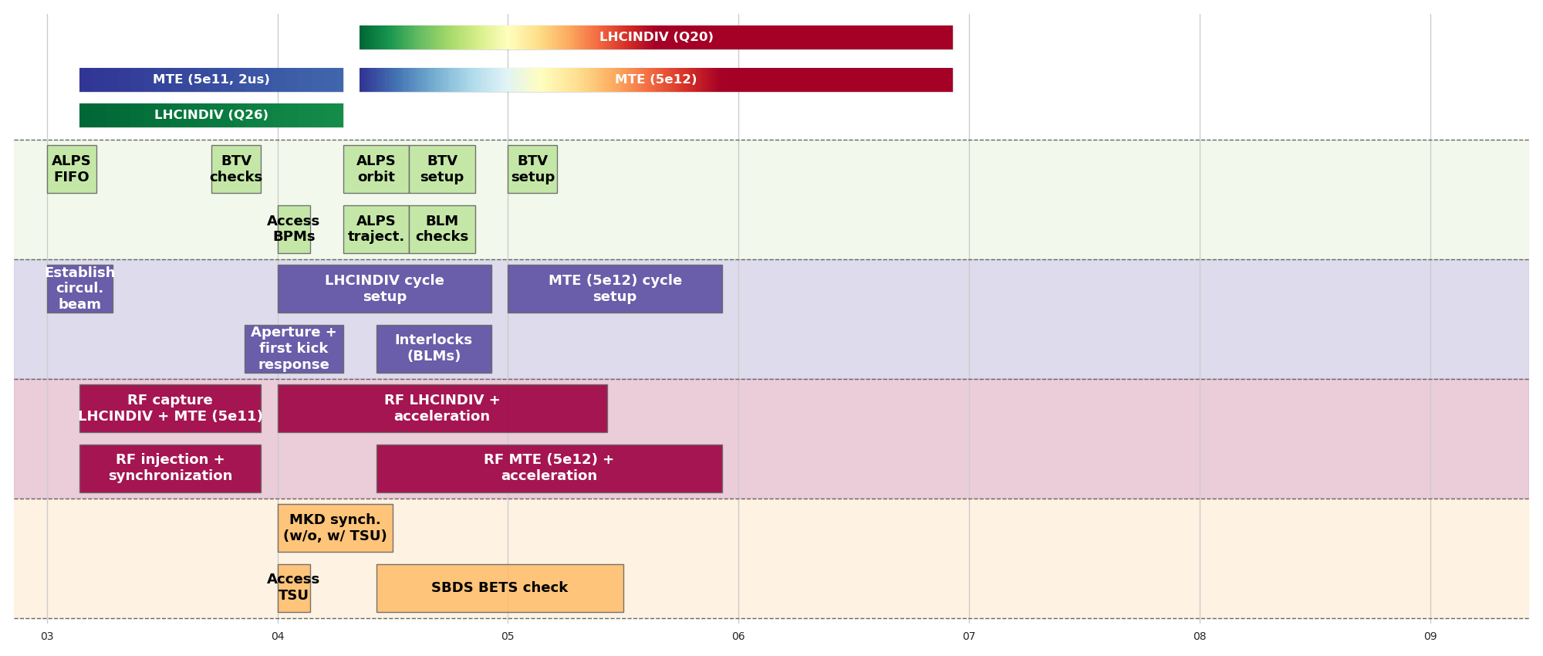
Beam commissioning overall breakdown by system
26 GeV
450 GeV
Beams
14 GeV
14 GeV
400 GeV
26 GeV
FT beam comes with additional requirements and functionalities on top of LHC beams:
Injection at 14 GeV
Possible use of resonant pickup
Commissioning of radial loop
Optimization of transition crossing
BI
OP
RF
ABT
3
4
5
6
7
8
9
Beam-based alignment

Slide 31
Beam commissioning – remarks
Foresee to start up by Monday 18. January 2021 (despite tradition)
  Reason: RF will need some time before OP work can start / continue → Friday startup ≡ no work on the first weekend
2nd priority (i.e., not mandatory during first 6 weeks; prepared and slotted in if time and teams available, e.g., overnight):
  Longitudinal damper, longitudinal blow-up
  BPM extraction interlock commissioning: needs to be done before LHCINDIV extraction
  COAST, HiRadMat and AWAKE cycles (e.g., HiRadMat not before beginning of May)
Intensity step overnight activity: TIDVG beam commissioning (xxx shots)
Proposed slot for scrubbing (10 days) is week 9
  Will have to be during LHC commissioning:
    → FT physics can only be planned to start end of week 10 since scrubbing not compatible with 25 ns beams

